Slide 1



A Global to Local-Scale Hurricane Forecasting System
Sundararaman gopalakrishnan (gopal)
noaa/aoml/Hurricane research division, Miami, FL, USA
Co-Lead: Vijay tallapragada (NCEP/EMC)
Development team: Thiago quirino (AOML), Thomas black (Ncep), Xuejin zhang (Aoml), Zavisa Janjic (NCEP) & steven diaz (AOML)
Acknowledgements: Frank marks, robert atlas, Geoff Dimego & timothy Schneider
Presented at HIWPP fall meeting, 18-19 September 2014,
NCEP, College Park, MD

Slide 2
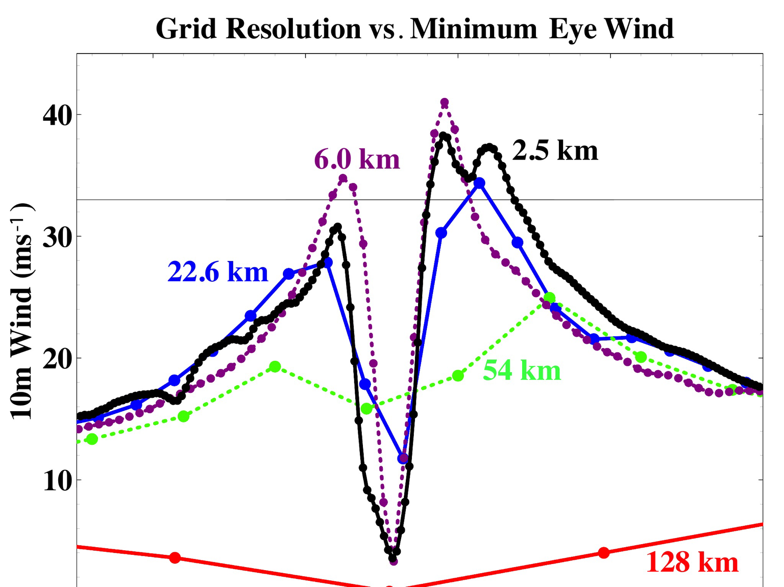
Project Goals
1
Create the next generation, non-hydrostatic, Hurricane Forecast system (HFS) capable of capturing better, land-TC multi-scale interactions, critical for land fall applications. This modeling system will have a very high potential to transition to operations (regional)
Proof of concept of Global tropical cyclone model with multiple moveable nests placed around all tropical systems in the world
Options to test HWRF nests in NMMB/NEMS regional framework with initial and boundary conditions from different hydrostatic and non-hydrostatic global models being developed in this HIWPP effort will be made available to other collaborators
Impact of global model resolution on prediction of the inner core structure of Hurricane Earl (2010)

Slide 3
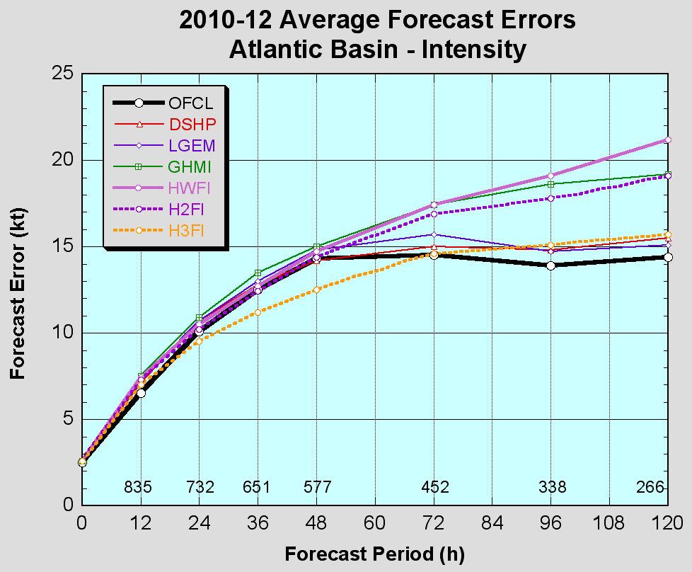
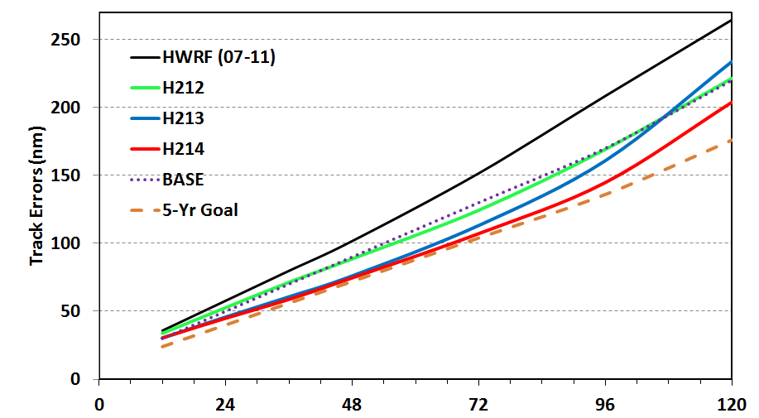
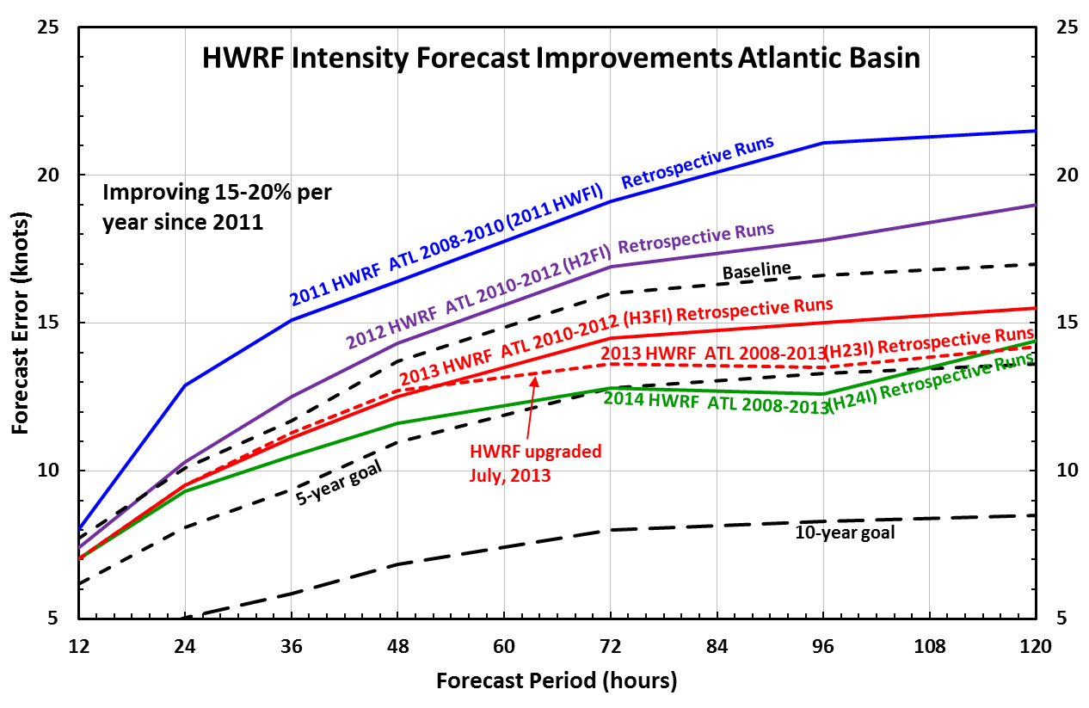
State-of-the-art: Operational HWRF System
2
FY13 HWRF
For Atlantic basin track, the HWRF is improved by ~5-15% and now appears competitive with the GFS. For intensity, the model reduces errors by ~15%, has demonstrated skill greater than that of the NHC official forecast and greater than that of the statistical models. These are remarkable results… James Franklin, NHC
Significant improvements in the Hurricane Track & intensity for the Atlantic Basin: Approaching the NOAA HFIP 5-year
Steep-Step Improvements to intensity predictions are due to (i) high resolution (3 km) moving nest (ii) physics carefully advanced by the use of inner core observations and (iii) vortex-scale initialization
Notes:
The project aims to transition all the three components to NEMS/NMMB framework and may be dubbed as the next generation HWRF system (HWRF-B)

Slide 4
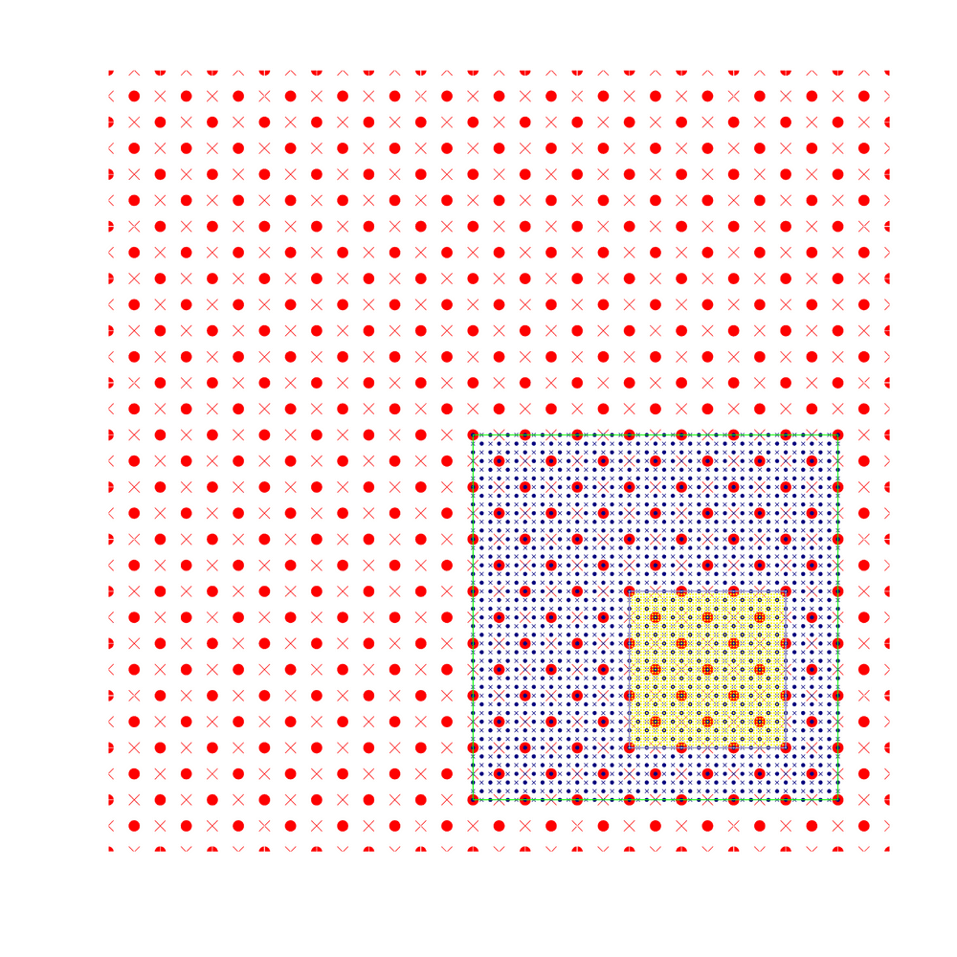
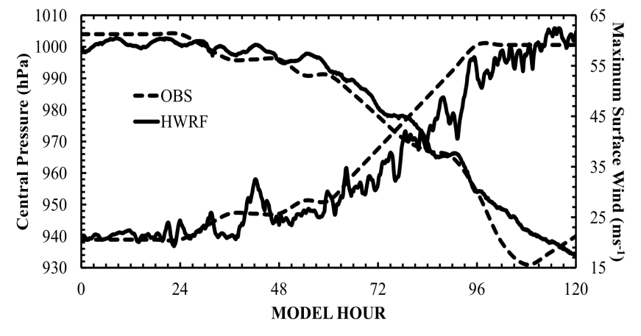
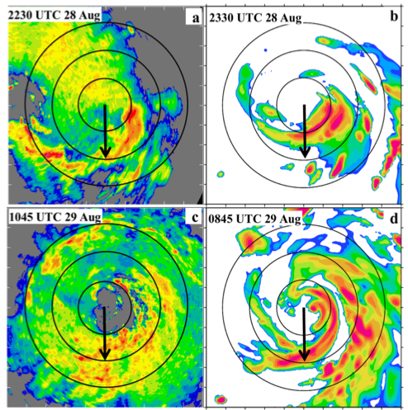
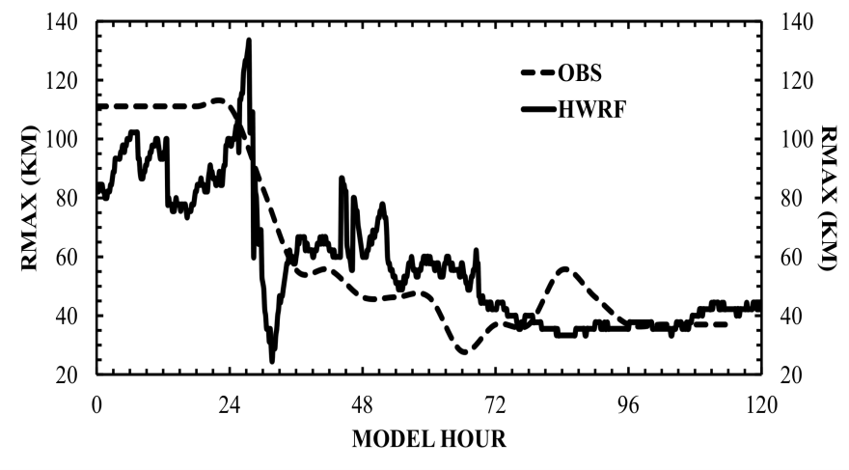
HWRF Nesting: High Resolution for TC vortex
3
Hurricane Earl (2010): example of RI case in a sheared environment
Structure predictions
Intensity Predictions
Size Predictions
Back Bone of HWRF: 3-km, two-way interactive moving nest; any number can be placed anywhere in a domain!
Spatial organization of convection is key for improving intensity predictions (Chen & Gopal, 2014 JAS). HWRF at 3 km resolution appears to capture the vortex tilt accurately.

Slide 5
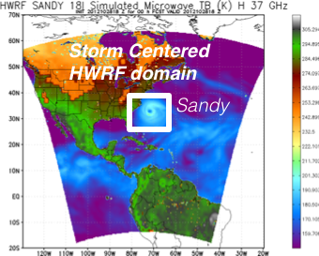
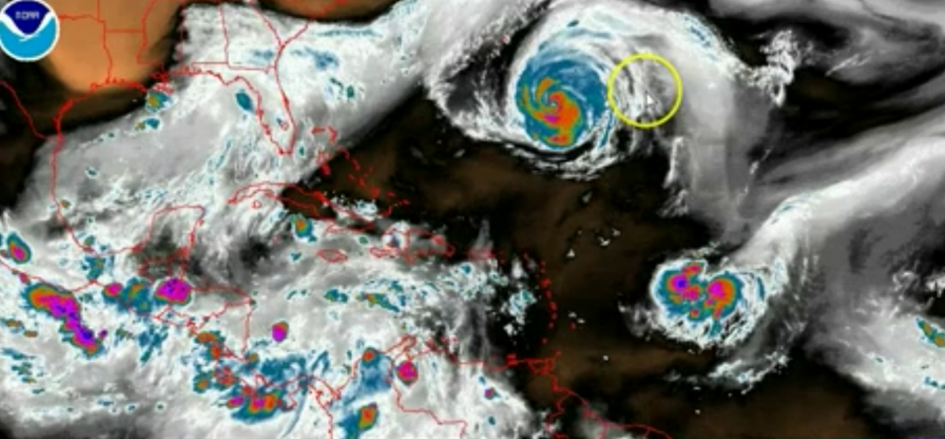
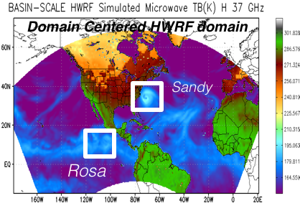
Addressing Our Immediate TC Prediction Needs
4
A Busy Day in the Tropics
Storm Centric -VS- Domain Centric Forecasts
- Tropical predictions system (Extended predictions)
- Improved storm-storm & multi-Scale interactions
- Landfall and post landfall (storm surge & rainfall)
- Genesis
- Regional ensembles
- Data assimilation

Slide 6
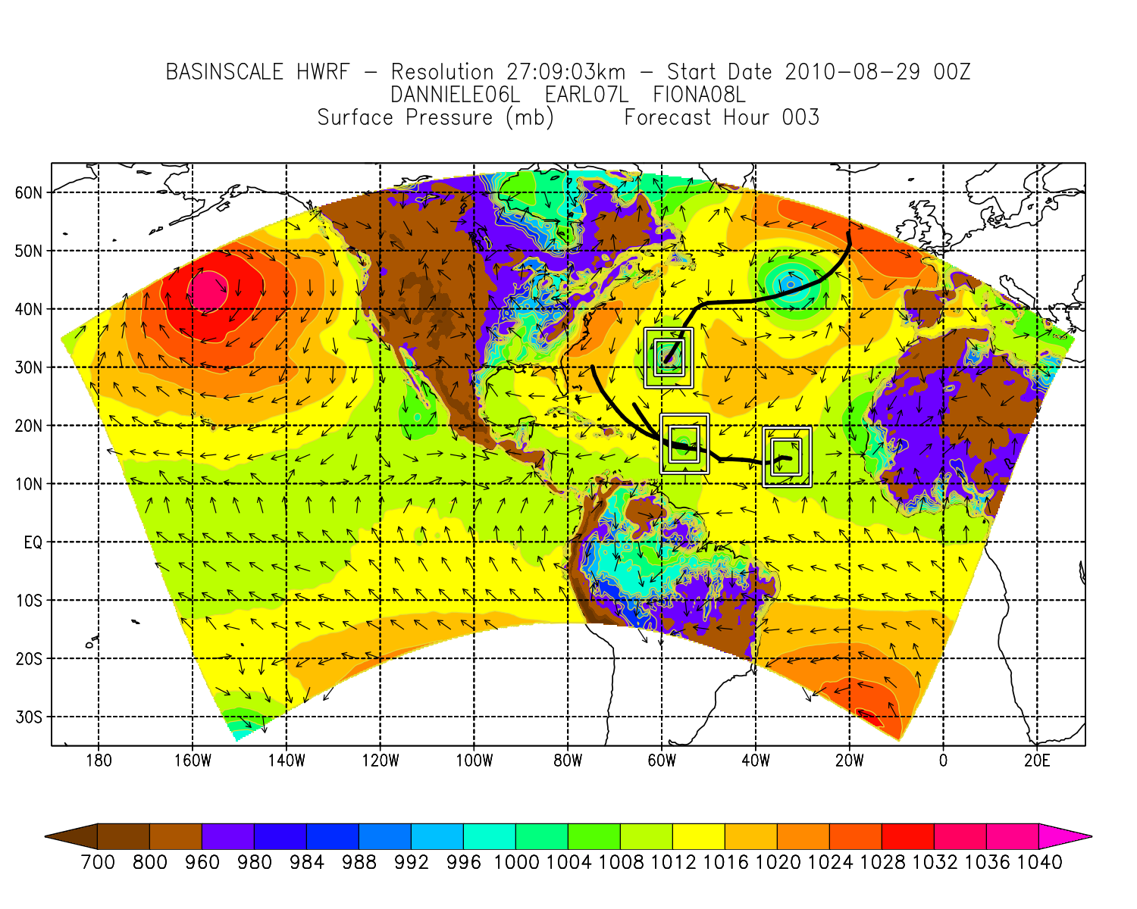
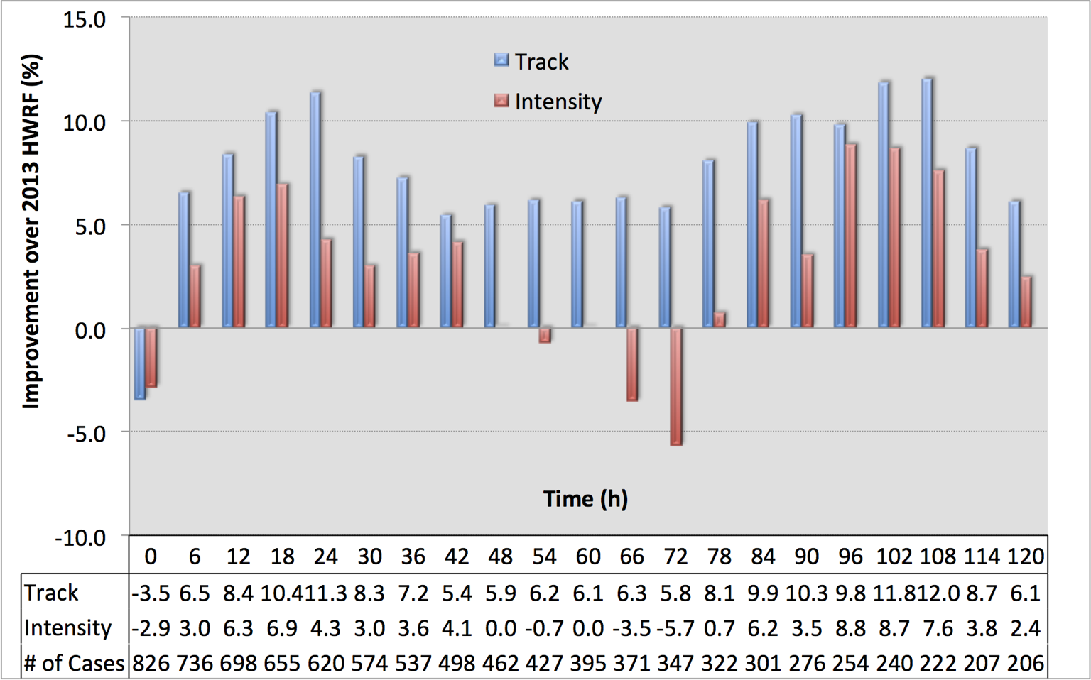

Basin-Scale HWRF: Experimental Prediction System
5
Basin-Scale HWRF: same version of HWRF but operates with multiple moving nest, initialization, cycling and physics all consistent with operational HWRF, with 61 levels, w/o active ocean coupling.
http://storm.aoml.noaa.gov/realtime

Slide 7
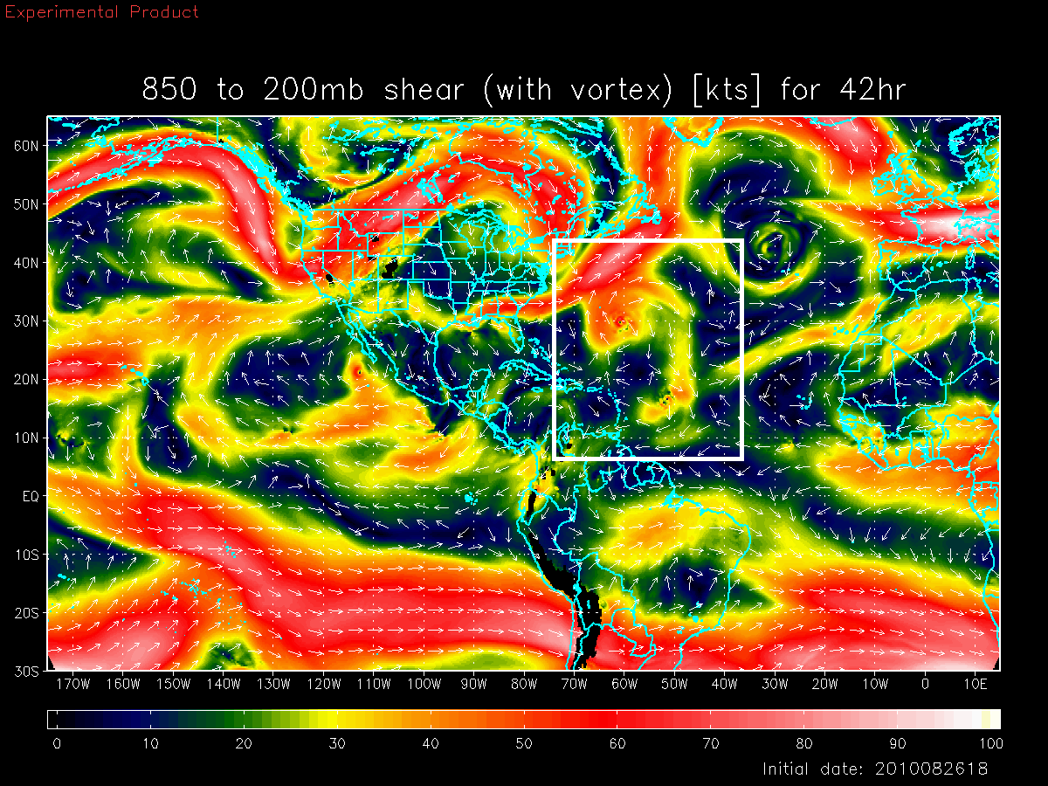
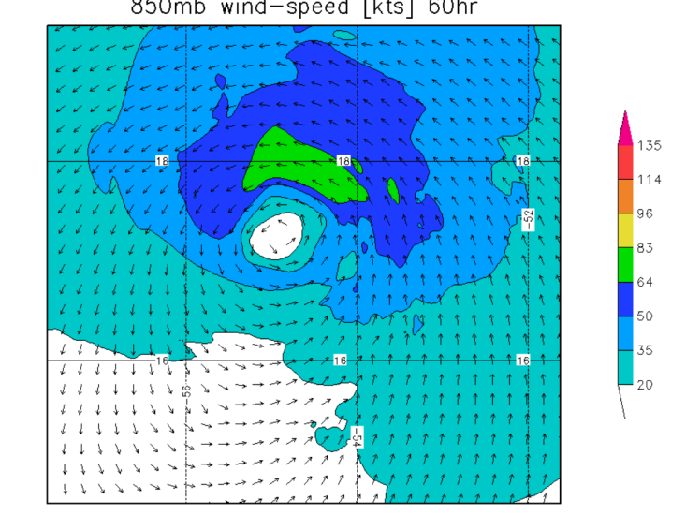
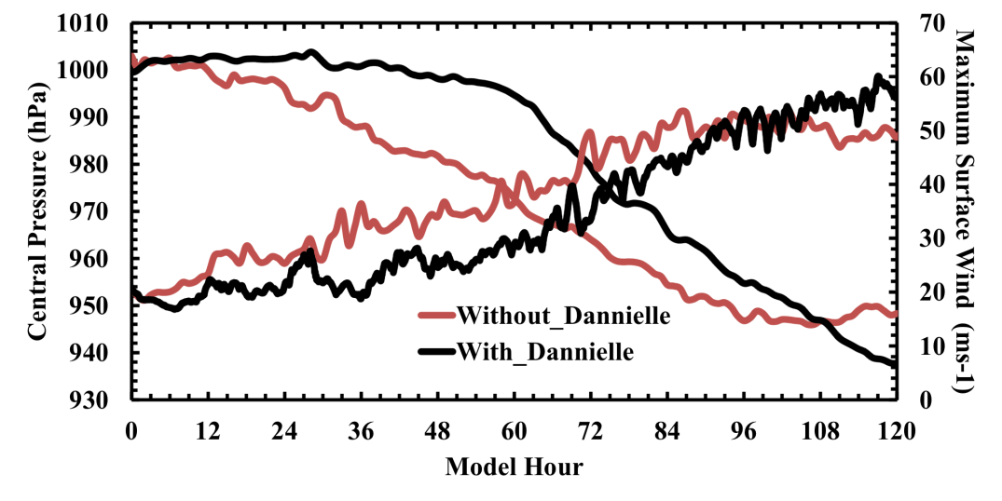
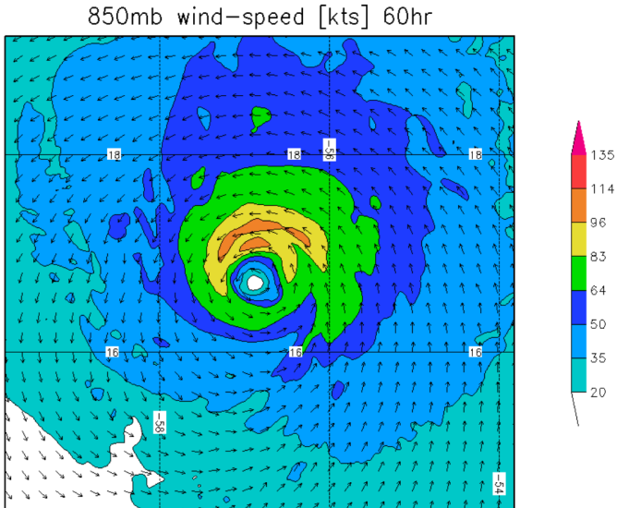
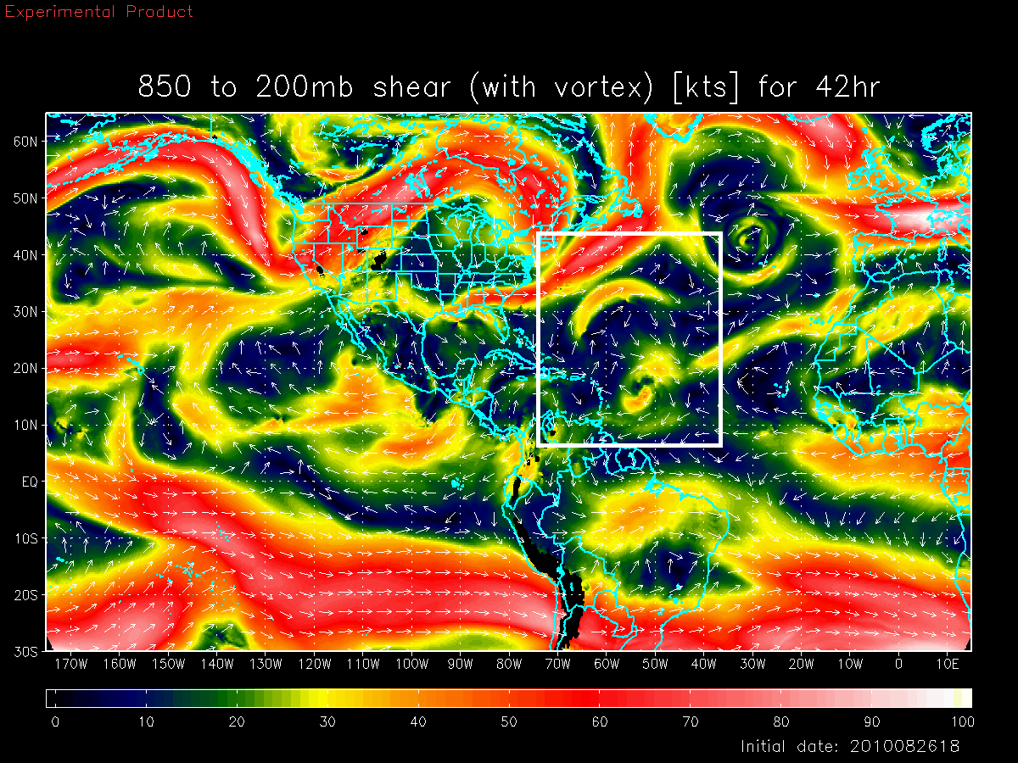
Basin Scale HWRF: Environmental Interactions
6
Shear vortex interactions during RI in Hurricane Earl, 2010
Deep-Layer Shear with Danielle
Earl
Earl with Danielle Interactions
Deep-Layer Shear without Danielle
Both large and vortex scale processes are critical for forecasting RI events. HWRF two-way interactive nests appears to capture these interactions well even between several storms
Earl
Earl W/O Danielle interactions
Notes:
Earl interactions with Dannielle: Despite the simplicity, the nesting technique gets the processes right.

Slide 8
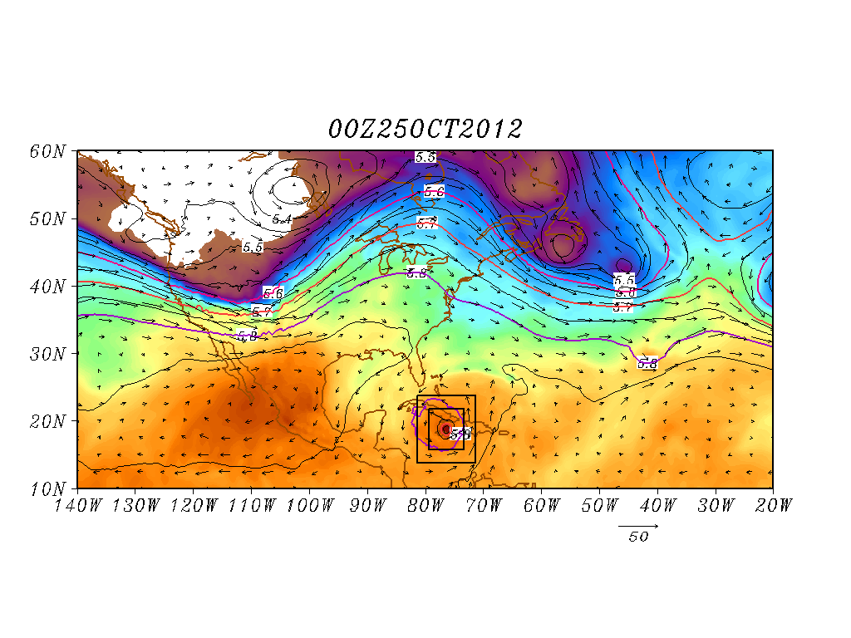
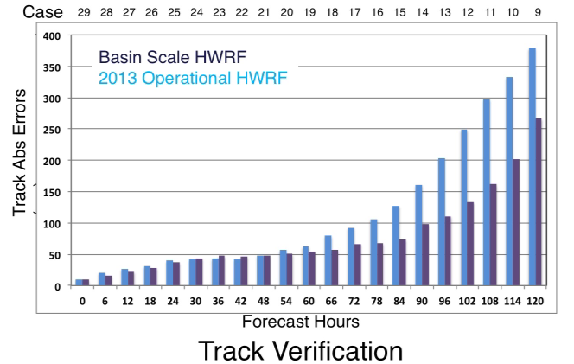
Basin Scale HWRF: Land-Storm Interactions
7
Hurricane Sandy Predictions: Domain Size and Vortex- Mean Flow interactions
Improved scale interactions and improved track & size forecasts (25 00Z Predictions)
Shading: T at 500 hPa; Contour: GHT at 500 hPa
Vector: Flow averaged between 500 hPa and 200 hPa
Shading: T at 500 hPa; Contour: GHT at 500 hPa
Vector: Flow averaged between 500 hPa and 200 hPa
Basin scale HWRF, after best efforts of optimization, takes about 3.8 hours on zeus using ~ 750 processors for 126 h with 3 storms in the domain. WRF framework has some flaws and cannot be used for operational advancements of HWRF. However, this system will serve as a baseline.

Slide 9
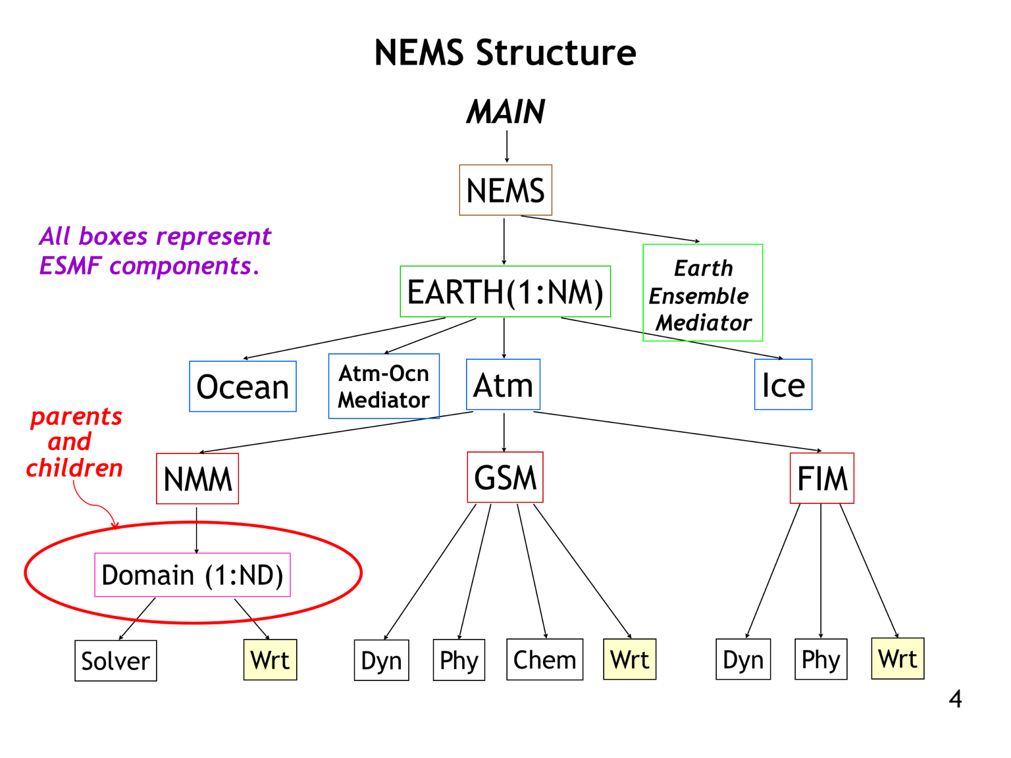
8
Addressing Next-Generation TC Prediction Needs
Common modeling infrastructure geared towards global models
Created for sharing developments (e.g, coupler, physics)
NMM and HWRF shares the same dynamics except grid structure (E vs B).
NMM can be configured in both regional (basin scale) and global mode
Nesting within NMM (under development) based on HWRF paradigm but recoded within NEMS
HWRF nest motion algorithms, physics and initialization under transition
Non-Hydrostatic Multi-scale Model (NMM) embedded within the NOAA Environmental Modeling System Framework (NEMS)

Slide 10
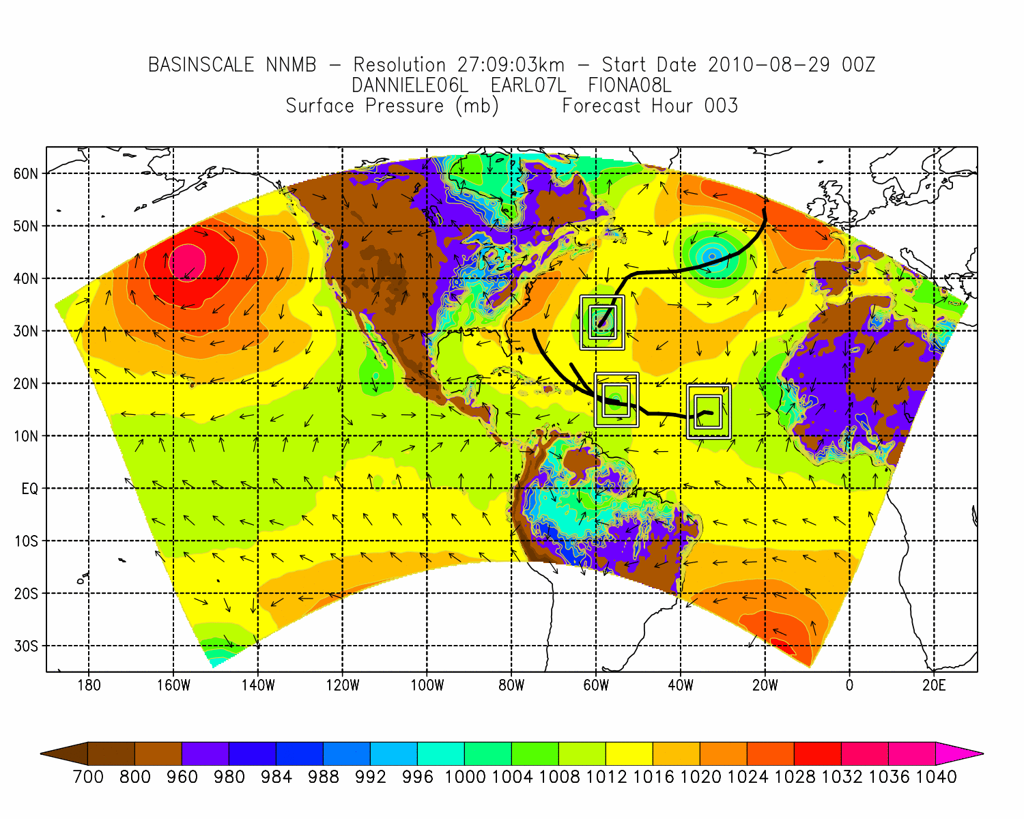
Basin Scale NMMB (HWRF-B ?)
9
Without much optimization efforts, Basin Scale NMMB (HWRF-B) is at least 2.5 times faster than Basin Scale HWRF. It takes less than 90 minutes for the same 3-storm configuration. Provides a potential pathway to operations without significant increases to HWRF resources!

Slide 11
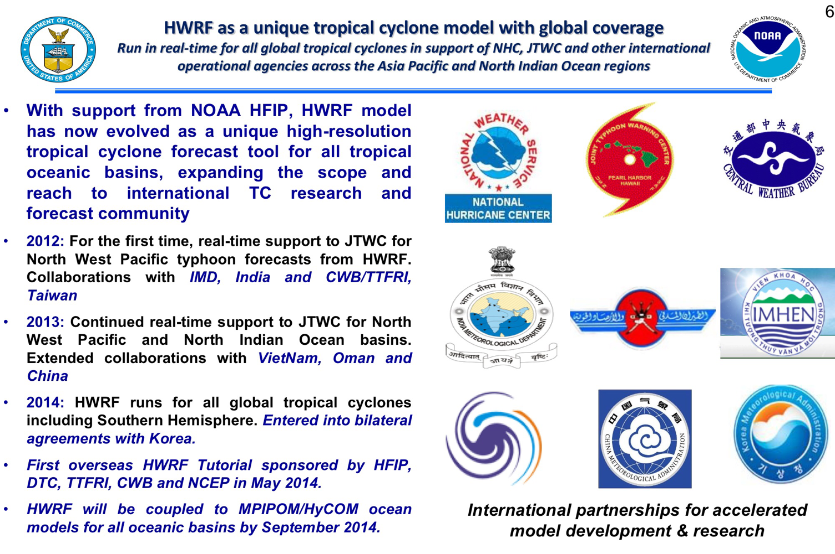
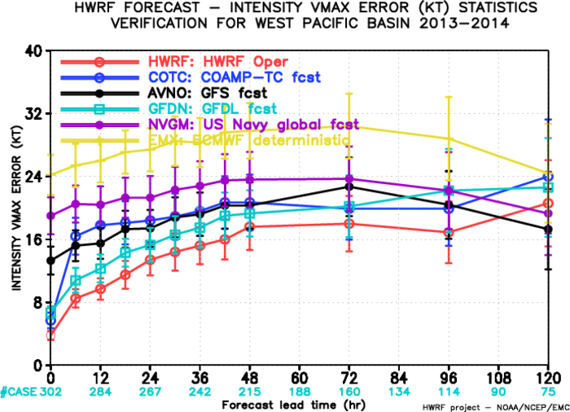
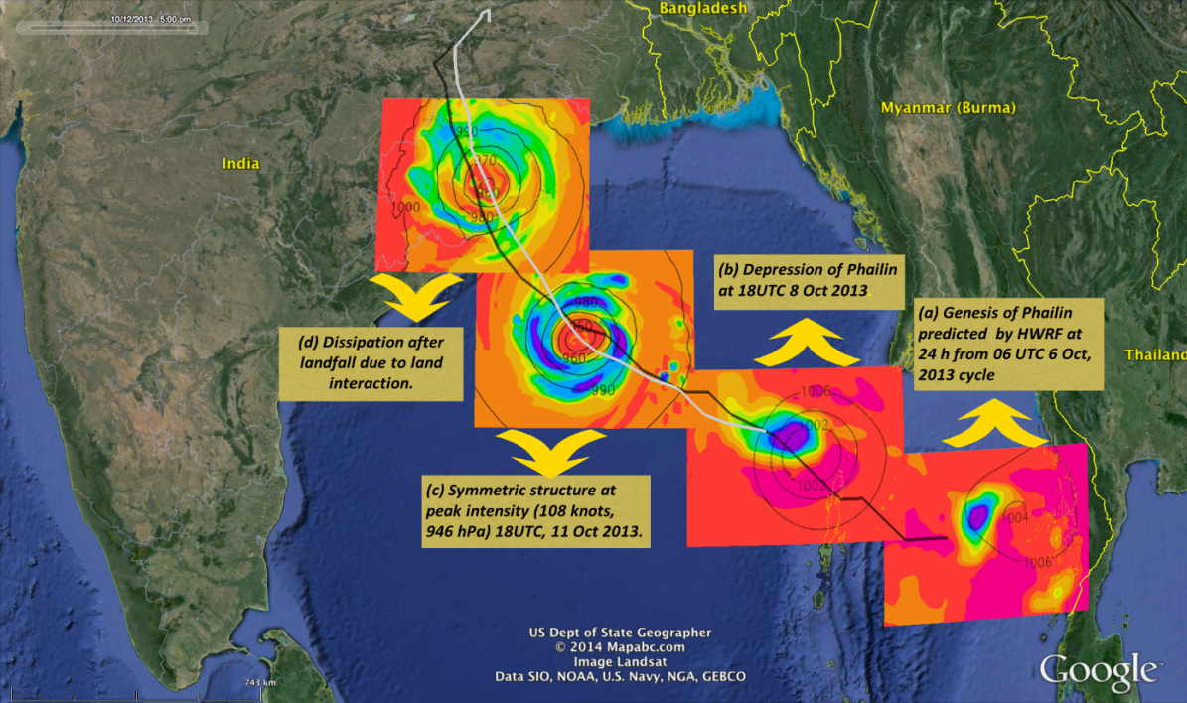
Addressing Our Global TC Prediction Needs
10
HWRF track forecasts outperformed all regional models; very close to GFS forecasts (ECMWF the best)
HWRF intensity forecasts superior than all other models
HWRF was able to forecast some of the most strongest storms of 2013 with high POD for Rapid Intensification

Slide 12
A Global Nested Tropical Prediction System
11
3 km, two-way interactive nests in a global framework!
Without much optimization efforts, this system takes 3.8 hours using 1500 processors for 126 h with 3 storms in the domain. Performance and scaling test ongoing. A global HWRF at the cost of Basin Scale HWRF is possible!

Slide 13
Progress, Future Directions and Challenges
12
Recommended Pathway: NEMS/NMMB with 2 way interactive nest appears to provide a seamless pathway for the global hurricane problem
Significant achievements: Development of two way interactive nest at 3 km resolution within global framework (nearly complete)
Transition of HWRF physics (nearly complete)
Transition of HWRF initialization (work will start after hurricane season)
Scalability experiments (will have to wait for additional computational resources)
Near real-time demonstration of Basin Scale NNMB/HWRF-B for 2015 season (will have to wait for additional computational resources)
Testing of global NMMB/HWRF-B (needs computational resources)
Significant Challenges: No dedicated computational resources for retrospective testing. This project is not able to utilize the available manpower to the fullest potential. One has to wait for several hours to make any dedicated test runs

Slide 14
Questions

