Slide 1



Influence of Environmental Shear on the Rapid Intensification Problem
Sundararaman gopalakrishnan (gopal)
noaa/aoml/Hurricane research division, Miami, FL, USA
Collaborators: Hua Chen, xuejin zhang, Jun zhang, robert rogers, Paul reasor, Jian-WEN BAO and Thiago quirino
Acknowledgements: Frank marks and robert atlas
Presented at NOAA HFIP MEETING, NOV 18-20, 2014

Slide 2
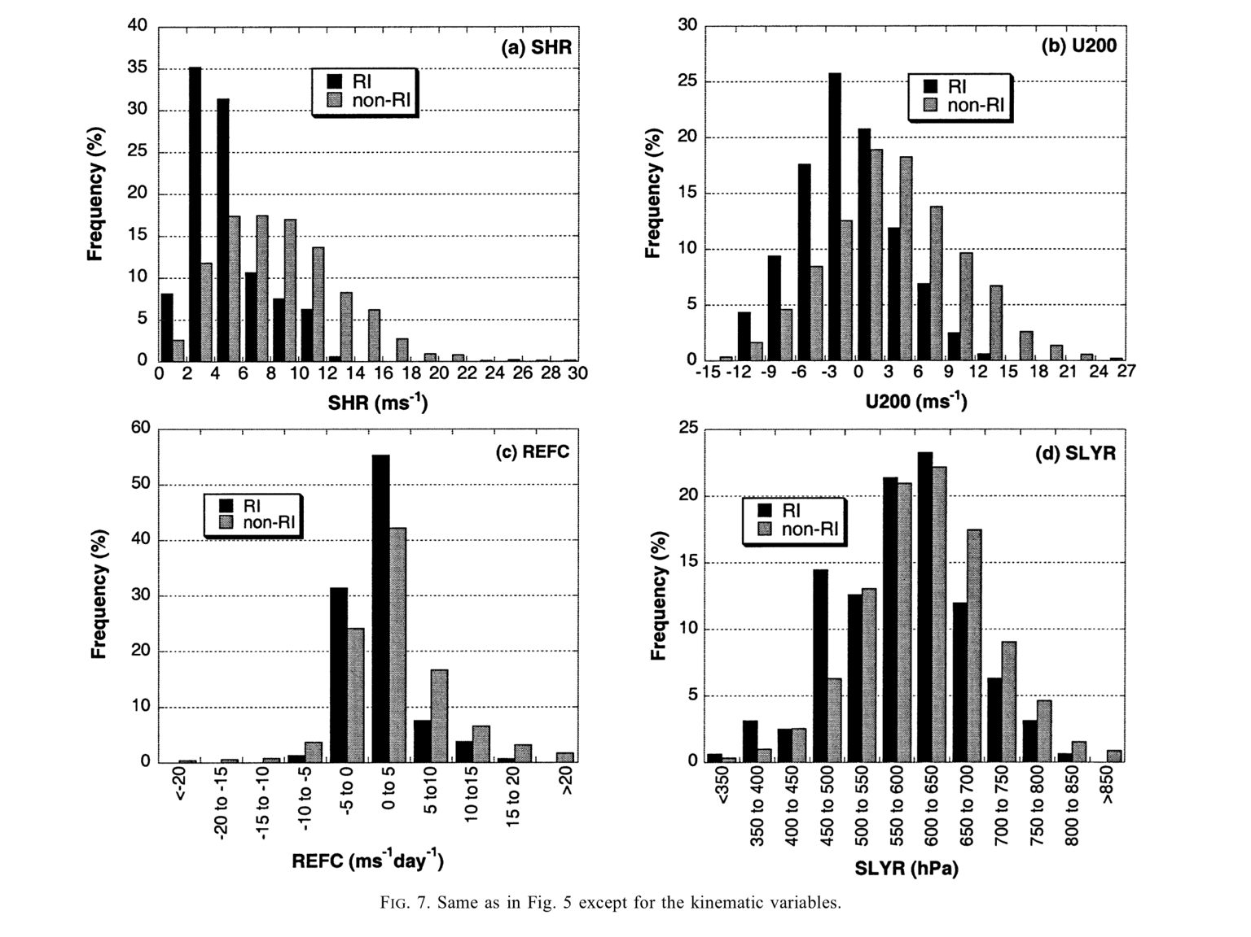
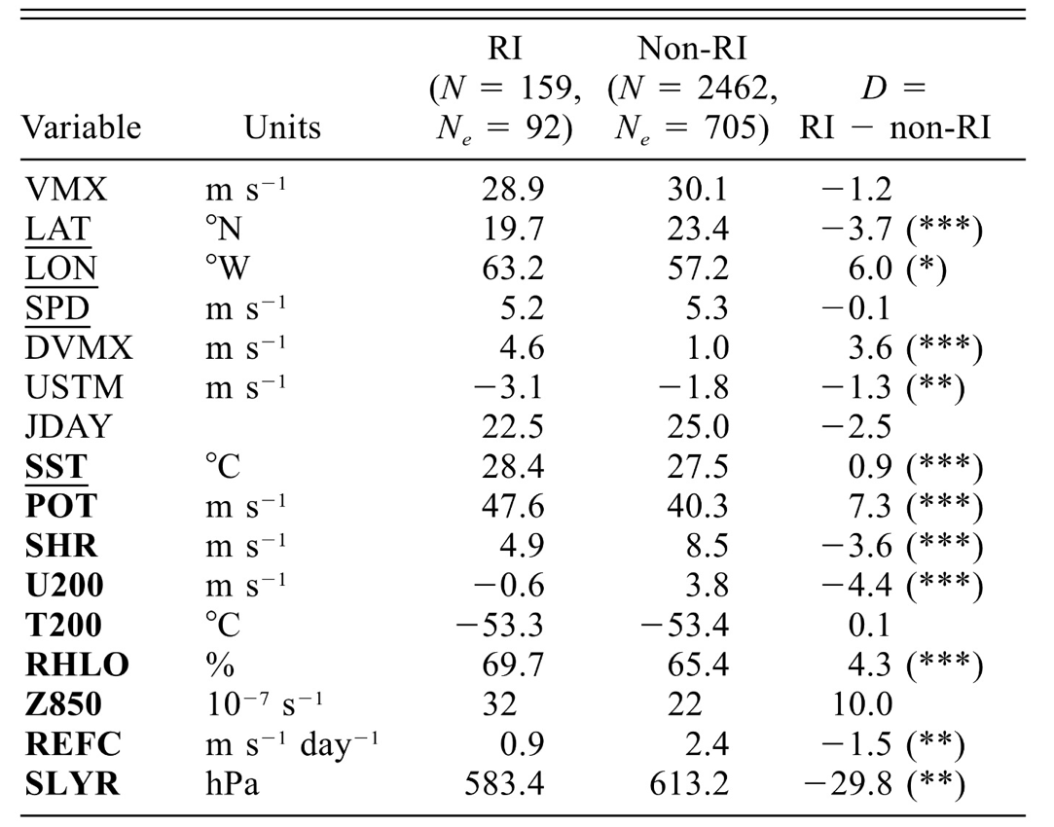
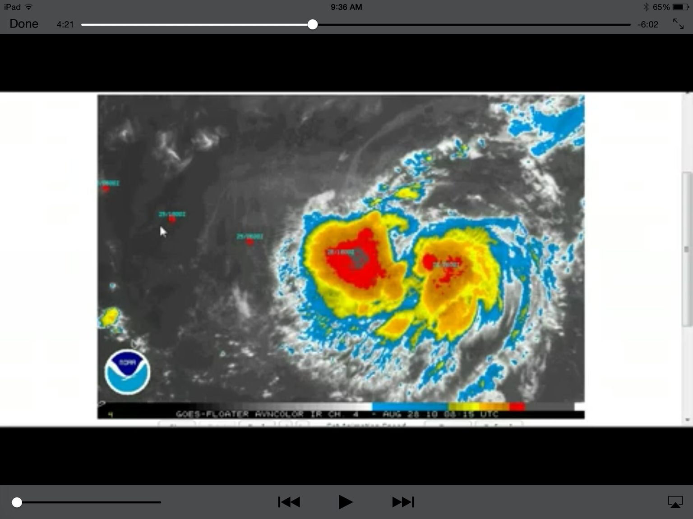
Factors that influence TC Rapid Intensification
3
Adopted from Kaplan and DeMaria, 2003, Weather and Forecasting
Deep-Layer Shear
Earl (2010) during early stages of RI
Factors interact in a non-linear manner. HWRF may be for conducting control experiments and for understanding modeled intensification process [Gopal et al, 2011 (MWR), Bao et al., 2012 (MWR), Gopal et al, 2013 (MWR), Kieu et al, 2014 (GRL), Halliwell et al, 2014 (MWR), D.-L. Zhang et al. ,2014 (MWR)

Slide 3

3
For the first time NOAA’s HWRF hurricane track and intensity forecast model was used to help understand the complex processes of Rapid Intensification (RI) in tropical cyclones. An important key to understanding the RI process was the availability of detailed aircraft observations in the inner core of the hurricane with which to compare the model results. The model was able to reproduce the evolution of the hurricane structure that caused the RI process similar to what was seen in the actual detailed observations. During the times and in the regions of the hurricane where detailed aircraft observations were not available, the model was able to used as a proxy to gain even more understanding of the four-dimensional intensification process.
A Study on the Asymmetric Rapid Intensification of Hurricane Earl (2010) using the HWRF System
Hua Chen and Sundararaman G. Gopalakrishnan
For the first time NOAA’s HWRF hurricane track and intensity forecast model was used to help understand the complex processes of asymmetric Rapid Intensification (RI) in tropical cyclones. An important key to understanding the RI process was the availability of detailed aircraft observations in the inner core of the hurricane with which to compare the model results. The model was able to reproduce the evolution of the hurricane structure that caused the RI process similar to what was seen in the actual detailed observations. During the times and in the regions of the hurricane where detailed aircraft observations were not available, the model was able to used as a proxy to gain even more understanding of the four-dimensional intensification process.

Slide 4
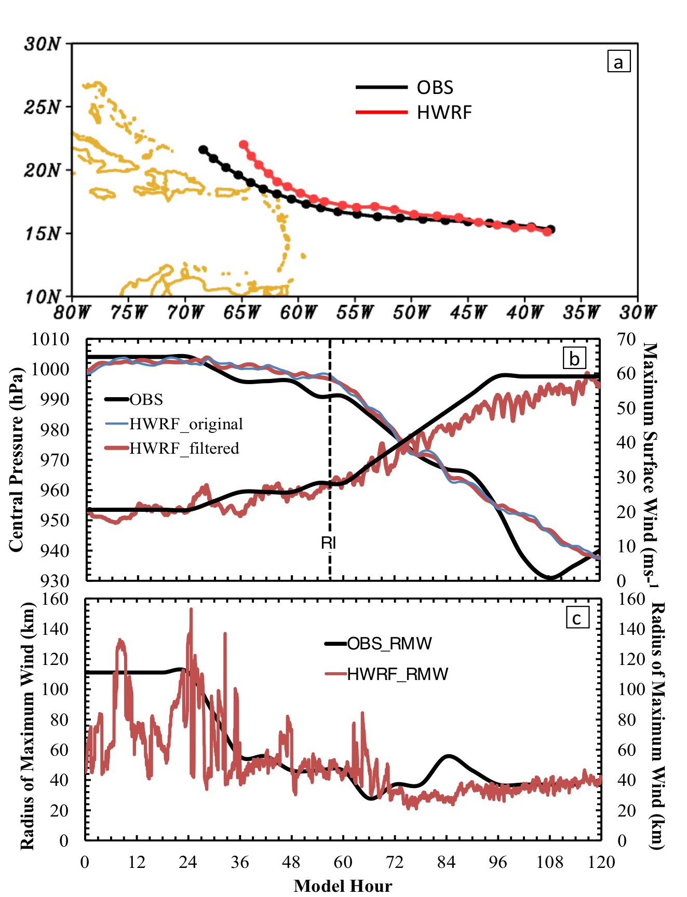
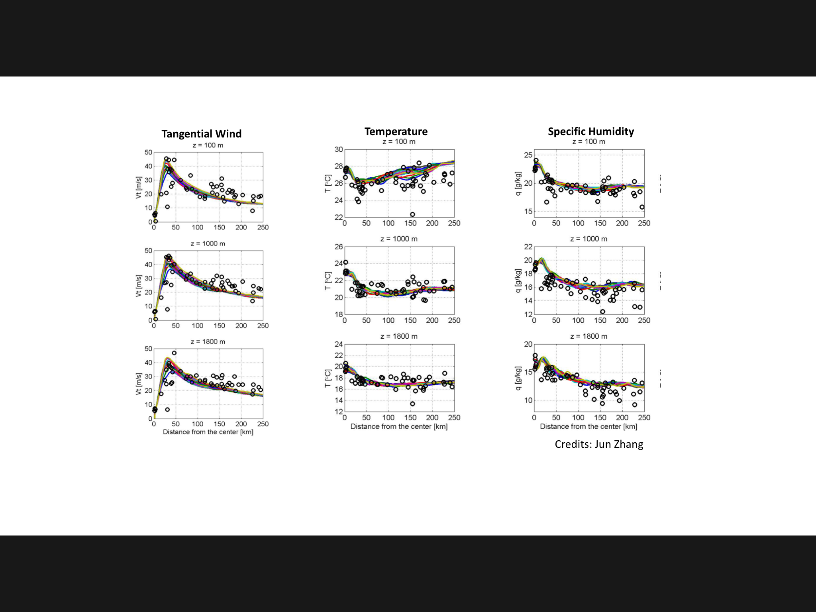
Hurricane Earl (2010): How close are we to reality?
3
Aug 26, 18 Z forecast
Apart from the standard verification metrics (track and peak winds), HWRF reproduced the storm structure extremely well making this an unique data set

Slide 5
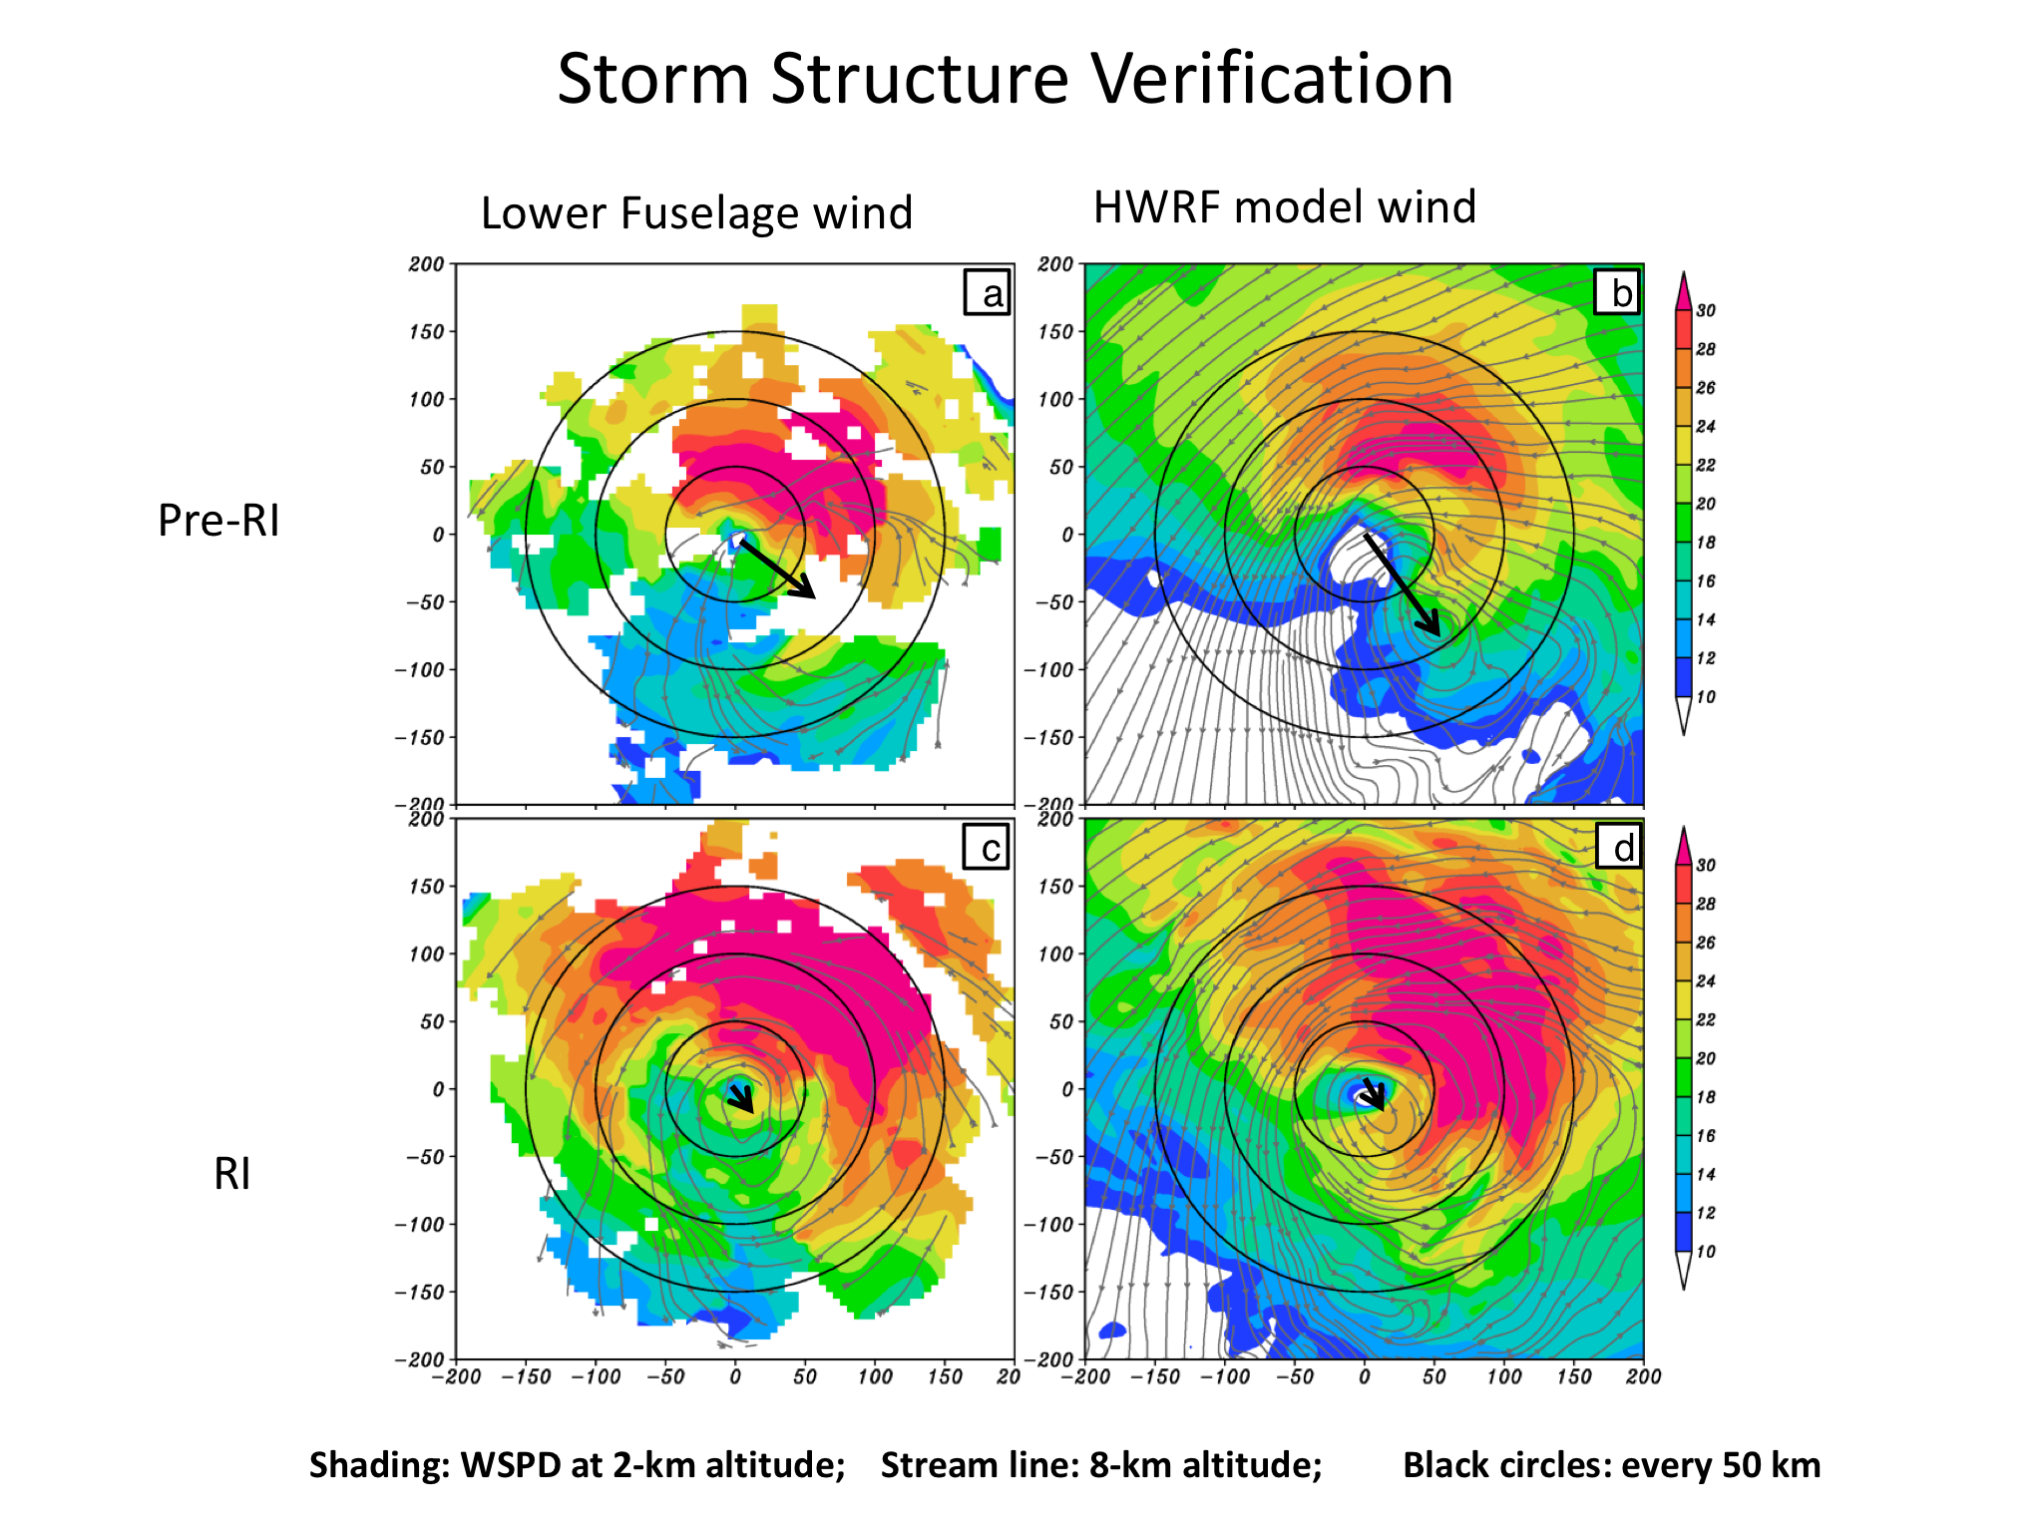
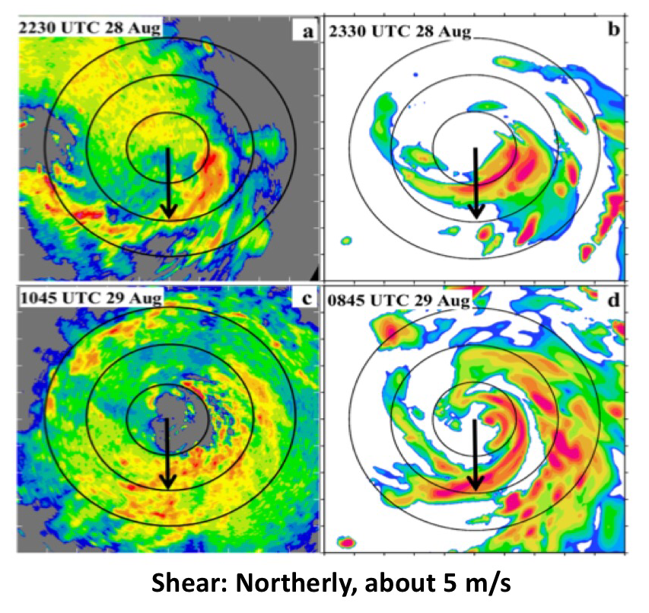
Hurricane Earl (2010): Vortex Tilt and Convection
3
P-3 Winds
HWRF simulated
P-3 Lower fuselage
HWRF simulated
Tilt
Pre-RI
RI
Well defined vortex below 5 km and weakly defined circulation aloft, pre-RI. Tilt decreased with improved alignment.
Persistent convection down shear left, pre-RI; Down shear left and up shear left during RI. Convection was asymmetric during RI

Slide 6
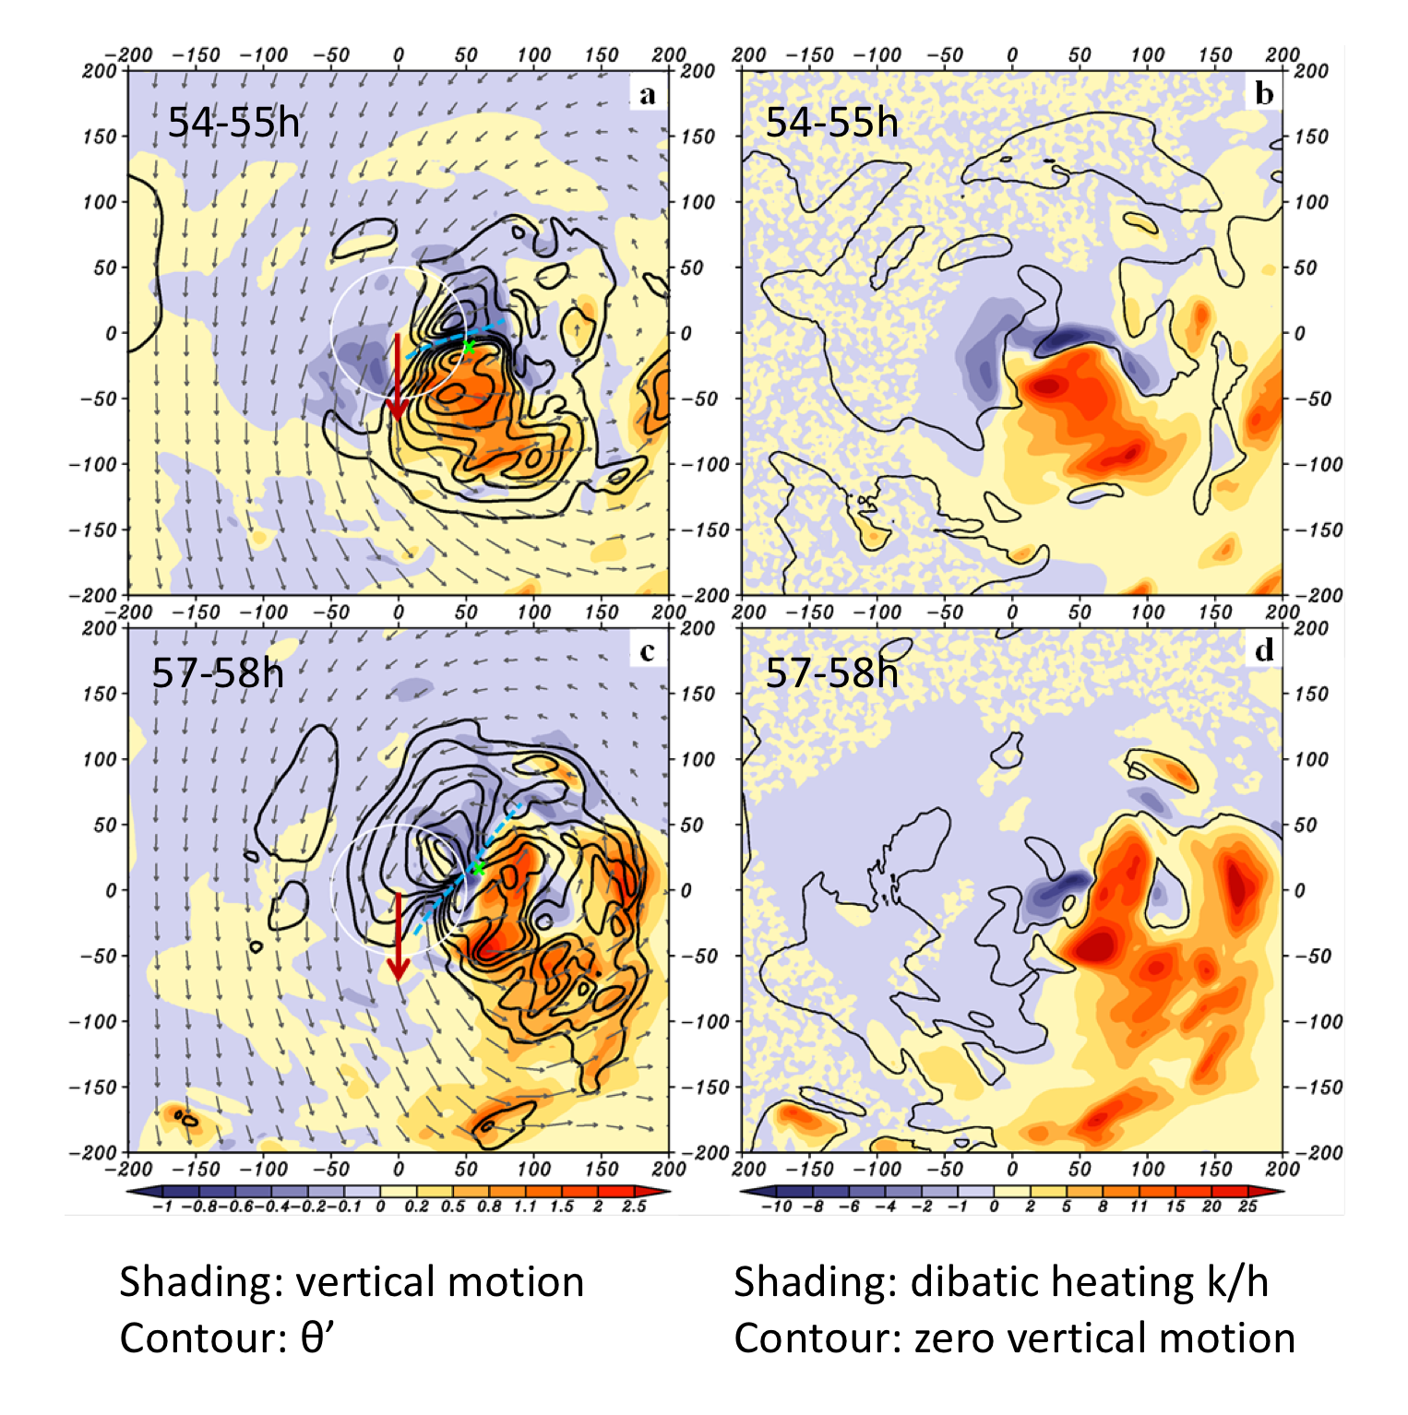
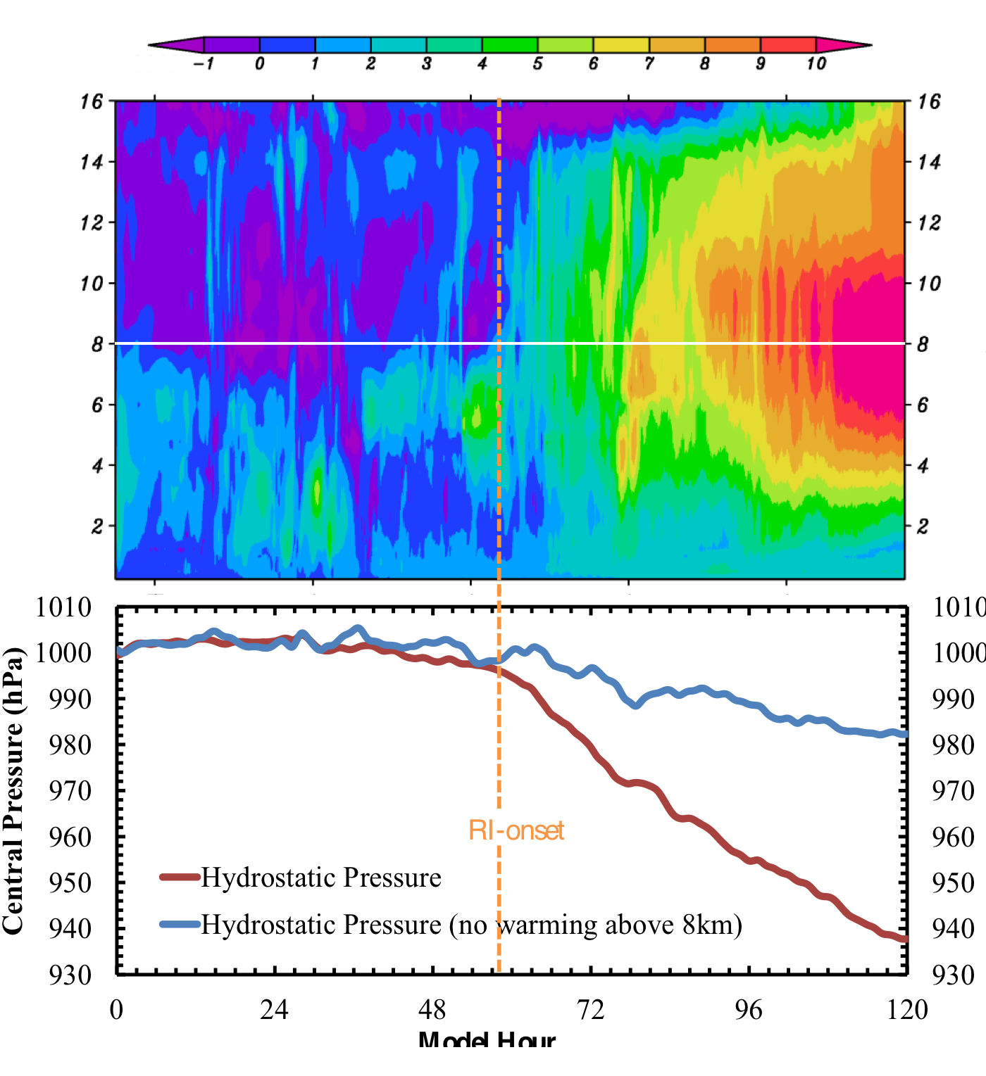
Hurricane Earl (2010): Modeled Rapid Intensification
Pre-RI
8 km height
RI
Horizontal advection of potential temperature perturbations associated with downdrafts/subsiding motion in a region of large scale descent. This configuration supports intensification
Development of upper level warm core and the associated deepening

Slide 7
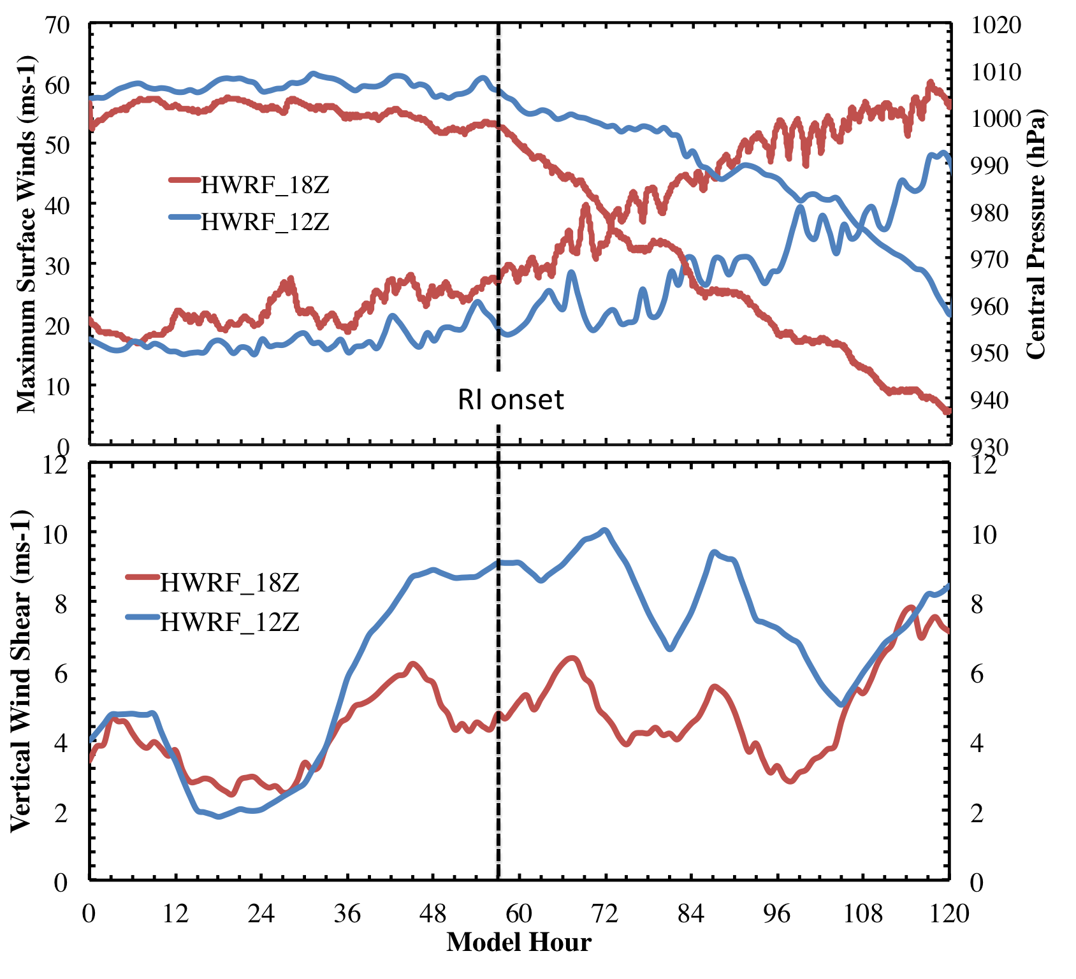
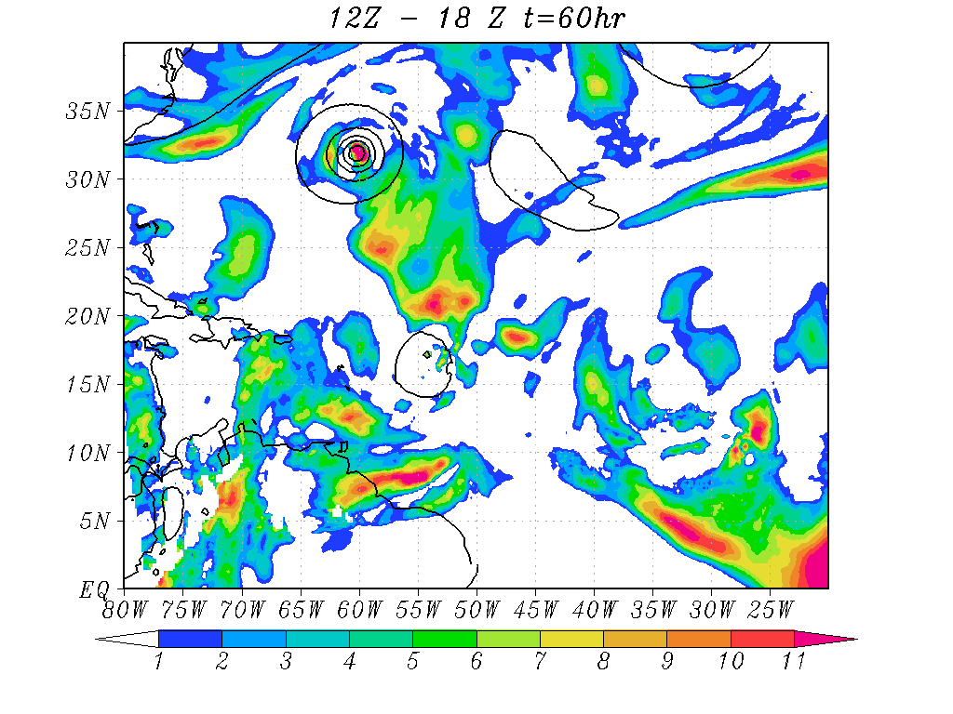
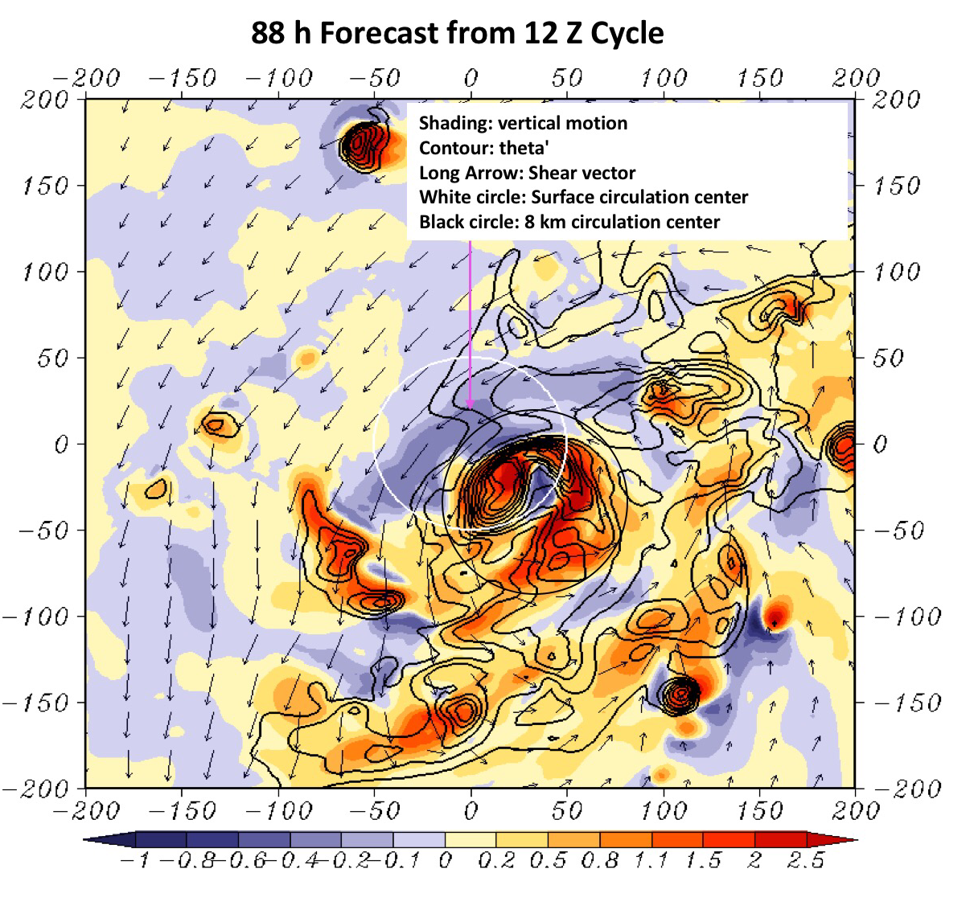
RI problem: Importance of Multi-Scale interactions
Shear vortex interactions during RI in Hurricane Earl (2010)
Shear difference between 12Z and 18Z runs at RI onset
Not all forecasts are as good as the 18Z run! The 12Z forecast was not impressive!
Larger Scale: Higher Shear mostly driven by outflow from Dannielle
Delayed RI with efficiency reduced due to larger shear. But the favorable configuration for RI still holds good!

Slide 8
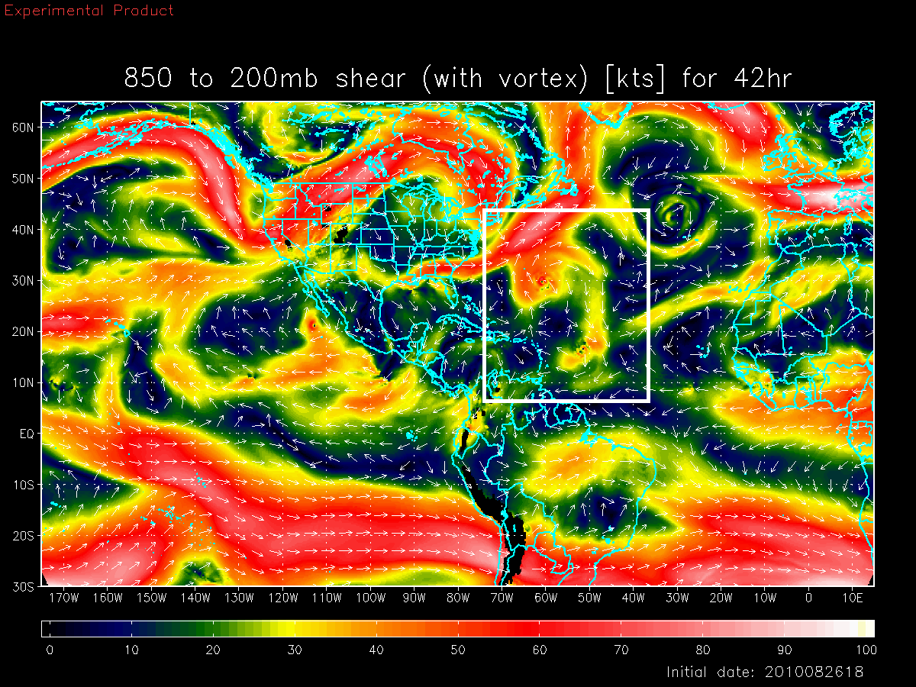
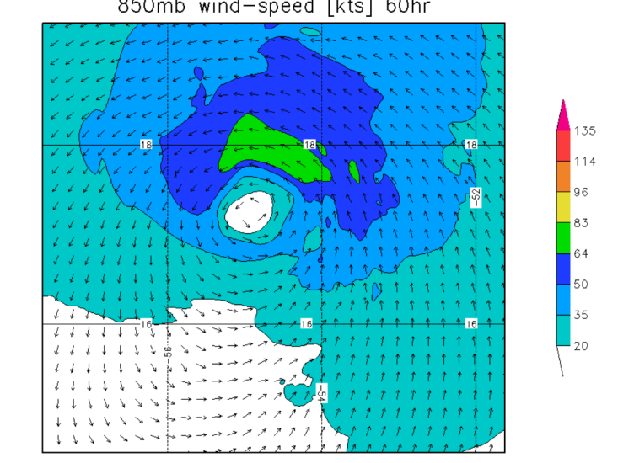
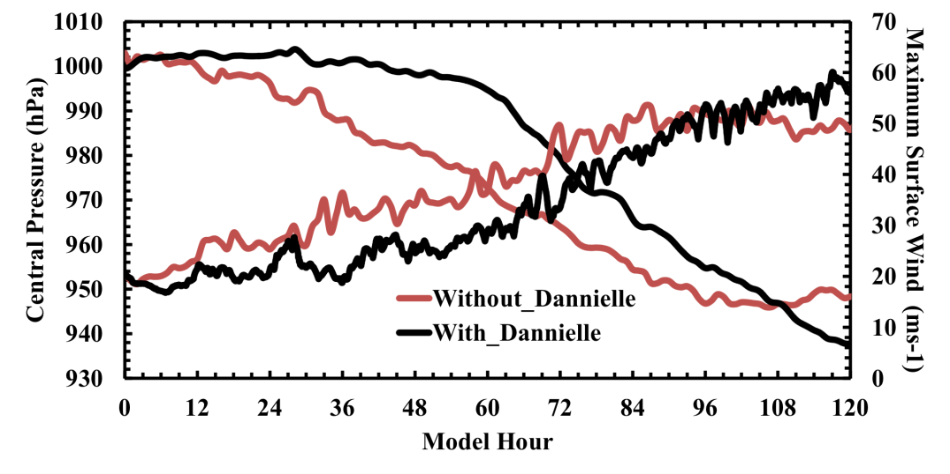
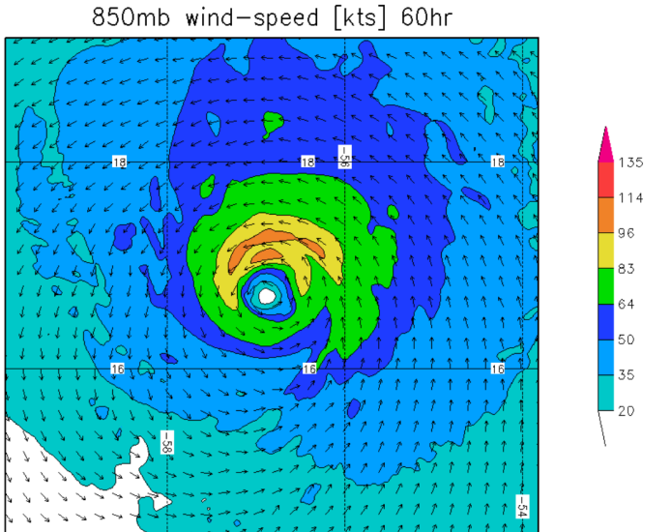
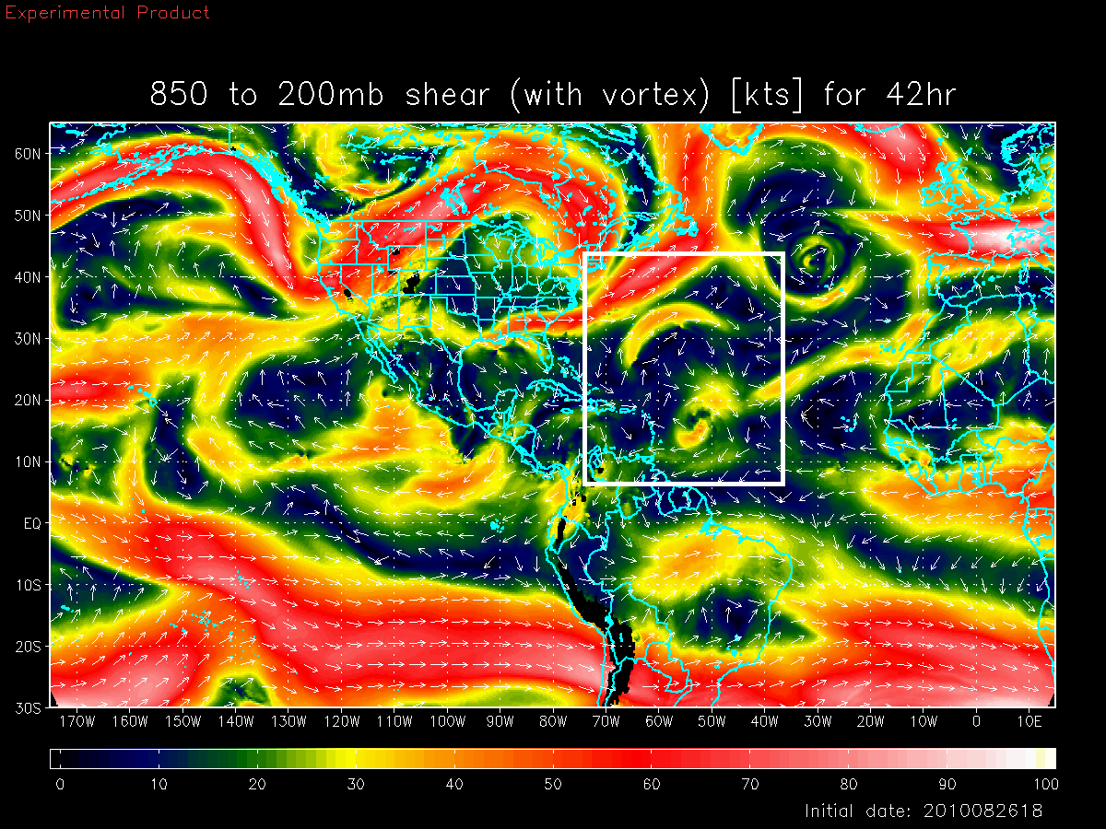
Basin Scale HWRF: Environmental Interactions
6
Shear vortex interactions during RI in Hurricane Earl (2010)
Deep-Layer Shear with Danielle
Earl
Earl with Danielle Interactions
Deep-Layer Shear without Danielle
Both large and vortex scale processes are critical for forecasting RI events
Earl
Earl W/O Danielle interactions
Credits: Xuejin Zhang
Notes:
Earl interactions with Dannielle

Slide 9
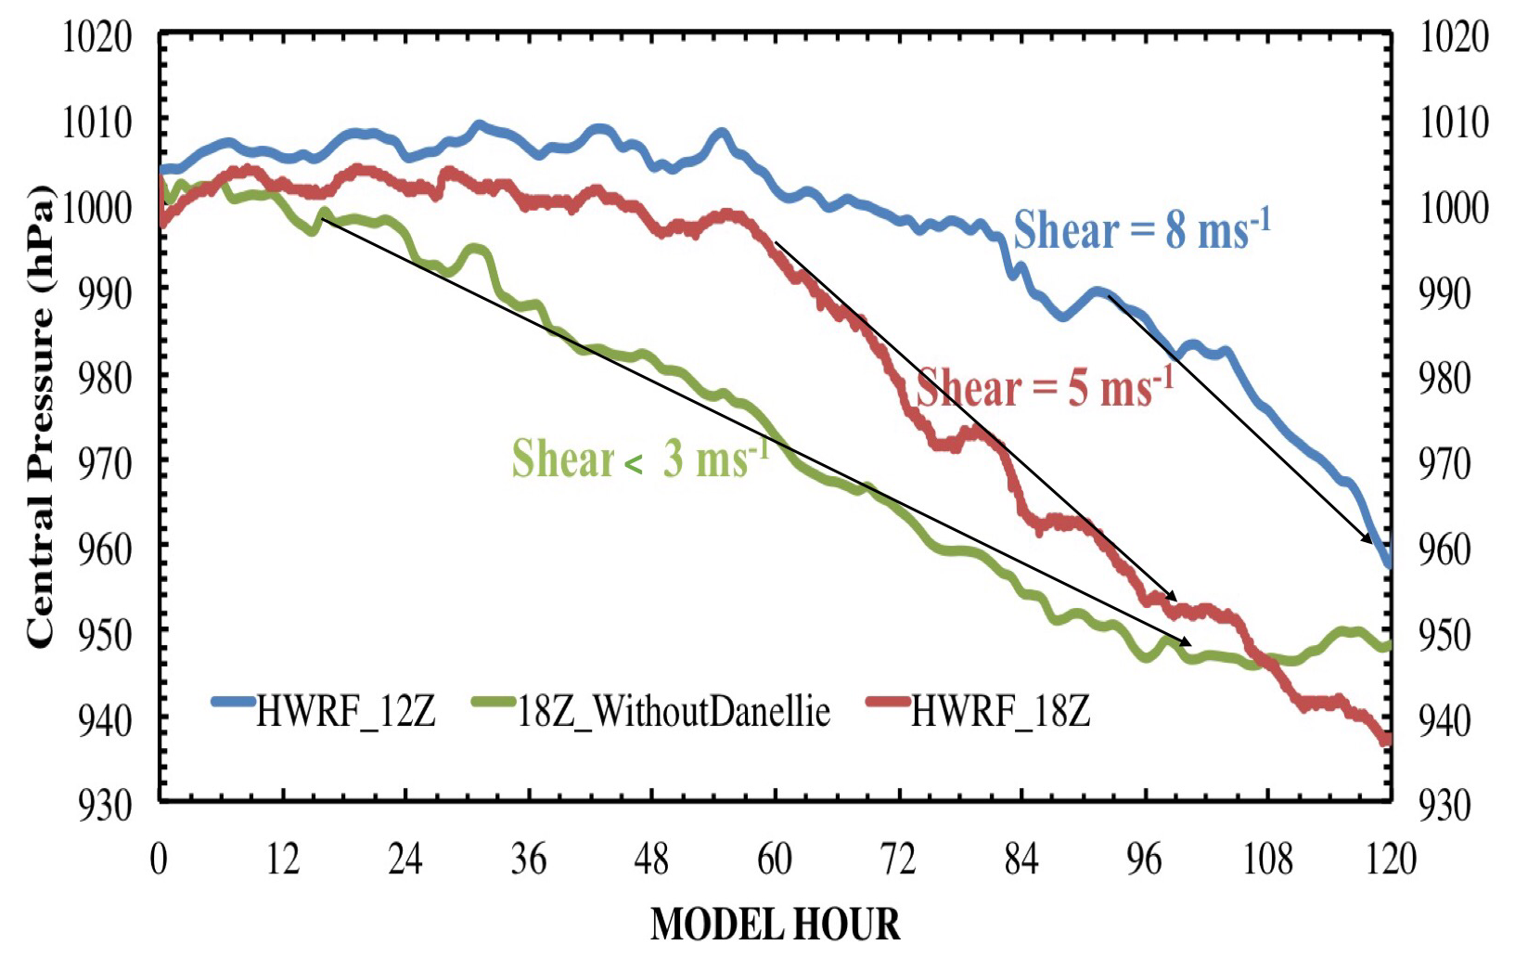
Summary & Talking Points
HWRF reproduces some of the key features observed in sheared storms
Tracks of all forecasts were consistent.
Inner core size was nearly the same in all simulations
All Earl forecasts intensified – less diversity
Similar analysis for more challenging forecasts is recommended
Role of moisture vs shear ?
Observations are key to improve HWRF system
Is shear an essential ingredient for RI ?

Slide 10
Questions

