Slide 1
A Global to Local-Scale Hurricane Forecasting System
Sundararaman gopalakrishnan (gopal)
noaa/aoml/Hurricane research division, Miami, FL, USA
Co-Lead: Vijay Tallapragada, NCEP, EMC
Presenter: xuejin zhang (Aoml)
DEVELOPERS: xuejin zhang (Aoml), Thiago quirino (aoml), Thomas black (Ncep), Joseph prusa (AoML) & Zavisa Janjic (NCEP)
Acknowledgements: Frank marks, robert atlas & timothy Schneider
Presented at American Meteorological Society’s Fifth Conference on Transition of Research to Operations, Jan 4-8, 2015, Phoenix, AZ

Slide 2
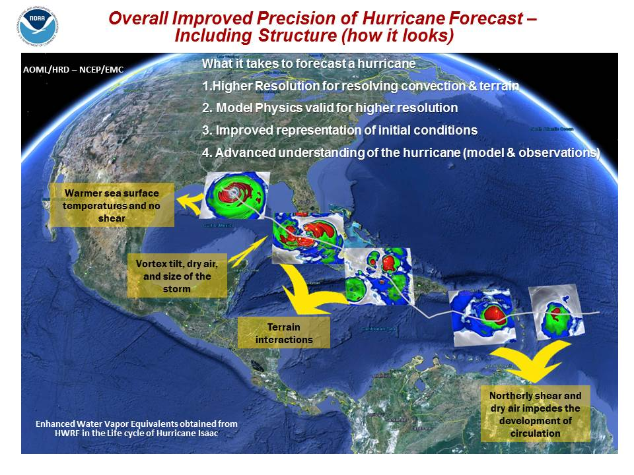
HWRF Nesting: High Resolution for TC vortex
3
Back Bone of HWRF: 3-km Moving nest; any number can be placed anywhere in a domain!

Slide 3
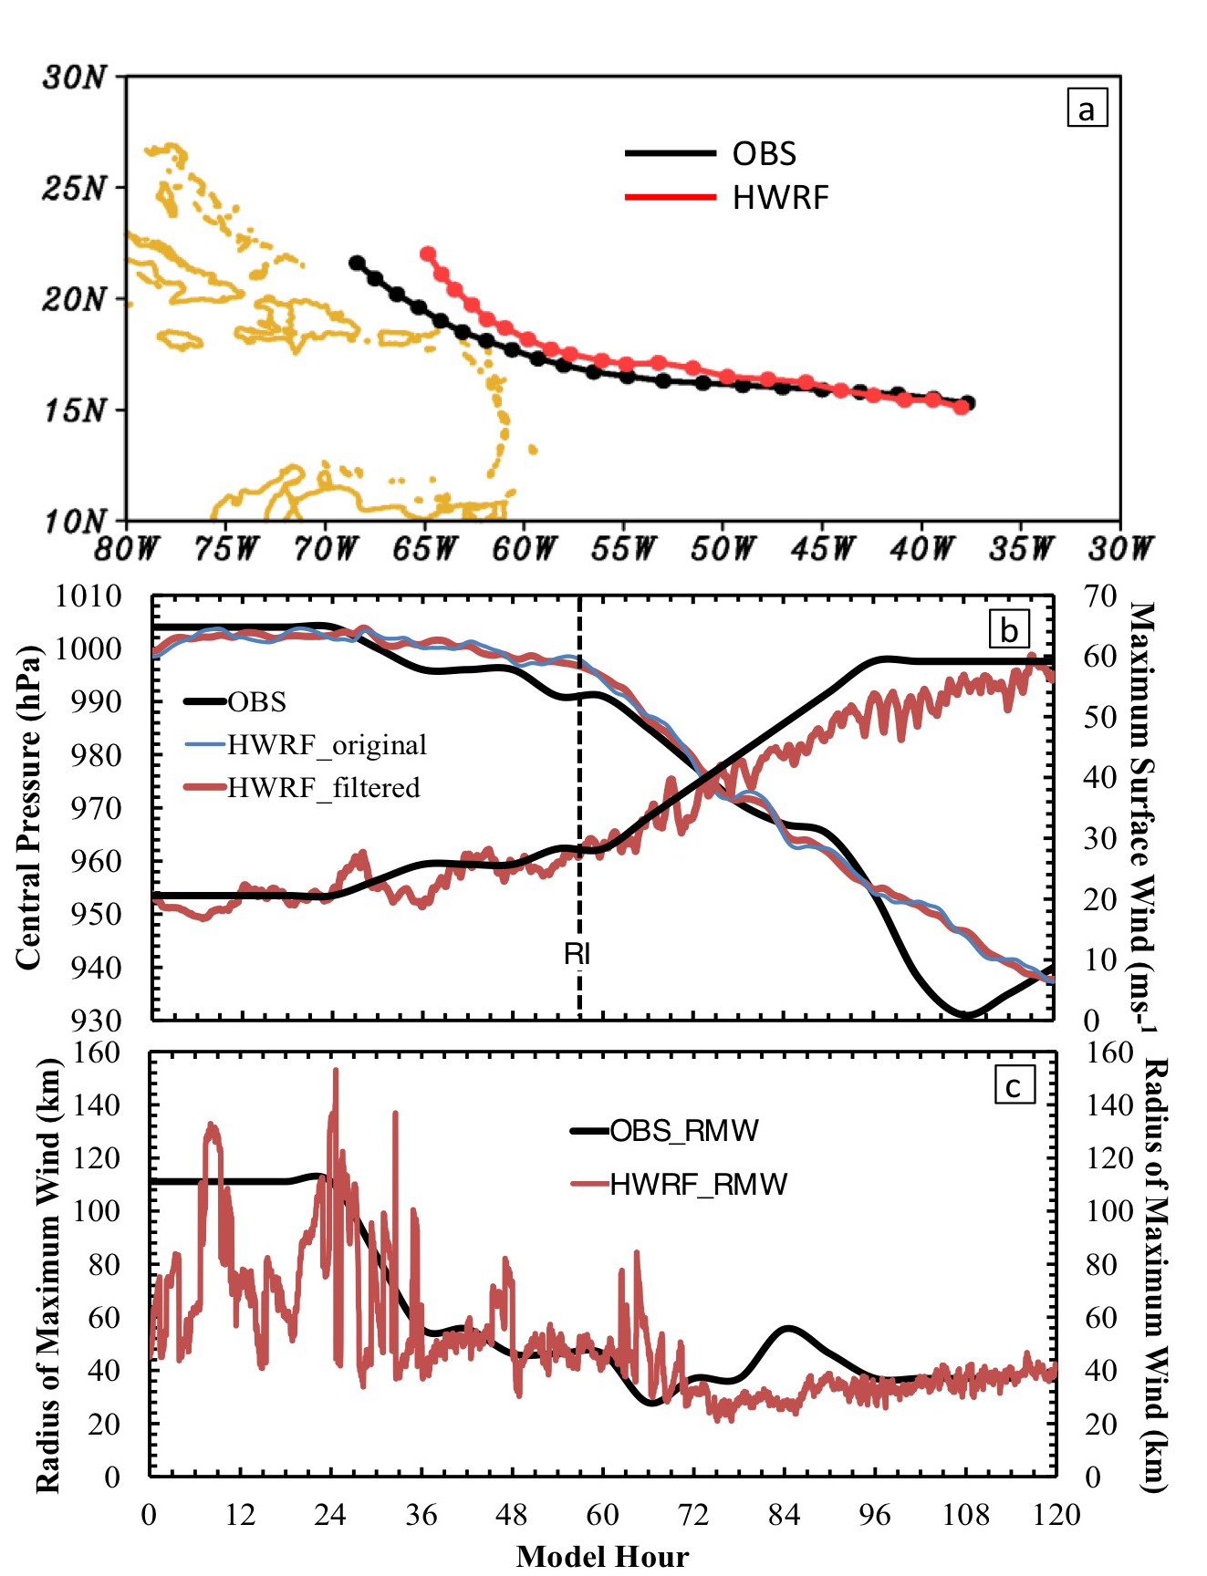
Hurricane Earl (2010): 3-km Forecast
Aug 26, 18 Z forecast
Apart from the standard verification metrics (track and peak winds), HWRF reproduced the storm structure extremely well making this an unique data set

Slide 4
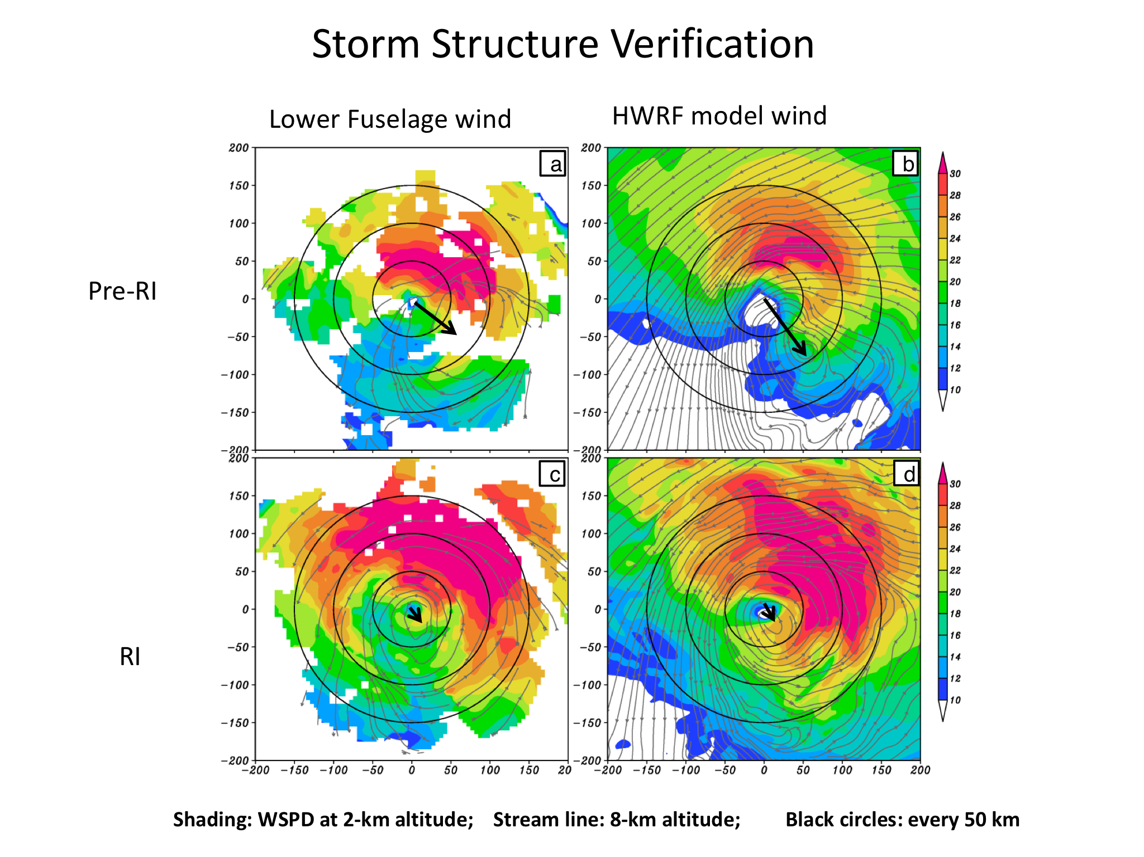
Hurricane Earl (2010): Vortex Tilt and Convection
P-3 Winds
HWRF simulated
P-3 Lower fuselage
HWRF simulated
Tilt
Pre-RI
RI
Well defined vortex below 5 km and weakly defined circulation aloft, pre-RI. Tilt decreased with improved alignment.
Persistent convection down shear left, pre-RI; Down shear left and up shear left during RI. Convection was asymmetric during RI

Slide 5
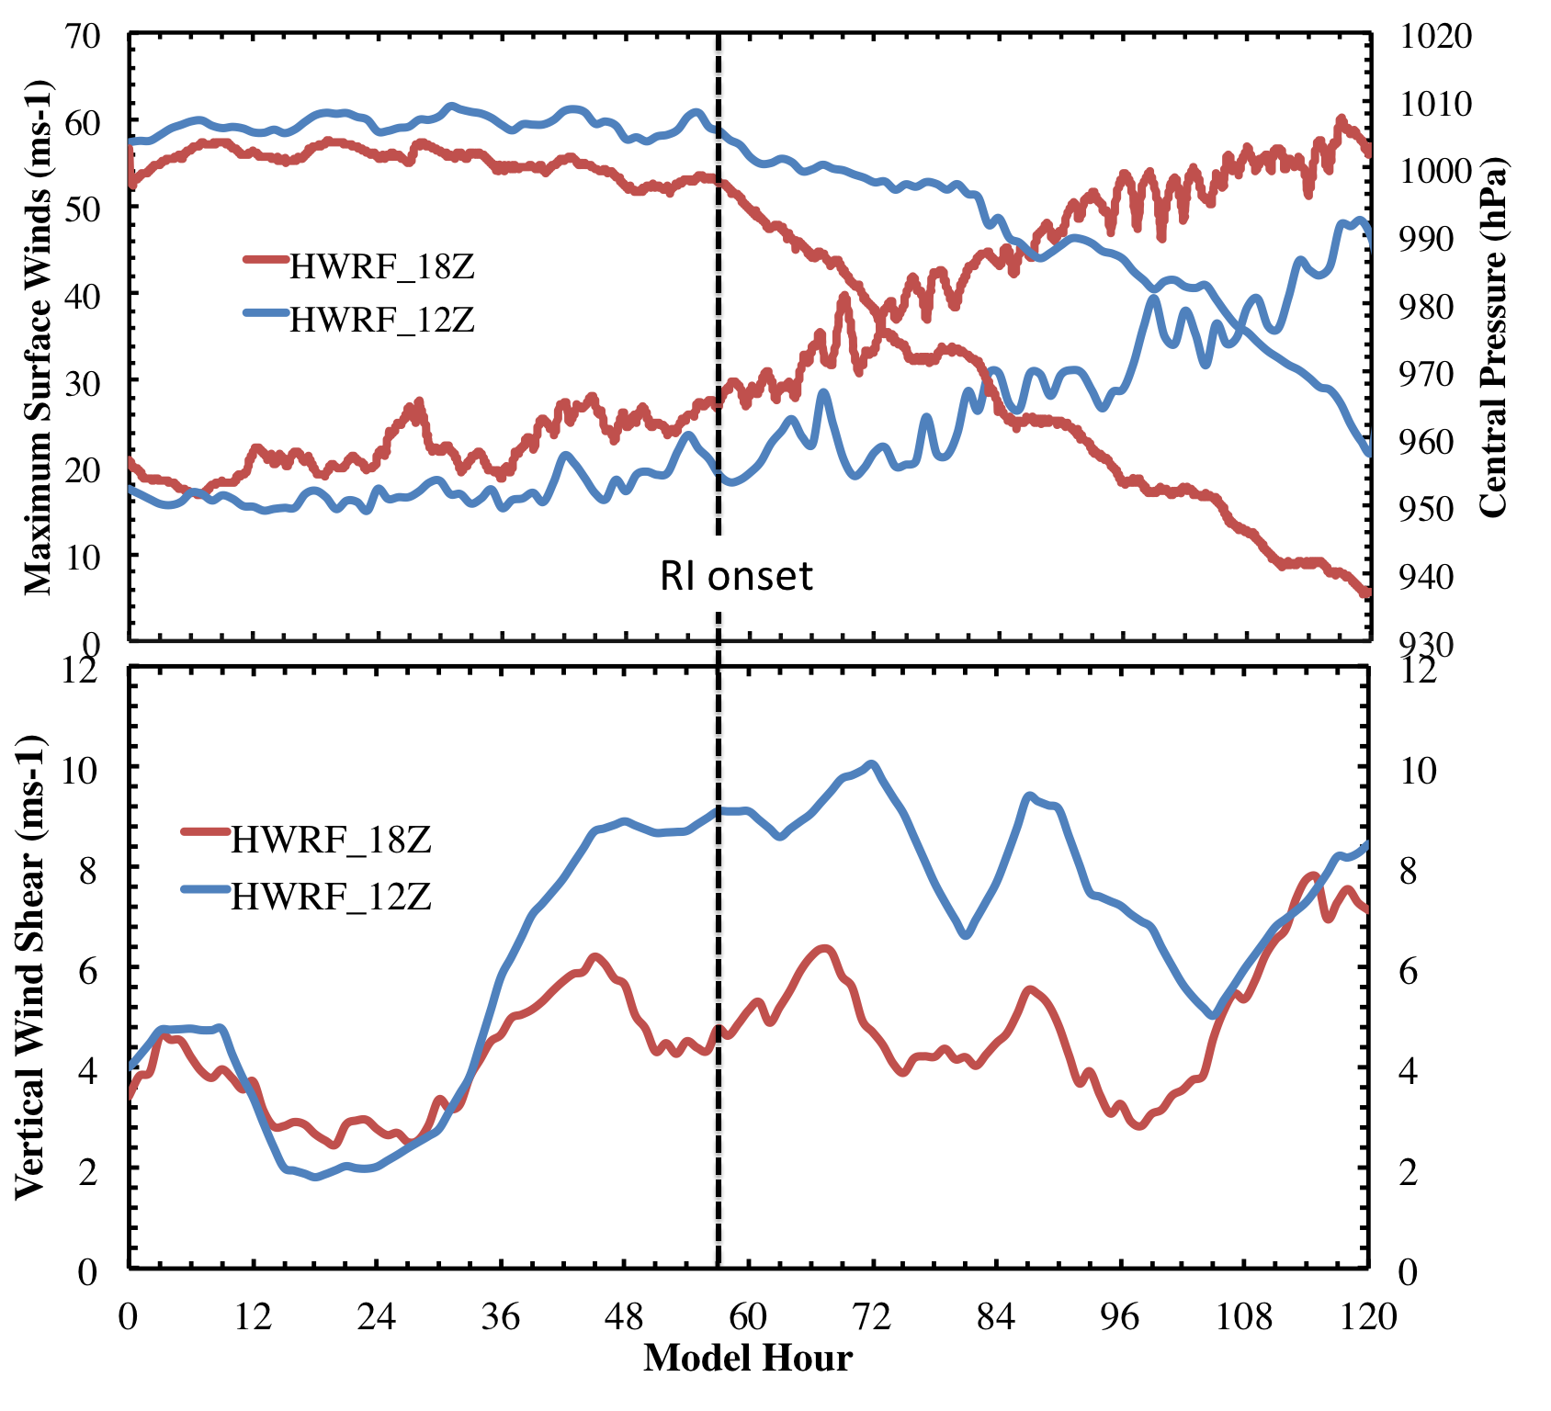
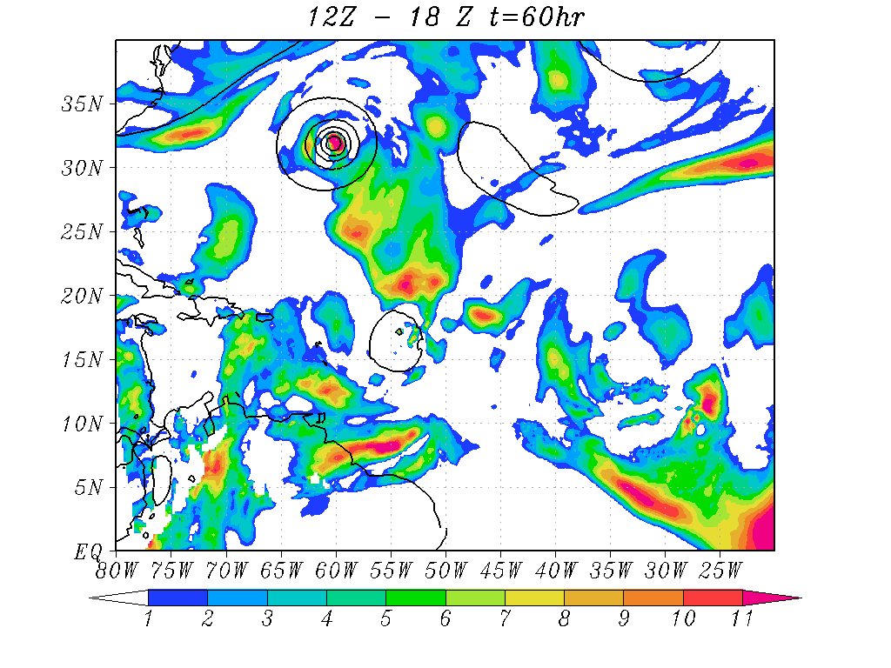
RI problem: Importance of Multi-Scale interactions
Shear vortex interactions during RI in Hurricane Earl (2010)
Shear difference between 12Z and 18Z runs at RI onset
Not all forecasts are as good as the 18Z run! The 12Z forecast was not impressive!
Larger Scale: Higher Shear mostly driven by outflow from Dannielle

Slide 6
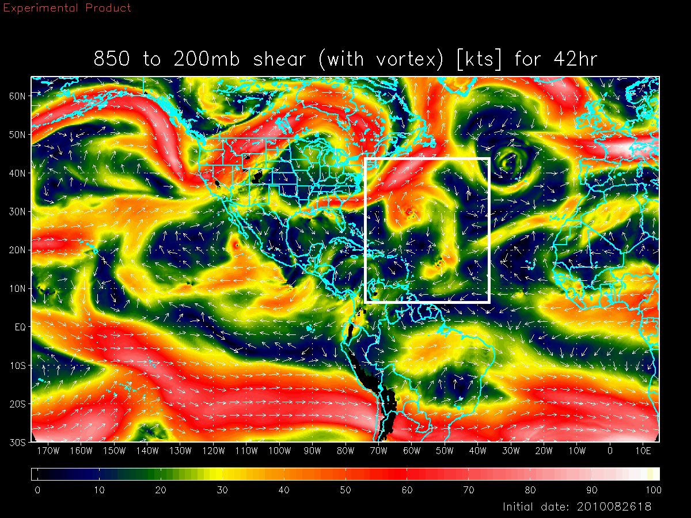
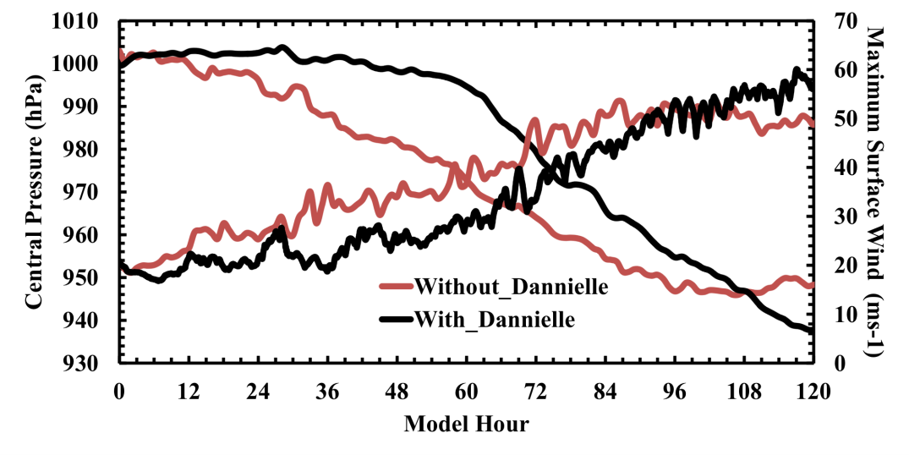
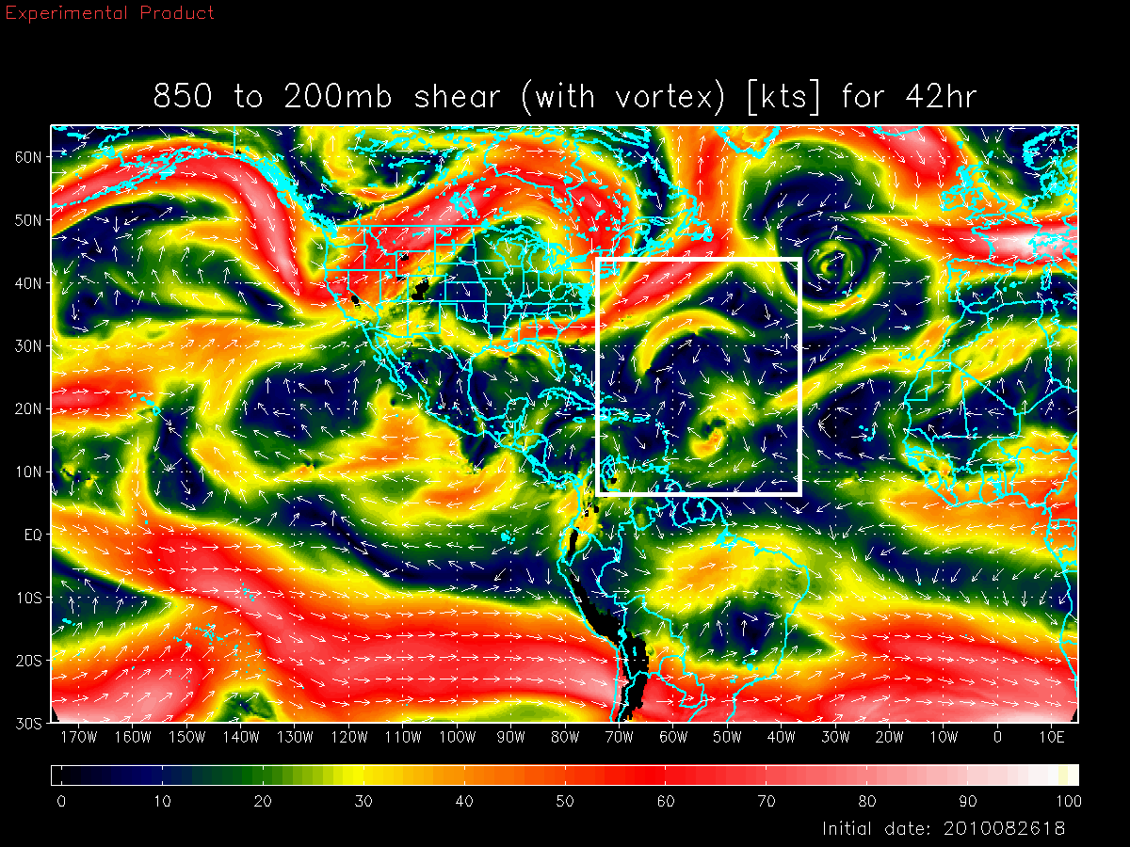
Basin Scale HWRF: Environmental Interactions
Shear vortex interactions during RI in Hurricane Earl (2010)
Deep-Layer Shear with Danielle
Earl
Earl with Danielle Interactions
Deep-Layer Shear without Danielle
Both large and vortex scale processes are critical for forecasting RI events
Earl
Earl W/O Danielle interactions
Credits: Xuejin Zhang
Notes:
Earl interactions with Dannielle

Slide 7
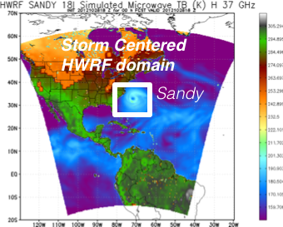
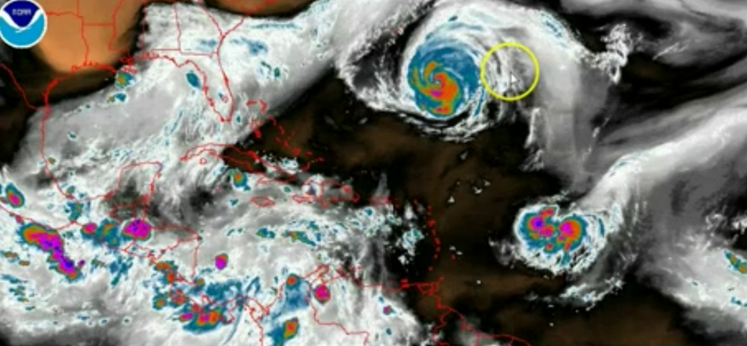
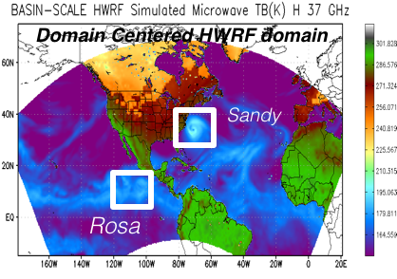
Addressing Our Immediate TC Prediction Needs
A Busy Day in the Tropics
Storm Centric -VS- Domain Centric Forecasts
- Tropical predictions system (Extended predictions)
- Improved storm-storm & multi-Scale interactions
- Landfall and post landfall (storm surge & rainfall)
- Genesis
- Regional ensembles
- Data assimilation

Slide 8
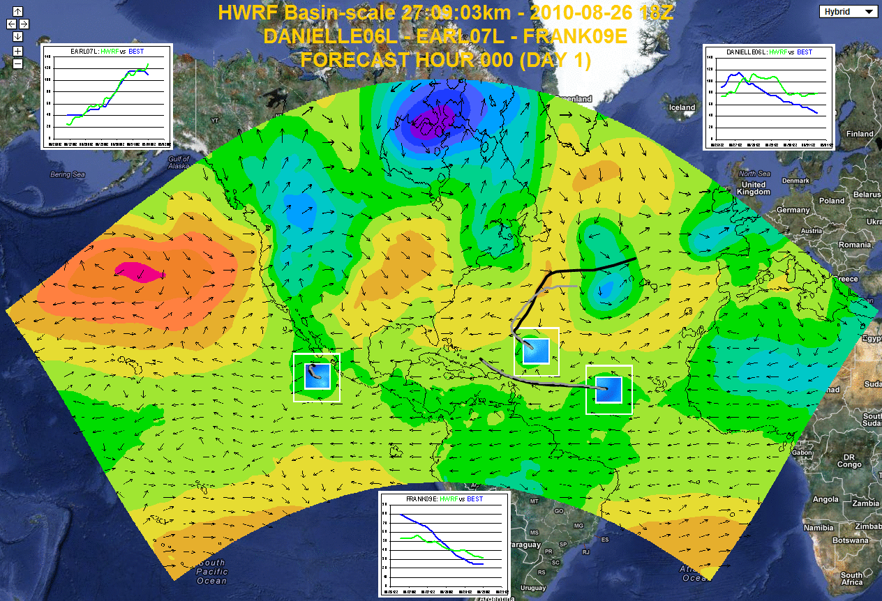
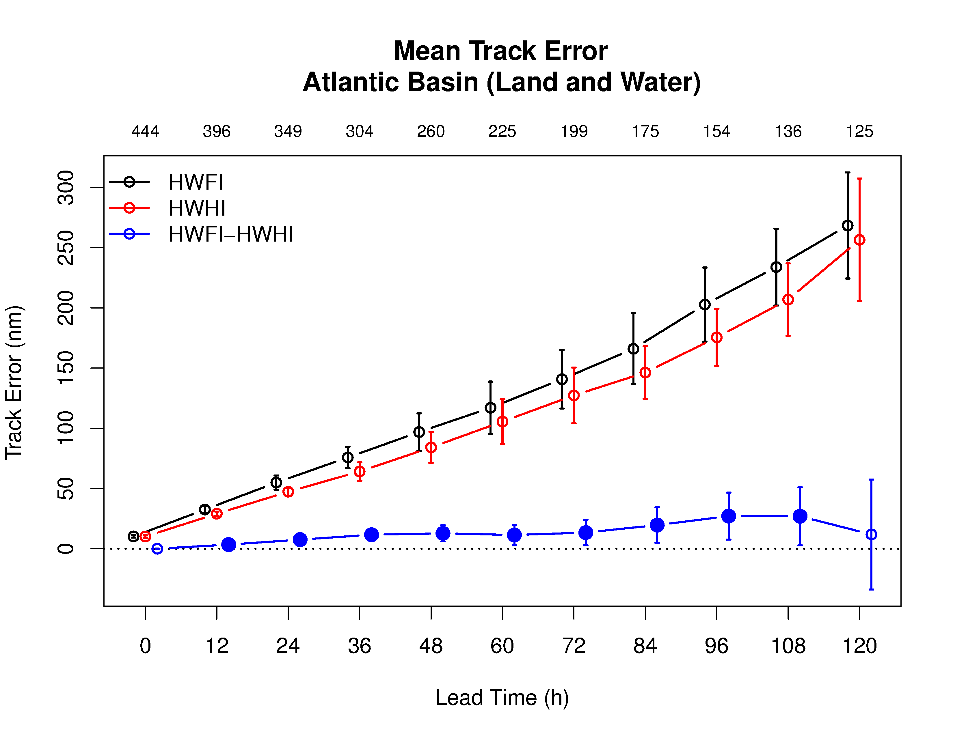
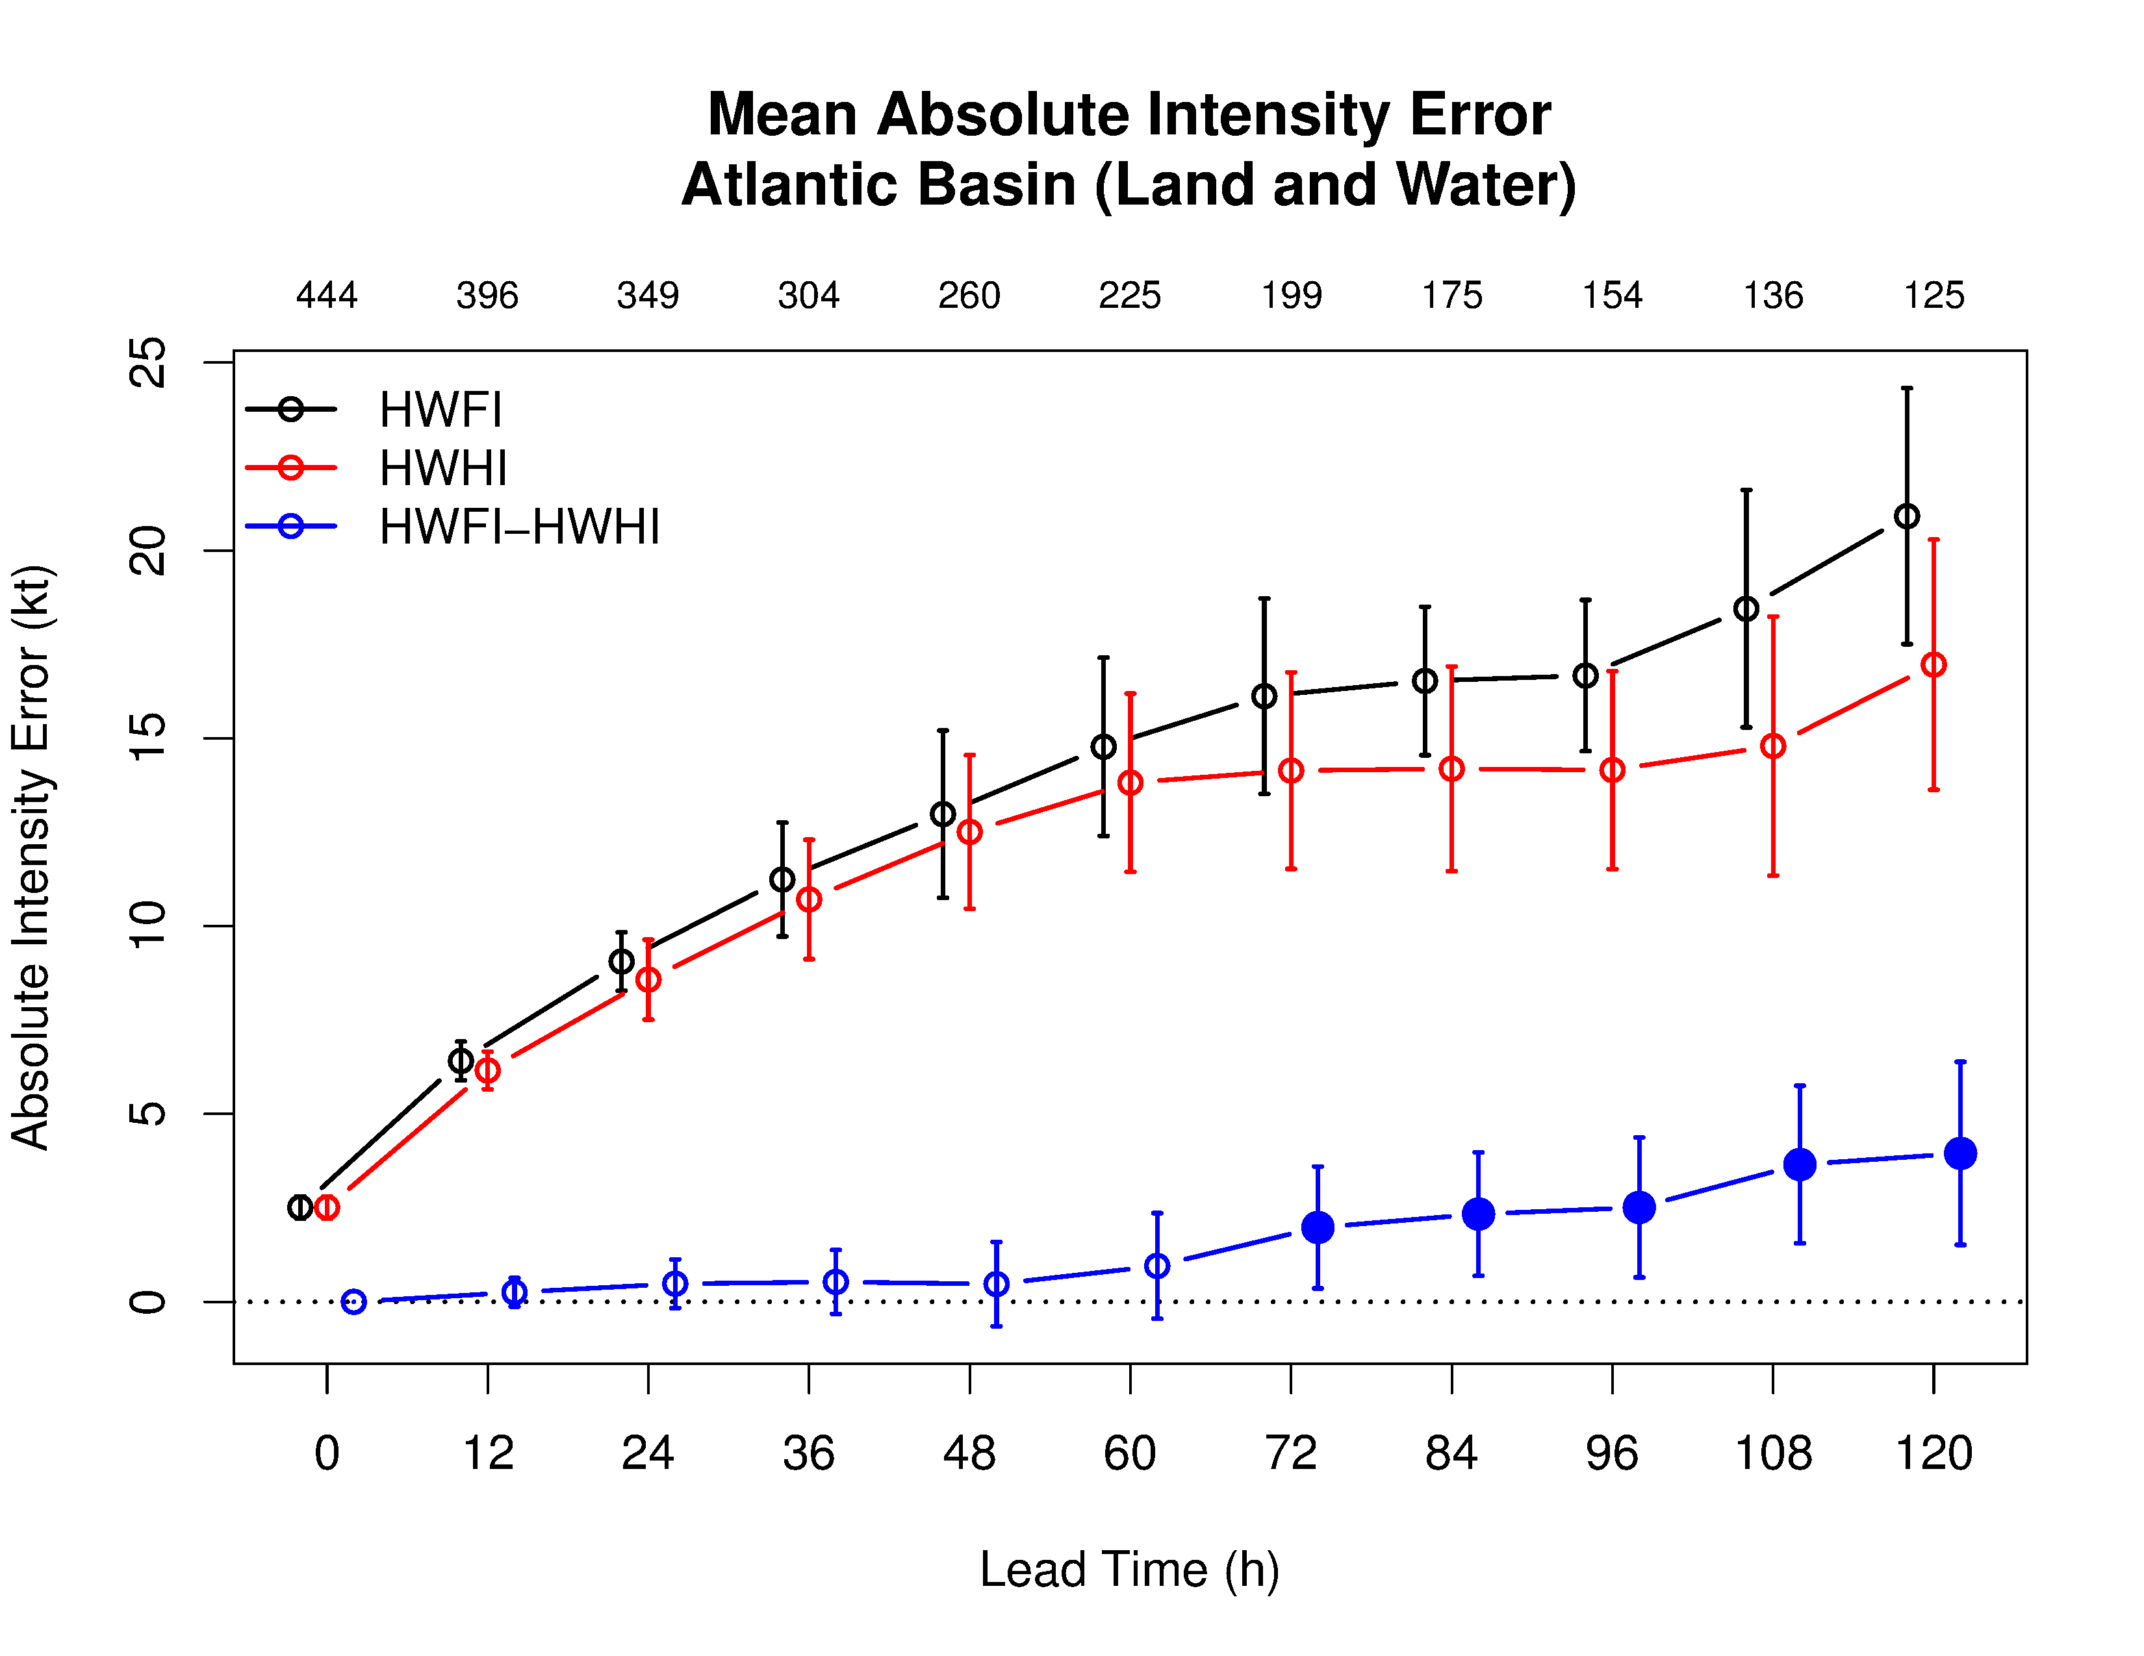
Basin-Scale HWRF: Experimental Prediction System
5
Basin Scale HWRF
Basin Scale HWRF
Basin-Scale HWRF: same version of HWRF but operates with multiple moving nest, initialization, cycling and physics all consistent with operational HWRF, with 61 levels, w/o active ocean coupling (http://storm.aoml.noaa.gov/realtime)
Performance of the Basin Scale HWRF (2013): Significant improvements over 2013 operational HWRF and comparable with 2014 HWRF

Slide 9
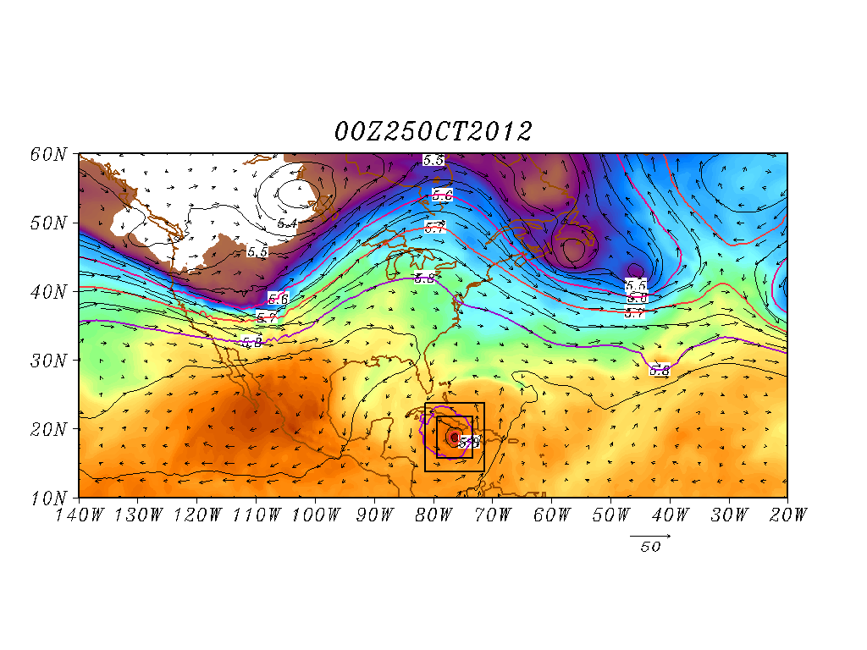
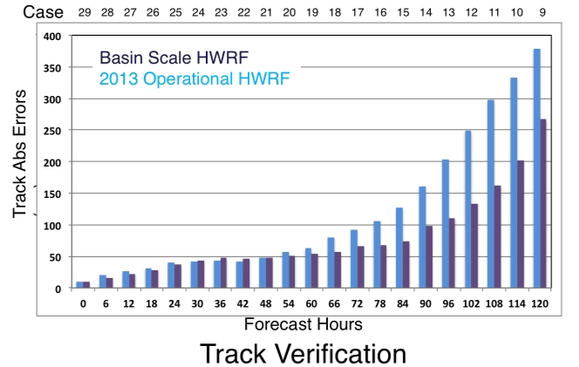
Basin Scale HWRF: Land-Storm Interactions
Hurricane Sandy Predictions: Domain Size and Vortex- Mean Flow interactions
Improved scale interactions and improved track & size forecasts (25 00Z Predictions)
Shading: T at 500 hPa; Contour: GHT at 500 hPa
Vector: Flow averaged between 500 hPa and 200 hPa
Shading: T at 500 hPa; Contour: GHT at 500 hPa
Vector: Flow averaged between 500 hPa and 200 hPa

Slide 10
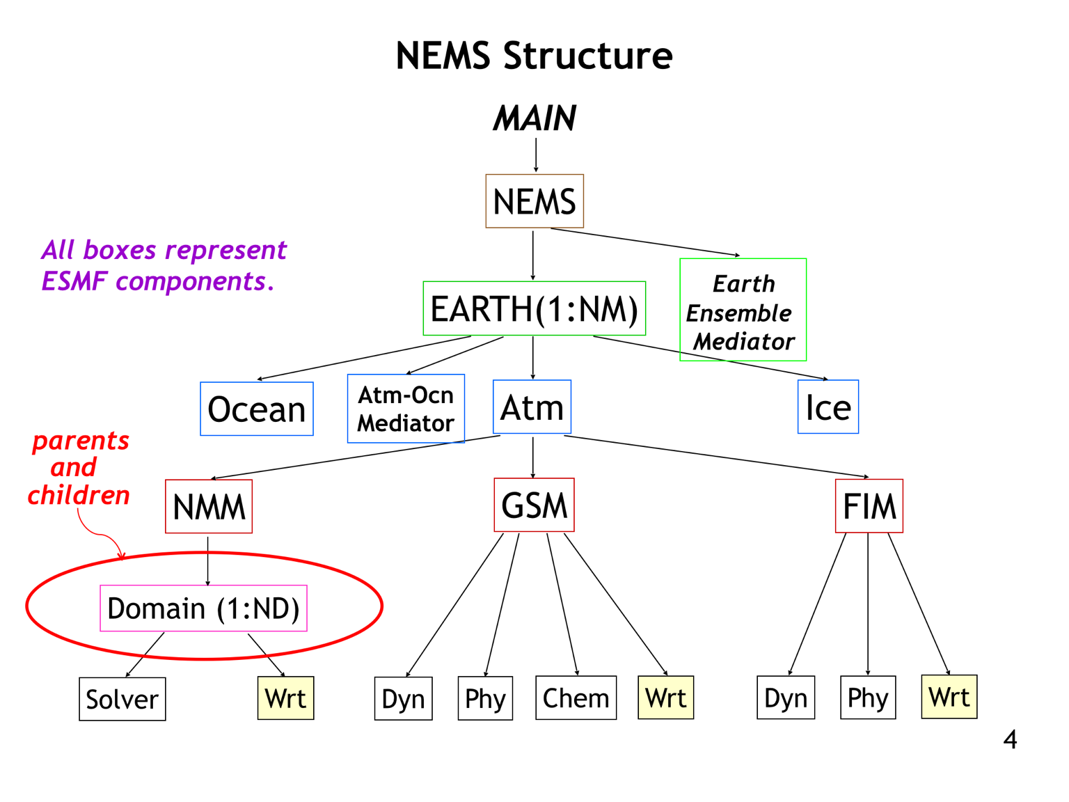
8
Addressing Next-Generation TC Prediction Needs
Common modeling infrastructure geared towards global models
Created for sharing developments (e.g, coupler, physics)
NMM and HWRF shares the same dynamics except grid structure (E vs B).
NMM can be configured in both regional (basin scale) and global mode
Nesting within NMM (under development) based on HWRF paradigm but recoded within NEMS
HWRF nest motion algorithms, physics and initialization under transition
Non-Hydrostatic Multi-scale Model (NMM) embedded within the NOAA Environmental Modeling Framework (NEMS)

Slide 11
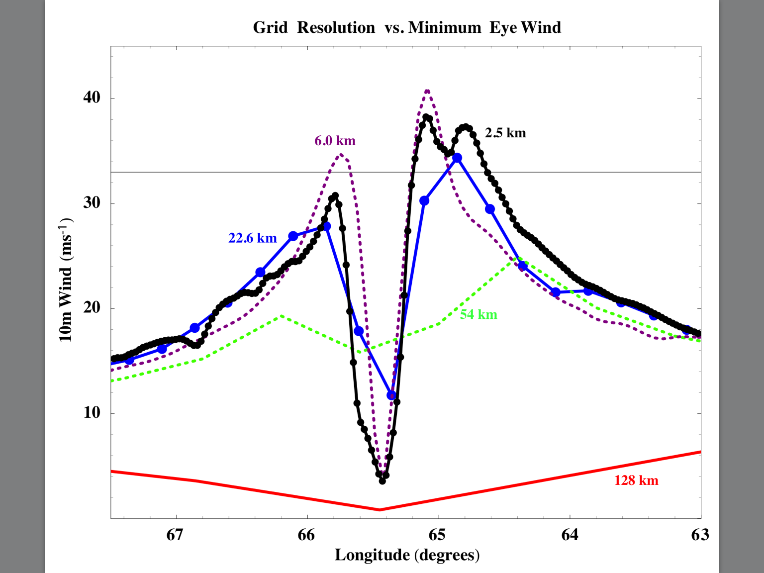
Motivation: Need For Global Nests
NOAA's High Impact Weather Prediction Project goal will be to develop a system that can produce 10-day forecasts at ~3-km global resolution fast enough to meet operational requirements by the end of the decade, with forecast skill exceeding that of the updated hydrostatic GFS and other chosen baselines.
HWRF is now used for guidance in all basins in the globe. Proven value for track, intensity and structure predictions.
Leverage on NOAA’s success with the HWRF system and accelerate progress towards creating high resolution, next generation model with the potential transitions to regional and global "HWRF".
We propose a seamless approach and illustrate how this approach is important for TC predictions
Impact of global model resolution on prediction of the inner core structure of Hurricane Earl (2010)

Slide 12
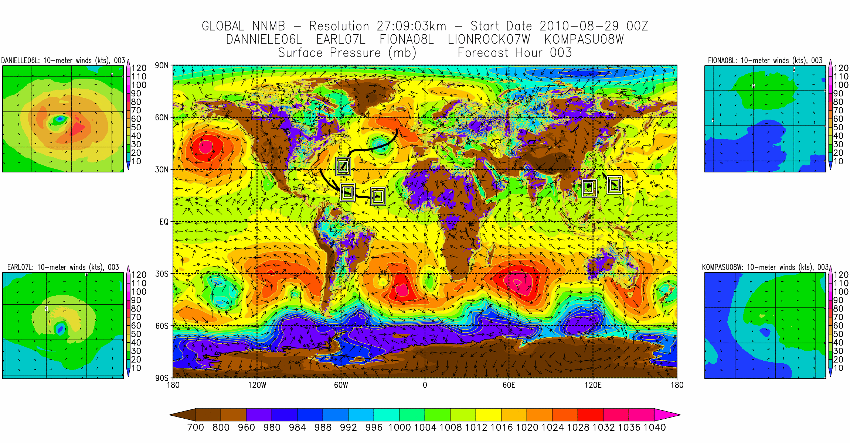
A Global Tropical Prediction System

