Slide 1



NOAA’s High-Resolution Hurricane
Modeling System (HWRF)
Improving our Nation’s Hurricane Track, Structure and Intensity Forecasts
Sundararaman G. Gopalakrishnan (Gopal)
NOAA/AOML/HRD, Miami
Notes:
Hurricane Bill: HWRF Equivalent of GOES-East Imager 10.7 micro m
1

Slide 2

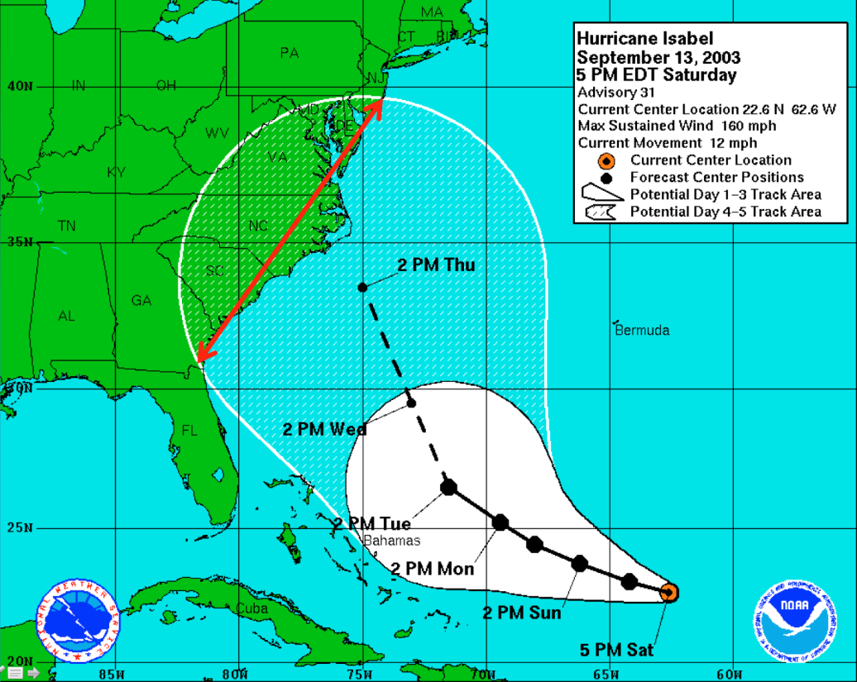
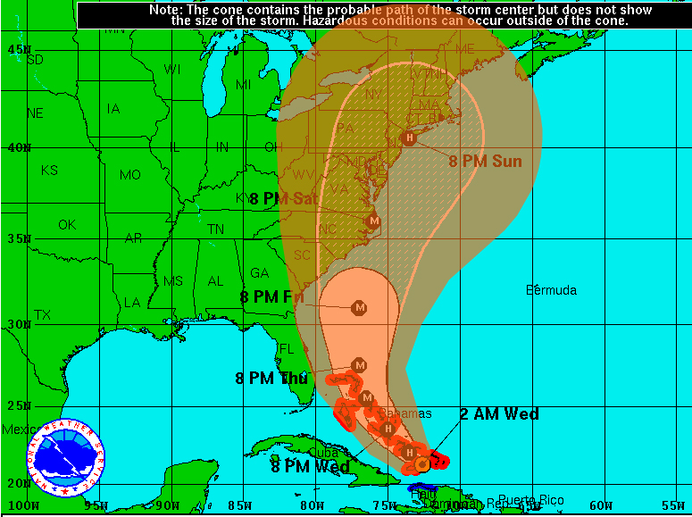
Improved Precision of Hurricane Track Forecast
Hurricane Irene forecast – a great example of track improvement
In 2003 the cone of uncertainty for the 5-day forecast for Isabel extended 878 nautical miles.
Hurricane Irene
August 24, 2011
2 AM EDT Wednesday
Advisory 15A
Center location 21.3 N 72.6 W
Max sustained wind 100 mph
Movement WNW at 9mph
With today’s advances in track forecasting, the 5-day forecast for Hurricane Irene in 2011 reduced the cone of uncertainty an estimated 54% (478 miles at 120 hours) compared to 2003.
The advances in forecasting reduced over-warning in Irene and saved the U.S. at least $384 million in evacuation costs.
Notes:
The cumulative hurricane research budget at AOML from 2003 – 2011 was less than $30 million, less than 8% of the money saved from unnecessary evacuations.
The estimate of $384 million saved results from the assumed evacuation of communities under the “red” 2003 cone, from Miami, FL to Charleston, SC - an estimated 600 miles of coastline.
The 2008 Economic Statistic for NOAA estimates an average cost of $640,000 to evacuate a mile of coastline. The actual cost of evacuation is highly variable and is dependent on coastal population and development in the evacuated area.
The 2012 cone radii will be slightly smaller than the previous year, with the greatest decease at 96 hours (4 day forecast).
Changes in Atlantic Cone of Warning radii from 2003 to 2012:
hr 49 to 36 nmi (-13)
24 hr 85 to 56 nmi (-29)
36 hr 121 to 75 nmi (-46)
48 hr 164 to 95 nmi (-69)
72 hr 232 to 141 nmi (-91)
96 hr 318 to 180 nmi (-138)
120 hr 439 to 236 nmi (-203)
2

Slide 3
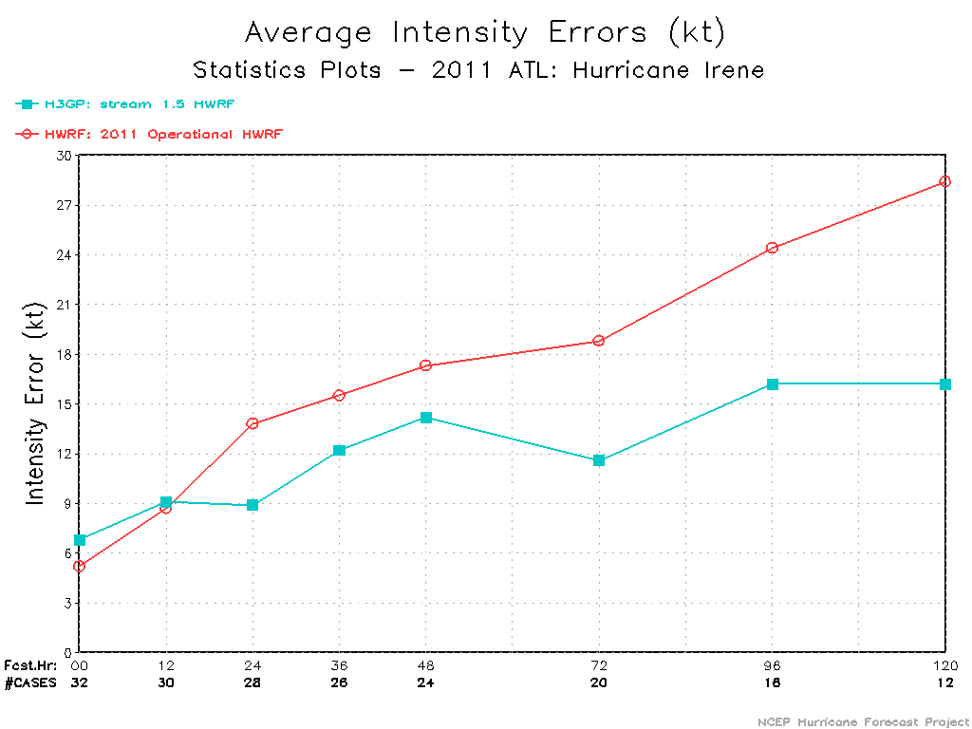
Improving Precision of Hurricane Intensity Forecast
Hurricane Irene
Intensity Verification
Old model – higher error
New model – lower error
3km Hi-res HWRF showed a 30-50% improvement over operational HWRF (statistics provided by NCEP)
Going to higher resolution models is the basis for improving intensity predictions
NOAA (AOML and their partners at NCEP) is creating a high resolution HWRF model at the 3km scale
This would make the HWRF model the highest resolution hurricane model ever implemented for operations in the National Weather Service
Notes:
3

Slide 4
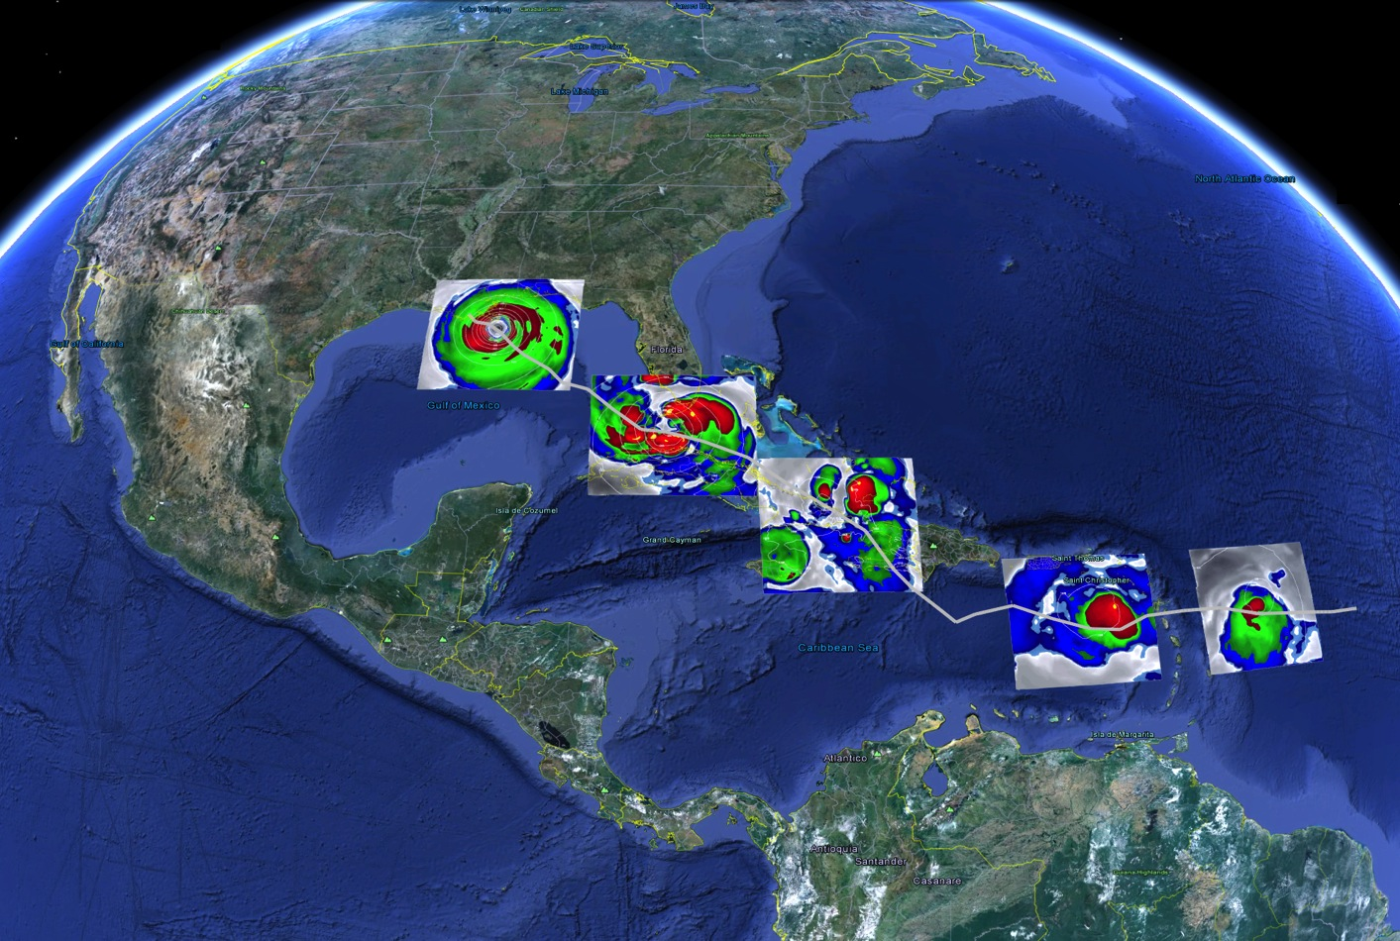

Overall Improved Precision of Hurricane Forecast – Including Structure (how it looks)
AOML/HRD – NCEP/EMC
What it takes to forecast a hurricane
1.Higher Resolution for resolving convection & terrain
2. Model Physics valid for higher resolution
3. Improved representation of initial conditions
4. Advanced understanding of the hurricane (observations)
Warmer sea surface temperatures and no shear
Vortex tilt, dry air, and size of the storm
Terrain interactions
Northerly shear and dry air impedes the development of circulation
Enhanced Water Vapor Equivalents obtained from HWRF in the Life cycle of Hurricane Isaac
Notes:
4

Slide 5
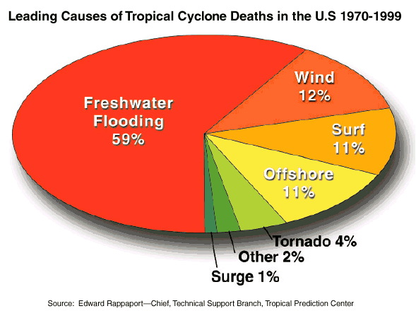
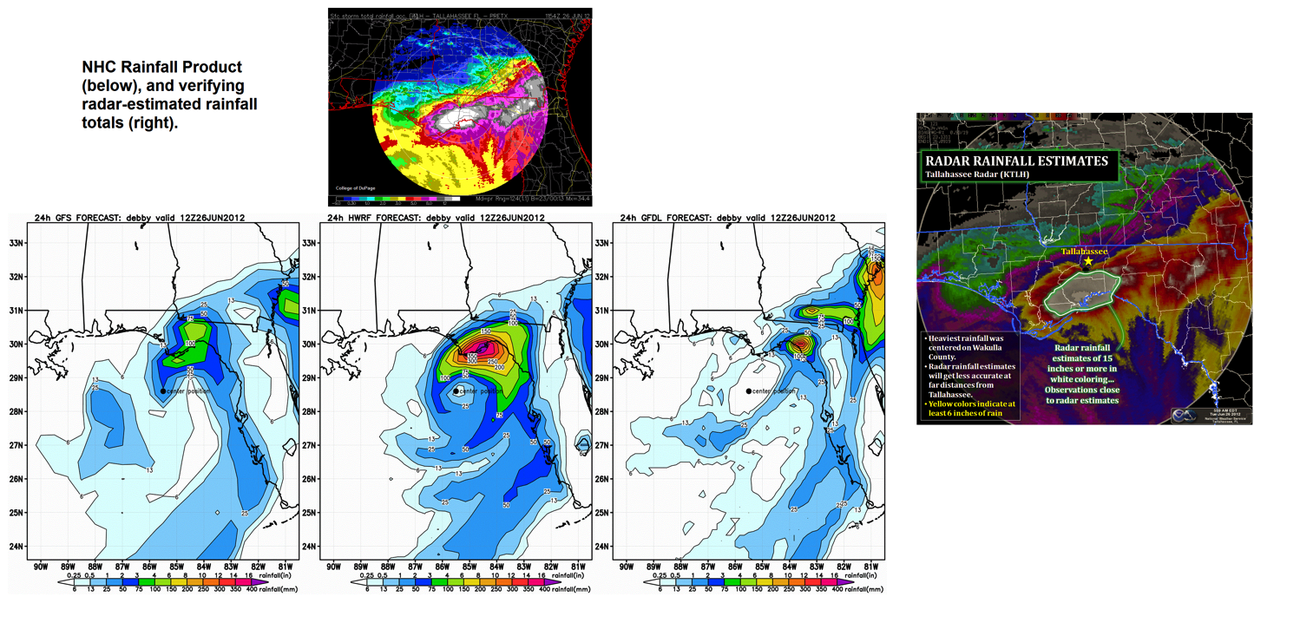
When you Get the Structure and Track Accurate, Rainfall Predictions Improve
…And Rainfall really matters!
GFS
HWRF
GFDL
NOAA-HFIP Advancements
Promises
Notes:
5

Slide 6
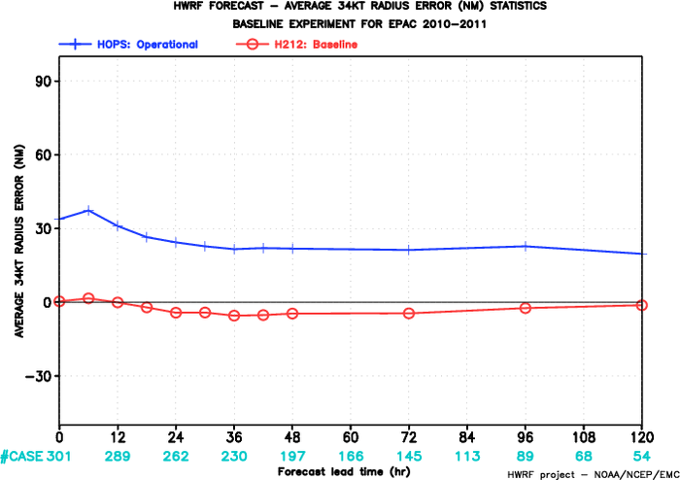
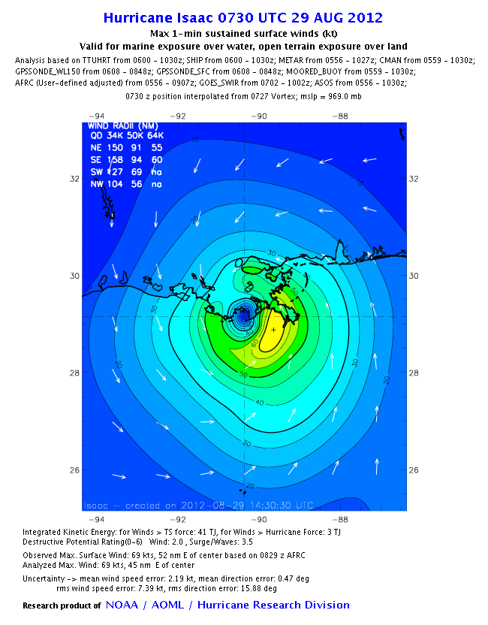
When the Structure is Accurate, Size Predictions Also Improve
Mean 34-kt Radius Error for Eastern Pacific Hurricanes
Radius
Of 34 kt
winds
Radius
Of Maximum
winds
9km HWRF
3km HWRF
NOAA-H*Wind Analysis
Size Matters!
(e.g. storm surge)
Notes:
6

Slide 7


It’s not just the Model itself – we need the best observations for creating the initial conditions
We use all types of observation platforms
Two examples: NOAA Gulfstream-IV (G-IV) jet and the NOAA P-3 jet
NOAA G-IV
NOAA P-3
NOAA P-3:
Flight altitude: ~25,000 ft (7600m, 400 hPa)
Instruments: uses Doppler Radar
NOAA G-IV:
Flight altitude: ~45,000 ft (13700m, 150 hPa)
Instruments: uses GPS dropsondes

Slide 8
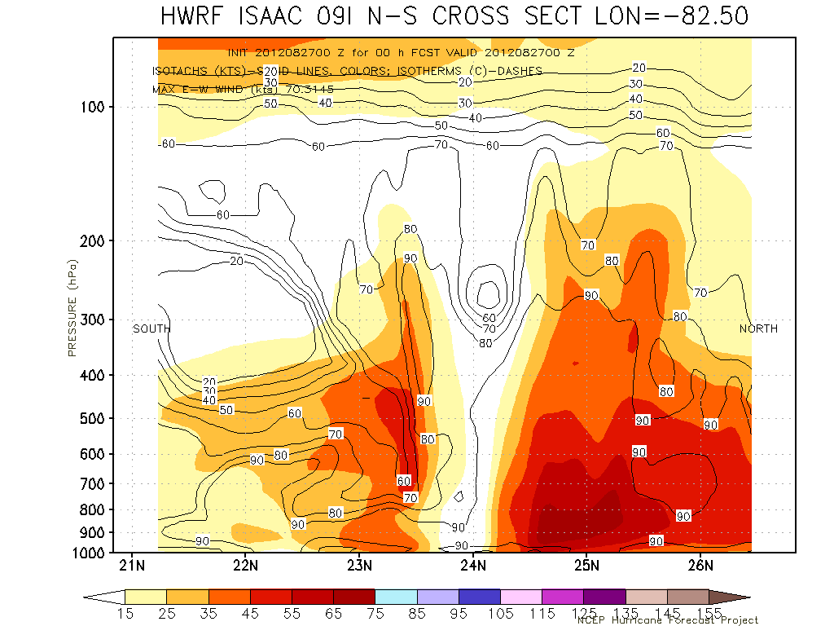
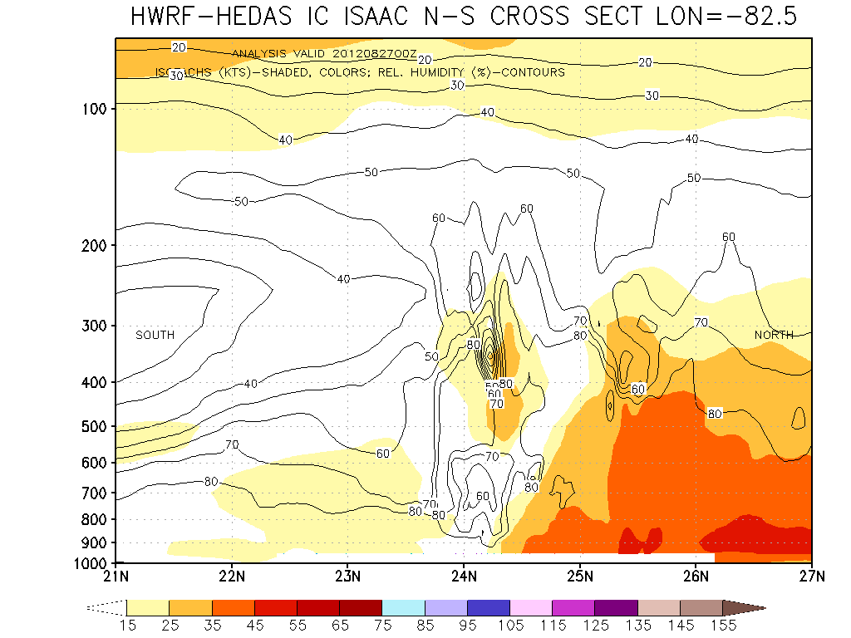
We also need Data Assimilation to Incorporate the Observations into the Model for Improved Initial Conditions
ISAAC Initial vortex (wind)
Operational HWRF (No Data Assimilation)
ISAAC Initial vortex (wind)
with assimilation of observations
ISAAC (2012): Intensity Errors (kt)
Hours | 12 | 24 | 36 | 48
Operational HWRF | 13 | 16 | 26 | 26
With P3 Data | 8 | 3 | 9 | 20
Cases | 9 | 7 | 5 | 3
Notes:
Reference for table:
Aksoy, A., S. Lorsolo, T. Vukicevic, K. Sellwood, S. Aberson, and F. Zhang, 2012: The HWRF Hurricane Ensemble Data Assimilation System (HEDAS) for highresolution data: The impact of airborne Doppler radar observations in an OSSE. Mon. Wea. Rev (in press).

Slide 9
Where We Are and What’s Next
Creating High-resolution hurricane models at 3 km resolution on a basin-scale (semi-global)
Improved observations and data assimilation to improve initial conditions
NOAA Research and operational Weather Service work hand-in-hand thanks to the NOAA HFIP project
  As our research improves, so do they
Resulting in better forecasts to protect lives and property
Providing Tropical Outlooks beyond 5 days
Notes:
9

Slide 10
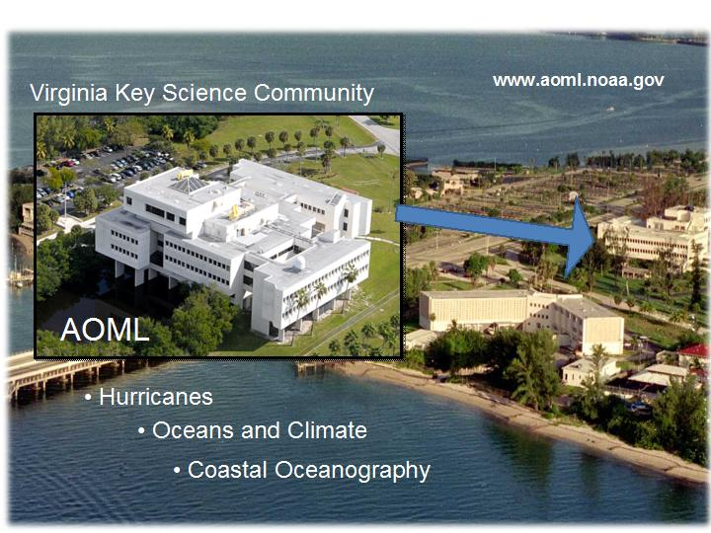
Questions ?
gopal@noaa.gov

