Slide 1
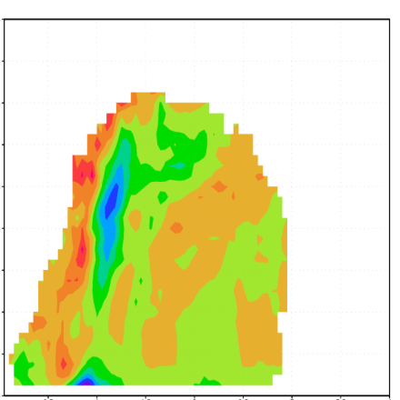
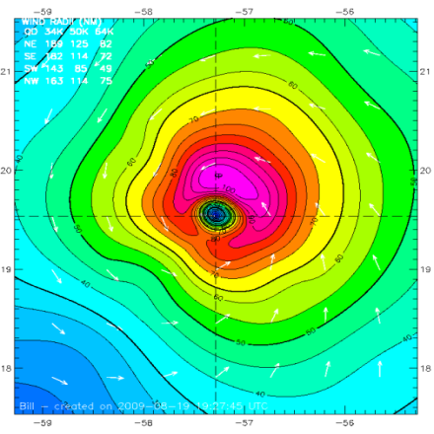
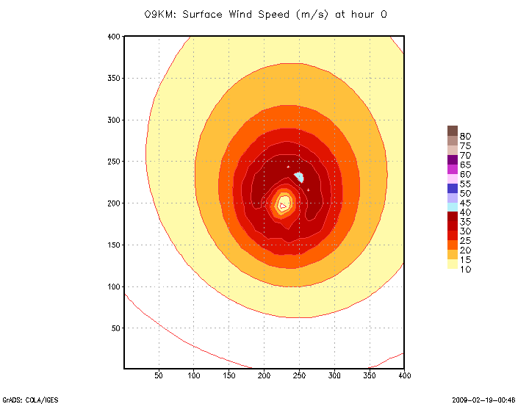
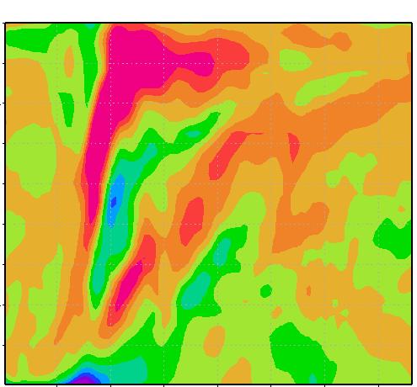
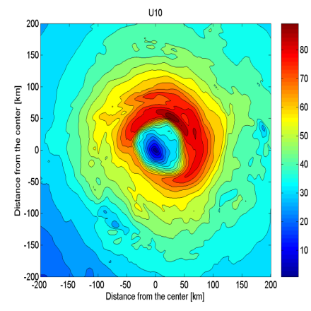
HWRF Nesting
Hurricane Bill, 2009
Hurricane Katrina, 2005
Hurricane Ike, 2008
Hurricane Katrina, 2005
Hurricane Bill, 2009
Ideal Case
S.G.Gopalakrishnan and Xuejin Zhang
HRD/AOML/NOAA, Miami
gopal@noaa.gov

Slide 2
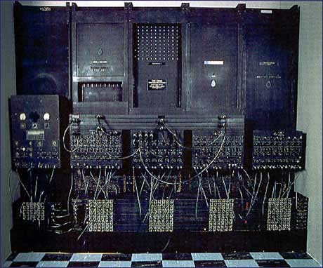
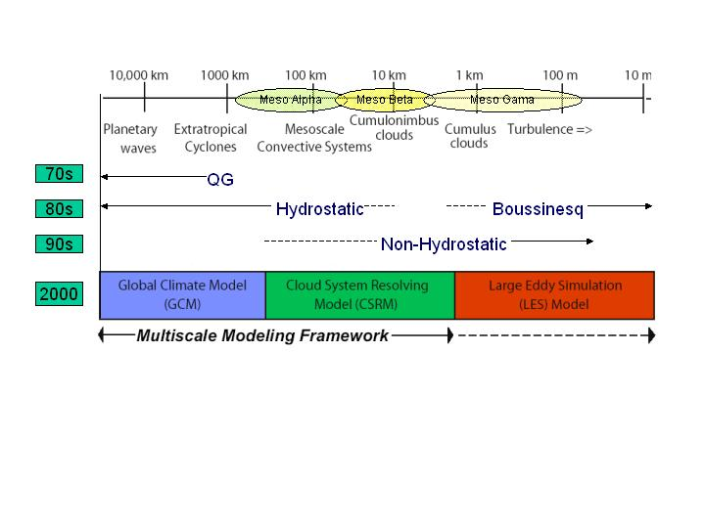

Acknowledgements
John Michalakes (MMM, NCAR)
Robert Tuleya (GFDL/EMC) and Morris Bender (GFDL)
Dusan Jovic, Zavisa Janjic, Thomas Black (EMC)
Vijay Talapragada and Naomi Surgi (HWRF team, EMC)
Frank Marks (HRD/AOML) and Robert Atlas (AOML)
ENIAC, 1950
ESRL JET, 2008
Notes:
2
2

Slide 3
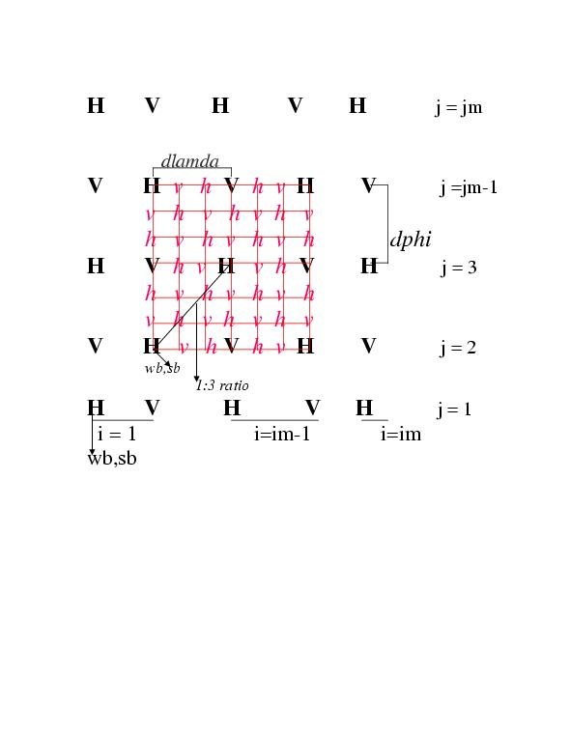
E grid Configuration
E-grid indexing
Nearest Neighbor is along the diagonal
Interpolations consistent with model dynamics along the diagonal
Boundary conditions uses square grid volume
Either ways need for hallos along the x and y directions

Slide 4
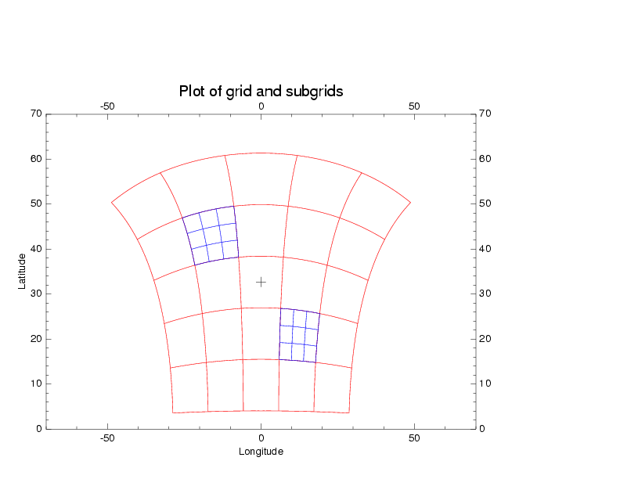
HWRF Grid Configuration
Horizontal: Rotated latitude-longitude, E-grid
Vertical: pressure hybrid
Coincident grid point approach eliminates the need for more complex, generalized remapping calculations in the WRF Advanced Software Framework

Slide 5
Terrain Forcings
The WPS is used to generate terrain data sets over multiple domains at the required grid resolution.
For instance, in a typical operational forecast at 27 km with a moving nest at 9 km resolution, terrestrial data are generated at both of the resolutions for the entire domain

Slide 6
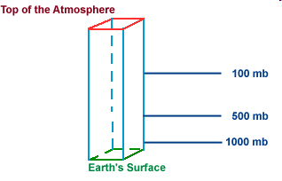
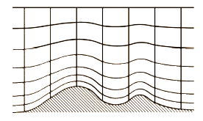
Mass Adjustment Procedure
Pressure NOT directly interpolated from parent hybrid to nested hybrid (hybrids don’t match!.)
The height, temperature and moisture fields from the parent domain are vertically interpolated onto pre-defined standard pressure surfaces.
The above meteorological fields from the mother domain are further interpolated horizontally onto nested grids on the same pressure surface.
Finally, by using the high-resolution topography over the nested domain, pseudo hydrostatic mass balancing is carried out to prescribe the initial values in the nested domain.

Slide 7
Salient features: Initial Conditions
Bi-linear Interpolation along the horizontal
Nearest neighbor for land state variables except terrain
Simplified land-surface treatment that avoids the need for additional inputs such as the soil temperatures, soil moisture or SSTs over isolated land or water bodies inconsistent with the parent domain
The algorithm sacrifices mass and energy conservation for the sake of smooth solutions across the interface (Zhang et al. 1986; MWR)
For short-term numerical forecasts in which the use of appropriate model physics and the patterns to be forecast may be important than exact mass and energy conservation, as long as the mass (or energy) discrepancy at the interface is small.

Slide 8
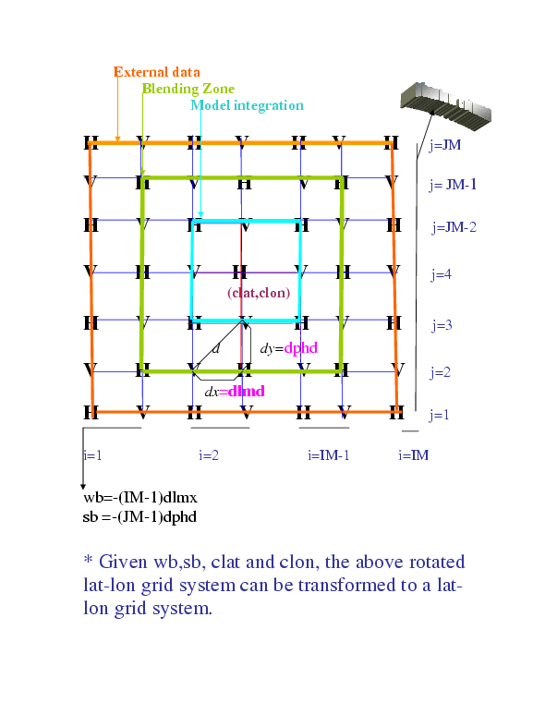
HWRF NESTED BOUNDARY CONDITIONS
External Data: Prescribed from the parent after mass adjustment of hydrostatic variables/ direct interpolation of other variables
Blending Zone: Simple 4 point averaging
Dynamic Interface: Model integration starts from 3rd row/column

Slide 9
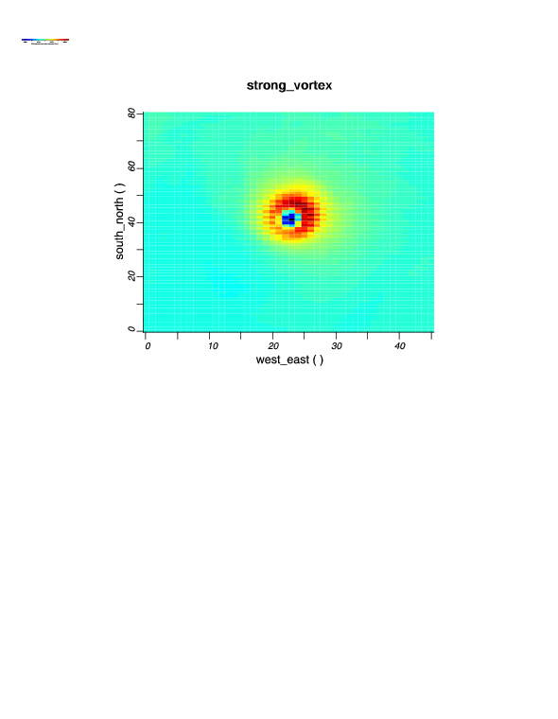
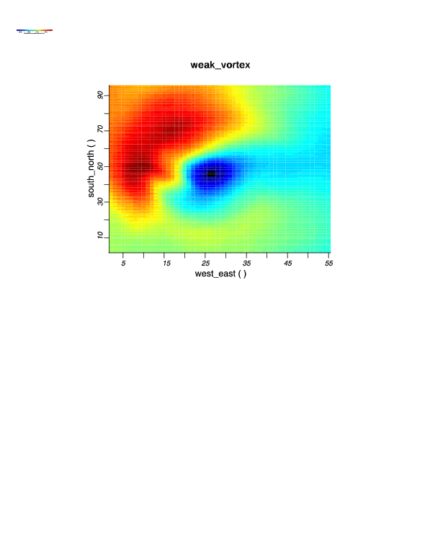
HWRF GRID MOTION
While data was exchanged between the region of nest before and after grid motion, bilinear interpolation code that was earlier developed for the one-way static nest was still applied, but this time with masking of the leading edge of the moving nest.
The nest is "set to sail" on the parent domain using a simple criterion based on variations in dynamic pressure. The so called “stagnation point” was chosen to be the center of the storm (Gopalakrishnan et al 2002, MWR.)

Slide 10
HWRF Two-Way Interaction
13 or 9 point average (repository uses 9)
Weighed equally between the parent and nest average

Slide 11
HWRF namelist.input: nest specific!
&domains
max_dom = 2,
grid_id = 1, 2,
parent_id = 0, 1,
&time_control
start_year = 2008, 2008,
start_month = 09, 09,
start_day = 09, 09,
start_hour = 00, 00,
start_minute = 00, 00,
start_second = 00, 00,
end_year = 2008, 2008,
end_month = 09, 09,
end_day = 09, 09,
end_hour = 06, 06,
end_minute = 00, 00,
end_second = 00, 00,
./frame/LOGICAL FUNCTION nests_to_open
CALL nl_get_max_dom ( 1, max_dom )
DO nestid = 2, max_dom
IF ( .NOT. active_domain( nestid ) ) THEN
CALL nl_get_parent_id ( nestid, parent_id )
IF ( parent_id .EQ. parent%id ) THEN
CALL nl_get_start_year (nestid,s_yr)
CALL nl_get_end_year (nestid,e_yr)
CALL nl_get_start_month (nestid,s_mm)
CALL nl_get_end_month (nestid,e_mm)
CALL nl_get_start_day (nestid,s_dd)
CALL nl_get_end_day (nestid,e_dd)
CALL nl_get_start_hour (nestid,s_h)
CALL nl_get_end_hour (nestid,e_h)
CALL nl_get_start_minute (nestid,s_m)
CALL nl_get_end_minute (nestid,e_m)
CALL nl_get_start_second (nestid,s_s)
CALL nl_get_end_second (nestid,e_s)
………….
ENDDO

Slide 12
Domain configuration for the nest
&domains
time_step = 54,
time_step_fract_num = 0,
time_step_fract_den = 1,
max_dom = 2,
s_we = 1, 1,
e_we = 216, 60,
s_sn = 1, 1,
e_sn = 432, 100,
s_vert = 1, 1,
e_vert = 43, 43,
parent_grid_ratio = 1, 3,
parent_time_step_ratio= 1, 3,
dx = .18, 0.06,
dy = .18, 0.06,
./frame/MODULE module_integrate
RECURSIVE SUBROUTINE integrate
DO WHILE ( nests_to_open( grid , nestid , kid ) )
a_nest_was_opened = .true.
CALL med_pre_nest_initial ( grid , nestid , &
config_flags )
CALL alloc_and_configure_domain &
( domain_id = nestid , grid = new_nest , &
& parent = grid , & kid = kid )
CALL Setup_Timekeeping (new_nest)
CALL med_nest_initial( grid , new_nest , config_flags )
END DO
Dummy for the
nested domain

Slide 13
HWRF: ISTART, JSTART AND GRID MOTION
&domains
grid_id = 1, 5,
i_parent_start = 0, ISTART1,
j_parent_start = 0, JSTART1,
num_moves = -99,
move_id = 2,
move_interval = 0,
move_cd_x = 0,
move_cd_y = 0/
Option for automatic grid motion, specifically for Hurricanes; For locating the initial grid based on storm center, we are providing an utility ../hwrf-utilities/vortex_init/hwrf_set_ijstart/swcorner_dynamic.F. However this code has to be re-compiled independent of the WRF model.

Slide 14
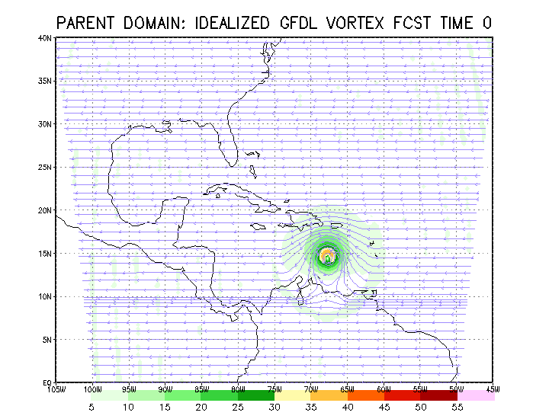
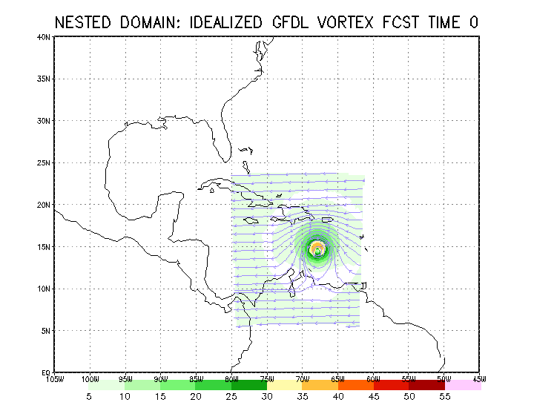
Basic Testing of the Nest Dynamics
Parent domain of the size of about 60º x 60º at 36 km resolution
Nested domain of the size of about 20º x 20º at 12 km resolution
* The initial condition for this idealized case did not include topography and land, however, as in the case of static, one-way nest the code is general enough to take care of topography.

Slide 15
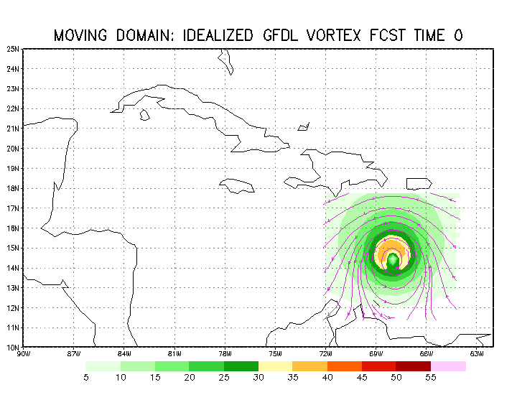
Moving domain of size of about 7⁰x7⁰ at about 12 km resolution
Despite the small size of the nested domain, as long as the vortex is located in the center of the nest, we see the effect of lateral boundary diffusion to be limited and we are indeed able to hold on to the intensities!

Slide 16
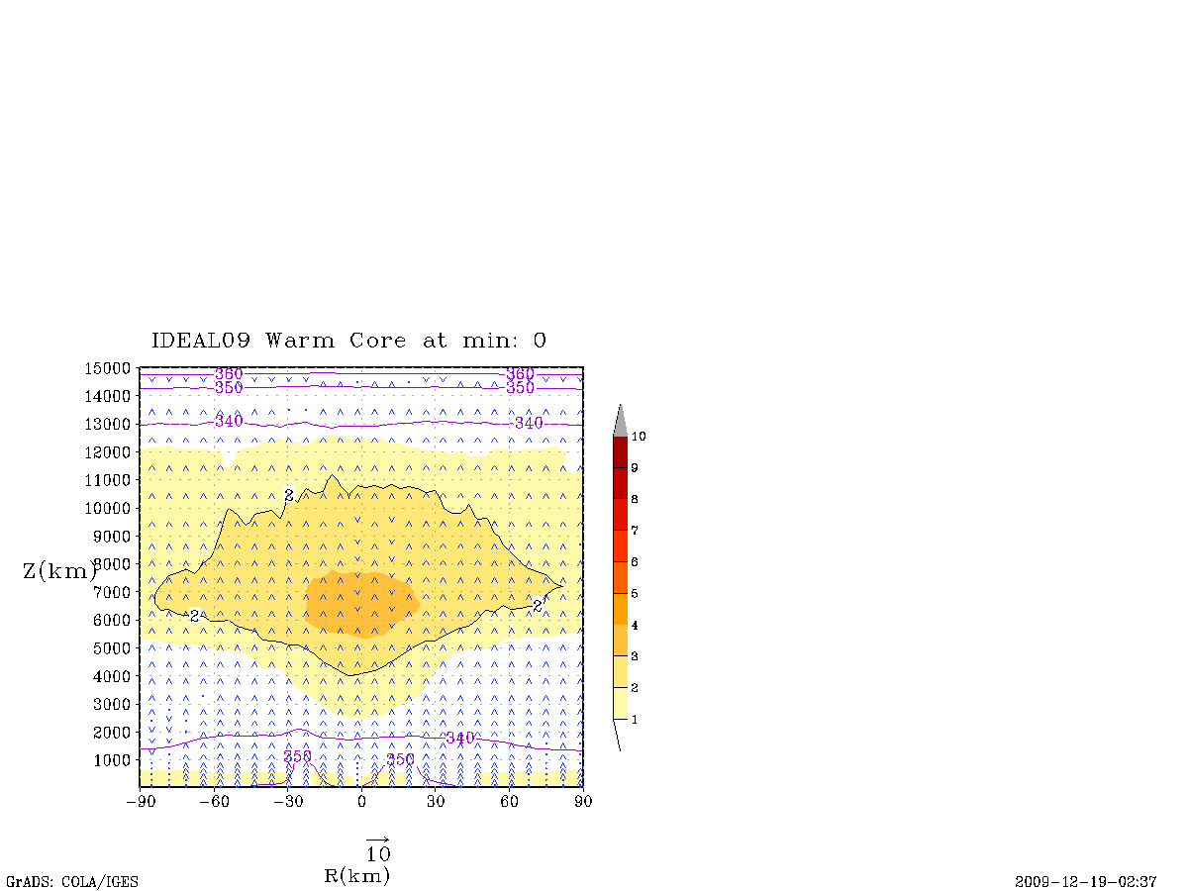
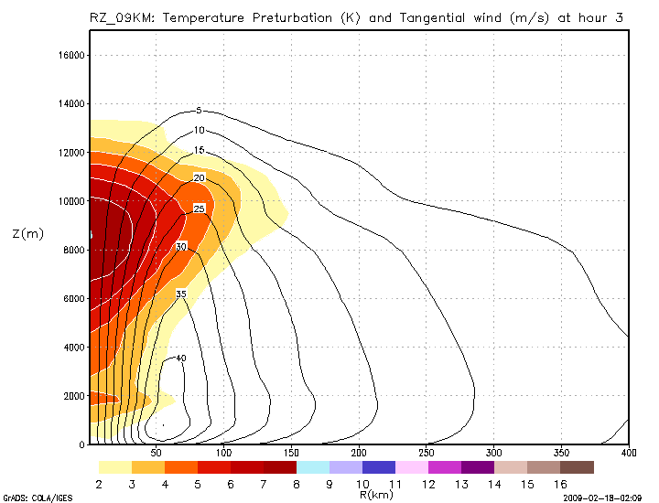
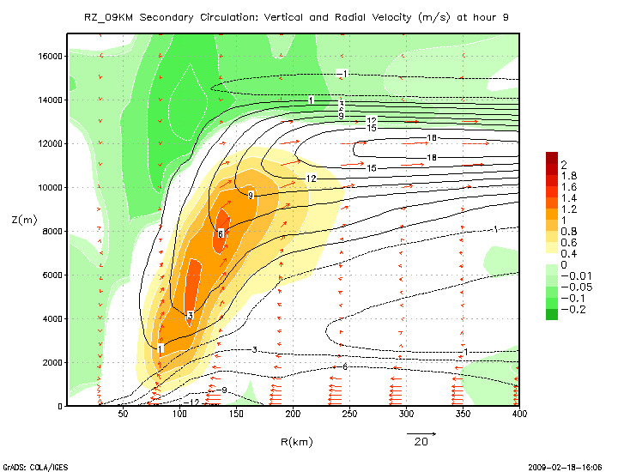
Structure Evaluation at 9 km resolution
Notes:
16

Slide 17
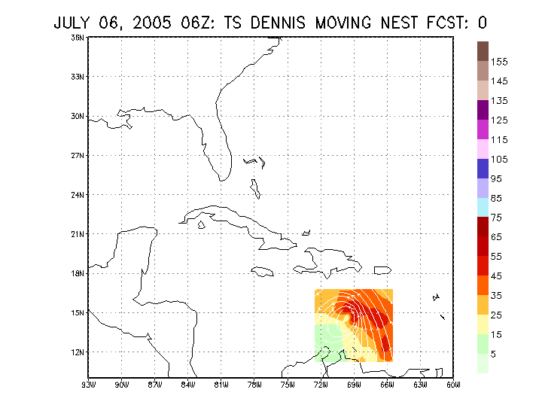
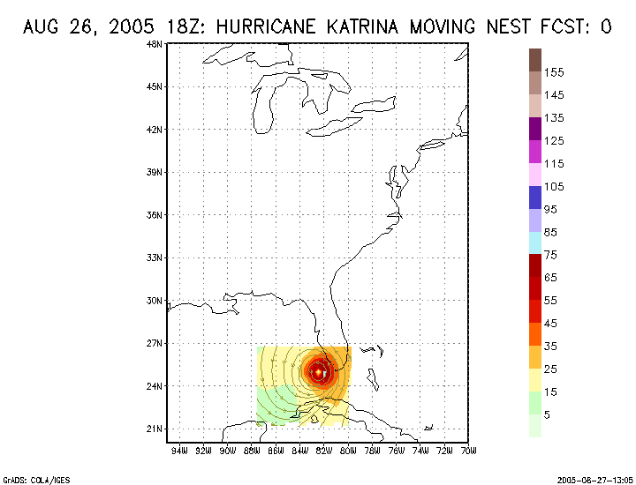
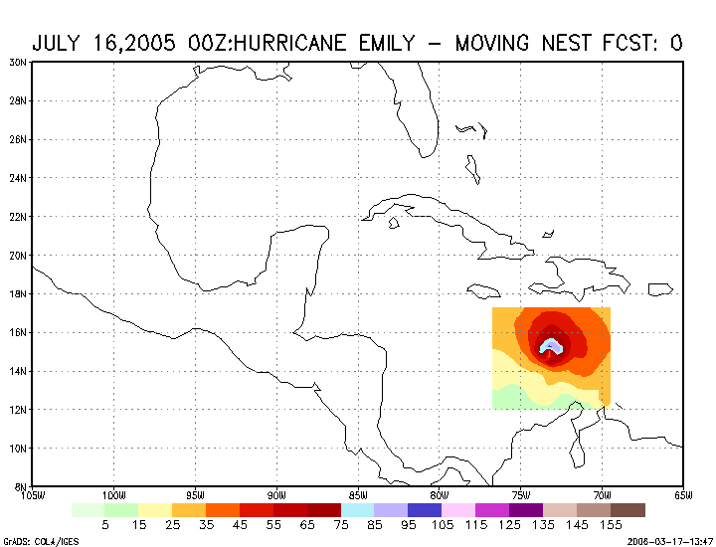
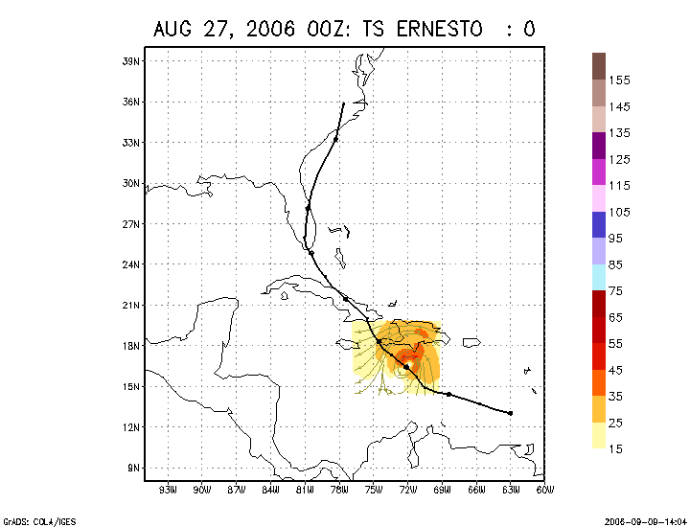
Examples of Real Time Testing of HWRF
HWRF DENNIS
HWRF Katrina, 2005
HWRF Emily, 2005
HWRF Ernesto, 2006

Slide 18
Advancing the HWRF: Setting up multiple domains
Option 1: Both grid 2 and
grid 3 are children of grid 1.
&domains
max_dom = 3,
grid_id = 1, 2, 3,
parent_id = 0, 1, 1,
&domains
max_dom = 3,
grid_id = 1, 2, 3,
parent_id = 0, 1, 2,
Possible only with one-way nests!
Option 2: Grid 2 is a child of grid 1
grid 3 is a child of grid 2.

Slide 19
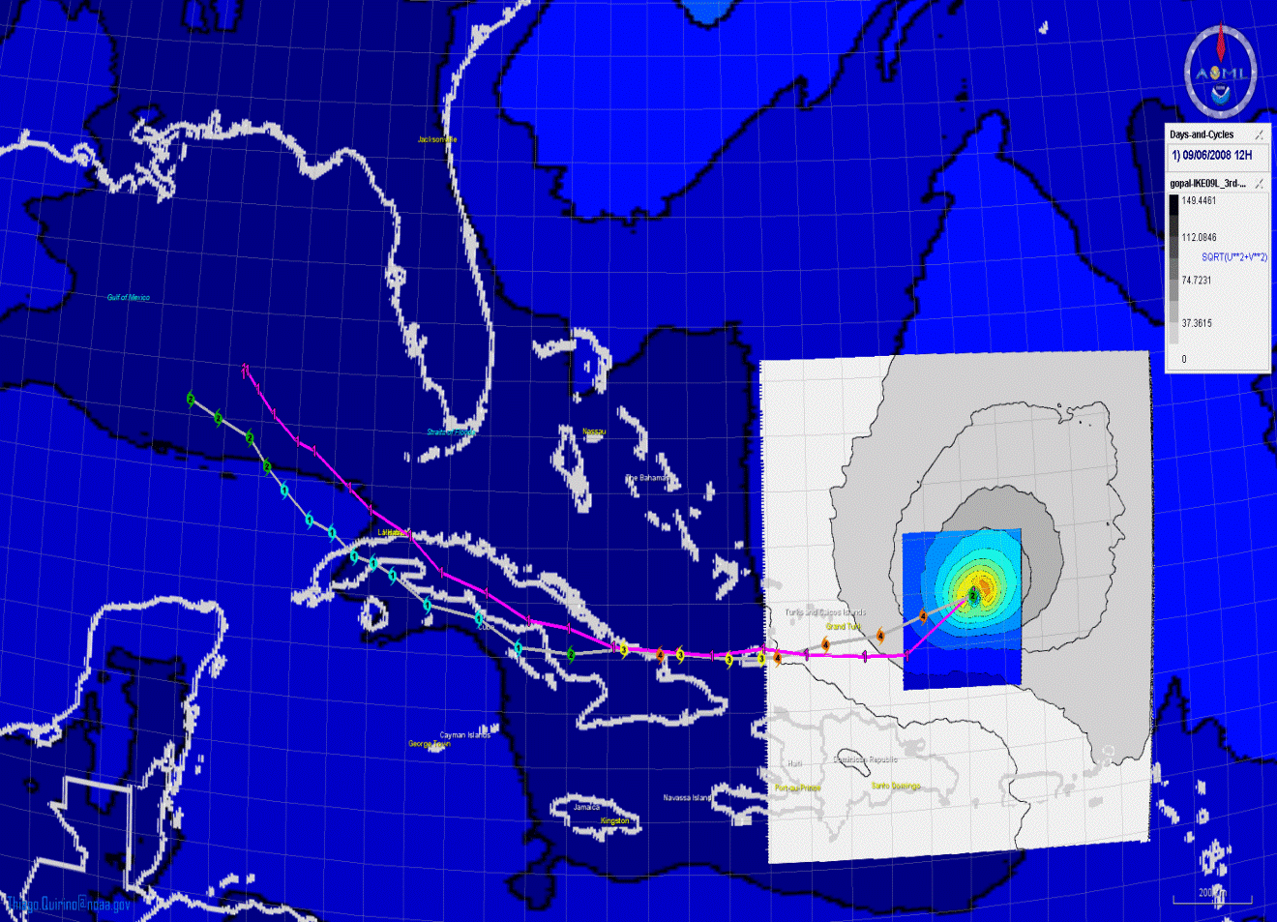
Future Updates
Constraints with projection
Modified approach for multiple nesting

