Slide 1

High-Resolution Hurricane Weather Research and Forecasting System (HWRF): Model Development and Stream 1.5 Verification
Presented by
Xuejin Zhang (UM/CIMAS & AOML/HRD)
Stanley Goldenberg (AOML/HRD)
Contributors
S. G. Gopalakrishnan & the modeling group at AOML/HRD
Vijay Tallapragada & the HWRF team at NCEP/EMC
Jian-Wen Bao at ESRL/PSD
DTC
NOAA Hurricane Conference, 29 November-2 December 2011, Miami, FL

Slide 2
NCEP Operational HWRF (2.0) 2007
AOML/HRD HWRFX (V3.0.1) 2008 (HFIP Stream 2)
HWRF Vortex
Assimilation & GSI
WRF pre-processing system
Flexibility for testing initial
Conditions for research
NMM dynamics with
one moving nest
NMM dynamics with
multiple moving nests
Operating resolution 27:9
Operating resolution
27:9, 9:3 and 27:9:3
Hurricane EnKF Data
Assimilation System (HEDAS)
Ocean Coupled
GFDL/GFS Physics/
Slab LSM
GFDL/GFS Physics/
NOAH LSM
Consistent w/ 3 km res.
Framework also
Includes Idealized
Cases/ 1-D HYCOM
HWRF post-processor
& HPLOT
Diapost: High Res. Hurricane Post-Processing system
Release Version HWRF V3.2
2010
Tropical Prediction System
(HWRF-GEN)
Basin-Scale &
Multiple-Movable Nests
27:9:3 REAL-TIME HFIP STREAM 1.5 SYSTEM (2011)
HWRF V3.2/V3.4

Slide 3
Current Model Configurations
 | Operational HWRF | Stream 1.5 HWRF
Domain | 27 KM: 77.76˚ X 77.76˚ 9 KM: 7.2˚ X 6.0˚ | 27 KM: 77.76˚ X 77.76˚ 9 KM: 10.56˚ X 10.2˚
Vortex Initialization | 27-9 KM: Yes | 27-9 KM: Yes 3 KM: No (Downscaling)
Cycling | Yes(Vortex only) | Yes (9 km domain vortex only)
Ocean Coupling (Ocean model: POM) | 27-9 KM: Yes | 27-9 KM: Yes 3 KM: No (Downscaling)
Physics schemes
Microphysics | Ferrier | Ferrier
Radiation (SW, LW) | GFDL | GFDL
Surface Scheme | GFDL (2011 implementation) | GFDL (HR implementation)
PBL Scheme | GFS | GFS (HR implementation)
Cumulus Parameterization | New SAS | New SAS (27-9 KM) no CP (3 KM)
Land Surface | GFDL Slab | GFDL Slab
GWD | Yes(27km); No(9km) | Yes(27km); No(9-3km)
3 KM: 7.6˚ X 6.4˚

Slide 4
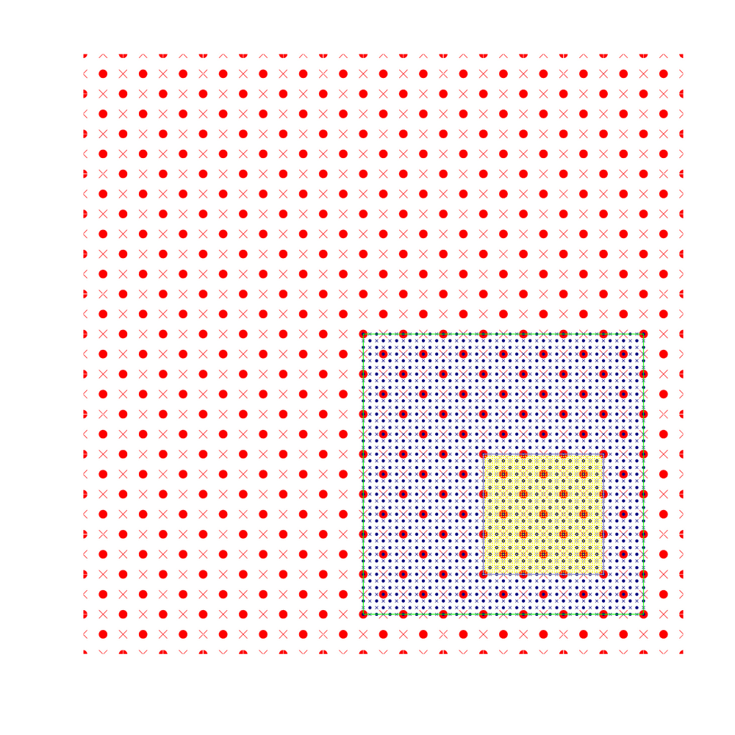
Main Development Activities
Moving Nest (HRD/EMC)
Starting point at mass points
Aligning at mass points
Mediate domain follows the inner most domain
Nest following centroid MSLP minima
Main Developments
Idealized framework (HRD/PSD)
Physics configuration (EMC/HRD/PSD)
3rd Nest Initialization (EMC/HRD)
Ongoing Developments
Hybrid DA (EMC/HRD/GSD)
Multiple moving nests (HRD/EMC)
3-Nest Oper. Implementation--2012 (EMC)
Repository Version (EMC/DTC)
• Mass points × Wind points
Successful O2R and R2O story under HFIP direction!

Slide 5
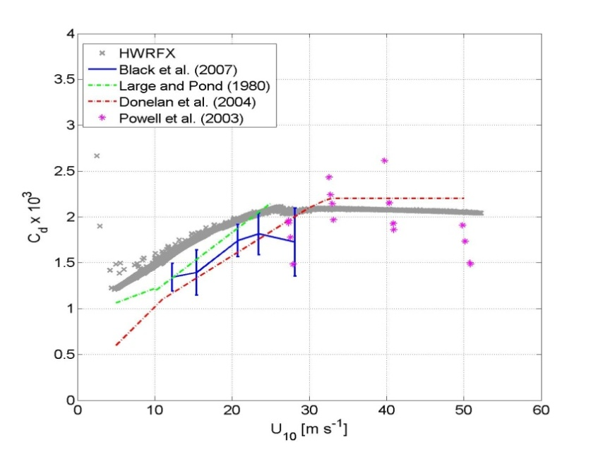
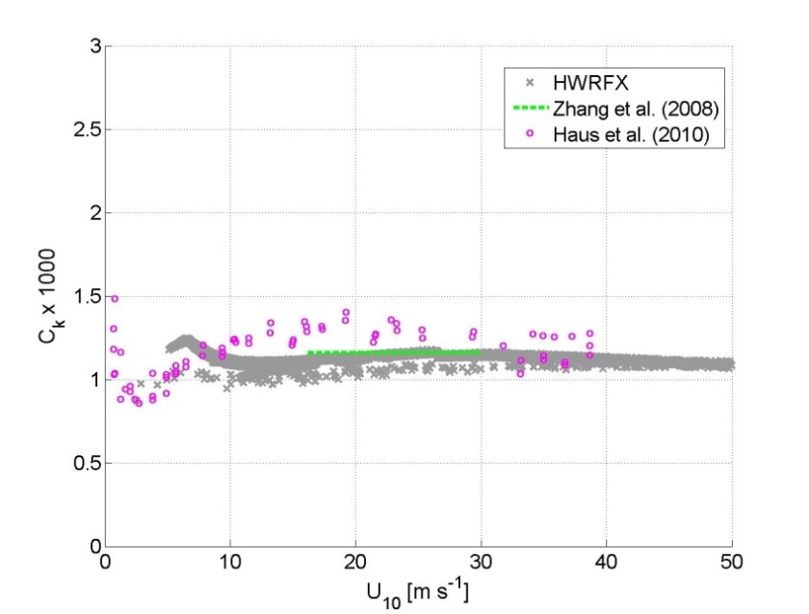
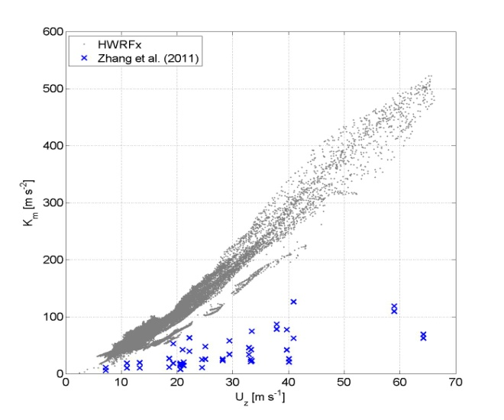
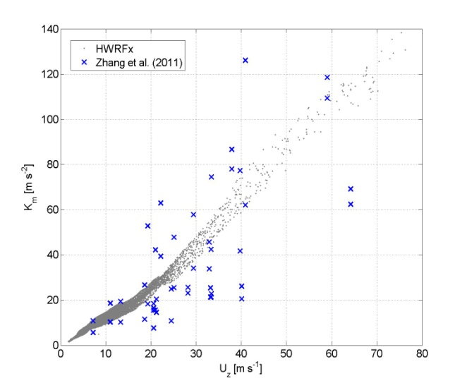
High Resolution PBL Physics
(AOML/EMC/ESRL)
C_{d}: Surface exchange coefficient for momentum
C_{k}: Surface exchange coefficient for moisture & heat
K_{m}: Eddy diffusivity for momentum
K_{m}: Eddy diffusivity for momentum
Modified GFS Scheme
Original GFS Scheme
Same Observations
Adjusted to be consistent with observations in hurricane wind regime
Gopalakrishnan et al. 2011
Notes:
1. Different scale
5

Slide 6
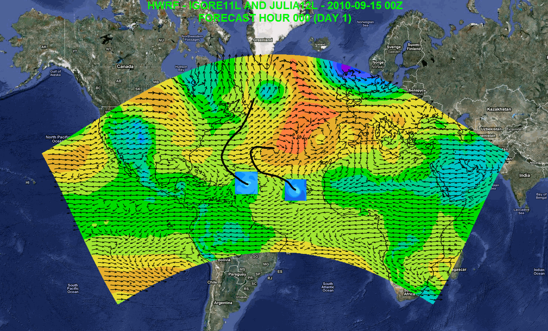
Research Applications (HWRF-GEN)
Independent DA and cycling system
7-day forecast
Track/intensity forecast
Local applications
Regional ensembles
Daily Tropical Outlook/genesis
Website at AOML: https://storm.aoml.noaa.gov/realtime
Basin-scale domain size: 200˚ × 90˚
vs.
Operational domain: 75 ˚ × 75˚
Multiple Moving Nests Forecast System
WFO Miami/Melbourne domain
Notes:
Independent DA system including vortex scale DA
Genesis
Track forecast
Local application
Drive local-scale model
Website at AOML: https://storm.aoml.noaa.gov/realtime

Slide 7
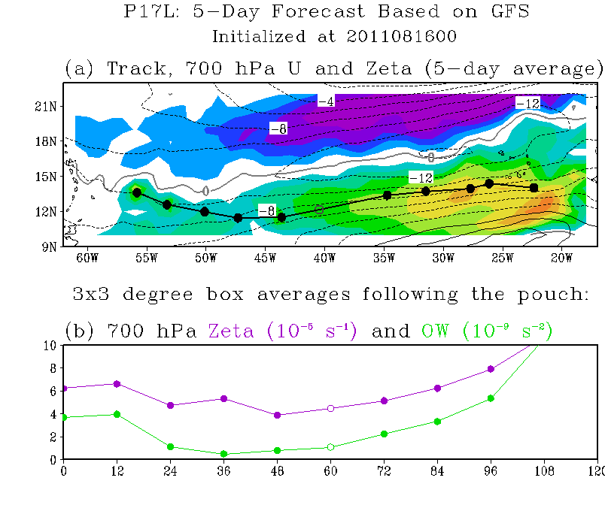
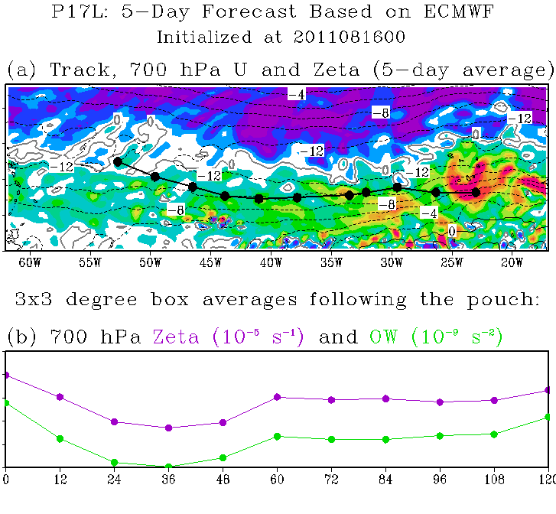
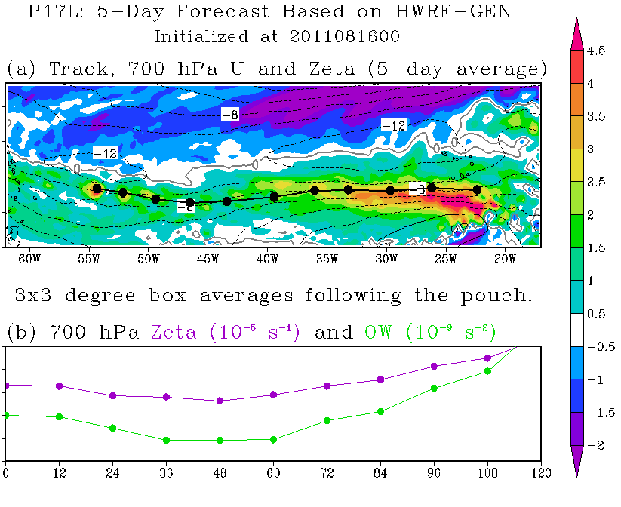
Research Applications (HWRF-GEN)
GFS
ECMWF
HWRF-GEN
Basin-scale Genesis Forecast
Forecast the pouch coming off the W. Africa coast like global model
Forecast a turn at 50W similar to what GFS/ECMWF forecast
Invest 97L genesis (Irene 2011)
Montgomery’s group starts tracking system 08/13 00Z
GFS & HWRF-GEN clearly show genesis at end of 08/16 00Z forecast
NHC first issues Invest 97L 08/18 12Z
NHC issues first advisory 08/20 23Z
Figures Credit to Boothe and Montgomery
Notes:
1. Okubo-Weiss (hereafter OW) parameter is a frame-independent measure of the tendency for a rotational flow to be shape preserving
2. A positive values of OW indicate that the flow is vorticity dominant and shape preserving, whereas negative values of OW indicate a strain-rate dominated flow susceptible to rapid filamentation. A negative OW region is unfavorable for rotational organization of deep convection and aggregation of vortical remnants of prior convective activity.
3. OW is defined here as OW = ζ^2 – S1^2 – S2^2 = (Vx – Uy)^2 – (Ux – Vy)^2 – (Vx + Uy)^2, where S1 and S2 denotes strain deformation, denotes vertical vorticity, (U, V) denotes zonal and meridional velocity, respectively, and subscripts x and y denote partial differentiation in the zonal or meridional directions.

Slide 8
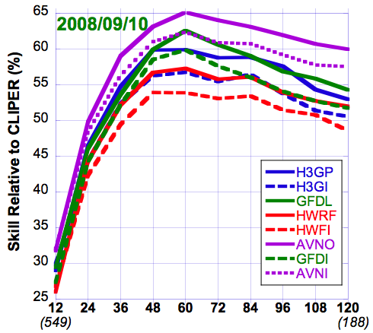
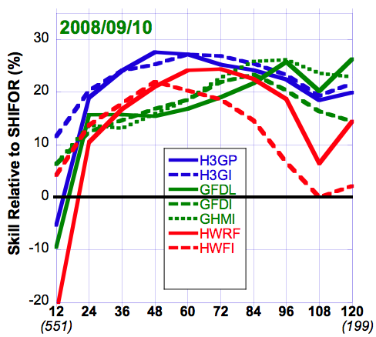
Track & Intensity Forecast Skill: H3GP (31 storms: 2008/09/10)
Retrospective Runs to test Stream 1.5 (27:9:3 km)
(Pre-2011 Season)
TRACK FORECAST SKILL
INTENSITY FORECAST SKILL
EARLY vs LATE Versions of Numerical Models: Use of interpolated 6-hr old run
Degrades Track forecast skill --all times
Intensity forecast skill about same
(But MUCH better at 12 h)

Slide 9
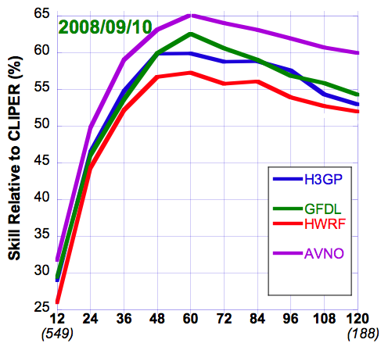
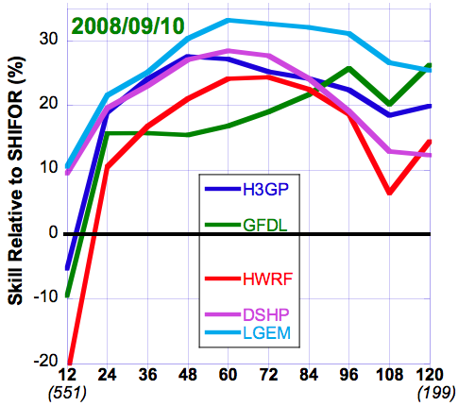
Track & Intensity Forecast Skill: H3GP (31 storms: 2008/09/10)
Retrospective Runs to test Stream 1.5 (27:9:3 km)
(Pre-2011 Season)
TRACK FORECAST SKILL
INTENSITY FORECAST SKILL
H3GP: Improved over HWRF
Comparable to GFDL
AVN0 (GFS) Best
H3GP: Improved over HWRF
Comparable/better than GFDL & DSHP
LGEM Best

Slide 10
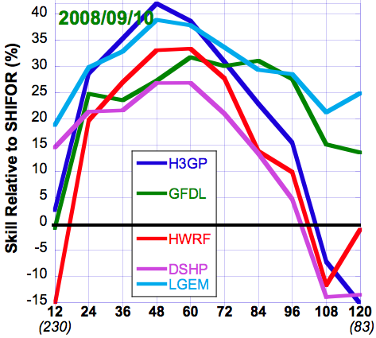
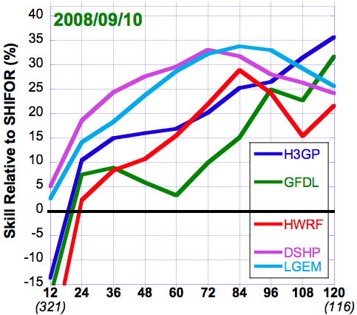
Stratified Intensity Forecast Skill: H3GP (31 storms: 2008/09/10)
Pre-2011 Season Retrospective Runs to test Stream 1.5 (27:9:3 km)
Initially Hurricane Strength
Initially <Hurricane Strength
H3GP: Improved over HWRF & DSHP
& Mixed with GFDL & LGEM
GFDL & LGEM Best >72h
H3GP: Improved over HWRF & GFDL
DSHP & LGEM Comparable & Better Overall
Notes:
Same rules as NHC verification -- tropical or subtropical --- at initial and verification
Wish I had looked at EPAC
Interpolation -- Early vs Late models -- Not just showing operational performance -- want to show model comparison and improvement

Slide 11
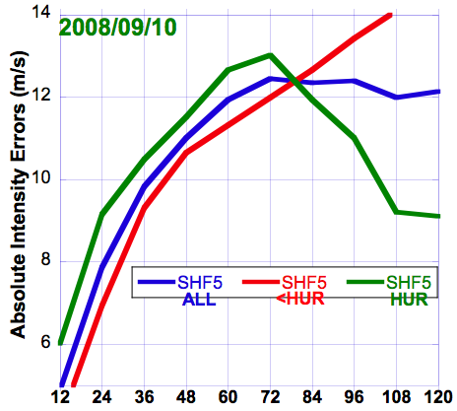
Stratified Intensity Forecast Skill: H3GP (31 storms: 2008/09/10)
Pre-2011 Season Retrospective Runs to test Stream 1.5 (27:9:3 km)
SHIFOR Actual Errors
Larger Errors for Stronger Storms
EXCEPT ≥84 h
Notes:
Same rules as NHC verification -- tropical or subtropical --- at initial and verification
Wish I had looked at EPAC
Interpolation -- Early vs Late models -- Not just showing operational performance -- want to show model comparison and improvement

Slide 12
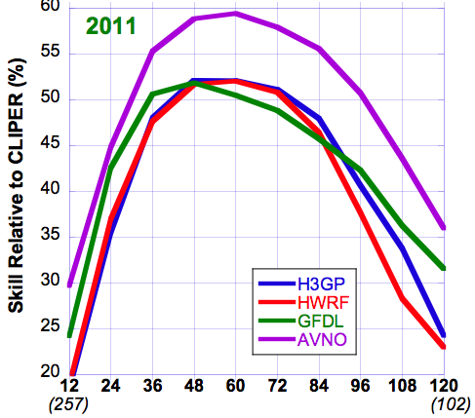
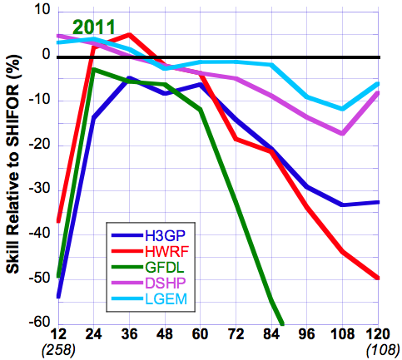
Track & Intensity Forecast Skill H3GP (2011)
2011 Real-Time Season Runs to test Stream 1.5 (27:9:3 km)
TRACK FORECAST SKILL
INTENSITY FORECAST SKILL
H3GP: Comparable with HWRF
Slightly Worse (some times)than GFDL
AVN0 (GFS) Best
H3GP: Mixed vs. HWRF
Better than GFDL after 48 hr
DSHP & LGEM Best
(But No Significant skill for any model)
Notes:
Morris is running new version of GFDL (in parallel) that is showing some promising results -- we will update with those later.

Slide 13
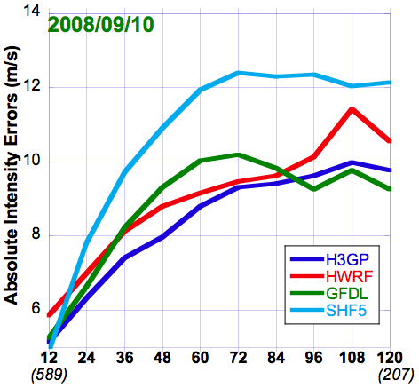
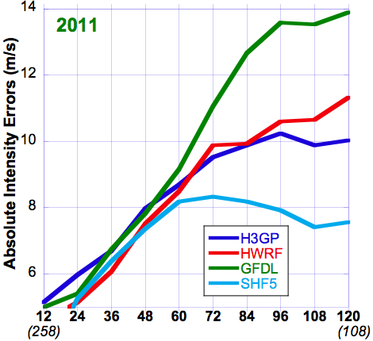
SHIFOR 2008/09/10 vs 2011
H3GP & HWRF about same for two samples
SHIFOR MUCH better for 2011
GFDL MUCH worse for 2011

Slide 14
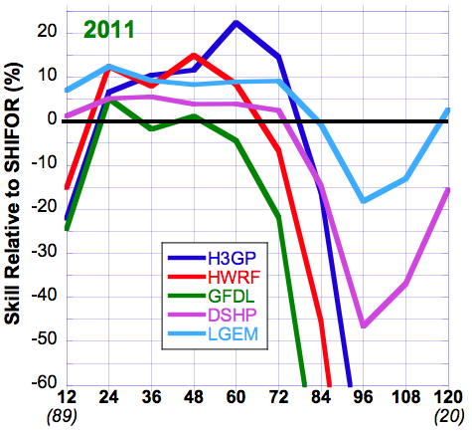
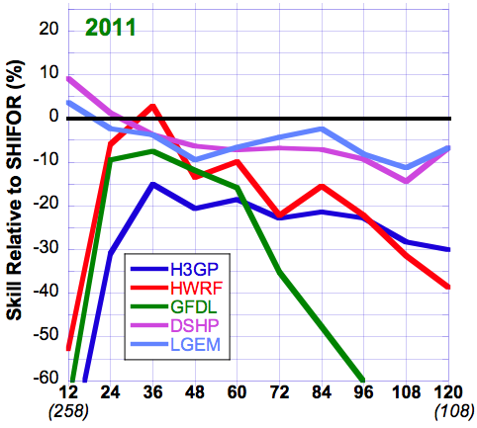
Stratified Intensity Forecast Skill H3GP (17 storms(A to P): 2011)
2011 Real-Time Season Runs to test Stream 1.5 (27:9:3 km)
Initially Hurricane Strength
Initially <Hurricane Strength
H3GP: After 48 hr much improved
Over HWRF & GFDL
DSHP & LGEM Best after 84 h
H3GP: Mixed vs. HWRF & GFDL
DSHP & LGEM Best

Slide 15
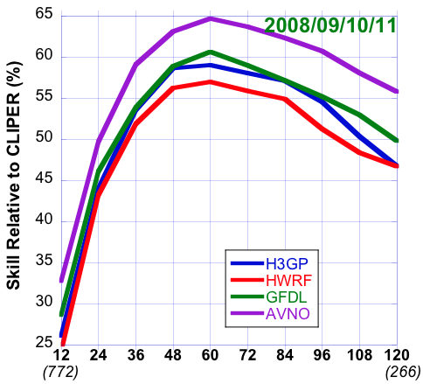
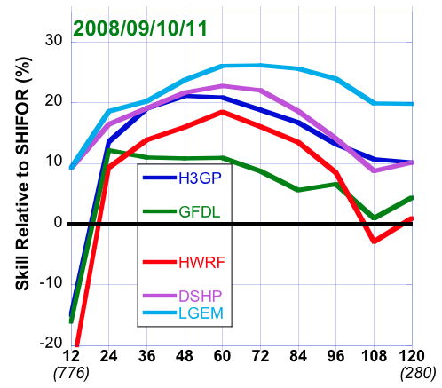
Track & Intensity Forecast Skill: H3GP (Stream 1.5 27:9:3 km)
Retrospective Runs 2008/09/10 + Real-Time Runs (2011 Season)
Late Versions of Numerical Models
TRACK FORECAST SKILL
INTENSITY FORECAST SKILL
H3GP: Improved over HWRF
Comparable to GFDL
AVN0 (GFS) Best
H3GP: Improved over GFDL & HWRF
Comparable to DSHP
LGEM Best
Notes:
Note -- 2011 for Complete Season
2008/09/10 for selected cases each season (total of over 500 cases at 12 hr)
Verification rules same as for NHC -- only verified if system Tropical (Dep, TS, HR) or Subtropical (SD, SS) for initial and verification times

Slide 16
Scope for Future Improvements
TRACK (=>Intensity?) -- I.e. WHY is GFS(AVN) better?
  Increase domain size (Basin Scale, multiple moving nests)
  Increase vertical resolution
  Improve model initialization: Can HYBRID DA provide improvements to the larger scale flow?
  Improvement of the Synoptic-scale: improved physics/nudging?
INTENSITY (=>Track?) Above list for track and …
  Vortex-scale physics, spin-up, etc.
  Multi-scale Data Assimilation (EnKF/HYBRID?)
  Solutions for poor performance for initially weaker storms: Is this a physics or initialization problem or both?

