Slide 1
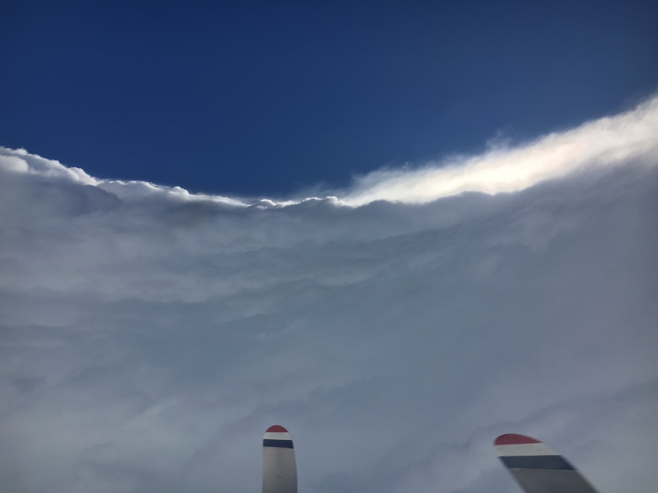


2018 NOAA/AOML/HRD Hurricane Field Program
Intensity Forecast Experiment (IFEX)
AL05 / Dorian Debrief
Hurricane Dorian and the TC Diurnal Cycle
Jason P. Dunion
University of Miami/CIMAS – NOAA/AOML/Hurricane Research Division

Slide 2
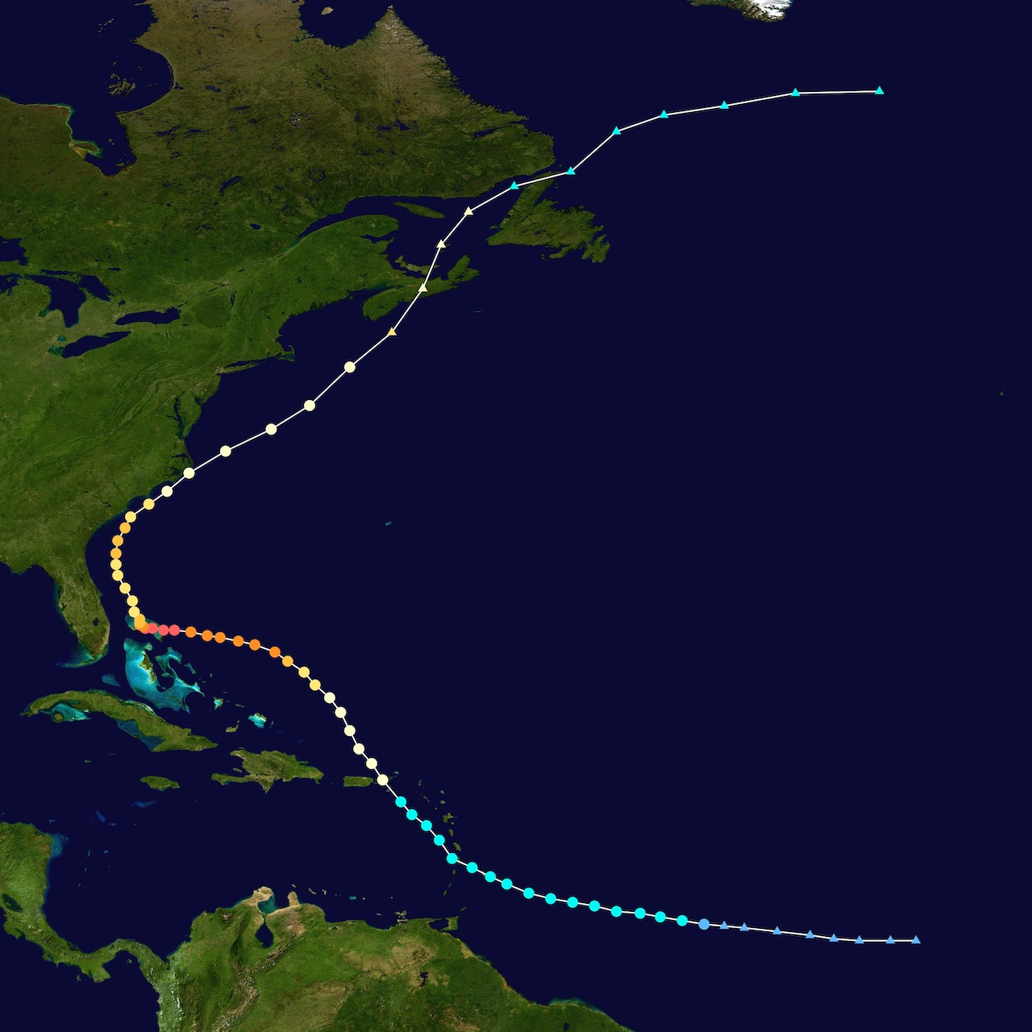

2018 NOAA/AOML/HRD Hurricane Field Program
Intensity Forecast Experiment (IFEX)
AL05 / Dorian Debrief
Discussion
The TC Diurnal Cycle: Dorian
GOES TC diurnal cycle imagery (25 Aug – 05 Sep)
GOES IR 6-hr brightness temperature trends
TCDC “Kaboom” (27 August)
Upper-level divergence (CIMSS and SHIPS)
Vertical Wind Shear (SHIPS)
05 Sep (Cat 3)
31 Aug (Cat 4)
25 Aug (TS)

Slide 3
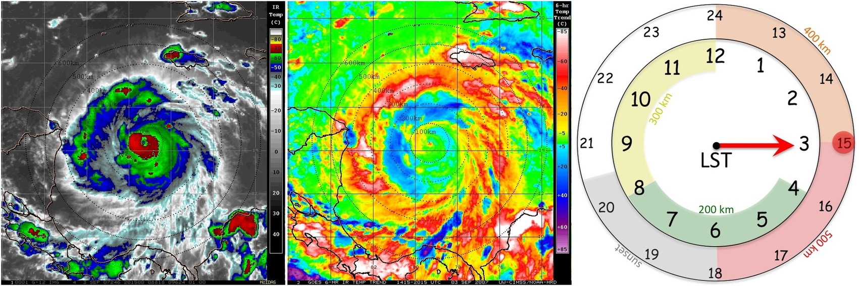
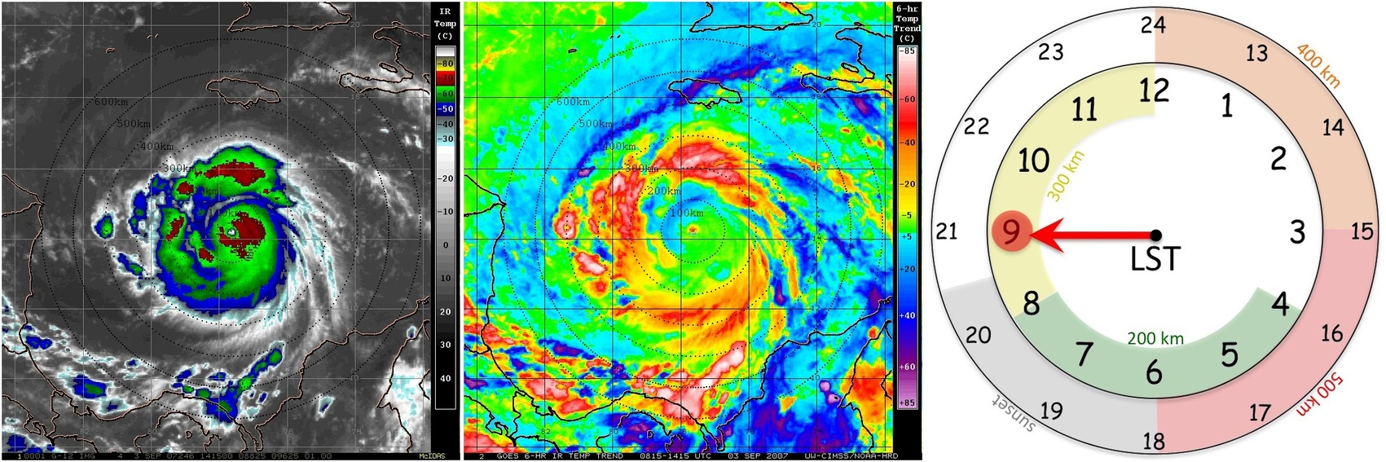
2018 NOAA/AOML/HRD Hurricane Field Program
Intensity Forecast Experiment (IFEX)
AL05 / Dorian Debrief
TC Diurnal Cycle: GOES-16 Satellite Imagery
GOES Enhanced IR
TCDC Imagery

Slide 4
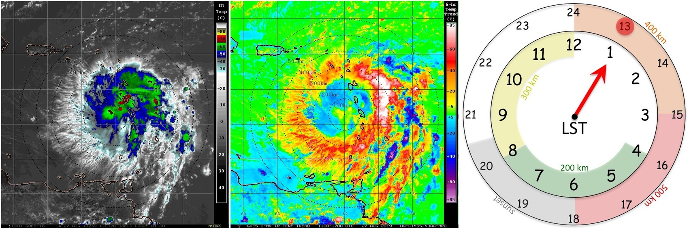
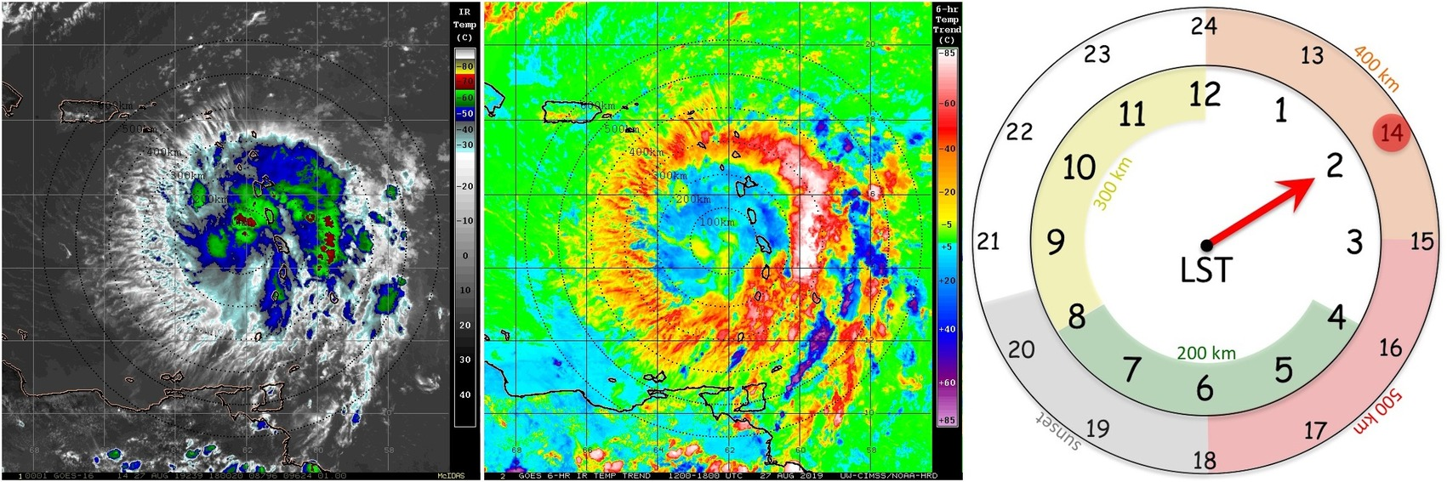
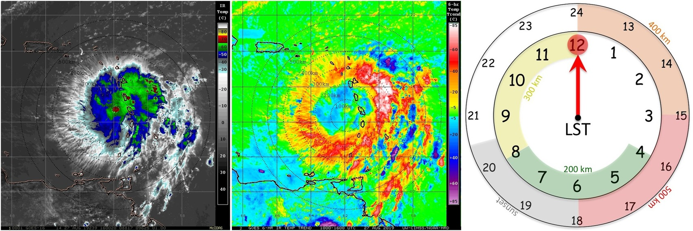
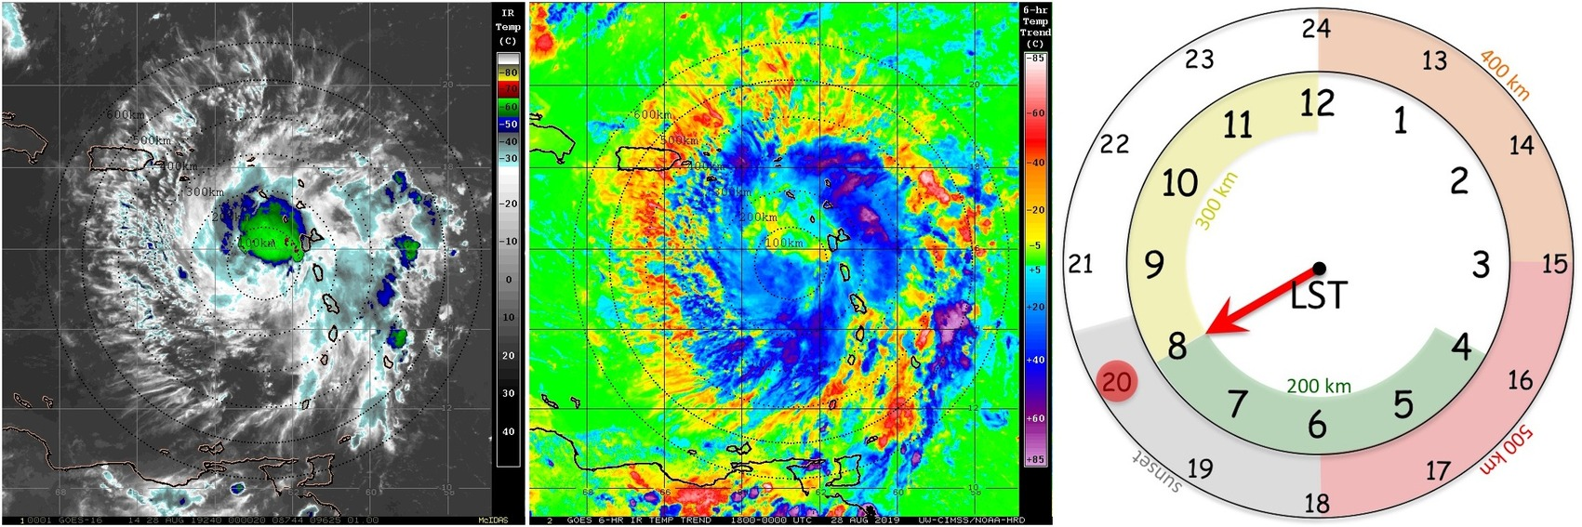
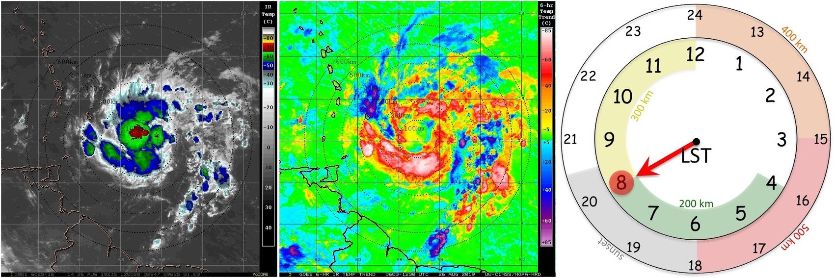
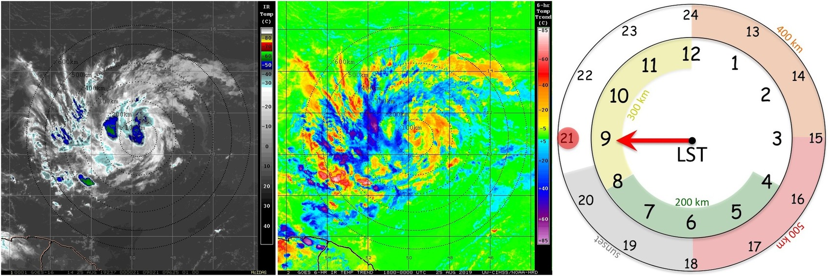
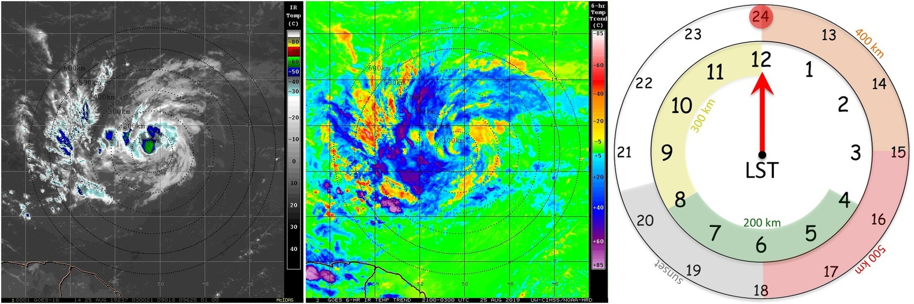
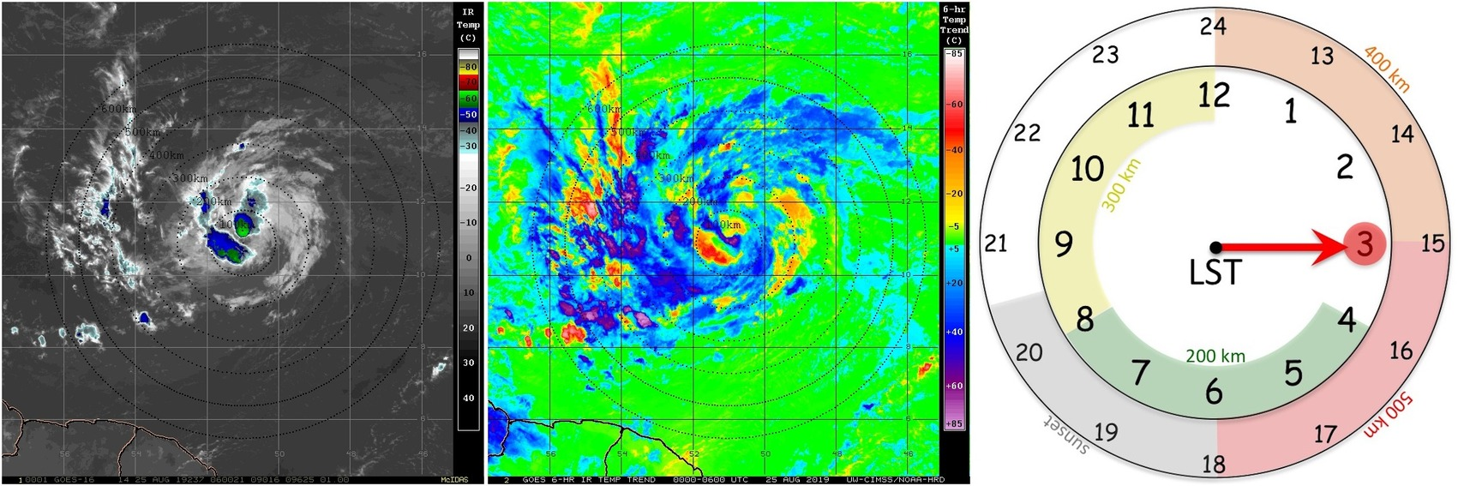
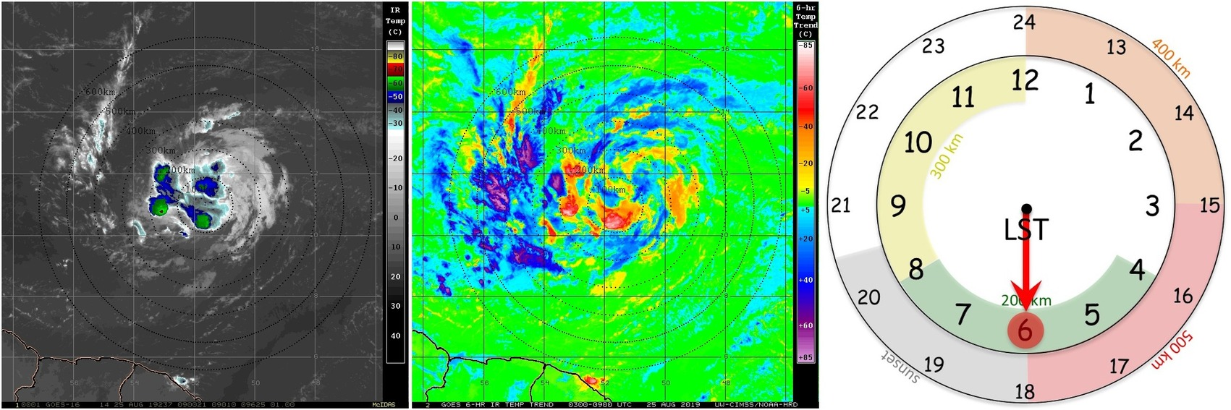
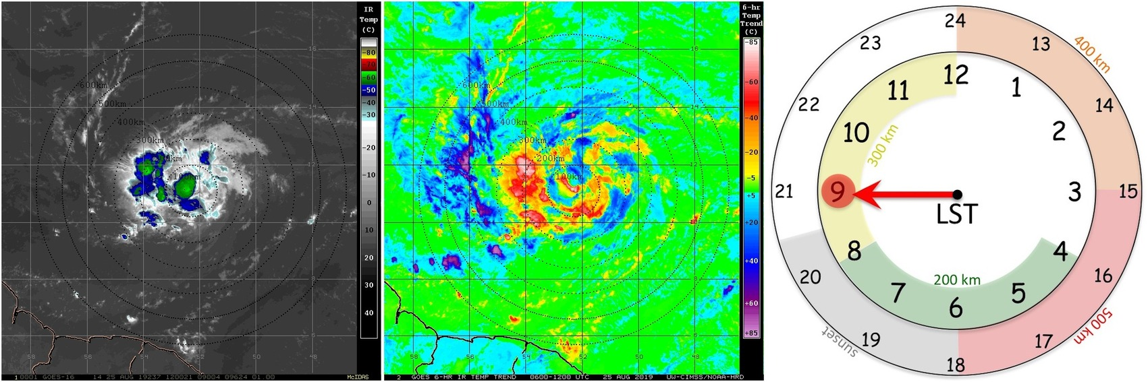
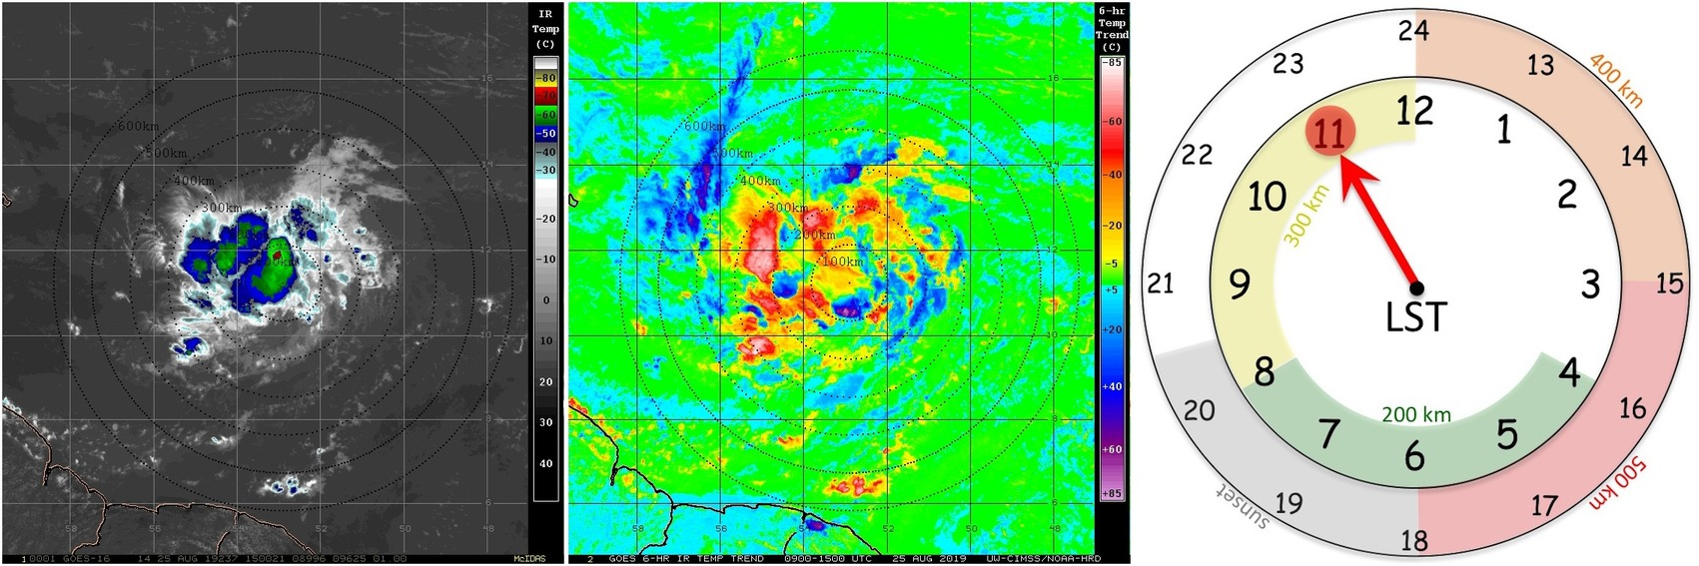
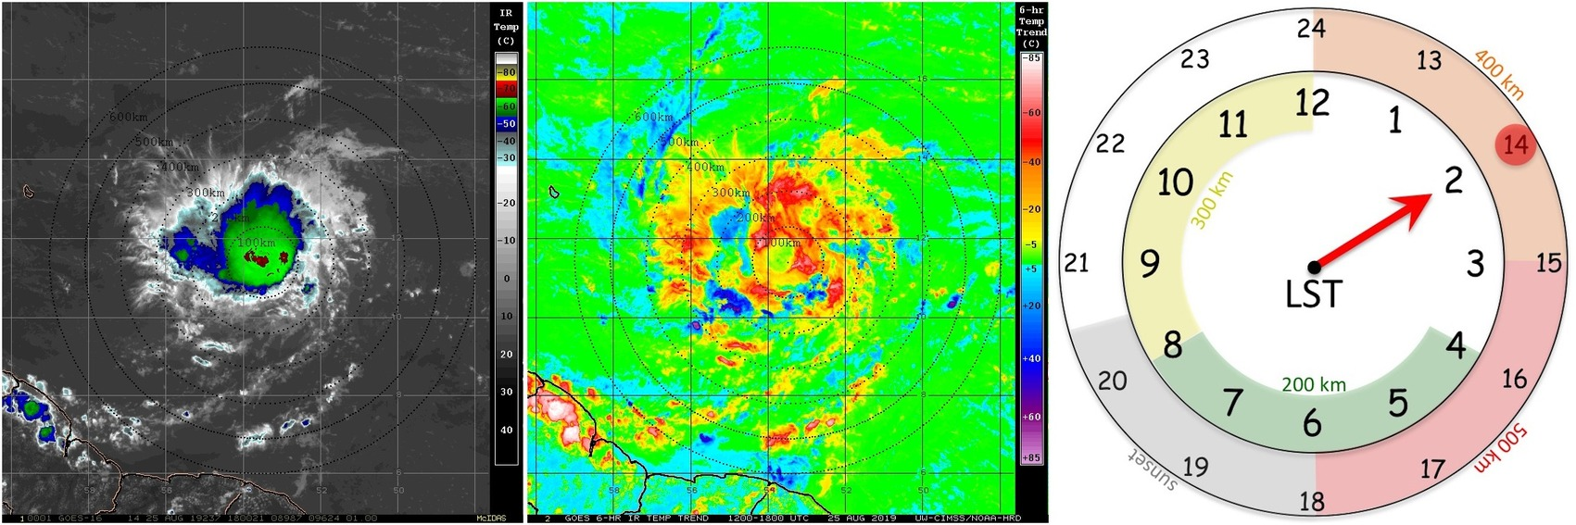
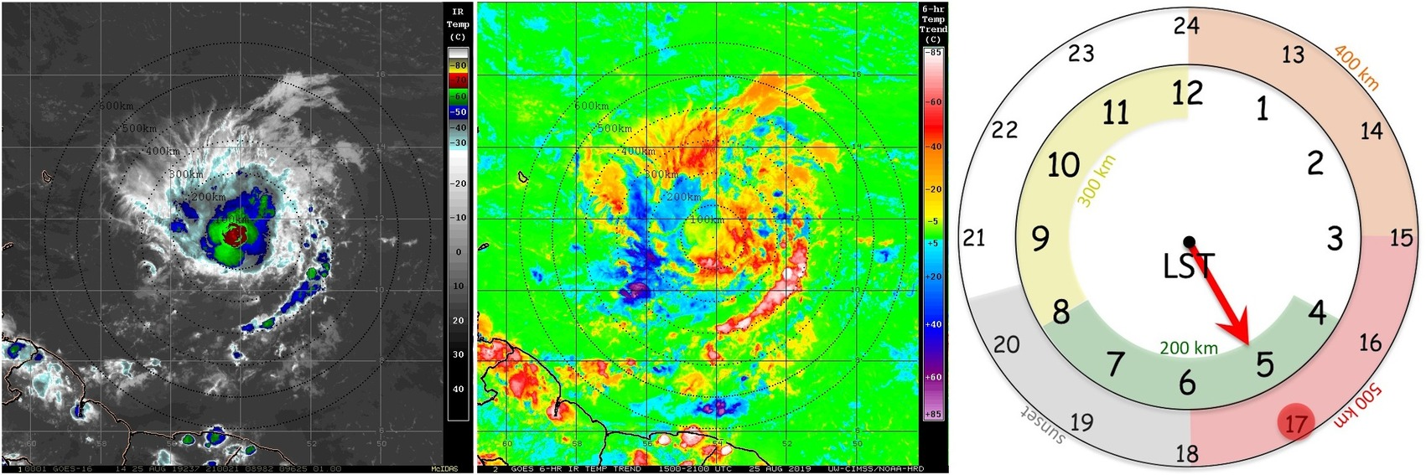
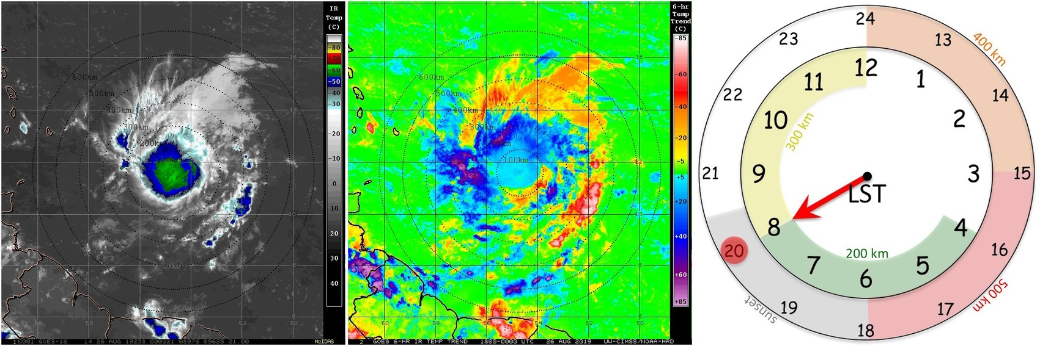
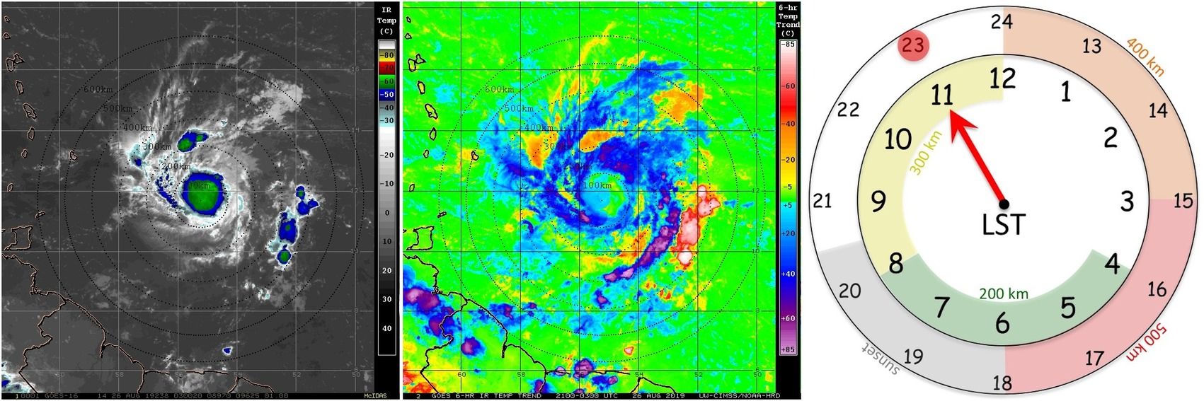
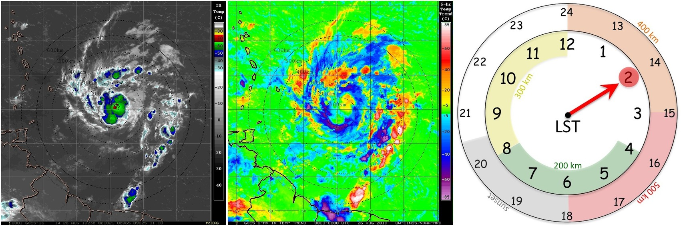
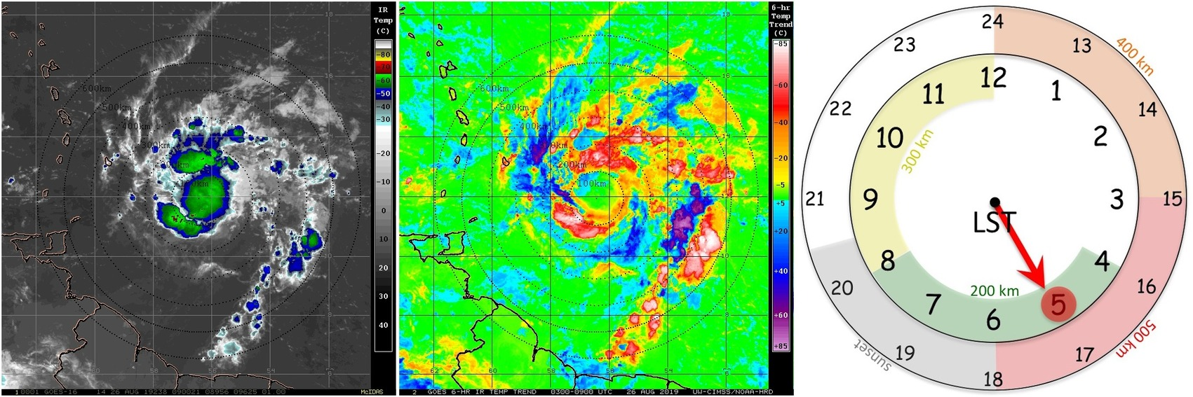
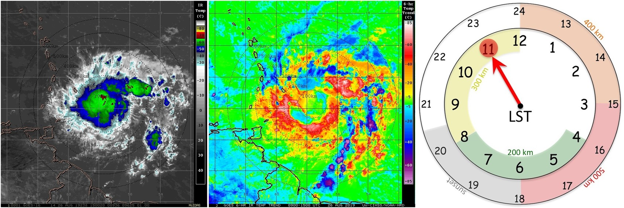
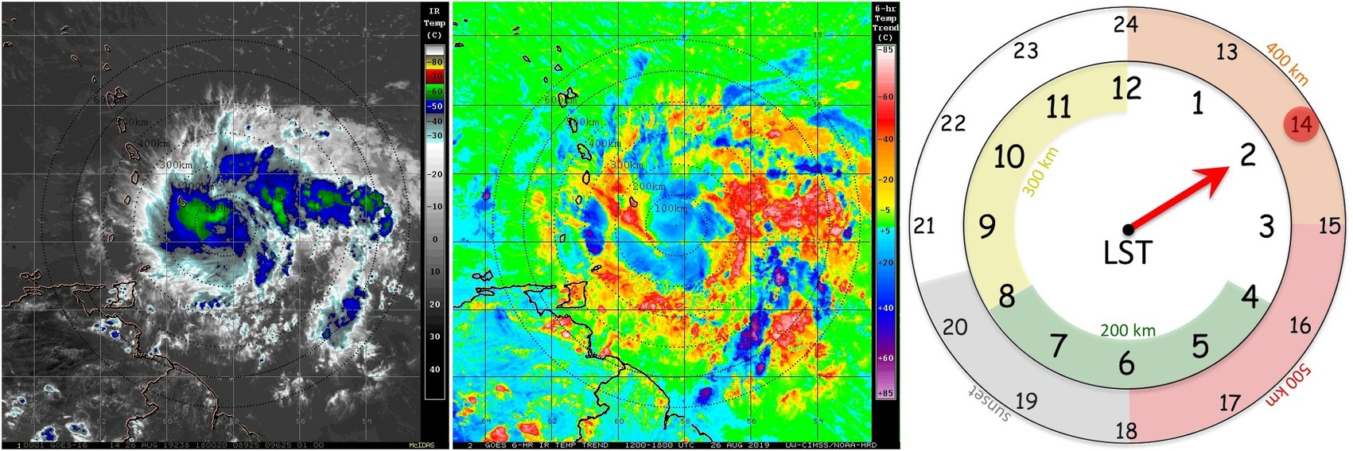
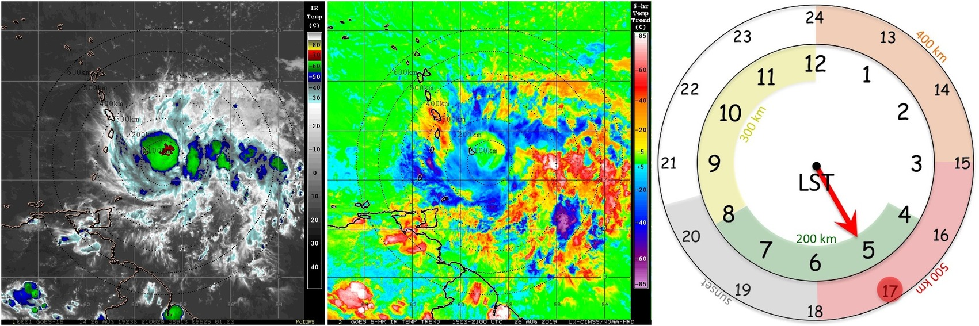
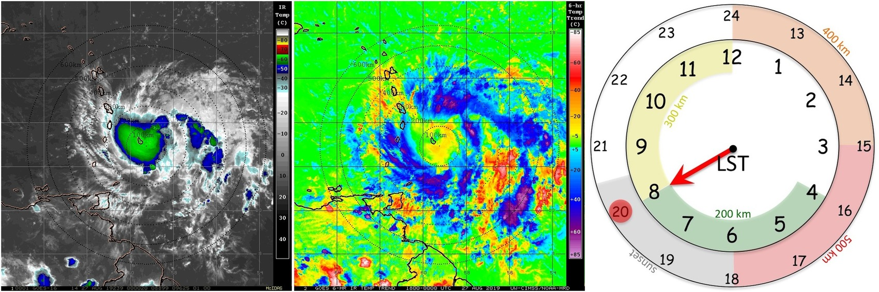
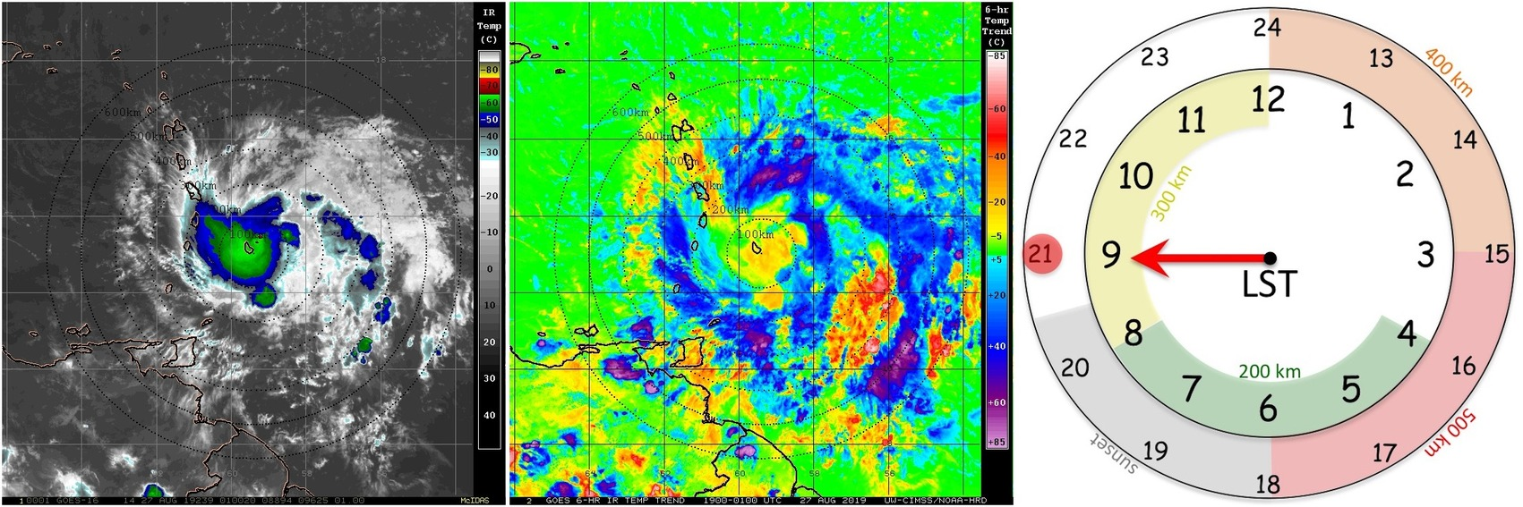
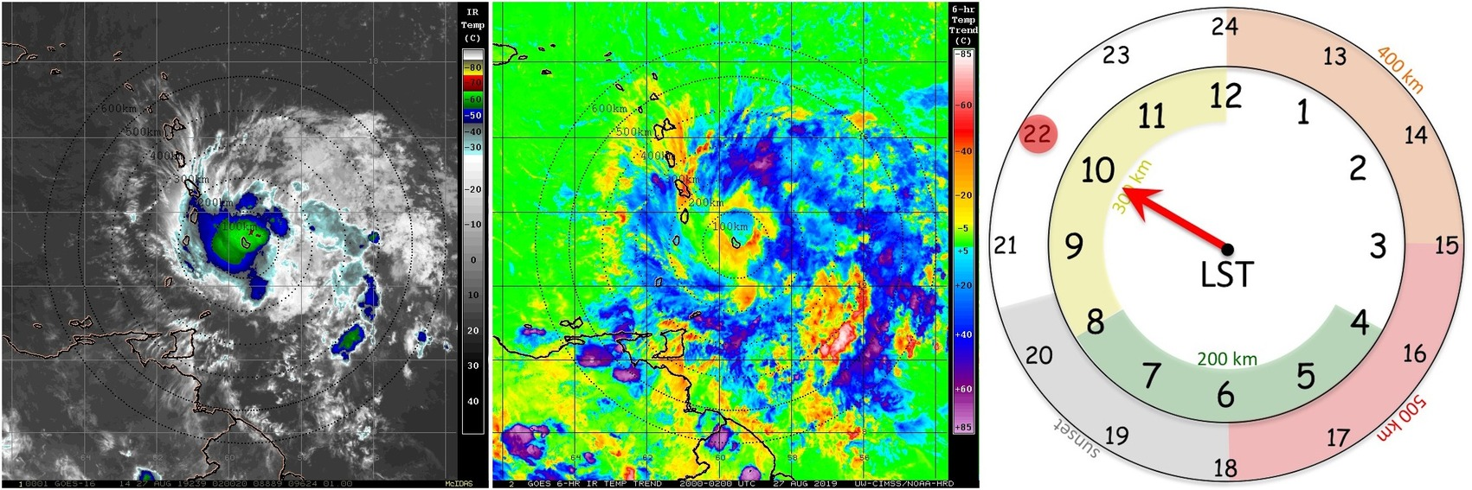
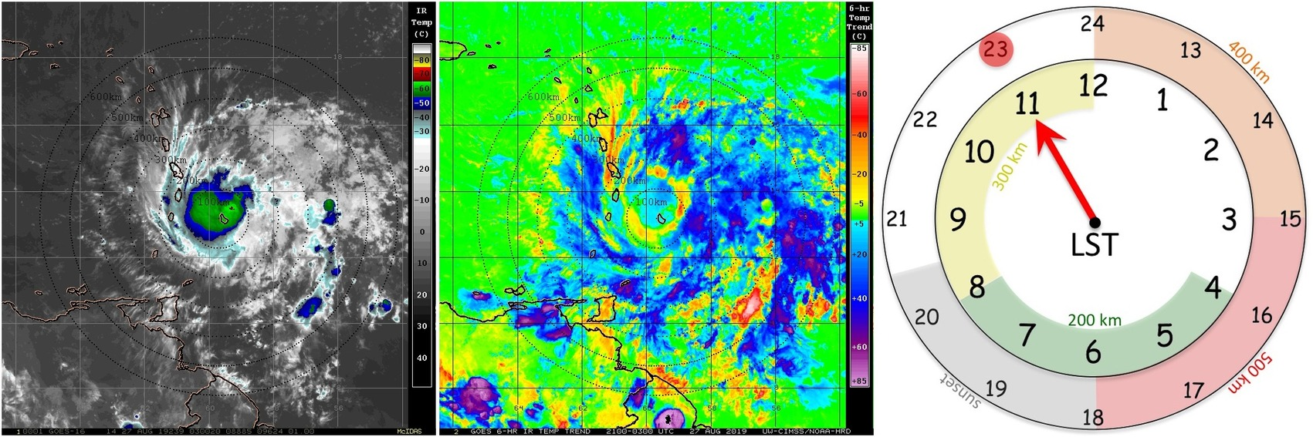
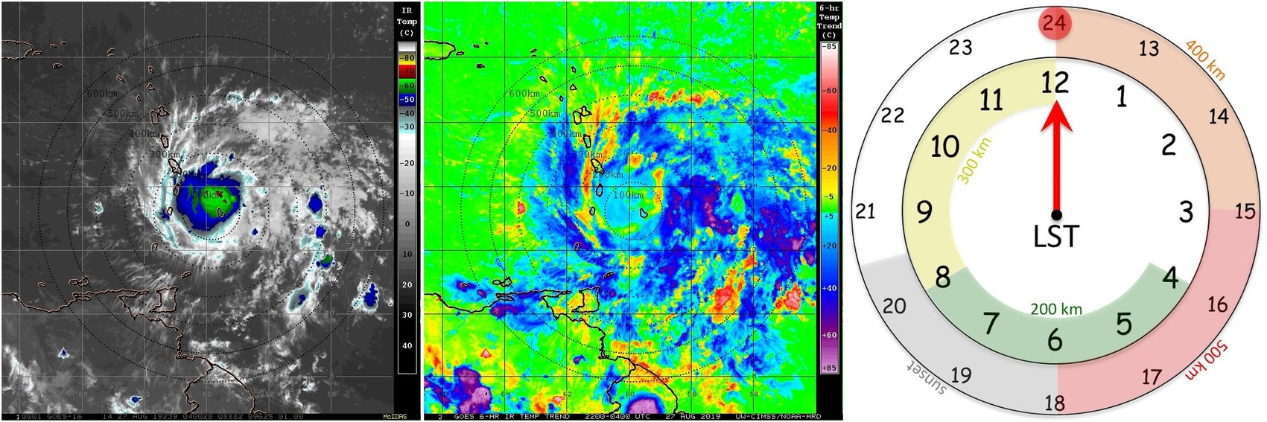
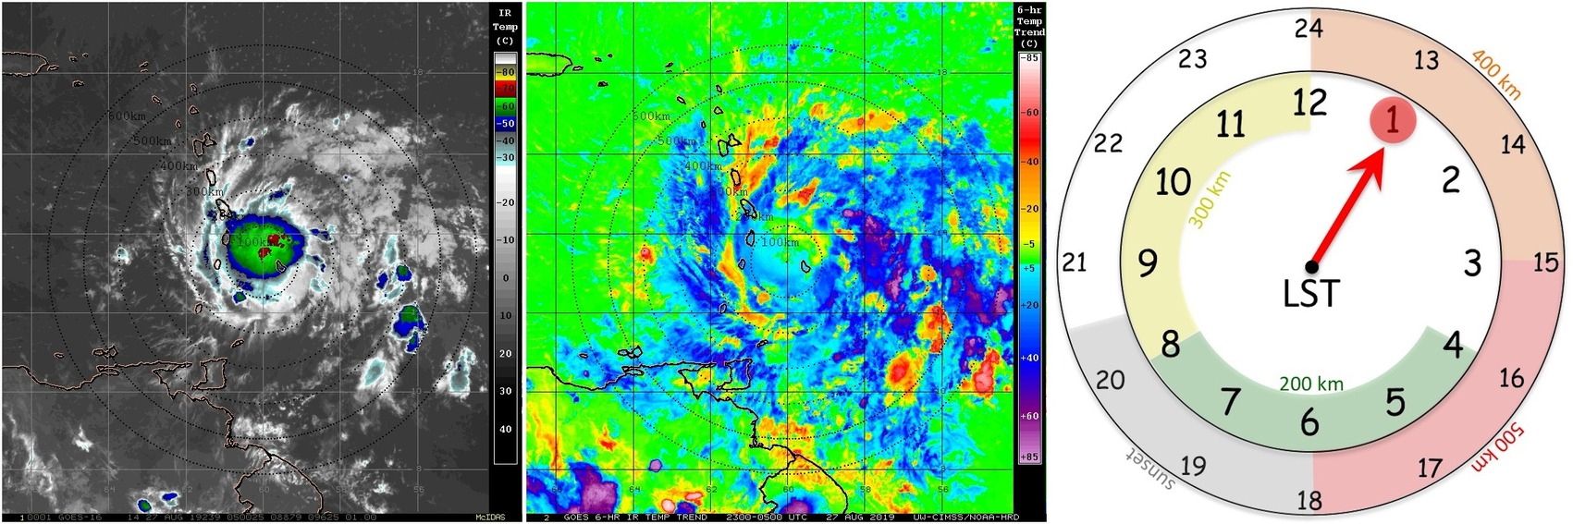
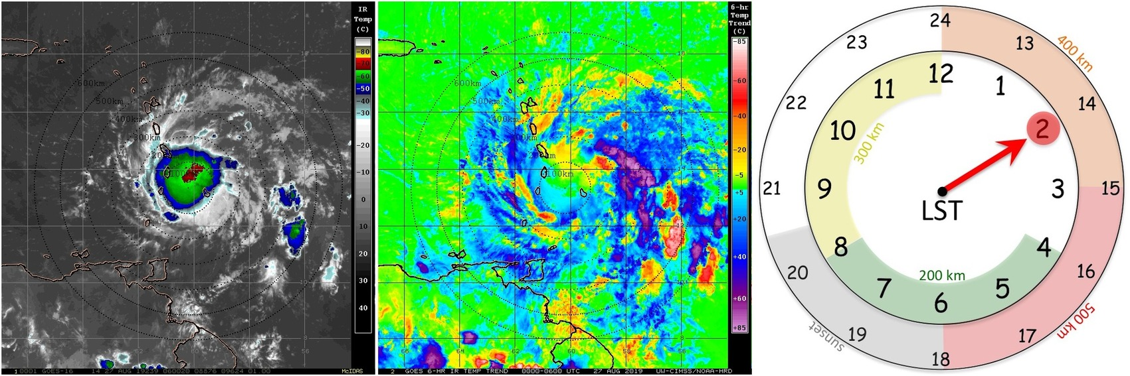
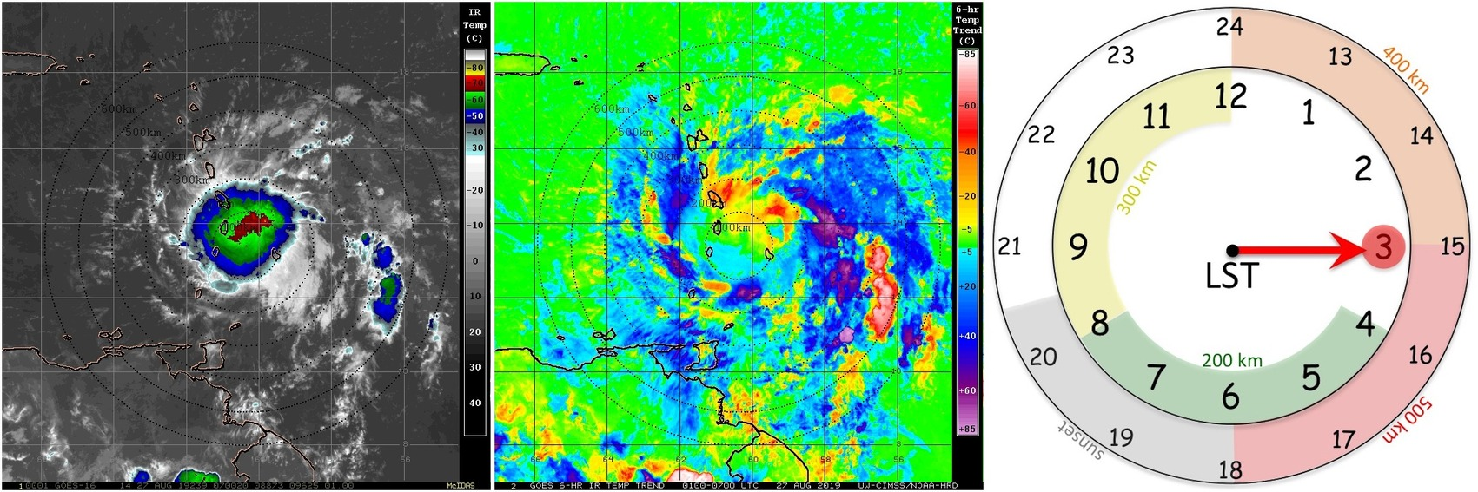
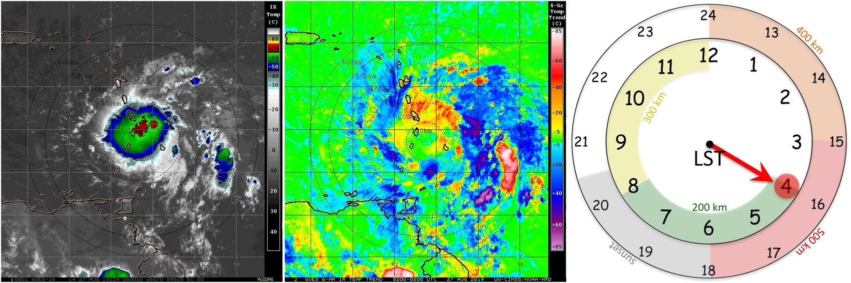
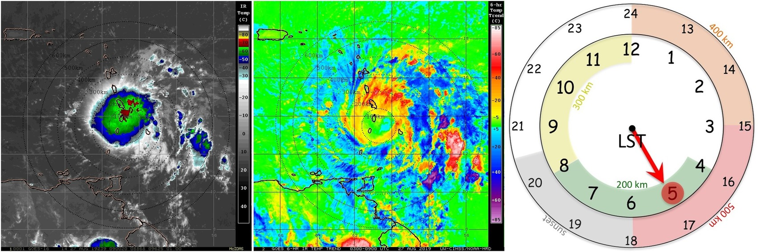
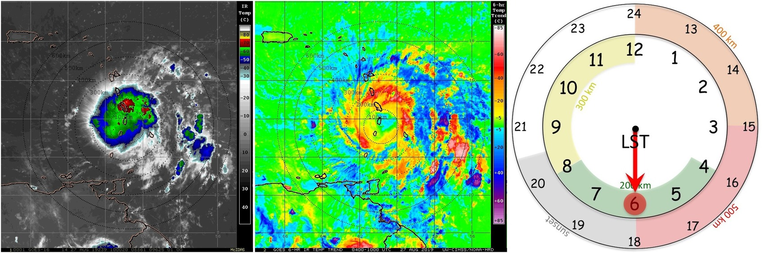
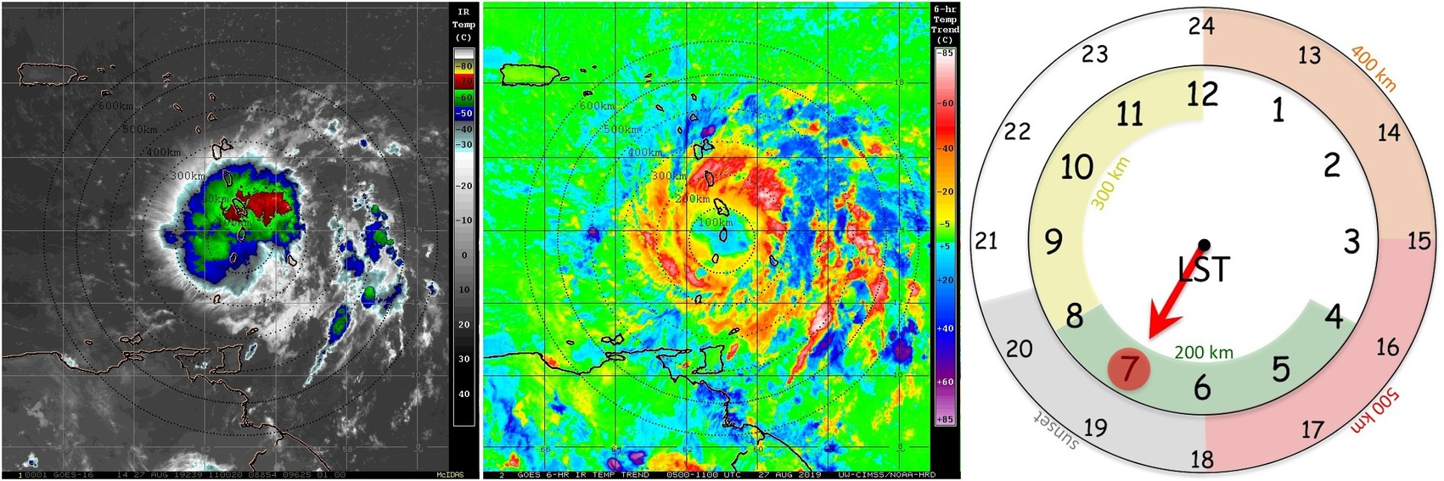
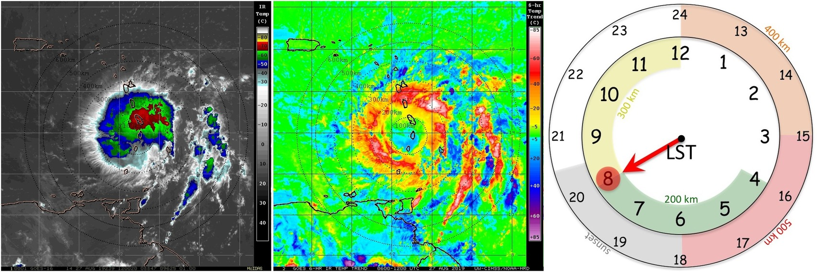
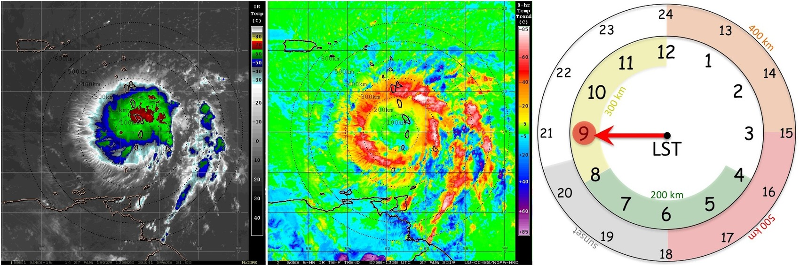
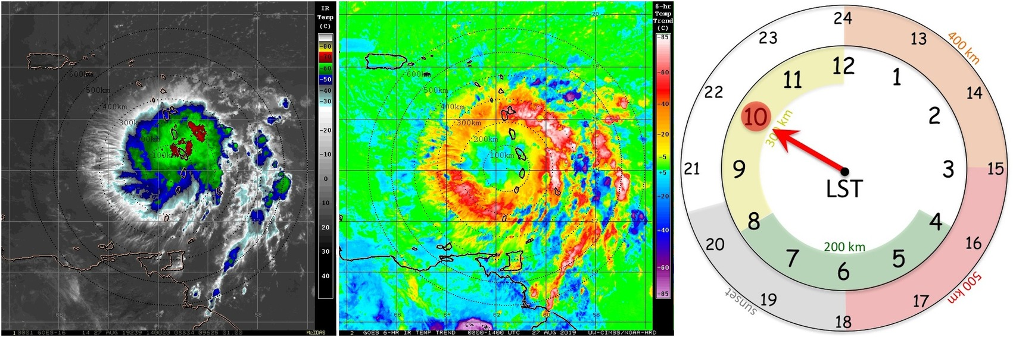
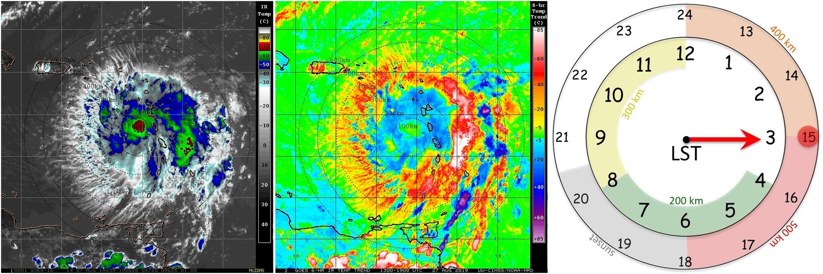
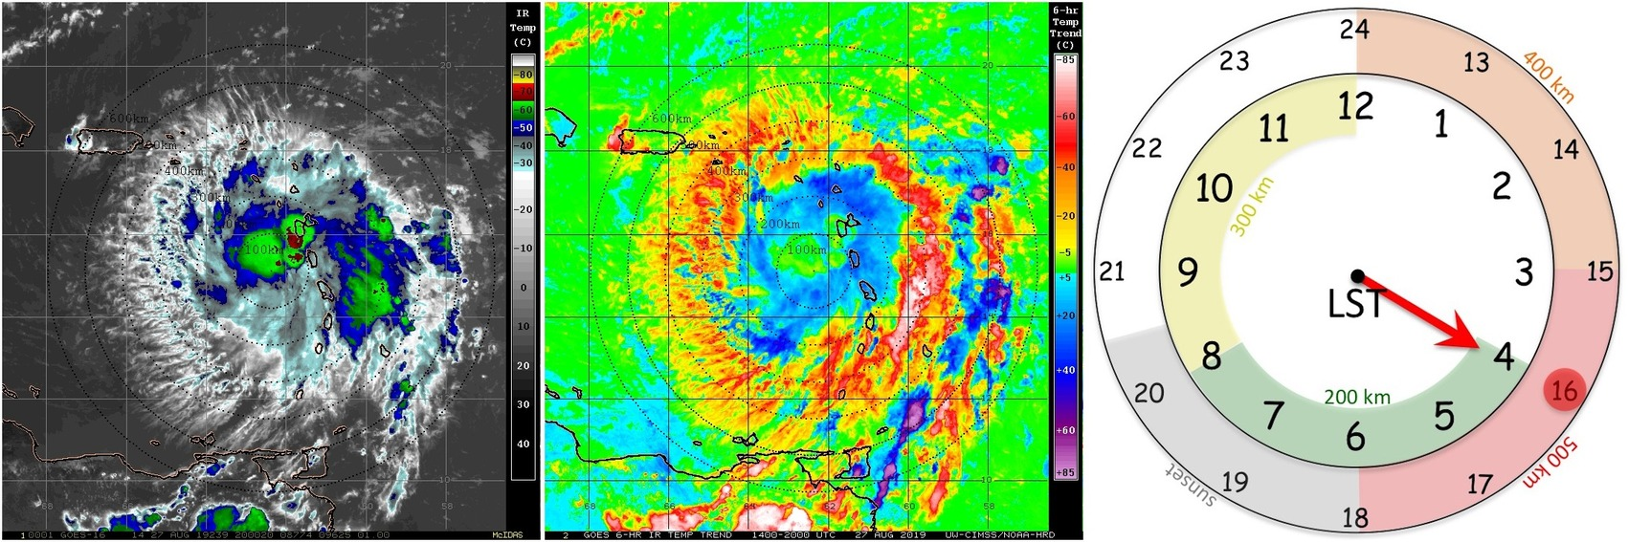
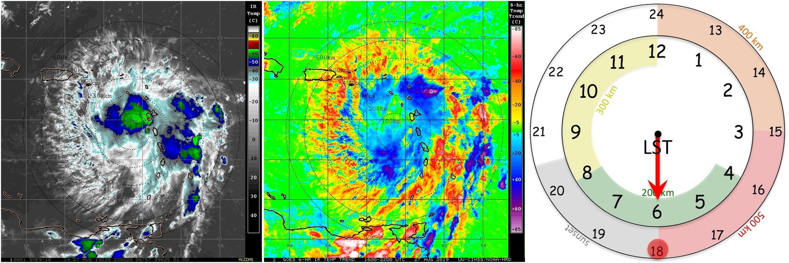
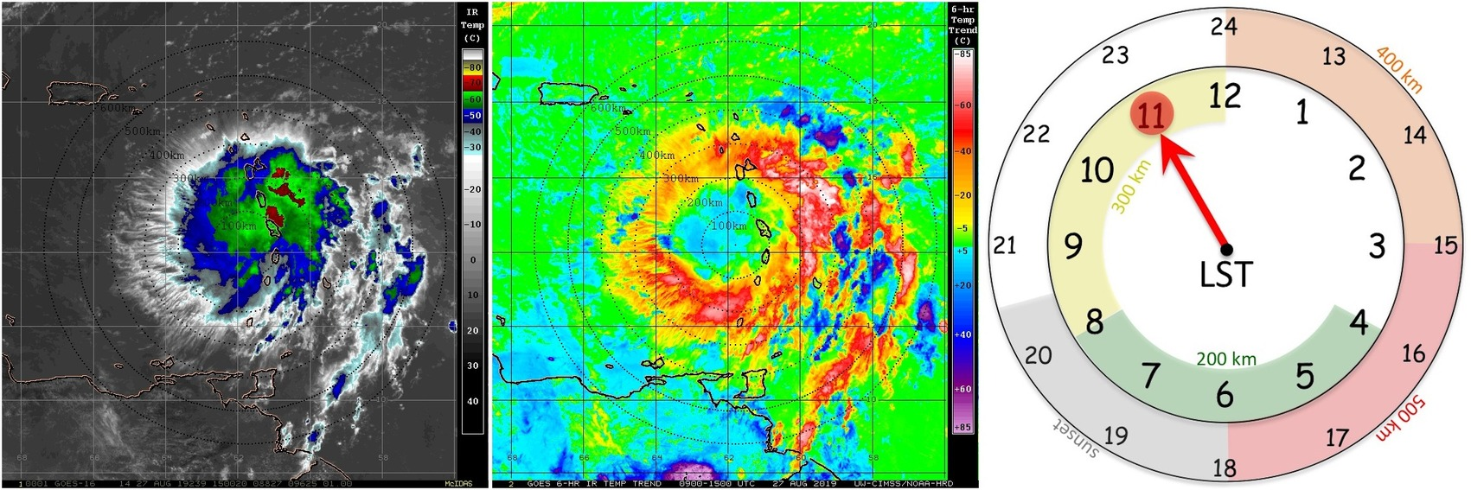
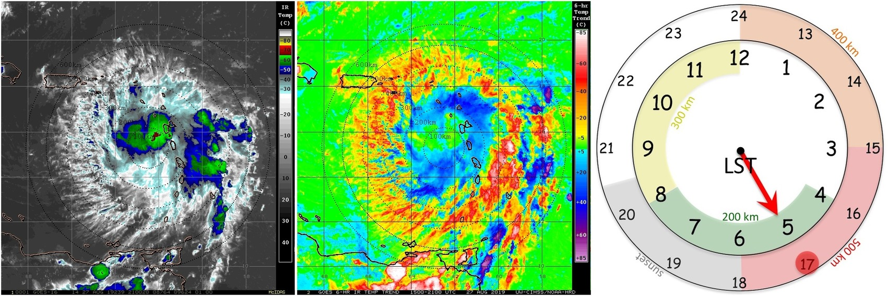
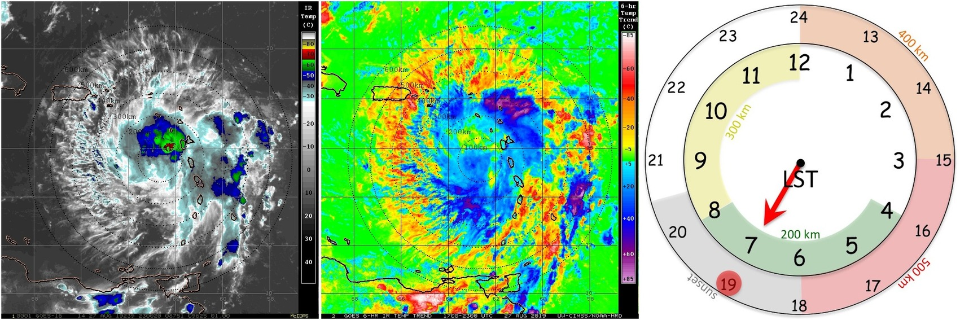
2018 NOAA/AOML/HRD Hurricane Field Program
Intensity Forecast Experiment (IFEX)
AL05 / Dorian Debrief
TC Diurnal Cycle: GOES-16 Satellite Imagery (25-28 Aug)
GOES Enhanced IR
TCDC Imagery

Slide 5
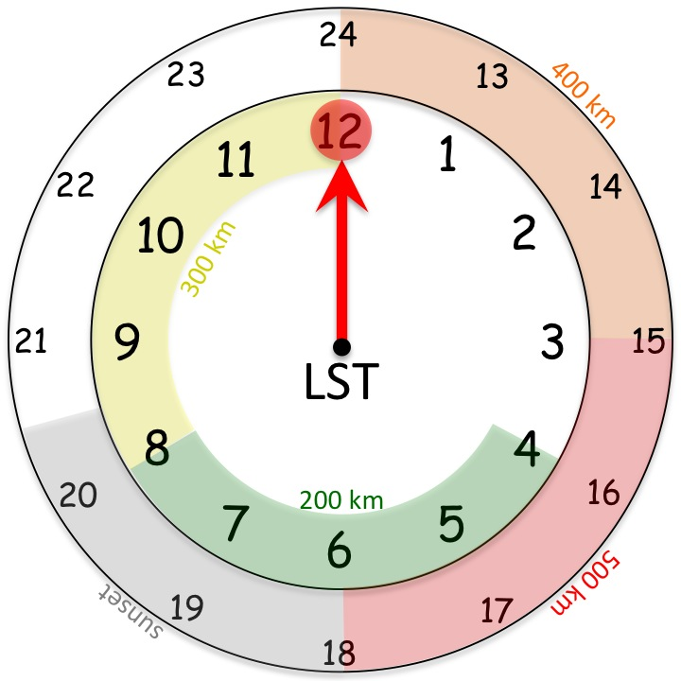
2018 NOAA/AOML/HRD Hurricane Field Program
Intensity Forecast Experiment (IFEX)
AL05 / Dorian Debrief
TC Diurnal Cycle: 6-hr IR Temperature Trend
R=300 km
00 LST
00 LST
00 LST
00 LST
00 LST
00 LST

Slide 6
2018 NOAA/AOML/HRD Hurricane Field Program
Intensity Forecast Experiment (IFEX)
AL05 / Dorian Debrief
TC Diurnal Cycle: 6-hr IR Temperature Trend
R=100 km
R=200 km
R=300 km
R=400 km

Slide 7
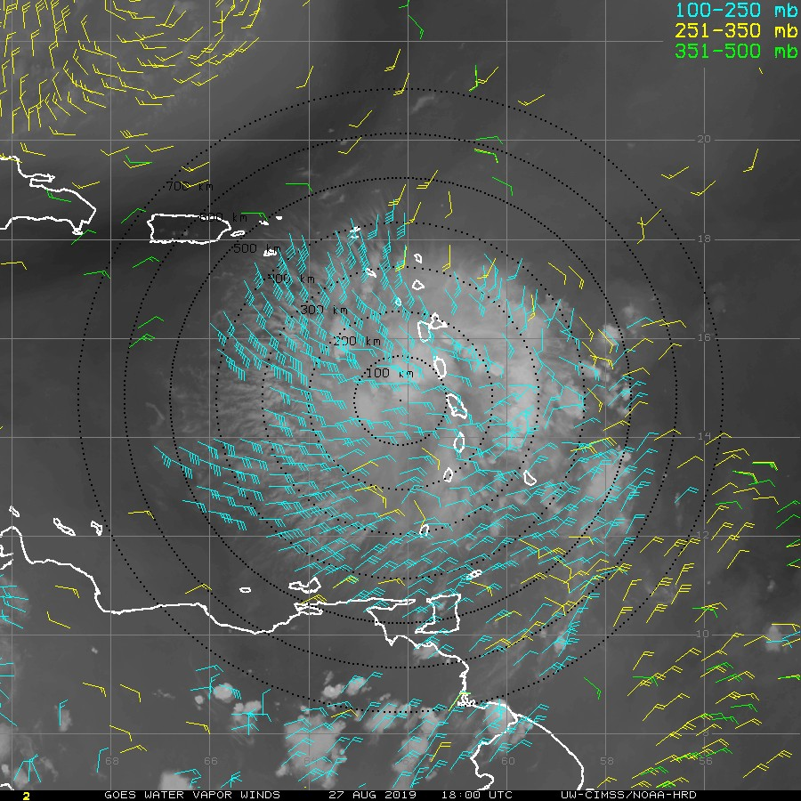
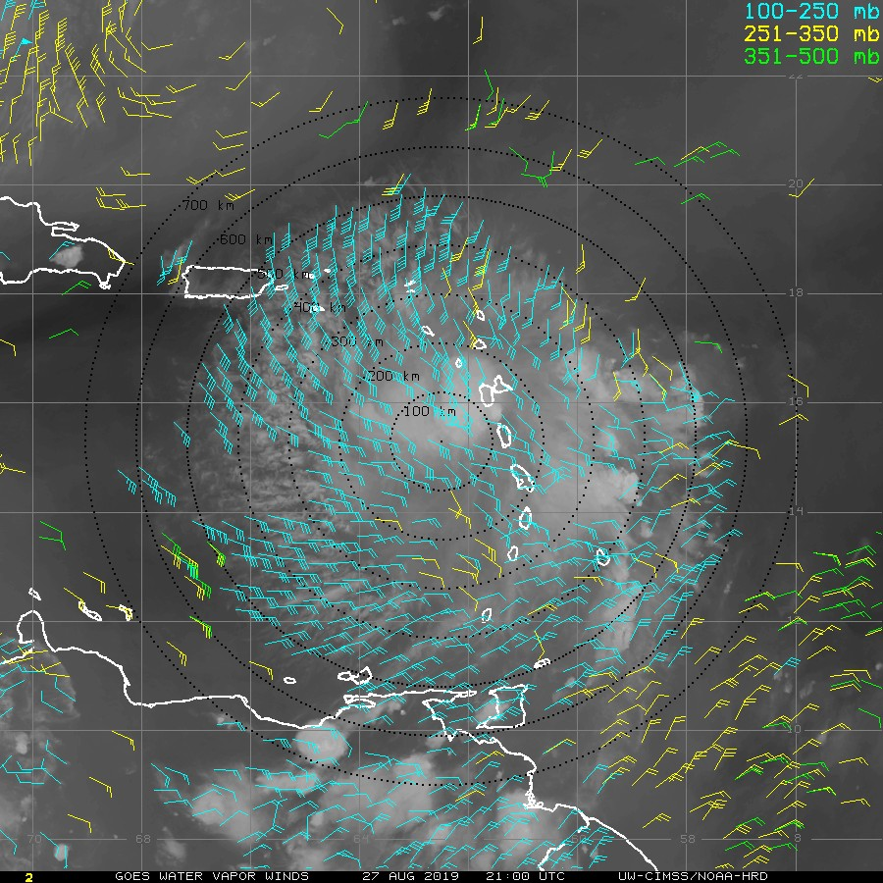
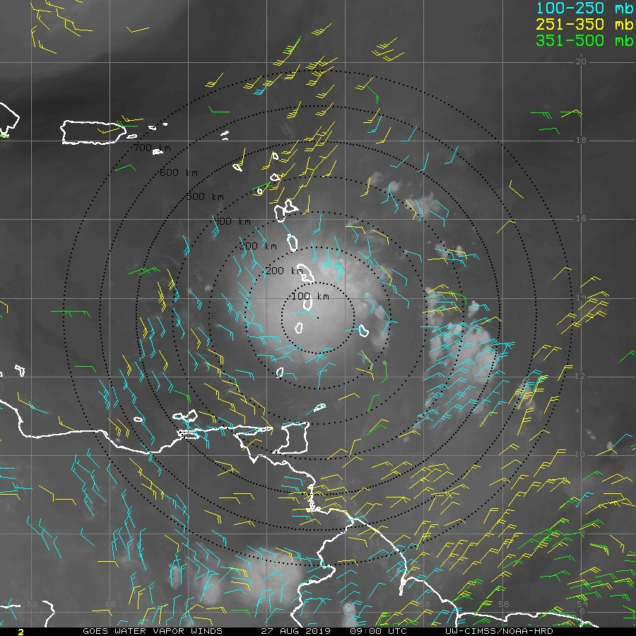
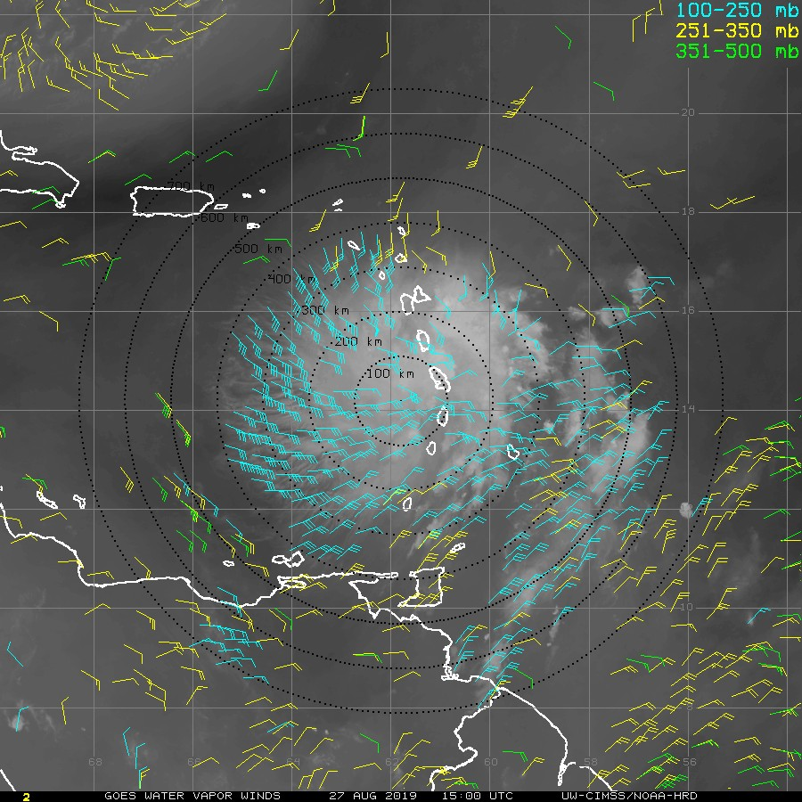












2018 NOAA/AOML/HRD Hurricane Field Program
Intensity Forecast Experiment (IFEX)
AL05 / Dorian Debrief
TC Diurnal Cycle: Upper Level Divergence
CIMSS Water Vapor AMVs
CIMSS 150-300 hPa Divergence

Slide 8
2018 NOAA/AOML/HRD Hurricane Field Program
Intensity Forecast Experiment (IFEX)
AL05 / Dorian Debrief
TC Diurnal Cycle: Upper-Level Divergence
CIMSS 150-300 hPa DVG (R=0-600 km)
SHIPS 200 hPa DVG (R=0-1000 km)
00 LST
00 LST
00 LST
00 LST
00 LST
00 LST

Slide 9
2018 NOAA/AOML/HRD Hurricane Field Program
Intensity Forecast Experiment (IFEX)
AL05 / Dorian Debrief
TC Diurnal Cycle: Vertical Wind Shear
SHIPS 200-850 hPa SHR
SHIPS 200-850 hPa SHR ADJ
00 LST
00 LST
00 LST
00 LST
00 LST
00 LST

Slide 10
2018 NOAA/AOML/HRD Hurricane Field Program
Intensity Forecast Experiment (IFEX)
AL05 / Dorian Debrief
TC Diurnal Cycle: Vertical Wind Shear
SHIPS 200-850 hPa SHR
SHIPS 200-850 hPa SHR ADJ
00 LST
00 LST
00 LST
00 LST
00 LST
00 LST
00 LST

Slide 11
2018 NOAA/AOML/HRD Hurricane Field Program
Intensity Forecast Experiment (IFEX)
AL05 / Dorian Debrief
Summary
TC Diurnal Cycle: Dorian
25 August – 05 September: pronounced TCDC signals in GOES IR imagery
27 August: Explosive TCDC (KaboomTM; Jeff Hawkins)
28 -31 August: strong diurnal signal in CIMSS and SHIPS upper-level divergence
CIMSS DVG peak >> early afternoon…2-3x greater than overnight hours (~00-06 LST)
SHIPS DVG trends >> similar, but less pronounced (large search area?)
28 August – 03 September: marked diurnal signal in SHIPS SHR and SHR ADJ
SHIPS SHR/SHR ADJ peak (lull) >> just after midnight (early afternoon) >> ~5-10 kt diurnal swings
Storm building its own UL flow in the afternoon? Protection from the environment?
What’s next: continue looking at how the TCDC impacts the TC near-environment

