Slide 1
SHOUT FY15 Field Work

Slide 2
Mission Plans / CONOPS NOAA SHOUT 2015
Objective
Utilize NOAA UAS assets to improve sampling strategies, numerical prediction, and understanding of tropical cyclone track, intensity, and structure
Project Assets
NASA/NOAA Global Hawk (AV-6);
Numerical simulations to optimize sampling strategies & aircraft instrument platforms to improve TC forecasts (OSEs, OSSEs, ensemble-based targeted observations);
HRD forecasting team, federal/university mission scientist team, aircraft track design software, real-time mission monitoring (NASA MTS), data analysis team;
Collaborations (NOAA IFEX, ONR TCI)

Slide 3
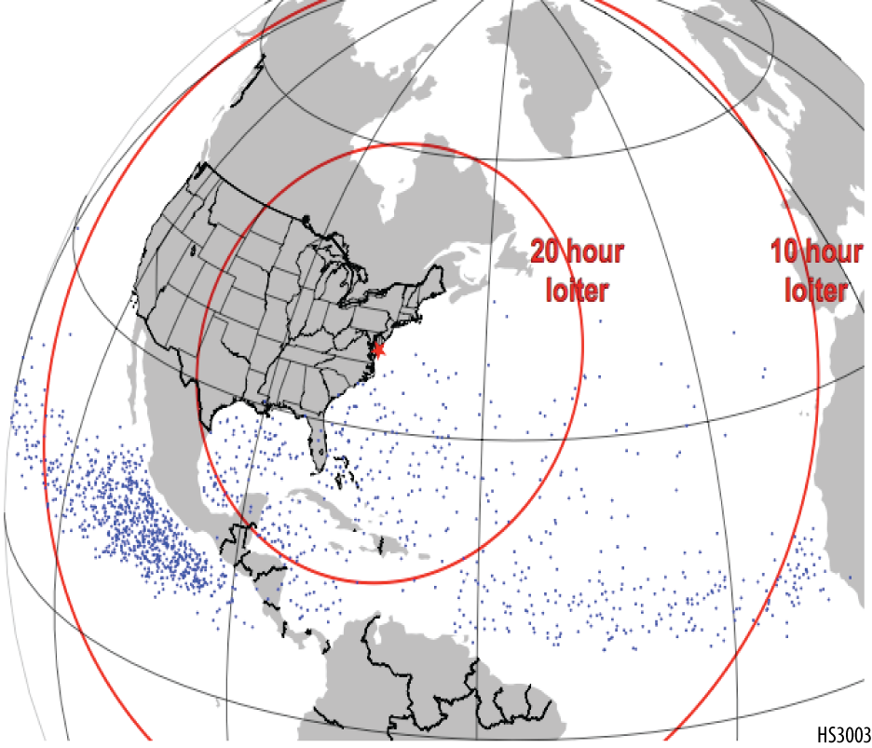
SHOUT 2015 Deployment
Atlantic Hurricane focus
Single Global Hawk deployed at NASA Wallops Flight Facility
Potential to shift to west coast if no activity
5 week deployment period
August 25 – September 29
3 week integration
10 science flights
Tempo to support 2-3 flights per week
24-hr duration flights
Range rings assume 30-hr flight. Graphic courtesy NASA

Slide 4

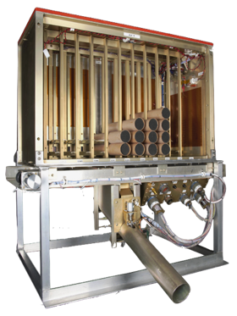
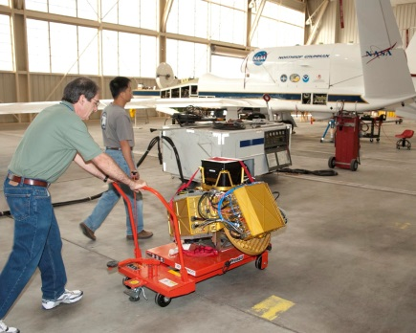
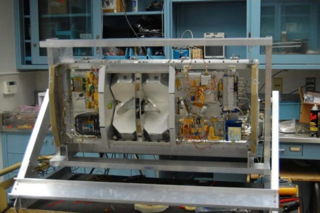
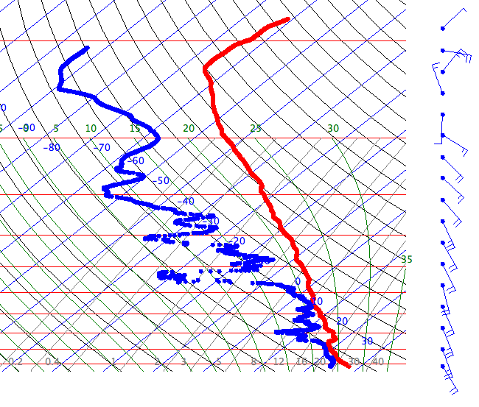
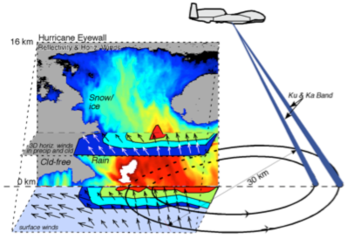
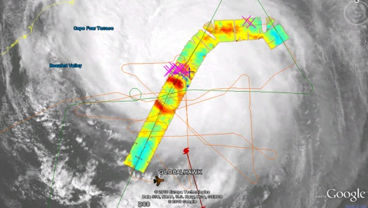
SHOUT 2015 Global Hawk Instrumentation
Airborne Vertical Atmospheric Profiling System (AVAPS)
High Altitude Monolithic Microwave Integrated Circuit (MMIC) Sounding Radiometer (HAMSR)
High-Altitude Imaging Wind and Rain Airborne Profiler (HIWRAP)
PI: Terry Hock, NCAR / Gary Wick, NOAA
Measurements:
temperature, pressure, wind, humidity (vertical profiles);
88 dropsondes per flight;
Resolution:
~2.5 m (winds), ~5 m (PTH)
PI: Dr. Bjorn Lambrigtsen, JPL
Measurements:
Microwave AMSU-like sounder;
25 spectral channels in 3 bands;(50-60 GHz, 118 GHz, and 183 GHz)
3-D distribution of temperature, water vapor, & cloud liquid water;
Resolution:
2 km vertical; 2 km horizontal (nadir)
40 km wide swath
PI: Dr. Gerald Heymsfield, NASA GSFC
Measurements:
Dual-frequency (Ka- & Ku-band), dual beam, conical scanning Doppler radar
3-D winds, ocean vector winds, and precipitation;
Resolution:
60 m vertical, 1 km horizontal;
~16-20km
2010 Karl
Notes:
HAMSR: 2010 NASA GRIP (Hurricane Karl overliflight)

Slide 5
Mission Timeline
Forecast discussion (1200 EDT daily)
HRD Team
Mission scientists
Target selection (T – 2)
Aircraft alert and flight box submission (T – 2)
Flight plan development
Mission scientists
Flight plan filing (T – 1)
Pilots
Go/no-go decision (T – 0)
Mission execution
Real-time changes possible throughout

Slide 6
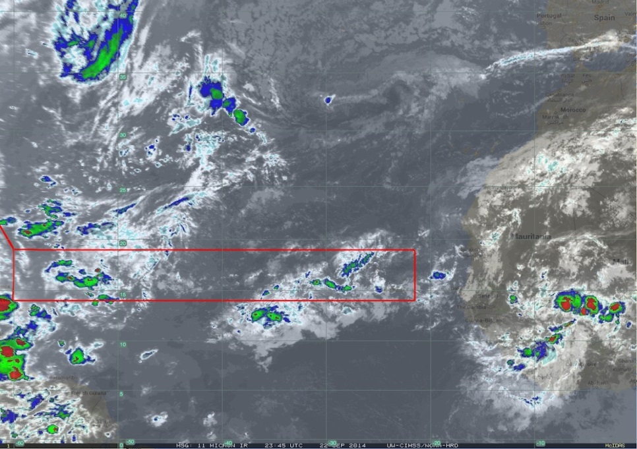
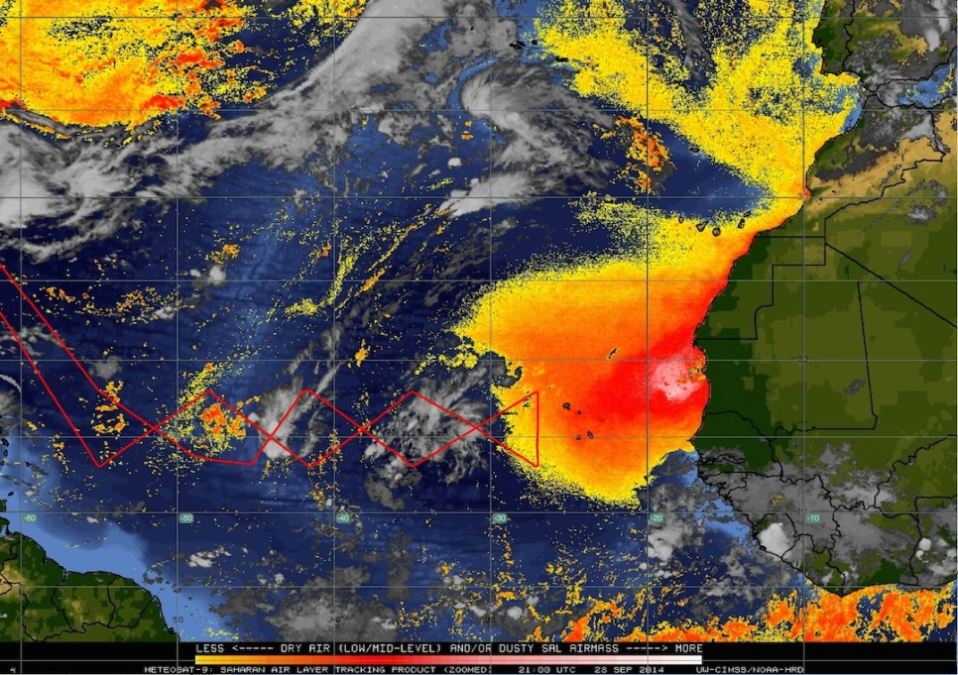
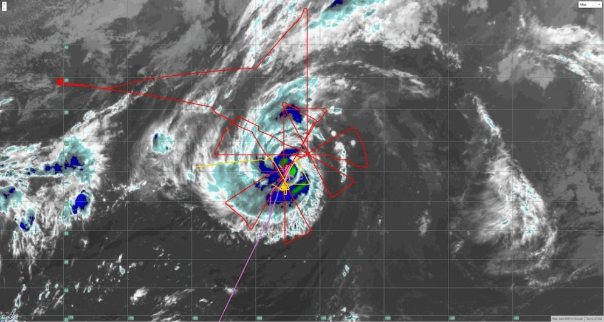
Mission Plans / CONOPS 2014 NOAA-led Global Hawk Missions
Main Development Region (22 Sep 2014)
Main Development Region (28 Sep 2014)
Hurricane Edouard (16 Sep 2014)

Slide 7
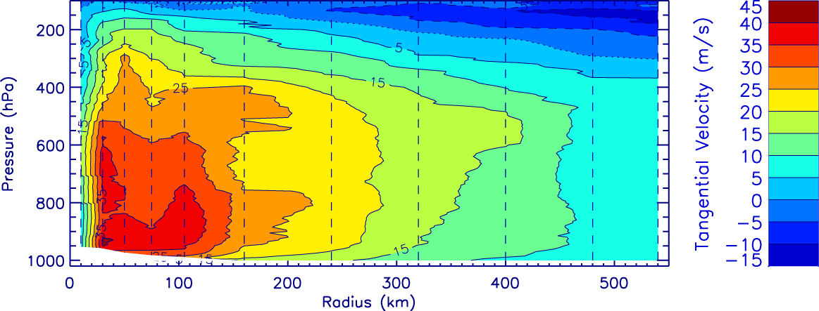
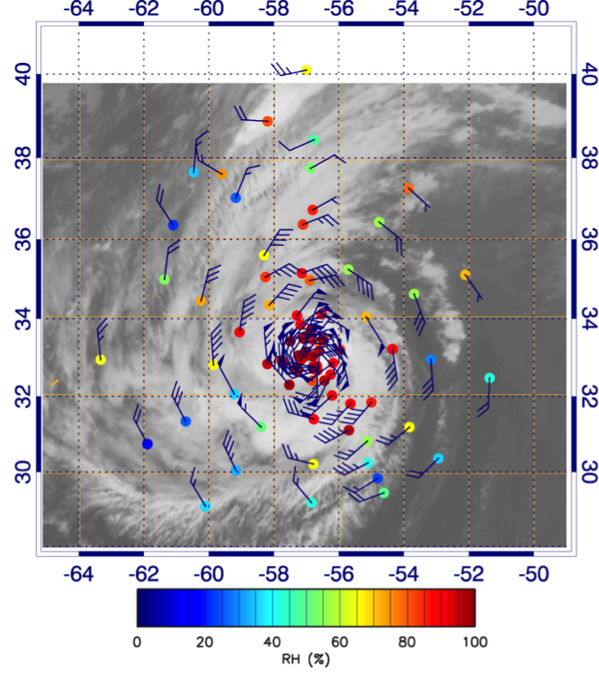
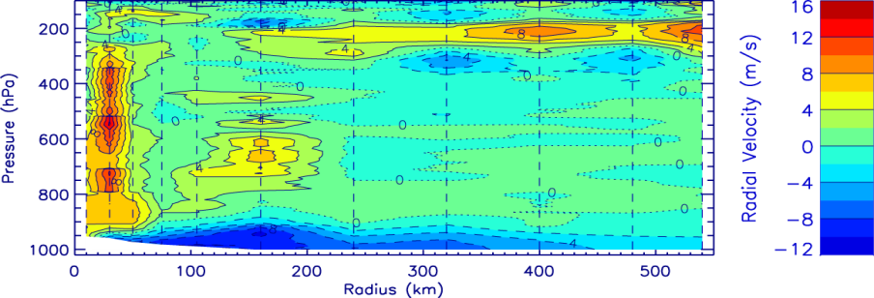
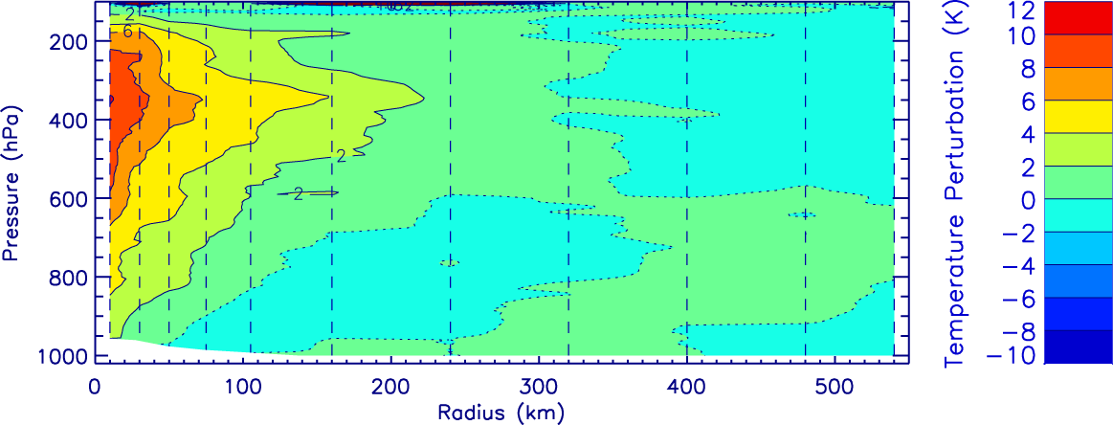
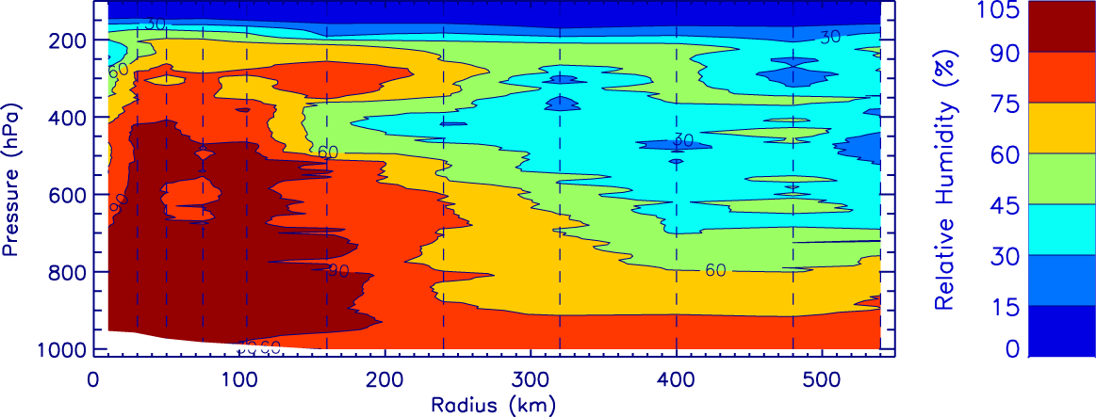
Mission Plans / CONOPS Hurricane Edouard Sept 16-17
Relative Humidity at 700 hPa
Tangential Velocity
Radial Velocity
Temperature Perturbation
Relative Humidity

Slide 8
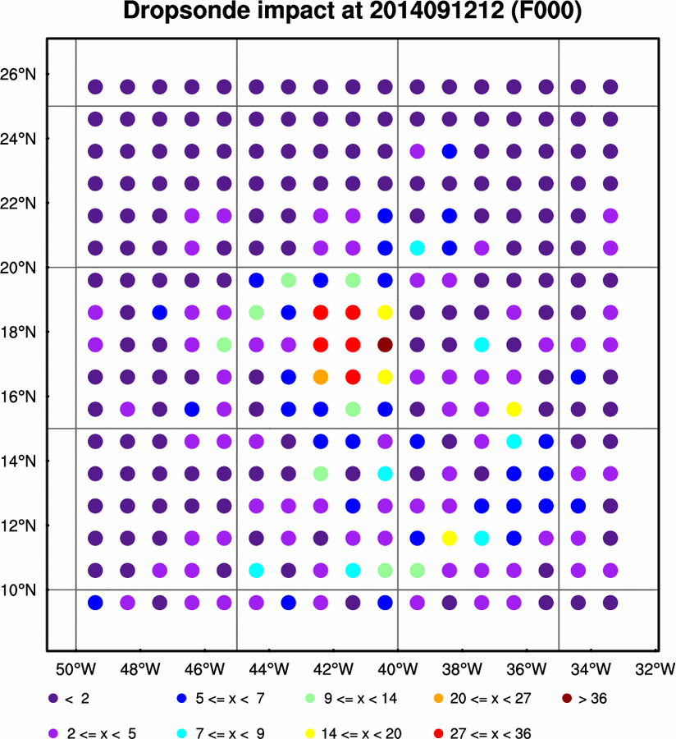
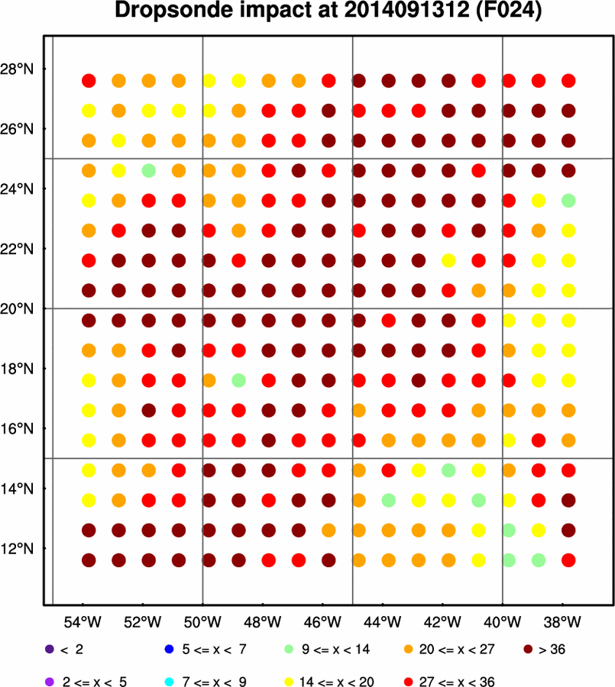
Mission Plans / CONOPS Targeted Global Hawk GPS Dropsonde Observations
Dropsonde Observation Impact
percentage reduction in forecast metric variance (max tangential wind) due to assimilating a dropsonde profile at that location

Slide 9
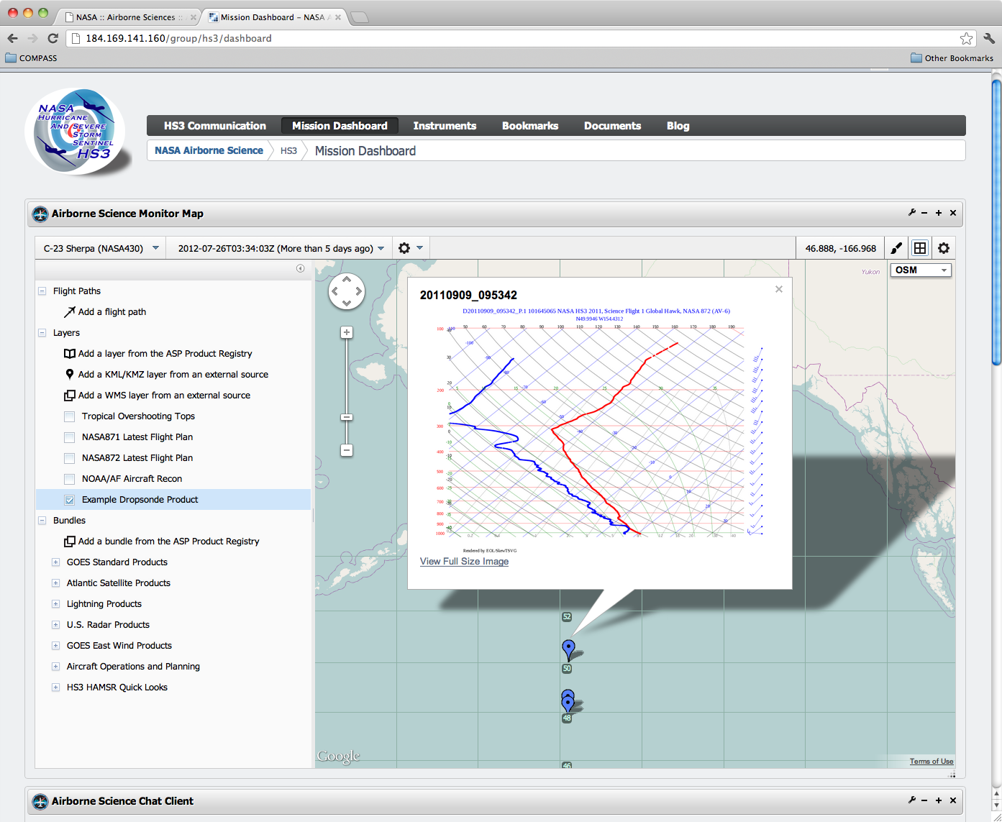
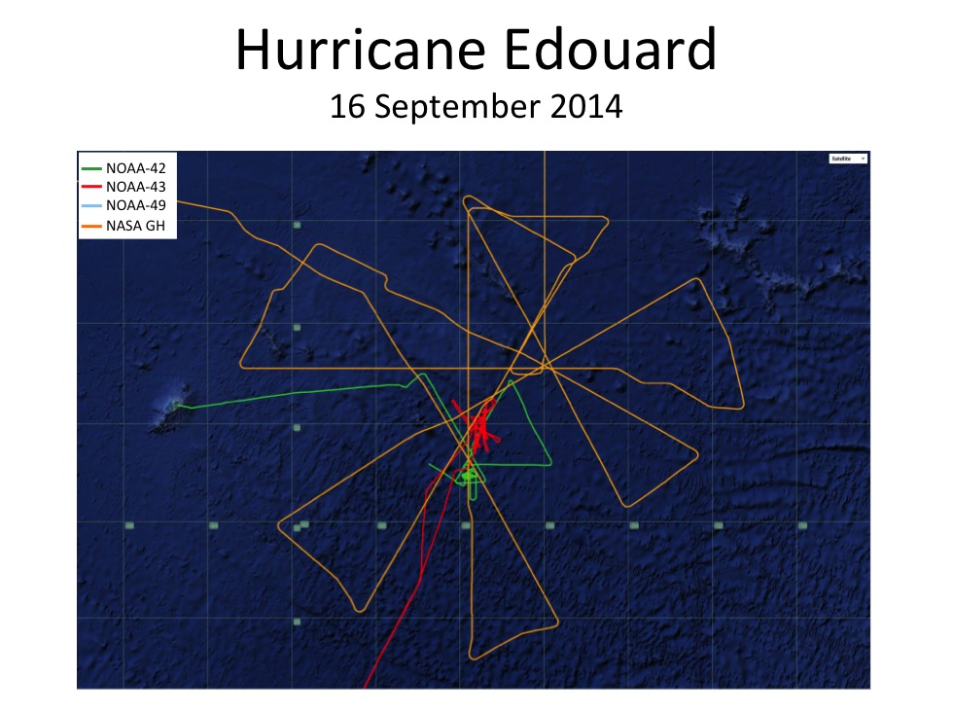
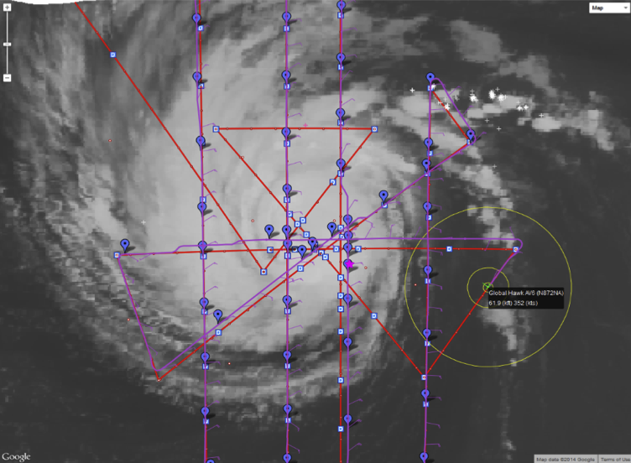
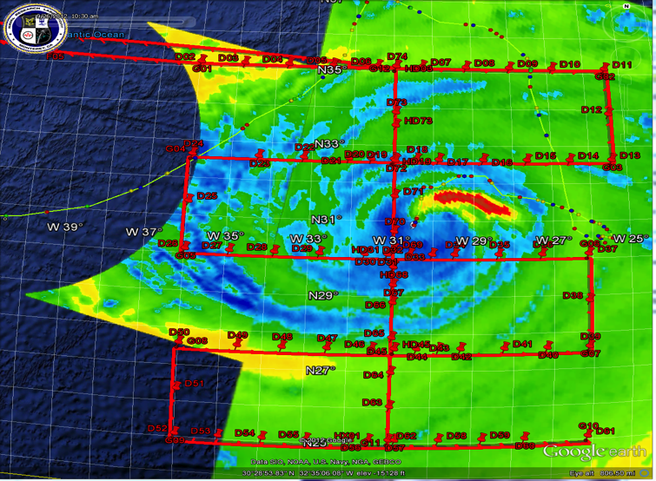
Mission Plans / CONOPS NASA Mission Tool Suite
Bermuda
Notes:
Screen shot of multiple aircraft (Edouard?)

Slide 10
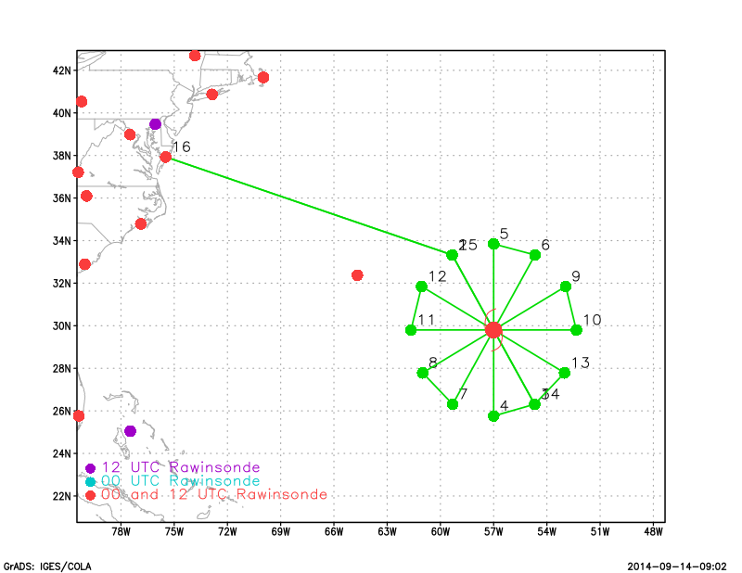
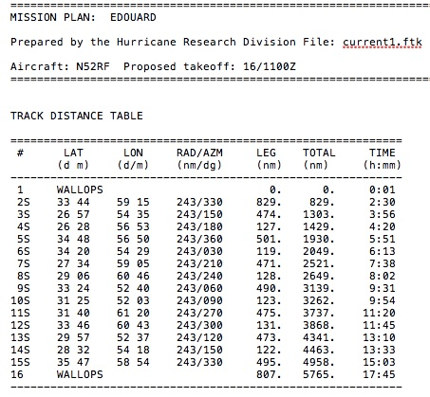
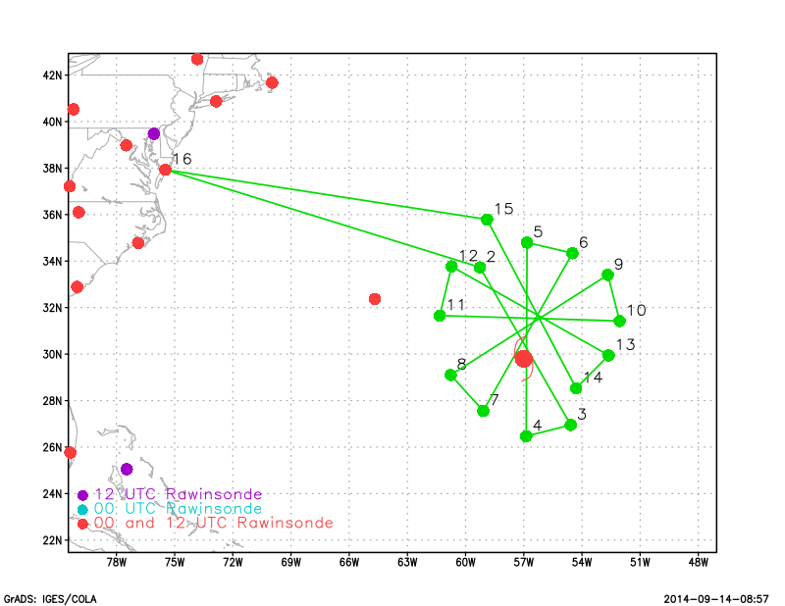
Mission Plans / CONOPS Global Hawk Flight Tracks
HRD TKMAP Track Software: Hurricane Edouard 16 Sep 2014
no storm motion
storm motion

Slide 11

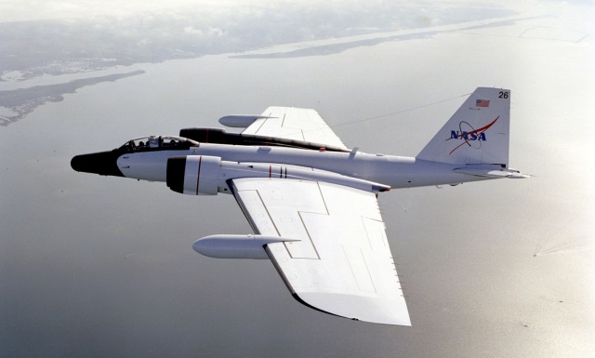
Mission Plans / CONOPS Inter-Agency Coordination (NOAA IFEX, ONR TCI)
NOAA IFEX
Operations: 01 June – 30 Nov
Aircraft: 1 P-3 Orion; G-IV jet
Goals: multi-faceted (TC track, intensity, structure)
ONR TCI
Operations: 01 July – 31 Oct
Aircraft: NASA WB-57
Goals: TC outflow layer & intensity change

Slide 12
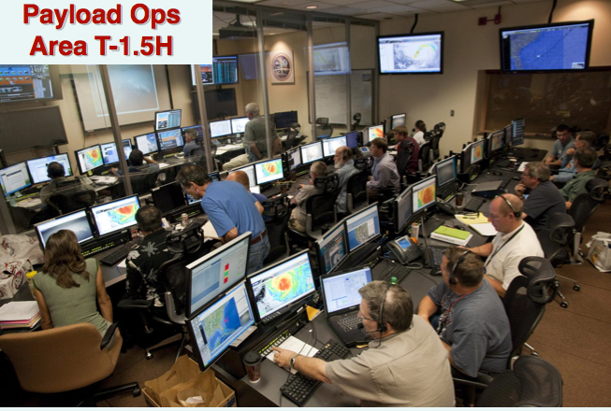
Staffing Status
Mission science
Team constructed, distributing funding
6 – 7 members onsite throughout field phase
NASA ESPO support planned
Instrument teams
Funding distributed or in work
Offsite processing
HRD team identified and funded
Pilots
NASA scheduling
One shift flown from NASA Armstrong
Crew
NOAA supplementing NASA staffing

