Slide 1
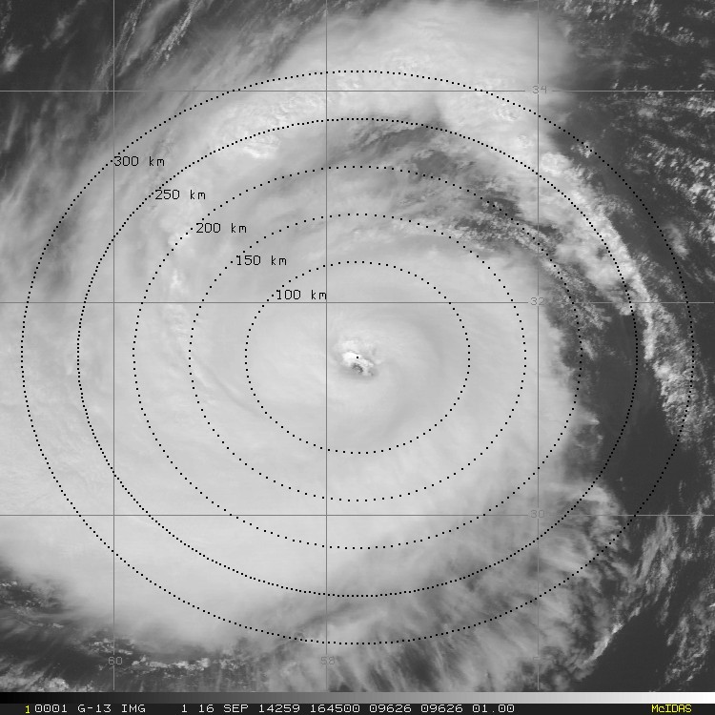
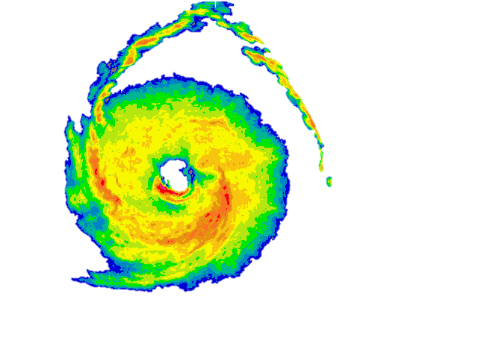
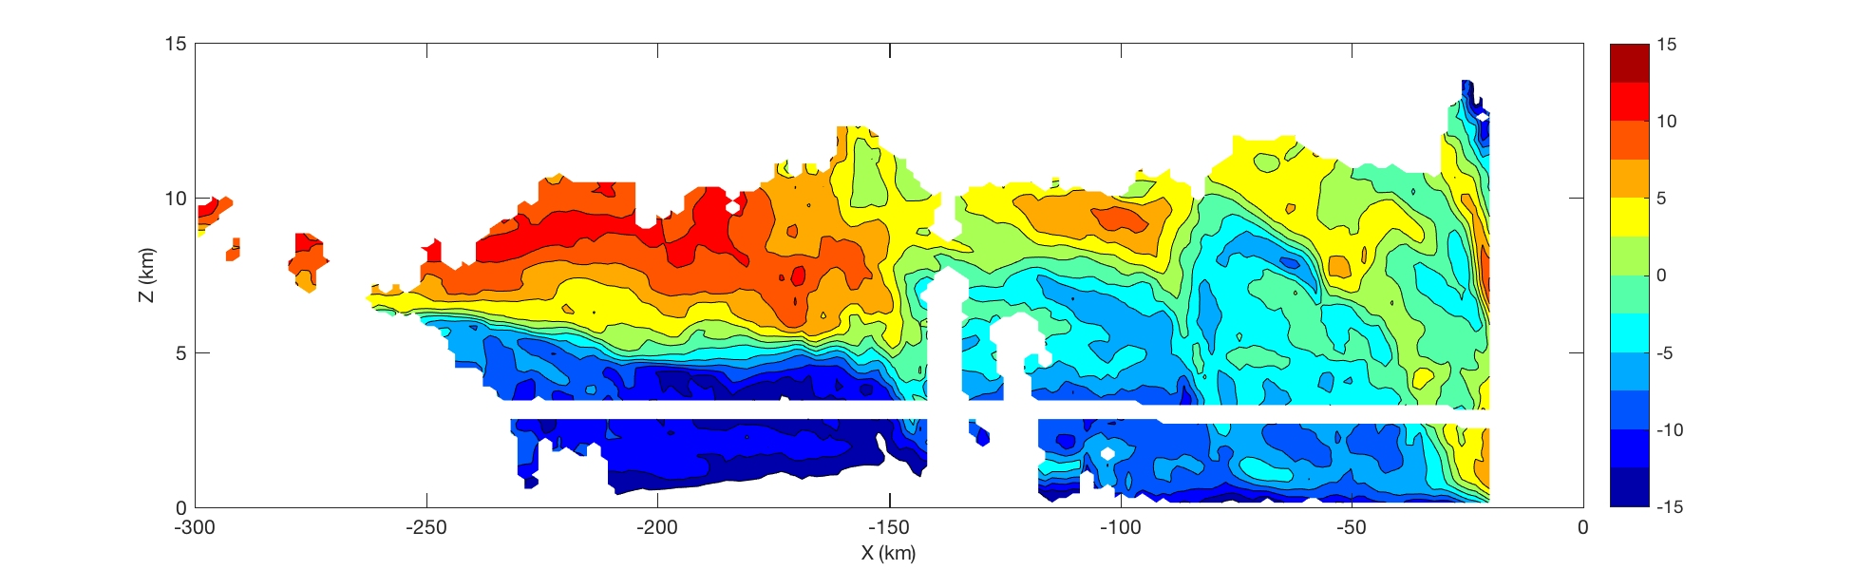
Environmental structure
The tropical cyclone diurnal cycle: connecting the TC inner core to the environment (2014 Hurricane Edouard)
GOES Visible and P-3 LF radar
P-3 tail Doppler radar cross-section: radial wind (m s⁻¹)
A
B
C
TC diurnal pulse
Enhanced Outflow
Reduced Outflow
A
B
C
1
Enhanced Inflow
Reduced Inflow
Radially propagating
TC diurnal pulse
TC diurnal pulse impacting storm structure
A (environment ) B (TC diurnal pulse) C (storm center)

