Slide 1
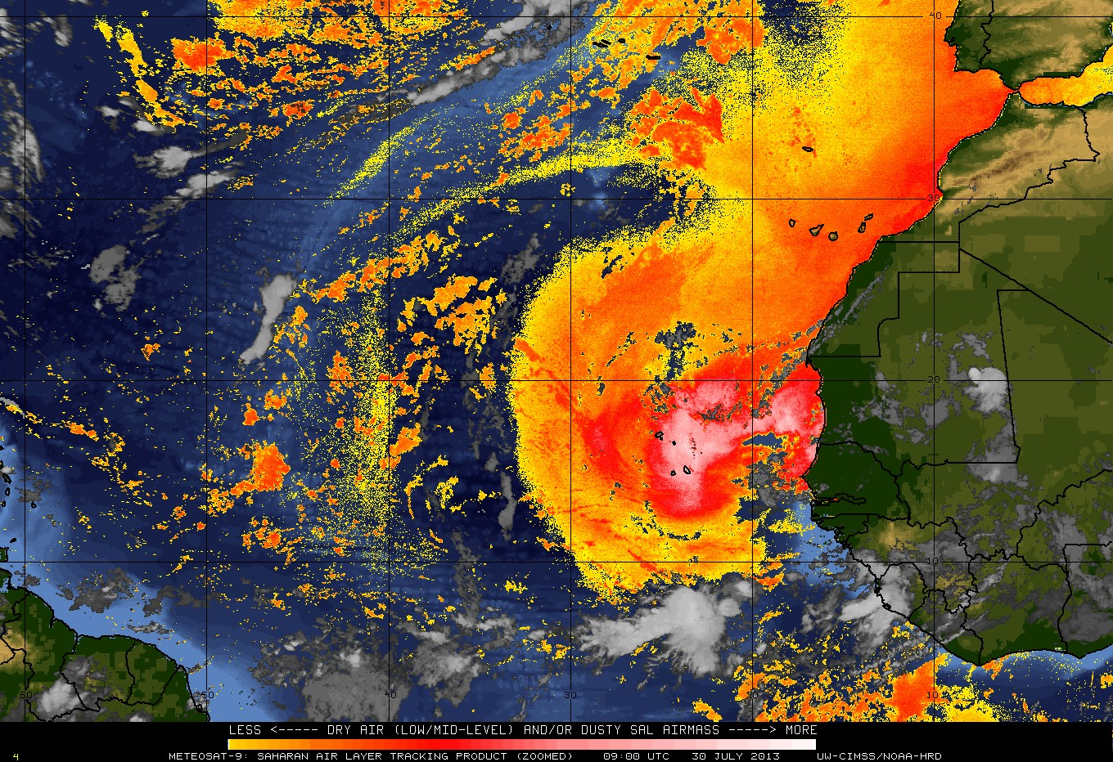
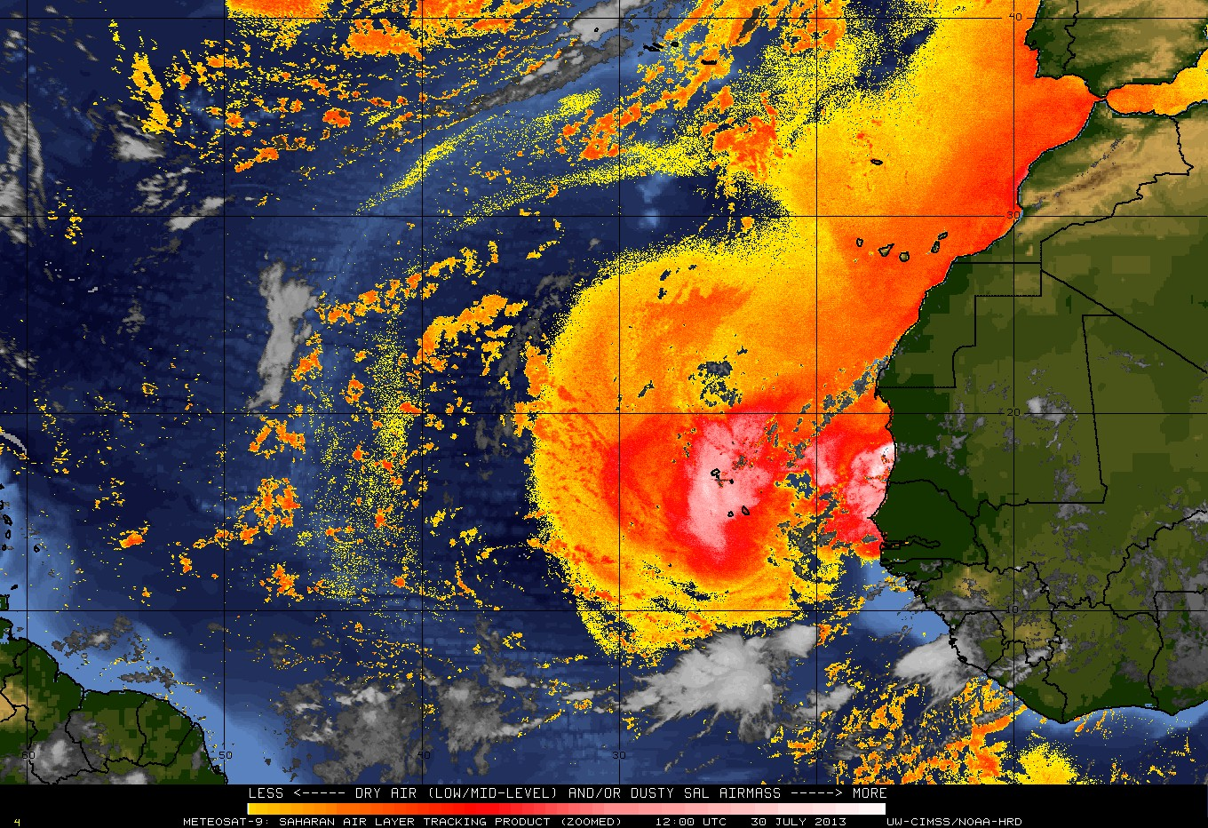
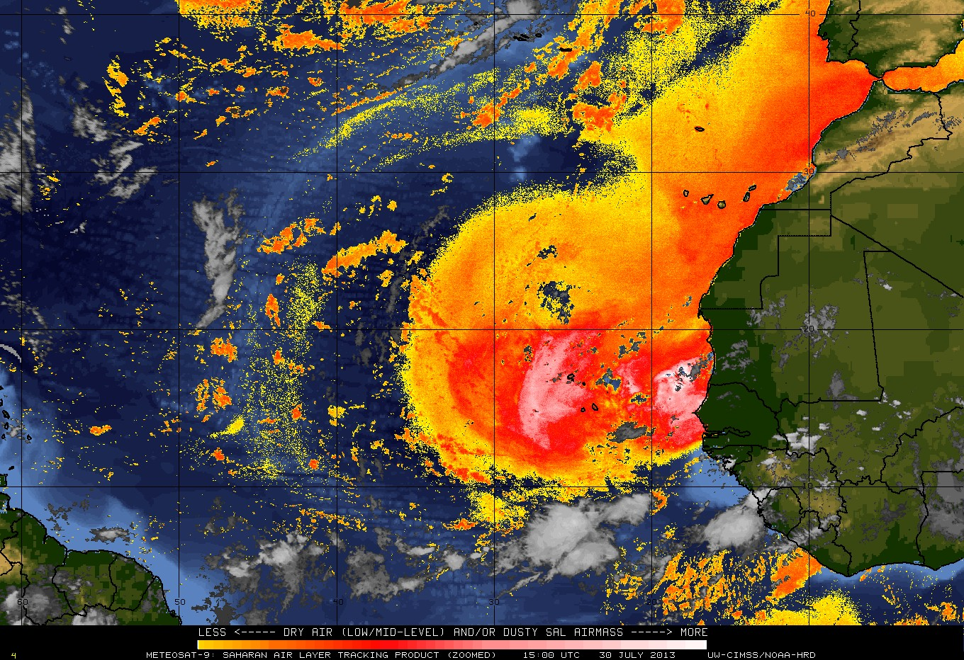
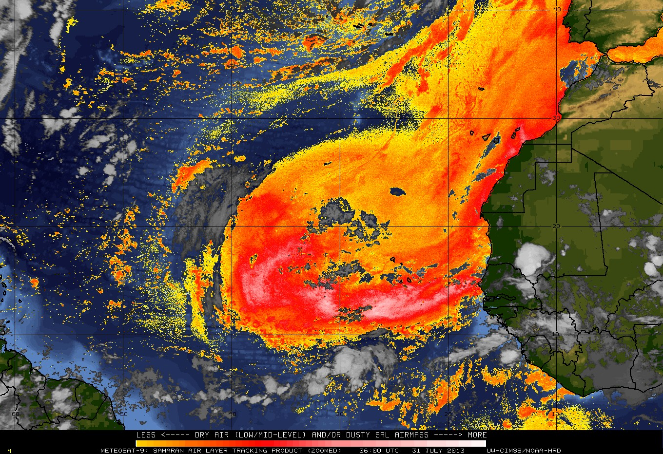
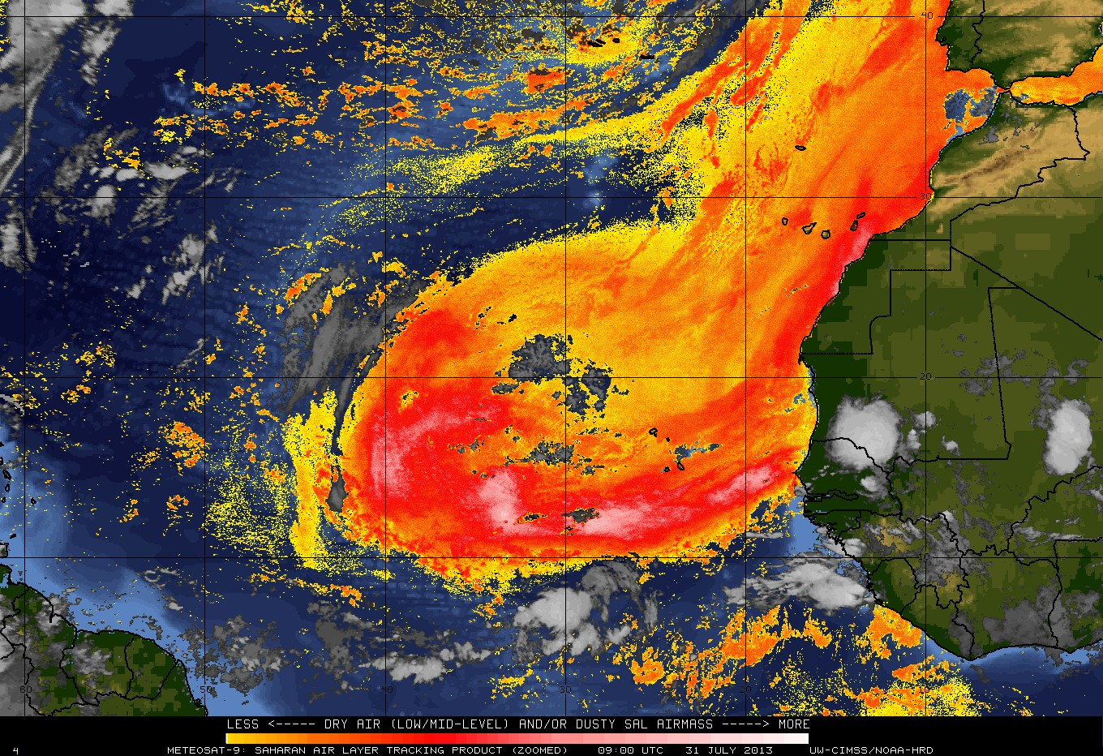
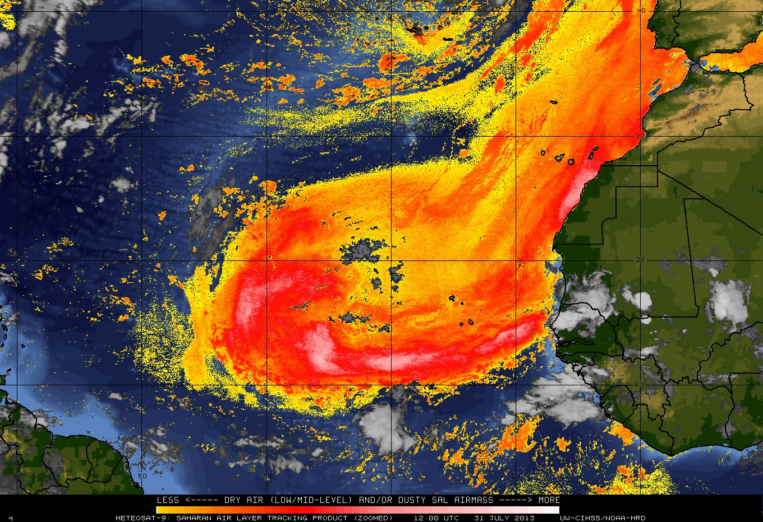
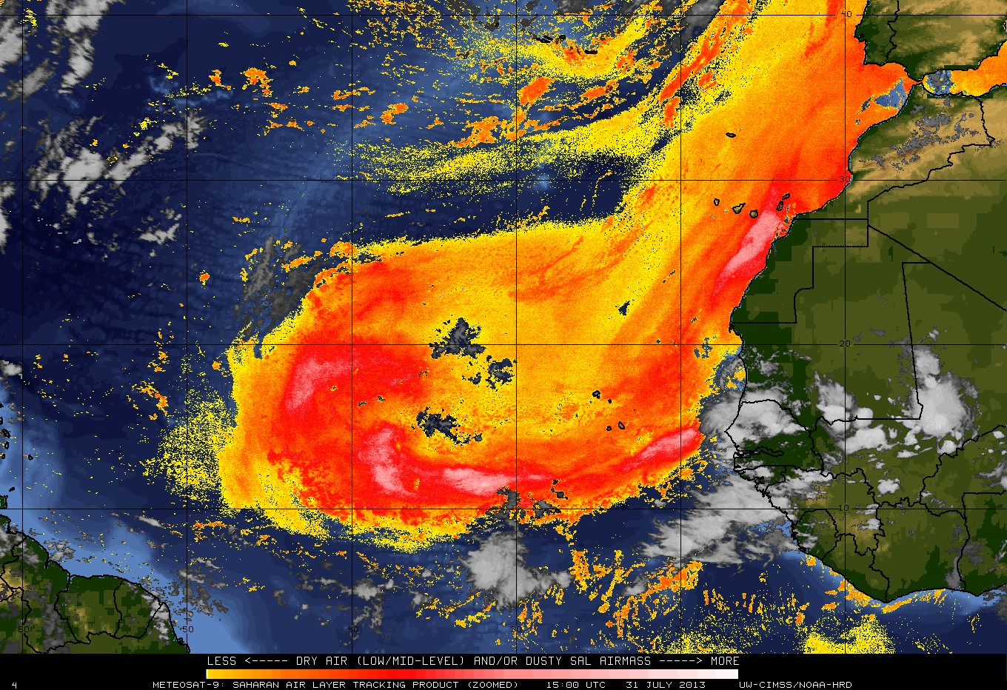
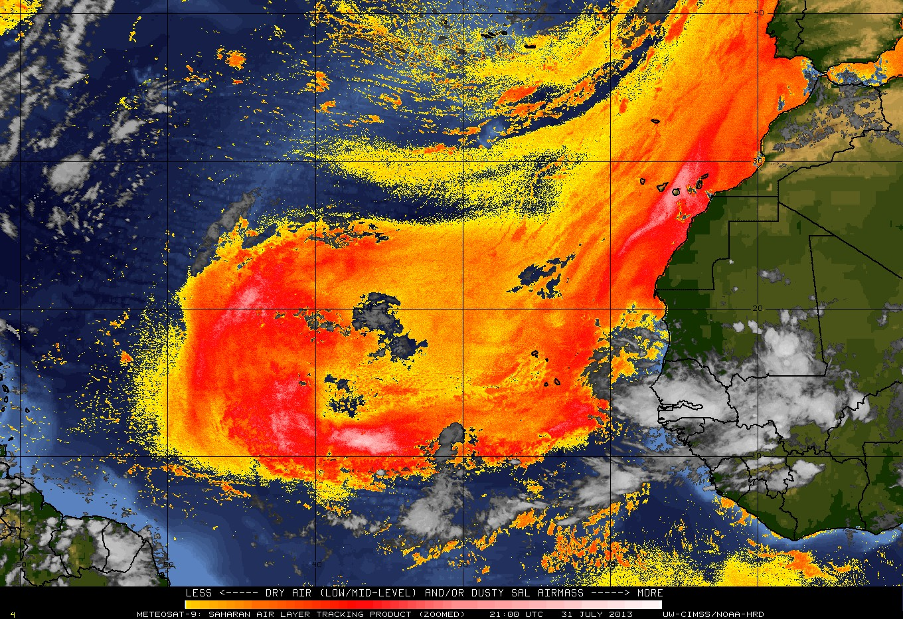
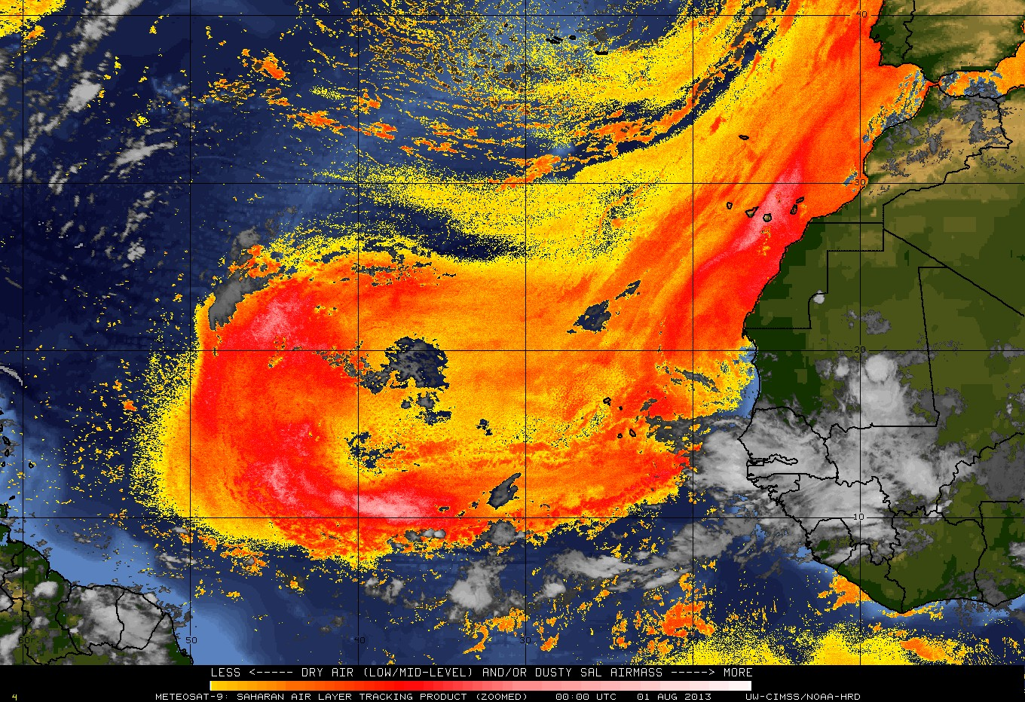
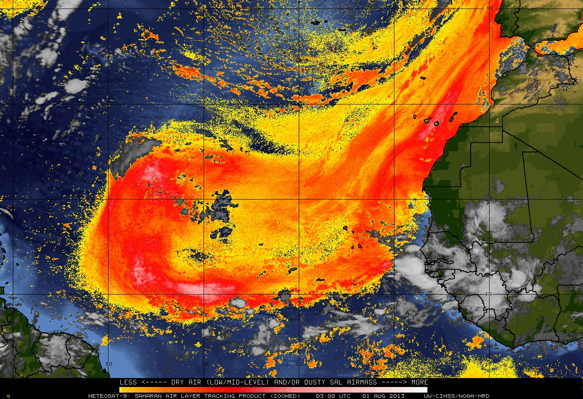
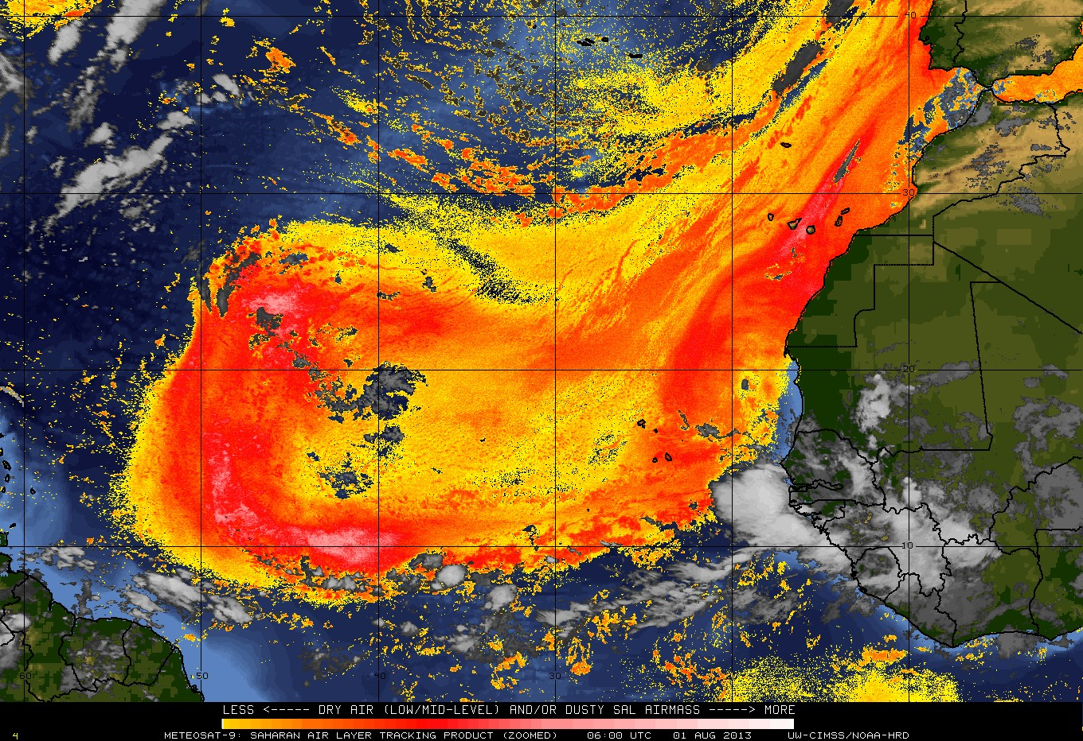
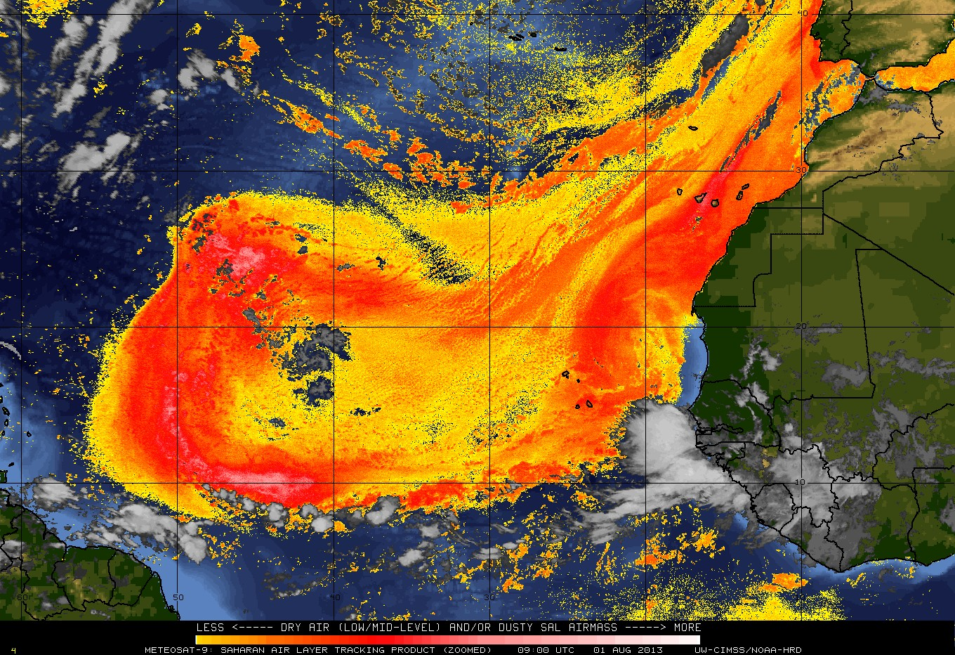
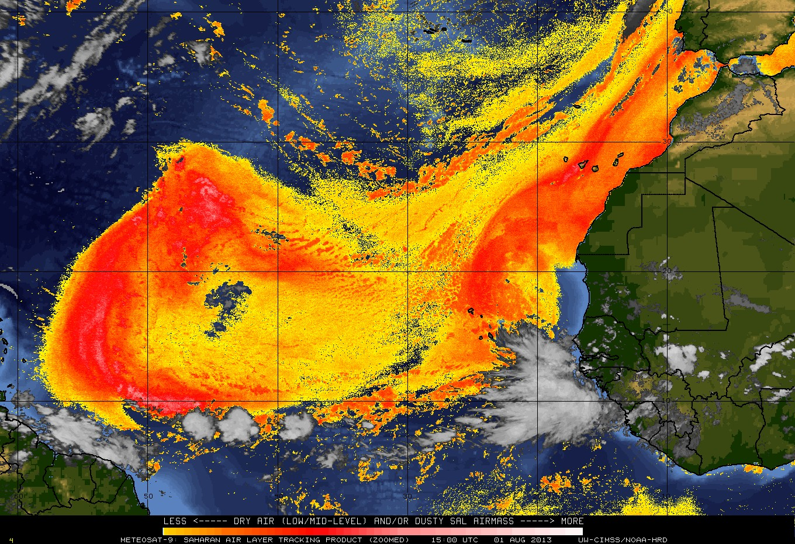
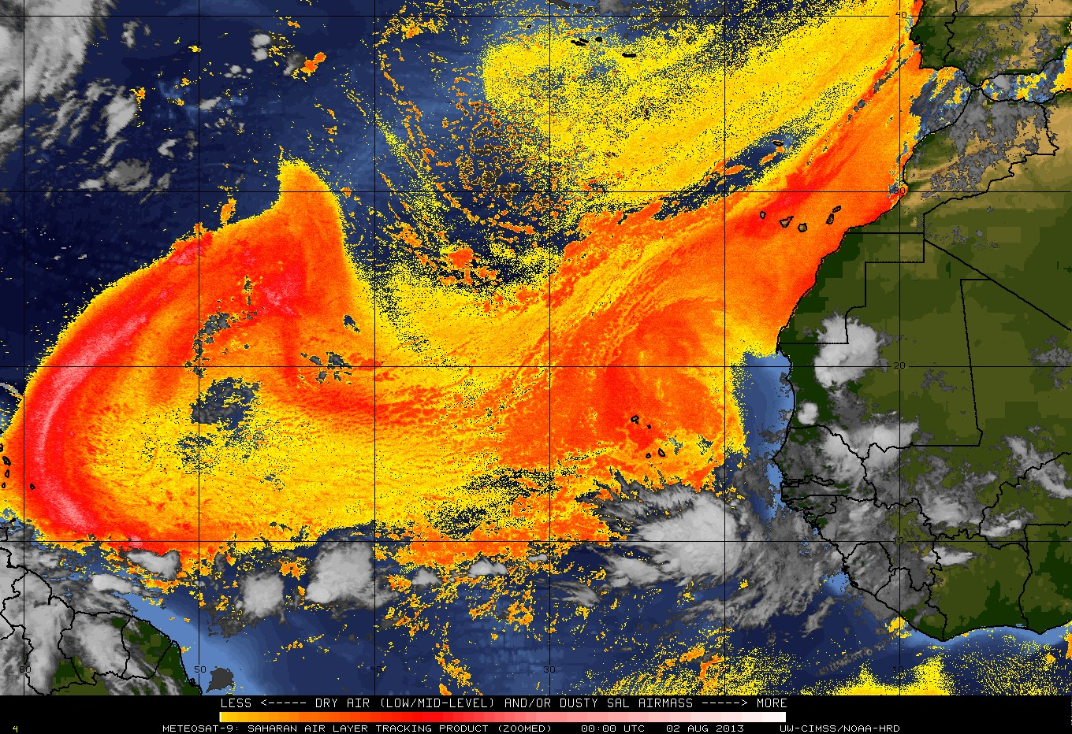
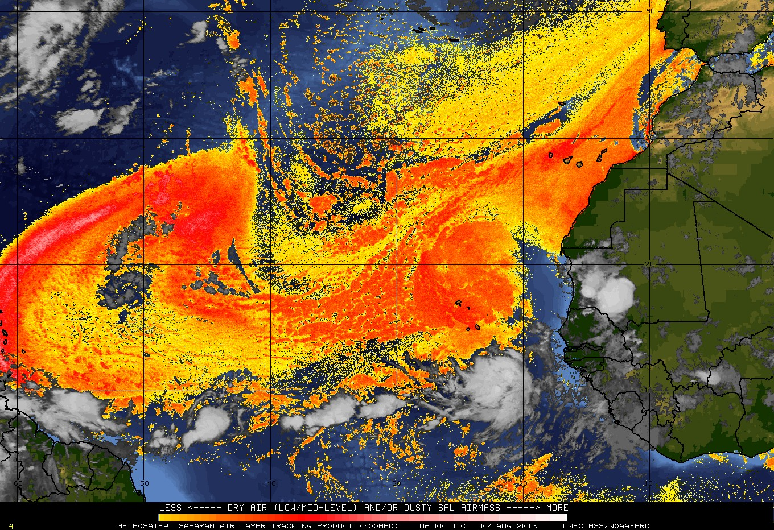
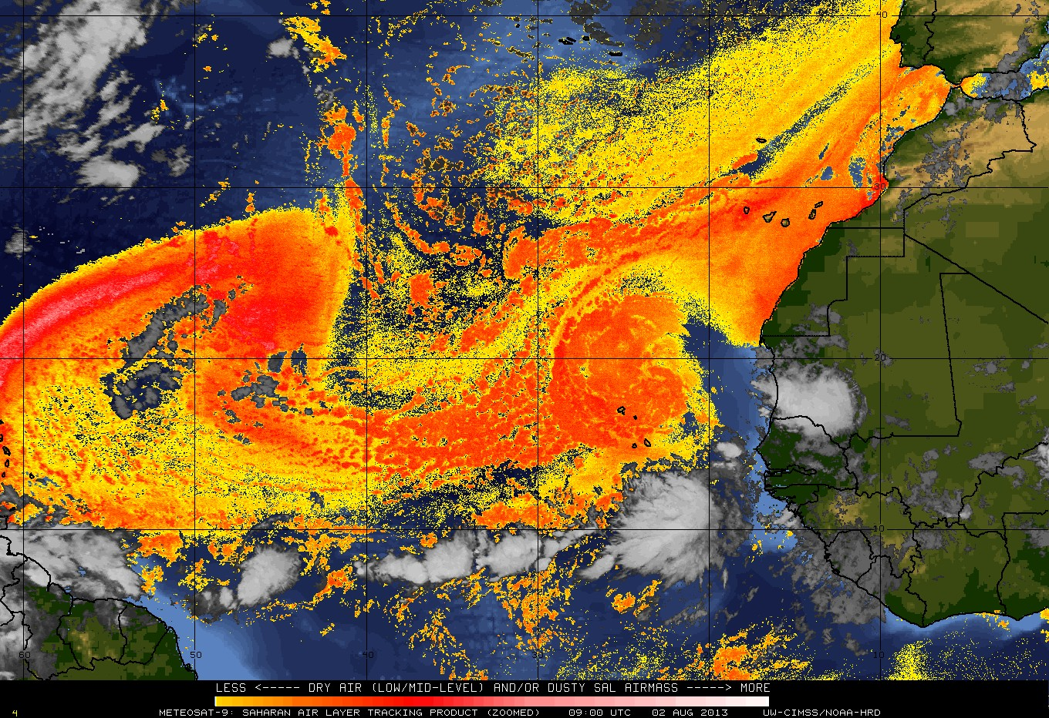
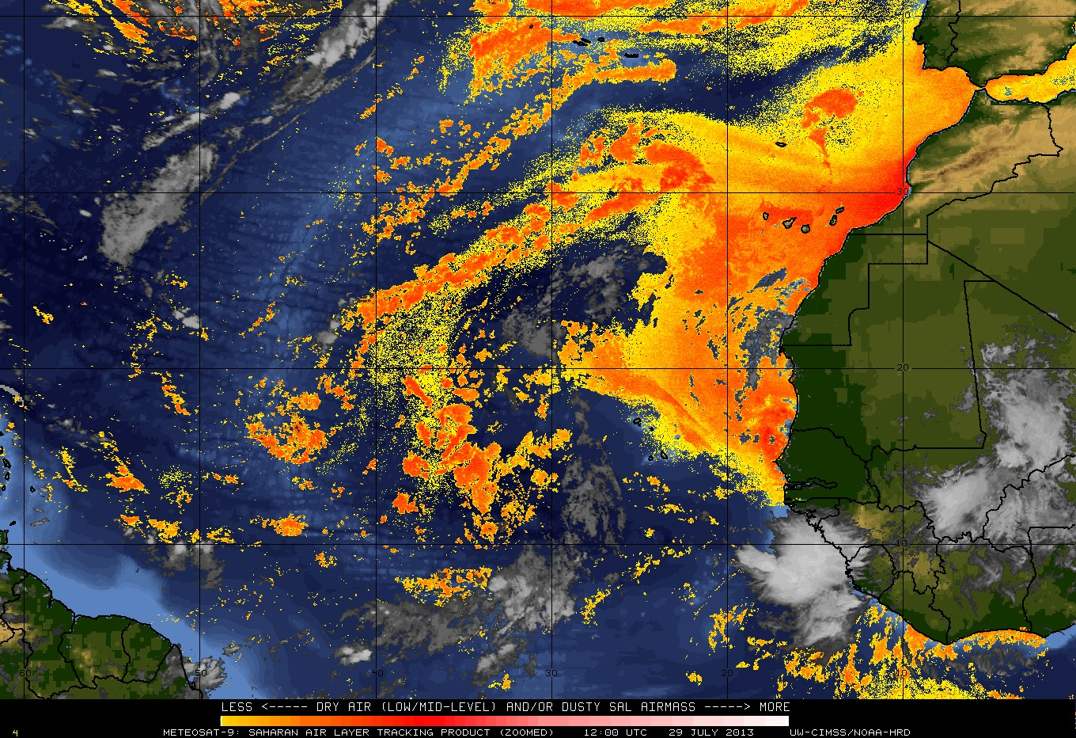
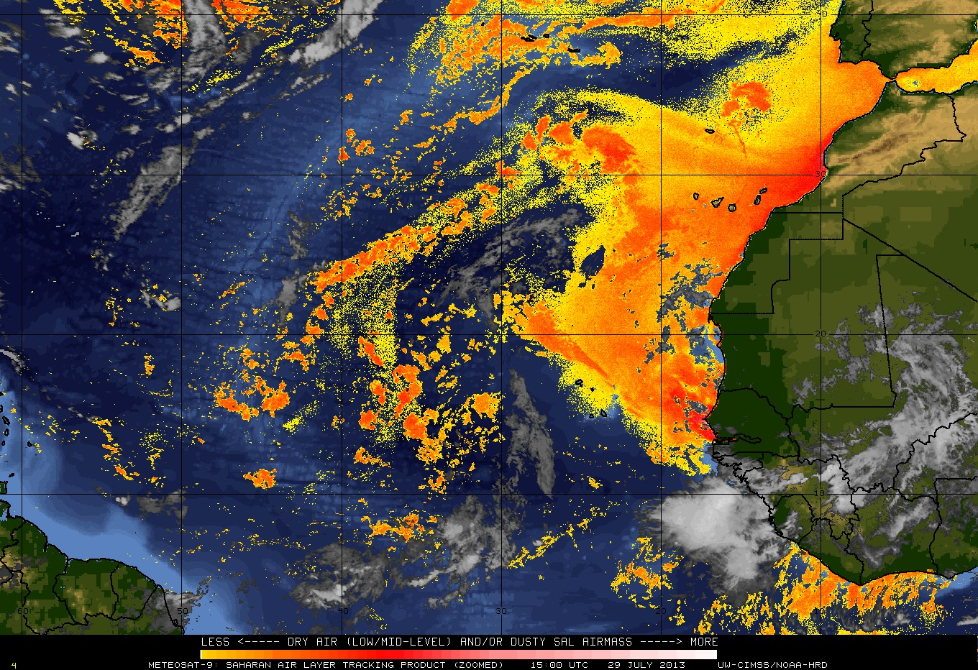
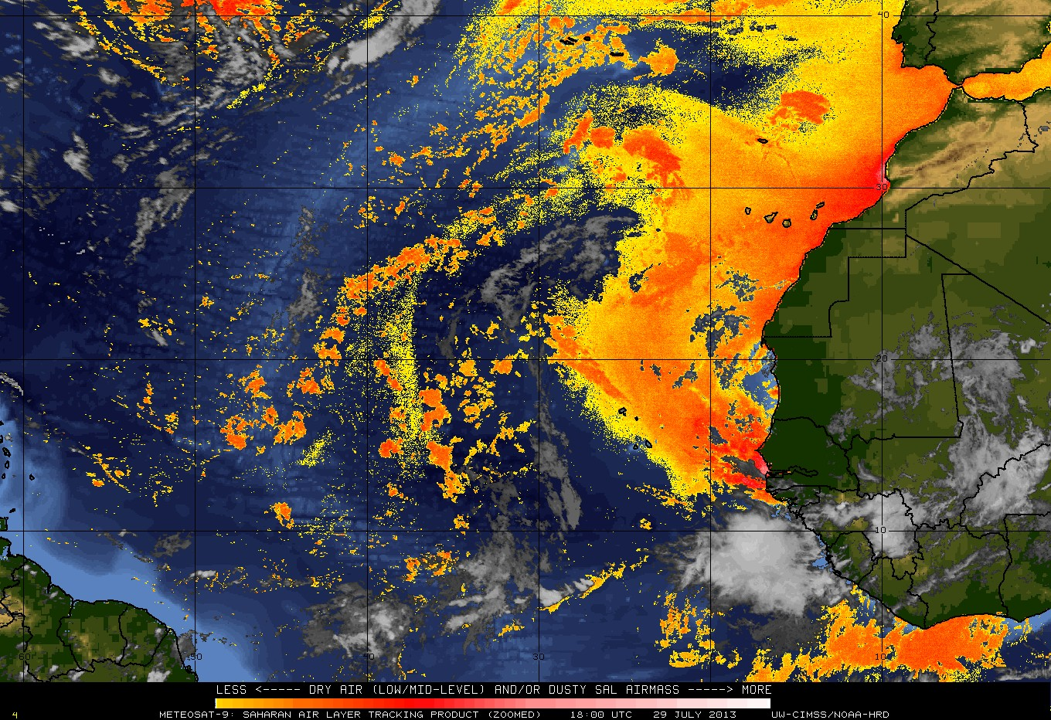
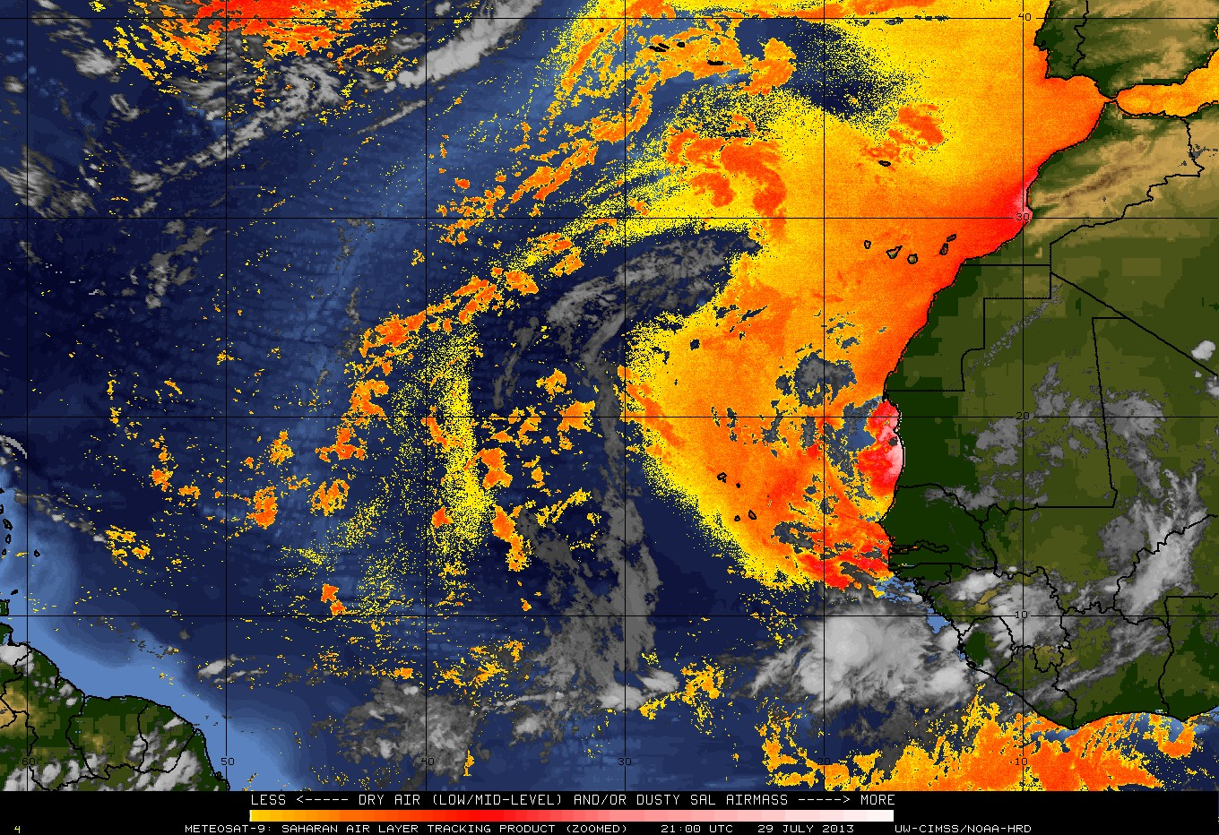
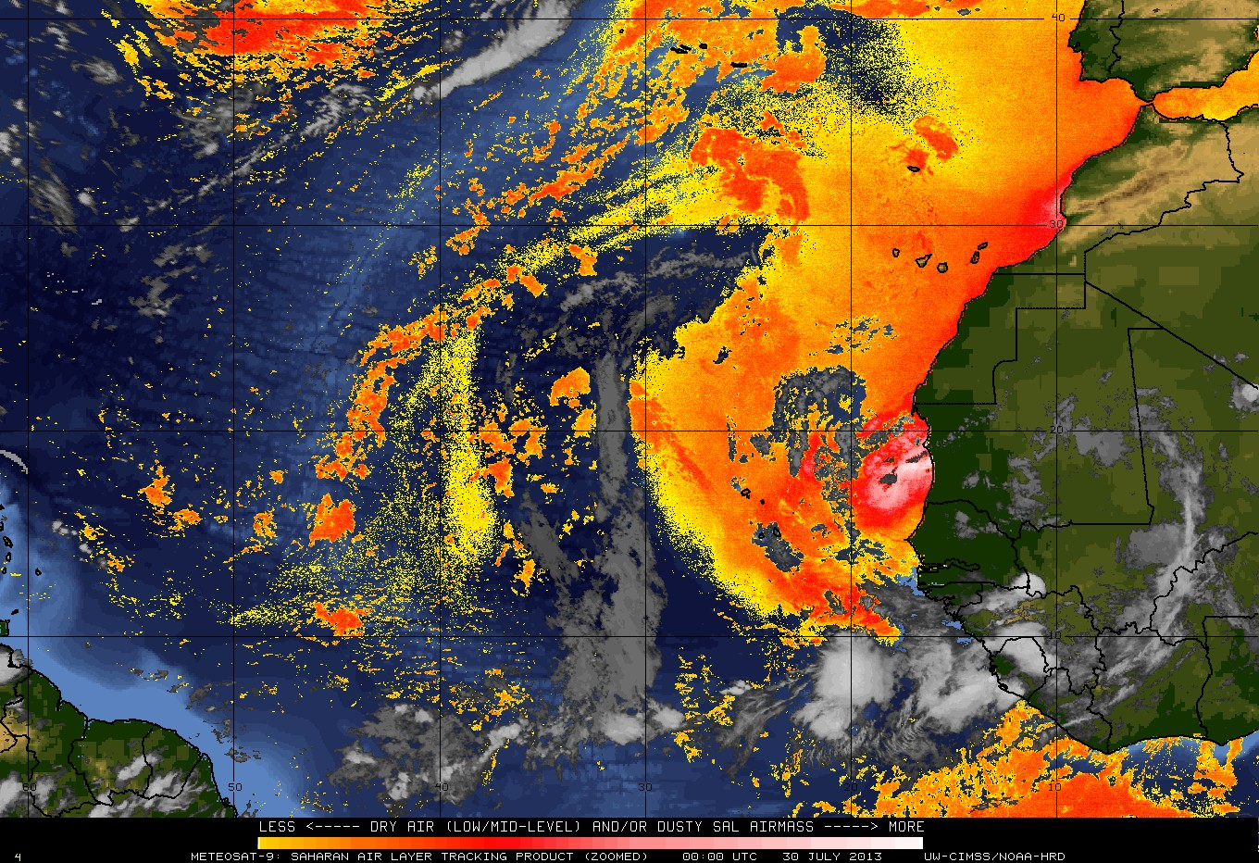
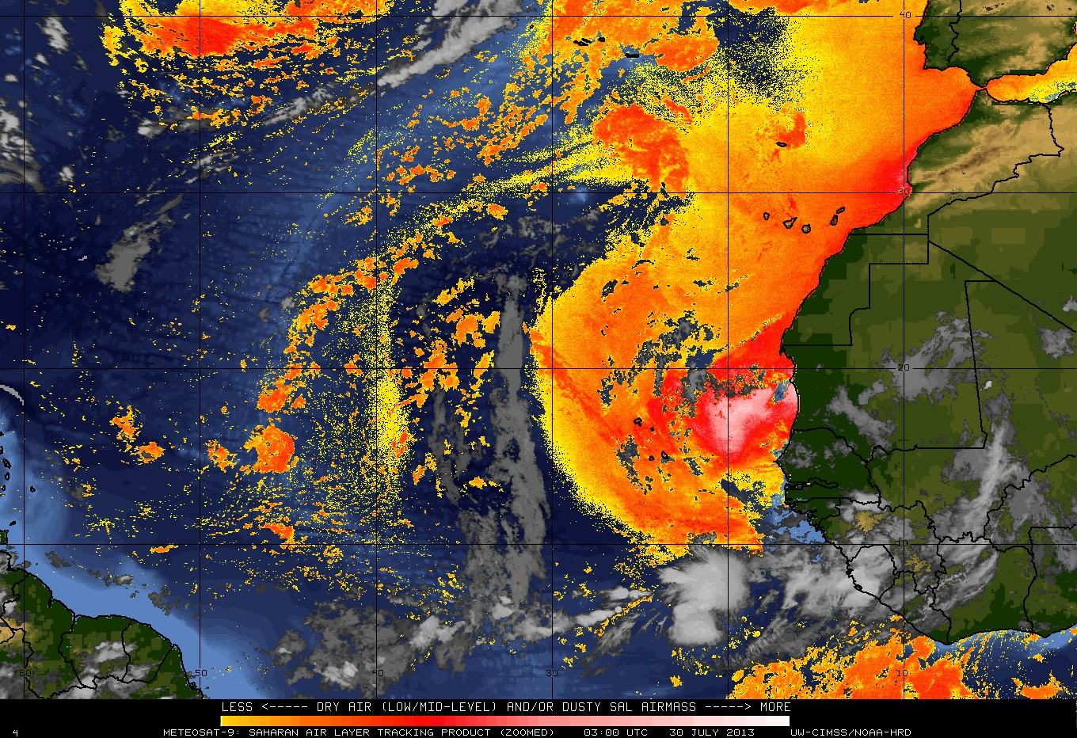
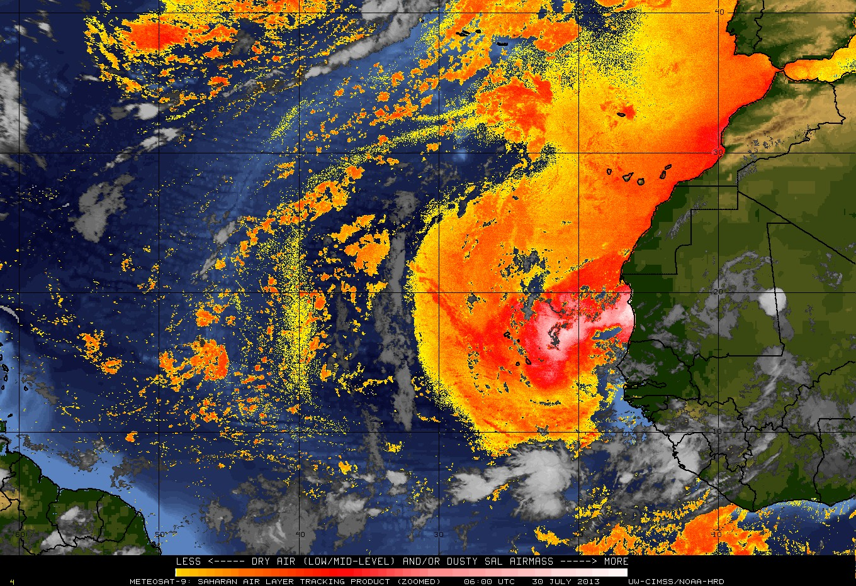
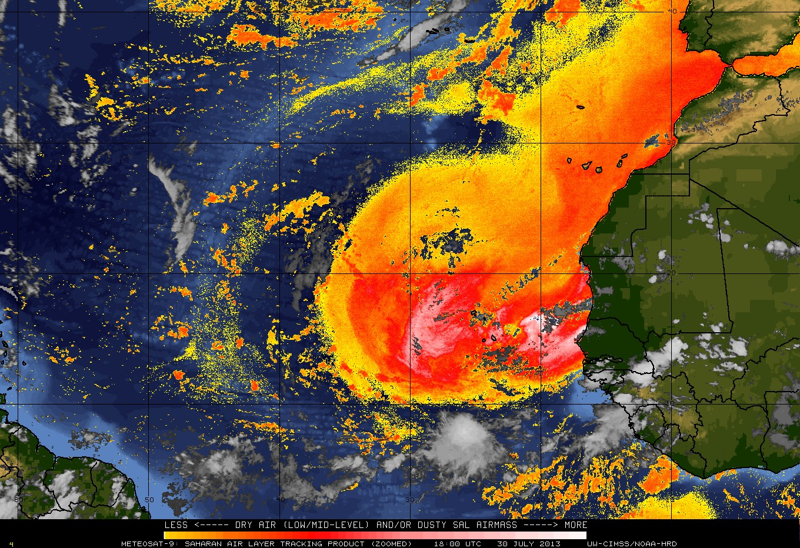
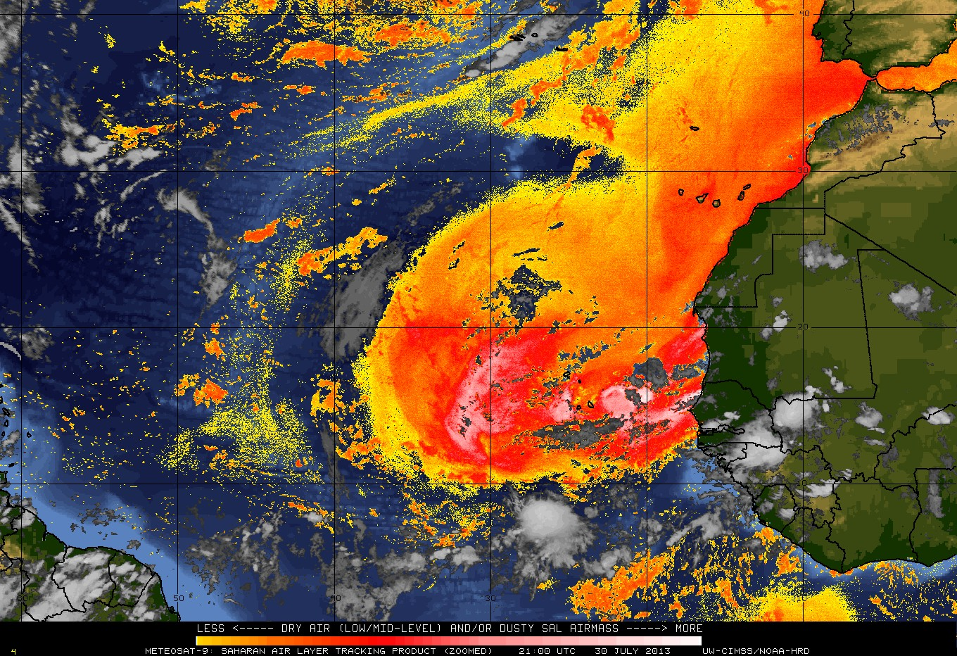
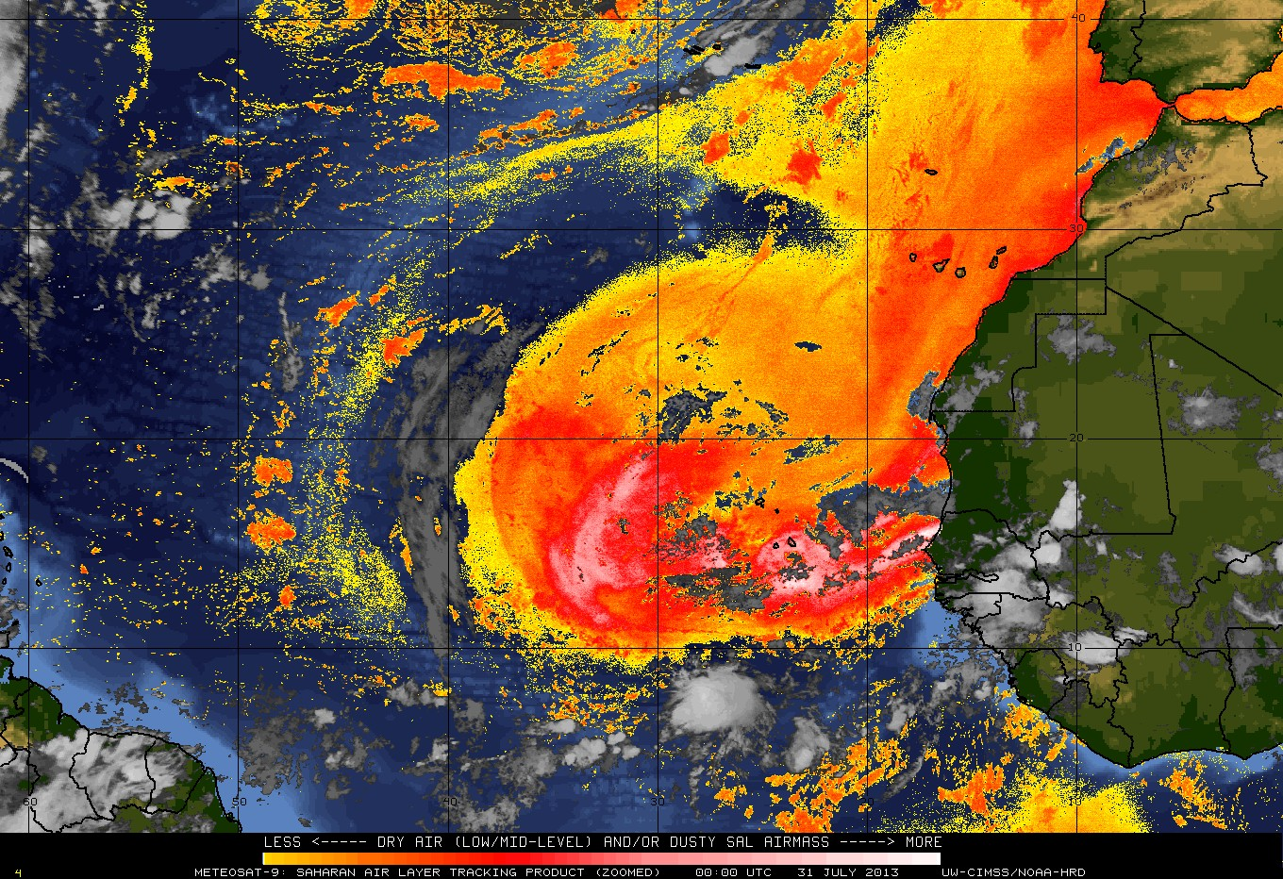
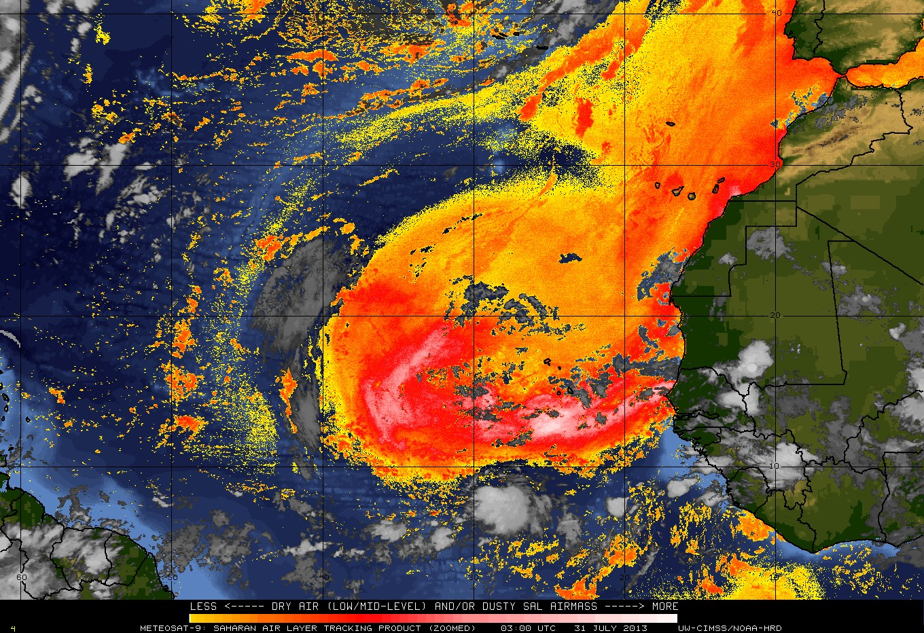
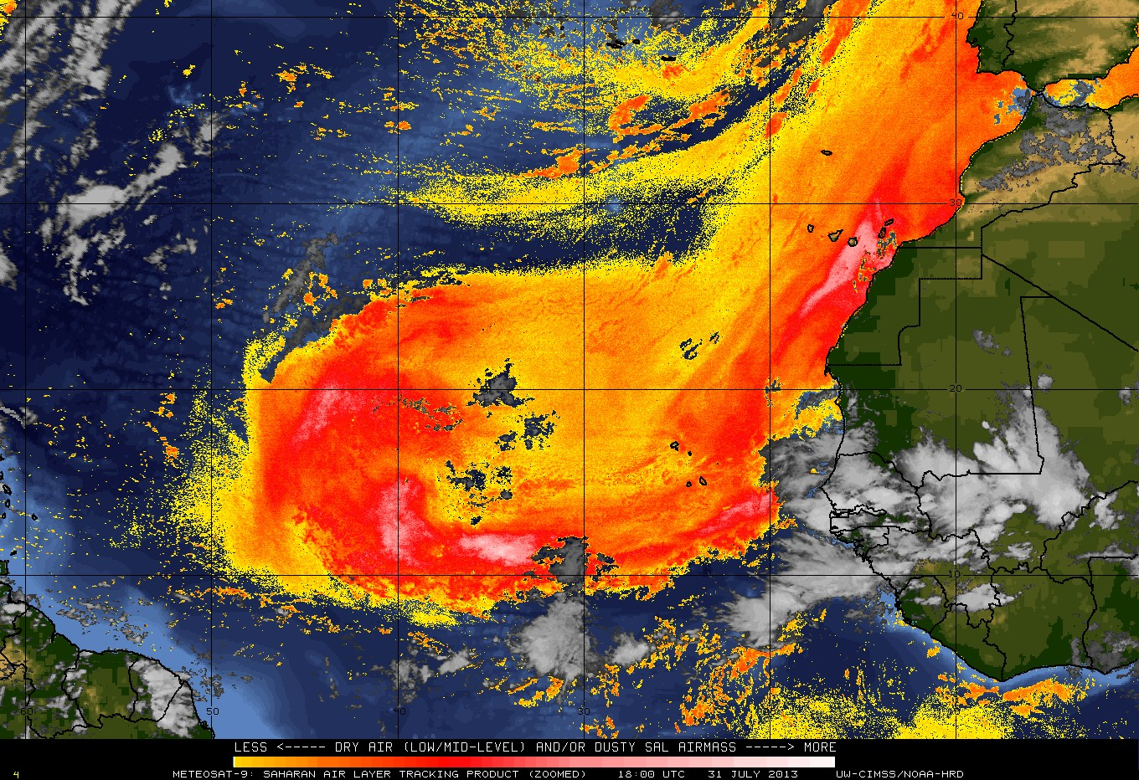
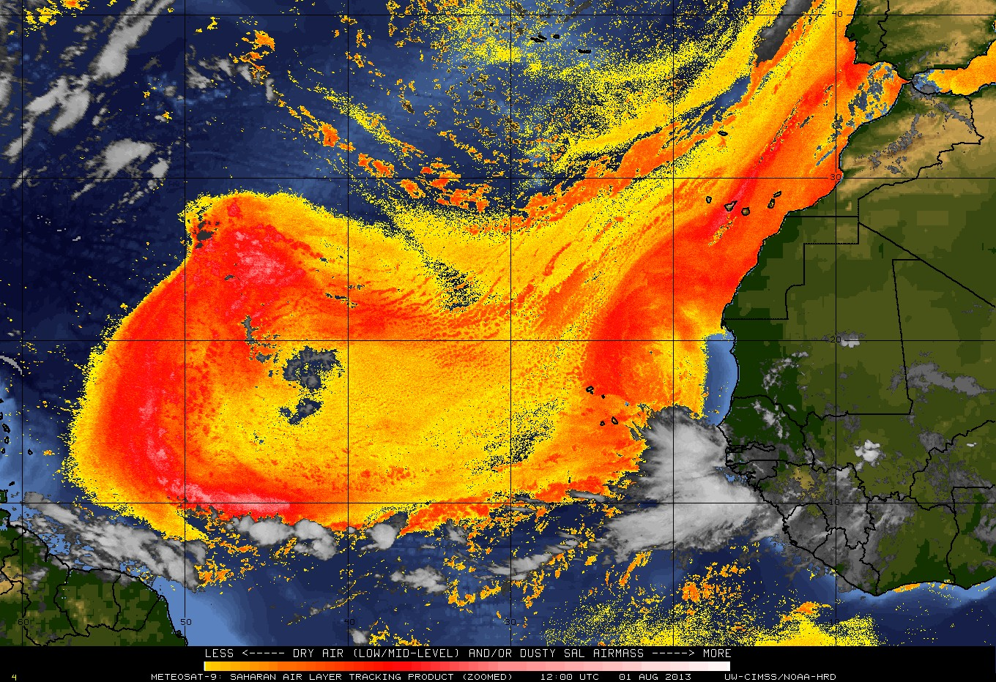
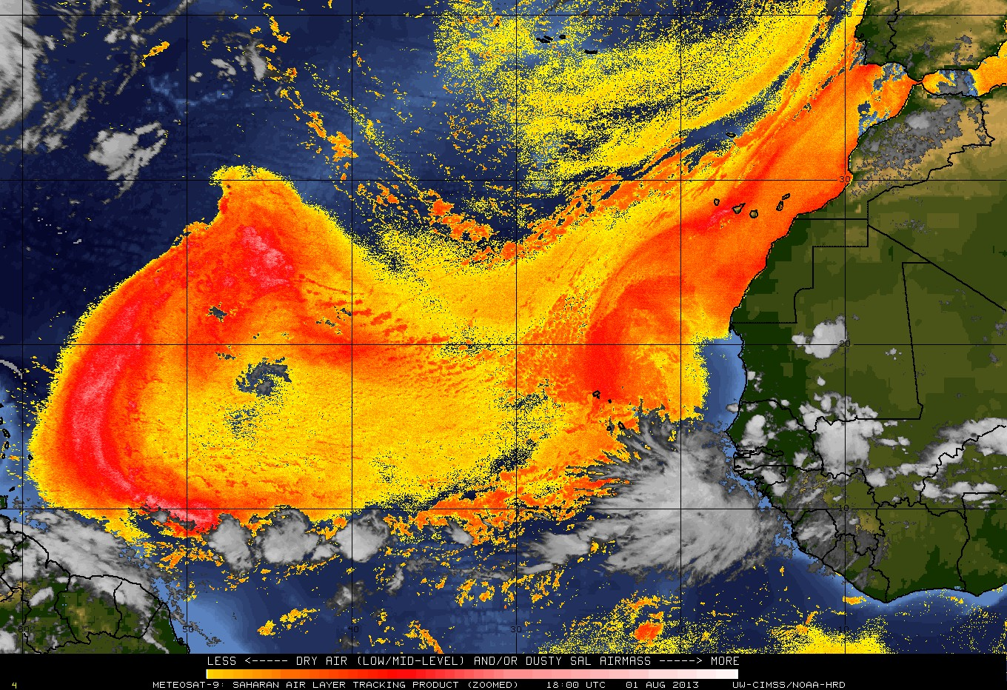
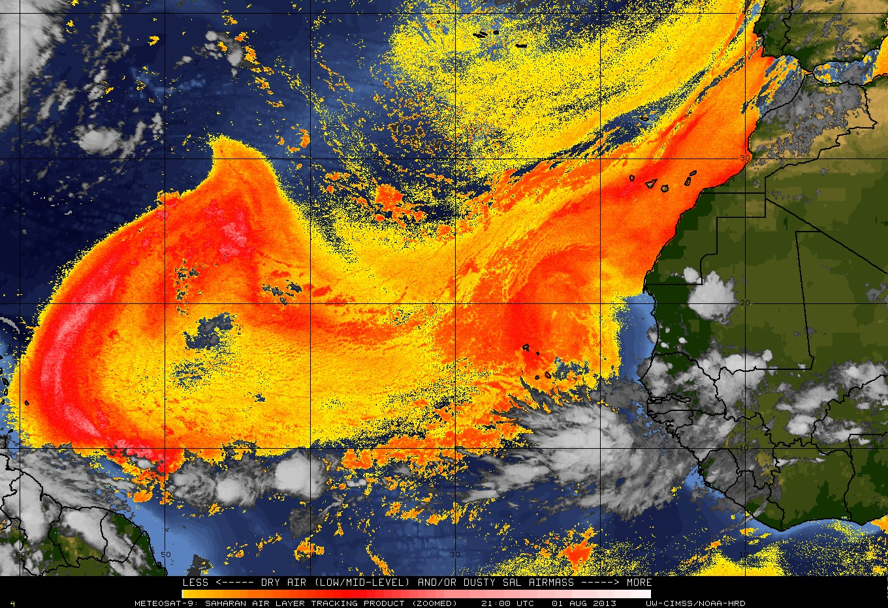
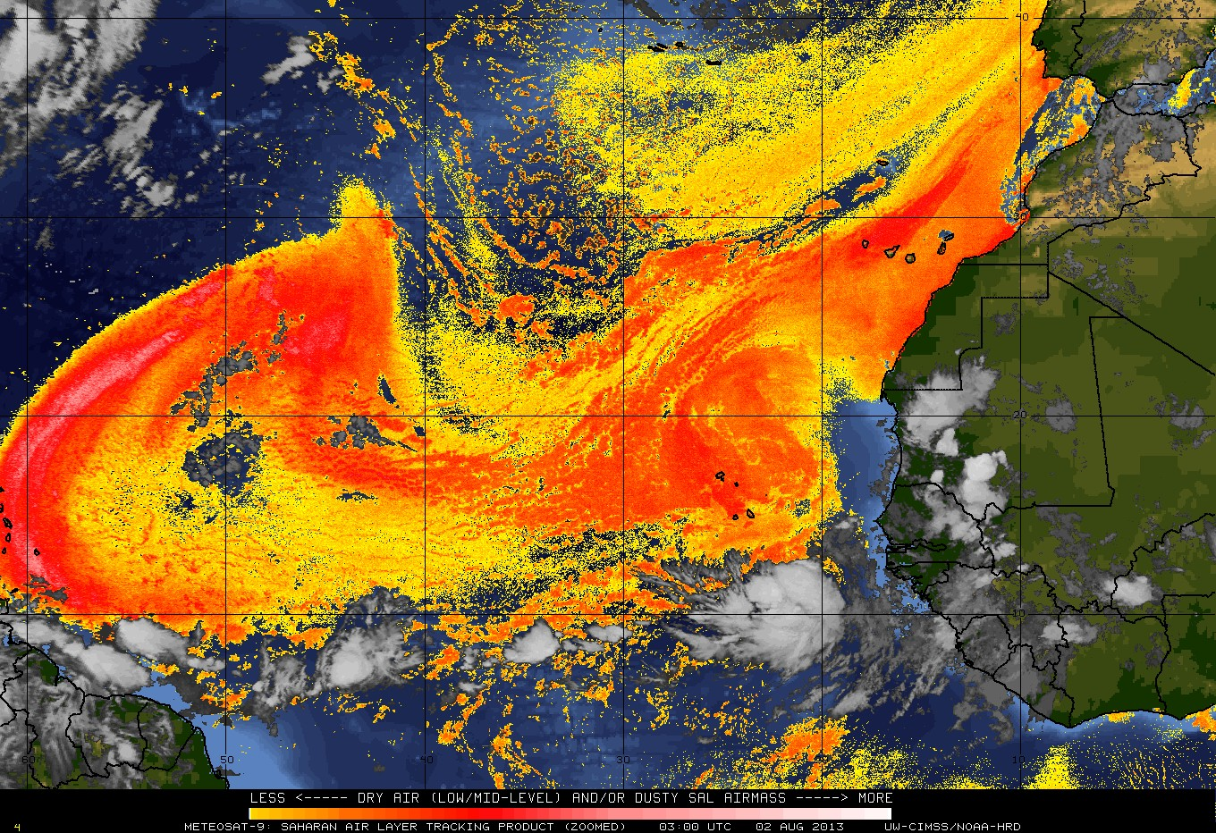
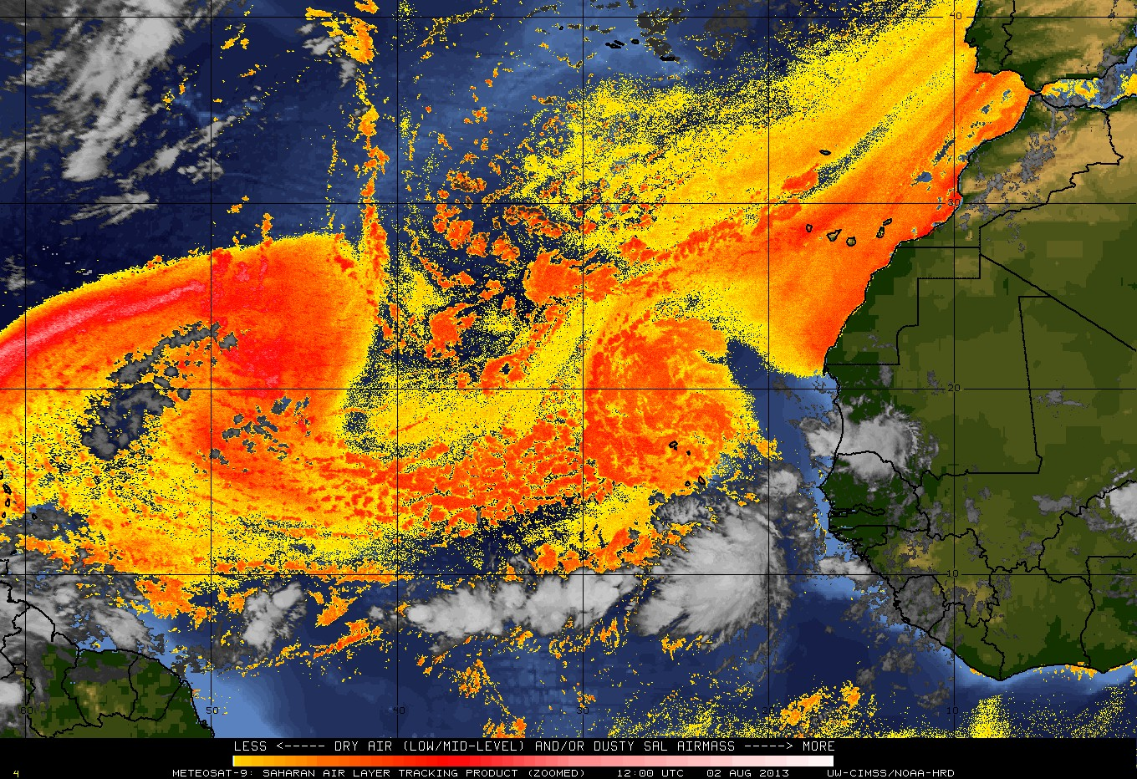

The Saharan Air Layer (SAL)
Understanding how Saharan dust storms can weaken tropical cyclones
National Educators’ Conference- July 9, 2019
Notes:
Rawinsondes: ~1,300 upper-air stations worldwide; NOAA US stations: 92

Slide 2
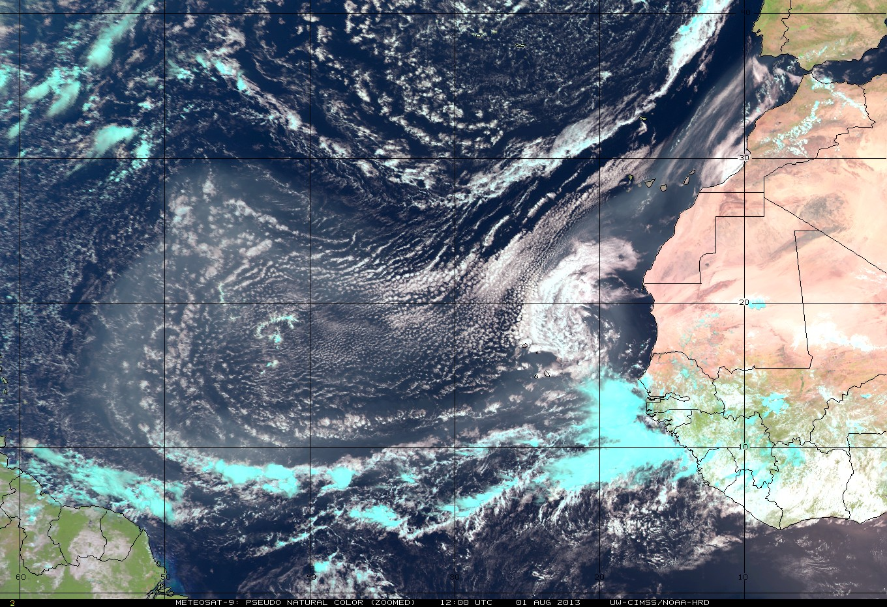
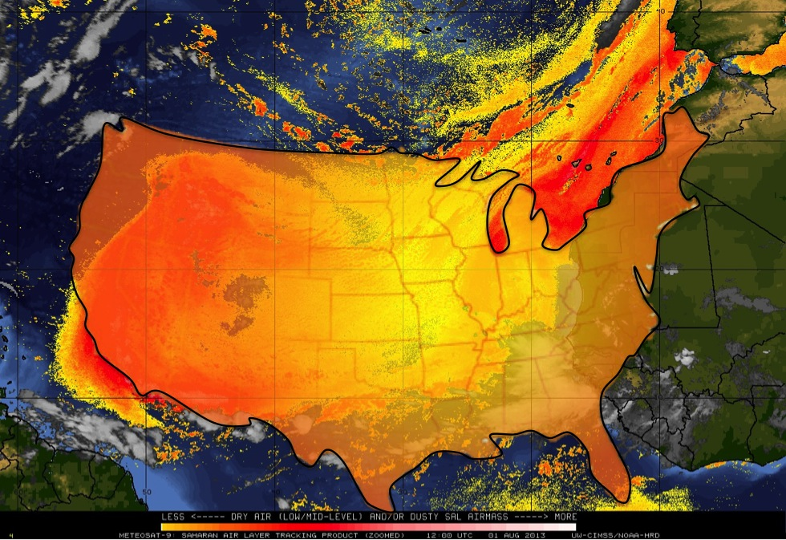
The Saharan Air Layer (SAL)
Understanding how Saharan dust storms can weaken tropical cyclones
Notes:
Rawinsondes: ~1,300 upper-air stations worldwide; NOAA US stations: 92

Slide 3
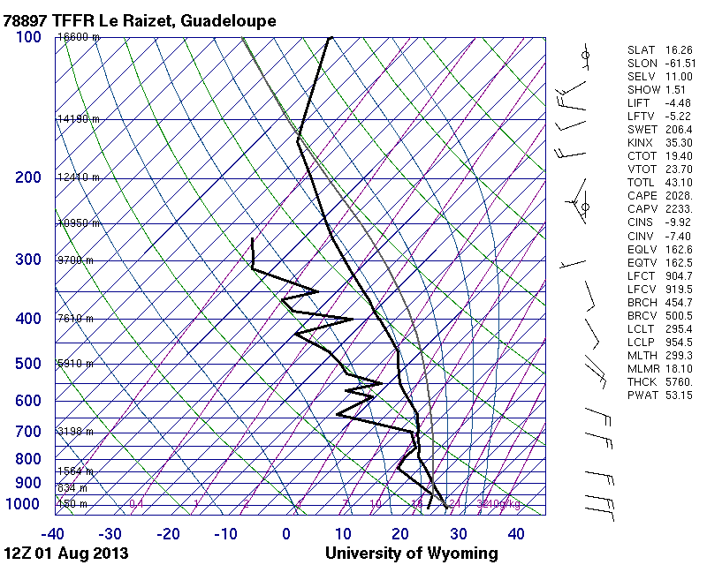
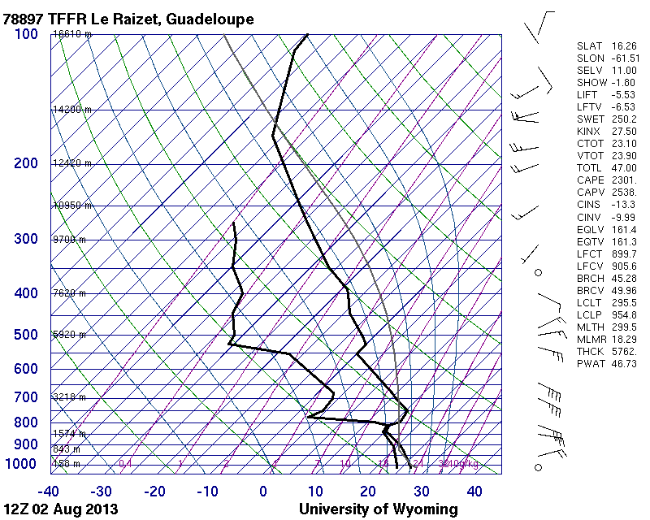
The Saharan Air Layer (SAL)
Understanding how Saharan dust storms can weaken tropical cyclones
Guadeloupe, WI
Temperature
Temperature
Temperature Inversion
(T increases with height)
Dewpoint
Dewpoint
Humidity: moisture from ~550-850 hPa (~5-12,000 ft): cut in ½ >> suppresses clouds
Temperature: 3-4ºC warmer from ~5-10,000 ft >> very stable (suppresses clouds)
look for a temperature inversion (T increases with height) >> SAL base and top
Wind: winds from ~5-12,000 ft: doubled (45 mph easterly jet) >> can rip storms apart
Notes:
Rawinsondes: ~1,300 upper-air stations worldwide; NOAA US stations: 92

Slide 4
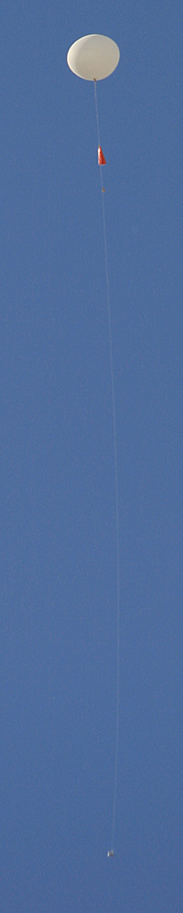
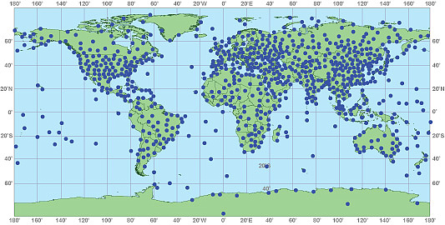
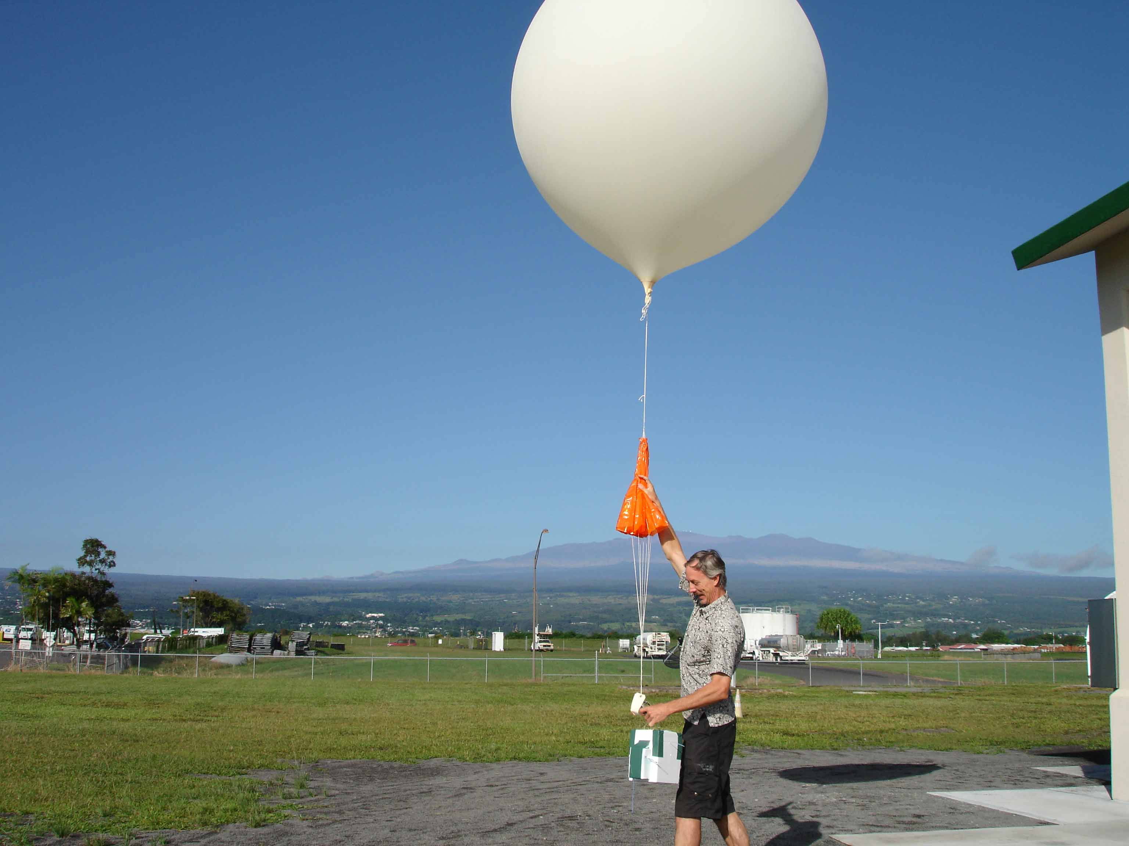
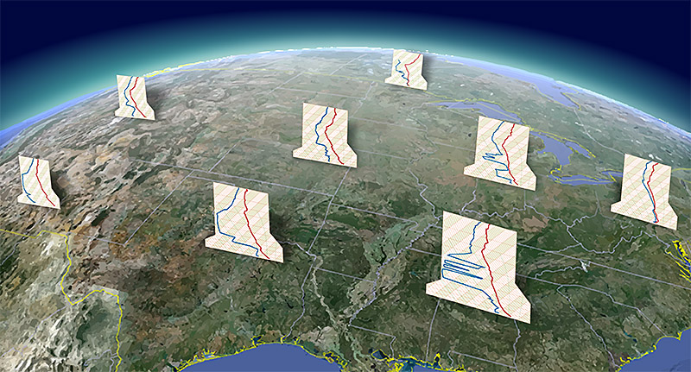
Hurricane Hunter Data Exercise
Weather Balloons (Rawinsondes)
5 ft (1.5 m)
Parachute
80-115 ft
(24-35 m)
Rawinsonde stations around the world (~1,300) and in the U.S. (~92)
Sensor
Rawinsonde launch: balloon reaches 100,000-115,000 ft (30,500-35,000 m) and expands to 25-35 ft (7.5-10.5 m) before popping.
Rawinsonde data plotted on Skew-T diagrams
Notes:
Rawinsondes: ~1,300 upper-air stations worldwide; NOAA US stations: 92

Slide 5
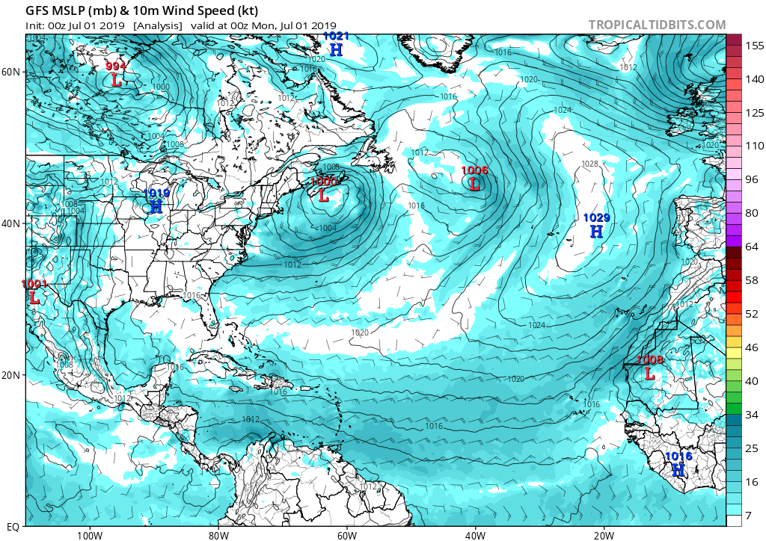
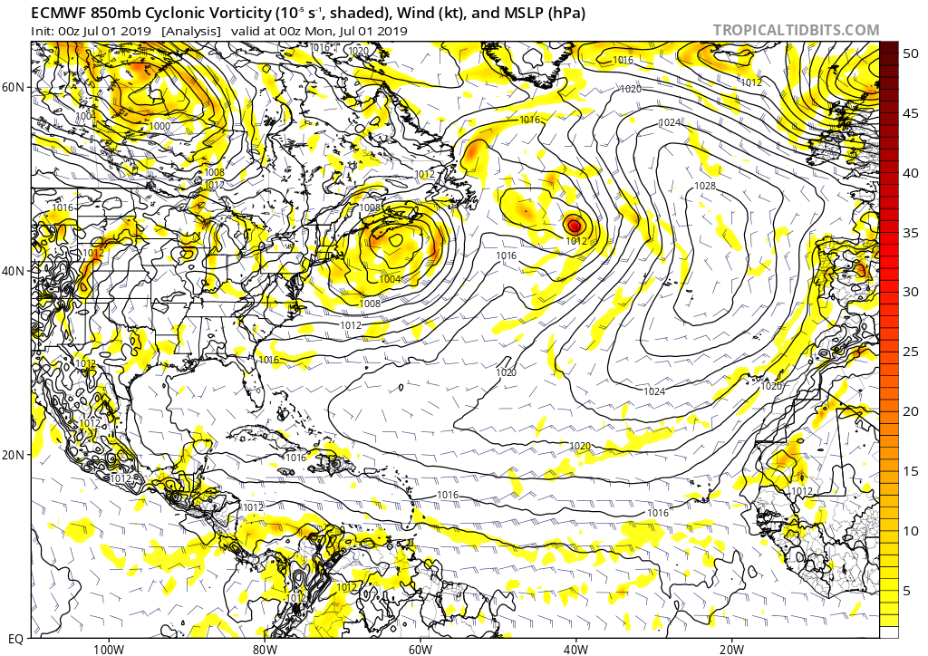
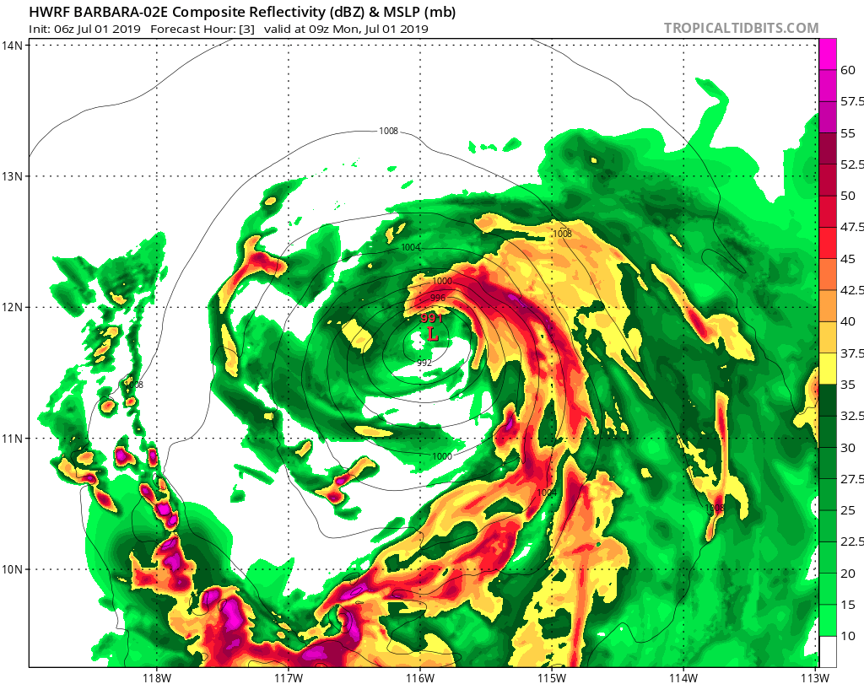
Hurricane Hunter Data Exercise
Rawinsonde data is assimilated into forecast models around the world
NOAA’s Global Forecast System (GFS) Model
Rawinsonde stations around the world (~1,300) and in the U.S. (~92)
European Centre for Medium-Range Weather Forecasts (ECMWF) Model
NOAA’s Hurricane Weather Research and Forecasting (HWRF) Model

Slide 6
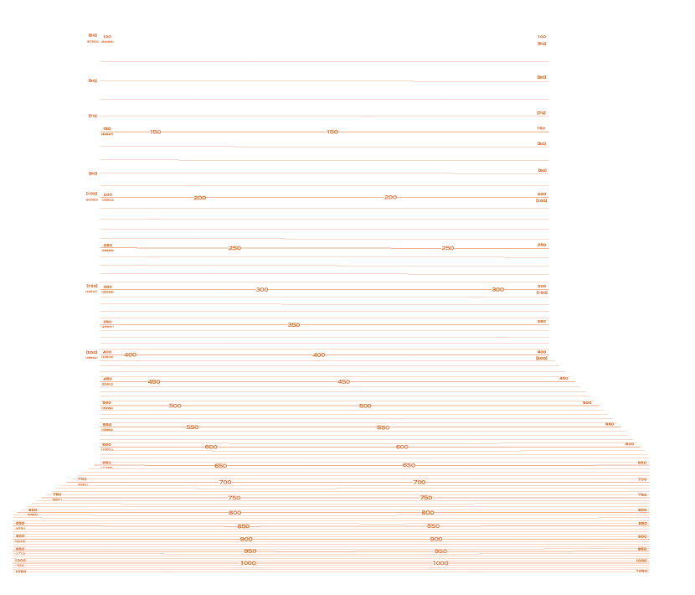
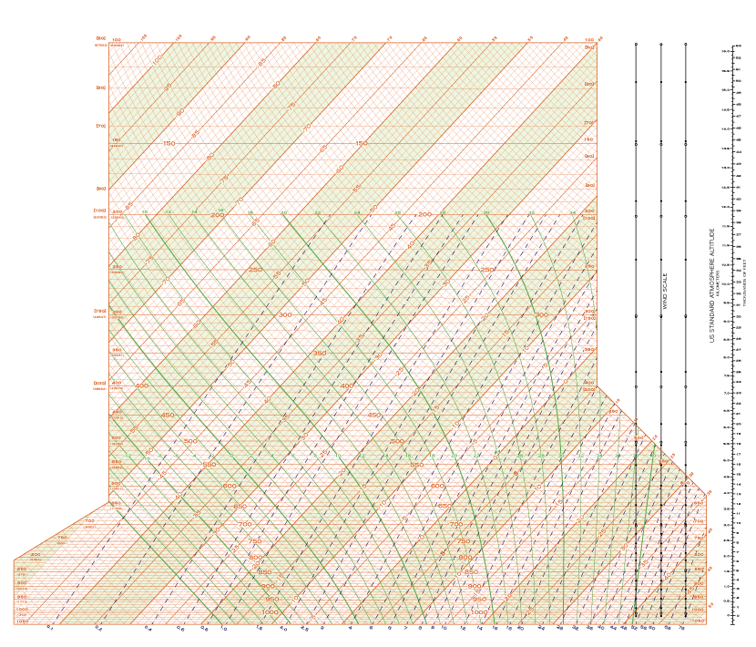

Hurricane Hunter Data Exercise
Skew-T Diagram: plotting Hurricane Hunter GPS dropsonde data
Pressure (hPa) & Height (ft)
200 hPa
38,662 ft)

Slide 7
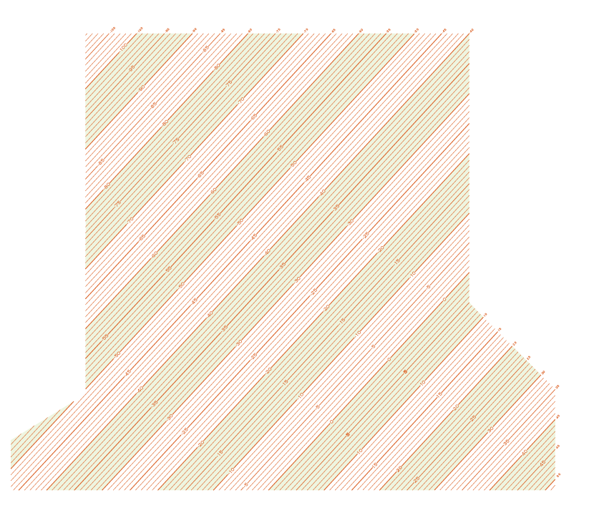

Hurricane Hunter Data Exercise
Skew-T Diagram: plotting Hurricane Hunter GPS dropsonde data
Temperature (C)
-30 to -20ºC

Slide 8
Hurricane Hunter Data Exercise
Skew-T Diagram: plotting Hurricane Hunter GPS dropsonde data
Moist Tropical Sounding: Climatology of the Tropical Atmosphere

Slide 9
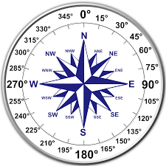
Hurricane Hunter Data Exercise
Skew-T Diagram: plotting Hurricane Hunter GPS dropsonde data
8 kt from 67 deg (NE)
100 hPa
-81.3 C
-74.5 C
Skew-T Exercise
1) Moist tropical sounding (climatology) < plot on both skew-Ts >
2) G-IV Saharan Air Layer Sounding (2015 Tropical Storm Erika)
3) Global Hawk Saharan Air Layer Sounding (August 2013)
Dewpoint
Temperature
Wind Barbs (knots)
150 hPa
-74.7 C
-67.2 C
7 kt from 330 deg (NW)
5 kt from the W
10 kt from the SW
50 kt from the S
65 kt from the SE

Slide 10
Hurricane Hunter Data Exercise
Skew-T Diagram: plotting Hurricane Hunter GPS dropsonde data
Moist Tropical Sounding: Climatology of the Tropical Atmosphere

Slide 11
Hurricane Hunter Data Exercise
Skew-T Diagram: plotting Hurricane Hunter GPS dropsonde data
20150825N 160232 UTC

Slide 12

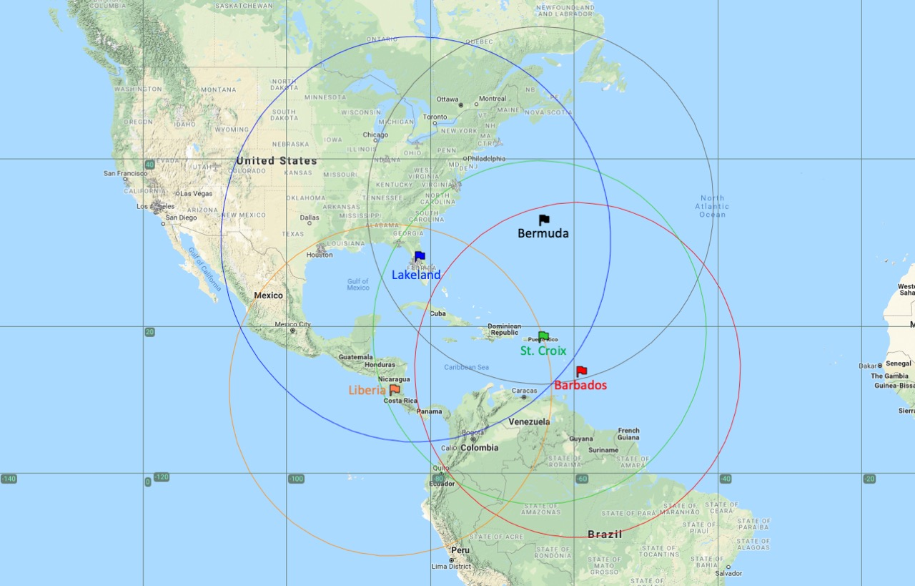

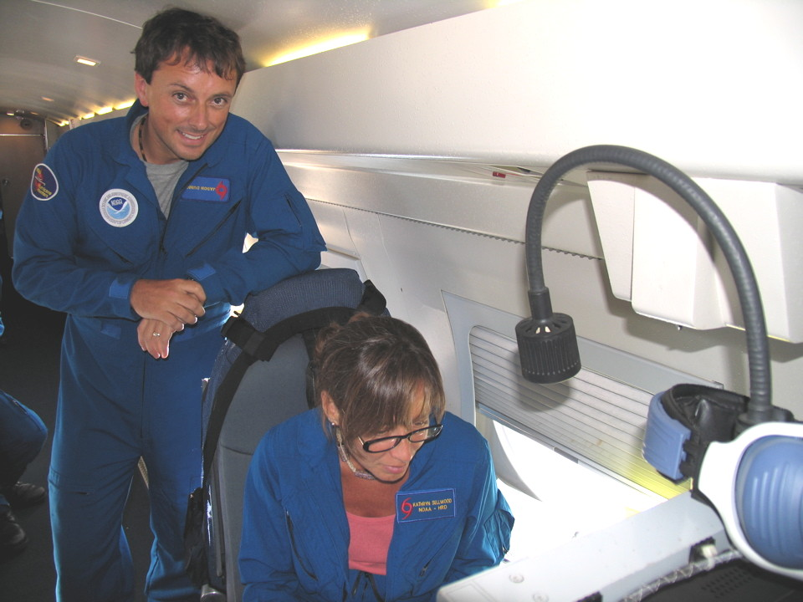
Hurricane Hunter Data Exercise
NOAA G-IV Hurricane Hunter
Flight Level: ~41-45,000 ft (12,500-13,500 m)
Duration: ~8-8.5 hr
Range: 3,800 nm (7,000 km)
    New York to Rome Italy
Flight Frequency
2 missions per day
GPS Dropsondes: RD94 dropsonde
G-IV ranges from some of NOAA’s deployment sites
G-IV Interior

Slide 13


Hurricane Hunter Data Exercise
NOAA G-IV Mission: Tropical Storm Erika (Aug 25, 2015)
Saharan Air Layer
Erika
Saharan Air Layer (SAL) infrared satellite imagery on Aug 25, 2015 1800 UTC. Yellow to red shading indicates dry and/or dusty air.
GOES East visible satellite image of Tropical Storm Erika on Aug 25, 2015 1745 UTC.

Slide 14

Hurricane Hunter Data Exercise
NOAA G-IV Mission: Tropical Storm Erika (Aug 25, 2015)
GPS Dropsonde #10 (1602 UTC)
10
G-IV mission 20150825N
Flight Track
10
G-IV Flight Track

Slide 15

Hurricane Hunter Data Exercise
NOAA G-IV Mission: Tropical Storm Erika (Aug 25, 2015)
GPS Dropsonde #10 (1602 UTC)
10
10

Slide 16
Hurricane Hunter Data Exercise
Skew-T Diagram: plotting Hurricane Hunter GPS dropsonde data
NOAA G-IV: Sampling Hurricane Erika and the Saharan Air Layer: August 25, 2015 (GPS Dropsonde #10)

Slide 17
Hurricane Hunter Data Exercise
NOAA G-IV: Sampling Hurricane Erika & the Saharan Air Layer: August 25, 2015
At about what pressure level and height (ft) is the base and top of the SAL?
  SAL Base: ~900 hPa (3243 ft)
  SAL Top: ~600 hPa (13,801 ft)
At about what pressure level and height (ft) is the base and top of the SAL?
SAL
G-IV Dropsonde
Climatology

Slide 18
Hurricane Hunter Data Exercise
NOAA G-IV: Sampling Hurricane Erika & the Saharan Air Layer: August 25, 2015
2. How strong is the temperature inversion (TINV) at the base of the SAL (where temperature increases with height)?
2. How strong is the temperature inversion (TINV) at the base of the SAL (where temperature increases with height)?
  TINV= 1.3ºC
  TINV depth: 890 hPa (19.9ºC) – 850 hPa (21.2ºC)
SAL
TINV
G-IV Dropsonde
Climatology

Slide 19
Hurricane Hunter Data Exercise
NOAA G-IV: Sampling Hurricane Erika & the Saharan Air Layer: August 25, 2015
3. Is this a stable or unstable temperature profile near the base of the SAL? (hint: think density)
3. Is this a stable or unstable temperature profile near the base of the SAL? (hint: think density)
  This profile is warm above cool, so it is stable
  T usually decreases with height (cool above warm = unstable)
SAL
TINV
G-IV Dropsonde
Climatology

Slide 20
Hurricane Hunter Data Exercise
NOAA G-IV: Sampling Hurricane Erika & the Saharan Air Layer: August 25, 2015
4. What might happen to rising air from below the SAL once it reaches the TINV at the SAL’s base? (Hint: rising air leads to the formation of clouds.
4. What might happen to rising air from below the SAL once it reaches the TINV at the SAL’s base? (Hint: rising air leads to the formation of clouds.
  Rising air will meet resistance once it reaches the TINV
  Cloud formation will be suppressed
SAL
TINV
G-IV Dropsonde
Climatology

Slide 21
Hurricane Hunter Data Exercise
NOAA G-IV: Sampling Hurricane Erika & the Saharan Air Layer: August 25, 2015
5. How much dryer is the SAL than the moist tropical (MT) sounding at 850 hPa/4781 ft? (give your answer in % relative humidity)
5. How much dryer is the SAL than the moist tropical (MT) sounding at 850 hPa/4781 ft? (give your answer in % relative humidity)
  The SAL is about ½ as moist as the MT sounding (41% lower RH)
  SAL (850 hPa) = 39% RH; moist tropical (850 hPa) = 80%
SAL
G-IV Dropsonde
Climatology

Slide 22
Hurricane Hunter Data Exercise
NOAA G-IV: Sampling Hurricane Erika & the Saharan Air Layer: August 25, 2015
6. What is the strongest wind in this SAL layer and at what pressure level is it? How much stronger was this wind than the typical wind at the nearest level in the moist tropical (MT) sounding?
6. What is the strongest wind in this SAL layer and at what pressure level and height is it? At 850 hPa (4,781 ft), how much stronger was the wind in the SAL compared to the moist tropical (MT) sounding?
  36 kt from the east-northeast (74 degrees) at 750 hPa/8,091 ft
  At 850hPa, the SAL wind was 26 kt stronger (almost 4x faster) than the MT wind (SAL= 35 kt, MT= 9 kt)
SAL
G-IV Dropsonde
Climatology

Slide 23
Hurricane Hunter Data Exercise
NOAA G-IV: Sampling Hurricane Erika & the Saharan Air Layer: August 25, 2015
7. How do you think the temperature, humidity, and winds in this SAL profile might affect cloud formation and even hurricanes?
7. How do you think the temperature, humidity, and winds in this SAL profile might affect cloud formation and even hurricanes?
  Temperature: the SAL’s warmth and temperature inversion at its base make the air more stable (suppresses clouds)
  Humidity: the SAL’s dry air starves clouds and storms of moisture
  Winds: the SAL’s strong easterly jet can rip clouds apart
SAL
G-IV Dropsonde
Climatology

Slide 24



Hurricane Hunter Data Exercise
NASA Global Hawk
Flight Level: ~55-65,000 ft (16,500-20,000 m)
Duration: ~24 hr
Range: 8-10,000 nm (15-18,000 km)
    New York to Sydney Australia
Flight Frequency
1 mission every other day
GPS Dropsondes: NRD94 Mini Dropsonde
Global Hawk ranges from NASA Wallops in VA
Global Hawk Operations Center (GHOC)

Slide 25


Hurricane Hunter Data Exercise
NASA Global Hawk Mission: Saharan Air Layer (Aug 24, 2013)
GPS Dropsonde #24 (2212 UTC)
Global Hawk Flight Track
GPS Dropsonde #24

Slide 26
Hurricane Hunter Data Exercise
Skew-T Diagram: plotting Hurricane Hunter GPS dropsonde data
NASA Global Hawk: Sampling the Saharan Air Layer: August 24, 2013 (GPS Dropsonde #24)

Slide 27
Hurricane Hunter Data Exercise
NASA Global Hawk: Sampling the Saharan Air Layer: August 24, 2013
At about what pressure level and height (ft) is the base and top of the SAL?
  SAL Base: ~850 hPa (4781 ft)
  SAL Top: ~500 hPa (18,289 ft)
At about what pressure level and height (ft) is the base and top of the SAL?
SAL
GH Dropsonde
Climatology

Slide 28
Hurricane Hunter Data Exercise
NASA Global Hawk: Sampling the Saharan Air Layer: August 24, 2013
2. How strong is the temperature inversion (TINV) at the base of the SAL (where temperature increases with height)? Why might this TINV be so much stronger than the SAL TINV measured by the NOAA G-IV?
2. How strong is the temperature inversion (TINV) at the base of the SAL (where temperature increases with height)? Why might this TINV be so much stronger than the SAL TINV measured by the NOAA G-IV?
  TINV= 6.4ºC (850 hPa = 16.1ºC minus 830 hPa=22.5ºC)
  This SAL is much closer to its source over the hot Sahara, so it hasn’t had as much time to cool.
  Large dust particles in this SAL outbreak also haven’t had as much time to settle out of the SAL, so there are more large dust particles to absorb the sun and warm the layer.
SAL
TINV
GH Dropsonde
Climatology

Slide 29
Hurricane Hunter Data Exercise
NASA Global Hawk: Sampling the Saharan Air Layer: August 24, 2013
3. How much dryer is the SAL than the moist tropical (MT) sounding at 700 hPa/9,882 ft? (give your answer in % relative humidity)
3. How much dryer is the SAL than the moist tropical (MT) sounding at 700 hPa/9,882 ft? (give your answer in % relative humidity)
  The RH in this SAL is 33% dryer than the MT sounding
  SAL=33% RH; MT=66% RH
SAL
GH Dropsonde
Climatology

Slide 30
Hurricane Hunter Data Exercise
NASA Global Hawk: Sampling the Saharan Air Layer: August 24, 2013
4. What is the strongest wind in this SAL layer and at what pressure level(s) and height(s) is it?
4. What is the strongest wind in this SAL layer and at what pressure level(s) and height(s) is it?
  35 kt from the east-northeast (83-87 degrees) at both 650 hPa (11,780 ft) and 700 hPa (9,882 ft)
SAL
GH Dropsonde
Climatology

Slide 31
Hurricane Hunter Data Exercise
NASA Global Hawk: Sampling the Saharan Air Layer: August 24, 2013
5. What component of this SAL profile (temperature, humidity, or winds) do you think differs the most from the G-IV profile? Do you think this difference would be better or worse for cloud and storm formation?
  The temperature in this SAL profile is significantly warmer and has a much stronger temperature inversion (5.1ºC stronger) than the NOAA G-IV SAL profile.
  This SAL temperature in this Global Hawk profile would probably be worse for (suppress) cloud and storm formation (compared to the NOAA G-IV SAL temperature profile).
5. What component of this SAL profile (temperature, humidity, or winds) do you think differs the most from the previous G-IV profile? Do you think this difference would help or hurt cloud and storm formation?
SAL
GH Dropsonde
Climatology

Slide 32

Great Work!!

