Slide 1
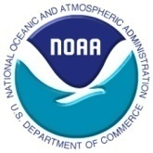

2011 NHC Proving Ground Products
Saharan Air Layer (SAL) Product and
Pseudo Natural Color Imagery
Jason Dunion
University of Miami/CIMAS - NOAA/HRD

Slide 2
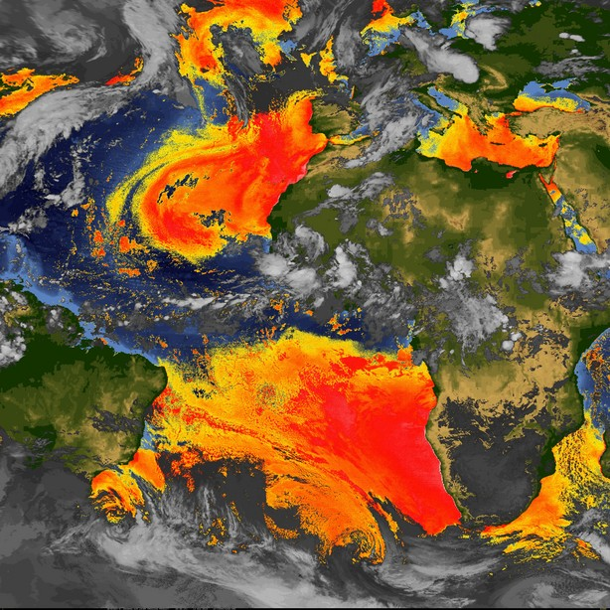
Split Window SAL Tracking
Satellite Imagery
Algorithm
-Split window (12-11 um) imagery used for detecting dry and/or dusty air in the lower to middle levels (~600-850 hPa/4,000-1500 m) of the atmosphere;
Product Utility
-Monitoring synoptic scale interactions between dry layers (e.g. the Saharan Air Layer) and tropical cyclones;
-Monitoring large scale movements of mid-latitude dry air intrusions and Saharan Air Layer outbreaks that routinely impact local weather in the tropical North Atlantic;
Availability
-UW/CIMSS webserver & NHC NAWIPS (15-min; July 2012);

Slide 3
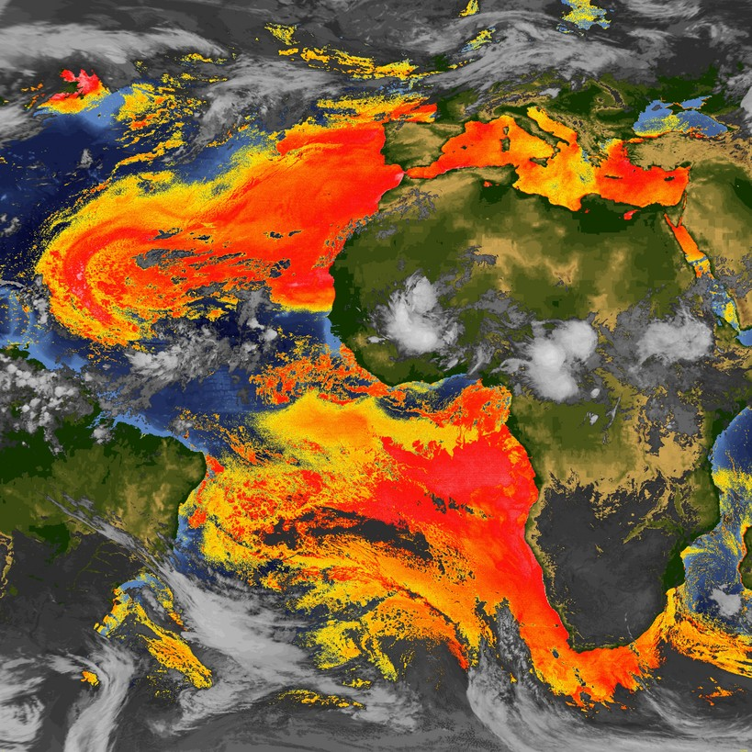
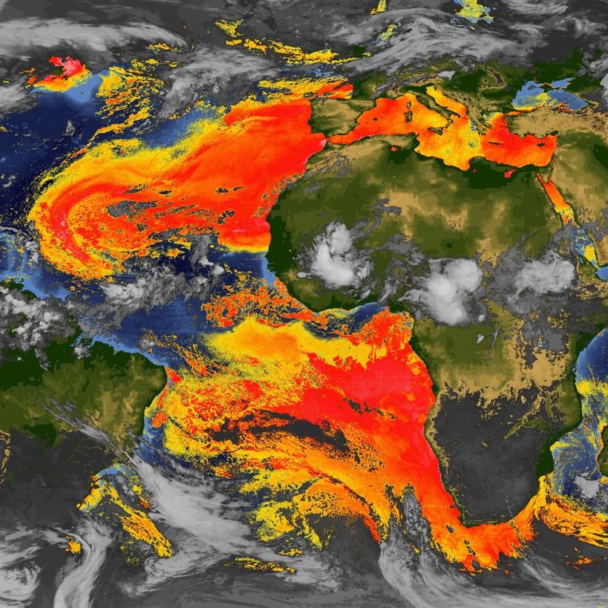

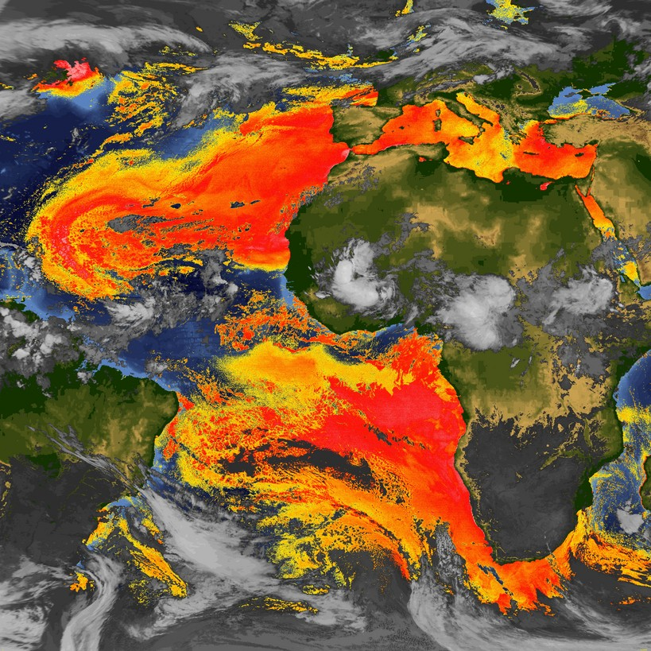
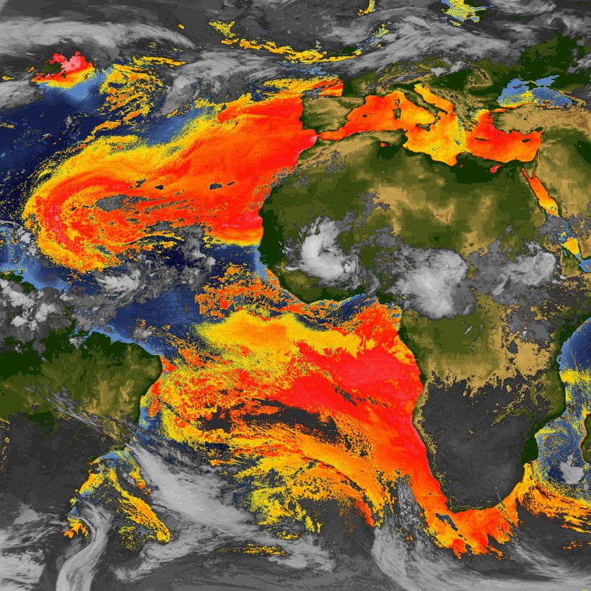
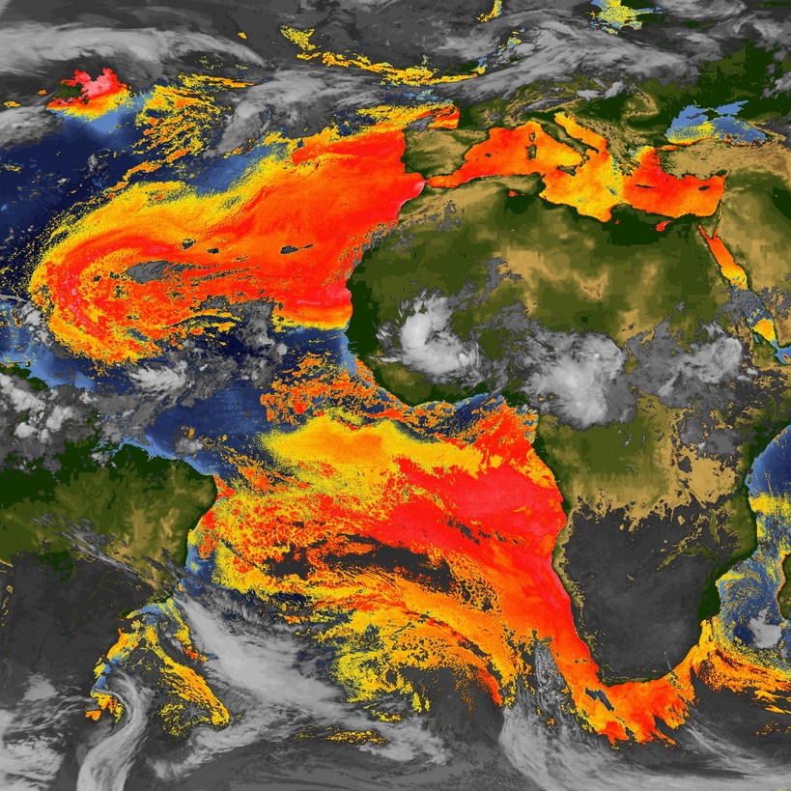

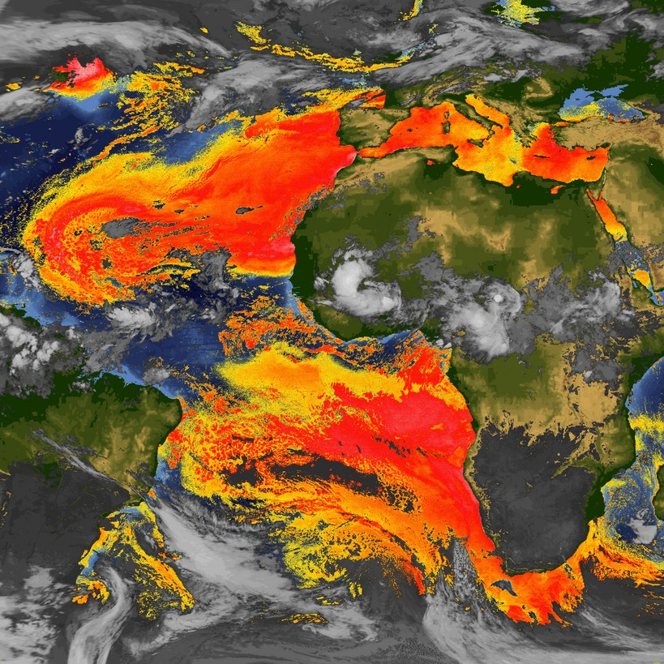
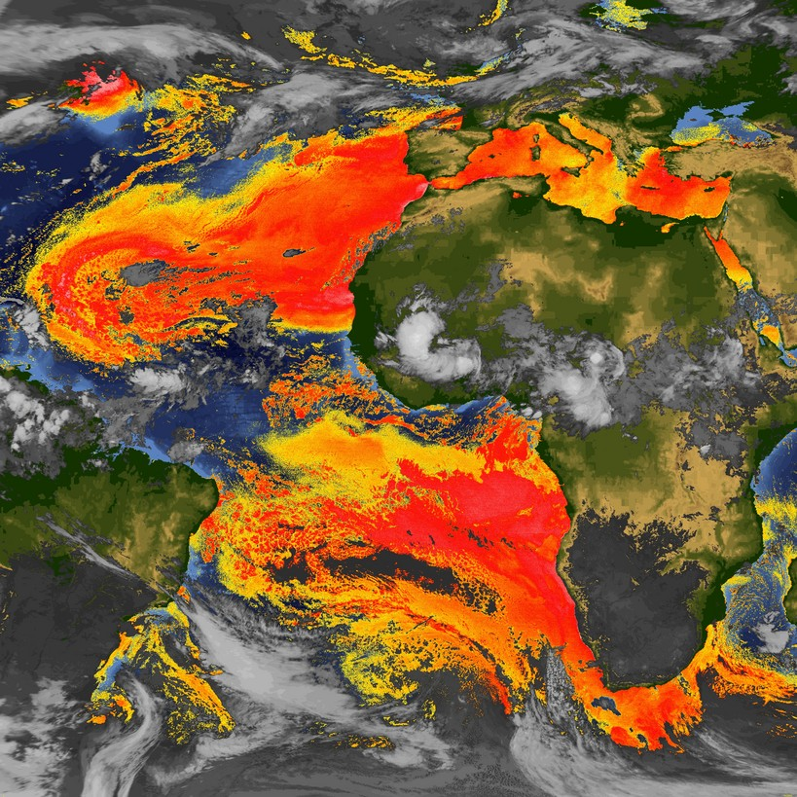
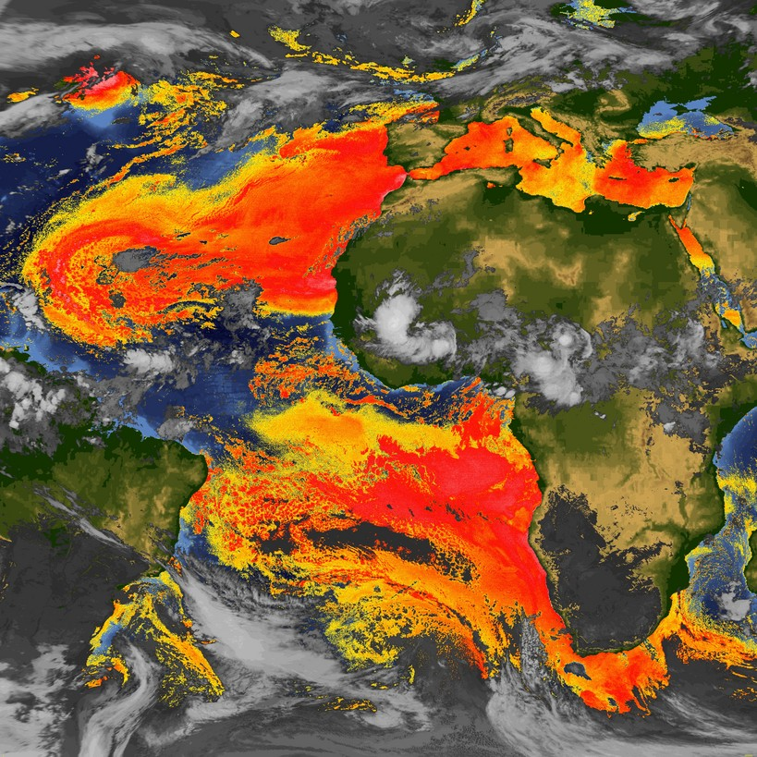
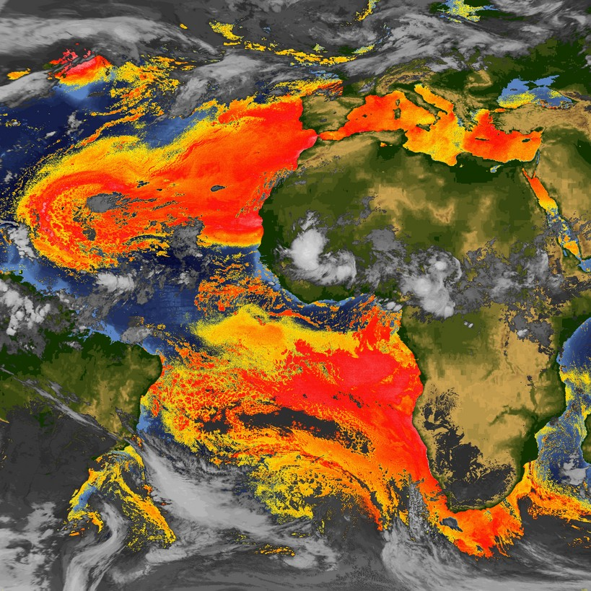
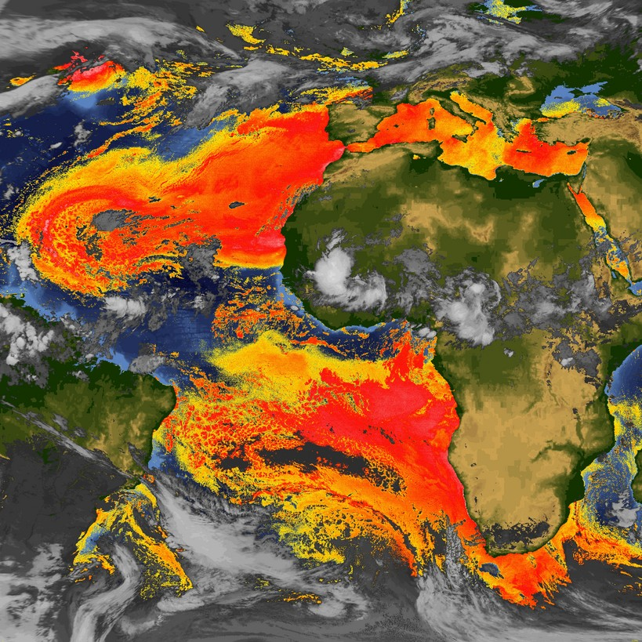
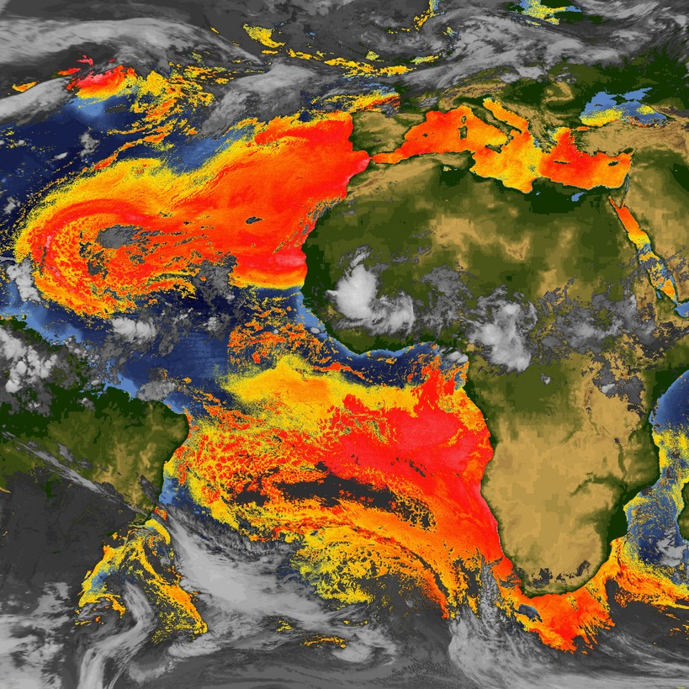
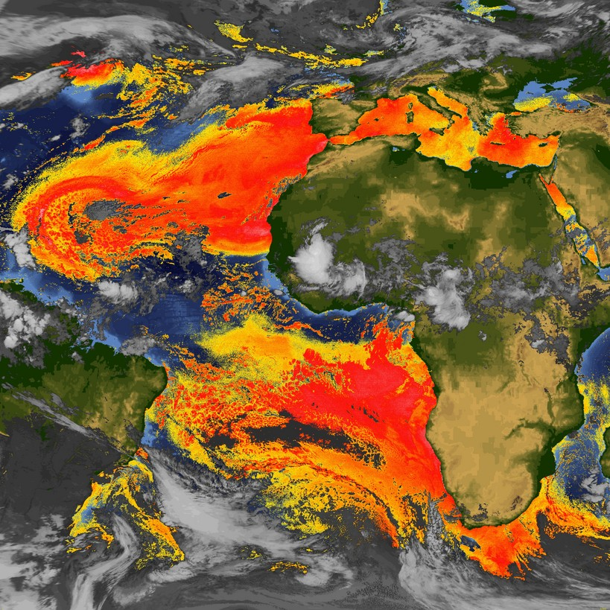

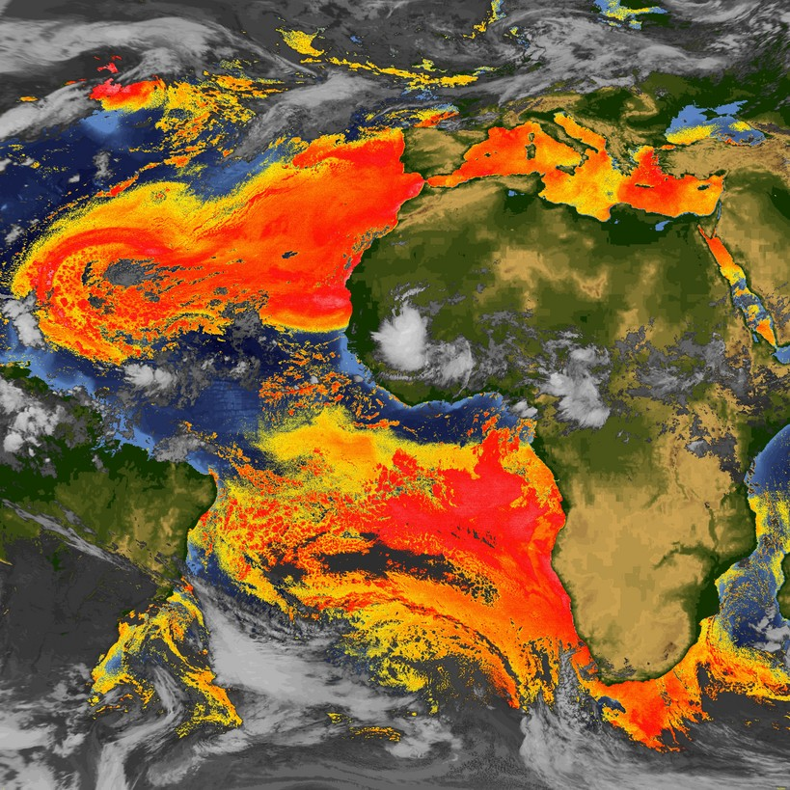
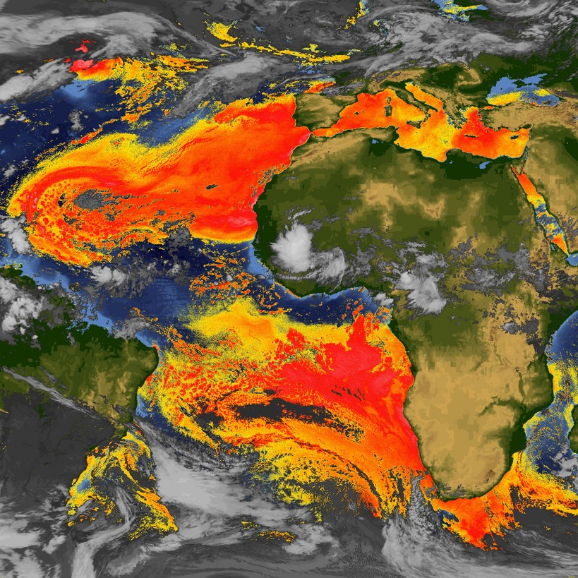

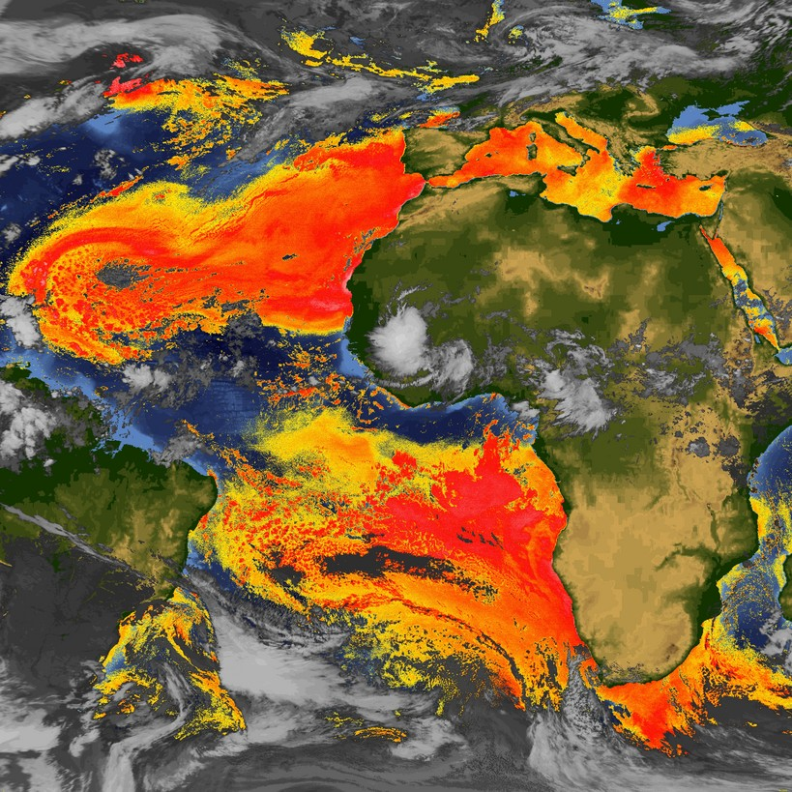
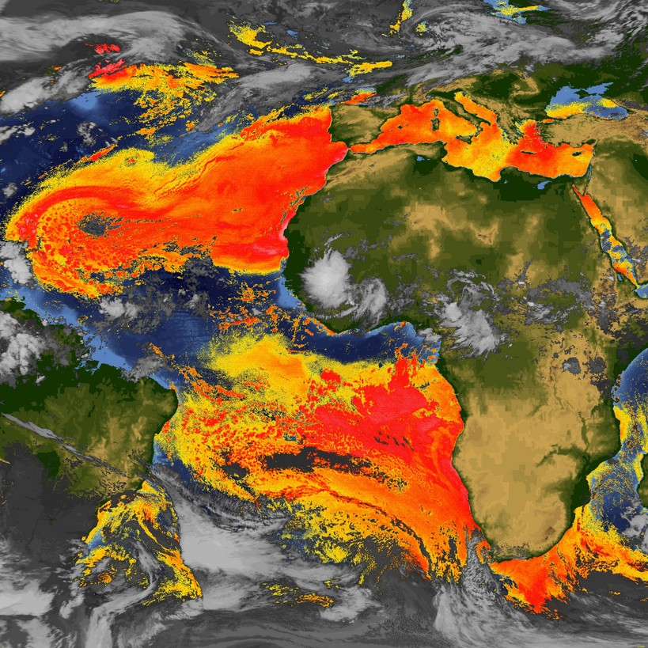

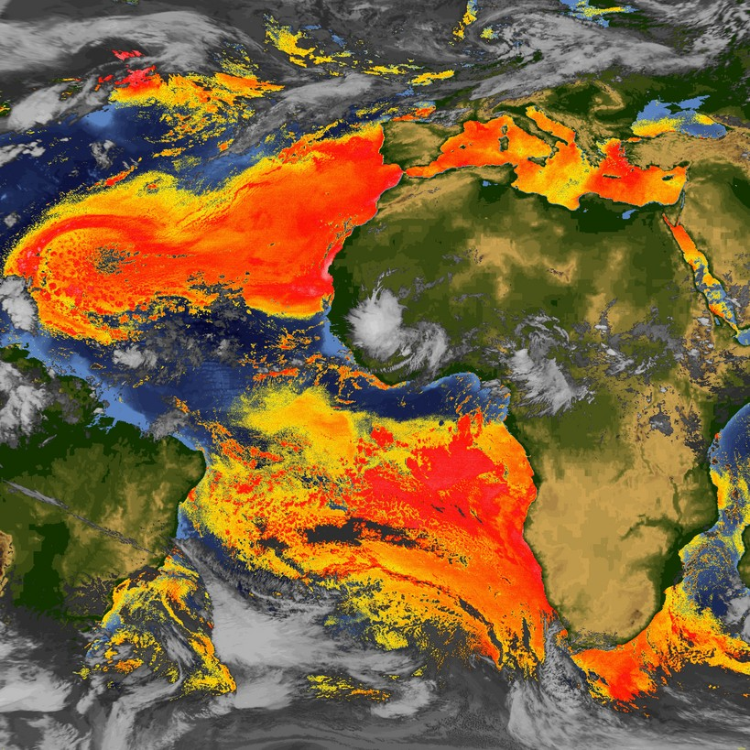

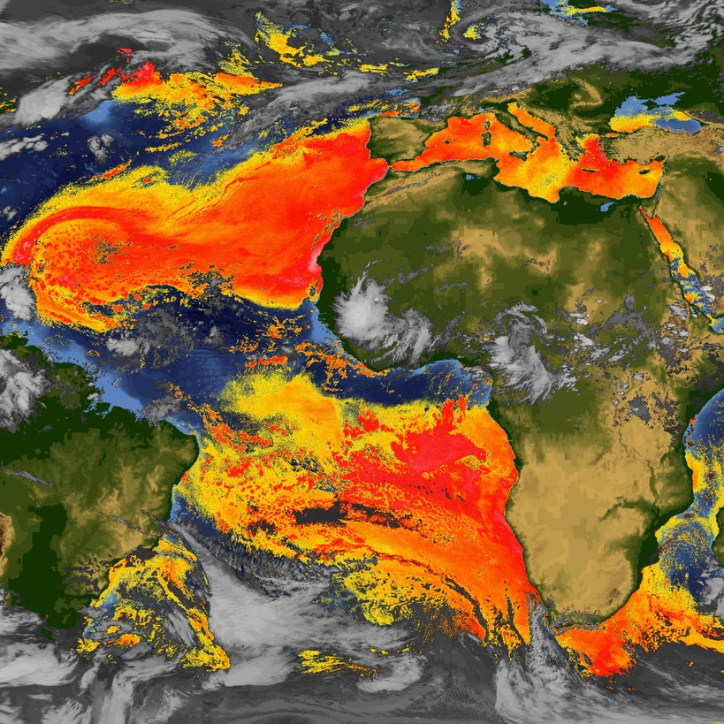


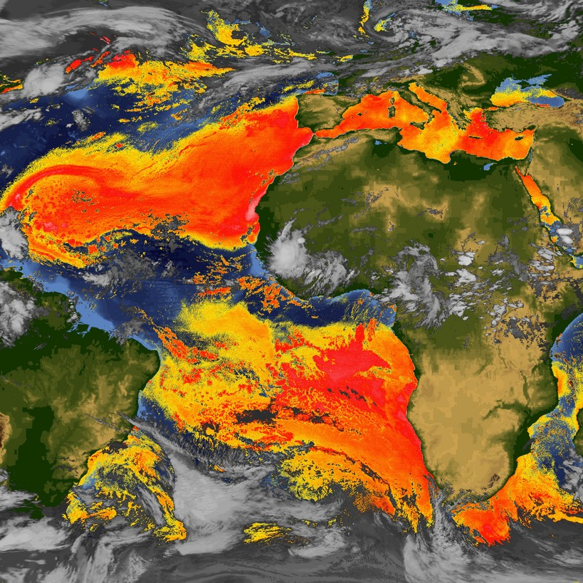


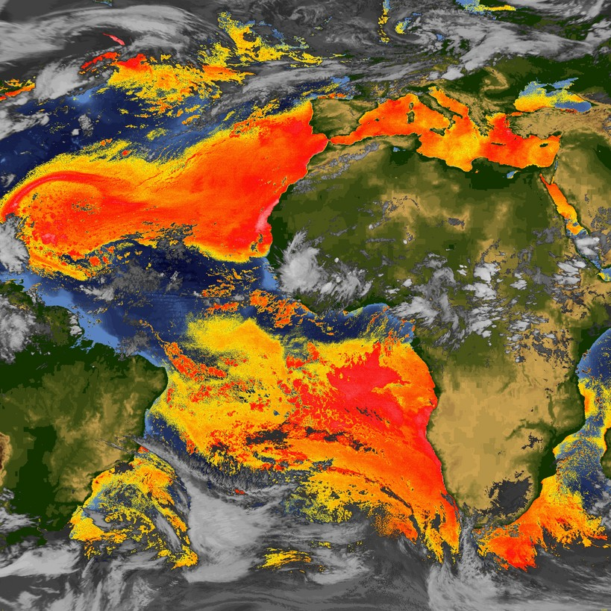
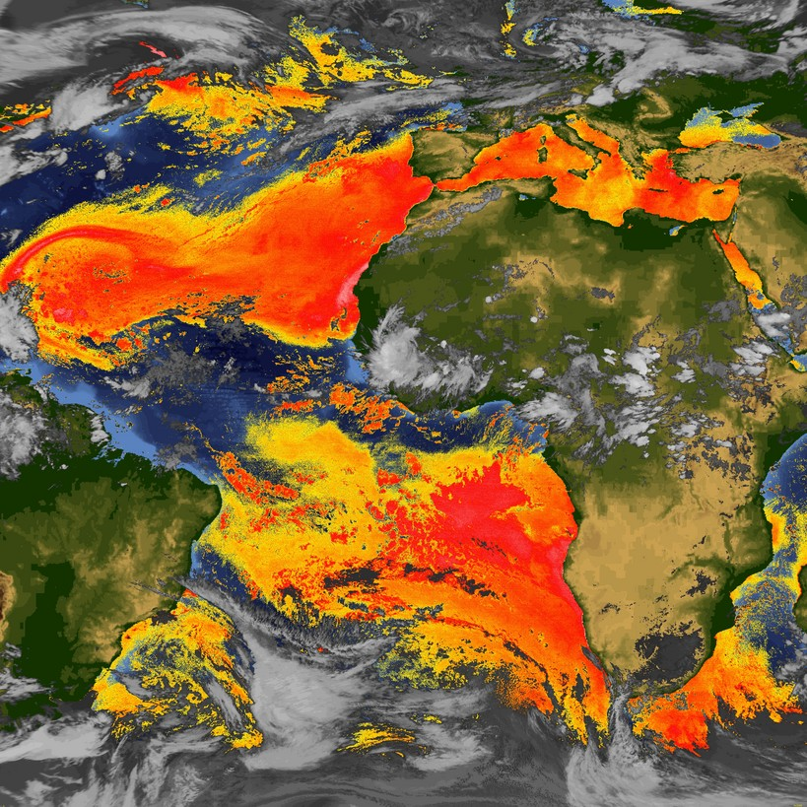
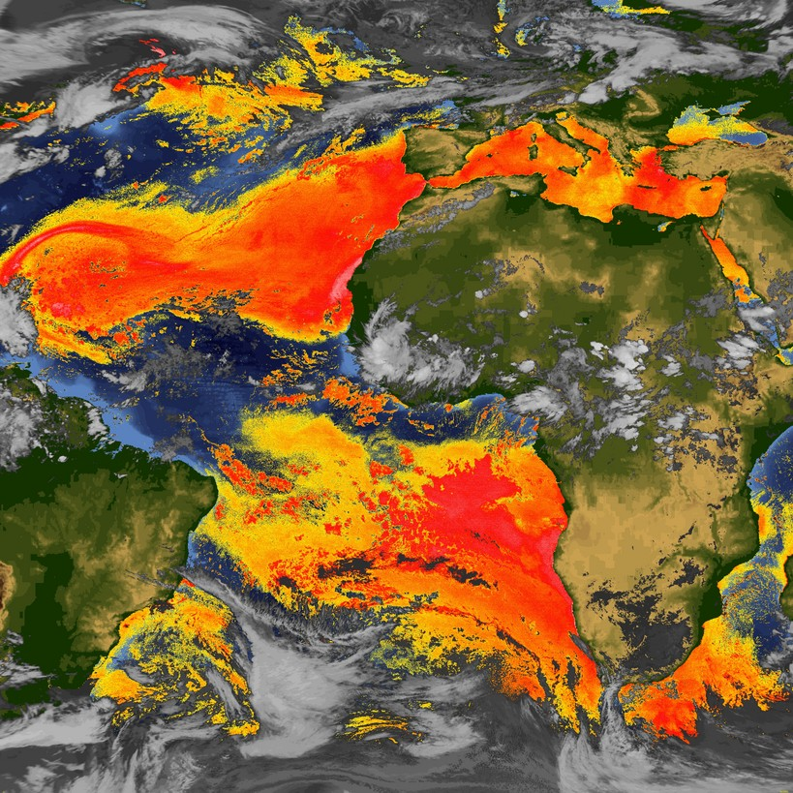
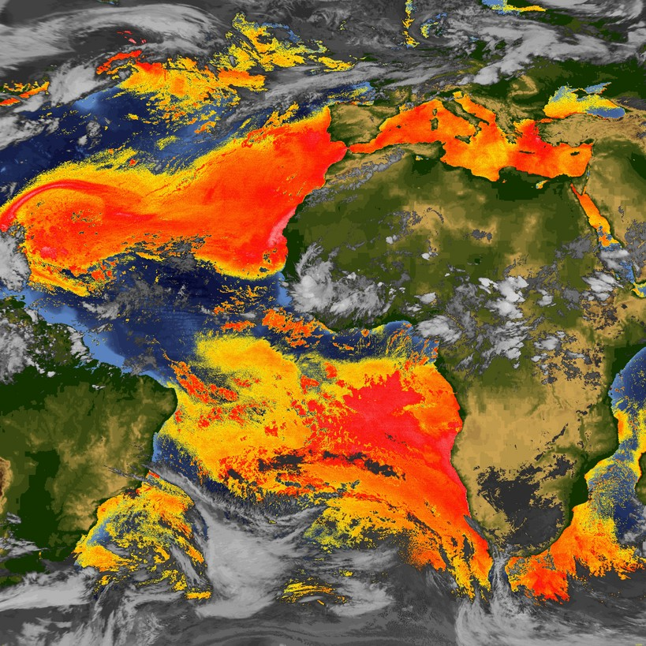
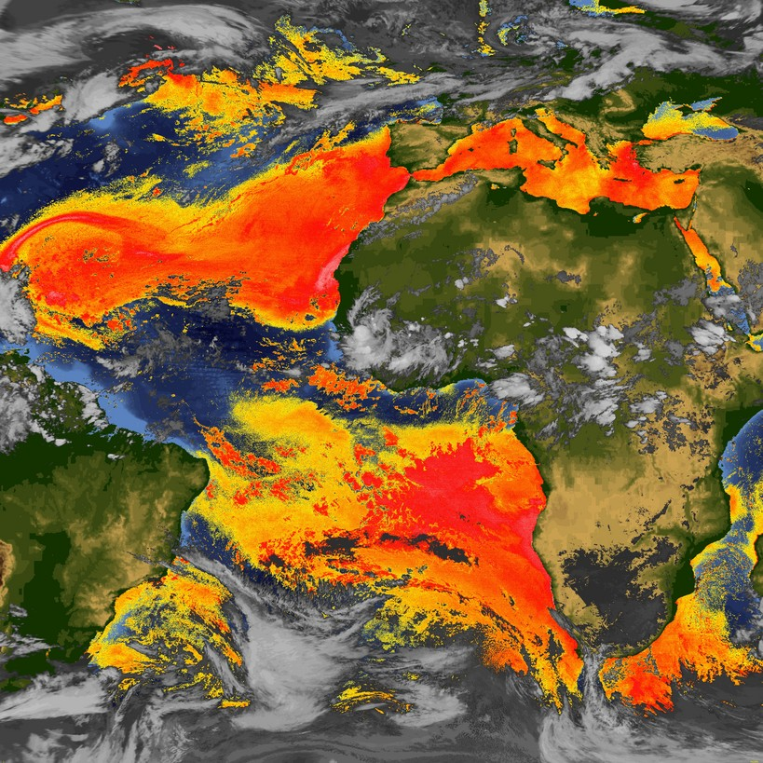
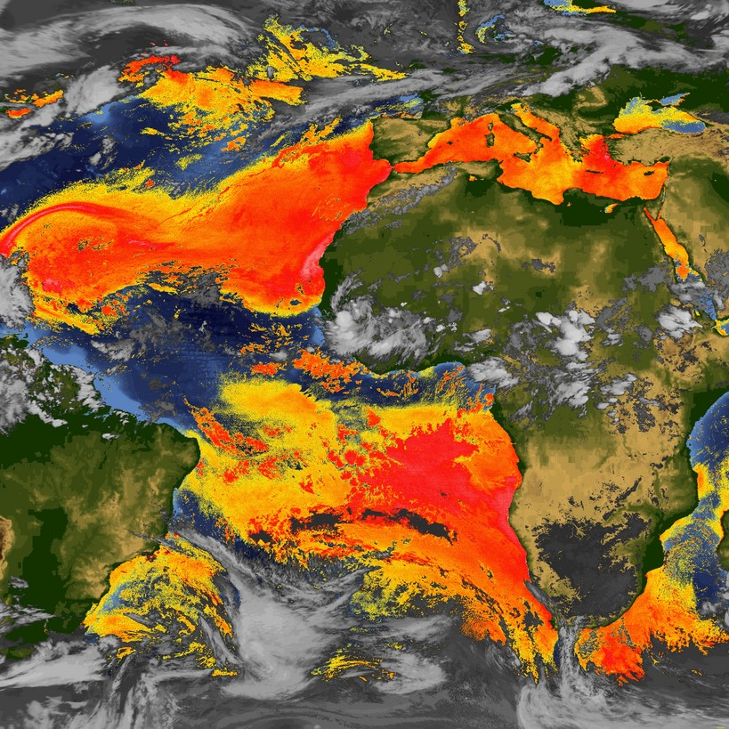
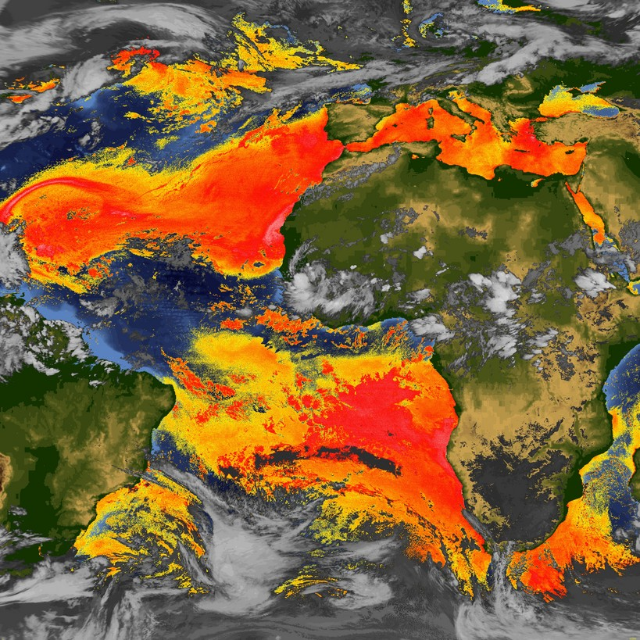
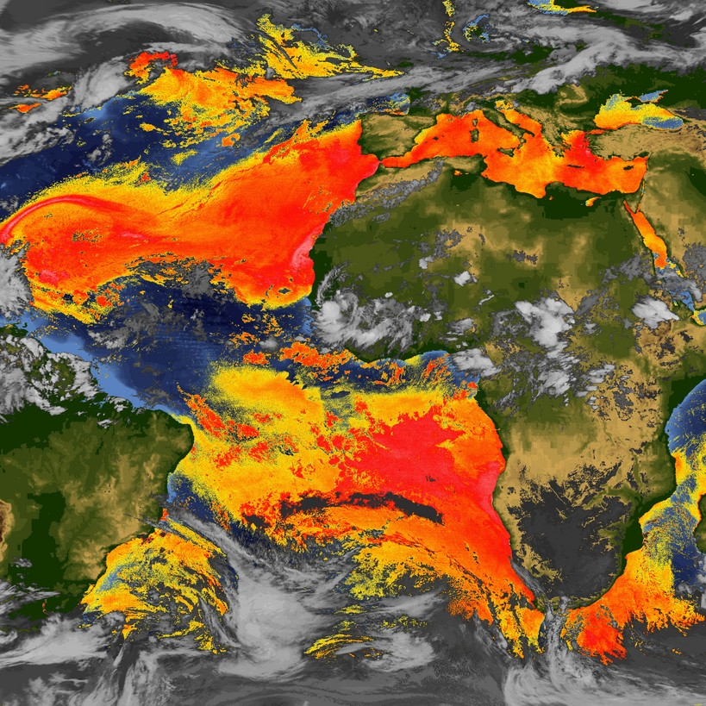
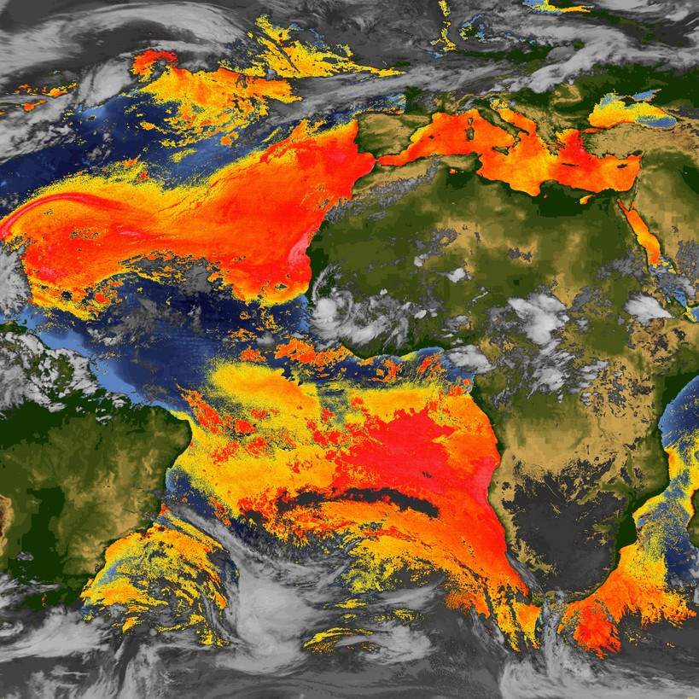

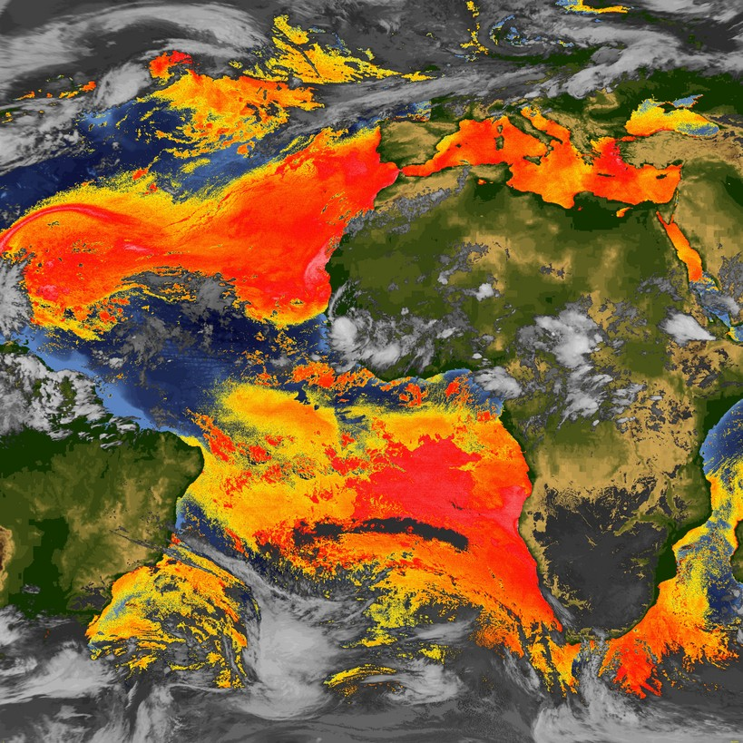

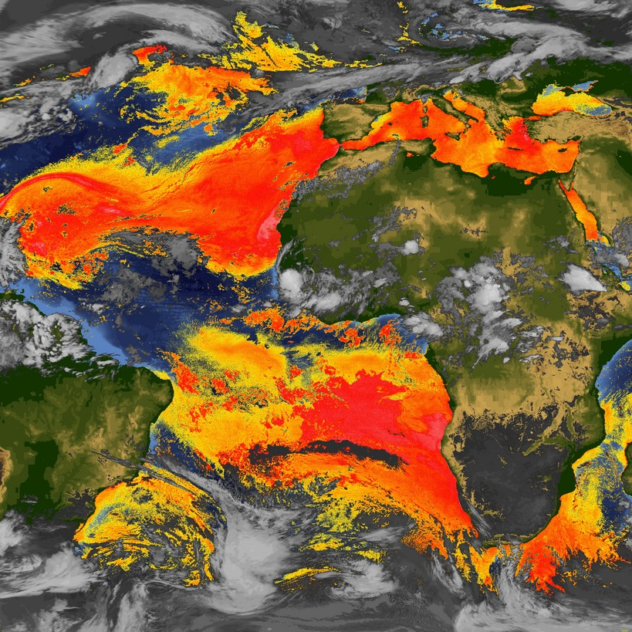

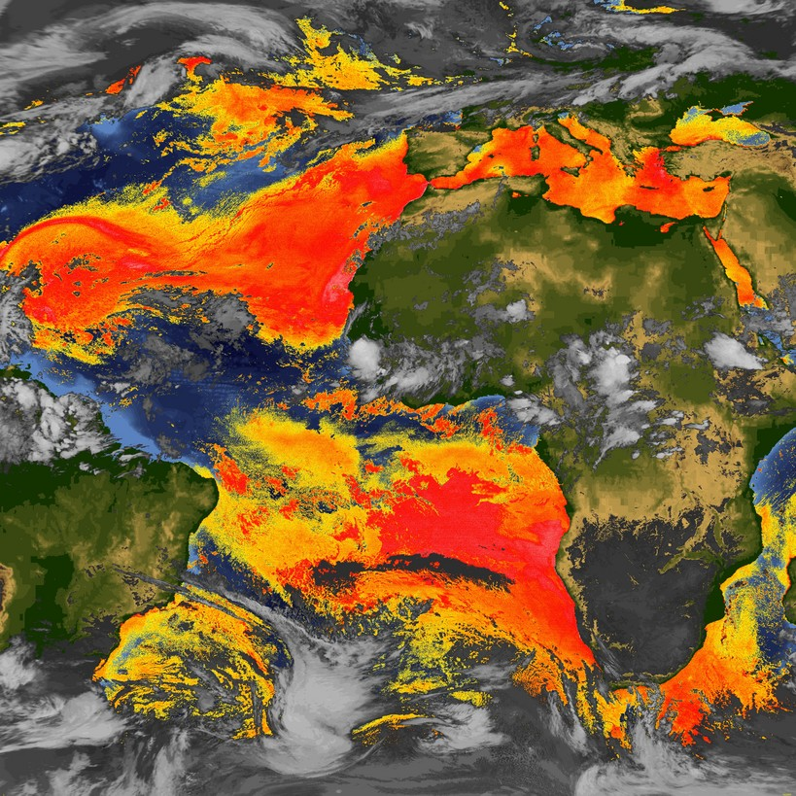

Split Window SAL Tracking
Satellite Imagery (Meteosat)
Mid-Latitude
Dry Air Intrusion
Saharan
Dust Storm
Mid-Latitude
Dry Air Intrusion

Slide 4
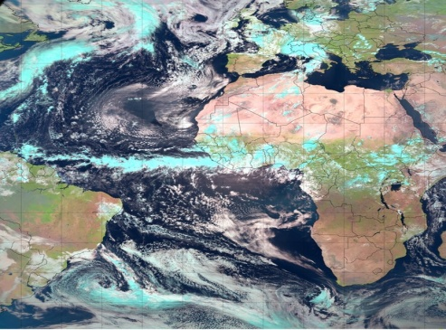
Pseudo Natural Color
Satellite Imagery
Algorithm
-0.6, 0.8, 1.6 and 3.9 μm channels (Meteosat-9 SEVIRI);
-0.6, 0.8, and 1.6 µm channels: blue, green, and red;
-3.9 µm channel: continuous nighttime coverage;
Product Utility
-Useful for highlighting ocean, land, aerosol (e.g. Saharan dust, pollution and biomass burning emissions), and cloud features in colors that are qualitatively similar to those of a true color image;
-Saharan mineral dust: appears as a brown haze;
-Biomass burning emissions: appear as a deep aqua blue;
-Shallow stratocumulus and cumulus clouds: appear white;
-Higher (colder) clouds: appear as a light blue;
Availability
-UW/CIMSS webserver & NHC NAWIPS (15-min; July 2012);

Slide 5
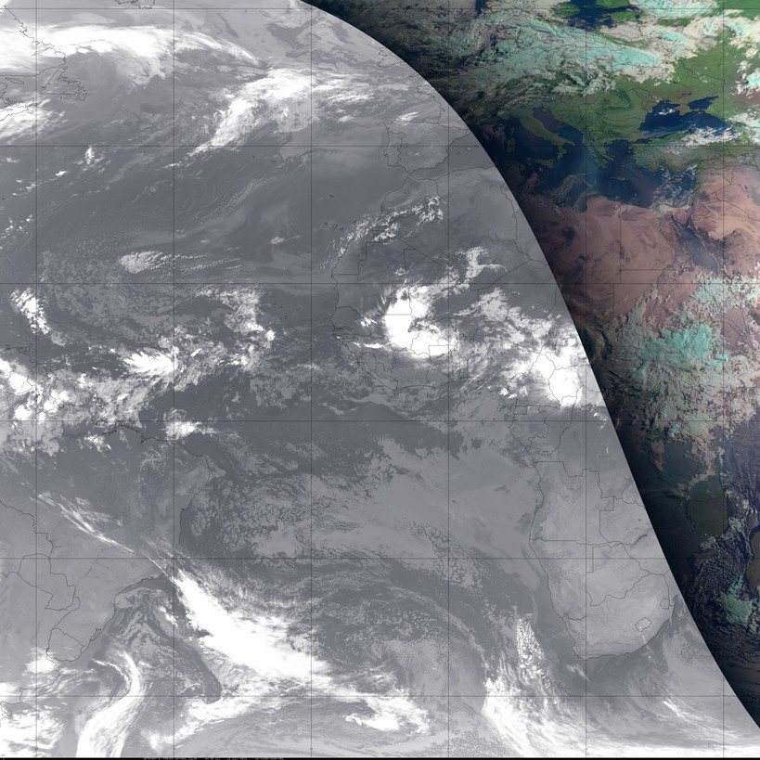
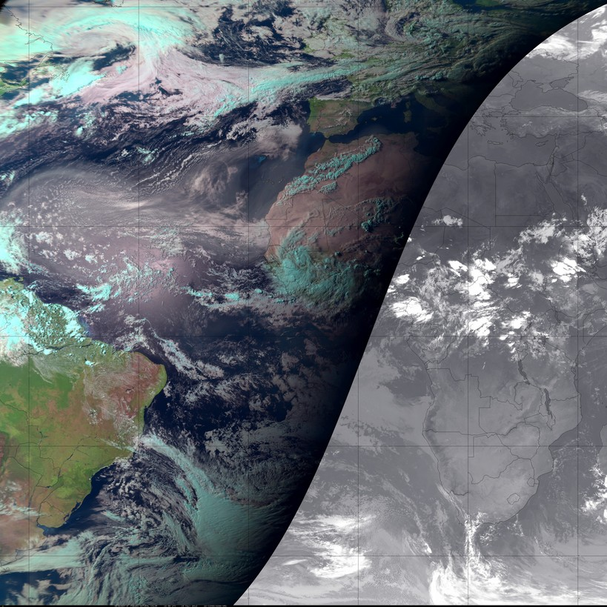
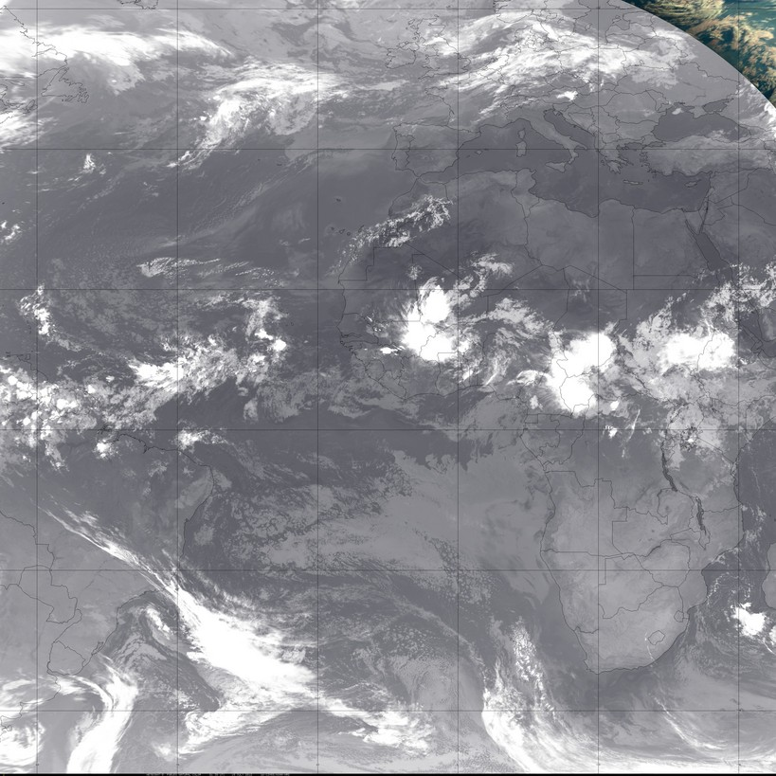
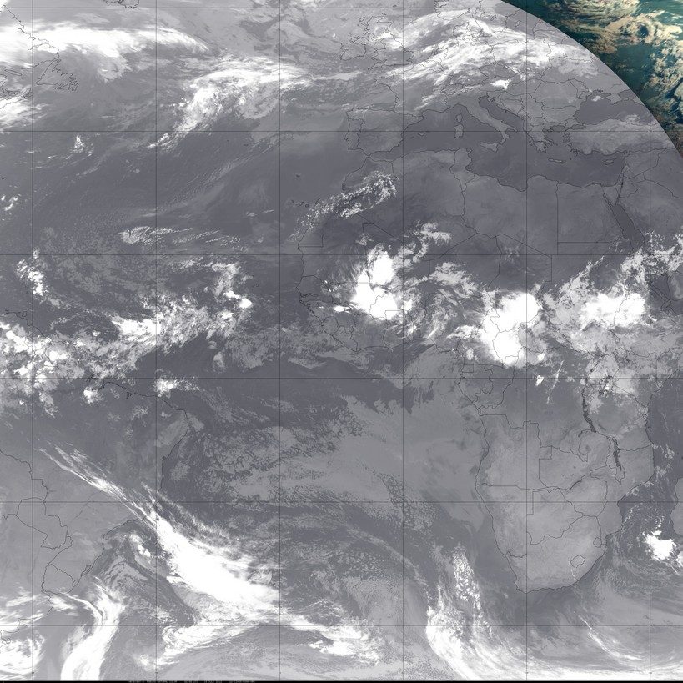
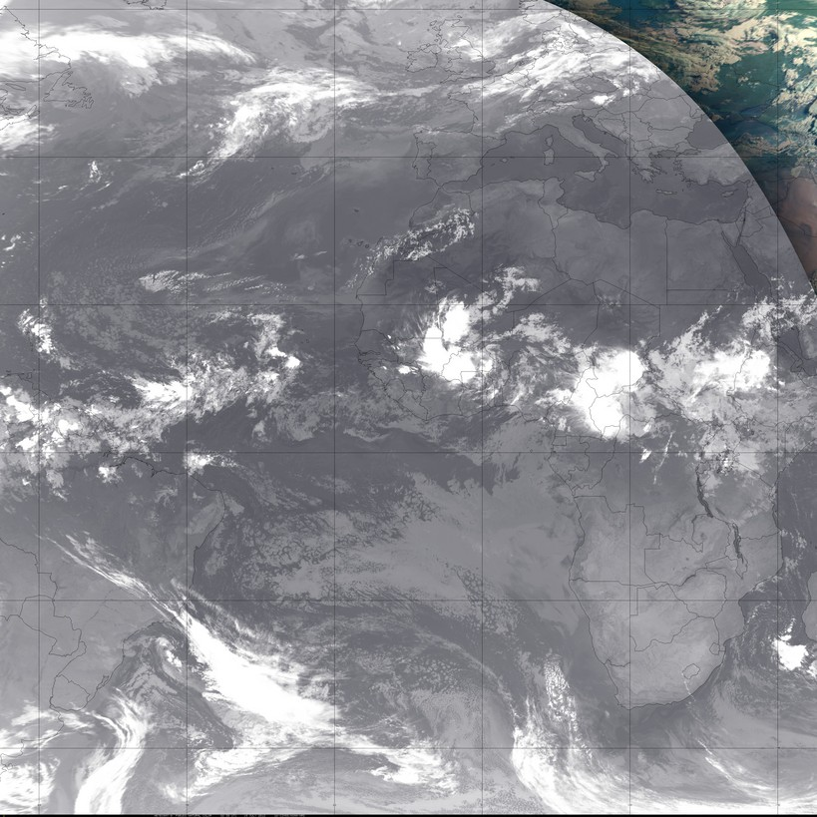
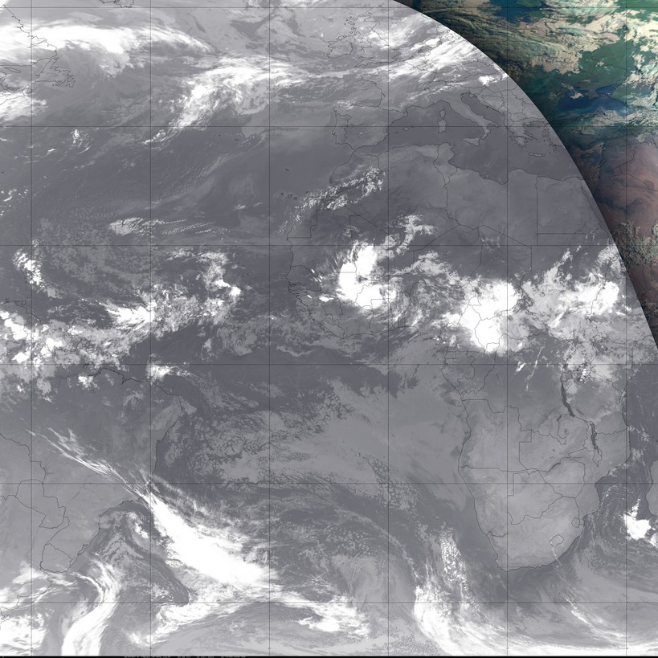
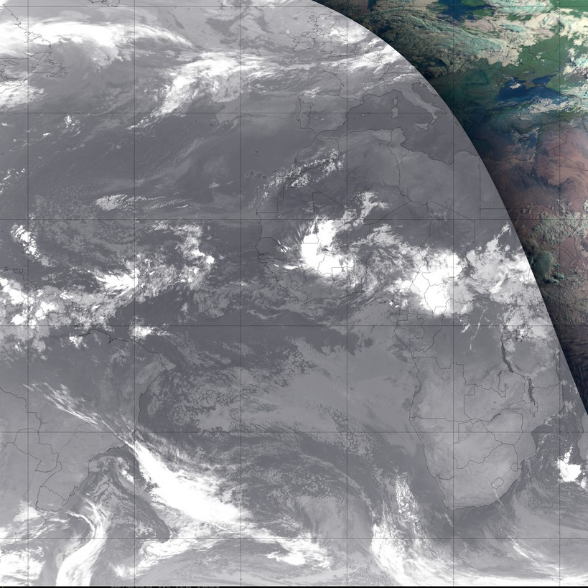
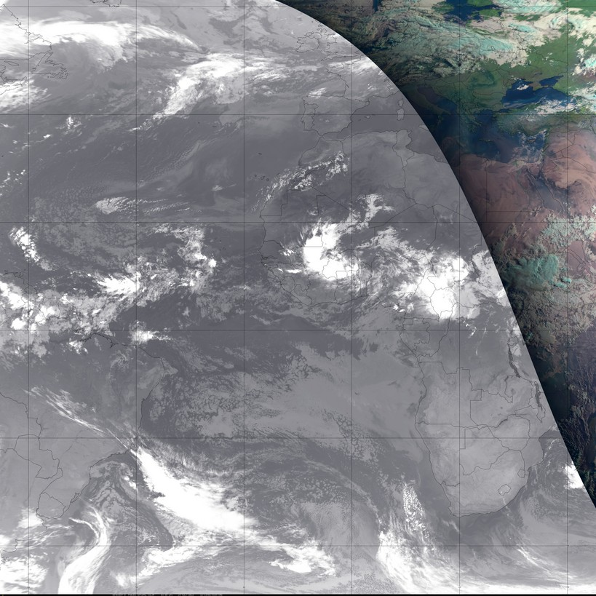
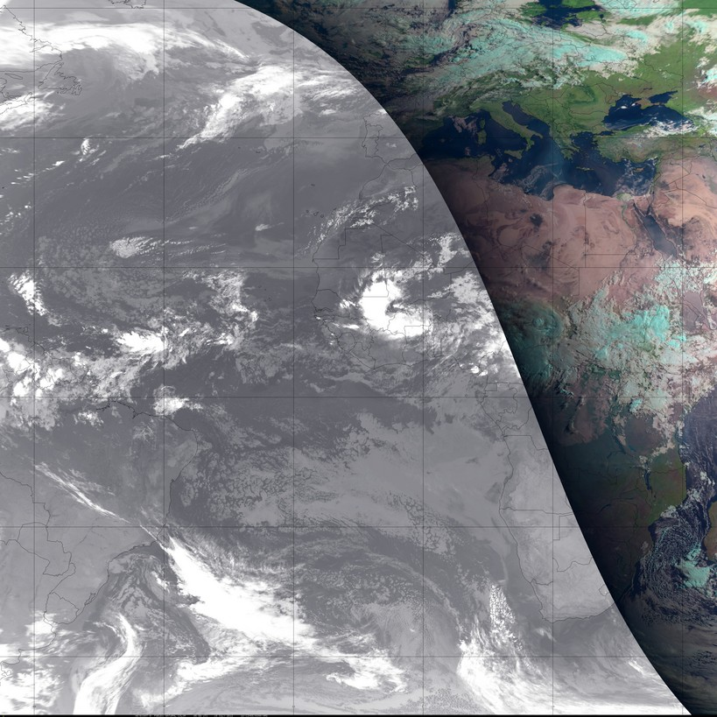
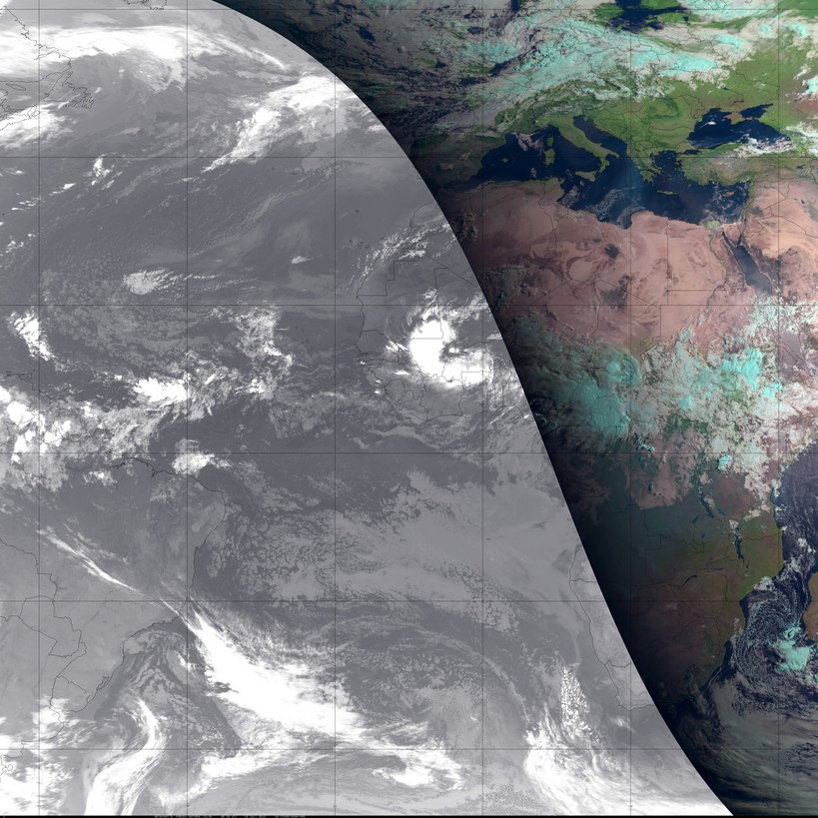
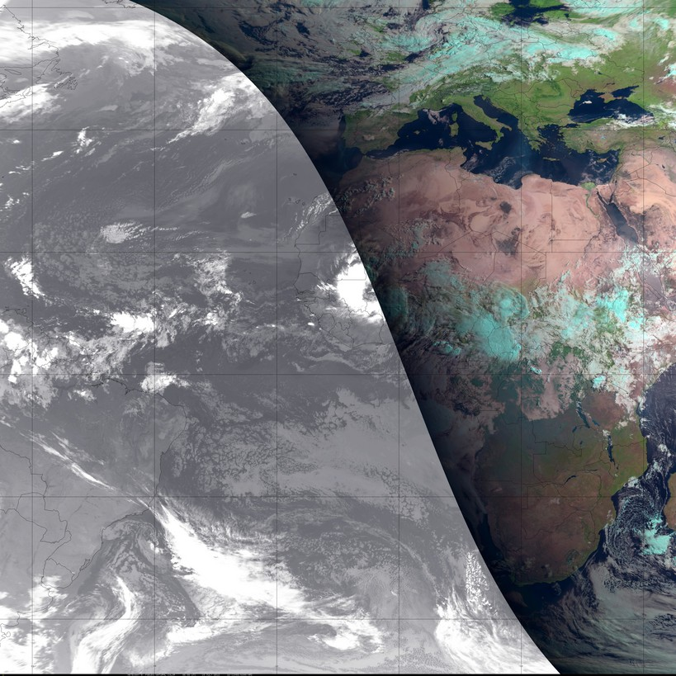
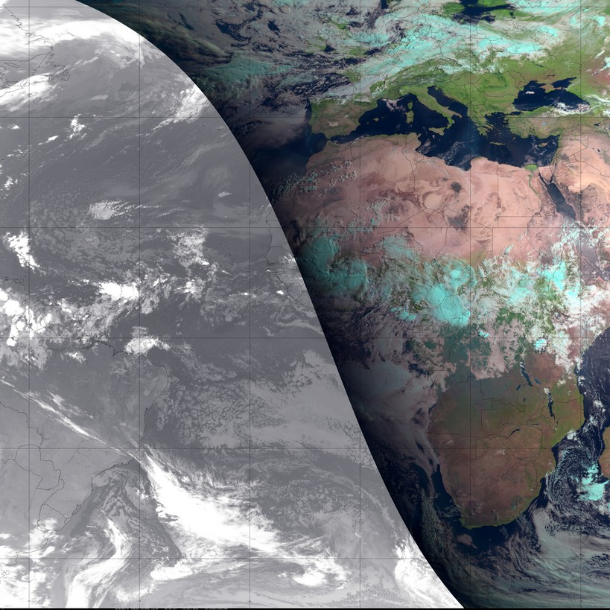
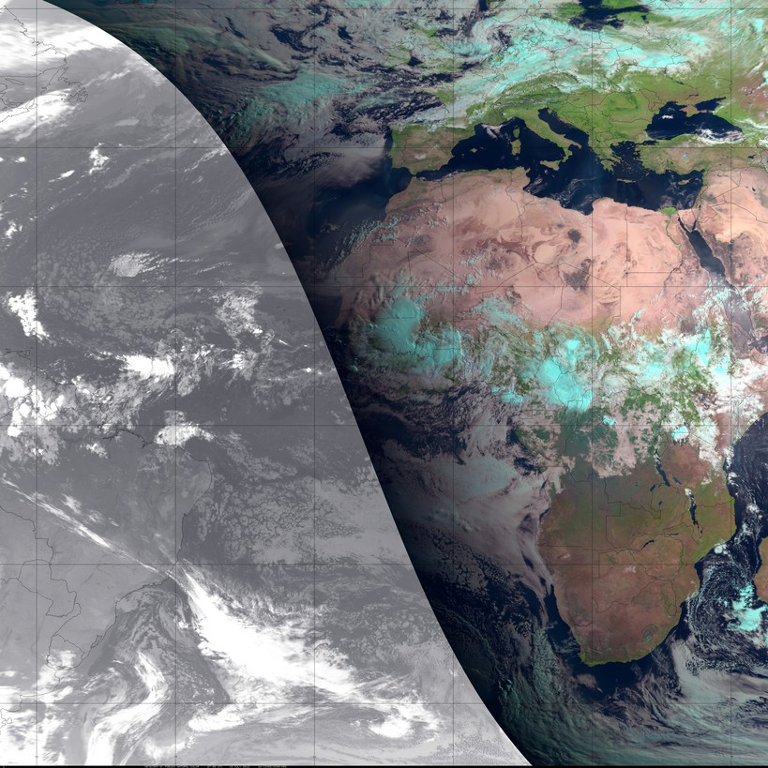
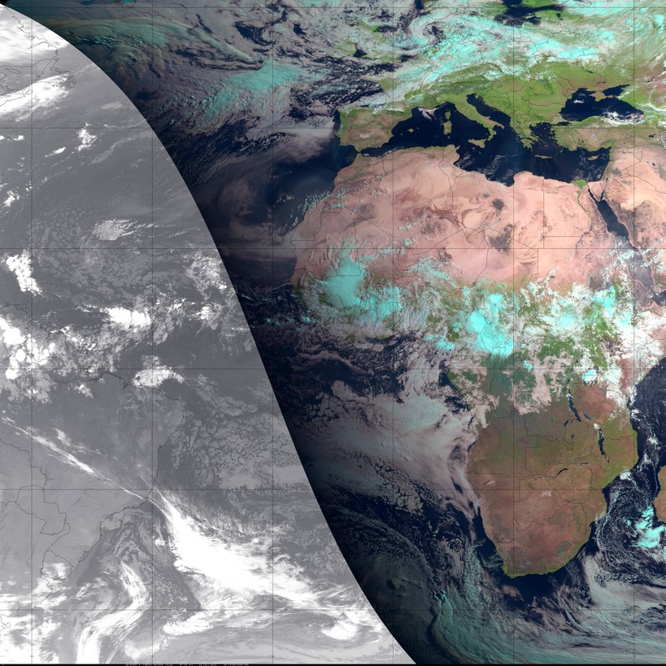
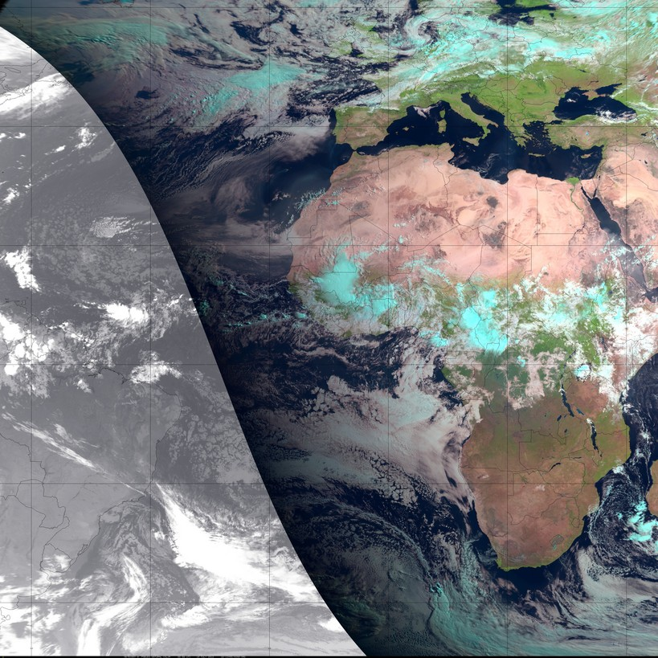
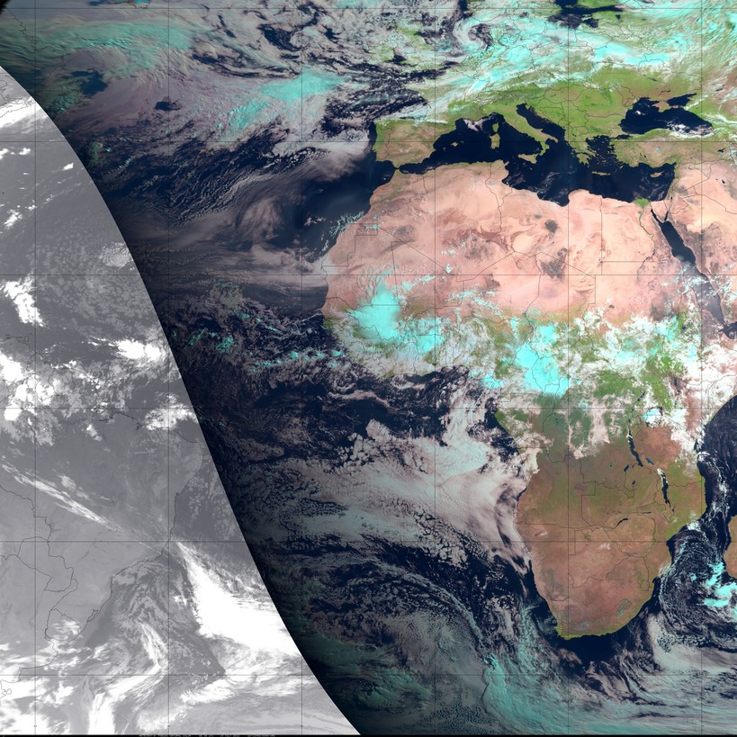
























Pseudo Natural Color
Satellite Imagery (Meteosat)
Greece
Wildfires
Saharan Dust
Saharan Dust
Strato Cumulus
Ice Cloud
19 July 2012

