Slide 1
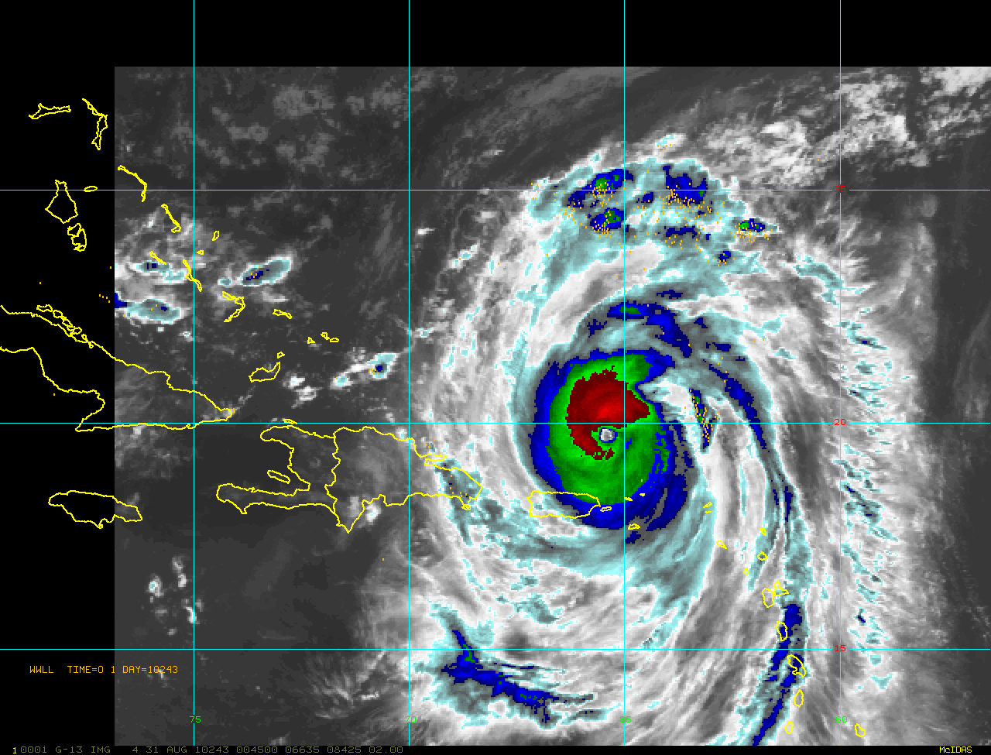
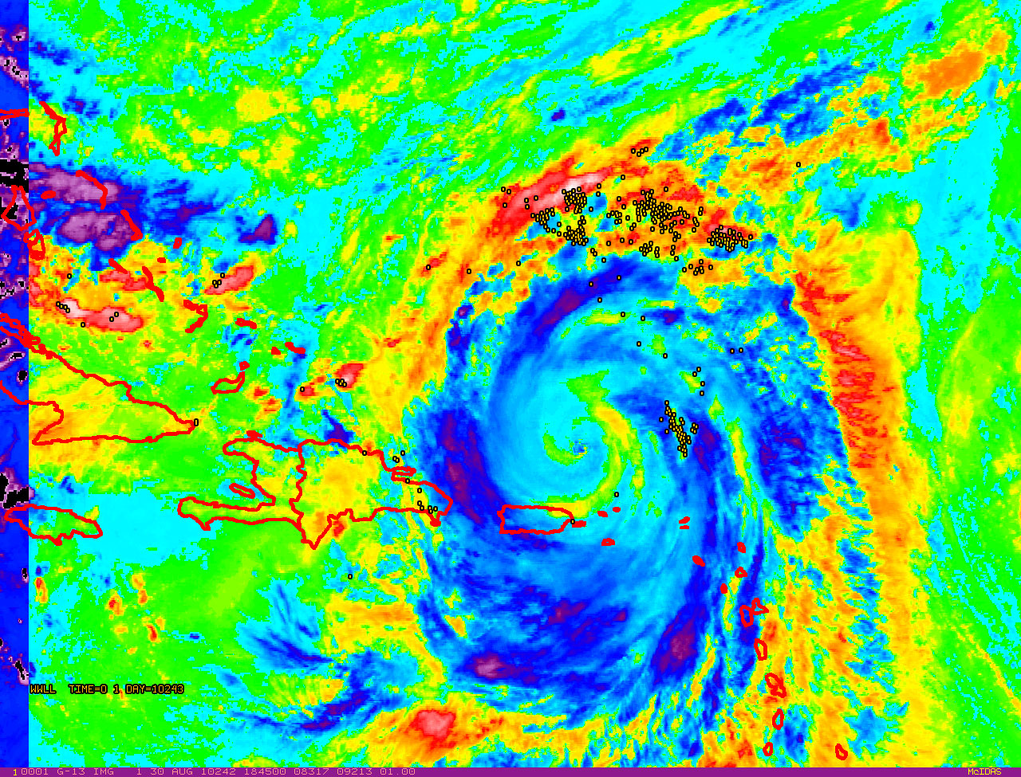
Hurricane Earl: 31 Aug 2010
(data from the World Wide Lightning Detection Location Network)
Imagery from: NOAA-HRD/UW-CIMSS/CIRA

Slide 2
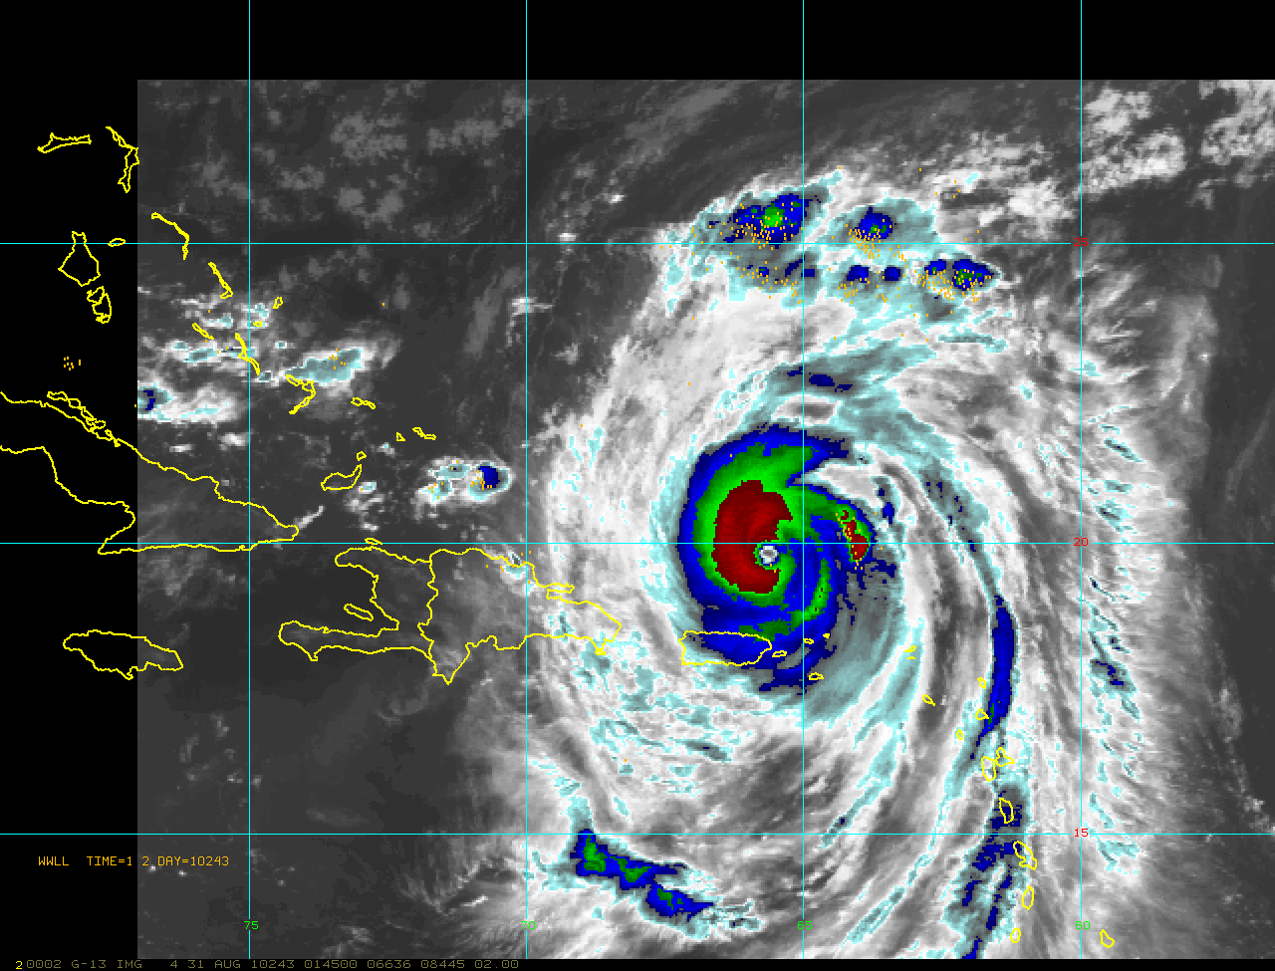
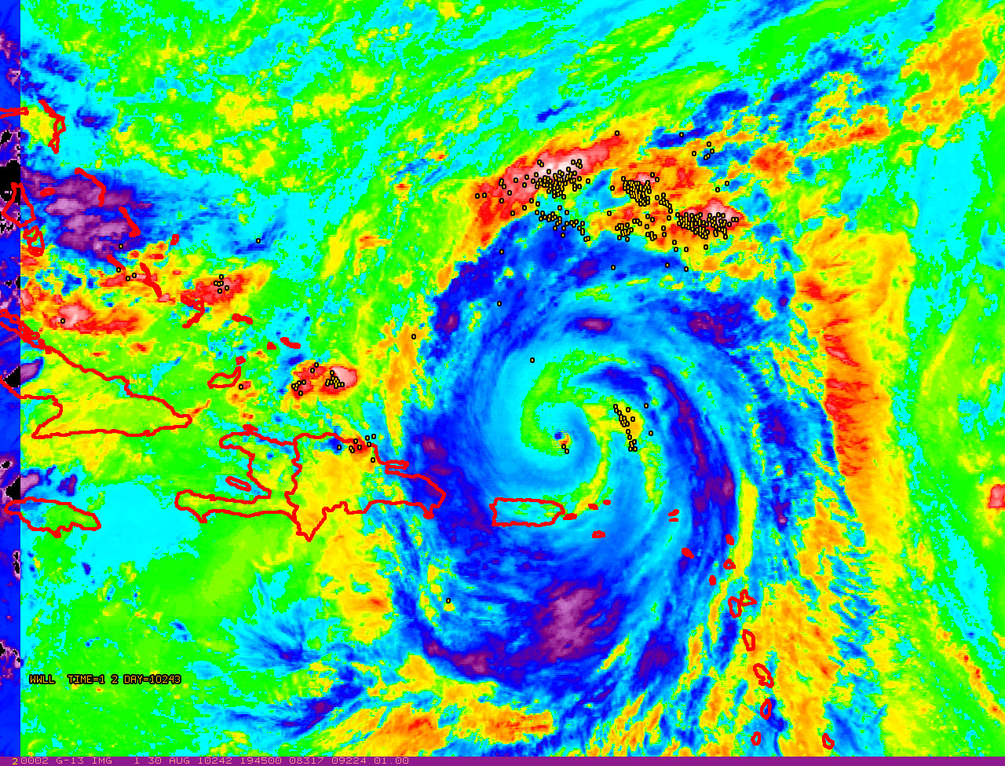
Hurricane Earl: 31 Aug 2010
(data from the World Wide Lightning Detection Location Network)
Imagery from: NOAA-HRD/UW-CIMSS/CIRA

Slide 3
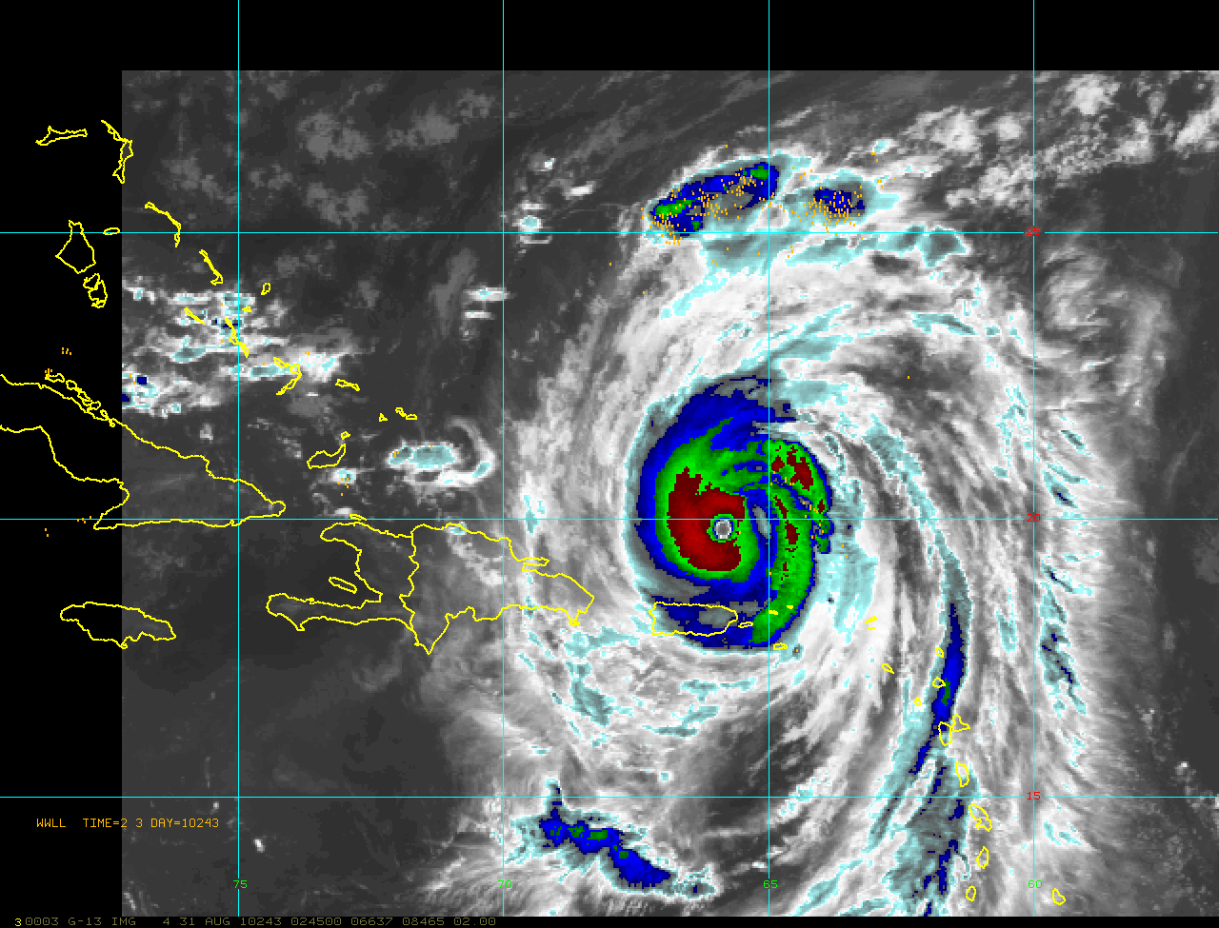
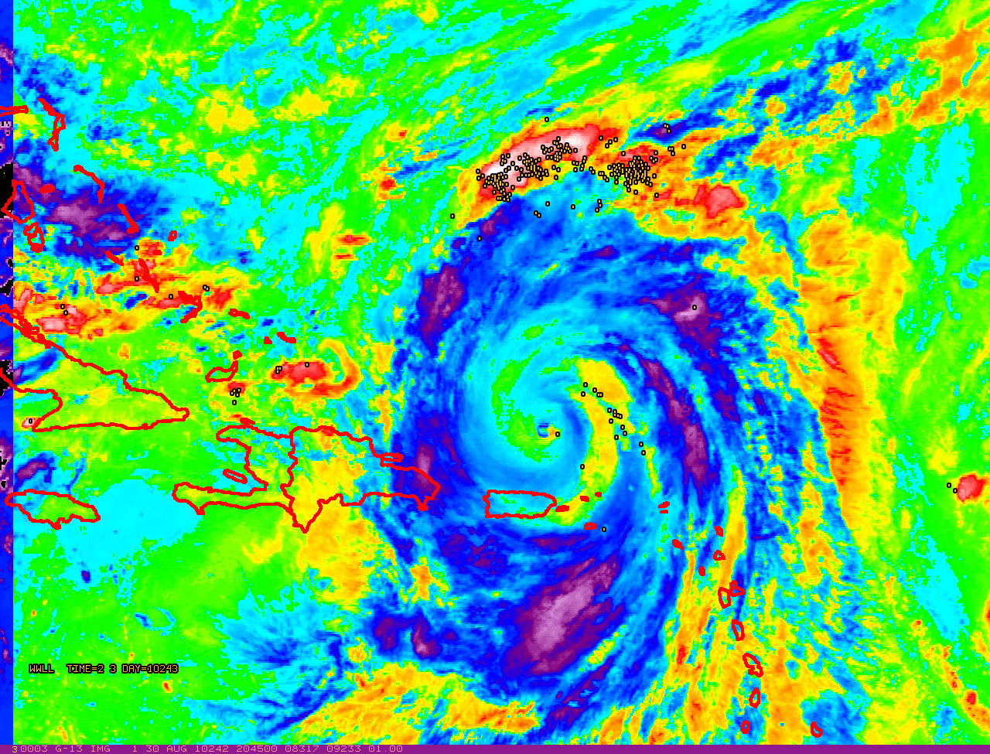
Hurricane Earl: 31 Aug 2010
(data from the World Wide Lightning Detection Location Network)
Imagery from: NOAA-HRD/UW-CIMSS/CIRA

Slide 4
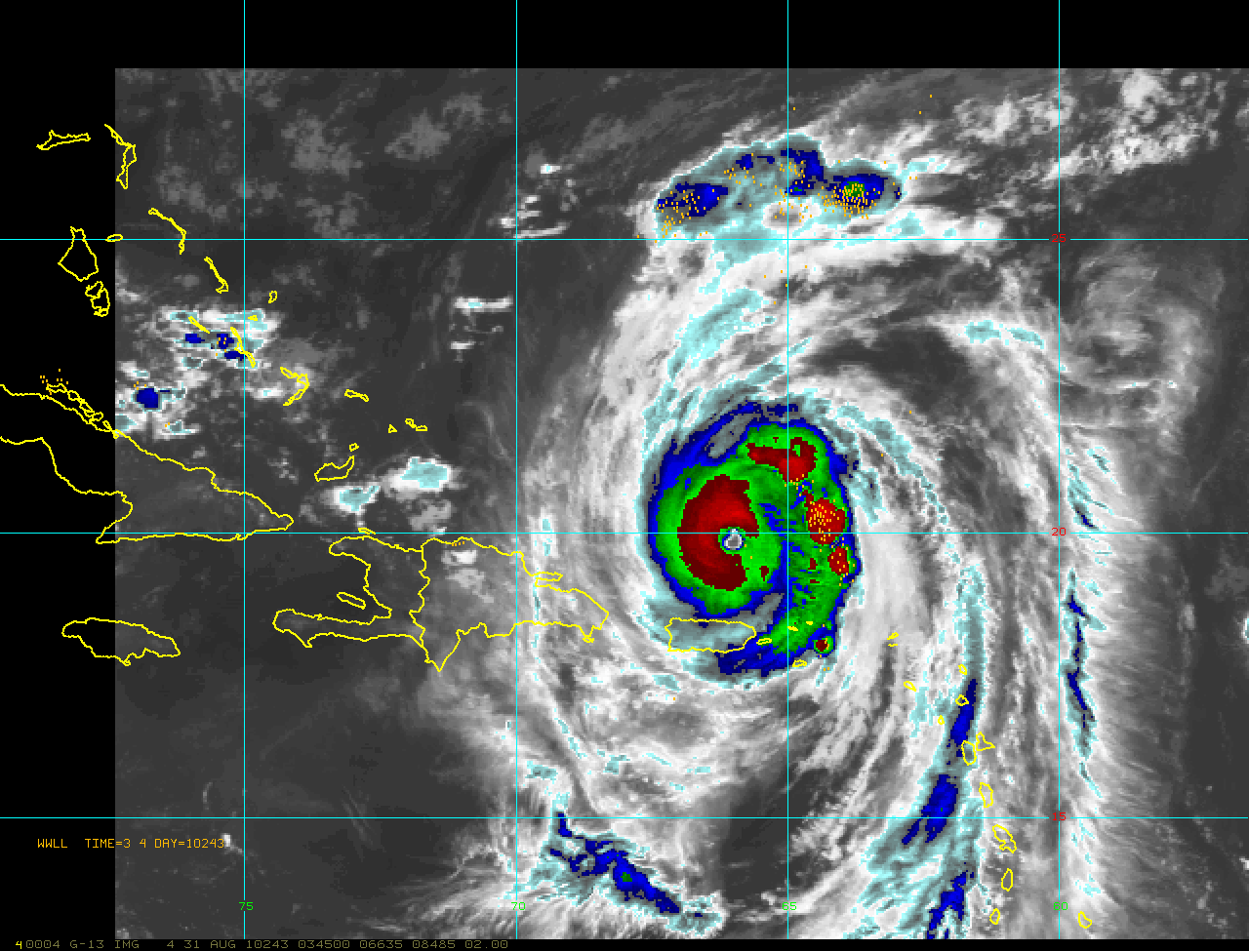
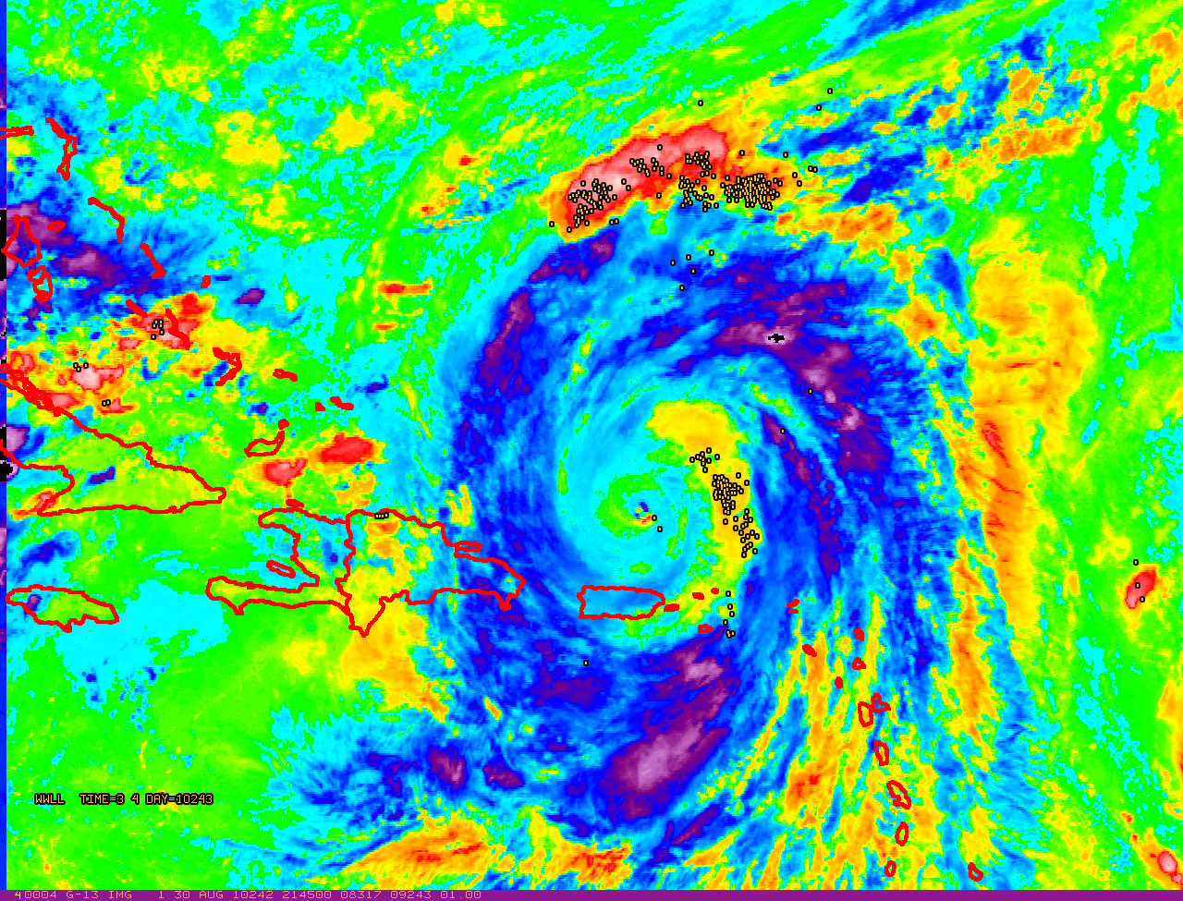
Hurricane Earl: 31 Aug 2010
(data from the World Wide Lightning Detection Location Network)
Imagery from: NOAA-HRD/UW-CIMSS/CIRA

Slide 5
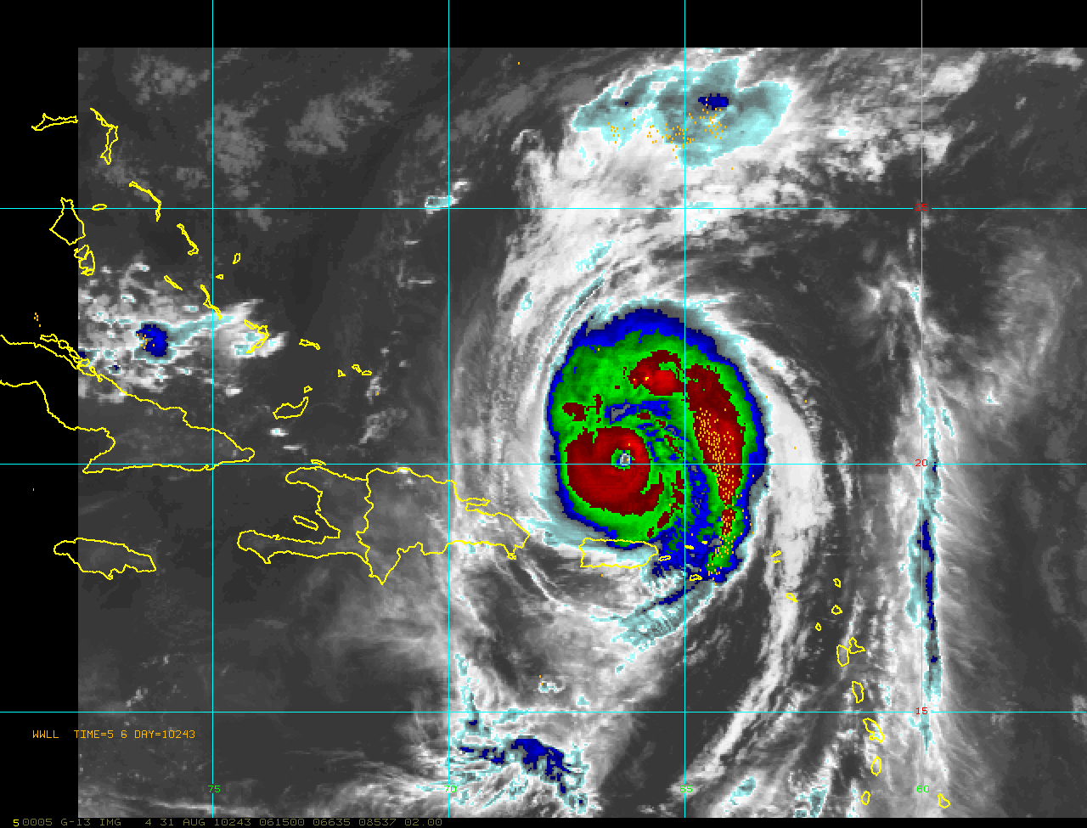
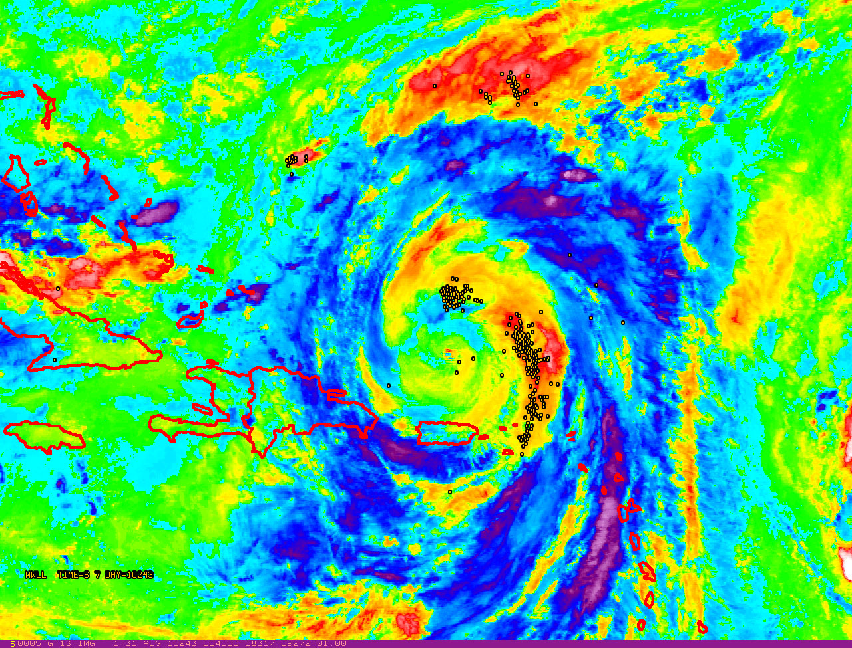
Hurricane Earl: 31 Aug 2010
(data from the World Wide Lightning Detection Location Network)
Imagery from: NOAA-HRD/UW-CIMSS/CIRA

Slide 6
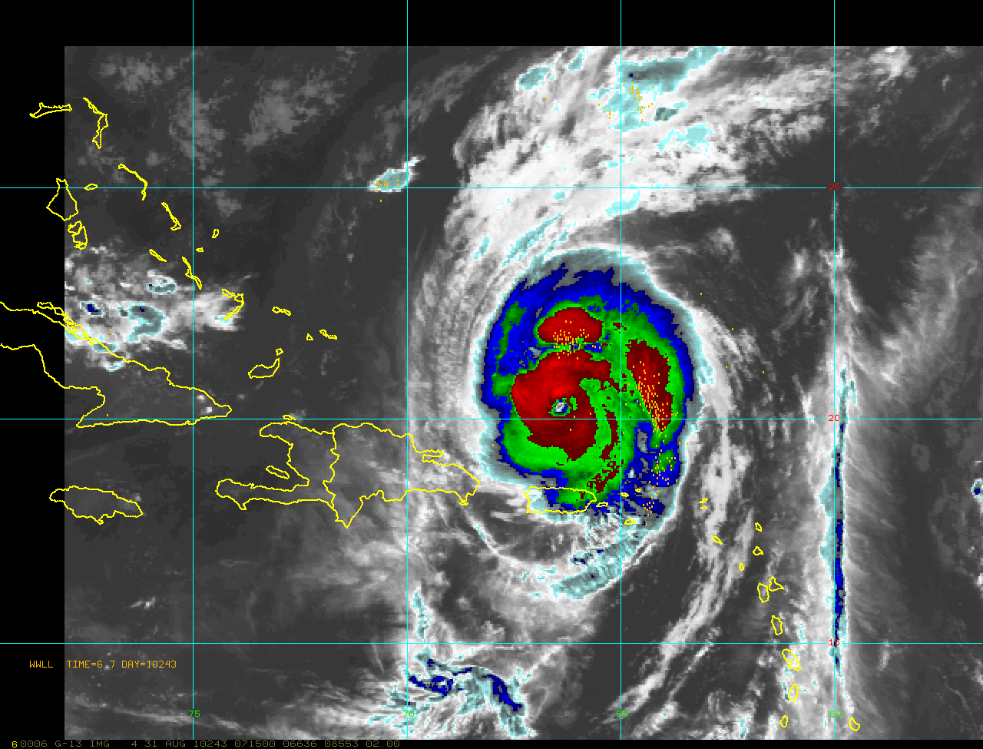
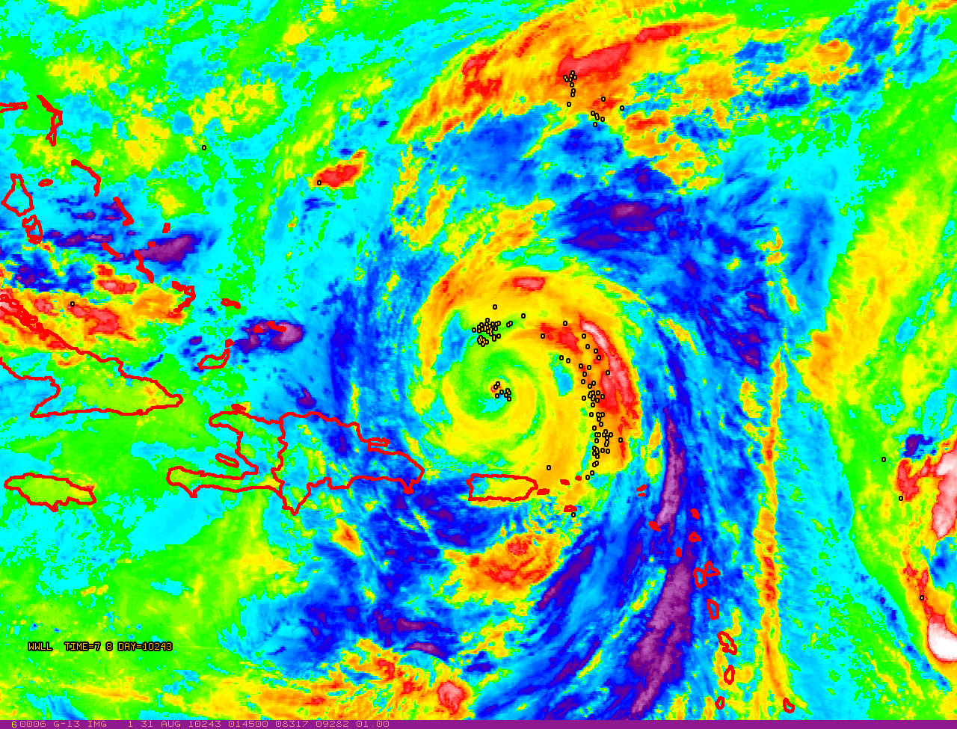
Hurricane Earl: 31 Aug 2010
(data from the World Wide Lightning Detection Location Network)
Imagery from: NOAA-HRD/UW-CIMSS/CIRA

Slide 7
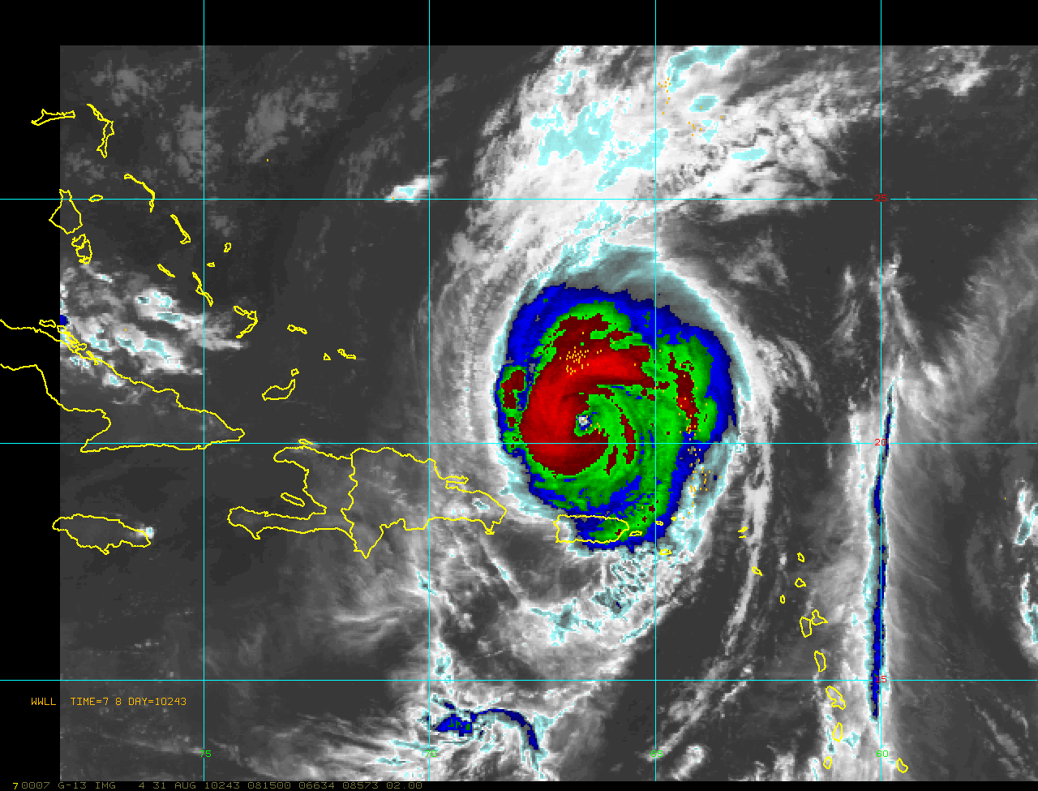
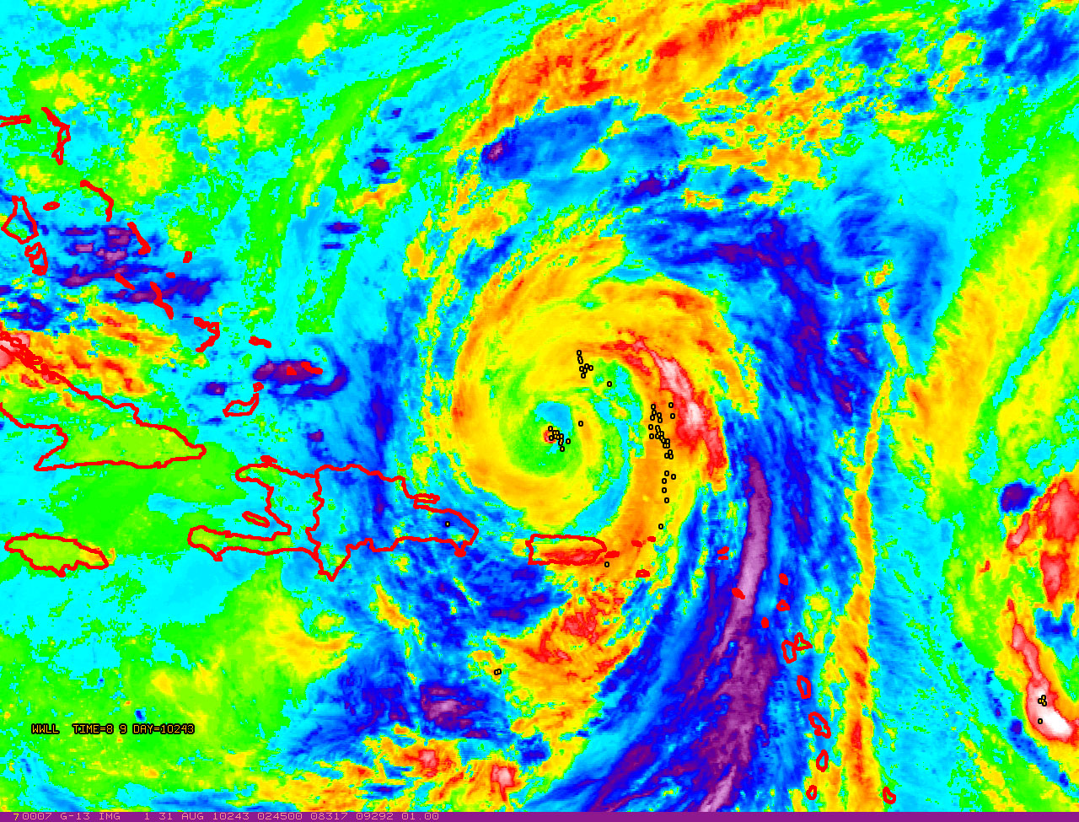
Hurricane Earl: 31 Aug 2010
(data from the World Wide Lightning Detection Location Network)
Imagery from: NOAA-HRD/UW-CIMSS/CIRA

Slide 8
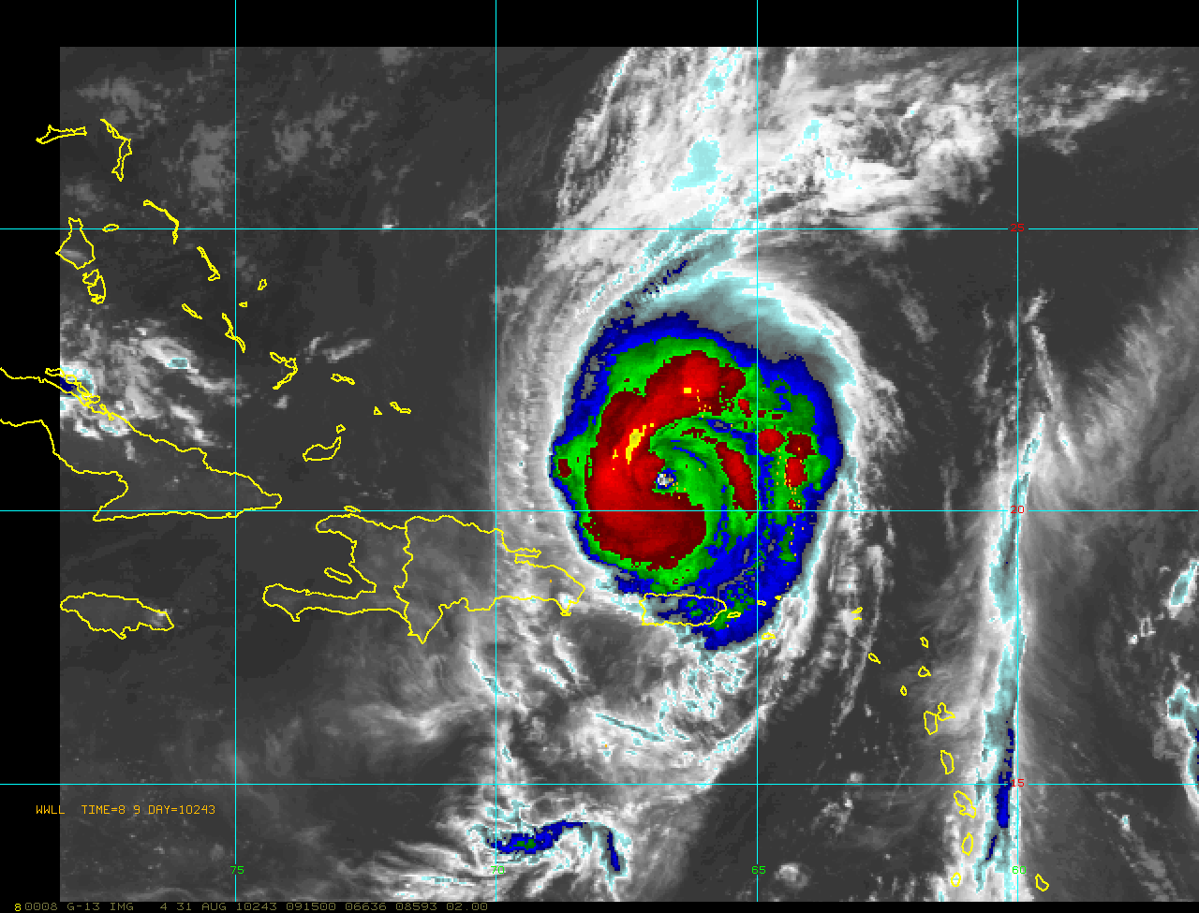
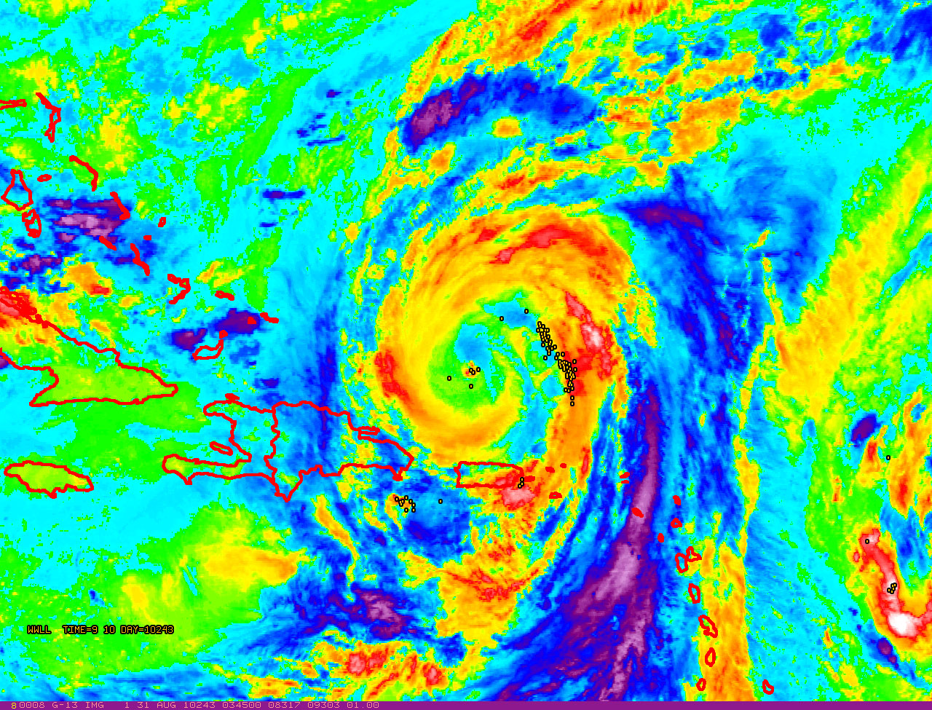
Hurricane Earl: 31 Aug 2010
(data from the World Wide Lightning Detection Location Network)
Imagery from: NOAA-HRD/UW-CIMSS/CIRA

Slide 9
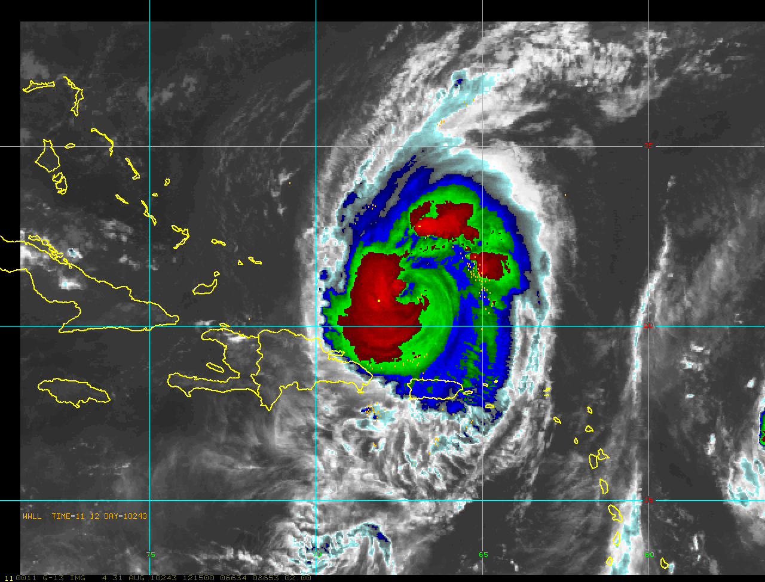
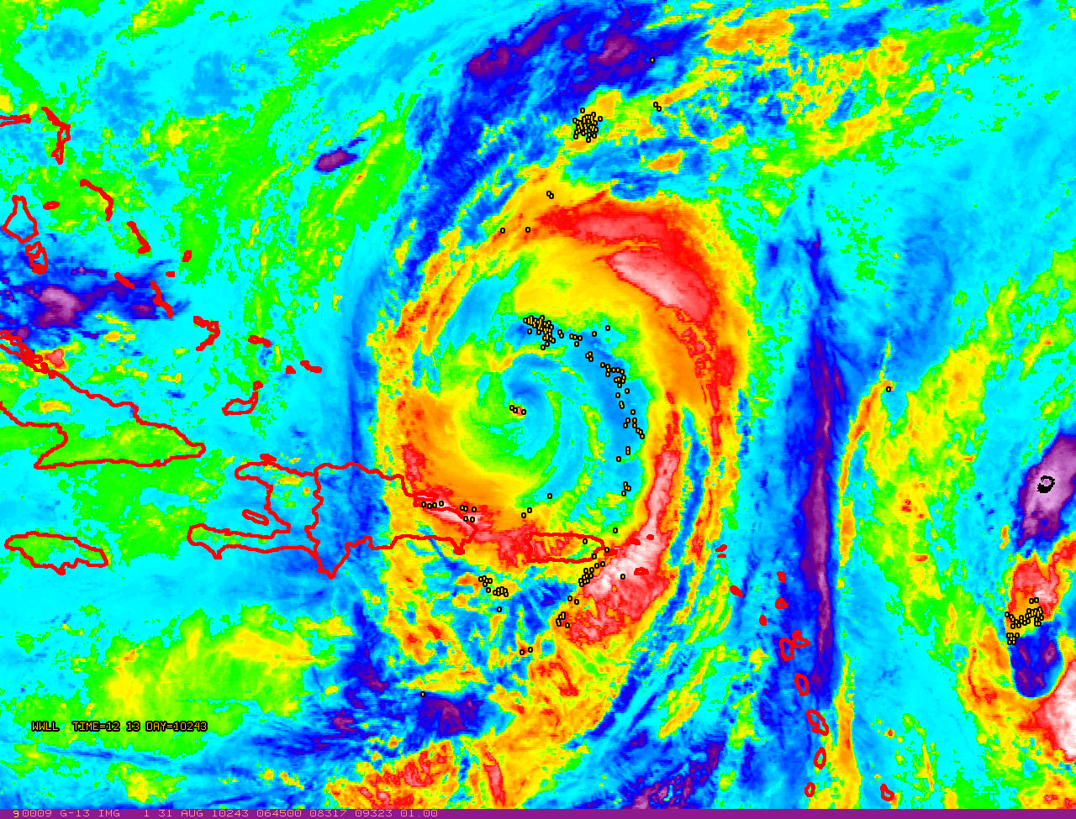
Hurricane Earl: 31 Aug 2010
(data from the World Wide Lightning Detection Location Network)
Imagery from: NOAA-HRD/UW-CIMSS/CIRA

Slide 10
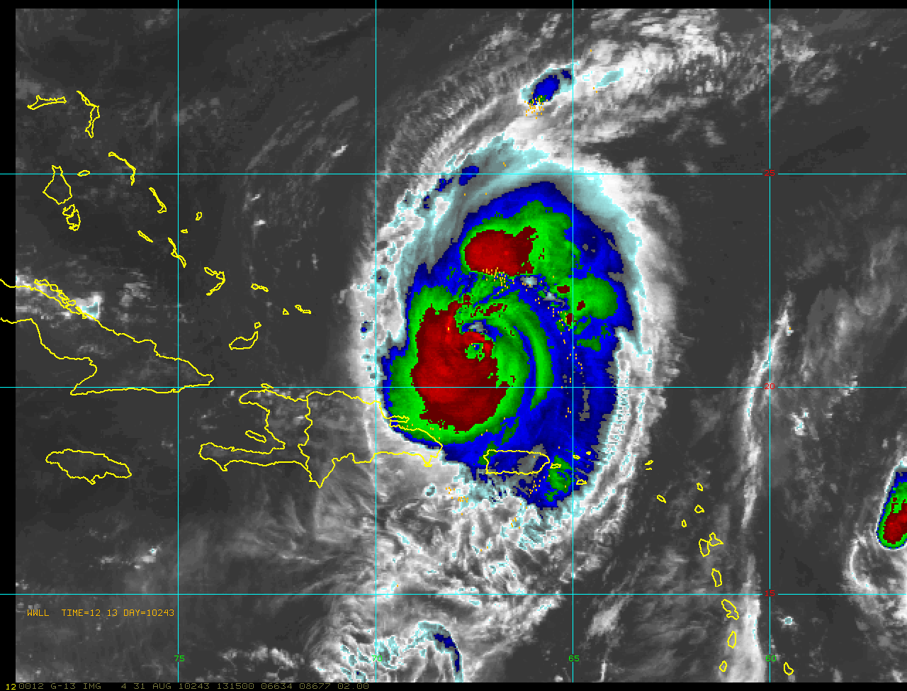
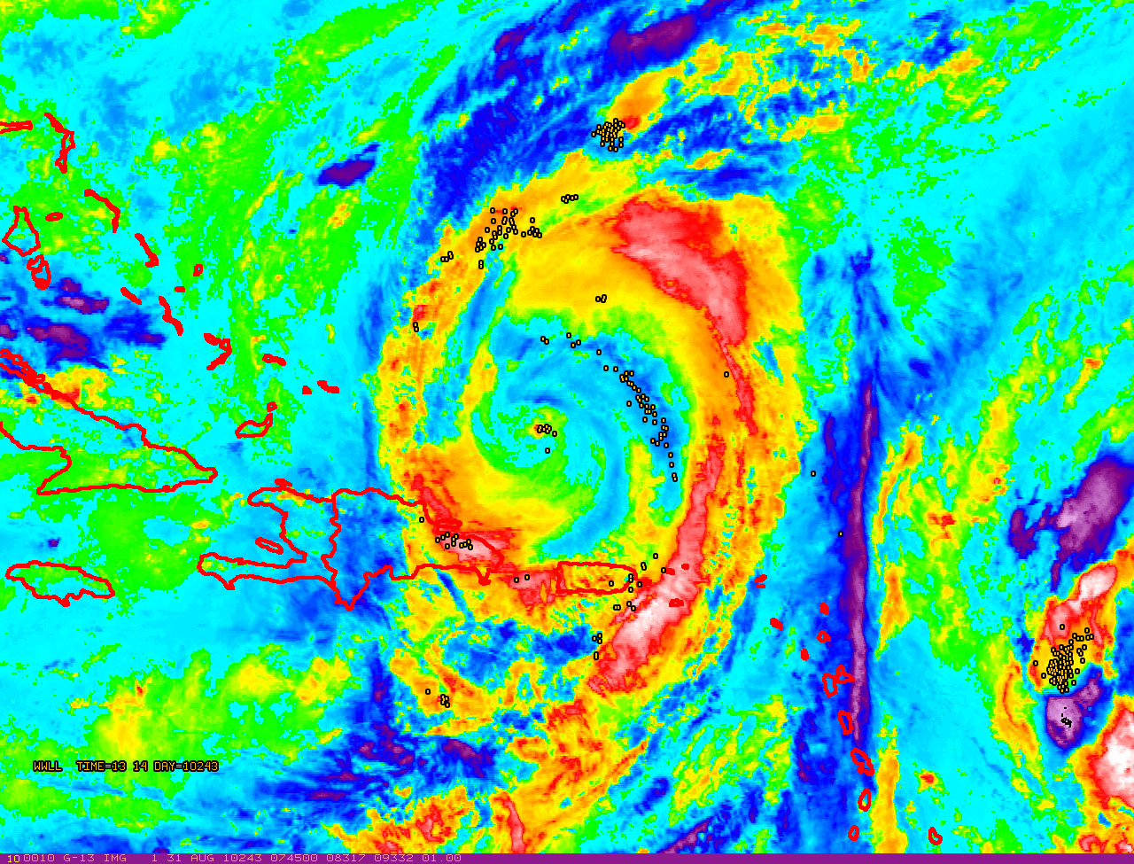
Hurricane Earl: 31 Aug 2010
(data from the World Wide Lightning Detection Location Network)
Imagery from: NOAA-HRD/UW-CIMSS/CIRA

Slide 11
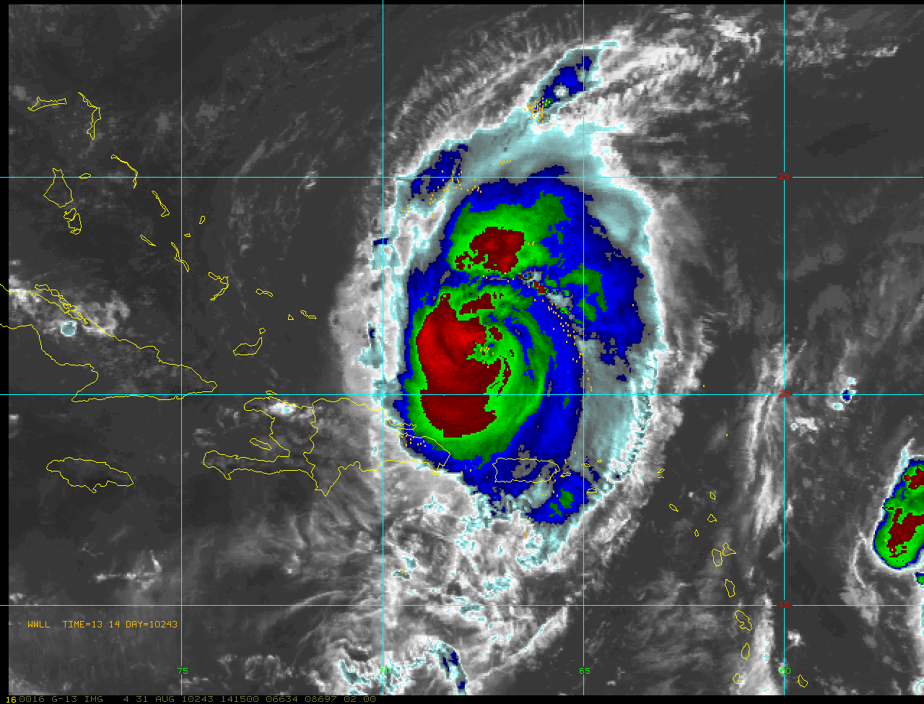
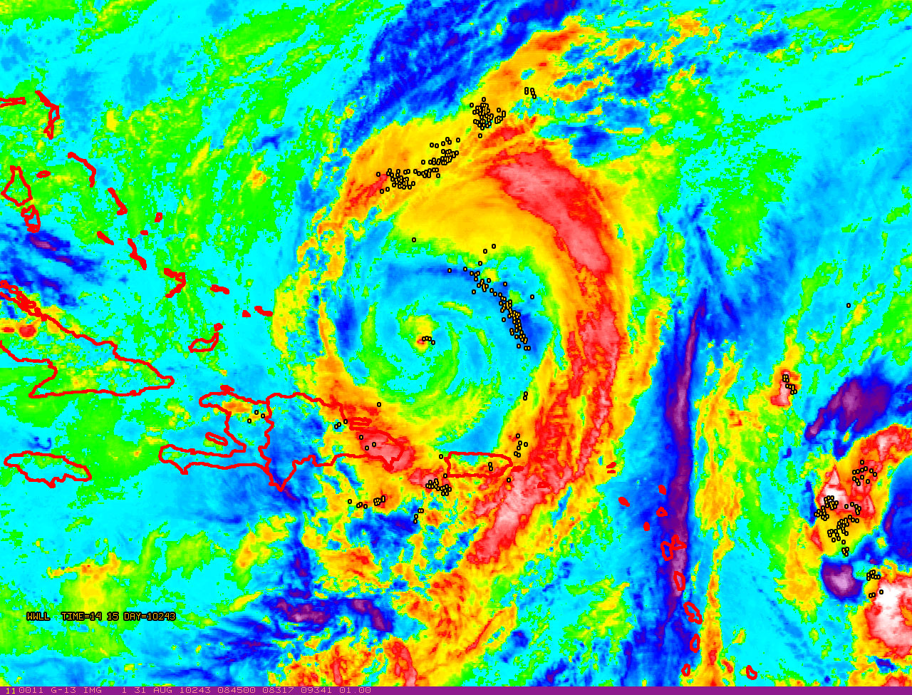
Hurricane Earl: 31 Aug 2010
(data from the World Wide Lightning Detection Location Network)
Imagery from: NOAA-HRD/UW-CIMSS/CIRA

Slide 12
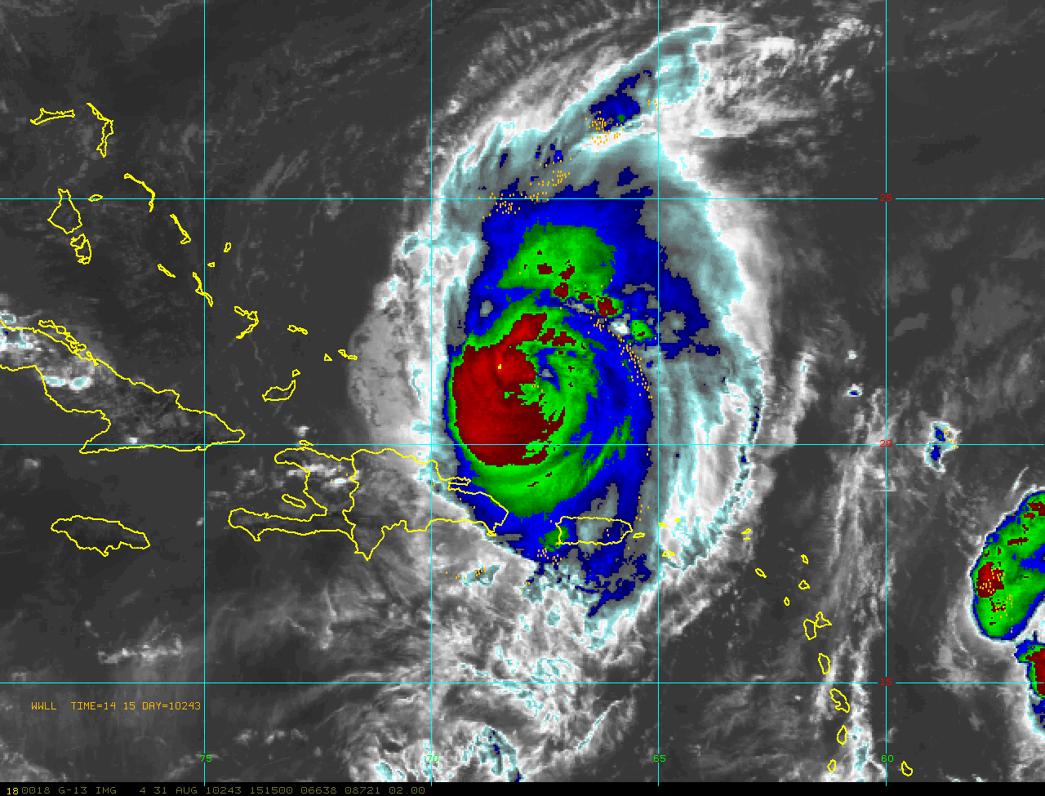
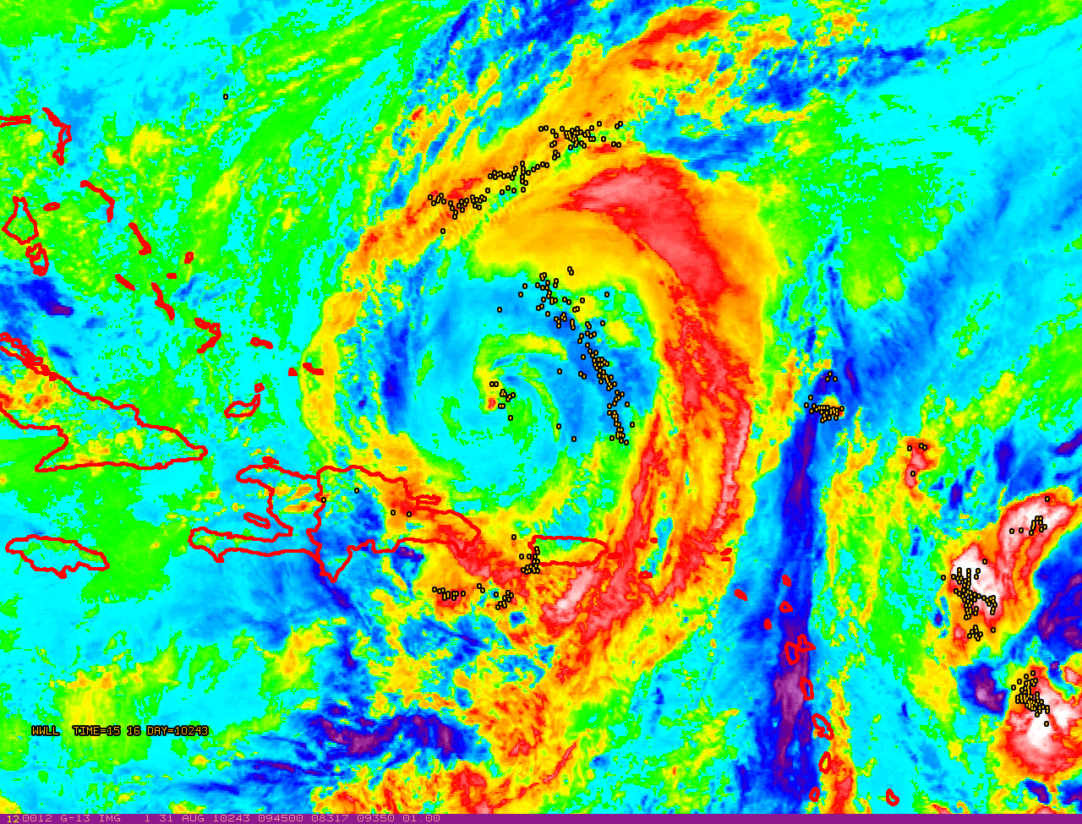
Hurricane Earl: 31 Aug 2010
(data from the World Wide Lightning Detection Location Network)
Imagery from: NOAA-HRD/UW-CIMSS/CIRA

Slide 13
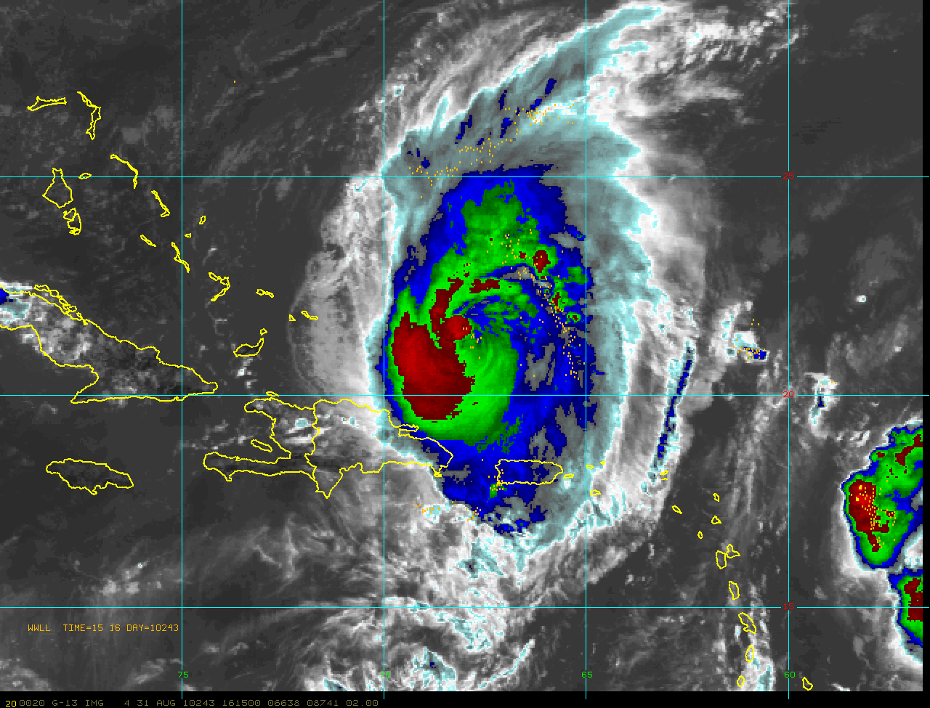
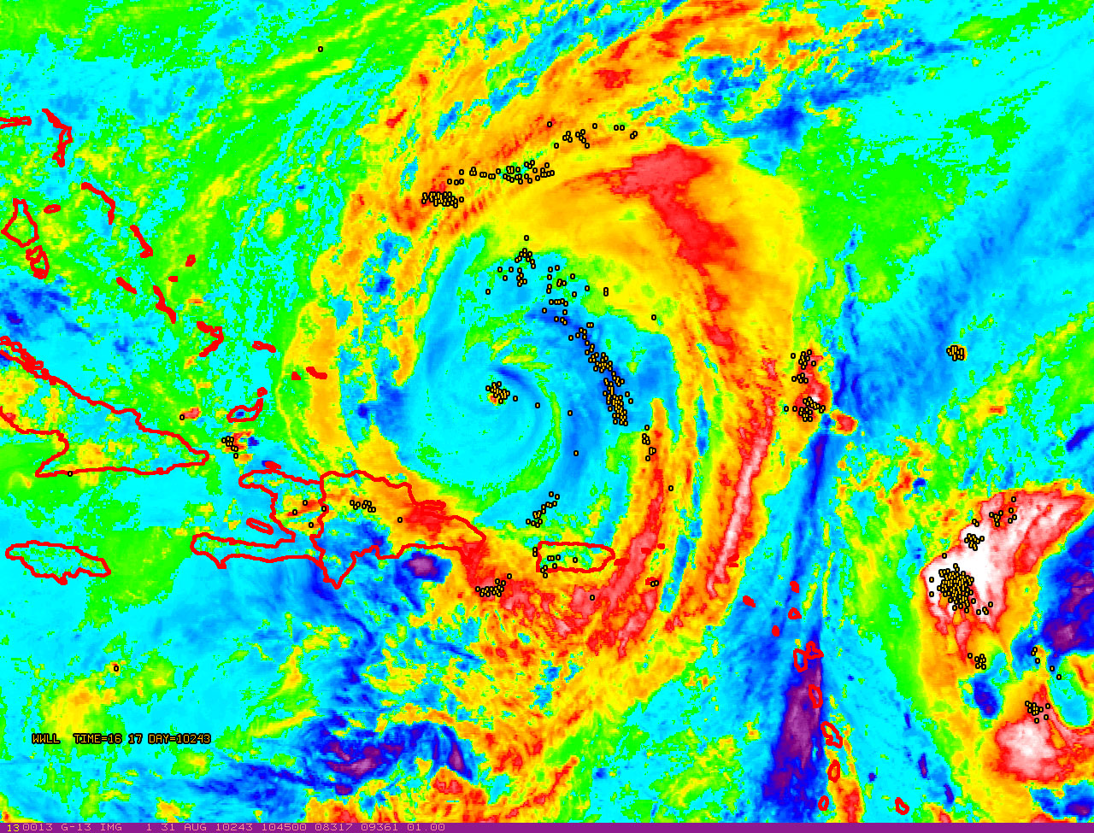
Hurricane Earl: 31 Aug 2010
(data from the World Wide Lightning Detection Location Network)
Imagery from: NOAA-HRD/UW-CIMSS/CIRA

Slide 14
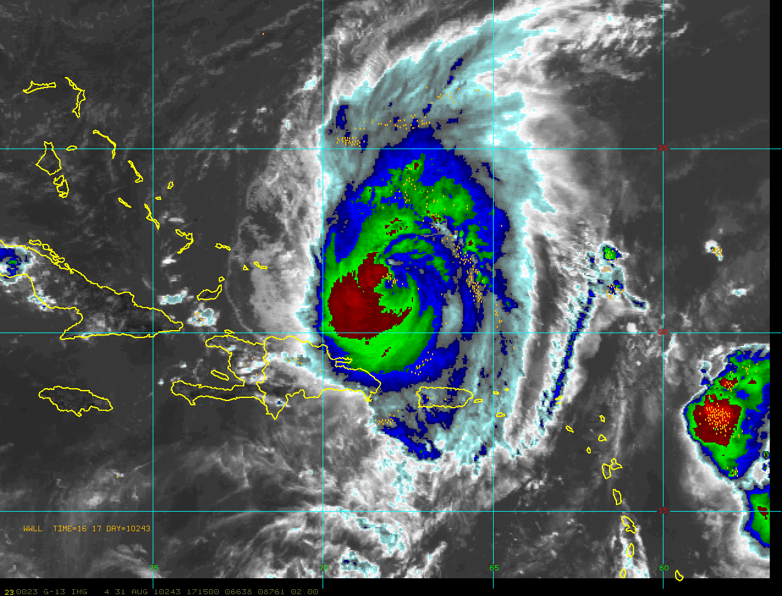
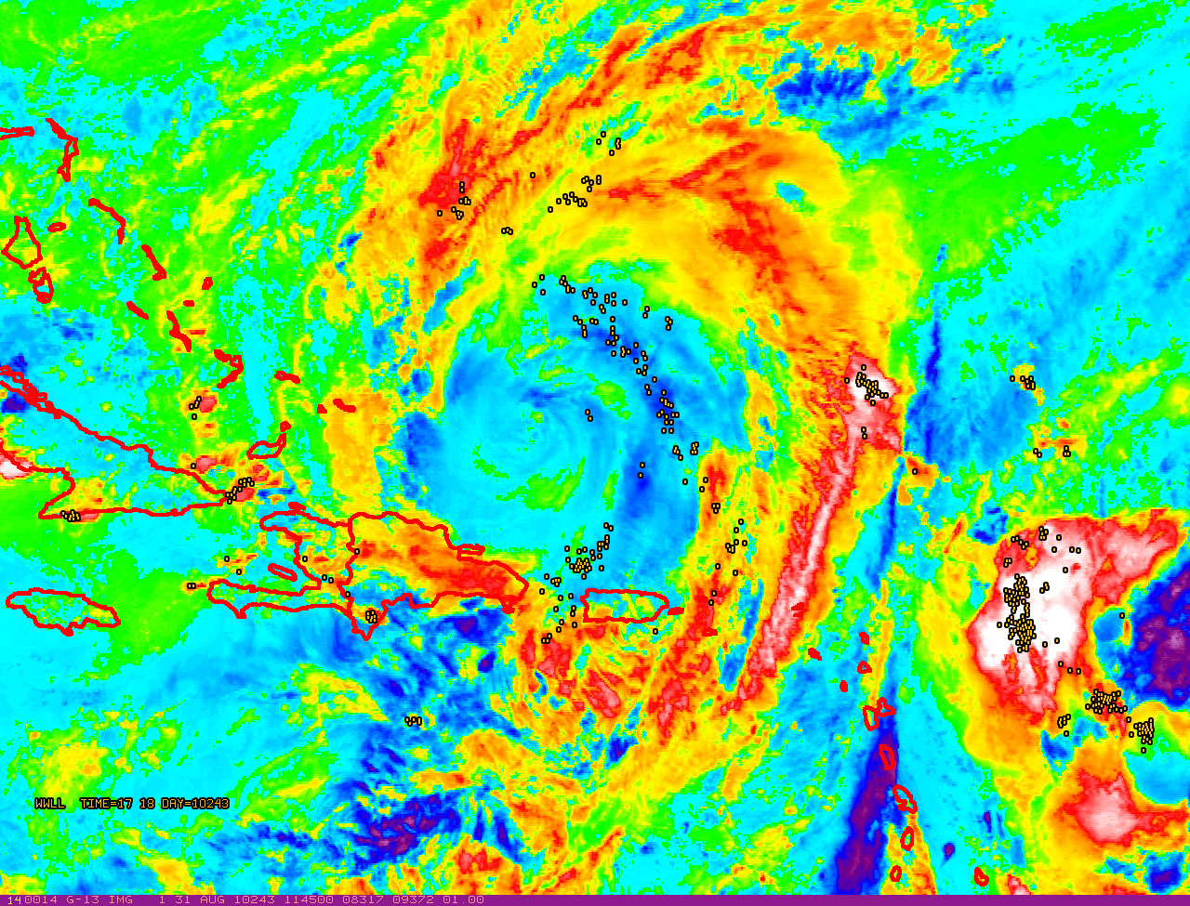
Hurricane Earl: 31 Aug 2010
(data from the World Wide Lightning Detection Location Network)
Imagery from: NOAA-HRD/UW-CIMSS/CIRA

Slide 15
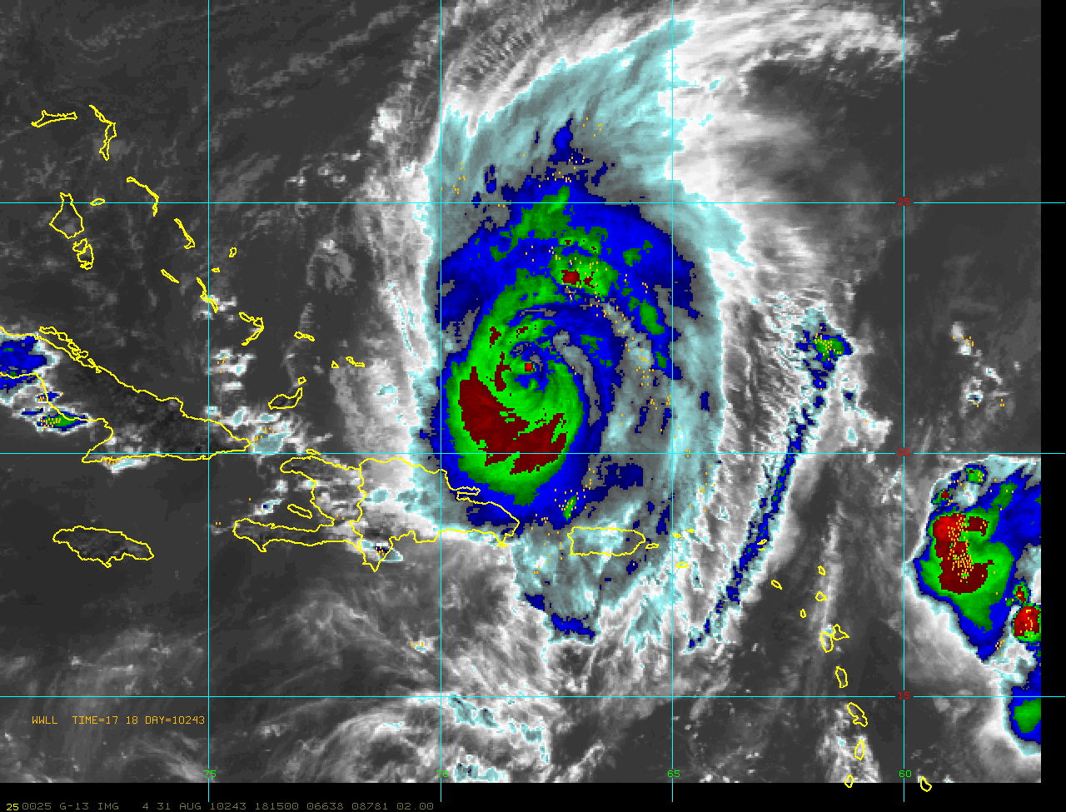
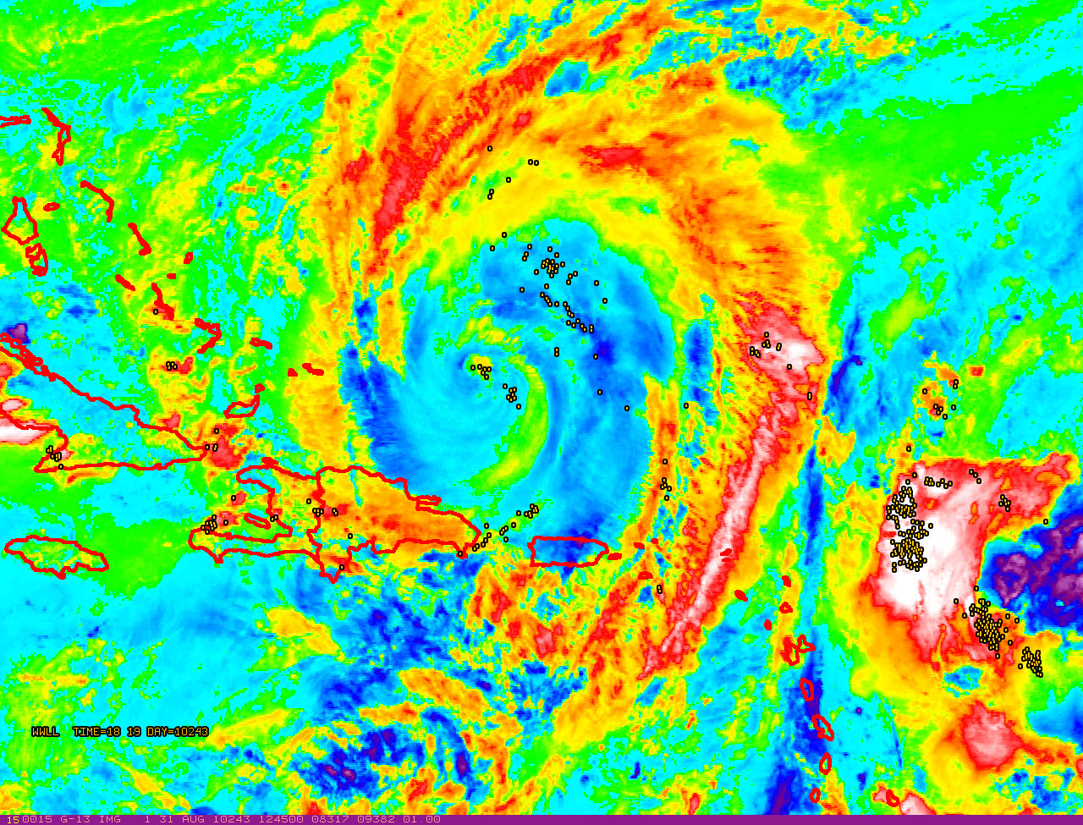
Hurricane Earl: 31 Aug 2010
(data from the World Wide Lightning Detection Location Network)
Imagery from: NOAA-HRD/UW-CIMSS/CIRA

Slide 16
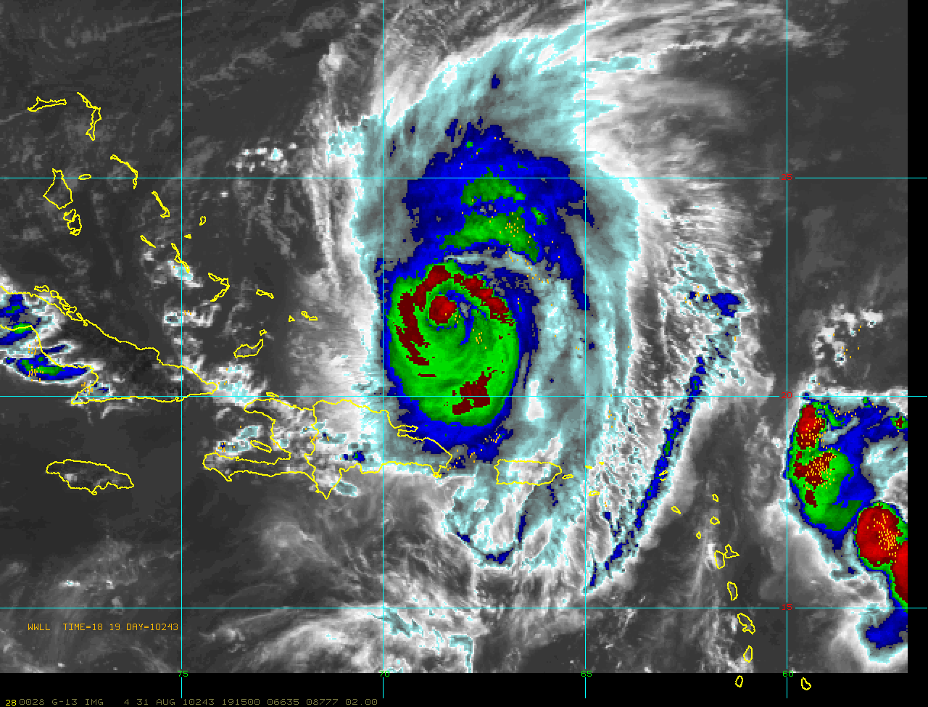
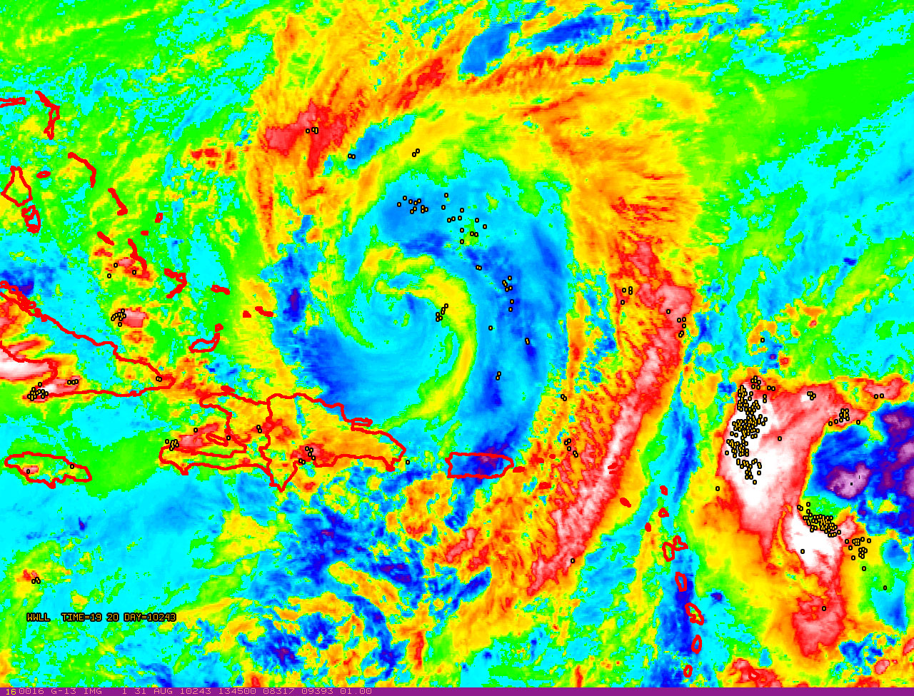
Hurricane Earl: 31 Aug 2010
(data from the World Wide Lightning Detection Location Network)
Imagery from: NOAA-HRD/UW-CIMSS/CIRA

