Slide 1
NASA Mission Tools Suite (MTS)
About MTS:
Purpose:
Support situation awareness during aircraft missions
Platform:
Can be run on any web browser
NOAA aircraft bandwidth >> too low to effectively run MTS
MTS-2 >> will include capability to run with low bandwidth
Access:
Password protected account
NOAA has its own dedicated account to support its missions
Training:
26 June 2019, 1300-1400 EDT (remote access TBD)

Slide 2
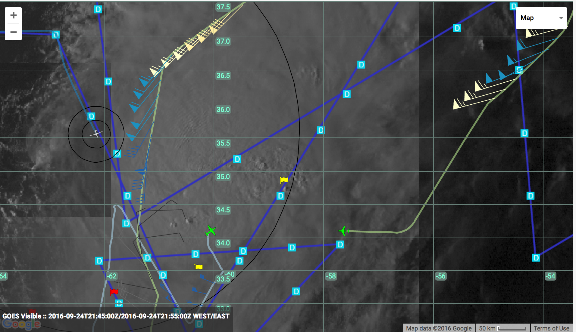
NASA Mission Tools Suite (MTS)
Hurricane Karl: 24 Sep 2016
Global Hawk
planned dropsondes
Global Hawk
25 nm range ring
NOAA
P-3 (N43)
NOAA
G-IV (N49)
NASA
Global Hawk
(N872)
Global Hawk
planned flight track

Slide 3
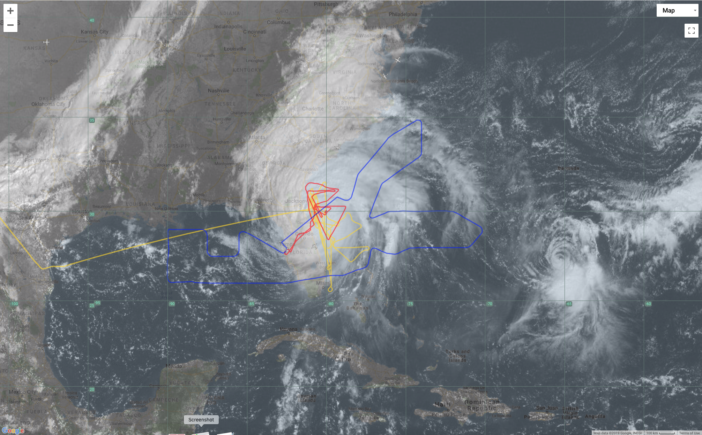
NASA Mission Tools Suite (MTS)
Hurricane Matthew: 7 Oct 2016
USAF 307: 0003-0854z
USAF 301: 0310-1100z
USAF 307: 1748-2348z
NOAA P-3: 1752-0130z
NOAA G-IV: 0553-1344z
Global Hawk: 0920-1915z
Questions for 53rd Weather Reconnaissance Squadron:
Interest in a dedicated MTS account?
  Access would be exclusively controlled by the AF
Possible to routinely integrate C-130 Hurricane Hunter locations into MTS?
  Blue Force trackers? HDOBS?
  Goal: promote inter-agency coordination and hazard avoidance

