Slide 1
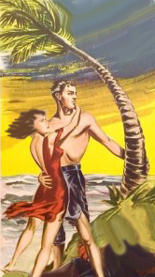
They Called the Wind Mahina
A history of the naming of cyclones
Neal M. Dorst
October 23, 2012
Atlantic Oceanographic and
Meteorological Laboratory

Slide 2
Motivation
Several emails prompted closer examination of subject
Most references were either inadequate or inaccurate
Will update our TCFAQ
Acknowledgments
Gloria Aversano, José Colon, Neil Frank, Andy Hagen, Diana Kohnke, Chris Landsea, Charlie Neumann, Bryan Norcross, Gary Padgett, John Pavone, Linda Pikula, David Reade, and Liz Skilton

Slide 3
Notes:
We are so used to using personal names for hurricanes and their use is so regulated that we have trouble remembering a time when tropical cyclones were NOT named.

Slide 4
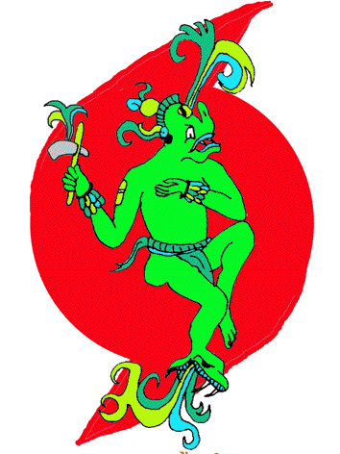
Derivation of the word “hurricane”
Hurakán or Hunrakán: “One leg”
One of the creator gods of ancient Maya
Popol Vuh codex: Destroyed race of wooden men by a terrible storm

Slide 5
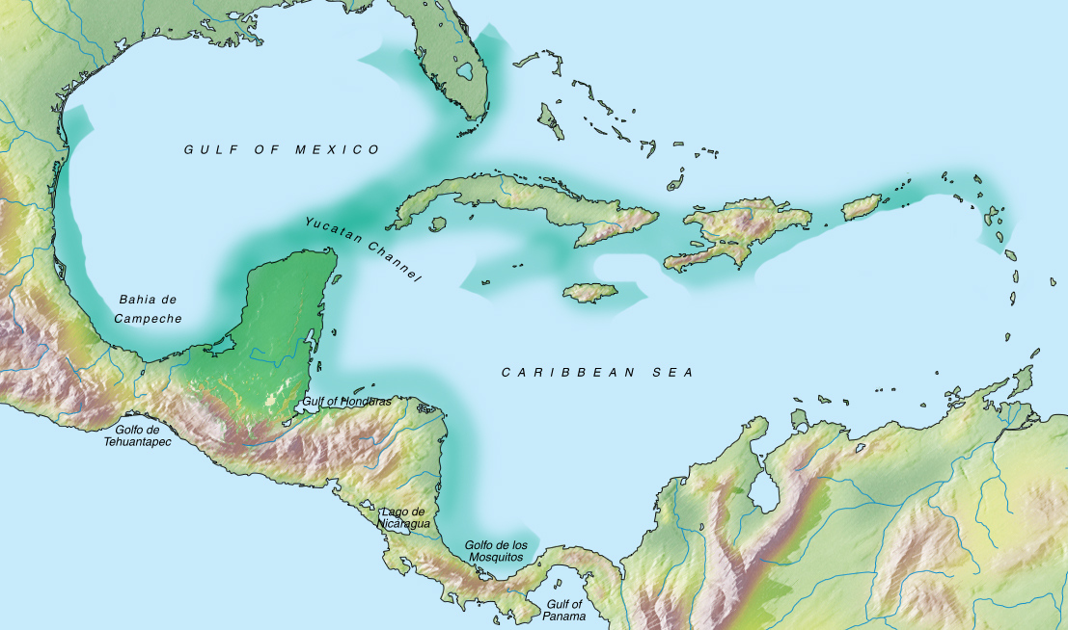
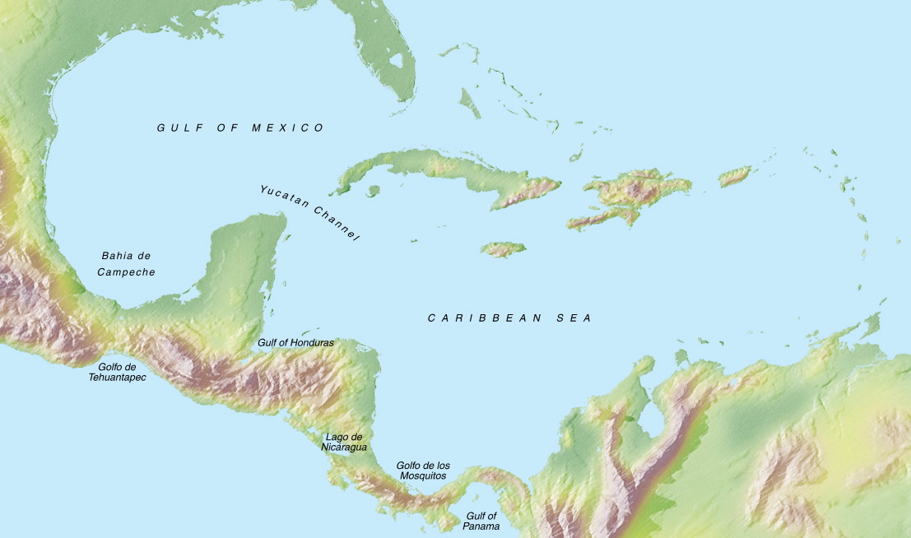
Mayan trade routes
Derivation of the word “hurricane”
Maya traded extensively throughout the Gulf of Mexico and Caribbean
With trade comes ideas
Evidence of Mayan counting system, calendar, and religious beliefs found throughout the area

Slide 6
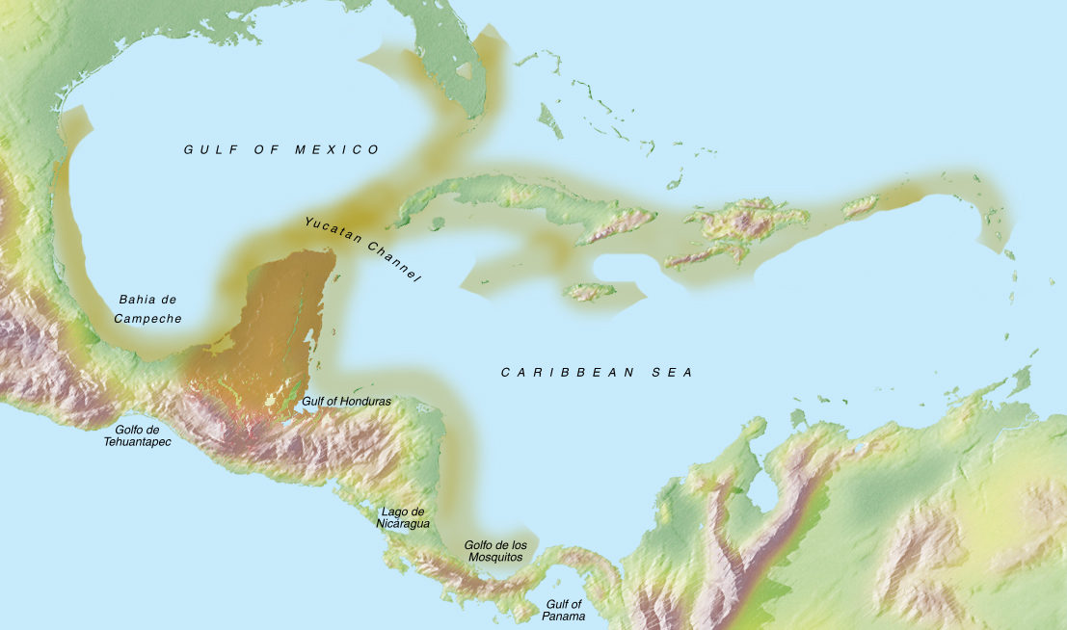
Mayan trade routes
Derivation of the word “hurricane”
Maya traded extensively throughout the Gulf of Mexico and Caribbean
With trade comes ideas
Evidence of Mayan counting system, calendar, and religious beliefs found throughout the area

Slide 7
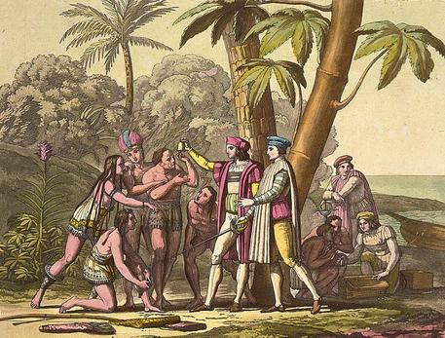
Derivation of the word “hurricane”
When Columbus encountered the Tainos on Hispañola they told him of the god Hurakán that brought great storms
Columbus encountered these storms twice on his voyages
Spanish sailors called them huracanes de los cuatro vientos
French and English sailors called them ouragans or hurricanes.
Notes:
huracanes de los cuatro vientos translates into “hurricanes of the four winds”

Slide 8
Early hurricane designations
Saint’s Feast Days
San Mateo 1575
San Rafael 1692
San Mateo 1804
Santa Ana 1825
San Felipe 1876
San Felipe 1928
Named post facto
Attempt to mark historical milestones
Associate with particular place, event, or time
Descriptive
Dreadful Harry Cane 1667
Salty Hurricane 1810
Great September Gale 1815
Yankee Hurricane 1935
Place Names
Great Colonial Hurricane 1635
Savannah-La-Mer 1780
Last Island 1856
Ships’ Names
Rising Sun Hurricane 1700
Racer’s Hurricane 1837
Antje’s Hurricane 1842
People’s Names
Solano’s Hurricane 1780
Dunbar’s Hurricane 1779
Saxby’s Gale 1869
Notes:
I.R. Tannehill’s “Hurricanes : their nature and history, particularly those of the West Indies and the southern coasts of the United States” (1938) p.257
D.M. Ludlum’s “Early American Hurricanes” (963) p.212
San Mateo feast day Sept. 21st
San Felipe feast day Sept. 13th

Slide 9
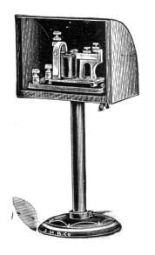
Telegraphy modernizes meteorology
Allowed central collection of simultaneous weather observations
Patterns of high and low pressure and their associated weather recognized
Forecast of future patterns
Instant dissemination of the forecast

Slide 10
Telegraphy modernizes meteorology
Smithsonian network 1849
Paris observatory 1854
UK Met office 1854
Manila Observatory 1865
US Weather Service 1870
Belem Observatory 1870
Danish Met Inst 1872
Indian Met Dept 1875
Japanese Met Org 1875
Finnish Central office 1881

Slide 11
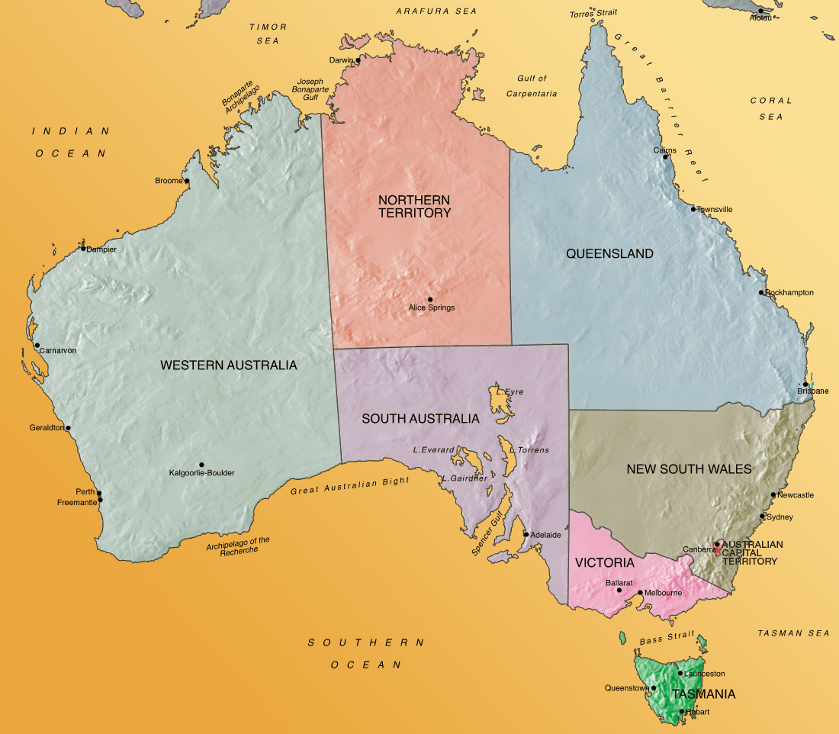
Australia
Late 19th Century
Notes:
Australia in late 19th century was NOT a unified nation rather a series of colonies and territories each with its own government. Each colony was responsible for organizing its own weather services
Usually under their telegraph office since modern meteorology was dependent on telegraphy to gather synoptic data.

Slide 12
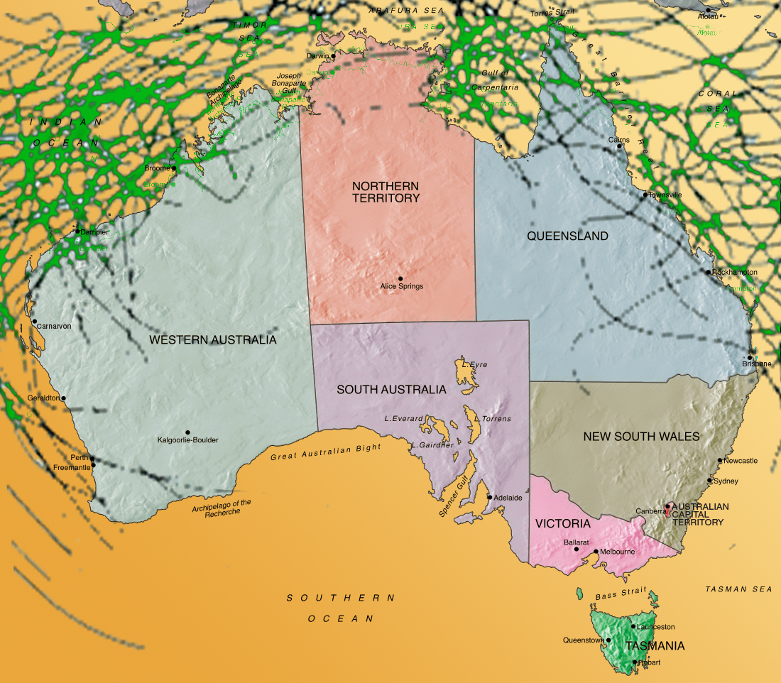
Australia
Late 19th Century
Notes:
Queensland was especially vulnerable to tropical cyclones forming over the Coral Sea. To protect shipping they needed a broad reaching, dedicated weather service.

Slide 13
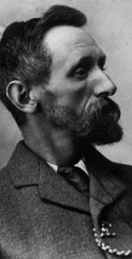
Clement L. Wragge
Born in Stourbridge, England in 1852
Orphaned at 5 years old
Raised by his aunts and uncles
Educated at Alleyne’s Grammar School and the Belvedere school
Took Latin and classics in Cornwall
Studied for the law at Lincoln’s Inn
After a world trip decided instead to study natural sciences and weather
John Oxley Library
Notes:
http://en.wikipedia.org/wiki/Clement_Lindley_Wragge

Slide 14
Clement L. Wragge
Set up weather stations in North Staffordshire
Wrote weekly for local newspapers and articles for the Midland Naturalist
Established mountain observatory on top of Ben Nevis
Earned a Gold Medal from the Scottish Meteorological Society
Moved with his family to Australia
John Oxley Library
Notes:
http://en.wikipedia.org/wiki/Clement_Lindley_Wragge

Slide 15
Clement L. Wragge
Set up weather stations in South Australia
Founding member of the Royal Meteorological Society of Australia
In 1887 hired by Queensland government to establish a weather service
Set up an extensive network of stations around Queensland and a system of storm signals to warn shipping
Established an observatory atop Mounts Lofty, Wellington and Kosciuszko
Expanded the scope of his forecasts to include other colonies
Bylined his bulletins “Chief Weather Bureau, Brisbane”
John Oxley Library
Notes:
http://en.wikipedia.org/wiki/Clement_Lindley_Wragge

Slide 16
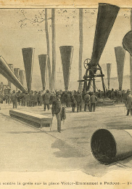
Clement L. Wragge
Purchased six Stiger vortex cannon for Queensland
Fired a blank charge which produced an enormous smoke ring
Supposed to dissipate hailstorms and produce rain
John Oxley Library
Notes:
http://en.wikipedia.org/wiki/Clement_Lindley_Wragge

Slide 17
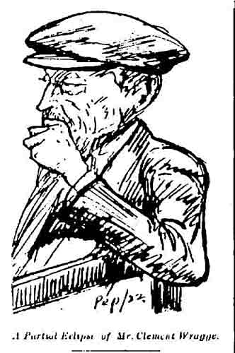
Clement L. Wragge
Aussies nicknamed him ‘Inclement’ Wragge and ‘Wet’ Wragge due to heavy rains early in his service
Wrote his forecast in a conversational style filled with literary allusions
In 1894 began to label extratropical cyclones with Hebrew letters and tropical cyclones with Greek letters
Hoped that names would help public track storms and remember which cyclones caused damage
Cyclone Mu 1895 and Cyclone Sigma 1896

Slide 18
Clement L. Wragge
By 1896 he had gone through the Hebrew and Ethiopian alphabets and was starting on Illyrian letters for ‘Antarctic’ cyclones
Decided to name extratropical storms after personal and place names drawn from classical literature and the Bible
Examples “Xerxes”, “Typhon”, and “Sychem”
Notes:
Western Mail, Perth, WA, Friday, November 1, 1895, p.11
“Typhon” was Greek “Father of all Monsters” and nothing to do with the term Chinese-derived term “typhoon”

Slide 19
Clement L. Wragge
For tropical cyclones he chose women’s names
Particularly the “soft dulcet names of the dusky beauties of the South Sea Islands”
Hoped to encourage Australian women to name their daughters with these “pretty, bubbling” appellations rather than ‘Susan’ or ‘Jane’
Notable examples Cyclone Eline 1898, Cyclone Mahina 1899, and Cyclone Leonta 1903
Notes:
The Brisbane Courier, Wednesday February 2, 1898 p. 5

Slide 20
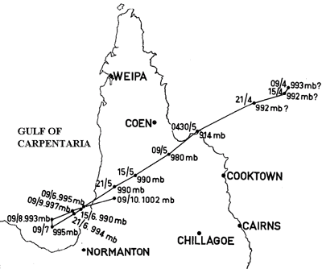
Cyclone Mahina 1899
Killed ~400 people
Destroyed the pearling fleet anchored in Bathurst Bay
World record storm surge of 13 meters (42 feet)
Recent scholarship points to a surge of about 5 meters (16 feet)
Wave run-up responsible for depositing porpoises on 14 meter cliffs
Notes:
“How high was the storm surge from Tropical Cyclone Mahina?”, Jonathan Nott & Matthew Hayne, Australian Journal of Emergency Management, Autumn 2000, p. 11-13

Slide 21
Australia United 1901
Notes:
In 1901, the various colonies and territories of Australia united under one federal government

Slide 22
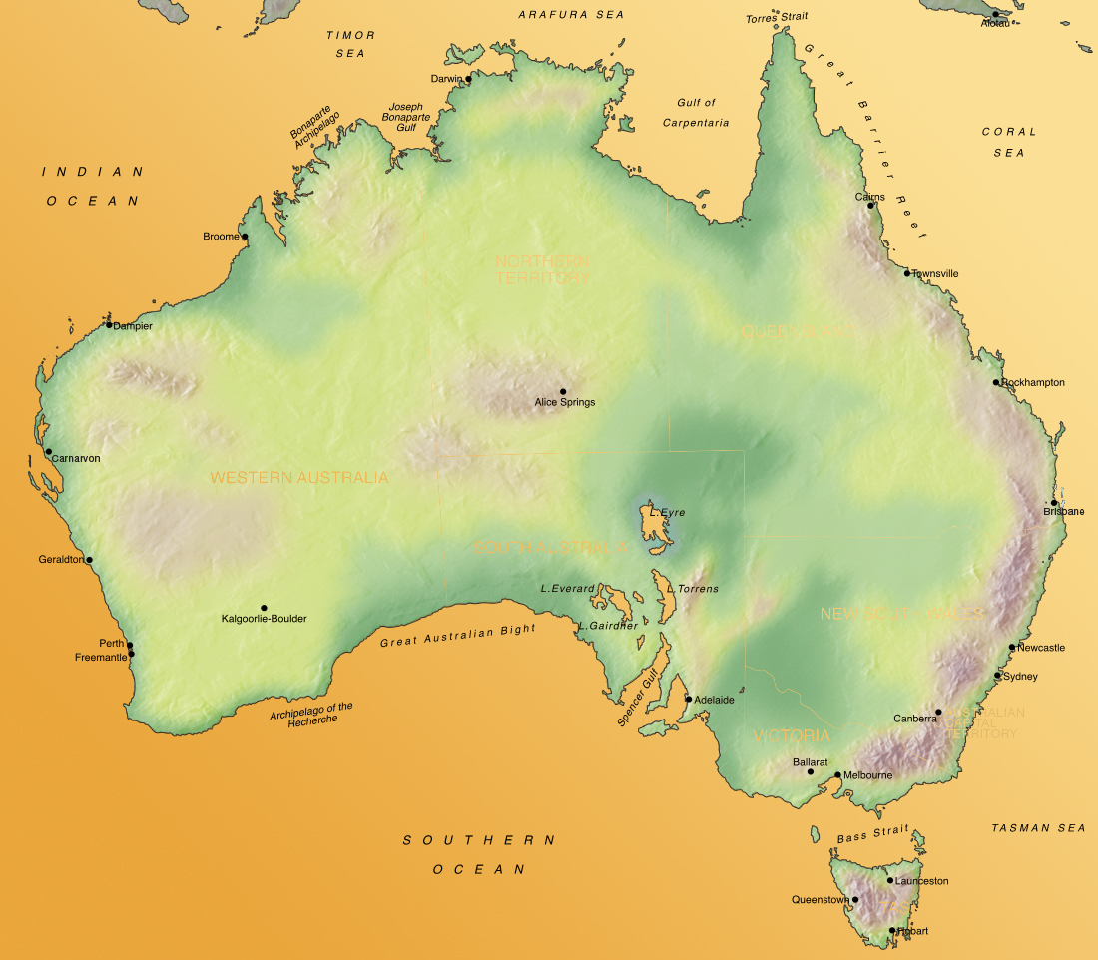
Australia United 1901
Notes:
The Commonwealth of Australia. Certain government services of the states were taken over by the federal government, such as telegraph and postal services. But not the various weather services and departments.

Slide 23
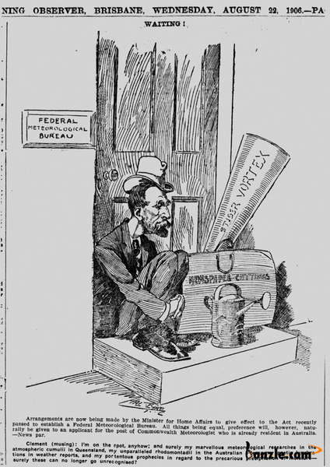
Clement L. Wragge
Advocated a federal meteorological bureau
Instead had to reorganize his weather bureau into a semi-private service
Persuaded other states to contribute and sold forecasts to the newspapers
Grew bitter about federal politicians and began naming Antarctic cyclones after them
Named storms after Alfred Deakin, Edmond Barton, and Charles Kingston
John Oxley Library
Notes:
Alfred Deakin, Edmond Barton, Charles Kingston

Slide 24
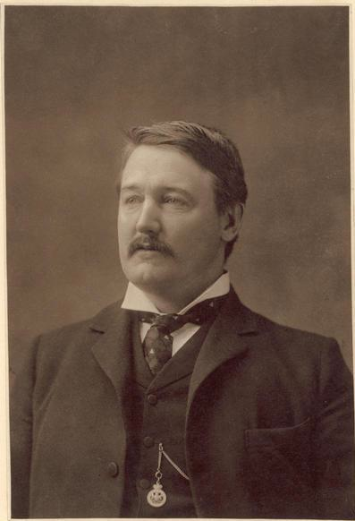
Alfred H. B. Conroy
MP for Werriwa NSW
Argued against federal subsidies for state weather services’ telegraph fees
Disparaged Wragge as a ‘Hottentot rain god’ and ‘an advertising scientist’
National Library of Australia
Notes:
Free Trade Party, Werriwa in western New South Wales

Slide 25
Clement L. Wragge
Named a midlatitude cyclone ‘Conroy’
“Conroy, looking black and suspicious”
“… we shall watch his movements with abnormal interest.”
Notes:
The Brisbane Courier, Tuesday, August 5, 1902, p.4

Slide 26
Clement L. Wragge
Named a midlatitude cyclone ‘Conroy’
“Conroy, looking black and suspicious”
“… we shall watch his movements with abnormal interest.”
Moved his Stiger Vortex Cannon west for rain experiments
“…we shall keenly enjoy the fun of bombarding him.”
Notes:
The Brisbane Courier, Tuesday, August 5, 1902, p.4

Slide 27
Alfred H. B. Conroy
Questioned Wragge’s scientific integrity
Said he attributed rain from one cyclone to another so his forecasts would verify
Voted to end any federal support for state weather services
National Library of Australia
Notes:
Free Trade Party, Werriwa in western New South Wales

Slide 28
Clement L. Wragge
Named a cyclone ‘Werriwa’
State support for his weather bureau dried up within the year
Closed down July 1903
Gave lectures on weather forecasting and magic lantern slide shows on astronomy
Set up a weather observatory in New Caledonia
In 1908 new federal Bureau of Meteorology director…
Notes:
The Brisbane Courier, Tuesday, August 5, 1902, p.4

Slide 29
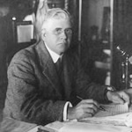
Henry A. Hunt
The decidedly less flamboyant and less controversial English meteorologist
Naming scheme for cyclones fell into disuse.
Wragge traveled the South Seas, wrote a book about it, and settled in Auckland, New Zealand
Bureau of Meteorology
Notes:
Free Trade Party, Werriwa in western New South Wales

Slide 30
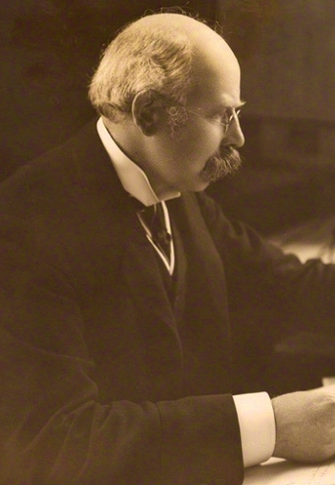
Gone but not forgotten
Wragge’s naming scheme occasional mentions in the press
1935 editorial advocating a restoration of the procedure siting Cyclone Pokol
Mentioned in Sir Napier Shaw’s “Manual of Meteorology”
Not endorsing Wragge’s practice, likened it to child naming waves
Notes:
Launceston Examiner, Saturday October 5, 1935, p.15
Shaw was director of British Met Office 1905-1920

Slide 31
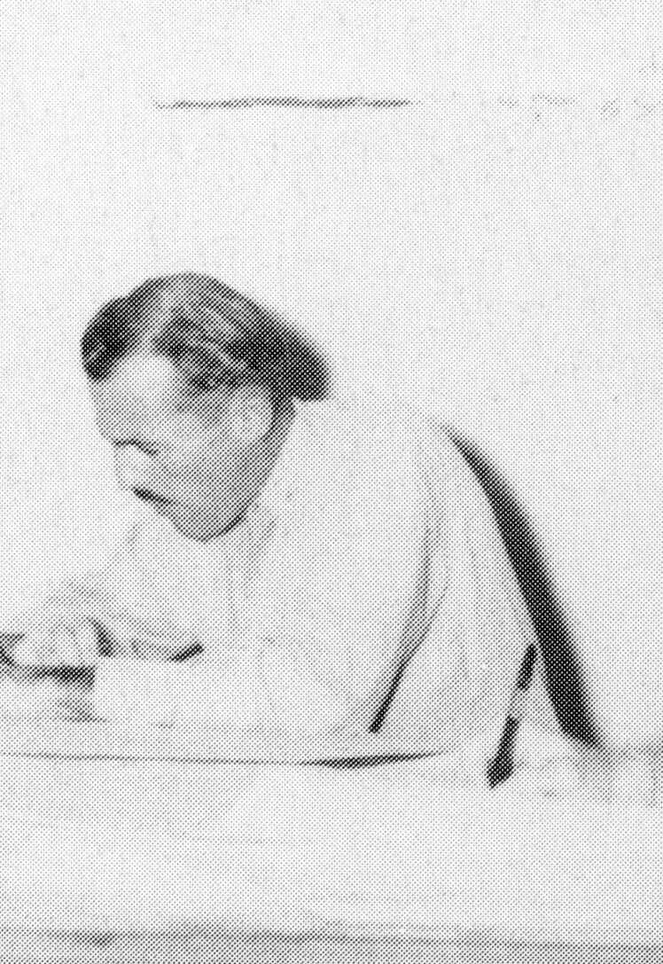
Gone but not forgotten
Edward B. Buxton, Pan American meteorologist is assigned to Auckland to study weather on possible Hawai'i to New Zealand route
Hears about Wragge’s naming scheme and adopts it
Joins Army Air Corps when US enters World War II
USAAF
Notes:
I.R. Tannehill, “The Hurricane Hunters”, Dodd/Mead, & Co., 1955, p.245

Slide 32
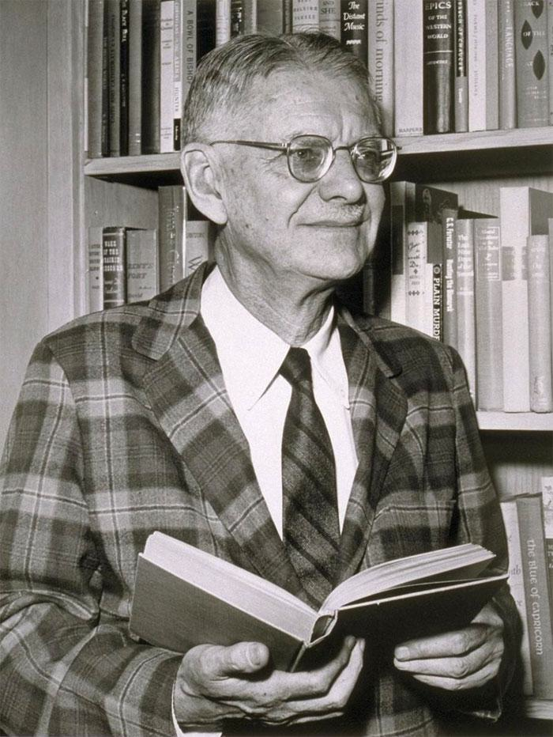
George R. Stewart
U Cal Berkeley English professor and novelist
On sabbatical in Mexico 1937-38 finishing his novel “Doctor’s Oral”
Read about midlatitude storm lashing California in local newspapers
Found that reading about his home state in foreign papers in a foreign language gave him a detached perspective
Decide to write a novel about a storm lashing the California coast

Slide 33
George R. Stewart
Frequently visited the San Francisco Weather Bureau office
Read Shaw’s “Manual of Meteorology”
Learned of Bjerknes’ life cycle of polar storms
Saw storm at novel’s center as a character in the story
Read Shaw’s account of Wragge
Thought a name would make storm a character
He called the storm Maria
Human characters not named
Notes:
In a modernist twist did not give names to human characters in his novel

Slide 34
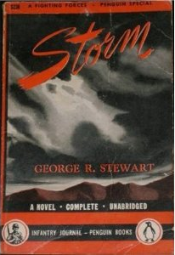
“Storm”
Published by Random House in November 1941
Book-of-the-Month club
Positive reviews in New York Times and BAMS
Book signing tour and movie rights auction cancelled after Pearl Harbor attack
Tens of thousands of copies sold including a special edition for GIs
Notes:
BAMS = Bulletin of American Meteorological Society. In early 1940s, BAMS not usually given to writing reviews of fictional books.

Slide 35
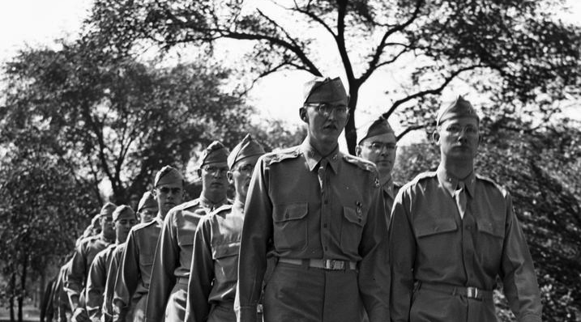
World War II
University of Chicago Library
Meteorology cadet programs established at MIT, Univ. Chicago,
New York University, UCLA, and Cal Tech. All focused on midlatitude
weather and all but Cal Tech emphasized theoretical training not
forecasting.
Notes:
US military needed soldiers, sailors, Marines, …. And meteorologists. MIT & Uchicago = Rossby, NYU = Athelstan Spilhaus, UCLA = Sverre Peterson, Cal Tech = Theodore von Karman

Slide 36
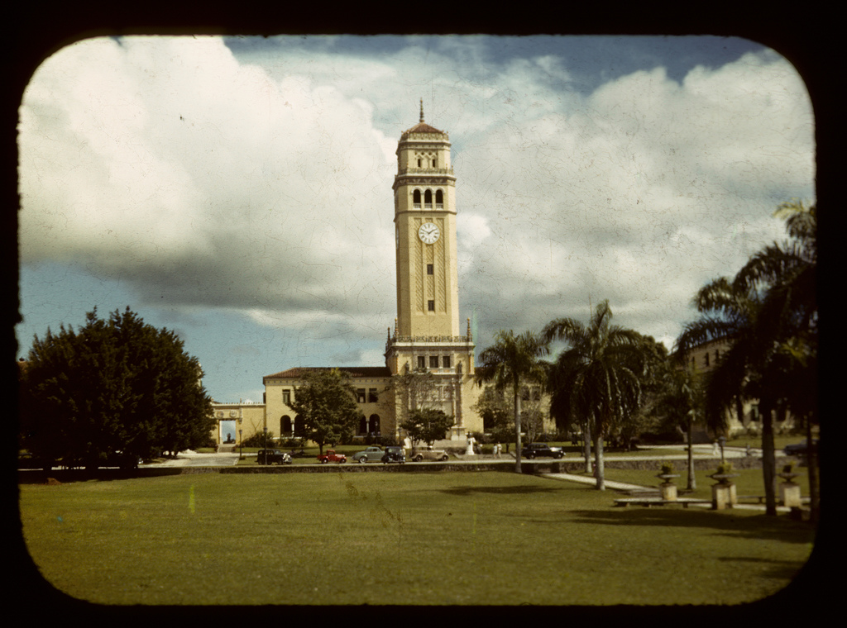
Institute of Tropical Meteorology
To improve tropical forecasting a joint institute between Univ. Chicago and Univ. of Puerto Rico was formed in 1943
Clarence Palmer, Herbert Riehl, and Gordon Dunn instructors
Emphasis on tropical weather and tropical cyclones
Use of aerial reconnaissance
Reid Bryson graduates in 1944
Universidad de Puerto Rico
Notes:
ITM at the Rio Piedras campus trained cadets from all of the university meteorology programs.

Slide 37
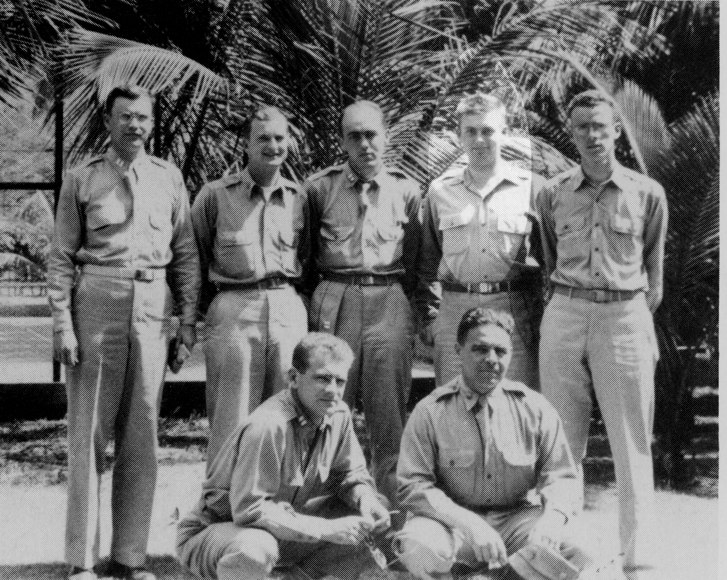
Saipan
Clifford Erickson
In 1944, a forward weather center was established by the USAAF on
the island of Saipan to forecast weather for bombing raids on Japan.
Reid assigned as tropical expert. E.B. Buxton was forecast expert.
Notes:
Norm Klivansk Martin Sebode, Clifford Erickson, Hopkins, James Barnett, Reid Bryson, Bill Plumley
Bryson’s tent mate on Saipan was Edward Lorenz

Slide 38
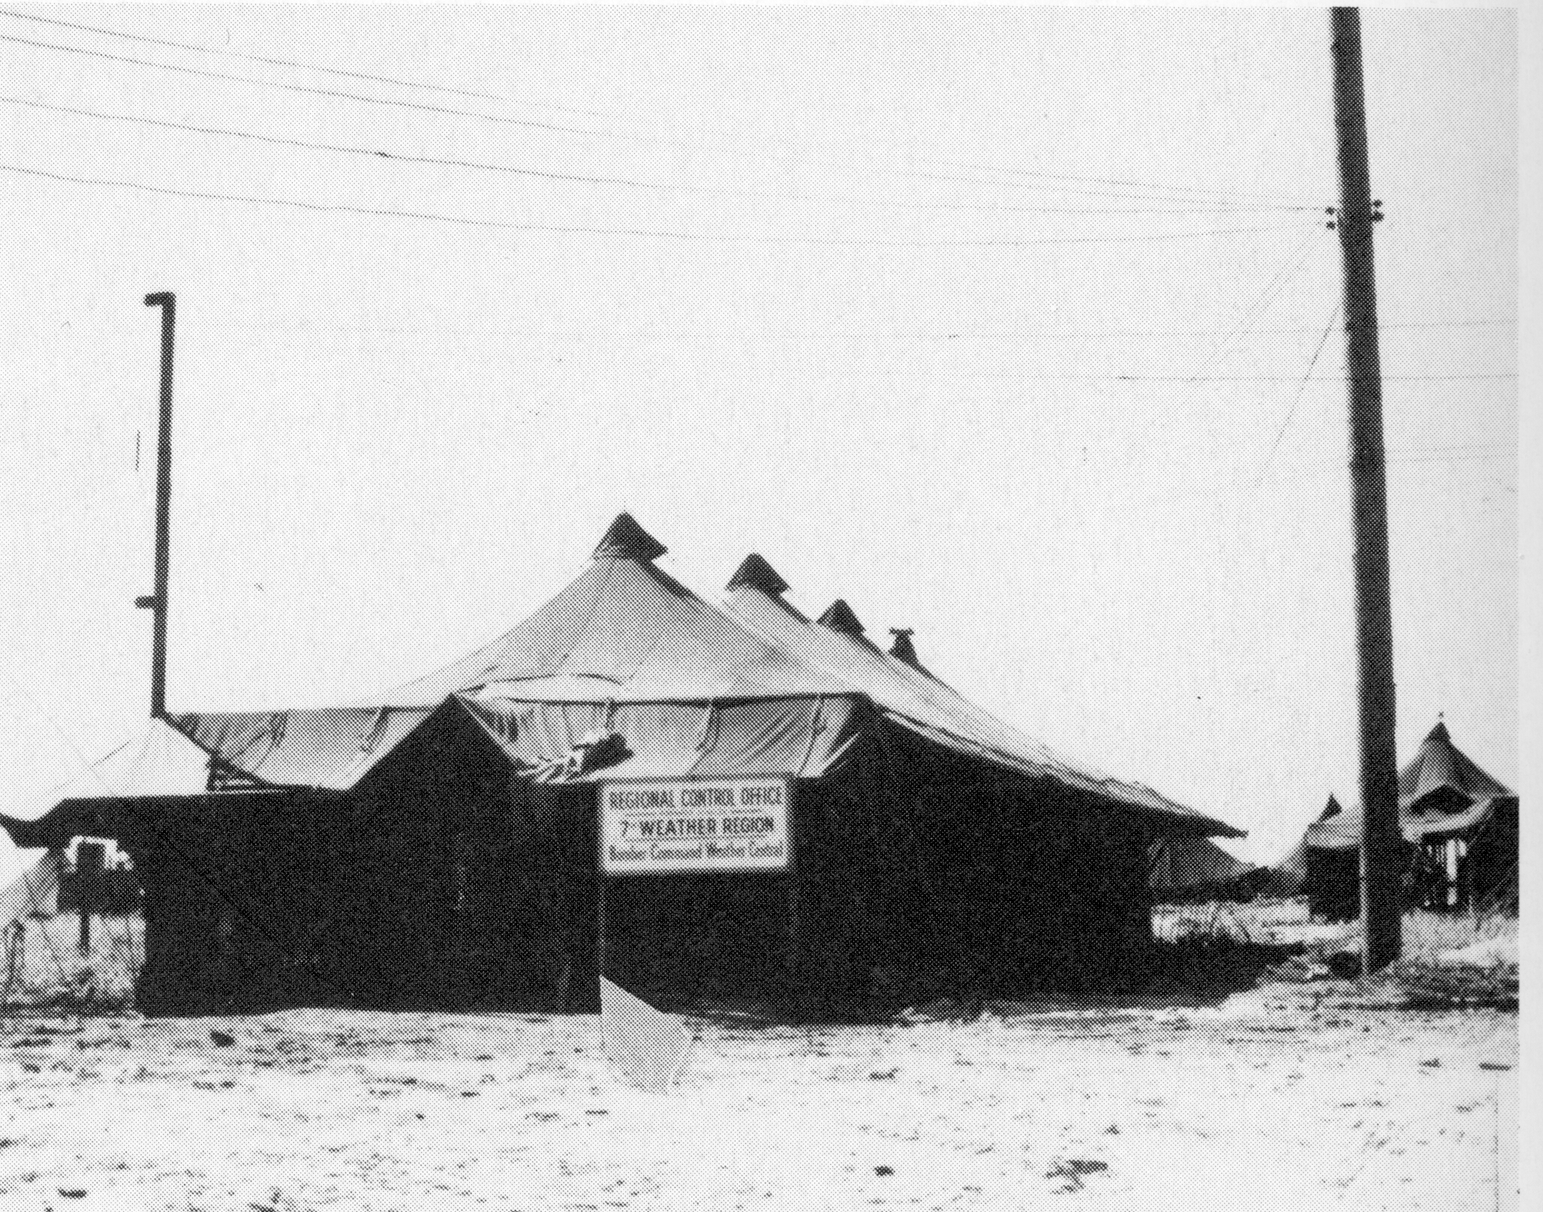
Saipan
Lester Gaynor
Bryson began the difficult task of detecting typhoons using minimal
data from wide regions of the ocean. Everyone had read George
Stewart’s “Storm”, and Buxton knew about Wragge, so naturally they
began naming storms after their wives and sweethearts.
Notes:
From interview of Bryson “Univ of Wisconsin Oral History Project” Interview #320 April 1986
7th Bomber Command weather central tent on Saipan. Reid named a storm after his wife Franny and Bill Plumley after his wife Denata.

Slide 39
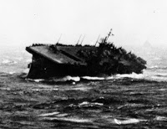
Typhoon Cobra
Cmdr. George Kosco, Halsey’s chief aerologist, labeled December 1944 typhoon “Cobra”
Also called June 1945 typhoon “Viper”
Unknown if these code names were used in operations or made up for his 1967 book.
U.S. Navy
Notes:
USS Monterey in high seas during Typhoon Cobra

Slide 40
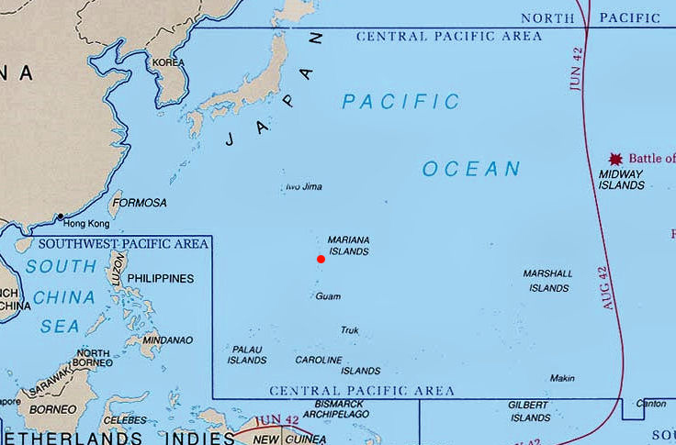
West Pacific 1945
Notes:
At the beginning of 1945 the AAF Central Pacific weather center was moved from Saipan …

Slide 41

West Pacific 1945
Notes:
To Guam and greatly expanded. The Navy also created an forward weather center on Guam in May of 1945.

Slide 42
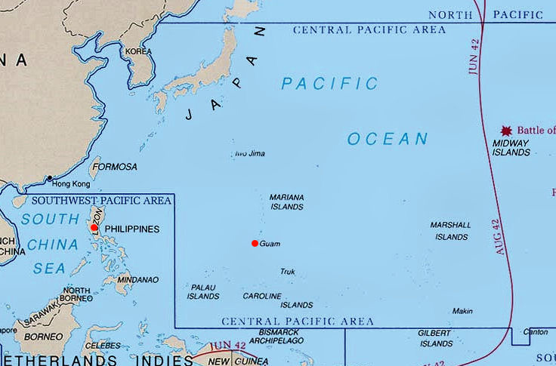
West Pacific 1945
Notes:
Also a new AAF weather center was established at Fort McKinley outside of Manila. Another Navy weather center was created neat there to facilitate forecasting for Philippine operations.

Slide 43
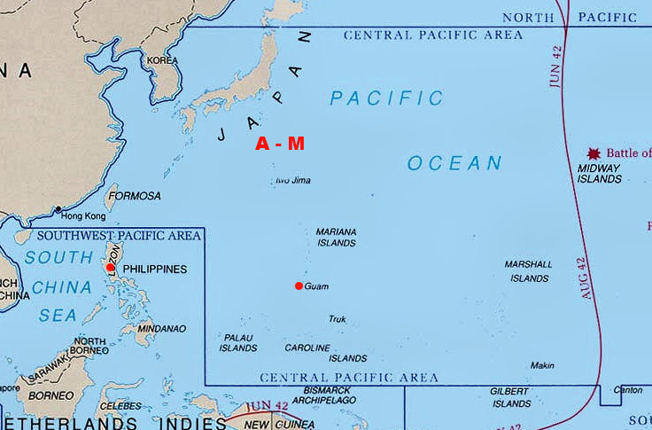
West Pacific 1945
Notes:
Responsibility for detecting and forecasting typhoons was divided between theaters of operation. For those systems forming in the Central Pacific names were
Selected from a list of names A-M

Slide 44
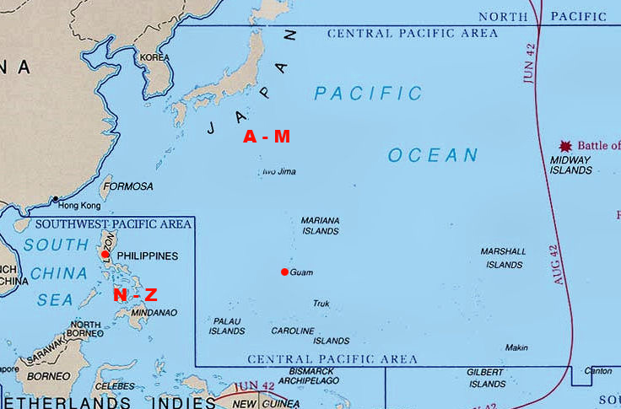
West Pacific 1945
Notes:
And for those forming in the Southwest Pacific Theater names from N-Z were selected.

Slide 45
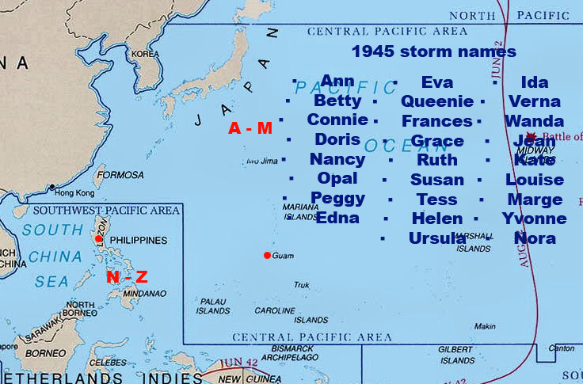
West Pacific 1945
Notes:
Looking at the list of 1945 names they seem to jump from one part of the alphabet to another. Oscar Senter lent his wife’s name “Ruth” to this list

Slide 46
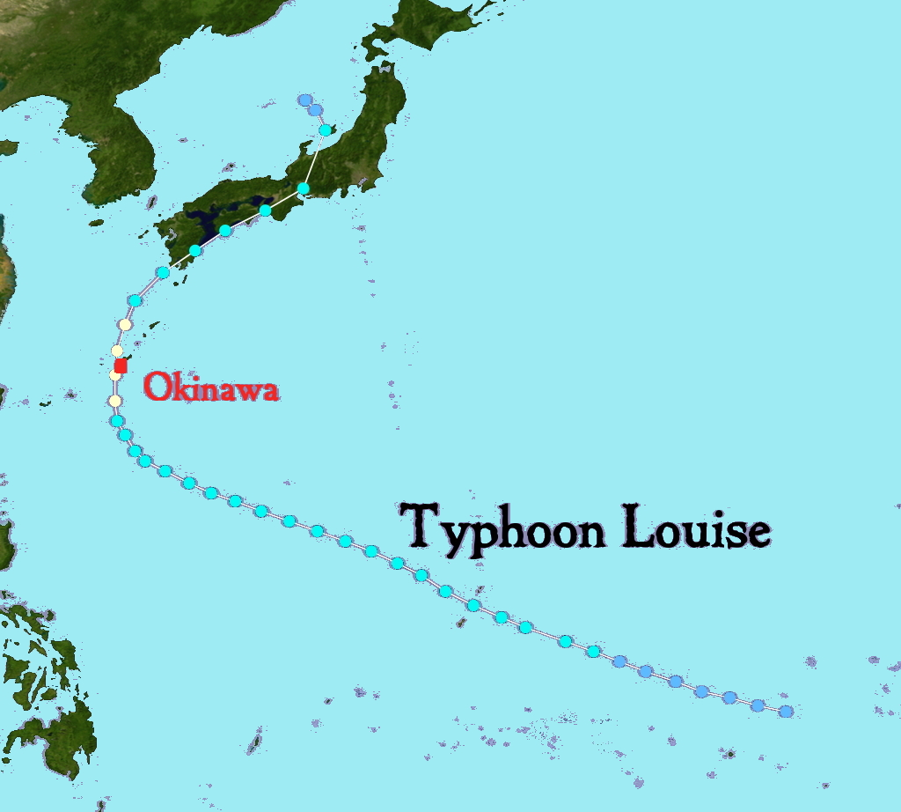
Typhoon Louise 1945
Typhoon Louise strikes Okinawa, hindering return of men and material from West Pac
End of wartime restrictions, press carries articles about “Typhoon Louise”
Notes:
Typhoon Louise strikes Okinawa, hindering return of men and material from West Pac
End of wartime restrictions, NYT carries article about “Typhoon Louise”

Slide 47
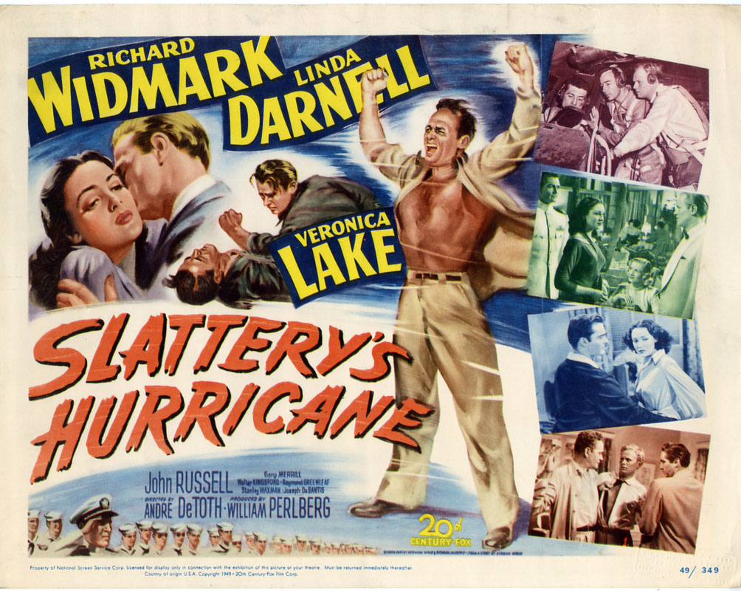
Atlantic 1945
Name hurricanes after weather officer on flight that discovers the storm
Kappler’s Hurricane was a major hurricane that traveled up the Florida peninsula
Radar movie made by Lt. Dave Atlas
Inspires Herman Wouk’s “Slattery’s Hurricane” (1949)
Notes:
Lt. Bernard J. Kappler was weather officer on flight which detected a hurricane that threatened Florida
In the movie, Wil Slattery flies a hurricane mission for a friend he’d betrayed. Locates the storm and Miami hurricane office names storm for him.

Slide 48
Atlantic 1946
Squadrons and meteorologists from Pacific theater rotated state-side to handle hurricane reconnaissance
Request USWB that women’s names be used for hurricanes
USWB feels system was OK for lovelorn, home sick crews halfway around the world but not appropriate in dealing with US public
Notes:
Email from Bob Simpson

Slide 49
Atlantic 1947
Army/Navy Phonetic Alphabet
A Able M Mike Y Yoke
B Baker N Nan Z Zebra
C Charlie O Oboe
D Dog P Peter
E Easy Q Queen
F Fox R Roger
G George S Sugar
H How T Tare
I Item U Uncle
J Jig V Victor
K King W William
L Love X X-ray
Instead the Air Force adopted an operational system using the Army/Navy phonetic alphabet to identify storms
Used for communications between aircraft and weather centers but NOT included in any public messages.

Slide 50
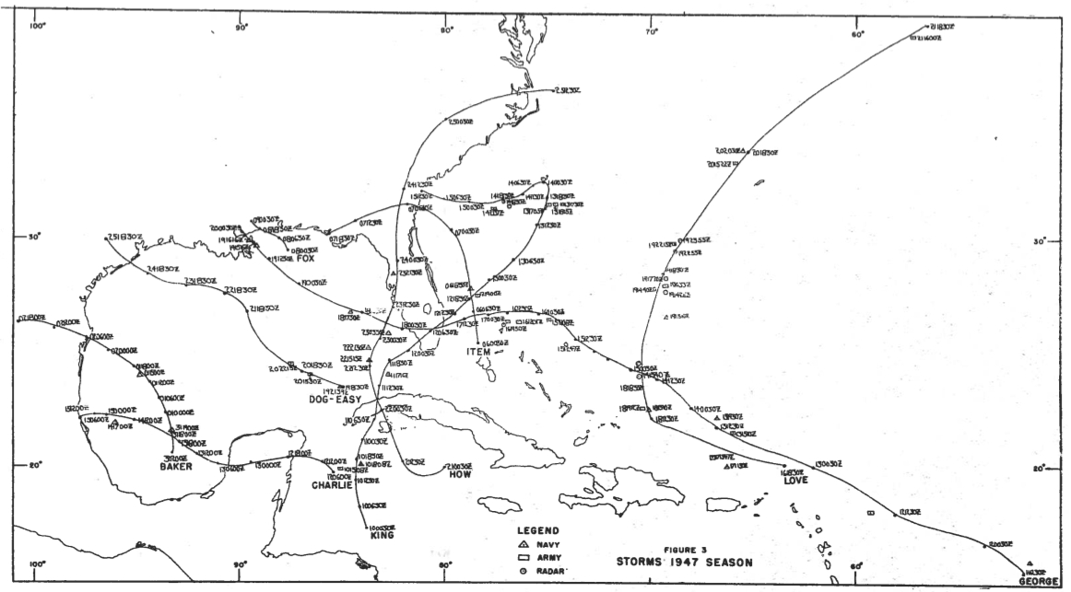
Atlantic 1947
Used in season summary by the Air Force Hurricane Office
Hurricane “King” dumps torrential rain on S. Fla.
Seeded by Project Cirrus
Simpson flies two piggyback missions into Hurricane “George”
Notes:
Notable storm Hurricane “George” in which Dr. Bob Simpson flew along on two Air Force flights to study storm structure
Hurricane “King” which caused great flooding in south Florida leading to formation of S Fla Water Management
District and was seeded by Navy and GE Labs as part of Project “Cirrus” when off Jacksonville. Storm swerves westward and strikes Savannah.

Slide 51
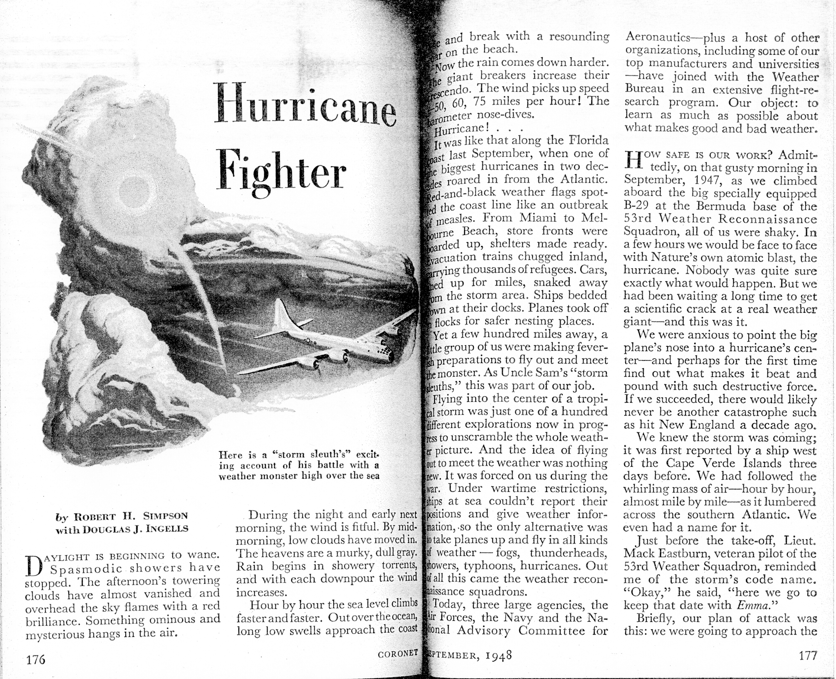
Atlantic 1947
“George” or “Emma?”
“Emma” used in Coronet article
Possible female name list used by Air Force
Not shared with Weather Bureau
“Bess” in 1949
Documentation needed
Notes:
Robert H. Simpson and Douglas J. Ingells, “Hurricane Fighter”, Coronet magazine, Sept. 1948, p. 176-180
Haven’t been able to verify any informal use of women’s names by Air Force crews.

Slide 52
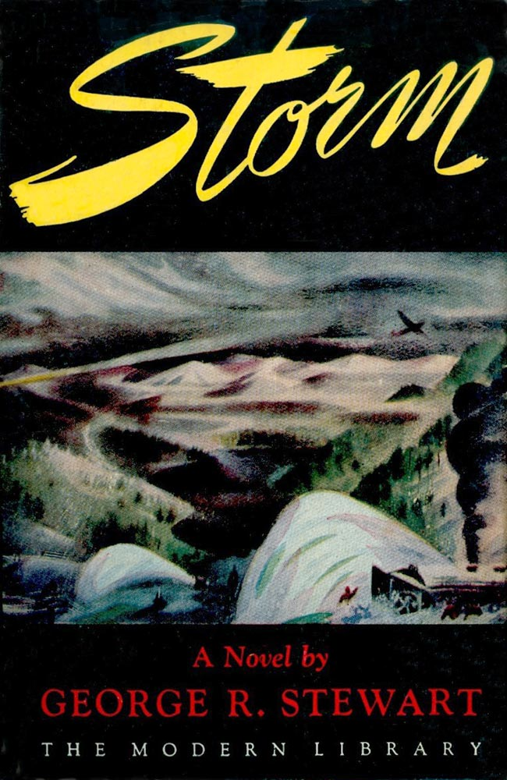
Re-issue of “Storm”
In 1947, The Modern Library re-issues “Storm”
Includes a new introduction from Stewart
Explains his inspiration from Wragge via Shaw’s Manual of Meteorology
Offers the correct pronunciation of Maria with the long ‘I’

Slide 53
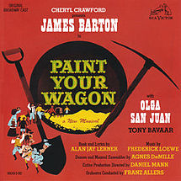
“Paint Your Wagon”
In 1951, Alan J. Lerner and Frederick Loewe collaborate on the Broadway musical “Paint Your Wagon”
Set in California during the Gold Rush
Hit song “They Call the Wind Maria”
Said to be inspired by Stewart’s novel
Has the same spelling and pronunciation of Maria with the long ‘I’
Notes:
Unable to find a reference that directly quotes Lerner on the inspiration for this song

Slide 54
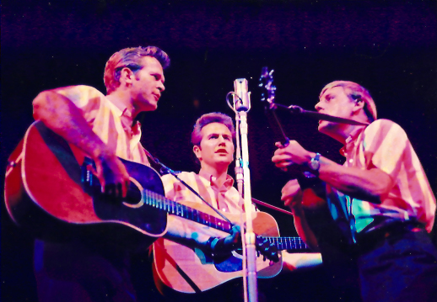
“They Call the Wind Maria”
Break away hit song
Folk music qualities “sad, wistful song”, “haunting”, evoking “emptiness”
Covers by Vaughn Monroe, Kingston Trio, Robert Goulet, and Burl Ives
Notes:
Composer Lehman Engel on folk qualities, historian Robert Wells on ‘sad and wistful’, Theater historian Don Wilmeth on ‘haunting’ and ‘emptiness’

Slide 55
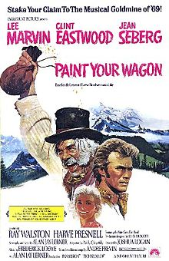
“Paint Your Wagon”
In 1969, Alan J. Lerner produces a movie version of “Paint Your Wagon”
Marvin and Eastwood sing!
Harve Presnell handles “They Call the Wind Maria”
Revives interest in the song
Inspires Patricia Hickey Carey to name her daughter Mariah
Notes:
Mariah Carey’s name spelled with an ‘H’ on the end to ensure proper pronunciation

Slide 56

“A Storm Called Maria”
Disney Studios purchases movie rights to “Storm”
In 1959 ‘Wonderful World of Disney’ TV show broadcasts an hour long episode “A Storm Called Maria”
Incorporates footage from NHRP research flights
Notes:
NHRP = National Hurricane Research Project, predecessor of AOML/Hurricane Research Division

Slide 57
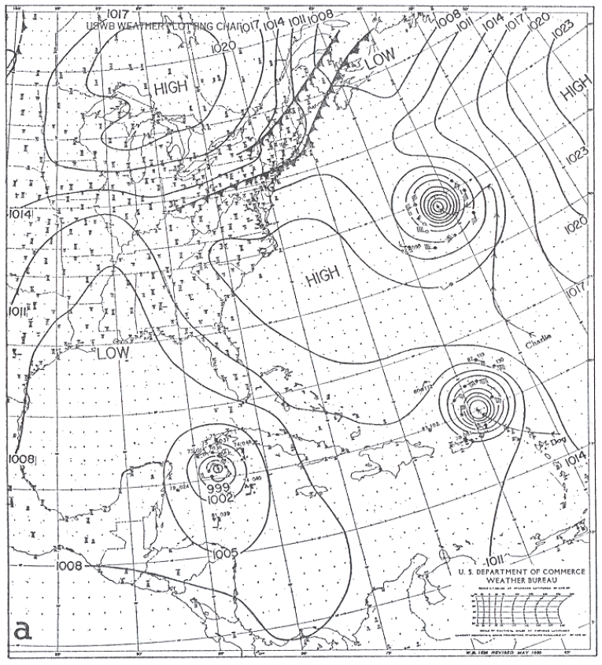
1950 Hurricane Season
Phonetic alphabet designations only operational
Short but busy season
Extraordinary three hurricanes simultaneous in Atlantic basin
Confusion among public and press
For next storm “Fox” designation used in public statements
Continued use of names through rest of busy season but not used by press
Used in post season summary
Notes:
I.R. Tannehill, “The Hurricane Hunters”, Dodd/Mead, & Co., 1955, p.246
Grady Norton, Hurricanes of the 1950 Season, Monthly Weather Review, Jan. 1951,p. 8-15
First post season summary written by Miami staff, previously written by USWB HQ

Slide 58
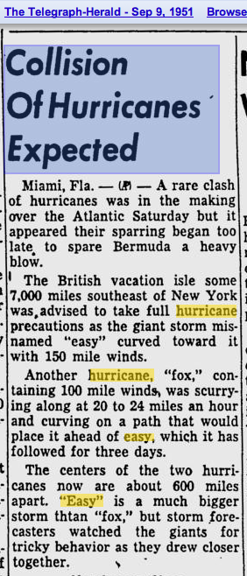
1951 Hurricane Season
Naming system made official
Picked up by the press for Hurricane “Charlie” when it hits Mexican coast
Useful when Hurricanes Easy and Fox pull a ‘Fujiwara’
Notes:
I.R. Tannehill, “The Hurricane Hunters”, Dodd/Mead, & Co., 1955, p.246

Slide 59
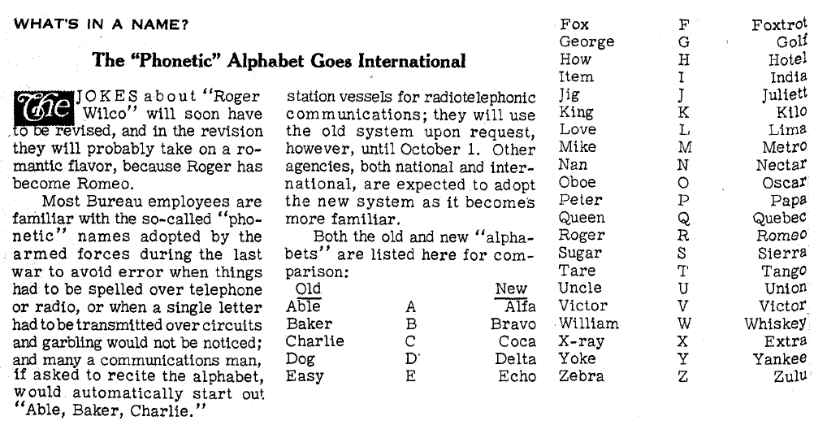
1952 Hurricane Season
International phonetic alphabet adopted
Army/Navy system too Anglo-centric
Confusion over which list to use, esp. with Charlie vs. Coca
1953 IHC - USWB accedes to military over use of women’s names
Notes:
Topics of the Weather Bureau, March 1952, v. 11 n.3, p.38
I.R. Tannehill, “The Hurricane Hunters”, Dodd/Mead, & Co., 1955, p.247-248
IHC = Interdepartmental Hurricane Conference (USWB, USAF, USN, other Gov’t agencies meet to discuss operations)

Slide 60
1953-4 Hurricane Seasons
Alice
Barbara
Carol
Dolly
Edna
Florence
Gilda
Hazel
Irene
Jill
Katherine
Lucy
Mabel
Norma
Orpha
Patsy
Queen
Rachel
Susie
Tina
Una
Vicky
Wallis
Names readily used in the press
Few objections in 1953
Repeat same names in 1954
Carol, Edna, and Hazel wreak havoc over populated northeastern corridor
Notes:
I.R. Tannehill, “The Hurricane Hunters”, Dodd/Mead, & Co., 1955, p.247-248

Slide 61
1954 Hurricane Season
Controversy rages over use of women’s names
Felt to be ungentlemanly
Rep. Jim Tumulty (D-NJ) threatens to pass name ban
Weather Bureau claims 99% of correspondence supports use of women’s names
A stripper named Julie Gibson requested her name be included
She sends photo of herself to make the case
Second Alice in 1954
Notes:
“Favors Law To Stop Girls’ Names for Hurricanes”, Times-News, March 2, 1955
“Girls’ Names For Storms Are Criticized in North”, Miami News, Oct. 18, 1954
Second Alice not detected until Jan. 1st, given first name on list, but post-analysis shows it formed in late December.

Slide 62
1955 Hurricane Season
Brenda
Connie
Diane
Edith
Flora
Gladys
Hilda
Ione
Janet
Katie
Linda
Martha
Nellie
Orva
Peggy
Queena
Rosa
Stella
Trudy
Ursa
Verna
Wilma
Xenia
Yvonne
Zelda
New list of names created
Carol, Edna, and Hazel retired for ten years
For next five years a new list is created every year at the IHC
Notes:
I.R. Tannehill, “The Hurricane Hunters”, Dodd/Mead, & Co., 1955, p.248

Slide 63
1960 Hurricane Season
1960
Abby
Brenda
Cleo
Donna
Ethel
Florence
Gladys
Hilda
Isbell
Janet
Katy
Lila
Molly
Nita
Odette
Paula
Roxie
Stella
Trudy
Vesta
Winny
1961
Anna
Betsy
Carla
Debbie
Esther
Frances
Gerda
Hattie
Inga
Jenny
Kara
Laurie
Martha
Netty
Orva
Peggy
Rhonda
Sadie
Tanya
Virgy
Wenda
1962
Alma
Becky
Celia
Daisy
Ella
Flossie
Gretta
Hallie
Inez
Judith
Kendra
Lois
Marsha
Noreen
Orpha
Patty
Rena
Sherry
Thora
Vicky
Wilma
1963
Arlene
Beulah
Cindy
Debra
Edith
Flora
Ginny
Helena
Irene
Janice
Kristy
Laura
Margo
Nona
Orchid
Portia
Rachel
Sandra
Terese
Verna
Wallis
4-year rotating lists are developed to avoid having to make up new lists each year
Names starting with Q, U, X, Y, and Z removed

Slide 64
1960 Hurricane Season
1960
Abby
Brenda
Cleo
Donna
Ethel
Florence
Gladys
Hilda
Isbell
Janet
Katy
Lila
Molly
Nita
Odette
Paula
Roxie
Stella
Trudy
Vesta
Winny
1961
Anna
Betsy
Carla
Debbie
Esther
Frances
Gerda
Hattie
Inga
Jenny
Kara
Laurie
Martha
Netty
Orva
Peggy
Rhonda
Sadie
Tanya
Virgy
Wenda
1962
Alma
Becky
Celia
Daisy
Ella
Flossie
Gretta
Hallie
Inez
Judith
Kendra
Lois
Marsha
Noreen
Orpha
Patty
Rena
Sherry
Thora
Vicky
Wilma
1963
Arlene
Beulah
Cindy
Debra
Edith
Flora
Ginny
Helena
Irene
Janice
Kristy
Laura
Margo
Nona
Orchid
Portia
Rachel
Sandra
Terese
Verna
Wallis
4-year rotating lists are developed to avoid having to make up new lists each year
Names starting with Q, U, X, Y, and Z removed
Any particularly damaging storm in removed from the list for at least ten years

Slide 65
1963
Bessie
Audrey
Berthe
Dora
Eva
Carmen
Hazel
Gertie
Katie
Henrietta
Auring
Bebeng
Karing
Diding
Etang
Herming
Ising
Luding
Neneng
Onlang
Pepang
Rosing
Sisang
Trining
Both BOM and PAGASA adopt name lists for tropical cyclones
Australian list of women’s names
Philippine list of Filipino names
Only for typhoons in affecting the Philippines
Some typhoons bearing two names, one from US military and other from PAGASA
Notes:
BOM = Australia’s Bureau of Meteorology
PAGASA = Philippine Atmospheric, Geophysical and Astronomical Services Administration

Slide 66
1965 Hurricane Season
1965
Anna
Betsy
Carla
Debbie
Elena
Francelia
Gerda
Holly
Inga
Jenny
Kara
Laurie
Martha
Netty
Orva
Peggy
Rhonda
Sadie
Tanya
Virgy
Wenda
10 year ban on Carol over and she’s substituted for Carla retired in 1961

Slide 67
1965 Hurricane Season
1965
Anna
Betsy
Carol
Debbie
Elena
Francelia
Gerda
Holly
Inga
Jenny
Kara
Laurie
Martha
Netty
Orva
Peggy
Rhonda
Sadie
Tanya
Virgy
Wenda
10 year ban on Carol over and she’s substituted for Carla retired in 1961
Edna was reintroduced in 1968

Slide 68
1969 Hurricane Season
1965
Anna
Betsy
Carol
Debbie
Elena
Francelia
Gerda
Holly
Inga
Jenny
Kara
Laurie
Martha
Netty
Orva
Peggy
Rhonda
Sadie
Tanya
Virgy
Wenda
1969
Anna
Blanch
Carol
Debbie
Eve
Francelia
Gerda
Holly
Inga
Jenny
Kara
Laurie
Martha
Netty
Orva
Peggy
Rhonda
Sadie
Tanya
Virgy
Wenda
10 year ban on Carol over and she’s substituted for Carla retired in 1961
Edna was reintroduced in 1968
At 1969 IHC Gentry and Miller asked that Carol, Edna, and Hazel be retired permanently because of their importance to the research community
Notes:
Cecil Gentry and Banner Miller from National Hurricane Research Laboratory

Slide 69
1969 Hurricane Season
1965
Anna
Betsy
Carol
Debbie
Elena
Francelia
Gerda
Holly
Inga
Jenny
Kara
Laurie
Martha
Netty
Orva
Peggy
Rhonda
Sadie
Tanya
Virgy
Wenda
1969
Anna
Blanch
Camille
Debbie
Eve
Francelia
Gerda
Holly
Inga
Jenny
Kara
Laurie
Martha
Netty
Orva
Peggy
Rhonda
Sadie
Tanya
Virgy
Wenda
10 year ban on Carol over and she’s substituted for Carla retired in 1961
Edna was reintroduced in 1968
At 1969 IHC Gentry and Miller asked that Carol, Edna, and Hazel be retired permanently because of their importance to the research community
Banner Miller suggest John Hope’s daughter’s name Camille be substituted

Slide 70
1971 Hurricane Season
1971 1972 1973 1974 1975 1976 1977 1978 1979 1980
Arlene Agnes Alice Alma Amy Anna Anita Amelia Angie Abby
Beth Betty Brenda Becky Blanche Belle Babe Bess Barbara Bertha
Chloe Carrie Christine Carmen Caroline Candice Clara Cora Cindy Candy
Doria Dawn Delia Dolly Doris Dottie Dorothy Debra Dot Dinah
Edith Edna Ellen Elaine Eloise Emmy Evelyn Ella Eve Elsie
Fern Felice Fran Fifi Faye Frances Frieda Flossie Franny Felicia
Ginger Gerda Gilda Gertrude Gladys Gloria Grace Greta Gwyn Georgia
Heidi Harriet Helen Hester Hallie Holly Hannah Hope Hedda Hedy
Irene Ilene Imogene Ivy Ingrid Inga Ida Irma Iris Isabel
Janice Jane Joy Justine Julia Jill Jodie Juliet Judy June
Kristy Kara Kate Kathy Kitty Kay Kristina Kendra Karen Kim
Laura Lucile Loretta Linda Lilly Lilias Lois Louise Lana Lucy
Margo Mae Madge Marsha Mabel Maria Mary Martha Molly Millie
Nona Nadine Nancy Nelly Niki Nola Nora Noreen Nita Nina
Orchid Odette Ona Olga Opal Orpha Odel Ora Ophelia Olive
Portia Polly Patsy Pearl Peggy Pamela Penny Paula Patty Phyllis
Rachel Rita Rose Roxanne Ruby Ruth Raquel Rosalie Roberta Rosie
Sandra Sarah Sally Sabrina Sheila Shirley Sophia Susan Sherry Suzy
Terese Tina Tam Thelma Tilda Trixie Trudy Tanya Tess Theda
Verna Velma Vera Viola Vicky Vilda Virginia Vanessa Vesta Violet
Wallis Wendy Wilda Wilma Winnie Wynne Willene Wanda Wenda Willette
10 year list inaugurated

Slide 71
1971 Hurricane Season
1971 1972 1973 1974 1975 1976 1977 1978 1979 1980
Arlene Agnes Alice Alma Amy Anna Anita Amelia Angie Abby
Beth Betty Brenda Becky Blanche Belle Babe Bess Barbara Bertha
Chloe Carrie Christine Carmen Caroline Candice Clara Cora Cindy Candy
Doria Dawn Delia Dolly Doris Dottie Dorothy Debra Dot Dinah
Edith Edna Ellen Elaine Eloise Emmy Evelyn Ella Eve Elsie
Fern Felice Fran Fifi Faye Frances Frieda Flossie Franny Felicia
Ginger Gerda Gilda Gertrude Gladys Gloria Grace Greta Gwyn Georgia
Heidi Harriet Helen Hester Hallie Holly Hannah Hope Hedda Hedy
Irene Ilene Imogene Ivy Ingrid Inga Ida Irma Iris Isabel
Janice Jane Joy Justine Julia Jill Jodie Juliet Judy June
Kristy Kara Kate Kathy Kitty Kay Kristina Kendra Karen Kim
Laura Lucile Loretta Linda Lilly Lilias Lois Louise Lana Lucy
Margo Mae Madge Marsha Mabel Maria Mary Martha Molly Millie
Nona Nadine Nancy Nelly Niki Nola Nora Noreen Nita Nina
Orchid Odette Ona Olga Opal Orpha Odel Ora Ophelia Olive
Portia Polly Patsy Pearl Peggy Pamela Penny Paula Patty Phyllis
Rachel Rita Rose Roxanne Ruby Ruth Raquel Rosalie Roberta Rosie
Sandra Sarah Sally Sabrina Sheila Shirley Sophia Susan Sherry Suzy
Terese Tina Tam Thelma Tilda Trixie Trudy Tanya Tess Theda
Verna Velma Vera Viola Vicky Vilda Virginia Vanessa Vesta Violet
Wallis Wendy Wilda Wilma Winnie Wynne Willene Wanda Wenda Willette
10 year list inaugurated
Edna sneaks back on list

Slide 72
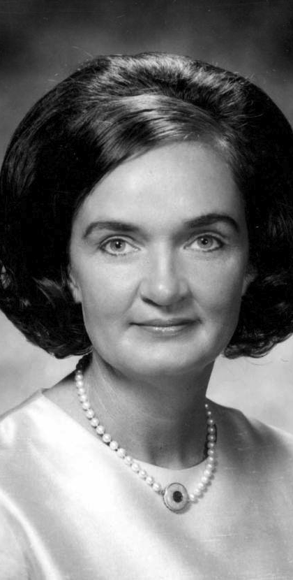
Roxcy Bolton
VP of NOW
At 1971 IHC petitioned the naming committee to stop using women’s names
NHC cites 20 to 1 ratio in positive response in using women’s names
At 1972 conference she advocated using Congressmen’s names instead
Also suggested ‘hurricanes’ be called ‘him-i-canes’
Appealed to IHC committee again in 1973
Notes:
NOW = National Organization for Women
Report of the 1971 Interdepartmental Hurricane Warning Conference (Miami, FL: OFCM, Jan. 13-14, 1971), pp. 73
“Hurricane Names for 1972 Picked,” Naples Daily News, April 20, 1972, sec. A, p. 2

Slide 73
1975 Down Under
1975
Ray
Joan
Kim
Sue
David
Vanessa
Alan
Beth
Wally
Colin
Alice
Dawn
Watorea
Carol
Hope
Linda
International Year of Women
The BOM decides to alternate cyclone names between men’s and women’s names
Notes:
“Hurricane Names Turn Bisexual,” Oakland Tribune, February 25, 1975, p. 10

Slide 74
1975 Down Under
1975
Ray
Joan
Kim
Sue
David
Vanessa
Alan
Beth
Wally
Colin
Alice
Dawn
Watorea
Carol
Hope
Linda
International Year of Women
The BOM decides to alternate cyclone names between men’s and women’s names
??
Notes:
“Hurricane Names Turn Bisexual,” Oakland Tribune, February 25, 1975, p. 10
Not sure exactly which gender Watorea is …

Slide 75
1977 WMO Region IV
Forms Hurricane Committee
Slated to hold first meeting in San Juan, PR on May 1978
IHC turns over control of Atlantic name list to WMO Hurricane Committee
Notes:
“Hurricane Names Turn Bisexual,” Oakland Tribune, February 25, 1975, p. 10

Slide 76
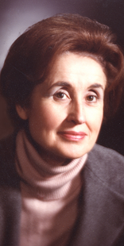
Juanita Kreps
Appointed Secretary of Commerce in 1977
In 1978 she instructed NOAA Administrator Bob White to cease use of women’s names for hurricanes
White calls NHC director Neil Frank to pass along Kreps’ order
Names for both eastern and central Pacific changed in 1978 to alternating gender appelations
Frank attends first WMO Region IV Hurricane committee to request that both men’s and women’s names be used
Gets approval starting in 1979
Notes:
Neil Frank, Phone call, August 20, 2012

Slide 77
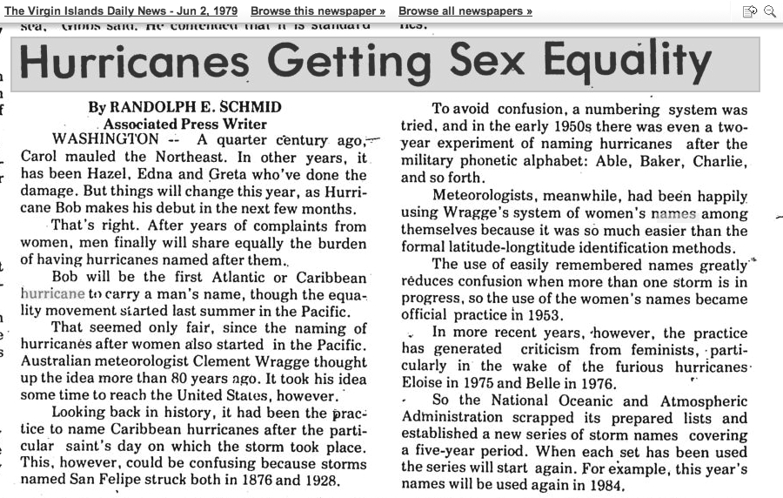
1979 Hurricane Season
Current system adopted
Six-year cycle
Alternating boy-girl-boy-girl system
Names drawn from English, French, Spanish, and Dutch origins to reflect cultural make-up of Caribbean and Central American countries
Two major hurricanes for 1979 were David and Frederic

Slide 78
1979 Typhoon Season
Western Pacific names follow suit
Boy’s names interspersed but not alternating
Most notable was Super Typhoon Tip one of the most intense and largest tropical cyclones on record
Starting in 1980 the names alternate gender
Alice
Bess
Cecil
Dot
Ellis
Faye
Hope
Gordon
Irving
Judy
Key
Lola
Mac
Nancy
Owen
Pamela
Roger
Sarah
Tip
Vera
Wayne
Abby
Ben

Slide 79
1980 Central Pacific Hurricane Season
Hawai’ian names adopted
Previously typhoon names had been borrowed from western Pacific lists
In early 1950s Hawai’ian names had been used
Akoni Aka Alika Ana
Ema Ekeka Ele Ela
Hone Hene Huko Halola
Iona Iolana Iopa Iune
Keli Keoni Kika Kilo
Lala Lino Lana Loke
Moke Mele Maka Malia
Nolo Nona Neki Niala
Olana Oliwa Omeka Oho
Pena Pama Pewa Pali
Ulana Upana Unala Ulika
Wale Wene Wali Walaka

Slide 80
2000 Typhoon Season
WMO Region I Typhoon Committee takes over western Pacific typhoon naming from JTWC
New scheme asks each participating nation to contribute ten names
Not necessarily proper names, some are flower, bird, food, or concept names
Cambodia Damrey Kong-rey Nakri Krovanh Sarika
China Haijui Yutu Fengshen Dujuan Haima
DPR Korea Kirogi Toraji Kalmaegi Mujigae Meari
Hong Kong Kai-Tak Man-yi Fung-wong Choi-wan Ma-on
Japan Tembin Usagi Kanmuri Koppu Tokage
Lao PDR Bolaven Pabuk Phanfone Ketsana Nock-ten
Macau Sanba Wutip Vongfong Parma Muifa
Malaysia Jelawat Sepat Nuri Melor Merbok
Micronesia Ewinlar Fitow Sinlaku Nepartak Nanmadol
Philippines Malaksi Danas Hagupit Lupit Talas
RO Korea Gaemi Nari Jangmi Mirinae Noru
Thailand Prapiroon Wipha Mekkhala Nida Kulap
U.S.A. Maria Francisco Higos Omais Roke
Vietnam Son-Tinh Lekima Bavi Conson Sonca
Cambodia Bopha Krosa Maysak Chanthu Nesat
China Wukong Haiyan Haishen Dianmu Haitang
DPR Korea Sonamu Podul Noul Mindule Nalgae
Hong Kong Shanshan Lingling Dolphin Lionrock Banyan
Japan Yagi Kajiki Kujira Kompasu Washi
Lao PDR Leepi Faxai Chan-hom Namtheun Pakhar
Macau Bebinca Peipan Linfa Malou Sanvu
Malaysia Rumbia Tapah Nangka Meranti Mawar
Micronesia Soulik Mitag Soudelor Fanapi Guchol
Philippines Cimaron Hagibis Molave Malakas Talim
RO Korea Jebi Neoguri Goni Megi Doksuri
Thailand Mangkhut Rammasun Morakot Chaba Khanun
U.S.A. Utor Matmo Etau Aere Vicete
Vietnam Trami Halong Vamco Songda Saola

Slide 81
Other basins
Naming systems adopted for
Southern Indian Ocean
Port Moresby, PNG
Fiji
Indonesia
Northern Indian Ocean

Slide 82
2012 Winter storms
The Weather Channel proposes naming winter storms
Use primarily drawn from classical Greek and Roman literature
Inconsistent and oddball names too
No ‘buy in’ from National Weather Service on using TWC’s names

Slide 83
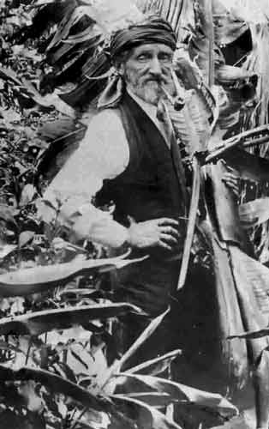
Conclusions
All roads lead from Wragge
Western Pacific naming inaugurated in 1944
Atlantic naming inaugurated in 1947
  Made public due to 3 hurricanes in 1950
  First used in press in 1951
Notes:
Previous histories had not properly acknowledged Wragge’s influence on modern naming practices. Earliest Wpac name list only go back to 1945. Air Force naming scheme prior to 1950 not usually acknowledged.

Slide 84
Philosophical Question
Would we be using personal names for tropical cyclones today if Clement Wragge hadn’t initiated the practice, or would we have adopted another (less colorful) identification scheme?

