Slide 1
Hurricanes and Climate
Neal M. Dorst
NOAA/Atlantic Oceanographic and Meteorological Laboratory
February 16, 2020
Boca Raton Museum of Art

Slide 2
Acknowledgements
I wish to thank the following colleagues for help with this presentation:
Dr. Chris Landsea (NHC)
Stan Goldenberg (AOML/HRD)
Shirley Murillo (AOML/HRD)

Slide 3
Hurricanes are cyclonic storms of tropical origin with maximum winds over 74 mph. They derive most of their energy from vertical temperature differences.
They act like a heat engine, they convert thermal energy (warm, moist air) into mechanical energy (wind and waves).

Slide 4
Hurricanes and global weather
Hurricanes are a part of the global circulation.
They transfer excess thermal energy from the tropics toward the thermal deficit at the poles.
It remains unknown if hurricanes are “necessary” in this transfer, or if more gradual processes (such as midlatitude cyclones) would be sufficient in mixing the atmosphere.
It remains unknown if adding more energy to the atmosphere would result in more or stronger cyclones.

Slide 5
The Past
"What's past is prologue"
Antonio
The Tempest
Act 2 Scene 1

Slide 6
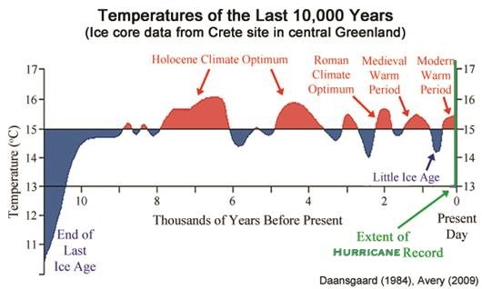
The Past
Tropical cyclones have been a feature of the globe’s weather since time immemorial, but accurate weather records only go back ~150 years.
Prior to historical records, geological proxies, such as storm surge over wash into coastal ponds, tree rings, and coral composition give indications of return frequency at select locations. Proxies go back at least to Holocene Optimum.
First historical record of a typhoon in China in 816 AD.
For the Atlantic, 16th Century, ships’ logs and accounts at long-occupied islands and coastal cities yield return frequencies and rough measures of strength.

Slide 7
The Past
These methods yield only very broad estimates with large error factors and may not represent basin-wide activity.
Proxies indicate that from 4000-2500 years ago and 1000 years ago, Atlantic hurricane activity might have been more frequent.
From Chinese historical records, “…the two periods of most frequent typhoon strikes in Guangdong (AD 1660–1680, 1850–1880) coincide with two of the coldest and driest periods in northern and central China during the Little Ice Age. “ (Kam-biu et al [2001])

Slide 8
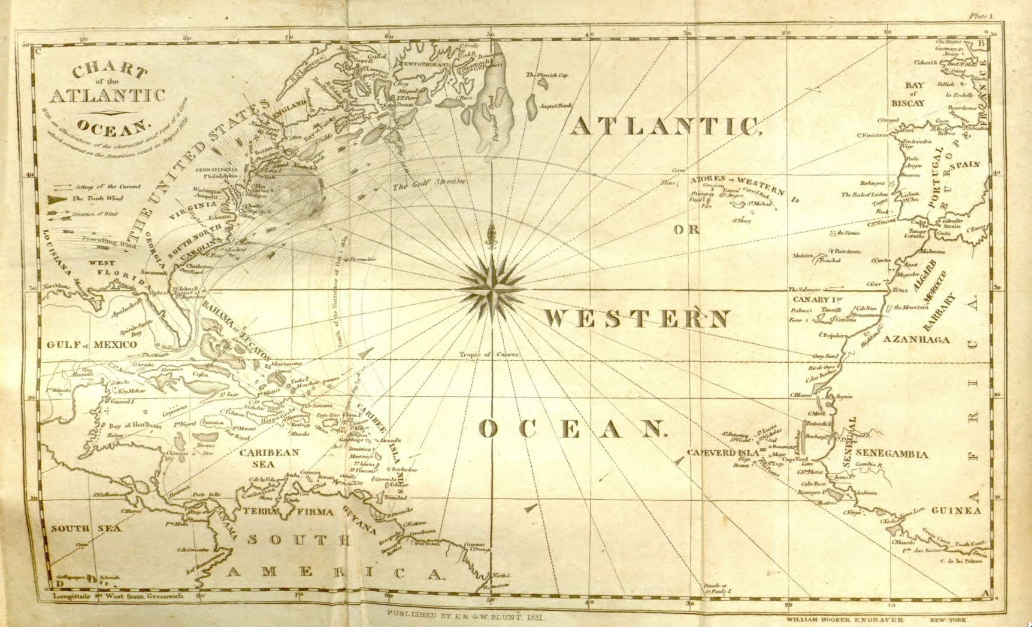
The Past
In 1851, William Redfield began to reconstruct annual Atlantic hurricane tracks.
Andrés Poey extends storm list back to Columbus.
In 1958, U. S. Weather Bureau publishes an atlas of Atlantic hurricane tracks going back to 1886.
Subsequent editions extended maps back, eventually reaching back to 1851.

Slide 9
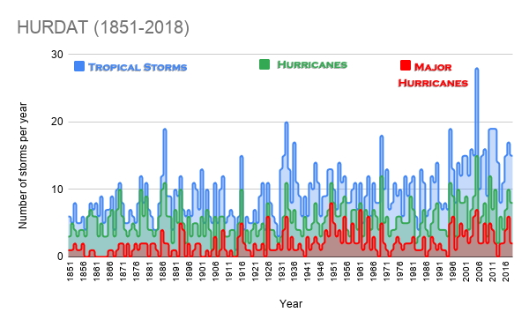
The Past
In 1970, a digitized hurricane database (HURDAT) was created from the atlas. This becomes NHC’s official historical reference file.
The HURDAT includes a storm position, central pressure (when known), and estimated maximum wind speed for every 6 hours over the storm’s existence.
Great amount of variability (“noisy”) from year to year and from storm to storm.

Slide 10
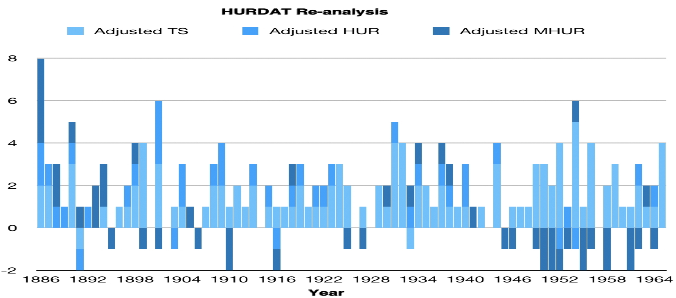
The Past
Presently there is a Reanalysis Project underway to correct errors to the HURDAT and update estimated values with our current understanding.
Some missed storms have been added, but also storms previously thought to be tropical were removed when analysis showed them to be midlatitude type storms.
While in the early part of the database, the overall numbers increased, since the mid-20th Century, more major hurricanes were subtracted than added.
Reanalysis cannot include storms that were never detected in the first place.

Slide 11
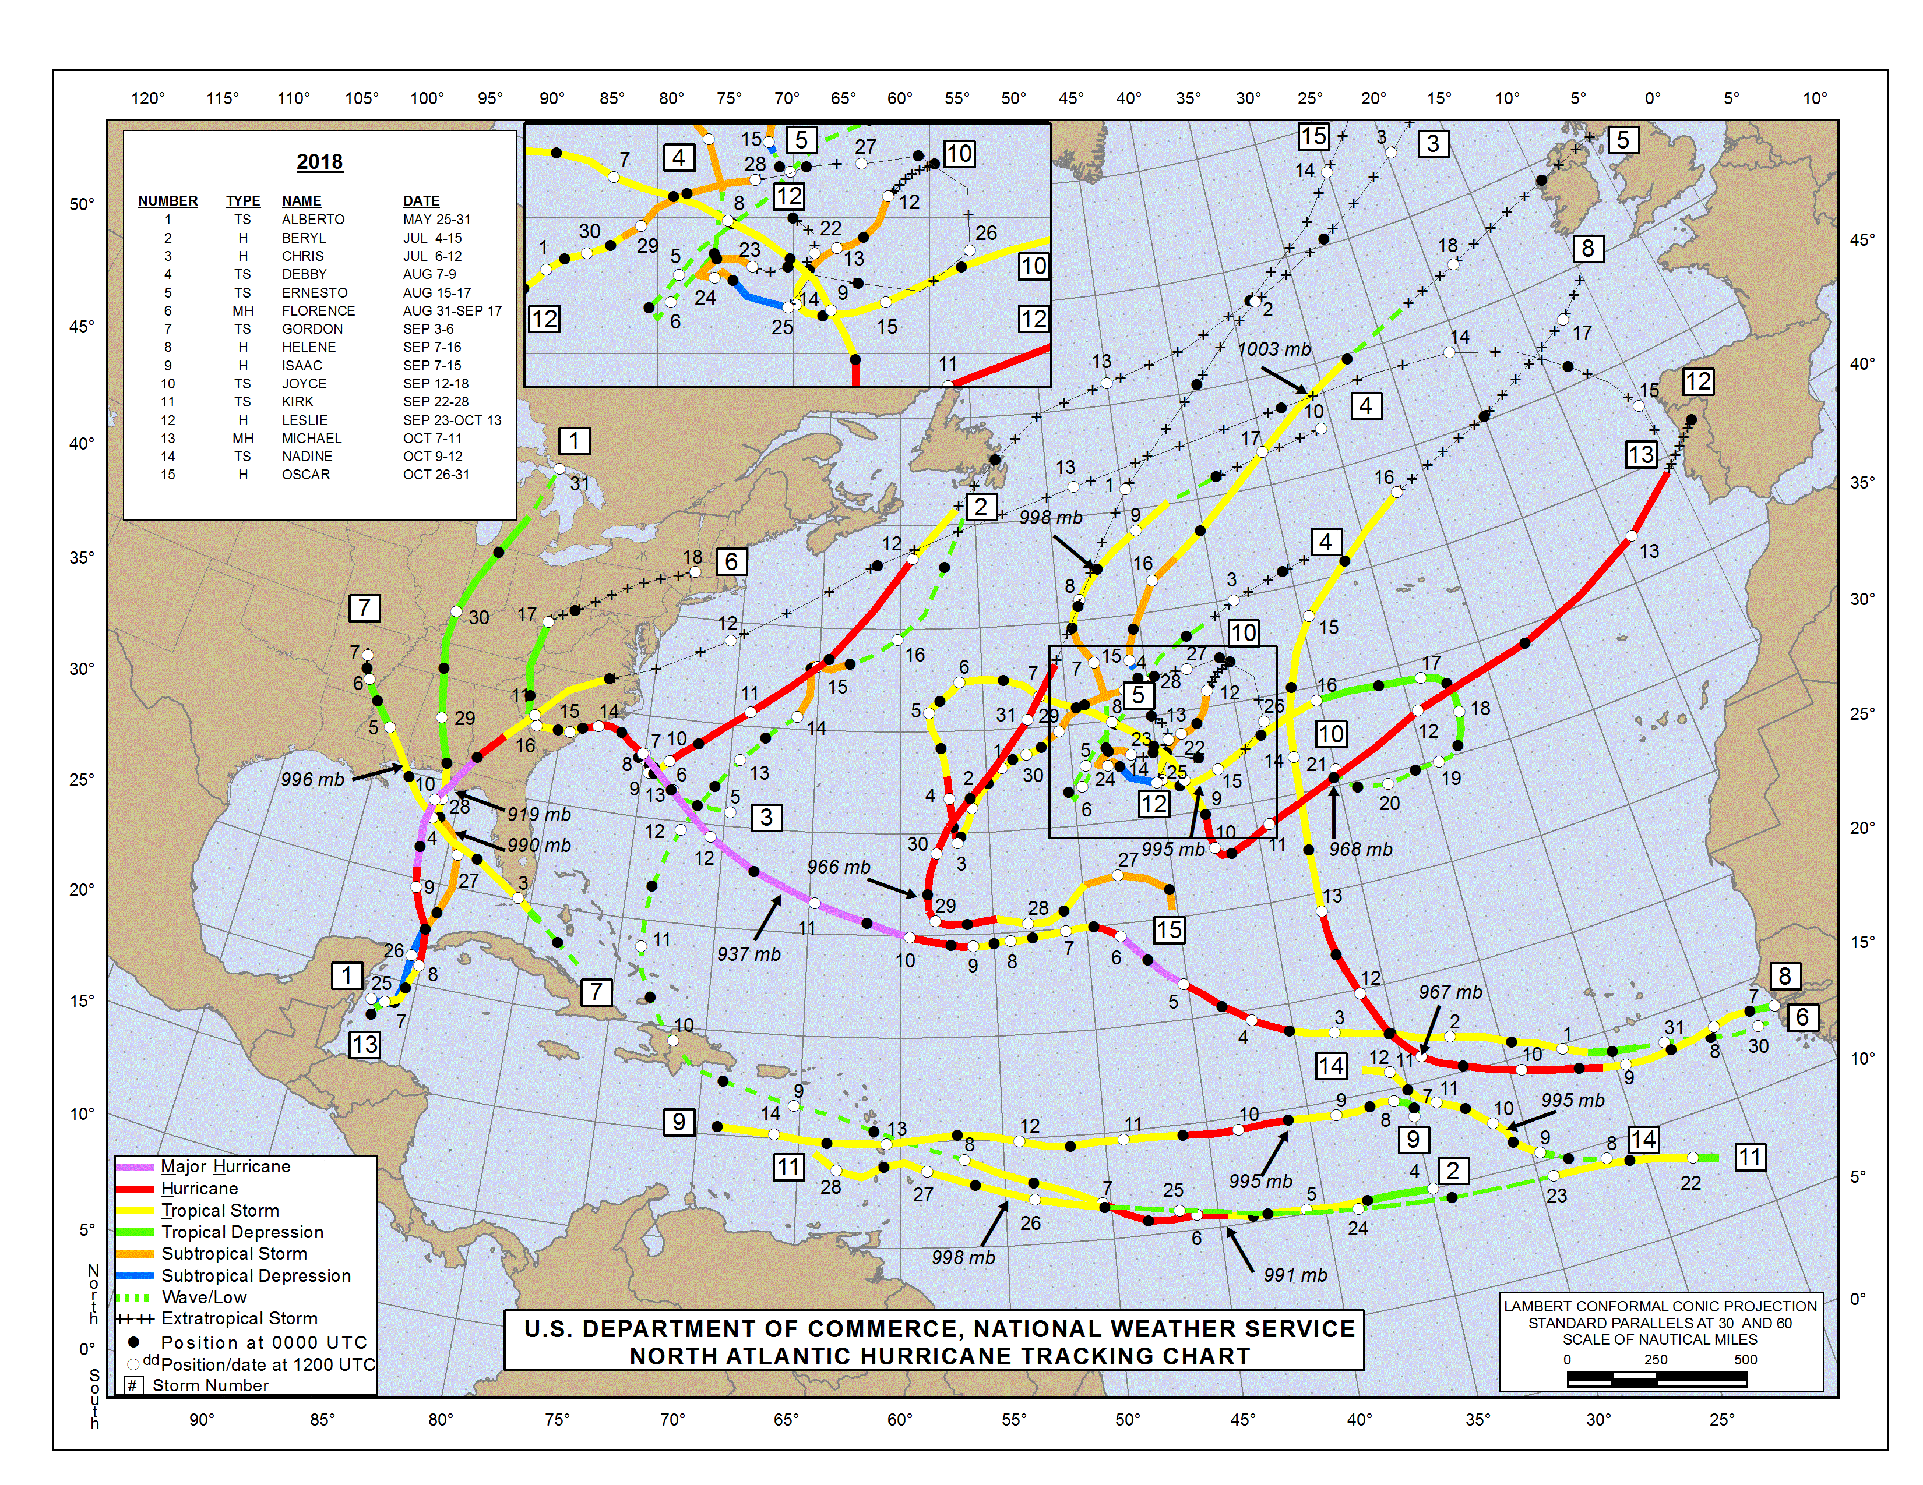
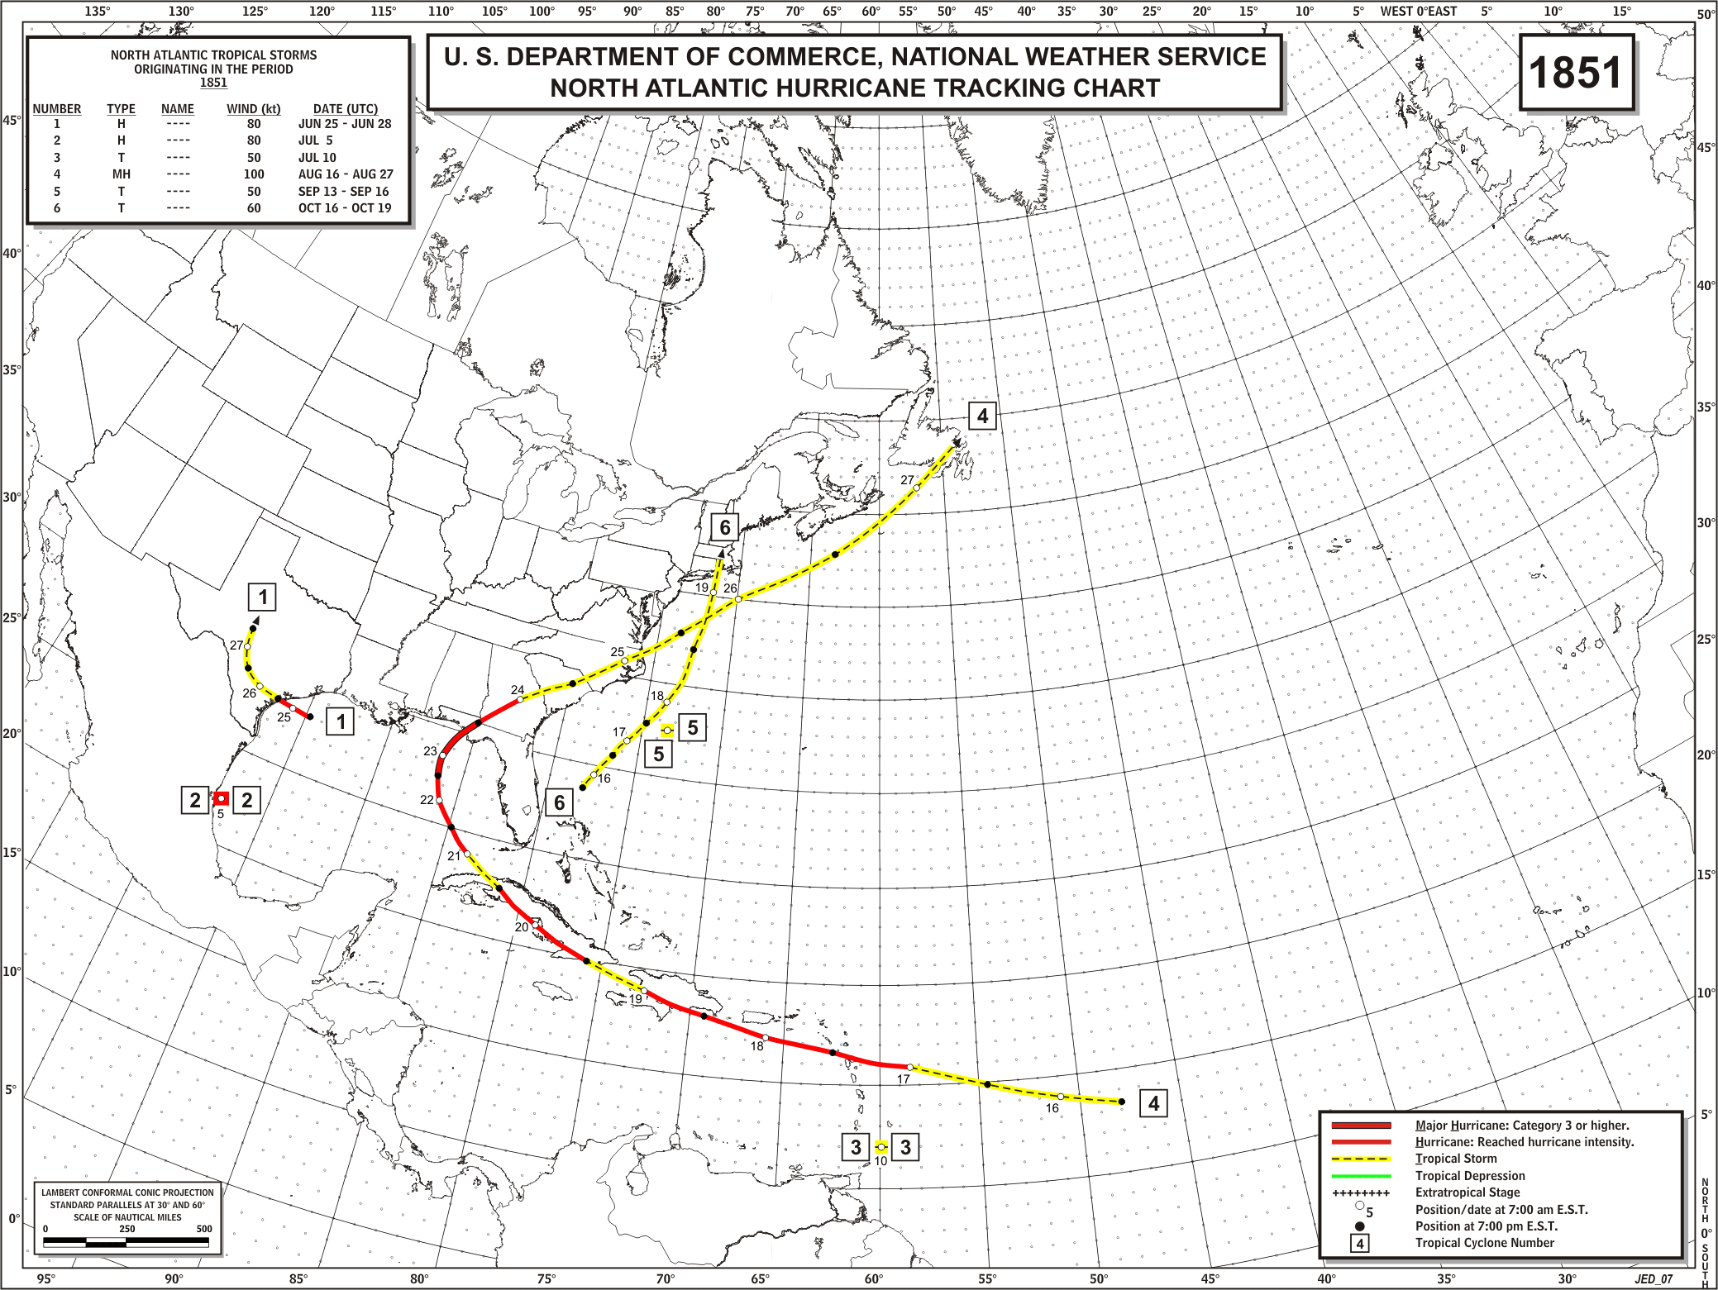
The Past
1851
2018
The database is neither uniform in quality nor comprehensive in number of storms.
The further back in time you look in the HURDAT, the less accurate the information is and the fewer storms that were detected.

Slide 12
The Past
No tracks begin before Tropical Storm status is reached.
Only wind speeds included, all winds estimated.
Several consist only of the landfall point.
No reports from deep Tropics or eastern Atlantic.
1851

Slide 13
The Past
Tracks encompass initial formation through dissipation or transformation.
Highly detailed wind and pressure data at each 6-hour fix. Most from direct observations.
Each storm under constant satellite surveillance, also aircraft and radar observation when within range.
Entire North Atlantic basin is covered.
2018

Slide 14
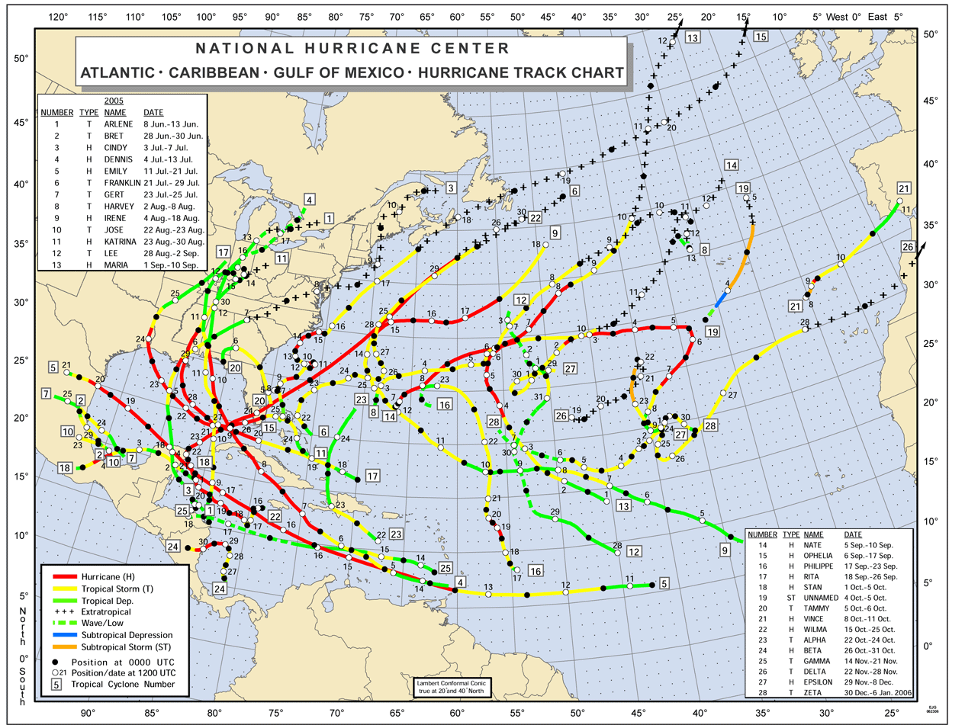
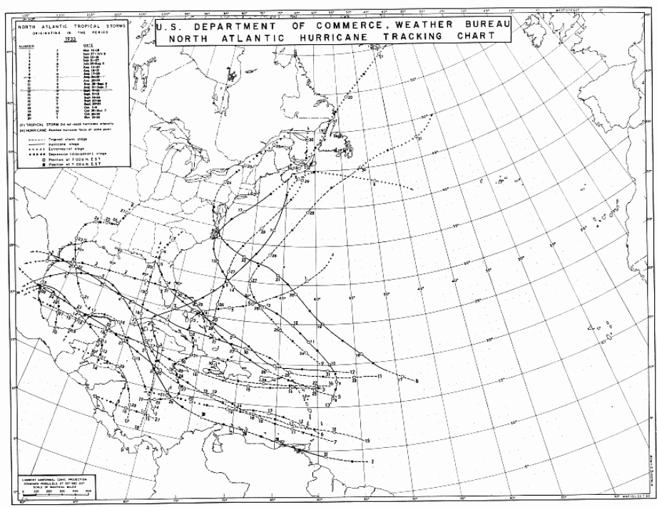
Compare the two most active seasons in HURDAT 1933 vs 2005
1933
2005

Slide 15
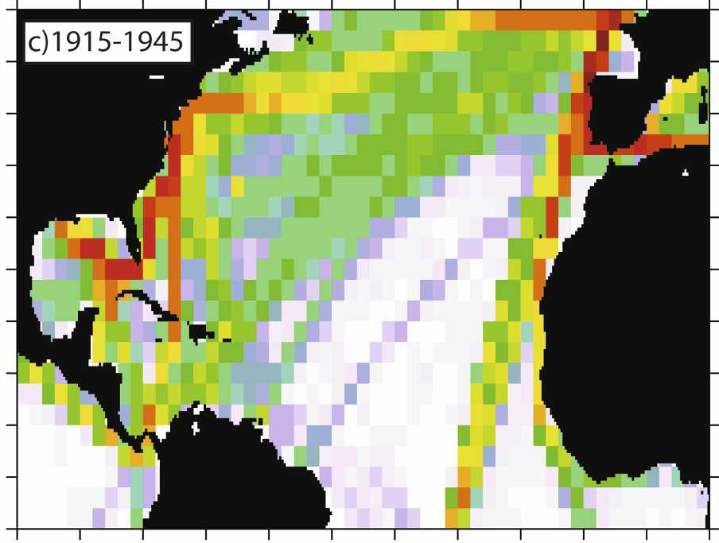
Compare the two most active seasons in HURDAT 1933 vs 2005
1933
Atlantic ship traffic changes
Vecchi and Knutson (2011)

Slide 16
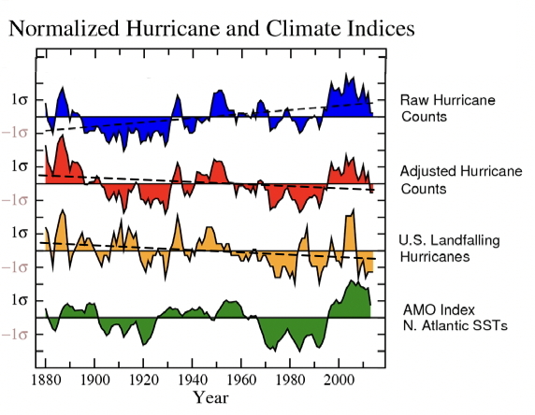
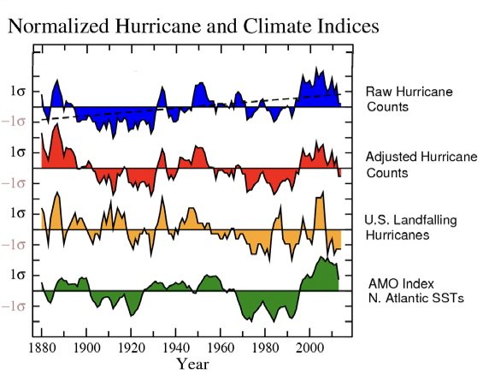
After accounting for likely “missed” hurricanes because of lack of technology…hurricane numbers show no change or even slight decrease over a century
Vecchi and Knutson 2011

Slide 17
The Present
”It may grow stronger, it may grow weaker, or it may just stay the same.”
Dr. Chris Landsea
National Hurricane Center

Slide 18
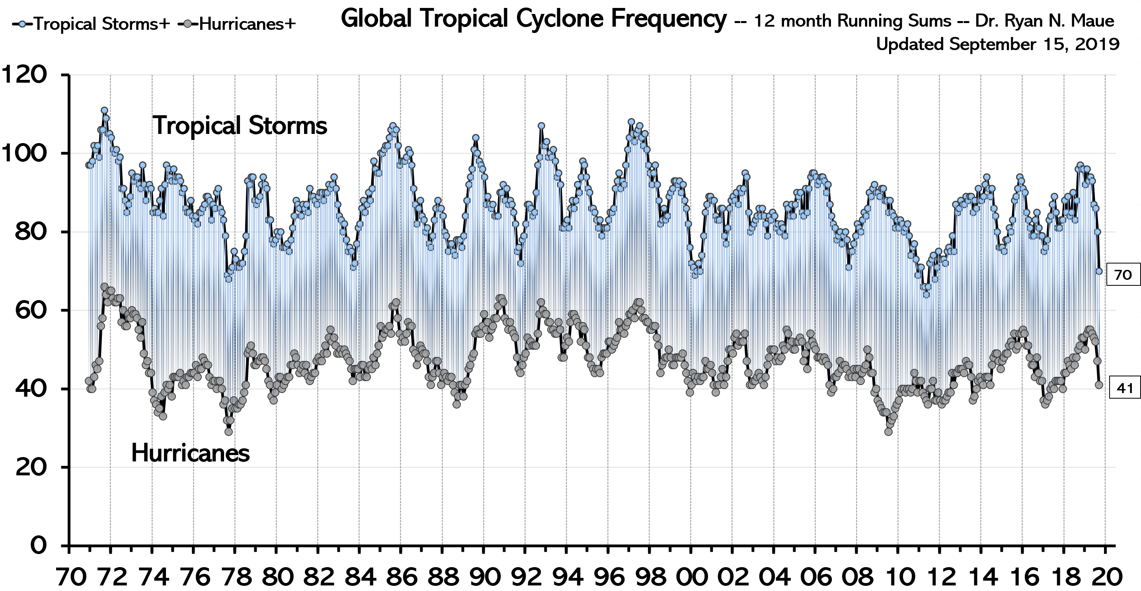
The Present
Dr. Ryan Maue
Global tropical cyclone activity with one-year running sum during the global satellite-era.
We see semi-cyclical fluctuations. Driven by short-term oscillations in oceans and atmosphere.

Slide 19
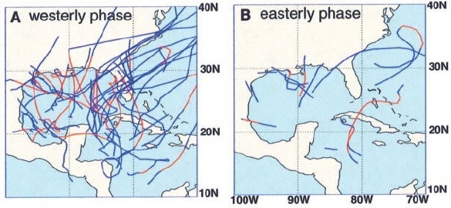
Madden-Julian Oscillation (MJO)
The Madden-Julian Oscillation is an upper atmospheric, east-ward moving pulse.
Roughly 40 days to circle the globe.
As its enhanced phase moves over an ocean basin, convection become enhanced.
The enhanced MJO phase can make tropical cyclone formation more likely.
Maloney, E. & Hartmann, D. (2000)

Slide 20
El Niño – Southern Oscillation (ENSO)
El Niño
La Niña

Slide 21
Atlantic Multi-Decadal Oscillation (AMO)
Kossin and Vimont (2007)
AMO Warm Phase
AMO Cool Phase
Goldenberg et al 2001

Slide 22
The Future
"All models are wrong, but some are useful.”
Statistician George Box
University of Wisconsin (Madison)

Slide 23
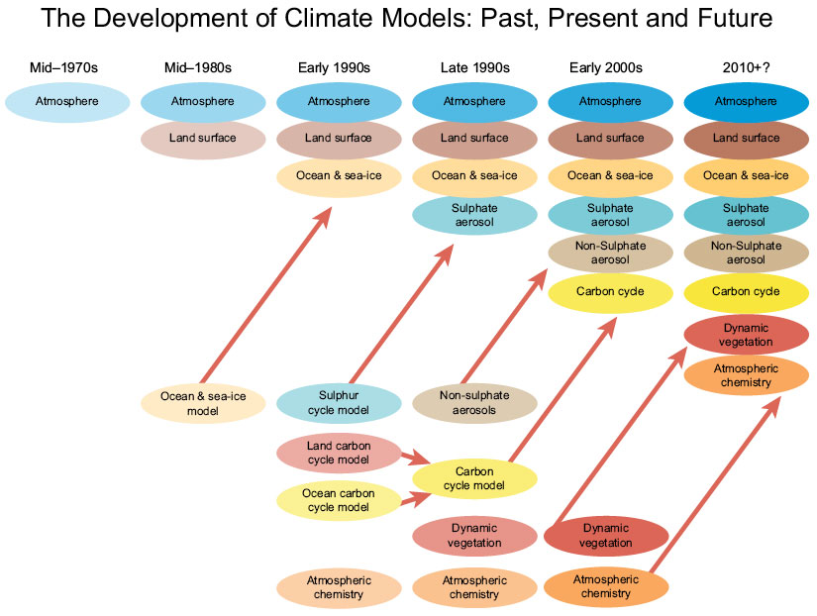
The Future
Global Climate Models (GCM) began to be developed in 1970s.
Gradual improvements have been made to include the influence of oceans, particulates, and chemistry.
Other factors, such as clouds, cosmic rays, and solar fluctuations are either not handled well or not included.
© 2019 Canadian Cryospheric Information Network

Slide 24
The Future
Global Climate Models (GCM) do a poor job of forecasting global temperature change (their primary purpose).
Current rate of global temperature change is .008℃ per year versus average model projection of .03℃ per year.
GCMs vary widely with each other over future precipitation patterns and sea-level rise.
Michaels & Knappenberg (2014)

Slide 25
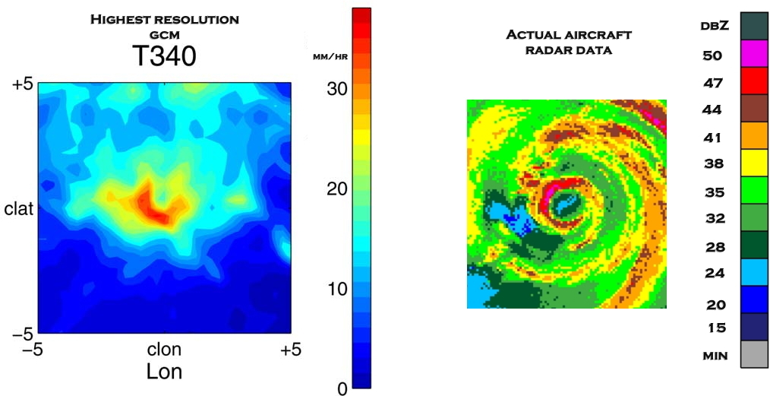
The Future
Li et al. (2013)
NOAA/AOML
GCMs have trouble simulating tropical cyclones due to spatial resolutions limits.
US Climate Variability and Predictability (CLIVAR) program in 2013 used a high-resolution GCM to project changes to tropical cyclones in a world of double carbon dioxide levels, a 2℃ warming of sea temperatures, and simulations with both scenarios.
When both scenarios were run, a 20% decrease in tropical cyclone activity was observed. When the two other scenarios were run separately each contributed ~10% decrease in activity.

Slide 26
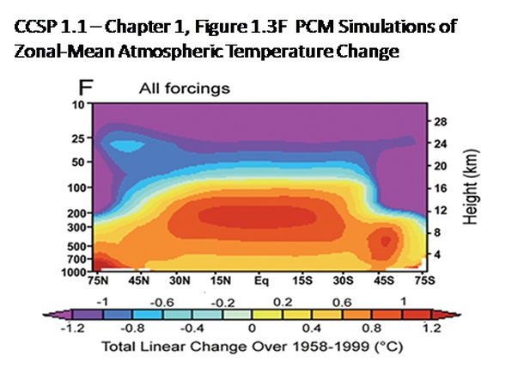
The Future
CCSP-SAP 2006
It is counterintuitive that a warmer atmosphere would result in fewer tropical cyclones.
In GCMs, the middle atmosphere warms more than the lower layers. This reduces that vertical temperature differences that drive tropical cyclones.
The GCMs also project that more vertical wind shear will occur over several tropical storm basins reducing tropical cyclone formation.

Slide 27
The Prediction
“It's tough to make predictions, especially about the future.”
Yogi Berra
New York Yankees

Slide 28
The Prediction
My personal prediction:

Slide 29
The Prediction
My personal prediction:
For the foreseeable future, short-term (< 30 years) oceanic and atmospheric oscillations (ENSO,AMO,MJO) will predominate in influencing Atlantic hurricane activity.

Slide 30
The Prediction
My personal prediction:
For the foreseeable future, short-term (< 30 years) oceanic and atmospheric oscillations (ENSO,AMO,MJO) will predominate in influencing Atlantic hurricane activity.
Long-term (> 30 years) climate changes will be too small to be detectable amid the ‘noisy’ fluctuations in hurricane activity and strength.

Slide 31
The Prediction
My personal prediction:
For the foreseeable future, short-term (< 30 years) oceanic and atmospheric oscillations (ENSO,AMO,MJO) will predominate in influencing Atlantic hurricane activity.
Long-term (> 30 years) climate changes will be too small to be detectable amid the ‘noisy’ fluctuations in hurricane activity and strength.
Every year, you should be prepared for a hurricane strike. Independent of basin-wide activity, one storm in your area can ruin your whole day.

Slide 32
References
Gray, W. M., (1984) Atlantic seasonal hurricane frequency. Part I: El Niño and the 30mb quasi-biennial oscillation influences. Mon. Wea. Rev., 112, 1649-1668.
Dansgaard, W., S. J. Johnsen, H. B. Clausen, D. Dahl-Jensen, N. Gundestrup, and C. U. Hammer (1984), North Atlantic climate oscillations revealed by deep Greenland ice-cores, in Climate Processes and Climate Sensitivity, Geophys. Monogr. Ser., vol. 29, edited by J. E. Hansen andT. Takehashi, pp. 288–298, AGU, Washington, D. C.
Maloney, E. & Hartmann, D. (2000). "Modulation of Hurricane Activity in the Gulf of Mexico by the Madden-Julian Oscillation" Science (New York, N.Y.). 287. 2002-4. 10.1126/science.287.5460.2002.
Goldenberg, S.B., C.W. Landsea, A.M. Mestas-Nuñez, W.M. Gray (2001) The Recent Increase in Atlantic Hurricane Activity: Causes and Implications, Science, 293(5529), 474-479 DOI: 10.1126/science.1060040
Kam-biu L., Caiming S. & Kin-sheun L. (2001) A 1,000-Year History of Typhoon Landfalls in Guangdong, Southern China, Reconstructed from Chinese Historical Documentary Records, Annals of the Association of American Geographers, 91(3), 453-464, DOI: 10.1111/0004-5608.00253
Pielke, R.A. Jr., C. Landsea, M. Mayfield, J. Laver, and R. Pasch (2005) “Hurricanes and Global Warming”, Bull. Amer. Meteo. Soc., 86(11), 1571-1575
Karl, T.R.; Hassol, S.J.; Miller, C.D.; Murray, W.L. (2006) “Temperature Trends in the Lower Atmosphere: Steps for Understanding and Reconciling Differences” U.S. Climate Change Science Program Synthesis and Assessment Product 1.1(CCSP-SAP-1.1 Washington, DC..
Kossin, J.P. and D.J. Vimont (2007) “A More General Framework for Understanding Atlantic Hurricane Variability and Trends” Bull. Amer. Meteo. Soc., 88(11),1767-1781
Singer, S. F. and D. T. Avery (2008) “Unstoppable Global Warming … Every 1,500 Years” Rowman & Littlefield, 2007, second rev. edition.
Vecchi, G. A., and T. R Knutson (2011) “Estimating annual numbers of Atlantic hurricanes missing from the HURDAT database (1878-1965) using ship track density” Journal of Climate, 24(6), doi:10.1175/2010JCLI3810.1.
Li, F., Collins, W., Wehner, M. & Leung, L.. (2013). Hurricanes in an aquaplanet world: Implications of the impacts of external forcing and model horizontal resolution. Journal of Advances in Modeling Earth Systems. 5. 10.1002/jame.20020.
Michaels, P.J., and P.C. Knappenberger, (2014) Quantifying the Lack of Consistency between Climate Model Projections and Observations of the Evolution of the Earth’s Average Surface Temperature since the Mid-20th Century. American Geophysical Union Fall Meeting, San Francisco, CA, Dec. 15-19, Paper A41A-3008.

Slide 33
Auxillary slides

Slide 34
The Past
https://en.wikipedia.org/wiki/Bushfires_in_Australia

Slide 35
The Past

Slide 36
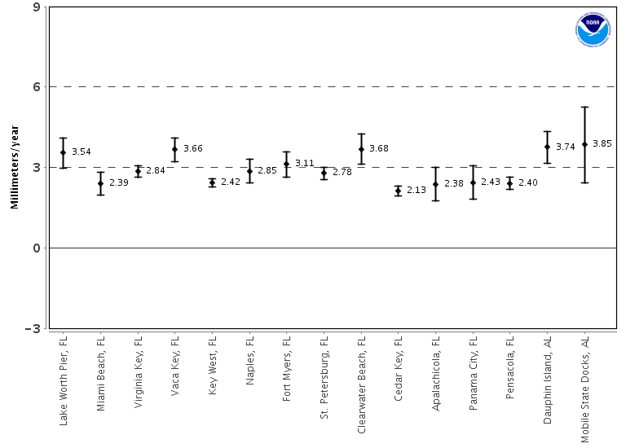
The Present

Slide 37
The Present
For Boca Raton Inlet
Maximum Storm Surge 4.70 feet
Daily Tidal variation 3.00 feet
Yearly Sea Level Rise 0.01 feet

Slide 38
The Future

