Slide 1
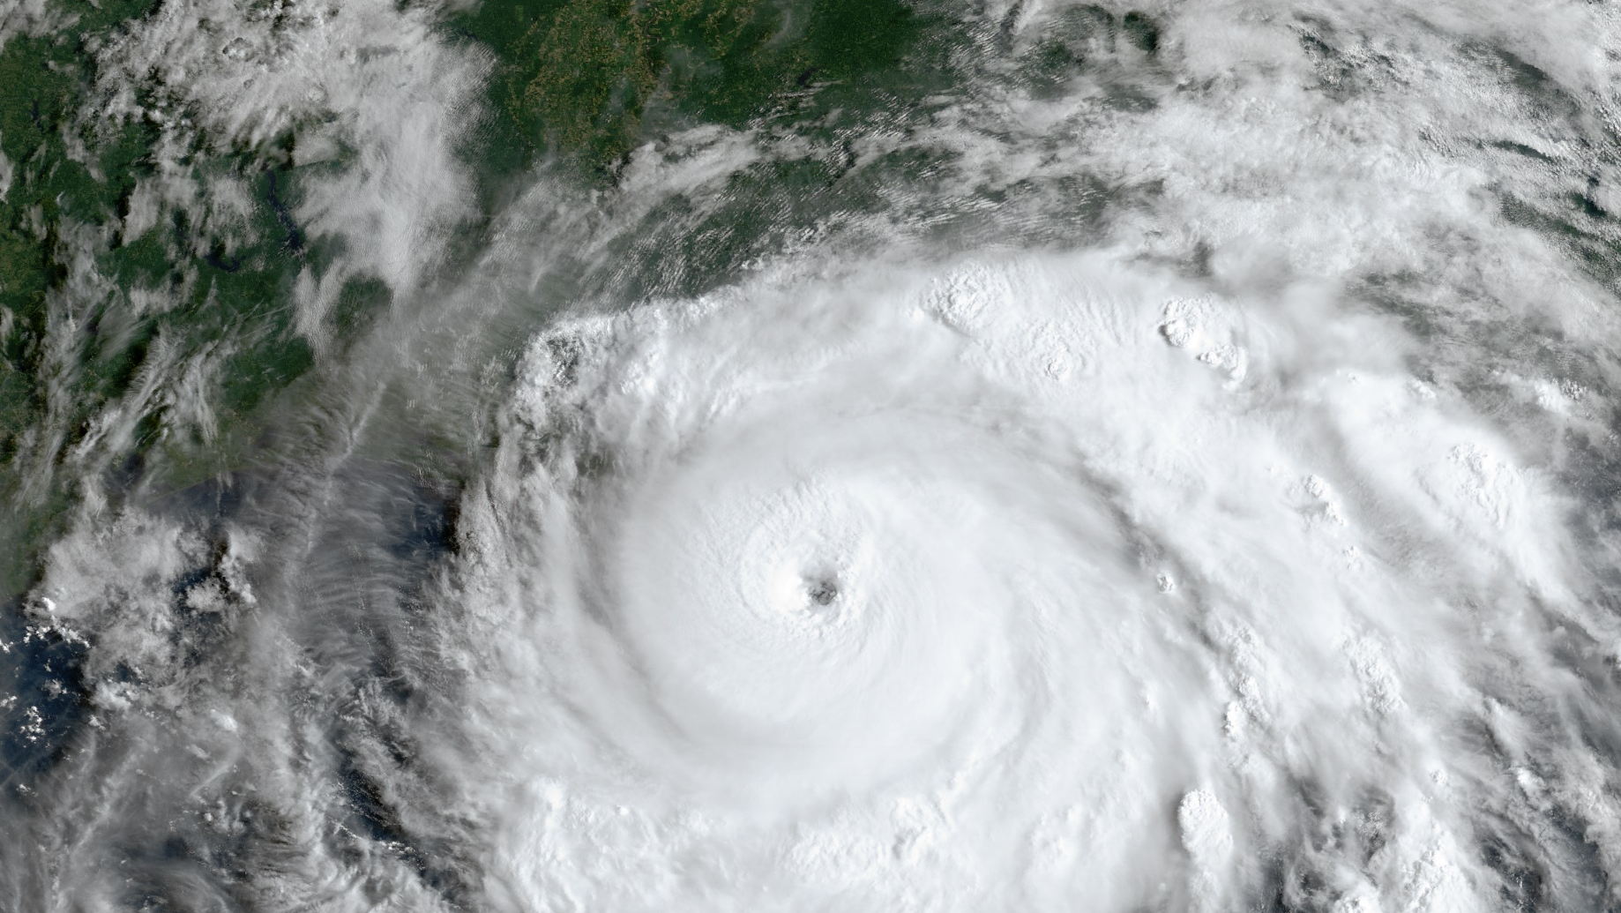



Exploring the Relationship between Vortex Misalignment and
Tropical Cyclone Intensity Change
Michael Fischer^{1,2}, Paul Reasor², Robert Rogers², Jason Dunion^{1,2}, Brian Tang³,
Kristen Corbosiero³, Ryan Torn³, and Xiaomin Chen^{2,4}
¹University of Miami/CIMAS
²NOAA/AOML/Hurricane Research Division
³University at Albany
⁴Northern Gulf Institute/Mississippi State University
HFIP Seminar, 12 April 2023

Slide 2
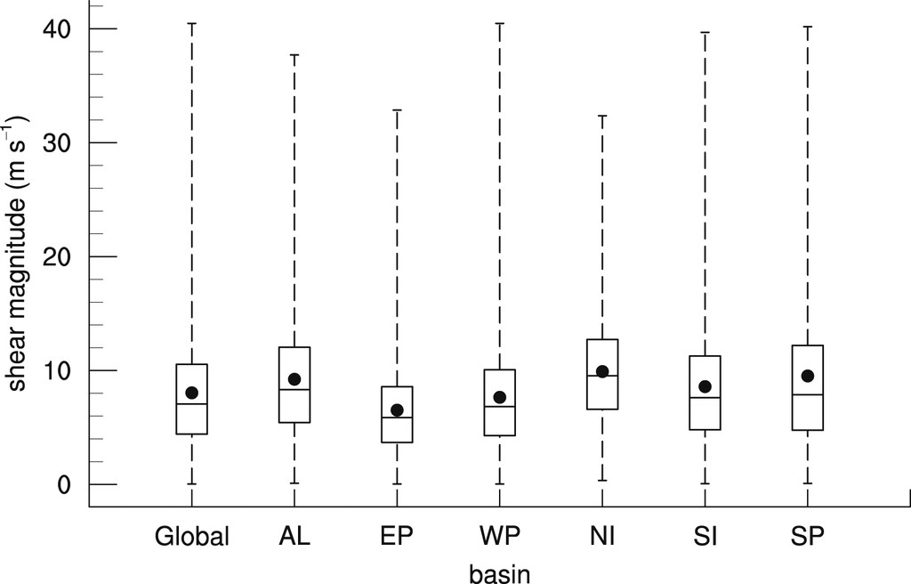
Motivation
Nearly all tropical cyclones (TCs) experience some degree of vertical wind shear!
Distribution of 850–200-hPa shear magnitude. Fig. 3 from Rios-Berrios and Torn (2017)

Slide 3
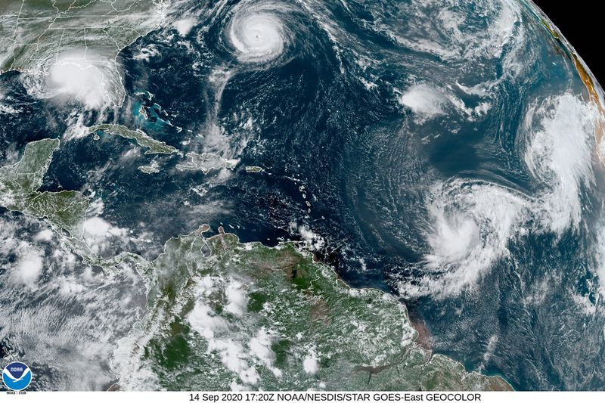
Motivation
Nearly all tropical cyclones (TCs) experience some degree of vertical wind shear!

Slide 4
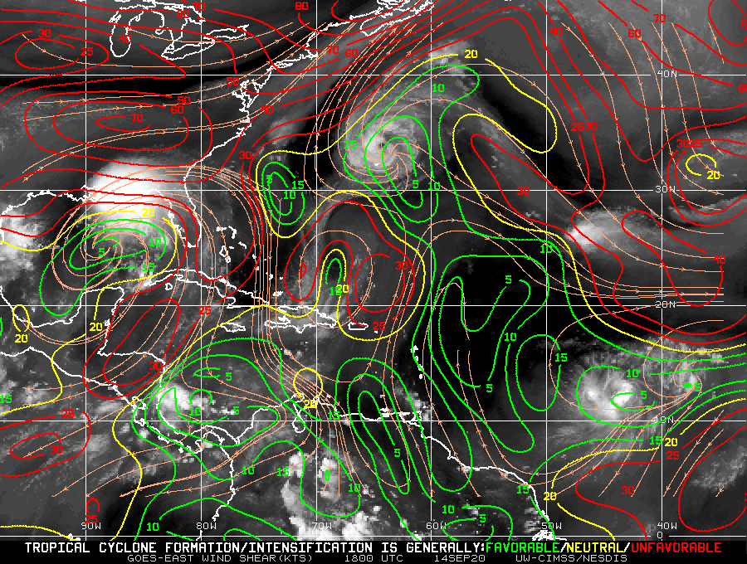
Motivation
Nearly all tropical cyclones (TCs) experience some degree of vertical wind shear!

Slide 5
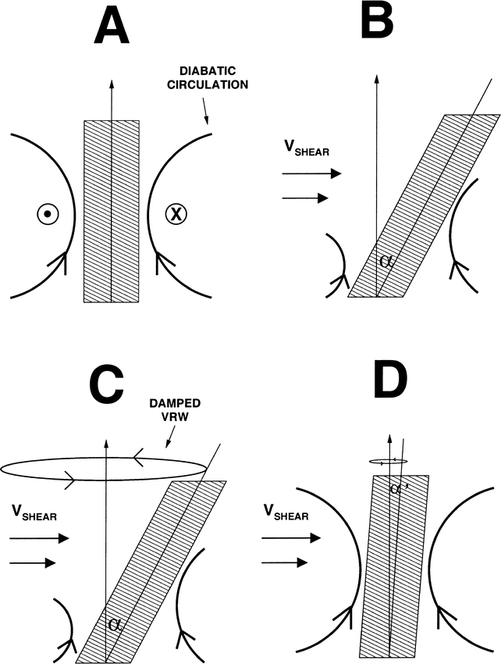
What does shear do to a TC vortex?
Shear acts to differentially advect (or tilt) a vortex
Adapted from Reasor et al. (2004)

Slide 6
What does shear do to a TC vortex?
Shear acts to differentially advect (or tilt) a vortex
Adapted from Reasor et al. (2004)

Slide 7
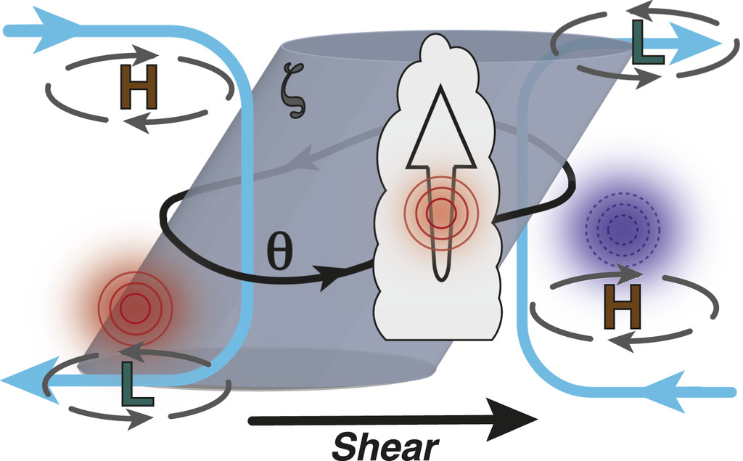
A tilted vortex is an asymmetric vortex
Thermal asymmetries exist in a tilted vortex
To maintain thermal wind balance, vertical velocity asymmetries arise
Adapted from Boehm and Bell (2021)

Slide 8
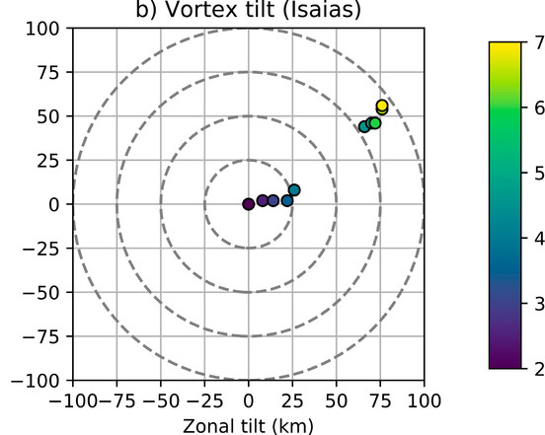
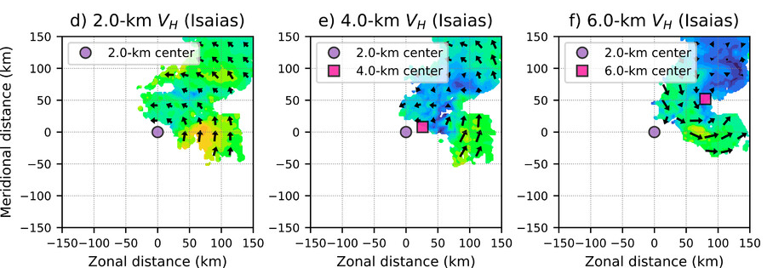
A tilted vortex can be a messy vortex
In relatively weak TCs, multiple circulations can exist
A TC may not be accurately characterized by a tilted column of vorticity
Tilt hodograph:
Tail Doppler Radar (TDR) analyses:
Adapted from Fischer et al. (2022)

Slide 9
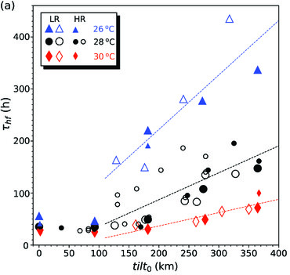
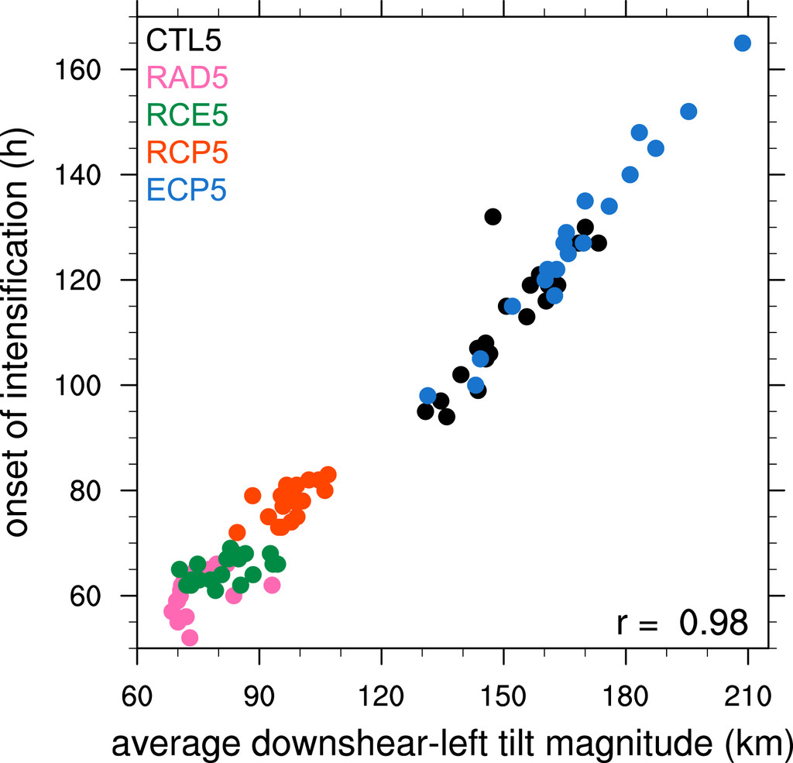
How is tilt related to intensity change?
Modeling studies have shown more tilted vortices delay intensification
Adapted from Schecter (2022)
Adapted from Rios-Berrios (2020)

Slide 10
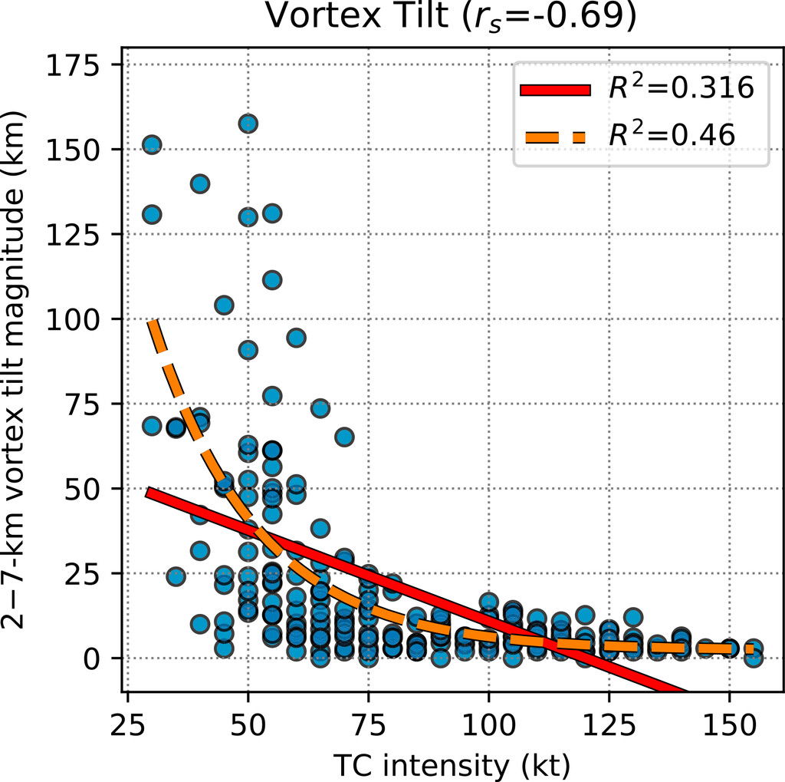
Is tilt related to intensity change?
Observations say: Well, we don’t really know…
Fig. 9 from Fischer et al. (2022)

Slide 11
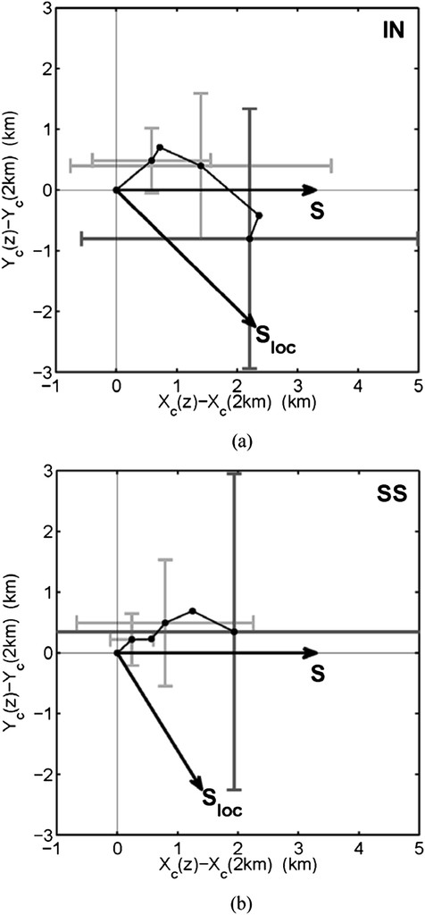
Is tilt related to intensity change?
Observations say: Well, we don’t really know…
Rogers et al.
(2013)
Fig. 9 from Fischer et al. (2022)

Slide 12
Is tilt related to intensity change?
Observations say: Well, we don’t really know…
???
Rogers et al.
(2013)
Fig. 9 from Fischer et al. (2022)

Slide 13
Is tilt related to intensity change?
Observations say: Well, we don’t really know…
There has not yet been a multi-case observational analysis of the relationship between TC intensity change and tilt for TCs below hurricane intensity!
???
Rogers et al.
(2013)
Fig. 9 from Fischer et al. (2022)

Slide 14
Key research questions
Q1) Is vortex tilt related to TC intensity change in nature?
Q2) You’ll see later :D

Slide 15
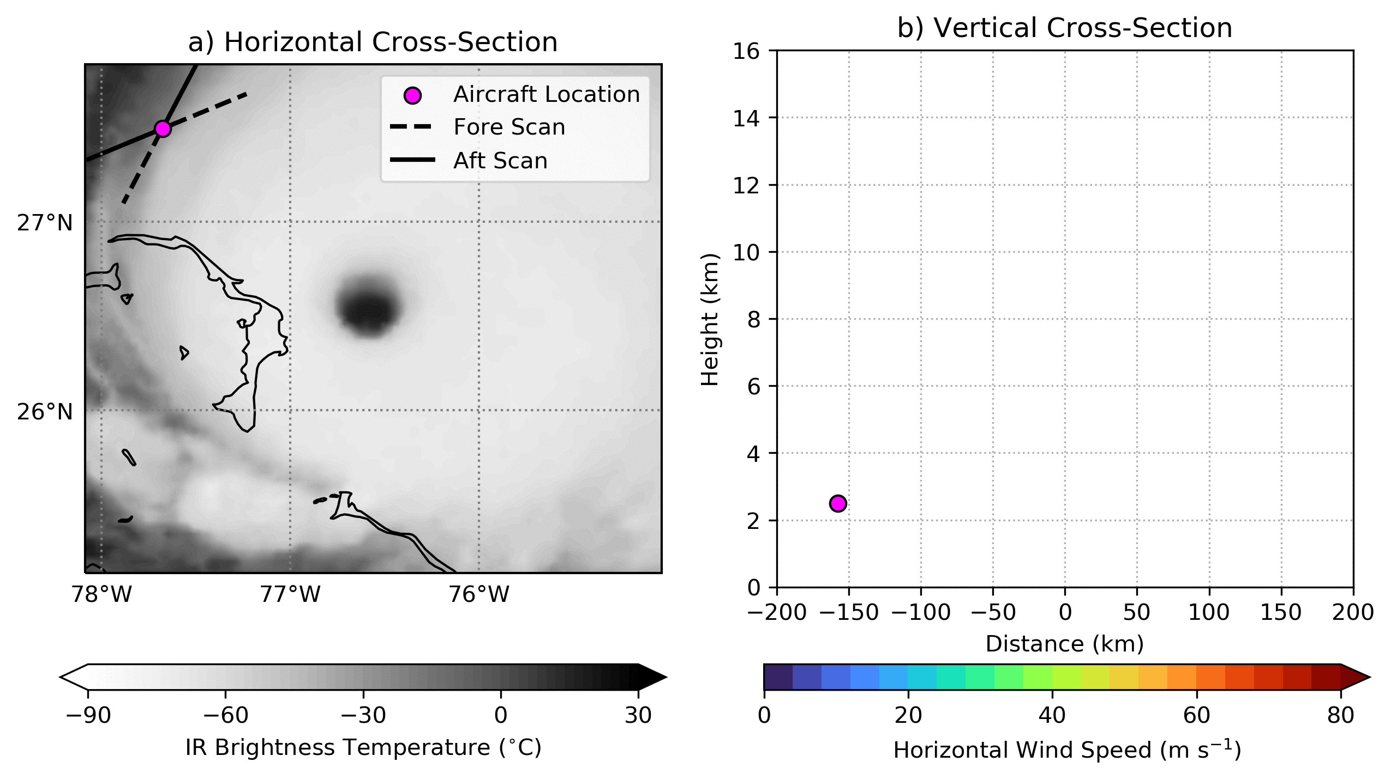
Tools to explore vortex tilt in nature
Let’s use a collection of tail Doppler radar (TDR) observations
The TDR is an X-band radar onboard NOAA’s P3 aircraft
Can retrieve 3D wind field within ~50 km of flight track if sufficient scatterers

Slide 16
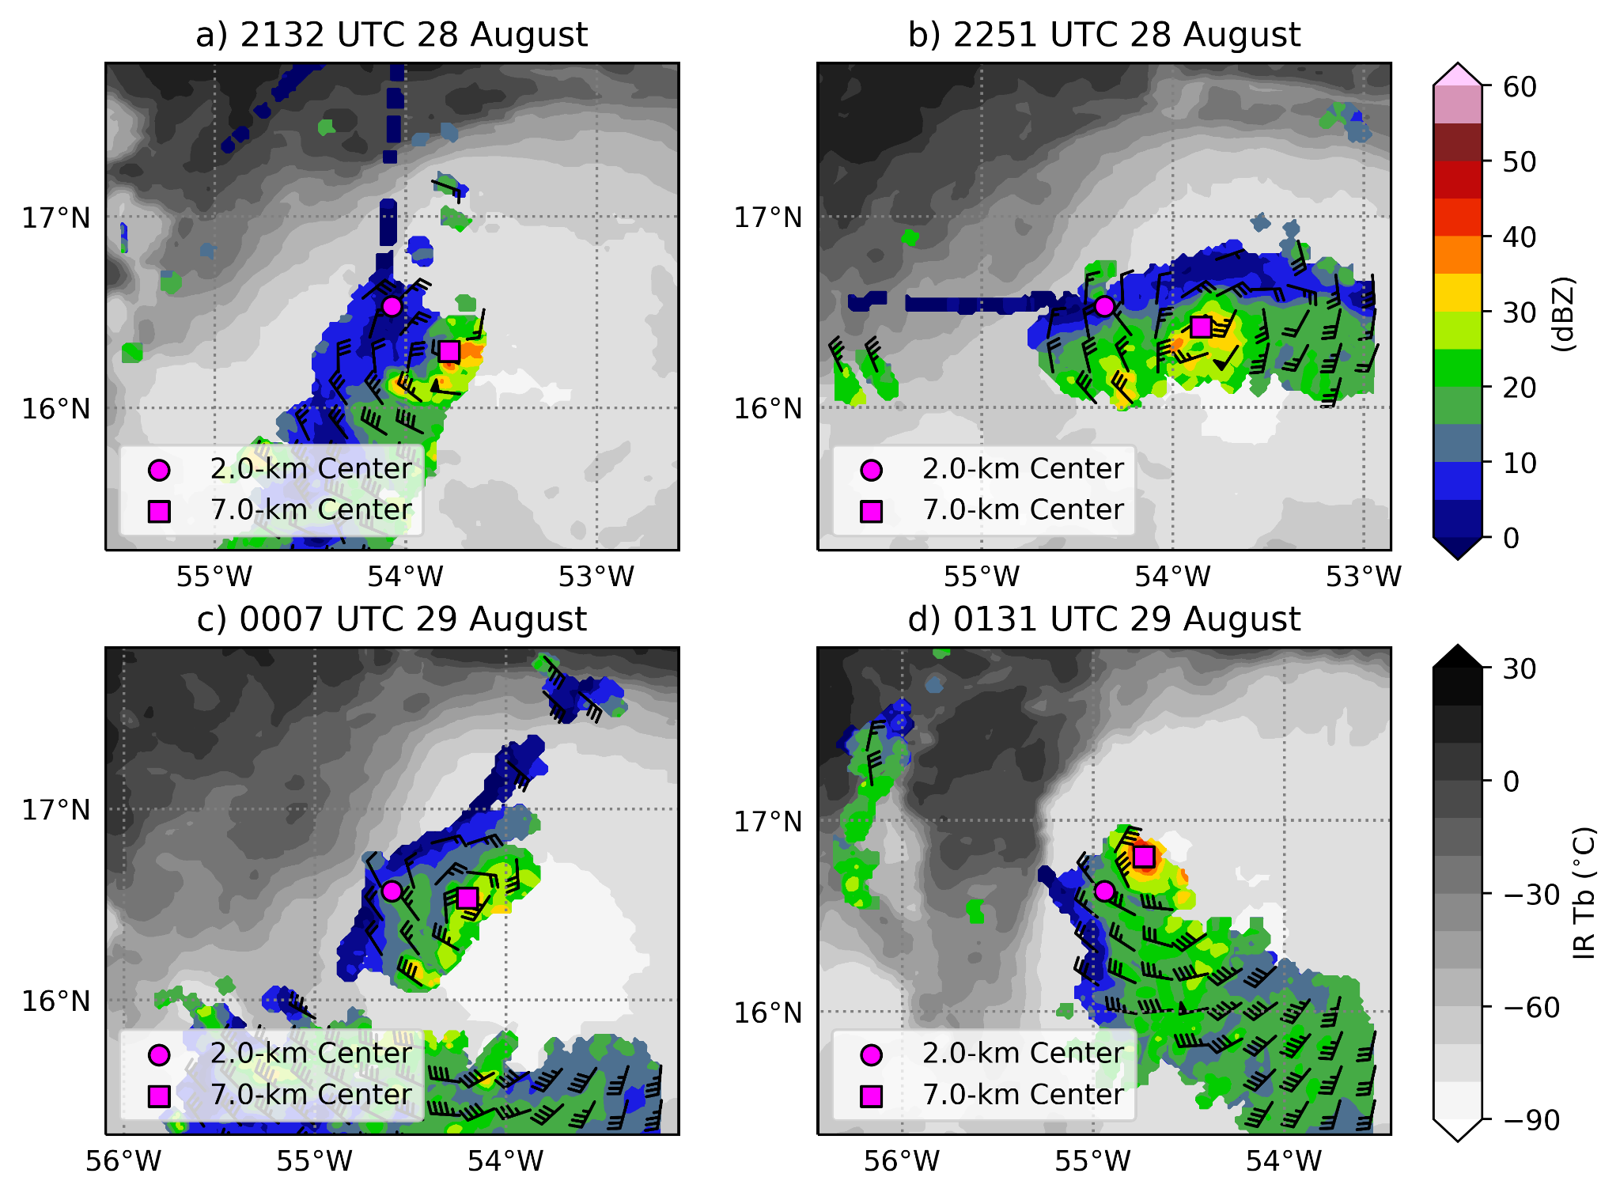
Tools to explore vortex tilt in nature
Use TC-RADAR (Fischer et al. 2022), which contains over 1,000 analyses of TC kinematic and precipitation structure
Uses a novel center-finding algorithm, which allows for estimates of vortex tilt from individual swaths (seen to the left)
Includes best-track and SHIPS diagnostics
Exclude cases that make landfall over the next 12 h or are in very unfavorable thermodynamic environments
Tropical Storm Earl (2010)

Slide 17
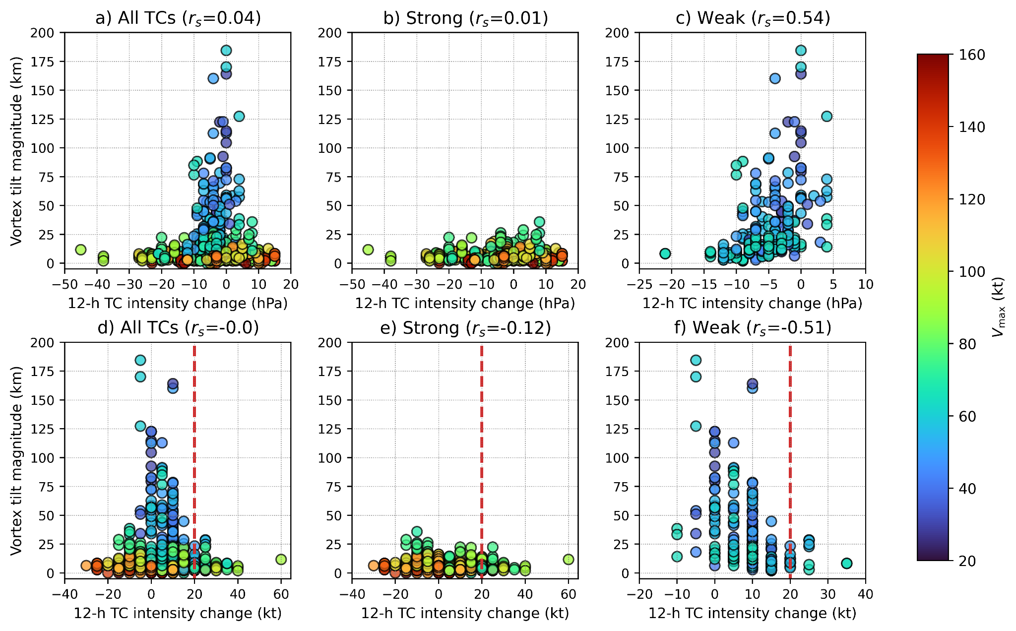
Vortex tilt vs. TC intensity change
Changes in MSLP:
Changes in Vmax:

Slide 18
Vortex tilt vs. TC intensity change
Changes in MSLP:
No signal?
  We need to look closer!
Changes in Vmax:

Slide 19
Vortex tilt vs. TC intensity change
The maximum 2–6.5-km tilt magnitude is a strong predictor of intensity change in weak TCs (Vmax ≤ 65 kt), but not in strong TCs
RI (12-h ΔVmax ≥ 20 kt; red line) is only observed to occur for relatively aligned vortices

Slide 20
Vortex tilt vs. TC intensity change
To answer Q1, we will focus on weak TCs, where tilt is strongly related to intensity change
The maximum 2–6.5-km tilt magnitude is a strong predictor of intensity change in weak TCs (Vmax ≤ 65 kt), but not in strong TCs
RI (12-h ΔVmax ≥ 20 kt; red line) is only observed to occur for relatively aligned vortices

Slide 21
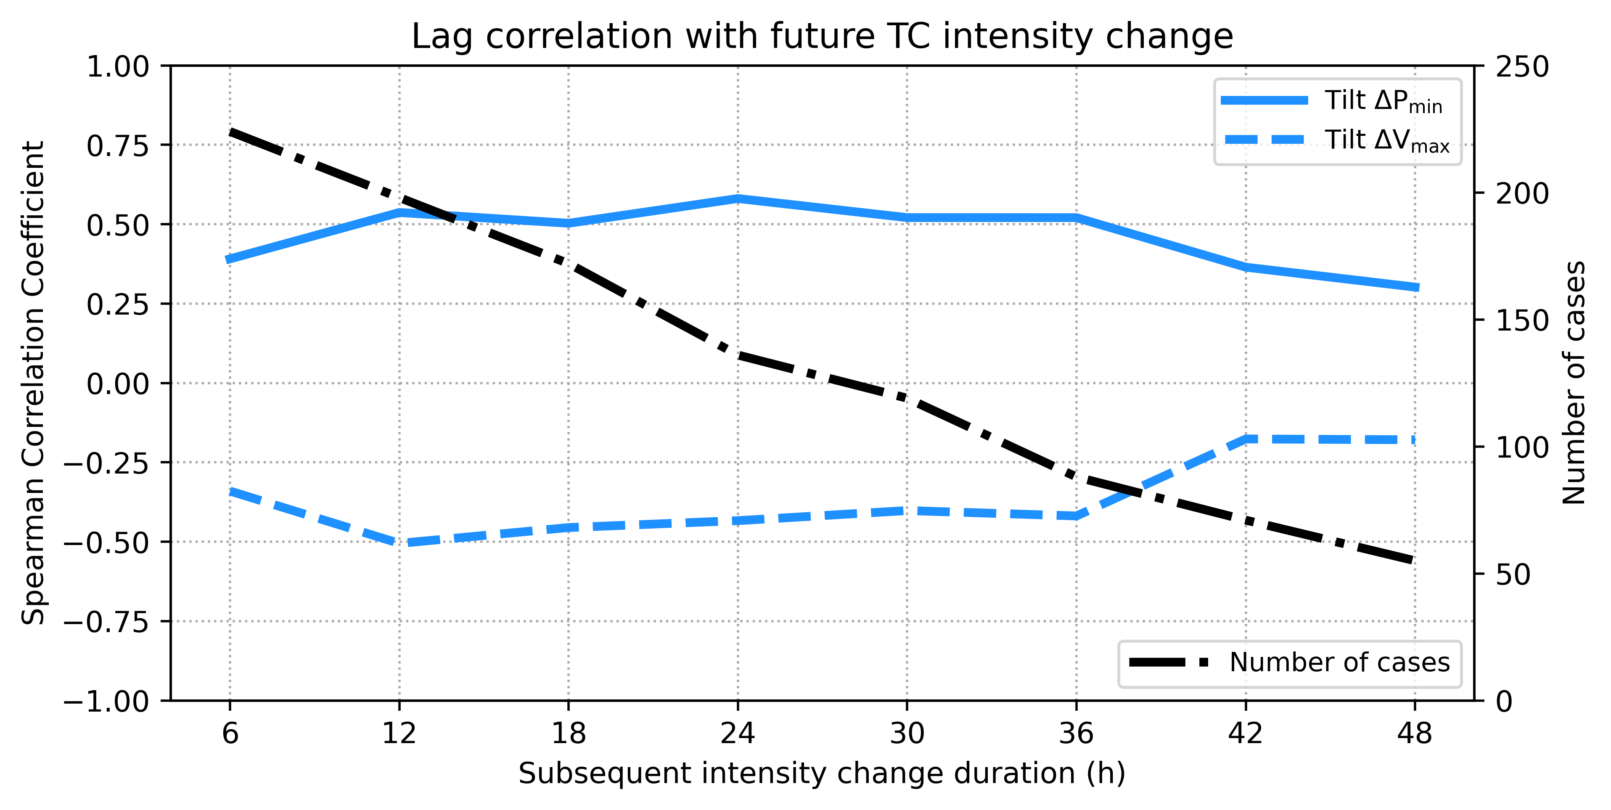
Lag correlation between tilt and intensity change

Slide 22
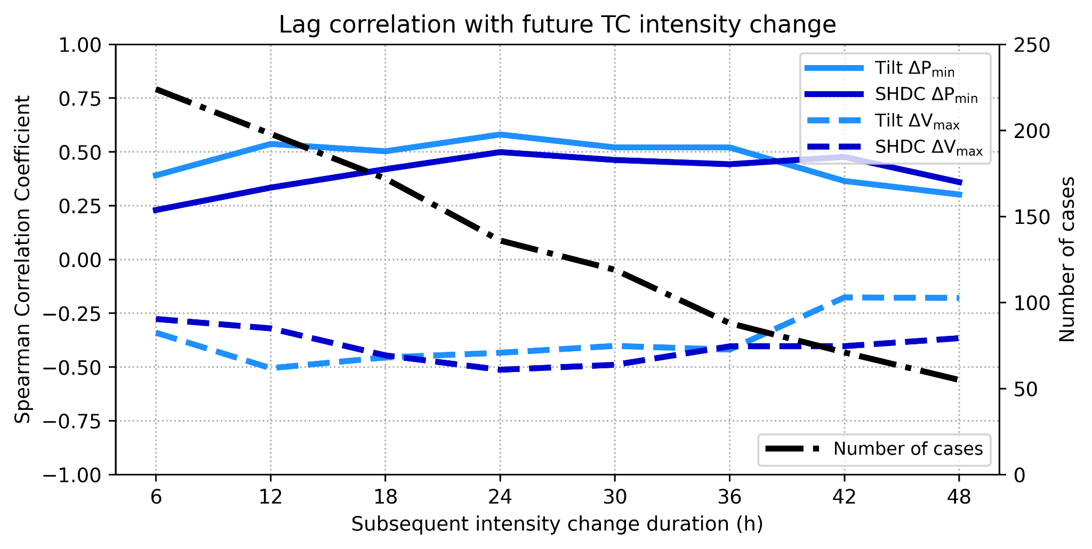
TC intensity change vs. shear and tilt
Tilt is more strongly correlated to short-term (e.g., 12–36-h) TC intensity change than the SHIPS deep-layer shear magnitude (SHDC)

Slide 23
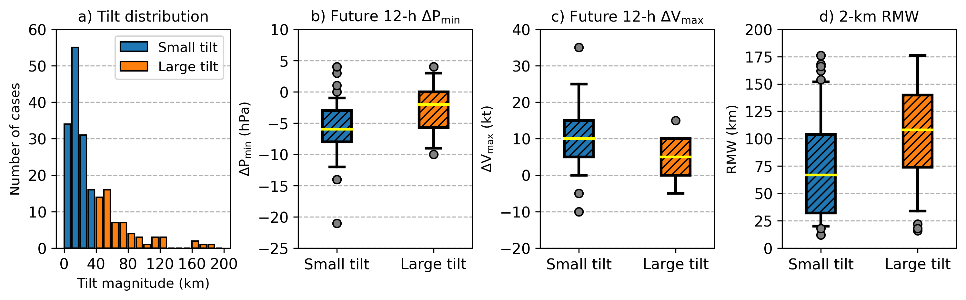
Comparing small-tilt vs. large-tilt TCs
All weak TCs tend to intensify, but small-tilt TCs intensify at significantly greater rates than their more tilted counterparts
Small-tilt TCs also have more compact vortices, consistent with idealized simulations in other studies

Slide 24
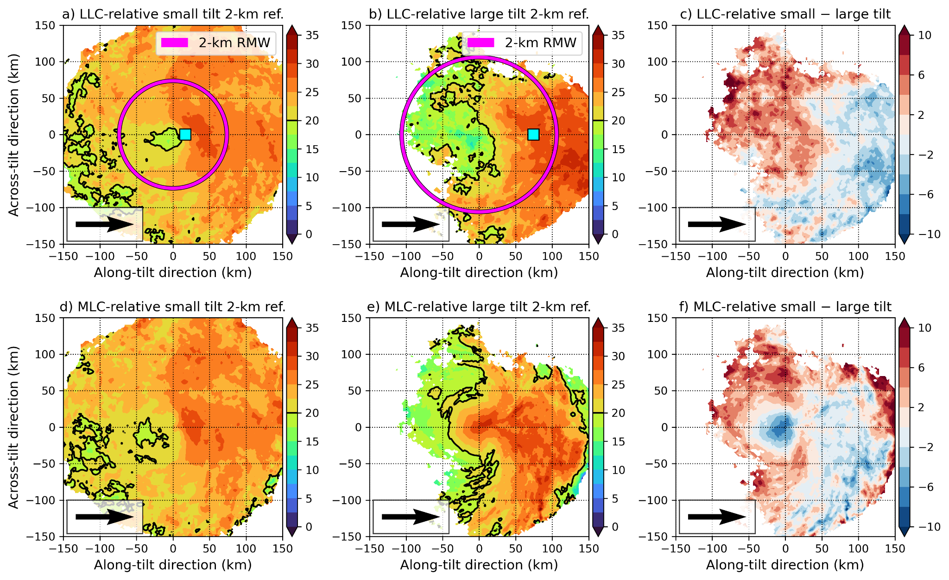
Tilt-relative reflectivity composites for two tilt groups
Small-tilt storms are associated with more symmetric precipitation structures and greater reflectivity near LLC

Slide 25
Tilt-relative reflectivity composites for two tilt groups
Small-tilt storms are associated with more symmetric precipitation structures and greater reflectivity near LLC
Interestingly, in large-tilt TCs, reflectivity structure is closely tied to MLC location
Large-tilt TCs tend to have more vigorous convection

Slide 26
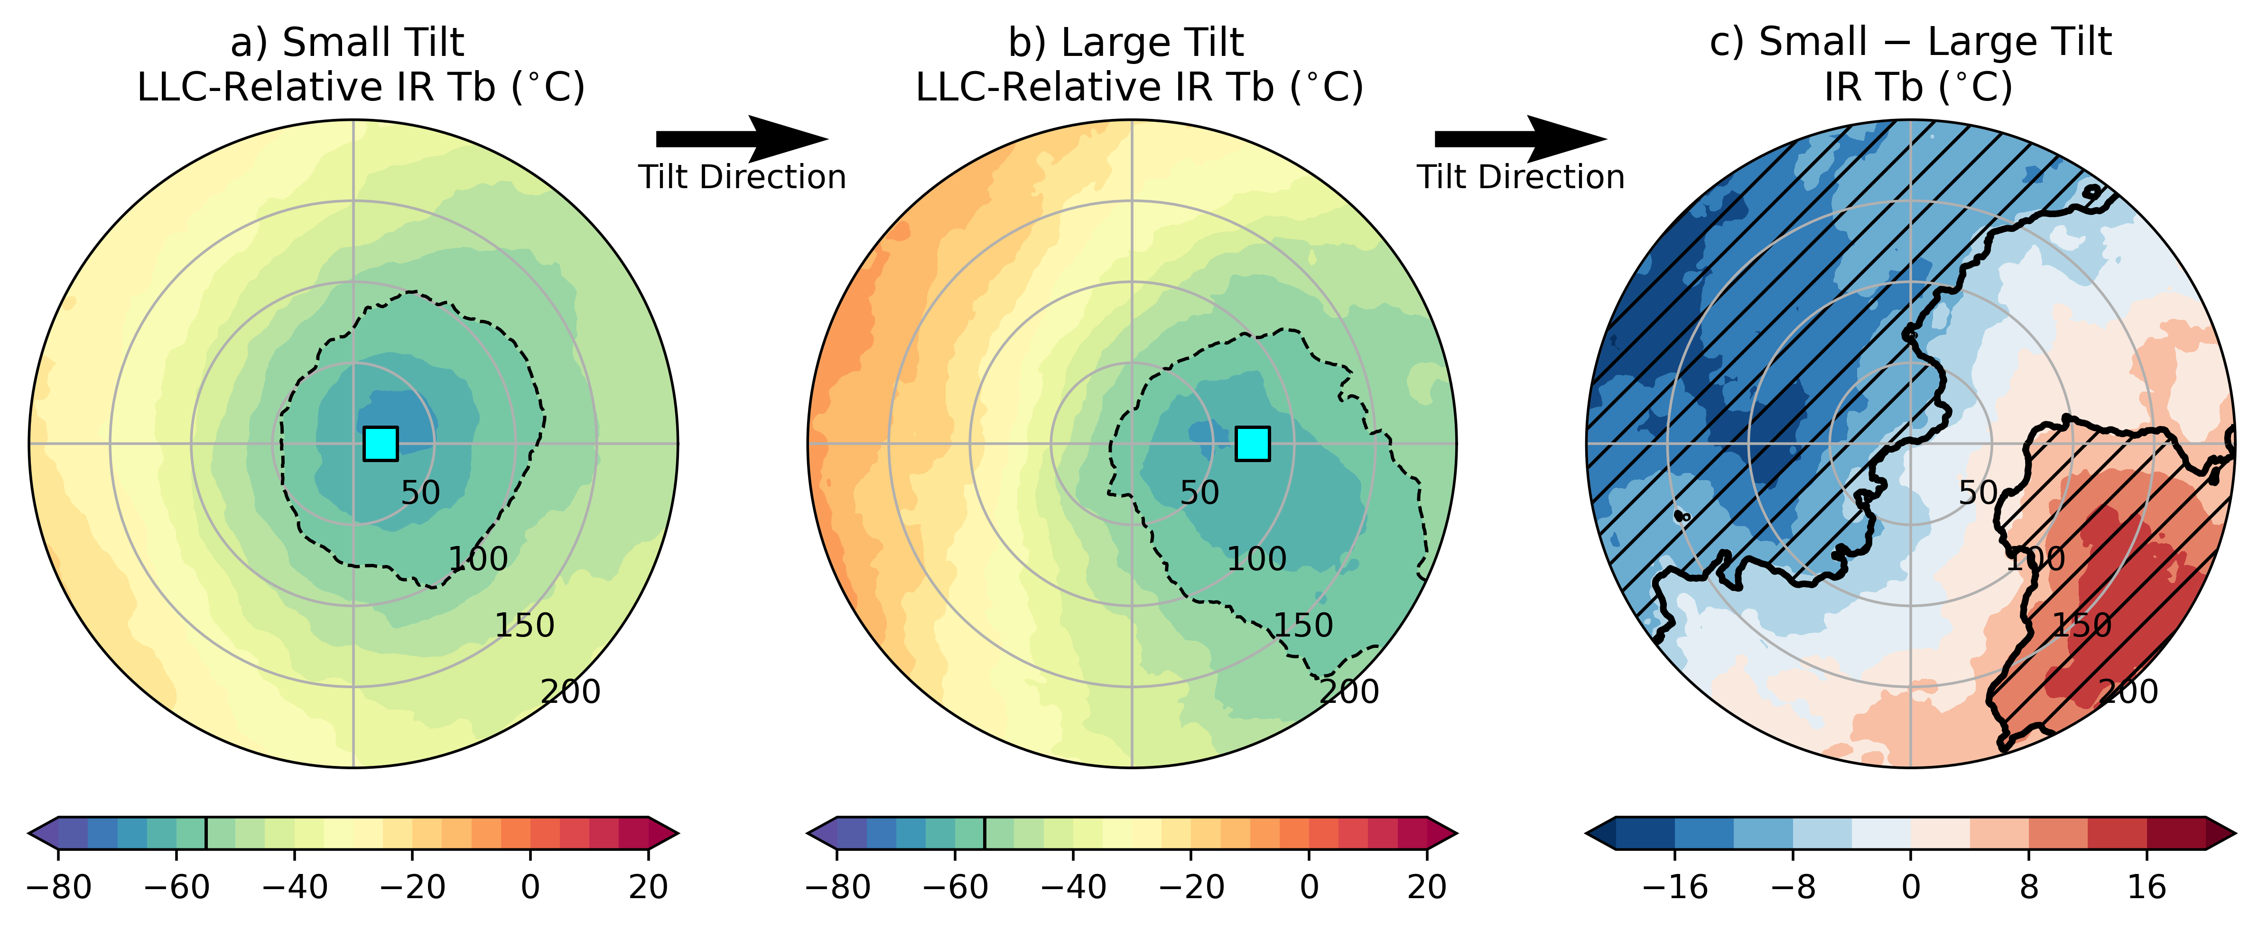
Tilt-relative IR brightness composites for two tilt groups
Composites of infrared brightness temperatures support TDR composites

Slide 27
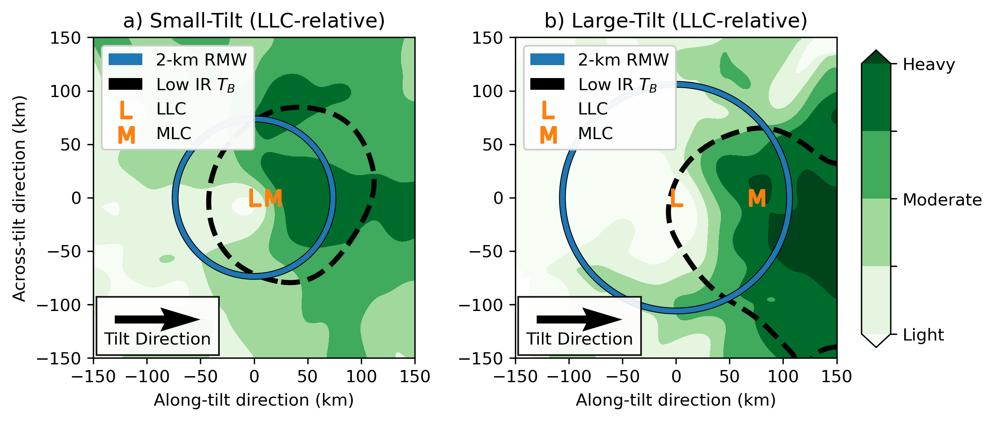
Q1 Summary
Q1) Is vortex tilt related to TC intensity change in nature?
  Yes! But primarily for weak TCs.
  TCs will smaller tilt magnitudes have a greater areal coverage of precipitation, and more frequent ascent, near the LLC
  A relatively aligned vortex appears required for RI over next 12 h

Slide 28
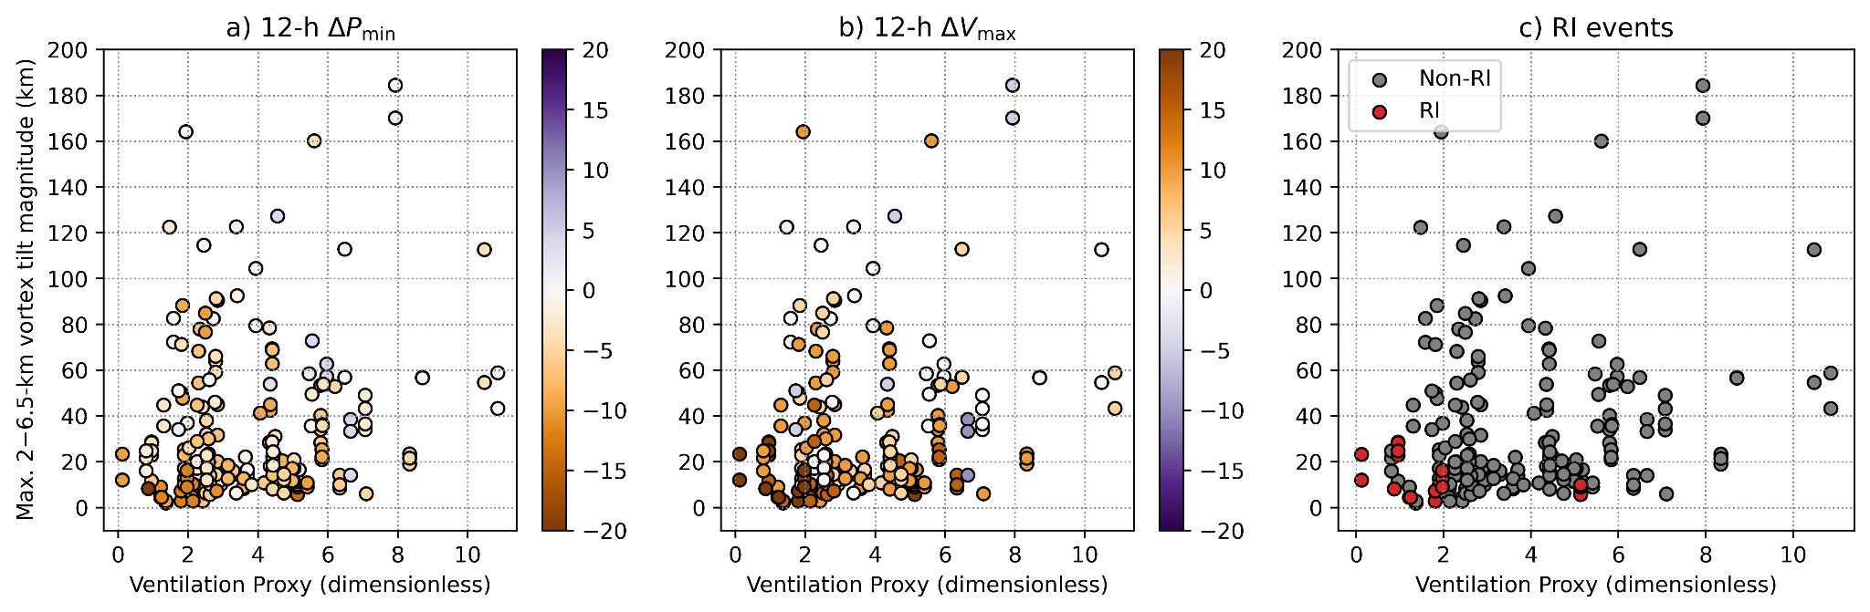
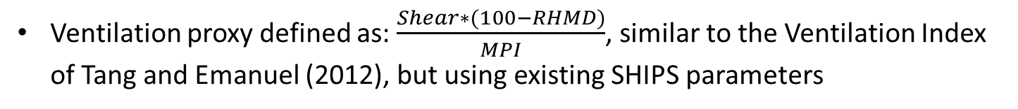
TC intensity change depends on multi-scale processes
Ventilation proxy defined as: $\frac{Shear∗(100−RHMD)}{MPI}$, similar to the Ventilation Index of Tang and Emanuel (2012), but using existing SHIPS parameters

Slide 29
TC intensity change depends on multi-scale processes
Ventilation proxy defined as: $\frac{Shear∗(100−RHMD)}{MPI}$, similar to the Ventilation Index of Tang and Emanuel (2012), but using existing SHIPS parameters

Slide 30
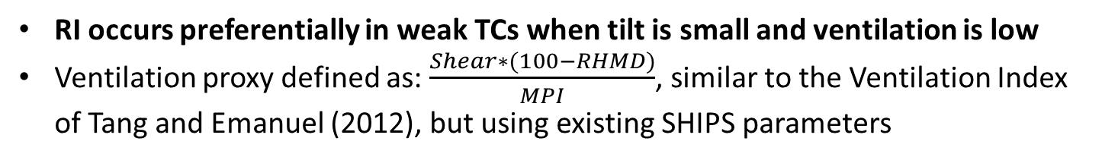
TC intensity change depends on multi-scale processes
RI occurs preferentially in weak TCs when tilt is small and ventilation is low
Ventilation proxy defined as: $\frac{Shear∗(100−RHMD)}{MPI}$, similar to the Ventilation Index of Tang and Emanuel (2012), but using existing SHIPS parameters

Slide 31
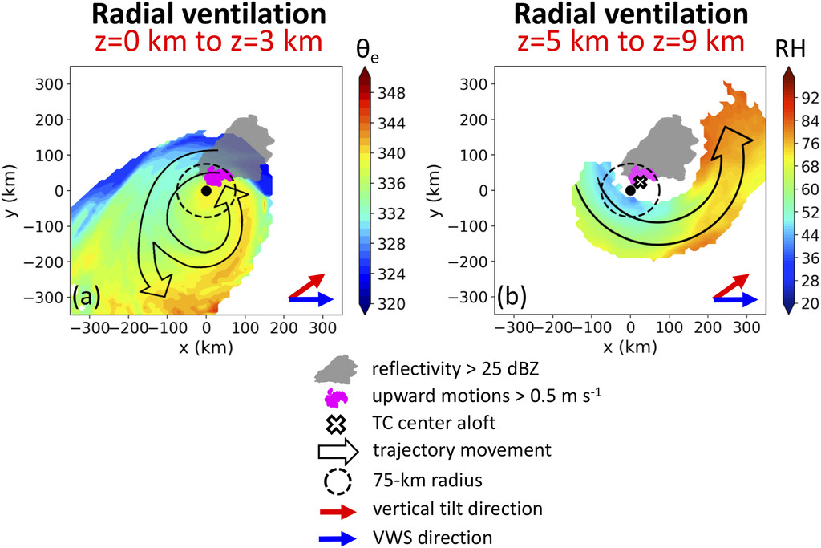
Vortex tilt can influence ventilation
Idealized modeling studies suggest the TC tilt structure in weak TCs strongly influences the extent of ventilation of the TC warm core
What happens in non-idealized TCs?
Fig. 13 from Alland et al. (2021b)

Slide 32
Q1 Summary
Q1) Is vortex tilt related to TC intensity change in nature?
  Yes! But primarily for weak TCs.
  TCs will smaller tilt magnitudes have a greater areal coverage of precipitation, and more frequent ascent, near the LLC
  A relatively aligned vortex appears required for RI over next 12 h
Q2:
How does tilt influence ventilation and TC intensity change in non-idealized vortices?

Slide 33
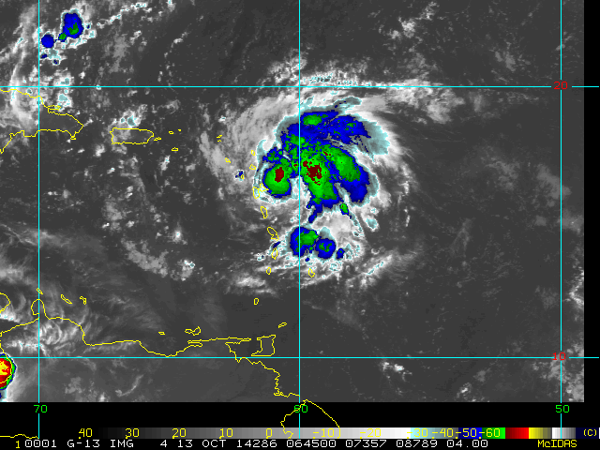
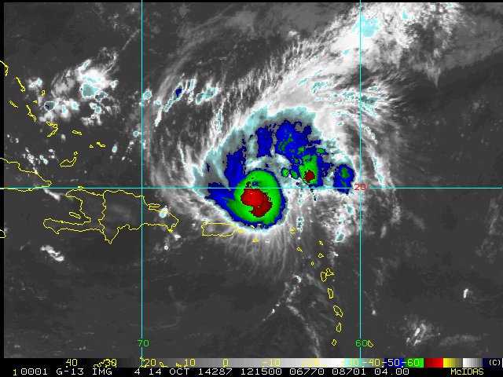
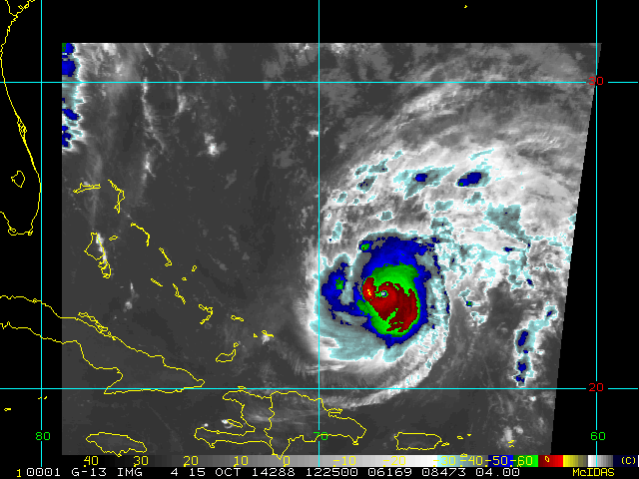
Ensemble set-up
Examined a 60-member WRF-AHW ensemble of Hurricane Gonzalo (2014)
  1.33-km grid spacing for inner nest
  Only differences between members are perturbations to initial and boundary conditions (e.g., Cavallo et al. 2013)
Simulations began at 1200 UTC 13 October 2014, near the start of an observed RI event with nearby dry air, and ran for 72 h
12Z 13 October: 65 kt
12Z 14 October: 95 kt
12Z 15 October: 115 kt

Slide 34
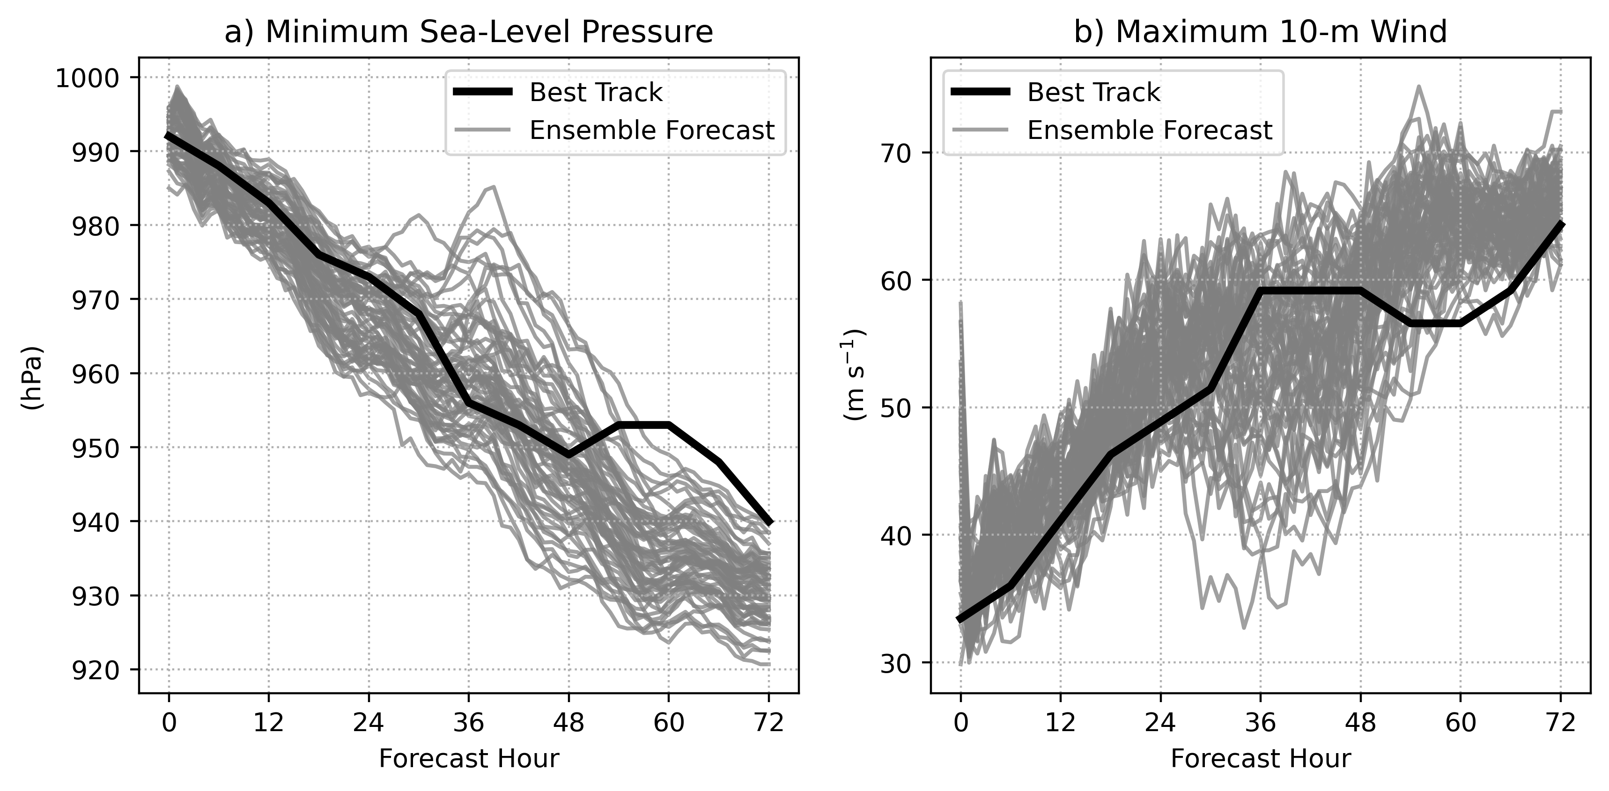
Ensemble set-up
Examined a 60-member WRF-AHW ensemble of Hurricane Gonzalo (2014)
  1.33-km grid spacing for inner nest
  Only differences between members are perturbations to initial and boundary conditions (e.g., Cavallo et al. 2013)
Significant intensity spread related to differences in the timing of RI onset

Slide 35
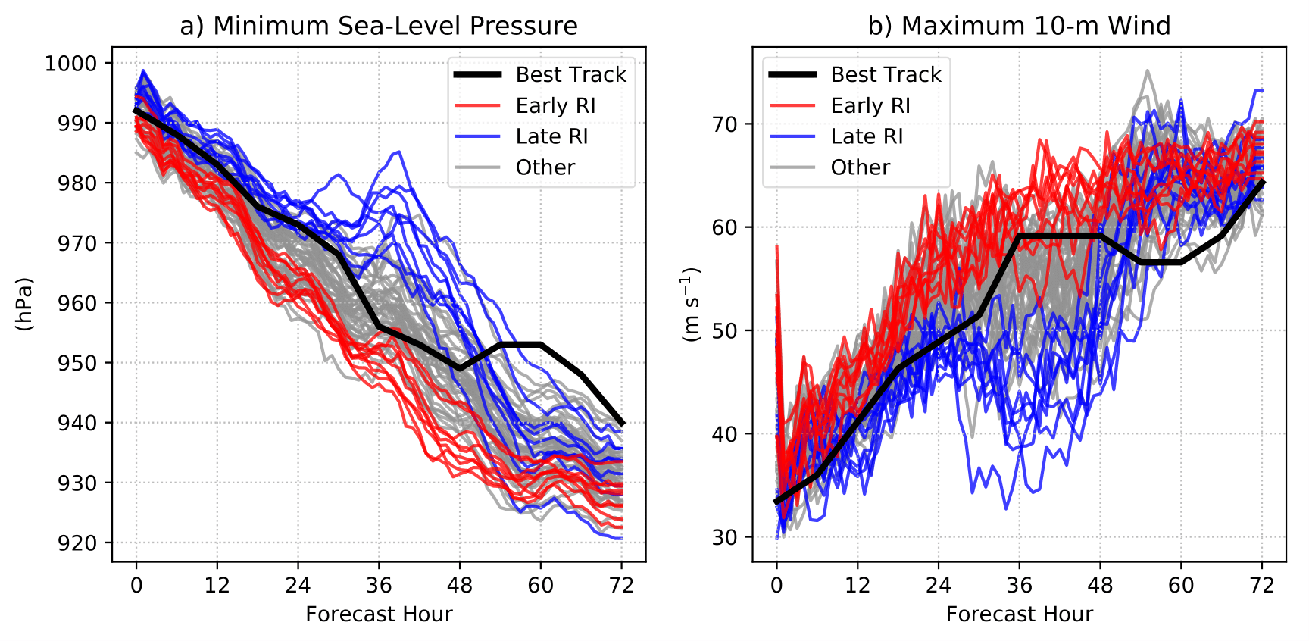
Ensemble set-up
Examined a 60-member WRF-AHW ensemble of Hurricane Gonzalo (2014)
  1.33-km grid spacing for inner nest
  Only differences between members are perturbations to initial and boundary conditions (e.g., Cavallo et al. 2013)
Significant intensity spread related to differences in the timing of RI onset
Focused on two groups of members
Nine strongest members through first 48 h
(Early-RI)
Nine weakest members through first 48 h
(Late-RI)

Slide 36
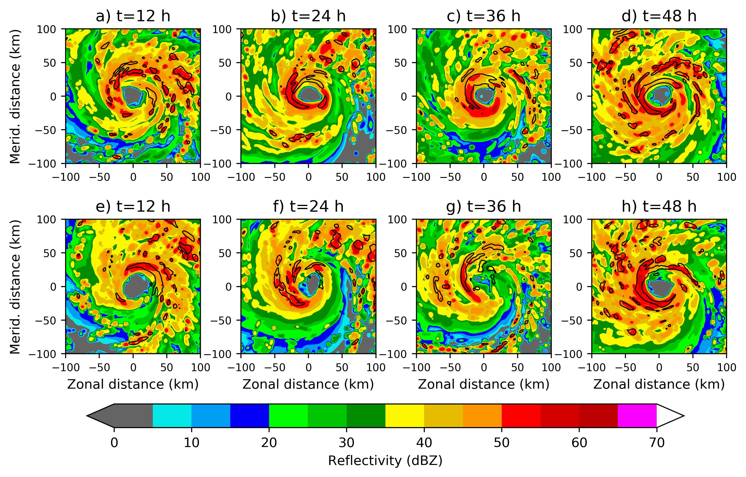
Reflectivity Evolution
Early-RI member
What is driving the stark differences
in TC intensity? → Differences in ventilation
Late-RI member
Significant differences in convective structure at t=36!

Slide 37
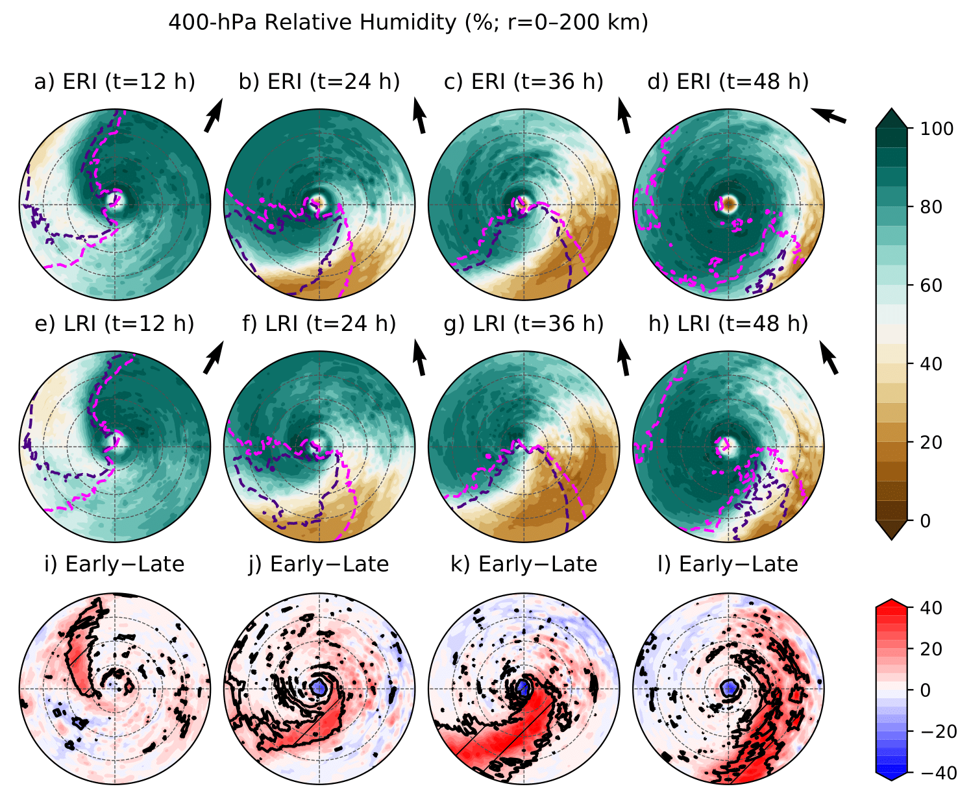
Evolution of 400-hPa relative humidity
400-hPa Relative Humidity (shaded; %) and inflow (contours):
Composite mean 400-hPa relative humidity and inflow for early-RI (top) and late-RI (bottom) members
Deep-layer shear vectors shown in black

Slide 38
Evolution of 400-hPa relative humidity
400-hPa Relative Humidity (shaded; %) and inflow (contours):
Composite mean 400-hPa relative humidity and inflow for early-RI (top) and late-RI (bottom) members
Deep-layer shear vectors shown in black
Late-RI members associated with a region of significantly drier mid–upper-tropospheric dry air than early-RI members, especially at the time of greatest TC intensity differences (t=36 h)
This dry air intrusion overlaps with inflow region, indicating radial ventilation

Slide 39
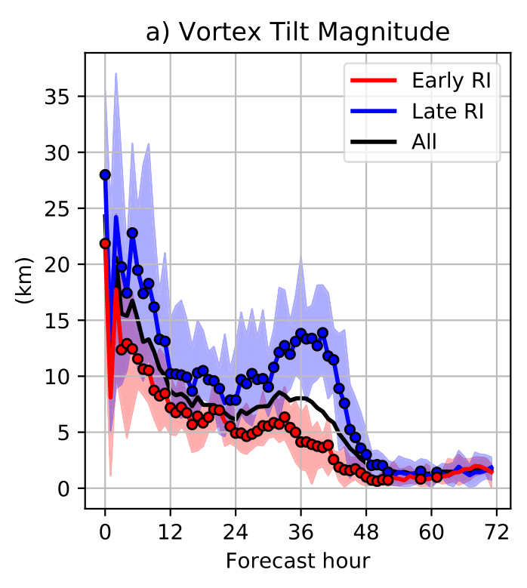
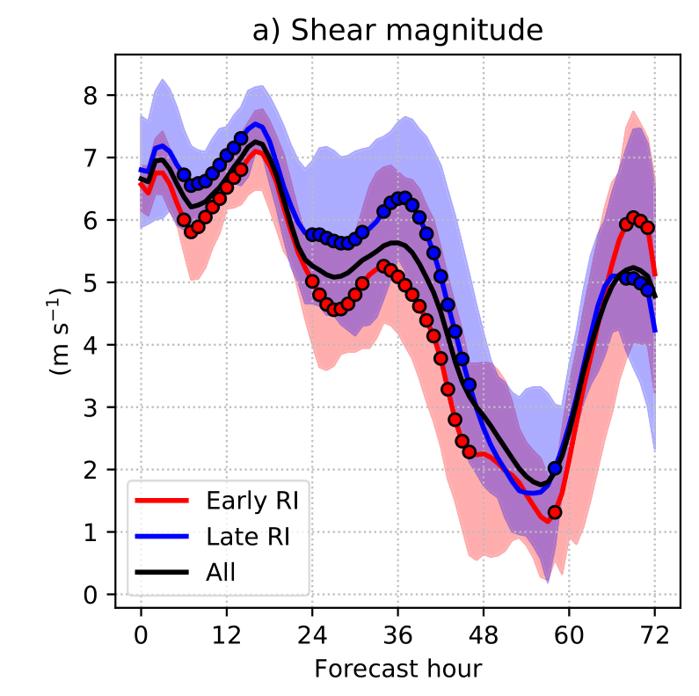
Vortex Tilt Evolution
Surface–400-hPa Vortex Tilt Magnitude:
Deep-Layer Shear Magnitude:
Early-RI members are consistently associated with statistically significantly smaller vortex tilt magnitudes than late-RI members over first 48 h
Late-RI members exhibit an increase in tilt leading up to t=36 h
Shear alone doesn’t seem to explain differences in tilt, as the shear distributions overlap
What’s going on here?
Markers indicate statistical significance at 95% confidence level
Notes:
The differences in ventilation between early-RI and late-RI members were found to be closely linked to differences in the evolution of vortex tilt

Slide 40
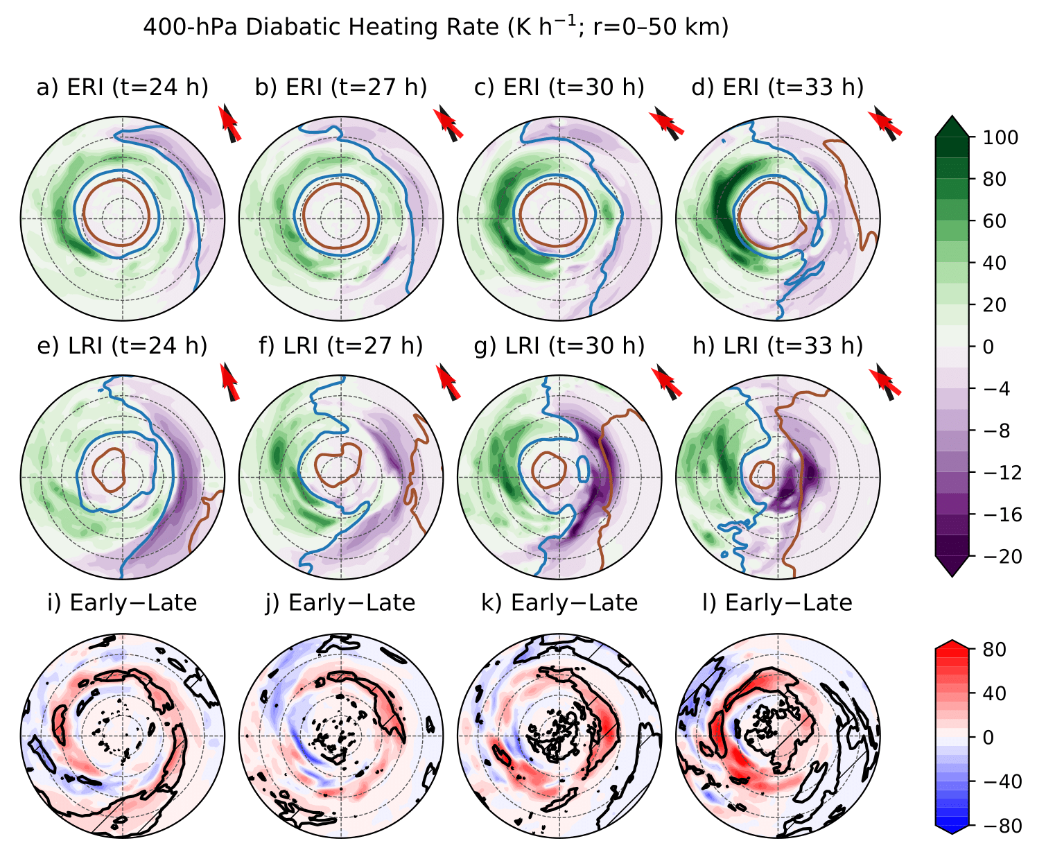
Relationship between tilt and ventilation
400-hPa Diabatic Heating (shaded; K/h) and RH (contours):
Composite-mean 400-hPa heating rate and RH (contoured at 75% and 50%) for early-RI (top) and late-RI (bottom)
Arrows show shear and tilt directions
Approaching dry air

Slide 41
Relationship between tilt and ventilation
400-hPa Diabatic Heating (shaded; K/h) and RH (contours):
Composite-mean 400-hPa heating rate and RH (contoured at 75% and 50%) for early-RI (top) and late-RI (bottom)
Arrows show shear and tilt directions
In late-RI members, dry air approaches from uptilt regions and significantly reduces diabatic heating in core. Diabatic cooling seen in dry regions
Leads to a weakening of the vortex and tilt amplifies with time… Part of an unfavorable feedback!

Slide 42
Relationship between tilt and ventilation
400-hPa Diabatic Heating (shaded; K/h) and RH (contours):
Composite-mean 400-hPa heating rate and RH (contoured at 75% and 50%) for early-RI (top) and late-RI (bottom)
Arrows show shear and tilt directions
In late-RI members, dry air approaches from uptilt regions and significantly reduces diabatic heating in core. Diabatic cooling seen in dry regions
Leads to a weakening of the vortex and tilt amplifies with time… Part of an unfavorable feedback!

Slide 43
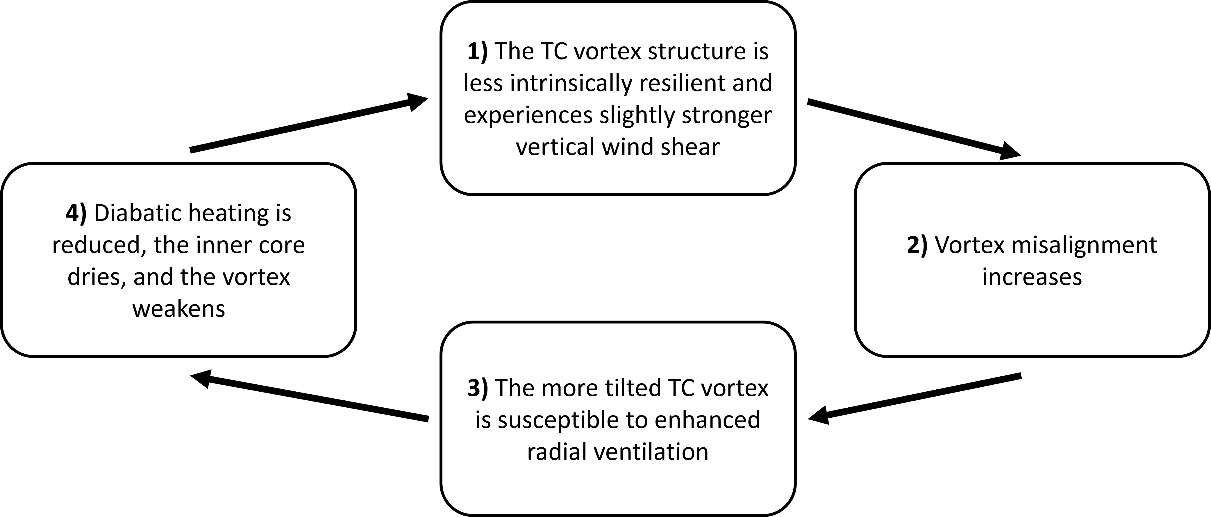
Weakening feedback in late-RI members

Slide 44
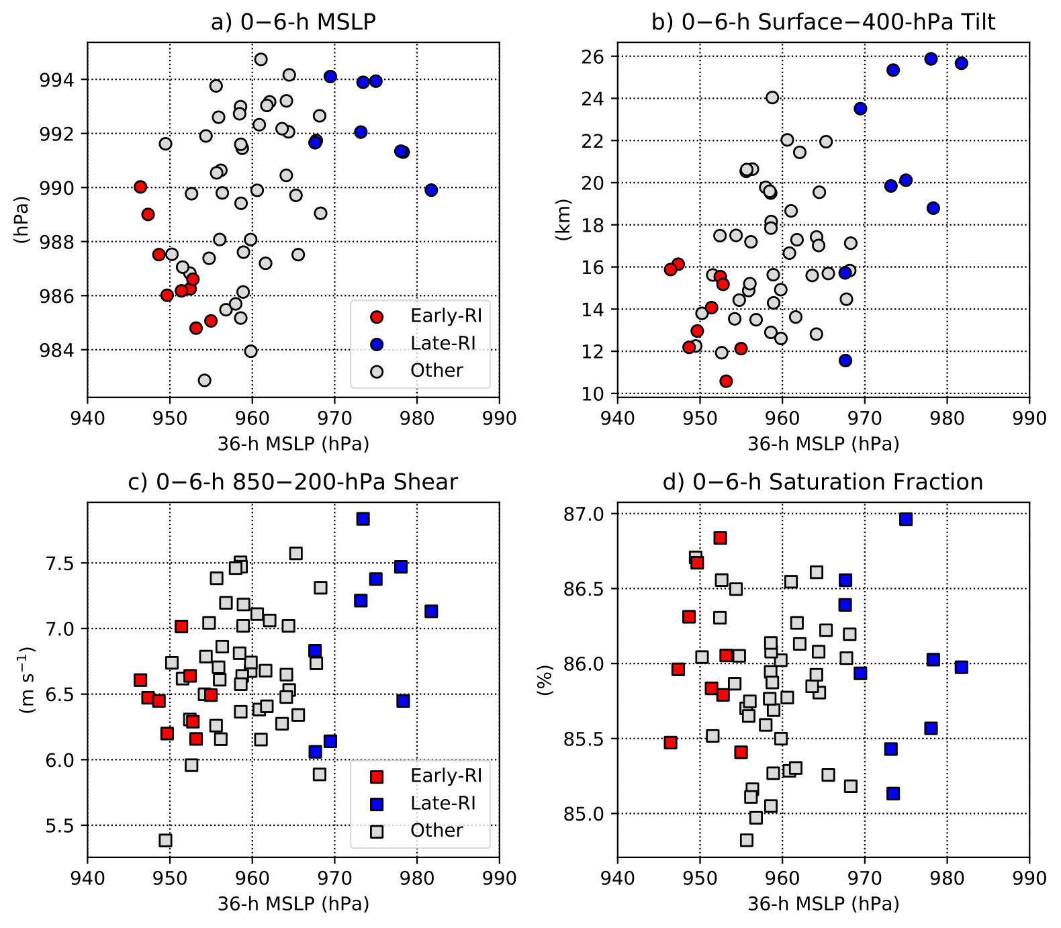
Significance of initial conditions
Scatterplots of initial value (averaged between t=0–6 h) and 36-h TC intensity (hPa)
Circle markers indicate sig. differences between early-RI and late-RI members
Initial differences in TC intensity and tilt were key

Slide 45
Significance of initial conditions
Scatterplots of initial value (averaged between t=0–6 h) and 36-h TC intensity (hPa)
Circle markers indicate sig. differences between early-RI and late-RI members
Initial differences in TC intensity and tilt were key
Interestingly, initial environmental conditions were similar…

Slide 46
Q2 Summary
Q2) How does tilt influence ventilation and TC intensity change
in non-idealized vortices?
Small differences in TC intensity and vortex tilt can quickly amplify with time in environments of moderate shear
More tilted (less resilient) vortices can provide a pathway for dry air to move directly over the low-level TC center and erode inner core convection, leading to an unfavorable feedback
To accurately predict TC intensity change, we need to accurately observe, assimilate, and model the multi-scale processes associated with TC intensity change.
  Getting the vortex intensity and structure right is important!

Slide 47


Future work
Through what processes do misaligned TCs become aligned in nature?
Do these processes vary depending on the alignment pathway (e.g., vortex precession vs. reformation)?
Use AI to estimate the vortex tilt structure from satellite observations when aircraft observations are not available
Fischer et al. 2022
Fischer et al. 2023

Slide 48
Extra slides

Slide 49
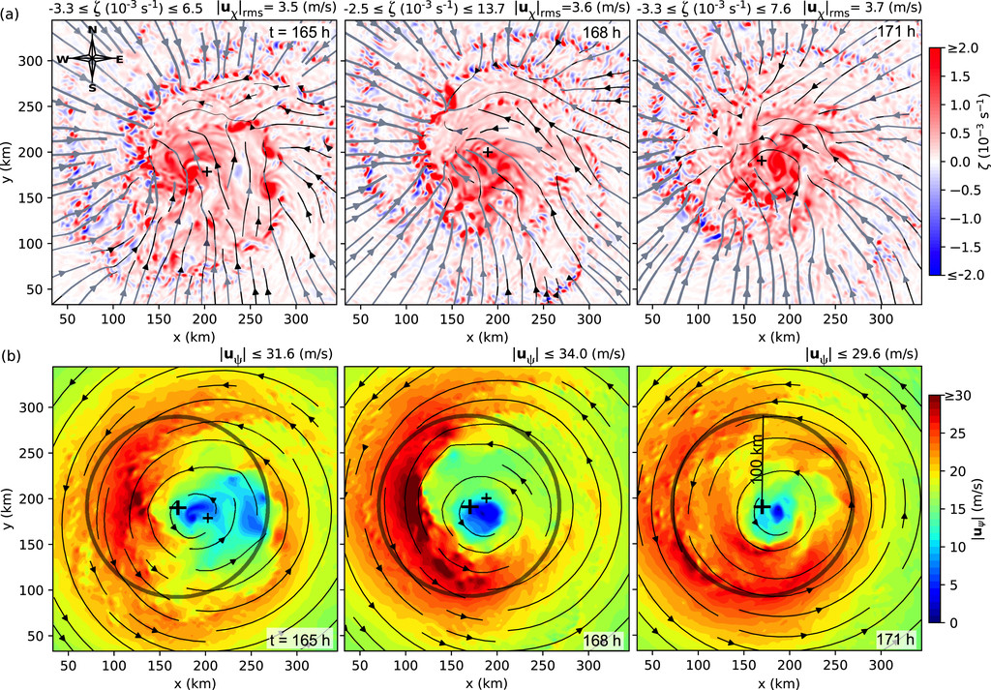
A tilted vortex can be a messy vortex
In relatively weak TCs, multiple circulations can exist
A TC may not be accurately characterized by a tilted column of vorticity
Vorticity (shaded):
Rotational wind (shaded):
Fig. 22 from Schecter and Menelaou (2020)

Slide 50
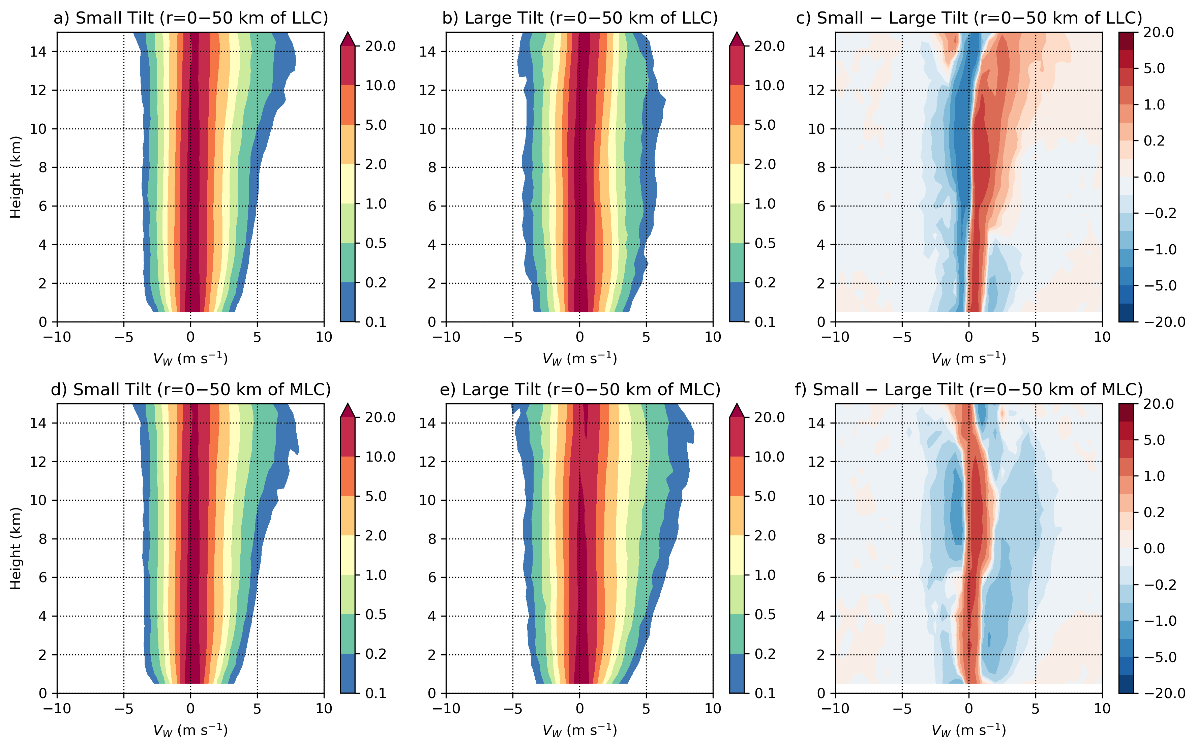
Vertical velocity CFADs
Small-tilt storms have a greater frequency of ascent near the LLC (within 50 km) than large-tilt storms

Slide 51
Vertical velocity CFADs
Small-tilt storms have a greater frequency of ascent near the LLC (within 50 km) than large-tilt storms
Large-tilt TCs have a greater frequency of large ascent (> 1 m/s) near the MLC, indicating more vigorous convection

Slide 52
Reflectivity Evolution
Early-RI member
Late-RI member

Slide 53
Reflectivity Evolution
Early-RI member
Late-RI member
Significant differences in convective structure at t=36!

Slide 54
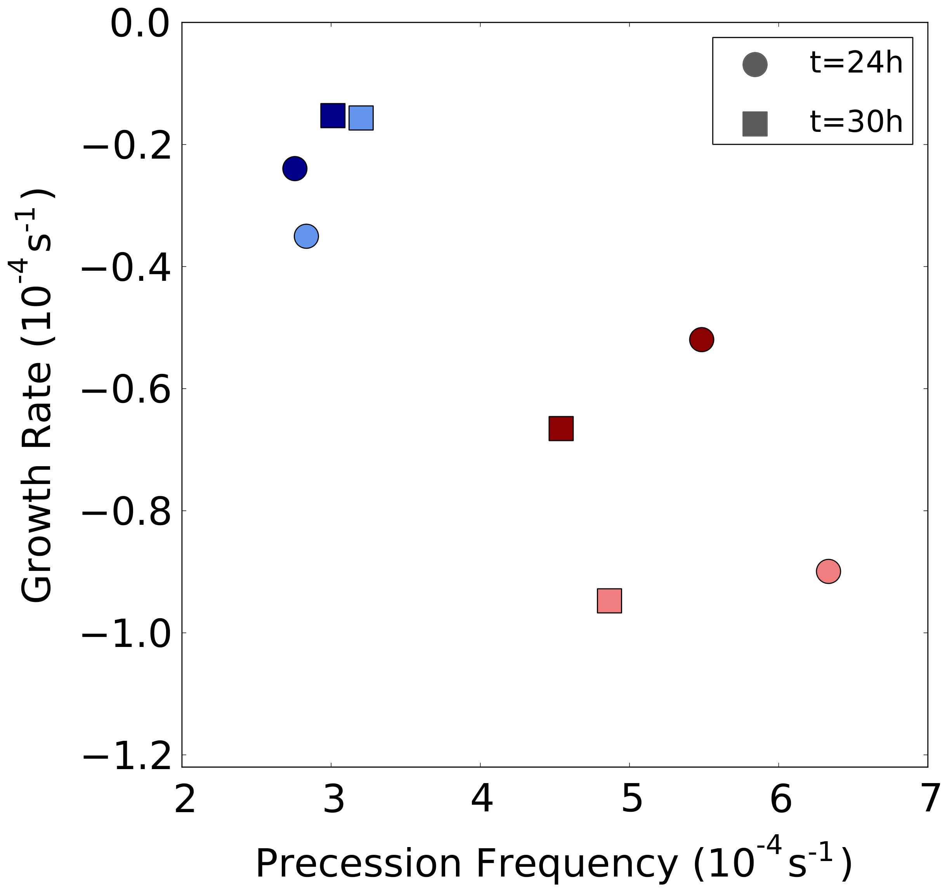
Vortex Resilience Analysis
We performed a vortex resilience analysis on a representative early-RI and late-RI member (following Schecter 2015; Reasor and Montgomery 2015)
Linearize equations about barotropic mean vortex state derived from early- and late-RI member
Shear is set to zero and model is initialized with a quasi-balanced vorticity perturbation, approximating tilt
“Cloudiness” in eyewall region is parameterized using a reduced static stability (lighter markers = more cloudy)
Less damping &
Slower precession
=Less resilient
More damping &
Faster precession
=More resilient

Slide 55
Vortex Resilience Analysis
We performed a vortex resilience analysis on a representative early-RI and late-RI member (following Schecter 2015; Reasor and Montgomery 2015)
At t=24 h, when tilt begins to amplify in late-RI members:
  The tilt mode of the late-RI vortex precesses a factor of two slower than early-RI vortex
  The late-RI vortex is damped at nearly 1/3 the rate of the early-RI vortex
Less cloudy
More cloudy

Slide 56
Vortex Resilience Analysis
We performed a vortex resilience analysis on a representative early-RI and late-RI member (following Schecter 2015; Reasor and Montgomery 2015)
At t=24 h, when tilt begins to amplify in late-RI members:
  The tilt mode of the late-RI vortex precesses a factor of two slower than early-RI vortex
  The late-RI vortex is damped at nearly 1/3 the rate of the early-RI vortex
At t=30 h, as the vortex is further ventilated and the vortex structure evolves, the early-RI member remains more resilient

Slide 57
Vortex Resilience Analysis
We performed a vortex resilience analysis on a representative early-RI and late-RI member (following Schecter 2015; Reasor and Montgomery 2015)
At t=24 h, when tilt begins to amplify in late-RI members:
  The tilt mode of the late-RI vortex precesses a factor of two slower than early-RI vortex
  The late-RI vortex is damped at nearly 1/3 the rate of the early-RI vortex
At t=30 h, as the vortex is further ventilated and the vortex structure evolves, the early-RI member remains more resilient
Key takeaways from resilience analysis:
The vortex structure of the early-RI member was intrinsically more resilient!
This helps explain difference in tilt evolution

Slide 58
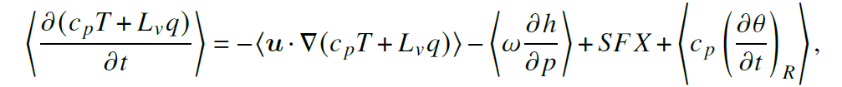
Moist Static Energy (MSE) Budget
MSE provides a desirable framework to examine the impacts of ventilation on TC convective processes as column-integrated MSE approximately conserved under moist adiabatic motions
Following the methods of Neelin (2007) and Chen et al. (2019), the MSE budget here uses the time tendency of moist enthalpy (Cp*T + Lv*q) as this leads to a better closure of the MSE budget
Computed within a 240x240-km TC-centered box

Slide 59
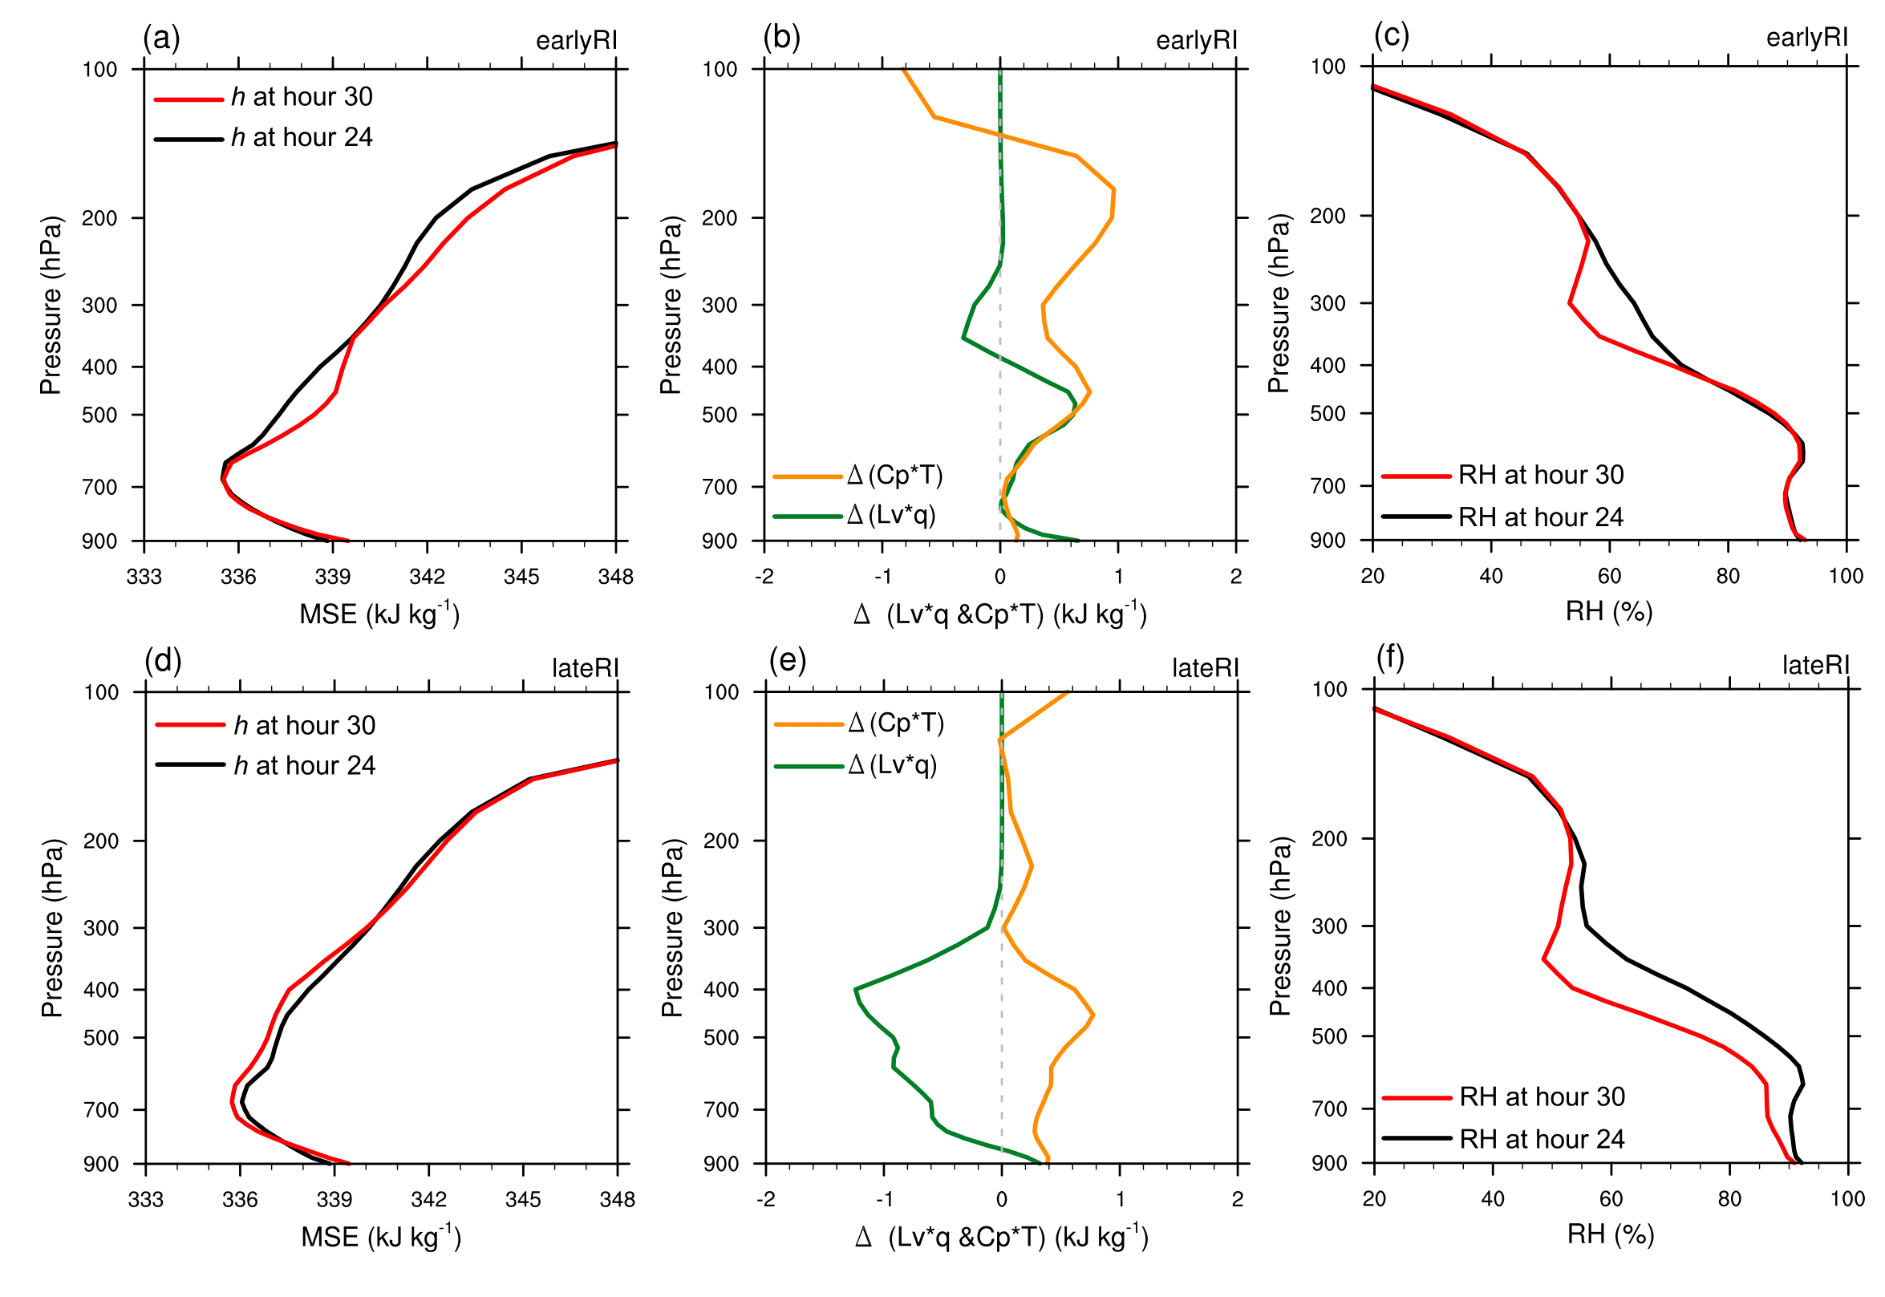
Moist Static Energy (MSE) Budget
(a),(d): Vertical profiles of area-averaged MSE (h) within a 240x240-km TC-centered box

Slide 60
Moist Static Energy (MSE) Budget
(a),(d): Vertical profiles of area-averaged MSE (h) within a 240x240-km TC-centered box

Slide 61
Moist Static Energy (MSE) Budget
(a),(d): Vertical profiles of area-averaged MSE (h) within a 240x240-km TC-centered box
(b),(e): Change in internal energy (Cp*T) and latent heat (Lv*q) between forecast hours 24 and 30

Slide 62
Moist Static Energy (MSE) Budget
(a),(d): Vertical profiles of area-averaged MSE (h) within a 240x240-km TC-centered box
(b),(e): Change in internal energy (Cp*T) and latent heat (Lv*q) between forecast hours 24 and 30
Increase in both
Cp*T and Lv*q
Increase in Cp*T
Decrease in Lv*q
Mesoscale subsidence
beneath dry air intrusion

Slide 63
Moist Static Energy (MSE) Budget
(a),(d): Vertical profiles of area-averaged MSE (h) within a 240x240-km TC-centered box
(b),(e): Change in internal energy (Cp*T) and latent heat (Lv*q) between forecast hours 24 and 30
(c),(f): Change in area-averaged RH between forecast hours 24 and 30
Evolution in late-RI member is consistent with drying from mesoscale subsidence beneath dry-air intrusion

Slide 64
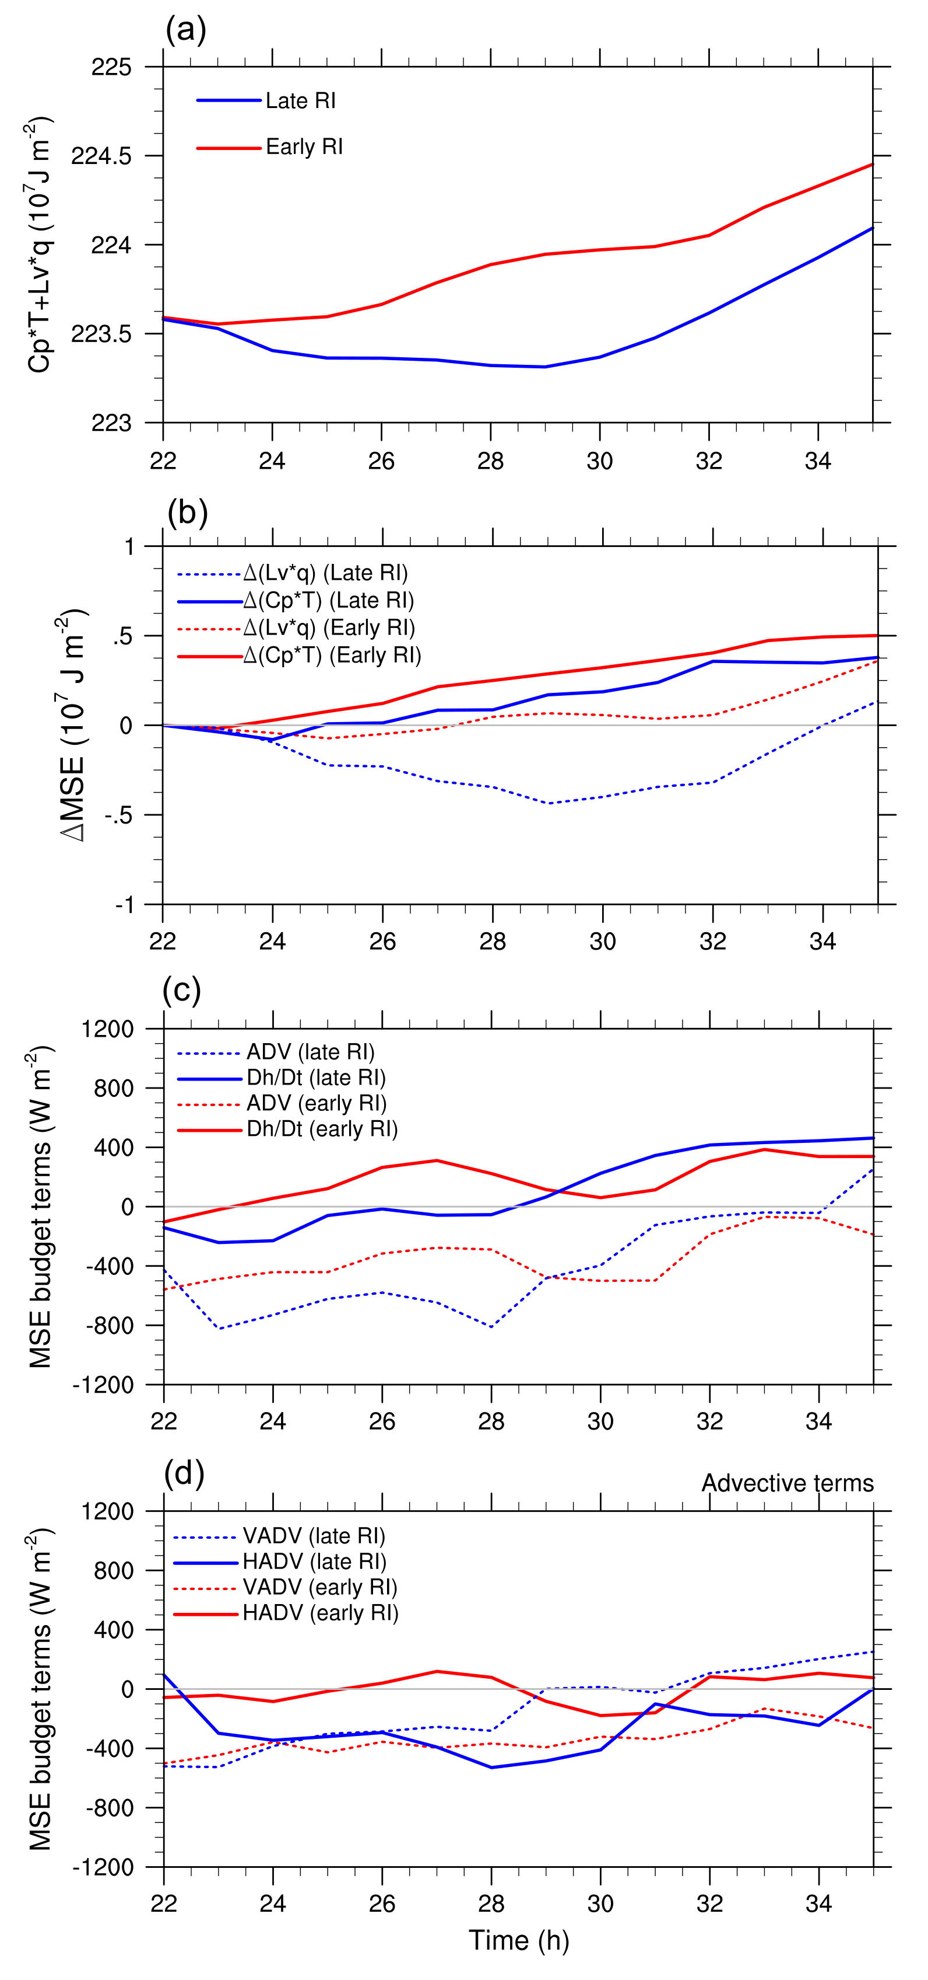
Moist Static Energy (MSE) Budget
Early-RI member experiences an increase moist enthalpy, while late-RI member experiences a decrease in moist enthalpy (panel a)
Change in moist enthalpy are primarily driven by changes in latent heat (Lv*q; panel b)
  Indicates a drying of the column, consistent with mesoscale subsidence
Forecast hour

Slide 65
Moist Static Energy (MSE) Budget
The time derivative of MSE for both members are shown more clearly in panel c
  The sum of the MSE advective terms vary in phase with the MSE tendency, indicating the key role of advective processes
The loss of MSE in the late-RI member is primarily driven by horizontal advection (panel d)
  Consistent with radial ventilation!

Slide 66
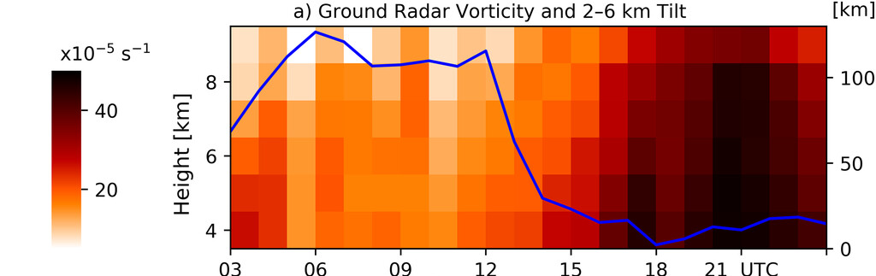
Is tilt related to intensity change?
Observations say: Well, we don’t really know…
Adapted from Stone et al. (2023);
RI of Hurricane Sally (2020)

Slide 67
Is tilt related to intensity change?
Observations say: Well, we don’t really know…
Adapted from Stone et al. (2023);
RI of Hurricane Sally (2020)
Adapted from Rogers et al. (2013)

Slide 68
Is tilt related to intensity change?
Observations say: Well, we don’t really know…
Rogers et al.
(2013)
Adapted from Rogers et al. (2013)
Fig. 9 from Fischer et al. (2022)

Slide 69
Is tilt related to intensity change?
Observations say: Well, we don’t really know…
???
Rogers et al.
(2013)
Adapted from Rogers et al. (2013)
Fig. 9 from Fischer et al. (2022)

