Slide 1
DROPSONDES IN HRD RESEARCH AVAPS User Group Meeting April 20-21 2022
Kathryn Sellwood ( U.M. CIMAS / HRD), Sim Aberson (NOAA/HRD)

Slide 2
NOAA DROPSONDE MISSIONS
STORM | P-3 FLIGHTS | DROPS | MANUAL QC | G-IV FLIGHTS | DROPS | NOT TRANSMITTED
Elsa | 4 | 58 | 22 | 1 | 29 | 5
Fred | 6 | 77 | 16 | 0 | 0 | 7
Grace | 8 | 131 | 26* | 3 | 109 | 20
Henri | 3 | 40 | 9 | 4 | 137 | 12
Ida | 6 | 169 | 13 | 3 | 100 | 27
Larry | 2 | 27 | 4 | 3 | 107 | 5
Sam | 6 | 187 | 3* | 3 | 96 | 18
Totals | 35 | 689 | 93 | 17 | 578 | 94
Issues requiring ASPEN operator intervention Dropsonde Failures
Post Splash Data: 70
Ended Early: 5 No Launch Detect: 11
Late Launch Detect: 13 No Wind or Late Wind: 6
Early Launch Detect: 2 No PTH: 1
Lat/Lon: 8 Fast Fall: 2
Notes:
Low failure rate < 1% not xmt due to redundant RMW/Wind max or missed center drops

Slide 3
Data Access: https://www.aoml.noaa.gov/2021-hurricane-field-program-data/
Notes:
Full resolution netcdf dropsonde data for all 2021 NOAA flights

Slide 4
Dropsonde Use in Flight Modules:
Short experiments designed to observe specific structures and processes
Executed in addition to basic flight plan
Experiments of opportunity

Slide 5
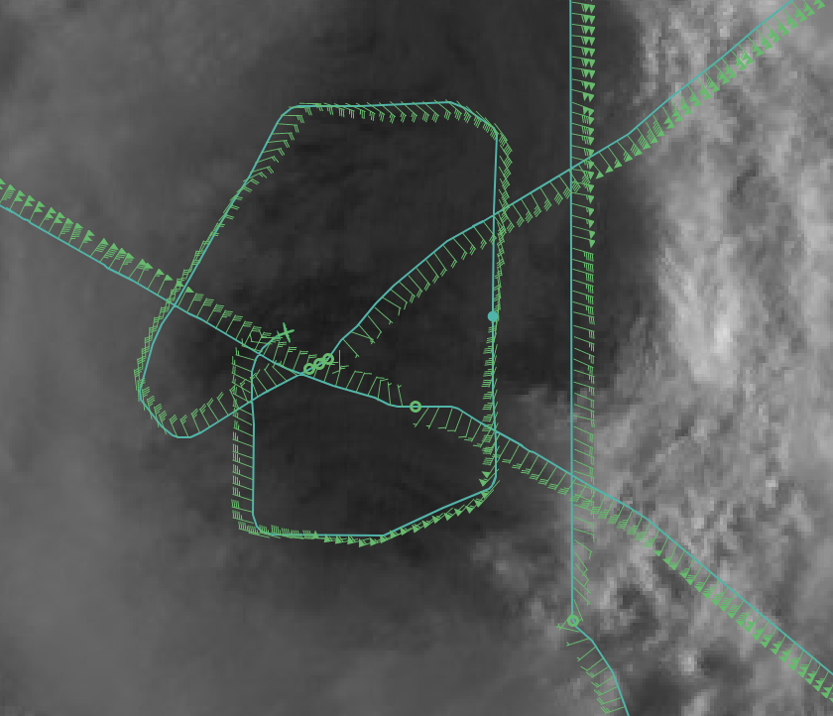
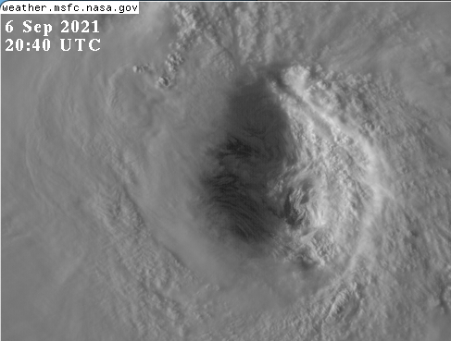
Eye/Eyewall mixing: Flight-level data acquired while circling in the eye (Single drop) with closely space dropsondes across the eyewall
Hurricane Larry: 6 September 2021
Notes:
Inner eyewall circumnavigations left – possible mesovortex features at interface

Slide 6
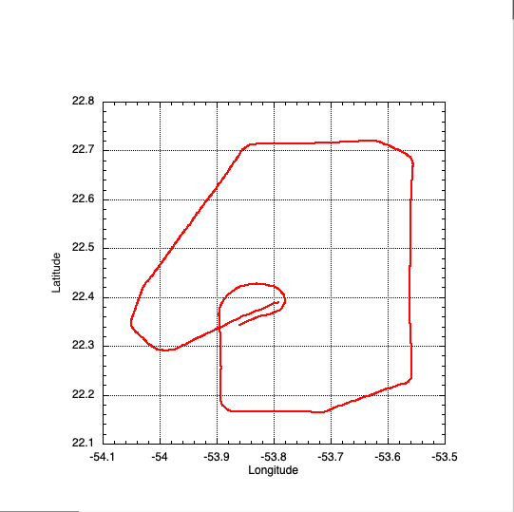
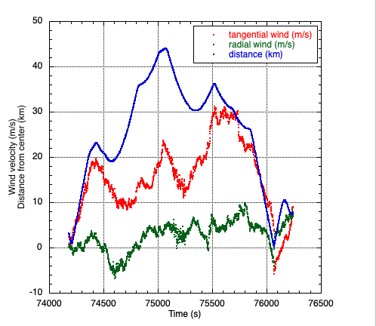
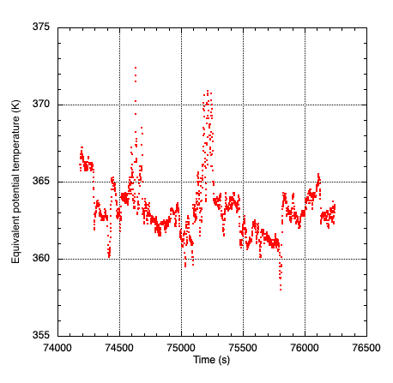
Compare with flight-level data at eye/eywall interface
Slide credit Sim Aberson (NOAA/HRD)
Notes:
Wind and theta e shifts suggest exchange of enthalpy and momentum between eye and eyewall

Slide 7
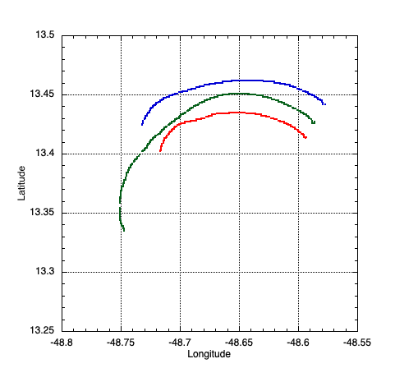
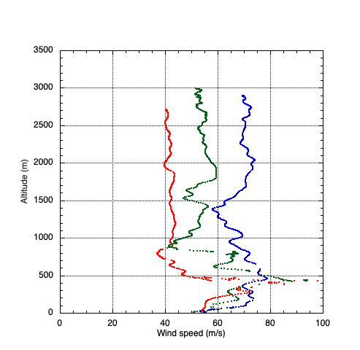
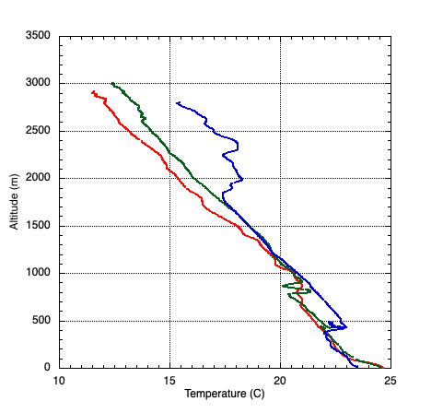
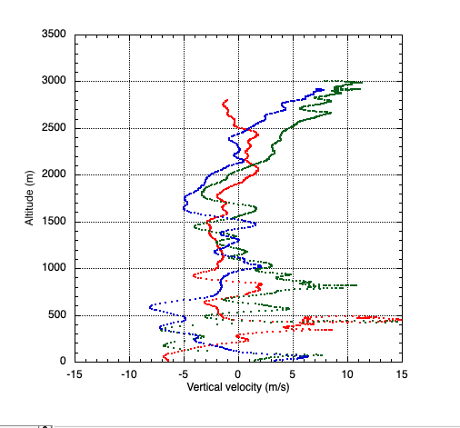
Rapid Sonde releases in Ida and Sam
Horizontal spacing of ~ 1 km
90m/s wind speeds recorded
Updrafts > 10 m/s
Temperature inversion
Second sonde sequence on subsequent pass
Hurricane Sam 25 September 2021
Slide credit Sim Aberson (NOAA/HRD)
Notes:
Sondes ~ 1km apart have different trajectories and rapidly evolving profiles

Slide 8
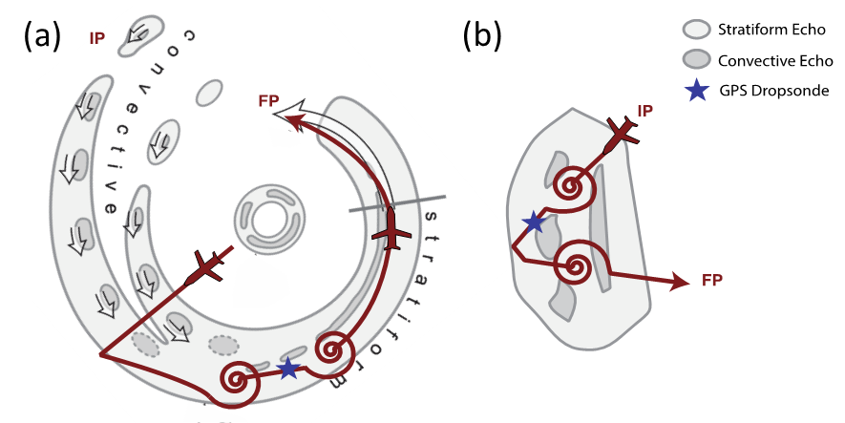
Stratiform Microphysics Spiral:
Spiral ascent and descent in stratiform portion of primary rainband
Cloud imaging probe measures hydrometeors
Dropsonde provides vertical structure information between spirals
Notes:
Probe collects and bins droplets during upward spiral – dropsonde gets full profile then downward spiral repeats measurements

Slide 9
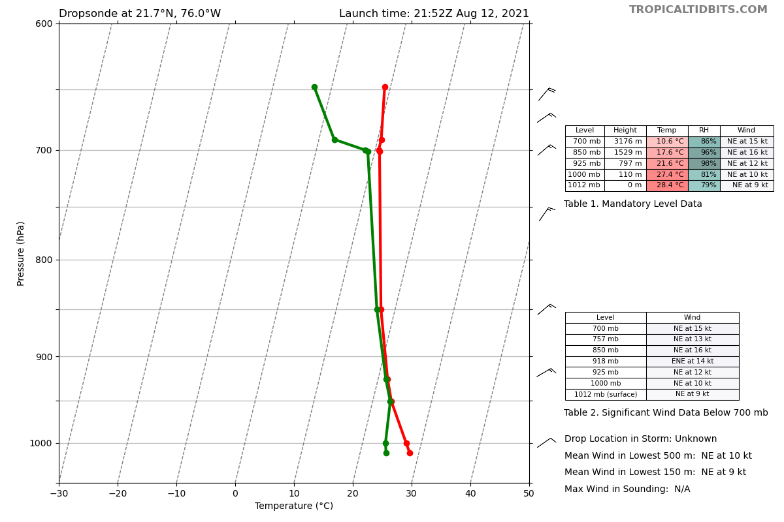
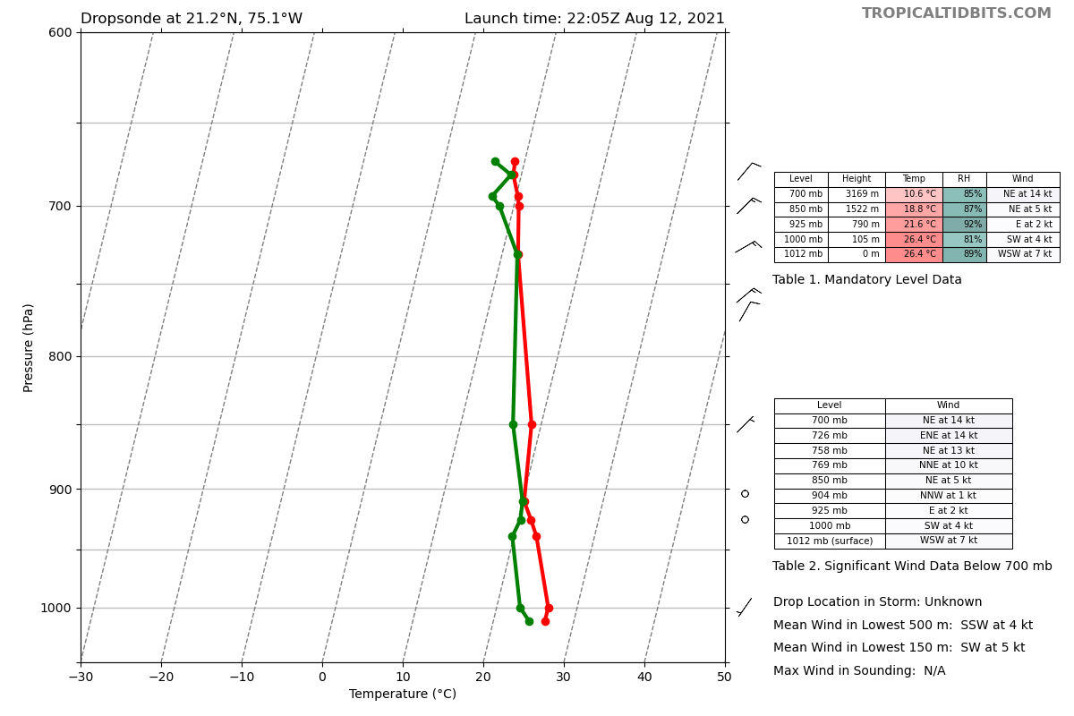
Dropsondes for real-time analysis:
Dropsondes 3 (original center) and 4 (outbound midpoint)
LLC seems to be between the two.
NW winds in lower troposphere in drop 3,
weak SE winds in drop 4
Both drops have splash pressure of 1012 hPa.
Indicates the surface center is between the original center and outbound midpoint
(i.e., to the southeast). Downshear reformation?
Slide credit Jon Zawislak (UM CIMAS / HRD)
Notes:
TS Fred center was difficult to pinpoint at flight-level but we were able to infer likely position between center and outward drop from pressures and low-level wind measurements

Slide 10
DROPSONDE USE FOR INSTRUMENT VALIDATION:
Satellite path intersection
Experimental P-3 mounted instruments
Calibration of operational P-3 mounted instruments

Slide 11
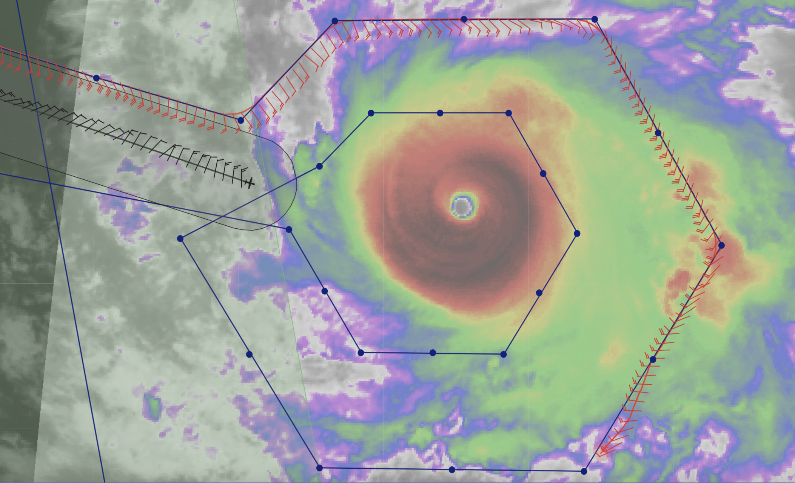
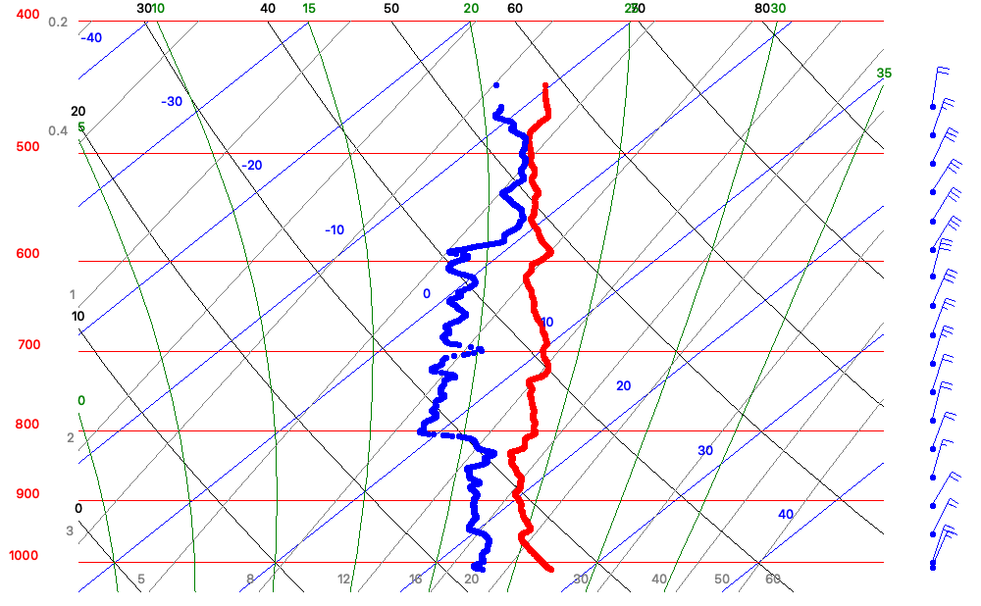
Hurricane Sam – 25 September 2021 – NOAA P-3 (N42) Aeolus Validation Dropsonde
Aeolus ground track
NOAA P-3
2135 UTC
Dropsonde released
~14 min after passage
13.5N / 50.5W
Aeolus
P-3
NOAA G-IV Planned Track
NOAA G-IV Flown Track
Snapshot at 2121 UTC – Aeolus passage
Notes:
Dropsonde release shortly after satellite passage

Slide 12
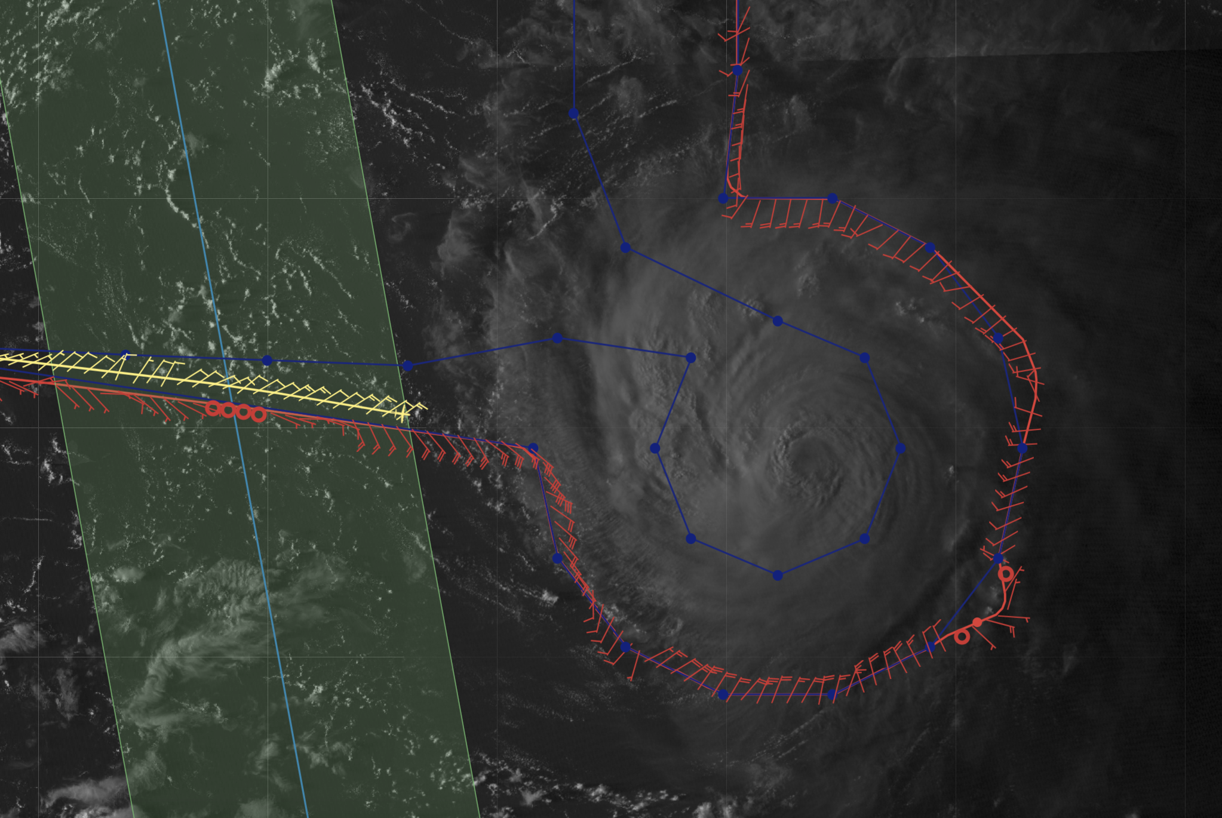
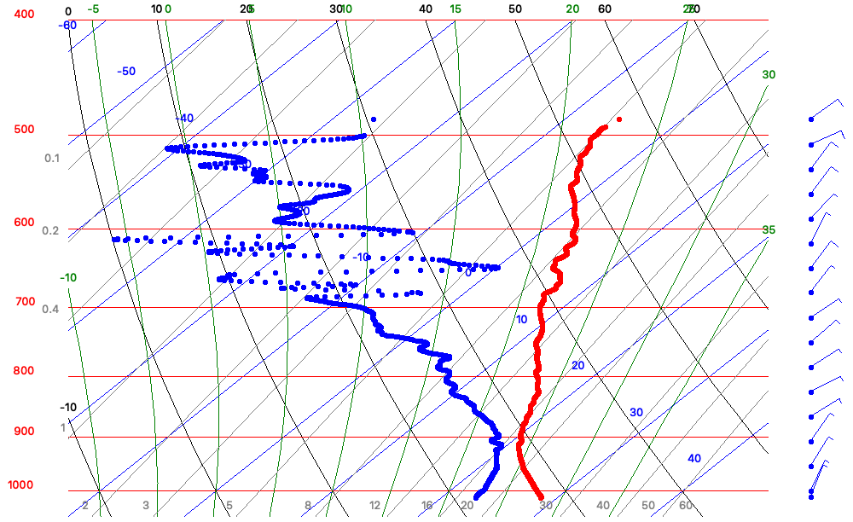
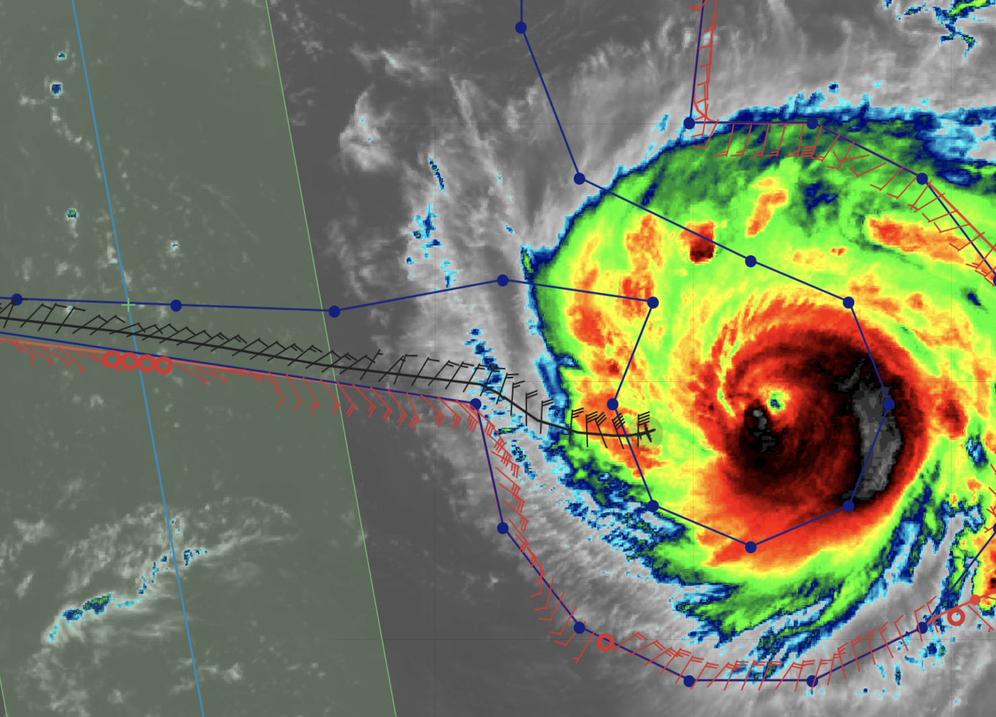
Hurricane Sam – 27 September 2021 – NOAA P-3 (N42) Aeolus Validation Dropsonde
Aeolus ground track
NOAA G-IV Planned Track
125 nmi / 230 km
~280 n mi from center of Hurricane Sam
Aeolus
NOAA P-3
2104 UTC
Dropsonde released
~43 min before passage
16.8N / 57.4W
P-3
NOAA G-IV Flown Track
Snapshot at 2147 UTC – Aeolus passage

Slide 13
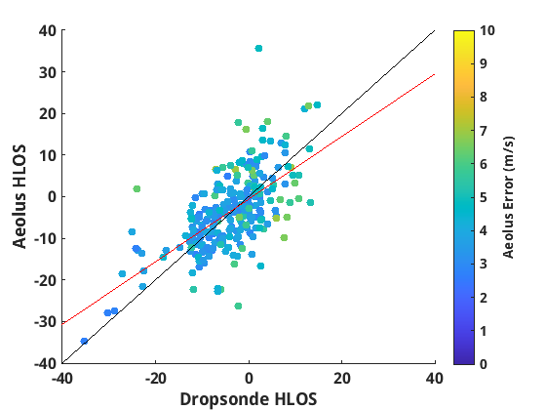
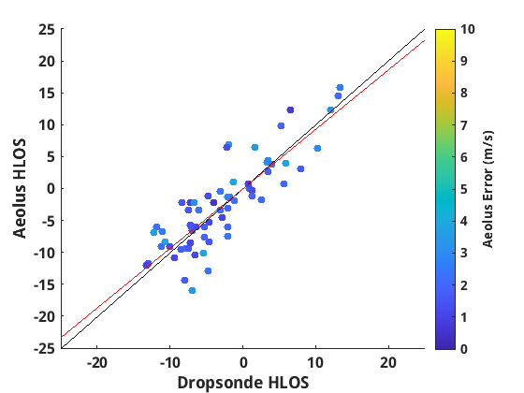
AMS 25th Conference on IOAS-AOLS
2019-2021 Composite using NOAA G-IV Dropsondes
Rayleigh Clear
Mie Cloudy
N=257
y=0.7543*x-0.6403
corr=0.6367
N=64
y=0.9339*x+0.0229
corr=0.8529
Line of best fit
One-to-one
Error < 7 m s⁻¹
Error < 4 m s⁻¹
Comparisons from Sam (2021) to added to 2019 & 2020 data for composite
Slide credit Lisa Bucci (NOAA/HRD)
January 25, 2022
Notes:
Multiple concurrent observations contribute to ongoing evaluation

Slide 14
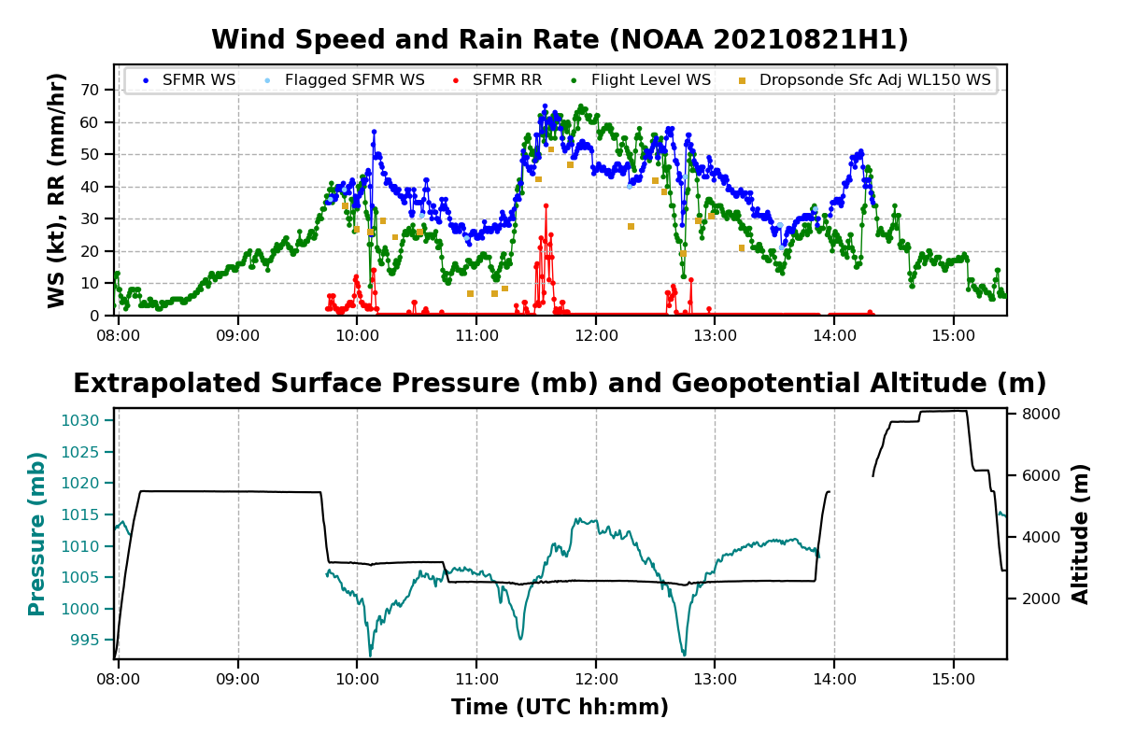
Surface wind comparisons with SFMR
Ongoing effort to improve SFMR algorithm in high winds
Extra Dropsondes released during coastal survey help understand SFMR response to bathymetry gradients
Notes:
Dropsonde winds in gold tend to be lower that SFMR (blue) in the strongest winds. Shoaling affects SFMR measurements.

Slide 15
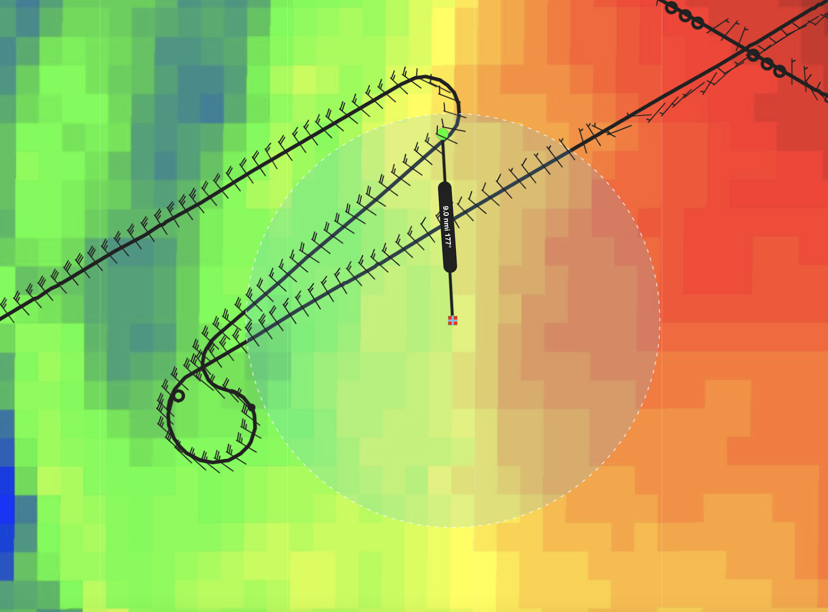
Saildrone overpasses in Hurricanes Grace and Henri
Estimation of enthalphy fluxes from combined atmosphere ocean observations
Determine boundary layer recovery
Investigate low-level ventilation
Notes:
Dropsondes used to confirm quality of data and used in combination to compute air/sea fluxes

Slide 16
Saildrone – Dropsonde comparison
Slide credit Jun Zhang (UM CIMAS / NOAA HRD)
Notes:
Comparisons so far show good agreement between saildrone and dropsondes

Slide 17
NESDIS OCEAN WINDS – surface wind validation Imaging Wind and Rain Airborne Profiler (IWRAP)
Instrument advantage
Recover 3-D flow and turbulent
eddies in hurricane boundary layer
Estimate maximum wind speed
Slide credit Stephen Guimond (University of Maryland Baltimore County)

Slide 18
Dropsondes in Research:
Composite studies
Case studies
Combine with ocean observations
DA optimization

Slide 19
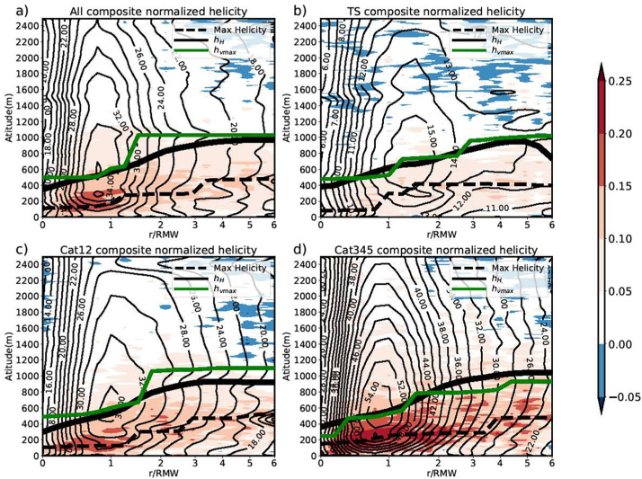
Boundary layer height defined by helicity:
Dropsondes composites stratified by intensity
Chen, Tang and Zhang et al. 2021 Atmospheric Research
Notes:
Maximum vertical gradient of helicity provides another method for estimating boundary layer height

Slide 20
Distribution of surface inflow angle:
Inflow angle from dropsonde composites
Normalized by RMW
Stratified by shear
Stratified by intensity change
Ming, Liu, Rogers and Zhang 2022 (in review)
Notes:
Surface inflow angle affected by shear and intensity tendency and varies with radius

Slide 21
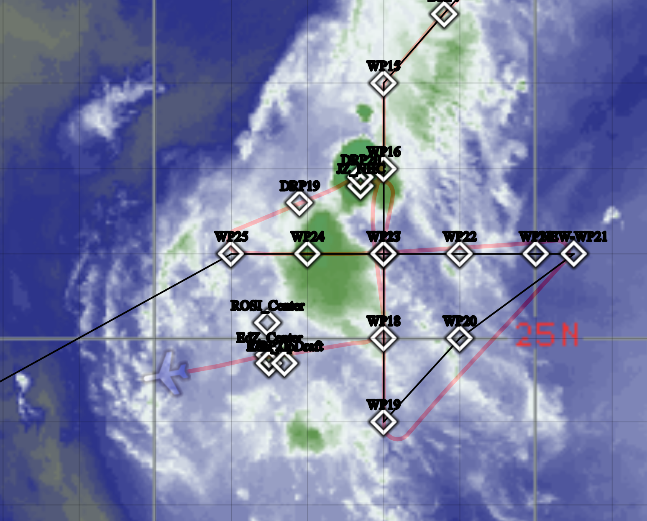
Convective Processes Experiment – Aerosols and Winds CPEX AW: Collaboration with NASA
Main Objectives Validate the ADM-Aeolus satellite wind lidar Better understand meteorological phenomena in the central and eastern Atlantic / West Africa Tropical convection, Saharan Air Layer, tropical waves, West African Monsoon, TC genesis
Tropical Storm Kate 1 September 2021
Convective structure and vertical structure sampling
Aeolus satellite validation
925 mb
500 mb
Slide credit Jon Zawislak ( UM CIMAS / NOAA HRD)
Notes:
Dropsondes show formation of mid-level center in response to convection

Slide 22
Tropical Cyclone Rapid Intensification (TCRI): Collaboration with ONR
Main Objectives
Identify the key processing governing TC rapid intensification
Identify the predictability barriers governing the rapid intensification of TCs
Currently in year 2 of a 3 to 4-year field campaign

Slide 23
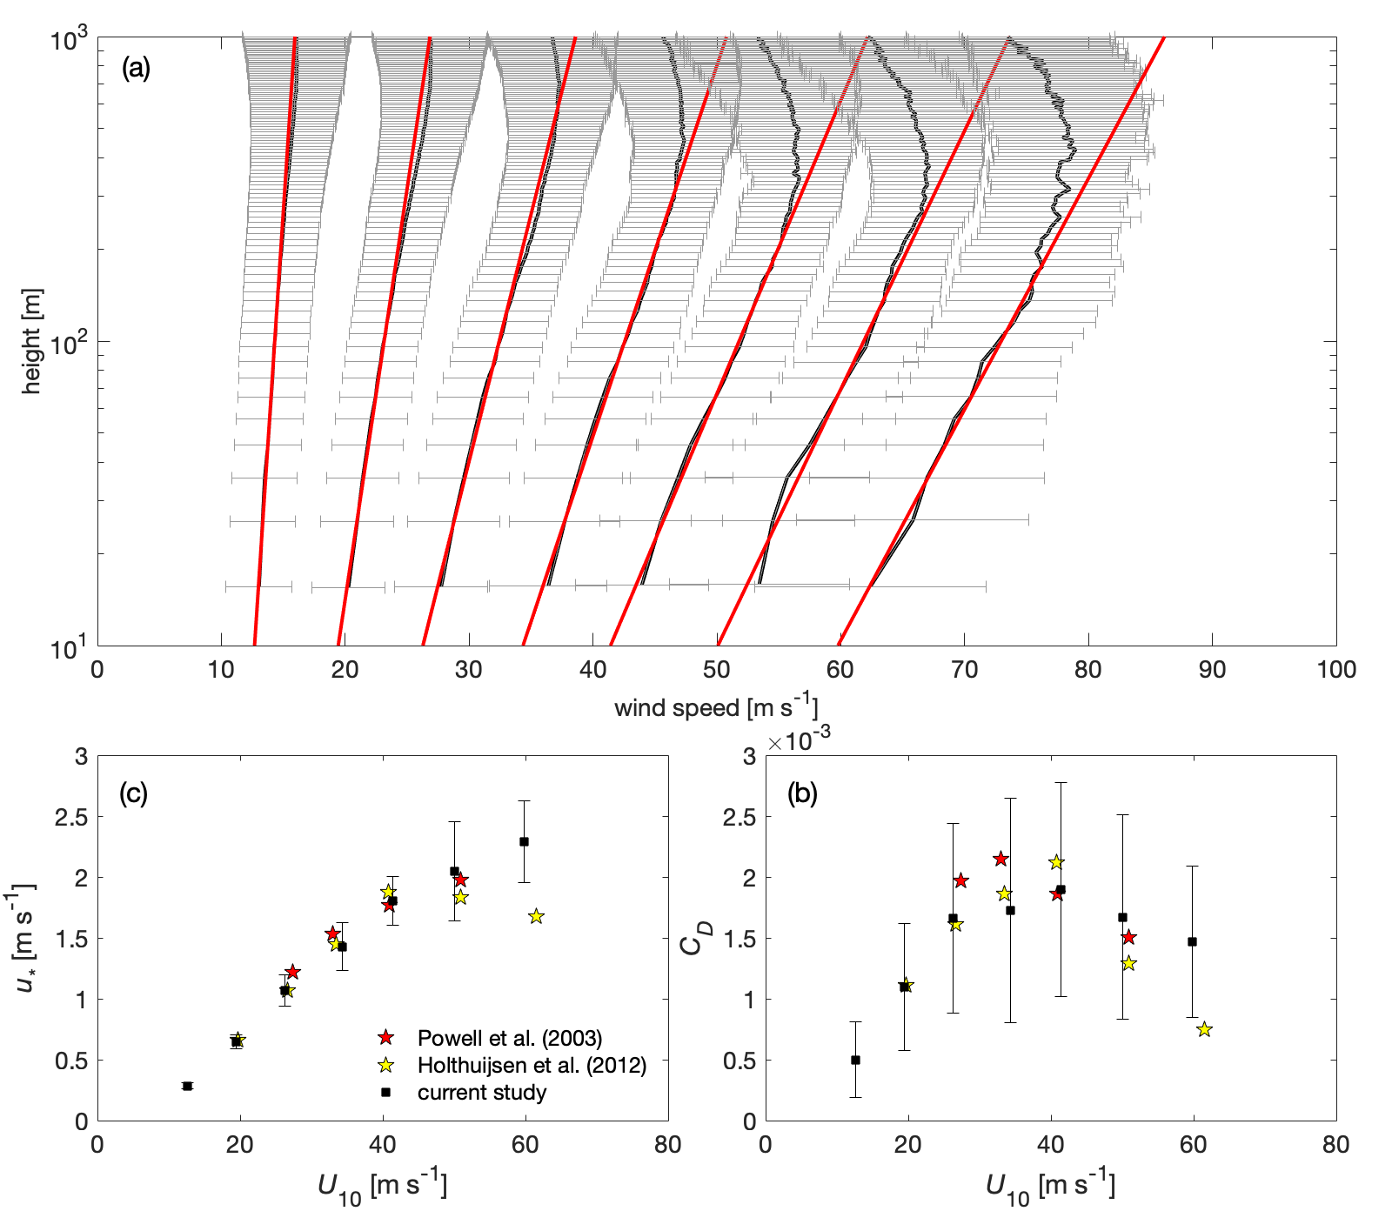
Trying to recover surface fluxes from dropsonde profiles
Dropsondes through 2021
15,420 total (9157 meet criteria)
Bin by mean boundary layer wind speed, average profiles together
Definition of “mean boundary layer wind” is ambiguous
Slope is related to surface stress according to MO theory
Similar results to past studies doing the same thing (not surprising)
Is this drop-off in C_{D} real?
From Richter et al., JAS, 2021
Slide credit David Richter (University of Notre Dame)
Notes:
Revisiting CD estimation with more observations at high wind speed

Slide 24
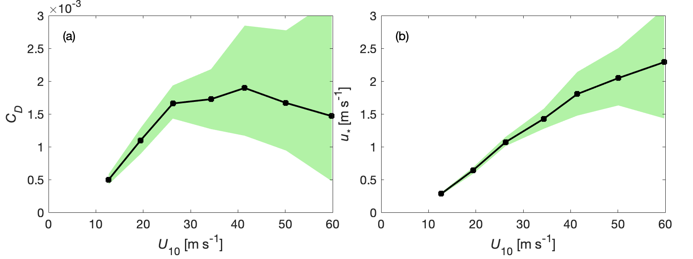
Results are very uncertain, and possibly biased downwards at high winds
Spread of C_{D} and u* from random subsampling
Random subsets of dropsondes give qualitatively different results
Do we even know sonde height near surface?
Add 5m to dropsonde height, shift closer to direct flux estimates of Andreas et al. (2012)
Shifts CD upwards by up to 25%
From Richter et al., JAS, 2021
Notes:
Question of what is actually 10m above sea-level – does CD really drop off at high winds or is this a result of the small sample size>\>

Slide 25
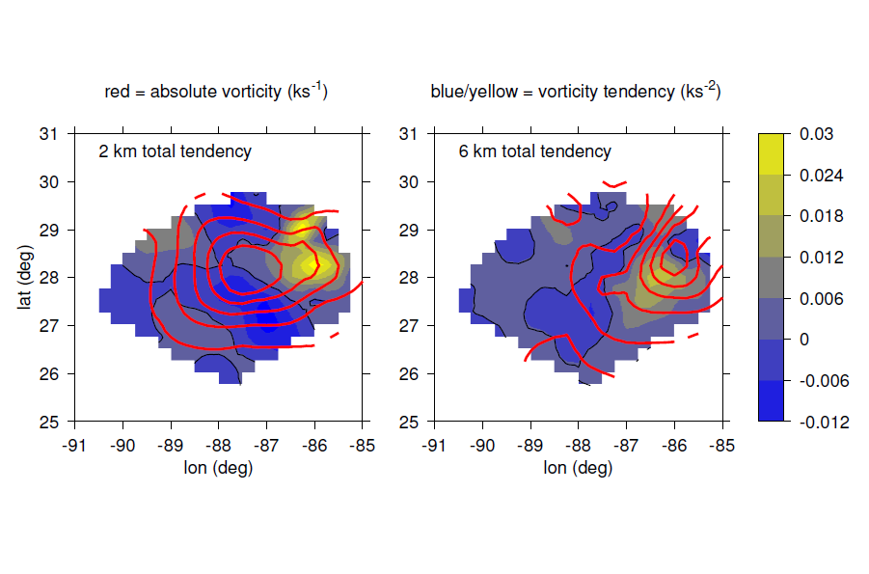
Dropsonde data
Three-dimensional variational analysis (3DVAR)
Penalty function method, anelastic mass continuity constraint
0.25 deg horizontal and 200 m vertical grid up to 13 km
Horizontal smoothing appropriate for 1 deg dropsonde spacing
Minimal vertical smoothing
Mass continuity used to calculate the vertical mass flux
No parametrization
Example: calculating vorticity and vorticity tendency for
Hurricane Sally
Slide credit Zeljka Fuchs-Stone (New Mexico Tech. )
Notes:
Vorticity tendency associated with convection generate aligned vortex – Stretching and tilting both important – Horizontal advection is not significant

Slide 26
Vorticity convergence and tilting in Sally (2020)
Vorticity tendencies associated with convection
Generate aligned vortex column
Stretching and tilting both important
Horizontal advection not significant
Notes:
How does vorticity evolve to produce an upright vortex?

Slide 27
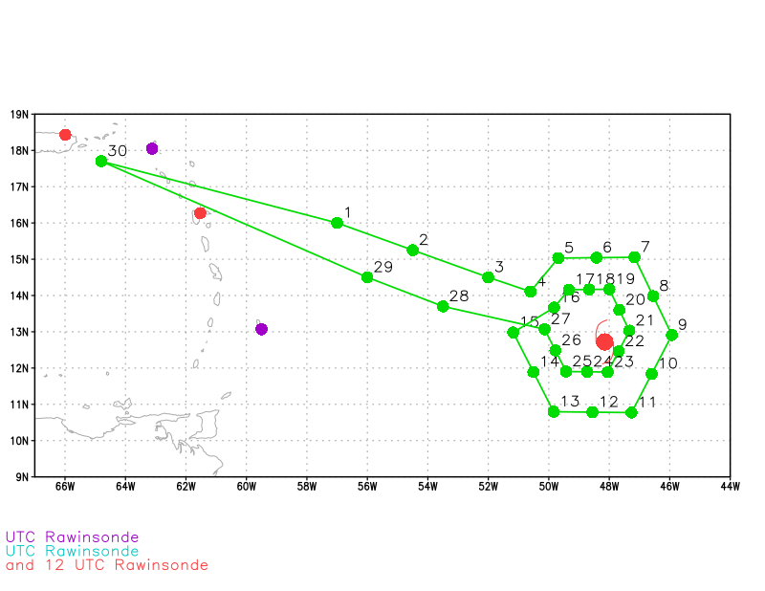
Goal: diagnose ventilation (eddy entropy/θ_{e} flux) using dropsondes
Data
Dropsondes from G-IV flights with two circumnavigations
G-IV missions around Hurricane Sam (Sept 25–27, 2021)
Methods
Quality control and θ_{e} calculation using ASPEN
TC motion calculated from HRD’s 1-min track
Ventilation was diagnosed by the storm-relative eddy (from an azimuthal mean) entropy flux:
u’θ_{e}’
Slide credit Rosimar Rios-Berrios (NCAR) and Brian Tang (SUNY)
Notes:
GIV circumnavigation provides full azimuthal dropsonde coverage

Slide 28
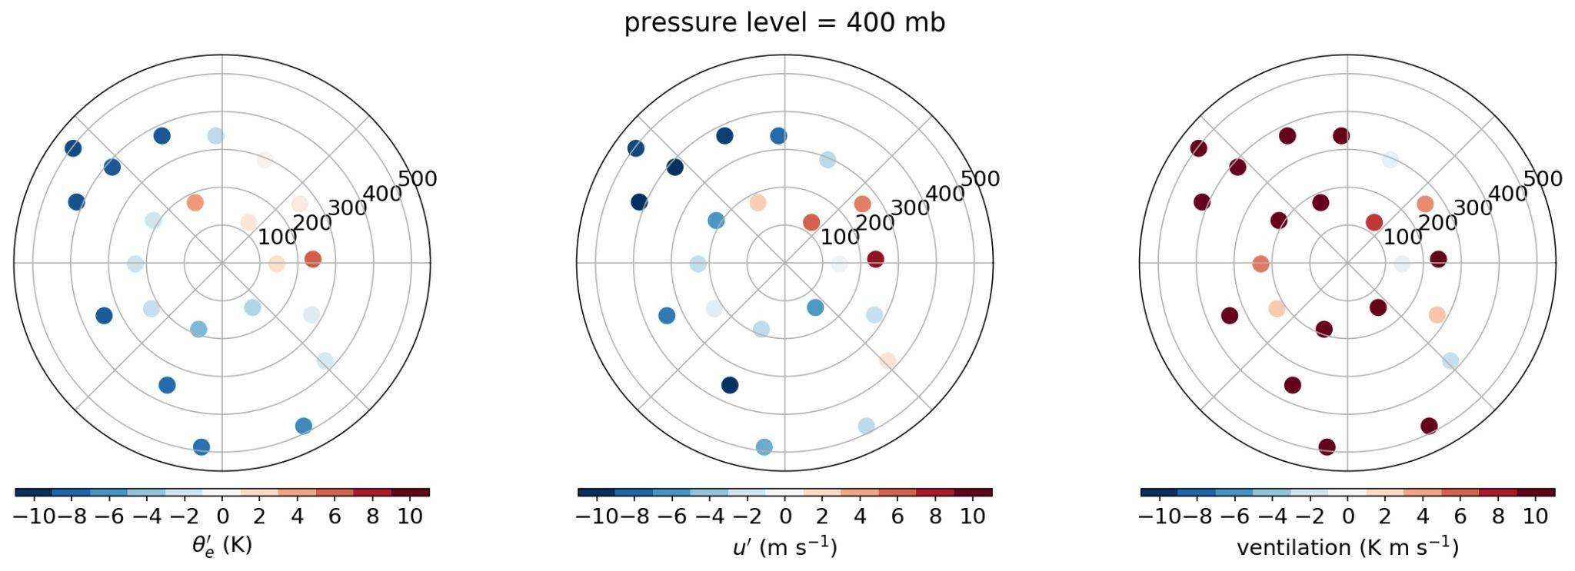
Initial results: horizontal distribution of θ_{e}’, u’, and ventilation
Notes:
One 2D view; one profile in the upshear sector and one profile in the downshear asymmetry

Slide 29
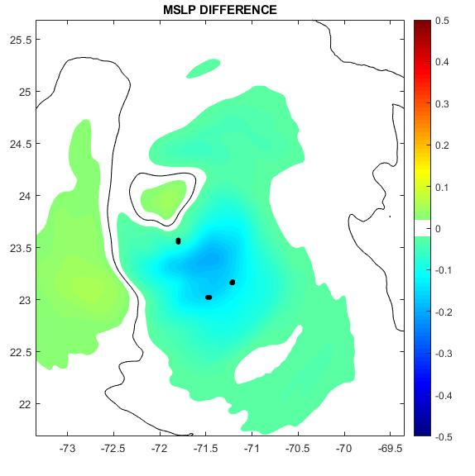
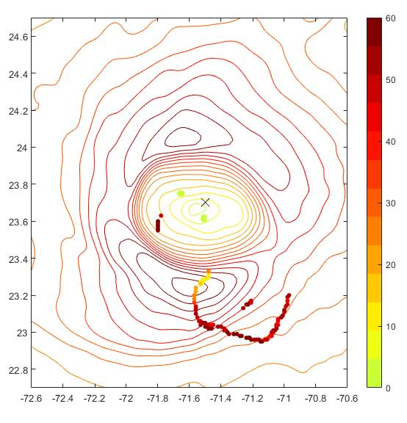
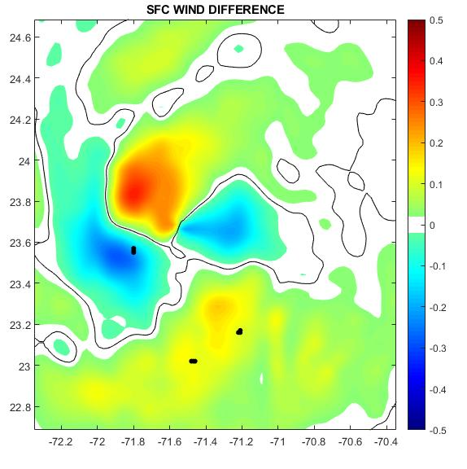
Use of Dropsondes in Data Assimilation:
Optimizing dropsonde data for DA
Super-obbing of full resolution data
Improving current methods of assimilating TEMPDROP messages
Develop tools to assimilate full resolution data with GSI for HAFS
Possible GSI issues with multiple RMW high wind sondes
Importance of symmetric distribution
Evaluating impact of dropsonde data
Combined impact of dropsonde
Coyote sUAS data
Explore best practices for dropsonde QA
Provide training with ASPEN software

Slide 30
Recent Results on the Impact of Reconnaissance Data on TC Forecasts in both the Basin-Scale HWRF and GFSv16
Sarah Ditchek (CIMAS/AOML-HRD) | Thursday, April 21st @ 11am (Mountain)
1. Overall Dropsonde Impact: first systematic, large-sample assessment to quantify the overall impact of dropsondes on TC forecasts of track, intensity, and structure using the 2020 implementation of the basin-scale, multi-storm configuration of HWRF (HB20)
2. G-IV Inner-Ring Circumnavigation Dropsonde Impact: evaluates the impact of dropsondes launched during the G-IV Inner Circumnavigation on TC track, intensity, and structure forecasts using HB20
3. Dropsonde/HDOBs Impact: quantifies the overall combined impact of 1) additional dropsonde wind data near the TC center and 2) the first-time addition of high-density, flight-level reconnaissance observations (HDOBs) on TC track forecasts using GFS version 16 (GFSv16)

Slide 31
2021 HRD PUBLICATIONS USING DROPSONDE DATA
Chen, X., Zhang, J., Marks, F.D., Rogers, R.F. and Cione, J.J. ( in review)
“Precipitation Symmetrization and Rapid Intensification of Tropical Cyclones in Shear”
Journal of the Atmospheric Sciences
https://doi.org/10.1175/MWR-D-20-0145.1
Chen, N., J. Tang, J.A. Zhang, LM. Ma, H. Yu
“On the Distribution of Helicitiy in the Tropical Cyclone Boundary Layer from Dropsonde Composites”
https://doi.org/10.1016/j.atmosres.2020.105298
Ming, J. Zhang, J.A. and X Cai (in review)
“Observed Difference of drag Coefficient in Tropical Cyclones between the Western Pacific and Atlantic Oceans”
Journal of Applied Meteorology and Climatology
Richter, D.H., Wainwright, C., Stern, D.P., Bryan, G.H., and Chavas, D. (2021)
“Potential Low Bias in high-wind Drag Coefficient Inferred from Dropsonde Data in Hurricanes”
Journal of the Atmospheric Sciences, 78, 2339–2353.
https://doi.org/10.1175/jas-d-20-0390.1

