Slide 1
The Governing Dynamics and Predictability of Recurving EPAC Tropical Cyclones
Alex K. Mitchell and Lance F. Bosart
Department of Atmospheric and Environmental Sciences University at Albany, SUNY
NOAA/AOML Hurricane Research Division (HRD)
Atlantic Oceanographic & Meteorological Laboratories (AOML)
Friday 6 May 2022
Supported by NSF grant AGS-1656406

Slide 2
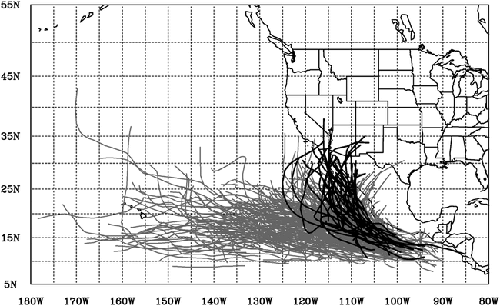
Background
Recurving eastern North Pacific (EPAC) tropical cyclones (TCs) can threaten life and property along the West Coast of North America
Corbosiero et al. (2009) found that roughly 10% (N=35) of all EPAC TCs (N=340) and their remnants brought heavy rainfall to the U.S.
The relative frequency of heavy TC rainfall impact occurred most during September
1 Aug – 15 Oct 1958–2003
Fig. 4 adapted from Corbosiero et al. (2009)

Slide 3
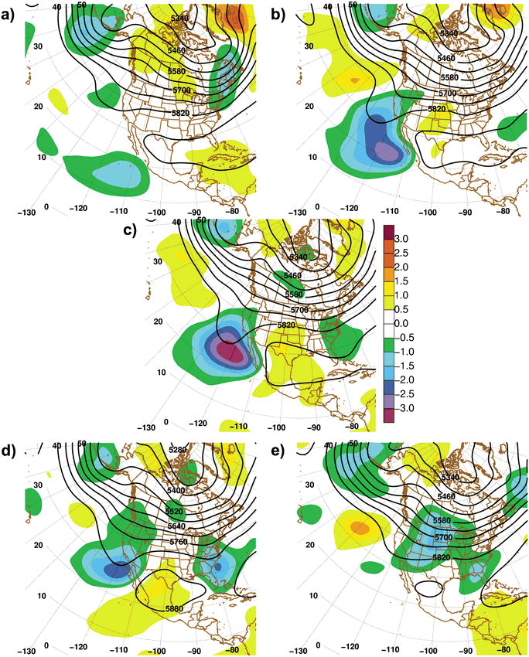
Background
Composite of 20 TCs from 1971–1999 that produced heavy rainfall in the SW U.S.
Corbosiero et al. (2009) results indicated the presence of a midlatitude trough that penetrates far enough south to interact with EPAC TCs
500-hPa heights (m) and standardized anomalies (shaded)
Standardized Anomalies (shaded)
500-hPa Geopotential Height (solid contours, m)
Fig. 7 adapted from Corbosiero et al. (2009)

Slide 4
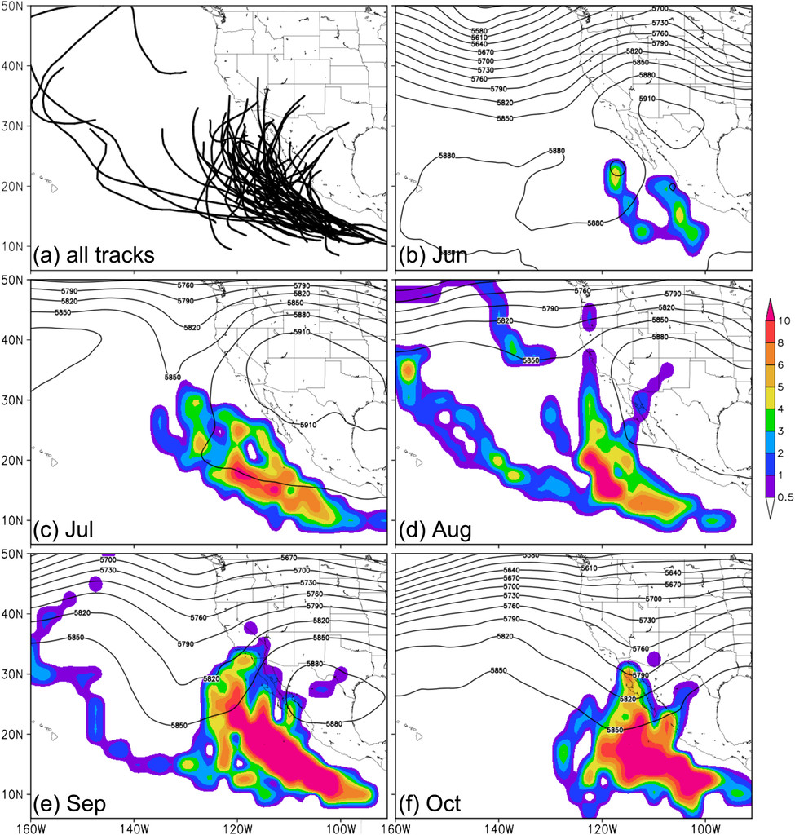
Background
Tracks of 55 TCs from 1971–2012 that underwent ET
Wood and Ritchie (2014) constructed a 42-year study of EPAC TCs undergoing extratropical transition (ET)
Showed that most of the ET events (65.5%) occur in September and October
Greatest track spread occurred in August and September due to the steering flow variability
Fig. 7 adapted from Wood and Ritchie (2014)

Slide 5
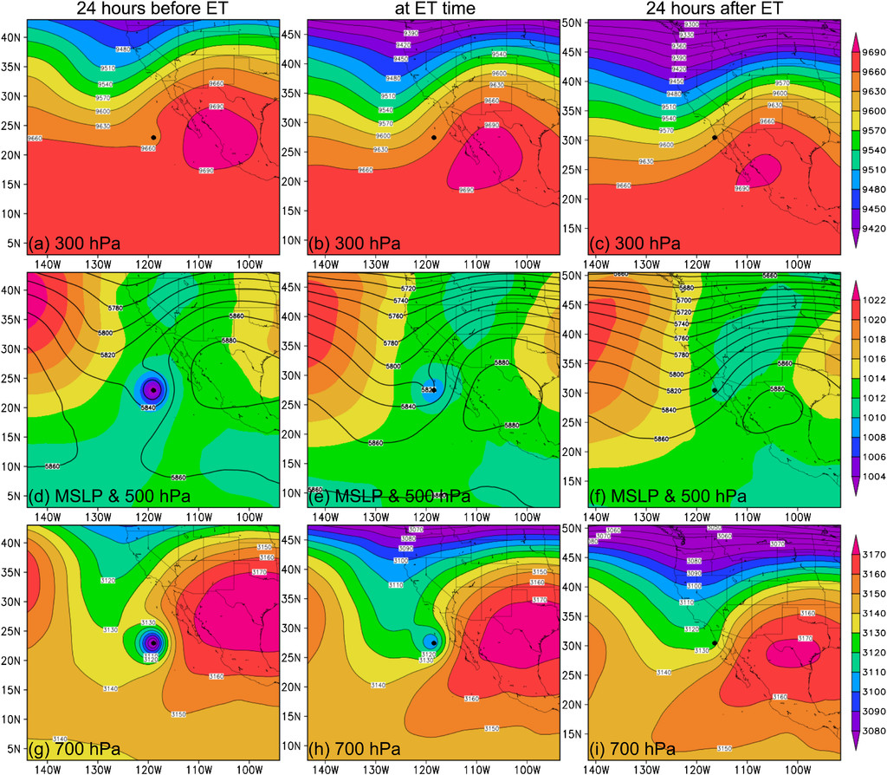
Background
Composite of 35 TCs from 1971–2012 that underwent ET
Wood and Ritchie (2014) showed that a weakening subtropical ridge over Mexico and approaching midlatitude trough during the ET of EPAC TCs
Their study also emphasized that there was large variability of an equatorward-protruding midlatitude trough when ET occurred in the EPAC
(a)–(c) 300-hPa geopotential height (m)
(d)–(f) 500-hPa geopotential height (m; contours) and MSLP (hPa; shaded)
(g)–(i) 700-hPa geopotential height (m): (left)
Fig. 14 adapted from Wood and Ritchie (2014)

Slide 6
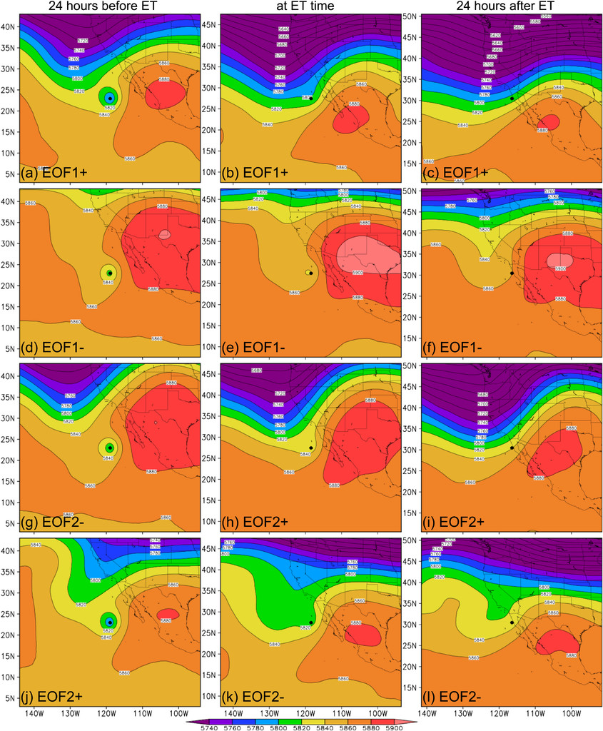
Background
EOF analysis of 35 TCs from 1971–2012 that underwent ET
Wood and Ritchie (2014) showed that a weakening subtropical ridge over Mexico and approaching midlatitude trough during the ET of EPAC TCs
Their study also emphasized that there was large variability of an equatorward-protruding midlatitude trough when ET occurred in the EPAC
Fig. 13 adapted from Wood and Ritchie (2014)

Slide 7
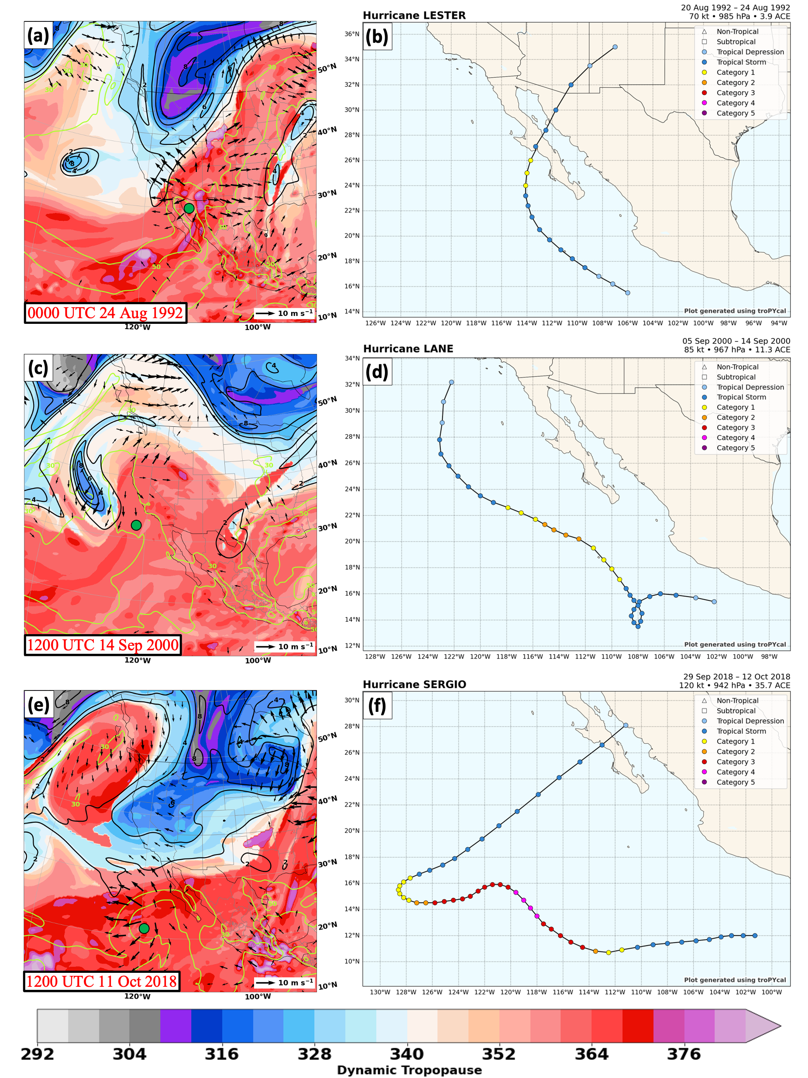
Background
The dynamic tropopause (shaded, K) illustrates a large spectrum of upper-level flow structures associated with recurving EPAC TCs
Positively and negatively tilted troughs
PV streamers
Cutoff Cyclones

Slide 8
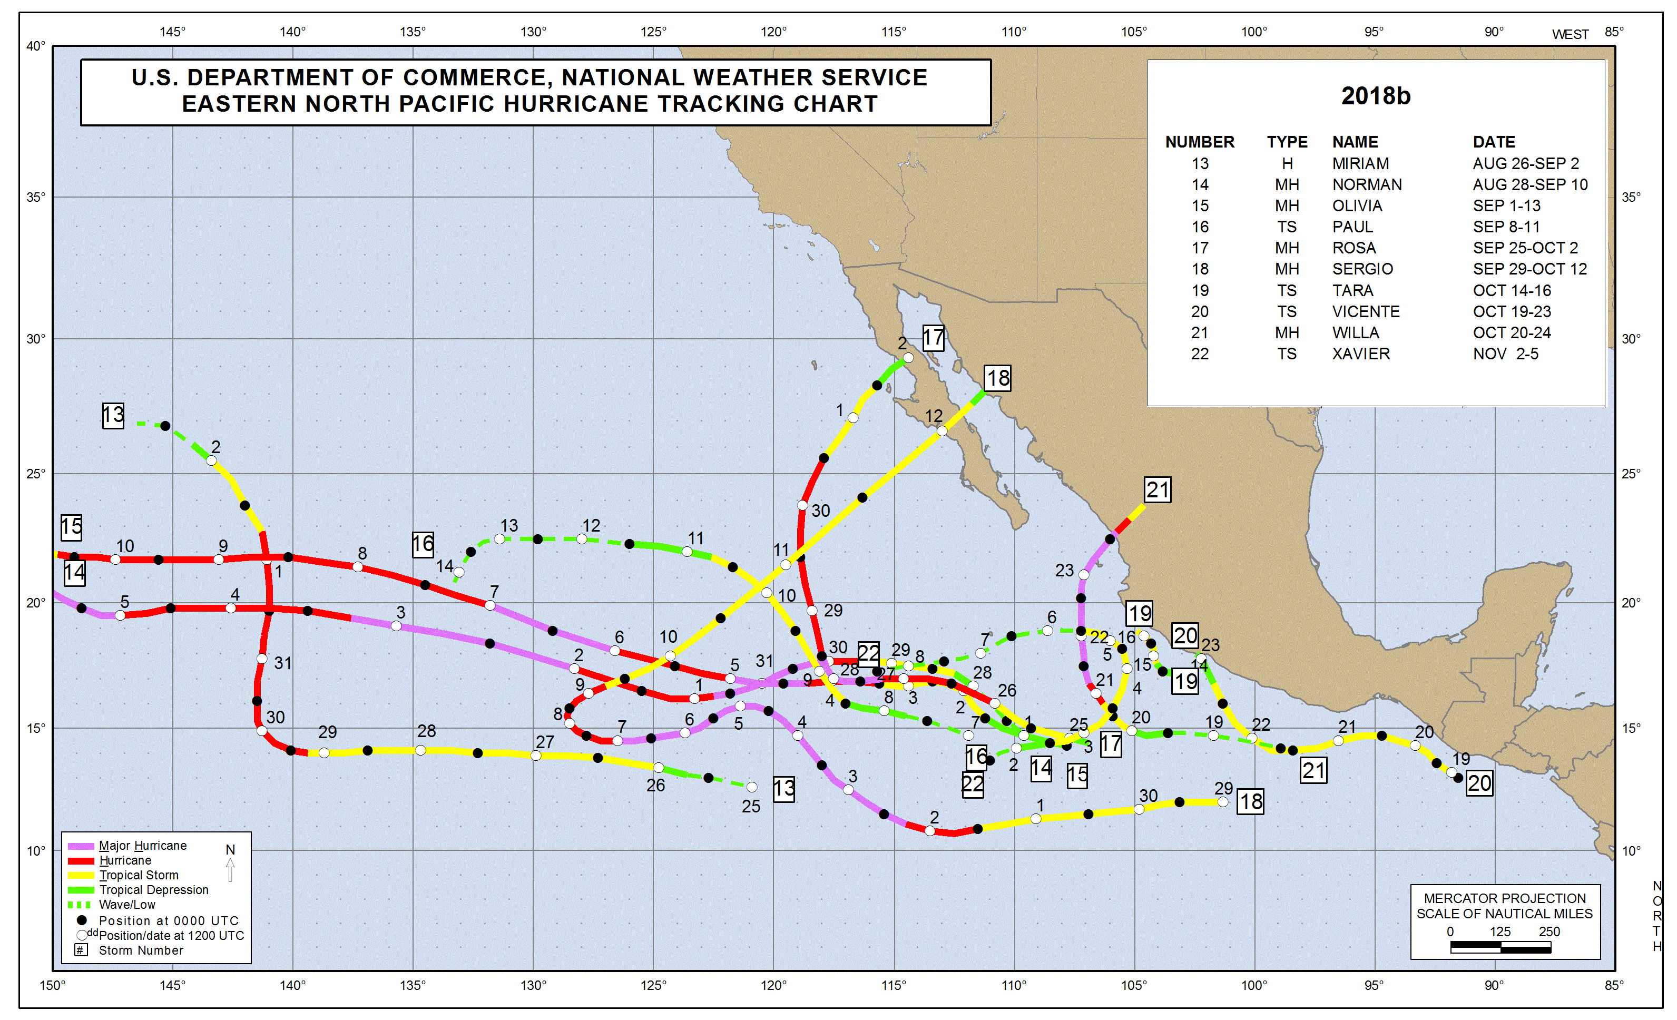
Background

Slide 9
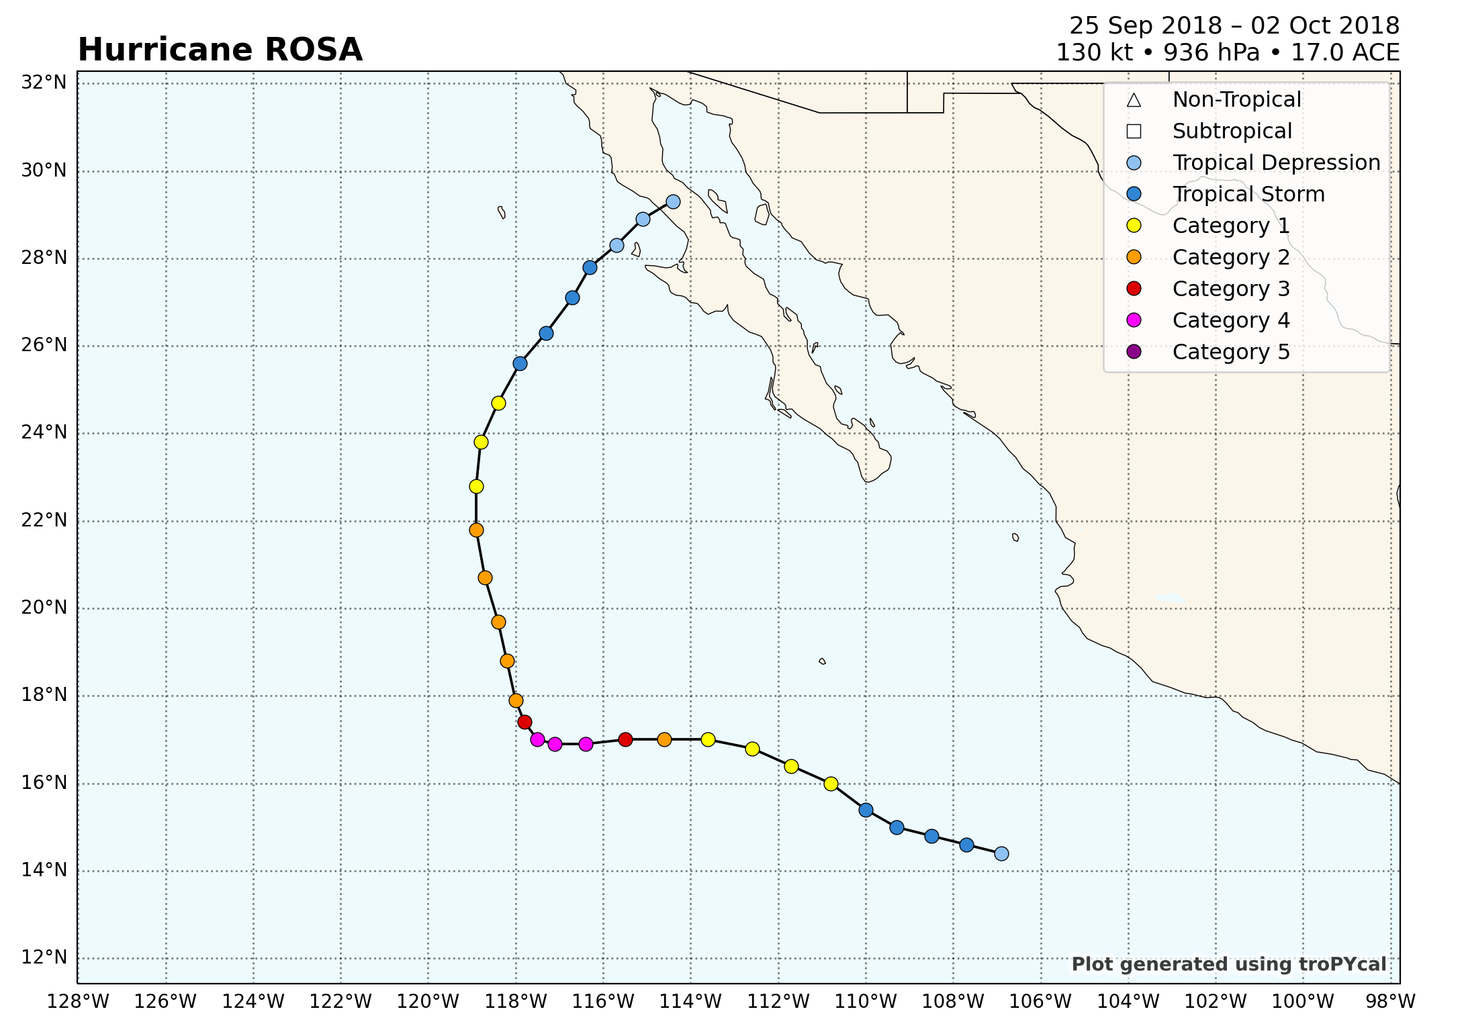
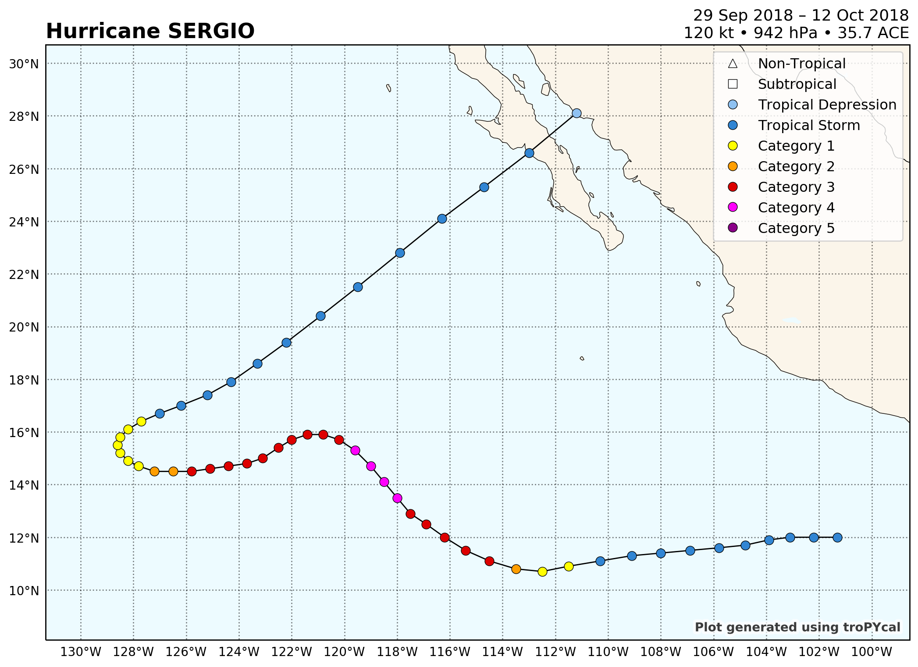
Background
EPAC TCs
TC Rosa
TC Sergio
23 Sep – 2 Oct 2018
29 Sep – 12 Oct 2018

Slide 10
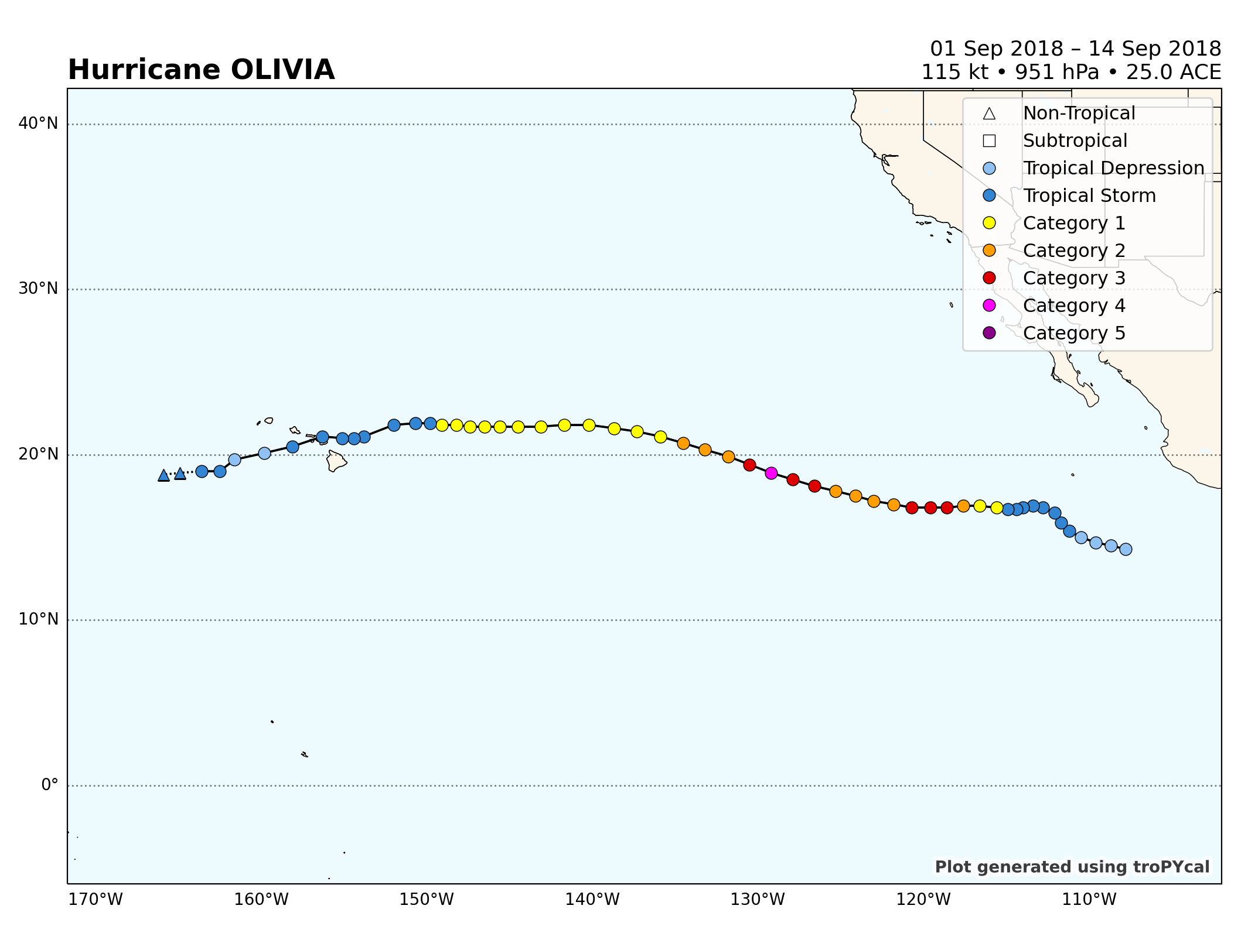
Background
EPAC TCs
TC Olivia
1 Sep – 14 Sep 2018

Slide 11
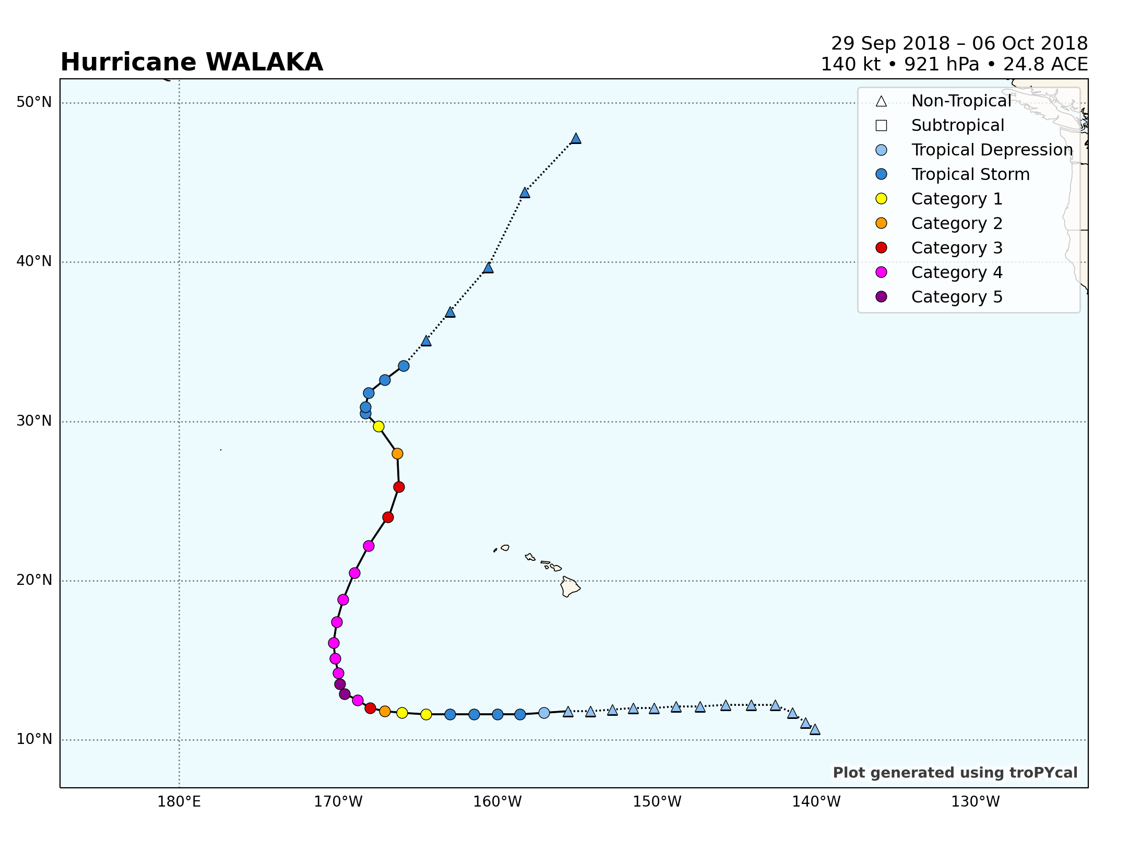
Background
CPAC TC
TC Walaka
29 Sep – 6 Oct 2018

Slide 12
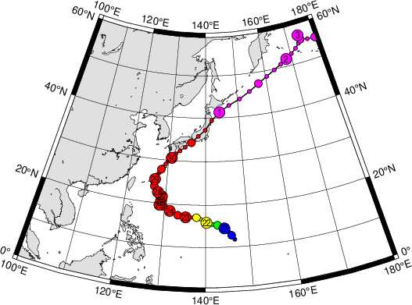
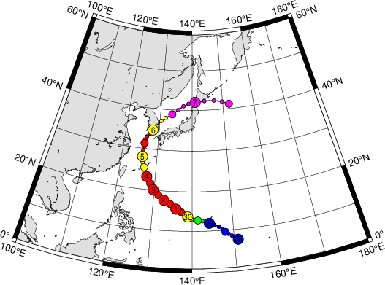
Background
WPAC TCs
Typhoon Trami
Typhoon Kong-Rey
20 Sep – 30 Oct 2018
28 Sep – 7 Oct 2018

Slide 13
Synoptic Overview
http://www.atmos.albany.edu/student/kbiernat/Michael/Michael_pacific_standard.php
http://www.atmos.albany.edu/student/kbiernat/Michael/Michael_north_america_standard.php

Slide 14
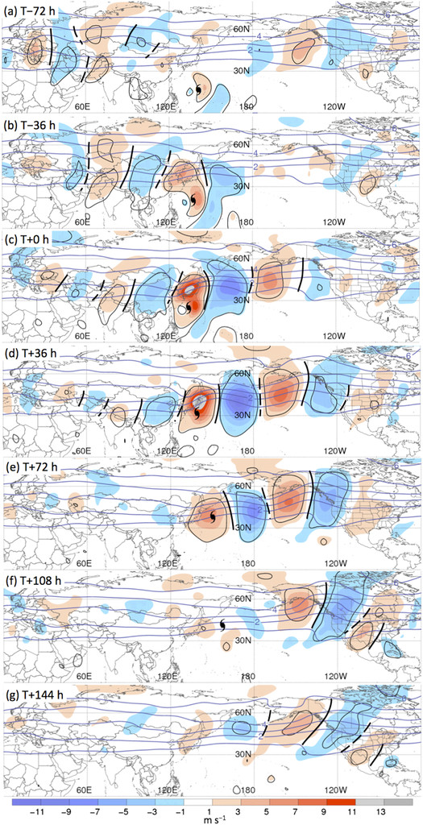
Motivation
Archambault et al. (2015) showed that, on average, the extratropical flow amplifies over NPAC following TC recurvature in the WPAC
Their results suggested that downstream flow amplification over the NPAC was associated with a preexisting RWT migrating from Asia that initially amplified over the WPAC following WPAC TC recurvature
Recurvature-relative composite analyses of all recurving WNP TCs (N = 292)
250-hPa meridional wind anomalies (shaded)
PV (black contours)
Fig. 3 adapted from Archambault et al. (2015)

Slide 15
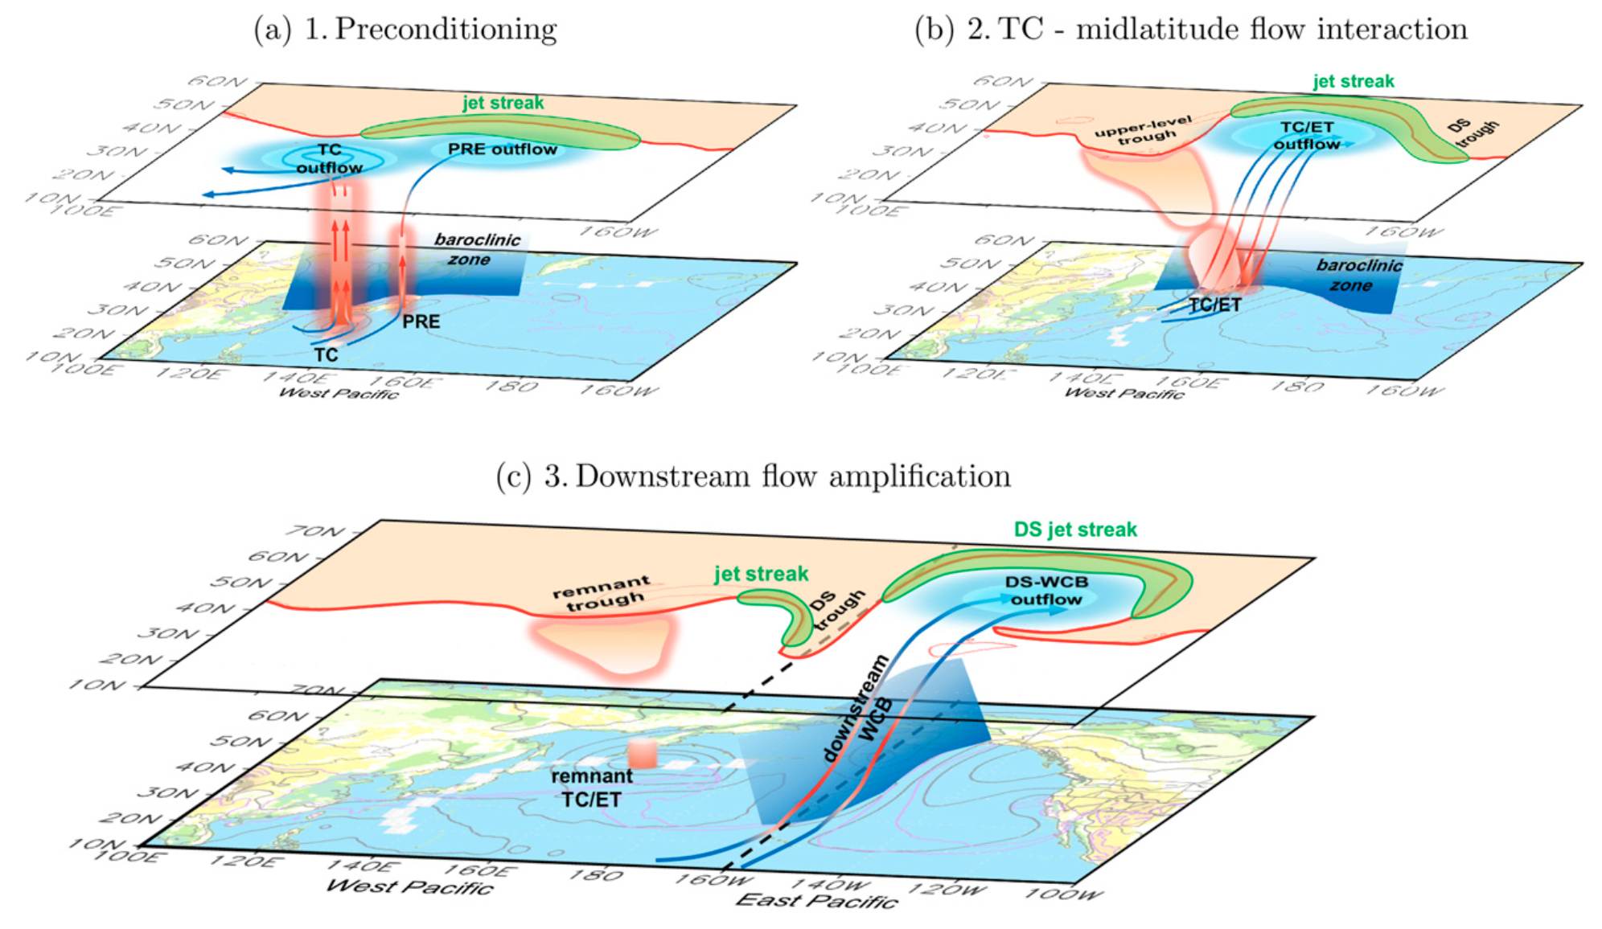
Motivation
Fig. 11 adapted from Archambault et al. (2016)

Slide 16
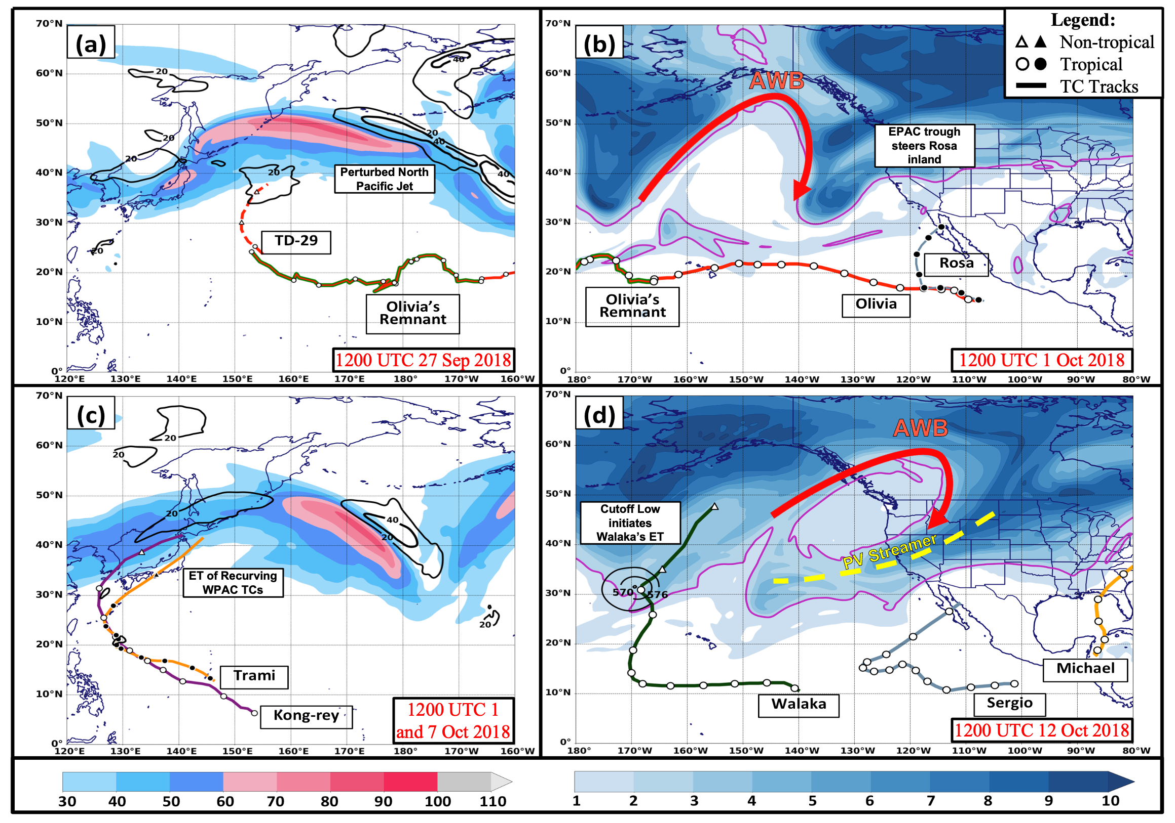
Synoptic Overview
250-hPa winds (shaded, m s⁻¹)
24-h difference of 250-hPa winds after initial classification of ET (black contours, every 20 m s⁻¹)
250–150-hPa layer-averaged potential vorticity (shaded, PVU) and 2-PVU contour (pink)
500-hPa geopotential heights (black contours, dam)

Slide 17
Background
Tropical Cyclone (TC) Sergio was a recurving eastern North Pacific system that made landfall in Baja California
TC Sergio’s impacts proved to be costly for much of Baja California and parts of the southwestern US ($2.67 million, 2018 USD) after landfall due to severe flooding
Track of TC Sergio derived from the HURDAT database valid 29 Sep 2018 – 12 Oct 2018

Slide 18
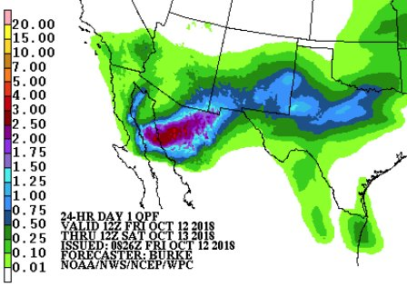
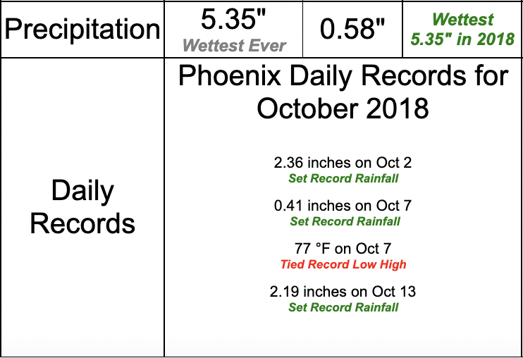
Background
24-hr Day 1 QPF
Forecast Valid 1200 UTC 12 Oct – 1200 UTC Oct 13
(Source: WPC)

Slide 19
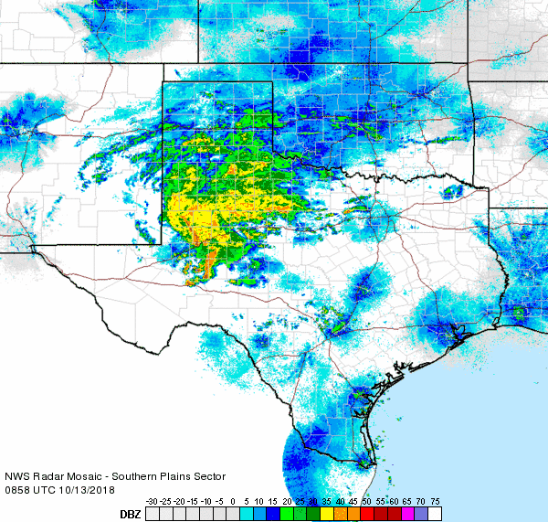
Background
Regional radar animation valid from 0858 UTC – 1008 UTC on 13 October 2018 (Source: NWS)

Slide 20
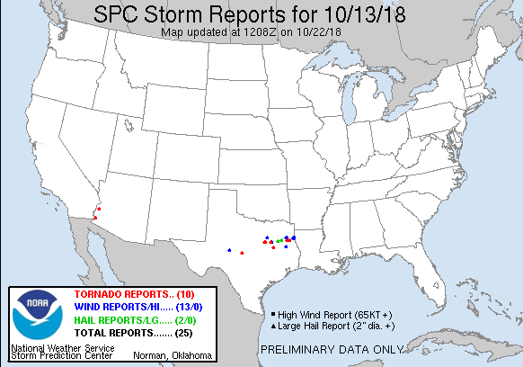
Background
SPC Storm Report 13 Oct (Source: SPC)

Slide 21
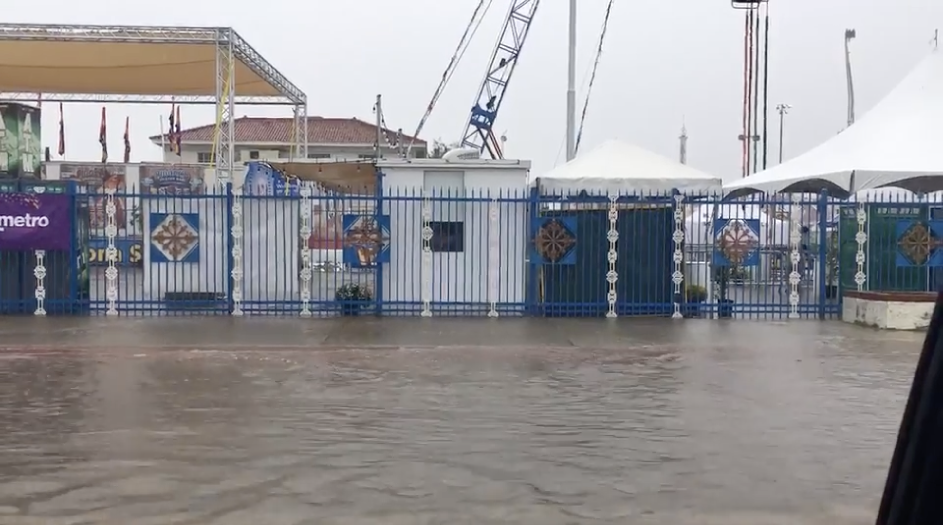
Background

Slide 22
Background

Slide 23
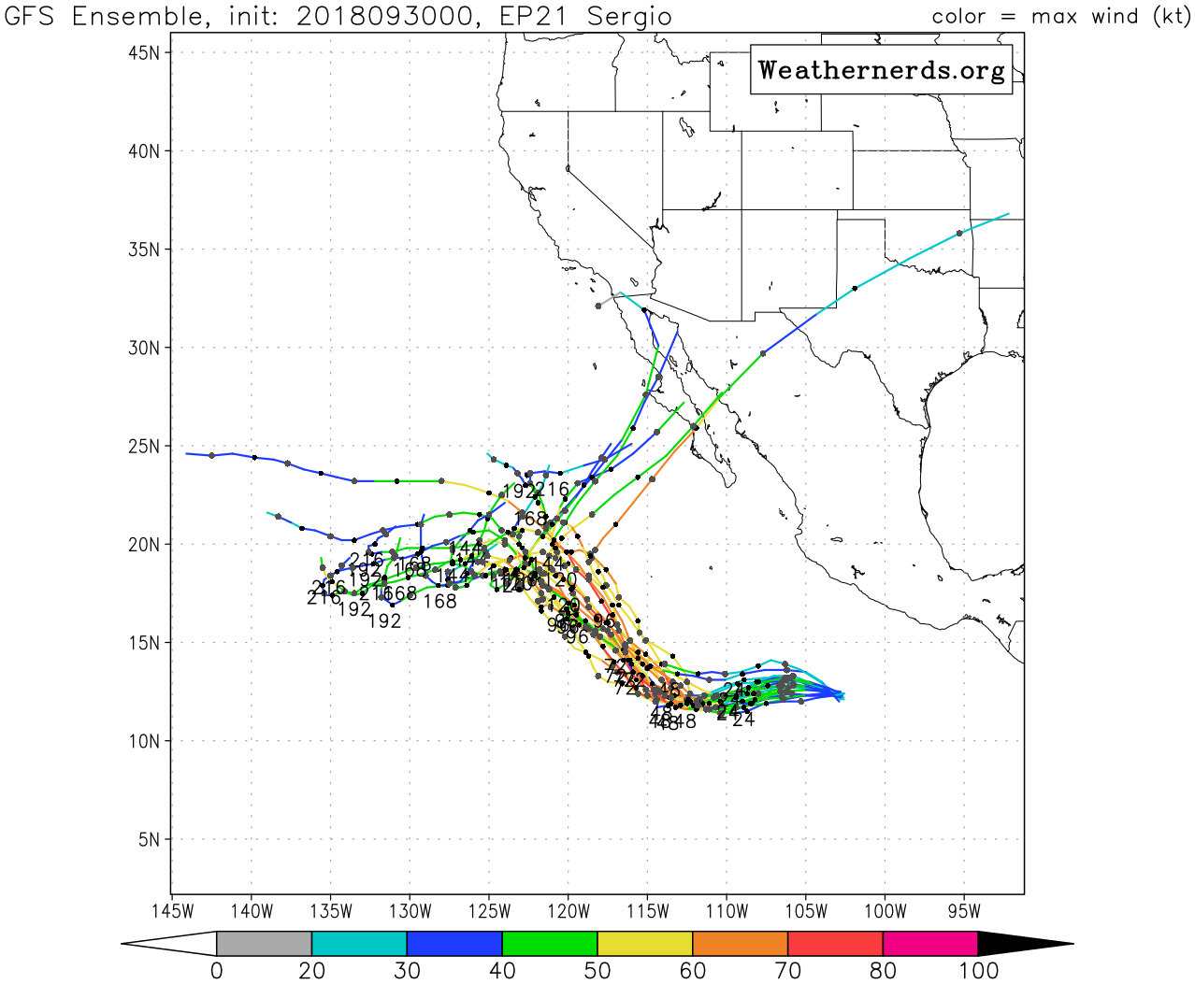
Background
GFS ensemble member tracks (contours, colored by intensity, kt) of TC Sergio initialized at 0000 UTC 30 Sep 2018

Slide 24
Data
National Centers for Environmental Prediction (NCEP) GFS Ensemble Forecasts (0.5° latitude x 0.5° longitude)
Used to investigate ensemble differences and evolution
NCEP Climate Forecast System Reanalysis (CFSR) (Saha et al. 2010)
0.5° latitude x 0.5° longitude
Utilized for synoptic overview maps

Slide 25
Objective
To evaluate the sources of error that lead to the northeastward turn of TC Sergio depicted in the forecasted track bifurcation beyond five days of initialization valid at 0000 UTC 30 Sep 2018

Slide 26
Hypothesis
Downstream baroclinic development induced by recurving western North Pacific TCs that underwent ET created larger forecast uncertainty for TC Sergio

Slide 27
Methodology
Extracted forecasted tracks of tropical cyclone Sergio for each ensemble member to determine updated local minima of mean sea level pressure at each forecast time step
GEFS track error was quantified by the lat and lon distance from the TC center (defined by lowest MSLP) at each ensemble member to the TC center within the GEFS
Notes:
*** ens 4 is large in error due to latitude

Slide 28
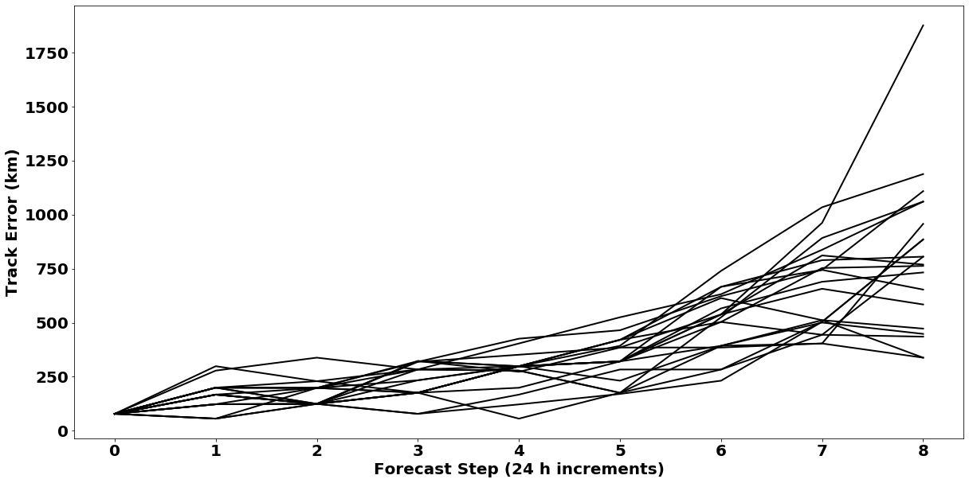
Track error
GEFS Track Error for all ensemble members (N=20)
Initialized at 0000 UTC 30 Sep 2018
Notes:
*** ens 4 is large in error due to latitude

Slide 29
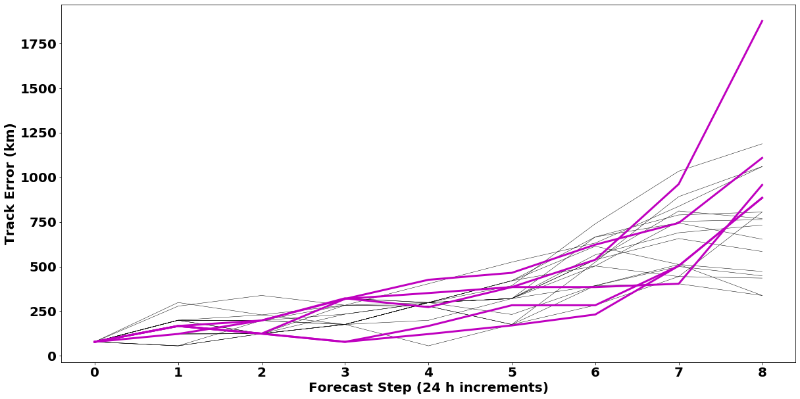
Track error
GEFS Track Error for Recurving TC scenarios with largest rate of error growth
Initialized at 0000 UTC 30 Sep 2018
Notes:
*** ens 4 is large in error due to latitude

Slide 30
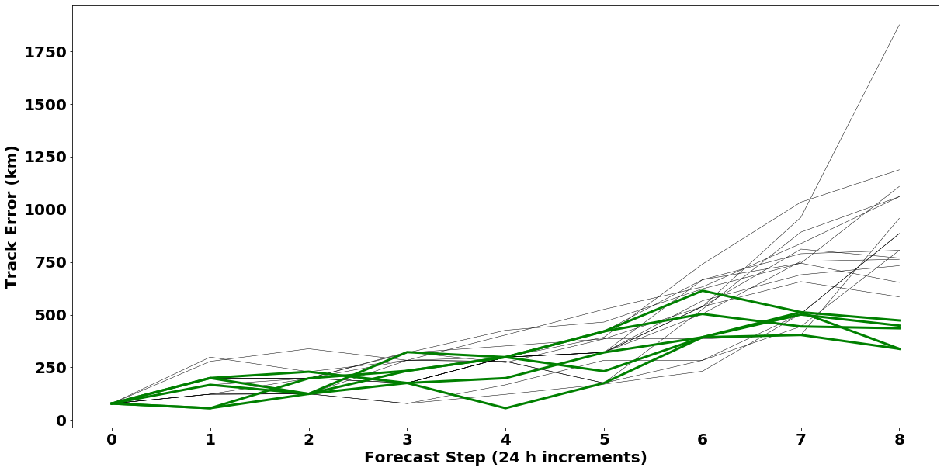
Track error
GEFS Track Error for Non-recurving TC ensemble members with smallest rate of error growth
Initialized at 0000 UTC 30 Sep 2018
Notes:
*** ens 4 is large in error due to latitude

Slide 31
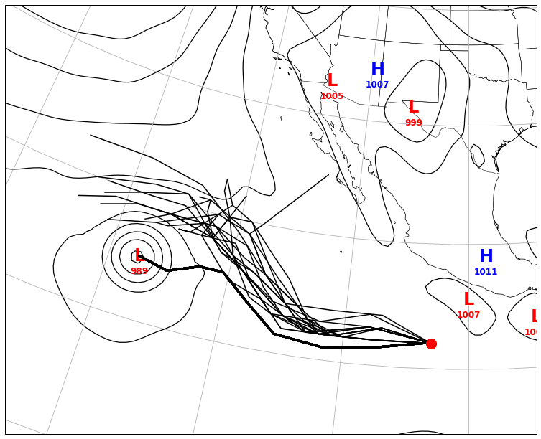
Sergio’s Track Distribution
MSLP analysis (thin black contours) valid 0000 UTC 8 Oct 2018
Notes:
2 Track Spread, valid 0000 UTC 8 Oct 2018
Last bifurcation around 0000 UTC 5 Oct 2018

Slide 32
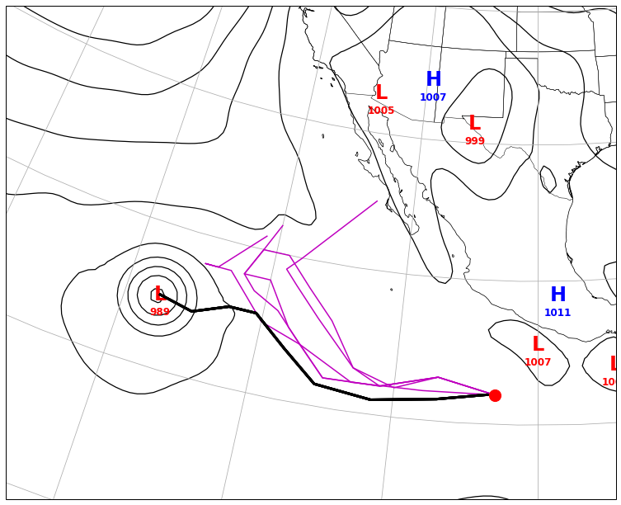
Sergio’s Track Distribution
MSLP analysis (thin black contours) valid 0000 UTC 8 Oct 2018
Notes:
2 Track Spread, valid 0000 UTC 8 Oct 2018
Last bifurcation around 0000 UTC 5 Oct 2018

Slide 33
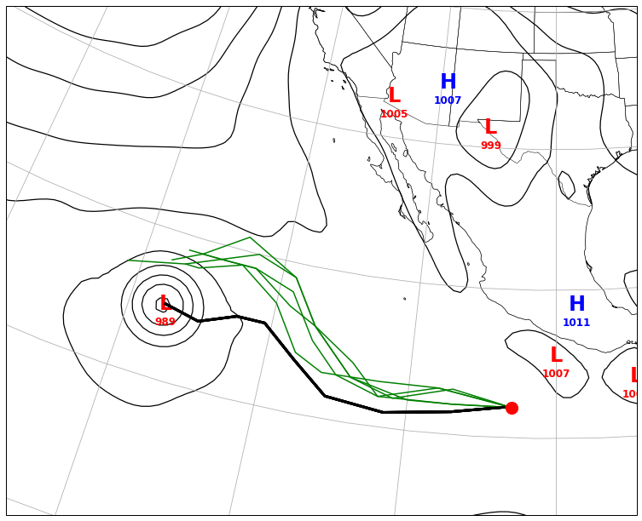
Sergio’s Track Distribution
MSLP analysis (thin black contours) valid 0000 UTC 8 Oct 2018
Notes:
2 Track Spread, valid 0000 UTC 8 Oct 2018
Last bifurcation around 0000 UTC 5 Oct 2018

Slide 34
Track Clustering Comparison
Recurving scenarios
Non-recurving scenarios
Notes:
2 Track Spread, valid 0000 UTC 8 Oct 2018
Last bifurcation around 0000 UTC 5 Oct 2018

Slide 35
Track Clustering Comparison
To test statistical significance between both clusters of interest:
Bootstrapped resampled without replacement two composited ensemble clusters (each at N=5) from the 20-member ensemble
Calculated the difference between the ensemble mean of the two subsets
Repeated 10,000 times to obtain the 95% confidence bounds on the composite difference
Notes:
2 Track Spread, valid 0000 UTC 8 Oct 2018
Last bifurcation around 0000 UTC 5 Oct 2018

Slide 36
Results
Composited Recurving Cluster 500-hPa Geopotential heights
Composited Non-recurving Cluster 500-hPa Geopotential heights
Recurving Cluster Composite minus Non-recurving Cluster Composite
300-hPa wind speed differences (*showing in this presentation)
500-hPa Geopotential height differences
. . . . . . . . . . . .
. . . . . .
Regions where difference is statistically significant at the 95% confidence level

Slide 37
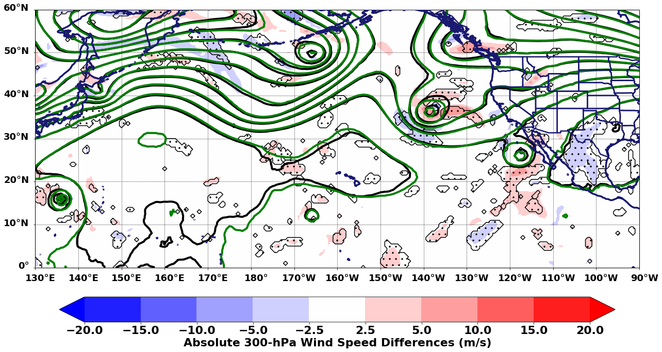
Results
Valid 0000 UTC Oct 1 (+24 h fcst)
Typhoon Trami undergoes ET
TC Rosa recurves and makes landfall

Slide 38
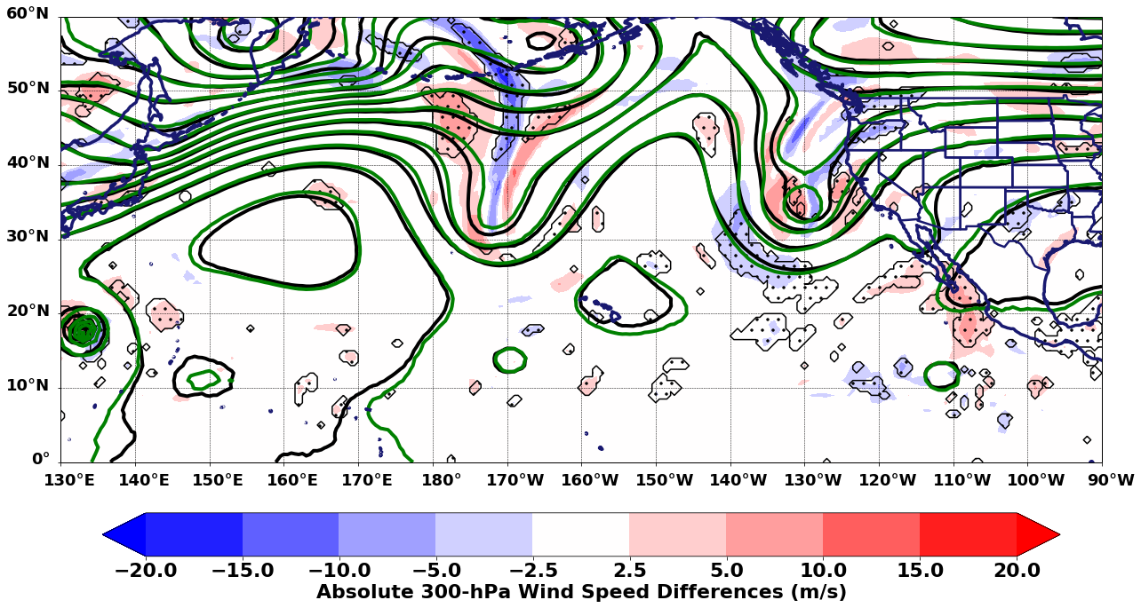
Results
Valid 0000 UTC Oct 2 (+48 h fcst)
Enhanced height gradient along jet
Differences exist where downstream trough amplifies

Slide 39
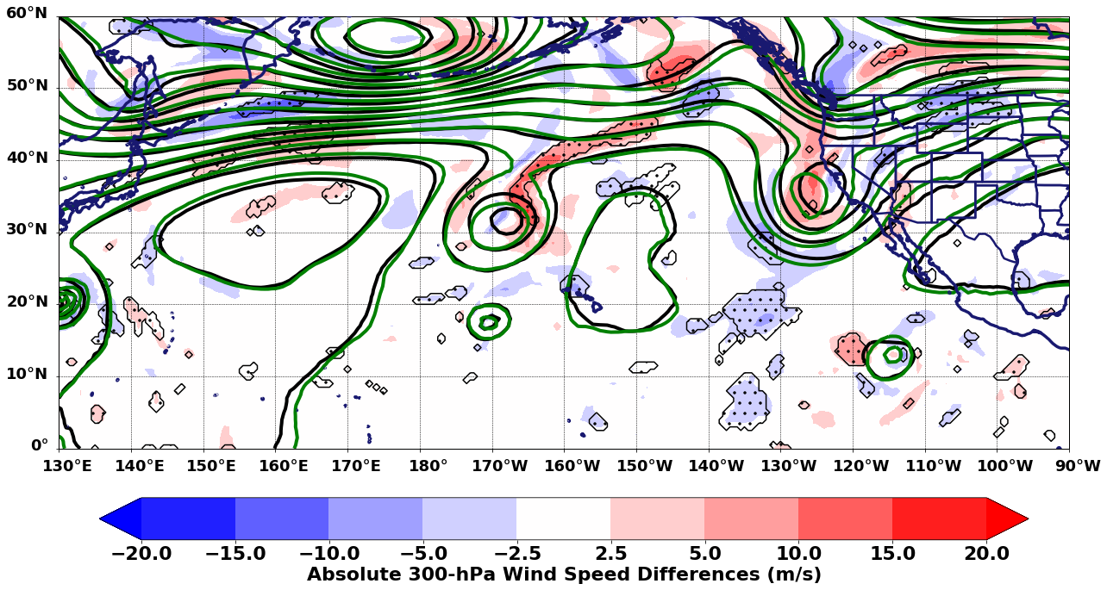
Results
Valid 0000 UTC Oct 3 (+72 h fcst)
Cutoff low Forms in proximity to
TC Walaka

Slide 40
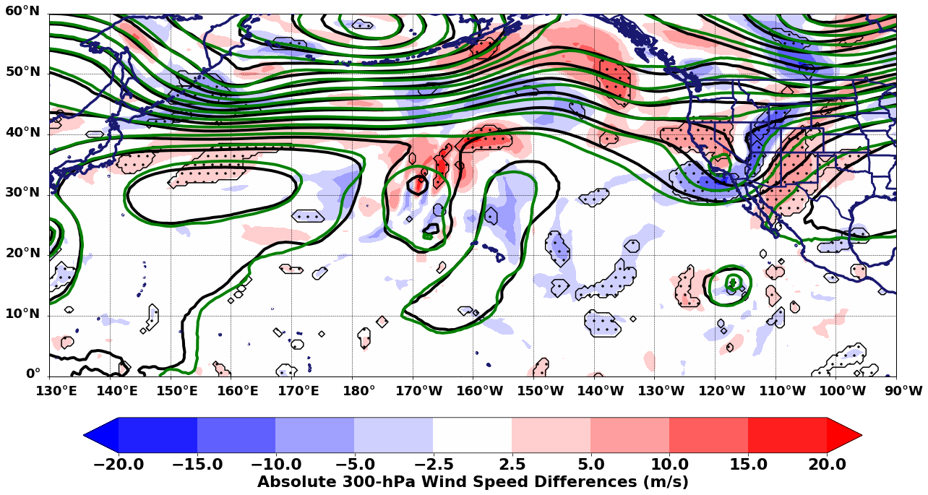
Results
Valid 0000 UTC Oct 4 (+96 h fcst)

Slide 41
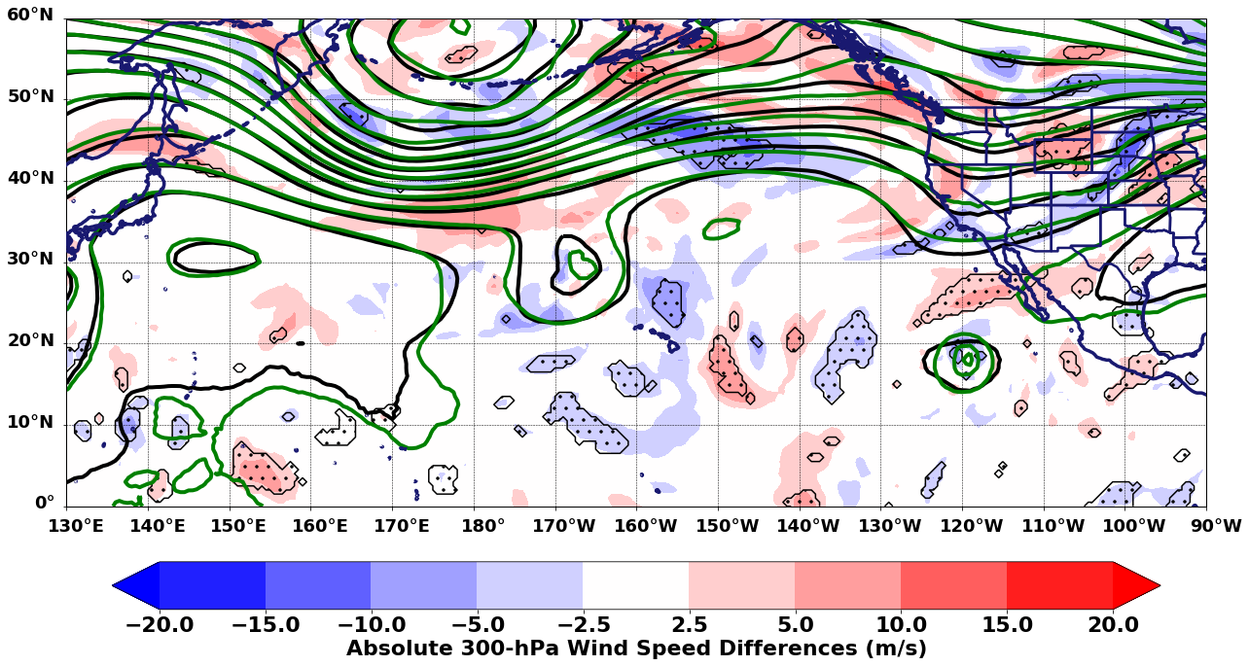
Results
Valid 0000 UTC Oct 5 (+120 h fcst)
Enhanced ridge building begins to occur

Slide 42
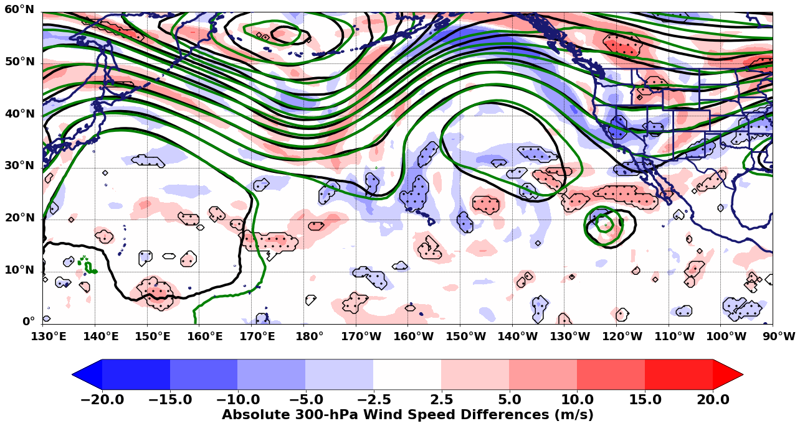
Results
Valid 0000 UTC Oct 6 (+144 h fcst)
Critical Point for TC Sergio in forecast

Slide 43
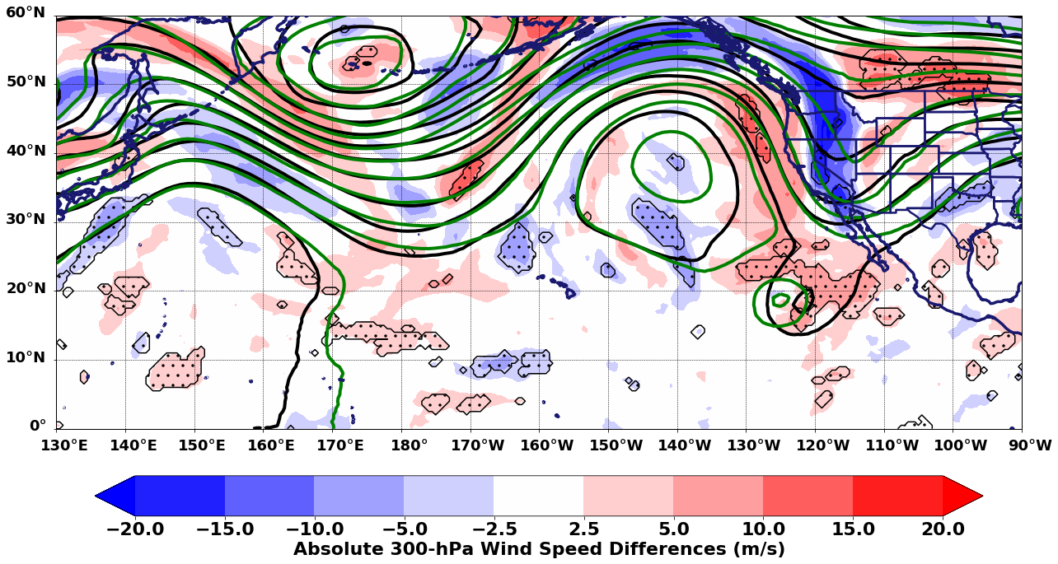
Results
Valid 0000 UTC Oct 7 (+168 h fcst)

Slide 44
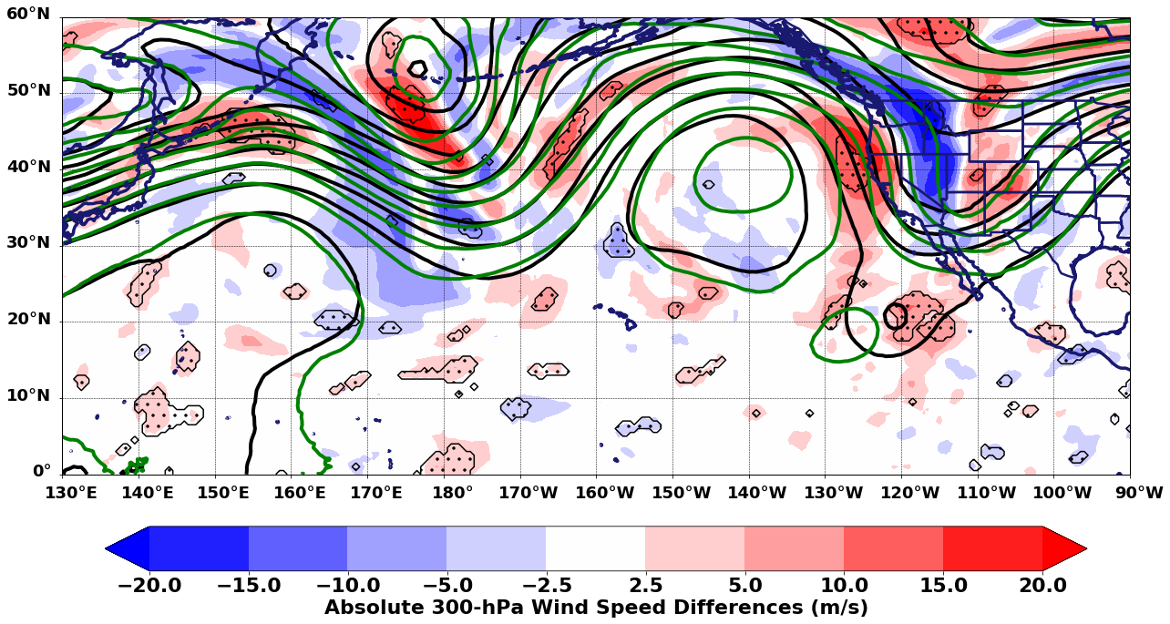
Results
Valid 0000 UTC Oct 8 (+192 h fcst)

Slide 45
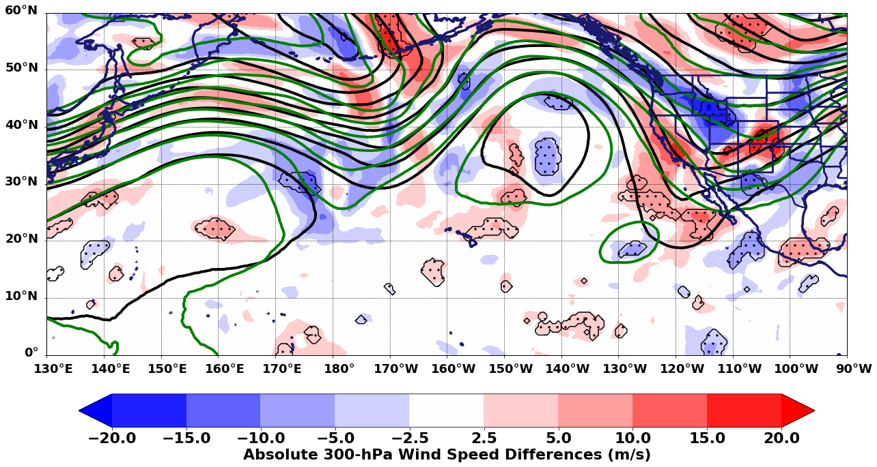
Results
Valid 0000 UTC Oct 9 (+216 h fcst)

Slide 46
Conclusions
GEFS ensemble members that predicted Sergio would recurve earlier in its lifetime were characterized by statistically significant differences in the handling of initial forecasts of the North Pacific jet and cutoff cyclone in the central Pacific
The mishandling of the aforementioned large-scale features likely lead to forecast uncertainties in the EPAC trough that steered Sergio inland too early as depicted in the recurving scenario

Slide 47
Conclusions
The cluster differences depicted local to Typhoon Trami’s and TC Walaka’s interactions with the North Pacific jet and Central Pacific cutoff cyclone respectively suggest a mishandling of the ET process that likely led to DBD over the North Pacific
An evaluation of the diabatic processes in proximity to TC Sergio and the upstream TCs that underwent ET upstream may further aid in explaining the local modifications made to the upper-level flow that resulted in Sergio’s forecast uncertainty

Slide 48
Questions?

Slide 49
Extra Slides

Slide 50
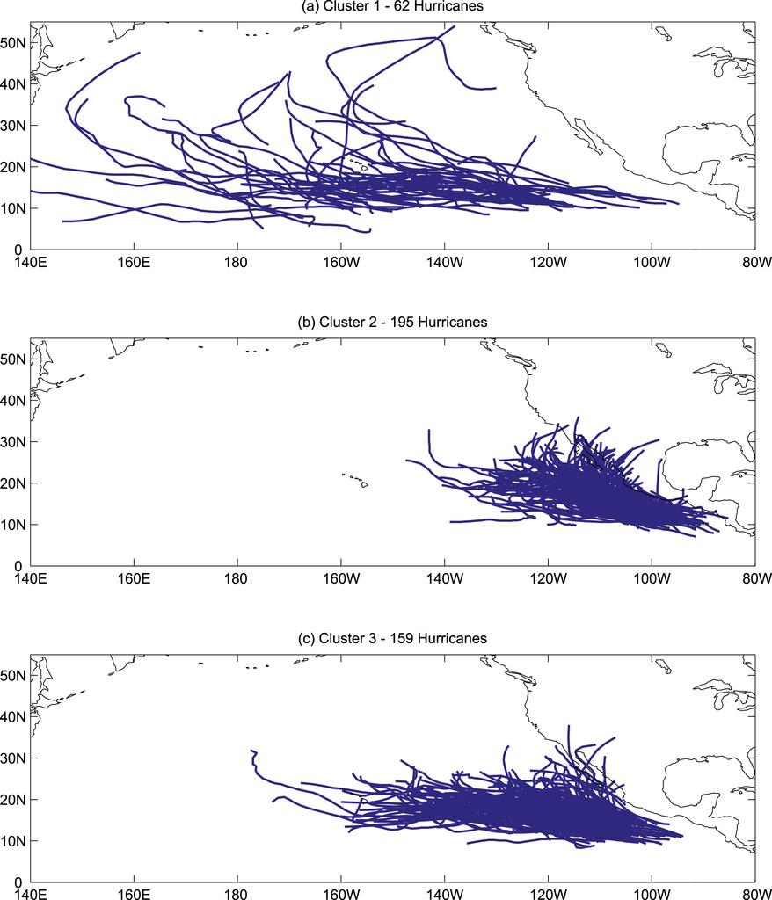
Background
Three clusters of EPAC TC tracks from 1966–2013
Camargo et al. (2008) applied a probabilistic clustering technique based on a regression mixture model to describe EPAC TC tracks
Cluster 2 depicts a higher landfall frequency of EPAC TCs
Cluster 2 was shown to be more prevalent and modulated by the westerly phase of the MJO (associated with enhanced convection in the region) and suppressed in the MJO's easterly phase
Fig. 3 adapted from Carmago et al. (2008)

Slide 51
Background
FIG. 6. Analyses and tracks of TCs Trami, Kong-rey, Walaka, Olivia, TD-29, Rosa, Sergio, and Michael in 2018. (a) 250-hPa winds (shaded, m s⁻¹) and 24-h difference of 250-hPa winds after initial classification of ET (black contours, every 20 m s⁻¹) valid at 1200 UTC 27 Sep 2018. (b) 250–150-hPa layer-averaged potential vorticity (shaded, PVU) and 2-PVU contour (pink) valid at 1200 UTC 1 Oct 2018. (c) As in (a), but for averaged winds associated with TCs Trami and Kong-Rey at the onset of ET valid at 1200 UTC 1 Oct and 1200 UTC 7 Oct, respectively. (d) As in (b), but valid at 1200 UTC 12 Oct 2018 and 500-hPa geopotential heights (black contours, dam) valid at 1800 UTC 2 Oct 2018.

Slide 52
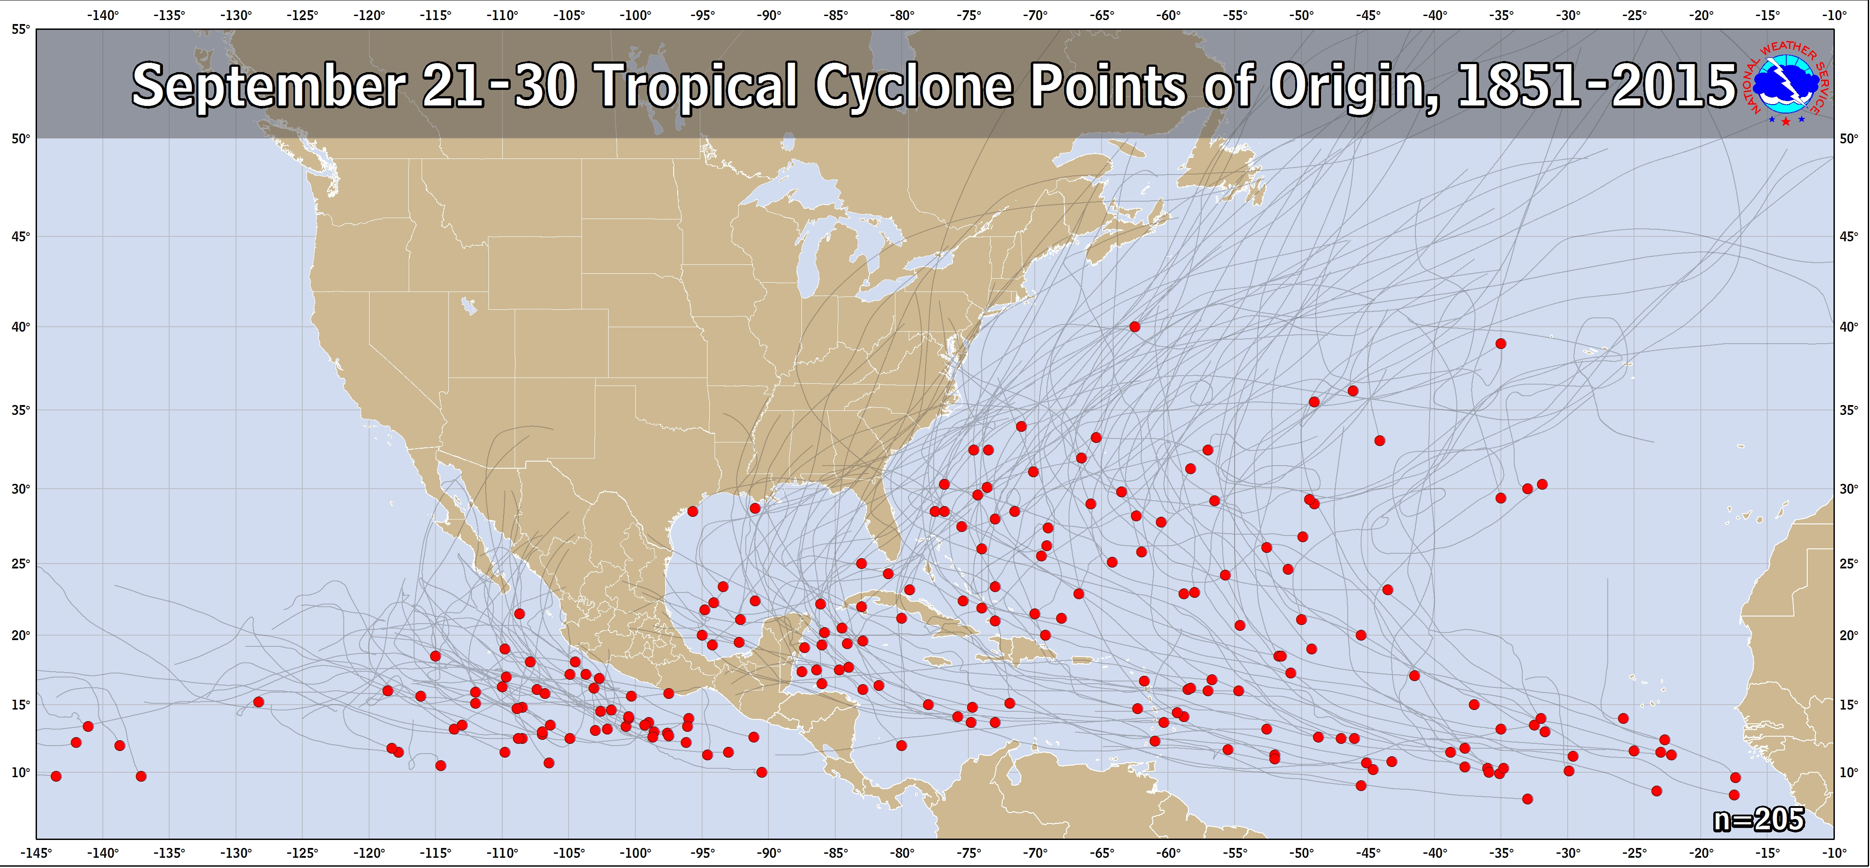
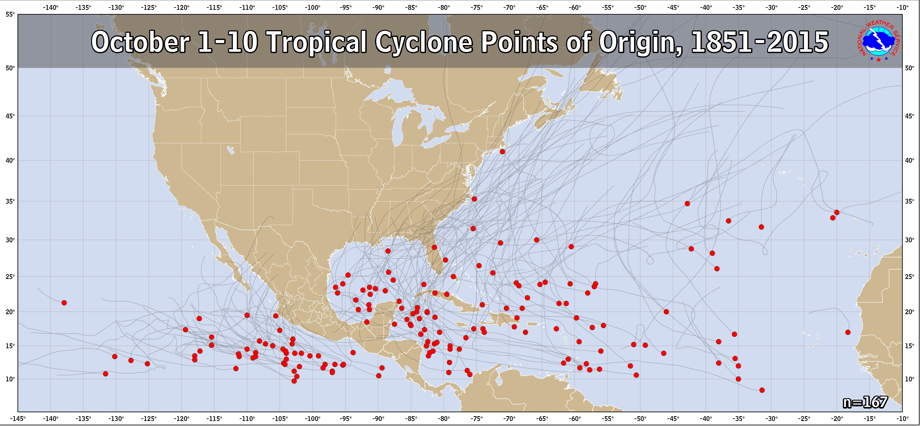
Introduction

Slide 53
Results – 500-hPa Analysis
Valid 0000 UTC Oct 1

Slide 54
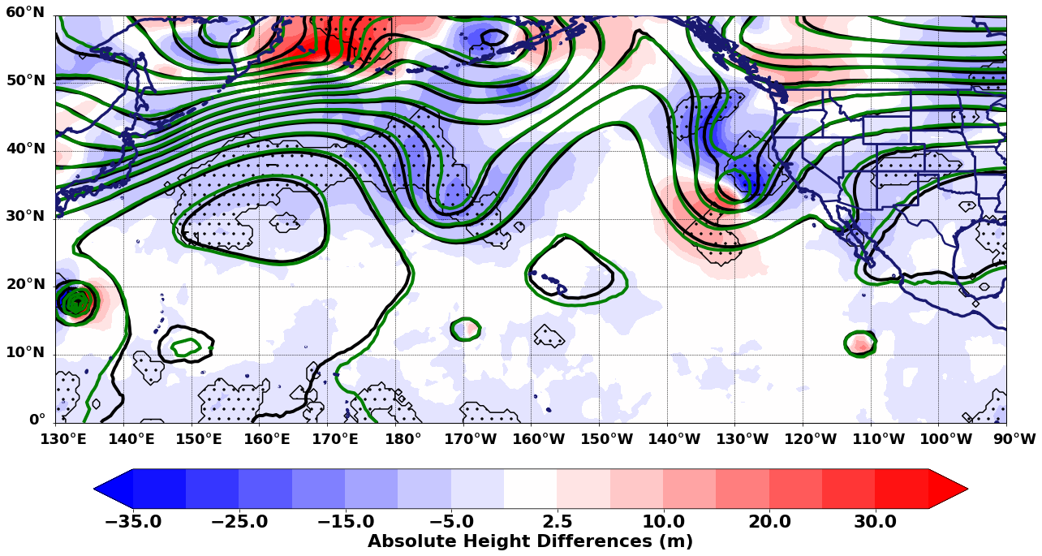
Results – 500-hPa Analysis
Valid 0000 UTC Oct 2

Slide 55
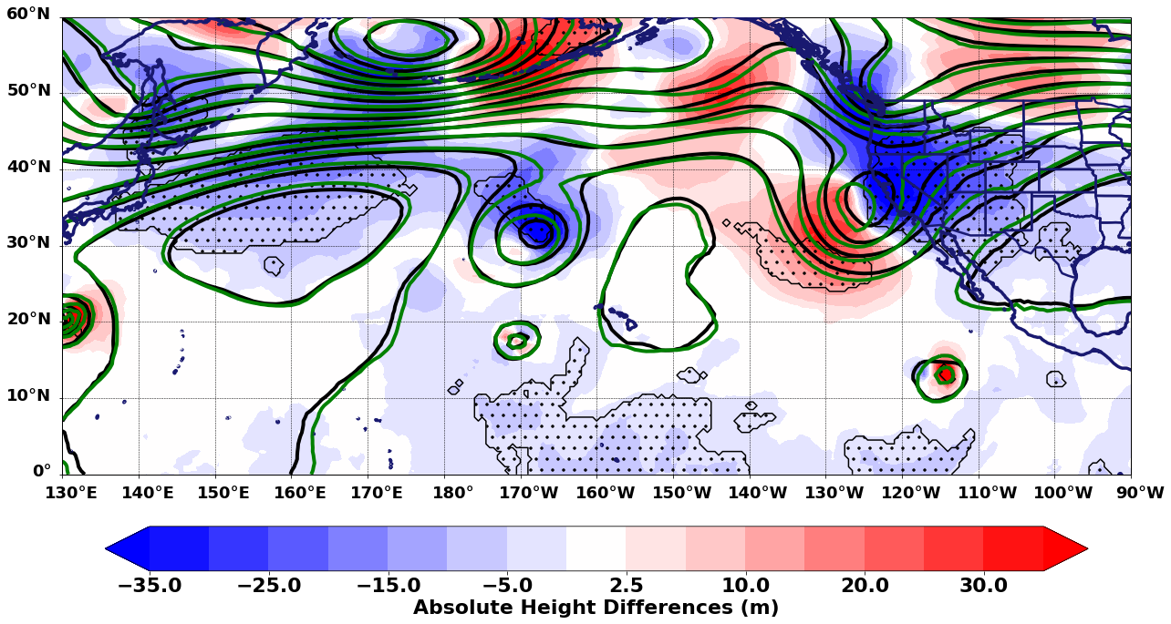
Results – 500-hPa Analysis
Valid 0000 UTC Oct 3

Slide 56
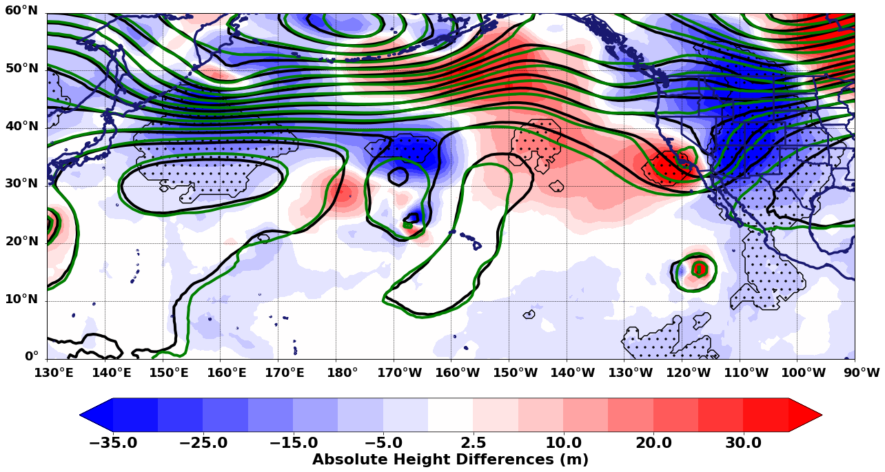
Results – 500-hPa Analysis
Valid 0000 UTC Oct 4

Slide 57
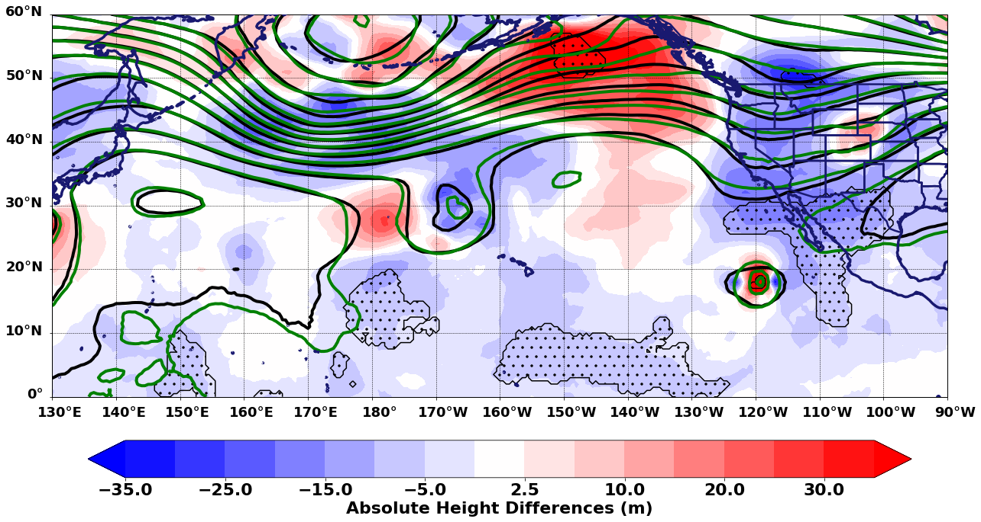
Results – 500-hPa Analysis
Valid 0000 UTC Oct 5

Slide 58
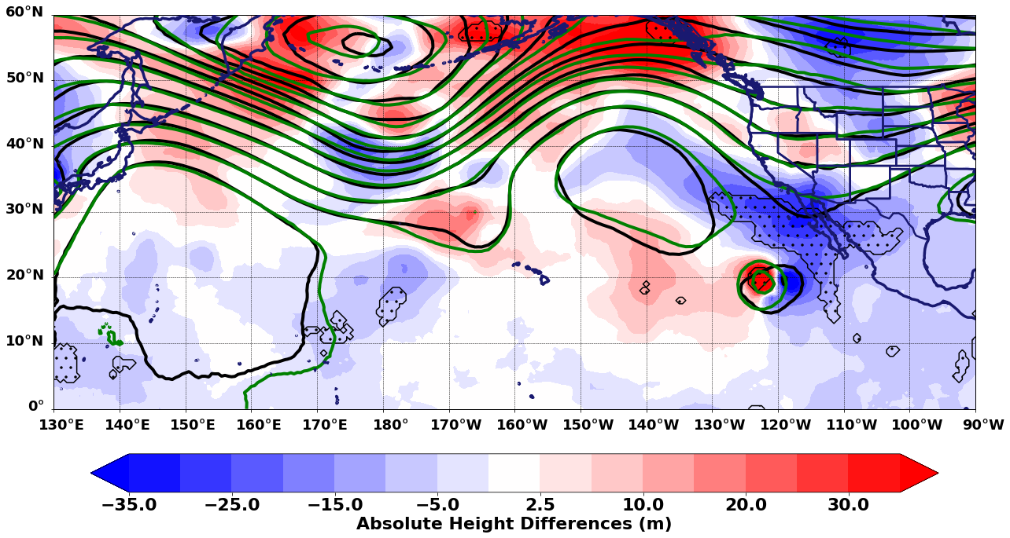
Results – 500-hPa Analysis
Valid 0000 UTC Oct 6

Slide 59
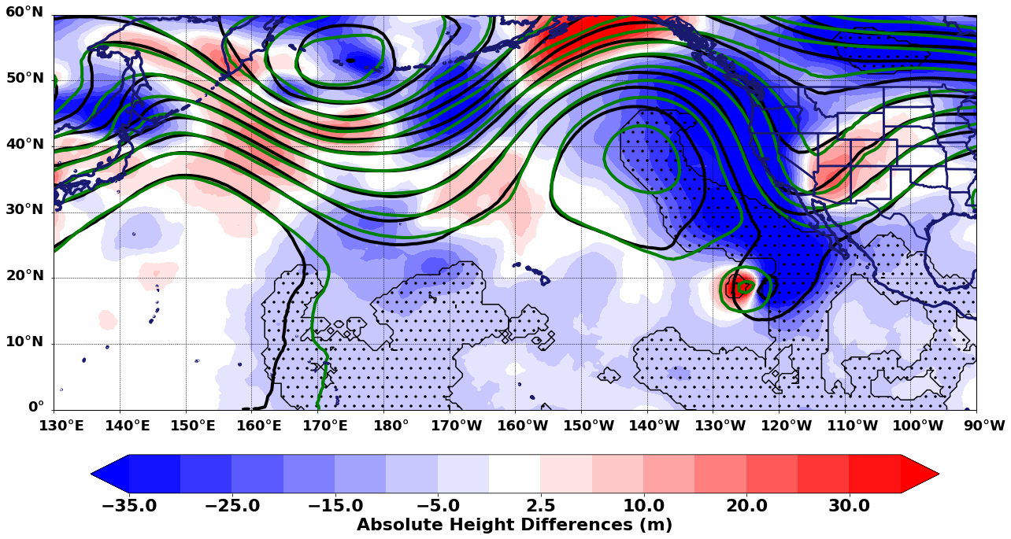
Results – 500-hPa Analysis
Valid 0000 UTC Oct 7

Slide 60
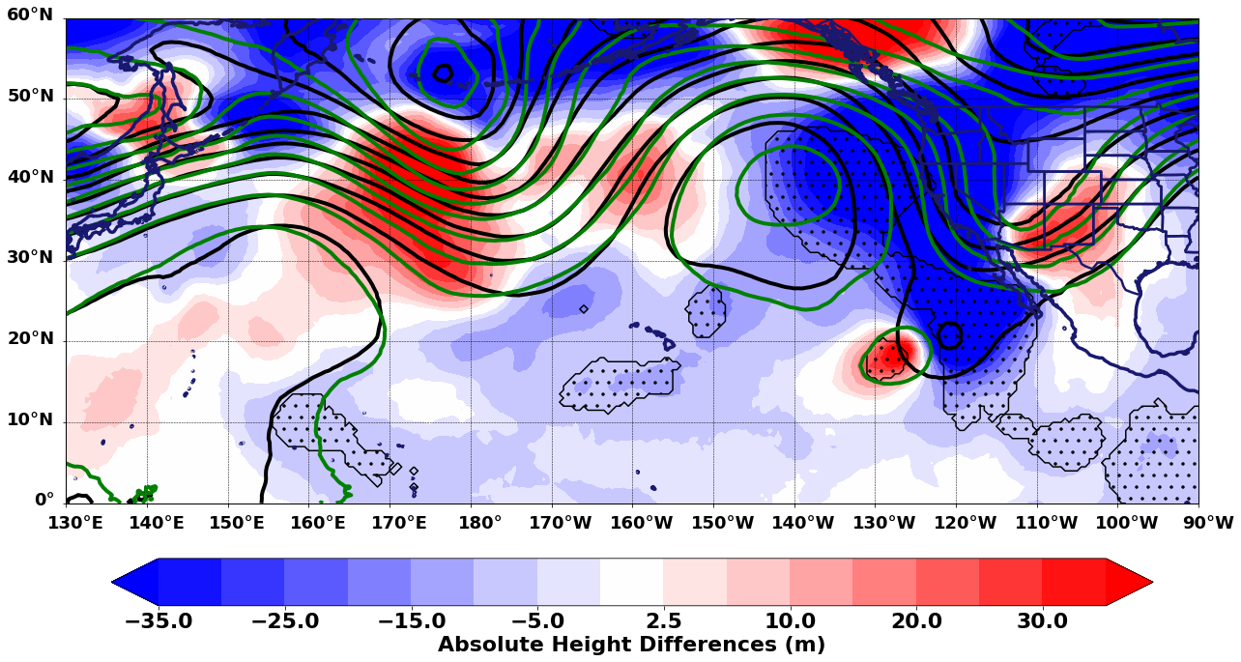
Results – 500-hPa Analysis
Valid 0000 UTC Oct 8

Slide 61
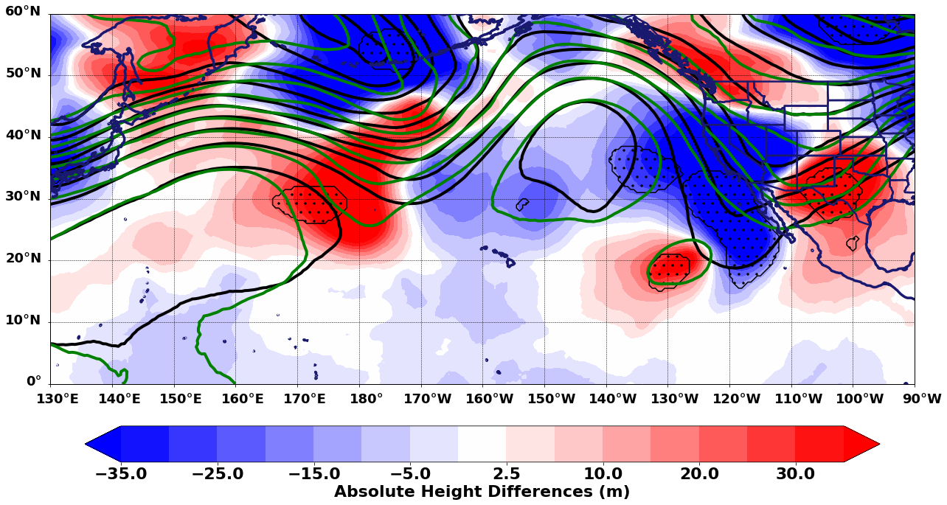
Results – 500-hPa Analysis
Valid 0000 UTC Oct 9

