Slide 1
NOAA Airborne Hurricane Research through the
Intensity Forecasting Experiment (IFEX):
Past, Present, and Future
Robert Rogers
NOAA/AOML Hurricane Research Division

Slide 2
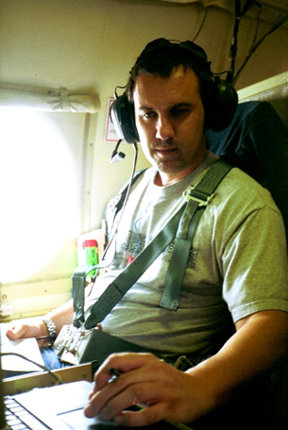
About me
started at HRD after getting my Ph.D from Penn State University in 1998
conduct research on hurricane structure and intensity change using data collected from NOAA’s aircraft and numerical models
more than 200 penetrations through hurricane eyewalls
supports NOAA’s mission of providing improved forecasts of hurricanes

Slide 3
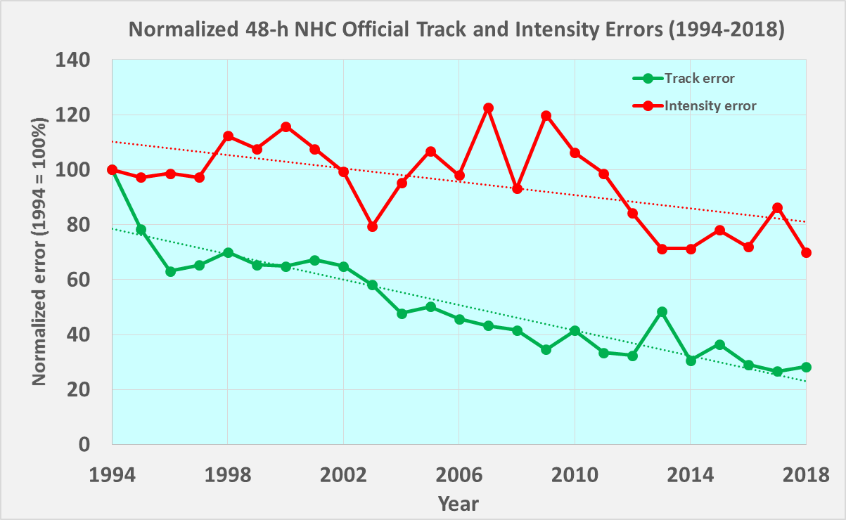
The Challenge: Hurricane Intensity Forecasting
NHC 48-h Track & Intensity Forecast Errors
Between 1994 and 2018
intensity
Track forecast
errors reduced by
Intensity forecast errors reduced by
70%
30%
track
For hurricanes undergoing rapid intensification
3 x
Greater intensity error than non-rapidly intensifying

Slide 4
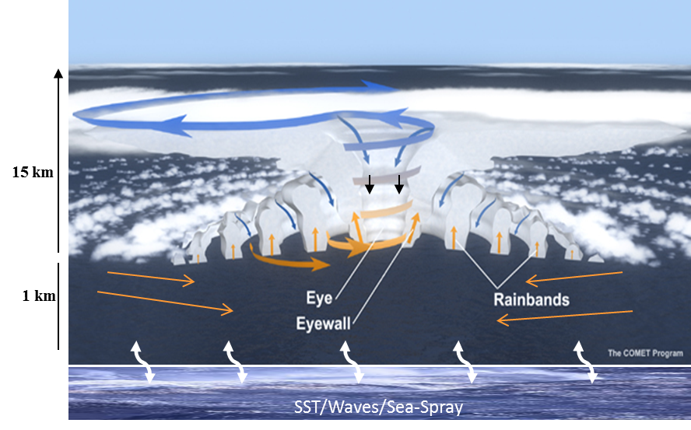
The challenge: Hurricane Intensity Forecasting
Multiscale nature of processes are major reason for this difficulty
Environment
(1000 km)
Vortex
(100 km)
Characterizing and understanding these processes and their interactions are key steps in forecast improvement
Airborne observations provide a unique opportunity to study these processes across scales
Thunderstorm
(1 km)
Turbulence
(0.001-0.1 km)

Slide 5
Why are observations important?
Many important physical processes within hurricanes span scales that cover many orders of magnitude, ranging from thousands of kilometers to millionths of meters
Observations can span these scales, and are a key component of a balanced approach toward advancing understanding and improving forecasts of hurricanes (observations, modeling, theory)
Provide real-time information on TCs, assess performance of models, and provide a check on theories
Three primary platform types: airborne, spaceborne, and land-based
Focus here on airborne

Slide 6
Outline
Tools for observing hurricanes
Use of observations to improve hurricane forecasts
Flight profiles
Views from the aircraft
Toward the future

Slide 7


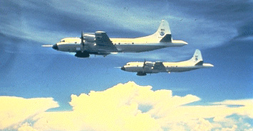
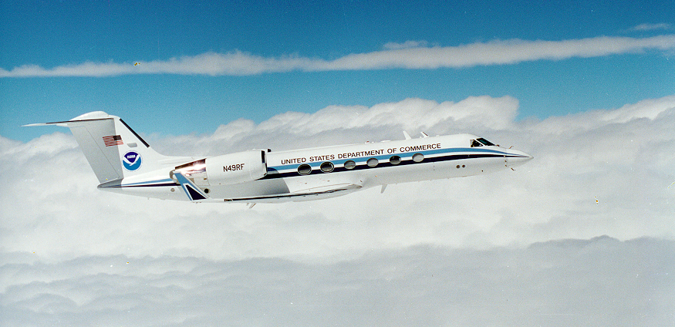

1. Tools for observing hurricanes - platforms
NOAA fleet
“Kermit” Built in 1975 at Lockheed-Martin, Marietta, Georgia
“Miss Piggy” Built in 1976 at Lockheed-Martin, Marietta, Georgia
“Gonzo” Built in 1994 at Gulfstream Aerospace Corporation, Savannah, Georgia

Slide 8
Tools for observing hurricanes - instruments
In-situ
  Wind
  Pressure
  Temperature
  Moisture

Slide 9
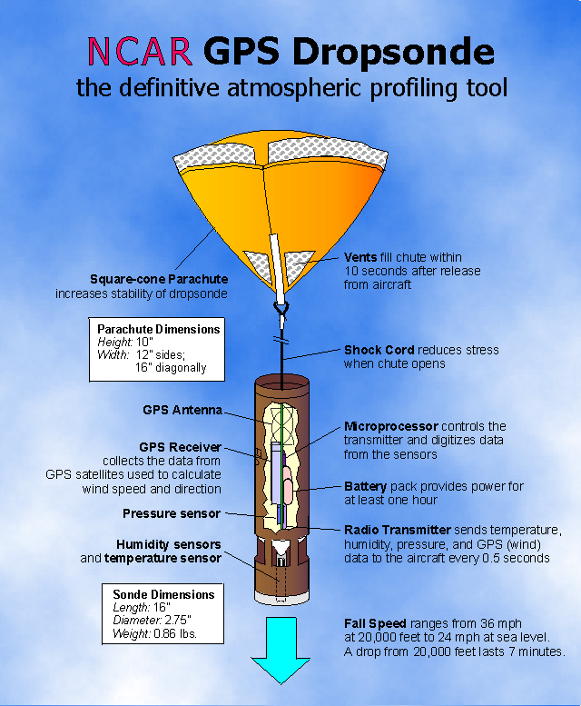
Tools for observing hurricanes - instruments
In-situ
  Wind
  Pressure
  Temperature
  Moisture
Expendables
  Dropsondes
  Aircraft-launched ocean probes
GPS Dropsonde

Slide 10
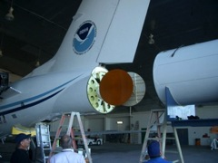
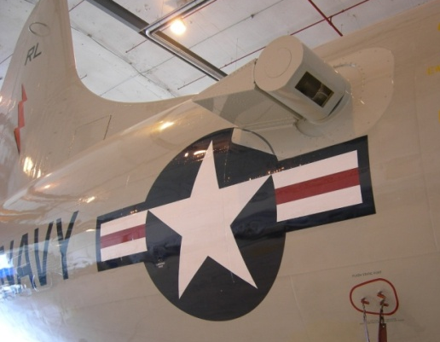
Tools for observing hurricanes - instruments
In-situ
  Wind
  Pressure
  Temperature
  Moisture
Expendables
  Dropsondes
  Aircraft-launched ocean probes
Remote Sensors
  Tail Doppler Radar(TDR)
  Stepped Frequency Microwave Radiometer (SFMR)
  Scanning Radar Altimeter (SRA)
  Doppler Wind Lidar
Tail Doppler Radar
GPS Dropsonde
Doppler Wind Lidar

Slide 11
Tools for observing hurricanes - instruments
In-situ
  Wind
  Pressure
  Temperature
  Moisture
Expendables
  Dropsondes
  Aircraft-launched ocean probes
Remote Sensors
  Tail Doppler Radar(TDR)
  Stepped Frequency Microwave Radiometer (SFMR)
  Scanning Radar Altimeter (SRA)
  Doppler Wind Lidar
Uncrewed
  Uncrewed Aerial Systems (UASs) (e.g., Coyote)
  Autonomous Underwater Vehicles (AUVs) (e.g., Ocean Glider)
Tail Doppler Radar
GPS Dropsonde
Doppler Wind Lidar

Slide 12
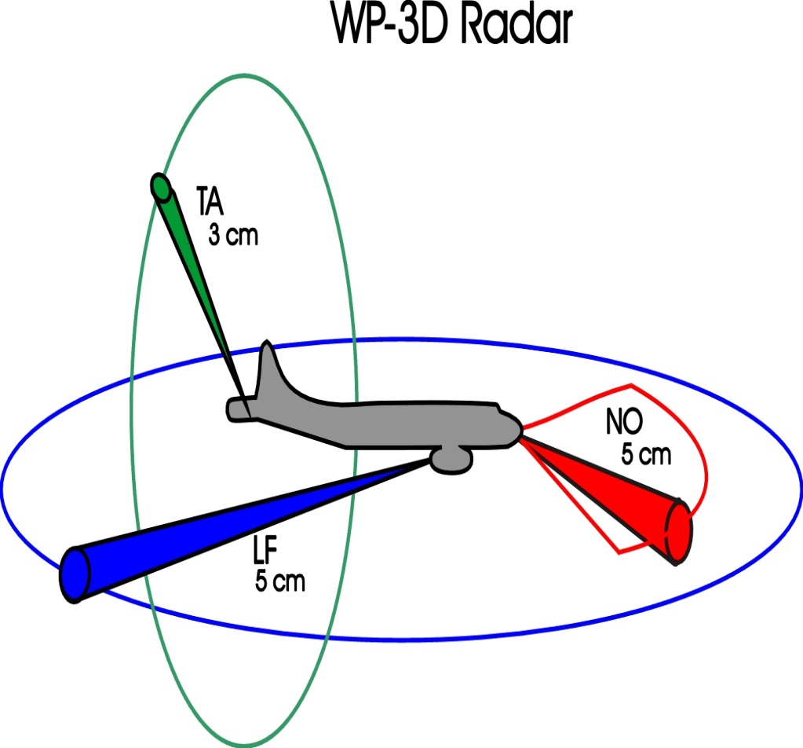
Airborne Radars on P-3
Tools for observing hurricanes - instruments

Slide 13
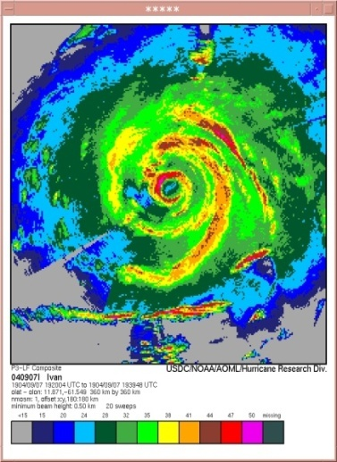
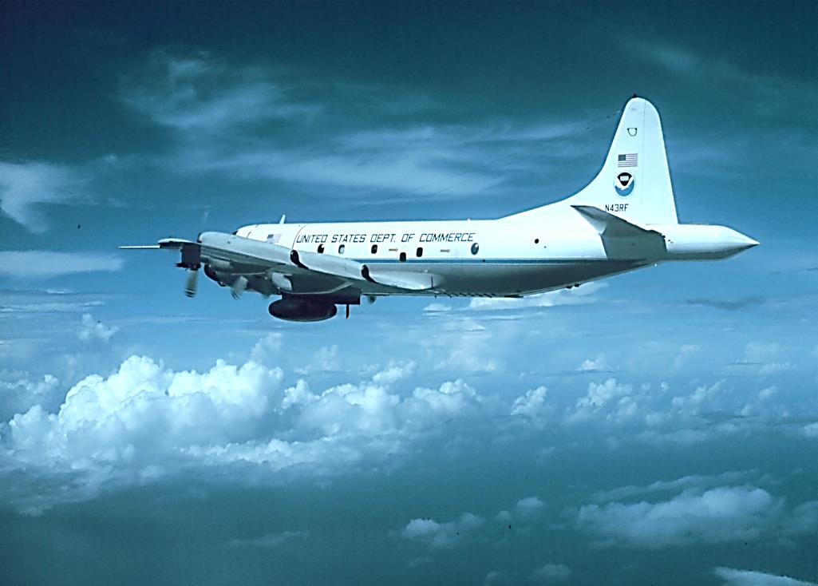
Tools for observing hurricanes - instruments
Lower Fuselage (LF) Radar
spiral rainbands
LF
eyewall

Slide 14
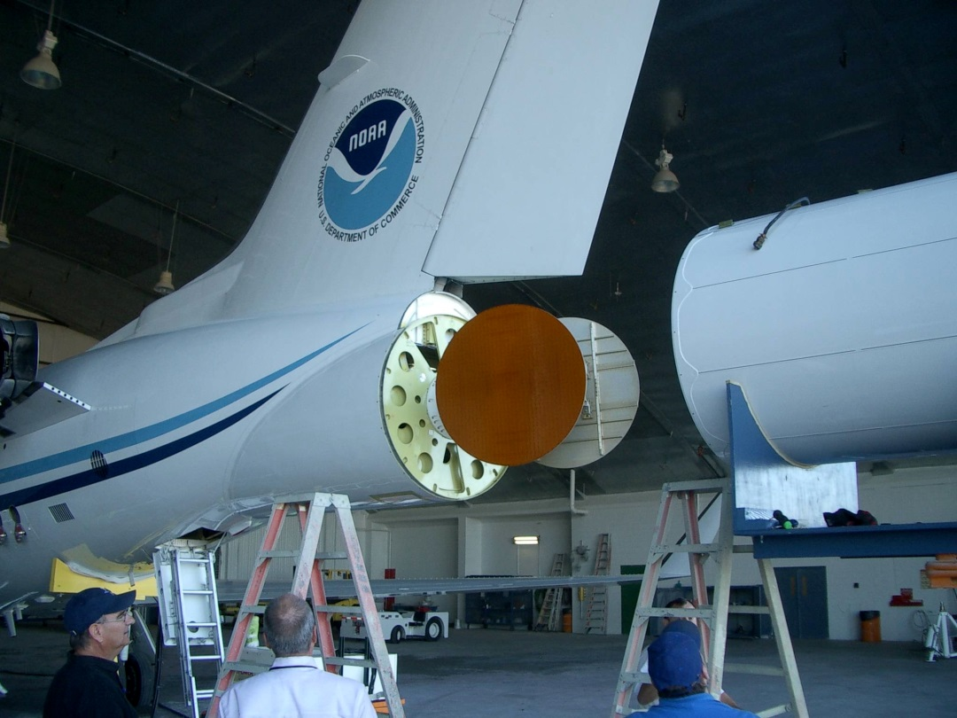
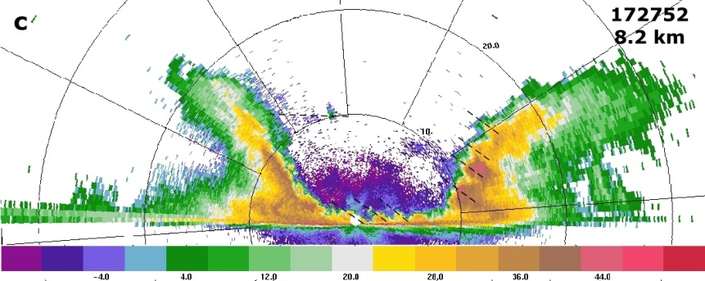
Tools for observing hurricanes - instruments
Tail Doppler Radar
eyewall
eye
TA
Vertical slice shows eyewall, eye structure

Slide 15
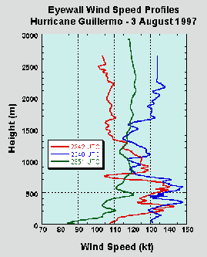
Tools for observing hurricanes - instruments
GPS dropsonde
Wind speeds in eyewall
3
2.5
2
Height (km)
1.5
1
0.5
Cat-5 wind speeds in lowest 1500 ft
0
70
80
90
100
110
120
130
140
150
Wind speed (kt)

Slide 16
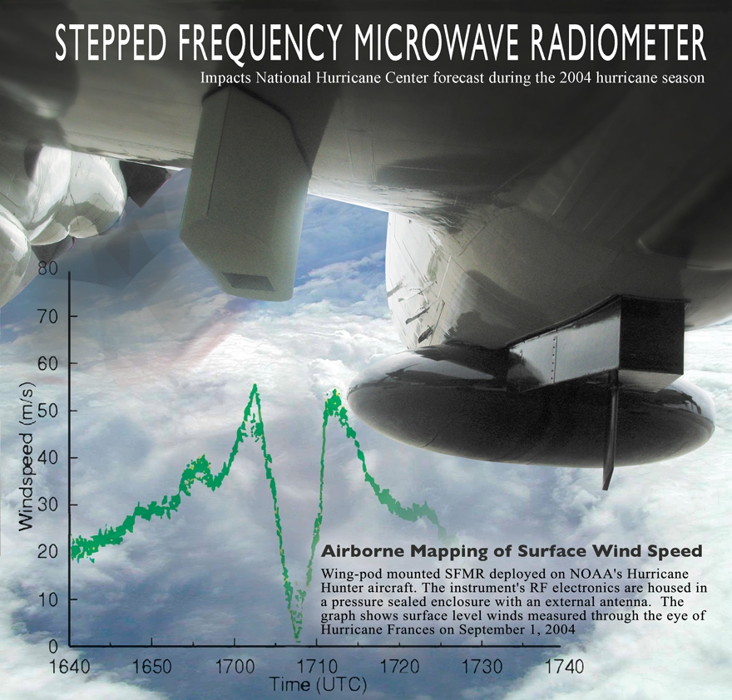
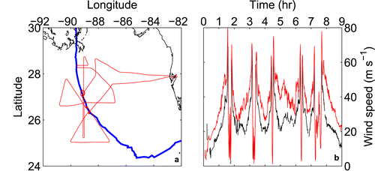
Tools for observing hurricanes - instruments
Stepped Frequency Microwave Radiometer (SFMR)
eyewall
Winds at surface usually a little weaker than winds at flight level
Winds at flight level (~10,000 ft)
Winds at surface

Slide 17

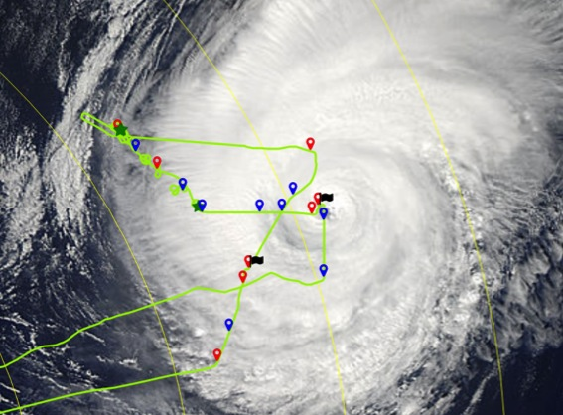
New Airborne Platforms
Small uncrewed aerial systems (sUAS)
Coyote measurements in Hurricane Edouard (2014)
MODIS
1640Z
1420Z
1341Z
1638Z
1316Z
released from P-3 like a dropsonde, can be controlled for ~2 h
new versions have 3-4 h duration, range of ~200 nm
can get measurements down to surface, where manned aircraft can not reach
1259Z

Slide 18
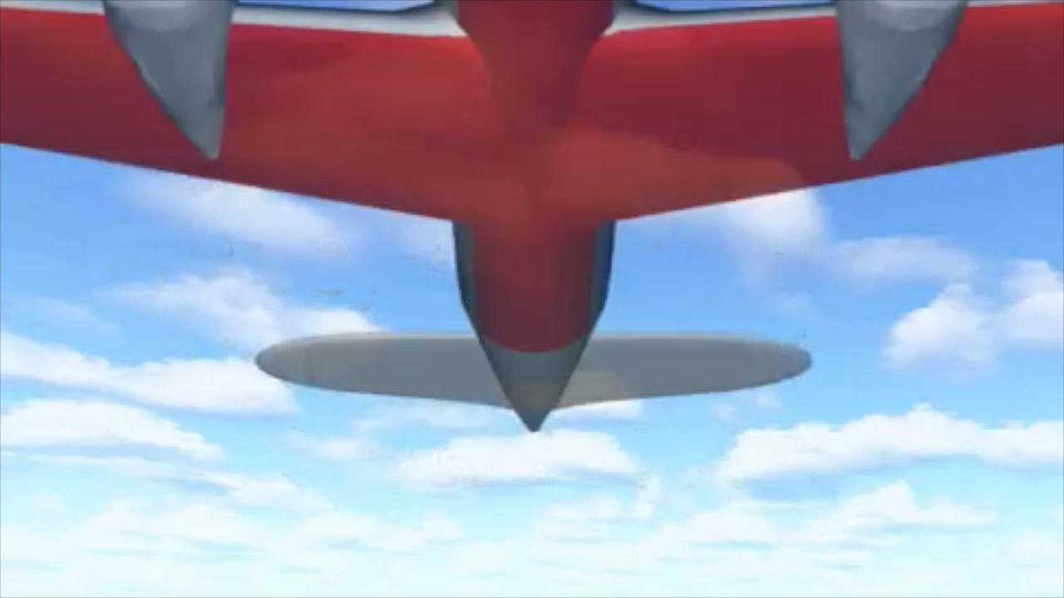
New Airborne Platforms
Depiction of sUAS launch

Slide 19
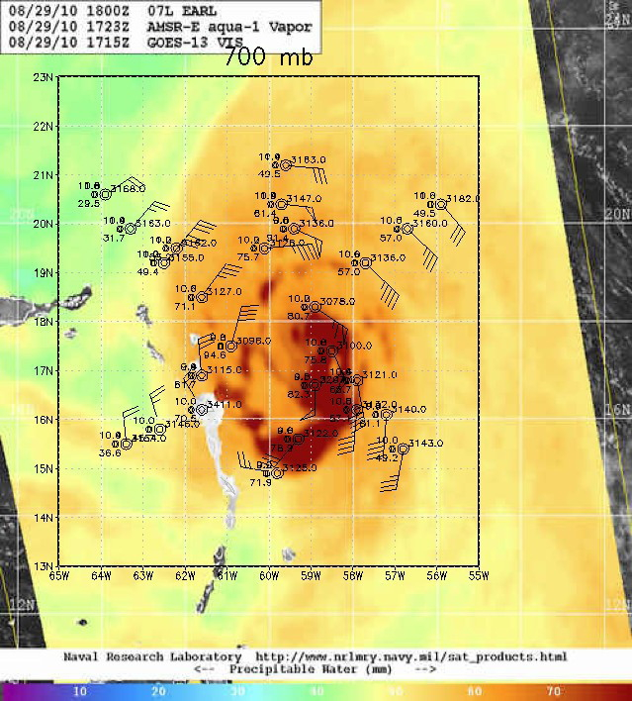

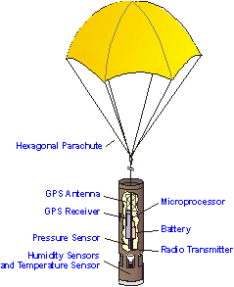
Scales sampled by Airborne Observations
Environmental structure
Synoptic-surveillance using dropsondes
Steering flow
Variation in moisture content of environment around hurricane

Slide 20
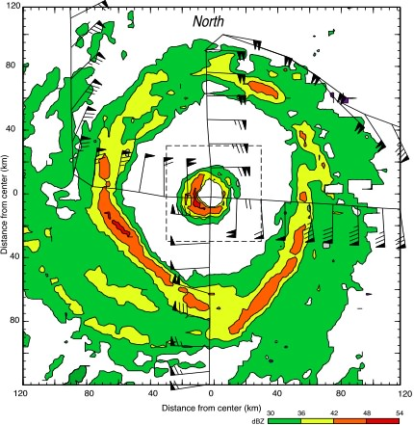
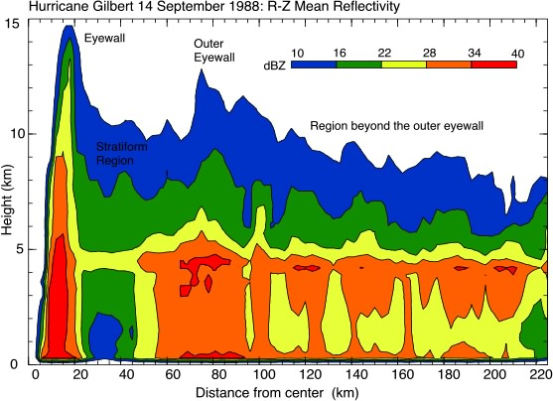
Scales sampled by Airborne Observations
Vortex Structure
Double eyewalls seen from airborne radar
eyewalls
inner
eyewall
stratiform
stratiform
Highest rain rates normally in eyewall, mostly convective, cover small area
Lighter rain rates in stratiform areas outside eyewall, cover larger area

Slide 21
Scales sampled by Airborne Observations
Convective Structure
ER-2 EDOP
ER-2 EDOP
Strong convection seen from radar
P-3 TA
P-3 TA
Vertical velocity (m/s)
Reflectivity (dBZ)

Slide 22
Scales sampled by Airborne Observations
Microphysical Structure
Flight track and LF image
Cloud physics particle images
snowflakes, graupel pellets, ice crystals seen in probe imagery

Slide 23

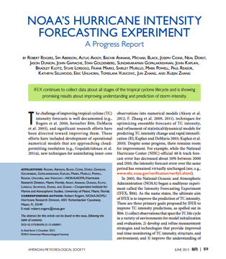
2. Use of observations to improve hurricane forecasts
Intensity Forecasting Experiment (IFEX)
Rogers et al., BAMS, 2006
Rogers et al., BAMS, 2013
IFEX intended to improve prediction of TC intensity change by addressing three goals:
FORECASTS: Collecting observations that span TC life cycle across scales for model initialization, evaluation
NOWCASTS: Developing and refining measurement technologies that provide improved real-time monitoring of TC intensity, structure, and environment
RESEARCH: Improving understanding of physical processes important in intensity change for a TC at all stages of its life cycle

Slide 24
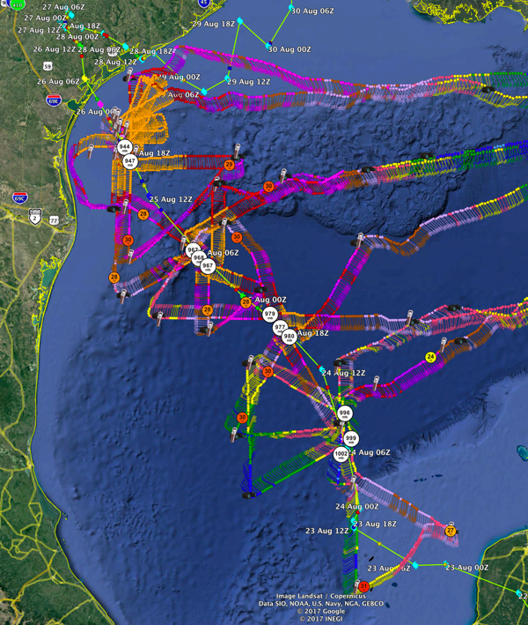
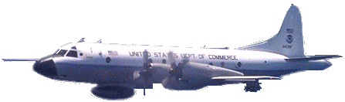
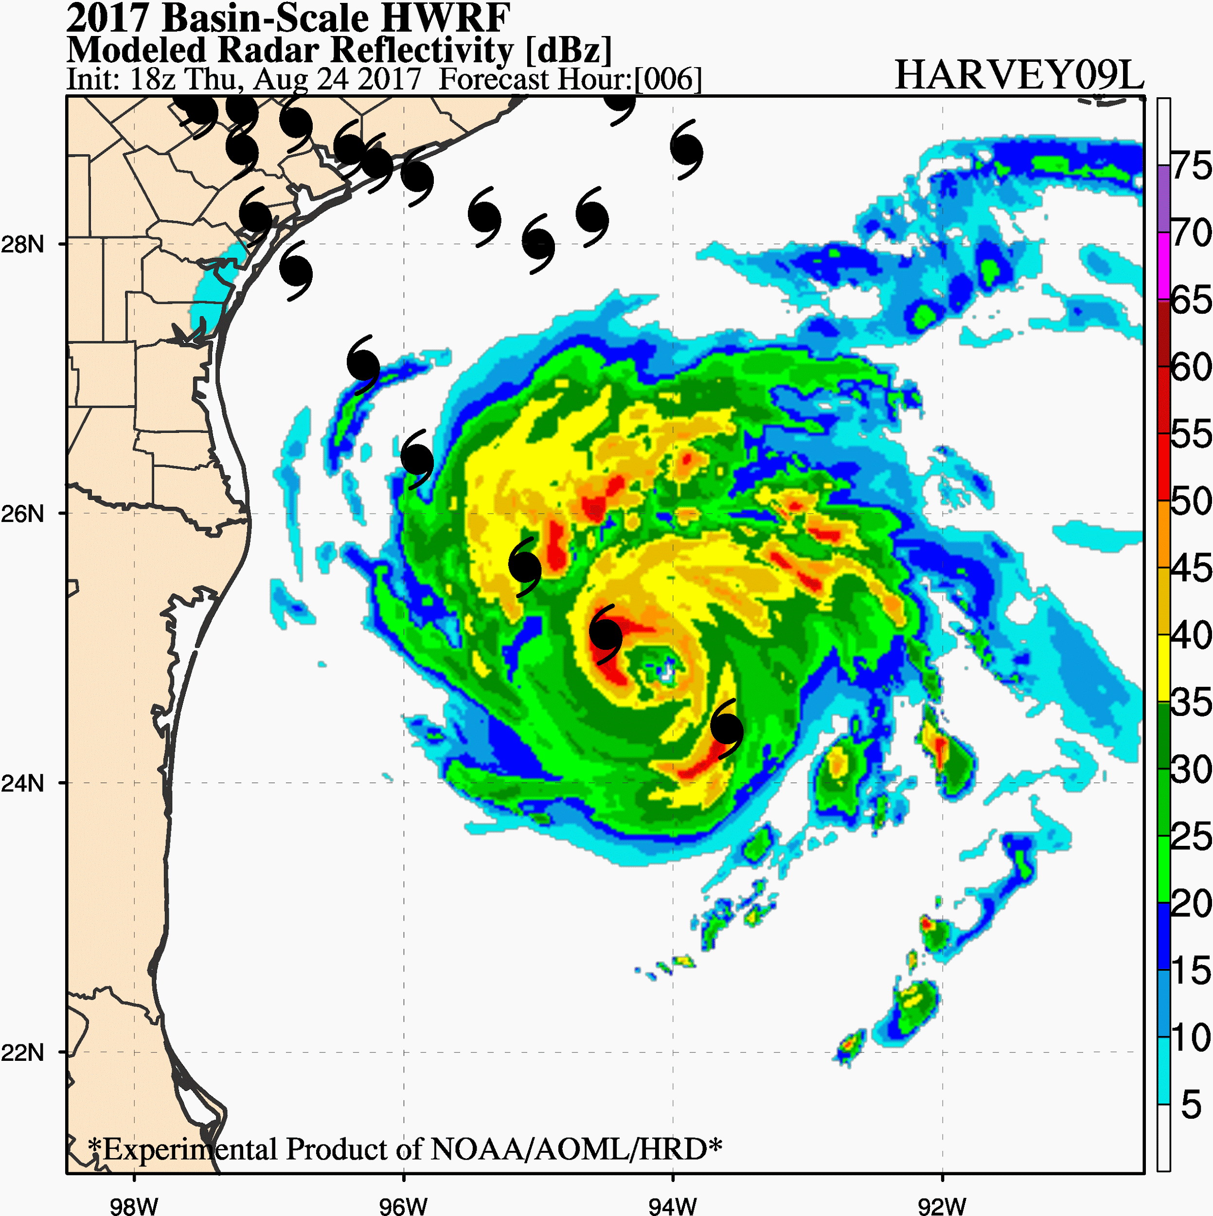
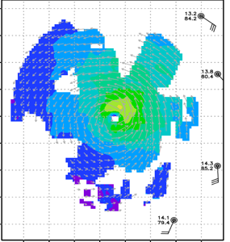
  IFEX FORECASTS: Assimilation of data into numerical models
NOAA P-3 transmitted Tail Doppler radar data in real-time for assimilation into HWRF
4 P-3 missions 24-26 August
Hurricane Harvey (2017)

Slide 25
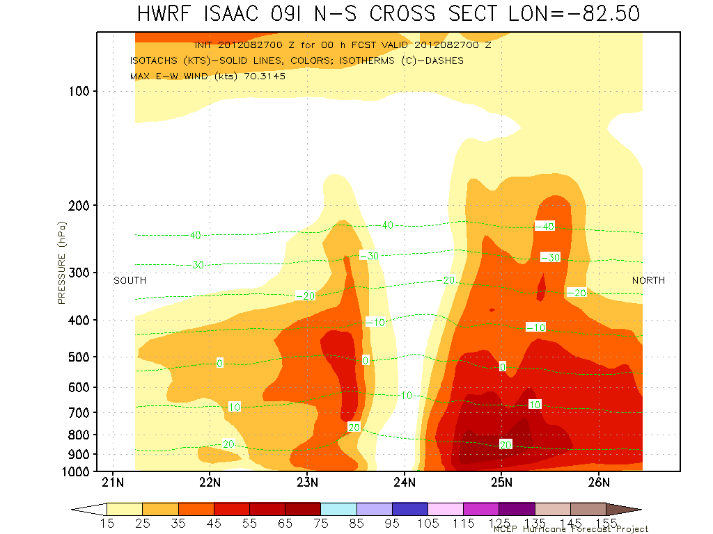
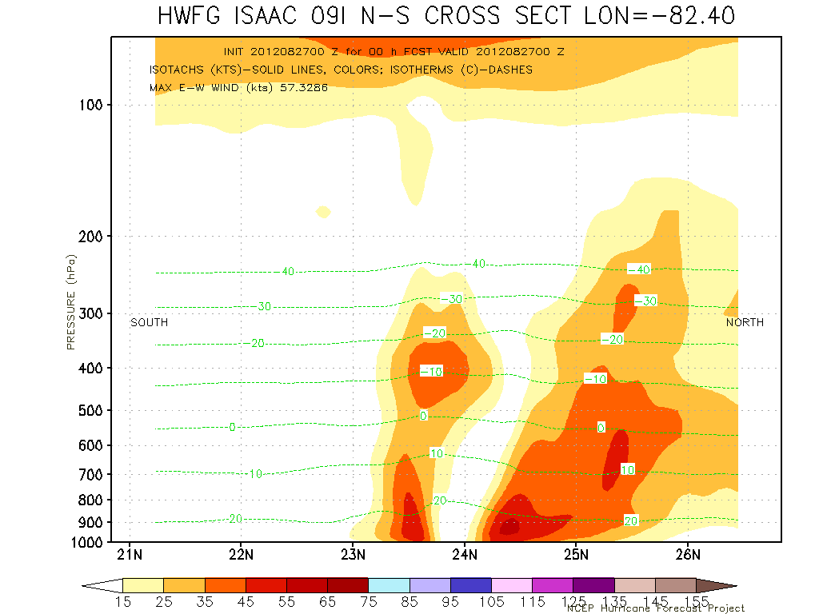
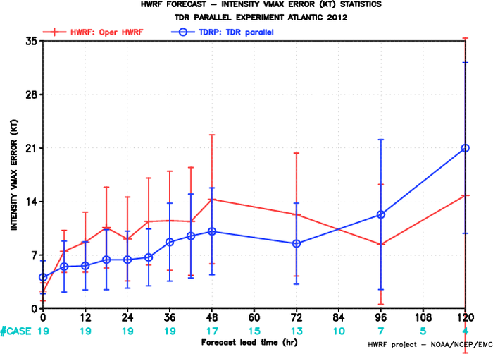
  IFEX FORECASTS: Assimilation of data into numerical models
Vertical cross section of wind speed in Isaac (2012) at start of model forecast
Isaac intensity forecast errors
Without radar data
With radar data
Improved representation of vortex tilt
25
Incorporation of radar data improved structure of Isaac at initial time
Resulting intensity forecast was improved

Slide 26
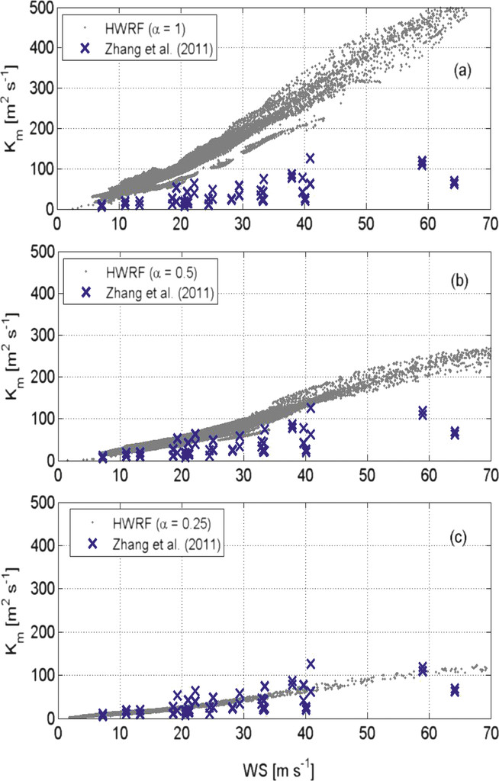
IFEX FORECASTS: Model evaluation
Sensitivity of radial wind to mixing processes in low levels
Values of vertical eddy diffusivity obtained from model simulations (dots) and aircraft observations (x’s)
Default value of mixing in HWRF model (alpha=1) too diffusive when compared with observations

Slide 27
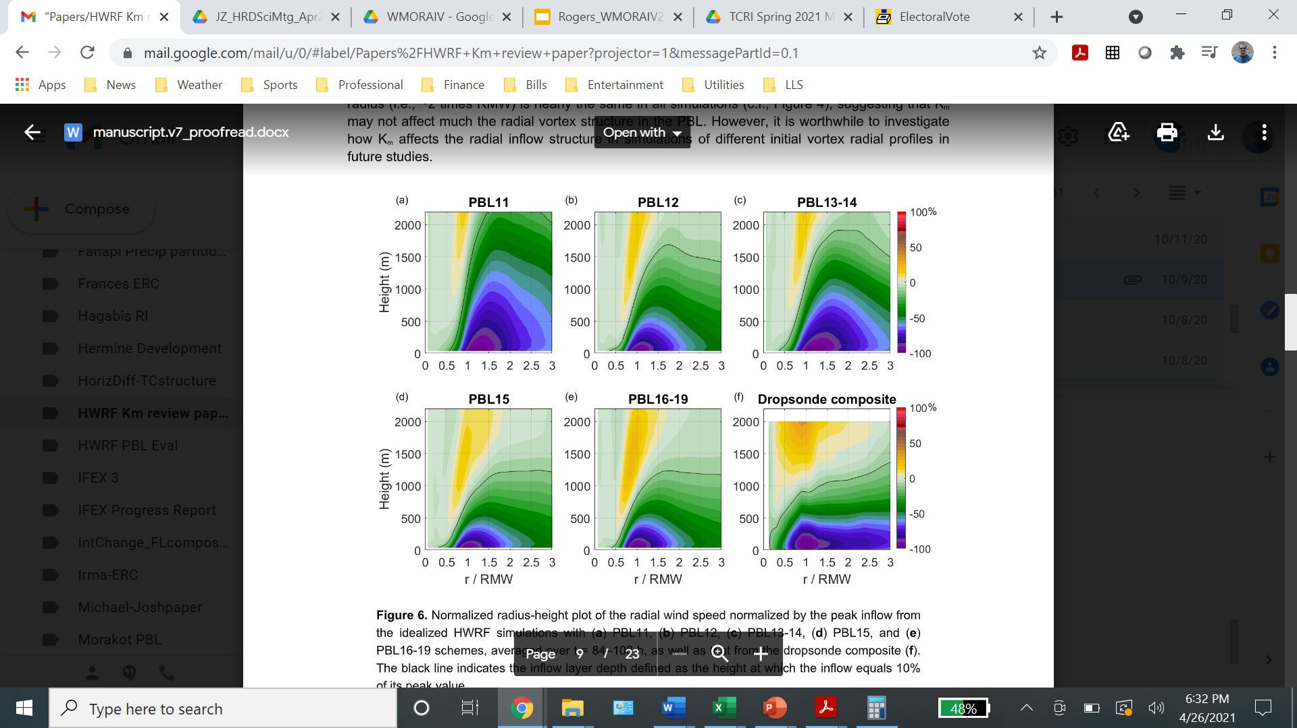
IFEX FORECASTS: Model evaluation
Sensitivity of radial wind to mixing processes in low levels
Radial inflow for different HWRF model configurations from 2011-2019
Zhang et al. 2020
PBL structure (depth of inflow layer, outflow channel) more consistent with dropsonde composites using mixing based on observations (more recent versions of model)

Slide 28
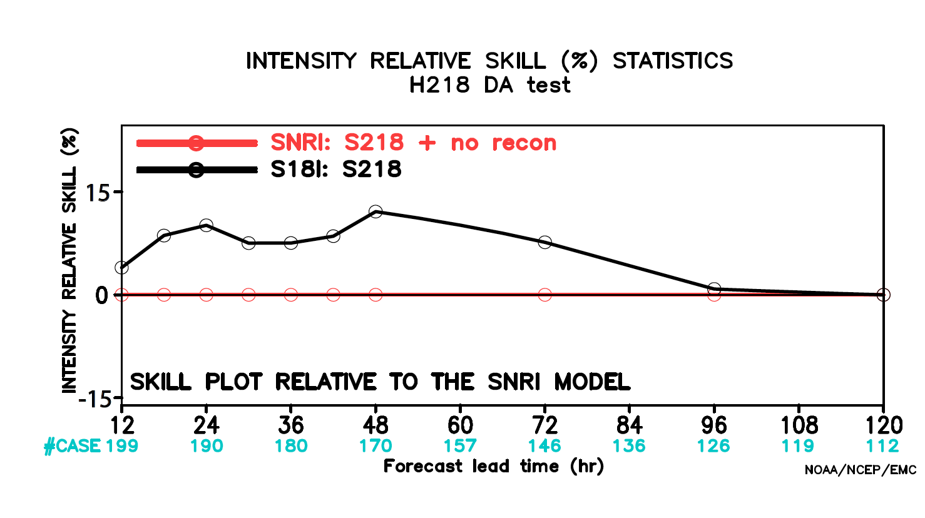
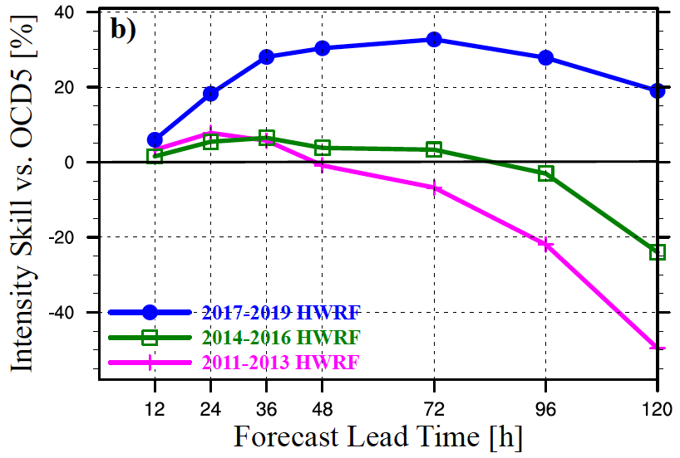
  IFEX FORECASTS: Improvements to numerical model forecasts
HWRF Intensity forecast skill
HWRF intensity forecast improved steadily from 2011-2019
Use of aircraft reconnaissance improves HWRF intensity forecast by ~15% at 48 h

Slide 29
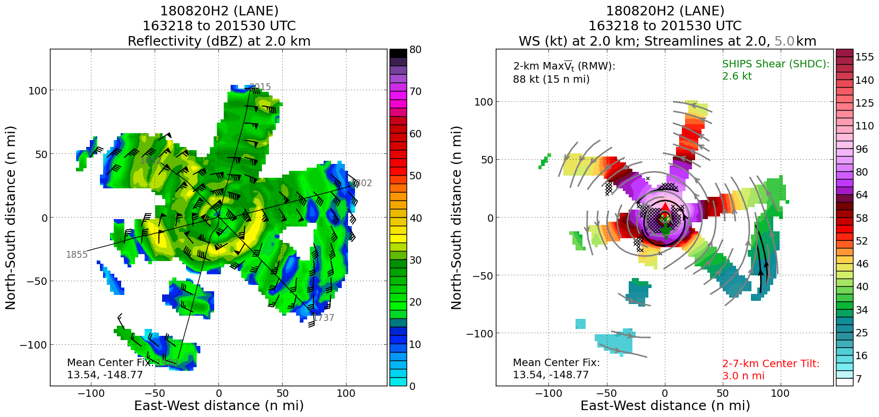
  IFEX NOWCASTS: Improved representation of TC structure
Real-time display of reflectivity and winds in Hurricane Lane

Slide 30
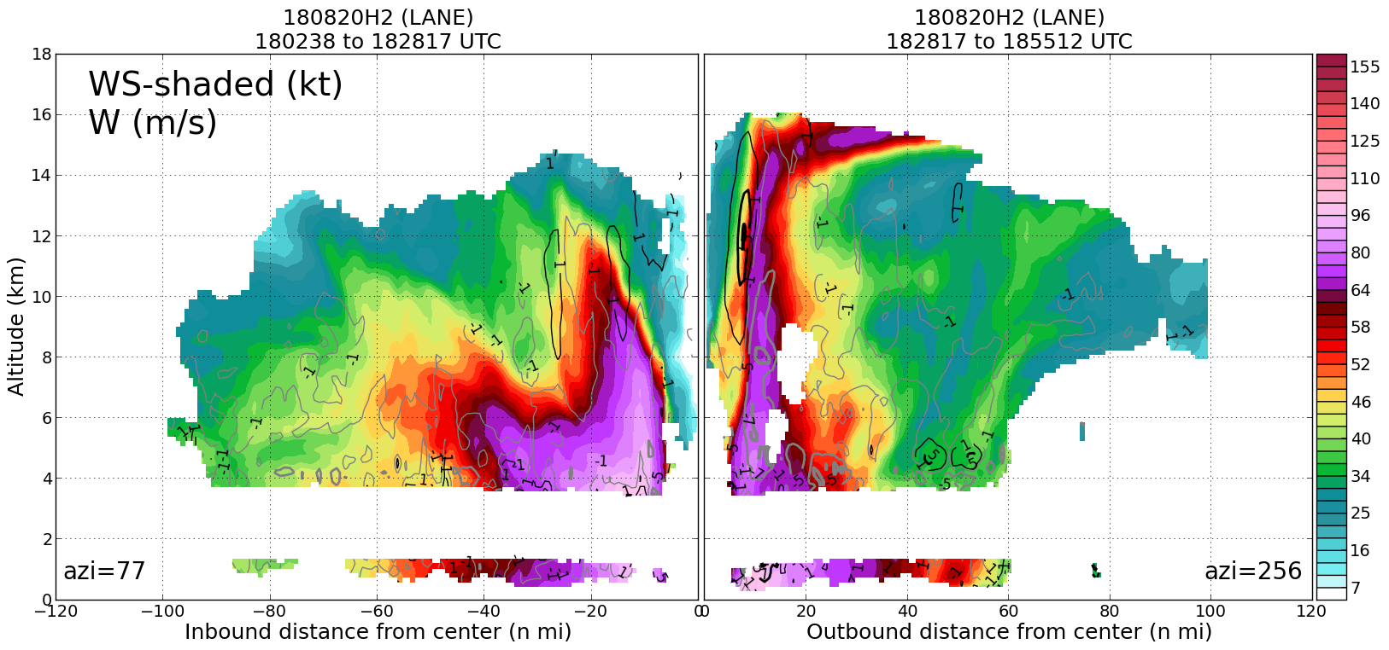
  IFEX NOWCASTS: Improved representation of TC structure
Real-time vertical cross section of wind speeds in Hurricane Lane

Slide 31
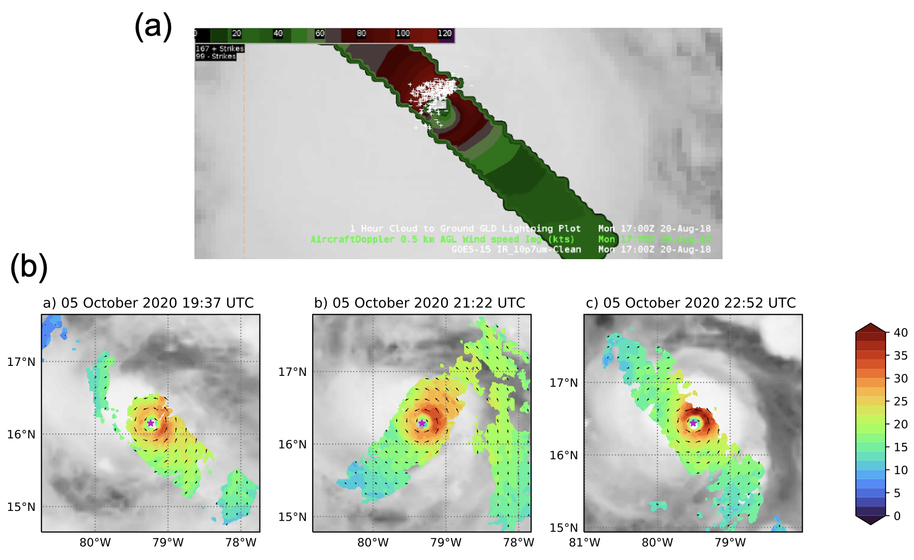
  IFEX NOWCASTS: Improved representation of TC structure
Real-time incorporation of aircraft data into operational visualization tools
The ”first look” of TDR data in AWIPS-II during Hurricane Lane (2018) flights
Sequence of passes in Delta (2020) while rapidly intensifying

Slide 32
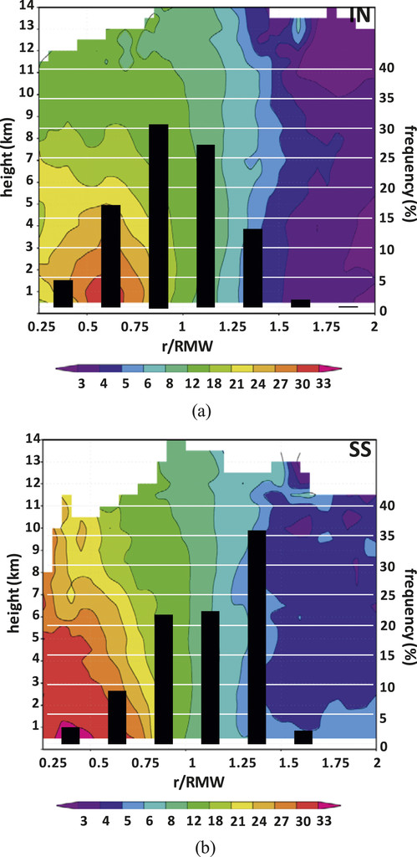
  IFEX RESEARCH: Improved understanding of intensity change
Characterizing TC Inner-core Structure and Intensity Change
composite TDR analysis for intensifying vs. non-intensifying TCs (Rogers et al. 2013)
composites of flight-level data (Martinez et al. 2017)
shear-relative TC asymmetry (Reasor et al. 2013)
analyses of Hurricane Patricia (Rogers et al. 2017; Martinez et al. 2019)
Azimuthally-averaged vorticity (shaded, x 10⁻⁴ s⁻¹) and radial distribution of convective bursts
Rogers et al. 2013

Slide 33
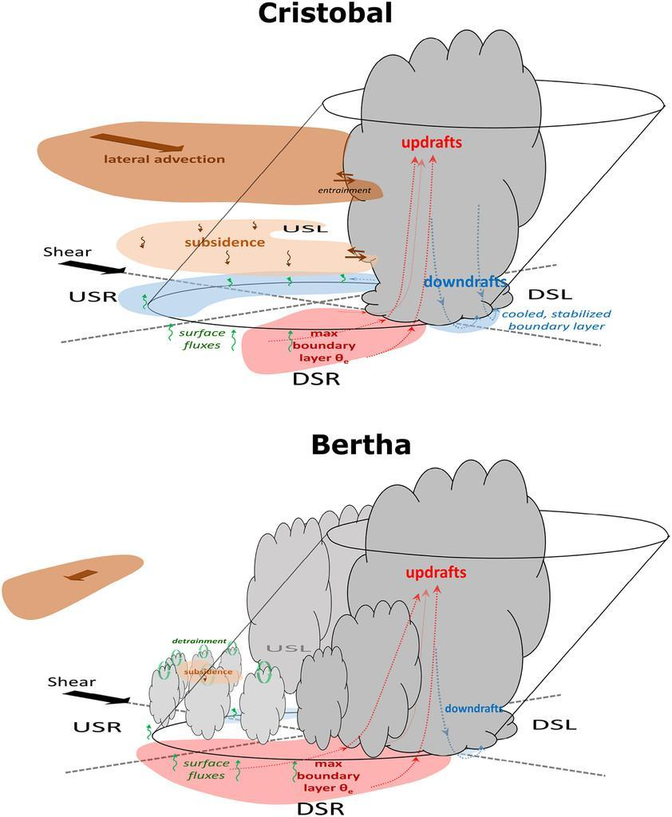
  IFEX RESEARCH: Improved understanding of intensity change
Schematic of intensifying and steady-state TC structure in shear
Characterizing TC Inner-core Structure and Intensity Change
TC Intensity Change in Vertical Wind Shear
Shear-relative evolution during RI of Edouard (2014) (Zawislak et al. 2016; Rogers et al. 2016)
Composited TDR data showing that convective bursts in the USL quadrant in intensifying v. non-intensifying (Wadler et al. 2018a)
Shear-relative distributions of RH, theta-e, stability in PBL (Nguyen et al. 2017) and mid-troposphere (Zawislak et al. 2016)
Nguyen et al. 2017

Slide 34
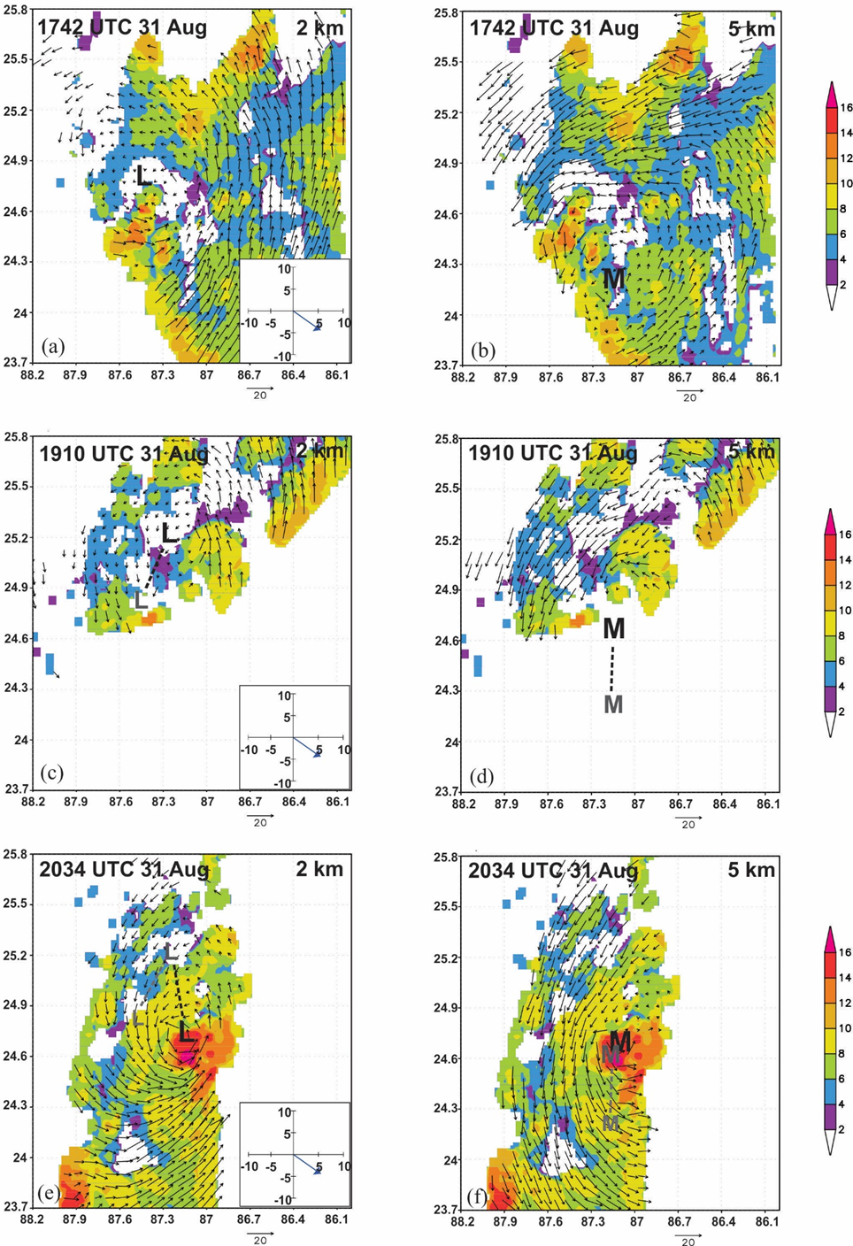
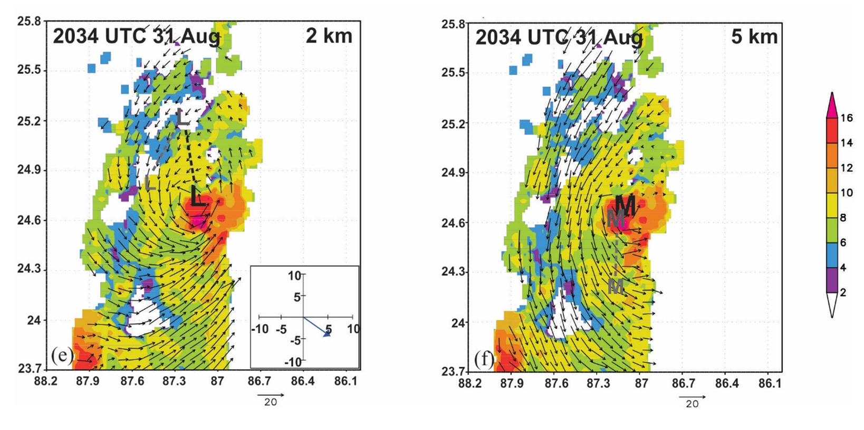
  IFEX RESEARCH: Improved understanding of intensity change
Winds, 20-dBZ echo tops (shaded, km) and mid- and low-level center positions during consecutive center passes in Hermine
Characterizing TC Inner-core Structure and Intensity Change
TC Intensity Change in Vertical Wind Shear
echo top (km)
Shear-relative evolution during RI of Edouard (2014) (Zawislak et al. 2016; Rogers et al. 2016)
2034 UTC
Composited TDR data showing that convective bursts in the USL quadrant in intensifying v. non-intensifying (Wadler et al. 2018a)
1910 UTC
1742 UTC
Shear-relative distributions of RH, theta-e, stability in PBL (Nguyen et al. 2017) and mid-troposphere (Zawislak et al. 2016)
echo top (km)
1910 UTC
L
L
Multi-scale interactions between convection, moistening, mass flux, and the vortex during downshear reformation of Hermine (Rogers et al. 2020)
1742 UTC
2034 UTC
Rogers et al. 2020

Slide 35
  IFEX RESEARCH: Improved understanding of intensity change
Characterizing TC Inner-core Structure and Intensity Change
TC Intensity Change in Vertical Wind Shear
Boundary Layer Processes and Air-sea Interactions
shear-relative low-level entropy distribution and importance of PBL recovery of downdraft cooled air for RI (Zhang et al. 2013; Zhang et al. 2017a; Wadler et al. 2020)
difference in upshear fluxes between intensifying and non-intensifying TCs (Cione et al. 2013; Jaimes et al. 2015; Zhang et al. 2017a; Wadler et al. 2018b; Nguyen et al. 2019; Zhang and Rogers 2019)
stronger and more symmetric PBL inflow in intensifying TCs v. non-intensifying (Zhang et al. 2017b; Zhang and Rogers 2019)
PBL structure of a landfalling storm (Alford et al. 2020)

Slide 36
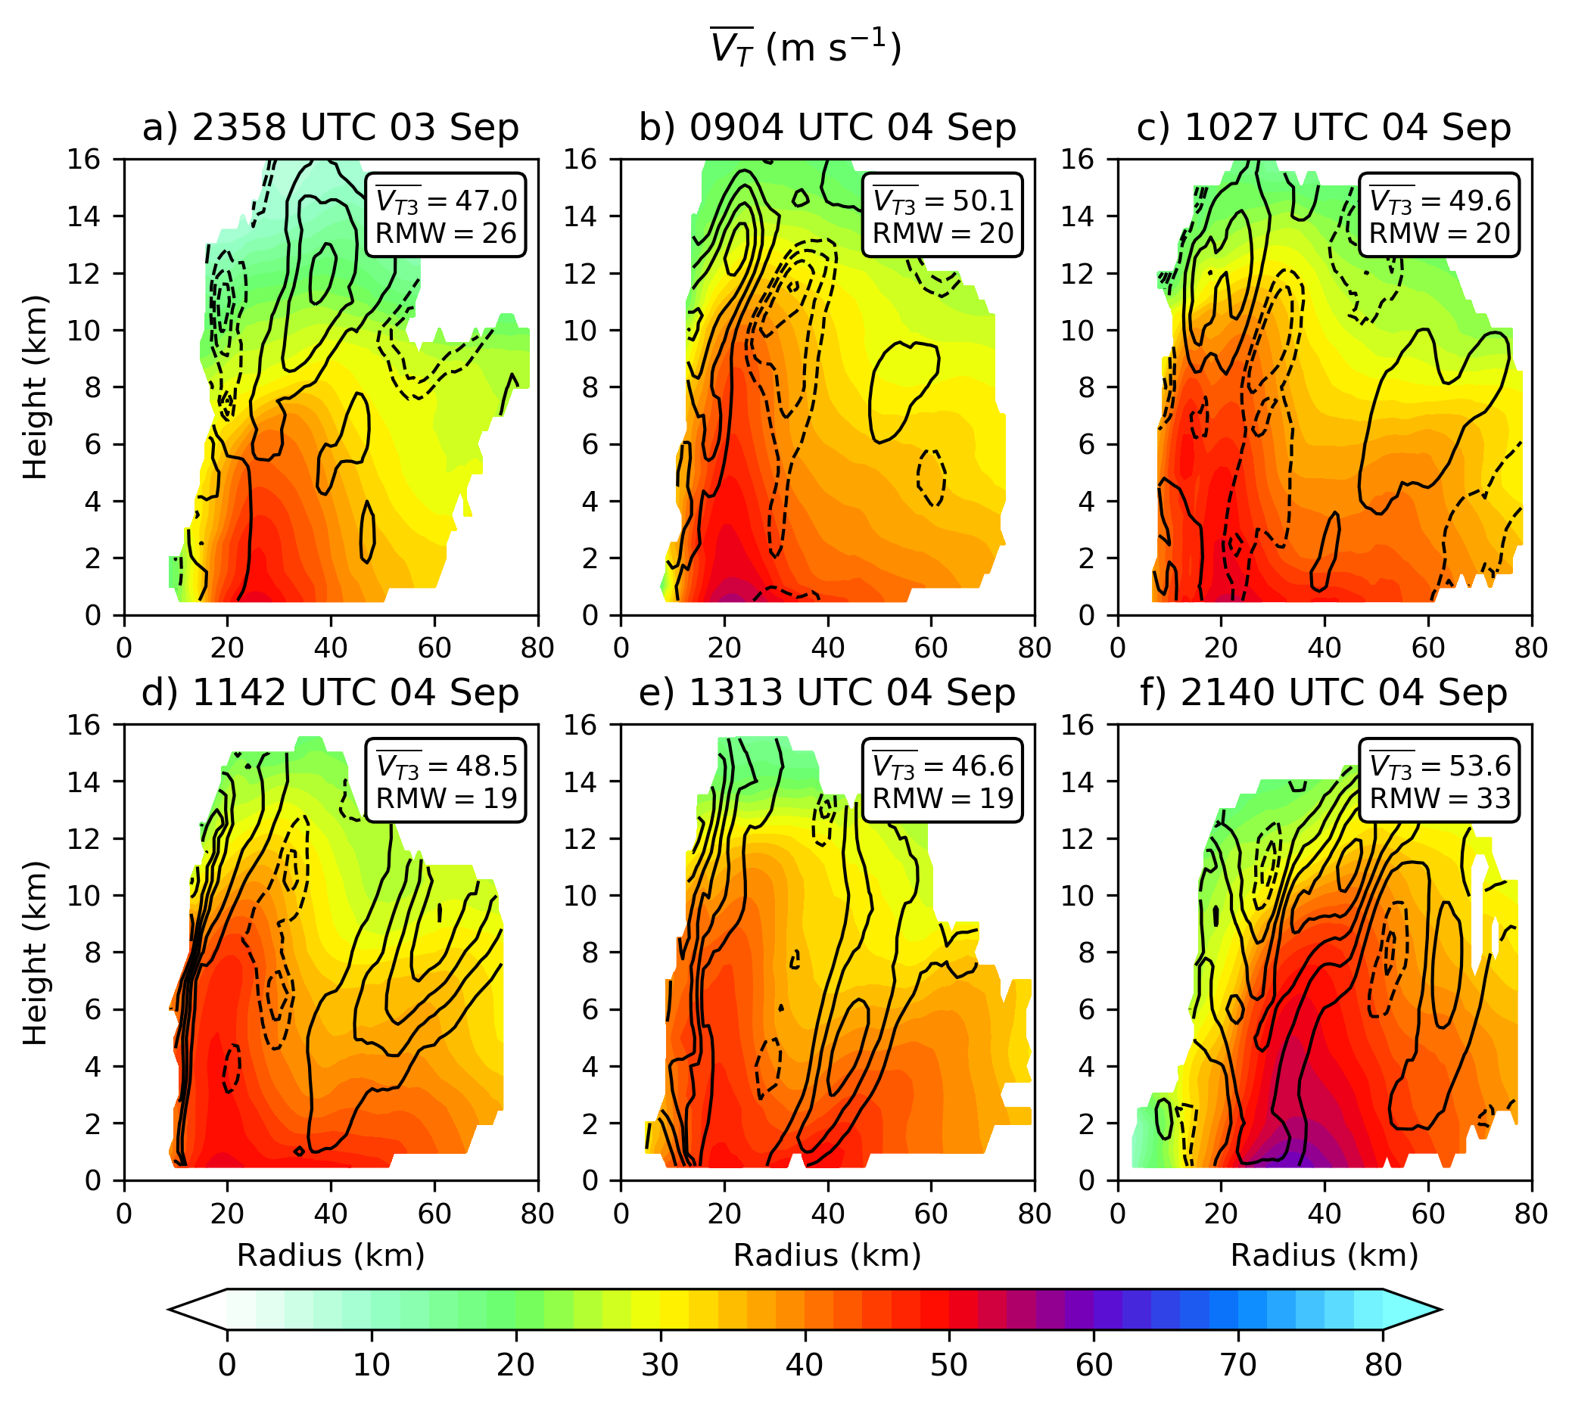
  IFEX RESEARCH: Improved understanding of intensity change
Characterizing TC Inner-core Structure and Intensity Change
Azimuthally-averaged tangential wind (shaded, m/s) and vertical velocity (contour, m/s) during consecutive center passes in Irma
TC Intensity Change in Vertical Wind Shear
Boundary Layer Processes and Air-sea Interactions
Secondary Eyewall Formation and Eyewall Replacement Cycles
Secondary eyewall
SEF: mesoscale descending inflow jet in the stratiform rain region (Didlake et al. 2018)
SEF: axisymmterizing vortex Rossby waves (Dougherty et al. 2018; Guimond et al. 2020)
SEF: contributions from both (Fischer et al. 2020)
ERC: storms don’t necessarily weaken (Dougherty et al. 2020) but can even rapidly intensify (Fischer et al. 2020)
ERC: convective asymmetries (Didlake et al. 2017, 2018)
Fischer et al. 2020

Slide 37

  3. Flight profiles

Slide 38
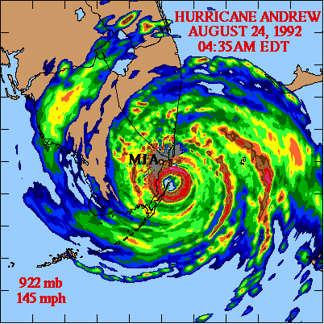
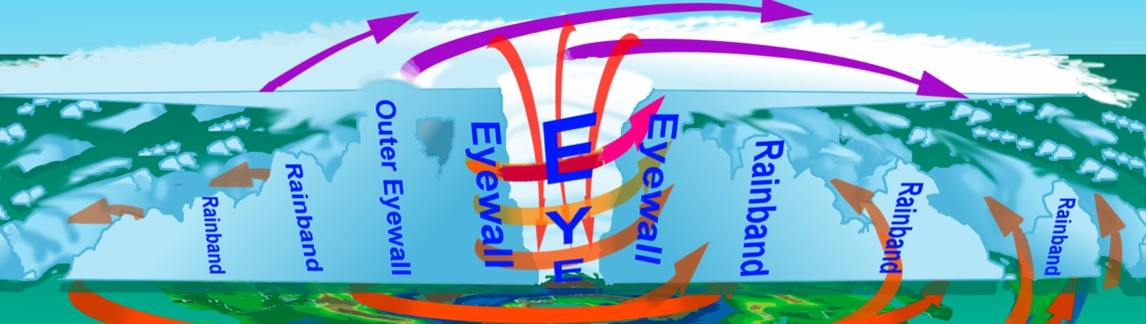


Aircraft sampling of TCs
10 mi

Slide 39
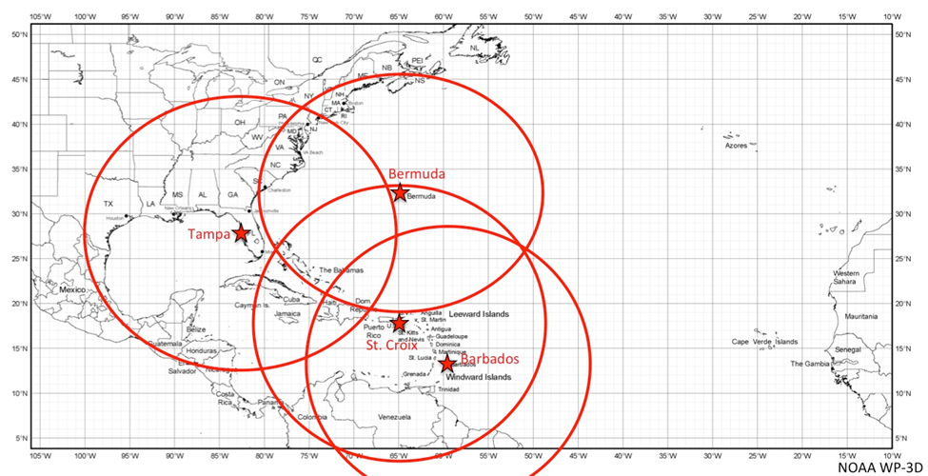
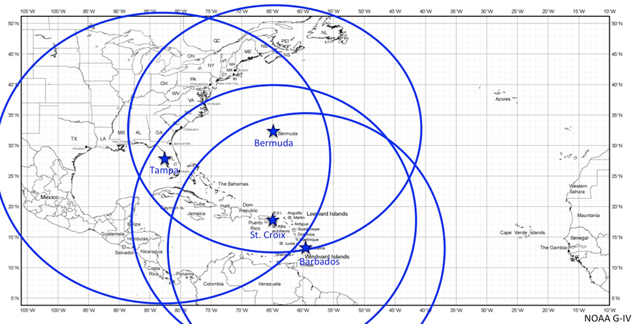
P-3 and G-IV Atlantic bases of operations
Assuming 2 hours of on-station time
P-3
G-IV

Slide 40
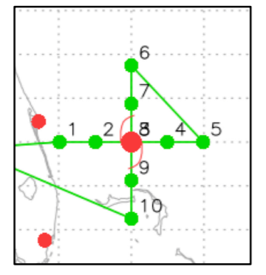

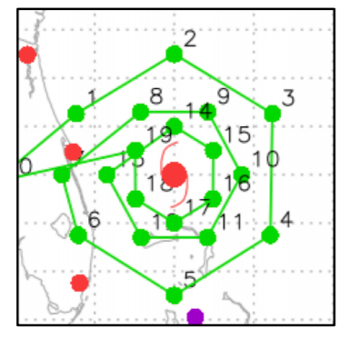
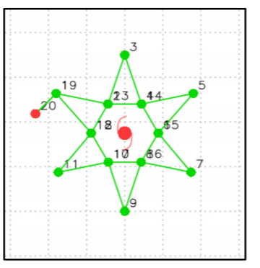
Typical flight patterns
P-3
G-IV
Figure-4
Butterfly
Circumnavigation
Star

Slide 41
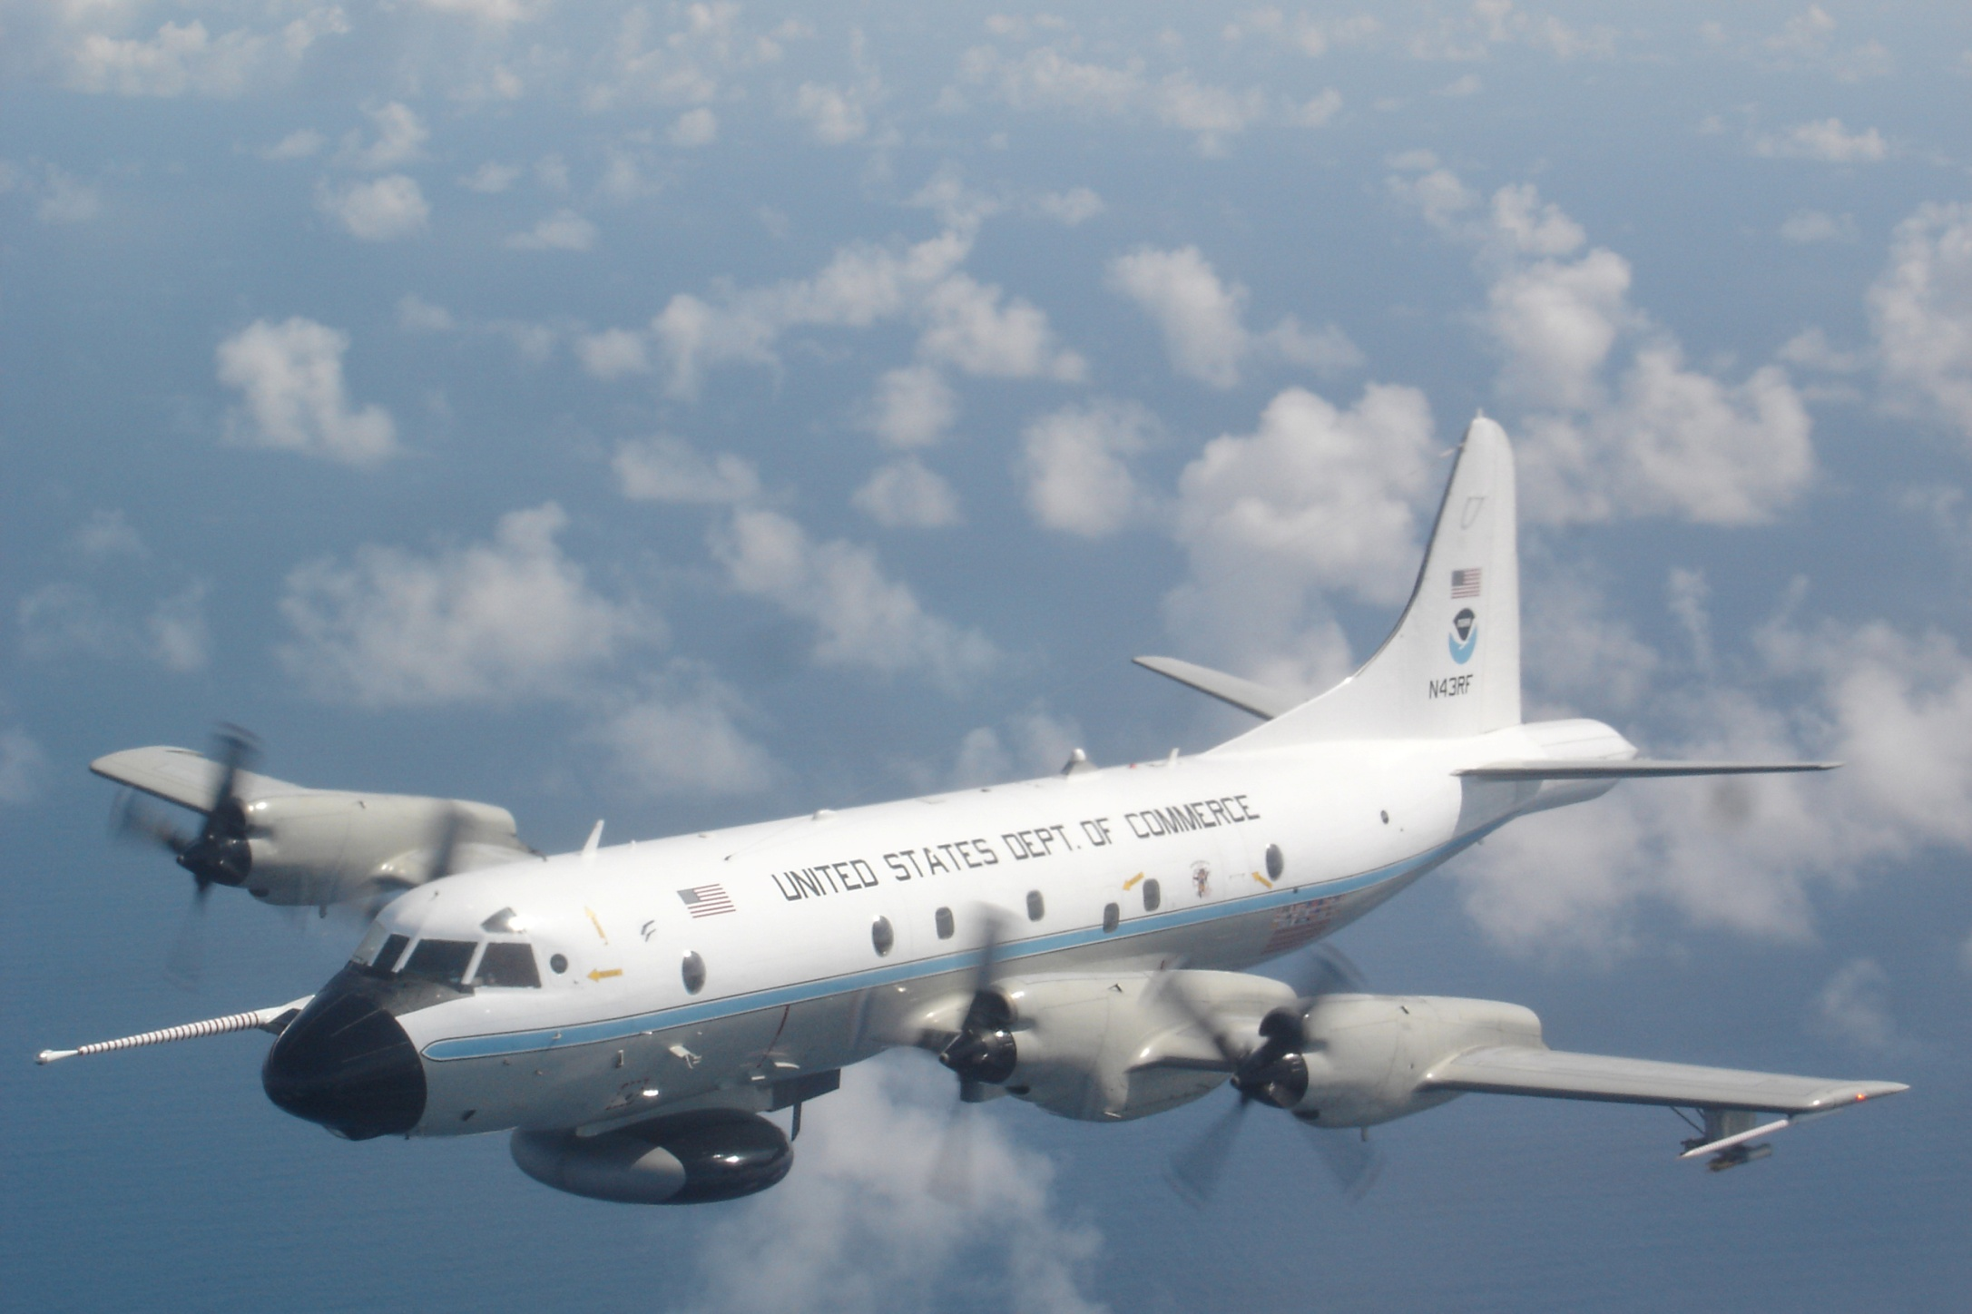
4. Views from the aircraft

Slide 42


Inside the P-3 Aircraft
Inside the G-IV Aircraft

Slide 43

Dropsonde release on P-3

Slide 44

Within the Eye of Hurricane Georges (1998)
eyewall
low clouds above
sea-surface

Slide 45

Low-level flight

Slide 46

Stadium effect

Slide 47

5. Toward the future
Over the past several years there have been multiple billion dollar TC-related disasters (NOAA/NCEI)
Storm-surge inundation, extreme rainfall, high surf, and tornadoes are significant contributors to damage, in addition to high winds
Water (inland flooding from rainfall and surge) are responsible for most deaths (Rappaport 2000)
Emphasizes the importance of hazards
Almost every one of these storms had at least one RI period
Zawislak et al. 2021

Slide 48
5. Toward the future
Focus on “intensity forecasting” at the inception of IFEX now a narrow scope within a broad expanse of forecast challenges and knowledge gaps that must be addressed at all stages of the TC life cycle
IFEX priorities broadened beyond intensity to include structure and hazards, and with the focus of improving model analyses with observations
APHEX (Advancing the Prediction of Hurricanes Experiment)
Goal 1: Collect observations that span the TC life cycle in a variety of environments for model initialization and evaluation
Goal 2: Develop and refine measurement strategies and technologies that provide improved real-time analysis of TC intensity, structure, environment, and hazard assessment
Goal 3: Improve the understanding of physical processes that affect TC formation, intensity change, structure, and associated hazards

Slide 49
THANK YOU
QUESTIONS?

