Slide 1
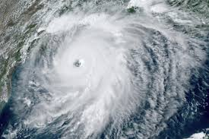




DROPSONDES IN HRD RESEARCH (2020)
AVAPS User Group Meeting April 13-14, 2021
Kathryn Sellwood, Sim Aberson
Contributions from Jonathan Zawislak, Xiaomin Chen, Joshua Wadler, Jun Zhang and Andrew Kren

Slide 2
NOAA Dropsonde Missions: 52 Flights 13 Storms
STORM | P-3 FLIGHTS | DROPS | G-IV FLIGHTS | DROPS | MANUAL QC | NOT TRANSMITTED
Cristobal | 2 | 39 | 1 | 6 |  | 4
Hanna | 3 | 23 | 0 | 0 |  | 2
Isaias | 7 | 91 | 3 | 108 |  | 10
Marco | 0 | 0 | 2 | 62 |  | 3
Laura | 10 | 171 | 8 | 258 |  | 22
Nana | 1 | 10 | 0 | 0 |  | 0
Paulette | 1 | 12 | 0 | 0 |  | 2
Sally | 4 | 76 | 3 | 111 |  | 1
Teddy | 4 | 98 | 3 | 95 |  | 54
Gamma | 1 | 17 | 0 | 0 |  | 0
Delta | 7 | 195 | 4 | 132 |  | 8
Zeta | 5 | 109 | 2 | 68 |  | 13
Eta | 7 | 98 | 3 | 104 |  | 12
Totals | 52 | 939 | 29 | 944 |  | 131

Slide 3
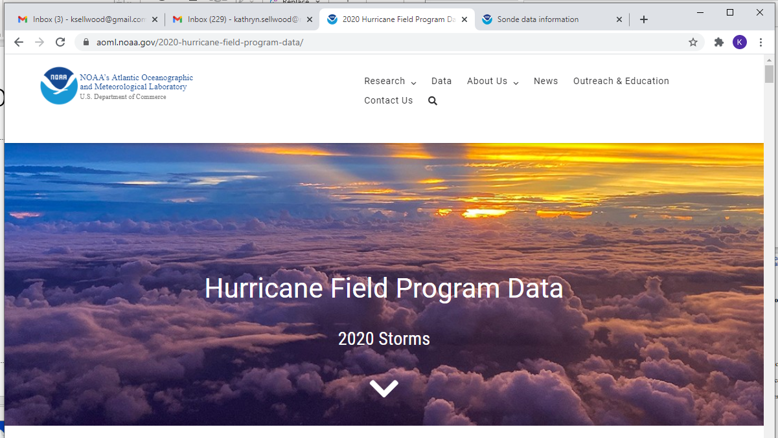
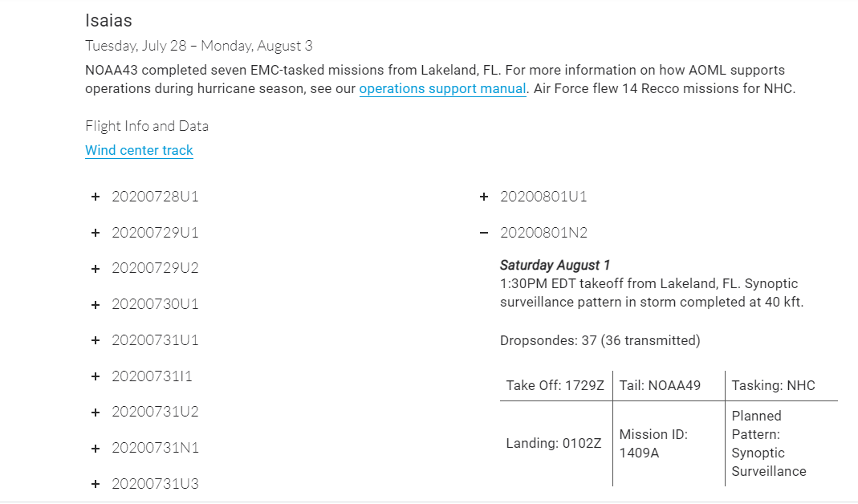
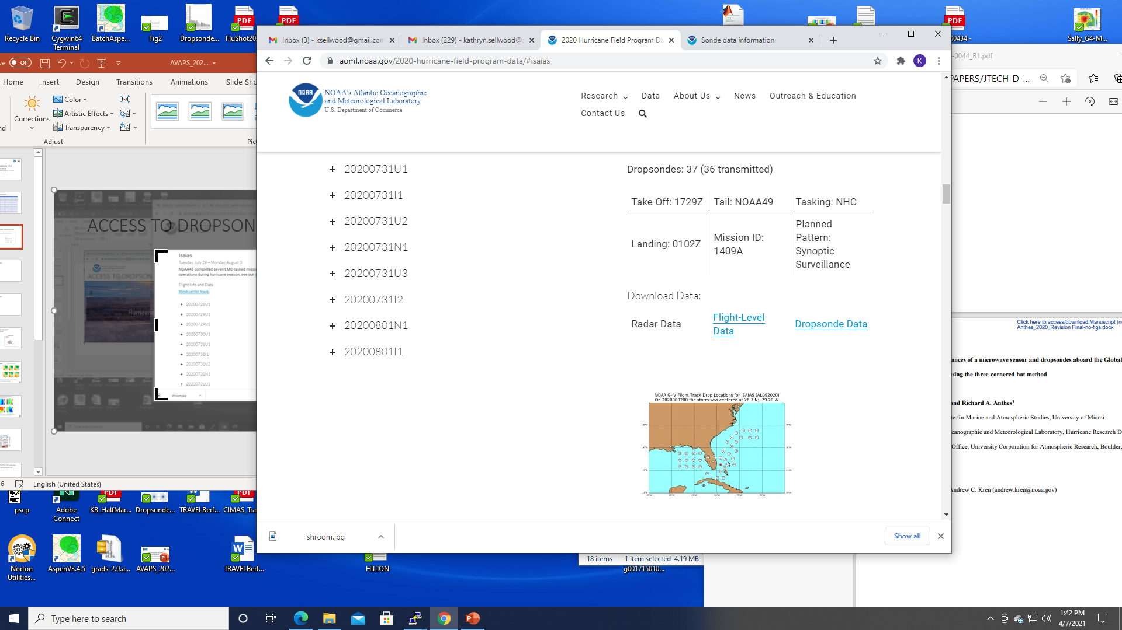
Data Access: https://www.aoml.noaa.gov/2020-hurricane-field-program-data/

Slide 4
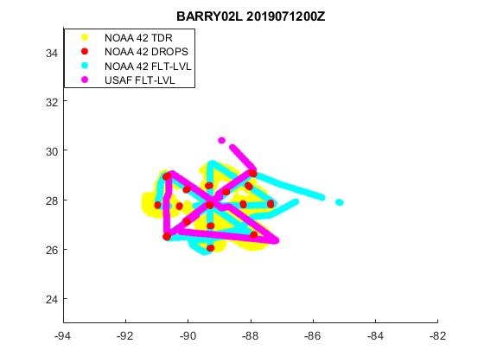
Coming Soon:
HRDOBS a TC Centric Aircraft Observations Dataset 2015 - 2020
NOAA and USAF data
6 hour time window
20 degree storm centric spatial range
Self describing
Standardized units
Instrument specific error estimates
STORMNAME: BARRY STORMNUMBER: 02L
CENTER LAT: 27.8 CENTER LON: -89.2
DATE VALID: 20190712 TIME VALID: 0000UTC
TIMEWINDOW: 2100Z TO 0300Z
-----------------------------------------------------------------------
PLATFORM #OBS #OBS
RAW DATA FINAL QC
-----------------------------------------------------------------------
NOAA 42 Dropsonde 1770 1770
NOAA 43 Dropsonde 0 0
NOAA 49 Dropsonde 0 0
USAF Dropsonde 116 116
GHAWK Dropsonde 0 0
NOAA 42 Flight-Level 704 704
NOAA 42 SFMR 704 704
NOAA 43 Flight-Level 0 0
NOAA 43 SFMR 0 0
NOAA 49 Flight-Level 0 0
NOAA 49 SFMR 0 0
USAF Flight-Level 504 497
USAF SFMR 504 497
NOAA 42 TDR 45252 45251
NOAA 43 TDR 0 0
NOAA 49 TDR 0 0
DWL 0 0
COYOTE 0 0
Vortex Message 2 2
Best Track 35 35
Hi-Res Track 2215 2215
Total 51806 51791

Slide 5
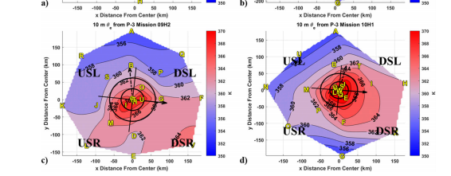
Thermodynamic Factors Influencing Tropical Cyclone Intensification: Joshua Wadler
Composite thermodynamic measurements from dropsonde observations
TC’s experiencing northerly shear tend to have more symmetric theta-e distribution
Symmetric theta-e distribution is more favorable for intensification
Hurricane Michael (2018) case study uses Dropsonde measurements to examine the
role of thermodynamic distribution in rapid intensification - published in MWR

Slide 6
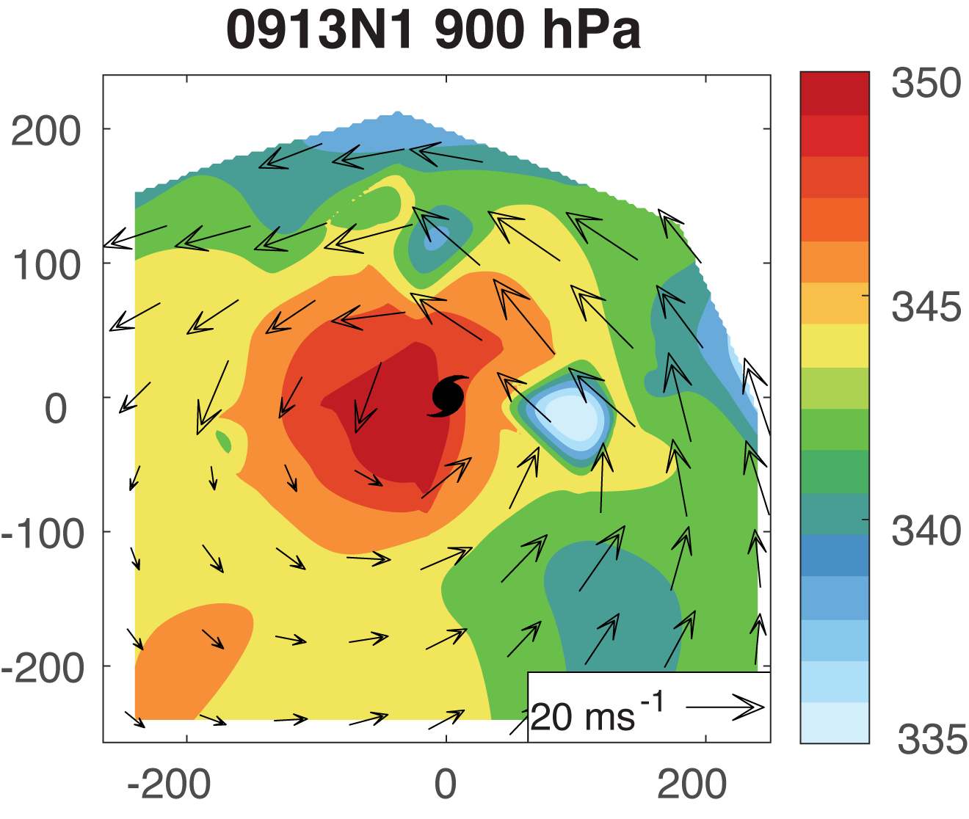
Thermodynamic Conditions Relating to Intensity Change in Hurricane Sally (2020): Xiaomin Chen
Sally strengthened from Tropical Storm to Hurricane
Intensity as it approached the Florida Panhandle
220 Dropsondes from 4 NOAA P-3, 3 NOAA G-IV flights
and 98 from 9 USAF flights spanning 9/12 to 9/16
Evolution of thermodynamic structure diagnosed from
dropsonde measurements

Slide 7
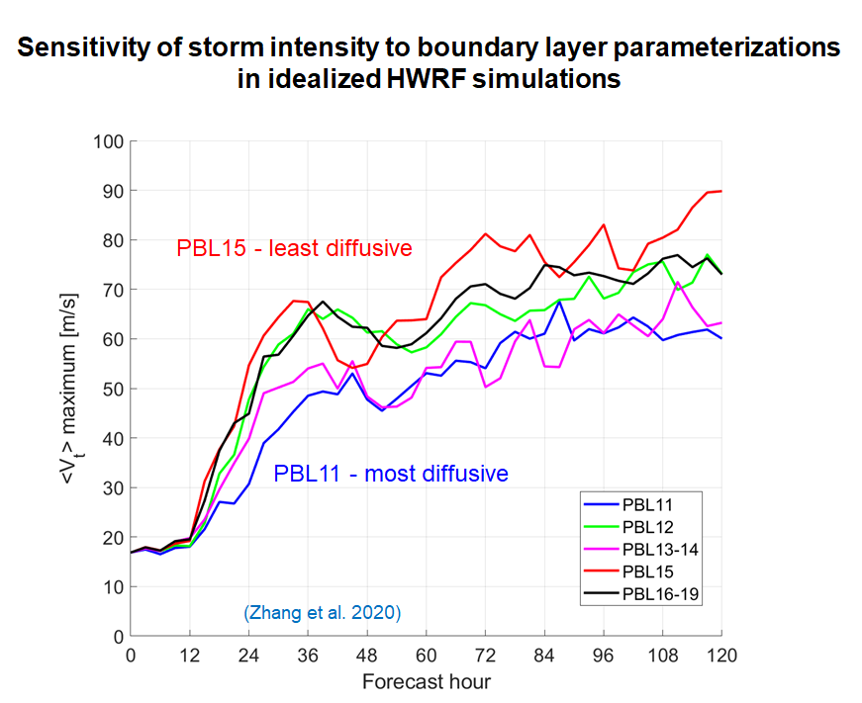
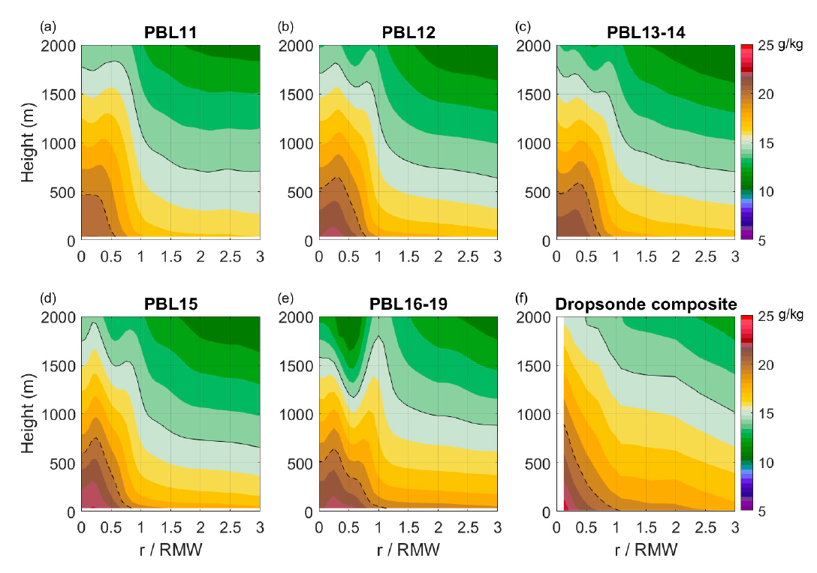
Using Dropsonde Measurements to Improve Boundary Layer Scheme in HWRF Model: Jun Zhang
- The upper boundary layer in all 5 simulations with different versions of the PBL schemes is much drier than that in the dropsonde composite.
Humidity Comparison

Slide 8
TC Diurnal Cycle and Boundary Layer Structure:
Zhang, Dunion and Nolan 2020 GRL
Notes:
Dropsonde composites of tangential wind (Vt) upper panels and radial wind (Vr) lower panels for nighttime (0-6 LT, left panels) and afternoon (12-18 LT middle panels) The difference fields are shown in the right panels. The black dashed line shows the height of the maximum Vt and athe black solid line shows the inflow layer depth. The vertical stiples show regions where the difference is statistically significant at the 95% confidence level following a t test

Slide 9
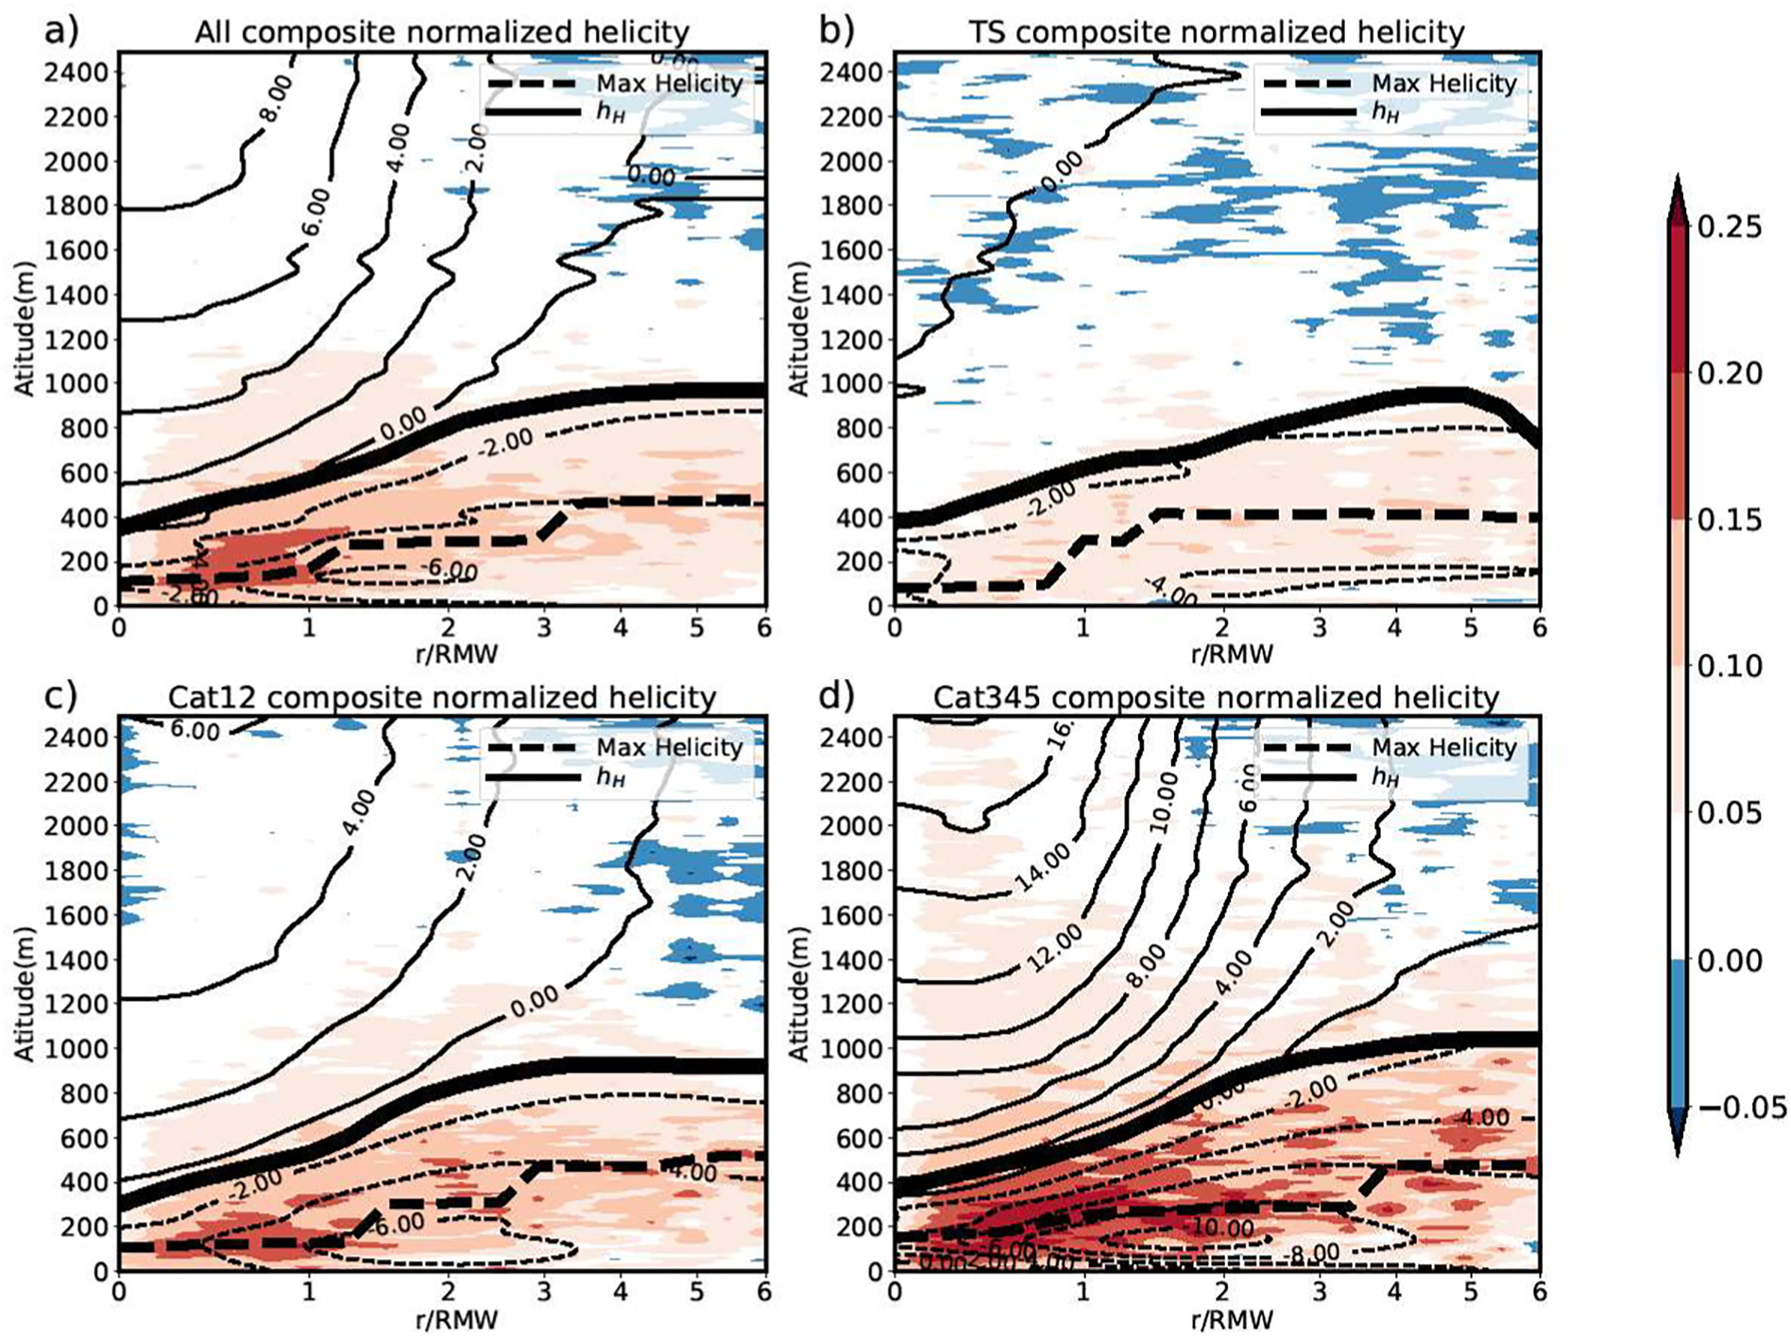
Composited Dropsondes to diagnose Helicity: N. Chen, J. Tang, J.A. Zhang, LM Ma and H. Yu
Analysis of 10 years of dropsonde data (1997-2017)
Helicity-based boundary layer height determination
at location of maximum vertical gradient
BL height varies with vortex strength
Consistent with other BL height methods, roughly
equal to Vtmax and between inflow and mixed layers
- Helicity magnitude greatest front and downshear
- Published in Atmospheric Research

Slide 10
ONR Tropical Cyclone Rapid Intensity (TCRI) program Collaboration with AOML/HRD Hurricane Field Program (IFEX/APHEX) : Enhanced sampling in the early stages of TCs (TD, TS, Cat 1) that could subsequently rapidly intensify
Sept. 13 G-IV (N1) (Pre-RI)
500-hPa
RH and wind
Sept. 14 G-IV (N1) (RI)

Slide 11
High Density Dropsonde Sampling in Sally: (2020): Shear and dry air present and undergoing center reformation, yet still RI
Upshear
Downshear
Relative Humidity
Meridional Wind Speed
Ex. High-density G-IV cross section of Sally along the shear vector (8km 2km wind)
Dry air in near proximity
to center
Circulation displaced
Downshear at 600 mb

Slide 12
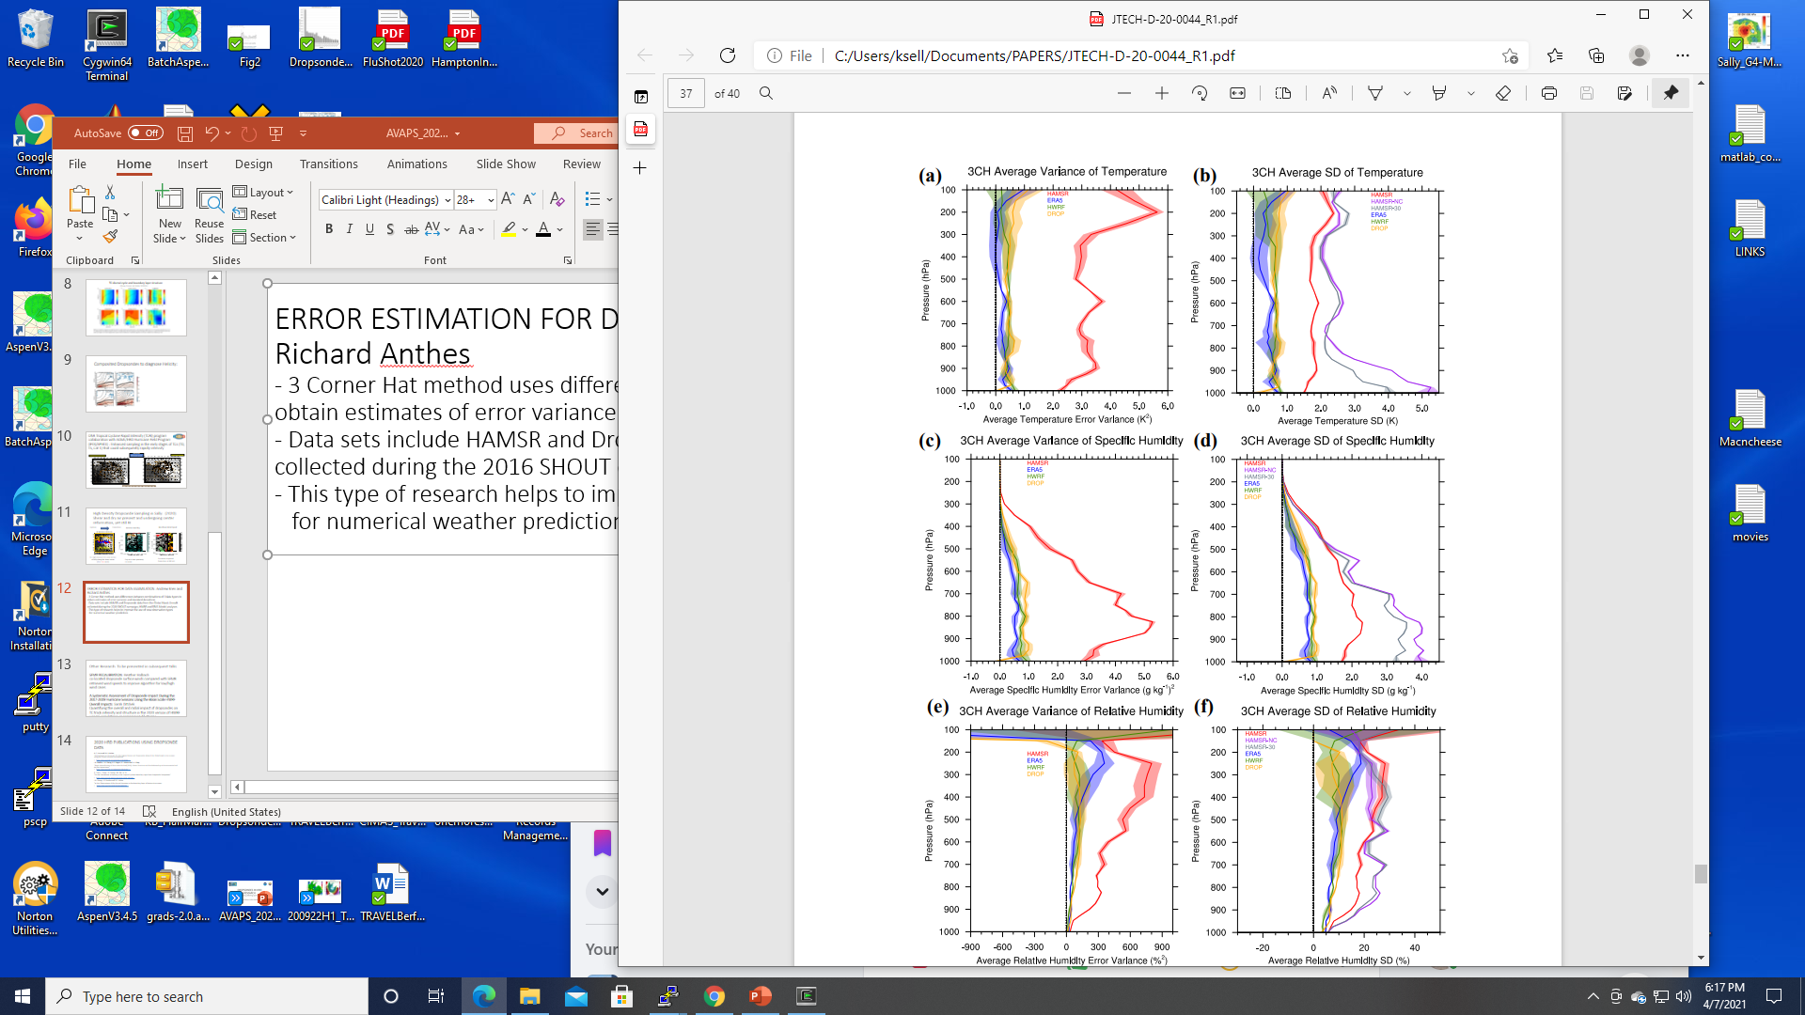
ERROR ESTIMATION FOR DATA ASSIMILATION: Andrew Kren and Richard Anthes
- 3 Corner Hat method uses differences between combinations of 3 data types to obtain estimates of error variance and standard deviations
- Data sets include HAMSR and Dropsonde data from the Global Hawk Aircraft collected during the
2016 SHOUT campaign, HWRF and ERA5 Model analyses
- This type of research helps to improve the use of new observation types for numerical weather prediction

Slide 13
HRD Research to be Presented by PI:
SFMR RECALIBRATION: Heather Holbach co-located dropsonde surface winds compared with SFMR retrieved wind speeds to improve algorithm, particularly for low/high wind cases
A Systematic Assessment of Dropsonde Impact During the 2017-2019 Hurricane Seasons Using the Basin Scale HWRF Overall Impacts: Sarah Ditchek
Quantifying the overall and radial impact of dropsondes on TC track intensity and structure in the 2020 version of HWRF-B using 6 simulations encompassing 47 storms, 22 with dropsonde observations. Basin-scale HWRF allows us to assess the impact of dropsonde observations on all TC’s regardless of sampling.
Exploring the Future of Hurricane Reconaissance Using Small Uncrewed Aircraft Systems (SUAS): Joe Cione

Slide 14
2020 HRD Publications Using Dropsonde Data
A.C. Kren and R.A. Anthes
“Estimating Error Variances of a Microwave Sensor and Dropsondes Aboard the Global Hawk in Hurricanes using the Three-Cornered Hat Method”
https://doi.org/10.1175/JTECH-D-20-0044.1
J.B. Wadler, J.A. Zhang, R.F. Rogers, B. Jaimes and L.K. Shay
“Rapid Intensification of Hurricane Michael(2018): Storm Structure and the Relationship to Environmental and Air-Sea Interactions”
https://doi.org/10.1175/MWR-D-20-0145.1
N. Chen, J. Tang, J.A. Zhang, LM. Ma, H. Yu
“On the Distribution of Helicitiy in the Tropical Cyclone Boundary Layer from Dropsonde Composites”
https://doi.org/10.1016/j.atmosres.2020.105298
J.A. Zhang, J.P. Dunion and D.S. Nolan
“In Situ Observations of the Diurnal Variation in the Boundary layer of Mature Hurricanes
https://doi.org/10.1029/2019GL086206
J.A. Zhang, E.A. Kalina, M.K. Biswas, R.F. Rogers, P. Zu and F.D. Marks
“A Review and Evaluation of the Planetary Boundary Layer Parameterizations in Hurricane Weather Research and Forecasting Model Using Idealized Simulations and Observations”
https://doi.org/01.3390/atmos11101091

