Slide 1
SFMR Re-calibration
Heather Holbach
AVAPS Users group meeting
April 14, 2021

Slide 2
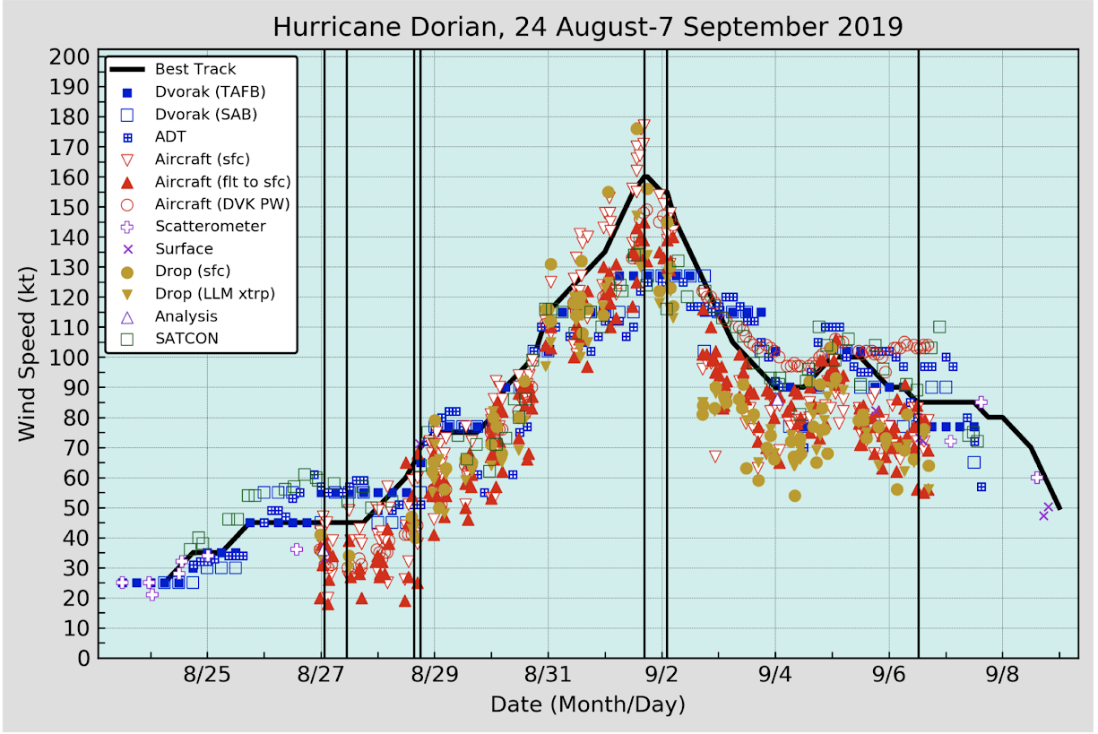
Motivation
Inconsistencies noted between the dropsonde, SFMR, and flight-level surface wind speed estimates
Especially in major hurricanes
Avila et al. (2020) Fig. 2

Slide 3
How does the SFMR algorithm work?
SFMR Measured T_{B}s
Minimize Error in Fit
Across Frequencies
Wind Speed and Rain Rate
Wind-Induced Emissivity Curve
Compute Modeled T_{B}
Air Temperature, Salinity, Altitude, Roll Angle, SST (satellite)
Wind Speed and Rain Rate Guess

Slide 4
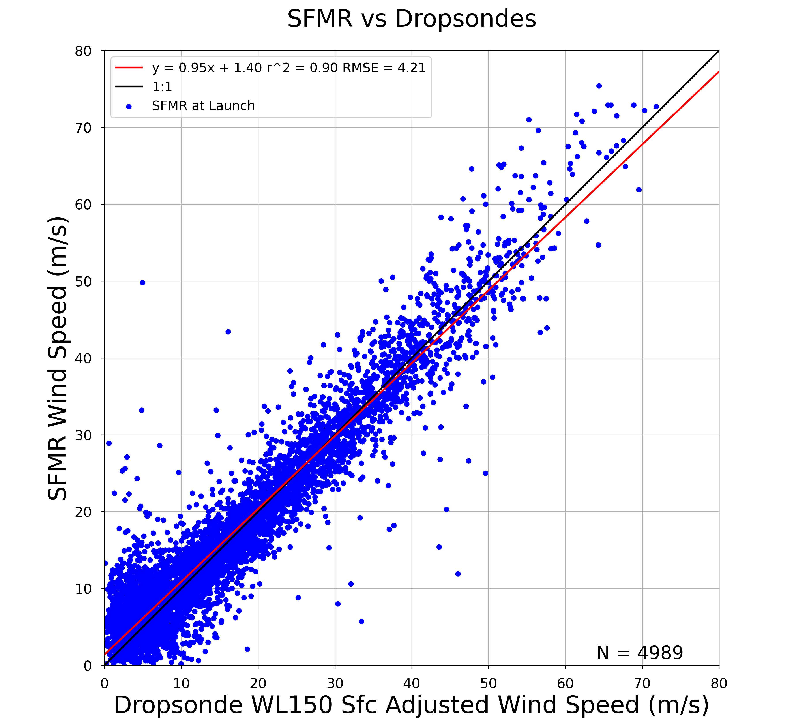
Wind Speed Fit to Sondes
2004 to 2018
155.5 kt
136.1 kt
116.6 kt
97.2 kt
77.8 kt
58.3 kt
38.9 kt
19.4 kt
Klotz and Uhlhorn (2014) Fig. 11b

Slide 5
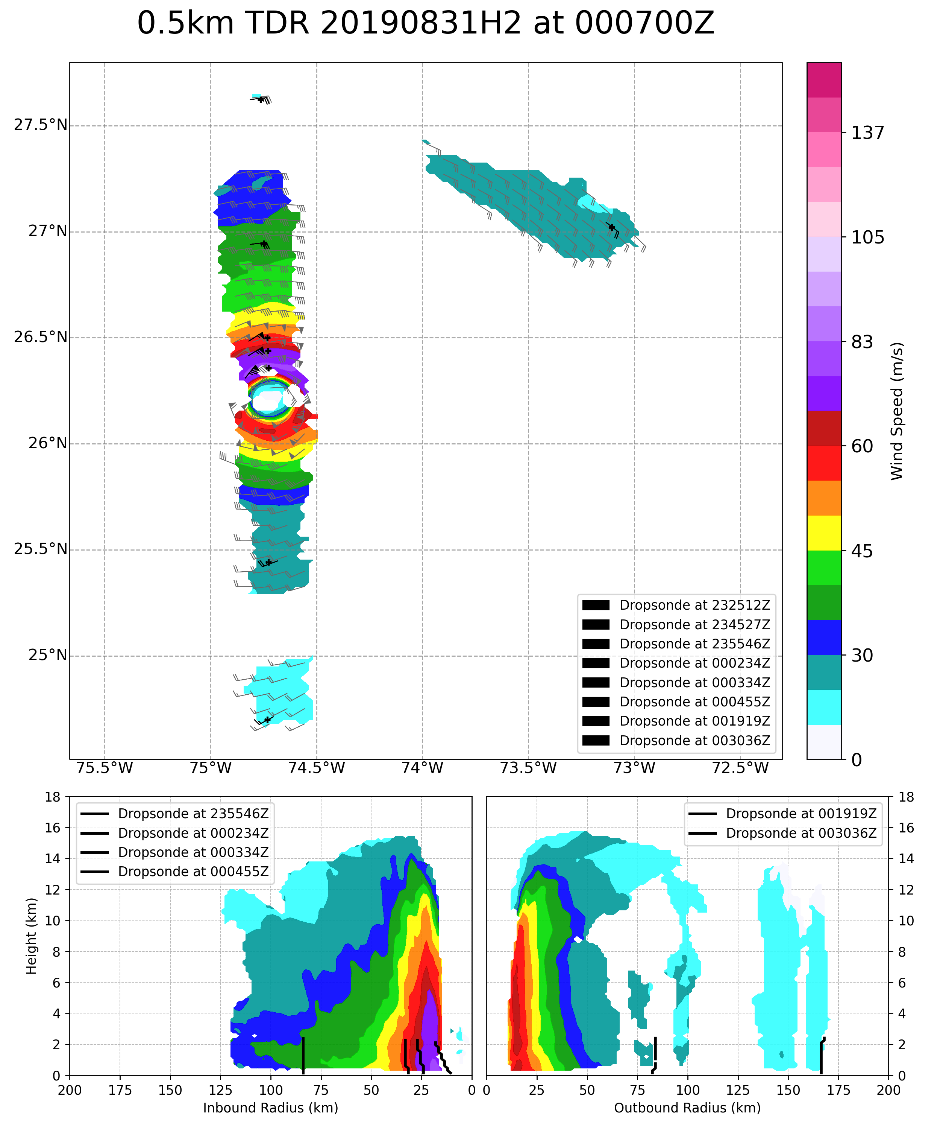
Collocation Challenges in High Winds

Slide 6
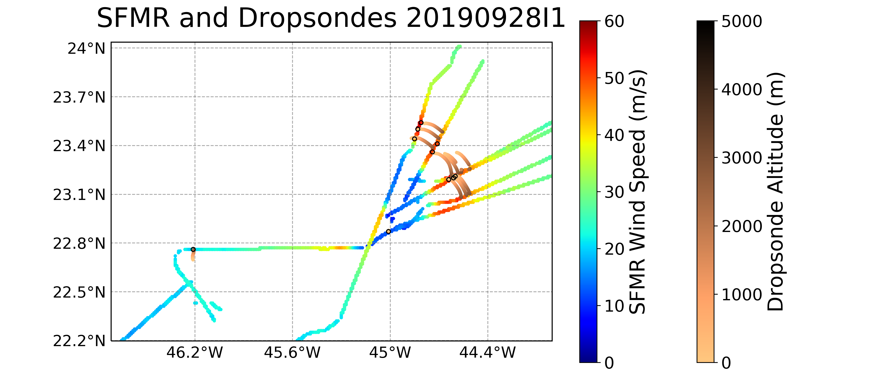
Dropsonde Overflights

Slide 7
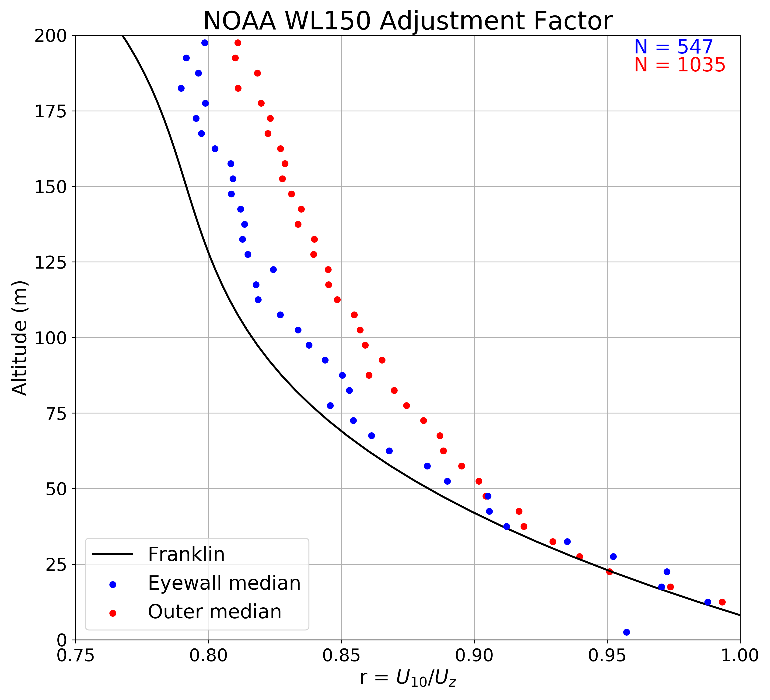
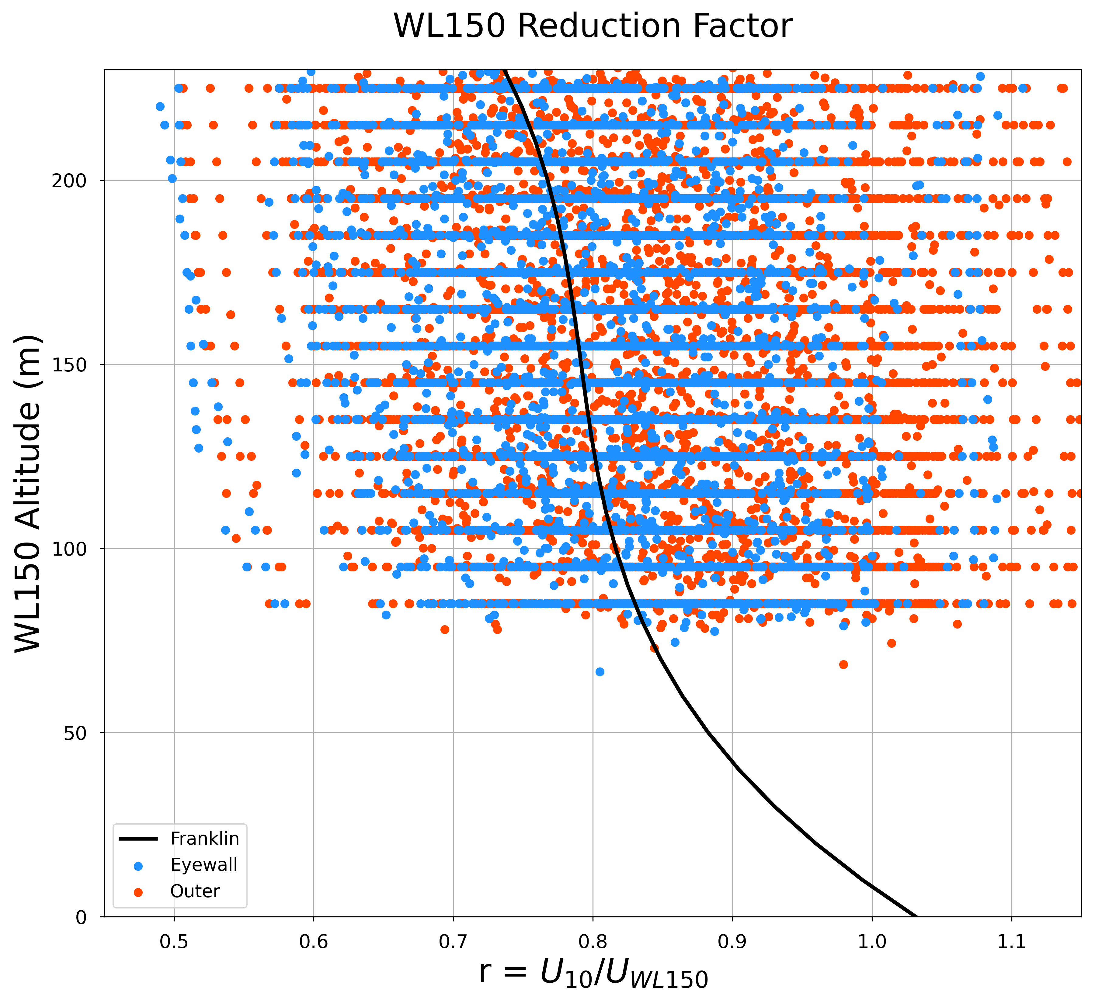
Dropsonde WL150

Slide 8
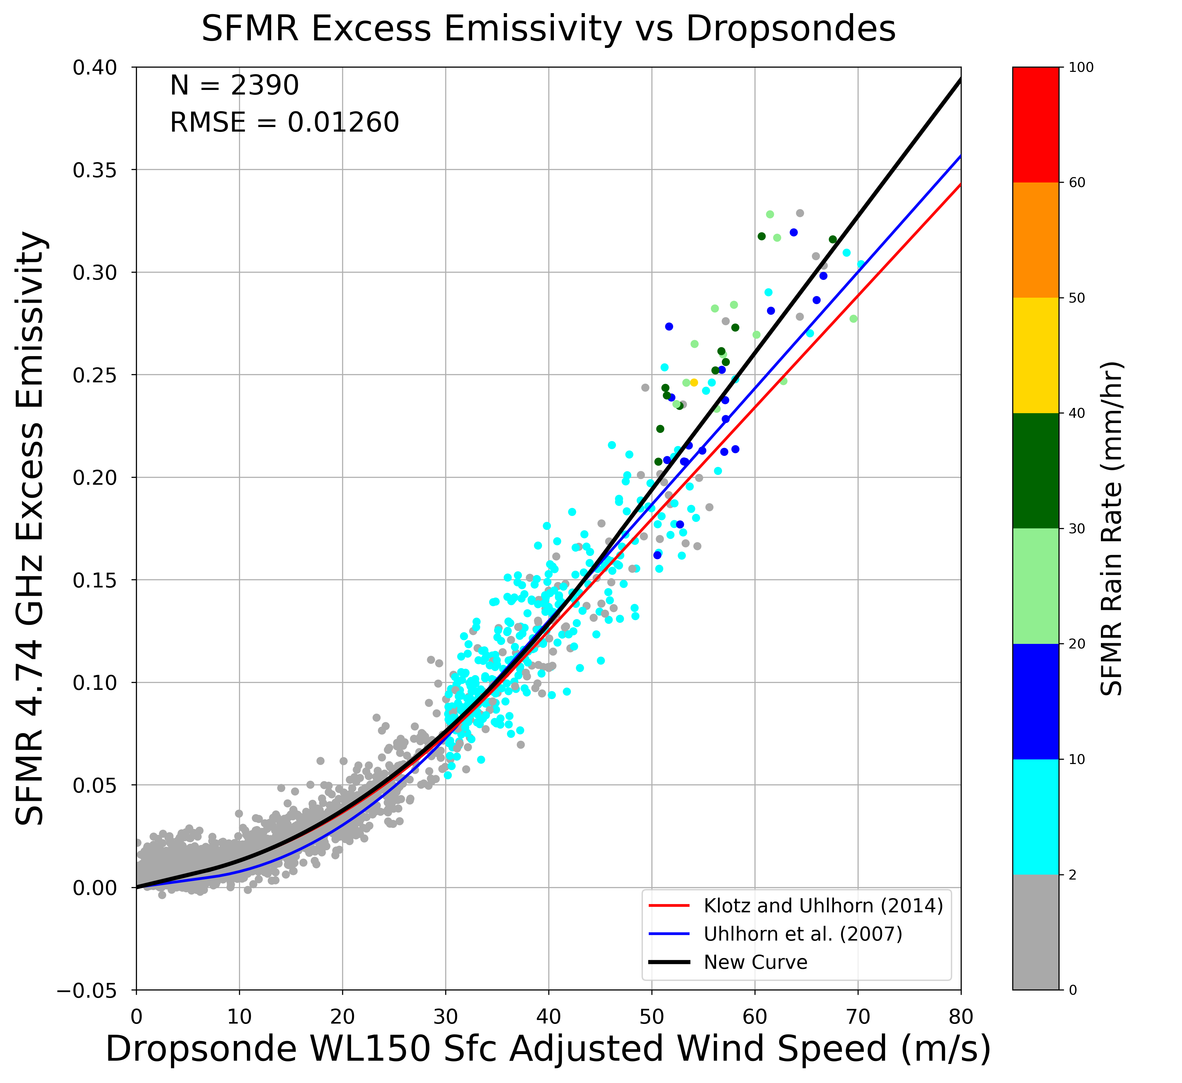
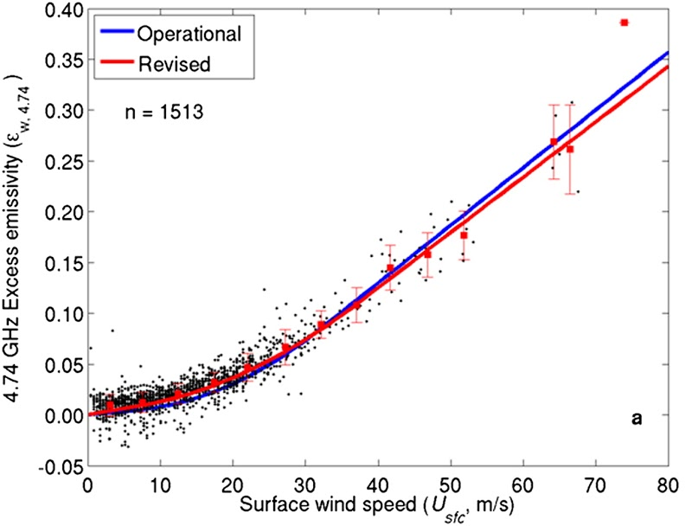
New Wind-Induced Emissivity Curve
Revised = Klotz and Uhlhorn (2014)
Operational = Uhlhorn et al. (2007)
Note: SFMR values are 10-sec centered average

Slide 9
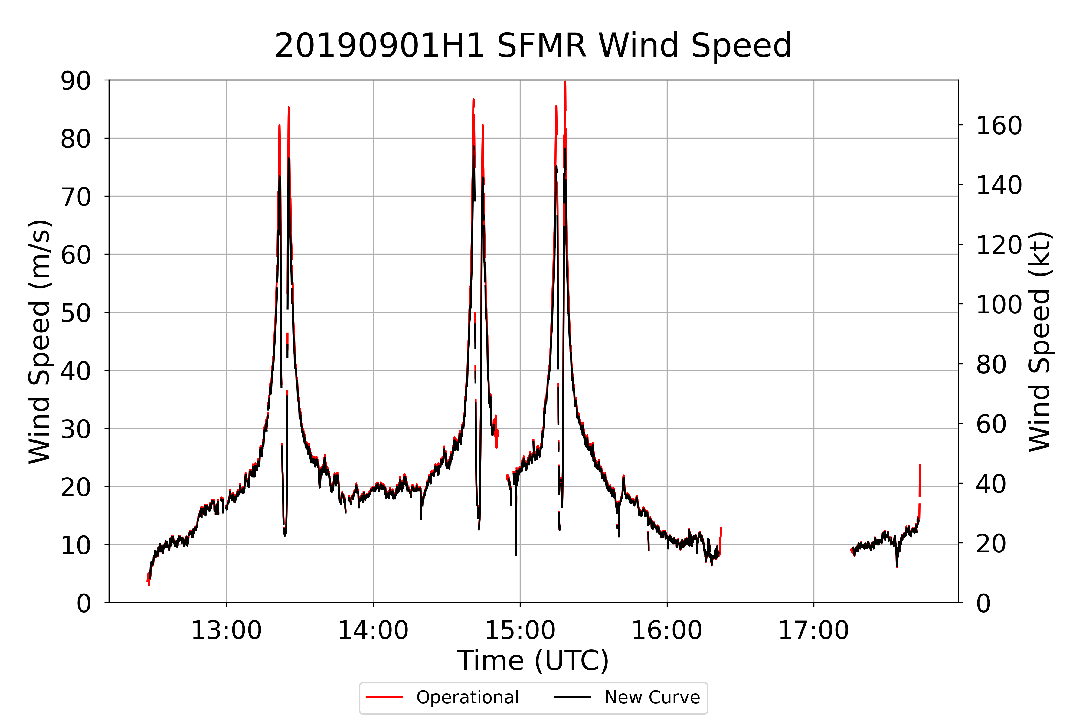
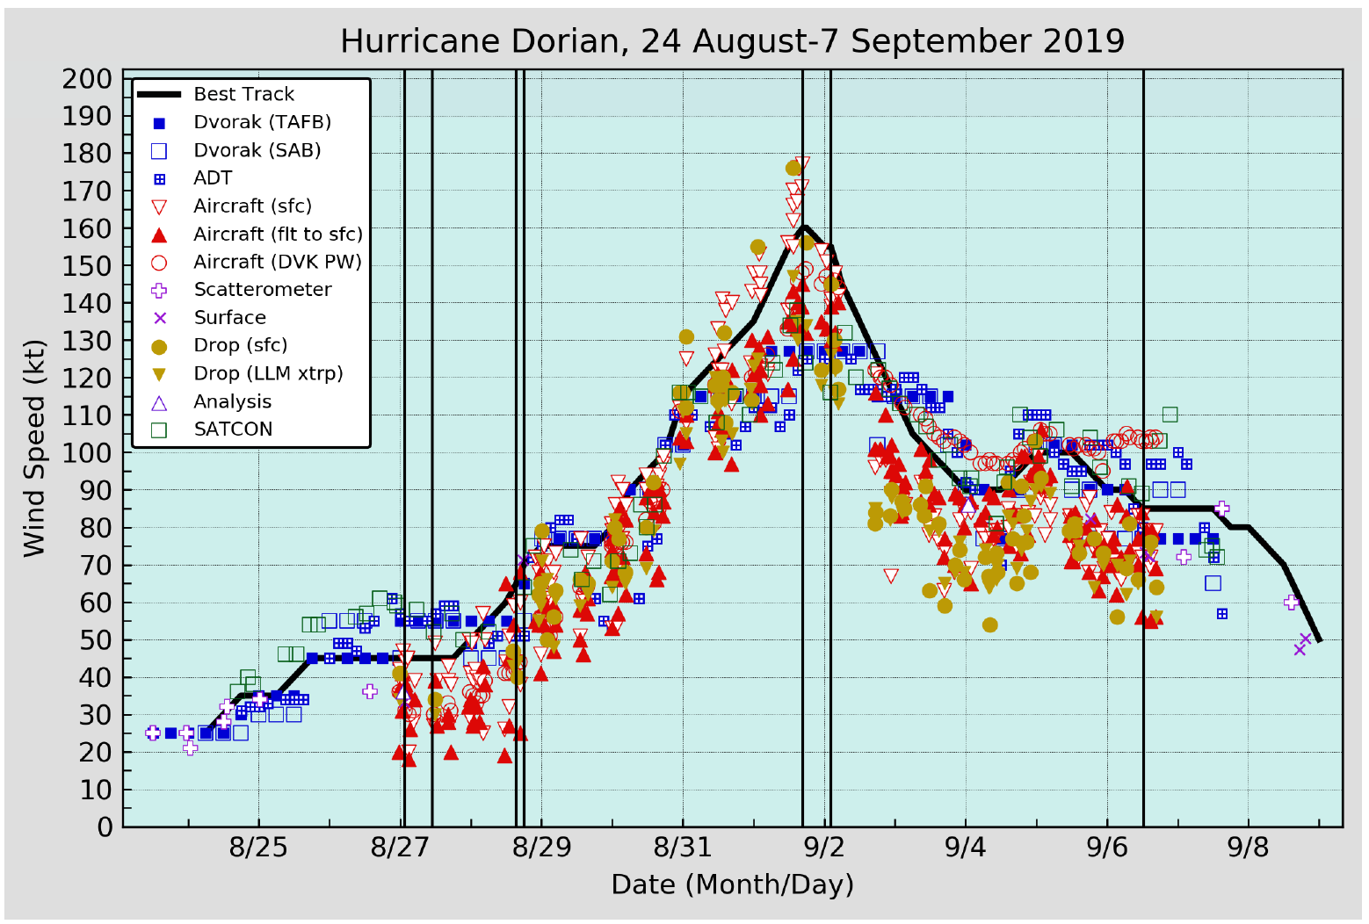
Hurricane Dorian (2019)

Slide 10
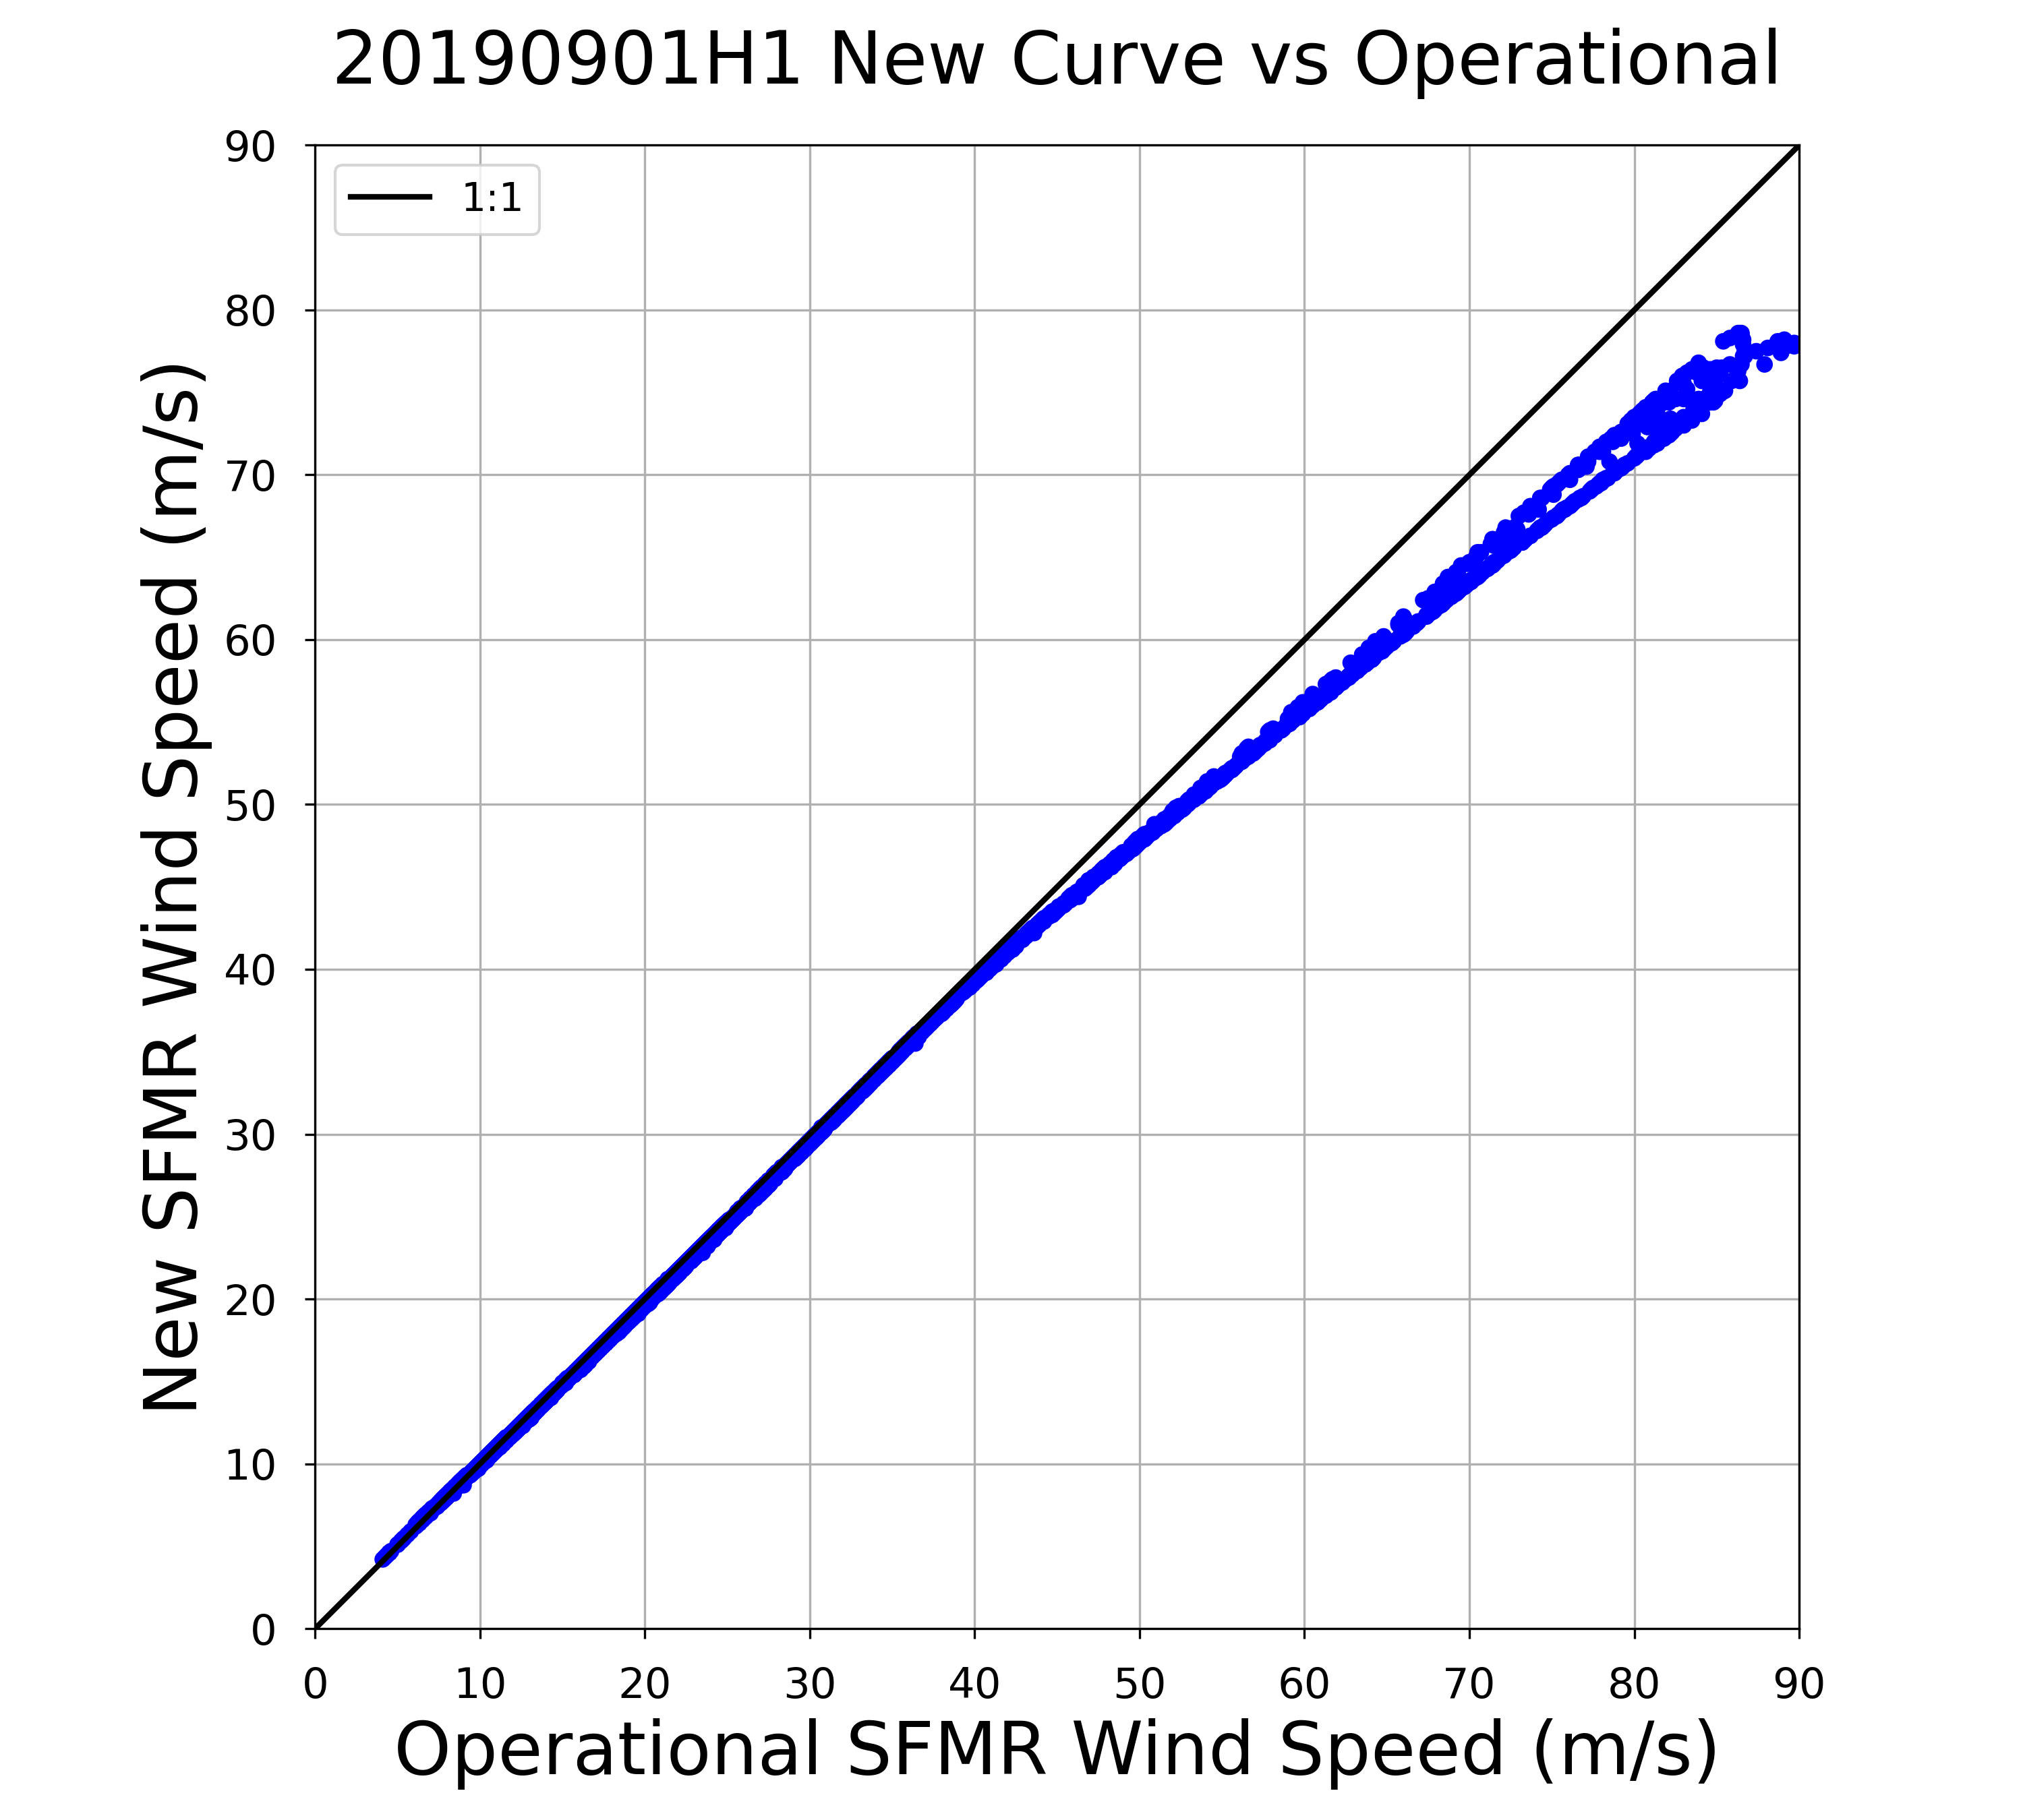
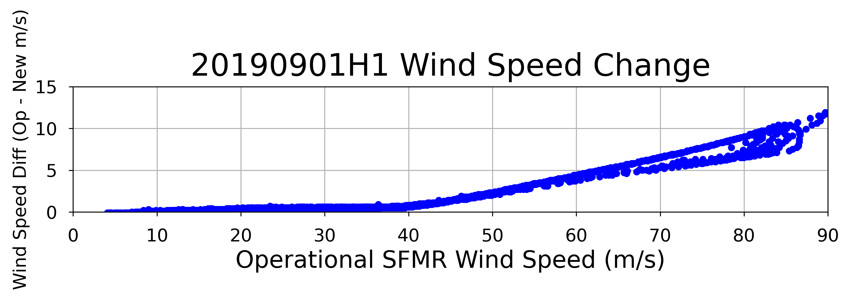
Hurricane Dorian (2019)
175.0 kt
155.5 kt
136.1 kt
29.1 kt
116.6 kt
19.4 kt
97.2 kt
9.7 kt
77.8 kt
58.3 kt
38.9 kt
19.4 kt

Slide 11
Summary
Increased dropsonde collocation time period from 2005–2012 (1513 sondes) to 2004–2018 (2390 sondes)
Collocations are with SFMR at time of dropsonde launch
Storm-relative collocations require more accurate surface storm center locations
Dropsonde overflights will help reduce spatial errors in collocations
WL150 surface reduction methodology may need updating
Interpretation of eyewall near-surface dropsonde observations is challenging
New curve results in reduced wind speeds above ~40 m/s (~77 kt)
Is there anything else we need to account for at these wind speeds?

Slide 12
Extra Slides

Slide 13
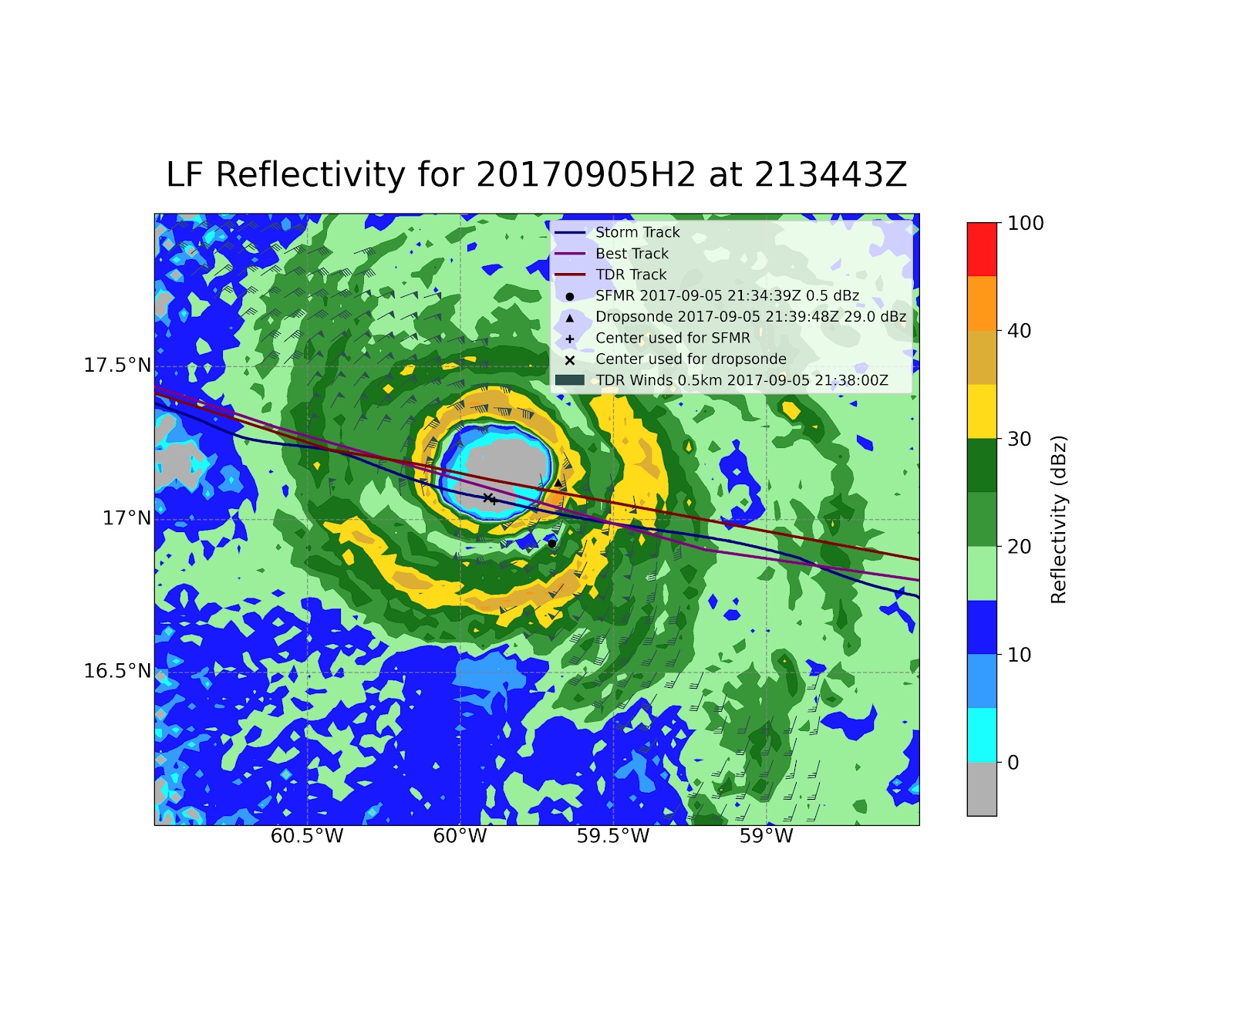
Storm-relative Collocations
Previous algorithm updates used SFMR at time of dropsonde launch
Assuming wind speed is azimuthally similar around a TC, using same radial position of SFMR as the dropsonde from the center should provide improved match-up
Very sensitive to accuracy of center

Slide 14
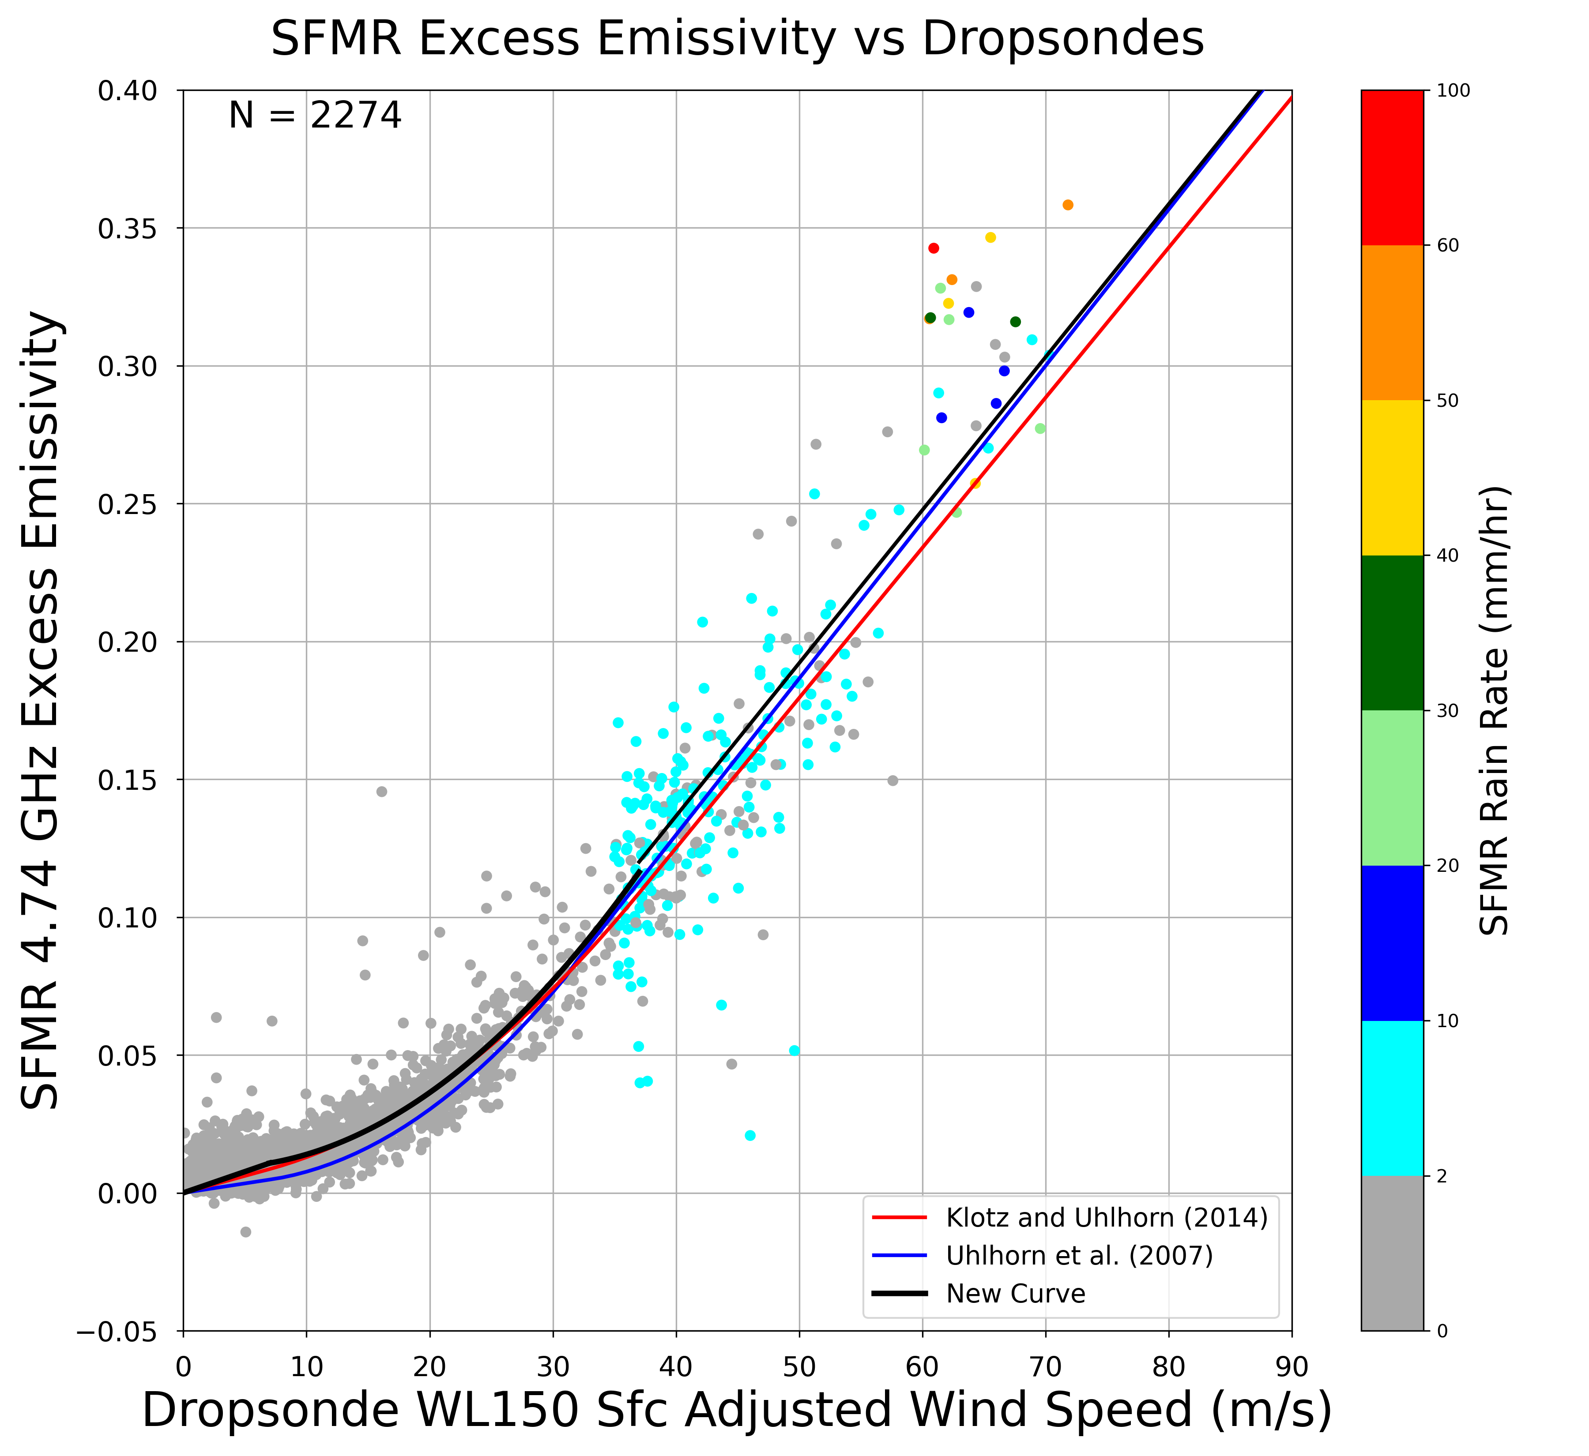
Updating Wind-Induced Emissivity Curve
Klotz and Uhlhorn (2014) Criteria:
U_{sfc} ≤ 35 m/s: RR ≤ 2 mm/hr
35 m/s < U_{sfc} ≤ 60 m/s: RR ≤ 10 mm/hr
U_{sfc} > 60 m/s: all RR
Current Emissivity Curve:
w_{l} = 7.0 m/s w_{u} = 37.0 m/s
a₁ = 0. 1232e-2 a₂ = 0. 3440e-2 a₃ = 0. 02492e-2
a₄ = 0. 007020e-2 a₅ = -0.9266 a₆ = 0.5444e-2
U_{sfc}: WL150 surface-adjusted wind speed
RR: SFMR rain rate

Slide 15
New Wind-Induced Emissivity Curve
New Rain Rate Criteria:
U_{sfc} ≤ 35 m/s: RR ≤ 2 mm/hr
30 m/s < U_{sfc} ≤ 50 m/s: RR ≤ 10 mm/hr
U_{sfc} > 50 m/s: RR ≤ 40 mm/hr
New w_{u}: 47.0 m/s
a₁ = 0.1205e-2 a₂ = 0.2670e-2 a₃ = 0.03298e-2
a₄ = 0.007046e-2 a₅ = -0.1396 a₆ = 0.6669e-2
Note: SFMR values are 10-sec centered average

Slide 16
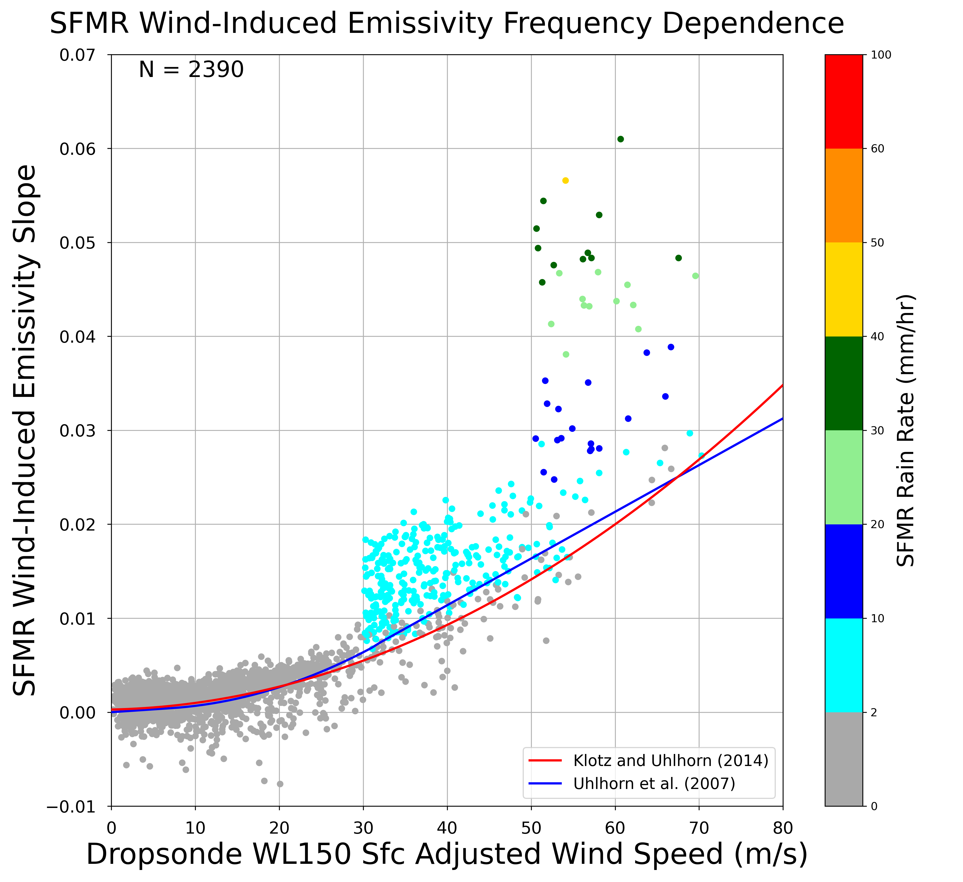
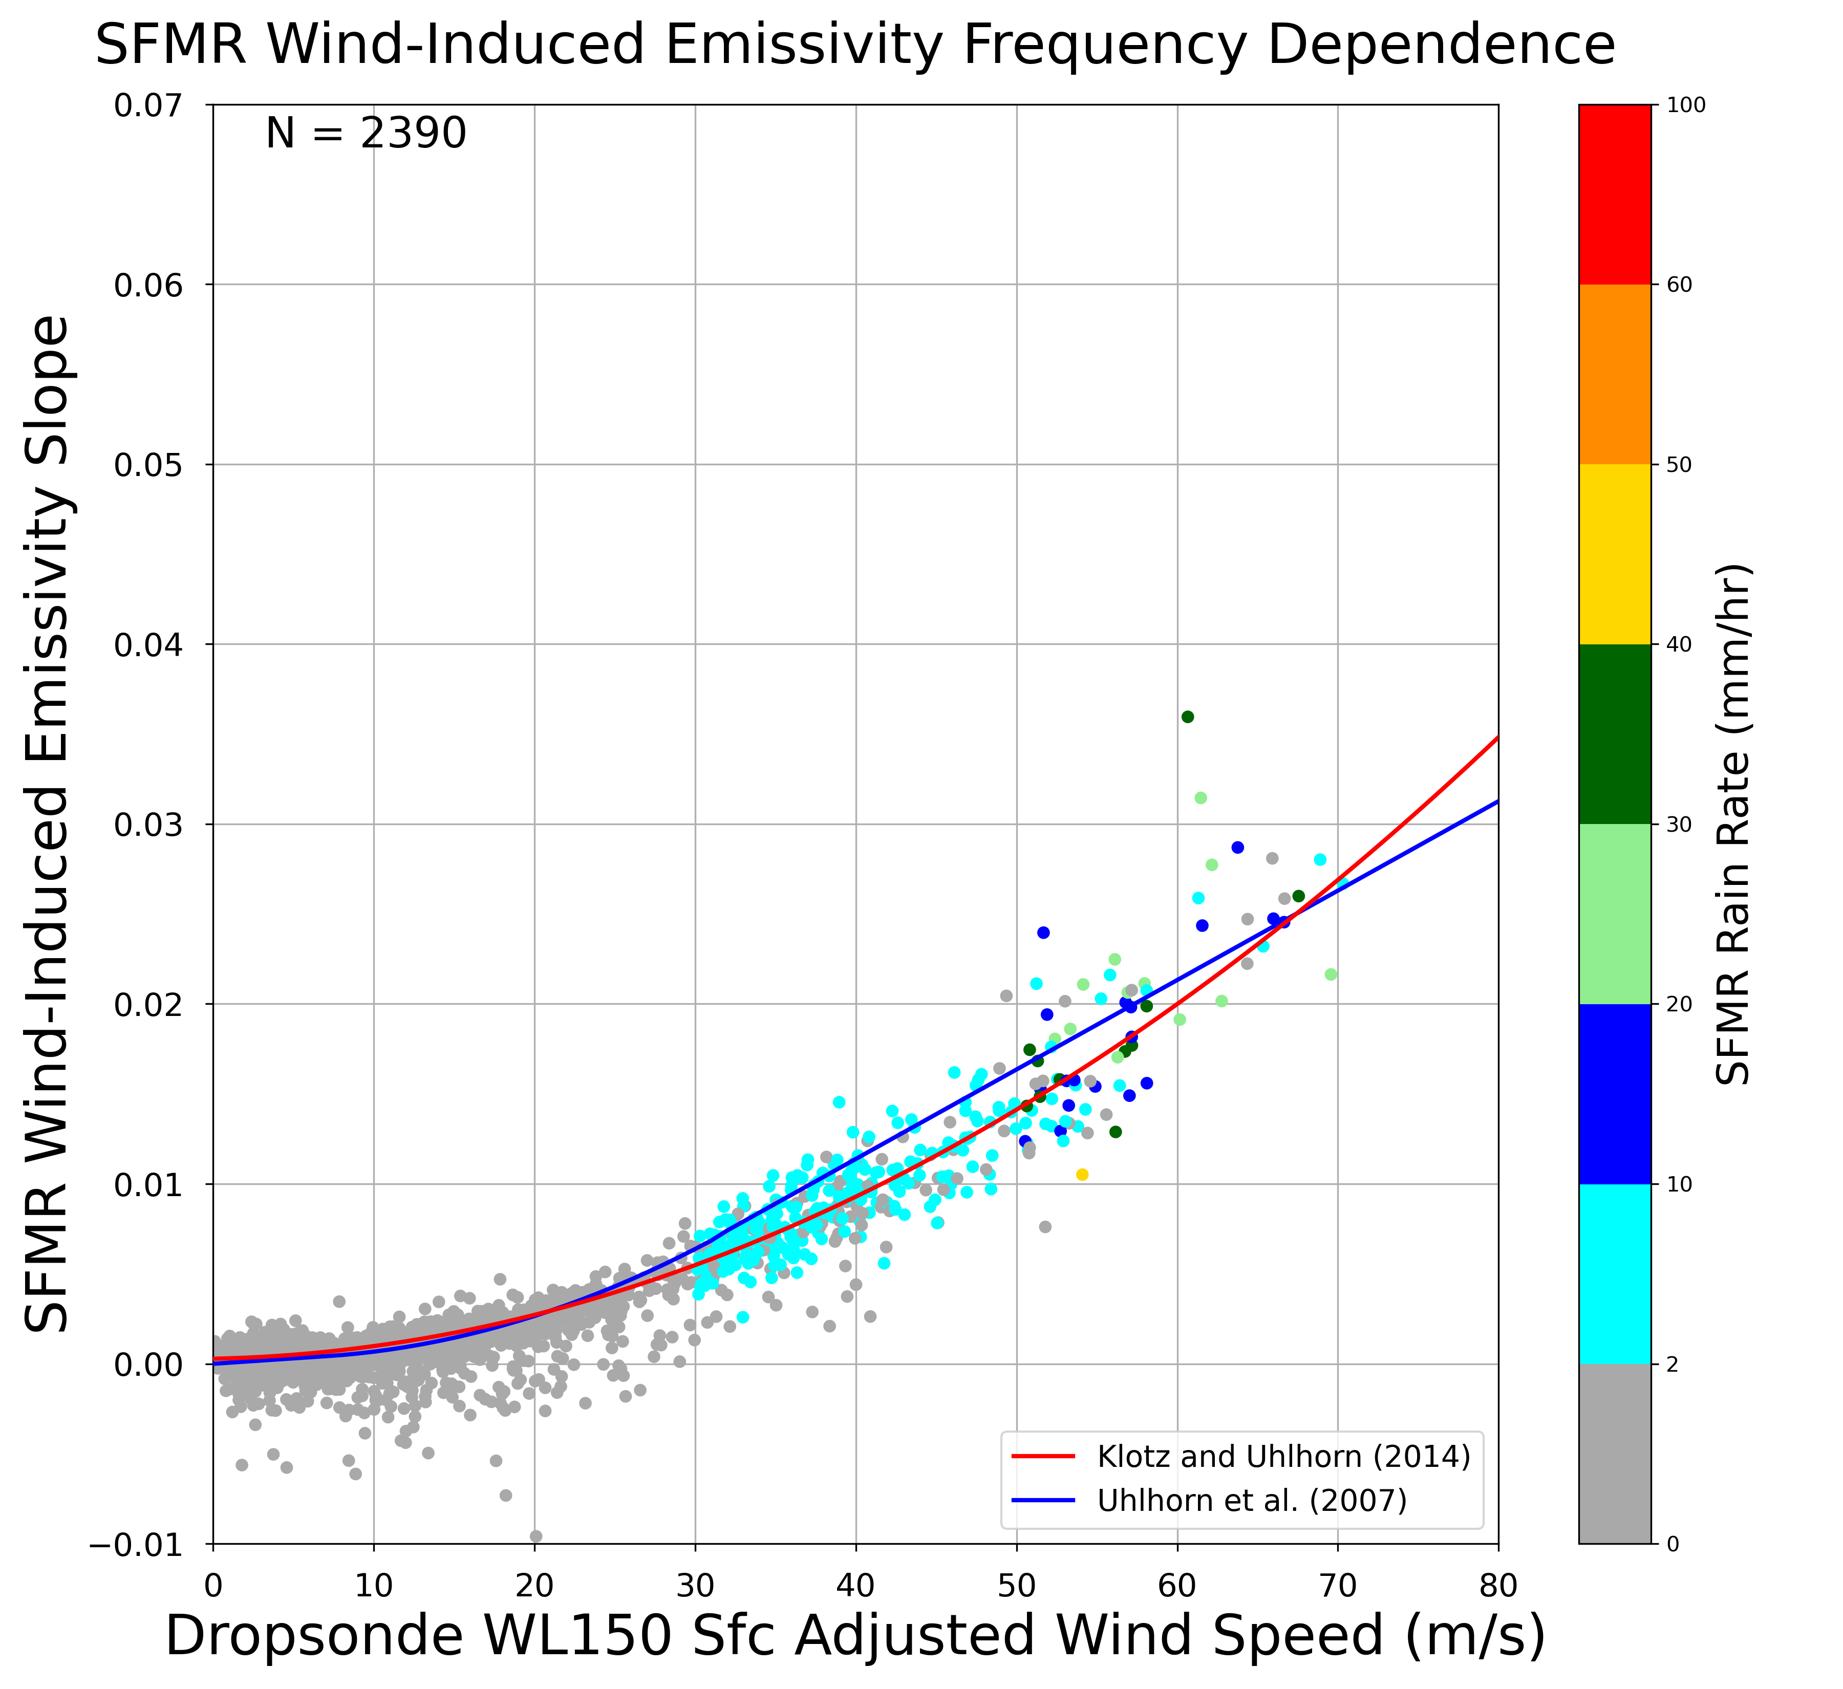
Frequency Dependence
$$\frac{∂ℇ_{w}}{∂f}$$
Using 0 mm/hr
Using SFMR rain rate

Slide 17
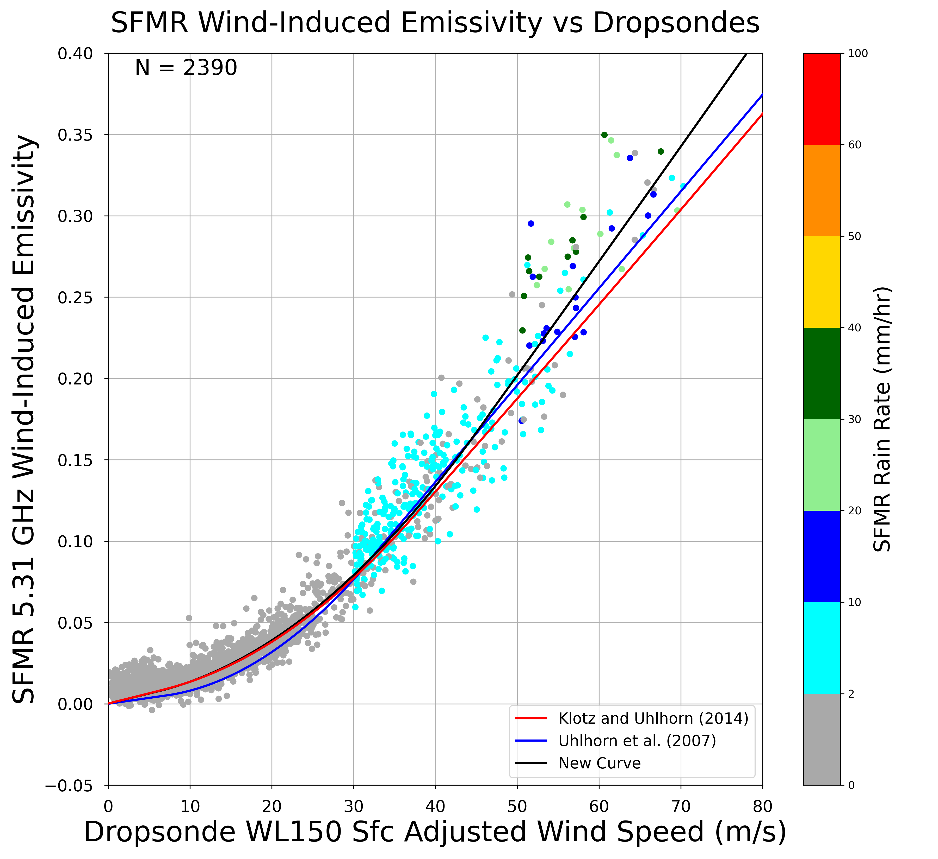
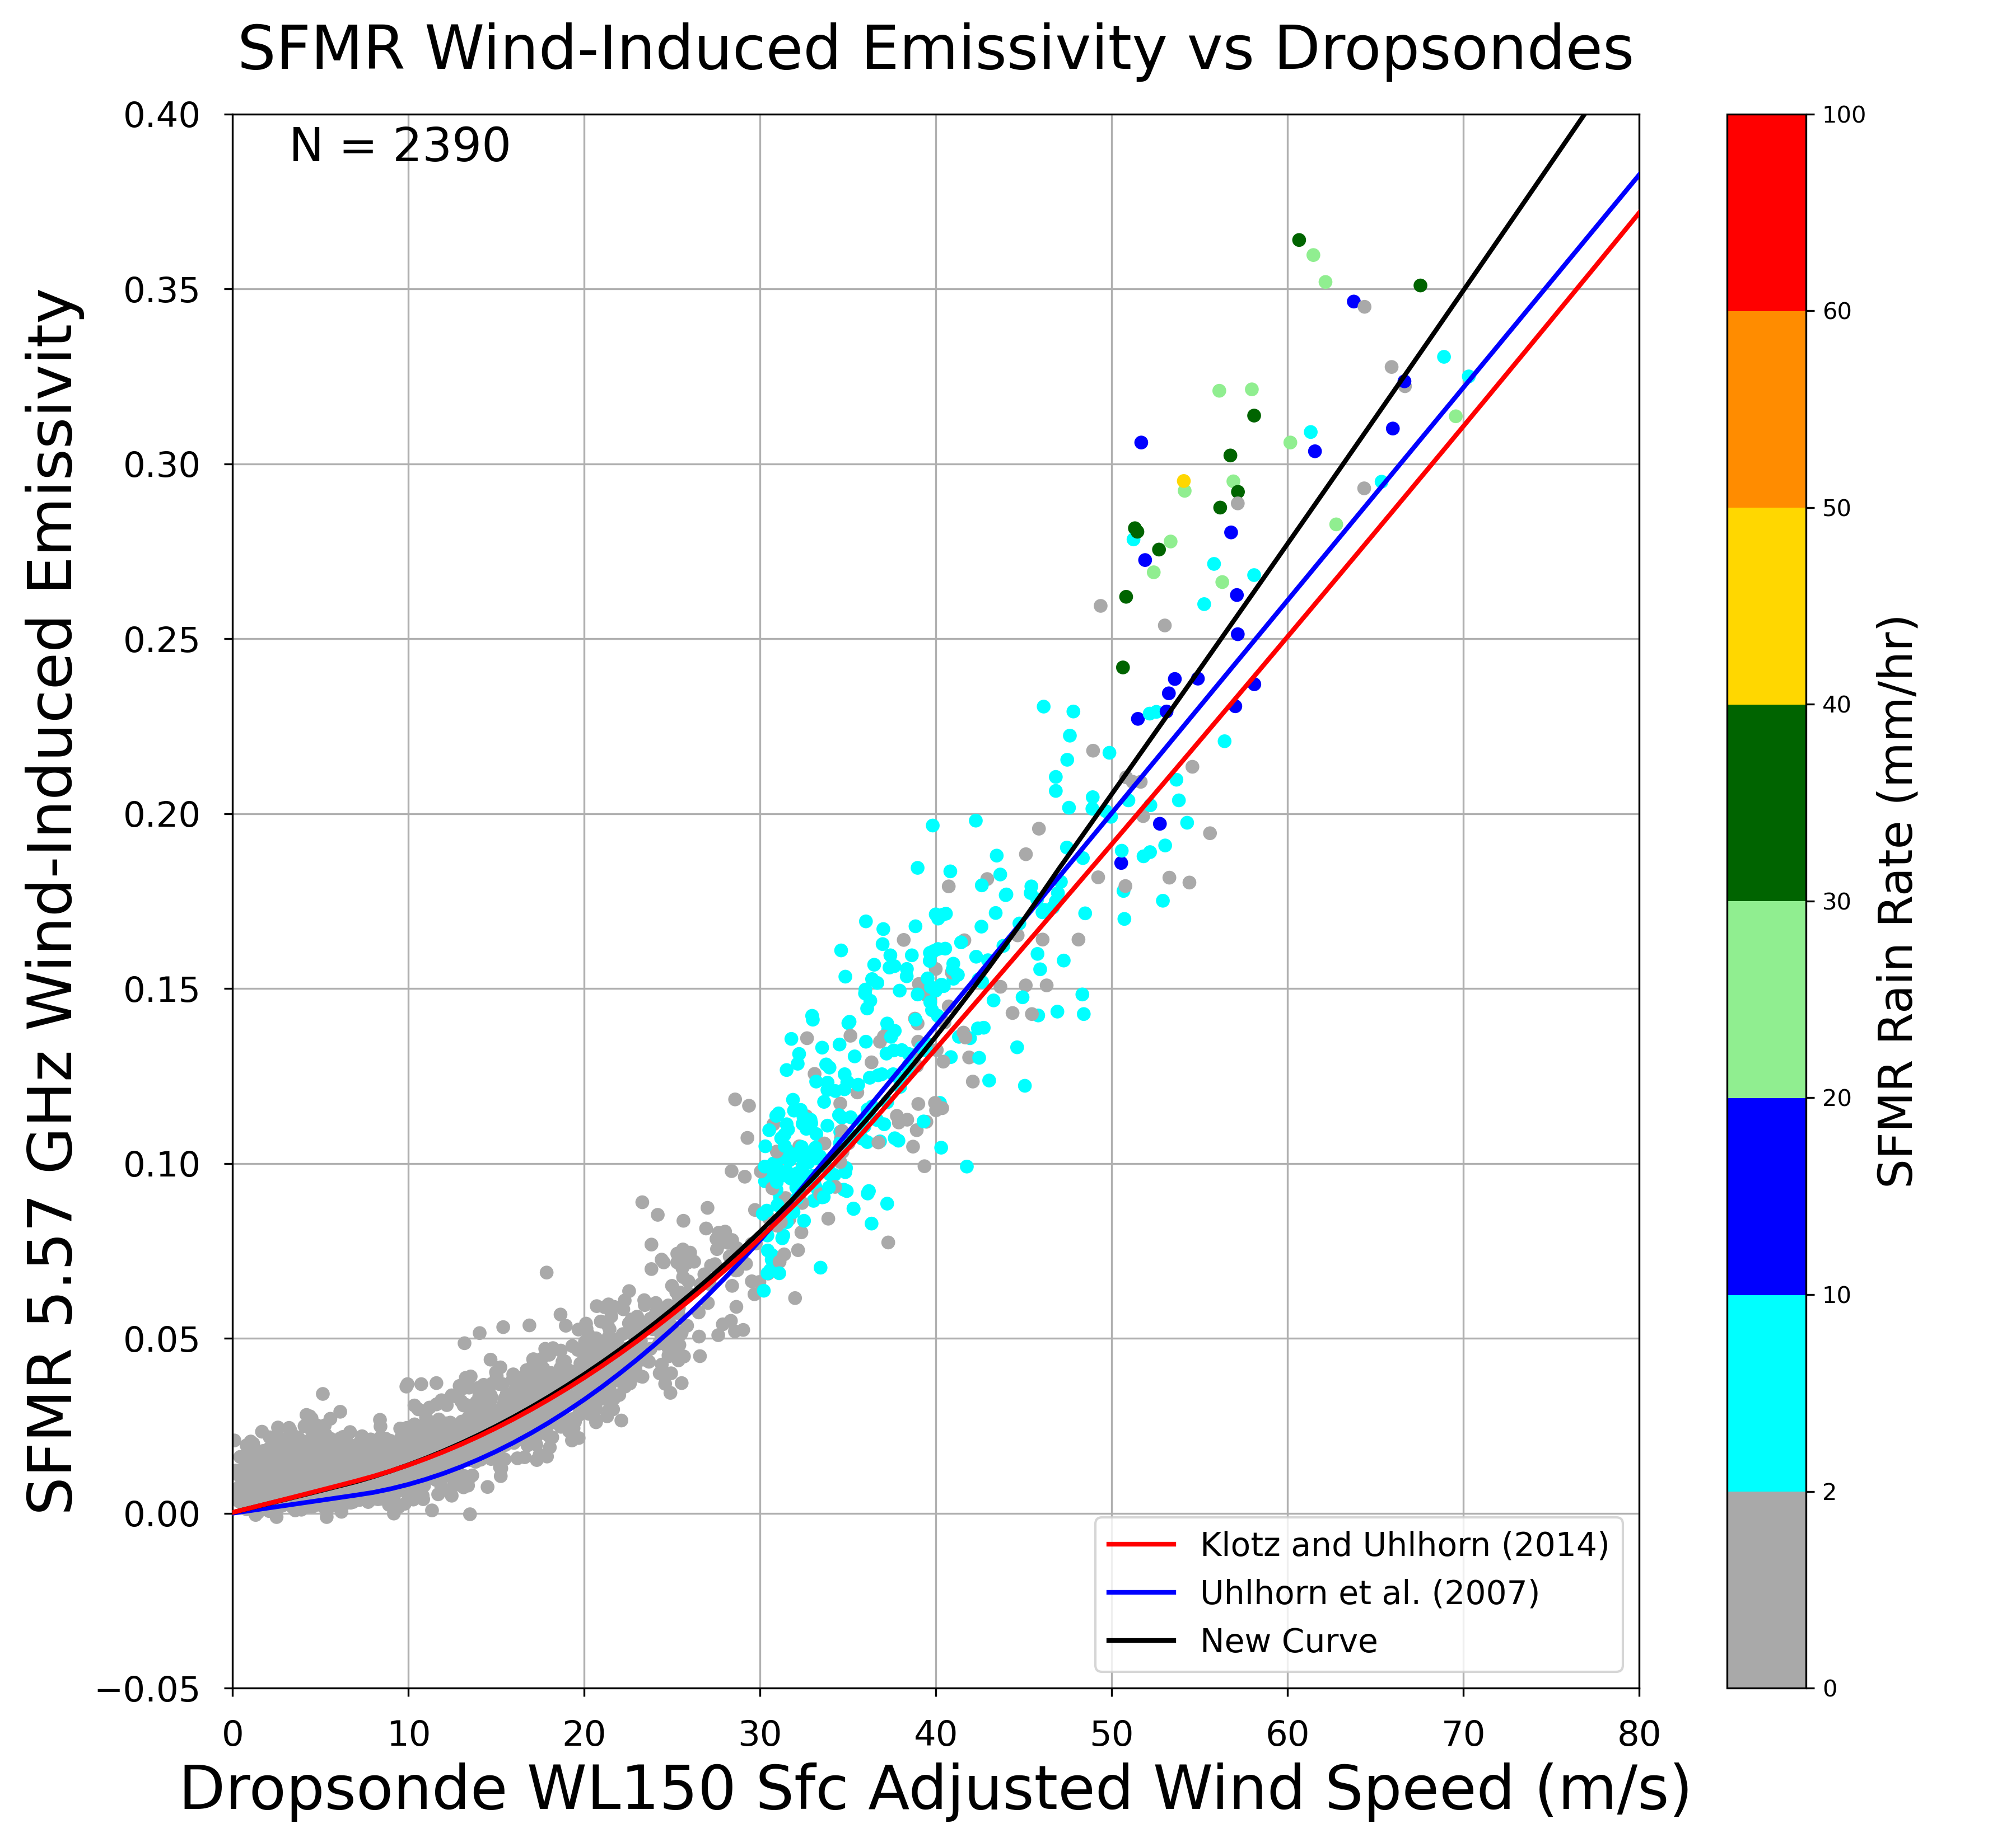
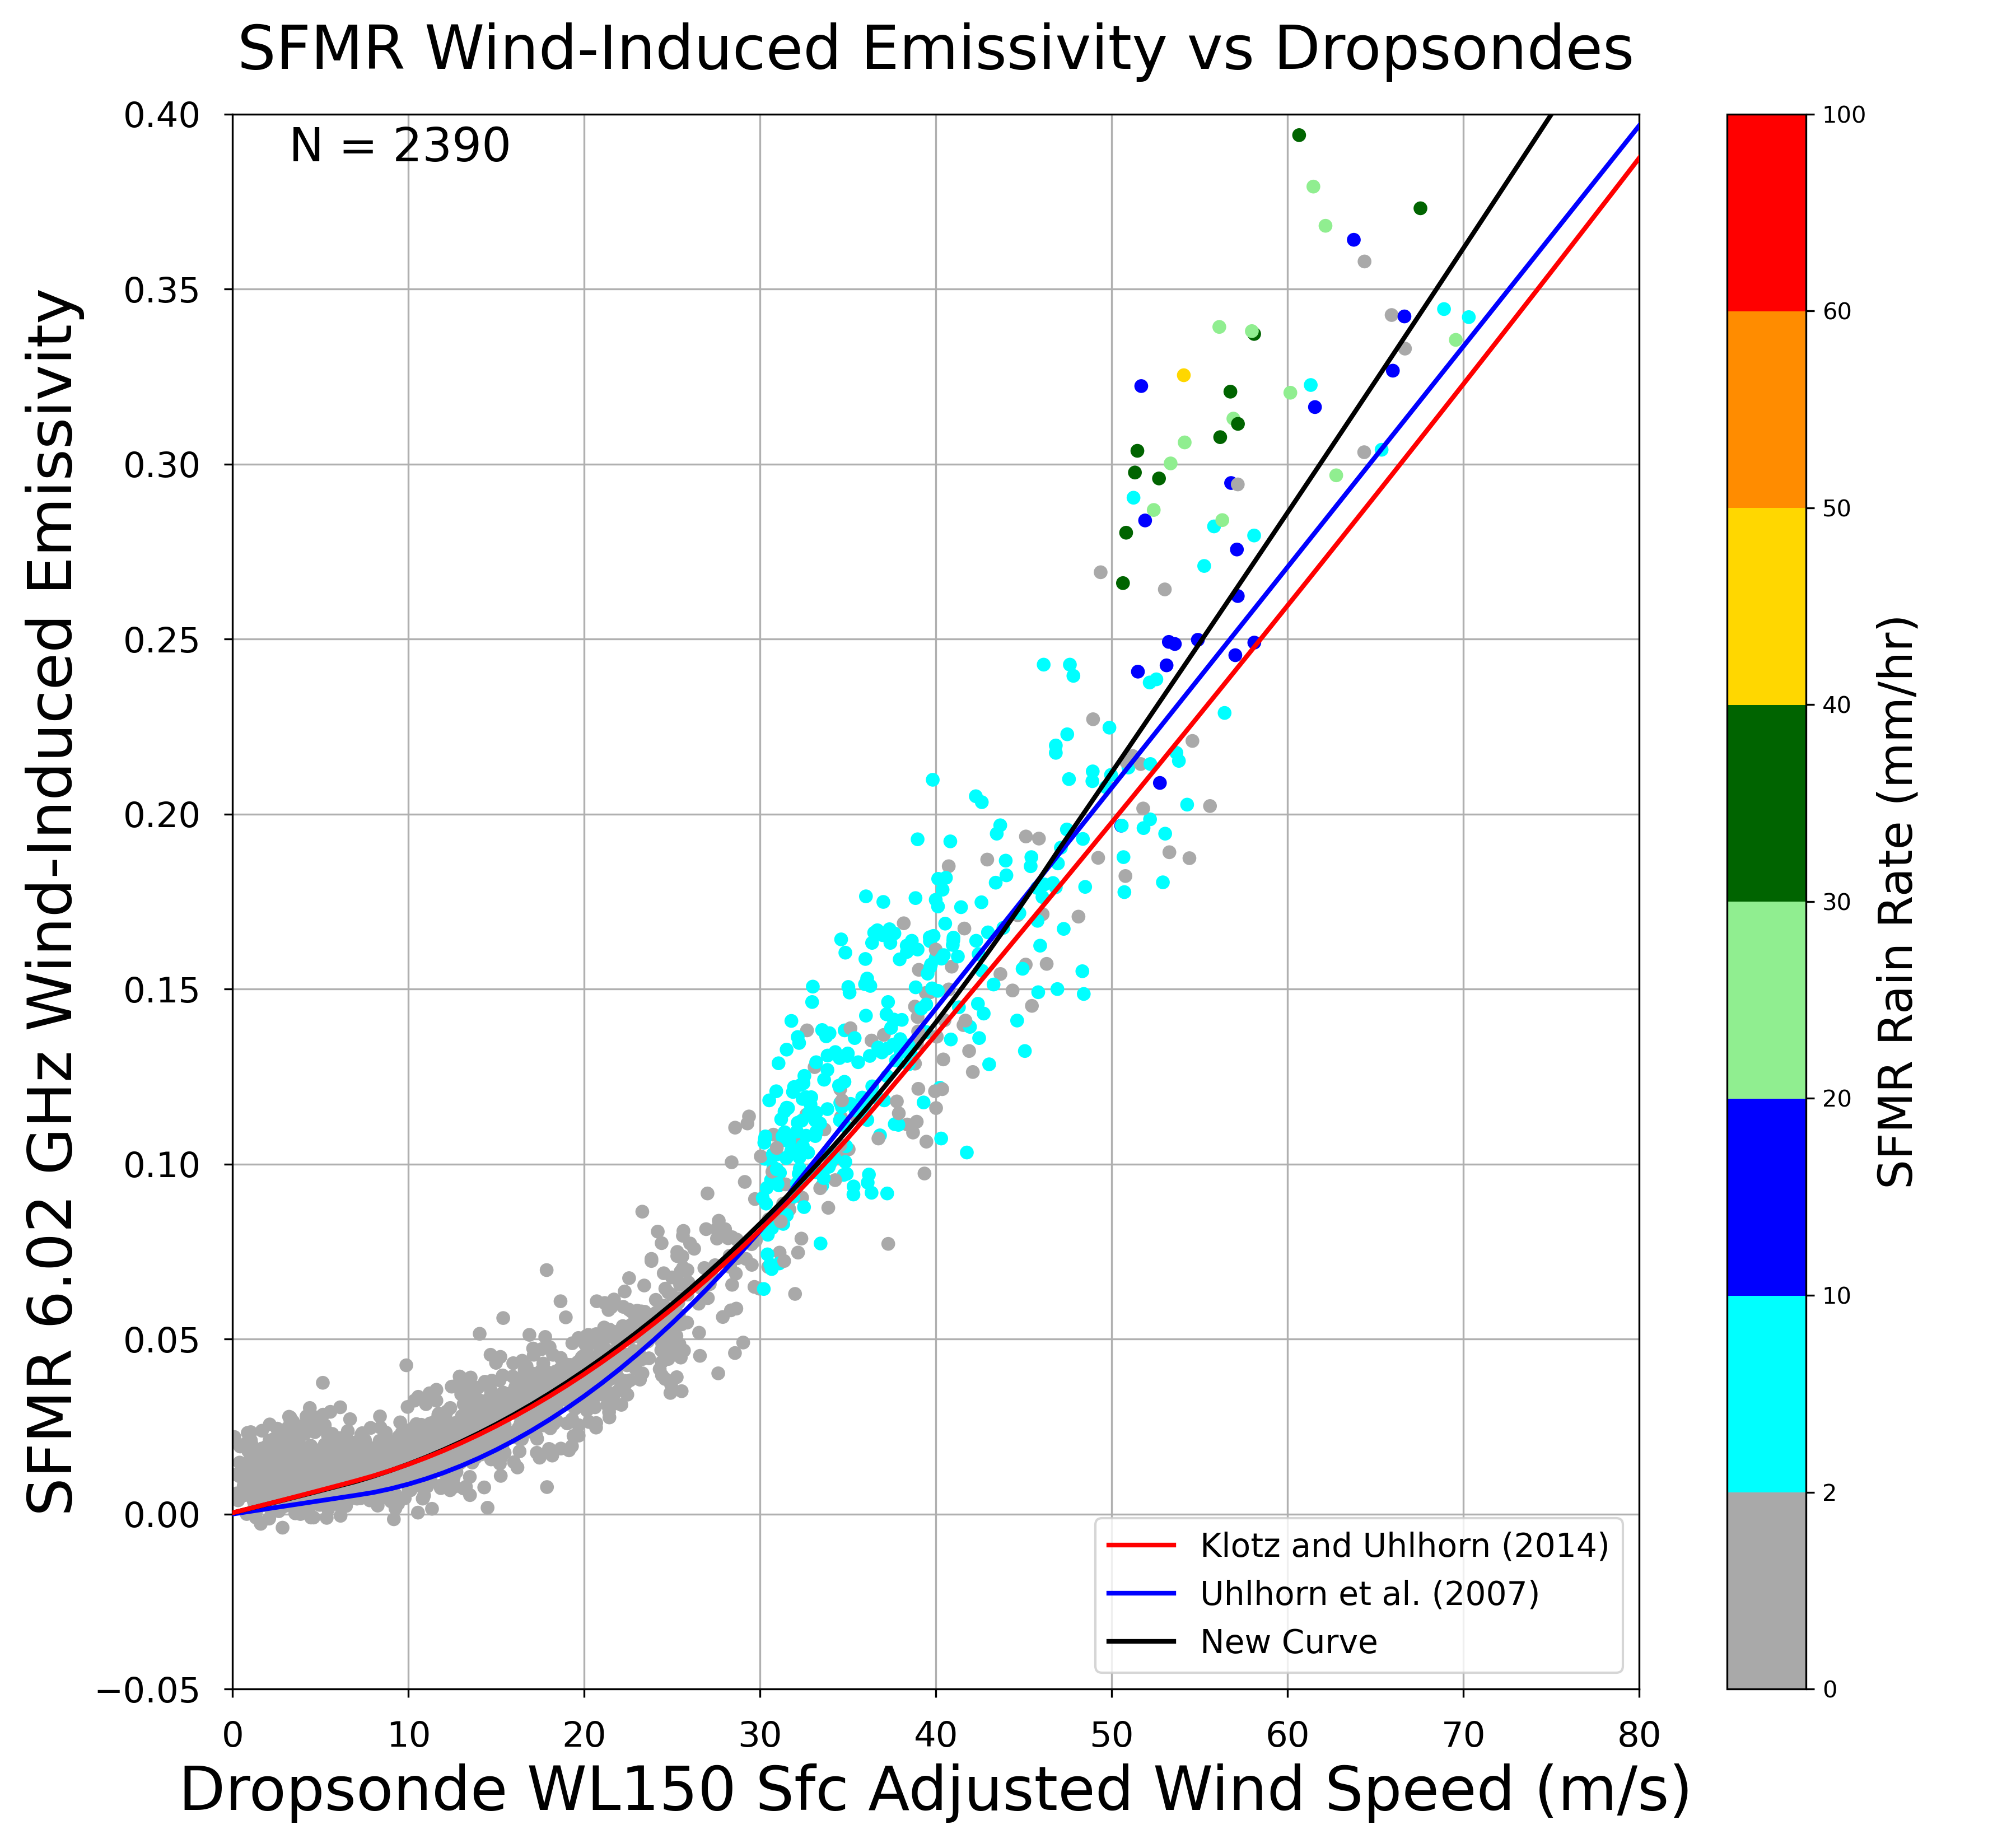
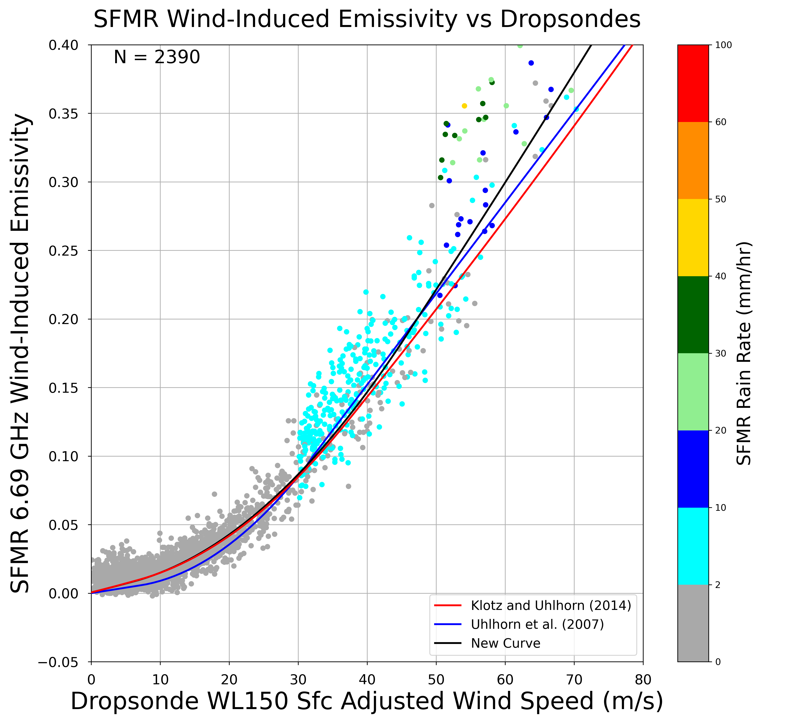
Wind-Induced Emissivity Curves

Slide 18
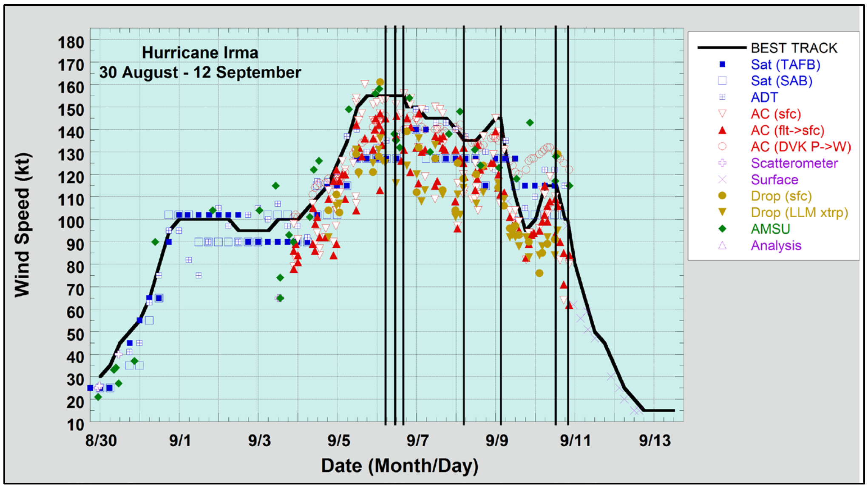
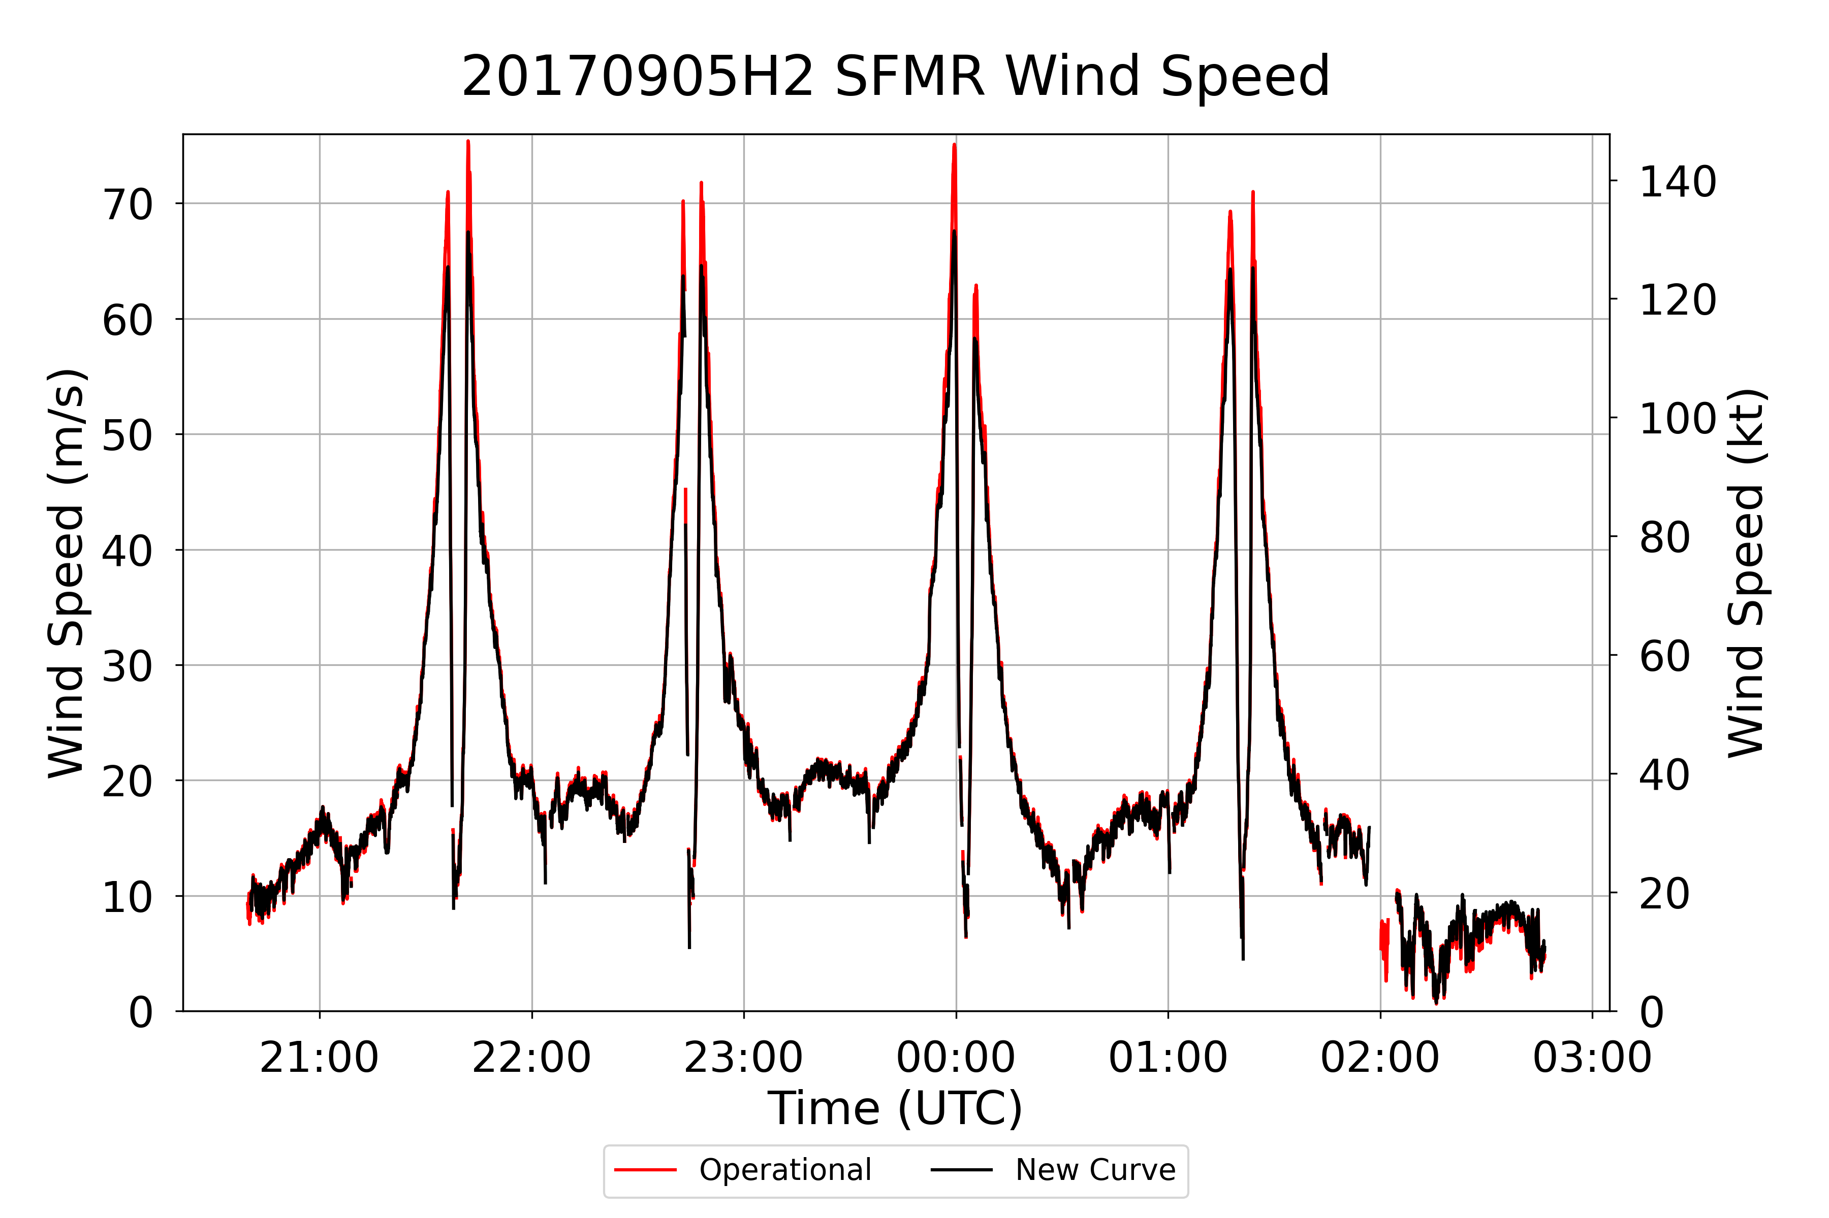
Hurricane Irma (2017)

Slide 19
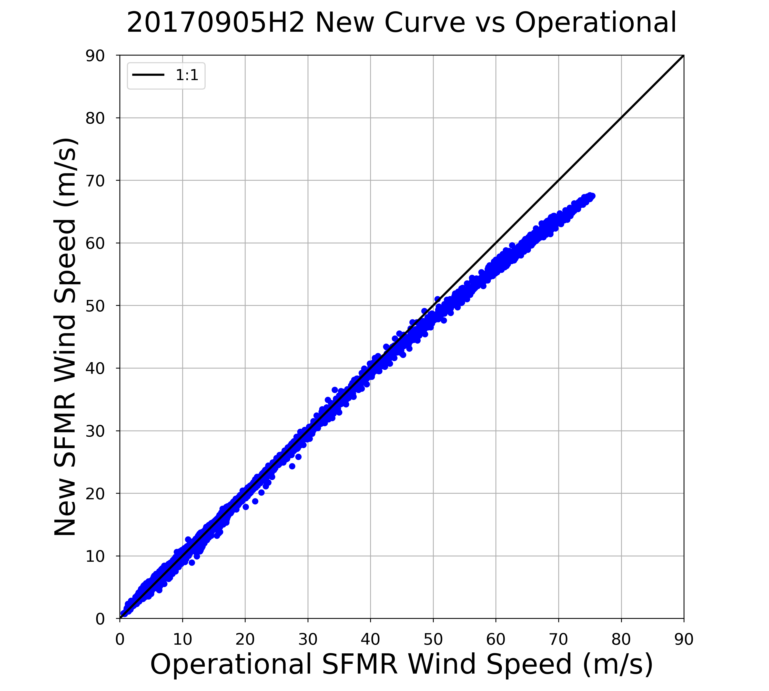
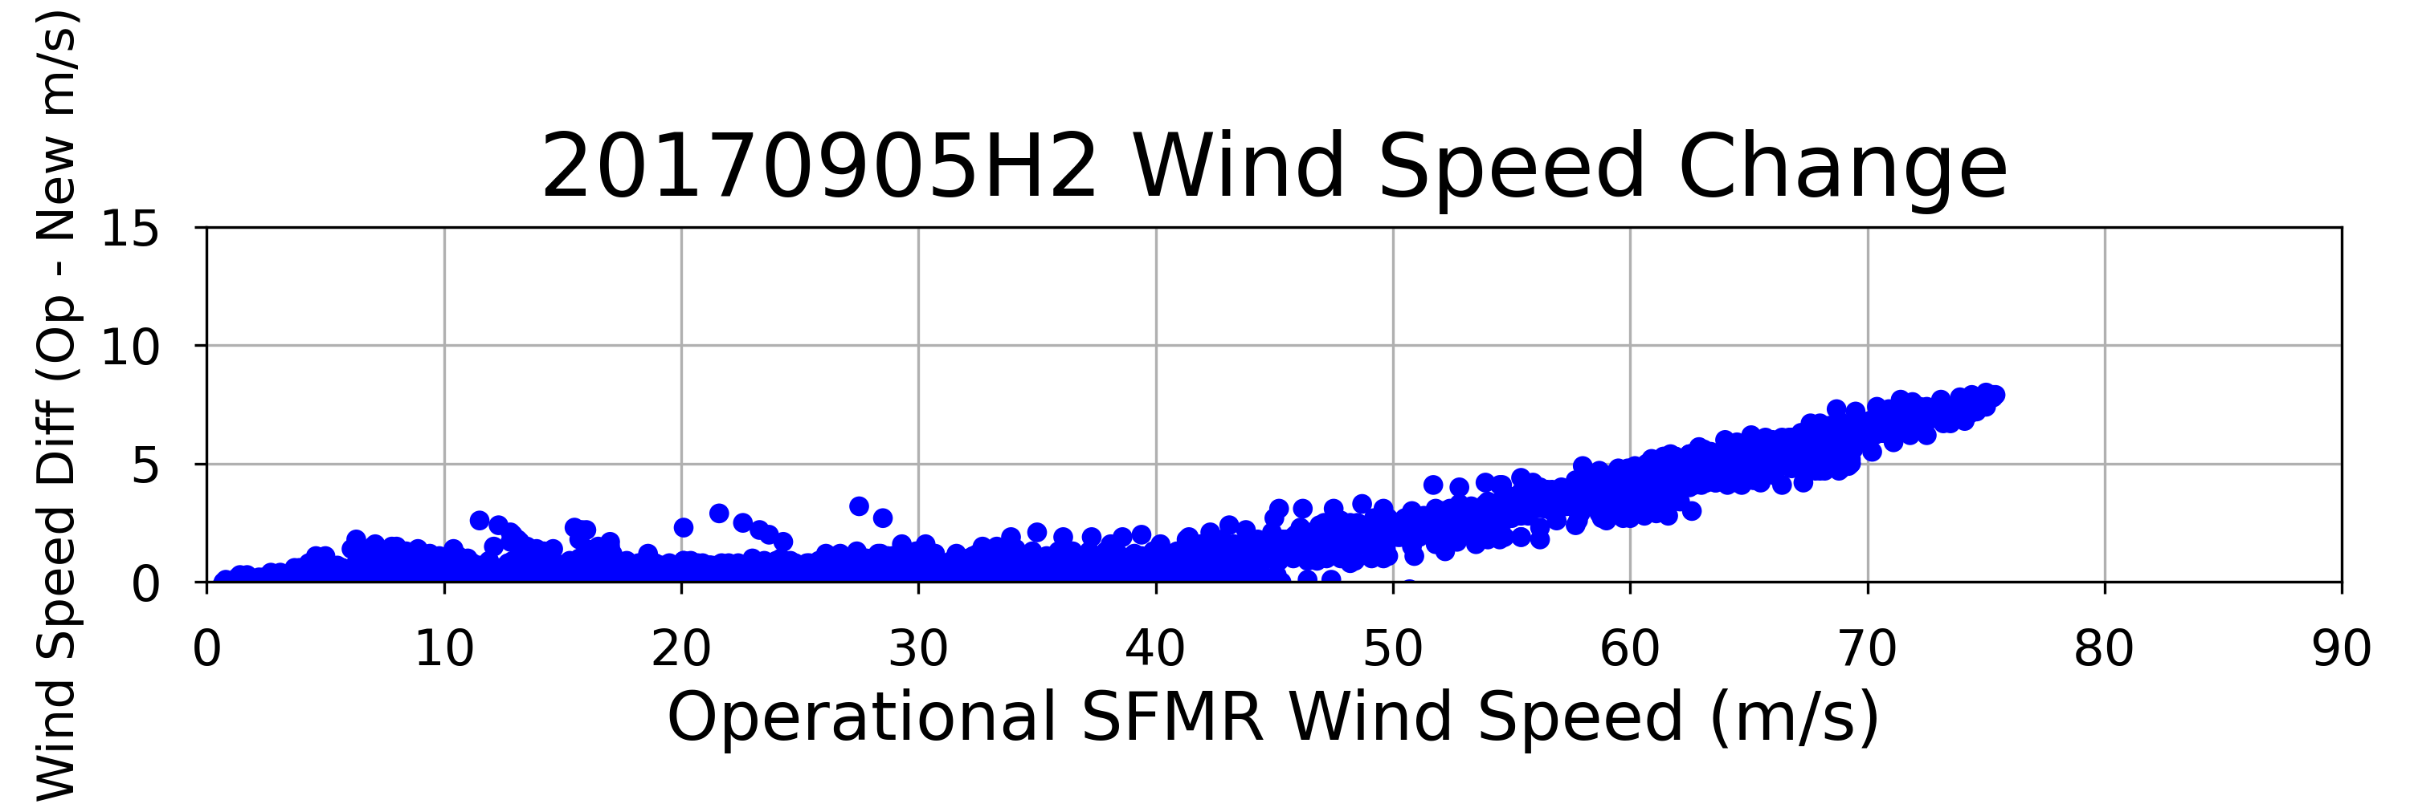
Hurricane Irma (2017)
175.0 kt
155.5 kt
136.1 kt
29.1 kt
116.6 kt
19.4 kt
97.2 kt
9.7 kt
77.8 kt
58.3 kt
38.9 kt
19.4 kt

Slide 20
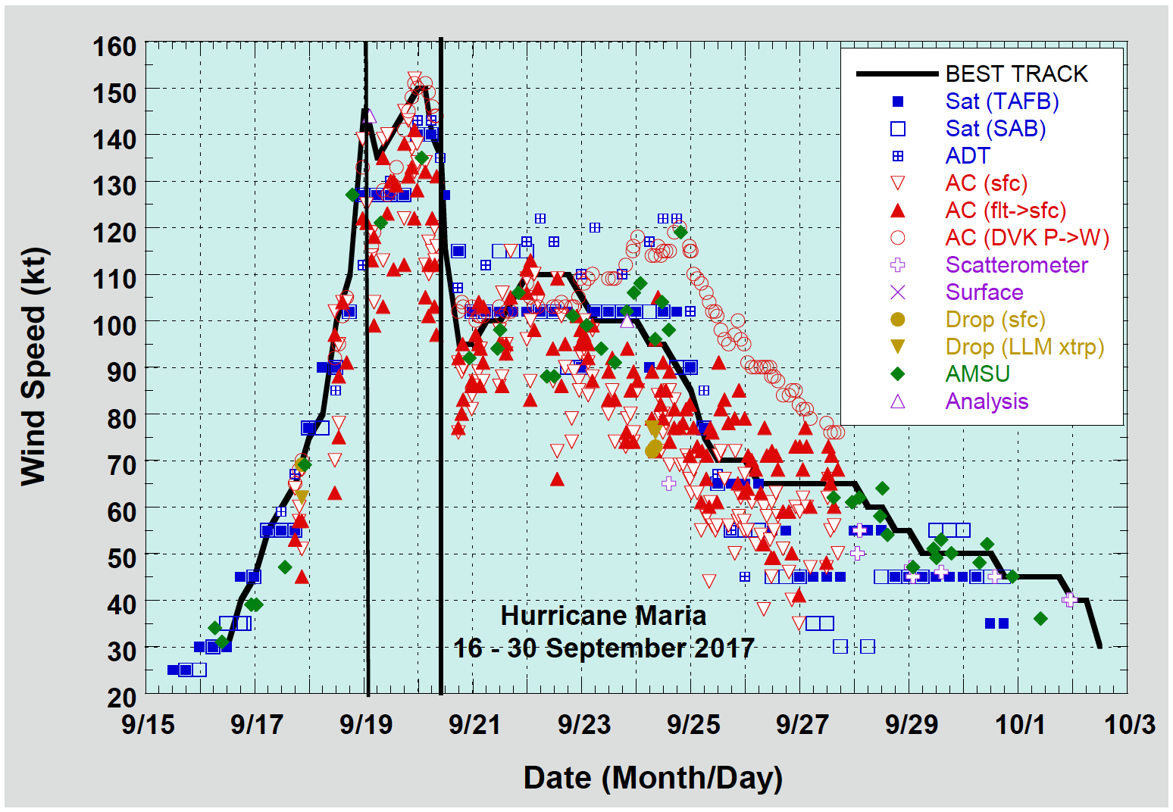
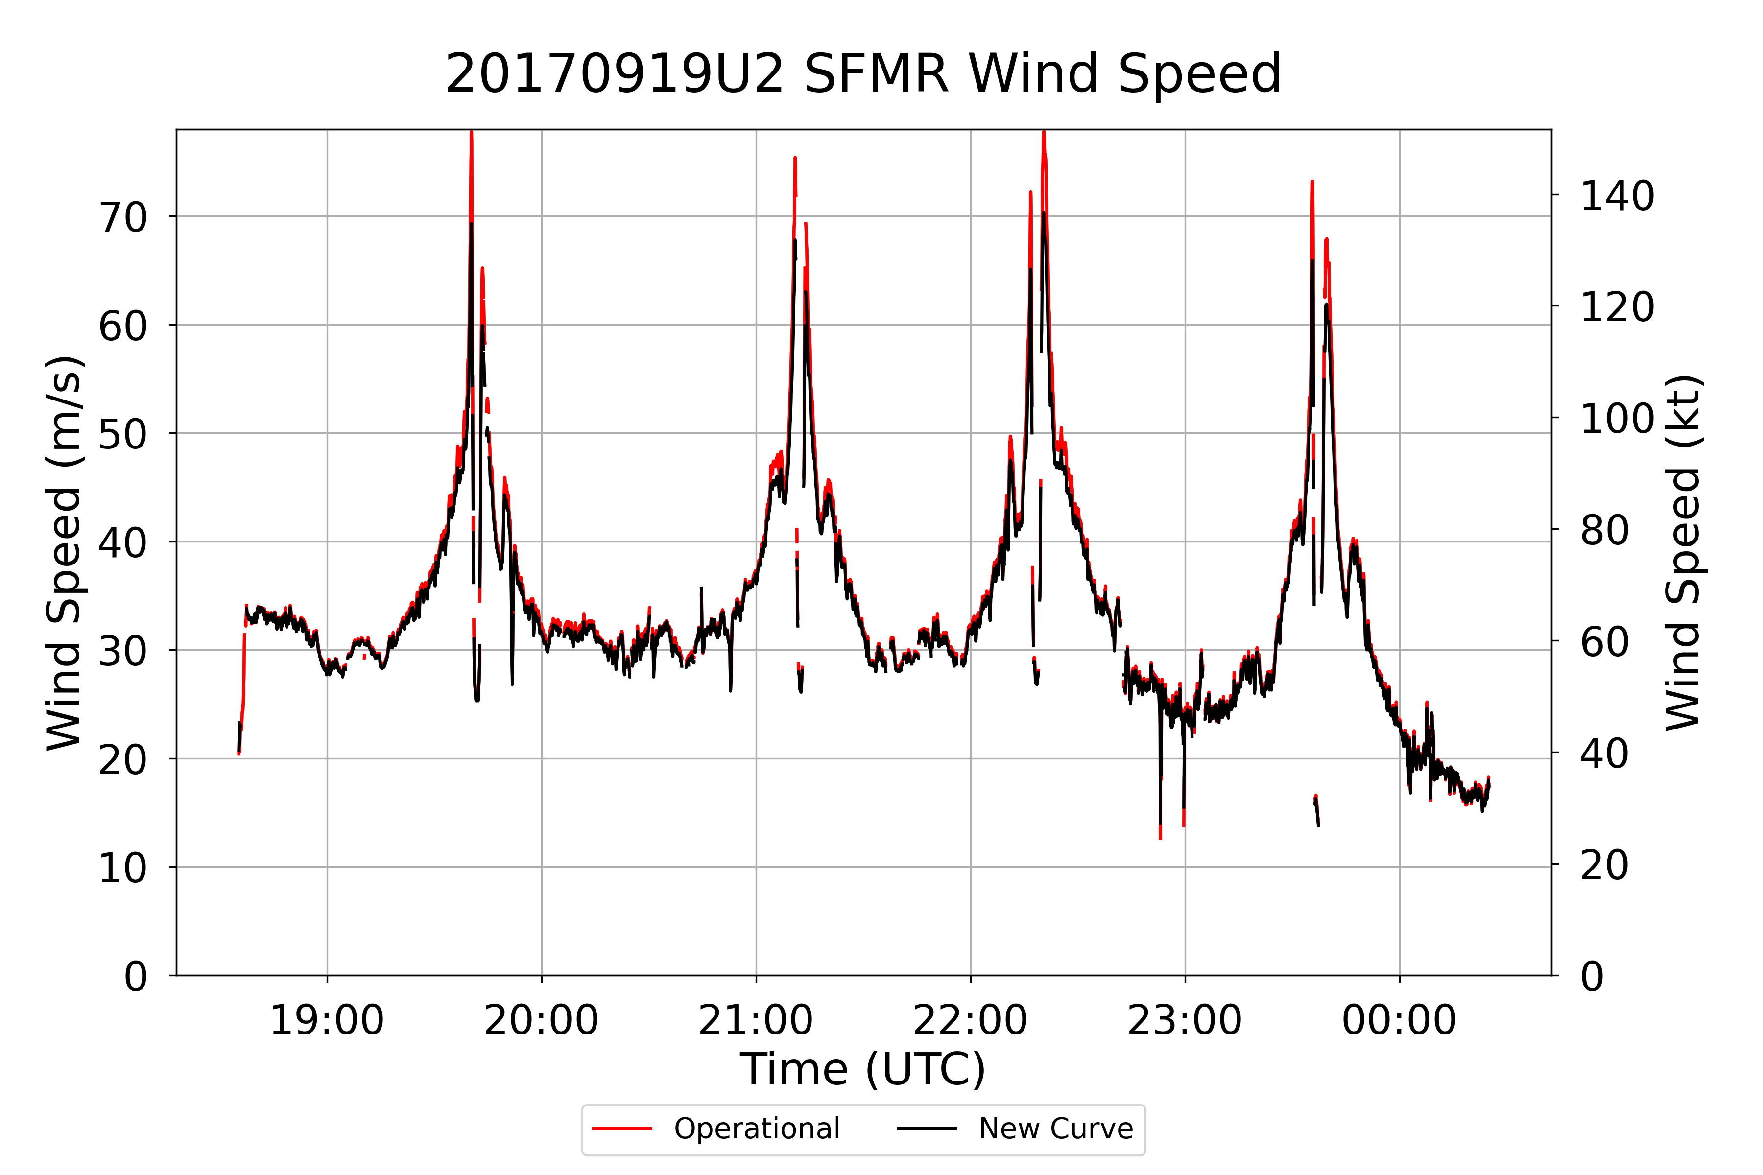
Hurricane Maria (2017)

Slide 21
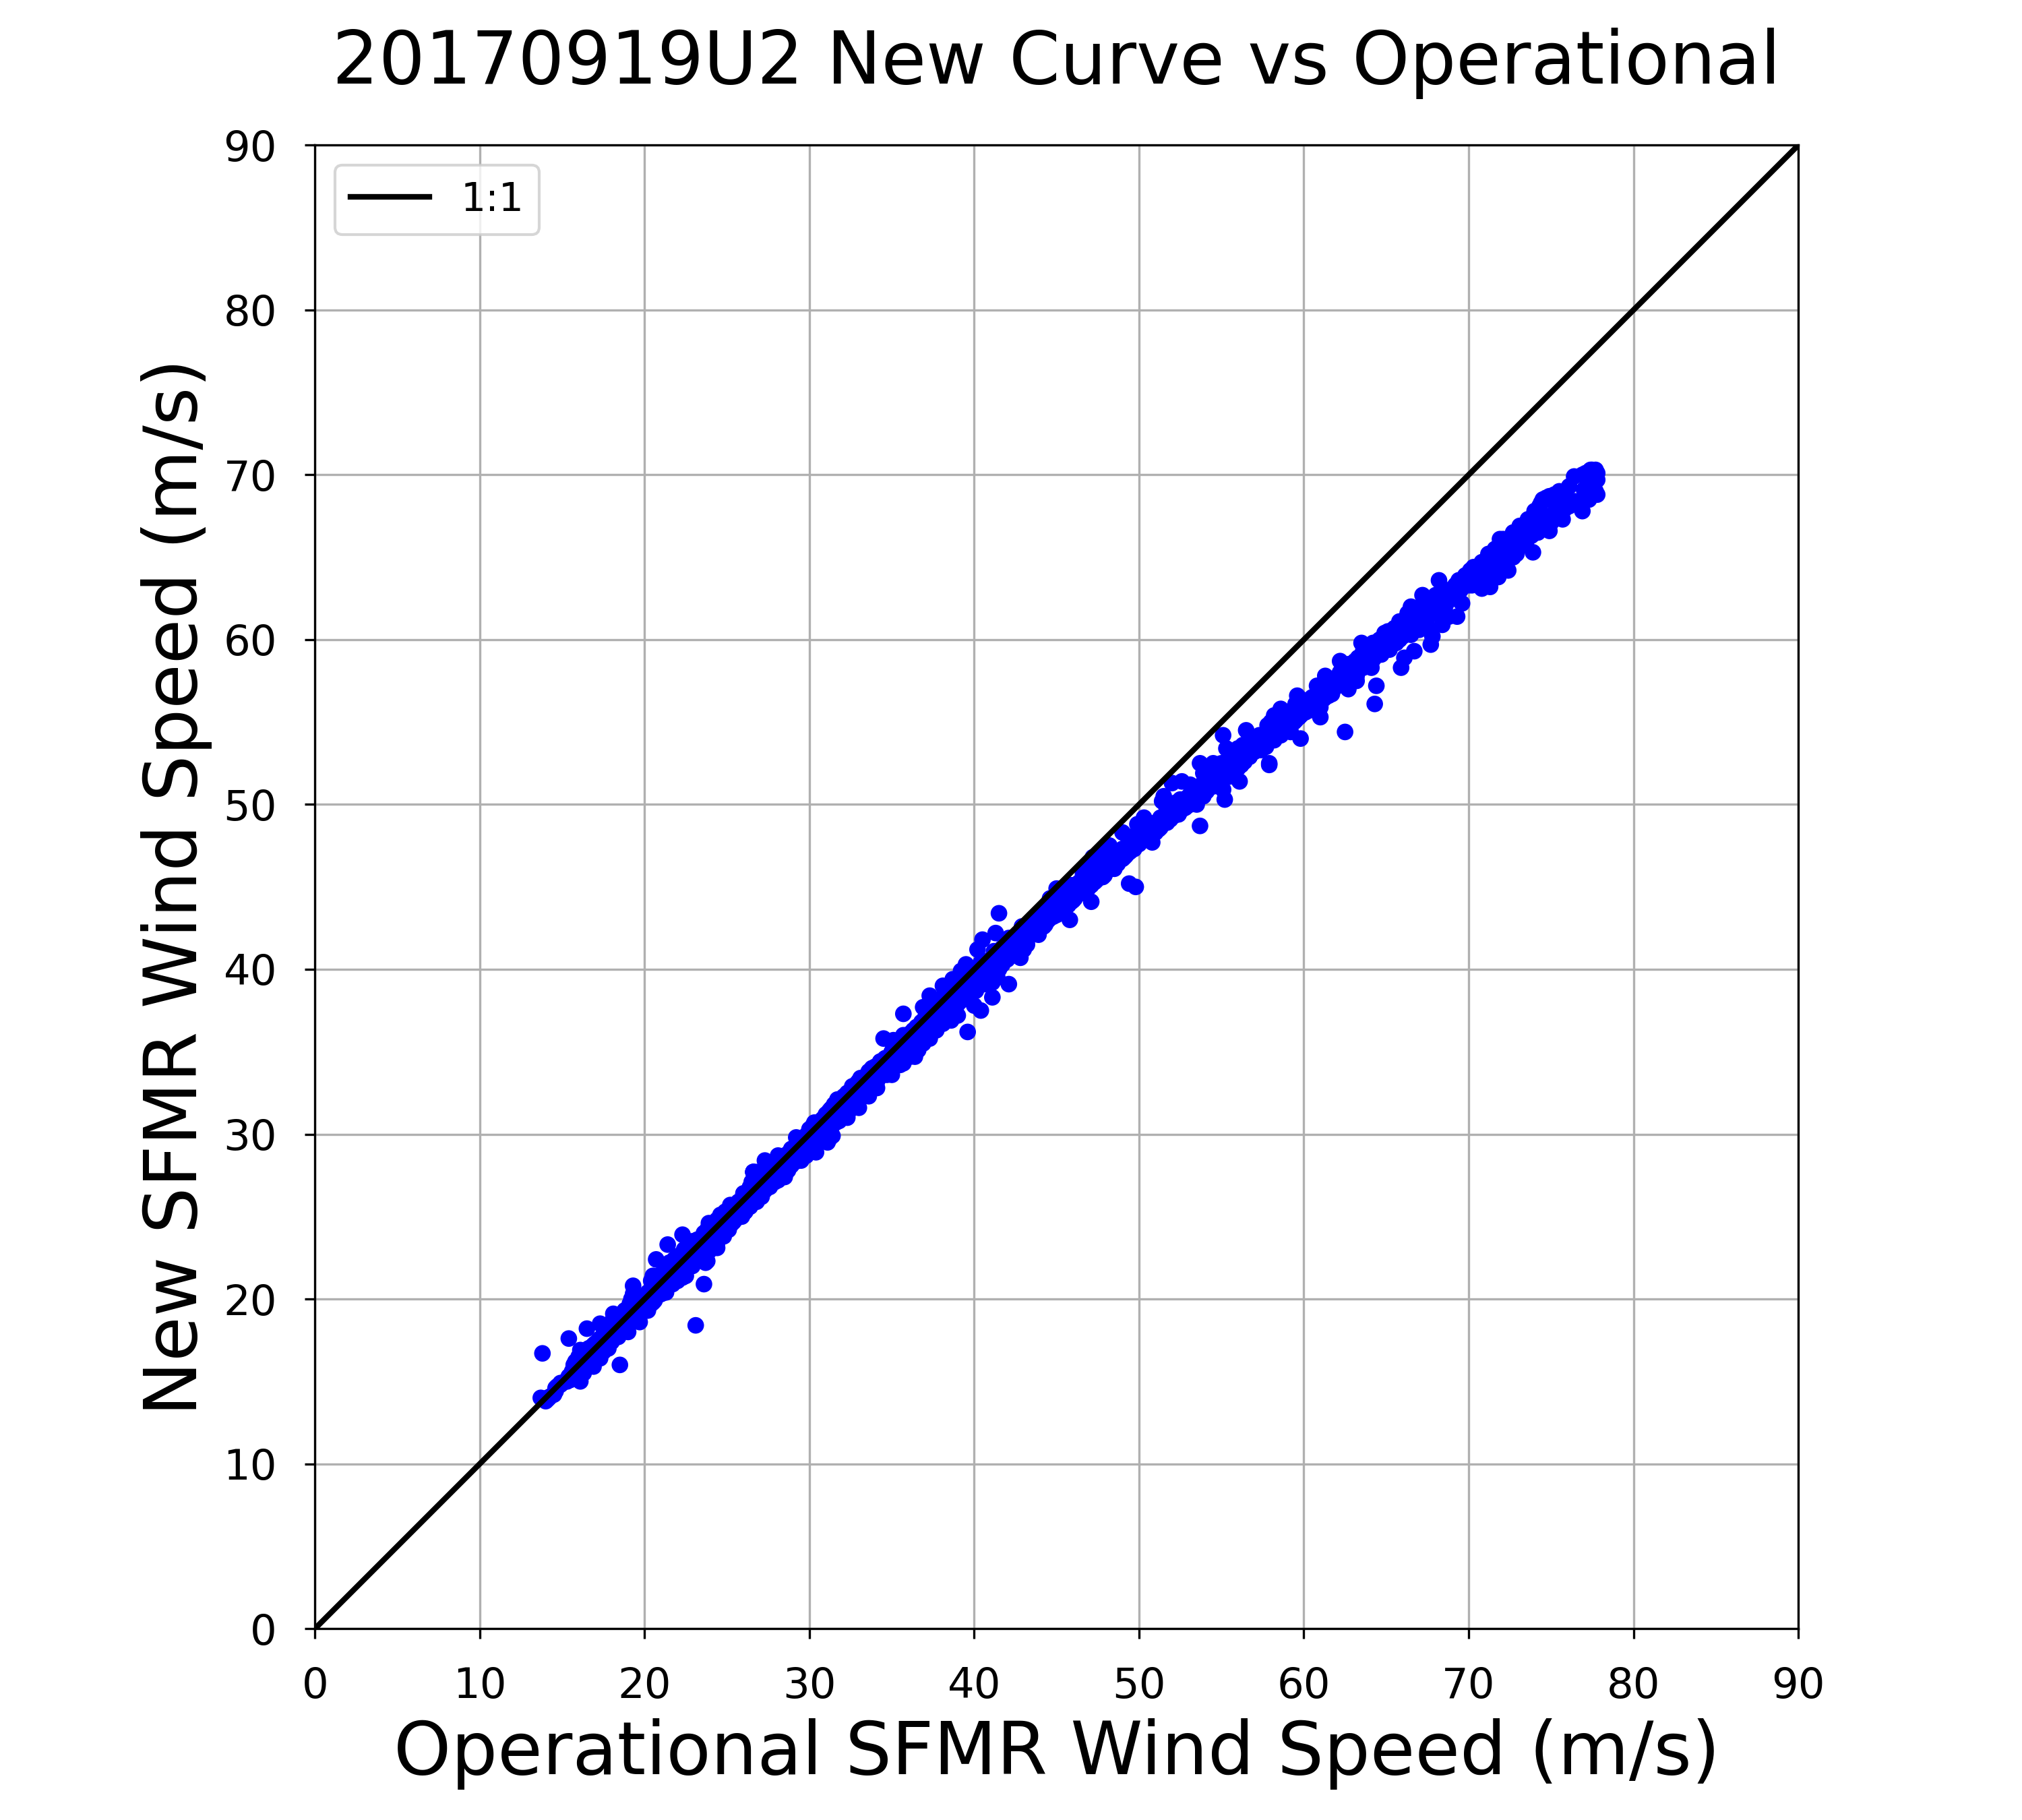
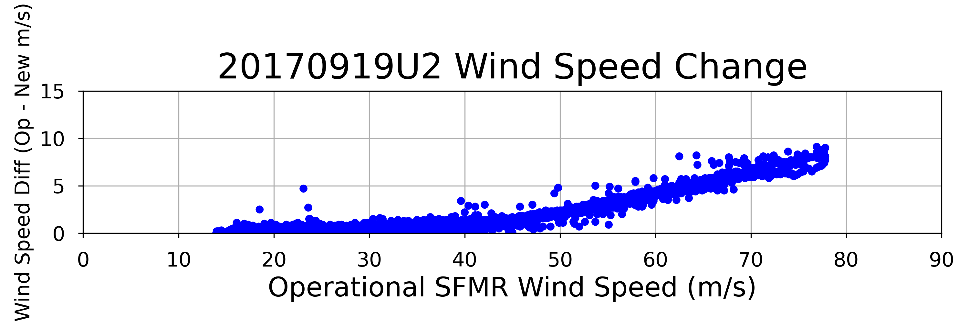
Hurricane Maria (2017)
175.0 kt
155.5 kt
136.1 kt
29.1 kt
116.6 kt
19.4 kt
97.2 kt
9.7 kt
77.8 kt
58.3 kt
38.9 kt
19.4 kt

Slide 22
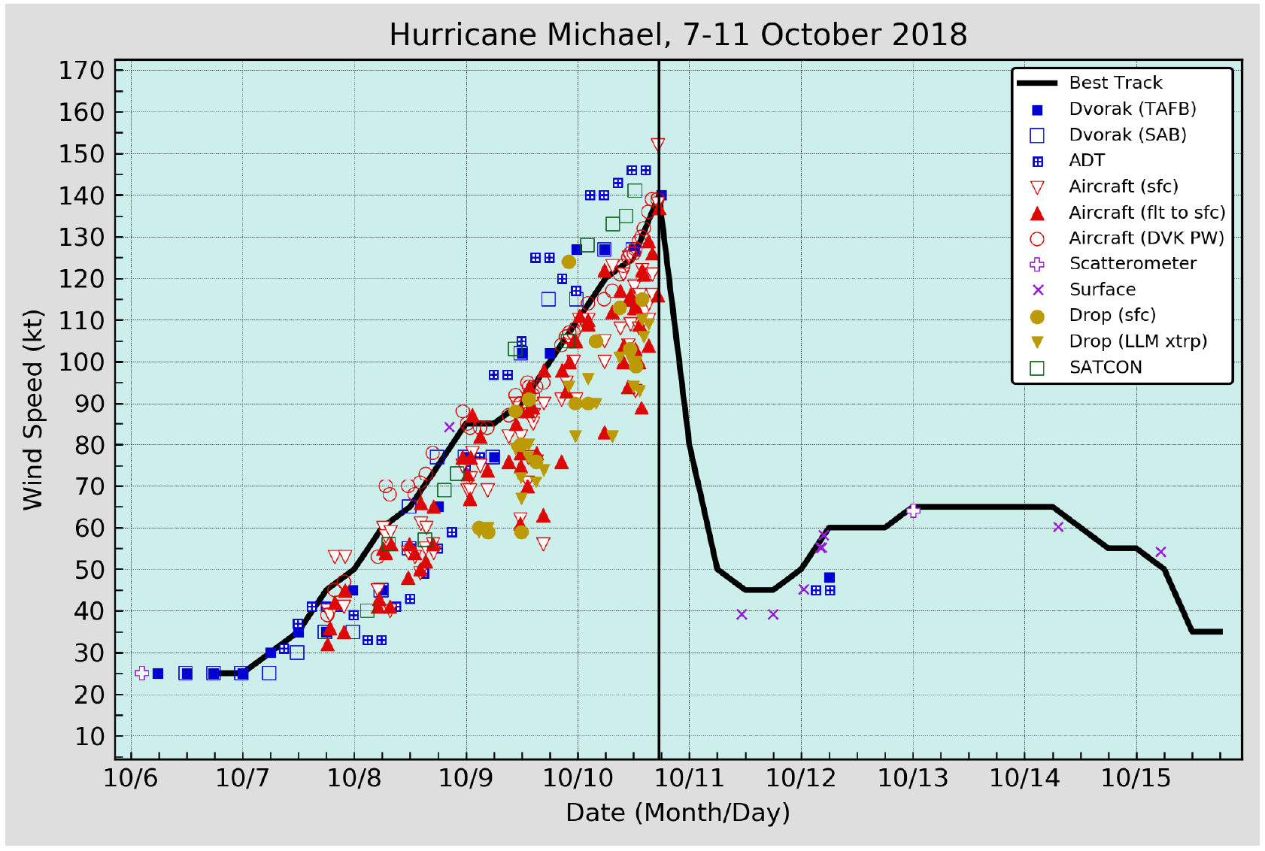
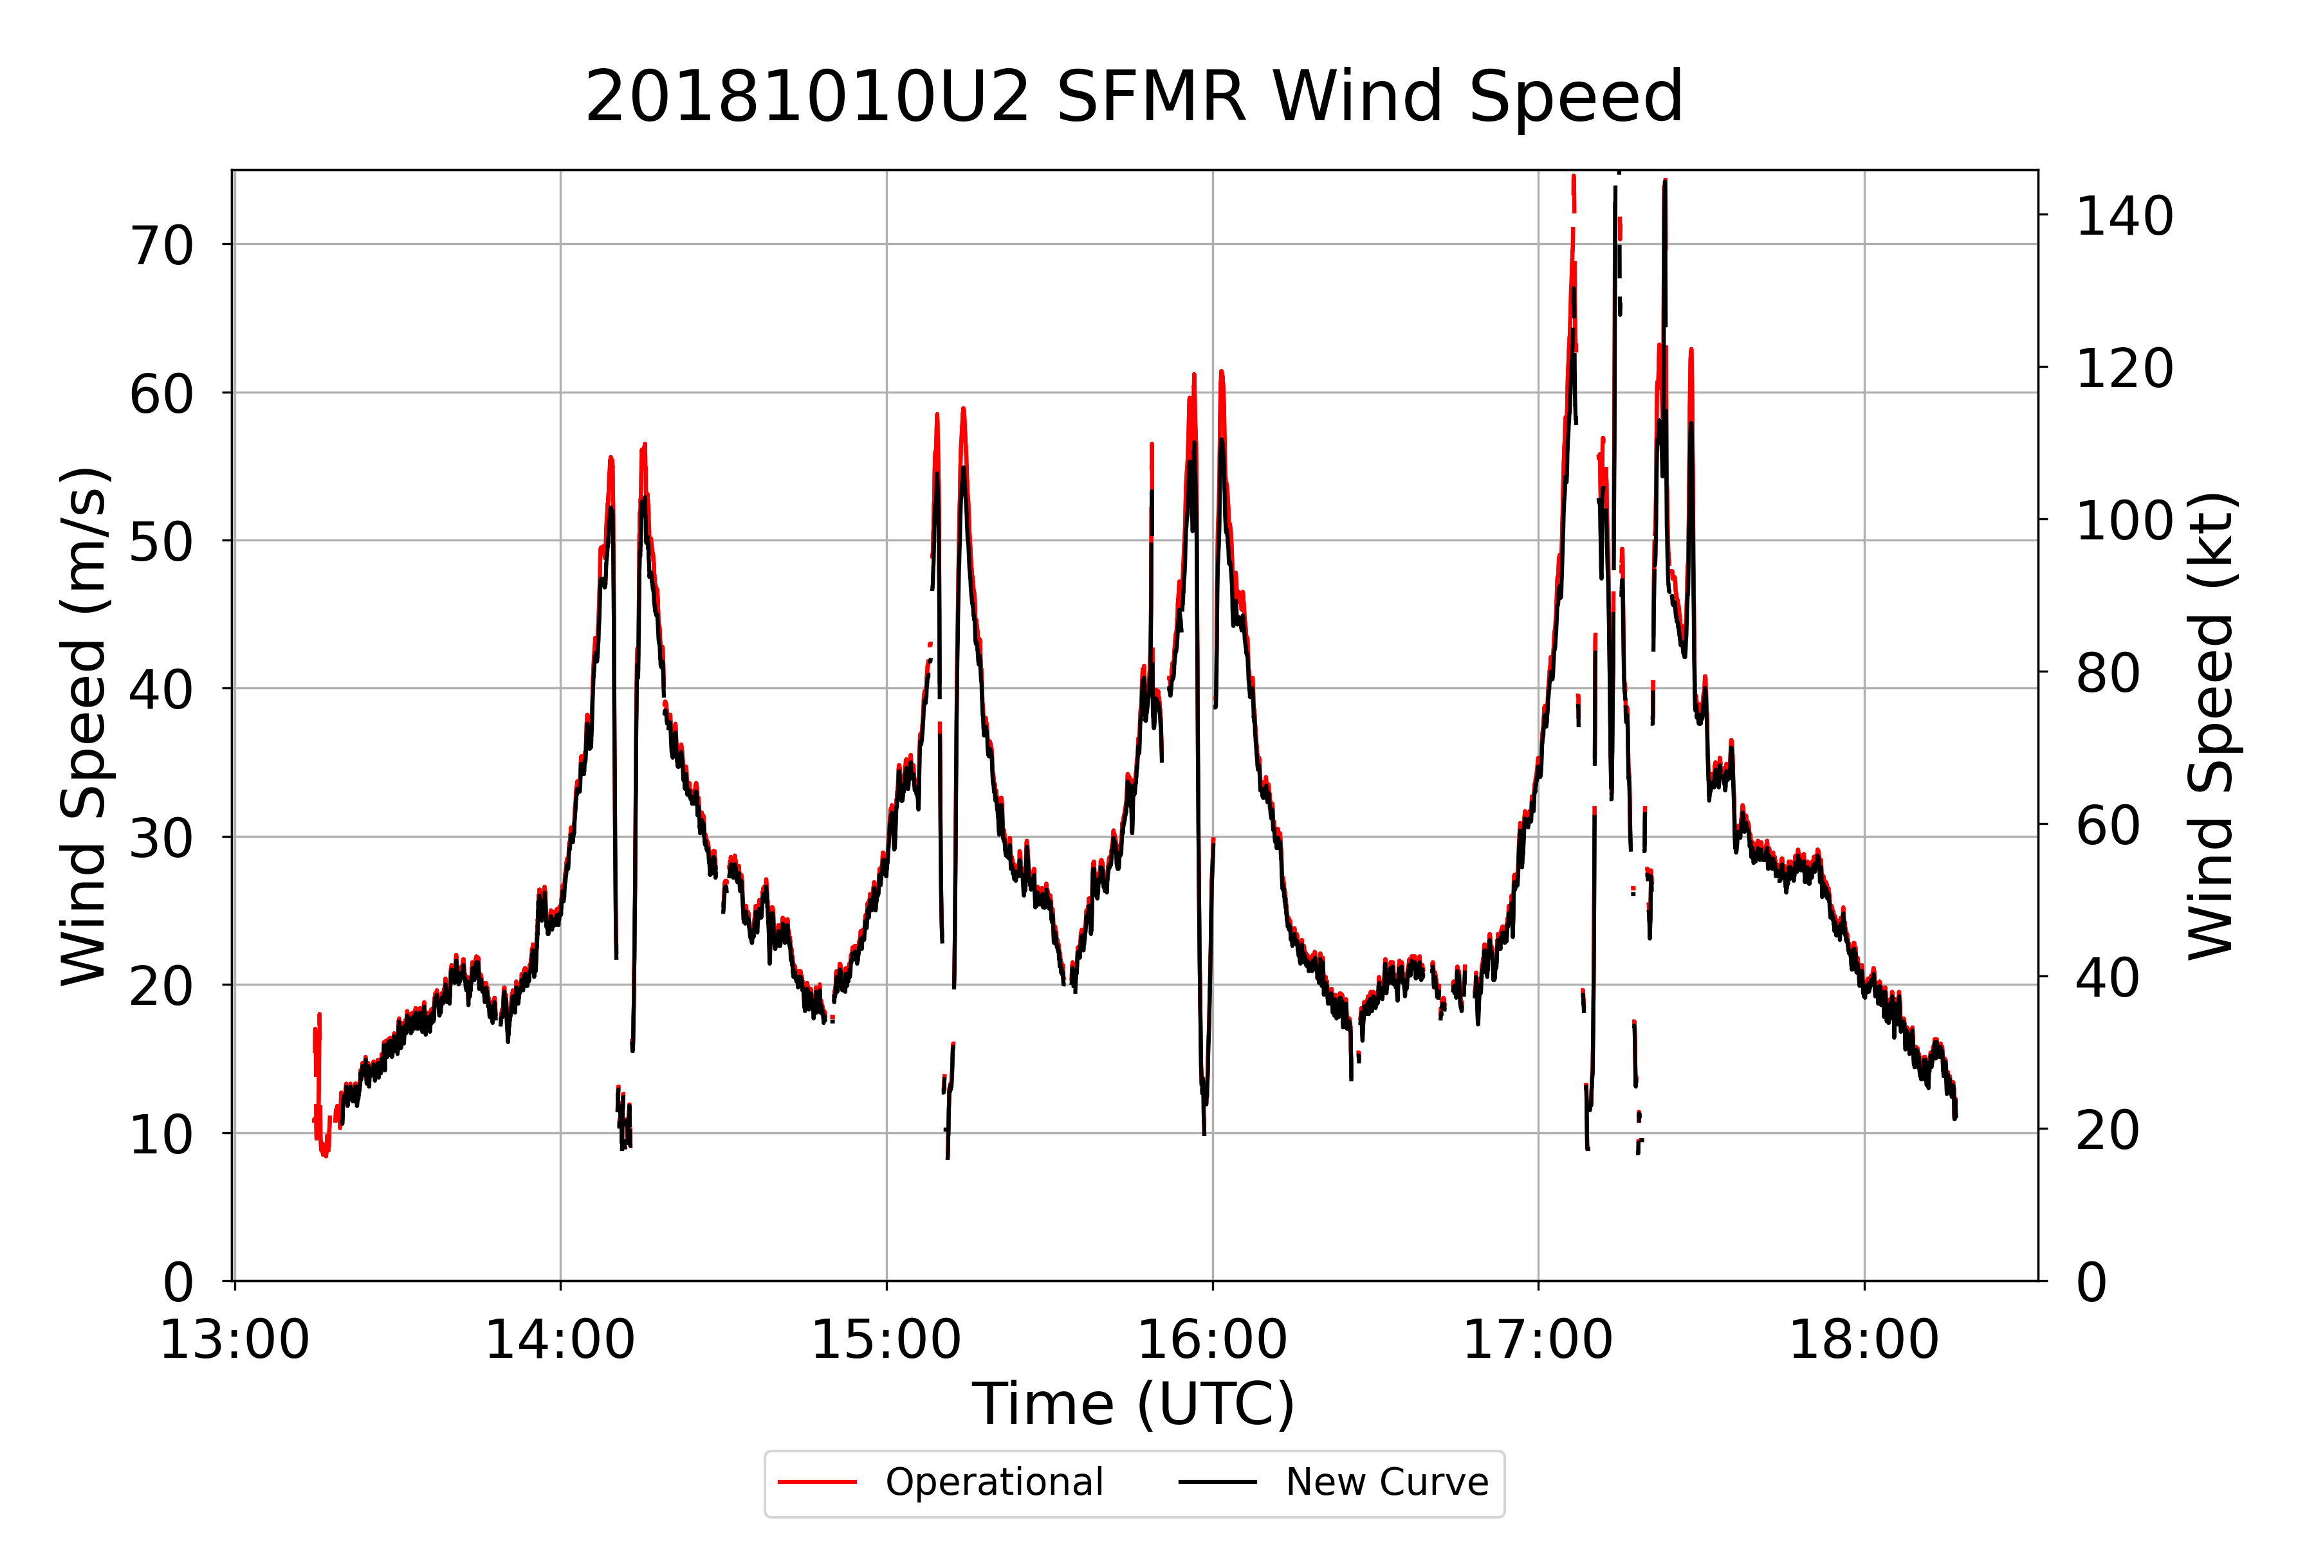
Hurricane Michael (2018)

Slide 23
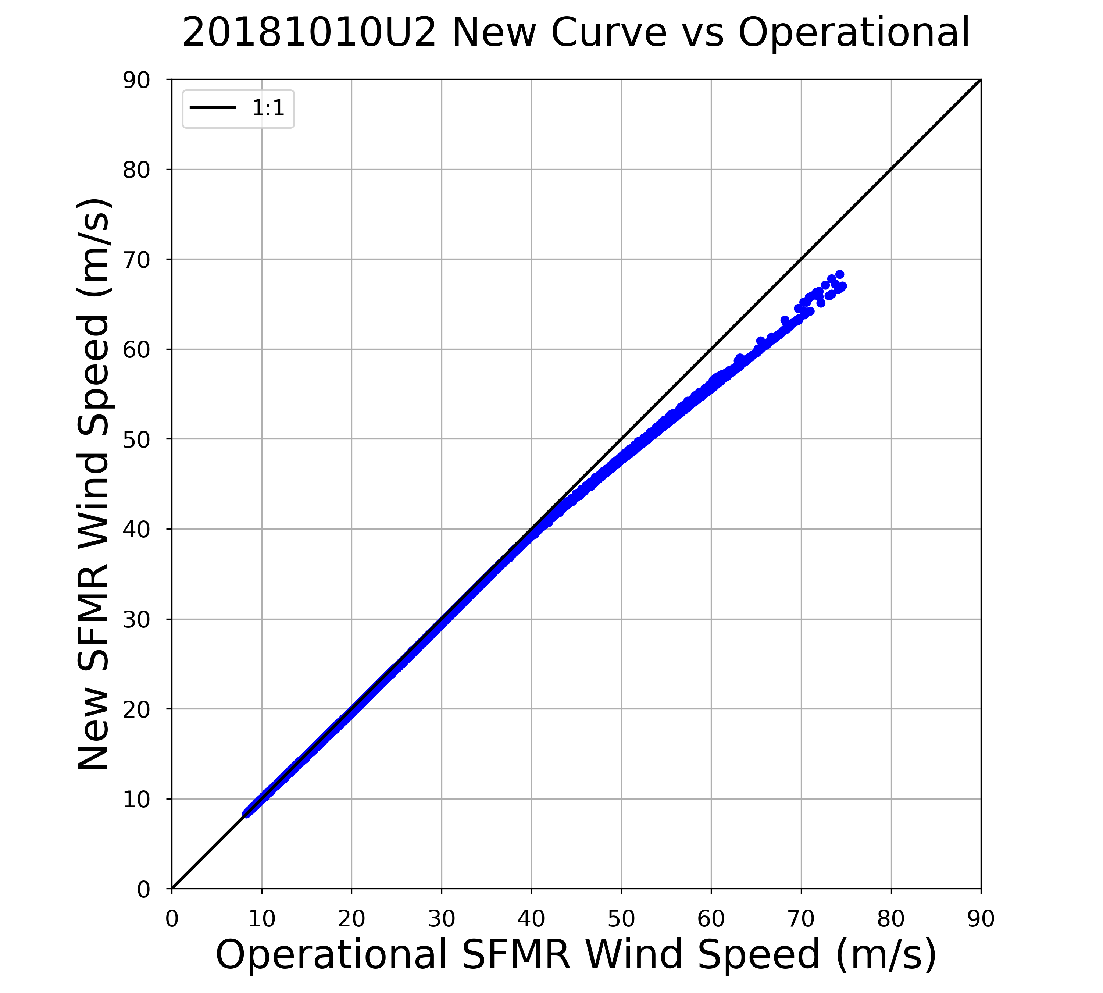
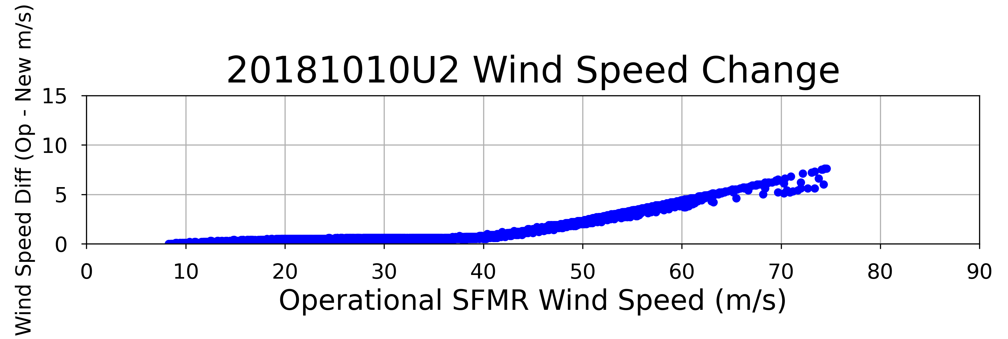
Hurricane Michael (2018)
175.0 kt
155.5 kt
136.1 kt
29.1 kt
116.6 kt
19.4 kt
97.2 kt
9.7 kt
77.8 kt
58.3 kt
38.9 kt
19.4 kt

