Slide 1
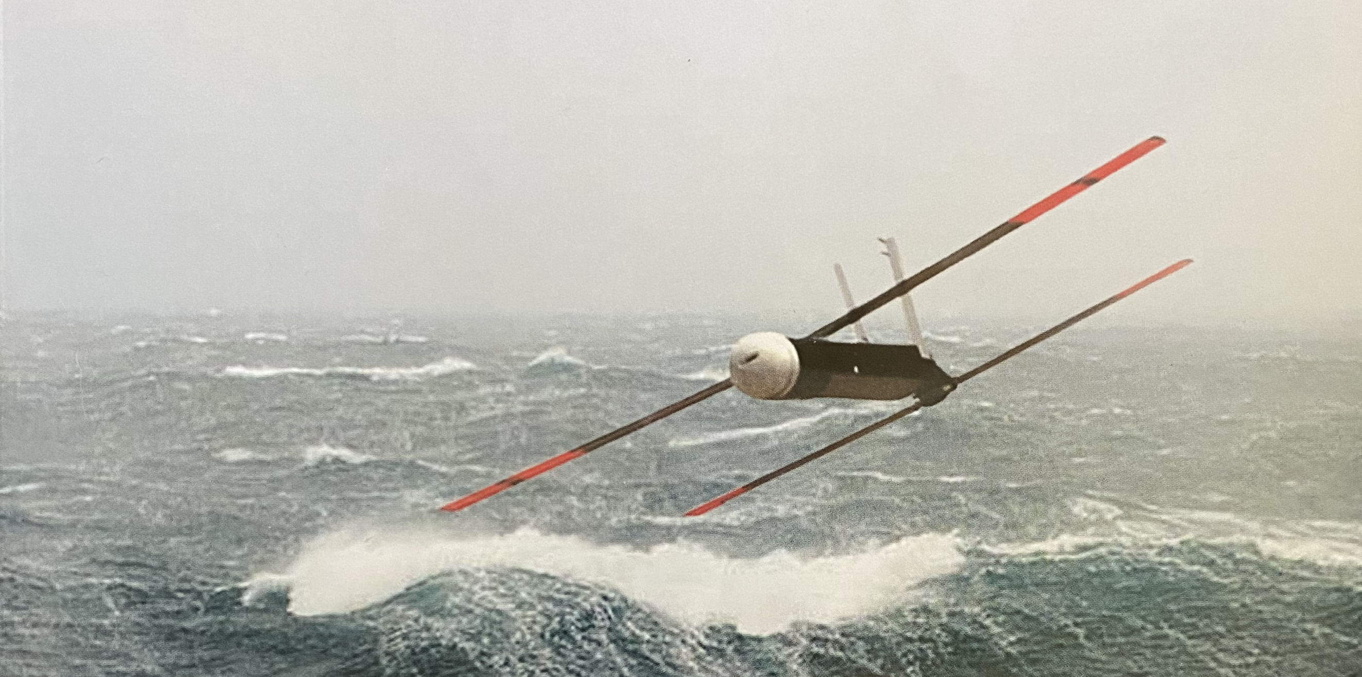



Exploring the Future of Hurricane Reconnaissance
Using Small Uncrewed Aircraft Systems (sUAS)
Joseph J. Cione
NOAA/AOML/HRD
(Many) Collaborators: AOML/HRD; NOAA/AOC; NCAR; UM/CIMAS; NOAA/ARL; NOAA/PSD; CU/CIRES; NOAA/GSD; NOAA/DTC and L3 Latitude

Slide 2
Background
sUAS operations date back to using the Aerosonde in ‘05 (Ophelia) and ‘07 and (Noel)
Observational Objective for using this technology:
Leverage key attributes of NOAA’s existing Hurricane Hunter aircraft to develop emerging unmanned technologies designed to enhanced data coverage of the critically important, yet sparsely-sampled tropical cyclone boundary layer environment.
End goal:
Through enhanced observation, improve basic understanding, operational situational awareness and ultimately, hurricane intensity forecast performance.

Slide 3
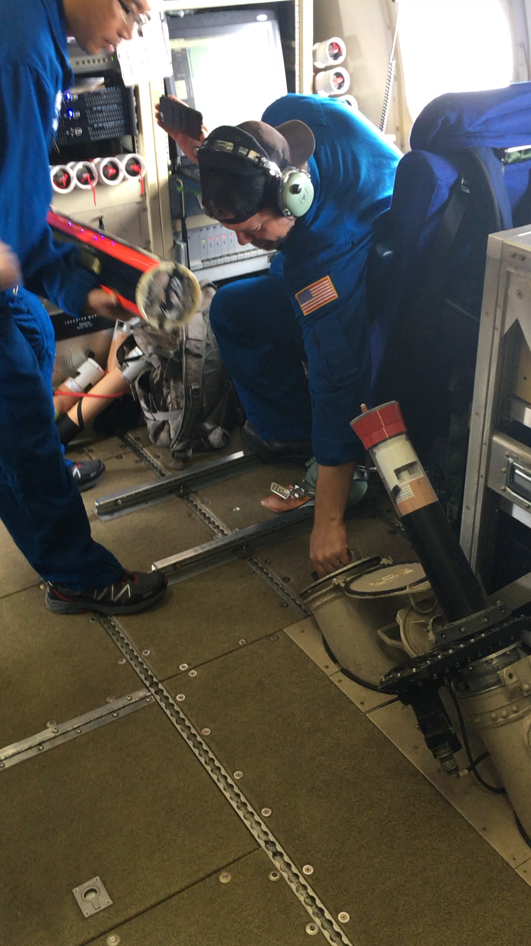
Launch!

Slide 4
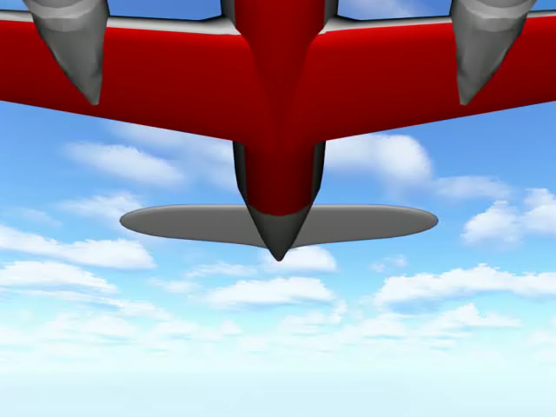
Post-Launch (with parachute):
video courtesy of Raytheon Corporation

Slide 5
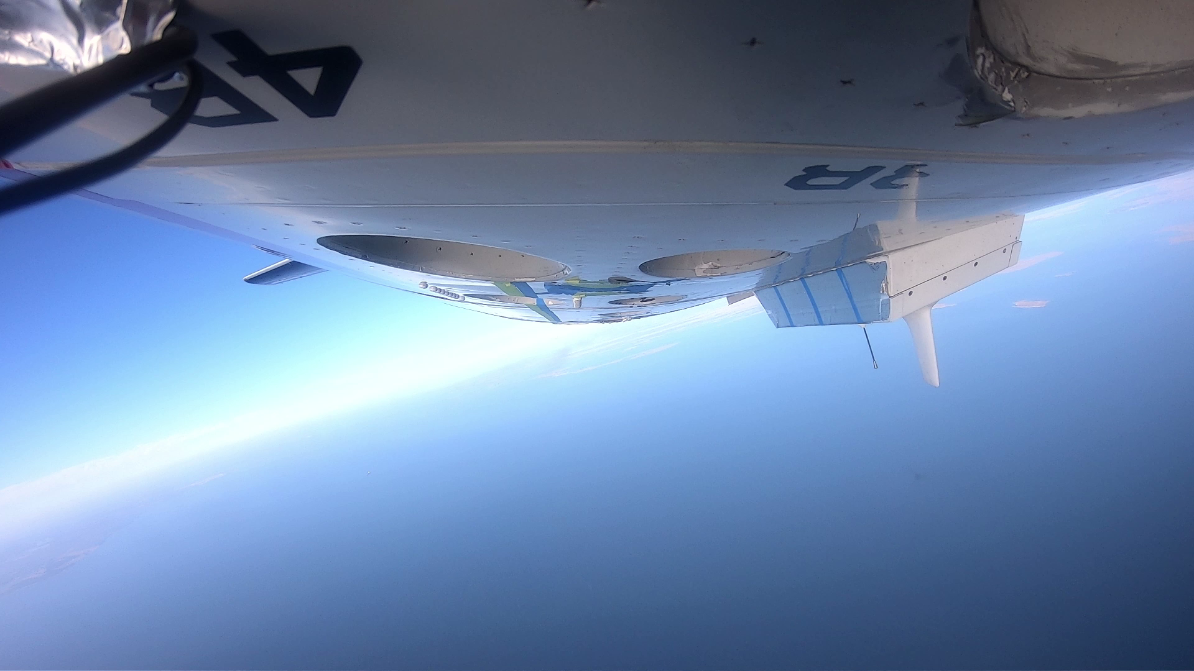
Post-Launch (without parachute):
video courtesy of Area-I

Slide 6
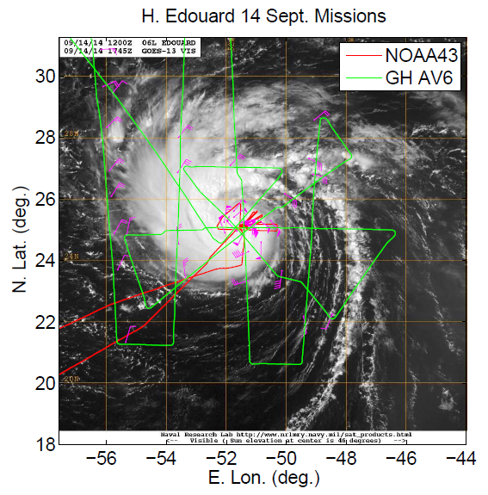
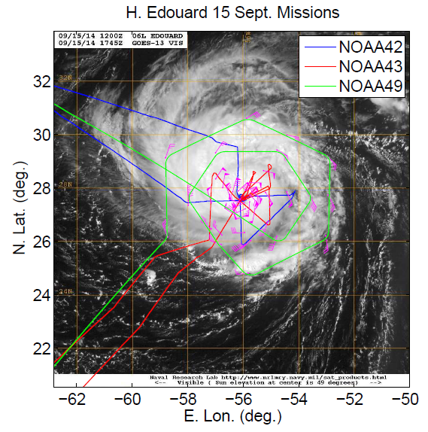
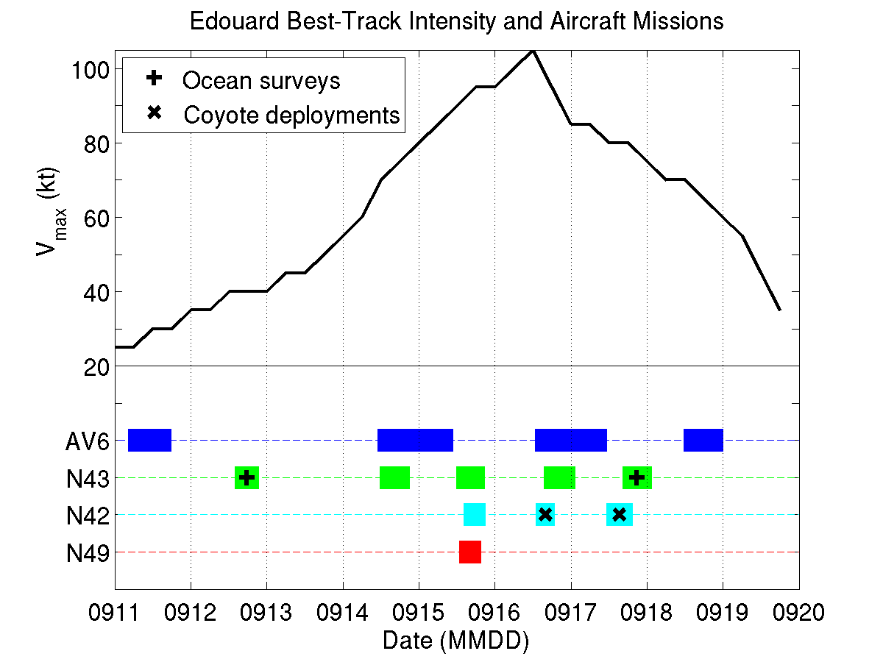
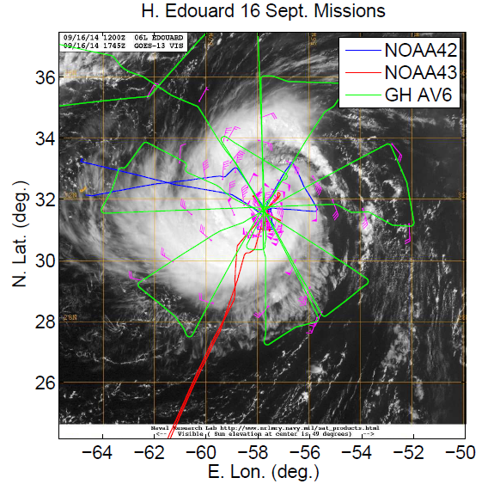
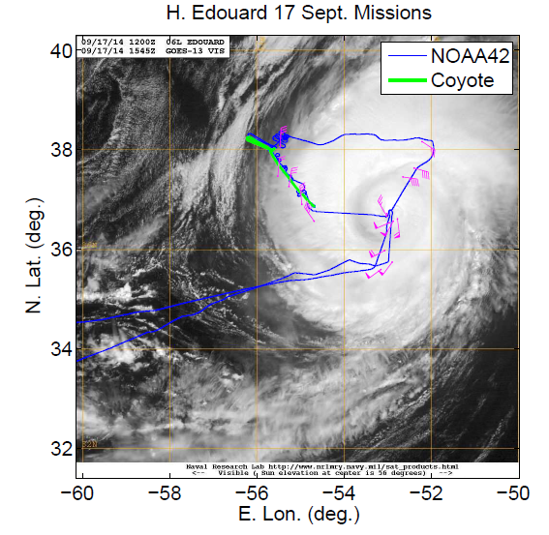
Current Capabilities: Proof of concept - Edouard (2014)
Aircraft based/used:
  St Croix (P-3 N43)
  Bermuda (P-3 N42, G-IV N49)
  Wallops Is. (GlobalHawk AV6)
  Two (2) sUAS deployed (Coyote)
a
b
x
x
c
d

Slide 7
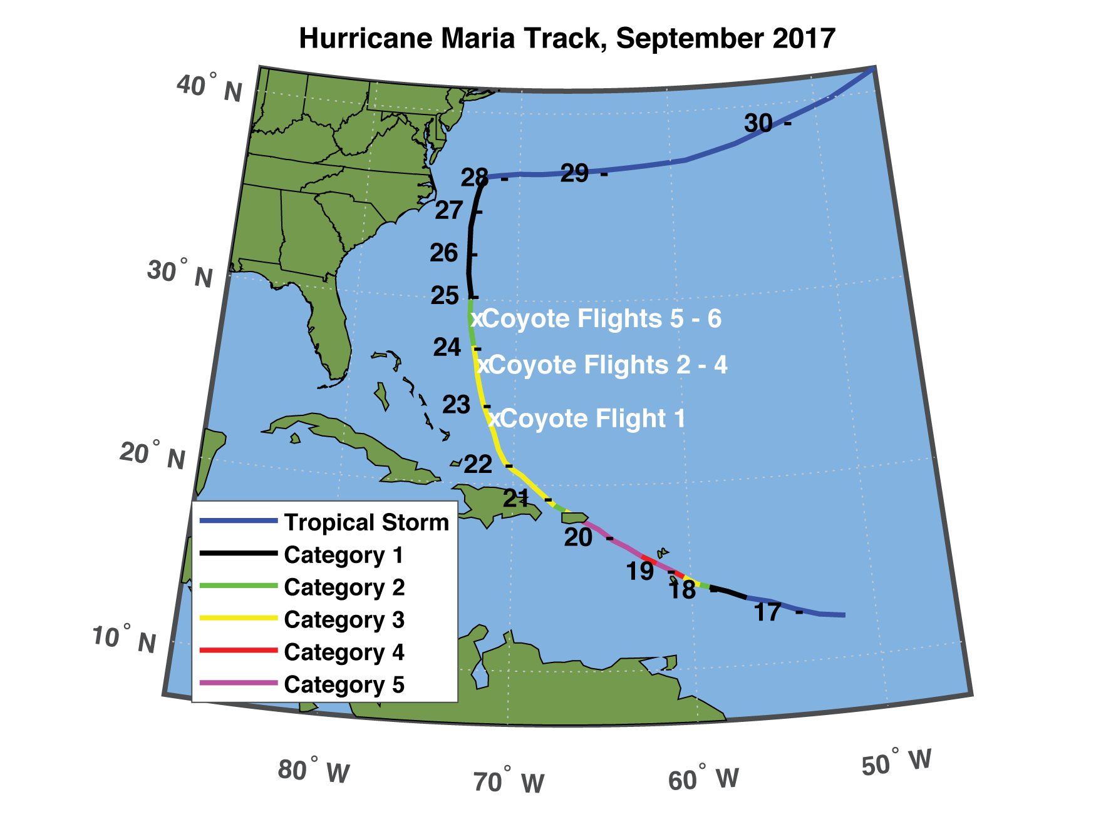
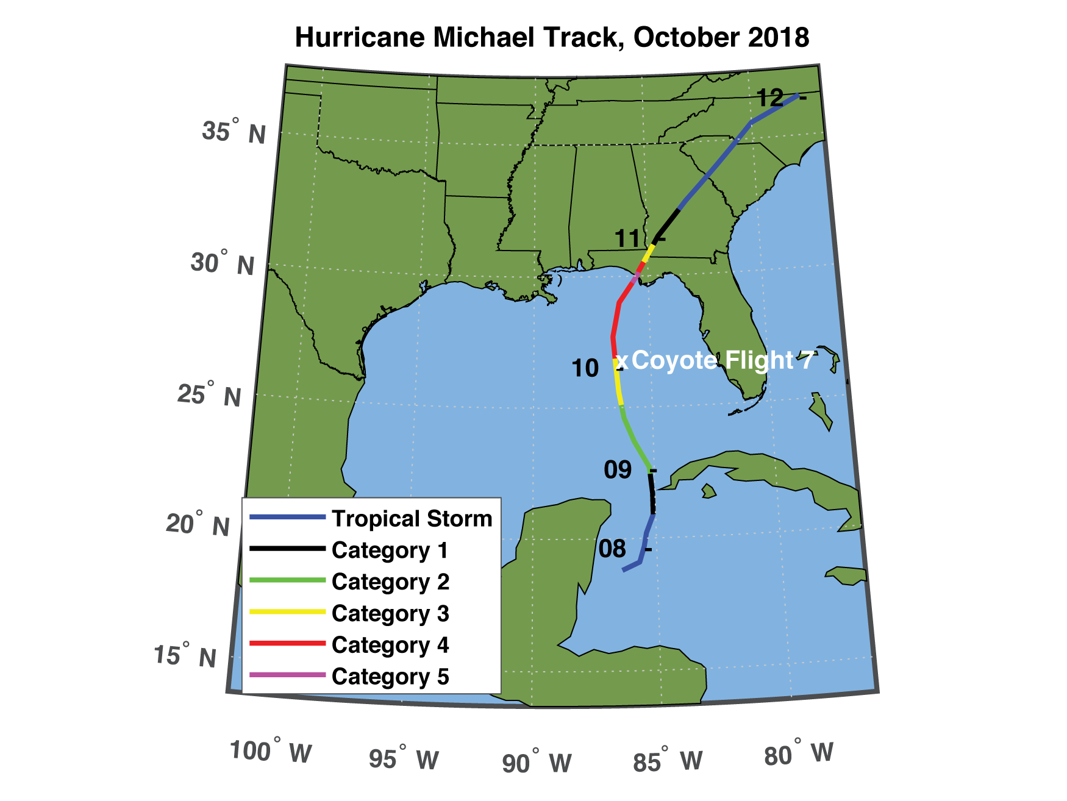
Current Capabilities: Significant Advancements –
Maria (2017); Michael (2018)
Six (6) total sUAS missions on 22-24 September 2017 (Maria)
One (1) sUAS flight on 10 October 2018 (Michael)
Longest duration mission: 41 minutes
Maximum horizontal wind speed: 87 m/s at 640 m ASL
Maximum vertical wind speed: +14.4 m/s at 620 m ASL

Slide 8
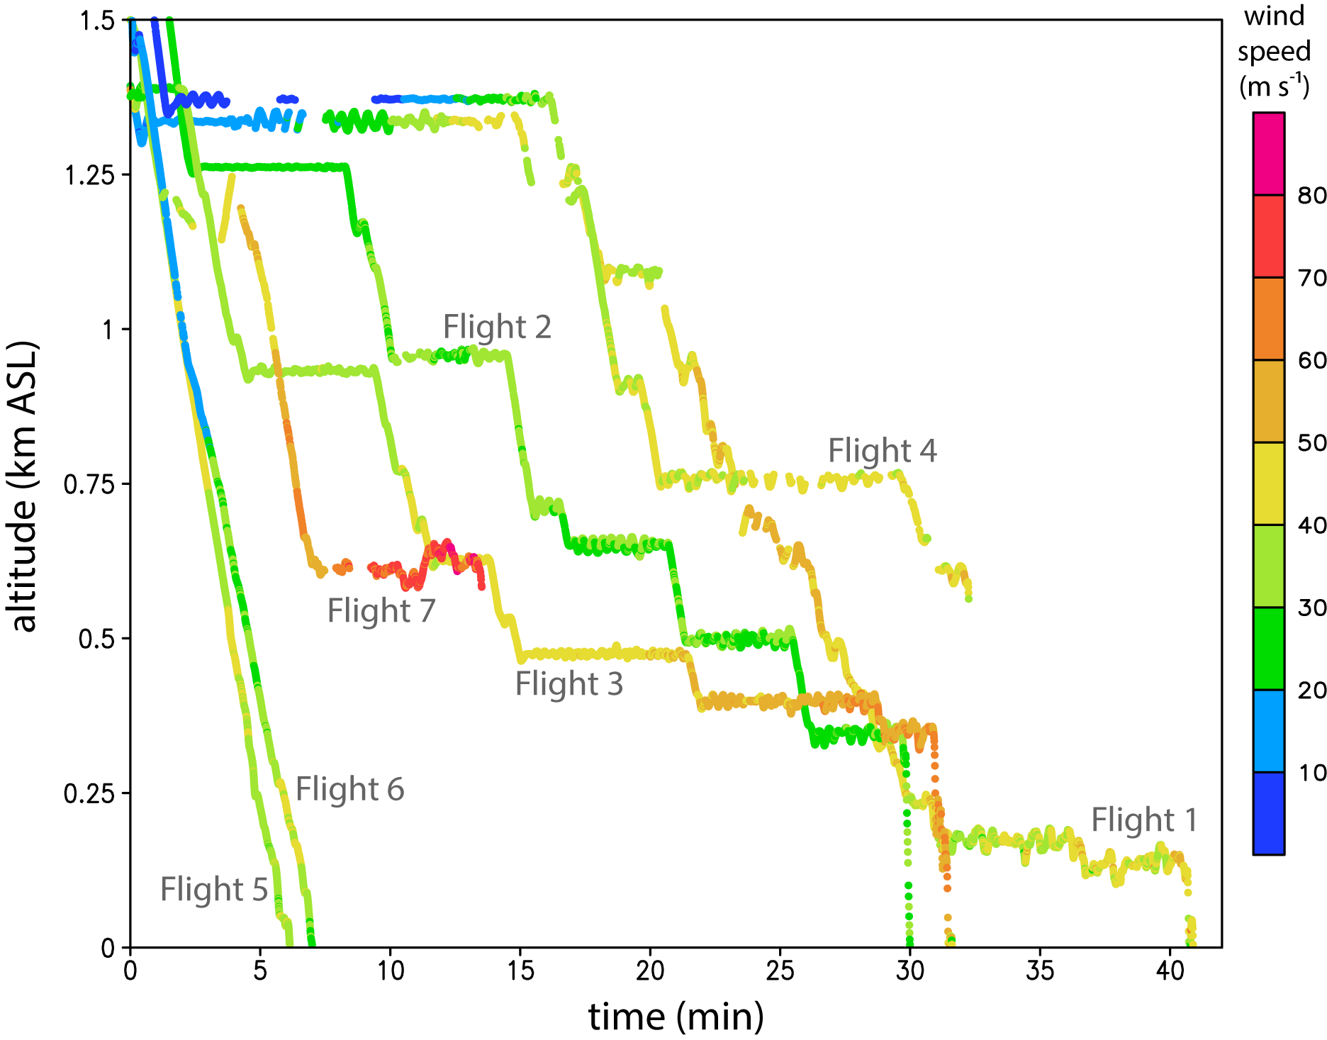
Summary of Maria (2017) and Michael (2018) sUAS Flights
Note: >90% data retrieval
(350 MHz data link)
Summary of all wind speed data collected during Coyote sUAS flights in 2017–2018 (m s⁻¹) as a function of time and height above sea level (ASL). Flights 1–4 and 7 were typical “stepped descent” flight patterns, while flights 5–6 were “glider” flights.

Slide 9
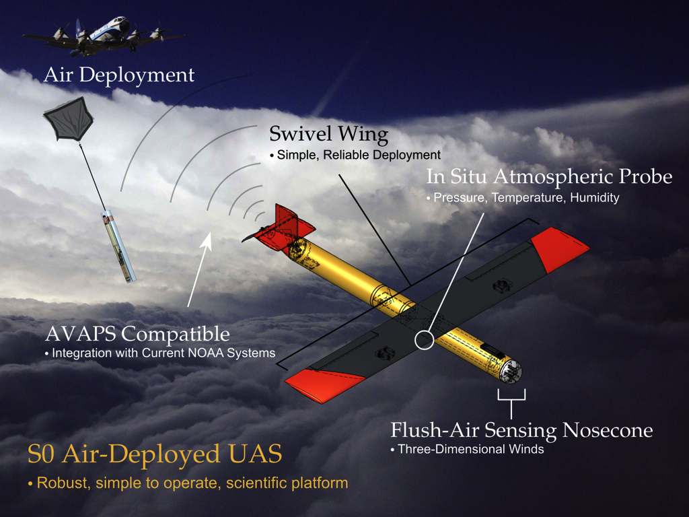
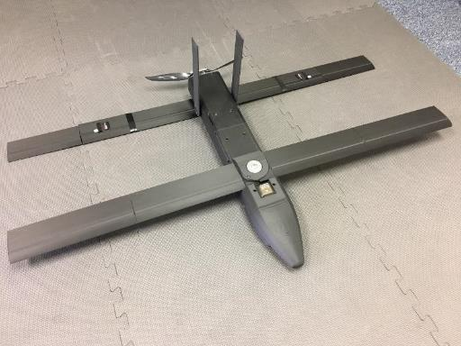
Near-term possibilities: Black Swift S0; Barron Wingsonde
Wingspan: S0 – 2 feet; WS – 4 feet
Weight: S0 – 3lbs; WS - 8.8 lbs
Performance (both): 25m/s cruise; 1-2h endurance
Range: >150nmi from P-3
Payload (both): Vaisala RSS421 PTH, IR (SST), Laser Altimeter, 3D winds (5hz)
Intended Flight Design: Air-Deployed, Autonomous, Multi-flight modes (e.g. eyewall, eye loiter, inflow)

Slide 10
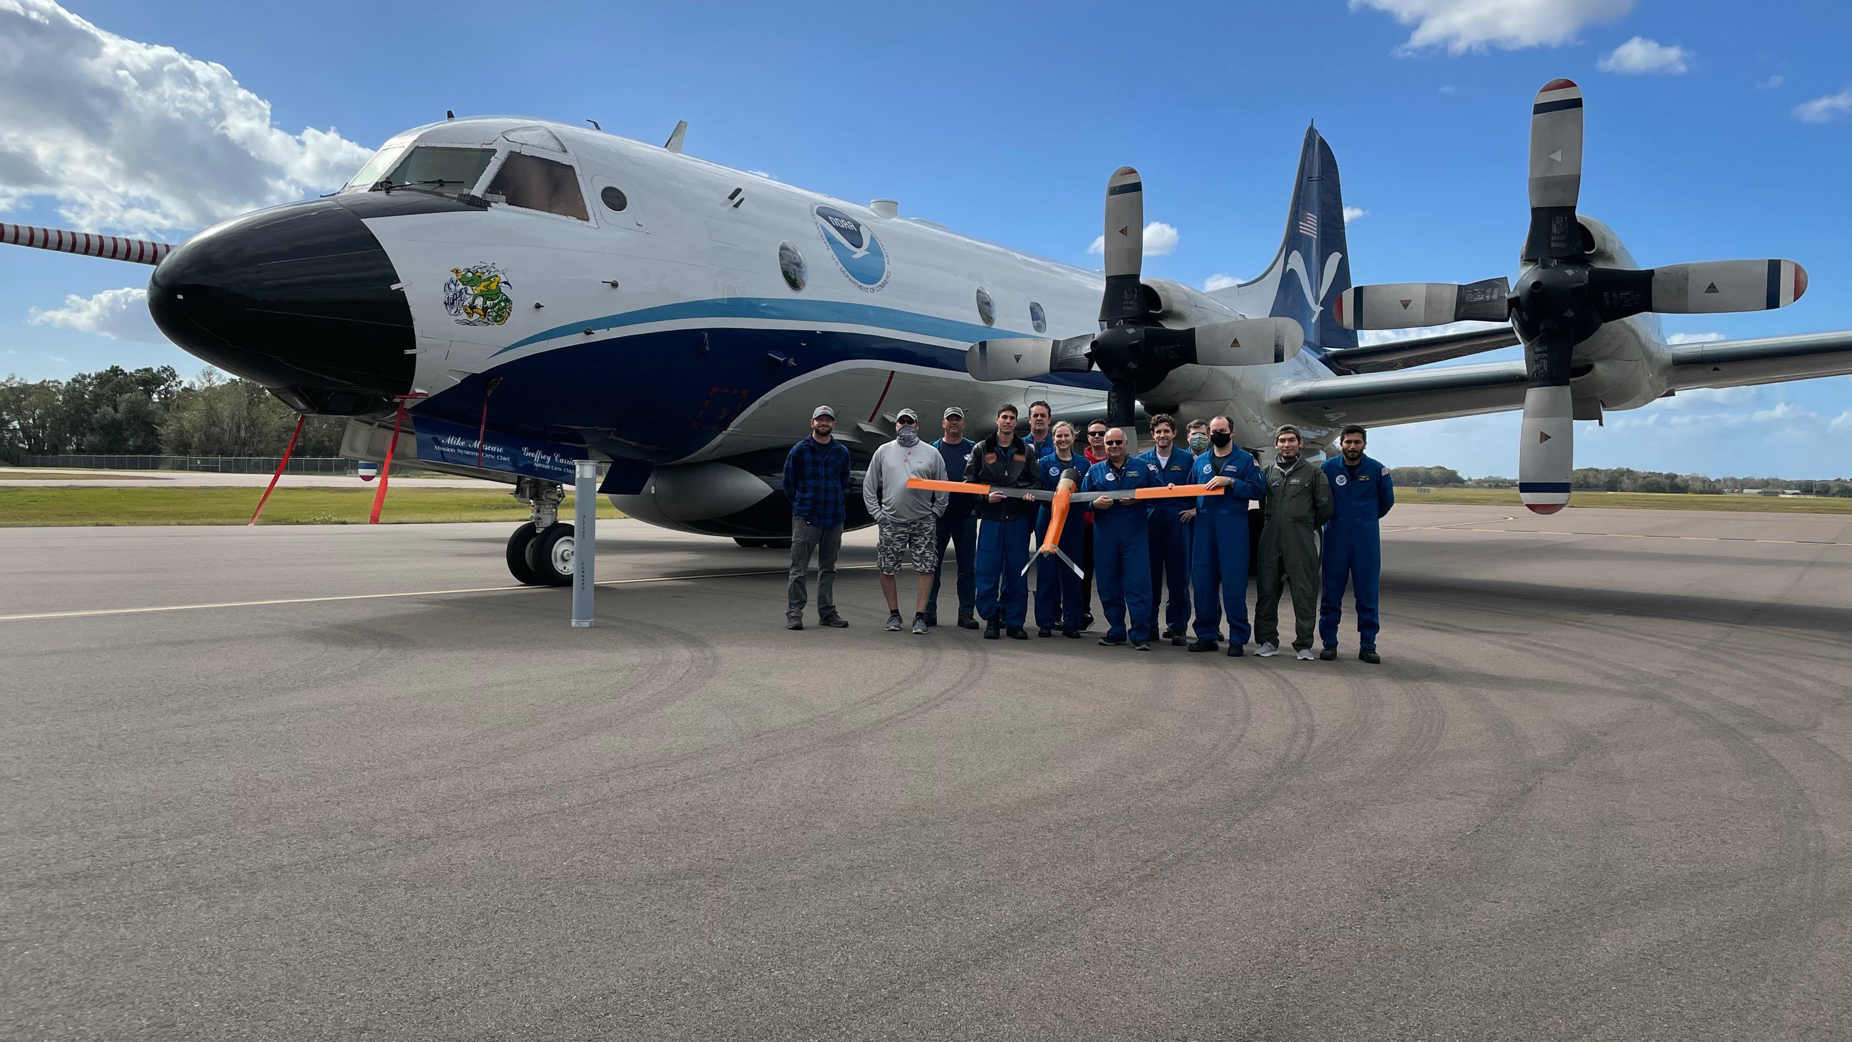
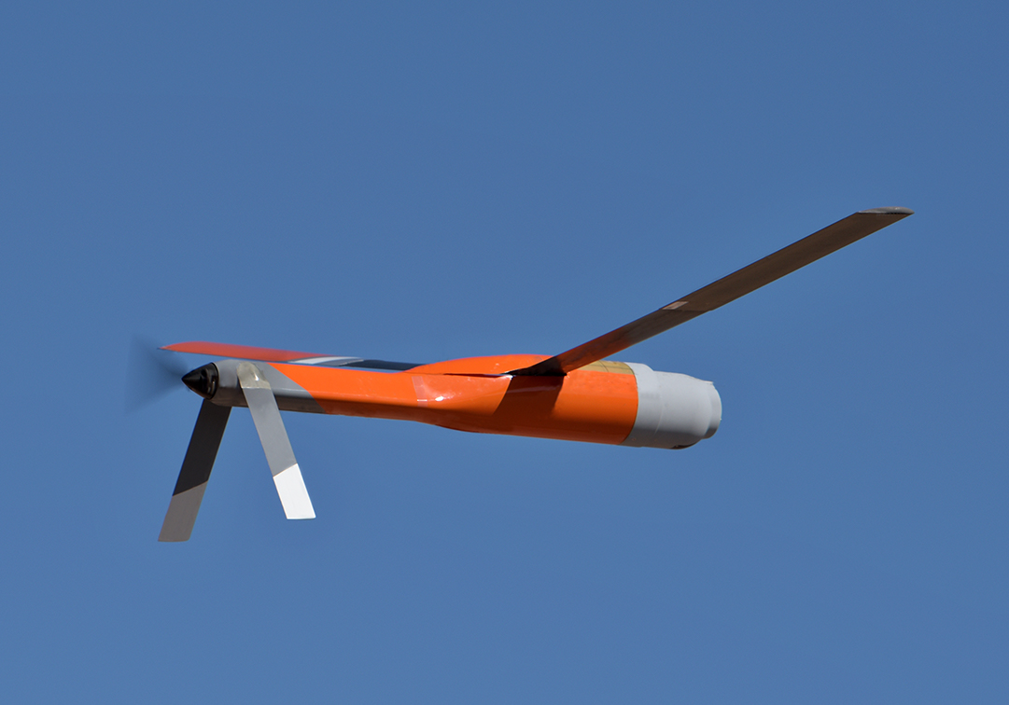
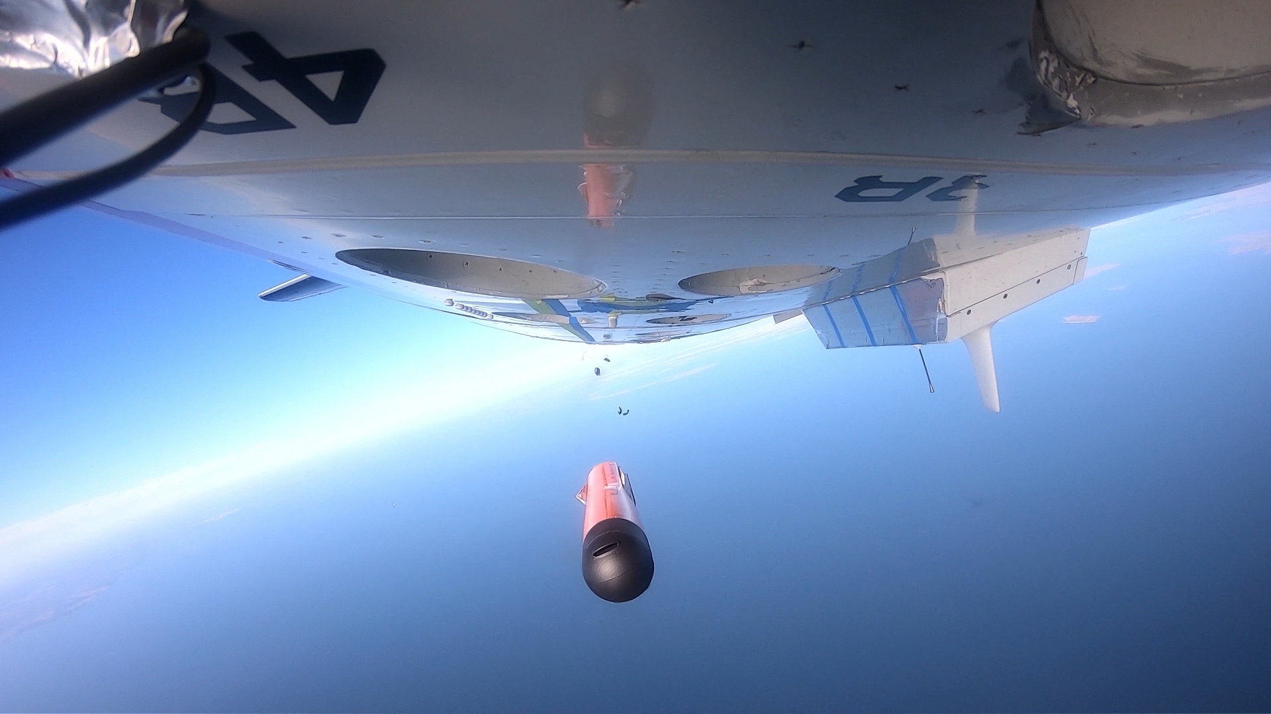
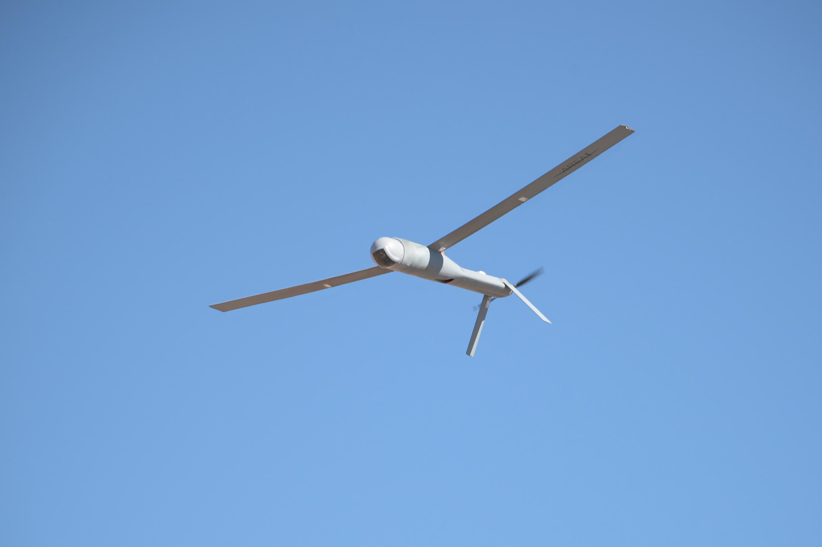
Near(est)-term possibility: AREA-I Altius 600
Wingspan: 9 feet
Weight: 25-27 lbs
Performance: 25m/s; 3-4h endurance
Range: 190 nmi from P-3
Payload: Vaisala RSS421 PTH, IR (SST), 2D winds (3D winds/turbulence; Radar/Laser Altimeter in 2022?)
Intended Flight Design: Air-Deployed, Autonomous, Multi-flight mode (e.g. eyewall, eye loiter, inflow)
Success! Clear Air Tests out of NAS PAX 1/13-15/2021
New record for P3-to-sUAS range (193mi!); Old record: 18nmi
New record for sUAS endurance potential* (4h); Old record 1h
*in-air flight time plus battery reserve after landing

Slide 11
Challenges and Gaps
Meeting the Requirements for All Future sUAS TC Operations…
Cost: Improvement over GPS dropsonde (~$300/min; $900/3 min) (PBL)
Command and Control (C2): 150nmi range between sUAS and P3 (C130)
Payload: High QC, reliable (Vaisala RD41; NOAA GPS Drop/Up Sondes)
Survivability_1: Consistency, 210-220kt air-deployed launch (P3/C130)
Survivability_2: Severely turbulent, high wind hurricane conditions
Full Autonomy : No onboard sUAS pilots (Similar to Dropsonde release)
Where are we right now (April 2021)?
- Cost: ALL 3 have, so far, met cost requirements (~$40- $200/minute)
- C2: Area-I’s Altius 600: up to 4h duration*, 193 nmi (P3-to-sUAS range)
- Payload: All have made strides (ground testing); Altius CAT prelim success (PTHU/SST)
- Survivability (1): Altius: CAT success; Barron, Blackswift: (Unknown)
- Survivability (2): All 3 (Unknown)
- Automation: All in progress…
What's Next?
Additional payload testing (Altius) April-July
Altius 600 final production (likely 4 sUAS) delivered by August
In-Storm Altius 600 Testing during the 2021 Hurricane Season
Continued development and testing of Black Swift and Barron sUAS

Slide 12


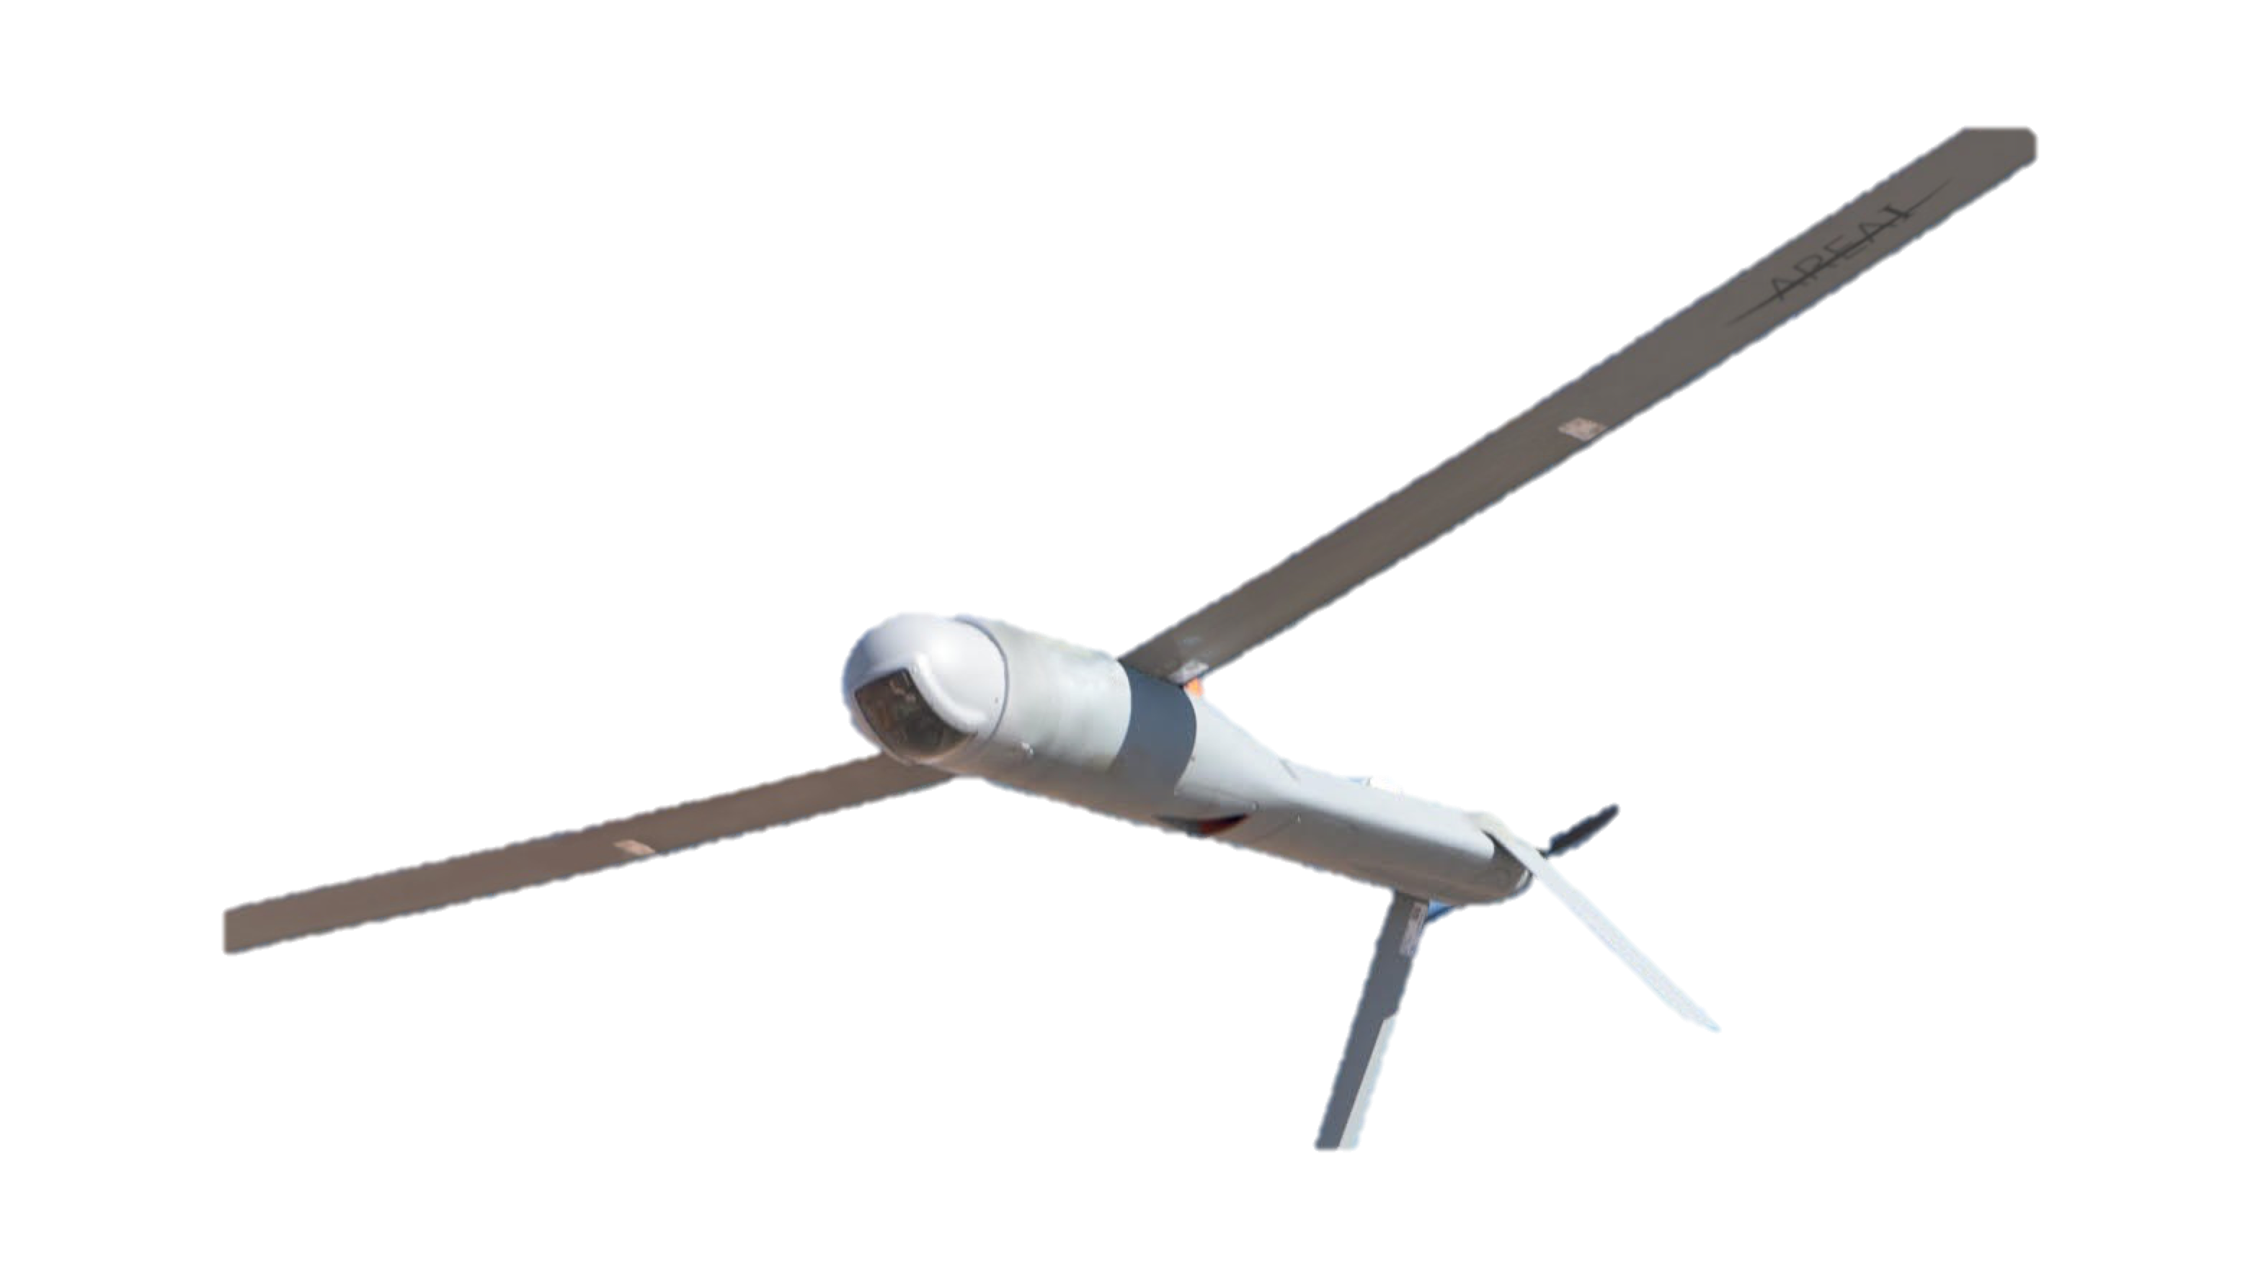
2021 NOAA/AOML/HRD Hurricane Field Program
Intensity Forecast Experiment (IFEX)
RESEARCH IN COORDINATION WITH OPERATIONS SMALL UNMANNED AIRCRAFT VEHICLE EXPERIMENT(RICO SUAVE)
jj
Science Team: Joseph Cione, Jun Zhang, George Bryan (NCAR), Ron Dobosy (NOAA/ARL-ret), Altug Aksoy, Frank Marks, Kelly Ryan, Brittany Dahl, Josh Wadler, Josh Alland (NCAR), Rosimar Rios-Berrios (NCAR), Gijs deBoer (NOAA/PSL), Evan Kalina (NOAA/DTC), Don Lenschow (NCAR), Xiaomin Chen, Chris Rozoff (NCAR), Eric Hendricks (NCAR), Falko Judt (NCAR), Jonathan Vigh (NCAR)
Plain Language Description: Use small drones to sample the lowest and most dangerous regions of the tropical cyclone. Observations from these unique platforms have the potential to improve basic understanding and enhance situational awareness. Analyses of data collected from these small drones also have the potential to improve the physics of numerical models that predict changes in storm intensity.

Slide 13
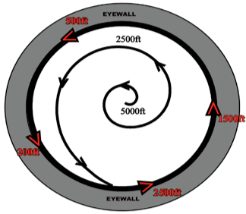
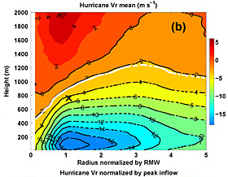
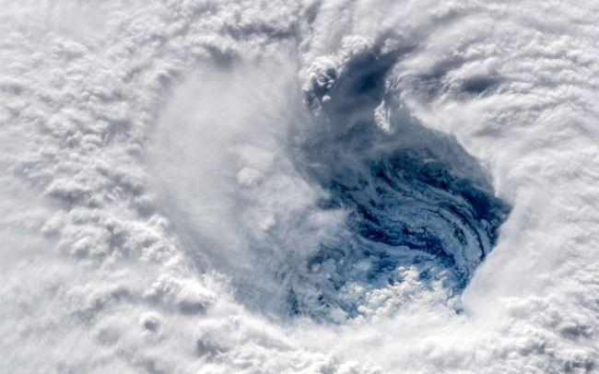
2021 NOAA/AOML/HRD Hurricane Field Program - IFEX
MATURE STAGE EXPERIMENT (RICO SUAVE)
Objectives:
Eyewall Module: Provide sUAS HDOBS at multiple altitudes and azimuths to NHC in near real time. Post storm, comparing sUAS atmospheric and SST high wind observations with operational analysis and forecast fields from coupled HWRF and HAFS.
Inflow Module: Provide sUAS HDOBS in near-real-time to NHC. Post storm, compare sUAS TC boundary layer (BL) thermodynamic, kinematic and SST radial structure with model output to improve TC BL parameterizations and ocean response in HWRF and HAFS.
Center Fix/Eye-Eyewall Module: Provide sUAS HDOBS and center fix estimates in near-real-time to NHC. Post storm, compare sUAS TC BL thermodynamic, kinematic and SST structure within the eye and eye/eyewall interface with mode output to improve TC BL parameterizations and ocean response in HWRF and HAFS.

Slide 14
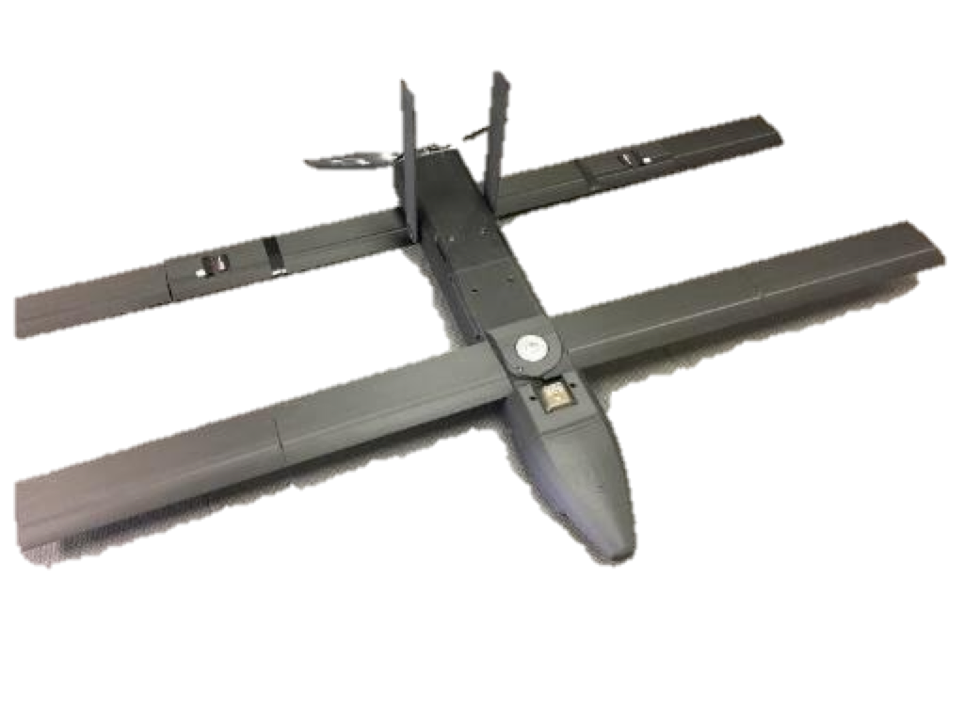
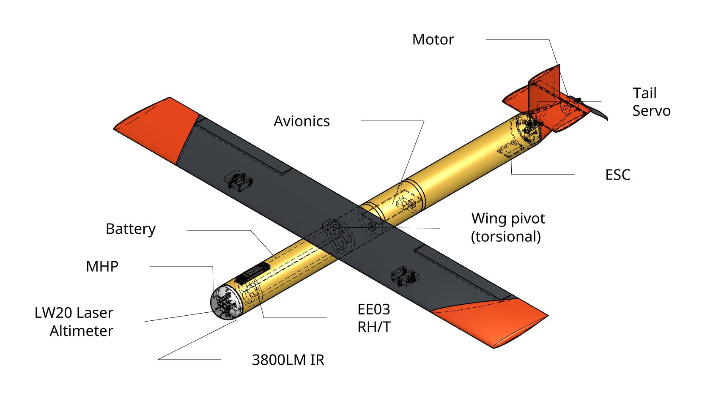
Summary
Observations from small Unmanned Aircraft Systems (sUAS) have the potential to enhance the basic understanding of dangerous and difficult to observe regions of the Tropical Cyclone, including the critical air-sea interface.
These unique data have the potential to improve situational awareness and future forecasts of Tropical Cyclone intensity change using NOAA’s operational coupled-ocean atmosphere modeling system.
As technology advances, small drones (such as the three new platforms highlighted today) will be able to fly longer, lower and for less money.
Working with public and private partners, NOAA will continue to explore this promising technology over the coming years in order to help the Agency better meet its ultimate goal of protecting property and saving lives.

Slide 15
Additional Resources/Links
Peer reviewed sUAS manuscripts…
Coyote Unmanned Aircraft System Observations in Hurricane Edouard (2014) Earth and Space Science (AGU) doi: 10.1002/2016EA000187
Eye of the Storm: Observing Hurricanes with a Small Unmanned Aircraft System (BAMS) doi.org/10.1175/BAMS-D-19-0169.1
Dobosy, R., J. Zhang, J. Wadler, X. Chen, G. de Boer, G. Bryan, A. Farber and J. Cione 2021: New perspectives on tropical-cyclone momentum fluxes from remotely piloted aircraft systems. To be submitted.

Slide 16

Questions? (Telemetry “Video” in Hurricane Maria)
Coyote position
waypoints
P-3 position

