Slide 1


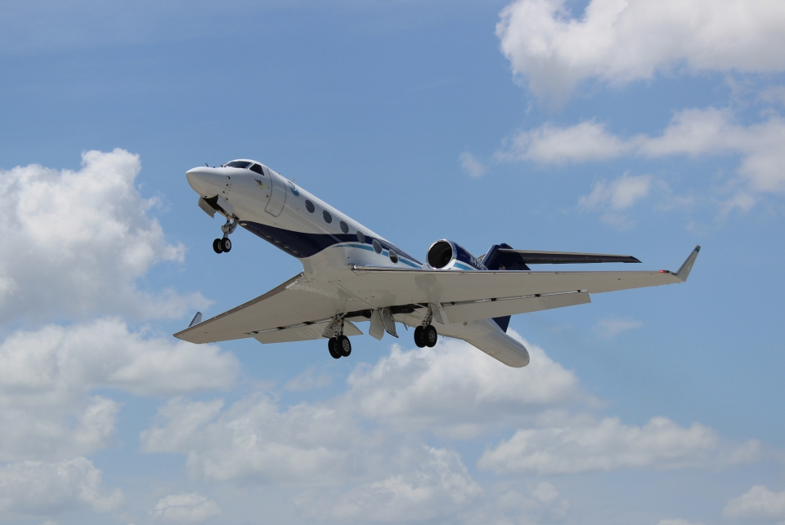
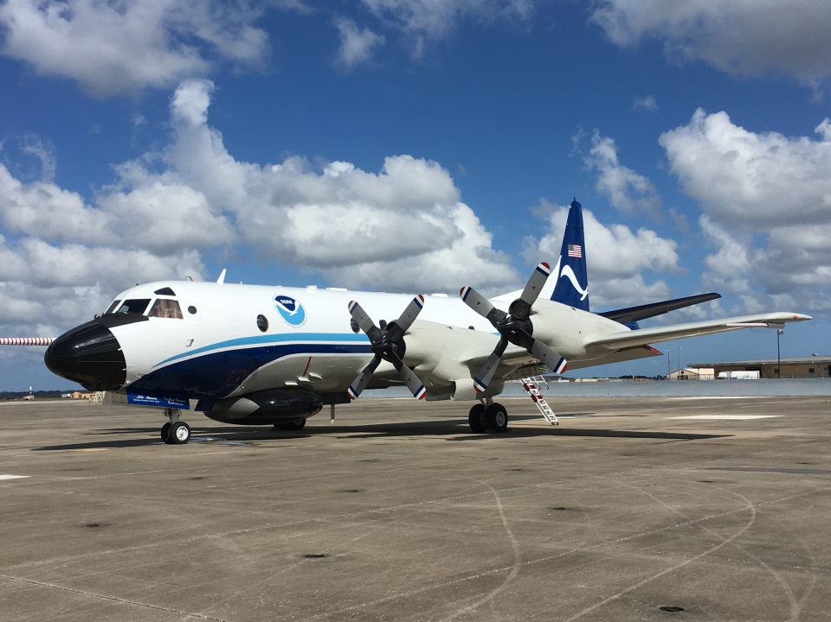
2021 Hurricane Field Program
Advancing the Prediction of Hurricanes Experiment (APHEX)
Kickoff Meeting
Jason Dunion – HFP Director
Jon Zawislak - HFP Deputy Director
HFP-APHEX Kickoff Meeting, May 26, 2021

Slide 2
2021 Hurricane Field Program-APHEX
Agenda
HFP-APHEX overview
COVID-19 Update
Operations & Logistics
Expendables & Instrumentation
10 Minute Break: 11:30 am EDT
Planned Collaborations with ONR & NASA
HFP Experiments & Modules
*just kidding

Slide 3
2021 Hurricane Field Program-APHEX
HFP-APHEX Overview

Slide 4
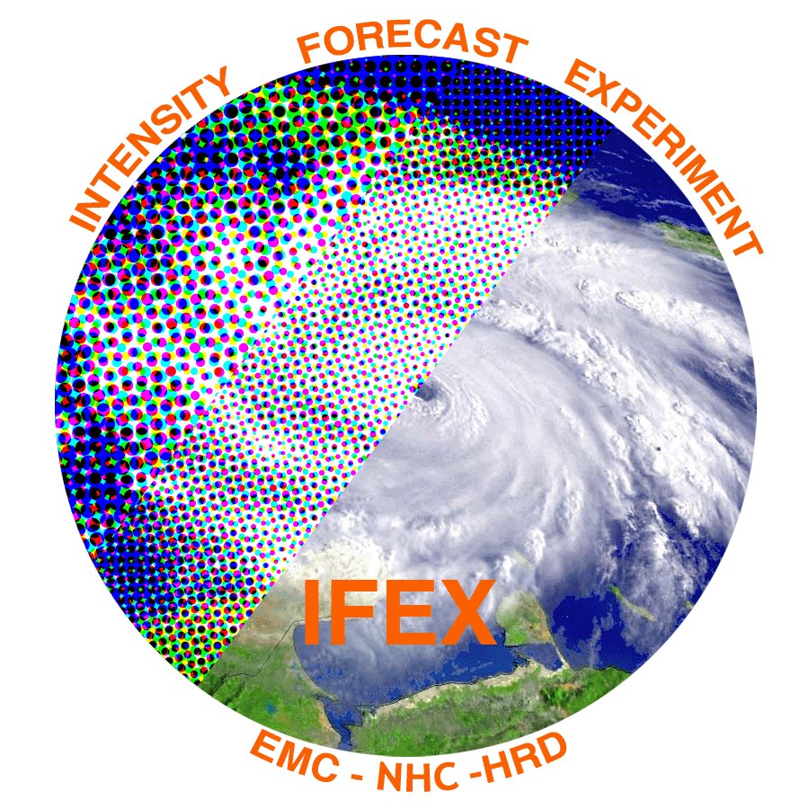
2021 Hurricane Field Program-APHEX
IFEX to APHEX
Intensity Forecasting EXperiment (IFEX)*
Goal 1: Collect observations that span the TC life cycle in a variety of environments for model initialization and evaluation
Goal 2: Develop and refine measurement strategies and technologies that provide improved real-time monitoring of TC intensity, structure, and environment
Goal 3: Improve the understanding of physical processes important in intensity change for a TC at all stages of its life cycle
* Intensity forecasting at the inception of IFEX in 2005 is now a narrow scope within a broad expanse of forecast challenges and knowledge gaps that must be addressed at all stages of the TC life cycle, though especially in the genesis and early stages

Slide 5
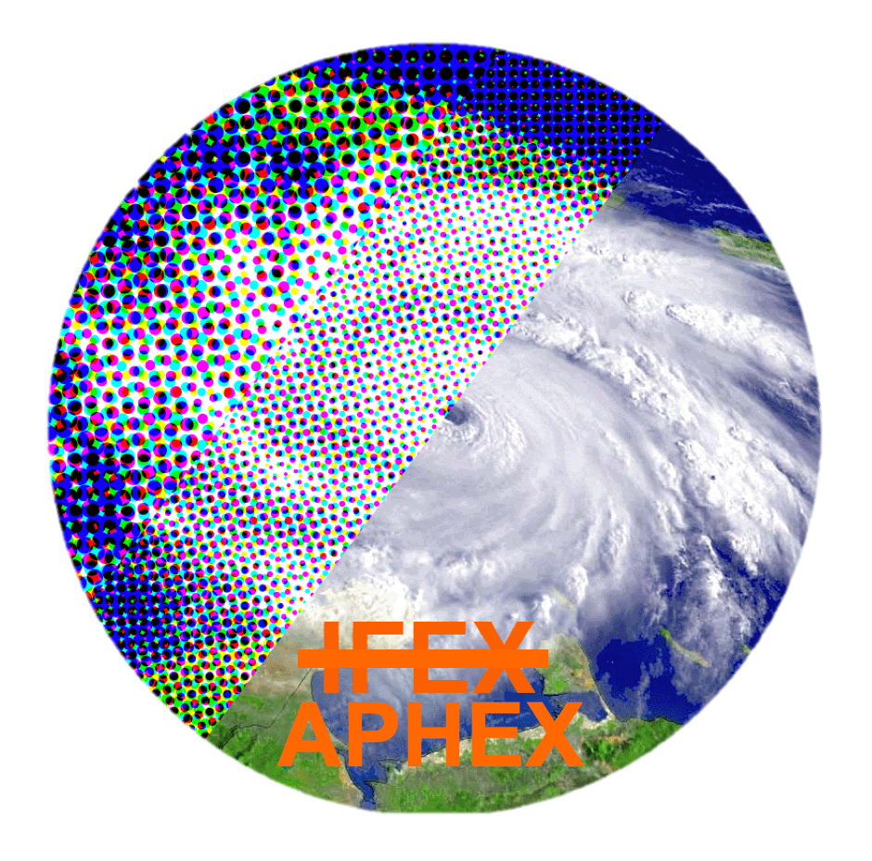
2021 Hurricane Field Program-APHEX
IFEX to APHEX
Advancing the Prediction of Hurricanes EXperiment (APHEX)
Goal 1: Collect observations that span the TC life cycle in a variety of environments for model initialization and evaluation
Goal 2: Develop and refine measurement strategies and technologies that provide improved real-time analysis of TC intensity, structure, environment, and hazard assessment
Goal 3: Improve the understanding of physical processes that affect TC formation, intensity change, structure, and associated hazards

Slide 6
2021 Hurricane Field Program-APHEX
COVID-19 Update

Slide 7
2021 Hurricane Field Program-APHEX
COVID-19 Update
Phase 1
No scientists on aircraft
Ground support radar and LPS
Phase 2
Medical screening and testing required by AOC
1 aircraft scientist/mission (multi-duty “super LPS”)
Ground support radar and LPS
Potential ground support dropsonde scientist
Miami and remote scientists
Medical screening and testing required by AOC
1-2 aircraft scientists/mission (LPS+dropsonde+radar)
Ground support radar
Miami and remote scientists
Phase 3
Medical screening and testing required by AOC
2-3 aircraft scientists/mission (LPS+dropsonde+radar)
Ground support radar
All scientists and academic collaborators
Nominal

Slide 8
2021 Hurricane Field Program-APHEX
COVID-19 Update
Phase 1
No scientists on aircraft
Ground support radar and LPS
Phase 2
Medical screening and testing required by AOC
1 aircraft scientist/mission (multi-duty “super LPS”)
Ground support radar and LPS
Potential ground support dropsonde scientist
Miami and remote scientists
Medical screening and testing required by AOC
1-2 aircraft scientists/mission (LPS+dropsonde+radar)
Ground support radar
Miami and remote scientists
Phase 3
Medical screening and testing required by AOC
2-3 aircraft scientists/mission (LPS+dropsonde+radar)
Ground support radar
All scientists and academic collaborators
Nominal

Slide 9
2021 Hurricane Field Program-APHEX
COVID-19 Update
Joining AOC Aircraft Cohorts
COVID vaccinations: currently no impact on cohort protocols
Miami HRDers joining cohorts
  Day-1: Start SIP in Miami Tue
  Day-3: Take AOC-provided COVID PCR test in Miami as soon as Thu (ship using provided label)
  Day-6, or -7: Travel in a bubble to Lakeland Sun or Mon (no stops)
  Day-8: Arrive AOC Tue >> take a Rapid COVID test >> if negative >> “flight ready”
Out-of-Town HRDers joining cohorts
  Day-1: Arrive in Lakeland Tue and begin SIP at local hotel
  Day-3: Take AOC-provided COVID PCR test at AOC as soon as Thu
  Day-8: Arrive AOC Tue >> take a Rapid COVID test >> if negative >> “flight ready”
Deployment PPE: “COVID Kits” (N95 masks, gloves, hand sanitizer, sanitizing wipes)

Slide 10
2021 Hurricane Field Program-APHEX
Operations & Logistics

Slide 11
2021 Hurricane Field Program-APHEX
Operations & Logistics
Aircraft
N42, N43, and N49 all available this season
Potential Deployment Sites: St. Croix, Barbados, Aruba, Bermuda
Twice daily P-3 and G-IV missions possible
Priority for 4 P-3 missions to conduct RI research (AOML/HRD – ONR TCRI collaboration)
HRD will continue to take advantage of “flights of opportunity” during operationally tasked missions
G-IV takeoff times for NHC Synoptic Surveillance: 1730/0530 UTC (adjustable for research)
P-3 take-off times for EMC: timed for roughly symmetric patterns (timewise) around the synoptic time
HRD Crewing
1-2 onboard scientists to support P-3 missions (up to 1 for G-IV research)
HRD crewing will be a combination of onboard and ground-based (LPS, radar, Aspen-TAG)
HRD aircraft crews will consist of essential personnel only (no visiting scientists/observers for now)

Slide 12
2021 Hurricane Field Program-APHEX
Operations & Logistics
FY21 P-3 OAR/NESDIS/NWS Flight Hours
Aircraft | Research (OAR) | Research (NESDIS) | NWS
P-3s | 140 | 25 | 174.5
G-IV | 111 | - | 139
Aircraft Status
N42
  Phase B Inspection completed
  TDR pedestal repairs underway
  25 May: successful SFMR/dropsonde/TDR test flight
  Hurricane Ready: 1 June
N49
  Currently at Gulfstream for OPS-1 Maintenance, returning late May/early June
  TDR plate de-lamination repairs begin at AOC
  Hurricane Ready: mid- to late June
N43
  Currently in Anchorage for GRAV-D
  TDR pedestal repairs planned
  NOAA CSD Doppler Wind Lidar install & flight tests: 2 weeks in mid-June
  Hurricane Ready: 1 July

Slide 13
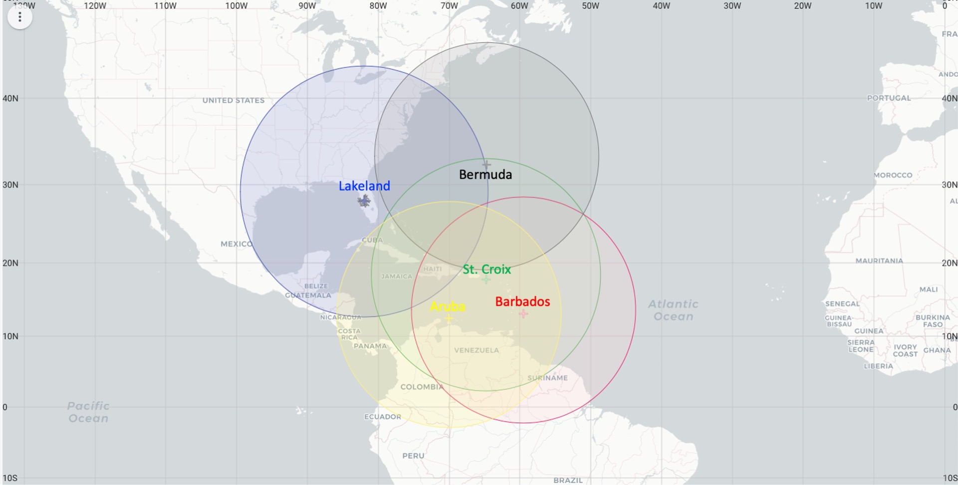
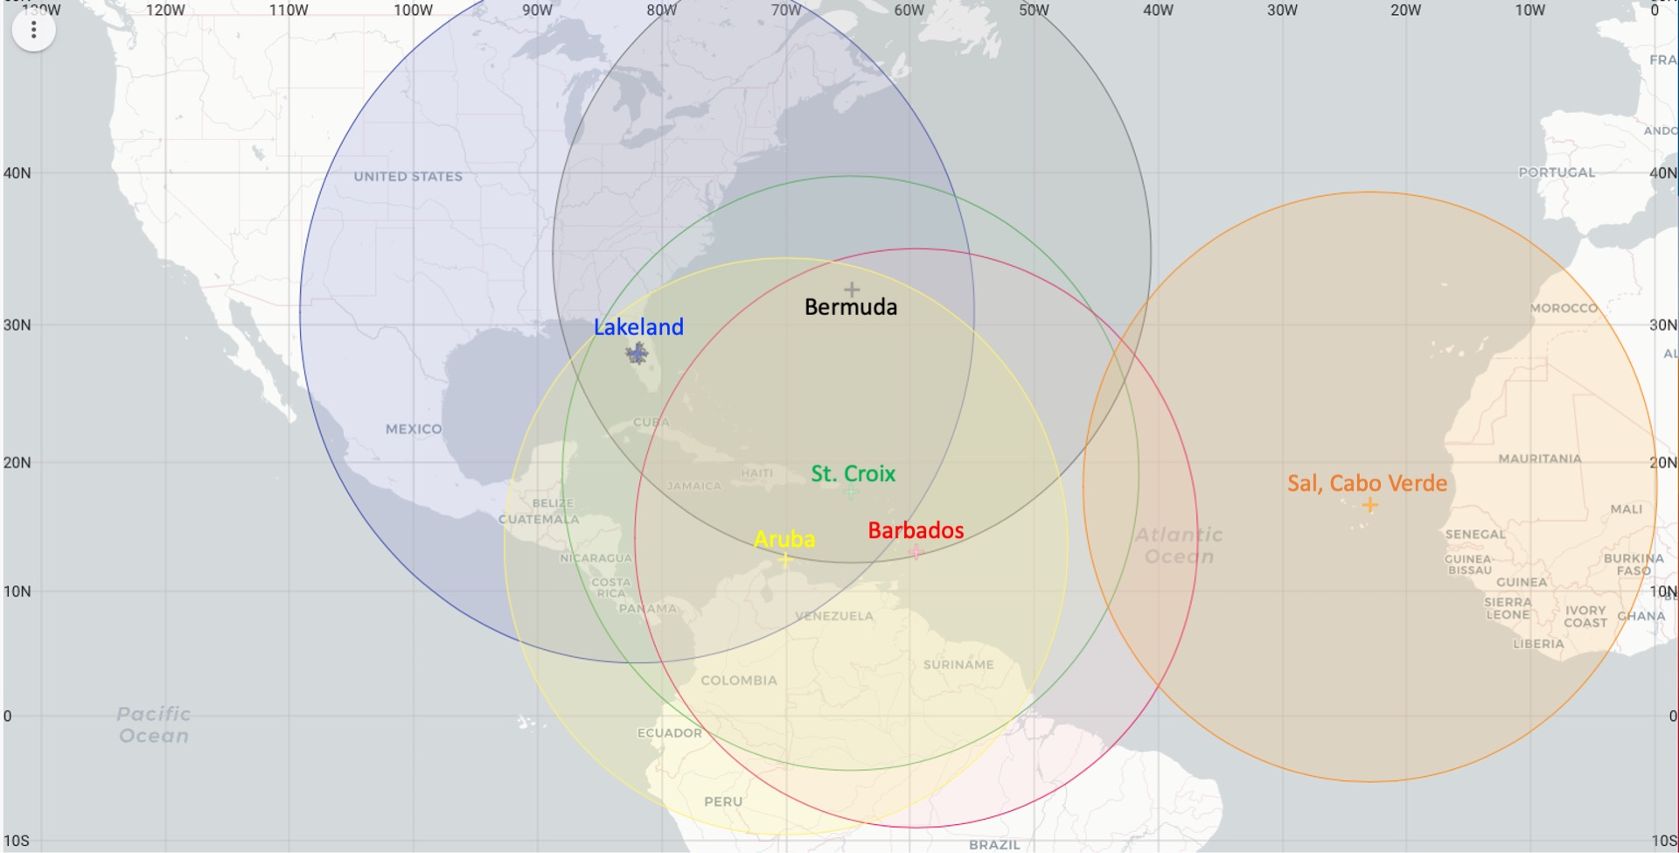
2021 Hurricane Field Program-APHEX
Operations & Logistics
Primary Atlantic Operating Bases and Ranges (2-h on-station time)
*Cabo Verde Ops planned for 2022

Slide 14
2021 Hurricane Field Program-APHEX
Operations & Logistics
Daily Schedule
0900 EDT (1300 UTC): Conference call with APHEX participants & collaborators (if needed)
1230-1300 EDT (1630-1700 UTC): HRD Map Discussion
1300 EDT (1700 UTC): Go/No-go coordination with NOAA AOC
HRD Map Discussion
Weekdays, 1230-1300 EDT (1630-1700 UTC), 19 July – 15 October
Remote participation via GotoMeeting or GotoWebinar
Contact Jason D. if you’d like to lead or co-lead a week of map discussions
HRD Map Discussion Links (HRD Google Drive Folder):
  Hurricane Field Program >> 2021 >> Map Discussion Links
  Contact Sim A. if you have a link that you’d like added to the links document

Slide 15
2021 Hurricane Field Program-APHEX
Operations & Logistics
Mission Monitoring and Communication
NASA MTS will serve as our primary tool for monitoring and coordinating missions
  MTS training: Tue 22 June, 1400 EDT – 1800 UTC
  Contact Jason D. if you’re interested in getting a MTS account
GeoCollaborate capabilities will be tested and demonstrated this season:
  https://aoml1.geocollaborate.com/dashboard/
Google Meet will be used again this year by ground-based crew
  Limited participation (ground-based LPS, radar scientist, Aspen-TAG scientist)
  Science PIs will also be invited/encouraged to join if he/she has an experiment/module being flown
  Mission Flight Logs
    Will be used again this summer by ground-based LPSs to document the mission in real-time
    New mission log template: will be used for each mission to help standardize HRD’s mission summaries
    HRD >> Hurricane Field Program >> 2021 >> AL##/STORMNAME >> Mission ID

Slide 16
2021 Hurricane Field Program-APHEX
Operations & Logistics
Administrative / Travel
FTEs
  Counter Threat Awareness Training (CTAT): available through the CLC
    Required for personnel traveling internationally for less than a cumulative 90 days for the calendar year
    Requires ~5 hr to complete; certificate is valid for 6 years
    You are not required to take the new CTAT training until the expiration of your current HTSOS certification
    Check with Jennifer C. if you need to confirm certification
  FTE Mission Critical Travel Requirements
    HRD Travel Request form is still required and must be approved by Frank before Jennifer can initiate travel
    We must adhere "NOAA's TRAVEL JUSTIFICATION for MISSION CRITICAL'' policy which requires 'Deputy Chief Financial/Administrative Officer' (DUS-O) approval of all FTE Travel requests
    Link to NOAA Travel Policy: https://www.corporateservices.noaa.gov/~finance/Travel_policy.html
  Inform Shirley and Jason of completion of Online Aviation Safety Training & Videos
CIMAS Employees
  Must complete travel request forms prior to traveling
  Vehicle form required -- email to Isabel and Nathalia
  Email Jennifer all completed travel forms
  Inform Shirley and Jason of completion of Online Aviation Safety Training & Videos

Slide 17
2021 Hurricane Field Program-APHEX
Operations & Logistics
To Participate in the HFP:
CTAT Foreign Travel Course (Fed)
Safety Training (CIMAS and Fed): due by June 18th
  Aviation Safety Trainings
    Aviation Health
    Aviation Policy & Procedures
    Aviation Safety & Survival
  Aviation Safety Videos:
    Surviving on Open Water
    Survival Medicine (back by popular demand!)
    http://www.faa.gov/about/office_org/headquarters_offices/avs/offices/aam/med_pilots/aircrew_videos/
Trained for one or more roles to perform HRD Science Crew duties
Lead Project Scientist (Ground or onboard)
Dropsonde Scientist (Ground or onboard)
Radar Scientist (Ground or onboard)

Slide 18
2021 Hurricane Field Program-APHEX
Operations & Logistics
HFP Trainings
Ground-based and onboard crews
  Radar (Ground, Invited): Mon 7 June, 11-12:00pm ET
  Radar (Airborne): Tue 8 June, 1-2:00pm ET
  ASPEN (Airborne): Wed 9 June, 11-12:30pm ET
  ASPEN (TAG): Fri 11 June, 11-12:00pm ET
  LPS (Ground & Airborne, Invited): Wed 22 June, 1:30-2:00pm ET
Mission monitoring tools
  NASA Mission Tools Suite (MTS): Wednesday, 22 June, 2-3pm
Safety Training
  Safety Training Video (FAA) Viewing Due: Fri June 18
  CLC / CIMAS Online Aviation Safety: Fri June 18
  GSA Drivers Course Due: Before driving GOV
  CIMAS Employees Submit New Van Forms: Before driving GOV

Slide 19
2021 Hurricane Field Program-APHEX
Expendables & Instrumentation

Slide 20
2021 Hurricane Field Program-APHEX
Expendables & Instrumentation
FY21 P-3 OAR/NESDIS/NWS Expendables (*recoverable)
Expendable | Research (OAR) | Research (NESDIS) | Research (ONR) | Research (STAN/JPSS) | NWS
GPS Dropsondes | 224 | 25 | 31 (+325, early July) | 50 / 96 | 381
IR Dropsondes | 16 | - | - | - | -
AXBTs | ~100 | - | 96 | - | -
sUAS (Altius-600) | 1-3 | - | - | - | -
ALAMO Floats | 10 | - | - | - | -
A-Sized Drifters | 10-20 | - | - | - | -
Hurricane Gliders* | Pre-deployed | - | - | - | -
Saildrones* | 5 | - | - | - | -
Spring 2021 dropsonde orders through Vaisala are delayed (global supply issue of TCXO oscillators)
NOAA’s dropsonde inventory is adequate for to support research and ops this summer
AF 53rd currently has ~600 dropsondes (burn rate is typically ~1000/season) >> mitigation being explored

Slide 21
2021 Hurricane Field Program-APHEX
Expendables & Instrumentation
2021 Aircraft Instrumentation
Instrument | Aircraft | Measurements
Flight-Level Measurements | N42, N43, N49 | Position, altitude, PT, moisture, winds (40 Hz & 1 Hz)
Tail Doppler Radar (TDR) | N42, N43, N49 | Reflectivity, 3-D winds (~0-15 km)
Multi-Model Radar (MMR) | N42, N43 | X-band horizontal-scanning pulse Doppler radar
Stepped Frequency Microwave Radiometer | N42, N43, N49 | Surface wind speed, rain rate
Cloud Microphysics: Cloud Combination Probe (CCP), Precipitation Imaging Probe (PIP), Cloud and Aerosol Spectrometer (CAS) | N42, N43 | Aerosol, cloud hydrometeor, & precipitation size distributions: CCP (2-1550 µm), PIP (100µm-6.4 mm), CAS (0.63-100µm)

Slide 22
2021 Hurricane Field Program-APHEX
Expendables & Instrumentation
2021 Aircraft Instrumentation (cont’d)
Instrument | Aircraft | Measurements
Imaging Wind and Rain Airborne Profiler (IWRAP) | N43 | Profiles of volume reflectivity and Doppler velocity of precipittion, ocean surface backscatter
KaIA | N43 | Significant wave height
Wide Swath Radar Altimeter (WSRA) requires a ~$155K upgrade (NWS, HRD, PSL, and AOC are discussing) | N42 | Significant wave height and directional wave spectra
Compact rotational Raman Lidar (CRL) | N42 | T, moisture, aerosols (FL to surface)
Terrestrial High-energy Observations of Radiation (THOR) | N42 | gamma ray emissions associated with lightning
Doppler Wind Lidar (DWL) NOAA CSL | N43 (install & testing: 2 wks mid-June) | Range resolved line-of-sight velocity profiles & backscatter intensity

Slide 23
2021 Hurricane Field Program-APHEX
Operations & Logistics
Data Products List
INSTRUMENTS | INVESTIGATORS
Tail Doppler radar (TDR) | John Gamache (john.gamache@noaa.gov) Paul Reasor (paul.reasor@noaa.gov)
Multi-Mode Radar (MMR) | John Gamache (john.gamache@noaa.gov) Paul Reasor (paul.reasor@noaa.gov)
Stepped Frequency Microwave Radiometer (SFMR) | Heather Holbach (heather.holbach@noaa.gov)
Cloud Physics Probes | Robert Black (Robert.a.black@noaa.gov)
Imaging Wind and Rain Airborne Profiler (IWRAP) | Paul Chang (paul.s.chang@noaa.gov)
Wide Swath Radar Altimeter (WSRA) | Heather Holbach (heather.holbach@noaa.gov) Ivan Popstefanija (popstefanija@prosensing.com)
Compact rotational Raman Lidar (CRL) | Zhien Wang (Zhien.Wang@Colorado.edu)
Terrestrial High-energy Observations of Radiation (THOR) | David Smith (dsmith8@ucsc.edu)
PLATFORMS | INVESTIGATORS
P-3 and G-IV Flight-level | Neal Dorst (neal.m.dorst@noaa.gov)
GPS Dropwindsonde | Kathryn Sellwood (Kathryn.sellwood@noaa.gov)
Airborne eXpendable BathyThermograph (AXBT) | Nick Shay (nshay@miami.edu) Jun Zhang (jun.zhang@noaa.gov)
OBSERVATIONAL PRODUCTS | INVESTIGATORS
HEDAS Pre-processing | Altug Aksoy (altug.aksoy@noaa.gov)
Center Fixes / Tracks (2-min) | Neal Dorst (neal.m.dorst@noaa.gov)
INFORMATIONAL | INVESTIGATORS
Flight Logs (e.g., LPS, Radar, Dropsonde, Boundary Layer) | Neal Dorst (neal.m.dorst@noaa.gov)
MODEL PRODUCTS | INVESTIGATORS
Basin-scale HWRF | Ghassan Alaka (ghassan.alaka@noaa.gov)
Hurricane Analysis and Forecast System (HAFS) | Andrew Hazelton (andrew.hazelton@noaa.gov)
HWRF Hurricane Ensemble Data Assimilation Scheme (HEDAS) | Sim Aberson (sim.aberson@noaa.gov) Altug Aksoy (altug.aksoy@noaa.gov)
Data Management
Main Document in the HFP Plan
Data Product List and contacts is provided in the HFPP
Focus on providing mission info and data to the HRD HFP Data Page as soon as possible after a storm sequence
Like last season, will maintain a Google Sheet inventory of mission info and data acquisition

Slide 24
2021 Hurricane Field Program-APHEX
Operations & Logistics
HFP Data
NOAA CorpSrv policy enables blocking of USB storage devices
  NOAA aircraft and ship computers will not be subjected to this policy in 2021
Most data collected on the aircraft will be uploaded by AOC to its archive server
For any data downloaded by HRDers while onboard the aircraft, options include:
  Upload data to the Google Drive for scanning
  Upload data to the AOML FTP (for smaller data transfers) - no scanning done
  Download data to a USB then upload to Google drive via GFE (gov’t issued laptops/equipment)
    Use McAfee to scan the USB stick before using and after loading data

Slide 25
2021 Hurricane Field Program-APHEX
Operations & Logistics
External Communication
HRD will be working closely with the AOML Comms Team
HRD blog: https://noaahrd.wordpress.com/
HRD webpage: http://www.aoml.noaa.gov/hrd/
Facebook: https://www.facebook.com/noaahrd/
Twitter: https://twitter.com/HRD_AOML_NOAA
Internal Communication
Daily PO(N)D, weekends when operations ongoing: aircraft status, potential targets, deployment logistics, travel
Daily map discussions

Slide 26
2021 Hurricane Field Program-APHEX
Planned Collaborations with
ONR & NASA

Slide 27


2021 Hurricane Field Program-APHEX
Planned Collaborations
2021 Inter-Agency Collaborations
NASA CPEX-AW: 19 Aug– 30 Sep
                Science objectives: convective processes, marine BL, ITCZ, AEWs, SAL, ADM-Aeolus validation
                DC-8 Deployment Site: St. Croix
                Possible DC-8 “suitcase flight” to Cabo Verde
ONR TCRI: 1 July – 30 Sep
Identify the key processes and predictability barriers governing the rapid intensification (RI) of tropical cyclones (TCs).

Slide 28

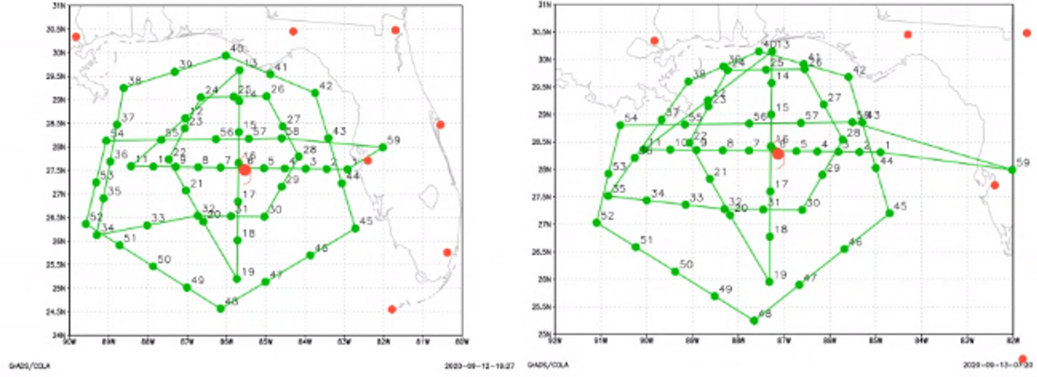
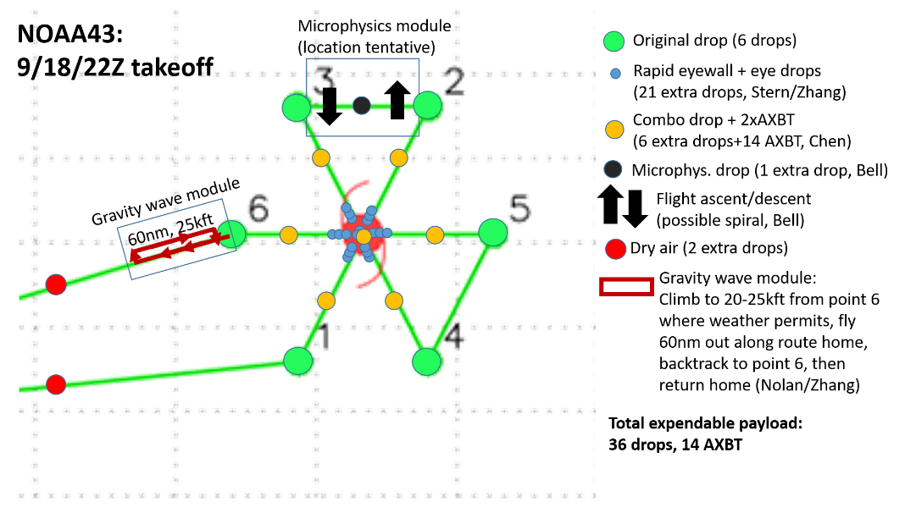
2021 HFP-APHEX: ONR TCRI
ONR Tropical Cyclone Rapid Intensification Program
Science Team: Doyle, Dunion, Bell, Rogers, Zawislak, Cione, Torn, Tang, Bryan, Zhang, Wimmers, Velden, Richter,
Majumdar, Nolan, Raymond, Fuchs, Ralph, Wu, Elsberry, Kieu, Chen, Jin, Komaromi, Moskaitis, Ryglicki
Identify the key processes and predictability barriers governing the rapid intensification (RI) of TCs. Special focus on:
  Onset of RI
  Boundary layer, precipitation, and cloud microphysics processes
Field measurements conducted in close collaboration with NOAA APHEX
In 2021, 4 P-3 Flights and collaborative G-IV flights are planned with ~300 dropsondes available
  High value on consecutive missions following a single storm (TCRI conducts first P3 mission, subsequent missions via APHEX or operational tasking)
Real-time COAMPS-TC, adjoint targeting (NRL), and ensemble targeting (R. Torn)
Examples of collaborative NOAA-ONR missions for Sally 13-14 Sep, 2020 (left, middle) and Teddy for 18 Sep, 2020 (right)

Slide 29
2021 Hurricane Field Program-APHEX
HFP Experiments & Modules

Slide 30
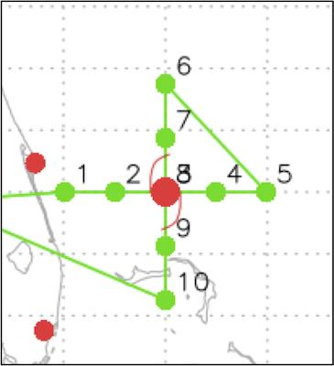
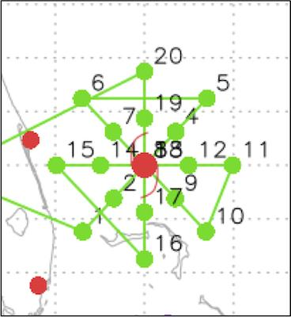
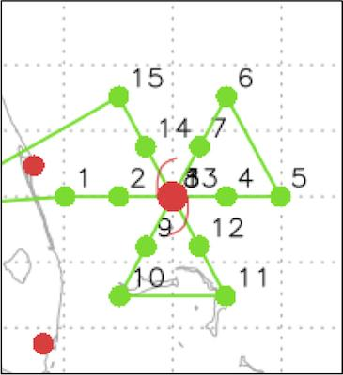
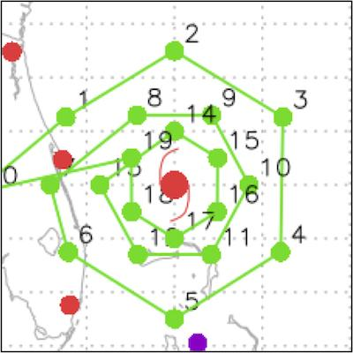
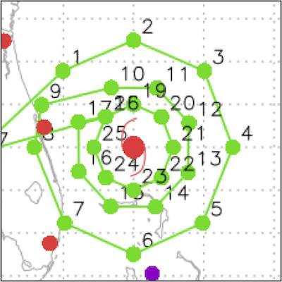
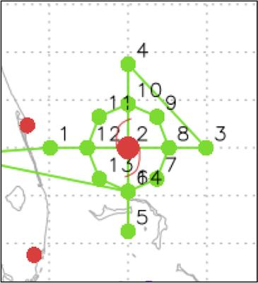
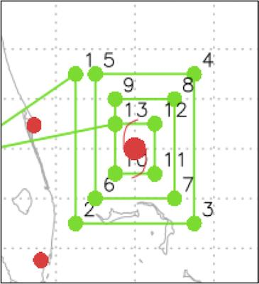
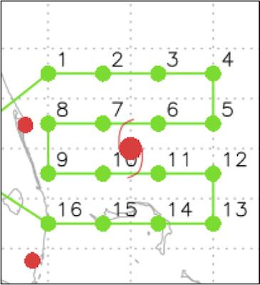
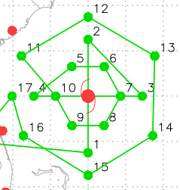
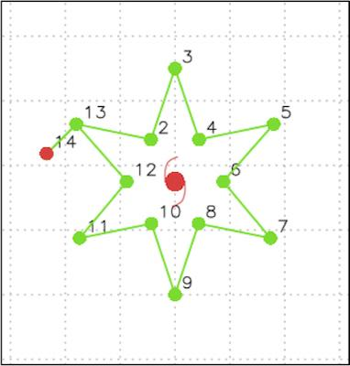
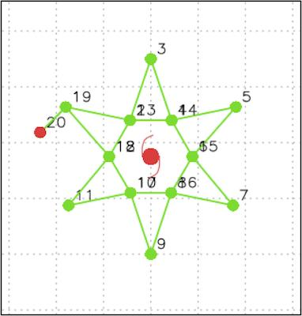
2021 Hurricane Field Program-APHEX
HFP Experiments and Modules
Figure-4
(P-3)
Rotated Figure-4
(P-3)
Butterfly
(P-3)
Circumnavigated Hexagon
(G-IV)
Circumnavigated Octagon
(G-IV)
Circumnav + Figure 4
(P-3)
Square Spiral
(P-3 & G-IV)
Lawn Mower
(P-3 & G-IV)
Figure-4 with
Double Circumnav
(G-IV)
Star 1
(G-IV)
Star 2
(G-IV)

Slide 31
2021 Hurricane Field Program-APHEX
HFP Experiments and Modules
EARLY STAGE
Analysis of Intensification Processes Experiment (AIPEX)
Convective Burst Structure and Evolution Module (CBM)
Hurricane Boundary Layer Module
Impact of Targeted Observations on Forecasts (ITOFS)
Stratiform Spiral Module (SSM)
GENESIS STAGE
Favorable Air Mass (FAM) Experiment
Precipitation during Formation and Observing its Response across Multiple Scales (PREFORM)
MATURE STAGE
Eye-Eyewall Mixing Module
Gravity Wave Module
NESDIS Ocean Winds
Rainband Complex Module (RCM)
Research In Coordination with Operations Small Unmanned Aircraft Vehicle Experiment (RICO SUAVE)
Surface Wind and Wave Validation Module
Tropical Cyclone Diurnal Cycle Experiment
END STAGE
Tropical Cyclones at Landfall Experiment
OCEAN OBSERVING
Ocean Survey Experiment
Sustained and Targeted Ocean Observations
SATELLITE VALIDATION
ADM-Aeolus Satellite Validation Module
NESDIS JPSS Satellite Validation Experiment
NASA TROPICS Satellite Validation Module

Slide 32
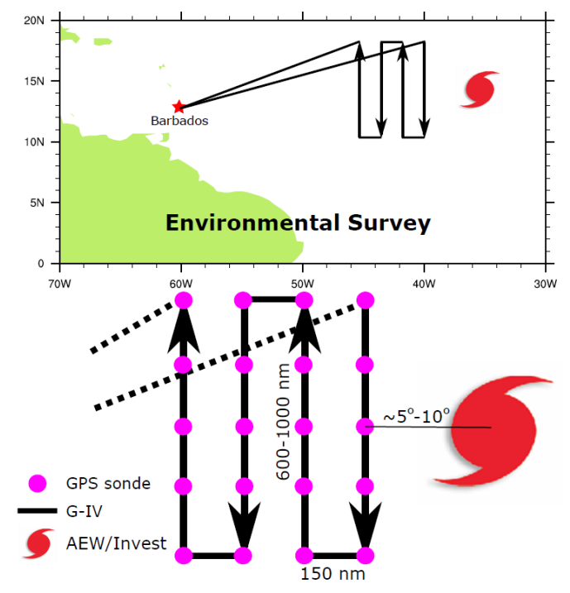
2021 HFP-APHEX: Genesis Stage
FAM (Favorable Air Mass)
Science Team: Alaka, Zawislak, Dunion, Brammer, Thorncroft, Fuchs-Stone, Raymond
To investigate the favorability in both dynamics (e.g., vertical wind shear) and thermodynamics (e.g., moisture, relative humidity) for tropical cyclogenesis in the environment near a pre-tropical depression, especially in the environmental air mass surrounding and ahead (downstream) of the pre-TD
Consecutive missions are recommended to observe the evolution of the observations over time and how that pertains to the (non-)development of a pre-TD
Adaptable to both the G-IV (preferred) and the P-3s
Twice-a-day missions preferred
Potential opportunity to collaborate with sampling from the DC-8 in NASA’s Convective Processes Experiment – Aerosols and Winds (CPEX-AW)

Slide 33
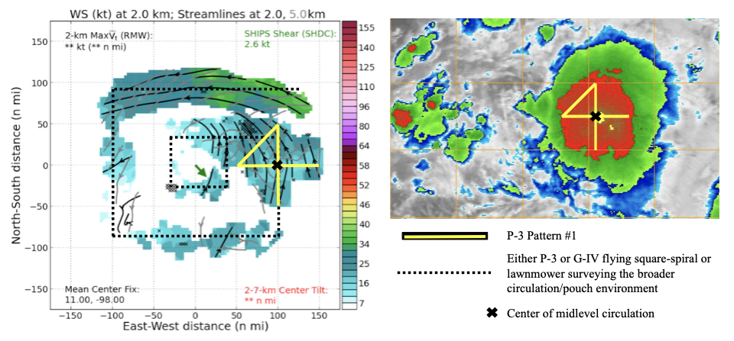
2021 HFP-APHEX: Genesis Stage
PREFORM
(PREcipitation during Formation and Observing its Response across Multiple scales)
Science Team: Zawislak, Alaka, Rogers, Dunion, Reasor, Boothe, Montgomery, Dunkerton, Rutherford, Fuchs-Stone, Raymond
Measure the relative contributions of various precipitation modes (e.g., deep convection, moderately deep convection, stratiform) to the total precipitating area
Quantify the moisture and relative humidity characteristics of the circulation/pouch, relate those to precipitation characteristics, and measure their evolutions over multiple days
Identify the location, strength, and origins of circulations (pouch) from the low to middle troposphere, and relate changes to the precipitation observed
Ideally 2 aircraft (adaptable for both P-3 and G-IV): one samples the environment (wave) and one focused on the convective systems
Twice-a-day missions preferred
Example strategy adapted to pre-Sergio (2018) in the EPAC

Slide 34
2021 Hurricane Field Program-APHEX
HFP Experiments and Modules
EARLY STAGE
Analysis of Intensification Processes Experiment (AIPEX)
Convective Burst Structure and Evolution Module (CBM)
Hurricane Boundary Layer Module
Impact of Targeted Observations on Forecasts (ITOFS)
Stratiform Spiral Module (SSM)
GENESIS STAGE
Favorable Air Mass (FAM) Experiment
Precipitation during Formation and Observing its Response across Multiple Scales (PREFORM)
MATURE STAGE
Eye-Eyewall Mixing Module
Gravity Wave Module
NESDIS Ocean Winds
Rainband Complex Module (RCM)
Research In Coordination with Operations Small Unmanned Aircraft Vehicle Experiment (RICO SUAVE)
Surface Wind and Wave Validation Module
Tropical Cyclone Diurnal Cycle Experiment
END STAGE
Tropical Cyclones at Landfall Experiment
OCEAN OBSERVING
Ocean Survey Experiment
Sustained and Targeted Ocean Observations
SATELLITE VALIDATION
ADM-Aeolus Satellite Validation Module
NESDIS JPSS Satellite Validation Experiment
NASA TROPICS Satellite Validation Module

Slide 35
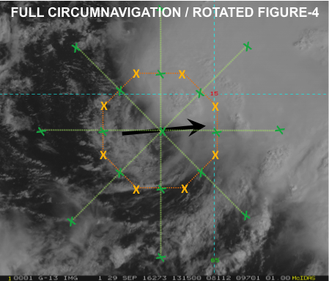
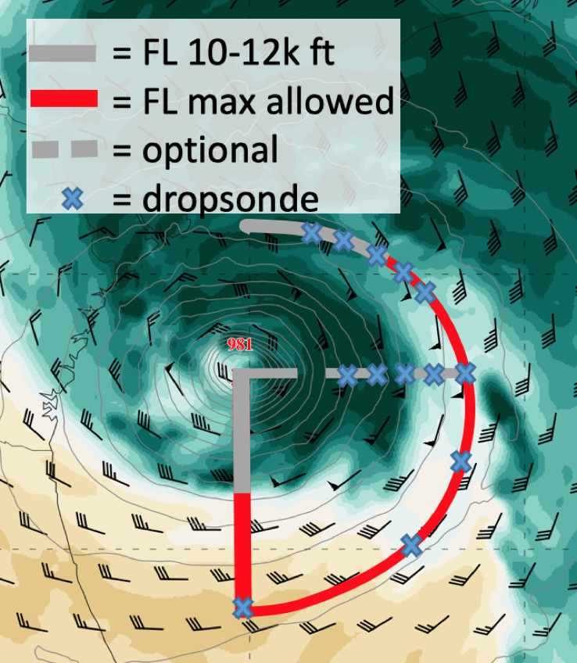
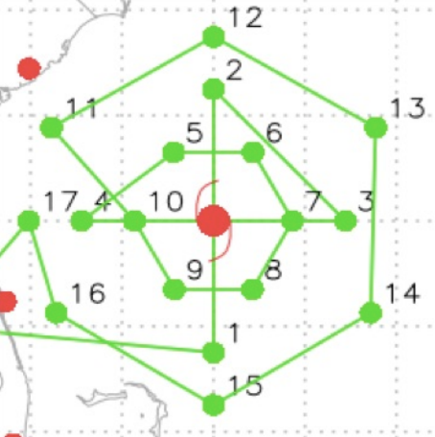
2021 HFP-APHEX: Early Stage
AIPEX (Analysis of Intensity Change Processes EXperiment)
Science Team: Zawislak, Rogers, Dunion, Alland, Rios-Berrios, G. Bryan, Judt, Fischer, J. Zhang, Reasor, Cione, Alvey, X. Chen, Alaka, Holbach, Wadler, Doyle, Stern, Finnochio, Majumdar, Nolan, Wimmers, Fuchs-Stone, Raymond, Tang, Bell, Foster
Collect aircraft observations that will allow us to characterize the precipitation and vortex-scale kinematic and thermodynamic structures of TCs experiencing moderate vertical shear
Understanding the reasons behind these structures, particularly greater azimuthal coverage of precipitation, vortex alignment, and boundary layer ventilation and recovery
Greater understanding of the physical processes that govern whether TCs will intensify, (especially those that undergo RI) in this type of environment
P-3 Circumnavigation at higher altitudes
P-3 Dry Air Entrainment Module
G-IV Figure-4 + Double Circumnavigation

Slide 36
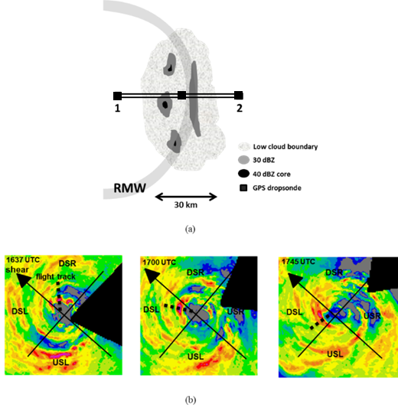
2021 HFP-APHEX: Early Stage
Convective Burst Structure and Evolution Module (CBM)
Science Team:Rob Rogers (PI), Jon Zawislak, Trey Alvey, Josh Wadler, Robert Black, Josh Wadler, Hua Leighton, Xuejin Zhang, Michael Bell (CSU), Anthony Didlake (PSU), Jim Doyle (NRL), Dan Stern (NRL), Ralph Foster (UW)
Obtain a quantitative description of the kinematic and thermodynamic structure and evolution of intense convective systems (convective bursts) and the nearby environment to examine their role in TC intensity change
Repeatedly sample the kinematic and reflectivity structure and evolution of individual convective bursts and their associated precipitation structures using airborne Doppler radar
Follow CBs as they translate azimuthally downwind in a shear-relative framework (where relevant)
Optimal additional measurements include:
  Deep-layer measurements of temperature and humidity in the local environment of the CBs from high-altitude aircraft will provide the thermodynamic context within the mid-and lower troposphere
  Measurements of sea-surface temperature and subsurface temperature profiles from ocean probes and/or IR dropsondes will provide context on the surface boundary
Sampling schematic of CB
Example pattern following CB during translation upshear

Slide 37
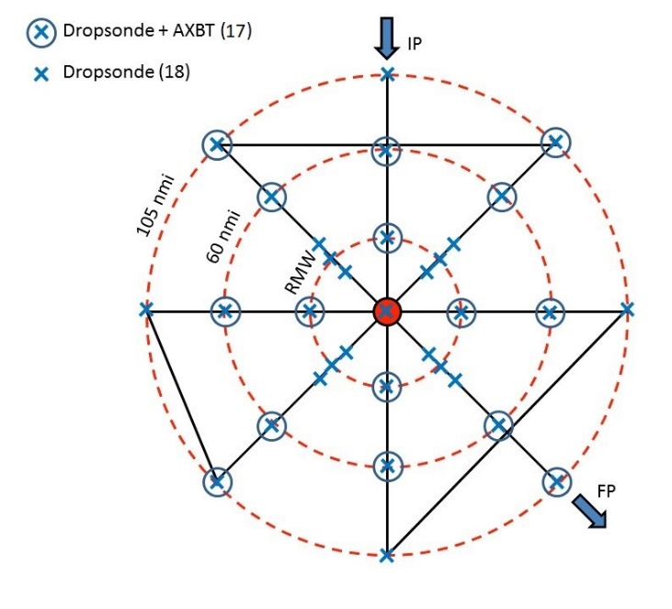
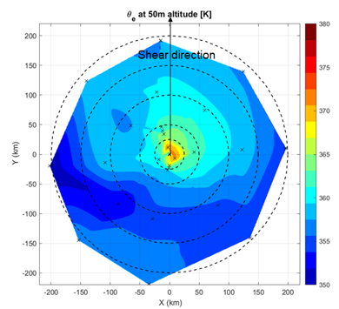
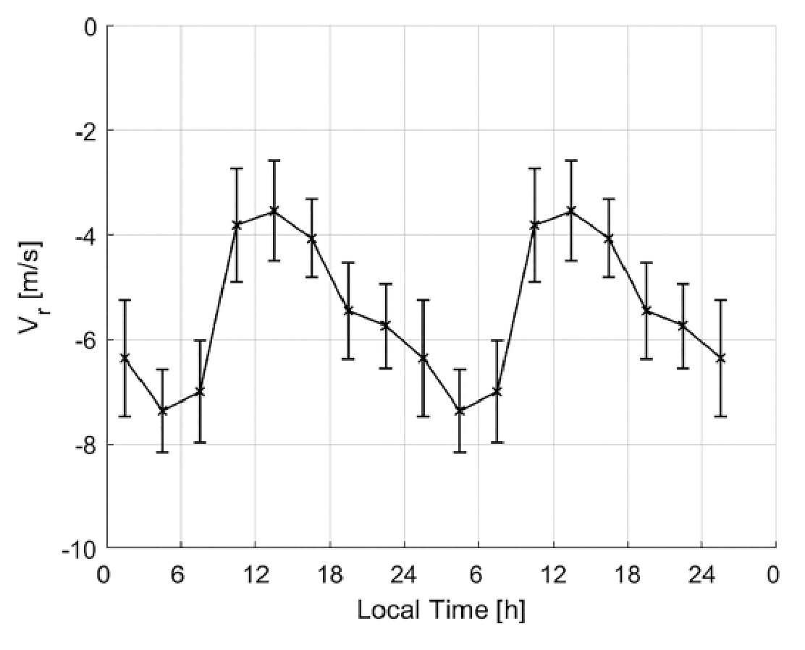
2021 HFP-APHEX: Early Stage
Hurricane Boundary Layer (HBL) Module
Science Team: J. Zhang, Dunion, S. Chen, Doyle, Stern, Rogers, Cione, Wadler, X. Chen, Hazelton, Zawislak,
Tang, Bryan, Fovell, Rios-Berrios, Judt, Sanabia, Bell, Wang, Foster, Jin, Rudzin
Collect aircraft observations in the boundary layer of TCs to improve the understanding of intensity change processes
How are boundary-layer inflow and thermodynamic fields related before TC intensification?
How do boundary layer height scales evolve before and during the intensification?
How might environmental shear modulate the boundary layer asymmetry?
What is the role of boundary layer recovery in TC intensity change in shear?
How does the boundary layer structure vary with the diurnal cycle in early-stage storms?
Dropsonde composite of radial velocity (V_{r}) at R=250-350 km below 1 km altitude in mature hurricanes
P-3 Rotated Figure-4

Slide 38
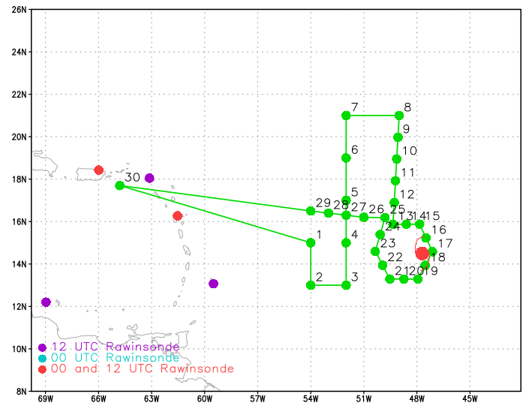
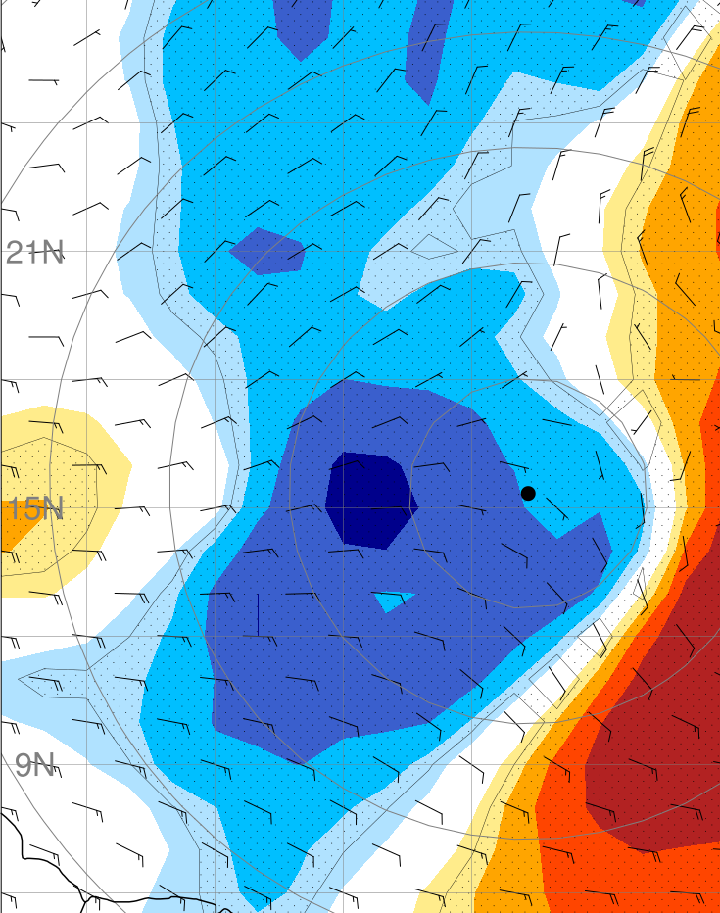
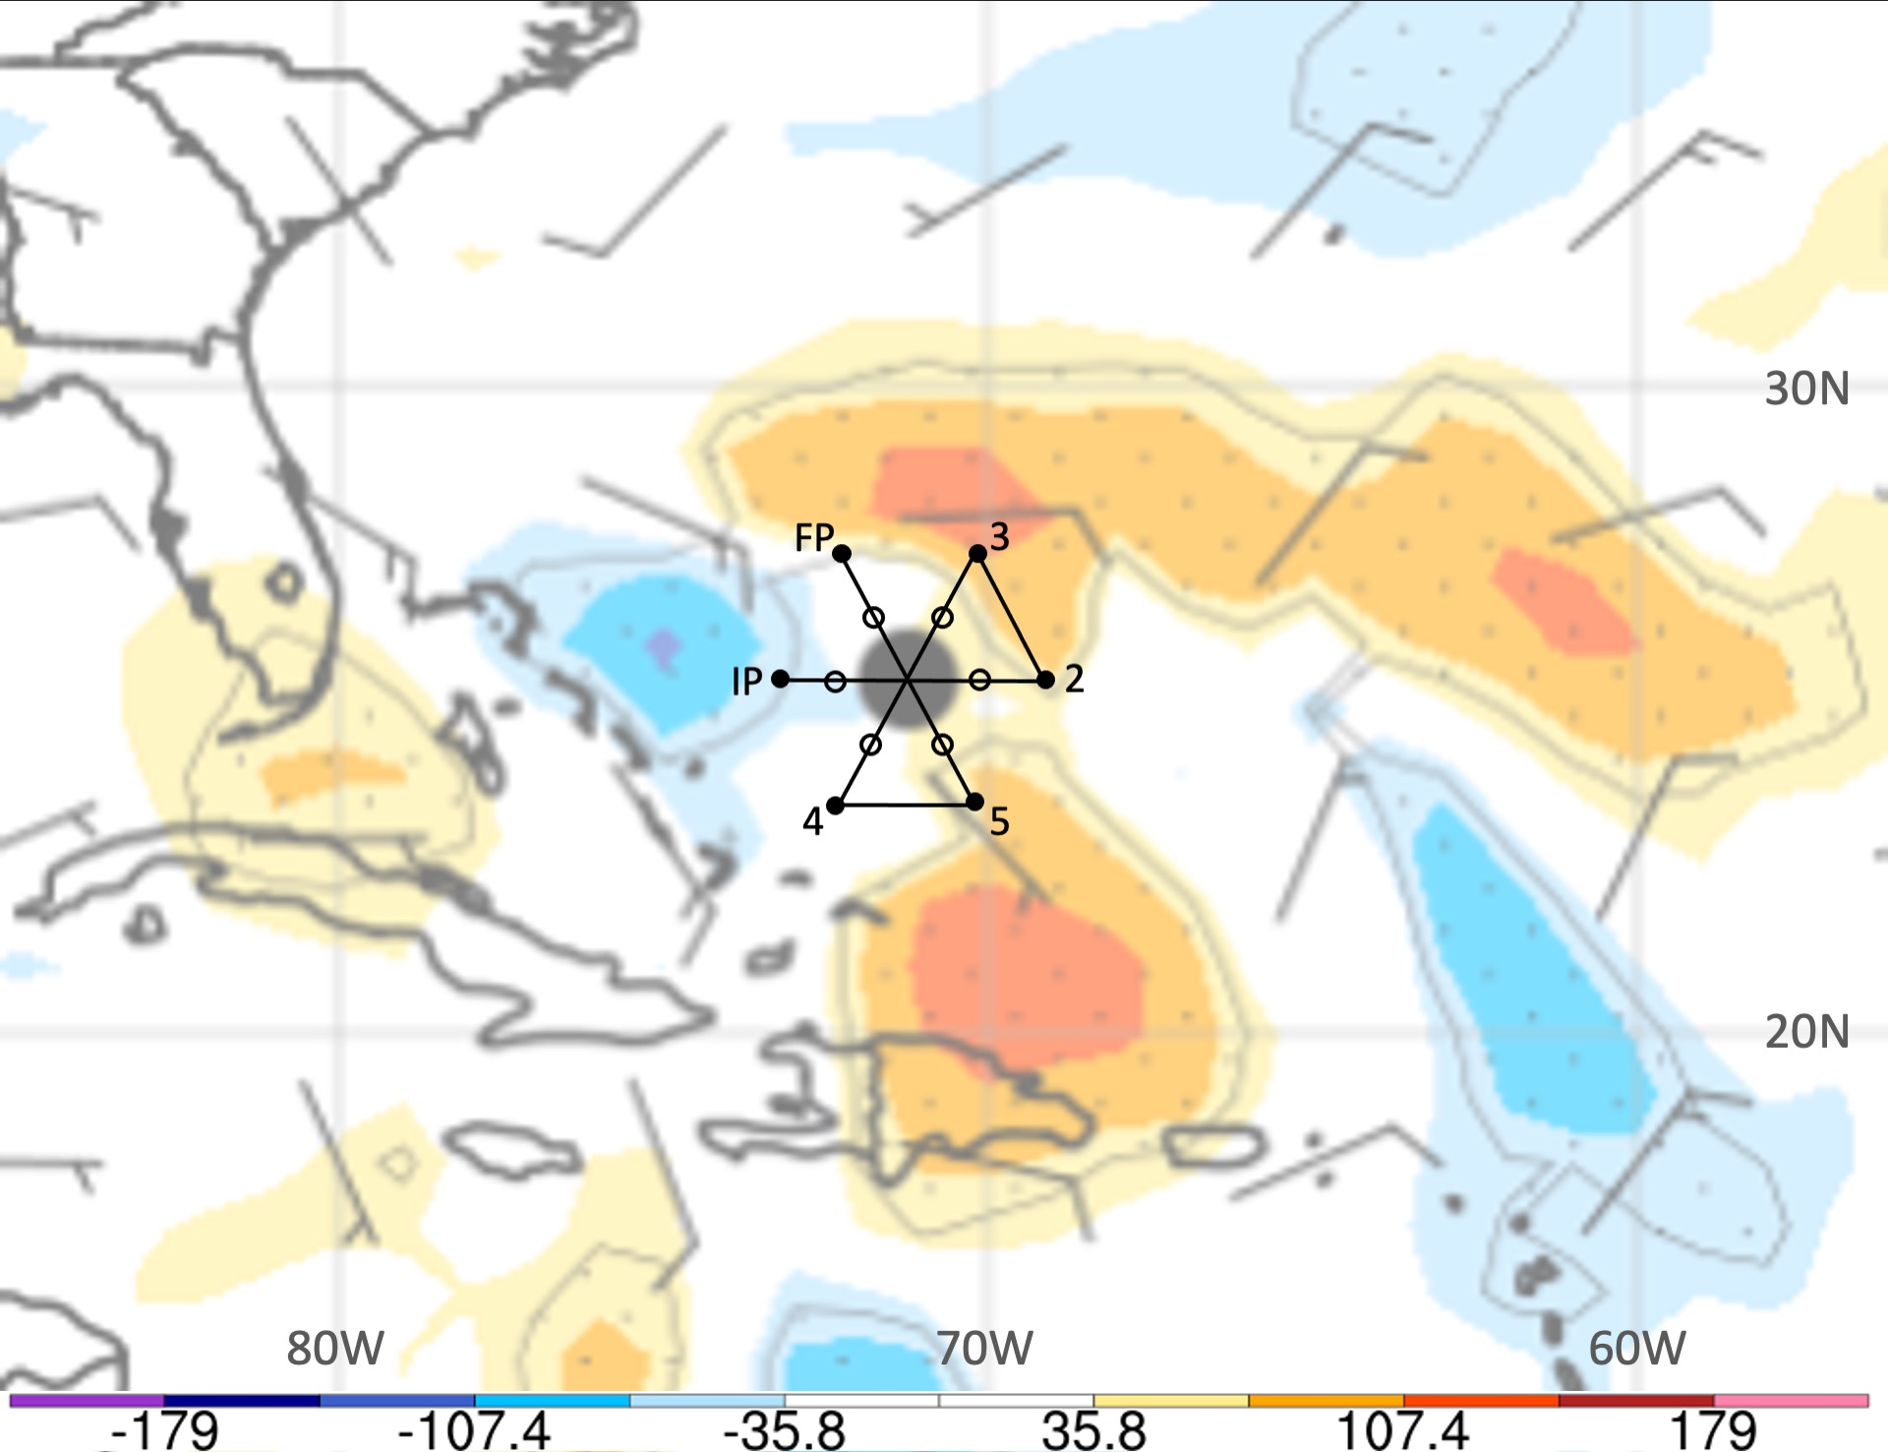
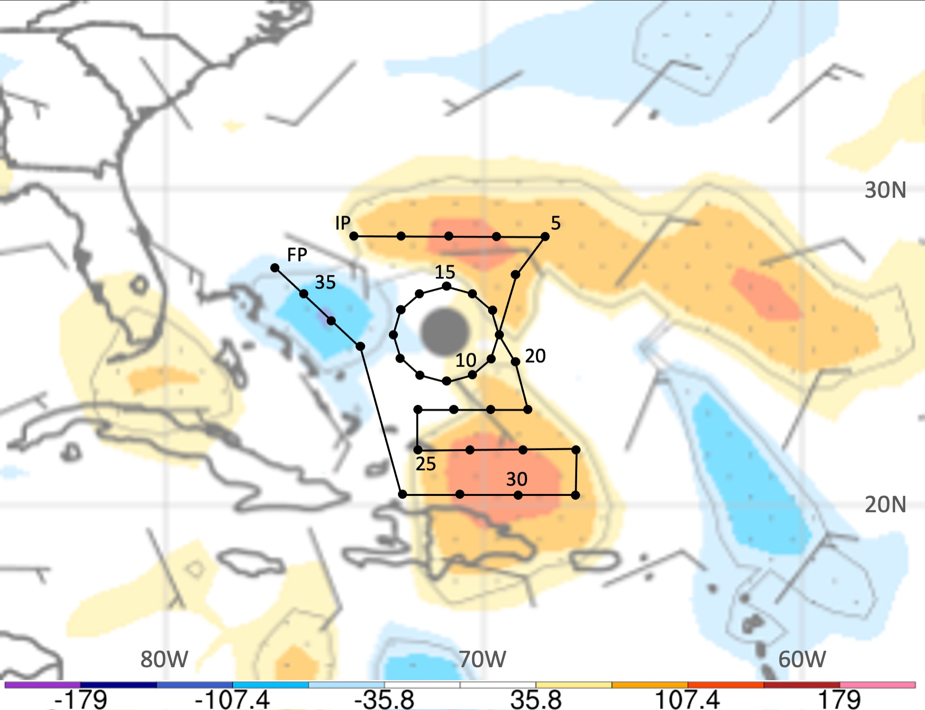
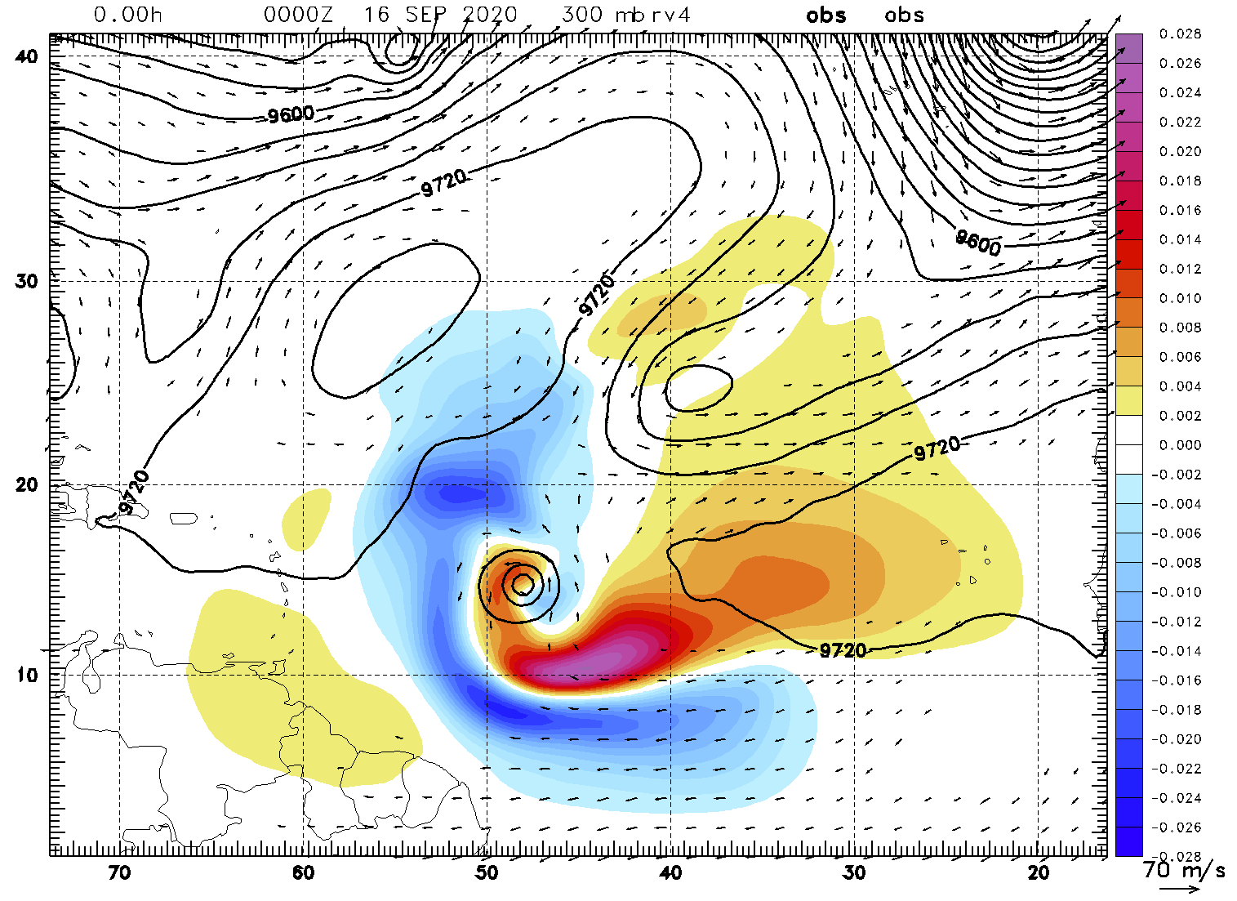
2021 HFP-APHEX: Early Stage
Impact of Targeted Observations on Forecasts (ITOFS) Experiment
Science Team: Jason Dunion, Sim Aberson, Jon Zawislak, Kelly Ryan, Jason Sippel, Ryan Torn (Univ at Albany-SUNY),
Jim Doyle (NRL-Monterey), Eric Blake (NWS/NHC), Mike Brennan (NWS/NHC), Chris Landsea (NWS/TAFB)
Plain Language Description: Investigate new sampling strategies for optimizing the use of aircraft observations to improve model forecasts of TC track, intensity, and structure.
G-IV Synoptic Flow Mission
  Hurricane Teddy: 15 Sep 2020
  To improve the 48-hr track forecast
NOAA P-3
NOAA G-IV
ECMWF Ensemble-Based Sensitivity
Courtesy: Ryan Torn (University at Albany/SUNY)
G-IV Synoptic Flow Mission
  Hurricane Teddy: 16 Sep 2020 00z
  300-hPa ζ sensitivity
ECMWF ensemble sensitivity analysis for 2019 Hurricane Dorian on 31 Aug. Warmer and cooler colors are target areas to improve the 48-hr track forecast.
Same as left figure except for the NOAA G-IV.
COAMPS-TC Adjoint Sensitivity
Courtesy: Jim Doyle (NRL/Monterey)

Slide 39
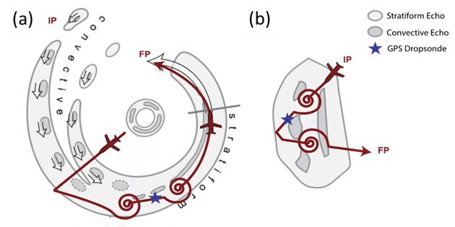
2021 HFP-APHEX: Early Stage
Stratiform Spiral Module (SSM)
Science Team: Rob Rogers (PI), Jon Zawislak, Trey Alvey, Robert Black, Josh Wadler, Hua Leighton, Xuejin Zhang, Michael Bell (CSU), Anthony Didlake (PSU), Jim Doyle (NRL), Dan Stern (NRL)
Obtain a quantitative description of the distribution of liquid and frozen hydrometeors in stratiform precipitation to better understand the processes that govern these distributions and how they are represented in numerical models.
Precipitation probe measurements of stratiform regions in TCs can also help improve retrievals of stratiform microphysical properties by polarimetric radar.
Spiral ascents/descents in stratiform regions of deep convection at radii outside the RMW will provide microphysical measurements from in situ probes, including how the microphysics vary in a shear-relative framework
Optimal additional measurements include:
  Deep-layer measurements of temperature and humidity in the local environment of the stratiform precipitation from high-altitude aircraft will provide the thermodynamic context within the mid-and lower troposphere
  Measurements of sea-surface temperature and subsurface temperature profiles from ocean probes and/or IR dropsondes will provide context on the surface boundary
(a) Example spiral ascent and descent in stratiform portion of primary rainband. (b) Example spiral ascent and descent in isolated CB during stratiform transition.

Slide 40
2021 Hurricane Field Program-APHEX
HFP Experiments and Modules
EARLY STAGE
Analysis of Intensification Processes Experiment (AIPEX)
Convective Burst Structure and Evolution Module (CBM)
Hurricane Boundary Layer Module
Impact of Targeted Observations on Forecasts (ITOFS)
Stratiform Spiral Module (SSM)
GENESIS STAGE
Favorable Air Mass (FAM) Experiment
Precipitation during Formation and Observing its Response across Multiple Scales (PREFORM)
MATURE STAGE
Eye-Eyewall Mixing Module
Gravity Wave Module
NESDIS Ocean Winds
Rainband Complex Module (RCM)
Research In Coordination with Operations Small Unmanned Aircraft Vehicle Experiment (RICO SUAVE)
Surface Wind and Wave Validation Module
Tropical Cyclone Diurnal Cycle Experiment
END STAGE
Tropical Cyclones at Landfall Experiment
OCEAN OBSERVING
Ocean Survey Experiment
Sustained and Targeted Ocean Observations
SATELLITE VALIDATION
ADM-Aeolus Satellite Validation Module
NESDIS JPSS Satellite Validation Experiment
NASA TROPICS Satellite Validation Module

Slide 41
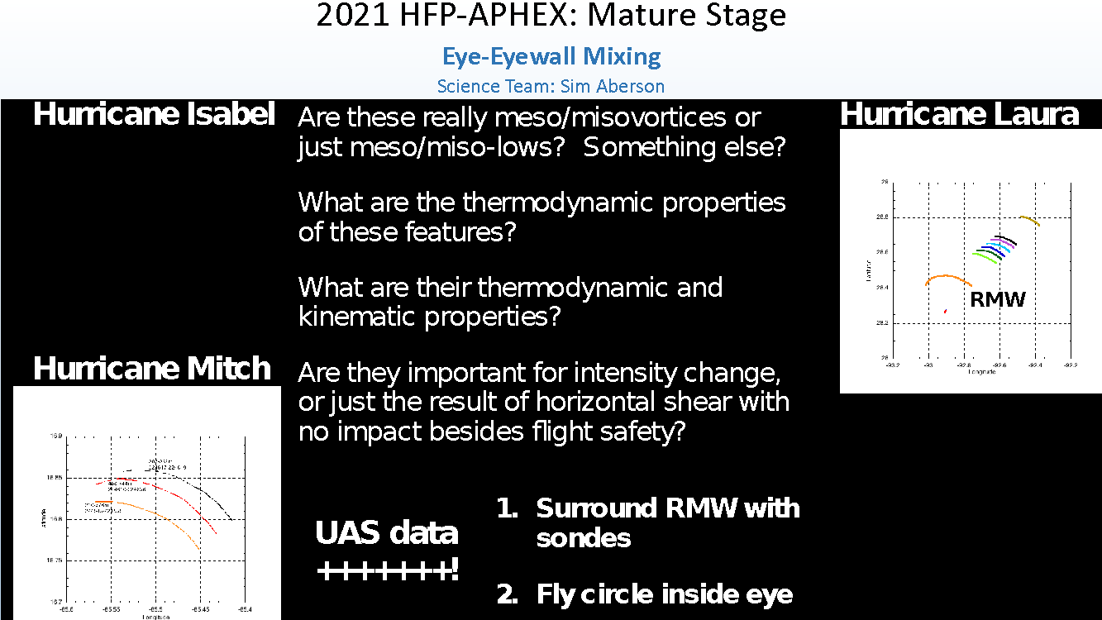

Slide 42
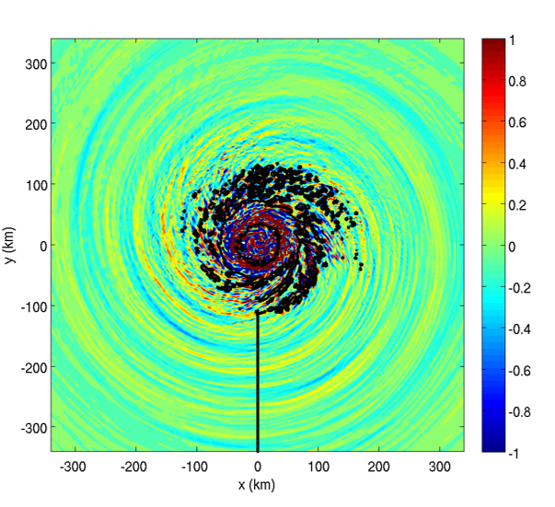
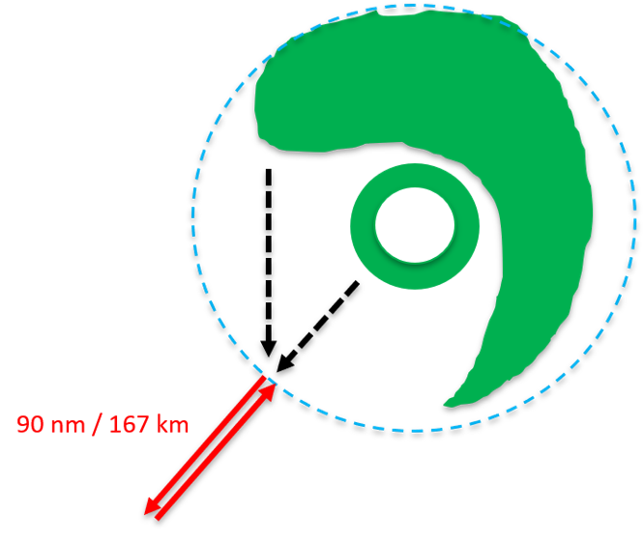
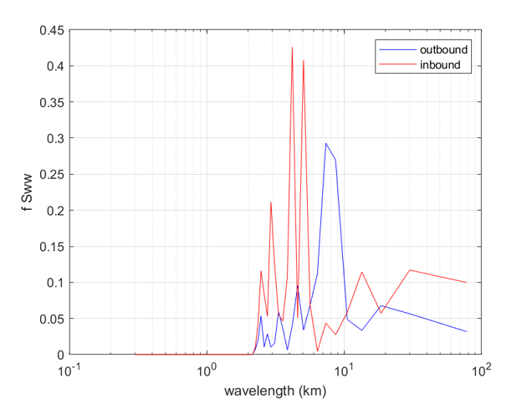

2021 HFP-APHEX: Mature Stage
Gravity Wave Module
Science Team: Jun Zhang and David Nolan
Collect observations targeted at better understanding the characteristics of gravity waves in hurricanes
Quantify how the characteristics of these waves are related to hurricane intensity and intensity change
Directly observe the phase speed (C_{p}), period (T) and wavelength (λ) of the outward moving gravity waves
It requires passing through the waves in both directions
Simulated gravity waves
Vertical velocity (w) spectrum

Slide 43
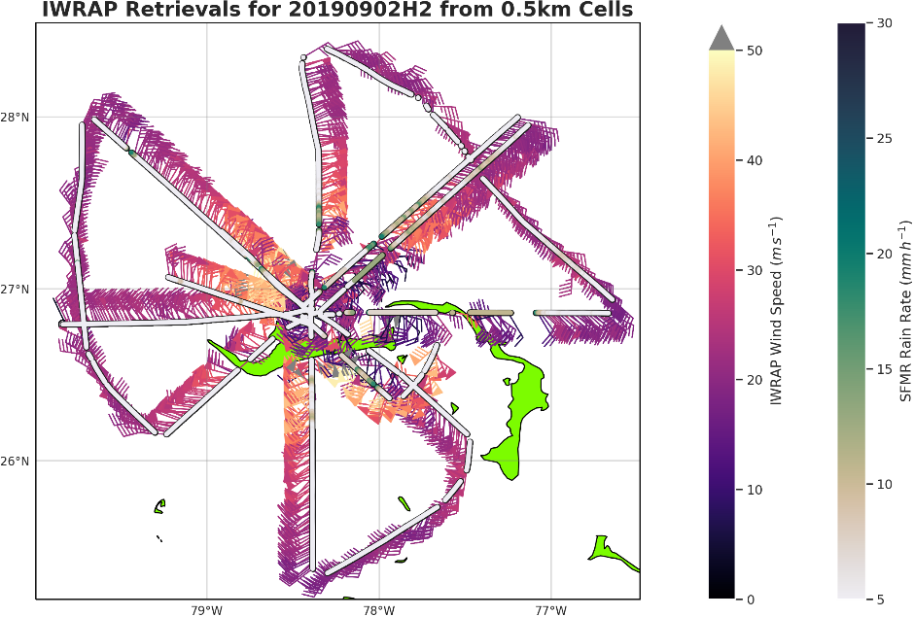
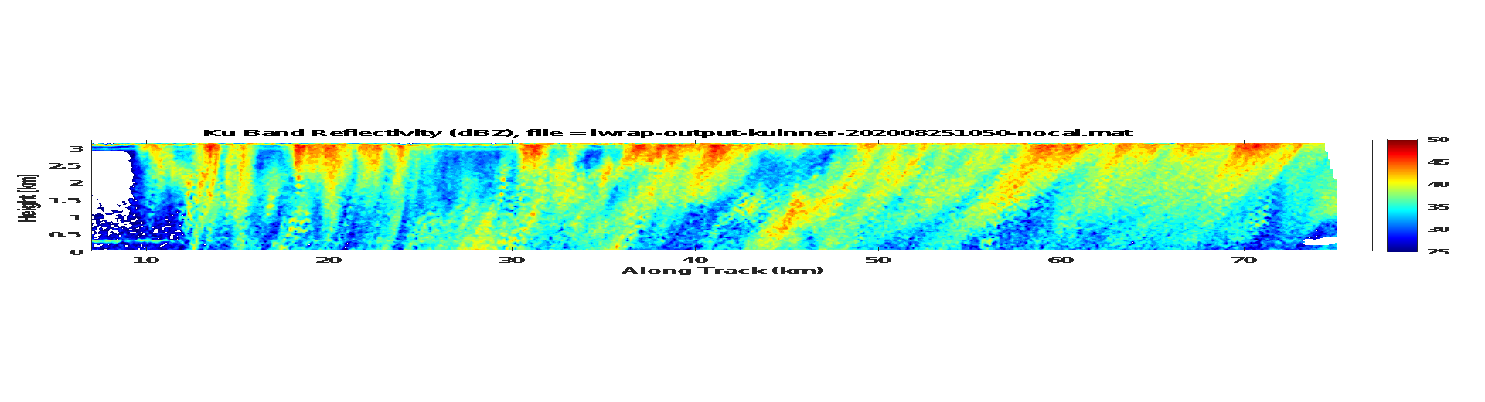
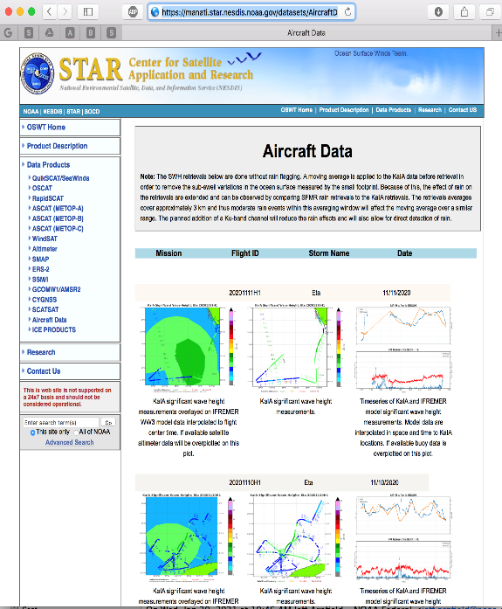
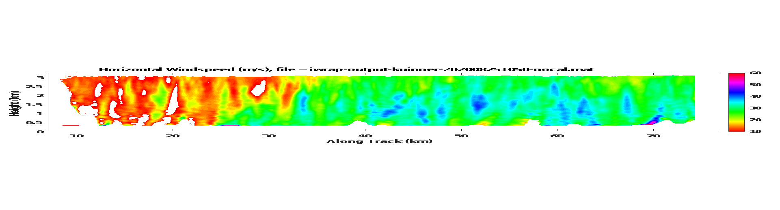
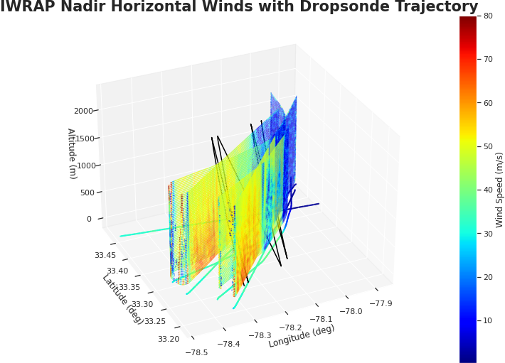
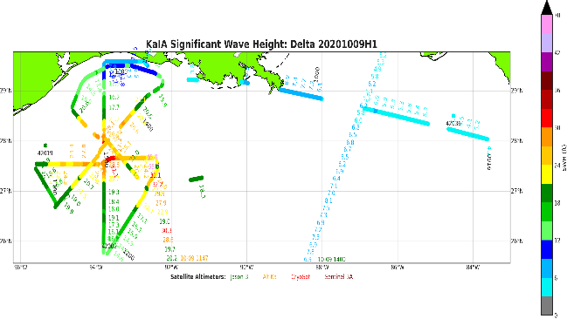
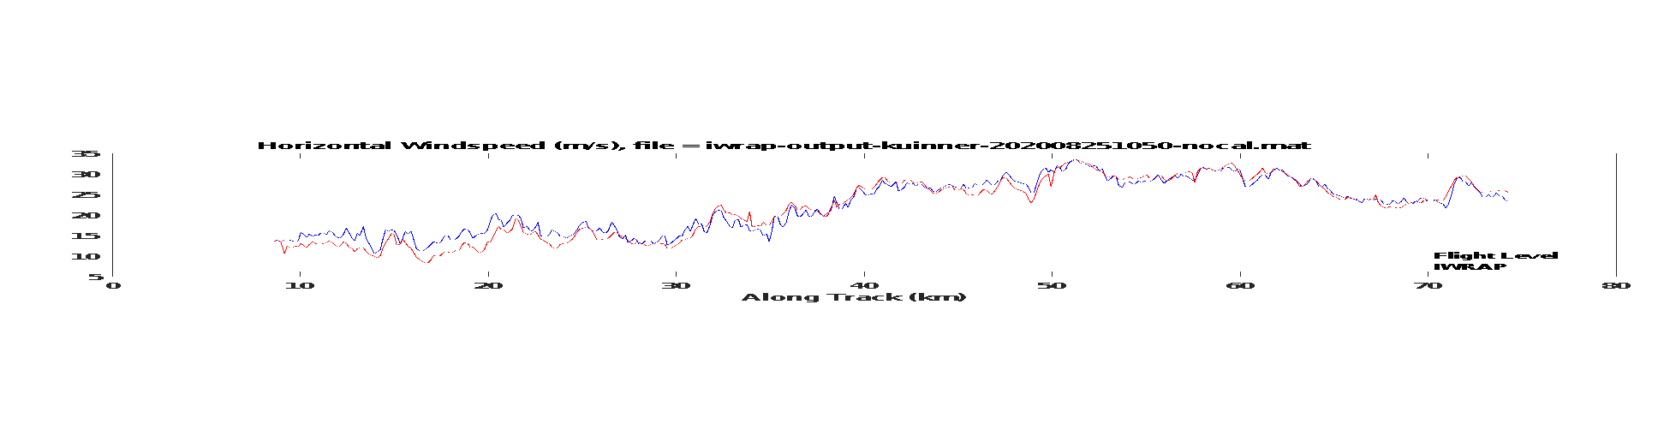
2021 HFP-APHEX: Mature Stage
NESDIS Ocean Winds
Science Team: Paul Chang, Zorana Jelena, Joe Sapp
To improve our understanding of microwave retrievals of the ocean surface and atmospheric wind fields and to evaluate new remote sensing techniques/technologies
To validate satellite-based sensors of the ocean surface in extreme conditions and perform risk reduction for future satellite missions
Provide real-time data to NHC (SWH, wind and reflectivity profiles, and surface wind vectors)
IWRAP Ocean Surface Wind Vector retrievals (Scatterometry)
IWRAP Ku-band Reflectivity (dBZ)
IWRAP 3-D winds, reflectivity and surface winds, KaIA SWH, SFMR winds and dropsonde winds are posted as flight progresses on our data distribution web site
IWRAP Horizontal Wind Speed (m/s)
IWRAP and Flight Level Wind Speed Comparison
SWH Retrievals from KaIA
https://manati.star.nesdis.noaa.gov/datasets/AircraftData.php

Slide 44
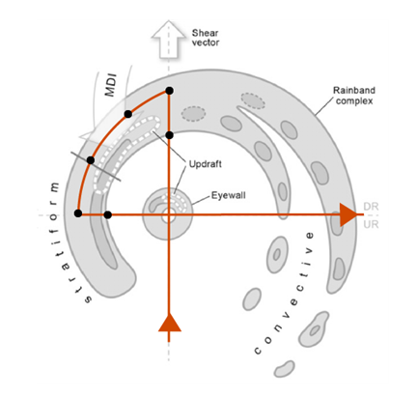
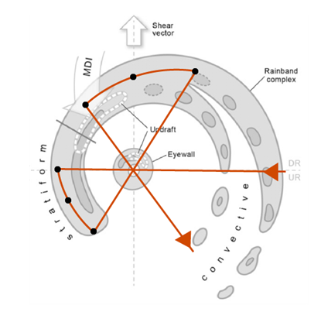
2021 HFP-APHEX: Mature Stage
Rainband Complex Module (RCM)
Science Team: Rob Rogers (PI), Michael Fischer, Anthony Didlake (PSU), Michael Bell (CSU), Anthony Wimmers (UWisc), Jim Doyle (NRL), Dan Stern (NRL)
Goal is to improve understanding of the dynamic and microphysical processes of the mature rainband complex and role in storm evolution.
Sample the wind and precipitation structures of both convective and stratiform regions of the rainband complex in varied storms across varied shear and moisture environments.
Sample the microphysics of the convective-to-stratiform transition and the downwind stratiform regions of the rainband complex (when combined with Stratiform Spiral Module)
Validate key features linked with different hypotheses of rainband-vortex interaction (e.g., sampling along the mesoscale descending inflow (MDI), generally located downshear left)
Rainband Complex modules in Figure-4 (left) and Butterfly (right) survey patterns. Target the stratiform and transition regions of a mature rainband complex. The downwind straight legs of a regular survey pattern are replaced with along-band curved legs, and the radial leg lengths are adjusted to meet the endpoints of the module leg. The “optimal” dropsonde (black dots) strategy is in the left panel, and the “acceptable” dropsonde strategy is in the right panel, for each RCM

Slide 45
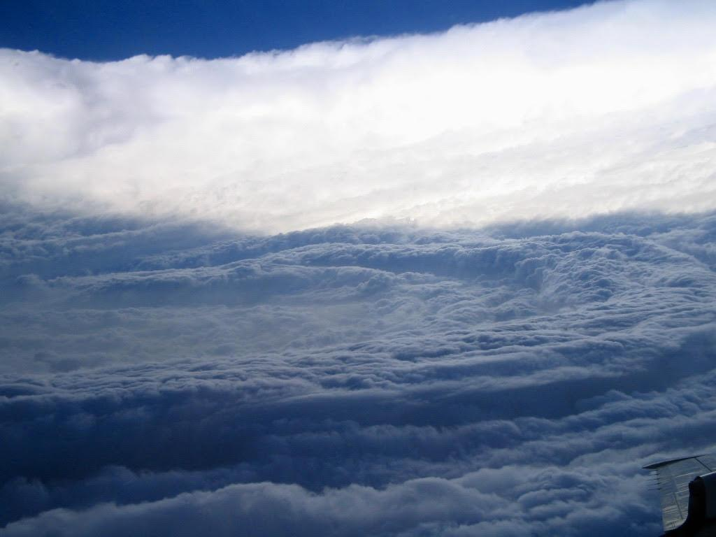
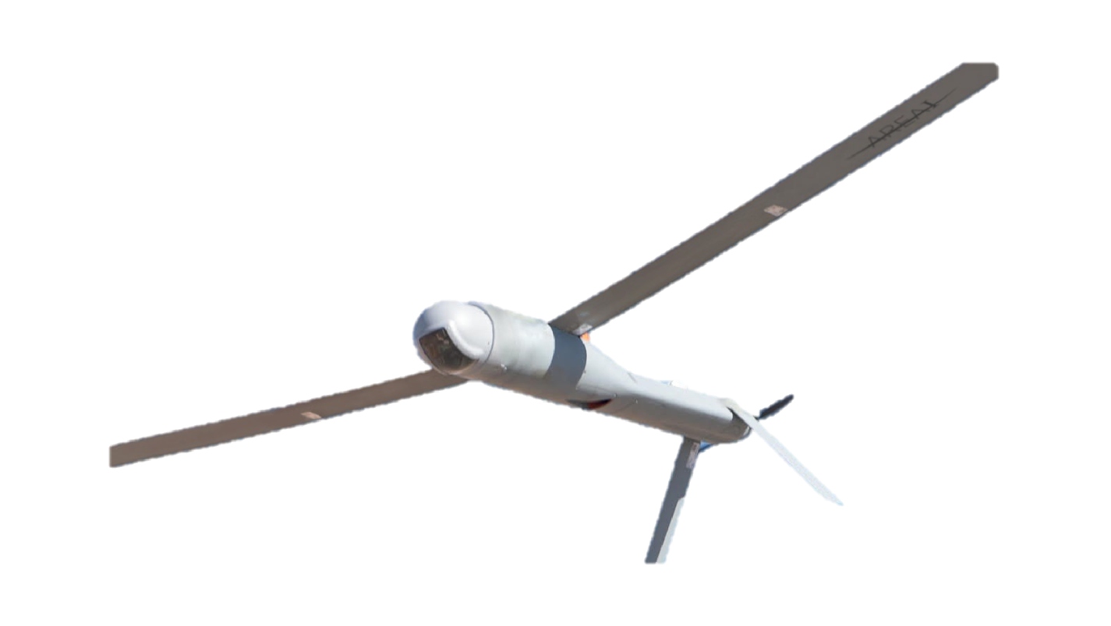
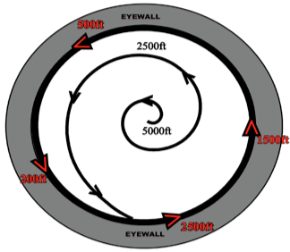



2021 NOAA/AOML/HRD Hurricane Field Program
Intensity Forecast Experiment (IFEX)
RESEARCH IN COORDINATION WITH OPERATIONS
SMALL UNMANNED AIRCRAFT VEHICLE EXPERIMENT
Science Team: Joseph Cione, Jun Zhang, Josh Wadler, Altug Aksoy, George Bryan (NCAR), Ron Dobosy (NOAA/ARL-ret), Frank Marks, Kelly Ryan, Brittany Dahl, Josh Alland (NCAR), Rosimar Rios-Berrios (NCAR), Gijs deBoer (NOAA/PSL), Evan Kalina (NOAA/DTC), Don Lenschow (NCAR), Xiaomin Chen, Chris Rozoff (NCAR), Eric Hendricks (NCAR), Falko Judt (NCAR), Jonathan Vigh (NCAR)
Plain Language Description: This experiment uses small drones, instead of manned aircraft, to sample the lowest and most dangerous regions of the tropical cyclone. It is believed that observations from these unique platforms will improve basic understanding and enhance forecaster situational awareness. Detailed analyses of data collected from these small drones also have the potential to improve the physics of computer models that predict changes in storm intensity.

Slide 46




2021 HFP-APHEX: Mature Stage
Surface Wind and Wave Validation Module
Science Team: Heather Holbach, Ivan PopStefanija, Tony Wimmers, Jim Doyle, Sue Chen, James Cummings, Ralph Foster
Goals
Improve SFMR wind speed and rain rate retrievals
Improve surface wind products from SAR satellites
Improve knowledge of surface wave field for analyses, forecasts, and models
Objectives:
Collect WSRA Data with
Significant Wave Height ≥ 8ft
or Near Wave Buoys
Collect Direct SFMR and Dropsonde Colocations
(Wind Speeds ≥ 100 kts)
Collect High-Incidence
SFMR Data
Collect Flight Data Coincident
with SAR Data Acquisition
Notes:
Key point: SFMR algorithm re-evaluation highlights the need for continued sonde overflights in high winds.
(full description of objectives for reference)
Objectives:
Collect collocated SFMR and dropsonde data in high wind regions (surface wind speeds ≥ 100 kts).
Collect off-nadir SFMR observations at several different incidence angles in several different storm-relative locations.
Collect SFMR, dropsonde, flight-level, WSRA (when available), IWRAP (when available), and/or DWL (when available) coincident with SAR data acquisition.
Collect WSRA significant wave height data for all regions of the storm with significant wave heights ≥ 8 ft or over wave buoys.

Slide 47



2021 HFP-APHEX: Mature Stage
Tropical Cyclone Diurnal Cycle Experiment
Science Team: Jason Dunion, Morgan O’Neill (Stanford Univ.), Allison Wing (FSU),
Dave Raymond (NM Tech), Zeljka Fuchs-Stone (NM Tech), Dan Chavas (Purdue Univ.)
Plain Language Description: This experiment aims to collect observations that improve the understanding of how day-night fluctuations in radiation affect the intensity and structure of TCs.
What are the 3-dimensional kinematic and thermodynamic structure and evolution of TC diurnal pulses/waves?
We need wide-coverage day and night flights:
core area + outflow
Upper level outflow divergence exhibits a strong diurnal cycle:
2019 TS Dorian
GOES AMVs
2019 Hurricane Dorian’s TC diurnal cycle
-afternoon peaks in upper-level outflow-
2020 Hurricane Teddy
TCDC flight
How is this divergence distributed in height and azimuth?
will we see a diurnal peak in outflow jet strength?

Slide 48
2021 Hurricane Field Program-APHEX
HFP Experiments and Modules
EARLY STAGE
Analysis of Intensification Processes Experiment (AIPEX)
Convective Burst Structure and Evolution Module (CBM)
Hurricane Boundary Layer Module
Impact of Targeted Observations on Forecasts (ITOFS)
Stratiform Spiral Module (SSM)
GENESIS STAGE
Favorable Air Mass (FAM) Experiment
Precipitation during Formation and Observing its Response across Multiple Scales (PREFORM)
MATURE STAGE
Eye-Eyewall Mixing Module
Gravity Wave Module
NESDIS Ocean Winds
Rainband Complex Module (RCM)
Research In Coordination with Operations Small Unmanned Aircraft Vehicle Experiment (RICO SUAVE)
Surface Wind and Wave Validation Module
Tropical Cyclone Diurnal Cycle Experiment
END STAGE
Tropical Cyclones at Landfall Experiment
OCEAN OBSERVING
Ocean Survey Experiment
Sustained and Targeted Ocean Observations
SATELLITE VALIDATION
ADM-Aeolus Satellite Validation Module
NESDIS JPSS Satellite Validation Experiment
NASA TROPICS Satellite Validation Module

Slide 49



2021 HFP-APHEX: End Stage
Tropical Cyclones at Landfall
Science Team: John Kaplan, Peter Dodge, Ghassan Alaka, Heather Holbach, Jun Zhang, Frank Marks, Michael Biggerstaff (University of Oklahoma), John Schroeder (Texas Tech University), Forrest Masters (University of Florida),
Kevin Knupp (University of Alabama at Huntsville), David Nolan (University of Miami)
Motivation: Landfalling tropical cyclones (TCs) can produce a variety of high impact over land weather including
tornadoes and damaging winds (particularly gusts) for which there exists limited objective forecast guidance.
Methodology: Utilize P-3 aircraft and land-based mobile research team instruments to collect data in landfalling TCs to: 1) improve our understanding and capability to predict landfalling TC induced tornadoes and damaging winds.
2) reduce the uncertainty in SFMR wind speed estimates of landfalling TCs in coastal regions.
Offshore Intense Convection Module
Coastal Survey Module
SFMR Coastal Module
Flight altitude: > 10 kft , duration ~1-2 hr.
Flight altitude: > 10 kft, duration ~2 hr.
Flight altitude: 5-12 kft, duration ~30-45 min.

Slide 50
2021 Hurricane Field Program-APHEX
HFP Experiments and Modules
EARLY STAGE
Analysis of Intensification Processes Experiment (AIPEX)
Convective Burst Structure and Evolution Module (CBM)
Hurricane Boundary Layer Module
Impact of Targeted Observations on Forecasts (ITOFS)
Stratiform Spiral Module (SSM)
GENESIS STAGE
Favorable Air Mass (FAM) Experiment
Precipitation during Formation and Observing its Response across Multiple Scales (PREFORM)
MATURE STAGE
Eye-Eyewall Mixing Module
Gravity Wave Module
NESDIS Ocean Winds
Rainband Complex Module (RCM)
Research In Coordination with Operations Small Unmanned Aircraft Vehicle Experiment (RICO SUAVE)
Surface Wind and Wave Validation Module
Tropical Cyclone Diurnal Cycle Experiment
END STAGE
Tropical Cyclones at Landfall Experiment
OCEAN OBSERVING
Ocean Survey Experiment
Sustained and Targeted Ocean Observations
SATELLITE VALIDATION
ADM-Aeolus Satellite Validation Module
NESDIS JPSS Satellite Validation Experiment
NASA TROPICS Satellite Validation Module

Slide 51



2021 HFP-APHEX: Ocean Observing
Ocean Survey Experiment
Science Team: J. Zhang, Cione, Shay, Jaimes, Wadler, S. Chen, Doyle, Cummings, Rudzin, Jin,
Sanabia, Centurioni, Paluszkiewicz, Jayne, Lumpkin, Goni, Foltz, Bringas, ‌Le‌ ‌Hénaff‌, Gramer
Collect observations targeted at better understanding the response of hurricanes to changes in underlying ocean conditions
Collect temporal and spatially coincident ocean, wave, and atmosphere observations during the pre-, during, and post-storm phases in order to better address hypotheses related to the ocean and wave boundary layer’s role in energy exchange and TC intensification
Pre- and post- storm P3 pattern
In-storm P3 pattern over drifters and floats
P3 over underwater Gliders

Slide 52






2021 HFP-APHEX: Ocean Observing
Sustained and Targeted Ocean Observations
Science Team: Stienbarger, Smith, Goni, Glenn, Miles, Marks, J. Zhang, Cione, Centurioni, Lumpkin,
Paluszkiewicz, Thurston, Chiodi, C. Zhang, D. Zhang, Meinig, Foltz, Black, Jayne, Trinanes, Kim, Morell, Chardon, Todd, Edwards, Petraitis, Mehra, Bailey, Whilden, Martin, Bringas, Rivero, Rawson, Wilson, CAPT Sanabia
GOALS:
1. Deploy and operate a suite
of ocean observing instruments and platforms to collect observations that can be assimilated into operational
and experimental forecast models and used to advance scientific research and improve tropical cyclone intensity forecasts.
2. Provide tools for monitoring the location of ocean observational assets and ocean conditions and products from in situ, aircraft, and satellite observations.
GLIDERS
A
B
ALAMO
C
DRIFTERS
D
SAILDRONE + GLIDERS

Slide 53


2021 HFP-APHEX: Ocean Observing
Upper-ocean measurements from ALAMO floats
Science Team: G. Foltz, G. Rawson, G. Goni, C. Schmid, S. Jayne
Goal: Ocean observations to improve intensity forecasts, advance understanding of hurricane-ocean interaction.
Autonomous profiling of upper ocean (0-300 m) temperature, salinity every ~2 hr before, during, after storm.
Priorities for deployment:
Major hurricanes
Hurricanes threatening landfall
Shallow pre-storm ocean T/S stratification
Deployed from P-3s.
All data transmitted in real-time via satellite to GTS.

Slide 54
2021 Hurricane Field Program-APHEX
HFP Experiments and Modules
EARLY STAGE
Analysis of Intensification Processes Experiment (AIPEX)
Convective Burst Structure and Evolution Module (CBM)
Hurricane Boundary Layer Module
Impact of Targeted Observations on Forecasts (ITOFS)
Stratiform Spiral Module (SSM)
GENESIS STAGE
Favorable Air Mass (FAM) Experiment
Precipitation during Formation and Observing its Response across Multiple Scales (PREFORM)
MATURE STAGE
Eye-Eyewall Mixing Module
Gravity Wave Module
NESDIS Ocean Winds
Rainband Complex Module (RCM)
Research In Coordination with Operations Small Unmanned Aircraft Vehicle Experiment (RICO SUAVE)
Surface Wind and Wave Validation Module
Tropical Cyclone Diurnal Cycle Experiment
END STAGE
Tropical Cyclones at Landfall Experiment
OCEAN OBSERVING
Ocean Survey Experiment
Sustained and Targeted Ocean Observations
SATELLITE VALIDATION
ADM-Aeolus Satellite Validation Module
NESDIS JPSS Satellite Validation Experiment
NASA TROPICS Satellite Validation Module

Slide 55



2021 HFP-APHEX: Satellite Validation
ADM-Aeolus Satellite Validation Module
Science Team: Lisa Bucci, Jason Dunion, Lidia Cucurull, Mike Hardesty (Univ. of Colorado – NOAA/CIRES),
Ralph Foster (Univ. of Washington)
Plain Language Description: This experiment seeks to use aircraft observations to validate satellite measurements of winds in the environment of TCs. This will be accomplished by coordinating NOAA's P-3s and G-IV high altitude jet with overpasses of the ADM-Aeolus satellite.
Fig. 1. Aeolus-ADM satellite
Fig. 2. Aeolus-ADM satellite orbit. Dashed (solid) lines show where wind obs are measured (satellite nadir).
Fig. 3. NOAA IFEX EMC TDR mission into 2019 TS Barry. Aeolus-ADM and NOAA 42 are shown on NASA’s MTS mission monitoring tool.

Slide 56



2021 HFP-APHEX: Satellite Validation
Evaluation of Tropical Cyclone Environment using Satellite Soundings
Science Team: Rebekah Esmaili (STC), Chris Barnet (STC), Jason Dunion (HRD),
Michael Folmer (NWS/OPC), Nadia Smith (STC), Tony Wimmers (UW/CIMSS), Jon Zawislak (HRD)
Objectives:
Validate and investigate the value of satellite soundings of temperature and moisture in TC/SAL environment.
Time G-IV observations to closely match NOAA-20, Suomi-NPP, and Aqua satellite overpasses.
Evaluate NUCAPS-Aqua for the first time for tropical hazard applications.
Assess if consecutive satellite soundings can diagnose temporal trends.
Sept 18, 2019 ~1600 UTC Hurricane Jerry
Sonde Number
Dropsondes
RH Cross section
Timed within 6 mins of overpass
Did not pass QC
MW+IR pass
NUCAPS-SNPP
MW-only pass
Both failed
Cloud Top
Sonde Number

Slide 57


2021 HFP-APHEX: Satellite Validation
NASA TROPICS Pathfinder
Science Team: Brittany Dahl, Jason Dunion, Rob Rogers, Jon Zawislak, Kelly Ryan, Bill Blackwell (MIT/LL)
Plain Language Description
Calibrate and validate temperature, moisture, and precipitation measurements obtained from new TROPICS Pathfinder satellite
Compare satellite obs to NOAA P-3 and NOAA G-IV aircraft obs (dropsondes and TDR) that are coordinated in space and time with satellite overpasses
TROPICS Pathfinder satellite
Flight Pattern
Straight flight leg targeting nadir or area within 750 km of nadir
TC inner core (r ≤ 150 km), near environment (r = 150-300 km), and far environment (r > 300 km)
Any stage of TC lifecycle
Satellite passes from full TROPICS constellation over simulated TC, dashed line = nadir

Slide 58
2021 Hurricane Field Program-APHEX
Questions?
Copies of the 2021 HFP Kickoff and today’s chat log can be found in the HRD Google Drive folder
HRD >> Hurricane Field Program >> 2021 >> Presentations >> HFP Kickoff

