Slide 1
Global Hawk Dropsondes Impact on Tropical Cyclone Prediction
Nikolaus Rentzke
Embry-Riddle Aeronautical University
Meteorology and Computational Mathematics
Weather-Ready Nation
NOAA Hollings Internship AOML/HRD
Mentors: Dr. Jason Sippel, Dr. Hui Christophersen Co-Mentor: Dr. Sarah Ditchek
7/27/2020

Slide 2
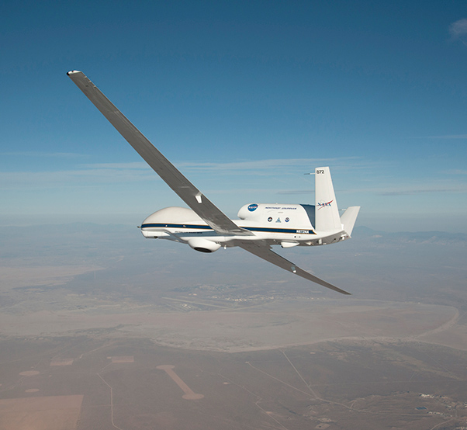
Background
The NOAA manned Lockheed WP-3D Orion (P3) and Gulfstream G-IV (G-IV) aircraft fly at average altitudes of ~10,000 ft (700 hPa) and ~45,000 ft (175 hPa)
The Global Hawk (GH), an unmanned aircraft system (UAS), flies even higher at around 60,000 ft, providing a full dropsonde profile of the tropical cyclone TC
Gulfstream G-IV
Lockheed WP-3D Orion
Global Hawk

Slide 3
Objectives
This project investigates the impacts of having a full profile of dropsonde observations from the GH, in contrast to, the conventional dropsonde profiles below G-IV level (175 hPa) and P3 level (700 hPa) on tropical cyclone prediction
Utilized the Operational Hurricane Weather Research and Forecasting Model (HWRF) to conduct data denial experiments of Hurricane Gaston 2016
Hypothesis
Assimilating full profile dropsonde data from GH will have better tropical cyclone track, intensity and structure forecasts than assimilating partial profile dropsonde data
This relates to my current research with UAS gathered weather data. That research is to explore the microclimates of the Urban Boundary Layer and flow around tall buildings with regards to commercial UAS operations

Slide 4
Methodology - Model
Model information:
Utilized the operational Hurricane Weather Research and Forecasting Model (HWRF)
Model version: H-220
Ran on NOAA Hera supercomputer
How model was used in experiments:
The assimilation of dropsonde data at different altitude ranges provides different HWRF initial conditions
The different initial conditions lead to the differences in track, intensity and structure forecasts

Slide 5
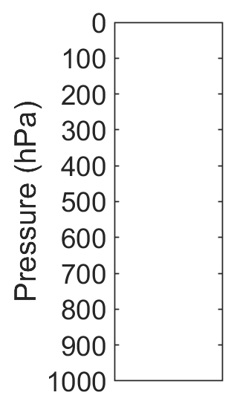
Methodology - Experiments
Control Cycles: 2016082212 – 20160900306 | Deny Cycles: 2016082412 – 20160900306
Assimilated GH Dropsonde Profile Levels
Control
G-IV Deny
P3 Deny
Deny All
Assimilated the full profile of dropsondes from GH level
Denied dropsondes above the G-IV level (175 hPa)
Denied dropsonde above the P3 level
(700 hPa)
Denied all dropsondes

Slide 6
Results: GH Observations
Cycles | Control | G-IV Deny | P3 Deny | Deny All
8/24/2016 18Z | 964 | 793 | 262 | 0
8/25/2016 00Z | 1203 | 1003 | 365 | 0
8/25/2016 06Z | 290 | 244 | 76 | 0
8/27/2016 06Z | 692 | 573 | 174 | 0
8/27/2016 12Z | 525 | 431 | 167 | 0

Slide 7
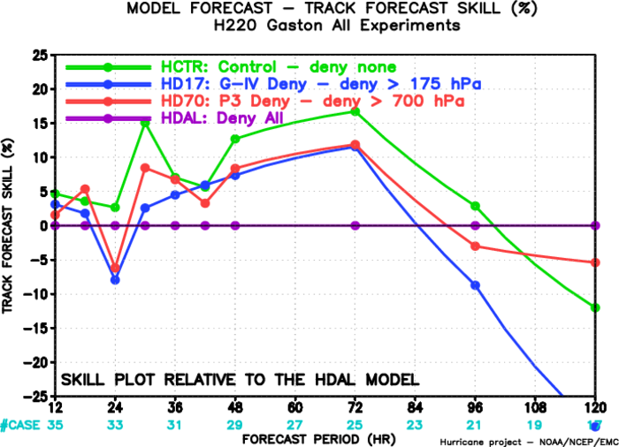
Results: Track
Including any dropsonde data improved track, except at later lead times
The GH level performs the best ~10% improvement with lead times < 72h
The G-IV level showed greatest degradation > 84h

Slide 8
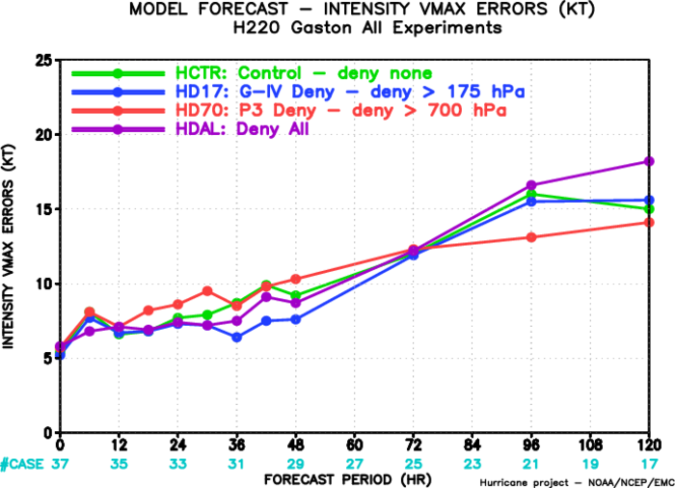
Results: Intensity
With lead times <72h the G-IV level had the least Vmax errors
There was degradation for the P3 level for first 72hrs

Slide 9
Results: Cycle Tracks Animation

Slide 10
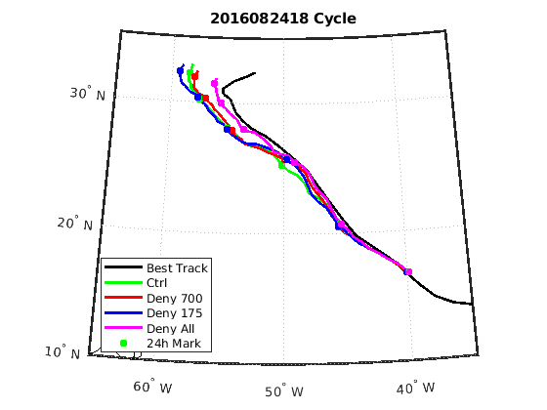
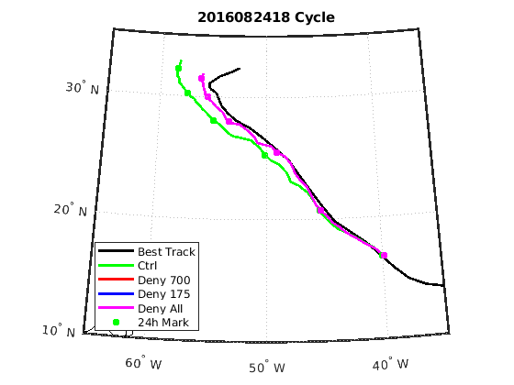
Results: Cycle Tracks
First cycle of assimilated GH dropsondes

Slide 11
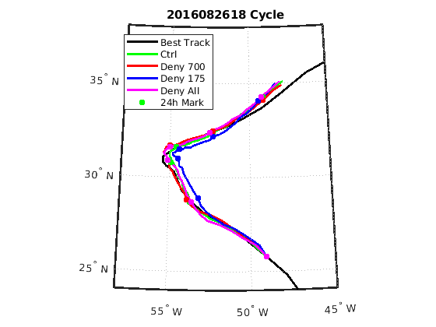
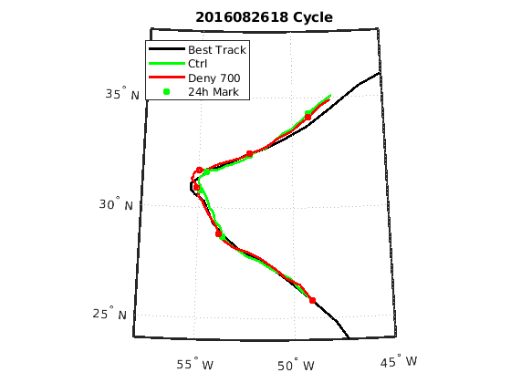
Results: Cycle Tracks
In between GH cycles, last was 8/25/2016 06Z

Slide 12
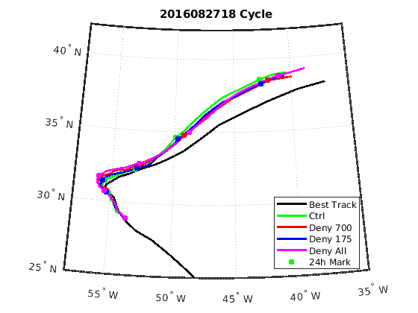
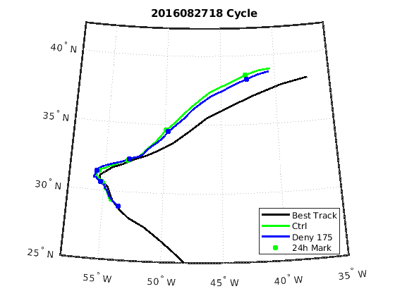
Results: Cycle Tracks
Last GH dropsonde 8/27/2016 12z

Slide 13
Summary
The assimilation of any range of GH levels improves track forecasts
GH level observations made greatest impact in track forecasts (~10% increase <72h)
G-IV level performed best with intensity
Results are from one storm with small sample size
Future Work: Include more storms (e.g. Hermine 2016), analyze storm structure,

Slide 14
Next Steps
Career/Educational Plan
Continue UAS research this Fall
Apply for Meteorology/data science jobs
Apply for fellowships and scholarships for grad school
The UAS industry is growing very fast and not only are package UAS being developed but also personal UAS which you can think of as air taxis

Slide 15
Acknowledgements
Thank You!!!
Mentors:
Dr. Hui Christophersen Dr. Jason Sippel
Co mentor:
Dr. Sarah Ditchek
AOML and HRD
Dr. Frank Marks
Ms. Shirley Murillo
Funding Sponsor: NOAA Ernest F. Hollings Undergraduate Scholarship Program

Slide 16
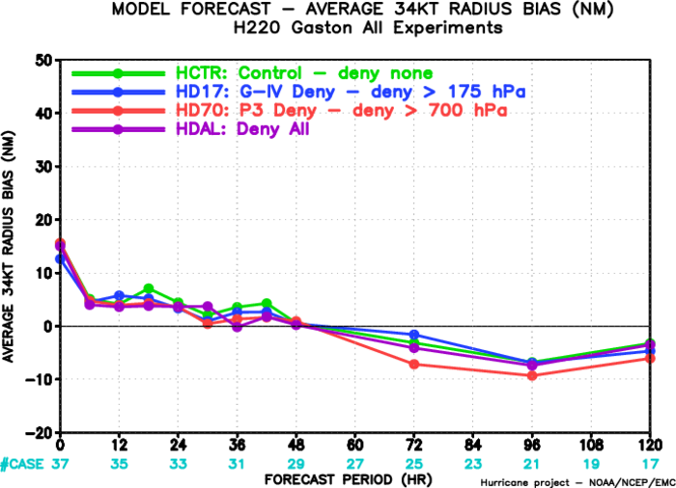
Backup Results: 34KT Radius

Slide 17
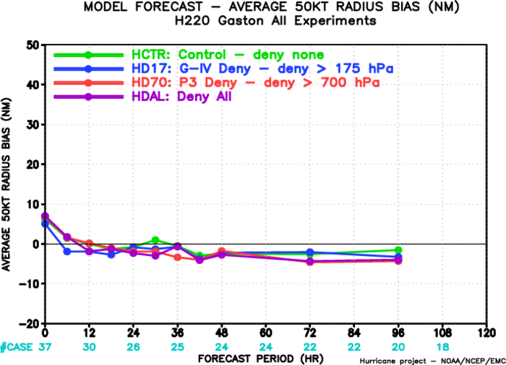
Backup Results: 50KT Radius

Slide 18
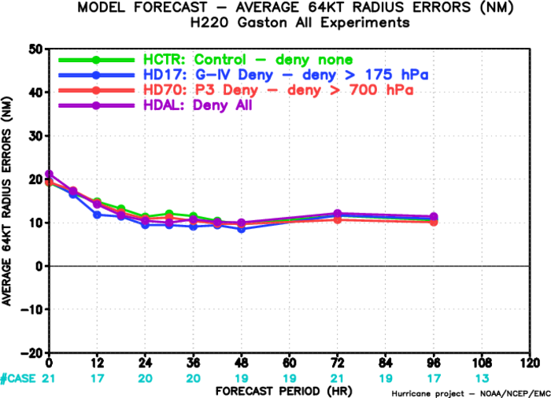
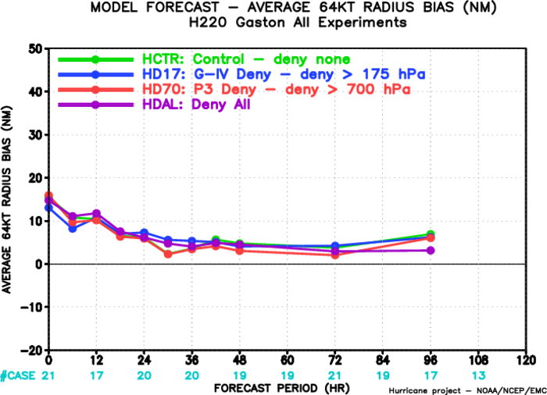
Backup Results: 64KT Radius

