Slide 1
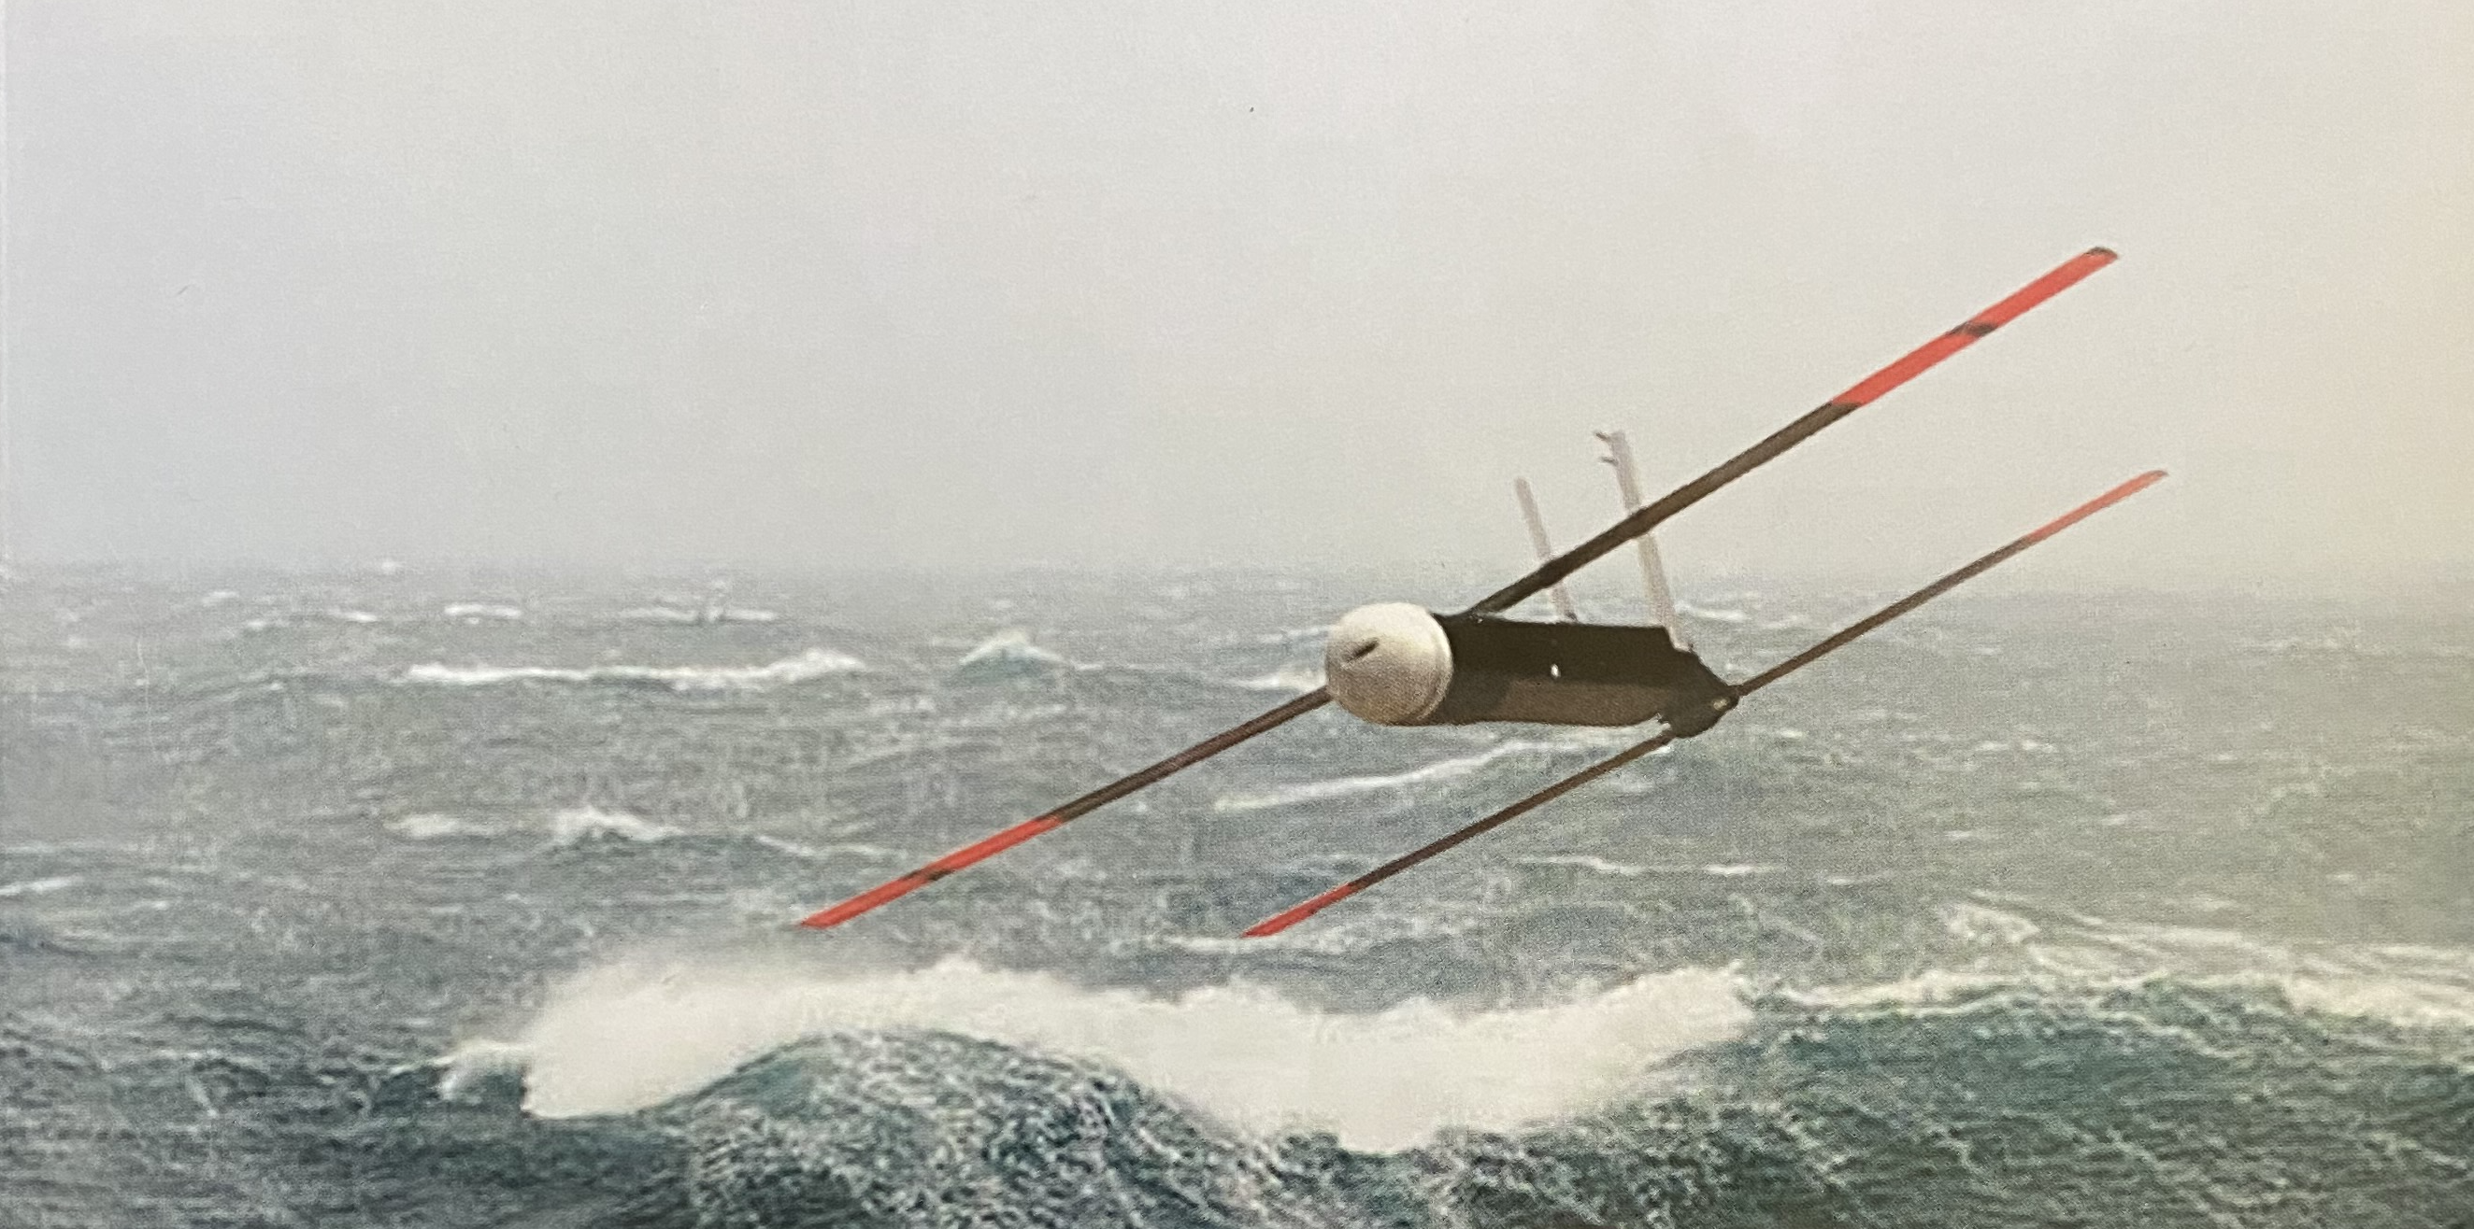
Exploring the Future of Hurricane Reconnaissance Using Small Unmanned Aircraft Systems
Joseph J. Cione
NOAA/AOML
Hurricane Research Division
(Many) Collaborators: AOML/HRD; NOAA/AOC; NCAR; UM/CIMAS; NOAA/ARL; NOAA/PSD; NOAA/GSD;
NOAA/DTC and L3 Latitude
Project Support: NOAA/OMAO/AOC, NOAA/SBIR, NOAA/UASPO, NOAA/OAR,
NCAR/MMM, NCAR/EOL
National Hurricane Center
Virtual Webinar
June 4th 2020

Slide 2
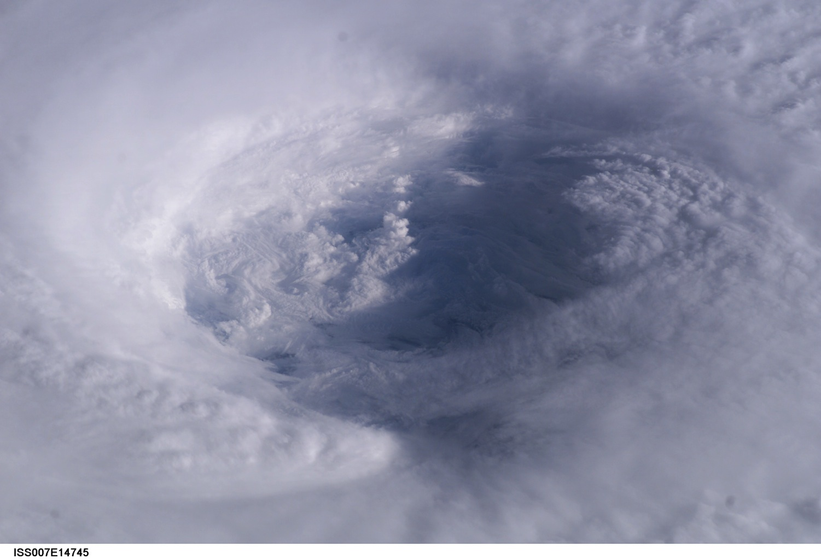
small Unmanned Aircraft System (sUAS) Operations
in Hurricanes…
Observational Objective:
Leverage key attributes of NOAA’s existing Hurricane Hunter aircraft to develop emerging unmanned technologies designed to enhanced data coverage of the critically important, yet sparsely-sampled tropical cyclone boundary layer environment.
End goal:
Through enhanced observation, improve basic understanding, operational situational awareness and ultimately, hurricane intensity forecast performance.
2

Slide 3
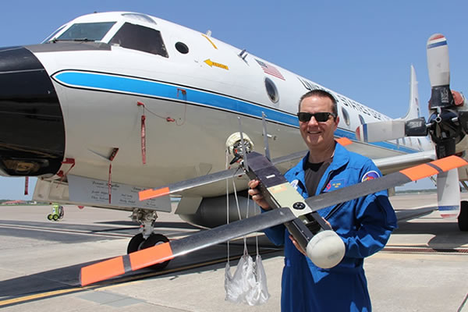
Concept of Operations
Employ a small, semi-autonomous, expendable,
“unmanned” aircraft, deployed from a “manned” aircraft…
NOAA P-3 Orion
“Manned” Aircraft
Coyote sUAS
“Unmanned” Aircraft System

Slide 4
Launch!

Slide 5
Post-Launch:
video courtesy of Raytheon Corporation

Slide 6
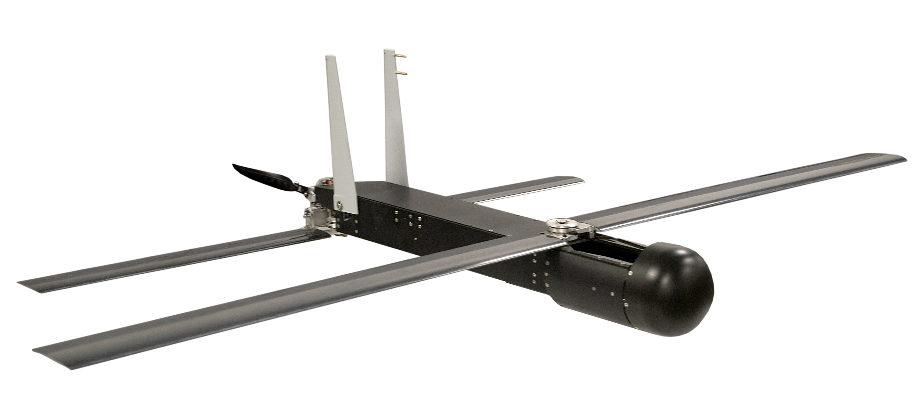
Coyote small Unmanned Aircraft System (sUAS)
Raytheon’s Coyote sUAS:
Wingspan: 1.5 m (~5 ft)
Length: 0.9 m (~3ft)
Weight: 6 kg (~13 lb)
Meteorological Measurements:
Wind speed and direction (up to 1-10 Hz)
Temperature, relative humidity, pressure
Sea surface temperature (SST) and cloud top temperature (IR)
Future: laser altimeter, turbulence gust probe

Slide 7
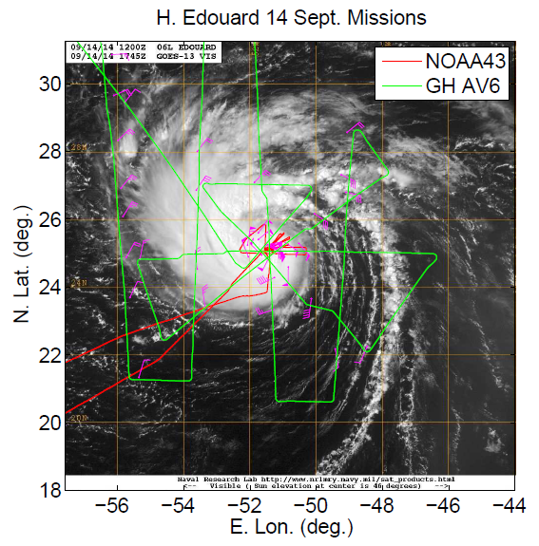
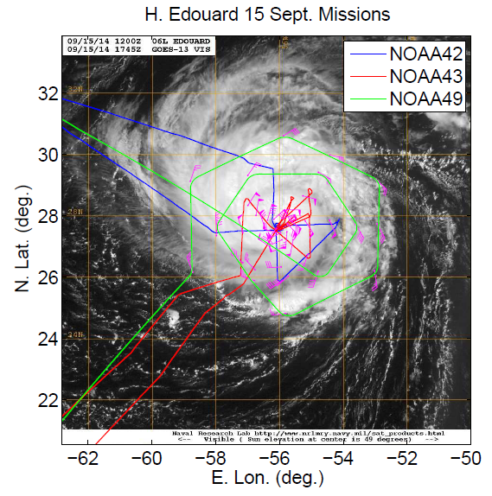
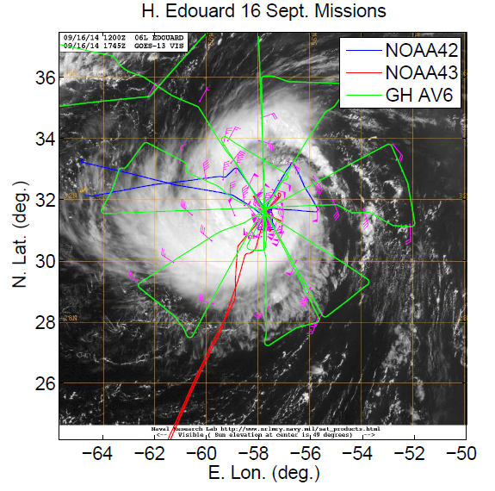
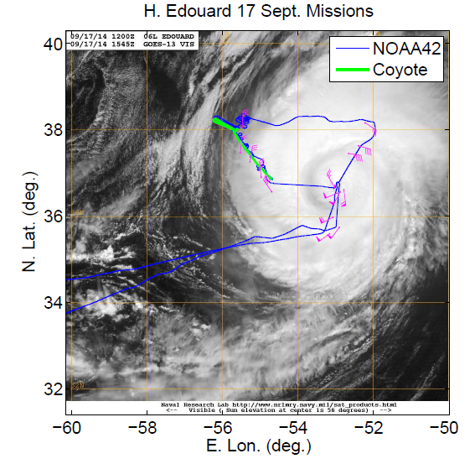
Summary of Edouard (2014) Operations Coyote Unmanned Aircraft System Observations in Hurricane Edouard (2014) Earth and Space Science (AGU) doi: 10.1002/2016EA000187
Aircraft based/used:
St Croix (P-3 N43)
Bermuda (P-3 N42, G-IV N49)
Wallops Is. (GlobalHawk AV6)
Two (2) sUAS deployed (Coyote)
a
b
x
x
c
d

Slide 8
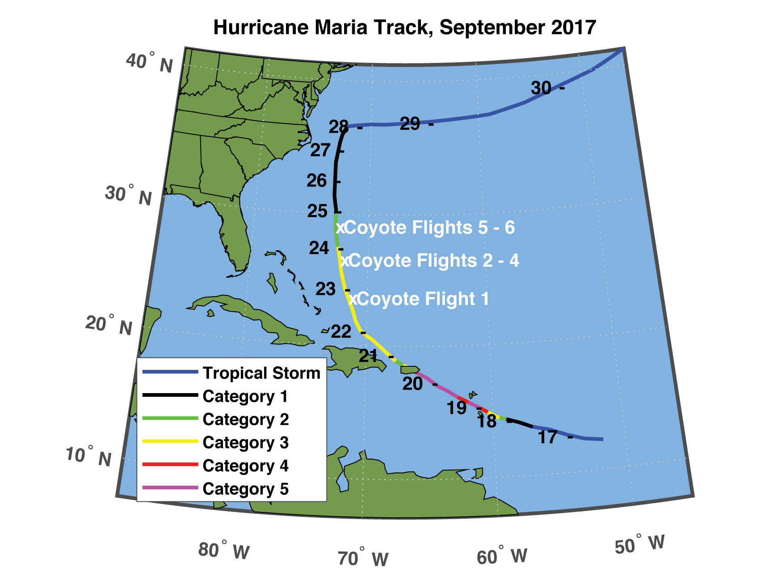
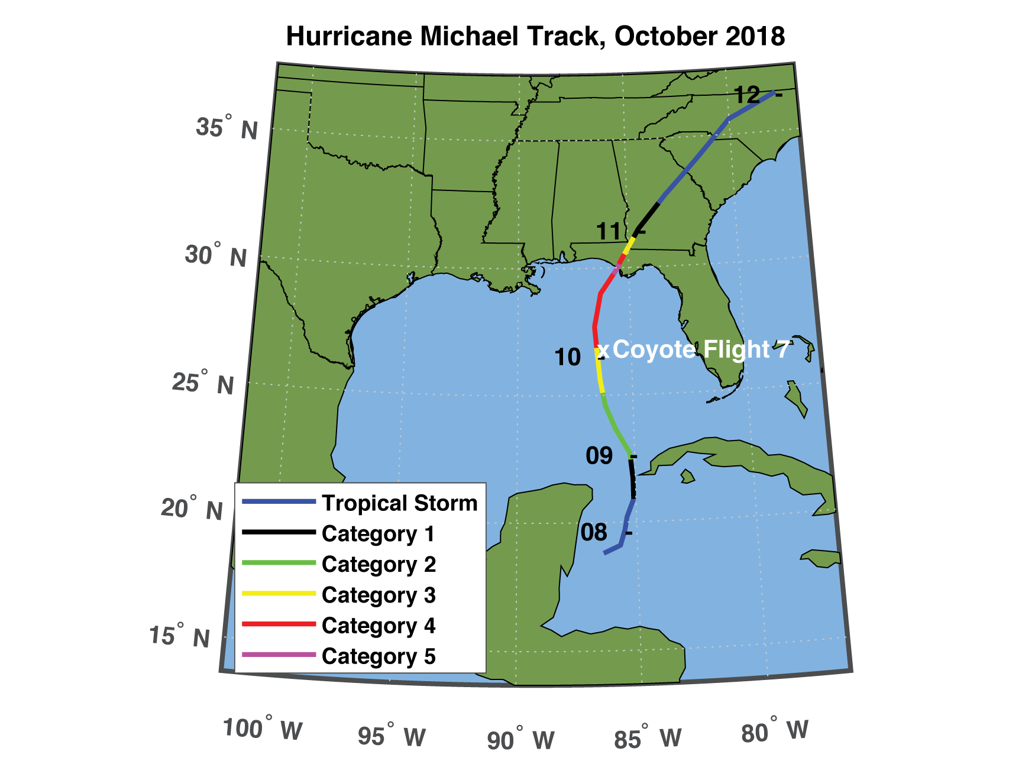
Summary of sUAS Flights in Maria (2017) and Michael (2018)
Eye of the Storm: Observing Hurricanes with a Small Unmanned Aircraft System (BAMS)
https://doi.org/10.1175/BAMS-D-19-0169.1
Six (6) total sUAS missions on 22-24 September 2017 (Maria)
One (1) sUAS flight on 10 October 2018 (Michael)
Longest duration mission: 41 minutes
Maximum horizontal wind speed: 87 m/s at 640 m ASL
Maximum vertical wind speed: +14.4 m/s at 620 m ASL

Slide 9
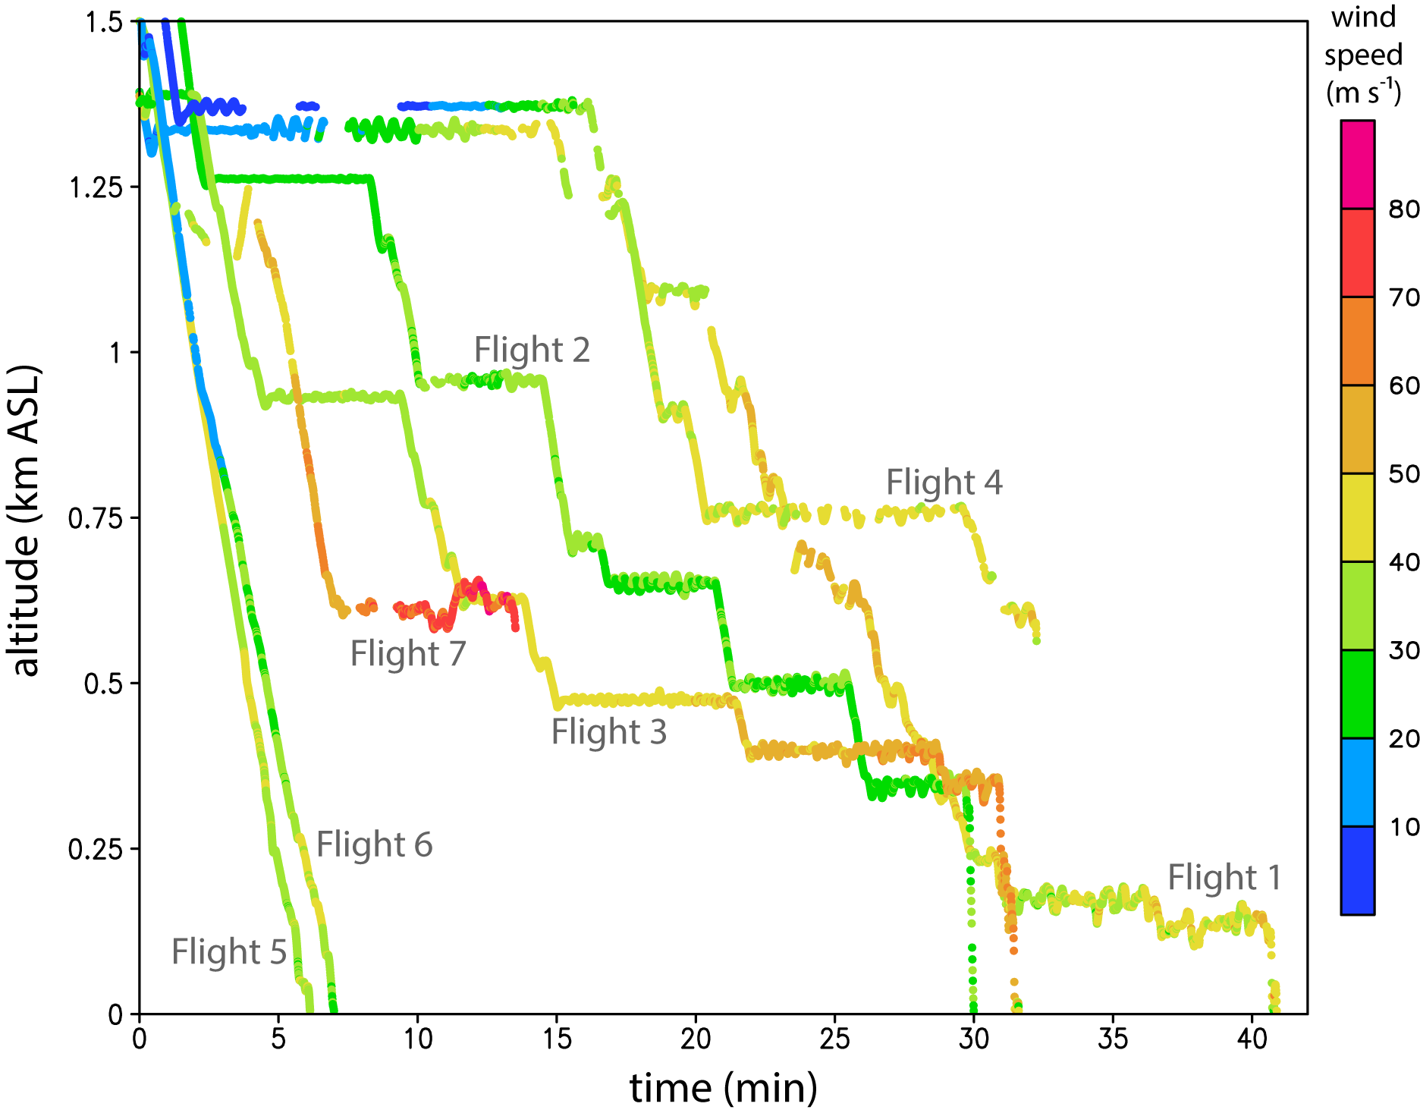
Summary of Maria (2017) and Michael (2018) sUAS Flights
Note: >90% data retrieval
(350 MHz data link)
Summary of all wind speed data collected during Coyote sUAS flights in 2017–2018 (m s⁻¹) as a function of time and height above sea level (ASL). Flights 1–4 and 7 were typical “stepped descent” flight patterns, while flights 5–6 were “glider” flights.

Slide 10
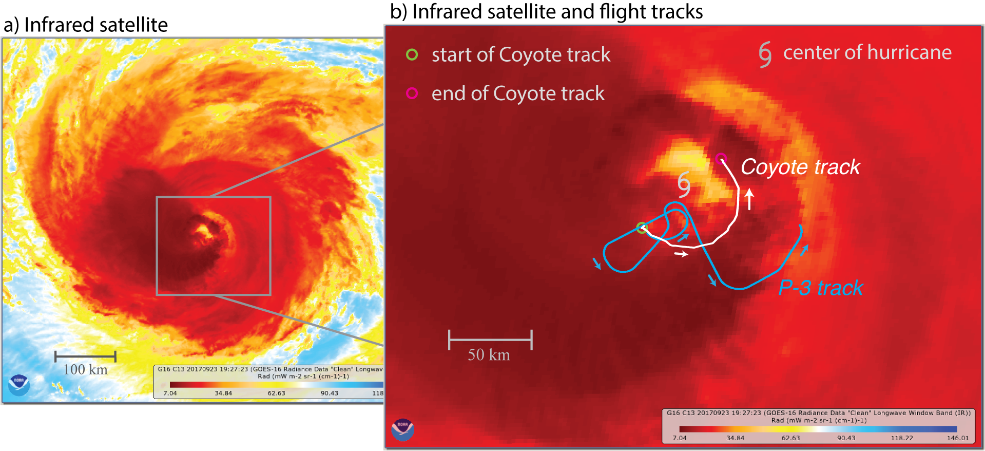
Aircraft Tracks
NOAA P-3 needs to remain close to Coyote
(to receive data, and to send instructions)
Future work will allow for >100 nmi displacement between sUAS and P-3
Infrared satellite images of Hurricane Maria at 1927 UTC on 23 September 2017. The image on the right shows the center of the hurricane and the tracks of Coyote Flight 3 (white) and the NOAA P-3 (blue) from 1925–1957 UTC.

Slide 11
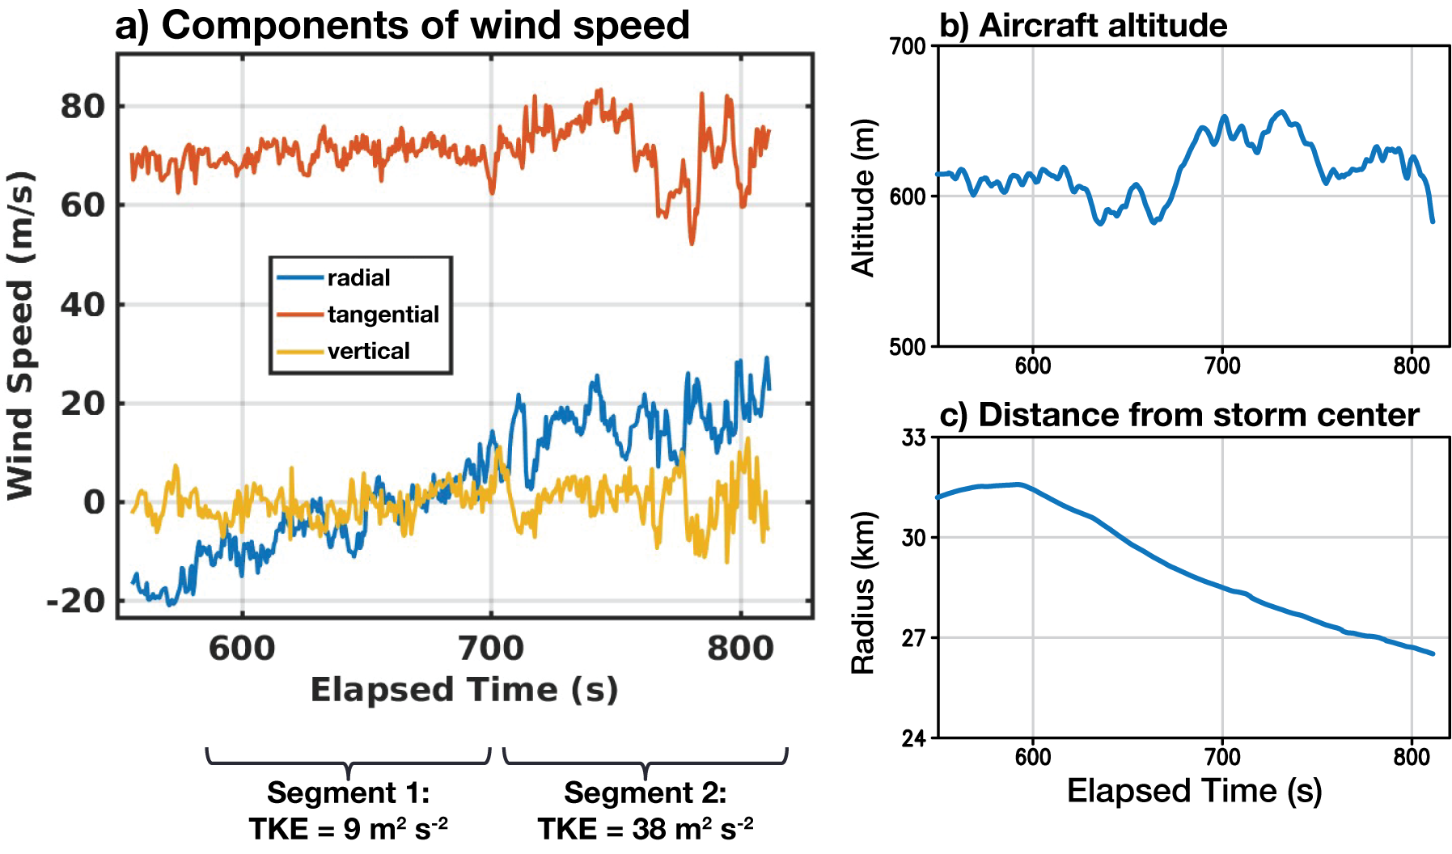
Analyses using High-Frequency Wind Measurements
Time series of flight-level data in Hurricane Michael. (a) u,v,w components of wind speed. Values of turbulence kinetic energy (TKE) are shown. (b) sUAS altitude, showing nearly level flight. (c) sUAS Distance from the TC center (with distance decreasing during flight).
Notes:
Regarding the winds:
We do it the same way as it would be done in 2D, by using a combination of airspeed, attitude and GPS velocity. The difference between the airspeed and gps speed (after factoring in pitch, roll, yaw from the autopilot) is representative of the wind. The main assumption that we make (right or wrong) is that the aircraft is always weathervaned into the local wind (sum of aircraft forward motion and earth-relative wind) and maintains a fixed angle of attack. In equation form, this means “Beta” (sideslip) is assumed to be zero at all times, and “Alpha” (angle of attack) is set to an angle where the mean vertical velocity for the flight is approximately zero. This last part might be controversial and is something we can reconsider, particularly if we have guidance on the mean vertical velocity over the length of our flight path from TDR or other. If we can install a multihole probe, we can actually measure alpha and beta and the need to make these assumptions goes away. Additionally, the other things to keep in mind that can introduce errors include a logging lag between the airspeed, gps and attitude information (I believe that in this case they all come directly from the Piccolo, so there shouldn’t be much lag but that should be verified somehow), and the potential for filtering within Piccolo to remove parts of the turbulent signal.
More details can be found in van den Kroonenberg et al., 2008 (see specifically equation(s) 5).

Slide 12
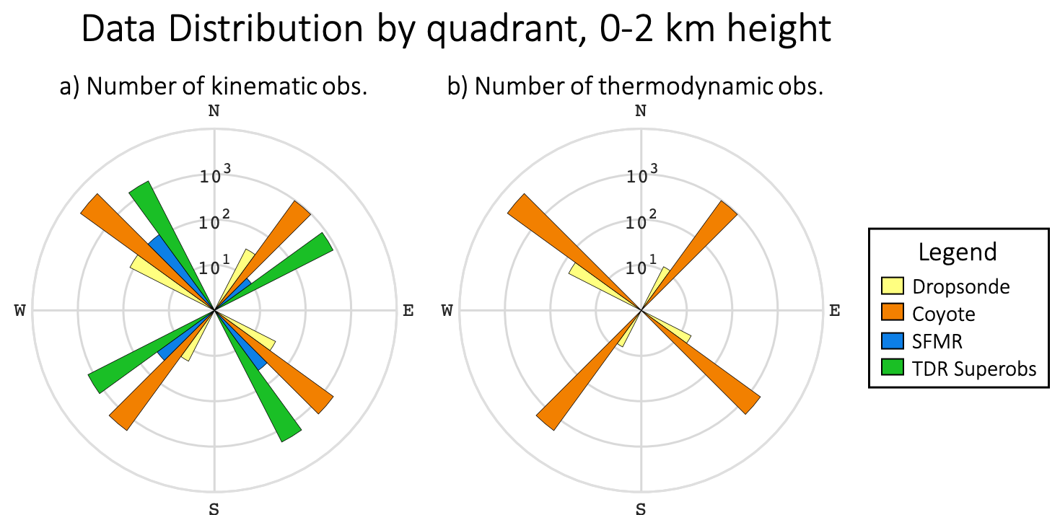
Analyses of Numerical Model Thermodynamics
• A collaboration with NOAA/HRD and DTC
Maria (2017)
flights 3 & 4
Altug Aksoy, HRD
Number of data points by quadrant using a logarithmic scale within lowest 2 km in Hurricane Maria on 23 September 2017. a) Number of kinematic observations (i.e., wind speed) and b) number of thermodynamic observations (i.e., temperature and humidity). Kinematic data volume from sUAS ~ number of observations from P-3 Doppler radar. Thermodynamic data from sUAS >> thermodynamic data from than any other instrument.

Slide 13
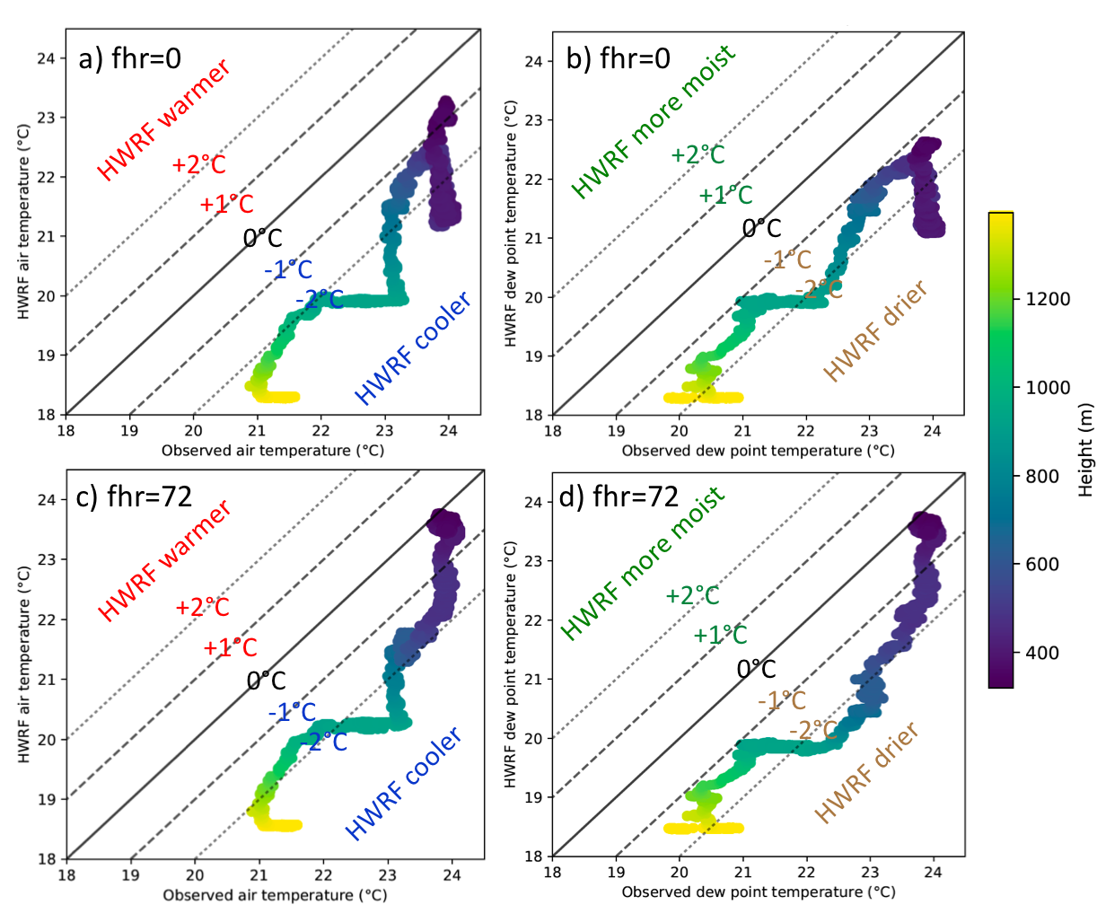
Analyses of Numerical Model Thermodynamics
• A collaboration with NOAA/HRD and DTC
Evan Kalina, DTC
Scatterplots comparing Coyote-observed (x) and HWRF-simulated (y) air temperature (left) and dewpoint temperature (right). Colors indicate the height of the data. The upper panels use the HWRF initialization from the 18 UTC 23 September 2017 model cycle, and the lower panels use the 72-hour forecast from the 18 UTC 20 September 2017 model cycle. sUAS data show that HWRF had a cool, dry and potentially unstable bias in the boundary layer.

Slide 14
BLACK SWIFT TECHNOLOGIES “S0” sUAS

Slide 15
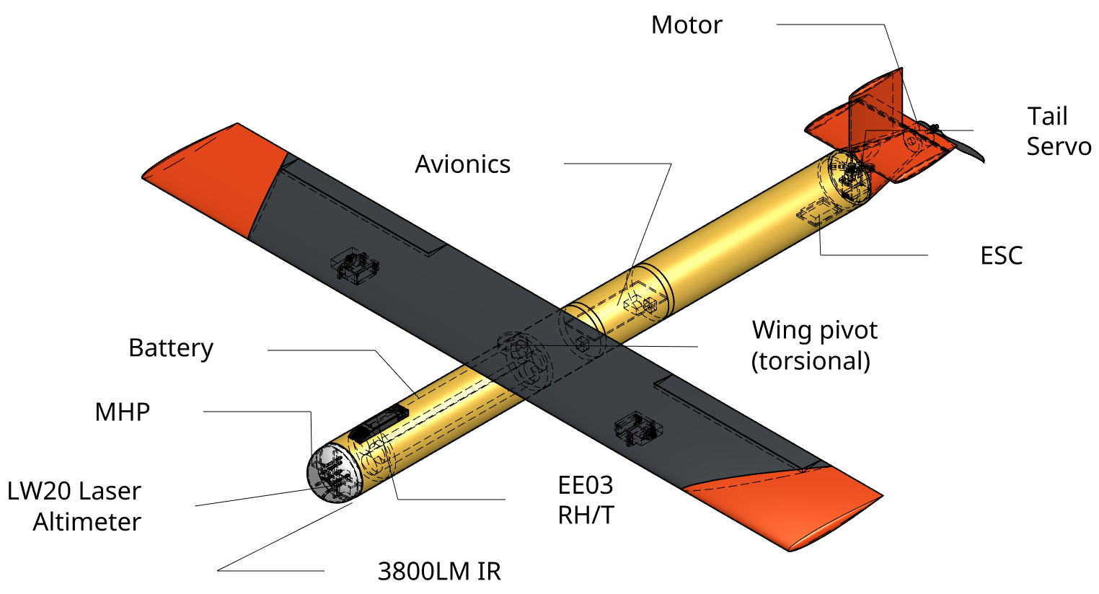
NOAA SBIR 8.2.13 - Developing a Cost Effective Air-Deployed UAS for use in Turbulent Environments
S0 Requirements:
GTOW < 2.5 lbs
Wingspan 2.5 ft
1-2 hrs cruise endurance
Air deployed from tube
Routine flights in hurricane conditions
Up to 160 mph winds
Precipitation
Notes:
Black Swift sUAS S0

Slide 16
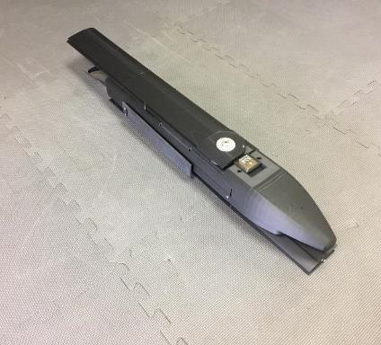
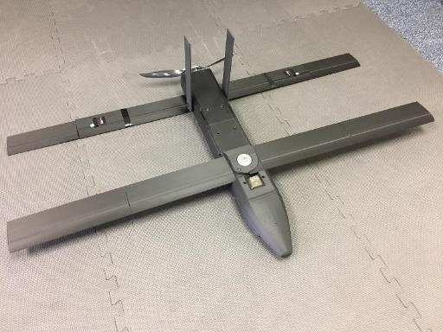
BARRON ASSOCIATES – WINGSONDE sUAS Fully-Assembled Tube-Deployed Model
Size: Wingspan 119cm (47 in) / Weight 4kg (8.8 lbs)
Performance: 22m/s cruise speed / 2h flight endurance
All deployment mechanisms integrated to deploy and lock flight surfaces
Propulsion system integrated
Vaisala RSS421 sensor integrated into nosecone
Initial autopilot integration and electrical wiring
NOAA SBIR 8.2.13 - Developing a Cost Effective Air-Deployed UAS
for use in Turbulent Environments
Notes:
BAI

Slide 17
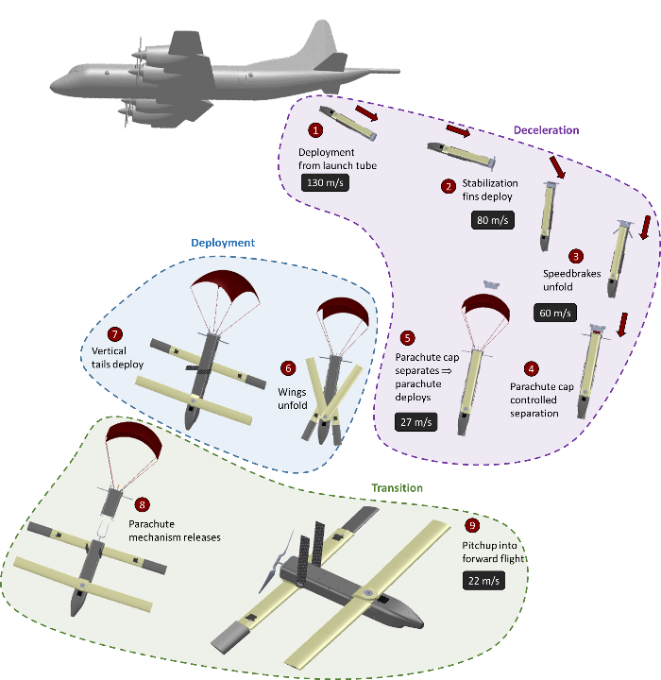
Deployment ConOps
Notes:
BAI

Slide 18
ALTIUS-600 Overview
Endurance: 4+ hrs
Cruise speed: 55 KIAS
Dash speed: 90 KIAS
Cruise range: 220 Nm
Excludes launch descent glide distance
Tube-stowed dimensions: 6”x40”
Deployed wing span: 100”
Deployed length: 40”
Gross Weight: 23-27 lbs
Air and ground launchable
Fully integrated with the Air Force Common Launch Tube (CLT)
Modular Payload:
Weight: 3-6lbs
Volume: 6” diameter by 7” length
ISR, C-UAS, EW, Kinetic, METOC, etc.
Successfully air launched from C-130A, AC-130J Ghostrider, UH-60M Blackhawk, Cessna Caravan, Beech A36, and others

Slide 19
Requirements for All Future sUAS TC Operations
Cost: Improvement over GPS dropsonde (~$300/min; $900/3 min) (PBL)
Command/Control: 150nmi range between sUAS and P3 (C130)
Payload: High QC, reliable (Vaisala RD41; NOAA GPS Drop/Up Sondes)
Survivability_1: Consistency, 210-220kt air-deployed launch (P3/C130)
Survivability_2: Severely turbulent, high wind hurricane conditions
Full Autonomy : No onboard sUAS pilots (Similar to Dropsonde release)
Where are we right now (June 2020)?
- Cost: ALL 3 have, so far, met cost requirements (~$40- $200/minute)
- C2: Area-I’s Altius 600 has exhibited ground-to-air range >150nmi
- Payload: All have made strides (ground testing only, no air tests to date)
- Survivability (1 + 2): Unknown (ALL)
- Automation: All in progress…
-----------------------------
What's Next?
Clear Air Testing with Area-I’s Altius 600 (COVID dependent)
Possible In-Storm Testing (4 Altius) in 2020 (Successful CAT dependent)
Continued testing and development of Black Swift and Barron sUAS

Slide 20
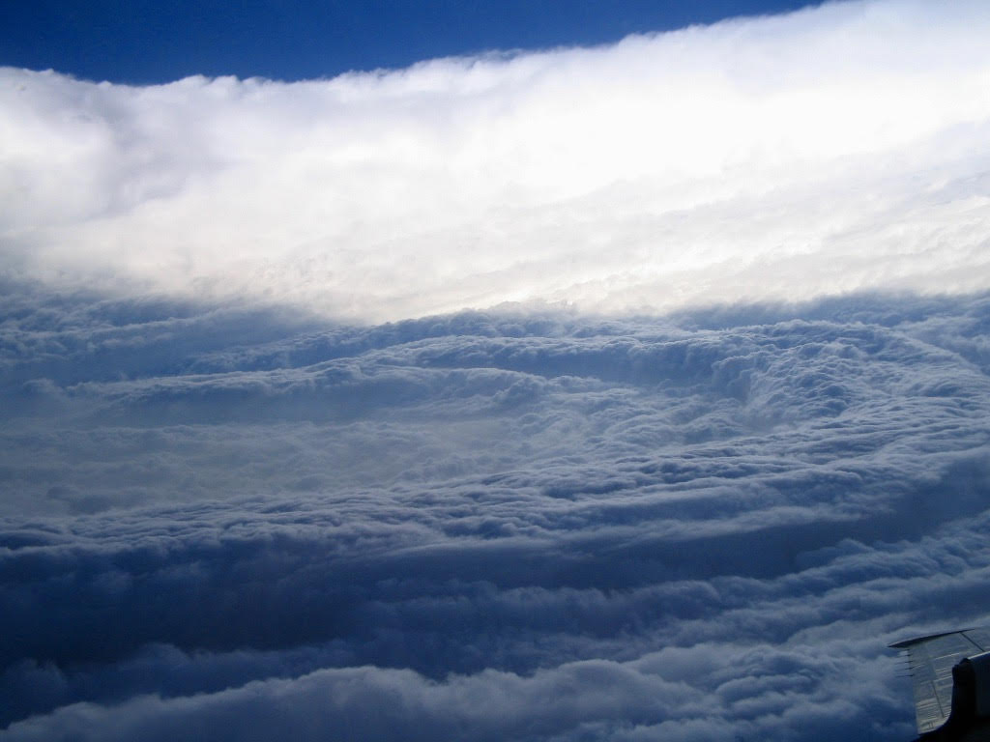
2020 NOAA/AOML/HRD Hurricane Field Program
Intensity Forecast Experiment (IFEX)
RESEARCH IN COORDINATION WITH OPERATIONS
SMALL UNMANNED AIRCRAFT VEHICLE EXPERIMENT
Science Team: Joseph Cione, Jun Zhang, George Bryan (NCAR), Ron Dobosy (NOAA/ARL-ret), Altug Aksoy, Frank Marks, Kelly Ryan, Brittany Dahl, Josh Wadler, Josh Alland (NCAR), Rosimar Rios-Berrios (NCAR), Gijs deBoer (NOAA/PSL), Evan Kalina (NOAA/DTC), Don Lenschow (NCAR), Xiaomin Chen, Chris Rozoff (NCAR), Eric Hendricks (NCAR), Falko Judt (NCAR), Jonathan Vigh (NCAR)

Slide 21
2020 NOAA/AOML/HRD Hurricane Field Program - IFEX
MATURE STAGE EXPERIMENT
Science Description
Experiment/Module: Research In Coordination with Operations Small Unmanned Aircraft Vehicle Experiment (RICO SUAVE)
Investigators: Joseph Cione, Jun Zhang, George Bryan (NCAR), Ron Dobosy (NOAA/ARL-ret), Altug Aksoy, Frank Marks, Kelly Ryan, Brittany Dahl, Josh Wadler, Josh Alland (NCAR), Rosimar Rios-Berrios (NCAR), Gijs deBoer (NOAA/PSL), Evan Kalina (NOAA/DTC), Don Lenschow (NCAR), Xiaomin Chen, Chris Rozoff (NCAR), Eric Hendricks (NCAR), Falko Judt (NCAR), Jonathan Vigh (NCAR)
Requirements: Category 1-5
Plain Language Description: This experiment uses small drones to sample the lowest and most dangerous regions of the tropical cyclone. Observations from these unique platforms have the potential to improve basic understanding and enhance situational awareness. Analyses of data collected from these small drones also have the potential to improve the physics of numerical models that predict changes in storm intensity.

Slide 22
2020 NOAA/AOML/HRD Hurricane Field Program – IFEX
MATURE STAGE EXPERIMENT
RICO SUAVE
Goals:
1. Collect PTH and wind observations within the high wind eyewall and boundary layer inflow regions of mature hurricanes.
2. Provide real-time wind data to improve operational situation awareness (RMW/VMax)
3. Improve basic understanding of a sparsely-sampled, yet critically important region of the storm where turbulent exchanges of heat, moisture, and momentum with the ocean and eye-eyewall interfaces regularly occur
4. Use these data to evaluate operational model performance as it relates to boundary layer thermodynamic and kinematic structure and SST ocean response
Hypotheses:
1. 360-degree depictions of hurricane boundary layer RMW and Vmax at multiple altitudes are possible by conducting repeated UAS eyewall orbit missions
2. Accurate depictions of the TC thermodynamic and kinematic inflow layer (100-1500m) are possible using dropsonde and sUAS strategically deployed observations
3. Eye loitering, TC center fixes, eye-eyewall targeting sampling are possible with sUAS

Slide 23
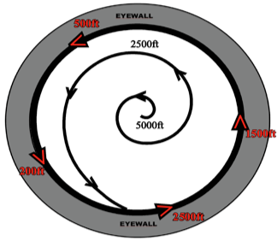
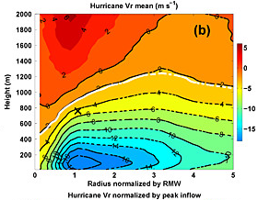
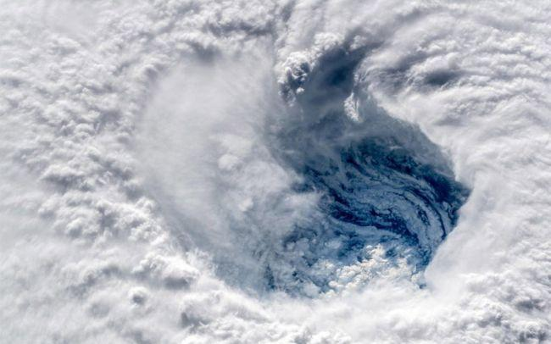
2020 NOAA/AOML/HRD Hurricane Field Program - IFEX
MATURE STAGE EXPERIMENT
RICO SUAVE
Objectives:
Eyewall Module: Provide sUAS HDOBS at multiple altitudes and azimuths to NHC in near real time. Post storm, comparing sUAS atmospheric and SST high wind observations with operational analysis and forecast fields from HWRF and HAFS.
Inflow Module: Provide sUAS HDOBS in near-real-time to NHC. Post storm, compare sUAS TC boundary layer thermodynamic and kinematic radial structure (incl SST) with model output to improve TC boundary layer parameterizations and ocean response in HWRF and HAFS.
Center Fix/Eye-Eyewall Module: Provide sUAS HDOBS and center fix estimates in near-real-time to NHC. Post storm, compare sUAS TC boundary layer thermodynamic, kinematic and SST structure within the eye and eye/eyewall interface with mode output to improve TC boundary layer parameterizations and ocean response in HWRF and HAFS.

Slide 24
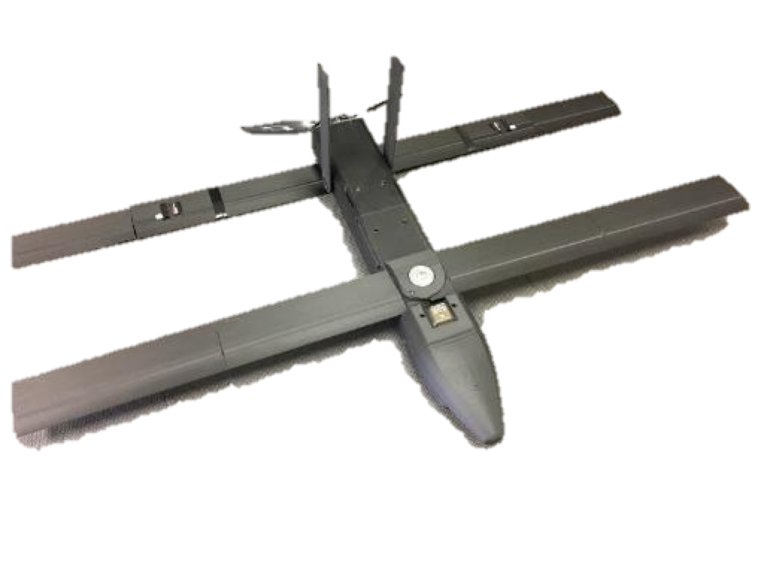
Summary
Observations from small Unmanned Aircraft Systems (sUAS) have the potential to enhance the basic understanding of dangerous and difficult to observe regions of the Tropical Cyclone.
These unique data may be able to improve situational awareness and future operational forecasts of Tropical Cyclone intensity change.
As technology advances, small drones (such as the three new platforms highlighted today) will be able to fly longer, lower and for less money.
Working with public and private partners, NOAA will continue to explore this promising technology over the coming years in order to help the Agency better meet its ultimate goal of protecting property and saving lives.
Project Support: NOAA/OMAO/AOC, NOAA/SBIR, NOAA/UASPO, NOAA/OAR,
NCAR/MMM, NCAR/EOL
The National Center for Atmospheric Research (NCAR)
is sponsored by the National Science Foundation (NSF)

Slide 25
Telemetry “Video” in Hurricane Maria
Questions?
Coyote position
waypoints
P-3 position

