Slide 1

Hurricane Forecast Improvement Program (HFIP):
Addressing Section 104 of the Weather Act
Frank Marks (NOAA/AOML/HRD)
Edward Rappaport (NOAA/NWS/NHC)
Dorothy Koch (NOAA/NWS/OSTI)
Sundararaman Gopalakrishnan (NOAA/AOML/HRD)
Vijay Tallapragada (NOAA/NWS/EMC)
July 7, 2020

Slide 2
Hurricane Forecast Improvement Program (HFIP):
Addressing Section 104 of the Weather Act
Frank Marks (NOAA/AOML/HRD)
Edward Rappaport (NOAA/NWS/NHC)
Dorothy Koch (NOAA/NWS/OSTI)
Sundararaman Gopalakrishnan (NOAA/AOML/HRD)
Vijay Tallapragada (NOAA/NWS/EMC)
July 7, 2020

Slide 3

Hurricane Forecast Improvement Program (HFIP)
Unified approach to guide & accelerate forecast improvements
      Improve forecast guidance for track & intensity by 20% in 5 years, 50% in 10 years
      Extend forecast guidance to 7 days with skill comparable to current 5 day forecasts
      Increase probability of predicting Rapid Intensity Change (RI/RW)
http://www.hfip.org
Gall et al., BAMS, 2013
Notes:
NOAA-wide HFIP Charter signed August 1, 2007
Hurricane Executive Oversight Board
Jointly chaired by AAs for National Weather Services & Oceanic and Atmospheric Research
Cross-NOAA Membership
Current HFIP Management
Project Manager: Dorothy Koch, NWS/OSTI
Research Lead: Frank Marks, OAR/AOML/HRD
Operations Lead: Ed Rappaport, NWS/NHC
Development Managers: Sundararaman Gopalakrishnan OAR/AOML/HRD & Vijay Tallapragada NWS/EMC
Gall, R., J. Franklin, F. D. Marks, E. N. Rappaport, F. Toepfer, 2013: The Hurricane Forecast Improvement Project. Bull. Amer. Meteor. Soc., 94, 329–343 doi: https://dx.doi.org/10.1175/BAMS-D-12-00071.1.
Hurricane Forecast Improvement Program (HFIP) began in 2009 and has significantly improved forecast performance for the last 10 years, while meeting the 5-year goal to reduce track and intensity errors by 20 percent
HFIP provides the unifying organizational infrastructure and funding for NOAA and other agencies to coordinate the research needed to significantly improve guidance for TC track, intensity, and storm-surge forecasts, as well as accelerate the transition of R2O
HFIP focuses activities to research, develop, demonstrate, and implement enhanced operational modeling capabilities, dramatically improving the numerical forecast guidance made available to the National Hurricane Center.
HFIP facilitates the development of the next generation of tropical cyclone (TC) researchers for NOAA.
HFIP will build upon the original goals of the program through the following specific goals:
Reduce numerical forecast guidance errors, including during rapid intensification, by 50 percent from 2017;
Produce 7-day forecast guidance that is similar to the 2017 5-day forecast guidance;
Improve guidance on pre-formation disturbances, including genesis timing, and track and intensity forecasts, by 20 percent from 2017; and
Improve hazard guidance and risk communication, based on social and behavioral science, to modernize the TC product suite (i.e., products, information, and services) for actionable lead times for storm surge and all other threats. http://www.hfip.org/
Percent improvement is determined by evaluating track, intensity, storm size, and rapid intensification error relative to those over the 3-year period, 2015-2017

Slide 4
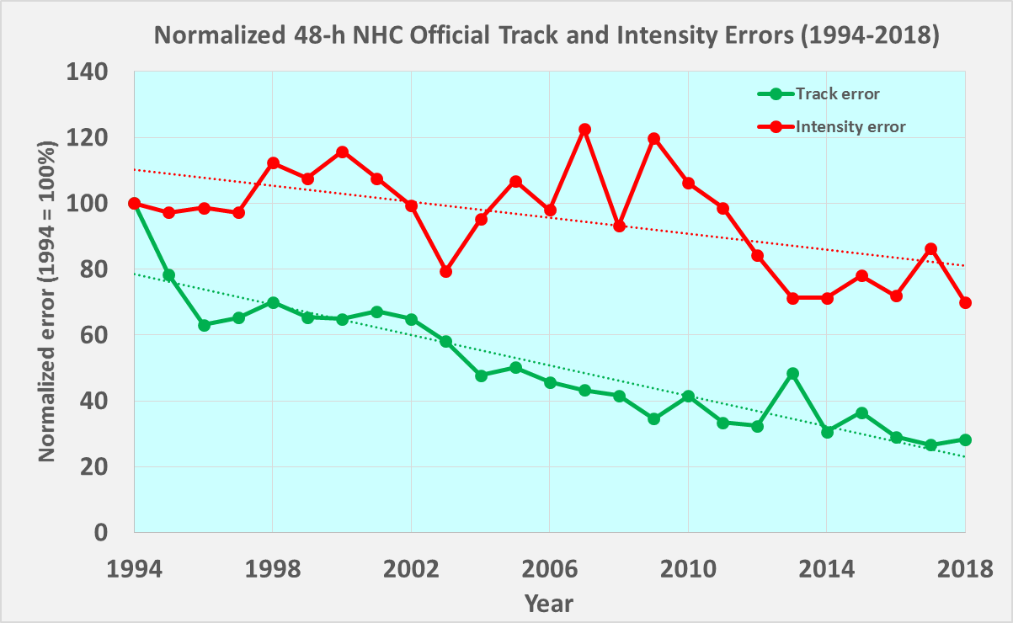
HFIP Goal: TC Track & Intensity Guidance
NHC 48-h Normalized Forecast Errors
Track forecast
errors reduced by
intensity
HFIP --->
70%
track
Intensity forecast errors reduced by
30%

Slide 5
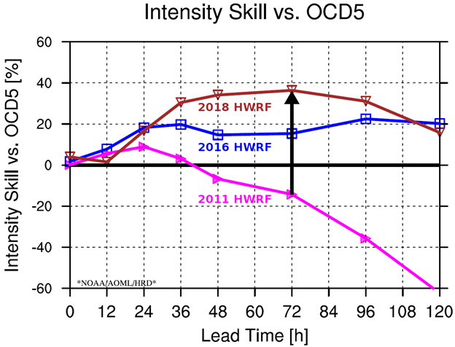
Forecast Improvement
HWRF Improvements
Remarkable improvements in HWRF since HFIP
HWRF model demonstrated ~15% improvement in hurricane intensity forecast accuracy each year since 2011
  NOAA upgraded HWRF model resolution; now 1.5 km
Notes:
Operational HWRF system (example of R2O)
Used in all global basins
160 countries use NOAA products
DA improvements to better use aircraft obs
HMON
HFIP Corrected Consensus Approach (HCCA) model
100s of publications on hurricane forecast problem
A capacity capable of advancing hurricane prediction
Partnerships: NOAA research working closely with operations (NWS/NCEP, DOD/JTWC), Federal & academic partners (NASA, NSF, ONR, NRL, NCAR), international collaborations (global TC forecasts)
Diversity: Manpower to evaluate model performance with hurricane datasets
Outreach and community participation (e.g. FFOs)
Developed and facilitated next generation of TC researchers for NOAA
HFIP R&D computing
Integrated use & support of testbeds (DTC & JCSDA)

Slide 6

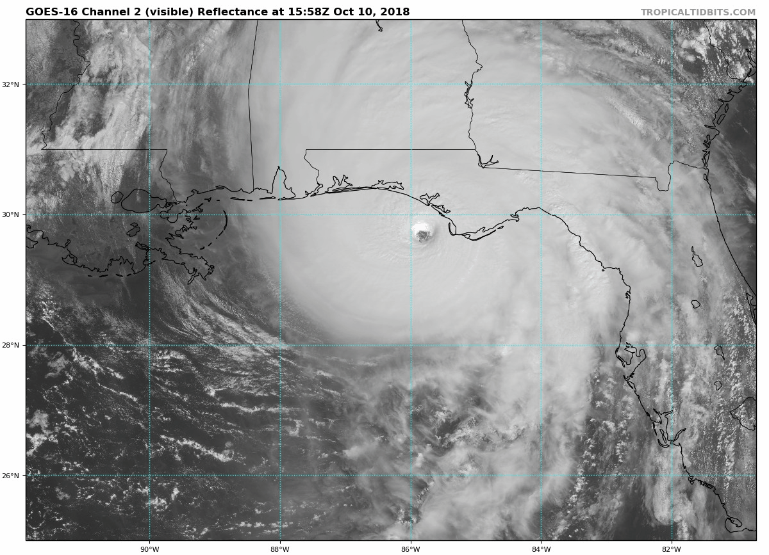

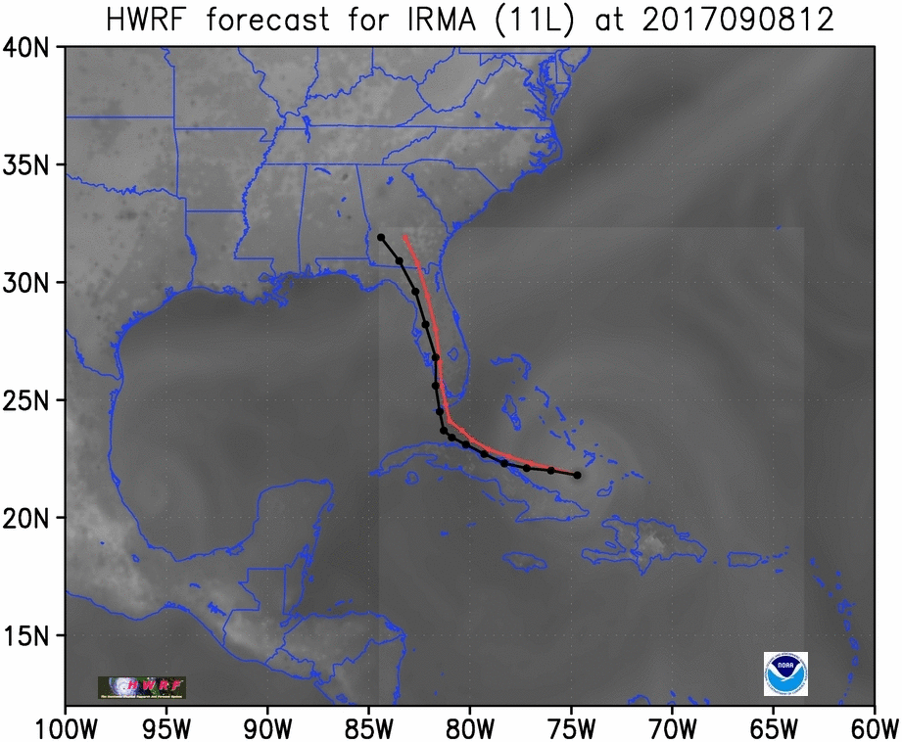

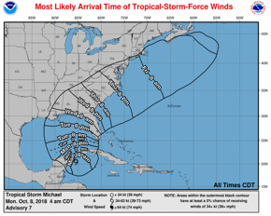

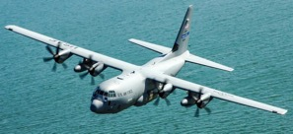
Lessons Learned: Link Obs, DA, & Model
Understanding & prediction of TCs
FACETs
Observations
Analysis system
Model
Observing strategies
Evaluation
Notes:
UFS TC application: HAFS is an FV3 based multi-scale model & data assimilation system capable of providing TC analyses & forecasts of inner core structure & large-scale environment.
HAFS development targets an operational system for TC forecasters with reliable, robust and skillful guidance on track & intensity (including RI), storm size, genesis, storm surge, rainfall & associated tornadoes.
HAFS provides an advanced analysis and forecast system for cutting-edge research on modeling, physics, data assimilation, and coupling to earth system components for high-resolution TC predictions within (FY20) UFS SIP objectives.

Slide 7
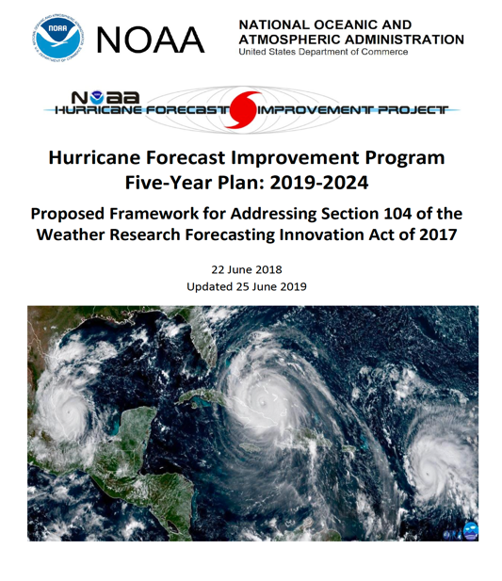
2017 Weather Act Sec.104:
Developed plan, detailing specific research, development, & technology transfer activities necessary to sustain HFIP & achieve 3 focus areas:
improve prediction of rapid intensification and track of hurricanes
improve forecast and communication of storm surges from hurricanes
incorporate risk communication research to create more effective watch and warning products
Plan submitted to Congress detailed long-term HFIP goals, priorities, & approaches.
http://www.hfip.org/documents/HFIP_Strategic_Plan_20190625.pdf
Notes:
The plan submitted to Congress was an executive summary of the updated HFIP Strategic Plan available at http://www.hfip.org/documents/HFIP_Strategic_Plan_20190625.pdf

Slide 8
Updated HFIP Goals
Reduce numerical forecast guidance errors, including during rapid intensification, by 50% from 2017
Produce 7-day forecast accuracy similar to 2017 5-day forecast accuracy
Improve guidance on pre-formation disturbances, including genesis timing, and track and intensity forecasts, by 20% from 2017
Improve hazard guidance and risk communication, based on social and behavioral science, to modernize the TC product suite (products, information, and services) for actionable lead-times for storm surge and all other threats
Notes:
TALKING POINTS: state the differences in the new version of HFIP (greater emphasis on storm surge and hazard products, including TC rainfall and severe weather)

Slide 9
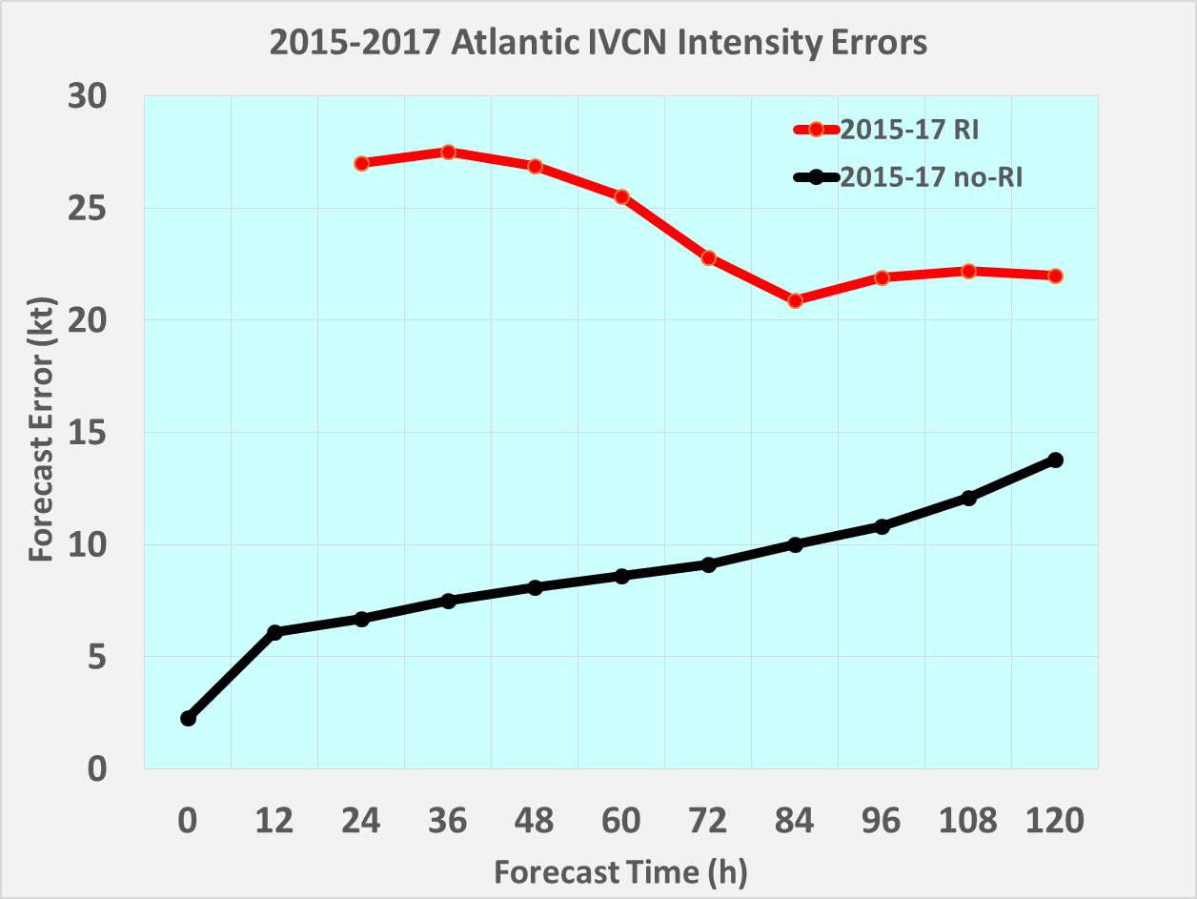
HFIP Goal: TC Intensity Guidance
Intensity Forecast Errors for Rapid Intensification (RI) & Non-RI Events (2015-2017)
RI
3x larger error
Non-RI

Slide 10
Key HFIP Strategies
Advance an operational Hurricane Analysis & Forecast System (HAFS)
Improve probabilistic guidance
Enhance communication of risk and uncertainty
Support dedicated high performance computing allocation
R2O Enhancement
Broaden expertise & expand interaction with external community

Slide 11
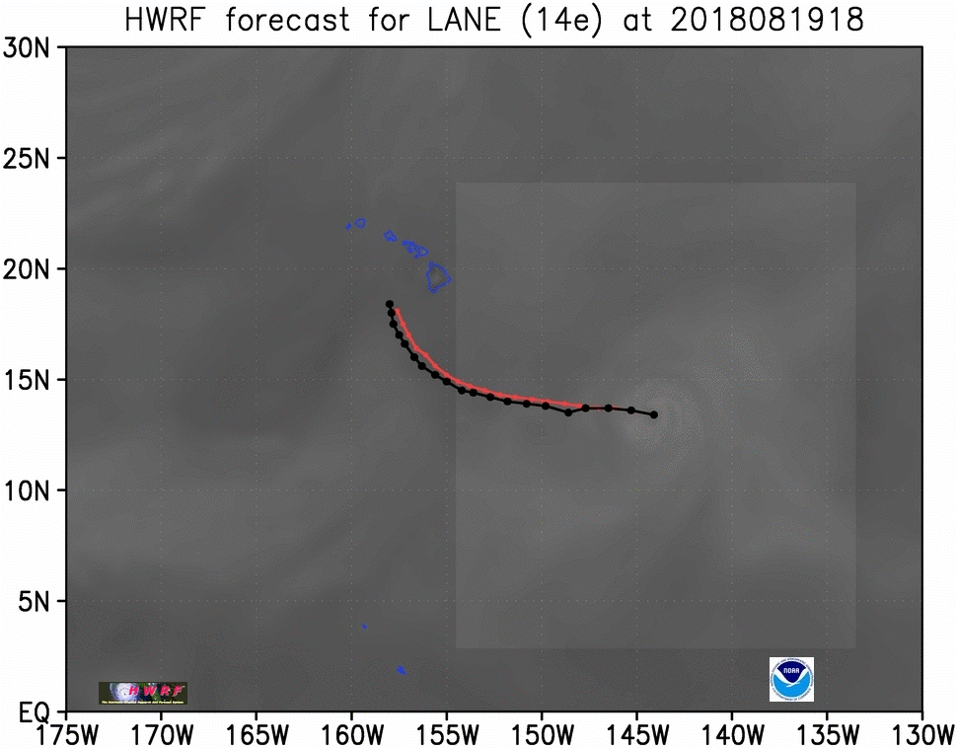
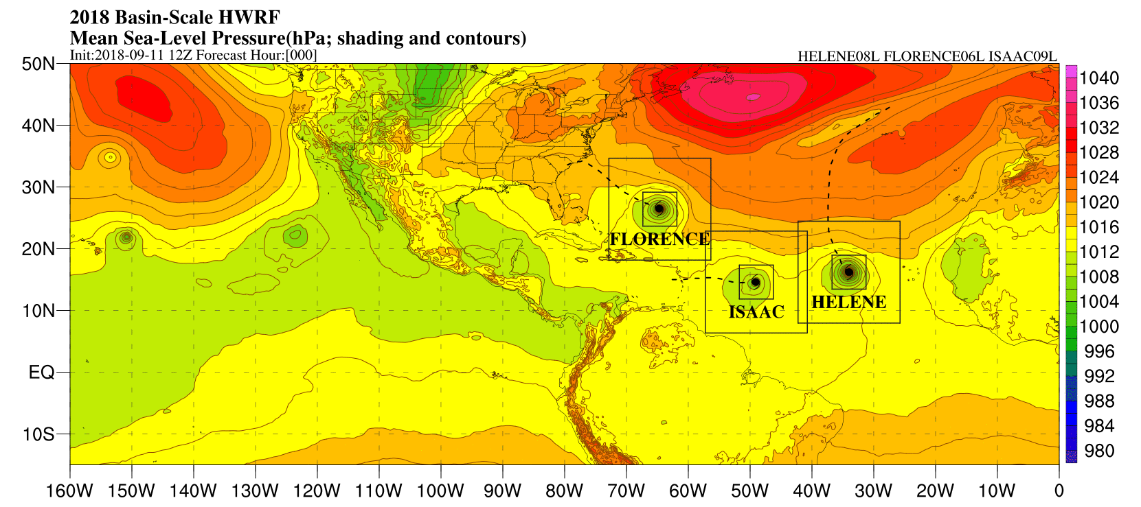
Key Strategies: HAFS
Global to regional Model R&D
HFIP worked tirelessly to advance hurricane forecasting through HWRF since 2009
HWRF propelled hurricane model intensity guidance forward
Basin-scale HWRF enabled storm-storm and land-storm interactions & provides basis for moving nest in HAFS
Figure Courtesy: Gopal (AOML)
Notes:
Both models are coupled to MPIPOM in the Atlantic, initialized by RTOFS
HAFS will use HYCOM/MOM6

Slide 12
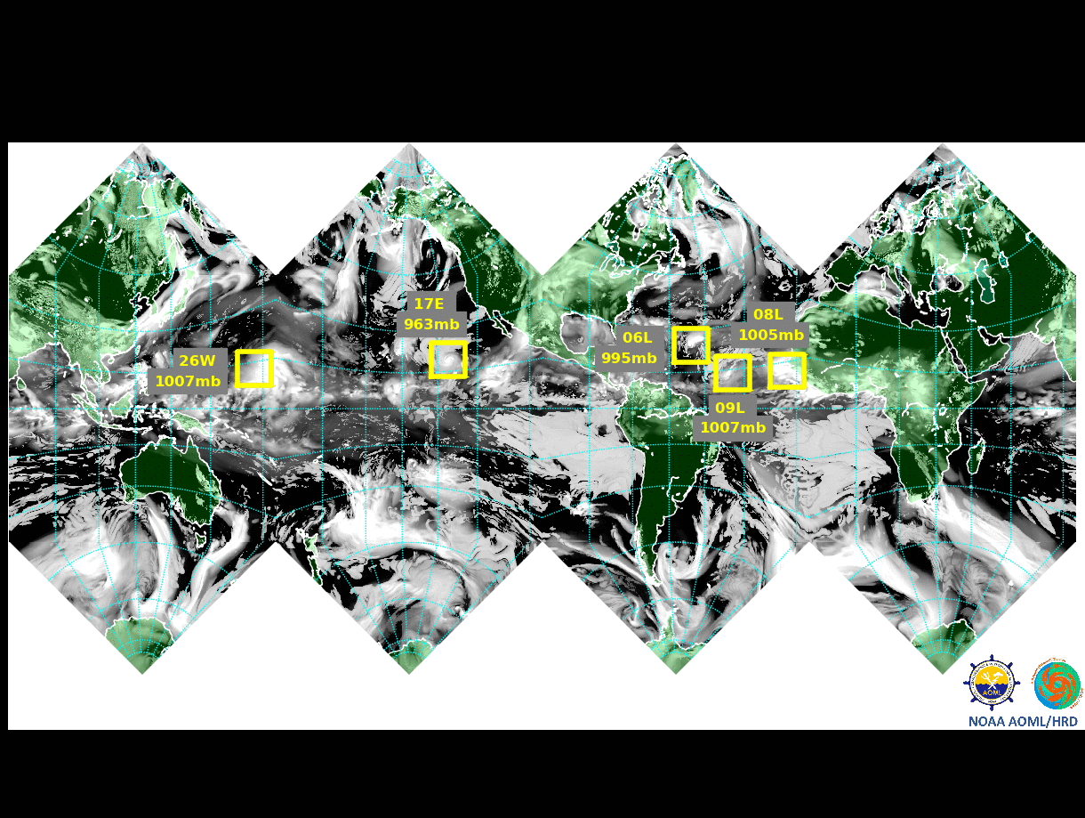

Development of HAFS:
Global to regional Model R&D in UFS
06L: Florence; 08L: Helene; 09L: Isaac; 17E: Olivia; 26W: Mangkhut
Figure Courtesy: Bill Ramstrom (AOML)
Notes:
The goals is to develop telescopic multiple moving nests within all global basins.
This is a prototype with five storms.
Coupling to MOM6 is ongoing effort at EMC
Once the HAFS is fully developed, it is envisioned to extend to include ocean, waves, storm-surge, inundation and severe weather associated with landfalling hurricanes.

Slide 13
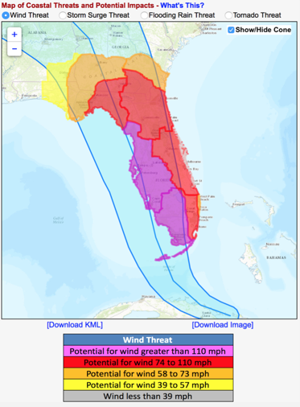
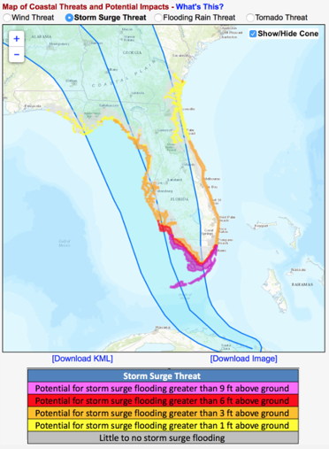
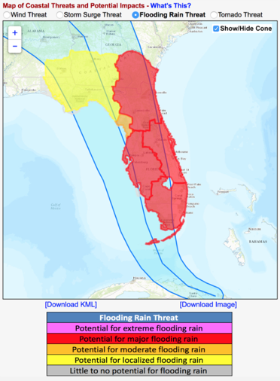
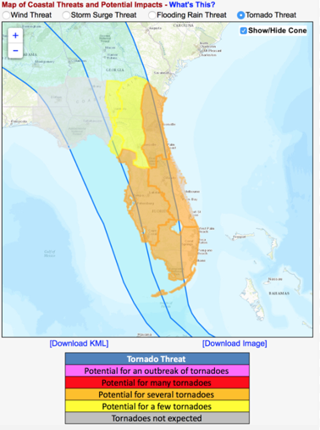
Tropical Timeline:
Hurricane Threats and Impacts
Key Strategies: Probabilistic Guidance
Figure Courtesy: Jessica Schauer (NWS/AFS)
Notes:
Calibrate guidance with HAFS
Incorporate model-based uncertainty into hazard models & products
R&D for hazard products from HAFS

Slide 14
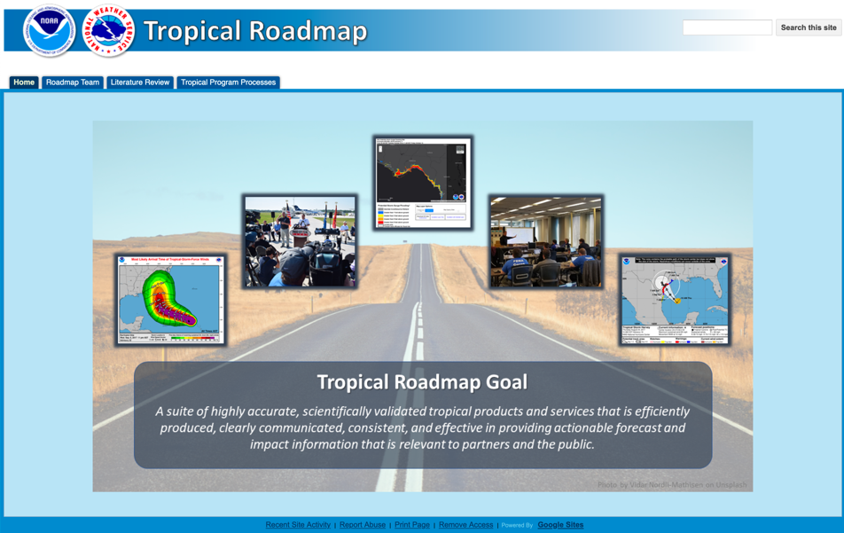
Key Strategies: Communication of risk & uncertainty
Coordinated Social & Behavioral Science Approach: OAR and NWS work together
NWS & OAR formed FACETs Working Groups
NWS created Tropical Products Roadmap
OAR supporting cadre of FACETs post docs
https://sites.google.com/a/noaa.gov/tropical-roadmap/home
Figure Courtesy: Jessica Schauer (NWS/AFS)
Notes:
Evaluate TC products for the effective communication of risk
Modernize TC products as informed by social & behavioral science

Slide 15
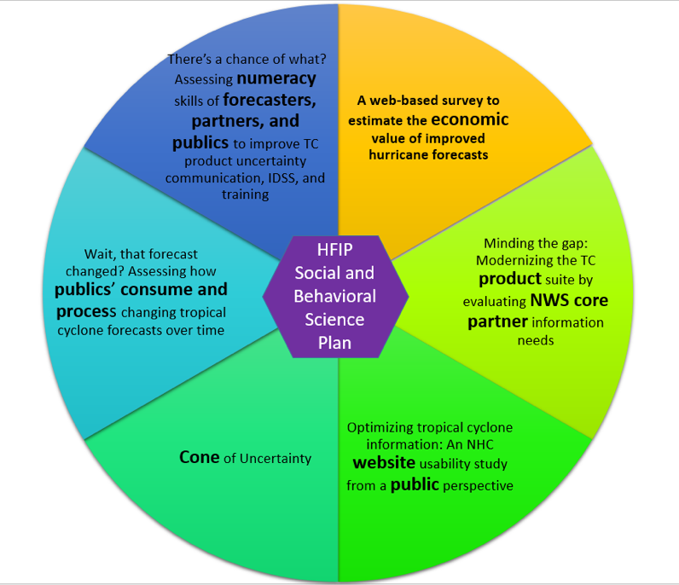
Communication of risk & uncertainty
Coordinated Social & Behavioral Science Approach: Hurricane Supplemental
6 projects supported
Projects purposely complement one another
Projects differ in their audience, theoretical focus and application to provide broader application to NWS
OAR focuses more on long-term
NWS focuses on more urgent needs
Figure Courtesy: Jennifer Sprague (NWS)
Notes:
Evaluate TC products for the effective communication of risk
Modernize TC products as informed by social & behavioral science

Slide 16
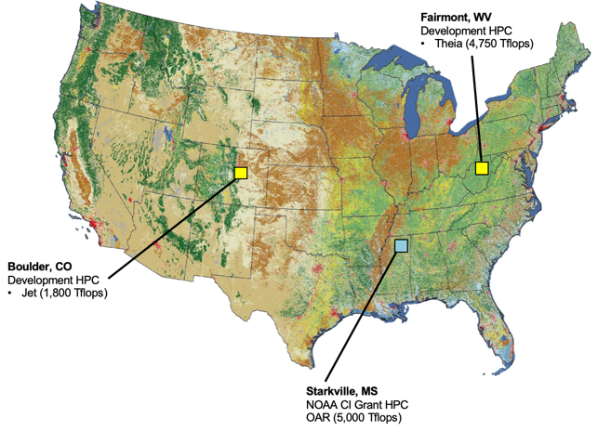
Key Strategies: HPC
Hurricane Supplemental Provided two new RDHPC Systems dedicated to hurricane research beyond Jet system
MSU System
  Orion
  72,000 Skylake Processors
  Dell System
Theia Replacement
  Hera
  52,000 Skylake Processors
  Cray System
HAFS development allocated 20M CPU h/month

Slide 17



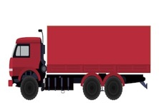
Key Strategies: R2O
Research to Operations (R20) Enhancements
Accelerate transition to operations following NOAA’s best practices for promoting readiness levels (RLs)
Develop a process to prioritize research targeted for operations
More integrated use & support of Testbeds (JHT, DTC, JCSDA, EPIC)
Research
Operations
O2R R2O
HFIP
VALLEY OF DEATH
Notes:
HFIP developed very successful O2R2O strategy for hurricane model development. The updated HFIP wants to expand that strategy to address HAFS R&D, development of probabilistic guidance, and improving risk communications

Slide 18
Key Strategies: External Community
NOAA Hurricane community continues to engage University partners through Notice of Federal Opportunity (NOFO) awarded projects
Next round Announcement of Opportunity published 4 Nov. 2019
  Expected award date for selected proposals 1 Sept. 2020;
34th Conference on Hurricanes & Tropical Meteorology, 9-14 May 2021, New Orleans, LA
  Session Topic Title: Hurricane Forecast Improvement Program (HFIP) & Hurricane Analysis and Forecast System (HAFS)

Slide 19
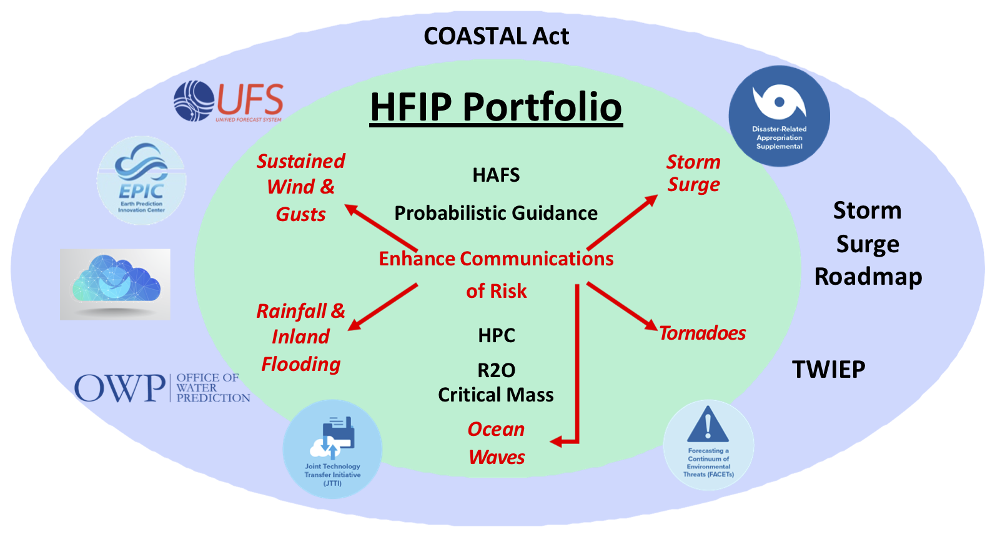


Connections
Notes:
When HFIP started it was one of a kind project linking research and model development to operational forecasting goals. Now HFIP strategies overlap with a number of NOAA research and development efforts

Slide 20
HFIP Priorities for 2020
Continue development of operational HWRF & HMON upgrades until HAFS transition – WCOSS upgrade
Align TC models with UFS through UFS TC application team
HAFS v0.1 - advance single storm configuration over ATL basin running in real-time
TC model physics consistent with UFS - use Common Community Physics Package (CCPP)
Move towards 7-day forecast
RI evaluated with new metrics
Continue improvement of storm surge models, including OCONUS
Improve extreme precipitation forecast

Slide 21
Questions?

Slide 22
Keys to Success
    Partnerships: NOAA research working closely with operations (NWS/NCEP, DOD/JTWC), Federal & academic partners (NASA, NSF, ONR, NRL, NCAR), international collaborations (global TC forecasts)
    Diversity: Manpower to evaluate model performance with hurricane datasets
    Outreach and community participation (e.g. FFOs)
      Develop & facilitate next generation of TC researchers for NOAA
    HFIP R&D computing
    Integrated use & support of testbeds (DTC & JCSDA)
Notes:
Elaborate as desired.

Slide 23










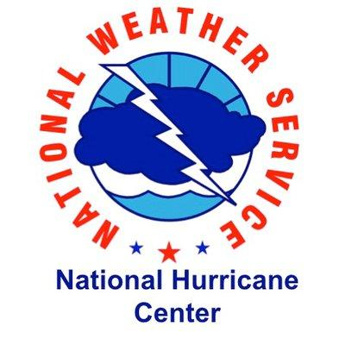

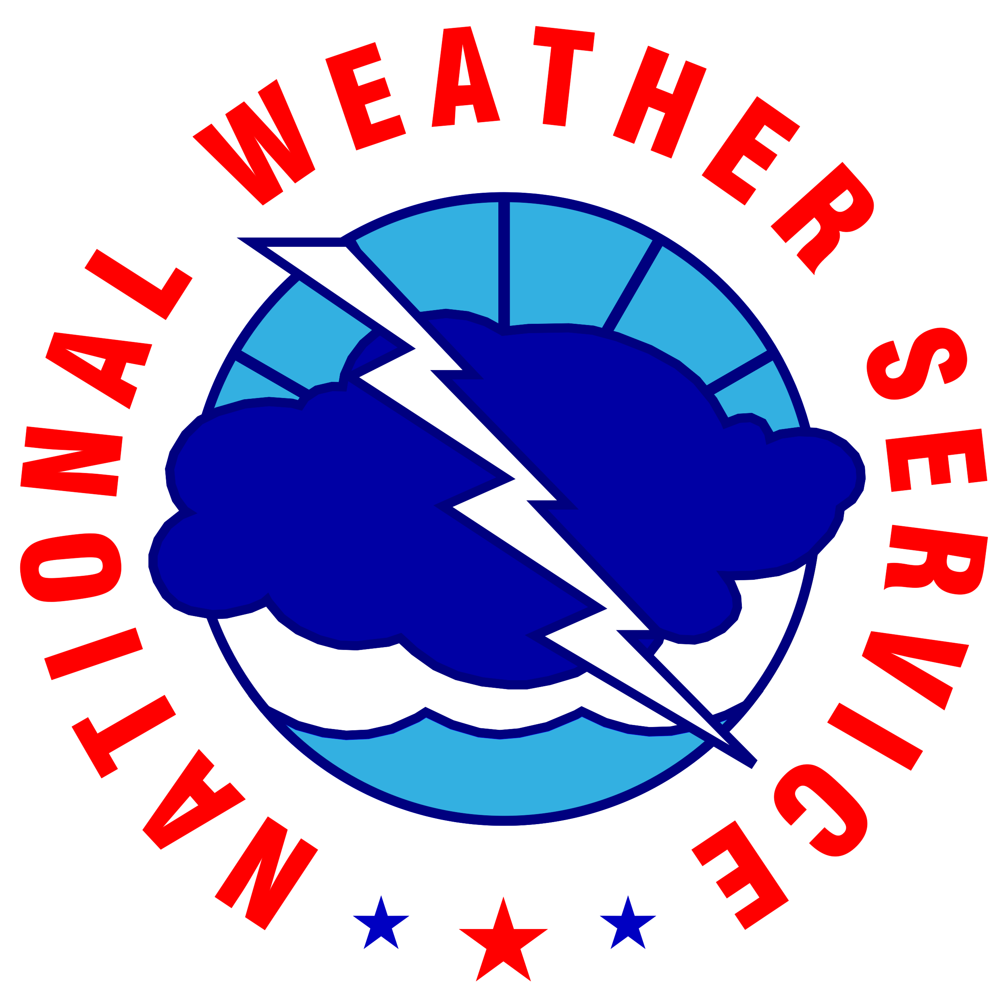
























Partners/Stakeholders
OMAO

Slide 24
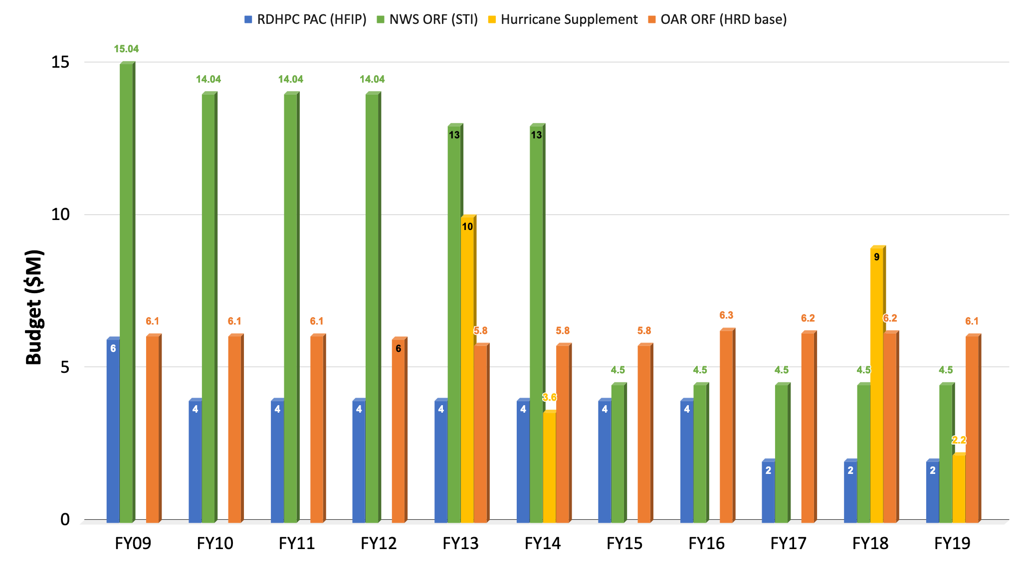
Appropriation History
(2009-2019)
Notes:
65% reduction in FY15/16 & FY17 slowed progress realized over the 1st 6 years, including reduced engagement with academia.
Hurricane Supplemental support in FY13, 18, & 19 allowed for acceleration to HWRF/HMON & HAFS development activities, respectively
Bipartisan Budget Act of 2018
H.R.2157 - Additional Supplemental Appropriations for Disaster Relief Act, 2019
Coordinated 7 Hurricane Supplemental Plans to Accelerate Improvements in Hurricane Intensity Forecasting
1A.3: Accelerate Development of Common Infrastructure (NCAR/NESII)
1A.4: Accelerate NGGPS elements related to severe weather prediction, especially landfalling tropical storms and hurricanes (HRD & GSD)
3A.1: Accelerate implementation of the updated HFIP Plan (HRD)
3A.2: Accelerate re-Engineering of Hurricane Analysis and Forecasting System (HAFS) (EMC)
3B: Sustained Ocean Observations - Train for, prepare, deploy “picket fence” gliders; deliver, assess data (AOML)
4A.1: Optimize current observing system to improve prediction of extreme weather (AOML)
4A.2: Data Impact Studies (OSE/OSSE) (AOML)

Slide 25
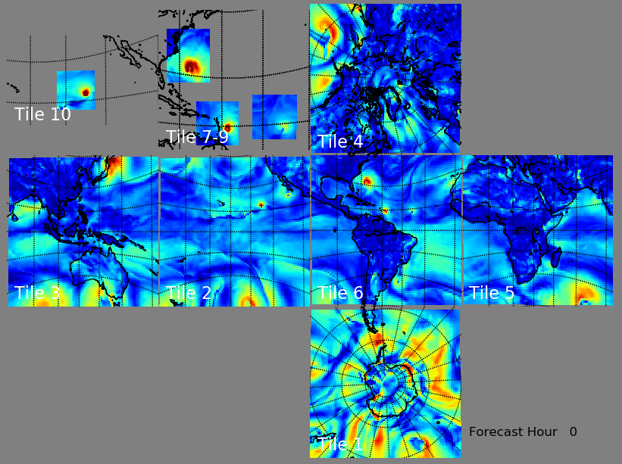
Hurricane Moving Nest Development
Irma, Maria, Jose (NATL) and Otis (EPAC)
Grid & terrain generation
Interpolate GFS ICs
Changes to FMS & FV3 dynamic core
Testing & evaluation
Commit to FV3 community repository
Real-time vortex-scale products and validation
Physics (PBL & MP) improvement (ongoing)
Figure Courtesy: Bill Ramstrom (AOML)

