Slide 1

Air-Sea Interactions in Hurricanes: How Much Does the Ocean Cool Underneath a Storm?
NOAA Mission Goal: Weather-Ready Nation
Samantha Michlowitz¹, Dr. Joseph Cione², and Dr. Joshua Wadler³
¹ University of South Alabama Meteorology
² NOAA/OAR/AOML/HRD
³ University of Miami RSMAS
Hollings Final 7/27/20

Slide 2


Motivation
In the absence of measurements and observations, can we estimate in storm SST changes?
Can we accurately estimate inner-core SSTs using pre-storm satellite measurements? Is this a good proxy for inner-core temperatures?
Increase the knowledge and understanding of air-sea interactions and bring it to the community

Slide 3

Ideas for this Research
To explore in-storm SST cooling variability, updating results found in the Cione and Uhlhorn (2003) study:
  Added (2002 – 2017) – creating a 42-year sample size
  Created a 2D map of the ∆SST to observe at what distance cooling occurs from the TC and the radial & azimuthal cooling distribution
To create an SST cooling algorithm also found in the JHT Report from 2005. We found the variables that produce the maximum predictability for cooling
Update the SHIPS model with new algorithm results

Slide 4


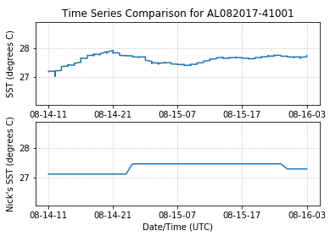
Part I: Calculating ∆SST
1975 – 2017 Tropical Cyclone Buoy Database (TCBD):
  Total buoys time series observations: 2,393
    Within 200km radius: 785 time series
    Within 60km radius: 160 time series
  Total Storms: 317
Initial SST = 27.92 °C
∆SST₂₀₀ = -.23 °C
∆SST₆₀ = None
Final SST₂₀₀ = 27.68 °C
SST_{wake} = 27.65 °C
∆SST definitions:
  Final SST – minimum SST observation when the TC is within 200km and 60km of the buoy
  Initial SST – Maximum SST from the beginning of the time series up to the Final SST observation
satellite observation in SMARTS
climatology, not measured as often as the buoy

Slide 5
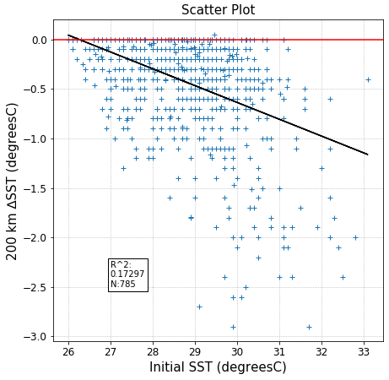
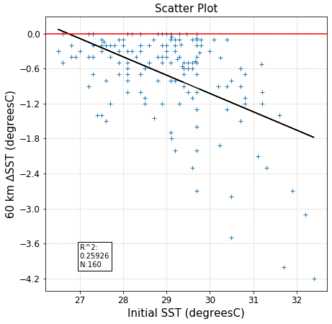
Take away: the larger the initial SST, the greater the cooling

Slide 6
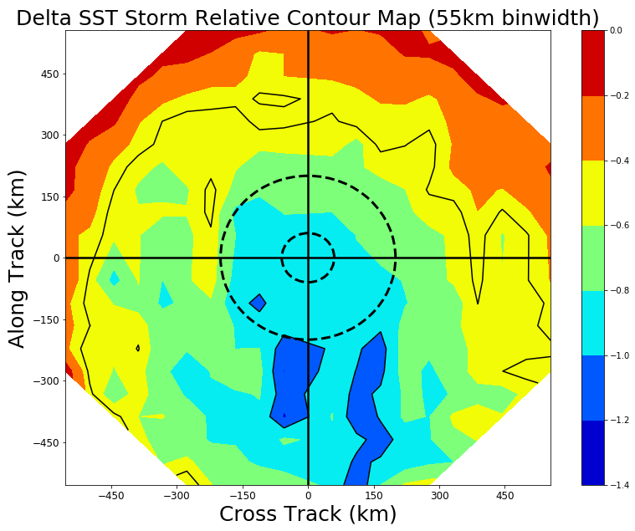
2D Map

Slide 7
2D Map
On average, < 1℃ is observed within 555 km of the TC center, with most of the cooling occurring within the core and rear quadrants of the TC
Cooling of 0.5℃ or greater is found starting at an average of 420 km ahead of the storm
Contrary to popular belief, we found that cooling is not only found primarily in the right rear, but all the rear

Slide 8
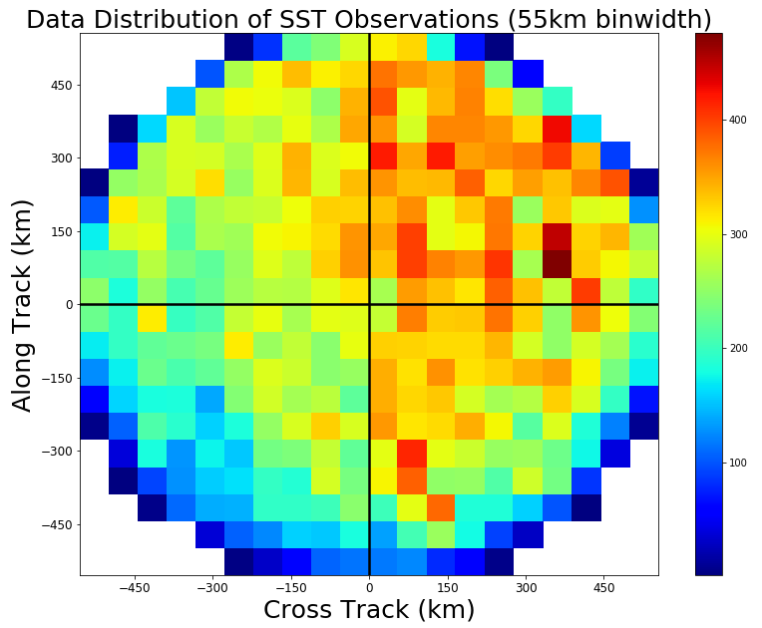
2D Map
On average, < 1℃ is observed within 555 km of the TC center, with most of the cooling occurring within the core and rear quadrants of the TC
Cooling of 0.5℃ or greater is found starting at an average of 420 km ahead of the storm
Contrary to popular belief, we found that cooling is not only found primarily in the right rear, but all the rear

Slide 9

Part II: Multi-variant Algorithm within 60km Radius
Variables investigated:
  Initial SST - TCBD
  Latitude - TCBD
  Ocean Heat Content - SMARTS
  Mixed Layer Depth - SMARTS
  Translation Speed - TCBD
  Max Wind Speed - TCBD

Slide 10
Part II: Multi-variant Algorithm within 60km Radius
Variables investigated:
  Initial SST - TCBD
  Latitude - TCBD
  Ocean Heat Content - SMARTS
  Mixed Layer Depth - SMARTS
  Translation Speed - TCBD
  Max Wind Speed - TCBD
The original algorithm from JHT Report used:
  Initial SST
  Translation Speed
  Latitude

Slide 11
Part II: Multi-variant Algorithm within 60km Radius
Variables investigated:
  Initial SST - TCBD
  Latitude - TCBD
  Ocean Heat Content - SMARTS
  Mixed Layer Depth - SMARTS
  Translation Speed - TCBD
  Max Wind Speed - TCBD
The original algorithm from JHT Report used:
  Initial SST
  Translation Speed
  Latitude
But what’s the point?
To predict the ocean cooling given pre-storm measurements given more data to work with

Slide 12
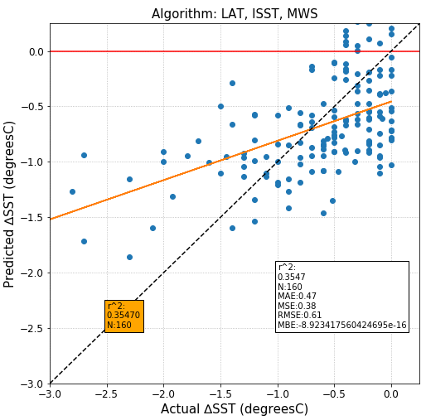

Slide 13
Algorithm Results:
After testing, Latitude, Initial SST, and Maximum Wind Speed produced the best predictability
This process looks at the inner-core (60km) observations
Tested all combinations of single, double, triple, and quadruple variable algorithms
This simple linear regression shows a predictability of 35.47%
However, testing different linear regressions may heed results closer to the 1:1 line and increase the skill of the overall equation

Slide 14
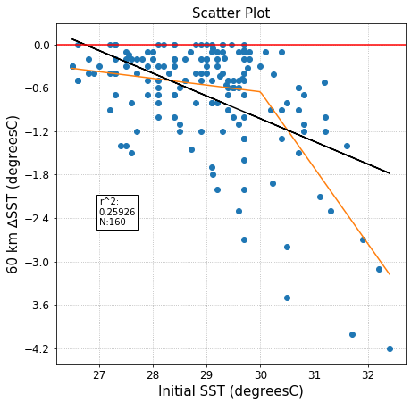
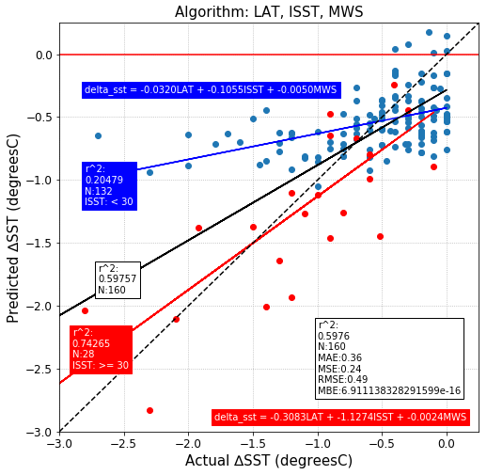

Slide 16
Algorithm Results:
Predictability with pre-storm observations is 59.76%
Looking at the initial SST, a piecewise linear regression was used to best fit the data
  The piecewise broke at 30°C
This process increased the cooling predictability by over 24%
Increased the cases observed and tested from the previous study by 471% over 42 years

Slide 18

In Conclusion
I recreated the Cione and Uhlhorn (2003) study:
  Found that typically < 1 ℃ cooling occurs in the rear of the storm
I recreated and updated the JHT report by testing variables to create an algorithm that produces the best skill
  Found that Latitude, Initial SST, and Max Wind Speed produced the best skill
  Increased the number of observable cases from 28, in the previous study, to 160
Next step: Work the new algorithm into the testing of SHIPS
Next Step: Publish results
Learned more about air-sea interactions and the researching field of meteorology
Learned how to create researching and networking relationships
Learned to code more efficiently

Slide 19
Acknowledgements
Thank you to my mentors Josh Wadler and Joe Cione for your guidance throughout my internship
Thank you to NOAA/OAR/AOML/HRD for hosting me during my internship and making me feel so welcome
Thank you to the NOAA Ernest F. Hollings Scholarship Program for funding this research
I look forward to our collaborations in the future

Slide 20

Reach out to Me
Samantha Michlowitz
University of South Alabama – NOAA Hollings
Samantha.Michlowitz@noaa.gov
Network remotely, get to know what you do and how you got to your position, or suggestions you may have regarding this research.

