Slide 1
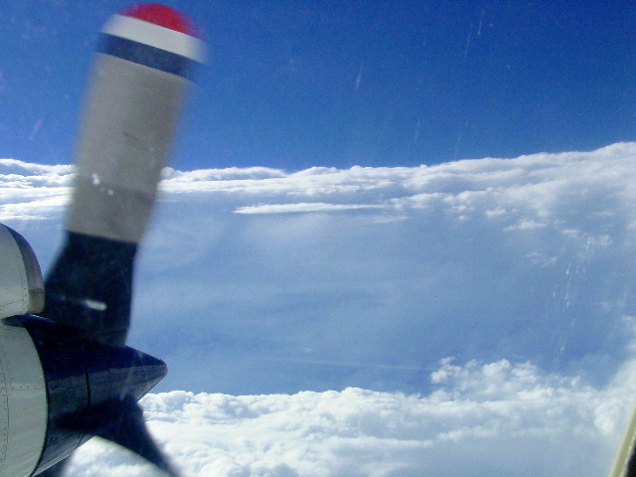


Improving the understanding and prediction
of tropical cyclones with aircraft observations
Robert Rogers
NOAA/AOML Hurricane Research Division
Hazardous Weather Processes Seminar
2020 WMO HIWeather Workshop
“Stadium effect” within a Category 5 hurricane eye

Slide 2
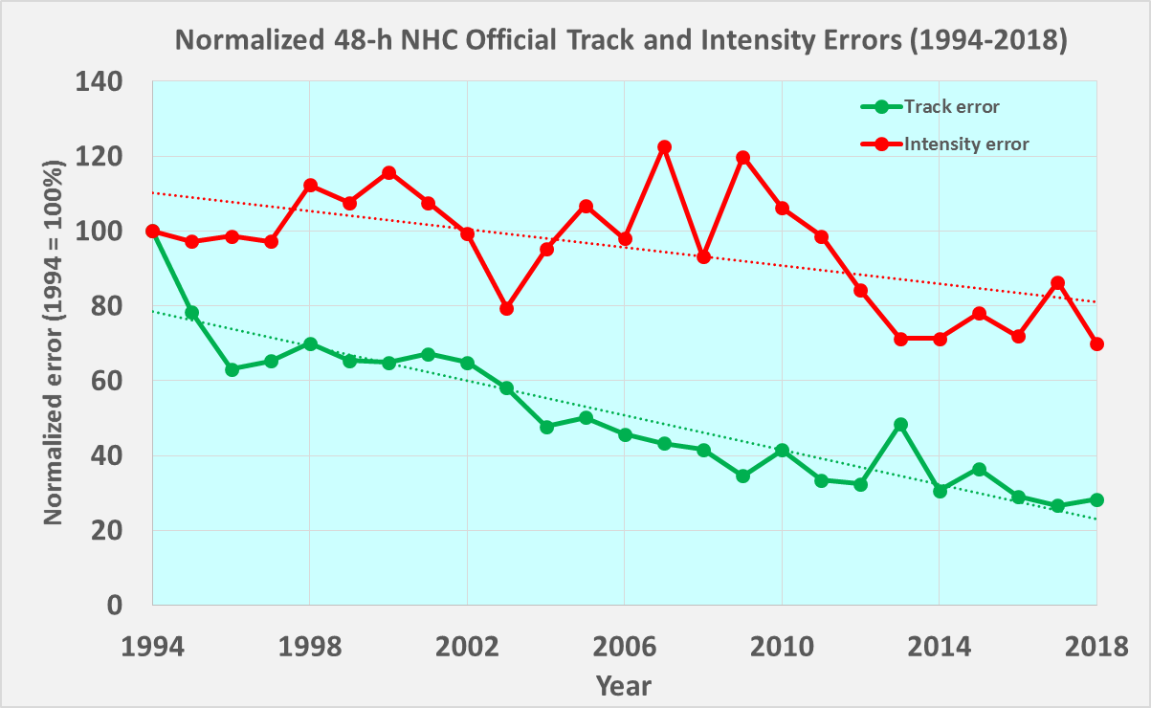
The Challenge: Tropical Cyclone Intensity Forecasting
Track and intensity forecast errors
NHC 48-h Normalized Forecast Errors
intensity
Track forecast
errors reduced by
Intensity forecast errors reduced by
70%
30%
track
TC intensity forecast improvements have lagged track forecast improvements
How can observations be used to improve TC intensity forecasts?

Slide 3

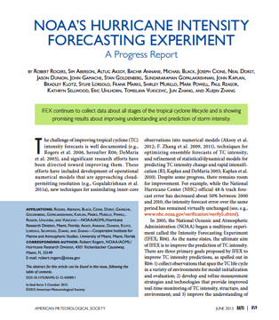
Intensity Forecasting Experiment (IFEX)
Coming (hopefully) in 2021
Rogers et al., BAMS, 2006
Rogers et al., BAMS, 2013
Zawislak et al., BAMS, 2021, in prep
IFEX intended to improve prediction of TC intensity change by addressing three goals:
FORECASTS: Collecting observations that span TC life cycle across scales for model initialization, evaluation
NOWCASTS: Developing and refining measurement technologies that provide improved real-time monitoring of TC intensity, structure, and environment
PROCESSES: Improving understanding of physical processes important in intensity change for a TC at all stages of its life cycle
These goals provide the linkage between observations, modeling, data assimilation, and theory that form the foundation of the work done at HRD

Slide 4
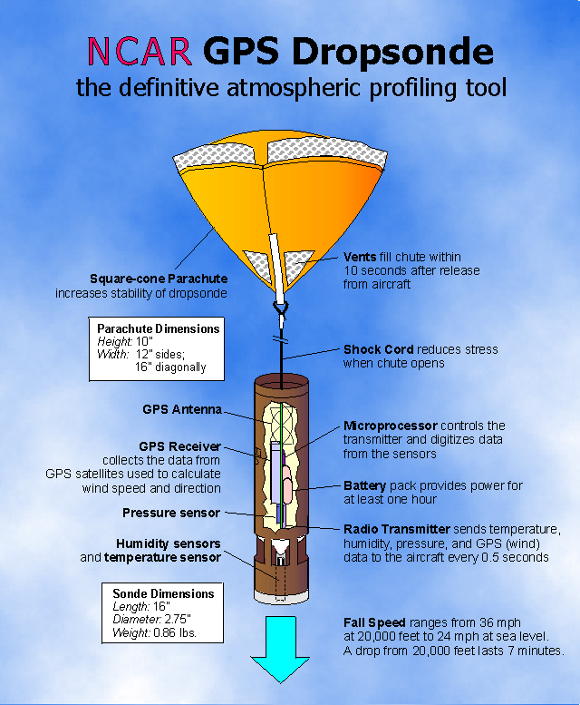
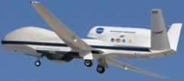
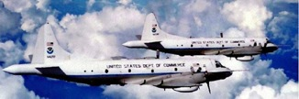
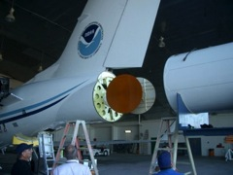
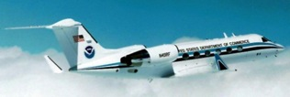
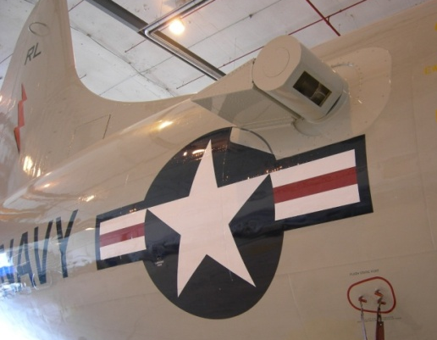

Intensity Forecasting Experiment (IFEX)
Platforms and instruments
In-situ
  Wind, press., temp.
NOAA P-3s
NASA Global Hawk
Expendables
  - Dropsondes
  - AXBT, AXCP, buoy
NOAA G-IV
GPS Dropsonde
Remote Sensors
  Tail Doppler Radar(TDR)
  SFMR/HIRAD
  WSRA
  Scatterometer/profiler
  UAS
G-IV Tail Doppler Radar
Doppler Wind Lidar
4
Coyote UAS
Notes:
UR image depicts dropsonde profiles in eyewall of Hurricane Guillermo (1997)
LR image is Doppler Wind Lidar profiles from TCS-08
See IFEX paper (Rogers et al 2006): http://dx.doi.org/10.1175/BAMS-87-11-1523
HRD IFEX website: http://www.aoml.noaa.gov/hrd/HFP2011/index.html

Slide 5
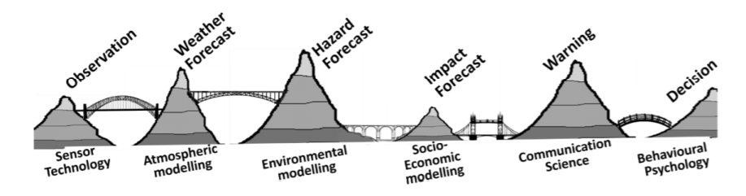
IFEX and the Warning Value Chain
Warning value chain for tropical cyclones
Golding et al. 2019
satellites
surface
aircraft
min pressure
position
peak winds
IFEX falls on the left side of the value chain
Provides aircraft observations to improve model forecasts of key TC parameters
IFEX

Slide 6
Addressing the IFEX goals: FORECASTS

Slide 7
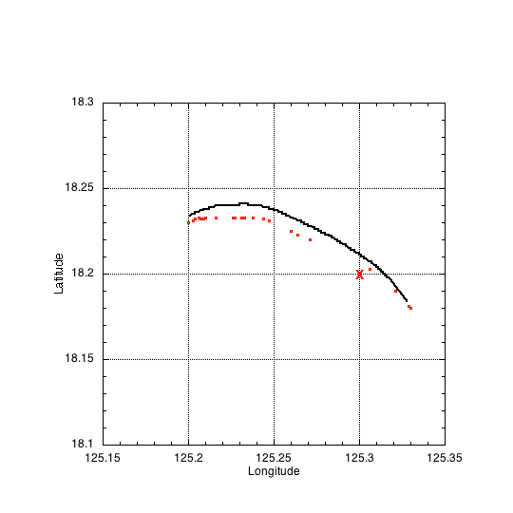
Addressing the IFEX goals: FORECASTS
Improved sonde usage
Dropsonde location (drift)
Drift impact on HWRF intensity errors
~15 km drift
NO DRIFT
Intensity error (kt)
Observed location
WITH DRIFT
HRD estimation
X
NCEP location
Forecast hour
Accounting for dropsonde drift reduces intensity error in HWRF forecasts

Slide 8
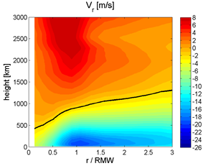
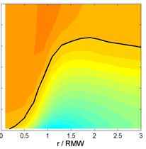
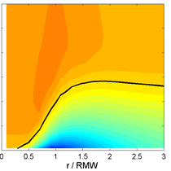
Addressing the IFEX goals: FORECASTS
Improved representation of physical processes
Radial flow in hurricane boundary layer from HWRF using different vertical eddy diffusivity (K_{m})
Observed
Incorrect K_{m}
Corrected K_{m}
Inflow layer
(Zhang et al., MWR, 2015)
Using eddy diffusivity corrected by observations produces PBL structure more consistent with observed structure

Slide 9
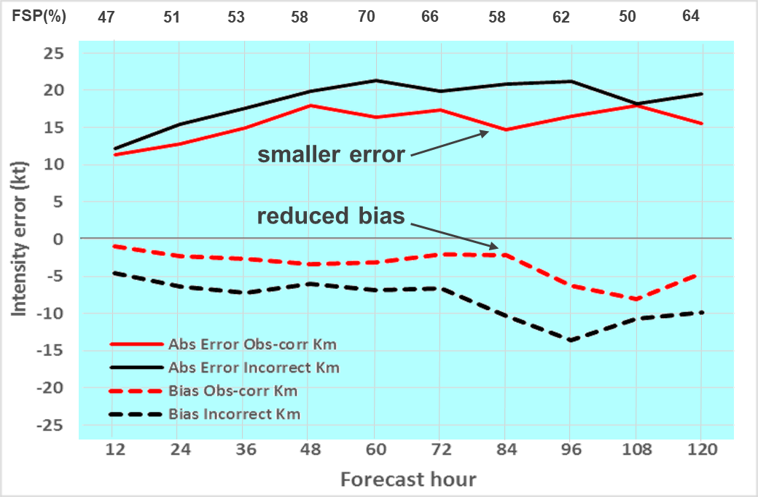
Addressing the IFEX goals: FORECASTS
Improved representation of physical processes
Intensity forecast errors for two RI TCs using different K_{m} in HWRF (55 cases)
Error (correct Km)
Error (incorrect Km)
Bias (correct Km)
Bias (incorrect Km)
Using correct K_{m} gives better RI prediction in operational HWRF model

Slide 10
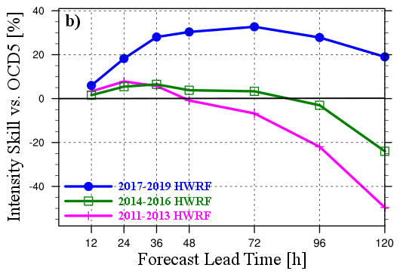
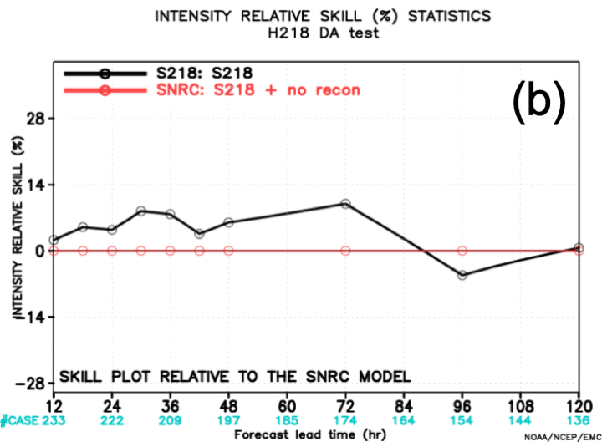
Addressing the IFEX goals: FORECASTS
Improvements in numerical model intensity forecasts
Change in model forecast skill due ONLY to use of aircraft observations
Change in overall model forecast skill over time
Improvement over baseline
Improvement over baseline
HWRF intensity forecast skill improved substantially (> 50%) over past 9 years
Direct contributions of aircraft observations in recent versions significant (> 10%)

Slide 11
Addressing the IFEX goals: NOWCASTS

Slide 12
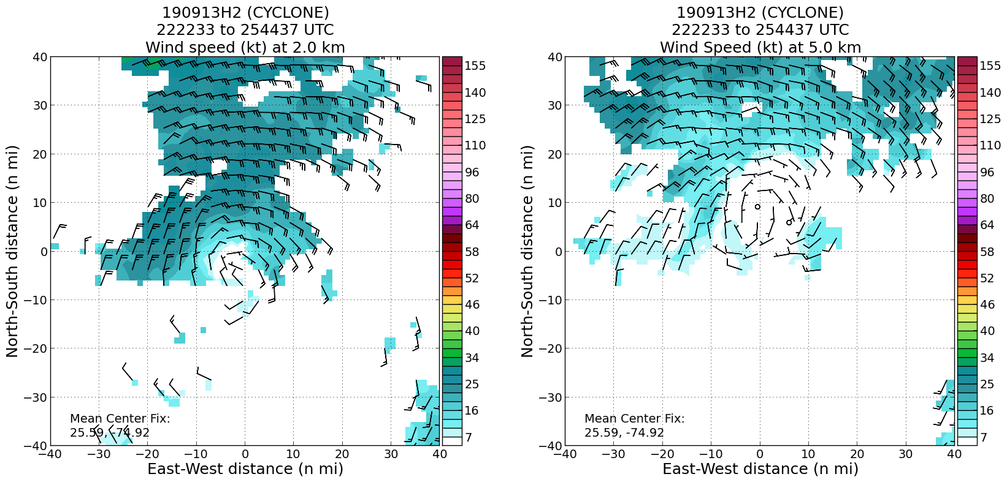
Addressing the IFEX goals: NOWCASTS
Improved real-time depiction of TC structure
Real-time airborne radar observations of Humberto (2019)
NHC Humberto Discussion, 2 h later: “The storm is still feeling some effects of southwesterly shear and drier air, which is causing…strong tilt in the aircraft data… conditions are expected to gradually become more conducive for strengthening ”
Midlevel center
Low-level center
Winds at 2 km
Winds at 2 km
Winds at 5 km
Winds at 5 km

Slide 13
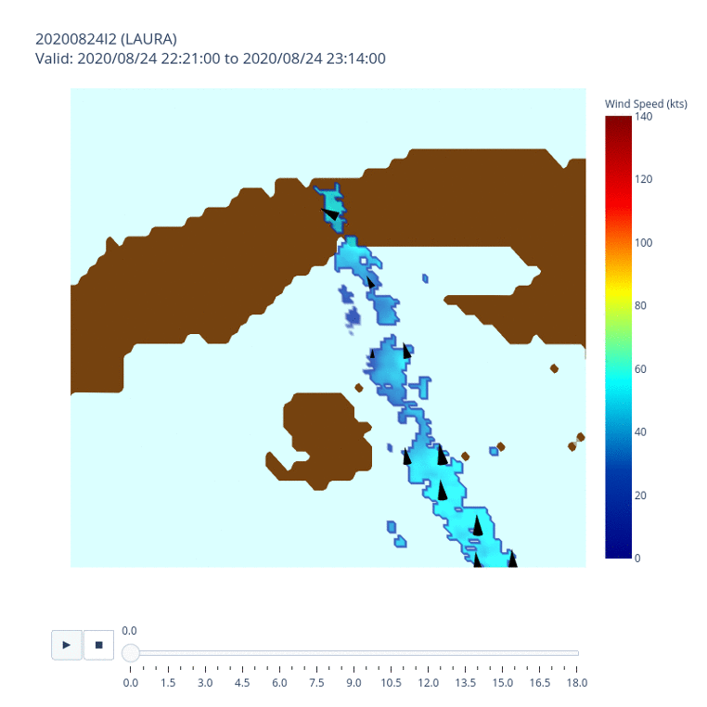
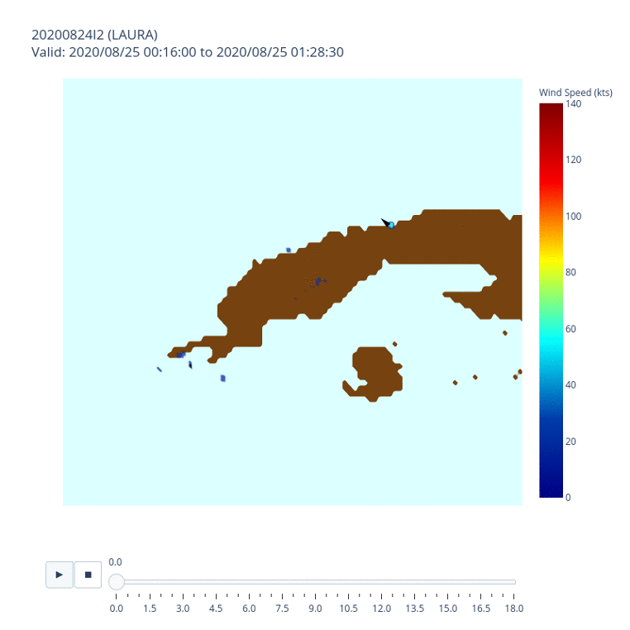
Addressing the IFEX goals: NOWCASTS
Improved real-time depiction of TC structure
Three-dimensional views of wind structure in TC Laura (2020) examined in real time
~2 h later
Storm center
Storm center
Early in the mission the radar data indicate that the vortex tilts southward with height
A few hours later the vortex is more vertically aligned, suggesting improved organization

Slide 14
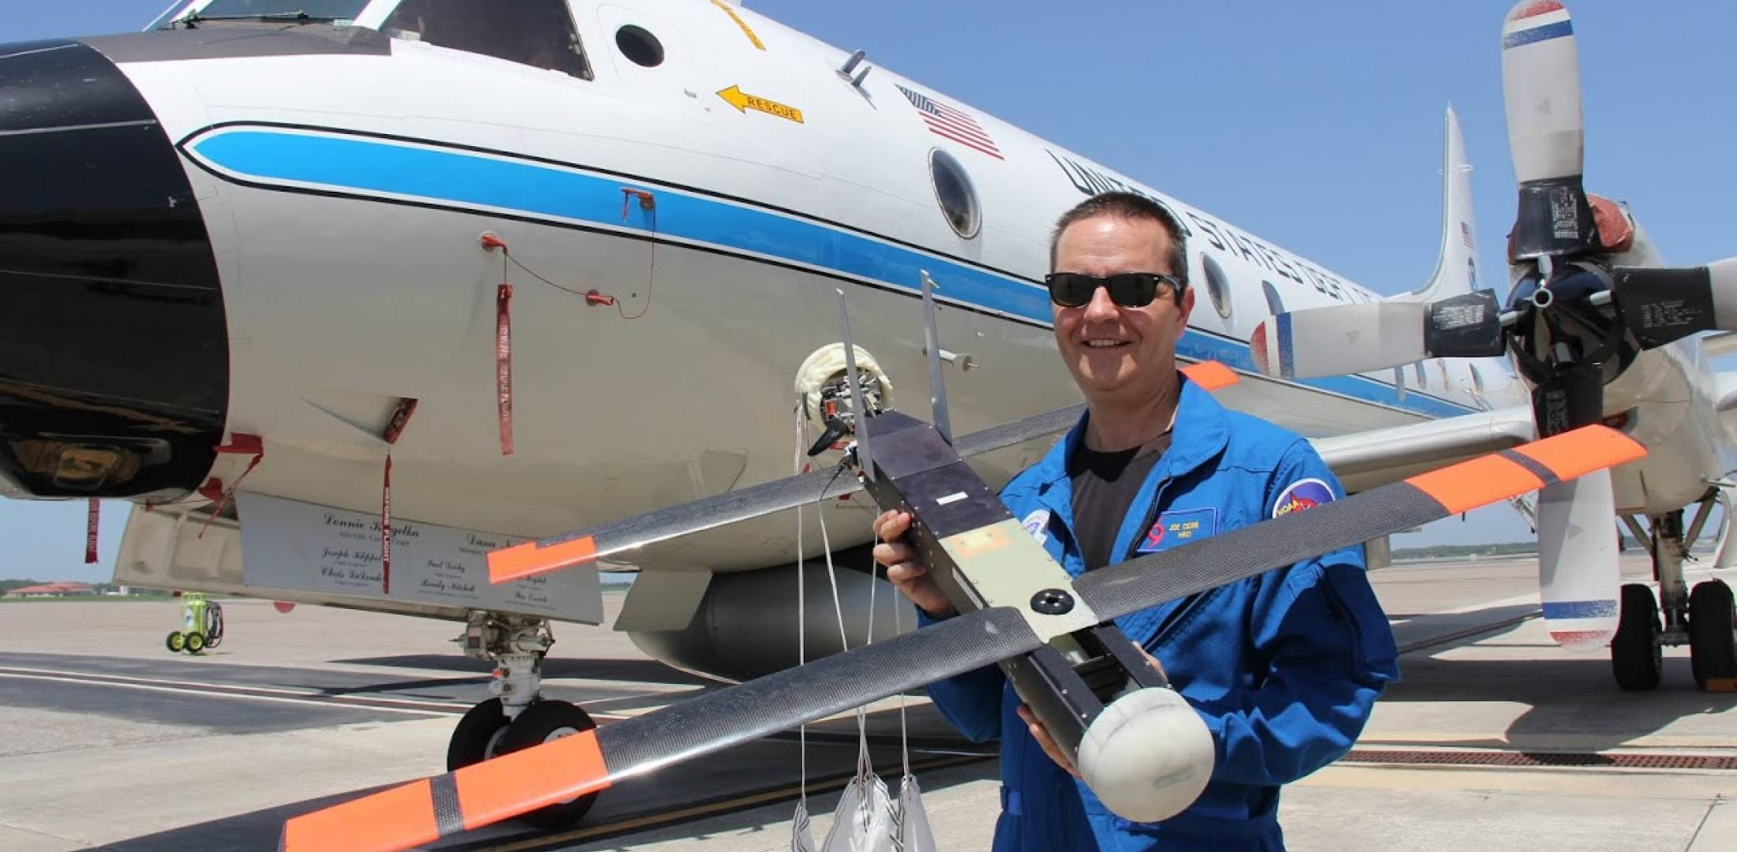
Addressing the IFEX goals: NOWCASTS
New technologies to measure TC structure
Coyote sUAS measurements of hurricane PBL
Coyote capable of sampling near-surface conditions in TC environments, regions that can not be safely sampled by manned aircraft
Useful for real-time monitoring of surface conditions, air-sea interaction research
Coyote

Slide 15
Addressing the IFEX goals: NOWCASTS
New technologies to measure TC structure
Coyote sUAS measurements of hurricane PBL
Coyote track, P-3 lower fuselage image from Maria (2017)
Altitude, wind speed from all Coyote missions
start
end
(Cione et al., BAMS, 2020)
sUAS capable of operating in variety of TC environments (e.g., eye, eyewall)
Multiple sustained measurements in lowest 1 km, including several > 30 min

Slide 16
Addressing the IFEX goals: PROCESSES

Slide 17
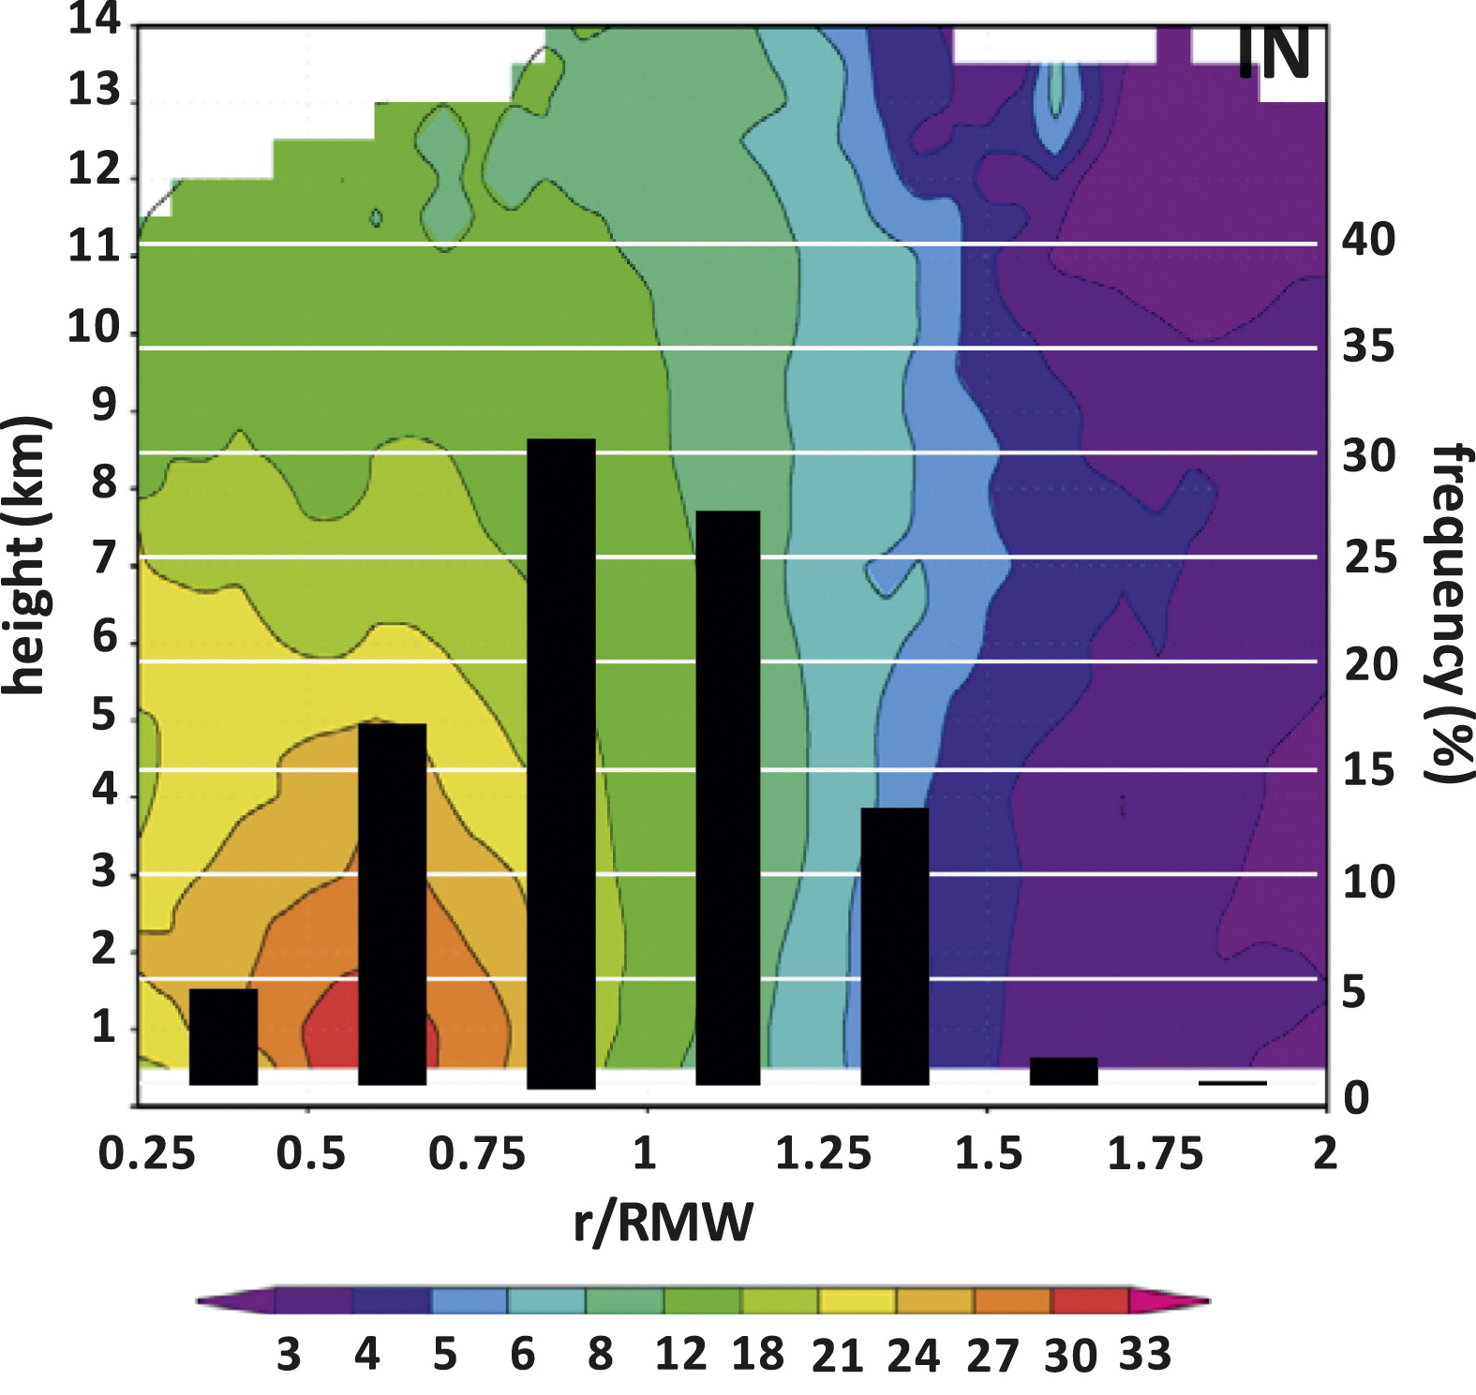

Addressing the IFEX goals: PROCESSES
Radial distribution of strong thunderstorms for intensifying, steady-state storms
RMW
Intensifying
Steady state
strong thunderstorms
(Rogers et al., MWR, 2013)
Airborne Doppler observations from 93 eyewall passes in 14 different tropical cyclones
Strong thunderstorms preferentially located inside radius of maximum wind for intensifying hurricanes

Slide 18
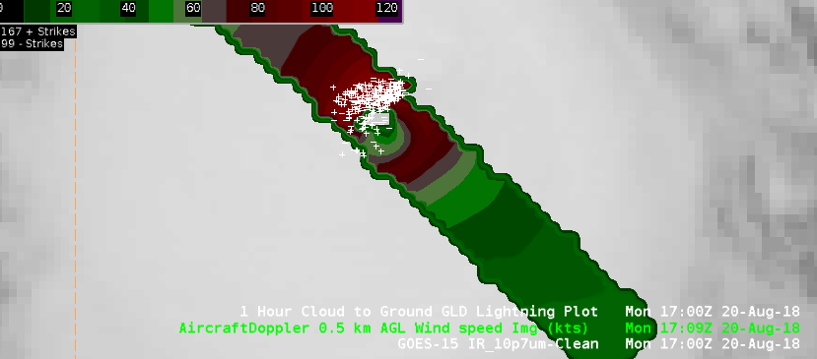
Addressing the IFEX goals: PROCESSES
Operational application of research results
Real-time NHC display observations in Hurricane Lane (2018)
Lightning flashes
Real-time display of blended satellite, aircraft, ground-based observations
Lightning (strong thunderstorms) concentrated within RMW
Hurricane Lane intensified 15 kt to near Category 5 in next 12 hours
Potential indicator of short-term (6-12 h) intensification
Radius of
Maximum Winds

Slide 19
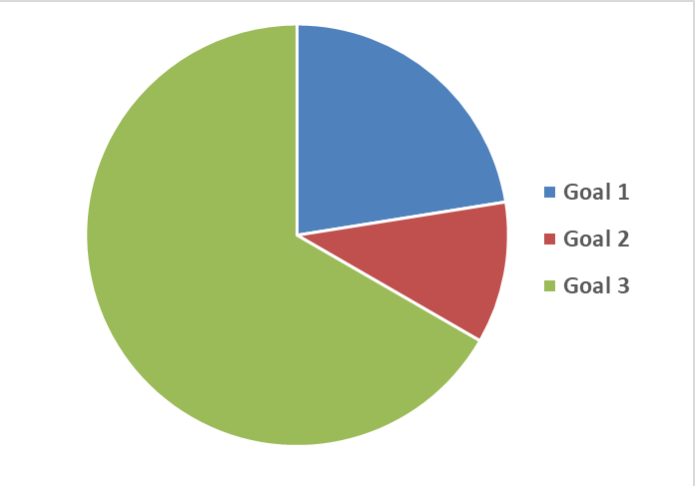
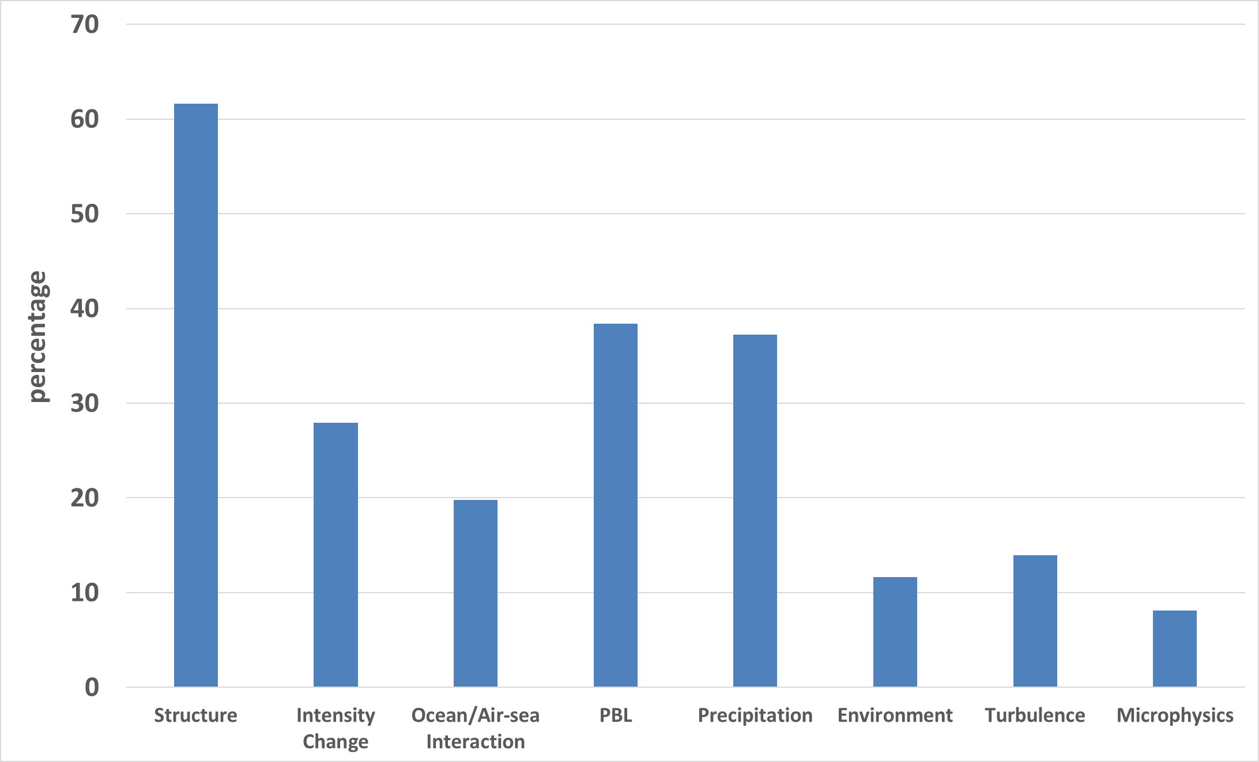
Research Foci of IFEX activities
Topics researched from HRD co-authors using NOAA aircraft data in IFEX era (2006-2019)
Number of publications by IFEX goal
Percentage of research publications by topic
29
FORECASTS
14
NOWCASTS
86
PROCESSES
Most IFEX publications address Processes
Most processes publications on structure, PBL, precipitation
Fewest: turbulence, microphysics, environment – Gap?

Slide 20
Future of IFEX
Improve RI prediction
Improve guidance on pre-formation disturbances
  7-day forecasts
Expand focus beyond intensity
  Improved hazard guidance – storm surge, severe weather, rainfall, winds
  Requires greater research emphasis on microphysics, turbulence, wind structure

Slide 21
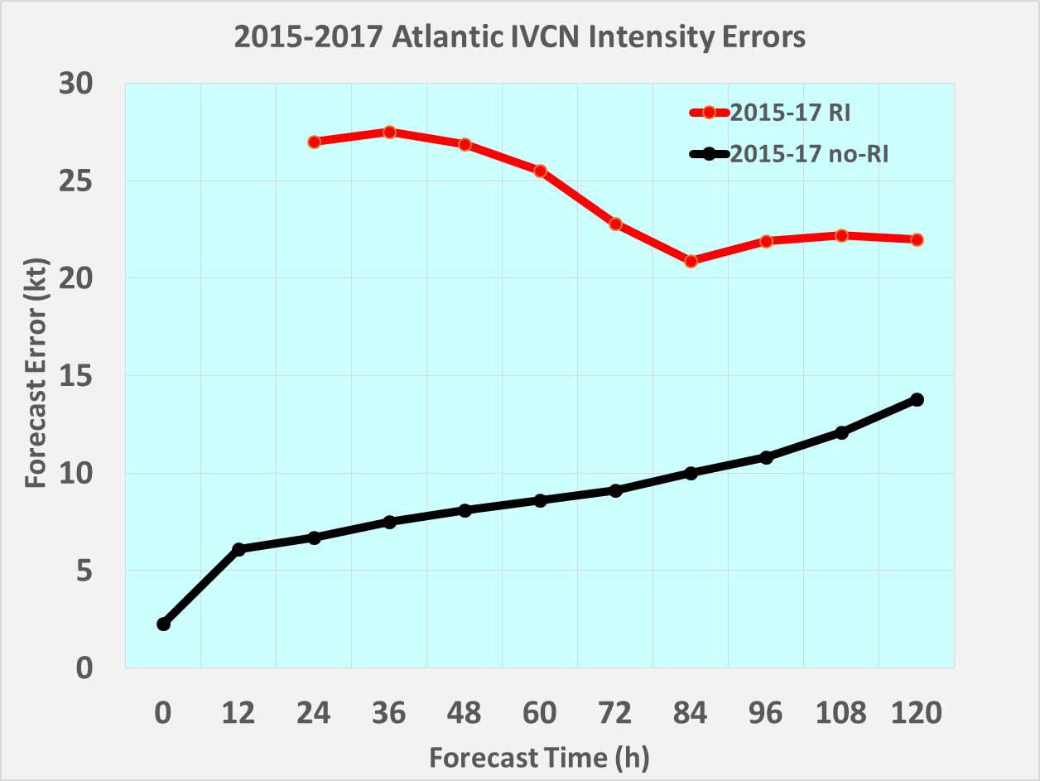
Future of IFEX – RI forecasts
Rapid intensification (> 30 kt/24 h) events
Intensity Forecast Errors for Rapid Intensification (RI) & Non-RI Events (2015-2017)
RI
3x larger error
Intensity forecast errors at 48 h three times larger for rapidly intensifying TCs than non-RI TCs
Non-RI

Slide 22
New IFEX and the Warning Value Chain
Warning value chain for tropical cyclones
Golding et al. 2019
satellites
surface
aircraft
min pressure
position
peak winds
surge
rainfall
wind gusts
severe weather
New IFEX will provide aircraft observations to improve model forecasts of a broader array of TC parameters
Improved model forecasts will yield improved hazard forecasts
wind structure
microphysics
turbulence
New IFEX

Slide 23
THANK YOU!

