Slide 1
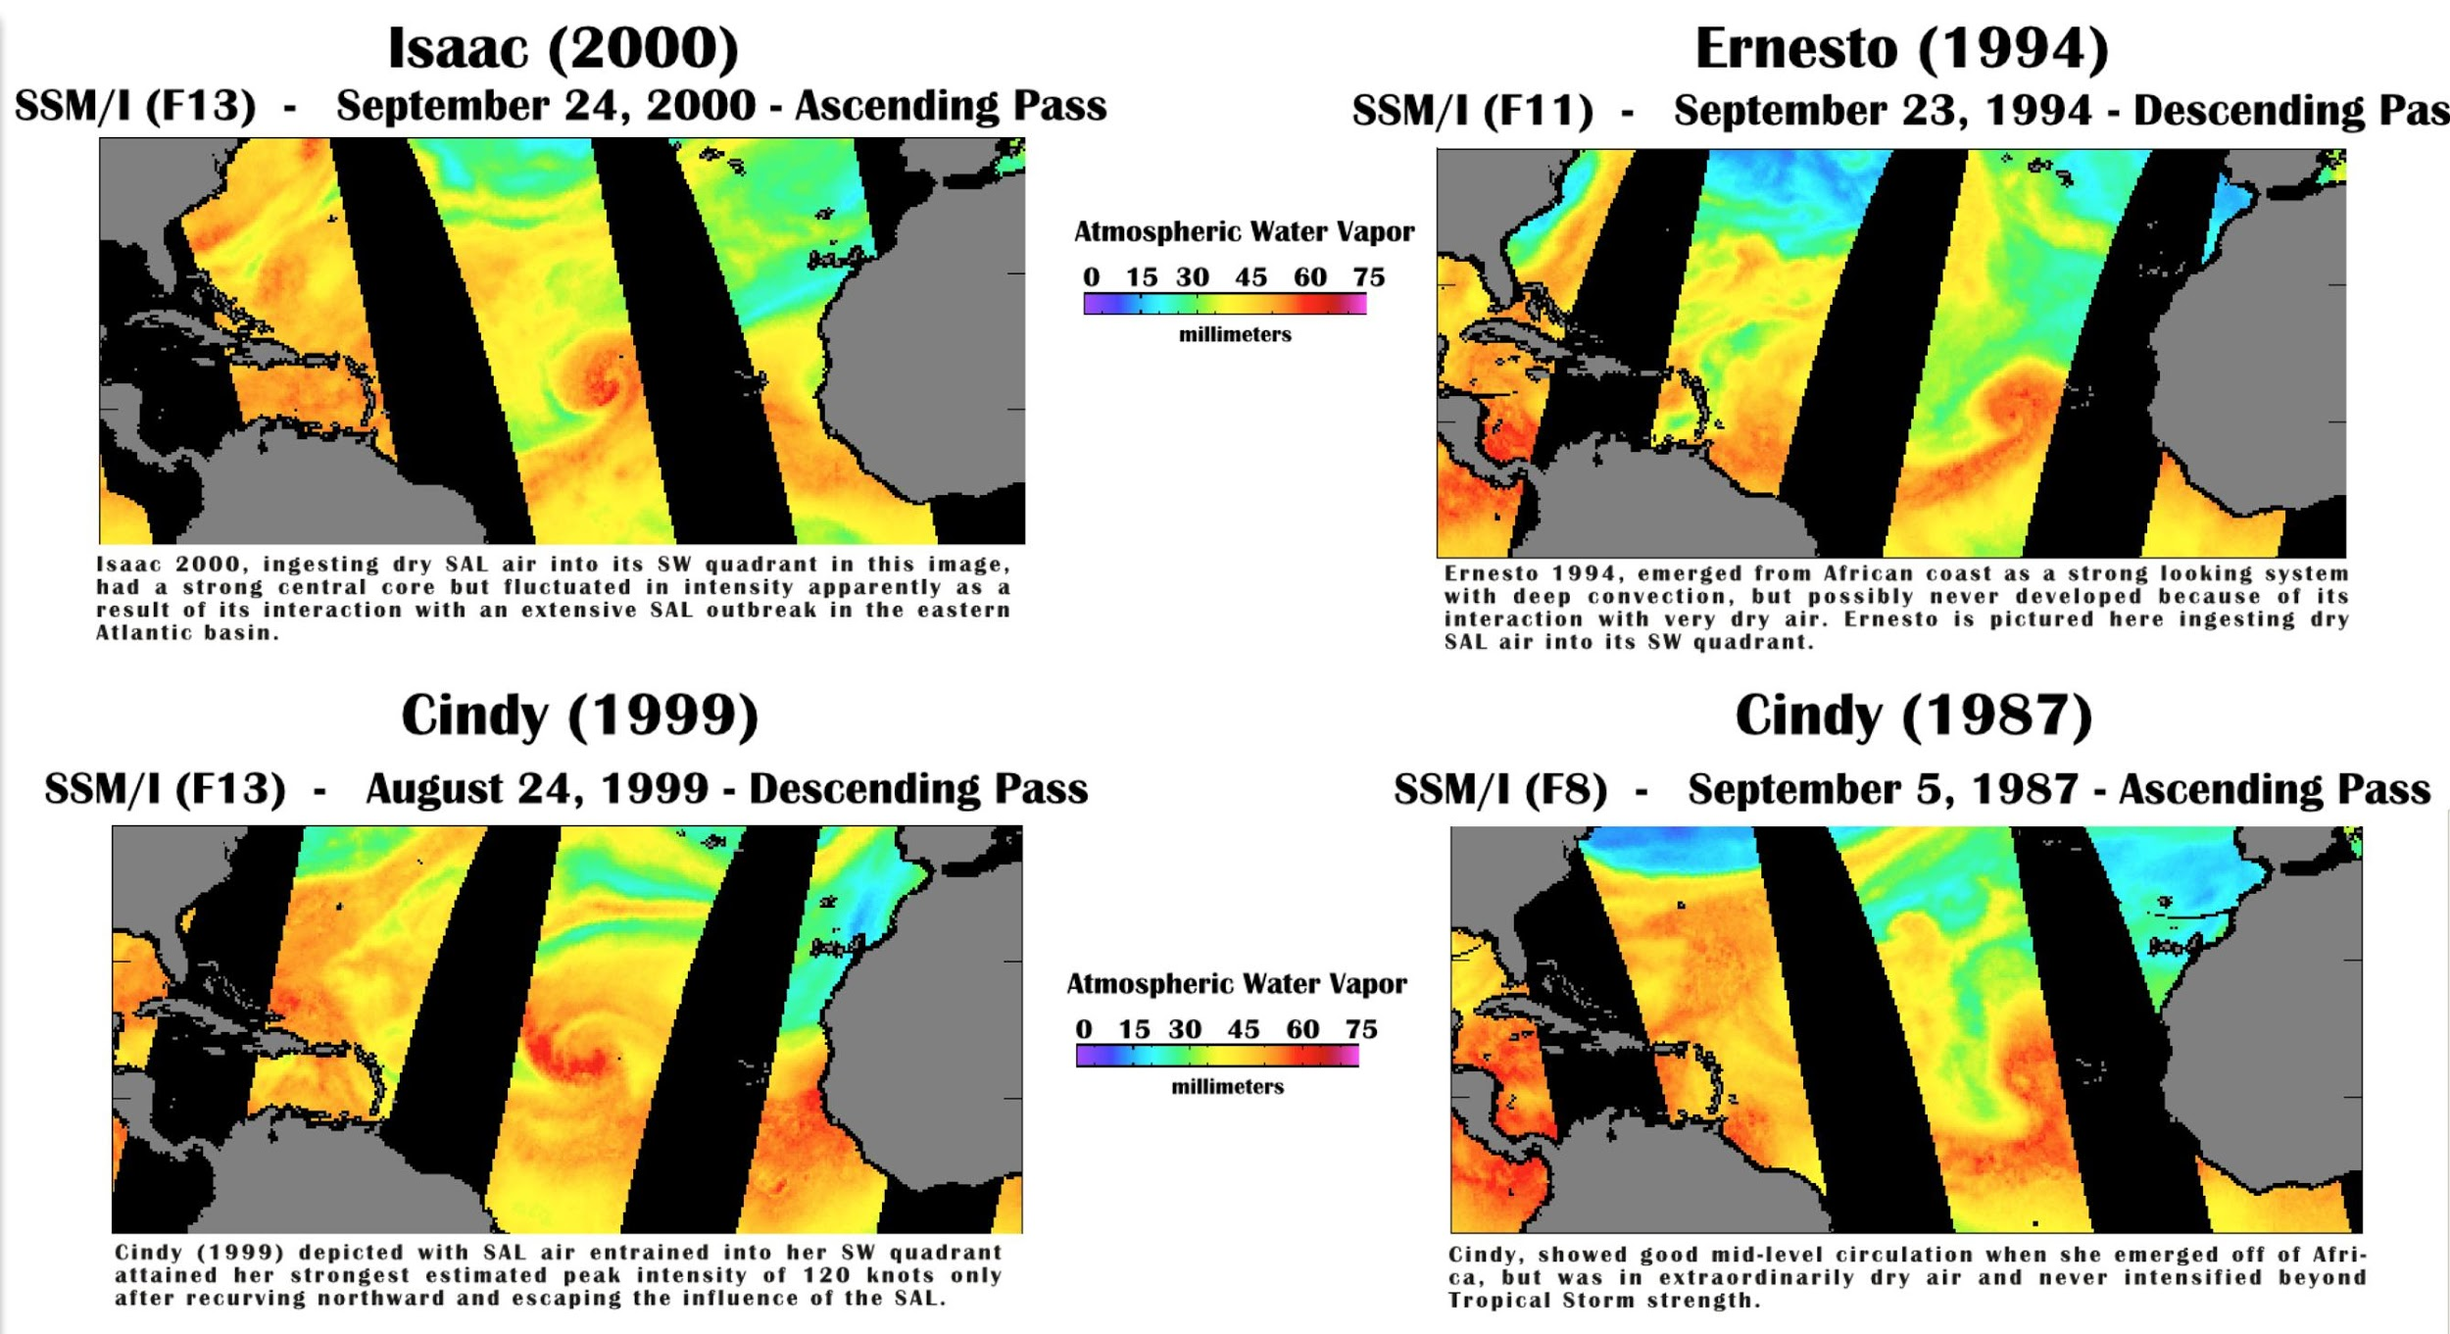
Identification of Atlantic Basin Tropical Cyclones in Proximity to Significant Dry Air Events in Total Precipitable Water Imagery (1987-2015)
s
Evan B. Forde (NOAA/AOML/OD)
Collaborators: Ghassan Alaka, Jr.*,
Jason P. Dunion*, & ¹Michael L. Black
*HRD & University of Miami, CIMAS)

Slide 2
MOTIVATION
Many questions remain about the yearly variation of Atlantic basin TC quantities & their fluctuations in intensity.
Modulation of the quantity and intensity of Atlantic basin TCs by the presence of SALs & other dry air masses is one probable factor in annual hurricane season variability
Recent research (by Forde, Alaka, Dunion, and Black) revealed that approximately 1/3 of all Atlantic basin TCs were in proximity to SALs or Dry Air events during some phase of their life cycle
Most earlier studies had a smaller sample size and therefore presented varying conclusions on SAL/dry air impacts
Greatest impact of dry air on TC production would likely be on AEWs or non-forming storms forming in the eastern portion of the MDR
Can we improve intensity forecasting skill?
Braun, S. A. (2010). Reevaluating the role of the Saharan air layer in Atlantic tropical cyclogenesis and evolution. Monthly Weather Review, 138(6), 2007-2037.
Dunion, J. P., and C. S. Velden (2004), The impact of the Saharan air layer on Atlantic tropical cyclone activity, Bull. Am. Meteorol. Soc., 85(3), 353–365.

Slide 3
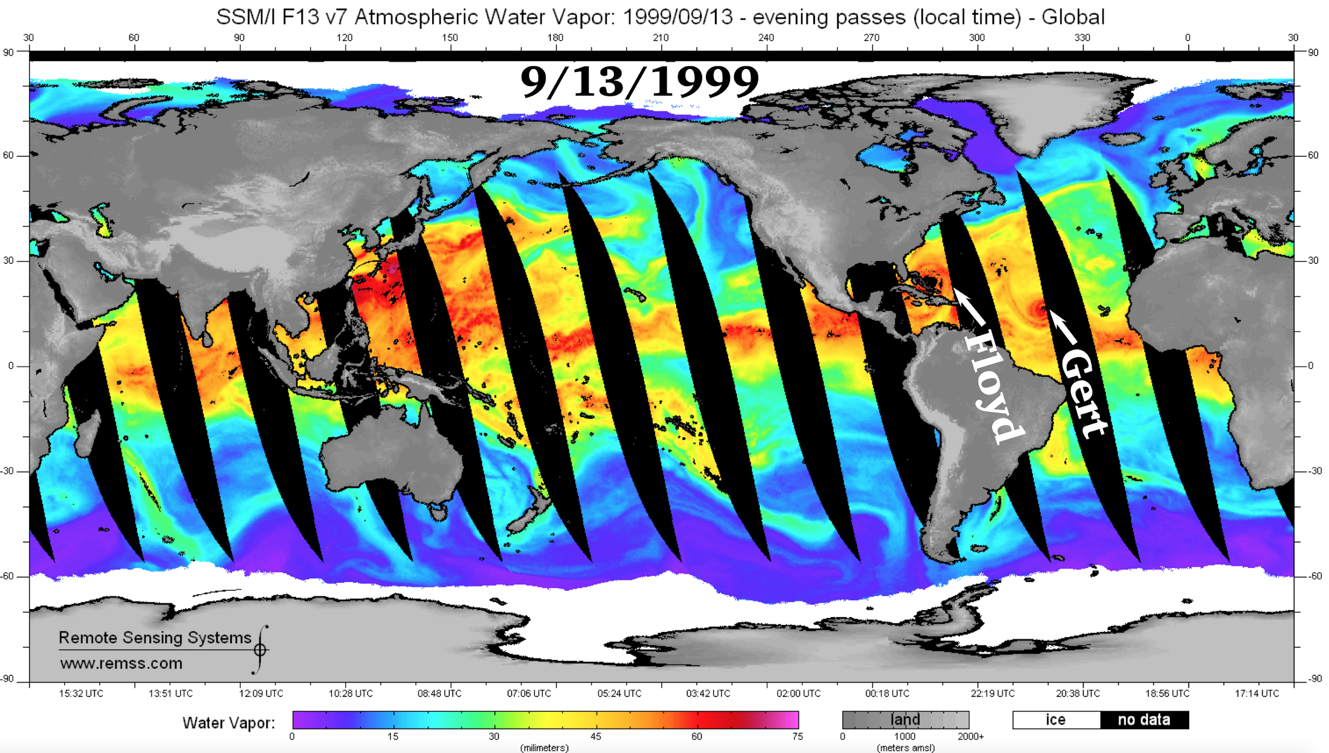
Worldwide SSMI/TPW
Evan B. Forde – IRR. – 9/26/18
Notes:
FIGURE 1. Global SSM/I TPW on September 19, 1999. TPW image is directly from www.remss.com. This particular example of the SSM/I products directly available on that web site from 1999 happened to image both Hurricane Floyd and Hurricane Gert. Note that the color legend online is different from the TPW plots created from the downloaded data.
FIGURE 1. Global SSM/I TPW on September 19, 1999. TPW image is directly from www.remss.com. This particular example of the SSM/I products directly available on that web site from 1999 happened to image both Hurricane Floyd and Hurricane Gert. Note that the color legend online is different from the TPW plots created from the downloaded data.

Slide 4
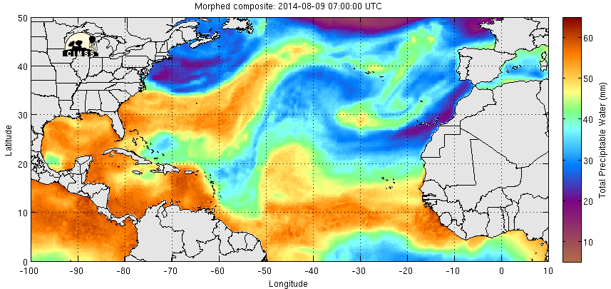
Worldwide SSMI/TPW
Total Precipitable Water is the depth of water in a column of the atmosphere,
if all the water in that column were precipitated as rain.
As a depth, the precipitable water is measured in millimeters or inches.
Evan B. Forde – IRR. – 9/26/18
Notes:
FIGURE 1. Global SSM/I TPW on September 19, 1999. TPW image is directly from www.remss.com. This particular example of the SSM/I products directly available on that web site from 1999 happened to image both Hurricane Floyd and Hurricane Gert. Note that the color legend online is different from the TPW plots created from the downloaded data.
FIGURE 1. Global SSM/I TPW on September 19, 1999. TPW image is directly from www.remss.com. This particular example of the SSM/I products directly available on that web site from 1999 happened to image both Hurricane Floyd and Hurricane Gert. Note that the color legend online is different from the TPW plots created from the downloaded data.

Slide 5
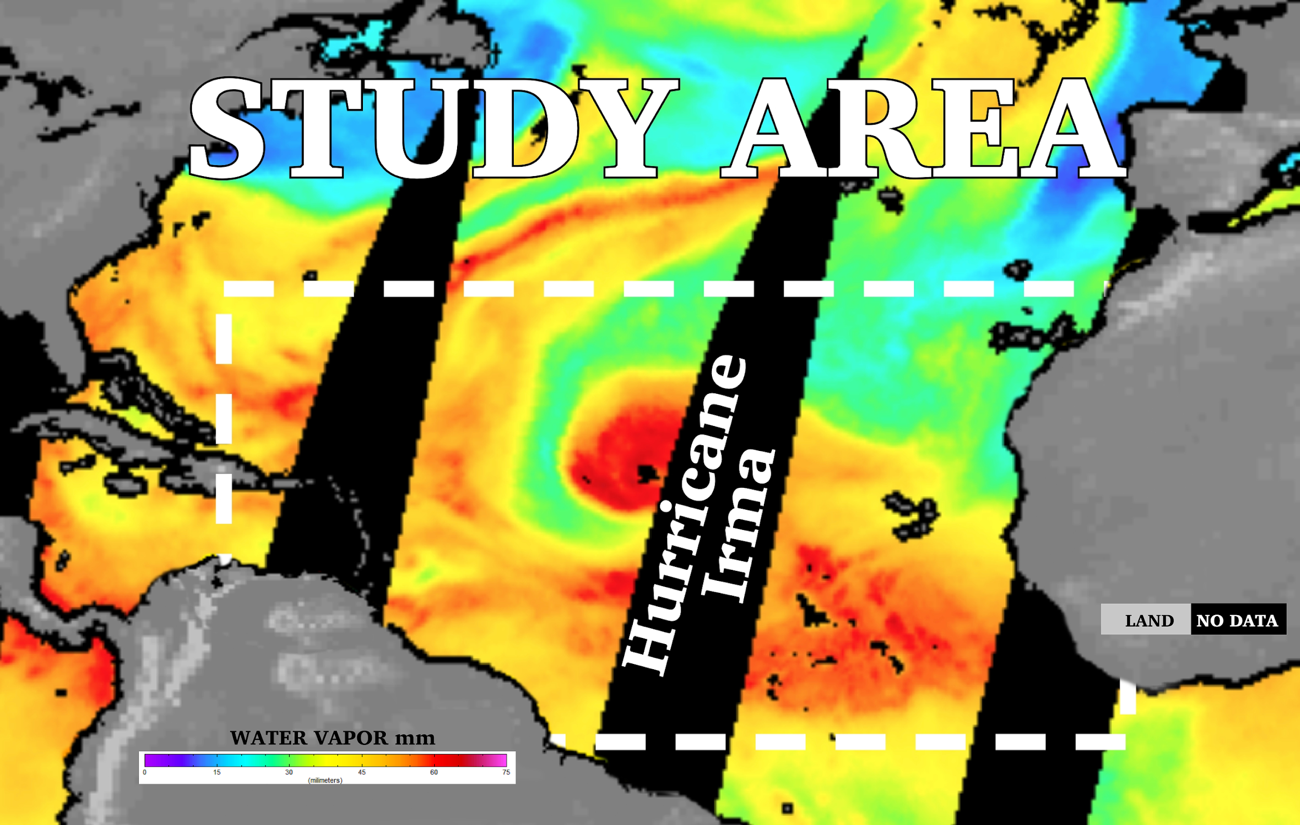
Evan B. Forde – IRR. – 9/26/18

Slide 6
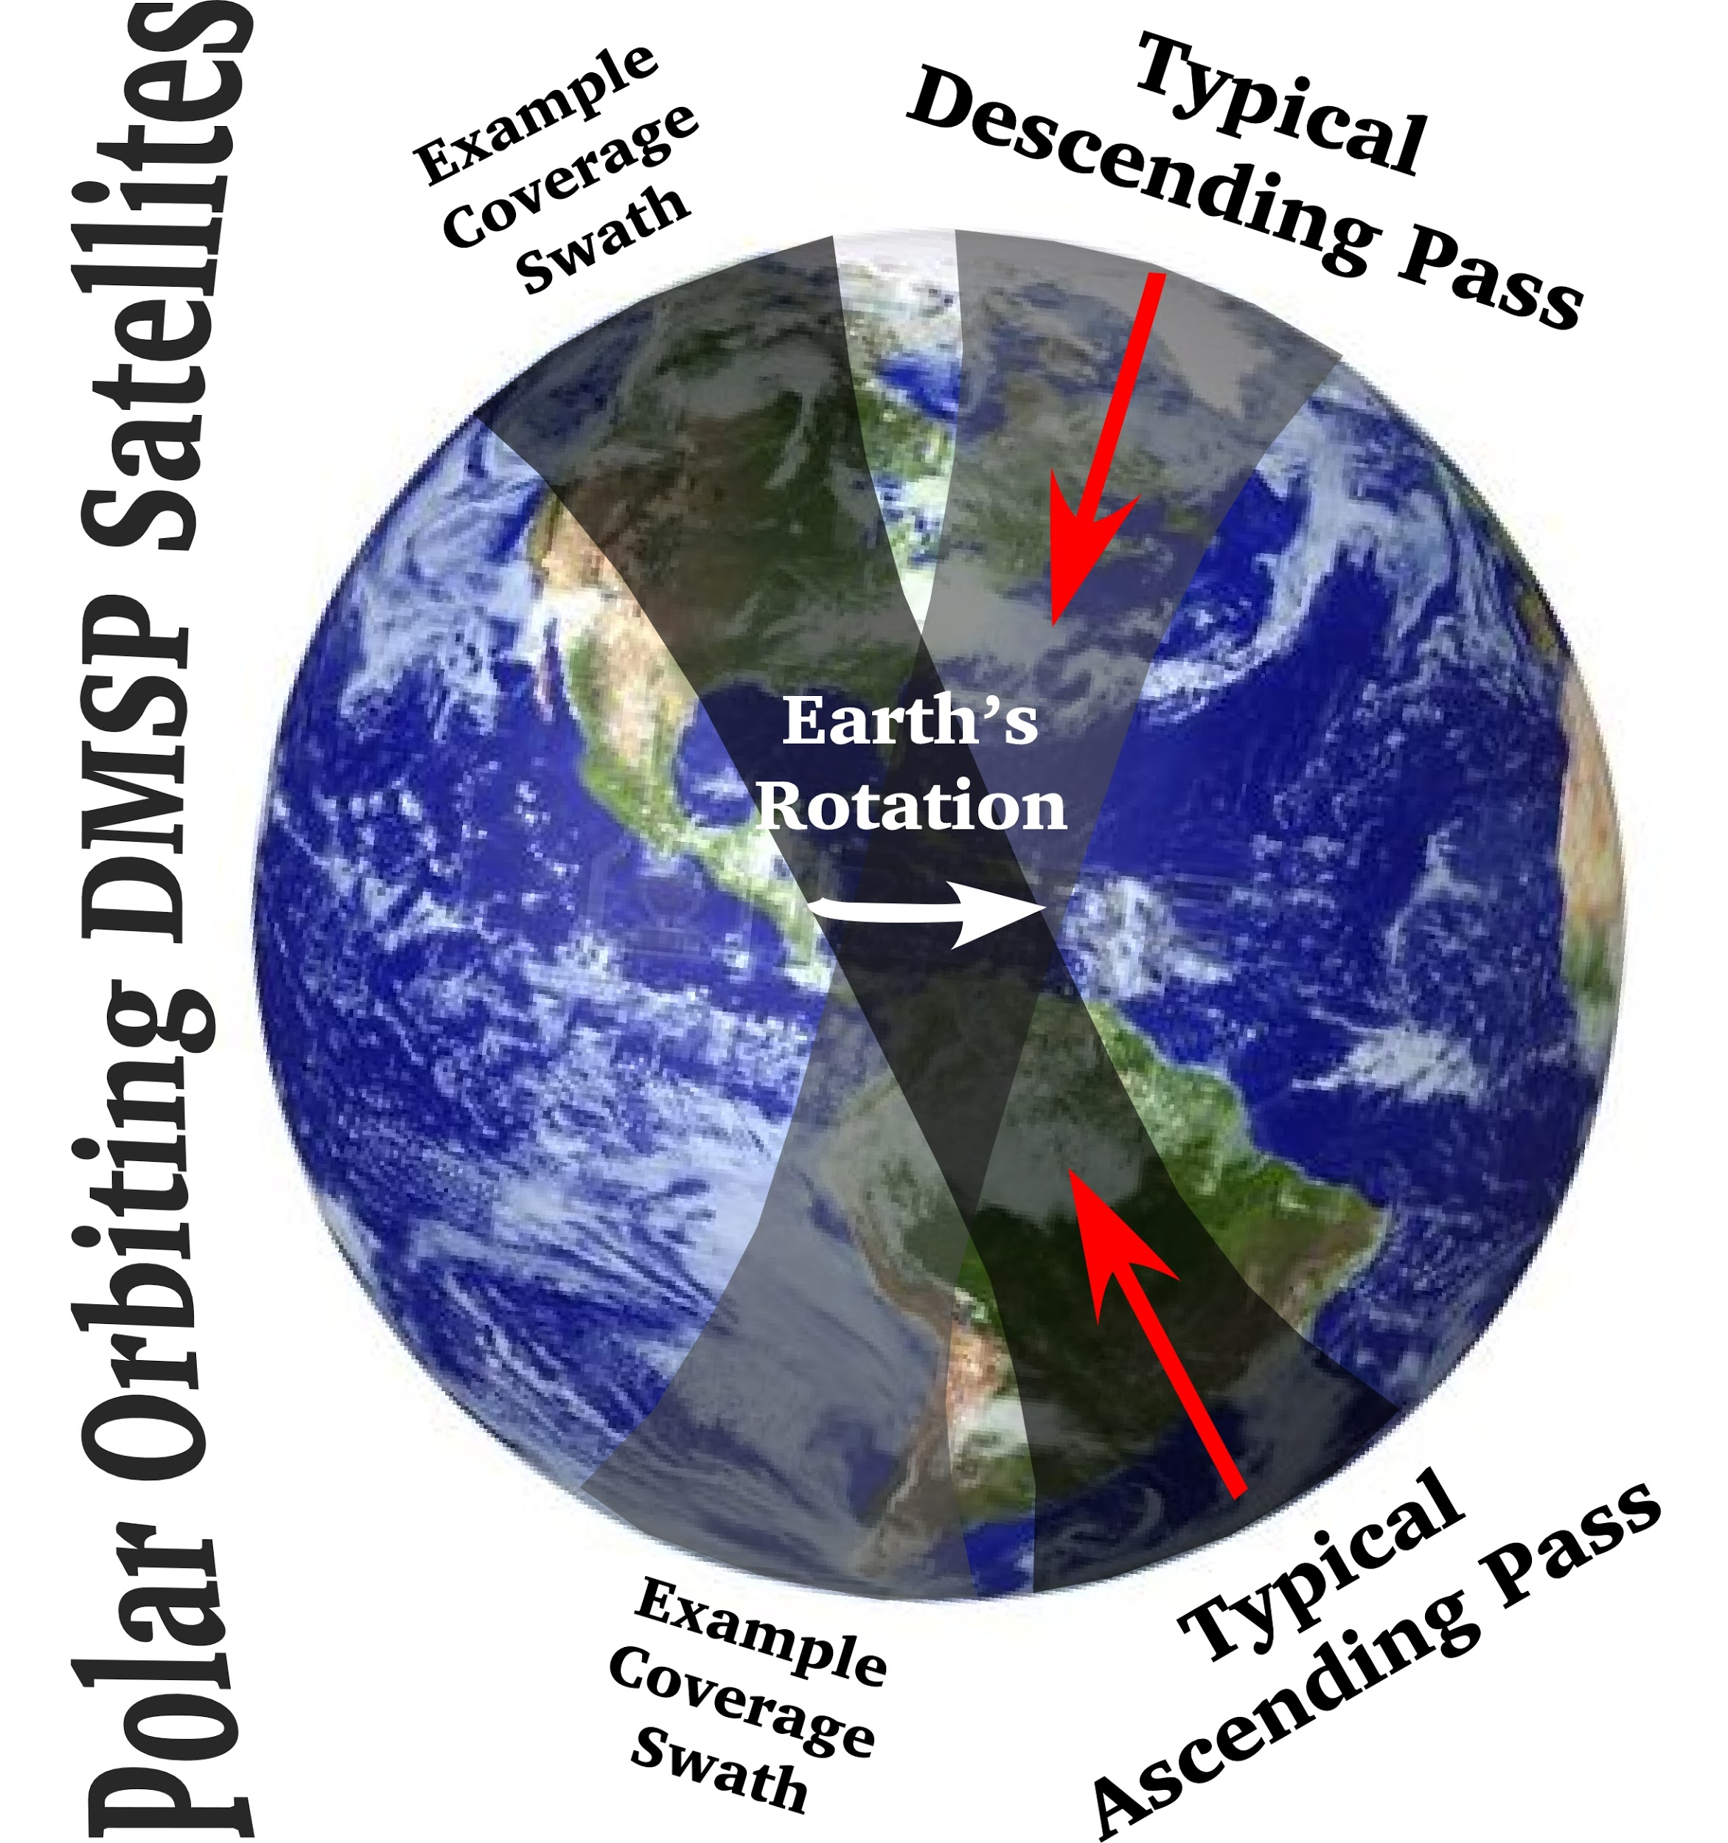
INTRODUCTION TPW Data
DMSP satellites:
F8, F-10, F-11, F-13, F-14, F-15, F-16 and F-17
Two daily passes → morning & evening
Data mapped to 0.25-degree grid
The Special Sensor Microwave Imager (SSM/I) was carried aboard
Defense Meteorological Satellite Program (DMSP) satellites
F-8, F-10, F-11, F12, F-13, and F-15.
The next generation Special Sensor Microwave Imager/Sounder (SSMI/S)
was carried aboard the DMSP F-17.
Study Period: 1987-2015 (29 hurricane seasons)
Version 7 of this data set was recently released
and has more useable data
Notes:
SSM/I is part of the Defense Meteorological Satellite Program (DMSP), which was part of NASA’s Pathfinder Program.
6 satellites – F-8, F-10, F-11, F-13, F-14, and F-15

Slide 7
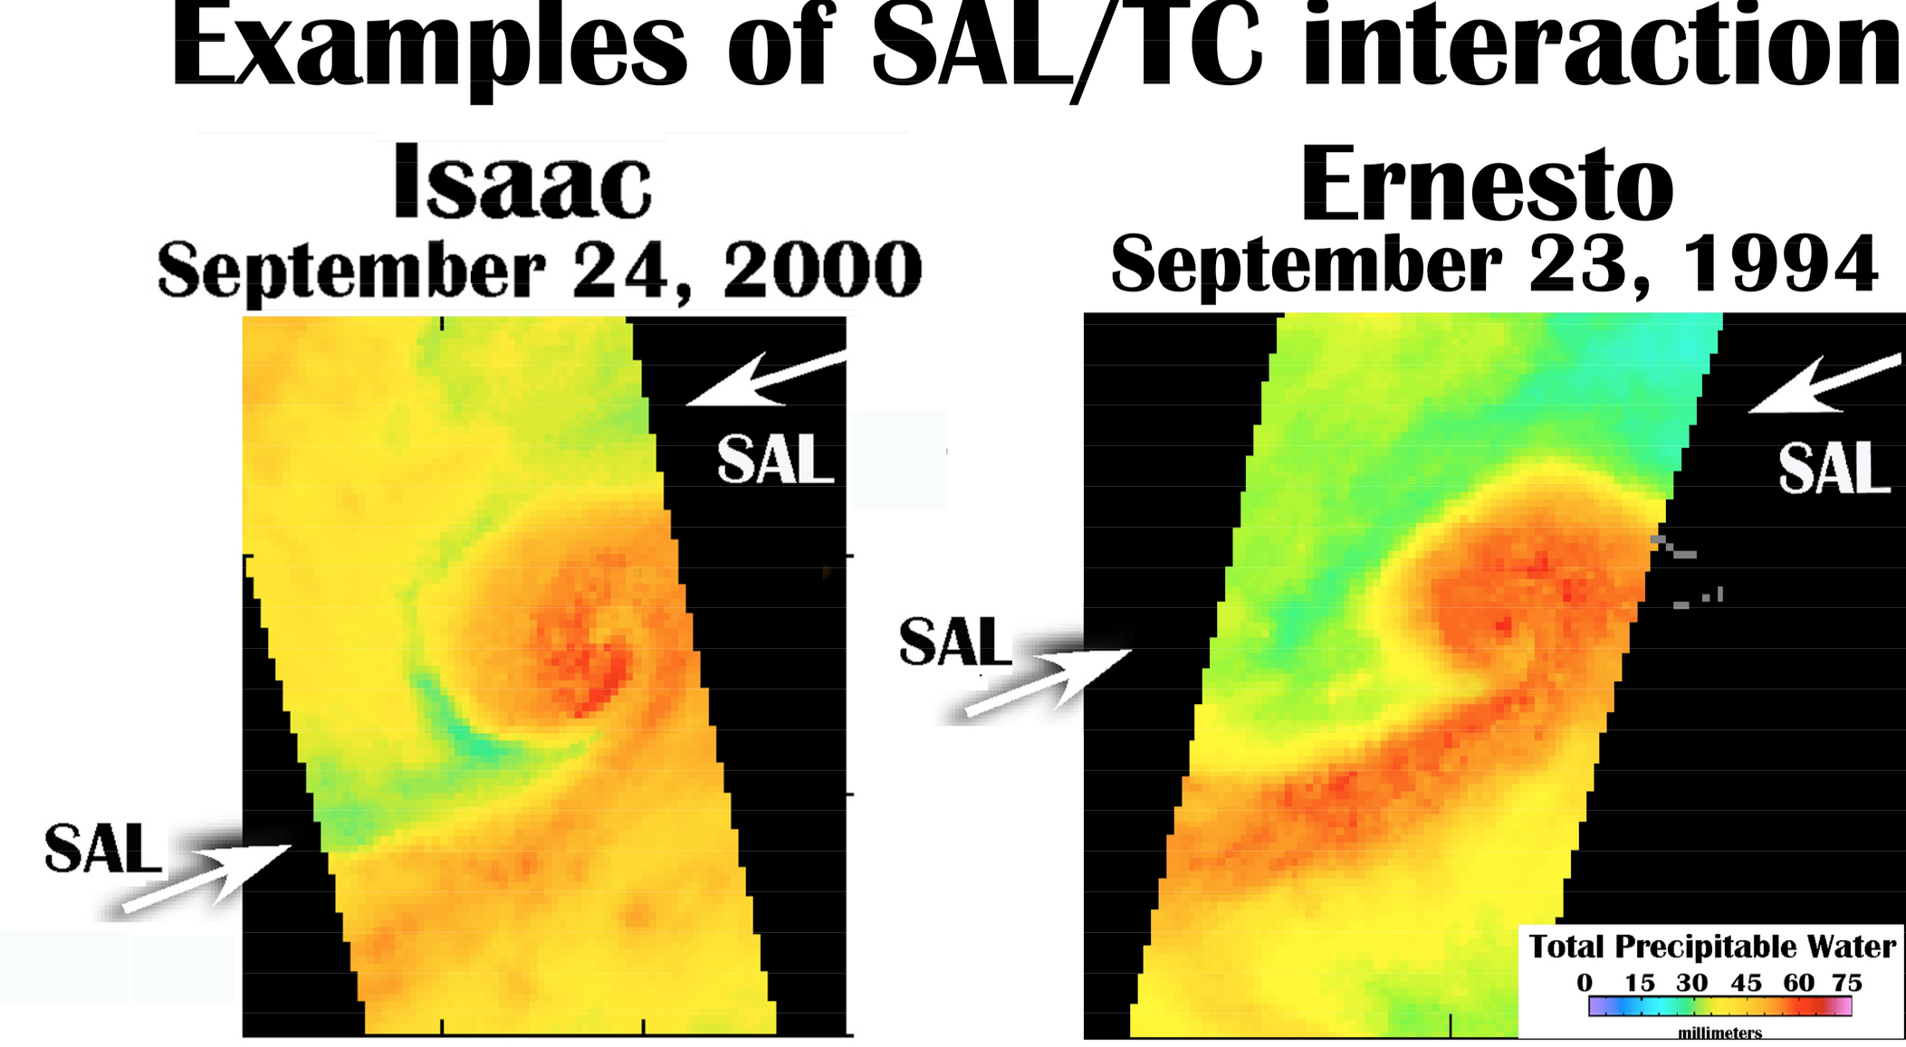
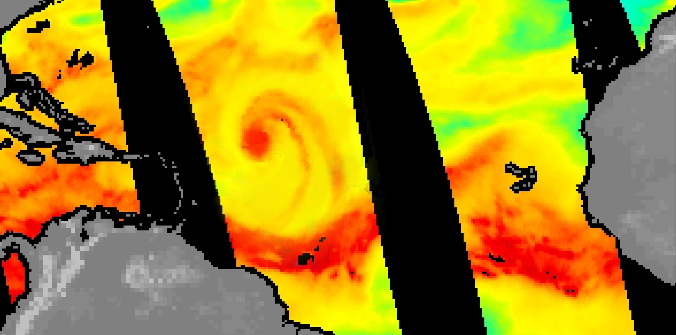
Methodology (old school) How was a SAL-TC Interaction Identified?
Used a conservative value of 30 mm TPW as a threshold to identify a SAL.
Dry air mass must originate from West Africa and move W-WSW.
SAL edges (i.e. discernable moisture gradients) influenced by TC inflow and circulation pattern.
Drier air usually located to the W-to-SW of TC center (curved by TC circulation pattern).
Viewed each TC multiple days on multiple satellites (when available) and used back trajectory plots to eliminate MLDAIs.
No SAL Interaction

Slide 8
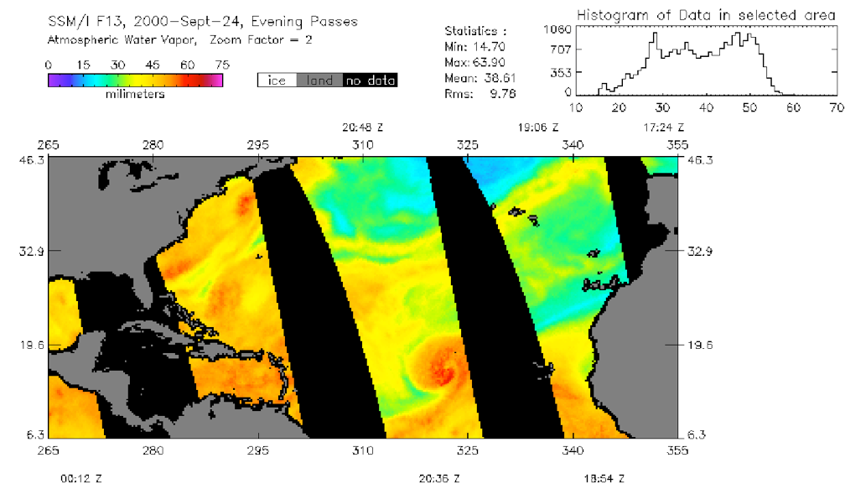
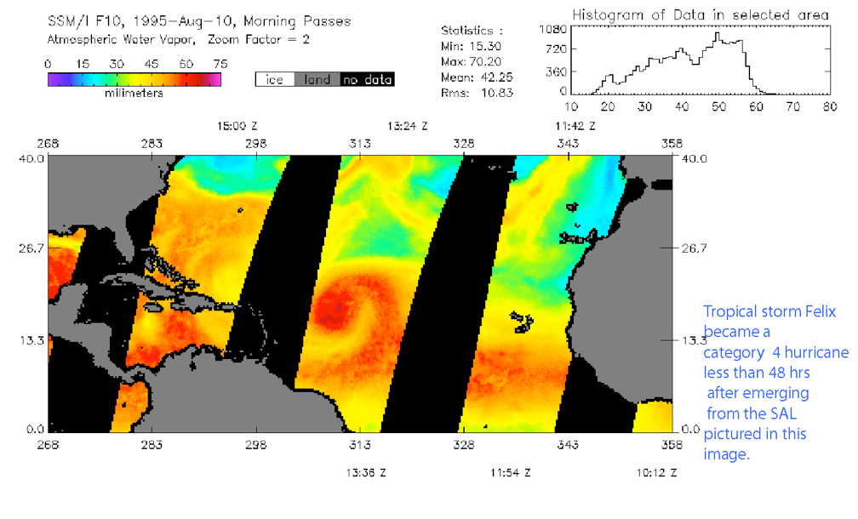
Old School Sample Plots
Isaac 2000
Felix 1995

Slide 9
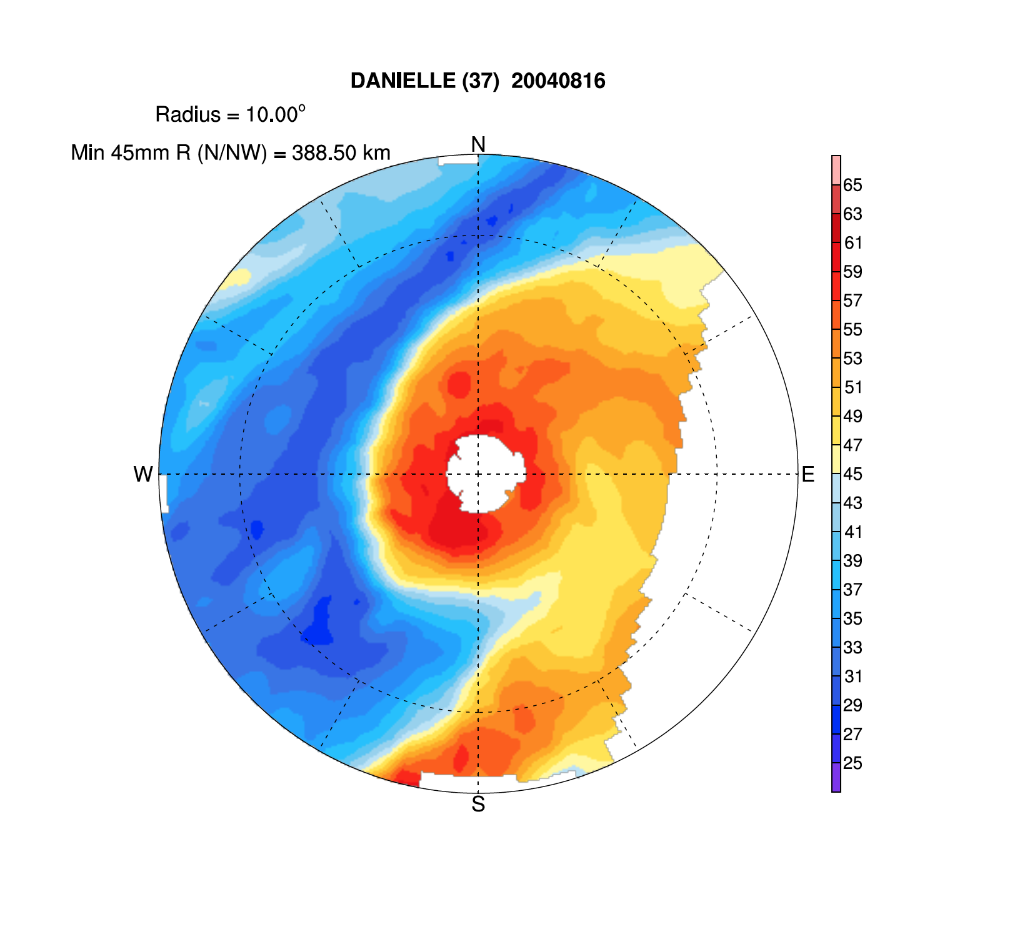
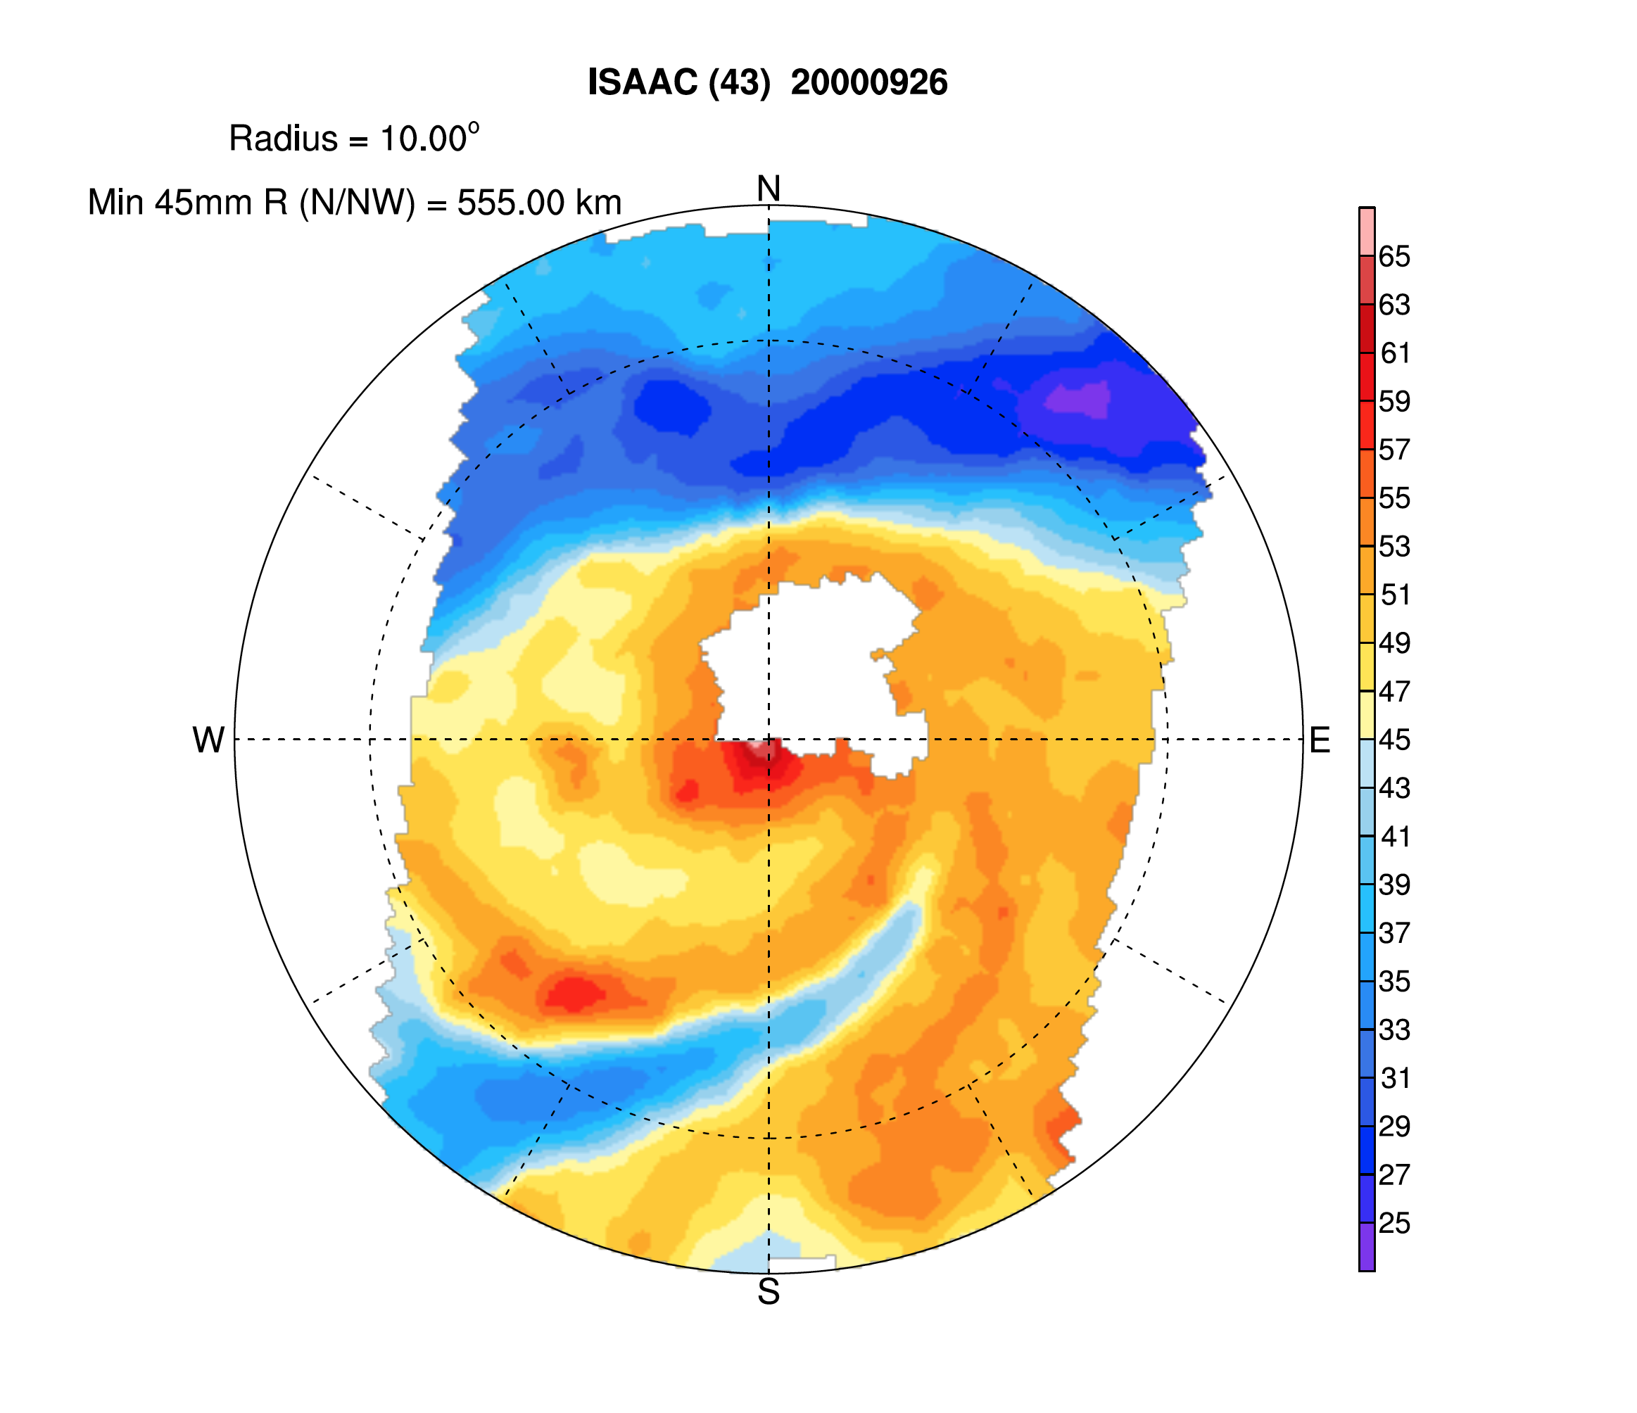
New Sample Plots
Cat. 2
Cat. 2

Slide 10
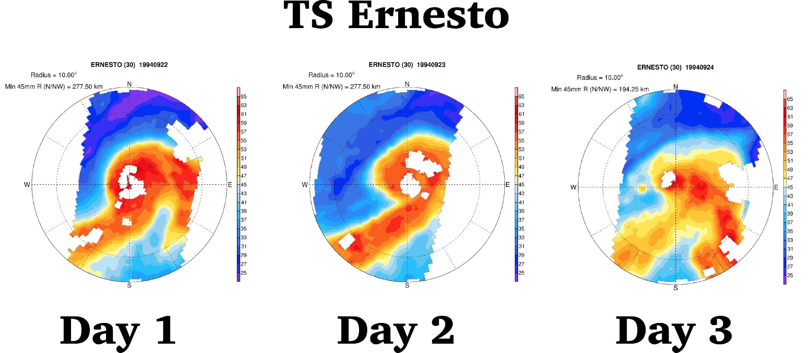
New Sample Plots

Slide 11
Methodology How is an SDAE Identified?
29 years of data goes into each “day’s” climatology
Compute the standard deviation during the boreal summer (JJAS) for the TPW index area (calculated to be 7.45 mm)
Subtract the 29-year climatology (for each corresponding day) from the TPW index
Create a time series of TPW anomalies
Identify air with a TPW minima that is at least 1 standard deviation below the climatology (these are our SDAEs)
Match SDAEs with named TCs from HURDAT

Slide 12
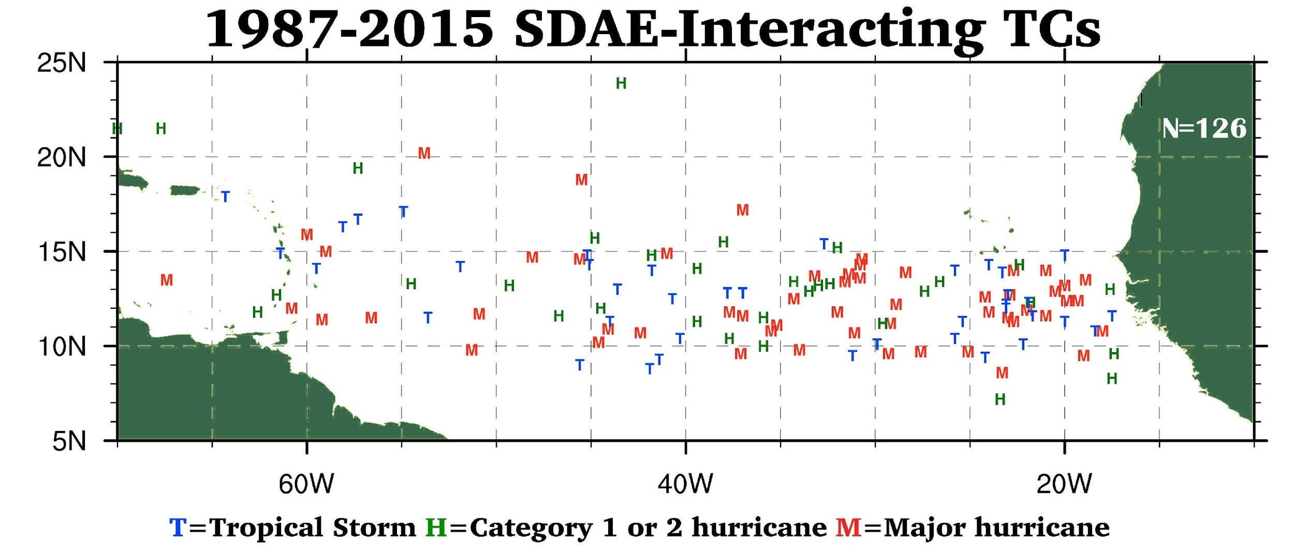

Slide 13
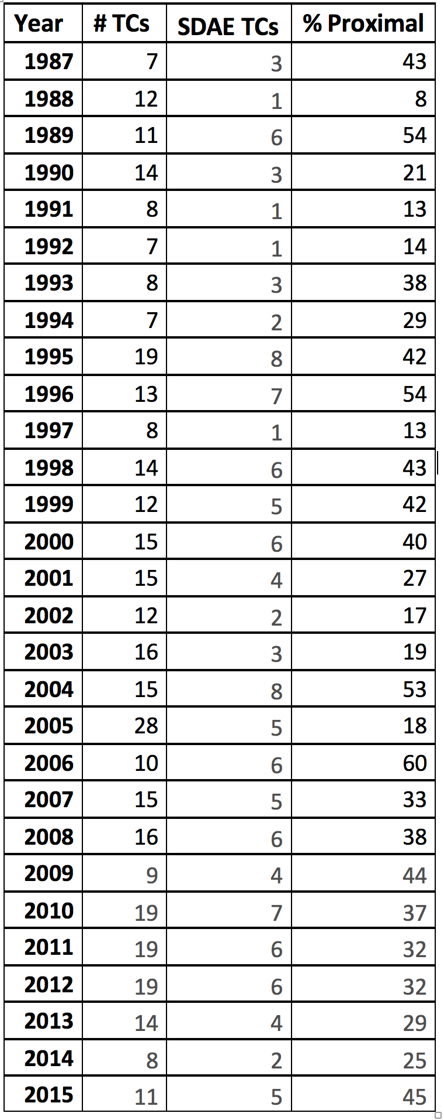
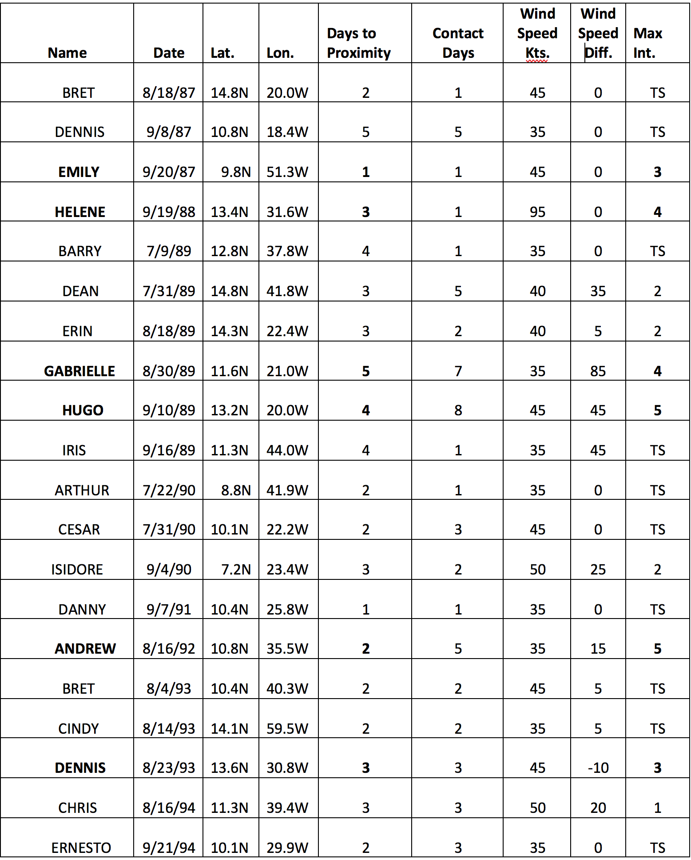
SDAE INTERACTION DATA

Slide 14
TC GENESIS & INTERACTION DATA
Average Genesis Coordinates:
All TCs:
18.92 N, 56.36 W
All SDAEs:
12.83 N, 36.23 W
SDAE non majors:
13.1 N, 37.5 W
SDAE majors:
12.5 N , 34.85 W
Days until contact
All SDAEs: 3.15 days
Hurricanes: 2.67 days
Majors: 3.79 days
SDAEs by month
July 17 (14%)
August 58 (47%)
September 50 (40%)

Slide 15
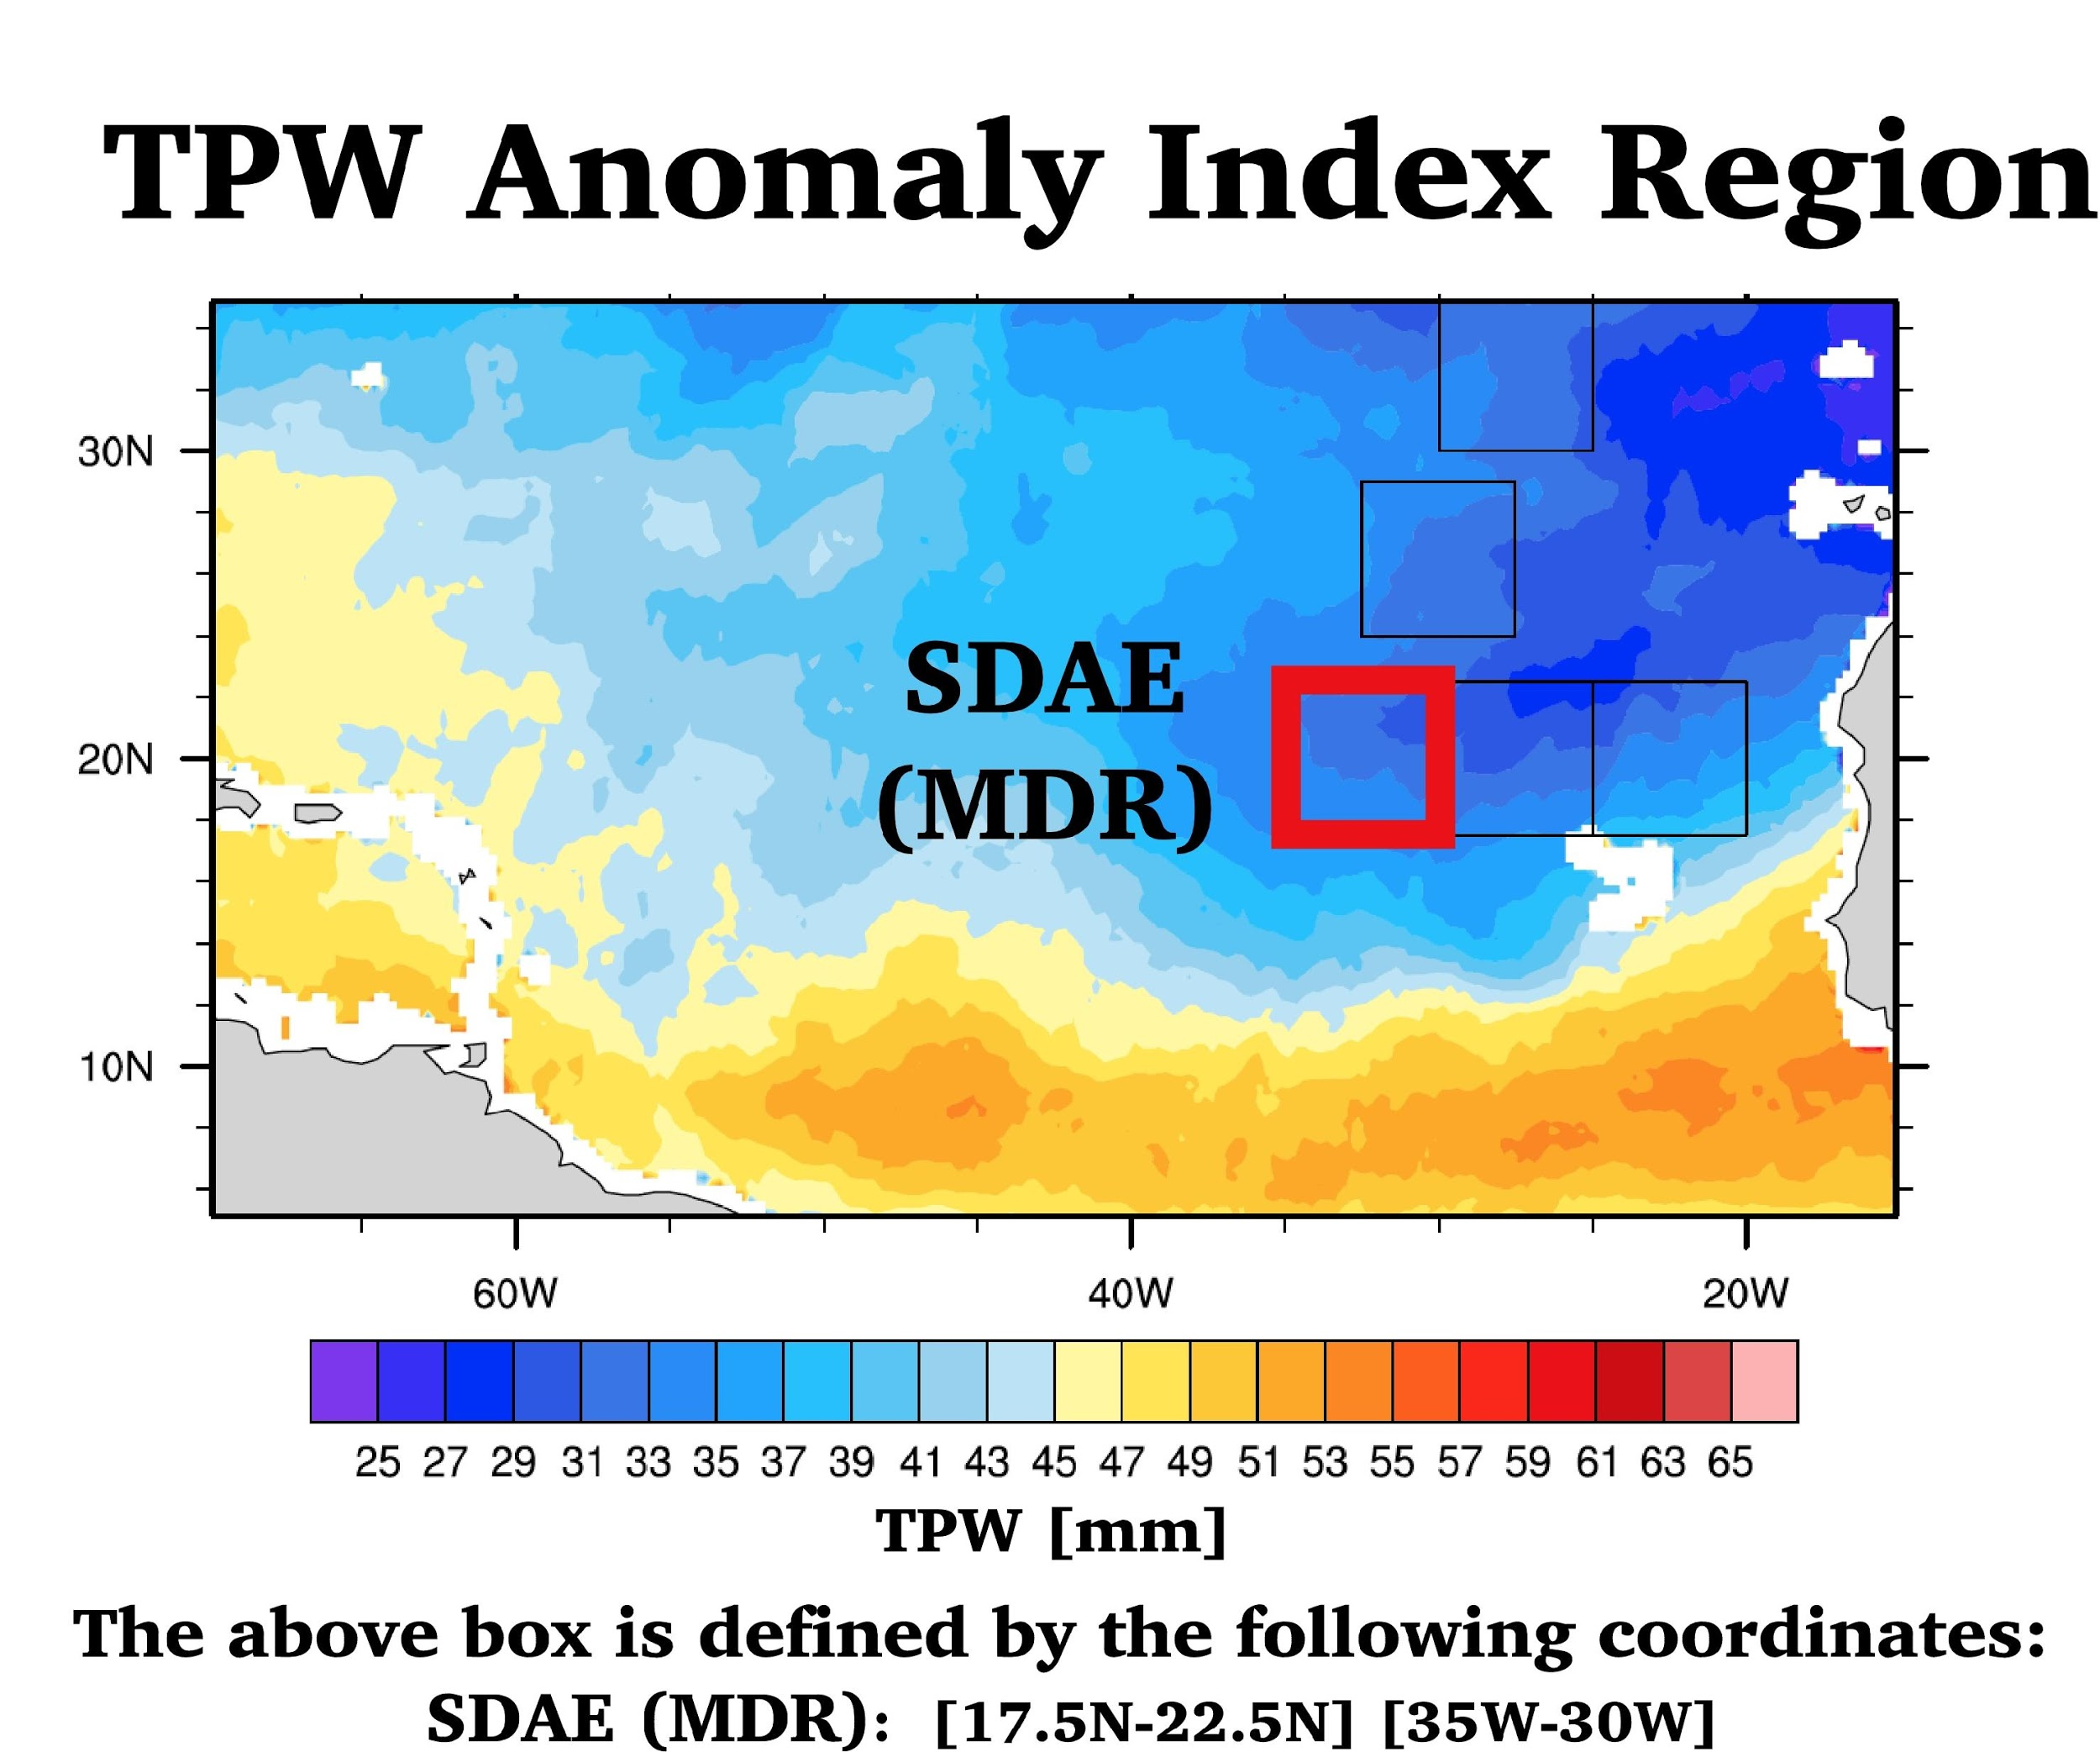
Evan B. Forde – IRR. – 9/26/18
Notes:
FIGURE 4 The detailed TPW detection scheme boxes created to allow algorithm detection and differentiation of SALs from MLDAIs and hybrids.

Slide 16
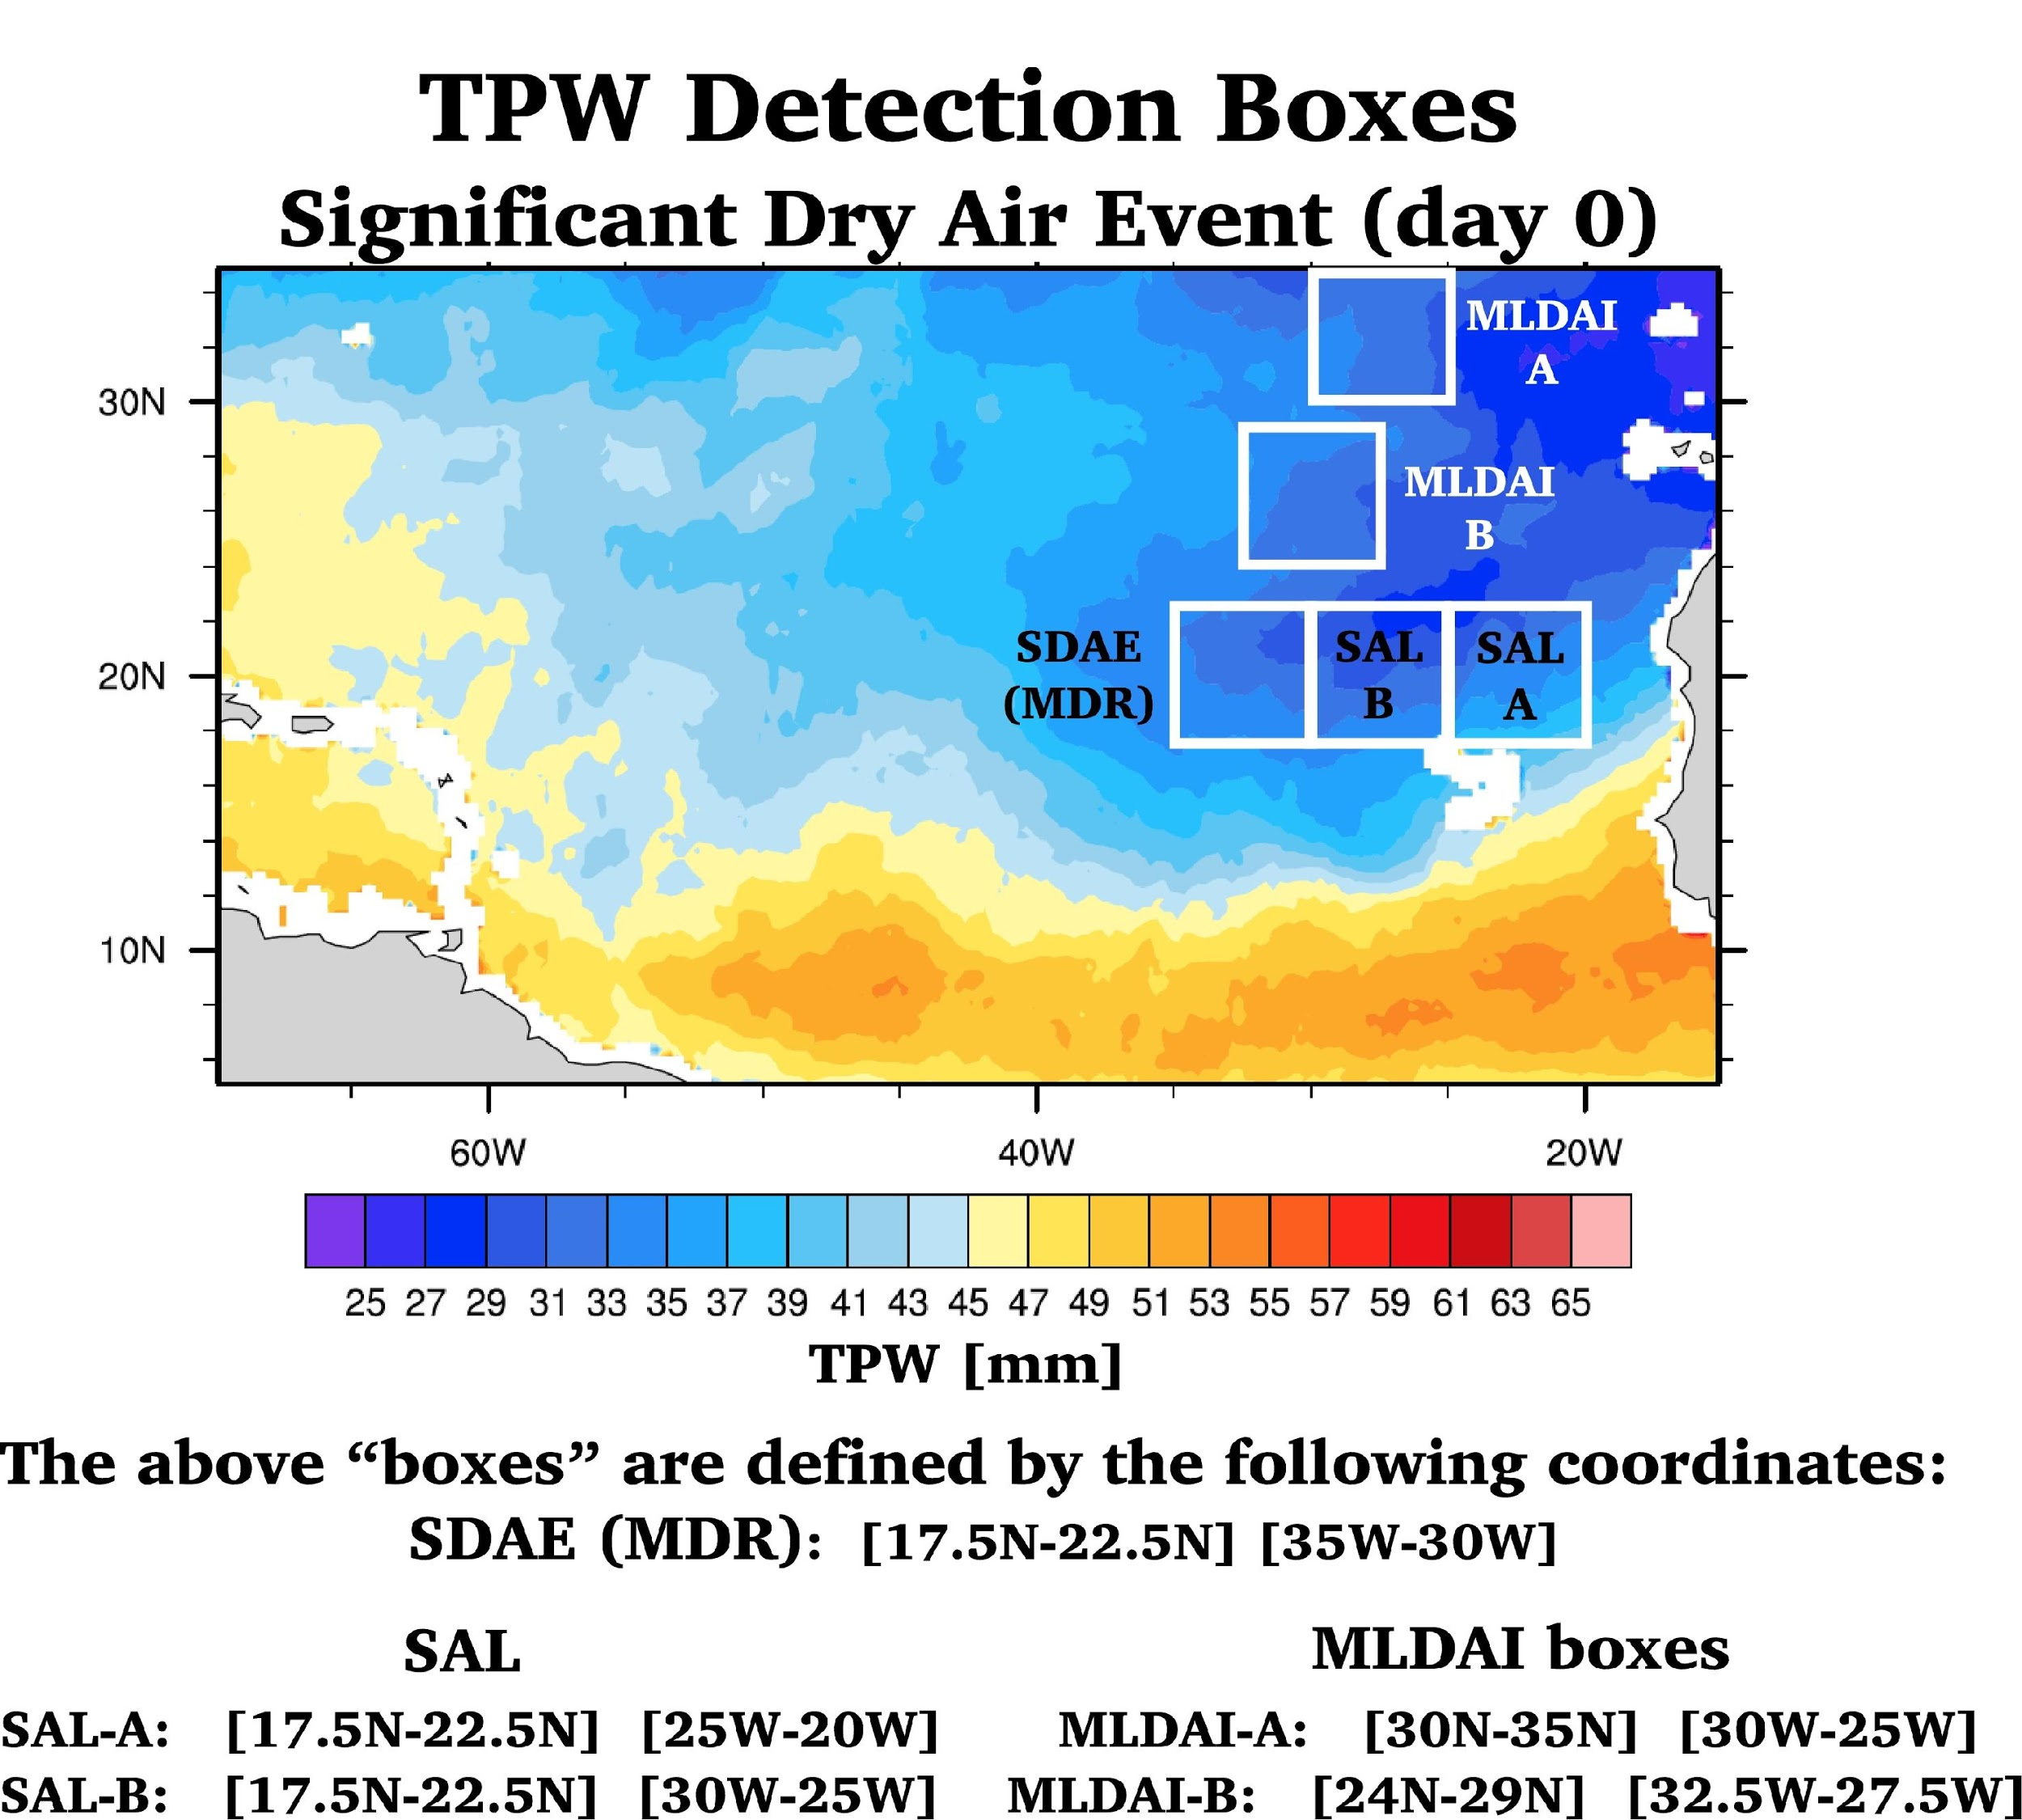
Evan B. Forde – IRR. – 9/26/18
Notes:
FIGURE 4 The detailed TPW detection scheme boxes created to allow algorithm detection and differentiation of SALs from MLDAIs and hybrids.

Slide 17
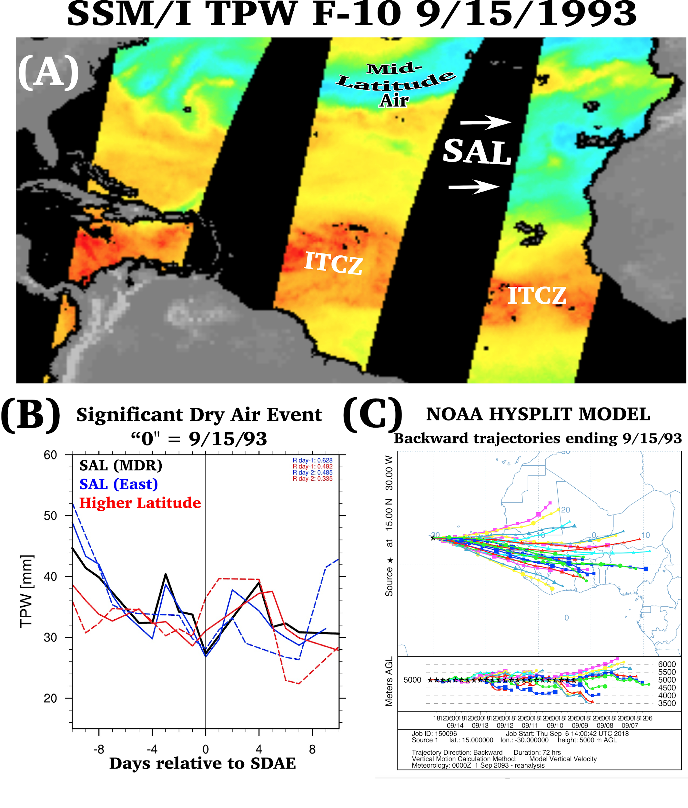
Notes:
“A” is a TPW plot taken from the online RSS site to get clarity of the relative positions of air masses represented by the plot in “B” of the input form the five boxes of TPW from 10 days before the SDAE and 10 days afterwards which was also compared with the HYSPLIT trajectory plot imaged in panel C.

Slide 18
SDAE INTERACTION DATA HIGHLIGHTS
126 TCs were in proximity (within 10° radial degrees) of an SDAE
The yearly proximity rate varied from 8—60% Overall rate was 33%. Subjective method found 135
~15% of SDAEs contained air that originated from latitudes north of 30º
68% of all TCs increased in intensity after being in proximity to an SDAE. Table (summary)
Forty-four percent (55) of the named storms that were in proximity to SDAEs became major hurricanes.

Slide 19
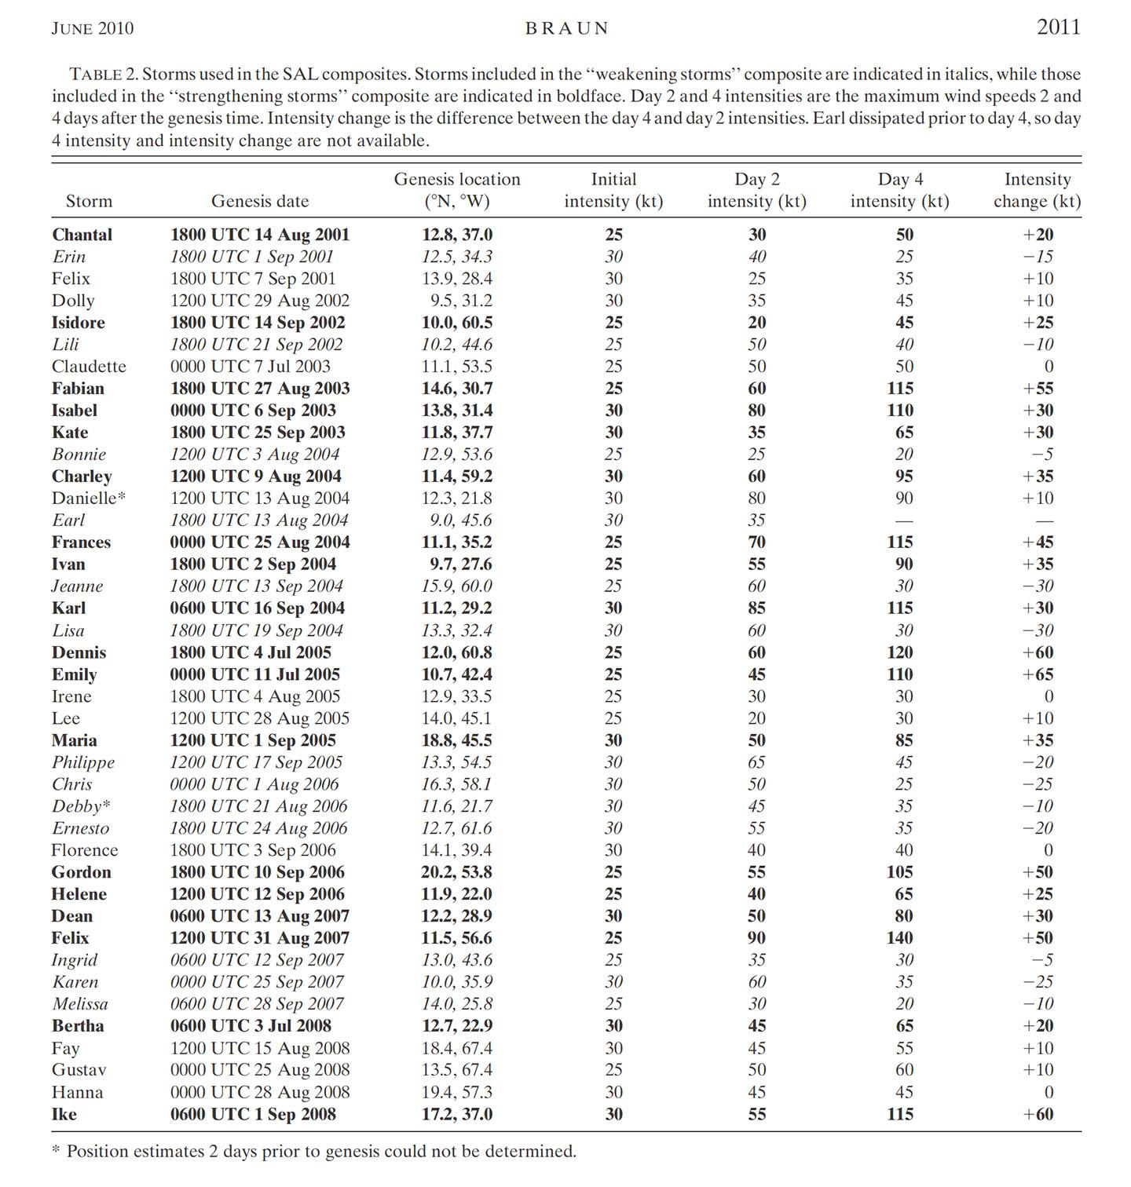
COMPARITIVE RESULTS
Used advanced tools to identify SALs
(TRMM, MODIS, AIRS-AMSU & NCEP)
Not much early difference in SAL–interacting
intensity changes
Current study proximity rate = 33%
Rate from Braun (2010) data was 32%
Current study proximal TCS that became majors = 44%
Rate from Braun (2010) data is 51%
Braun, S. A. (2010). Reevaluating the role of the Saharan air layer in Atlantic tropical cyclogenesis and evolution. Monthly Weather Review, 138(6), 2007-2037.

Slide 20
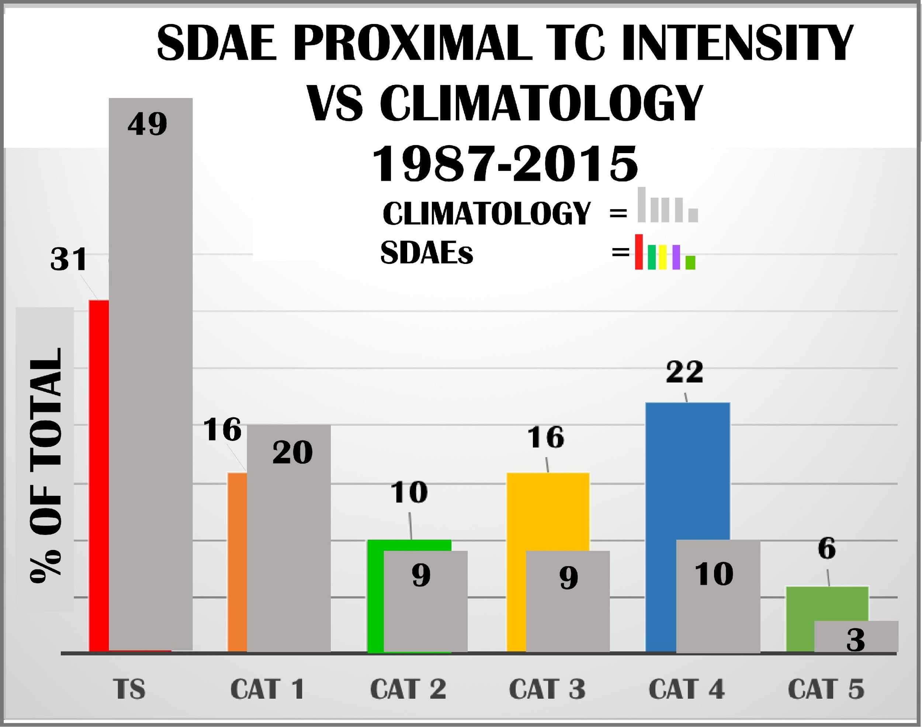
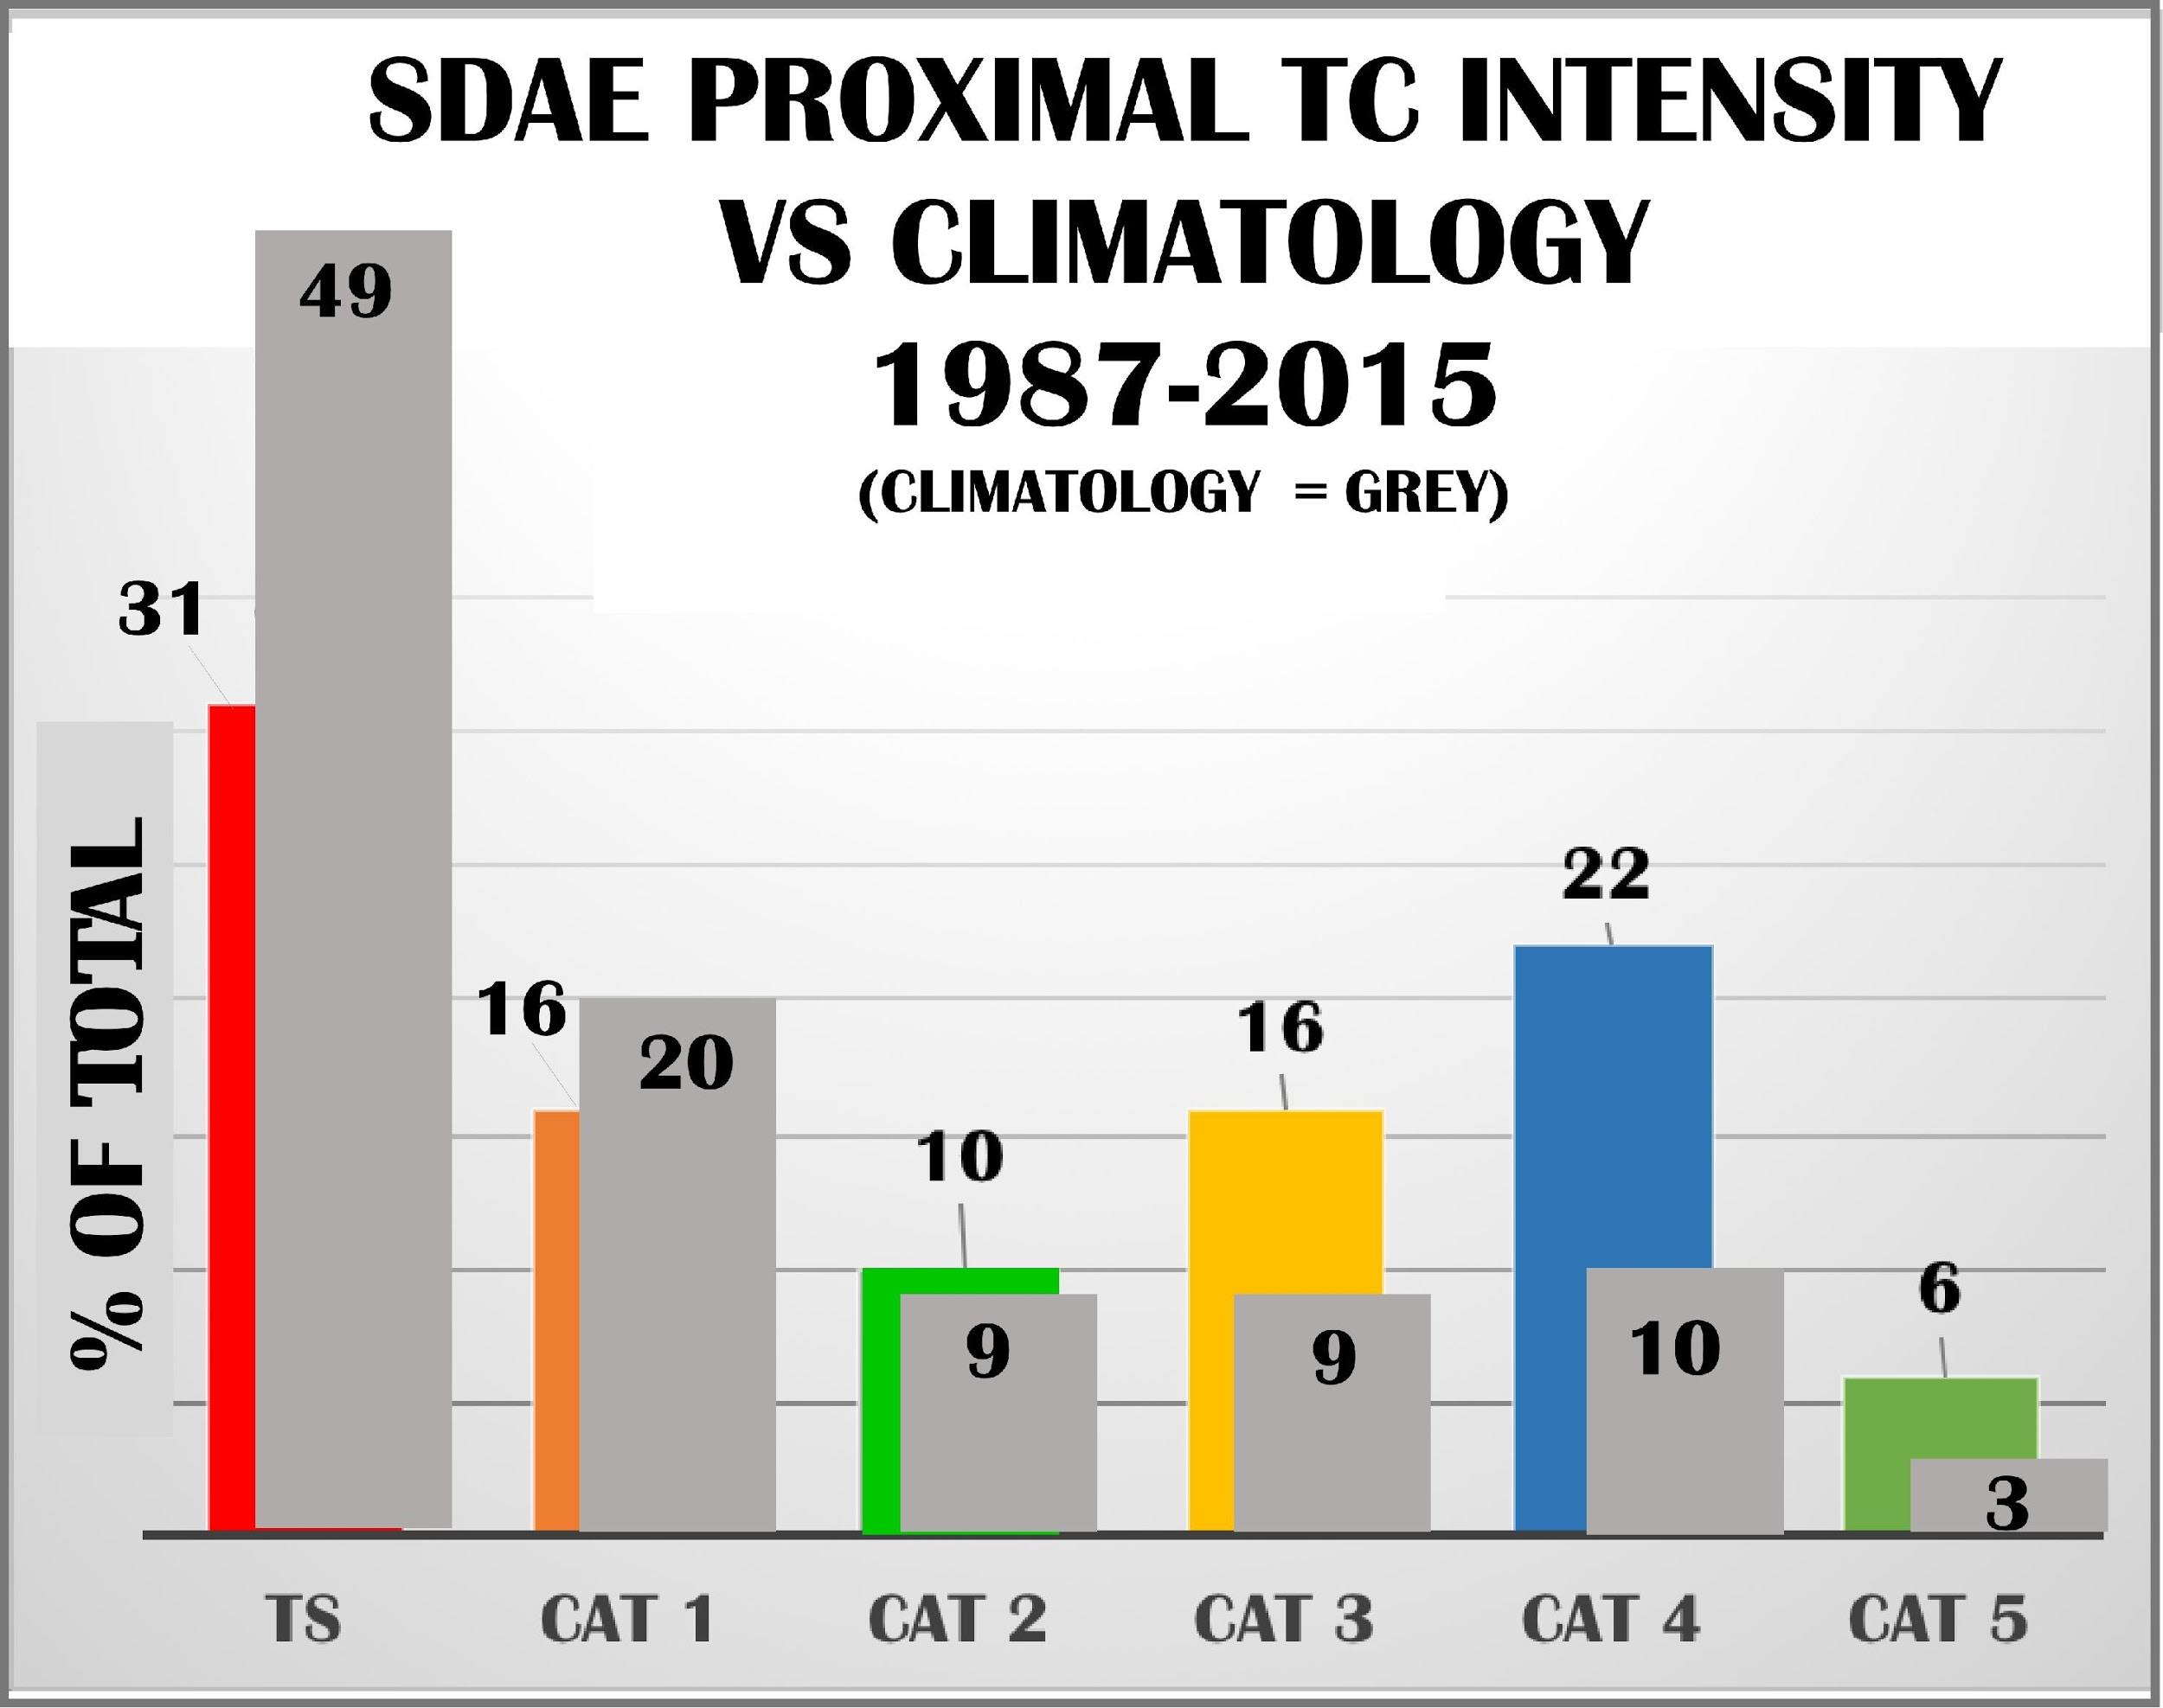
Results
Notes:
The maximum attained intensity of TCs that came in proximity to SDAEs versus climatology of all named systems for the same period . Comparisons worth noting are the difference between the percentage of tropical storms 31% SDAE interacting vs. 49% present in climatology, as well as the category 3, 4 and 5 (major) values, all of which are roughly double that of climatology.

Slide 21
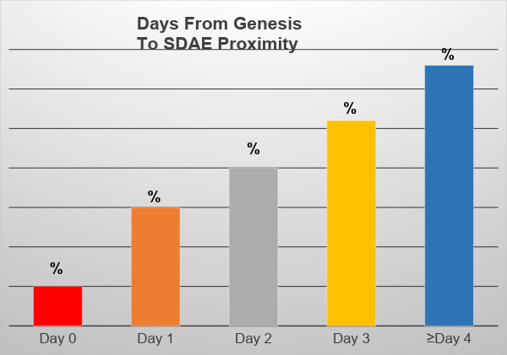
Results
Notes:
FIGURE 7. Days between TC genesis and their proximity to the SDAE, binned into: day 0 =same day(red), day 1 (orange), day 2 (gray), and day 3 (yellow) and ≥4 days (blue). More than half of all SDAE proximal occurrences were 3 days after genesis, or later.

Slide 22
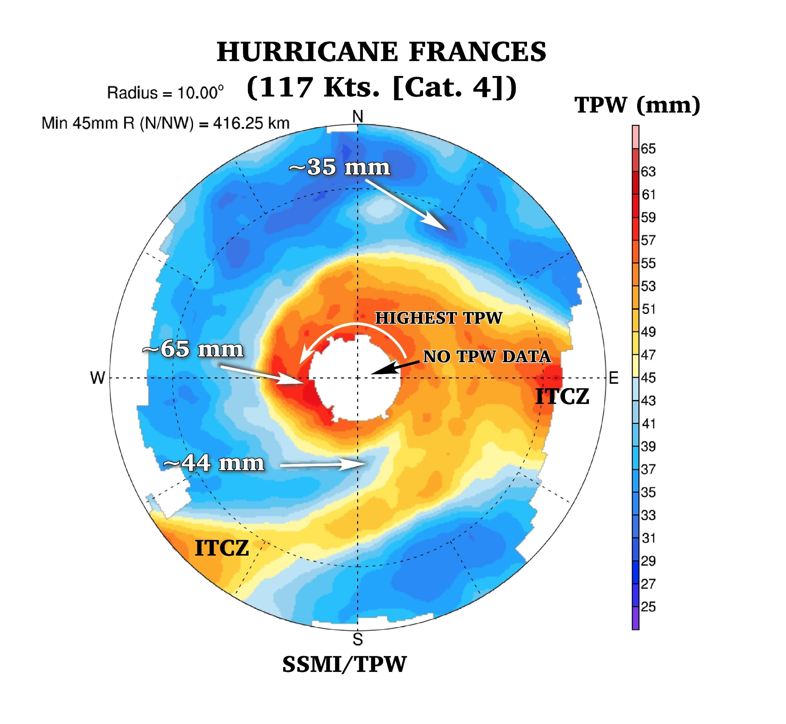
TPW PLOT EXAMPLE
Notes:
. This storm-centered TPW plot of Hurricane Frances (2004) reveals the TCs cyclonic circulation is as well as inflow of some of the drier environmental air (SDAE) as an inflow of moist air from the ITCZ to the system’s south. Several TPW plot idiosyncrasies and features as well as some estimated TPW values are highlighted for clarity.

Slide 23
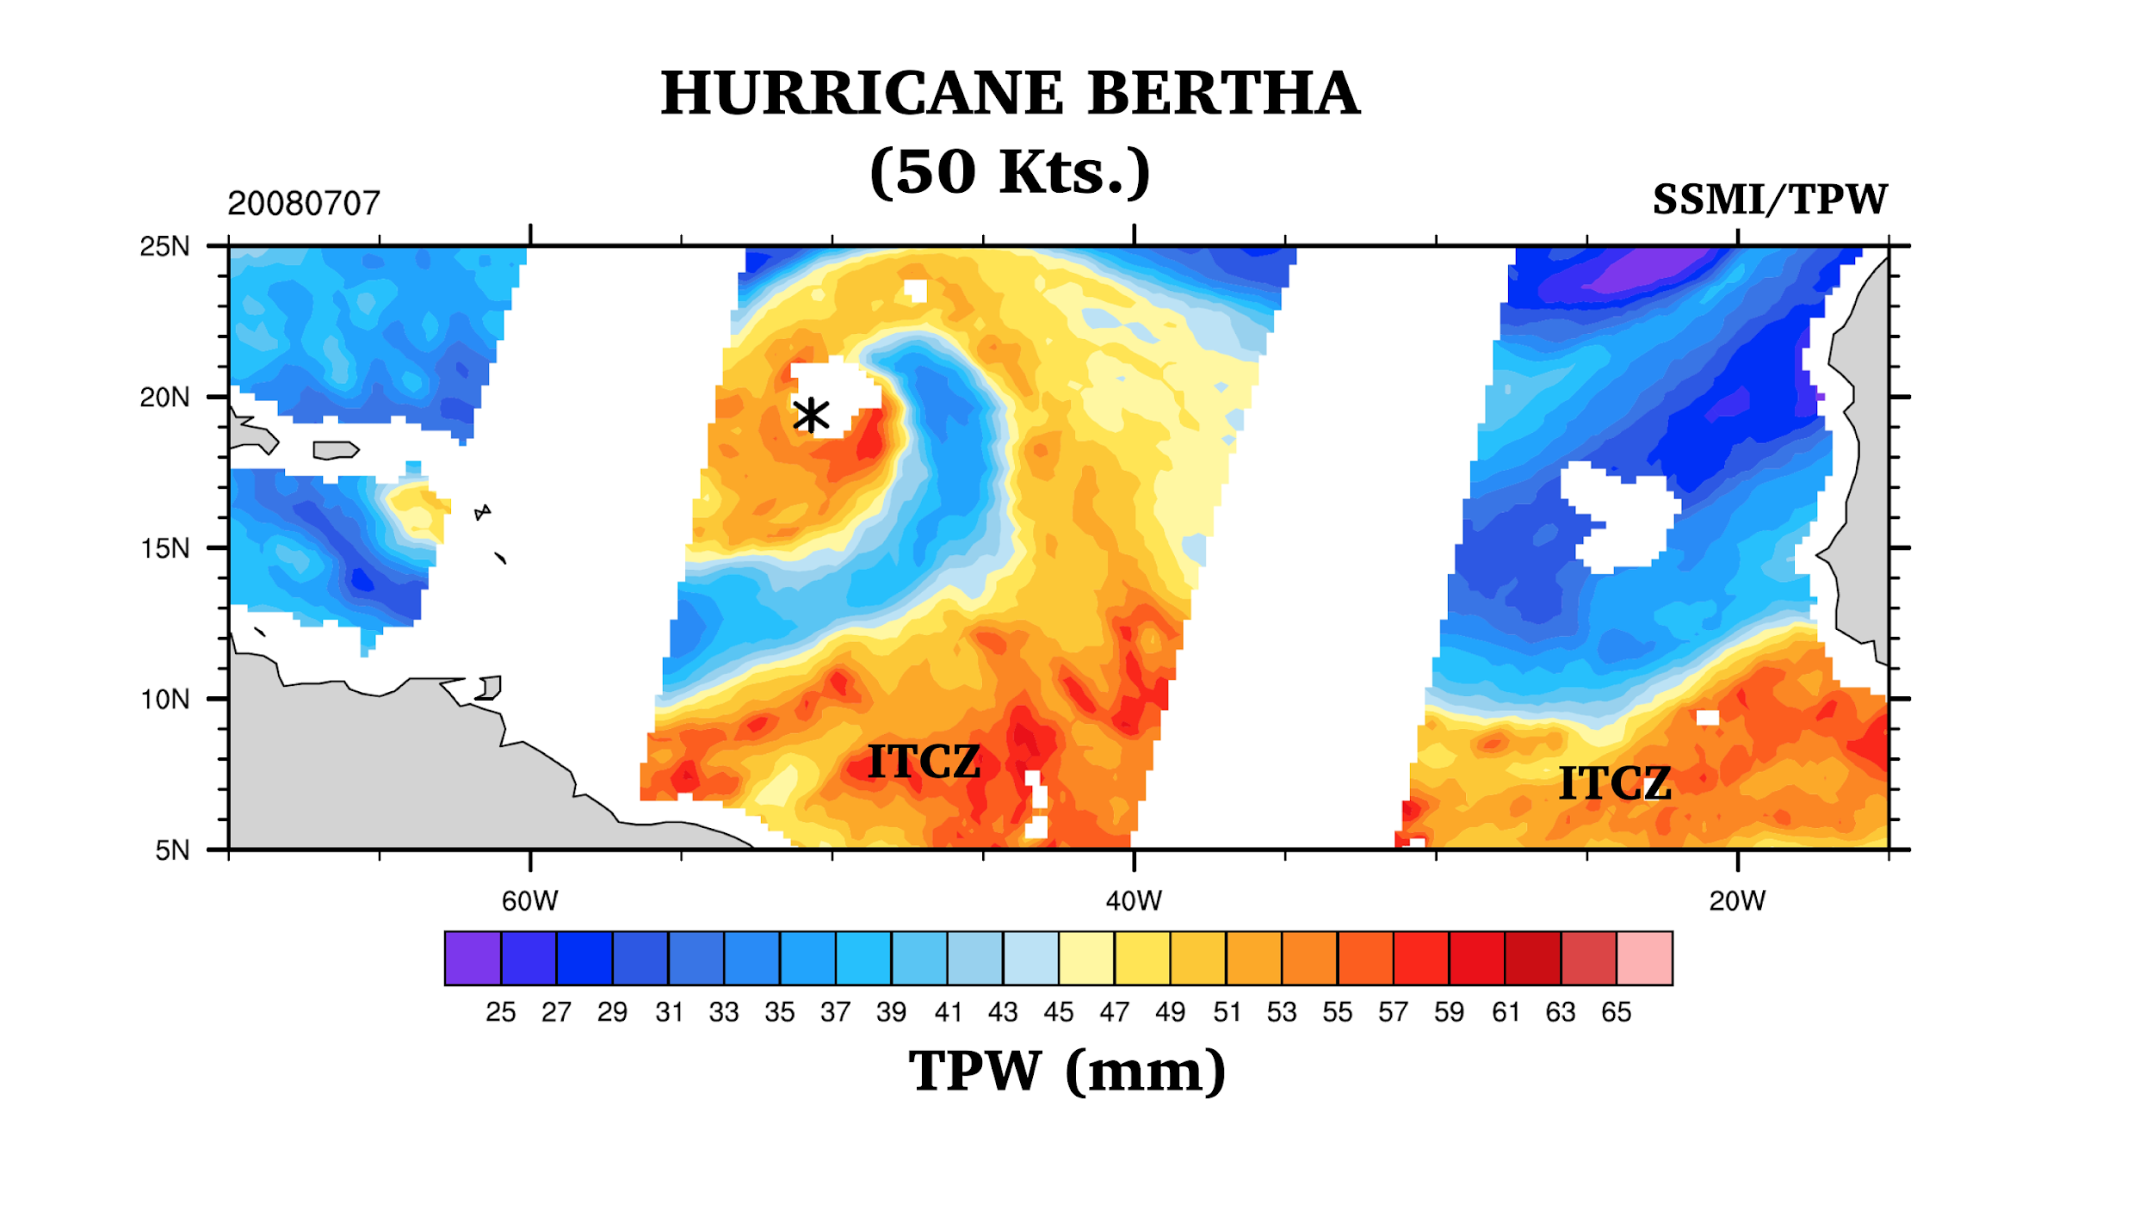
BERTHA INGESTING MOISTURE FROM THE ITCZ

Slide 24
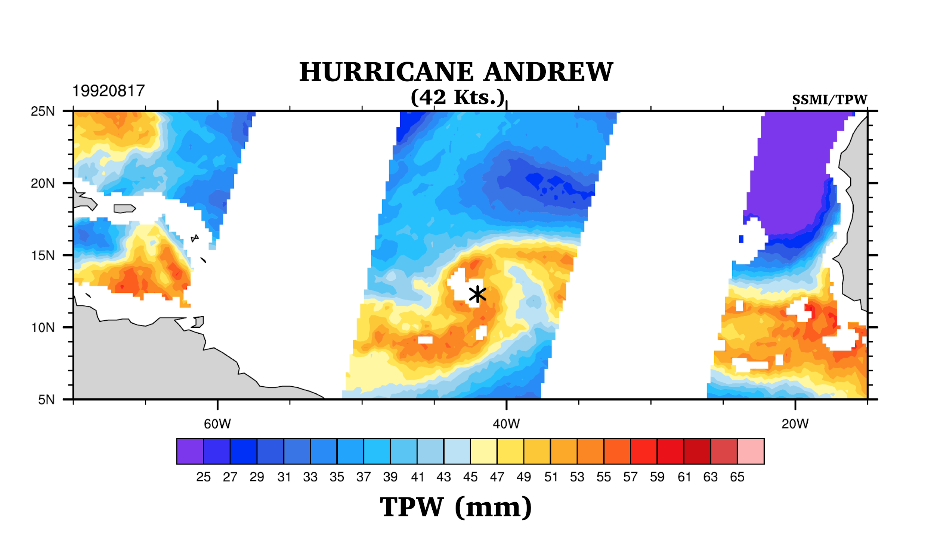

Slide 25
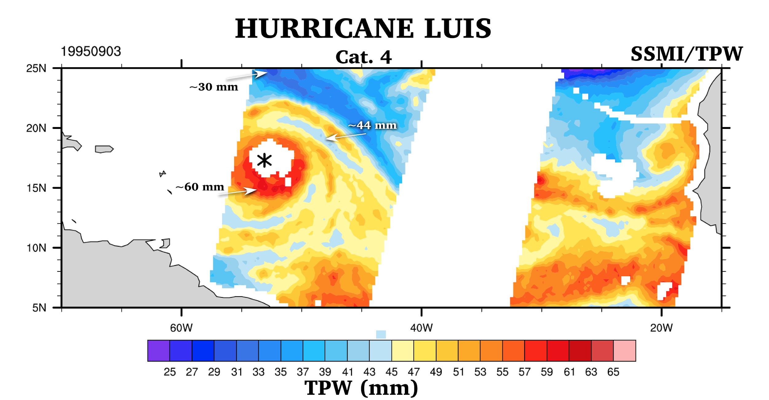
DRY AIR NOT PENETRATING CORE

Slide 26
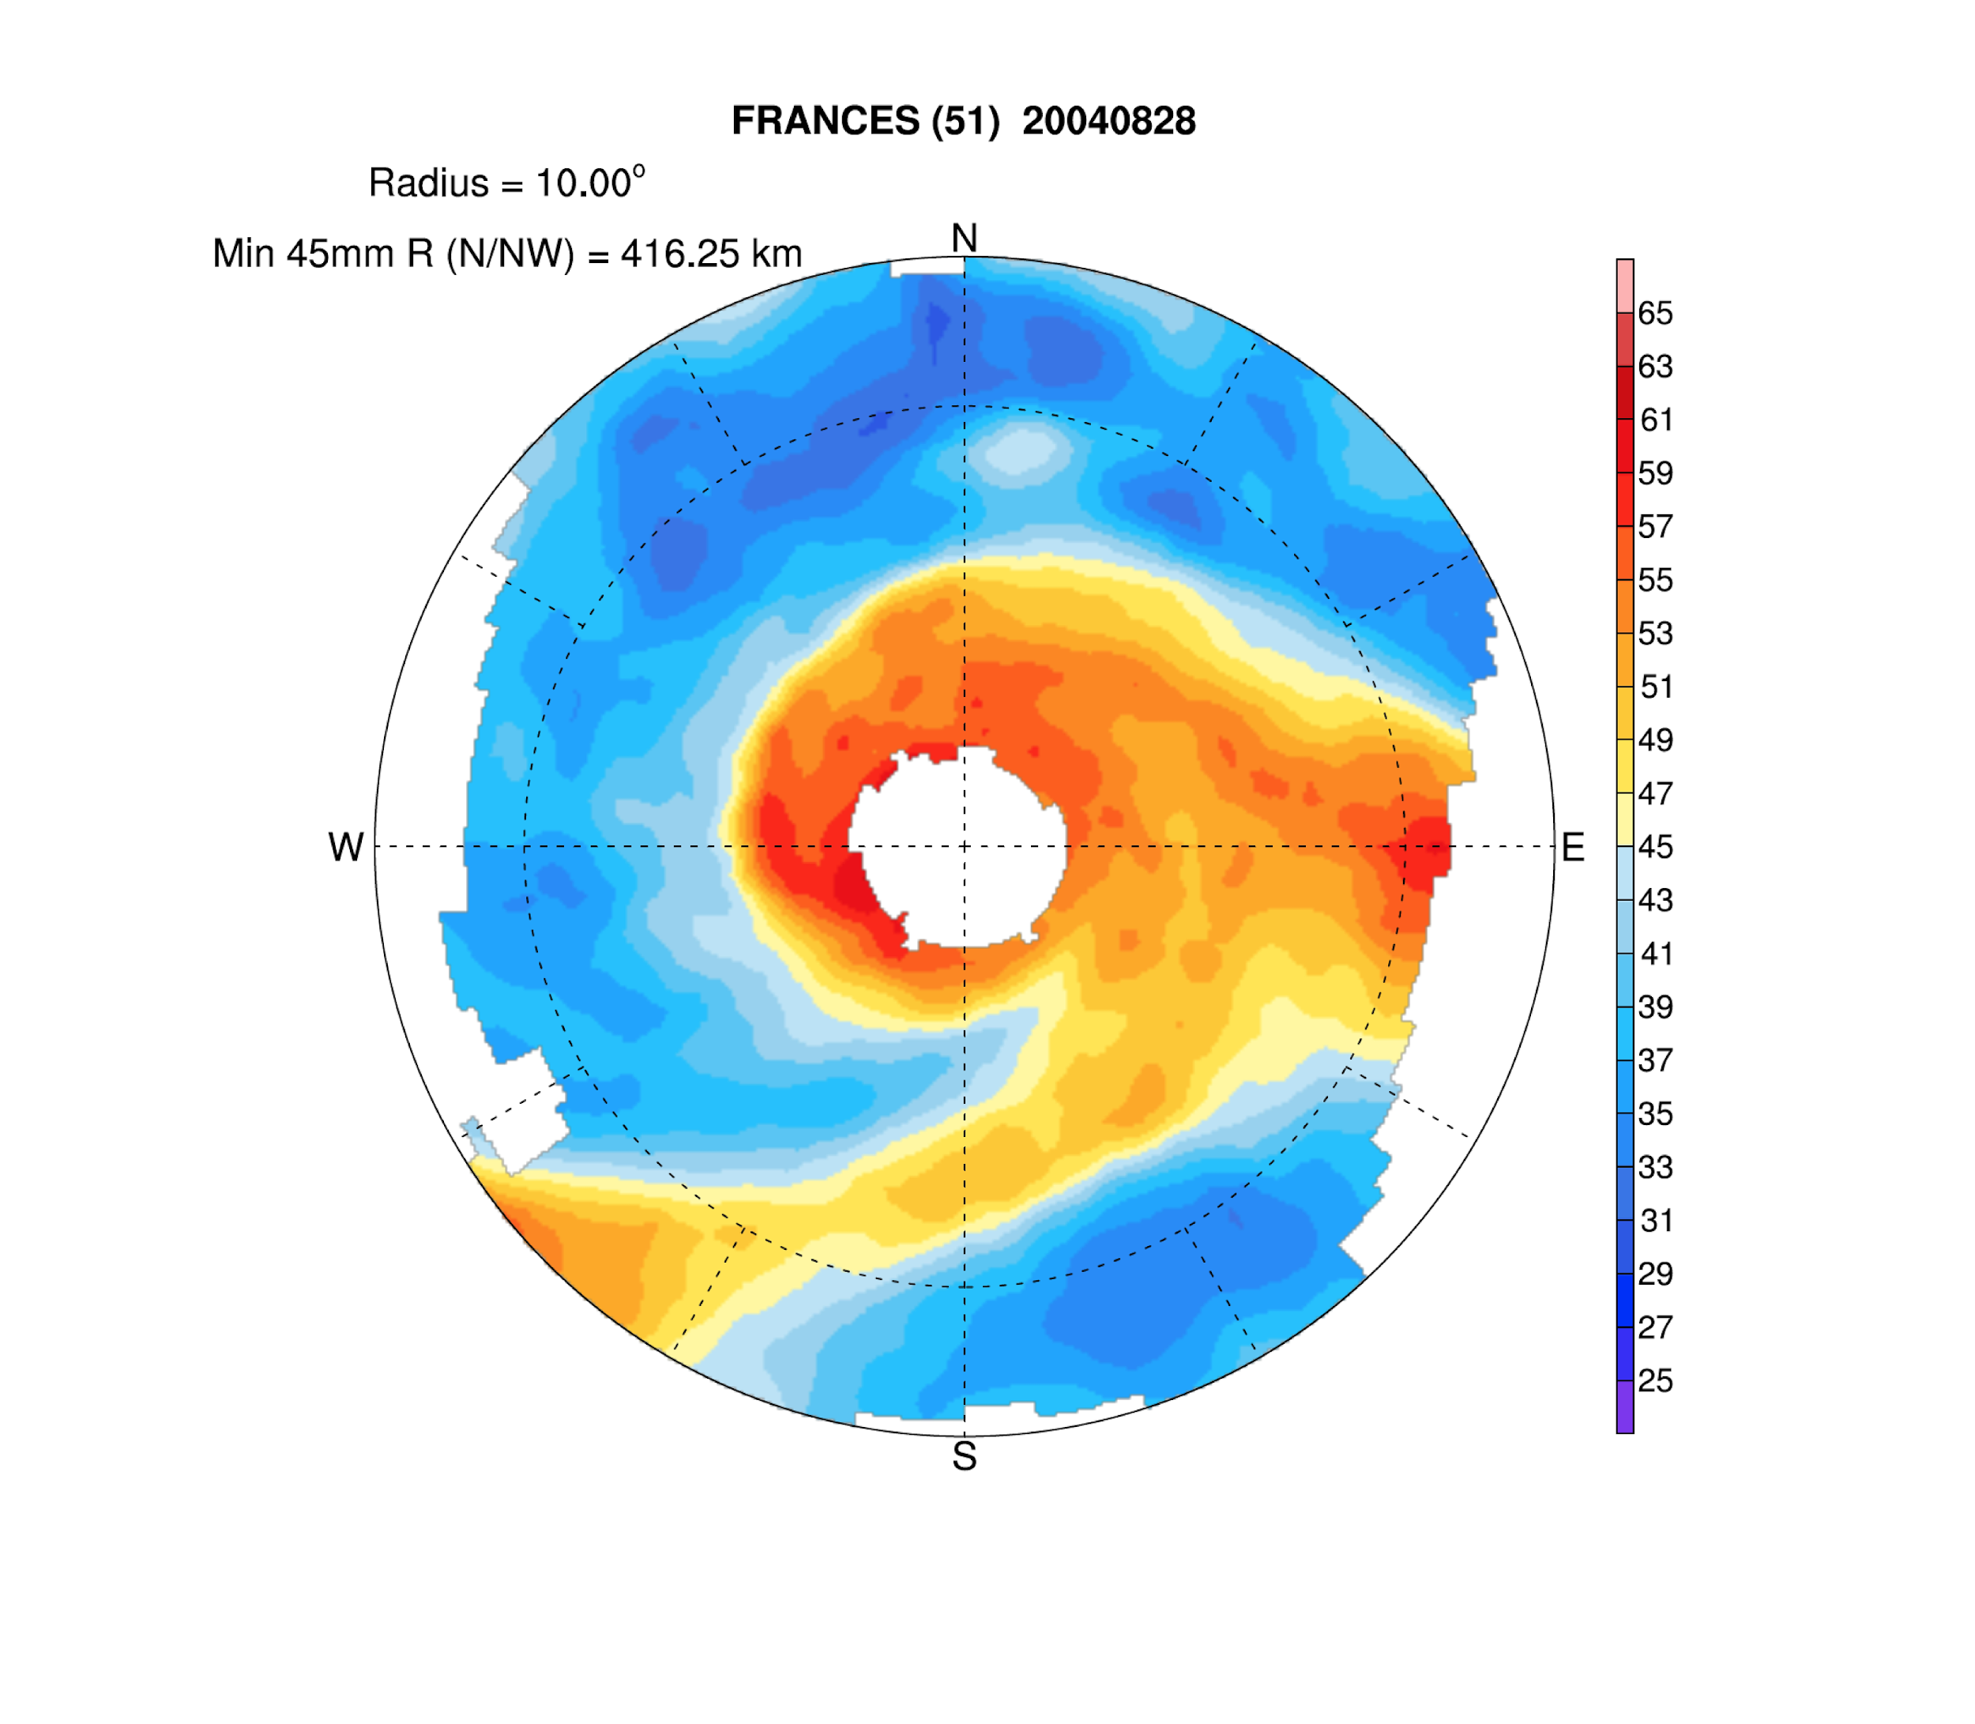

Slide 27
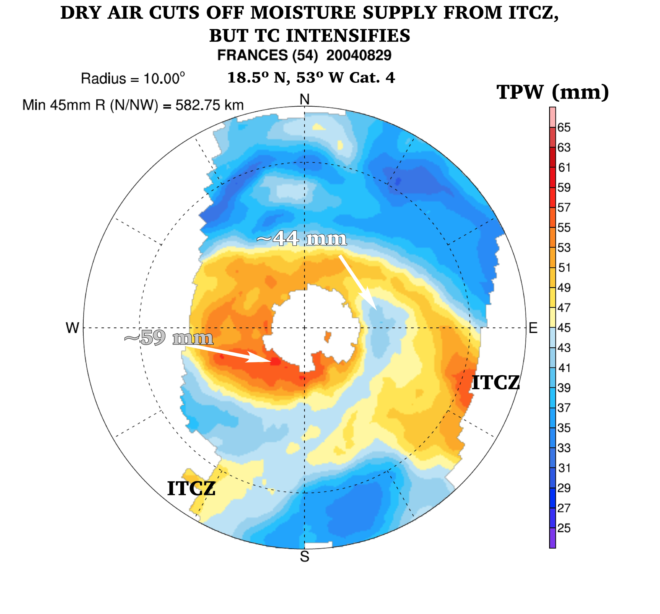
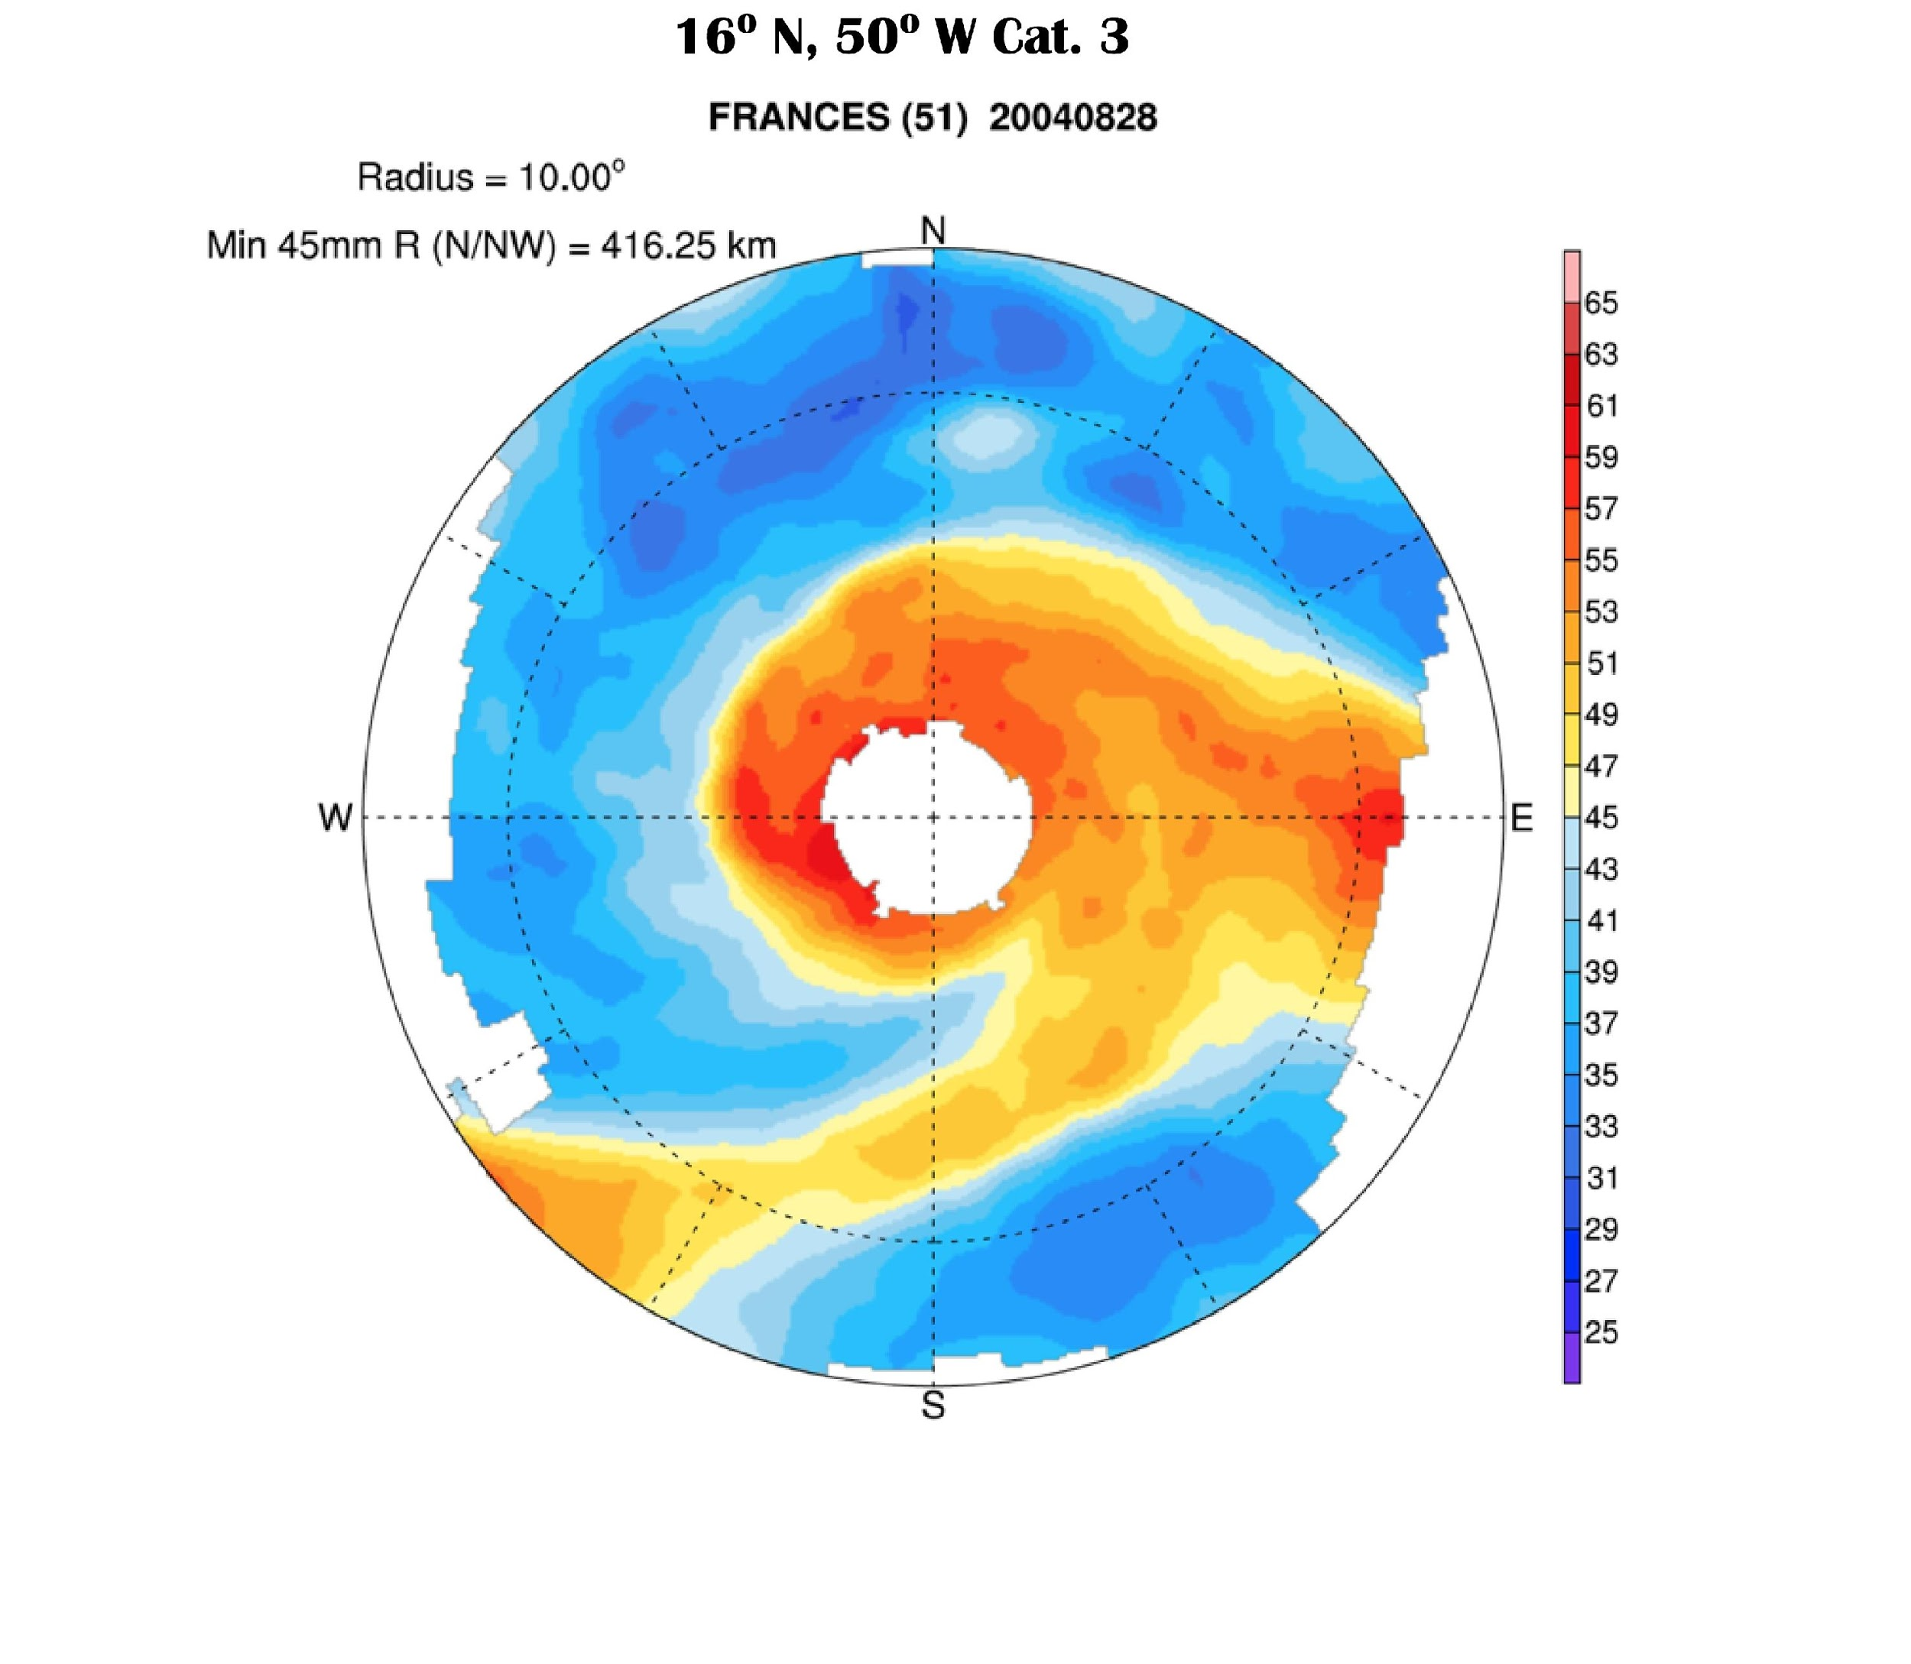
Variable Penetration of Dry Air
Thickness of moist air

Slide 28
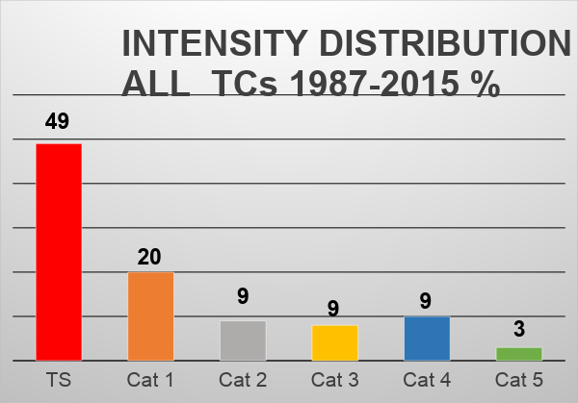
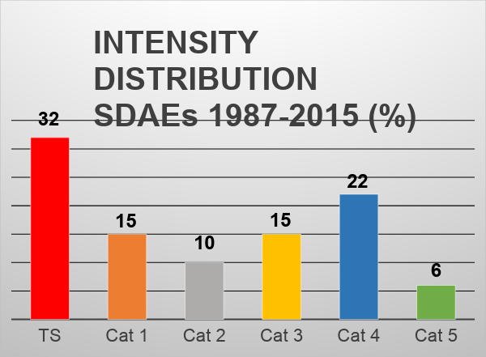
CLIMATOLOGY
(Intensity Distribution)

Slide 29
CLIMATOLOGY
(Intensity Distribution)

Slide 30
Conclusions
Of the 381 TCs that formed in the Atlantic basin within the 29-year study period, 126 were in proximity (within 10° radial degrees) to an SDAE at some stage of their life cycles.
The yearly SDAE-TC proximity rate varied considerably (8-60%), and the aggregate proximity rate was 33%. Subjective method found 135
Approximately 15% of SDAEs identified in this study contained air that originated from latitudes north of 30º and this which suggests these events may contain MLDA, but apparent SAL sources was the major component of all significant dry air events.
Only four of the 126 interacting TCs were category 1 or greater intensity at the time of first interaction, and we observed that 69% of all TCs increased in intensity after being in proximity to an SDAE.
Forty-four percent (55) of the named storms that were in proximity to SDAEs at some time during their life cycles became major hurricanes. THIS IS DOUBLE CLIMATOLGY!
On average, the SDAE-proximal major hurricanes formed ~3 degrees further east and came in contact with the SDAEs 1 day later than non-major SDAE-proximal TCs. Distribution of contact
This research demonstrates that SSM/I TPW can be used as a tool to detect past TCs that were in proximity to SDAEs and the yearly 33% proximity rate of these incidents establishes that these encounters are a significant element in Atlantic basin TC climatology.

Slide 31
FUTURE WORK
Create a detailed SDAE climatology
Extending studies of SDAE interactions to all tropical disturbances in the Atlantic basin, including non-developers
Extending the SSM/I TPW dataset to directly compare with the Dunkerton et al. (2009) pouches is a topic for future research
By examining several decades of data, we also hope to determine other relevant factors that modulate seasonal TC genesis
Create a predictive component that would impact cyclogenesis and intensification studies

Slide 32
ACKNOWLEDGEMENTS
The authors thank the AOML Office of the Director for providing partial support for this research. SSMI data
used in this study were obtained from the Remote Sensing Systems (RSS) website (http://www.ssmi.com/).
SSM/I data are produced by Remote Sensing Systems and sponsored by the NASA Earth Science Measures
Discover Project. Data are available at www.remss.com. The authors thank Kristina Katsaros for identifying
an appropriate SSMI data set to use for the study and Frank Marks for his insightful comments.
Archived hurricane best track data is from AOML’s HURDAT data base. Specific analysis of historical tropical
cyclones was obtained from the National Hurricane Center’s archives
at: http://www.nhc.noaa.gov/pastall.shtml .

