Slide 1
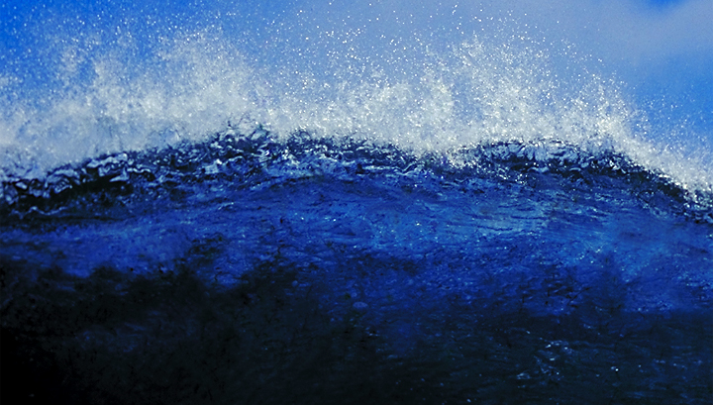
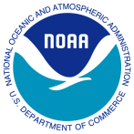
NOAA’s Atlantic Oceanographic and Meteorological Laboratory
Our research in basic and applied science
Shirley Murillo
Deputy Director - Hurricane Research Division
4301 Rickenbacker Cswy.
Miami, FL 33149
www.aoml.noaa.gov
Notes:
The Atlantic Oceanographic and Meteorological Laboratory (AOML) is an environmental Research Laboratory of the National Oceanic and Atmospheric Administration (NOAA).
AOML conducts research of the physical, chemical, and biological characteristics and processes of the ocean and atmosphere, both separately and as a coupled system.
The principal focus of these investigations is to provide knowledge that will ultimately lead to more accurate forecasting of severe storms, better management of marine resources, better understanding of the factors affecting both climate and environmental quality, and improved ocean and weather services for the nation.

Slide 2
I’m a Research Meteorologist
Research team lead - Evaluate the potential impact of new (proposed) observing systems on hurricane track and intensity predictions.
Joint Hurricane Testbed – Oversee the transition of science research into hurricane operations
Research focus on new radar technology and landfalling hurricanes
Fly into hurricanes!

Slide 3
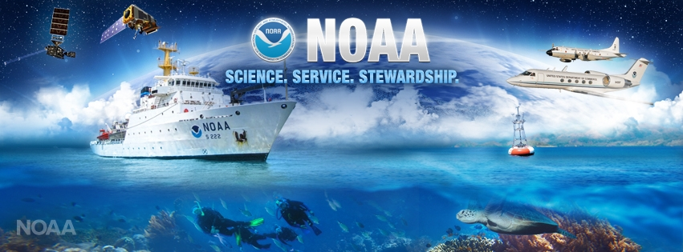
To understand and predict changes in climate, weather, oceans and coasts;
To share that knowledge and information with others; and
To conserve and manage coastal and marine ecosystems and resources.

Slide 4
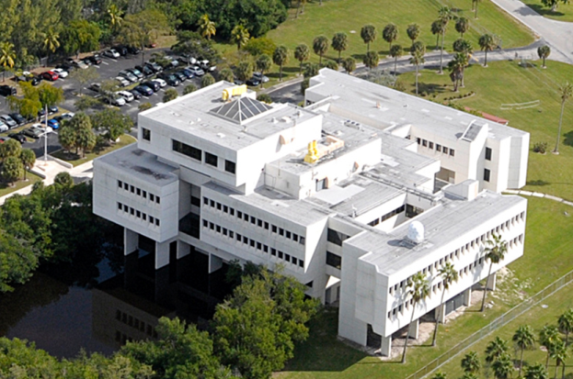
A NOAA Research Lab in Miami, Florida
Hurricanes
Oceans and Climate
Coastal Oceanography
AOML
Conduct both basic and applied science research
Notes:
AOML is located on Virginia Key, directly off shore from downtown Miami.
We are co located with NOAA’s Southeast Fisheries Science Center, and the University of Miami’s Rosenstiel School for Marine and Atmospheric Science, as well as the Maritime and Science Technology Academy and the Miami Seaquarium.
Our research encompasses hurricane observation and modeling, oceans and climate, the global impacts of increased carbon dioxide and ocean acidification, ocean and human health studies, and the ocean’s influence on regional rainfall and hurricanes.
AOML is also a major partner in the collection and interpretation of oceanographic data collected via ships, satellites, aircraft, drifting buoys, and floats.

Slide 5
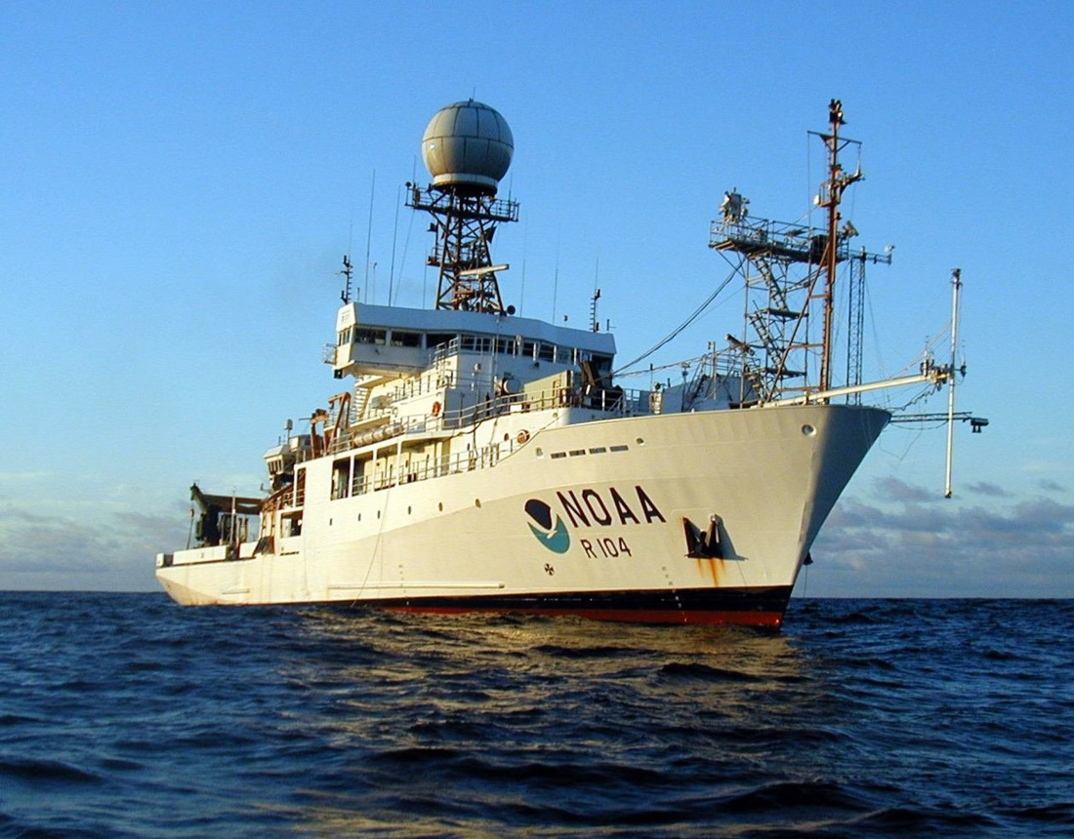
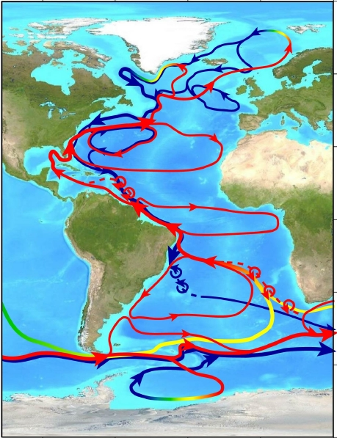
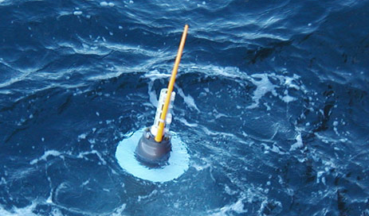
Ocean and Climate Research
Oceans and Climate Research
Ocean Observations and Climate
Gulf Stream
Notes:
(Pictured, NOAA Ship Ronald H. Brown, an Argo float, and a conceptual diagram of ocean circulation in the Atlantic)
AOML conducts research based on models and observations to understand and characterize the role of the oceans in climate variability and change.
Techniques vary from shipboard-conducted process studies, models, long-term continuous time series, and satellite-derived products.

Slide 6
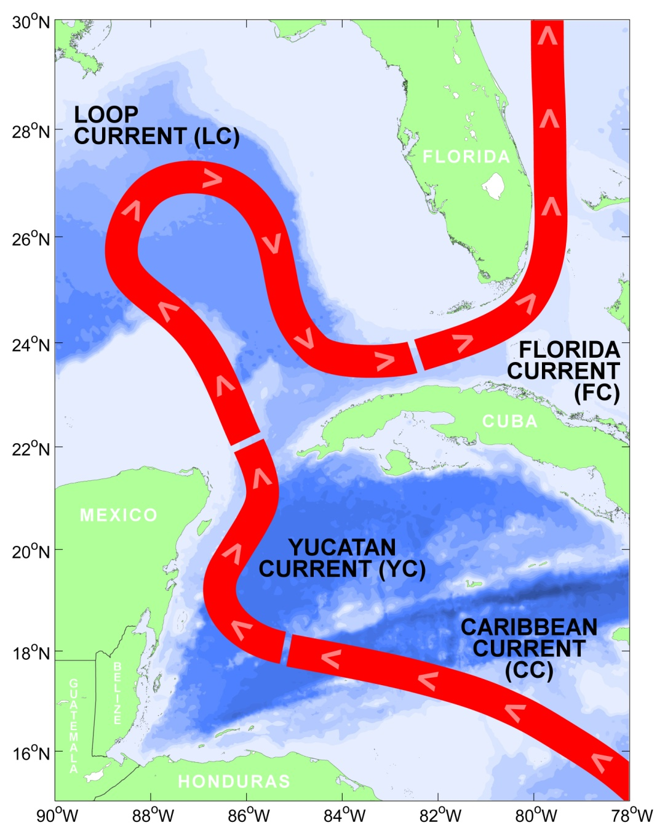
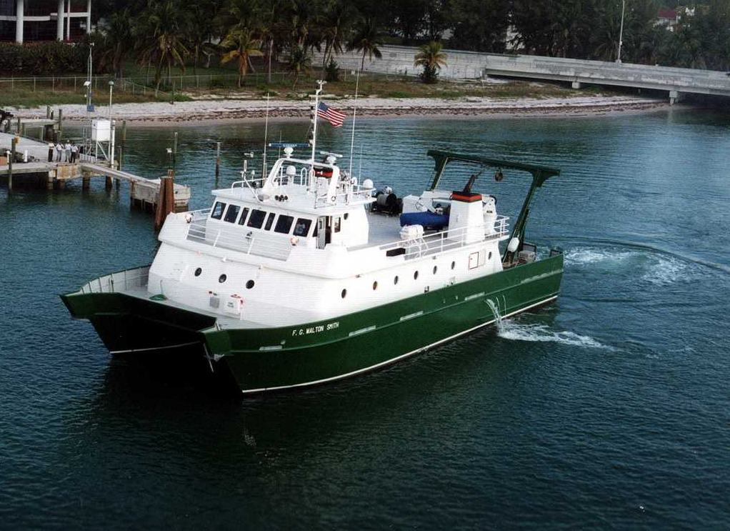
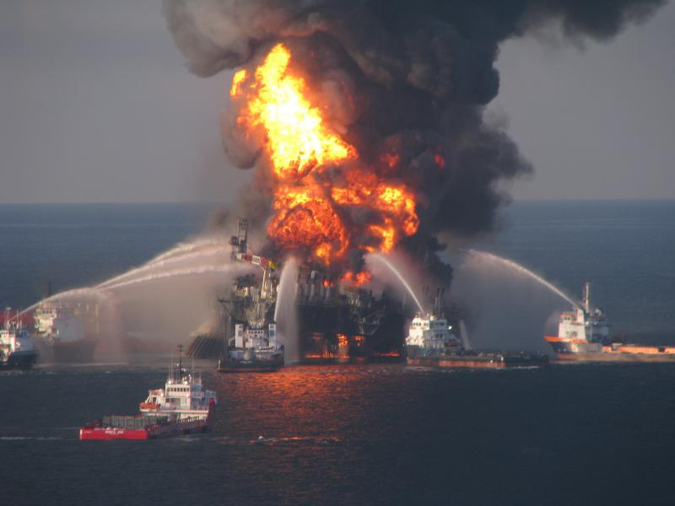
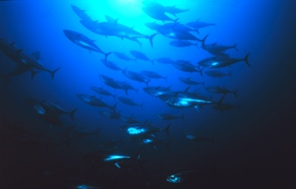
Ocean Connectivity
Notes:
(Pictured: a diagram of the ocean surface currents in the Caribbean and Gulf of Mexico, including the Loop Current; the UM/RSMAS R/V Walton Smith; a school of blue fin tuna, which spawn in the GOM)
AOML also studies these large currents on smaller scales – such as the Gulf Stream, which actually begins south off the coast of Brazil.
Working with our NOAA Fisheries partners, and using research vessels to take samples from within the currents, our scientists are mapping out where juvenile fish spend their earlier years upstream before they mature into the adults that we catch off of Florida’s coasts.
This information helps NOAA better manage important commercial fish stocks that we all eat.
Knowing the detailed location and changes of these currents were critical during the Deep Water Horizon disaster, as officials tried to predict where the oil might move and where it could impact fisheries and coastlines.

Slide 7
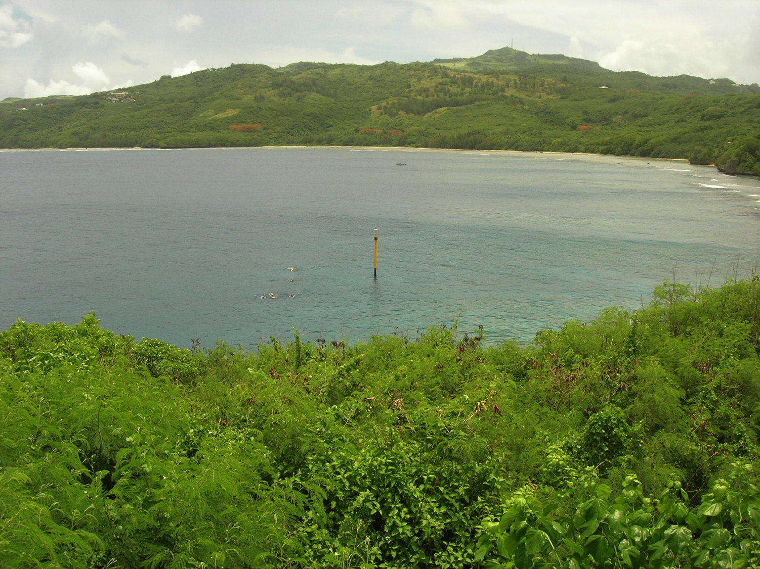
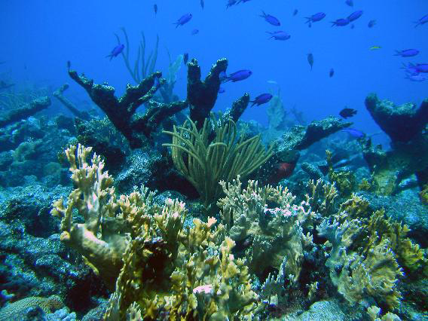
Ocean Ecosystems
Notes:
(Pictured: the newest Integrated Coral Observing Network (ICON) station in Saipan; a closer image of an ICON stick showing atmospheric instrumentation; a Caribbean coral reef)
AOML’s coast research focuses on the impact man has on the ocean, and how our changing climate impacts coastal ocean ecosystems.
One component of AOML’s research predicts the effects of global climate change and local anthropogenic stresses, such as pollution, on coral reef ecosystems.
Our scientists are developing the next generation of sensors and integrated environmental sensing systems required to monitor ecological and chemical processes in the coastal marine ecosystem, such as ocean acidification.

Slide 8
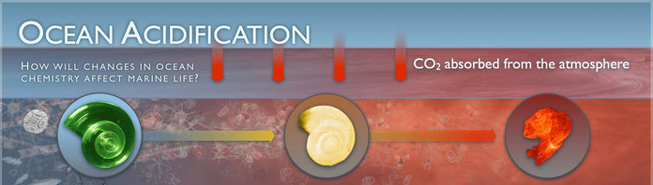
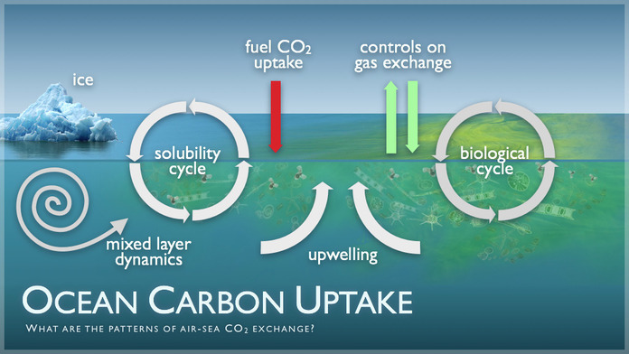
Carbon Dioxide and Ocean Acidification
Ocean Acidification
Notes:
AOML is a principal player in the NOAA Carbon Cycle Science Program, which aims to improve forecasts of atmospheric CO2 levels by measuring air-sea CO2 fluxes and oceanic inventories of anthropogenic (or excess) CO2.
Payoffs: The oceans sequester roughly 1/4 of the excess CO2 released by fossil fuel burning. A quantitative knowledge of its uptake capacity and changes thereof is imperative for future energy policy, mitigation strategies, and climate research.
We are already seeing impacts of increased CO2 in the oceans in the form of Ocean Acidification. The increase in oceanic CO2 causes a slight change in the chemistry of ocean water, making it more acidic. While undetectable to you and I, it does impact ocean creatures who use calcium carbonate to build their shells and skeletons, like corals.
(pictured is a coral reef from the Pacific that exists in a naturally occurring highly acidic environment – showing the fragile skeletal structure of the reefs and how susceptible they can be to increases pH)

Slide 9
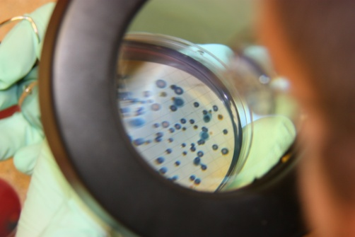
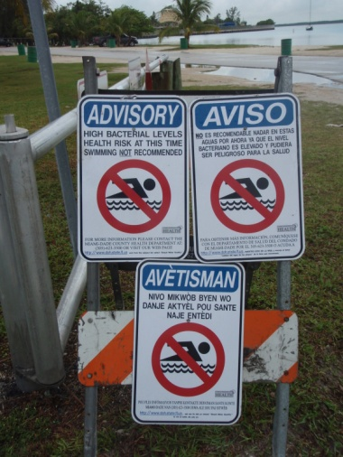
Healthy Beaches
Notes:
(Pictured: an AOML Environmental Microbiologist takes water samples at a local beach; a traditional plating technique for growing bacteria from samples; signage from a beach closure)
AOML also conducts studies of the microbiology of the tropical coastal environment. Our scientist have developed molecular assays to detect bacterial pollution and its sources in large-scale field and epidemiology studies.
This research allows resource managers to better understand the prevalence, scope, and distribution of microbial pollution in coastal waters. Allowing them to be better informed if beach closures and health advisories are required.

Slide 10
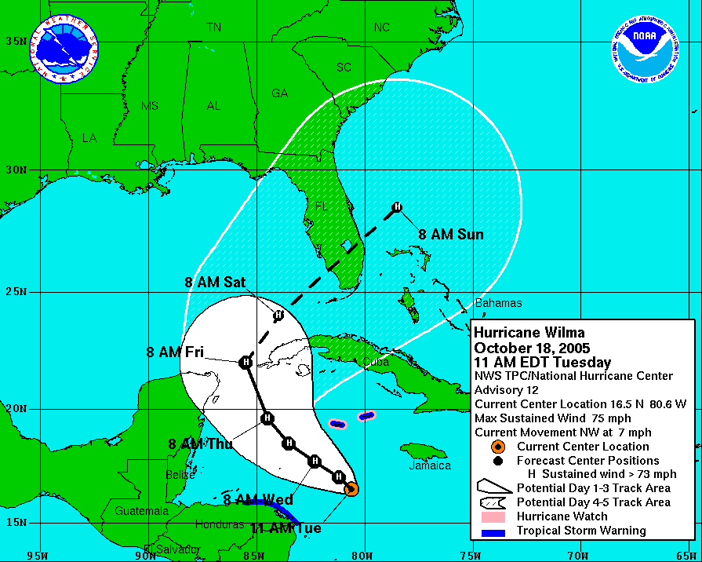
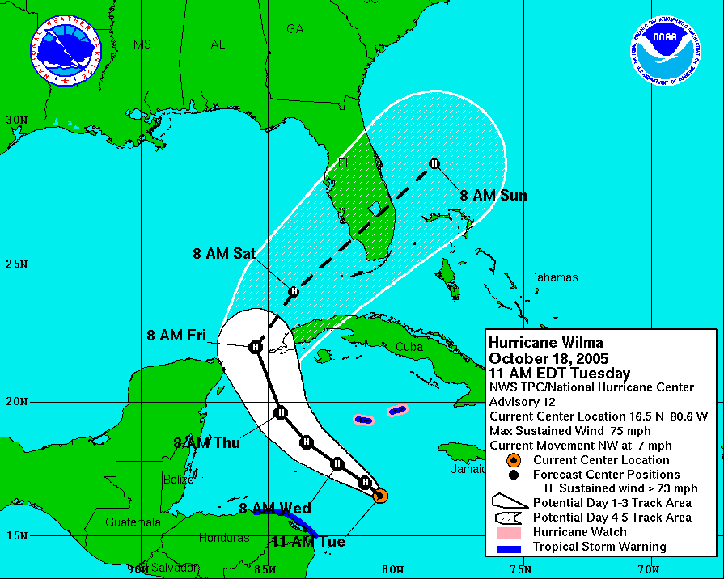
Hurricane Research Improves Forecasts
Hurricane Wilma (reduced uncertainty)
50%
reduced
forecast
errors
Hurricane Wilma (larger uncertainty)
Notes:
Goals of our hurricane research are to Improve prediction of hurricane track, intensity, and storm surge.
Specifically, improvements in the 1 to 5 day hurricane forecasts are a major NOAA goal.
Pictured here is the 5-day forecast for Hurricane Wilma in 2005. The possible location for the hurricane in 5 days ranges from South Carolina to the Bahamas.
The picture at right demonstrates the forecast NOAA would like to produce, with a 5-day forecast ranging from Central Florida to the Bahamas.
Reducing the “cone of uncertainty” by 50% will provide coastal communities with more accurate predictions of a storm’s location at landfall and will reduce unnecessary evacuations and disruption.

Slide 11
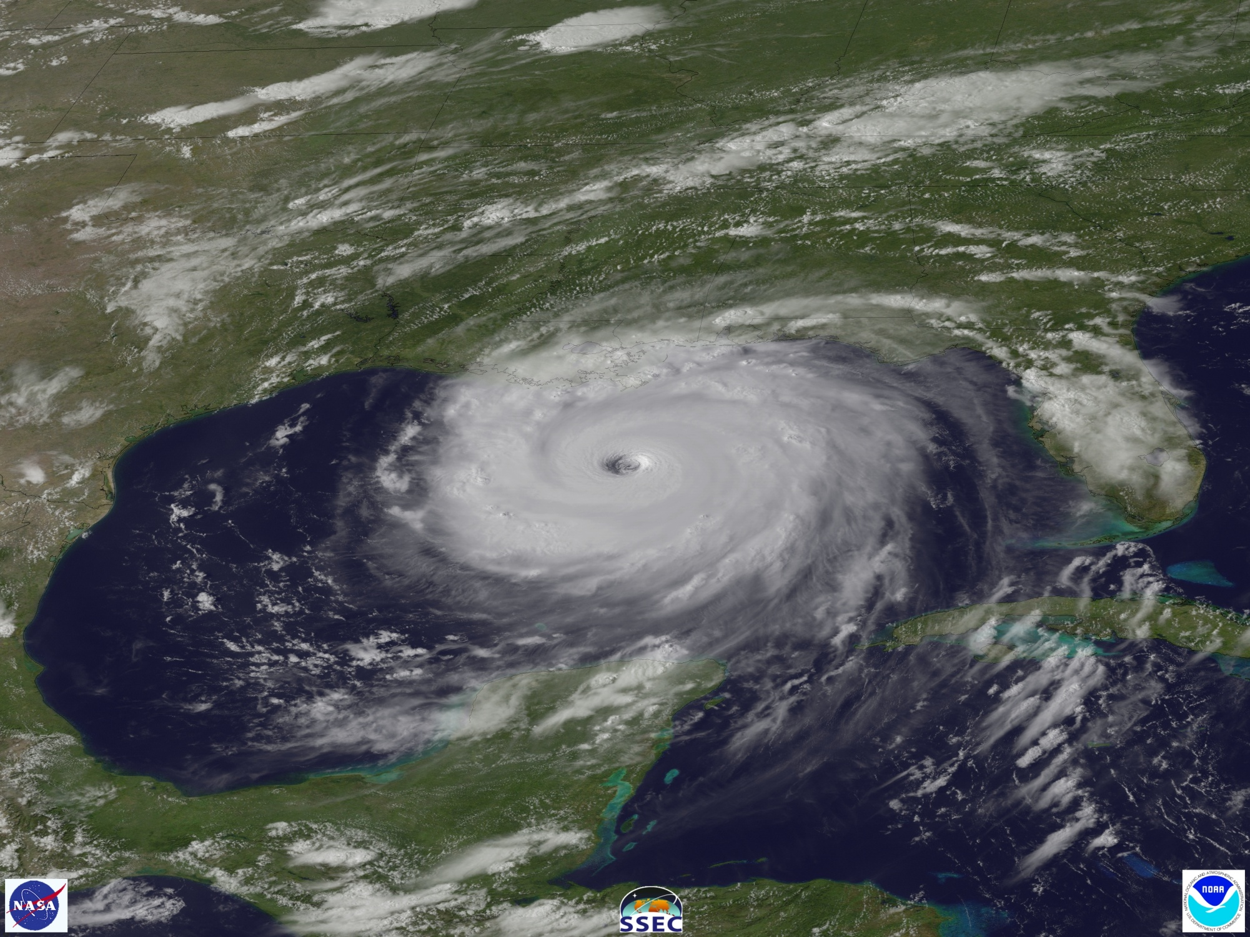
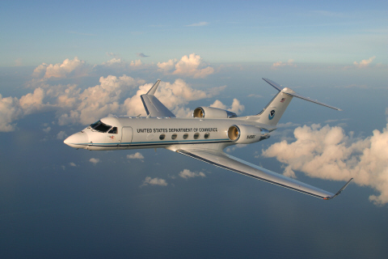
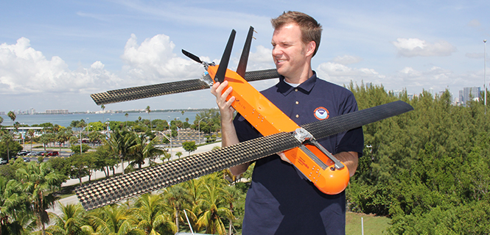
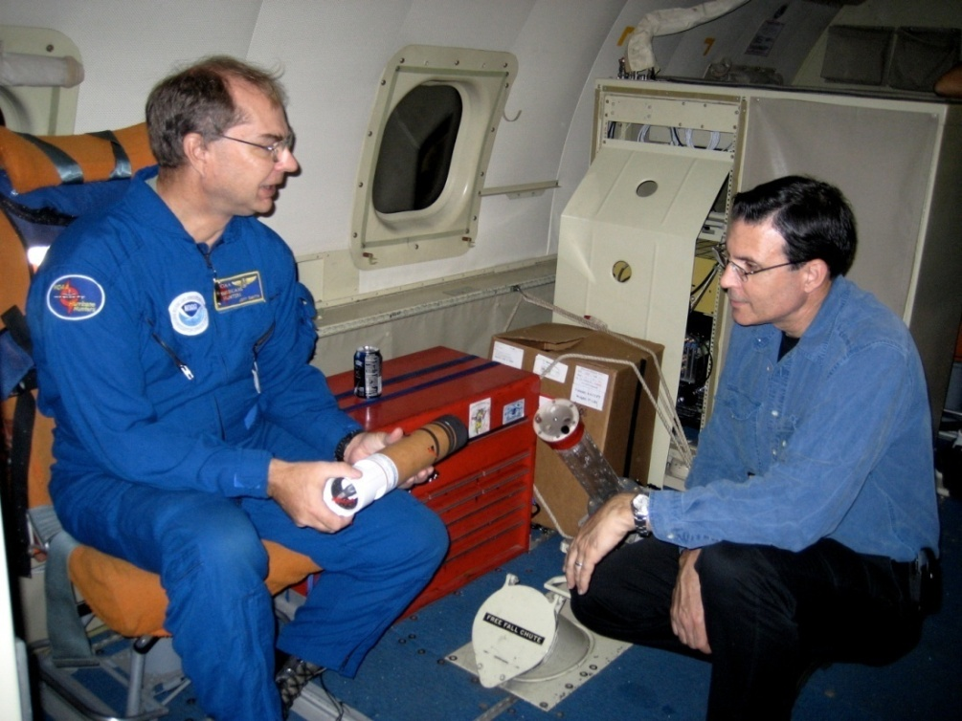
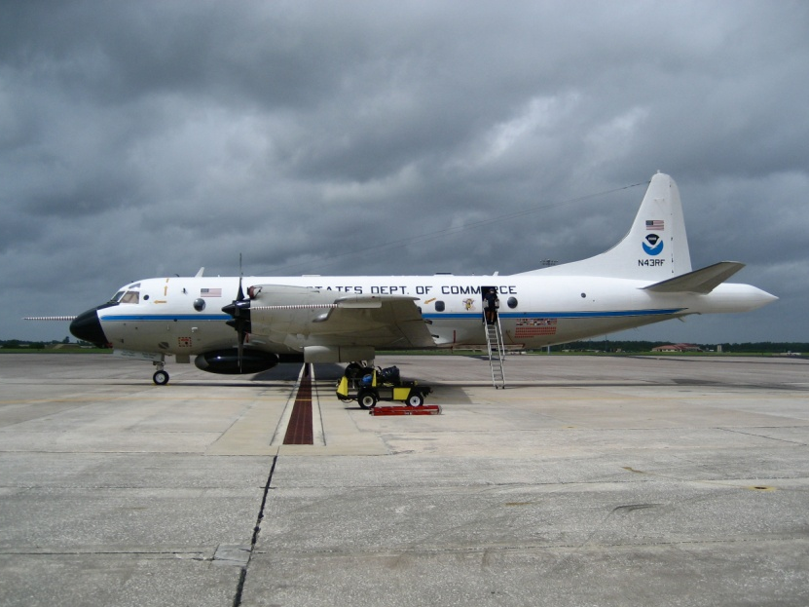
Hurricane Observations
Notes:
(Pictured: Hurricane Katrina, 2005; NOAA’s G-IV jet Hurricane Hunter, one of NOAA’s two P-3 Hurricane Hunters, the dropsonde station on board the P-3, the Coyote Unmanned Aircraft we are testing this season in a hurricane for low level observations)
Everyone is South Florida is very aware of our annual exposure to hurricanes that develop in the Atlantic basin.
Hurricane Katrina, pictured here, was a recent disaster that reminded everyone in our nation of the importance of accurate forecasts from NOAA’s National Hurricane Center, and appropriate action citizens must take based on those forecasts and warnings.
The mission of AOML’s Hurricane Research is to advance the understanding and prediction of hurricanes and other tropical weather and to ultimately improve hurricane forecasts.
AOML hurricane research is based on a combination of computer models, theories, and observations, with particular emphasis on data obtained with research aircraft, such as the P-3 and the G-IV jet.
AOML researchers and their colleagues regularly fly into storms impacting the U.S., collecting information from instruments deployed from and integrated into these flying laboratories.

Slide 12
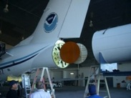
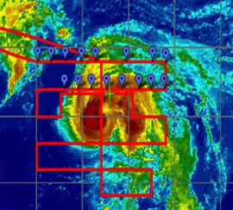
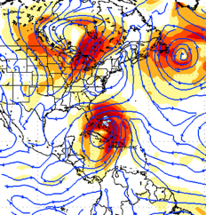
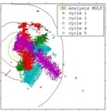
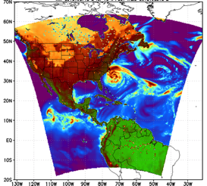
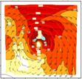
Research Focus
Accomplished through:
Research experiments in hurricanes
Improving hurricane observing strategies
Developing & evaluating numerical models
Transition technology & applications
Outreach to the public
Hurricane Nadine
10-m wind
Notes:
Evaluating numerical models to improve their ability to simulate nature, improve forecasts, and to optimize hurricane observing through the development of improved observing strategies and instrumentation;
Designing and conducting research experiments in the hurricane such as the Intensity Forecast experiment (IFEX) to collect and provide data for research and operational applications;
Developing new technology and applications based on this research to improve NOAA’s products; and
Providing outreach to the public by publishing research in the refereed literature, conferences, workshops, presentations, WWW, and other means.
Research Themes:
Observing Techniques-Involves designing, testing, and automating optimal data collection, as well as quality control, analysis, and transmission of data to improve initialization and validation of operational and research tropical-cyclone models, and to further basic understanding.
Modeling and Prediction-This research is aimed at developing and improving both multi-layer numerical and statistical-dynamical models for use in real-time tropical cyclone (TC) track and intensity forecasting.
Data Assimilation-Focuses on the utilization of a wide range of observations for the state analysis of tropical systems and their near environments for the purpose of studying physical/dynamical processes and improving numerical forecasts by employing advanced ensemble-based and variational techniques.
Dynamics and Physics-This research is aimed at improving our understanding of tropical cyclones through the application of fundamental physical principles of air motion, moist thermodynamics, and radiation.
Impacts-The multi-faceted nature of hurricane hazards (winds, storm surge, waves, heavy rainfall, flooding, mudslides, etc) continues to result in natural disasters with loss of life and property. HRD scientists are involved in research to advance the understanding of these impacts
Images:
Far right: Top - G-IV TA Doppler radar; middle –NASA Global Hawk; bottom – Coyote airborne-deployed UAS
Bottom: left – Global Hawk flight track overlaid on IR satellite image of Hurricane Nadine (2012);
middle – data collection strategy for P-3 TDR in Hurricane Sandy at 0000 UTC 26 September 2012 showing superob distribution in the inner nest domain; and
right – HWRF operational domain showing synthetic 37-GHz microwave satellite image for Hurricane Sandy initialized at 00 UTC 26 October

Slide 13
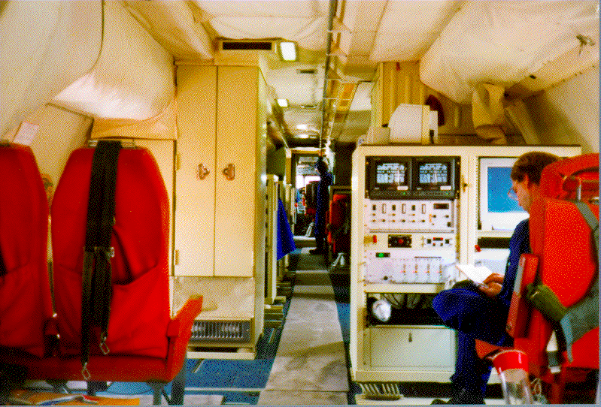
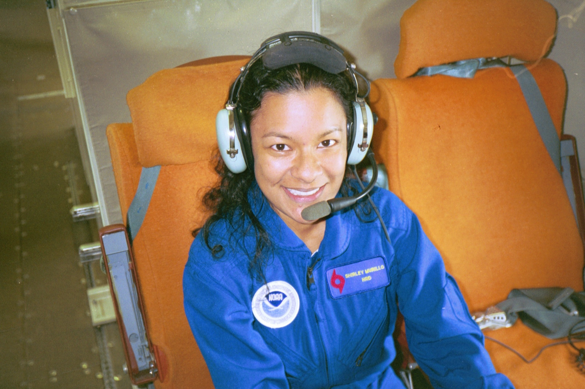
Inside the P-3 Aircraft

Slide 14
Notes:
https://www.youtube.com/watch?v=XNIwYVyszs0#action=share
https://www.nnvl.noaa.gov/animations/high_quality/104514_HurricaneHunter-HD1080-slow.mp4

Slide 15
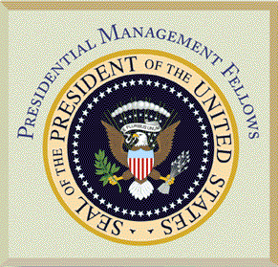
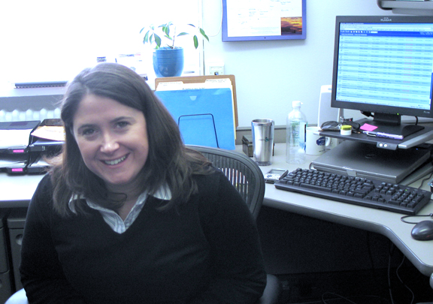
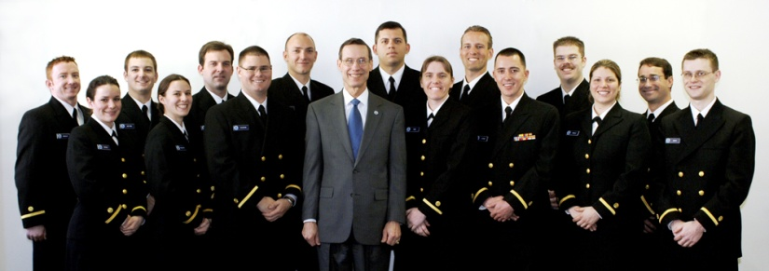
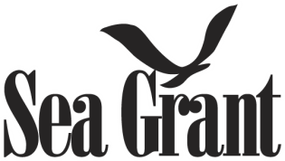
NOAA & You: You can be a part of NOAA
NOAA’s Office of Education Opportunities
Fellowships
Knauss Sea Grant Fellows
Presidential Management Fellows
Great Lakes Summer Fellows
Internships
Hollings
NOAA Corps
Cooperative Institutes
Federal Employee
PMF & NWS Employee, Mary Ann Kutny
NOAA Sea Grant Fellows Katie Fitzgibbons & Dr. Chad McNutt
NOAA 109th Basic Officer Training Class
15
Notes:
NOAA needs scientists that are cross trained in large scale meteorology, various areas of science or in science, management, and policy
how NOAA's scholarship programs are addressing future workforce needs.
The NOAA’s Office of Education has many opportunities, some of which those of you in the audience have taken advantage of.
The Knauss Sea Grant fellowship Program matches highly qualified graduate students with "hosts" in the legislative and executive branch of government located in the Washington, D.C. area, for a one year paid fellowship. Sea Grant college programs generally accept applications annually in March from students with an interest in ocean science and policy.
Presidential Management Fellows: The purpose of the Program is to attract to the Federal service outstanding men and women from a variety of academic disciplines and career paths who have a clear interest in, and commitment to, excellence in the leadership and management of public policies and programs.
Great Lakes Summer Interns: NOAA’s Great Lakes Environmental Research Laboratory and the Cooperative Institute for Limnology and Ecosystem Research manages this program. Each summer approximately 30 college students receive ‘real world’ ecosystem research projects and are provided a stipend as well as mentorship by a scientist. Research is needed in the fields of chemistry, biology, physics, engineering and meteorology.
There are several types of internships at NOAA. One example is the Student Temporary Employment Program (STEP), which is designed to integrate students' educational studies with a wide range of technical and professional experiences. STEP opportunities are available to students pursuing college degrees.
Federal Employee: apply on-line through the Automated the Commerce Employment System Quickhire

Slide 16
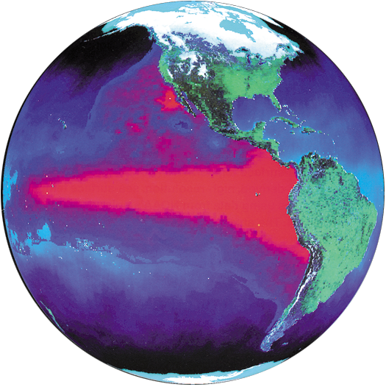
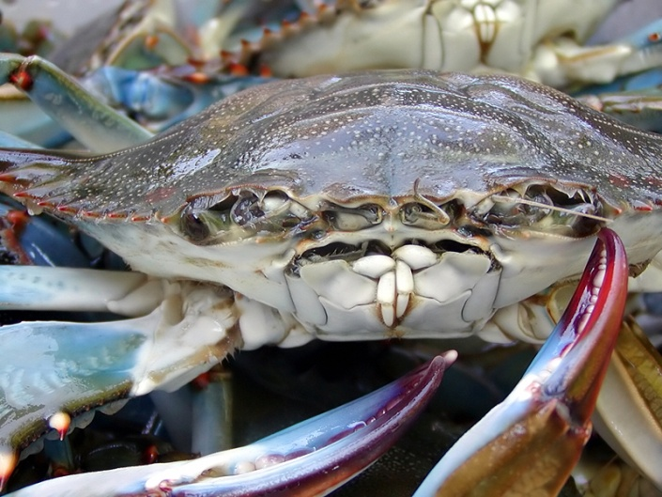
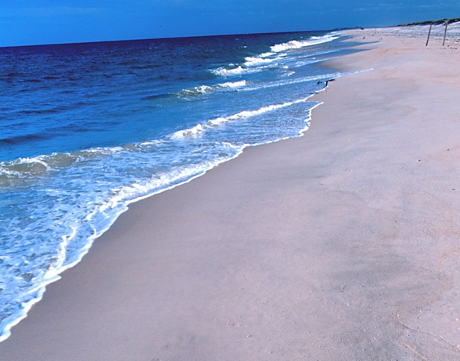
What you should take away
This Is An Exciting Time!!!
Significant Environmental Challenges
Increasing Attention On Oceans, Coasts and Great Lakes
You Have An Opportunity To Contribute
16
Notes:
This is an exciting time to be involved in making our oceans, coasts and Great Lakes cleaner, healthier, and more productive. We have a unique opportunity to collaborate across agencies and throughout the government. We can work together to make technology, policy, and inter-agency initiatives effective instruments to use in our changing world.
There are significant challenges in developing management strategies that ensure continued conservation of coastal and marine habitats and living resources while at the same time ensuring that society as a whole can still enjoy and benefit from those same resources.
You have an opportunity to contribute your expertise as we move toward sustainable management and conservation. Based on the opportunities and challenges I highlighted previously, I am excited about what the future holds and look forward to your involvement on these issues.
Thank you!

Slide 17
NOAA’s Atlantic Oceanographic and Meteorological Laboratory
Our research in basic and applied science
Shirley Murillo
Deputy Director - Hurricane Research Division
4301 Rickenbacker Cswy.
Miami, FL 33149
www.aoml.noaa.gov
Notes:
The Atlantic Oceanographic and Meteorological Laboratory (AOML) is an environmental Research Laboratory of the National Oceanic and Atmospheric Administration (NOAA).
AOML conducts research of the physical, chemical, and biological characteristics and processes of the ocean and atmosphere, both separately and as a coupled system.
The principal focus of these investigations is to provide knowledge that will ultimately lead to more accurate forecasting of severe storms, better management of marine resources, better understanding of the factors affecting both climate and environmental quality, and improved ocean and weather services for the nation.
17

