Slide 1
OSSE Evaluation of the Impact of Aircraft Observations on Hurricane Analyses and Forecasts
¹K. Ryan, ¹L. Bucci, ¹J. Delgado,³R. Atlas, ²S. Murillo
¹Univ. of Miami/CIMAS and NOAA/AOML/Hurricane Research Division, Miami, FL
²NOAA/AOML/Hurricane Research Division, Miami, FL
³NOAA/AOML, Miami, FL
Special thanks to: Frank Marks, Rob Rogers, Ghassan Alaka, John Gamache, Paul Reasor, Peter Dodge, Jason Dunion, Eric Uhlhorn, Xuejin Zhang and the observations/DA teams at HRD

Slide 2
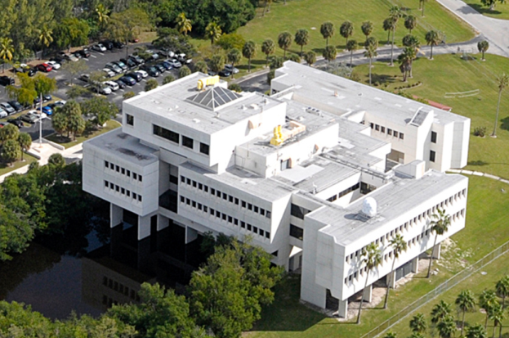
Atlantic Oceanographic and Meteorological Laboratory
Virginia Key Science Community
AOML
Hurricane Research
Oceans and Climate
Coastal Oceanography
Notes:
AOML is located on Virginia Key, directly off shore from downtown Miami.
We are co located with NOAA’s Southeast Fisheries Science Center, and the University of Miami’s Rosenstiel School for Marine and Atmospheric Science, as well as the Maritime and Science Technology Academy and the Miami Seaquarium.
Our research encompasses hurricane observation and modeling, oceans and climate, the global impacts of increased carbon dioxide and ocean acidification, ocean and human health studies, and the ocean’s influence on regional rainfall and hurricanes.
AOML is also a major partner in the collection and interpretation of oceanographic data collected via ships, satellites, aircraft, drifting buoys, and floats.

Slide 3
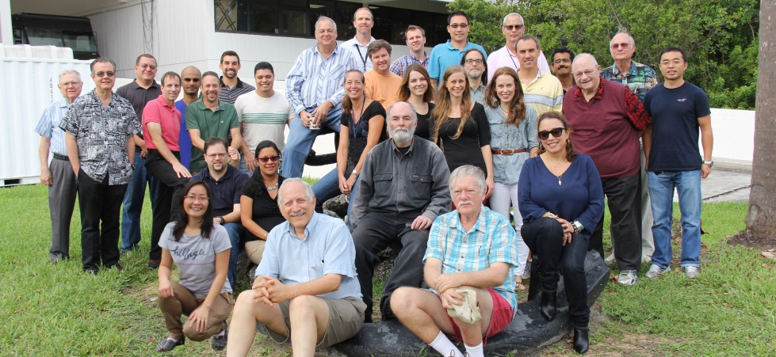
Hurricane Research Division
HRD Research Mission Statement:
Advance the prediction of hurricanes through observations, modeling, and theory, with an emphasis on inner core processes.
Develop and refine tools used for operational hurricane forecasting (NHC, EMC)
Expand fundamental understanding of physical processes that drive TC formation and evolution
Unified NOAA approach to guide and accelerate improvements in TC forecasts; created in 2009
HRD
Research Groups:
Observations
Modeling
Data Assimilation
OSE/OSSE
Reduce errors by 50% in track and intensity forecasts in 10 years
Detect rapid intensity change
Improve storm surge prediction
Quantify, bound, and reduce forecast uncertainty
Extend forecast reliability to 7 days
Notes:
HFP: emphasize inner core obs
HRD’s research is based on a combination of models, theories, and observations, with particular emphasis on data obtained from high-resolution numerical models and research aircraft in the inner core of tropical cyclones and their surrounding environment.
Optimize our resources and secure funding for new/replacement instrumentation

Slide 4
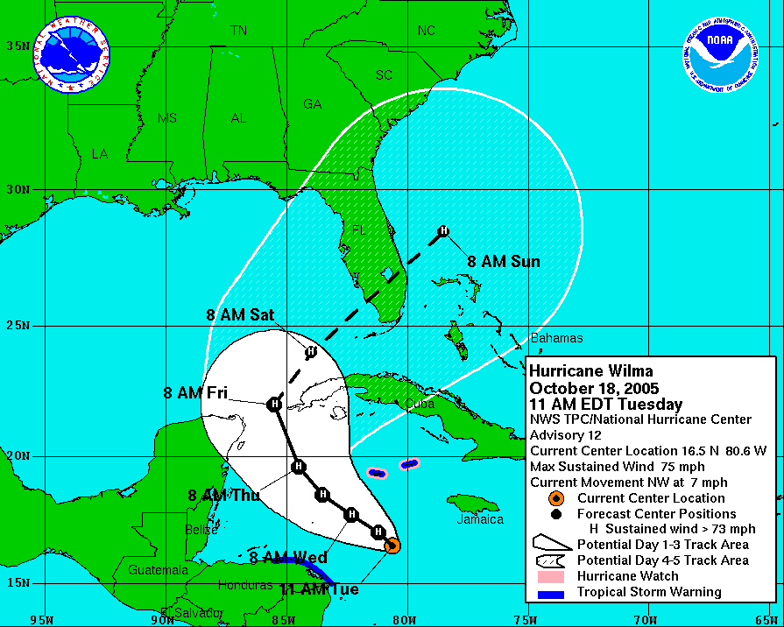
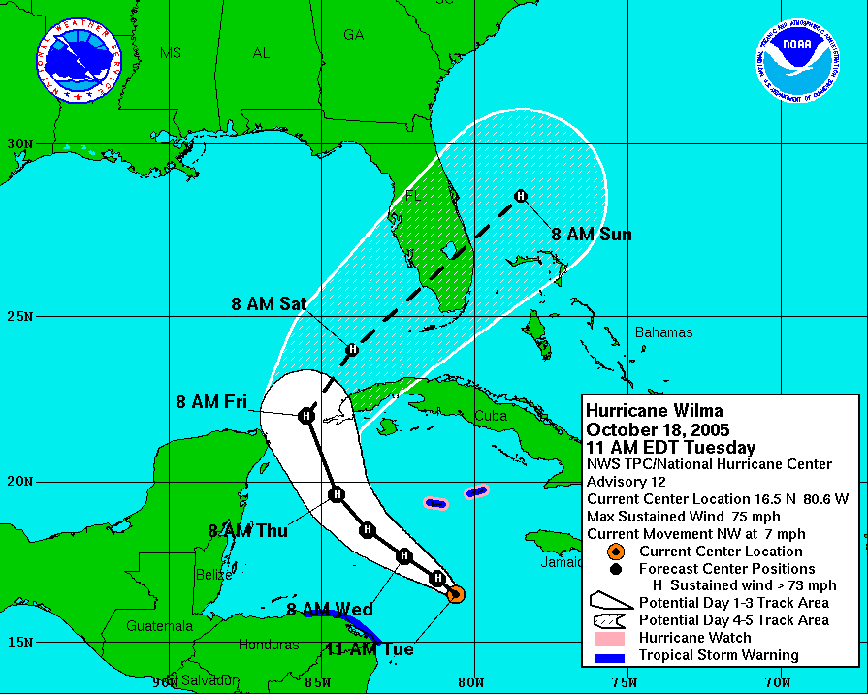
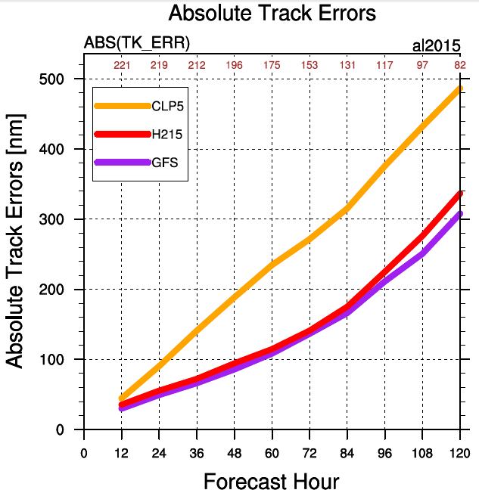
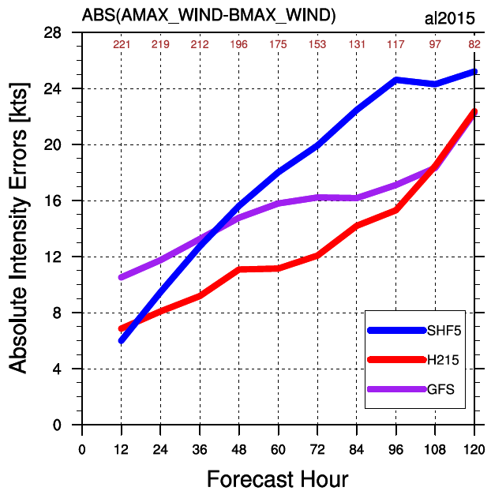
> 50%
reduction
in
uncertainty
HRD’s Hurricane Field Program
allows for the annual collection of aircraft reconnaissance data in the E. Pac and Atlantic basins (AOC)
provides real-time aircraft observations to be assimilated in the operational models during hurricane season
Notes:
Goals of our hurricane research are to Improve prediction of hurricane track, intensity, and storm surge.
Specifically, improvements in the 1 to 5 day hurricane forecasts are a major NOAA goal.
Pictured here is the 5-day forecast for Hurricane Wilma in 2005. The possible location for the hurricane in 5 days ranges from South Carolina to the Bahamas.
The picture at right demonstrates the forecast NOAA would like to produce, with a 5-day forecast ranging from Central Florida to the Bahamas.
Reducing the “cone of uncertainty” by 50% will provide coastal communities with more accurate predictions of a storm’s location at landfall and will reduce unnecessary evacuations and disruption.

Slide 5
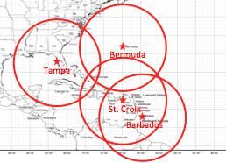
Hurricane Field Program
IFEX Goals (Rogers et al. BAMS 2006, 2013)
Collect observations that span TC lifecycle in a variety of environments for model initialization and evaluation
Develop and refine measurement technologies that provide improved real-time monitoring of TC intensity, structure, and environment
Improve understanding of physical processes
important in intensity change at all lifecycle stages
Preparation
Mission experiments
Map discussion/targeting
Project coordination
Range of P-3 aircraft
Rotated Figure 4
Notes:
Hurricane Field Program is a unifying element in our activities at HRD
Observations collected during HFP are used in research to
Evaluate and improve models
Initialize models
Improve understanding
Pic of G-IV & P-3
2-3 Pics of crew

Slide 6
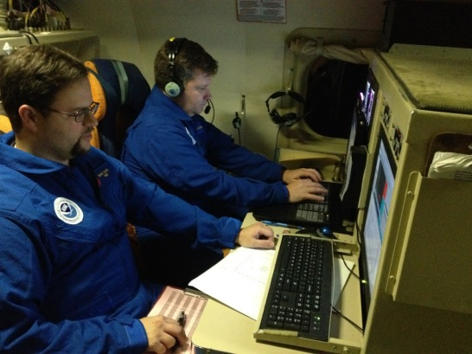
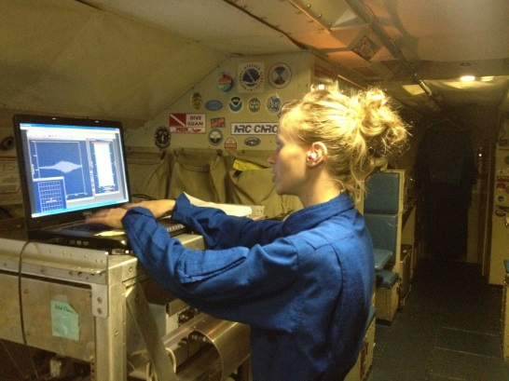
Hurricane Field Program
Field experiment process
airborne crew
ground crew
typical deployment
8-12 hours per mission
12-15 people per mission
Missions every 12 hours
Notes:
Hurricane Field Program is a unifying element in our activities at HRD
Observations collected during HFP are used in research to
Evaluate and improve models
Initialize models
Improve understanding

Slide 7
Hurricane Field Program
Debrief of missions
Evolution of sampled TC
Data collected
P-3 track and flight level wind barbs
View from inside the eye of Hurricane Matthew
Notes:
Hurricane Field Program is a unifying element in our activities at HRD
Observations collected during HFP are used in research to
Evaluate and improve models
Initialize models
Improve understanding
Pic of G-IV & P-3
2-3 Pics of crew

Slide 8
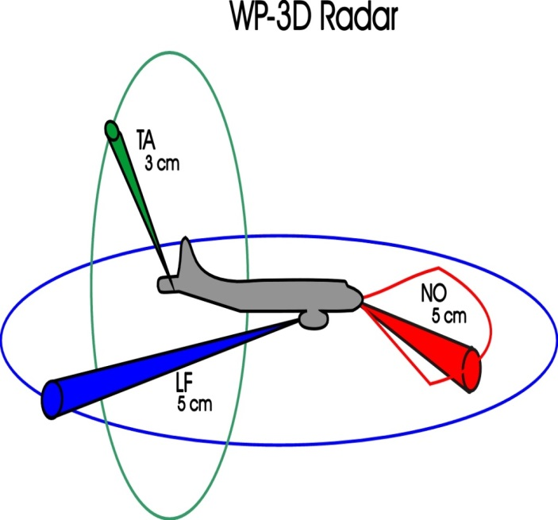
Aircraft Instruments
Measurements: temperature, pressure, humidity, wind, precipitation, cloud microphysics, sea surface temperature, ocean heat content, sea spray
Airborne Instruments:
Flight level sensors
Dropsondes
IRsondes
AXBTs
SFMR
Tail Doppler Radar
Lower Fuselage Radar
Doppler Wind LIDAR
IWRAP
Precipitation Imaging Probe
HAMSR
HIRAD
HIWRAP
Scanning HIS
Notes:
Scanning High-resolution Interferometer Sounder (S-HIS)
Hurricane Imaging Radiometer (HIRAD)
High-altitude Imaging Wind & Rain Airborne Profiler (HIWRAP)
High-altitude MMIC Sounding Radiometer (HAMSR)

Slide 9
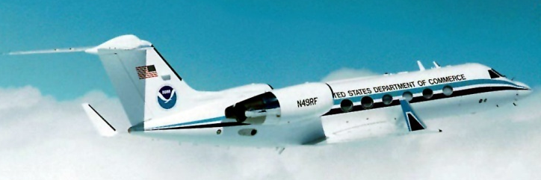
NOAA Aircraft
Orion WP-3D
P-3
5-10 kft through core
G-IV
45 kft through environment
UASonde
Gulfstream IV
Global Hawk
UAS
(Coyote)
2 kft through core in Boundary Layer
Global Hawk
65 kft above core and environment

Slide 10
Observing System Simulation Experiments (OSSEs)
Assess the value of current/proposed observing systems on forecasts and analyses by assimilating synthetic observations obtained from a Nature Run
Motivation for performing OSSEs:
Cost of development/maintenance/use of observing systems
Large time lag between instrument deployment and use in NWP
DA
Fcst Model
Nature Run
Calibration
Quantify potential impact of proposed observing systems
Model and OSSE system Validation
Optimize design and configuration of existing or proposed observing systems
Test new instruments before installation
Evaluate/develop new methodology for processing and assimilating new types of observations
Notes:
developed at NOAA/AOML and UM/RSMAS

Slide 11
Observing System Simulation Experiments (OSSEs)
Assess the value of current/proposed observing systems on forecasts and analyses by assimilating synthetic observations obtained from a Nature Run
Early OSSEs including those for Global Atmospheric Research Program (GARP):
Aimed to determine observational requirements for NWP
Station locations and optimal density of observations
Required accuracy for radiosonde data
Provided Analysis of
Useful range of predictability
Need for reference level data
Asynoptic vs. synoptic data assimilation
DA
Fcst Model
Nature Run
Calibration
Determined the extent to which temperature, moisture, and wind can be determined given a continuous history of observations
Notes:
Early OSSEs (point 1): *where stations should be added, *required accuracy of radiosonde data, * optimal network density

Slide 12
Observing System Simulation Experiments (OSSEs)
Assess the value of current/proposed observing systems on forecasts and analyses by assimilating synthetic observations obtained from a Nature Run
Early OSSEs including those for Global Atmospheric Research Program (GARP):
Revealed limitations to consider
Simulated errors assumed to be random and uncorrelated: not generally realistic
DA
Fcst Model
Nature Run
Calibration
Same model dynamics/physics: Identical or Fraternal Twin Experiments
Notes:
Early OSSEs (point 1): *where stations should be added, *required accuracy of radiosonde data, * optimal network density

Slide 13
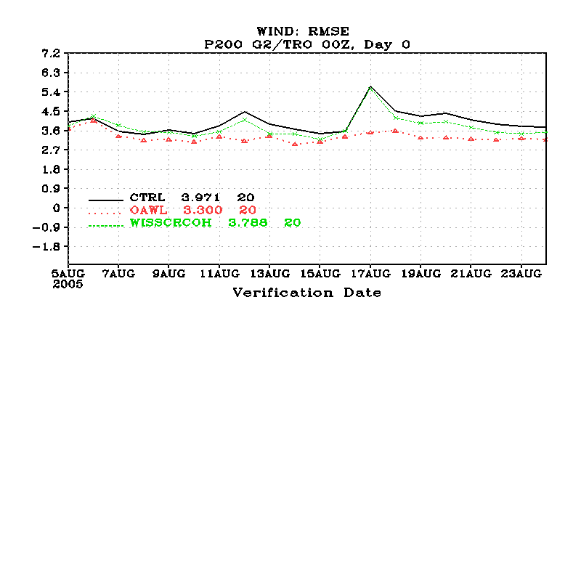
Observing System Simulation Experiments (OSSEs)
Assess the value of current/proposed observing systems on forecasts and analyses by assimilating synthetic observations obtained from a Nature Run
Major results from modern global OSSEs:
Typically assess impact based on average RSME of specific variables of interest in the domain or over defined regions (horizontally or vertically)
200mb RMSE results from global OSSE evaluation of 2 space-based LIDARs
Indicate that:
Wind data is more effective than temperature/moisture data
Upper level data provides more impact on forecasting
Impacts are highly dependent on observing system configuration
Notes:
Early OSSEs (point 1): *where stations should be added, *required accuracy of radiosonde data, * optimal network density

Slide 14
Observing System Simulation Experiments (OSSEs)
Assess the value of current/proposed observing systems on forecasts and analyses by assimilating synthetic observations obtained from a Nature Run
HRD’s Regional OSSE System for Hurricanes
Utilizes a regional Hurricane Nature Run (Nolan et al., 2013) and creates analyses used by the high-resolution regional forecast model HWRF
Calibration
“Quick OSSEs”
Performed for shorter periods with limited DA
Used to demonstrate potential or to address a particular event
NR finer resolution than forecast model
Captures phenomenon of interest
Notes:
developed at NOAA/AOML and UM/RSMAS

Slide 15
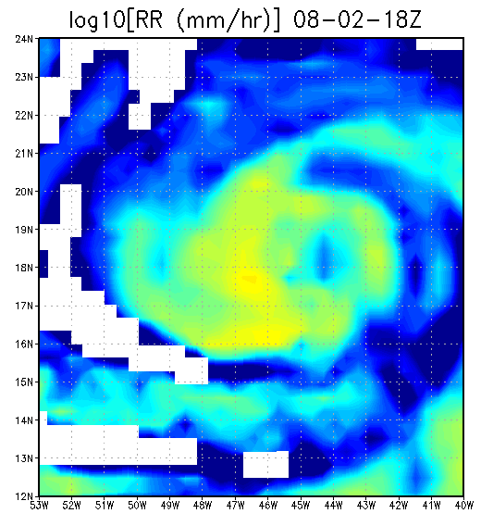
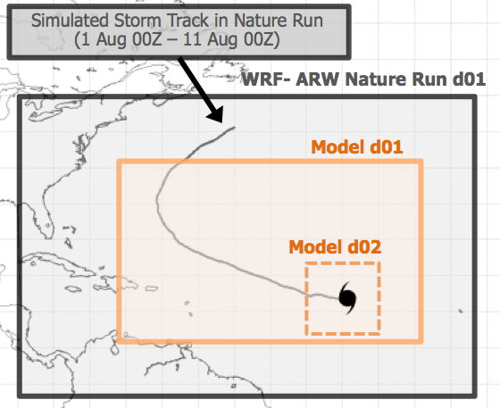
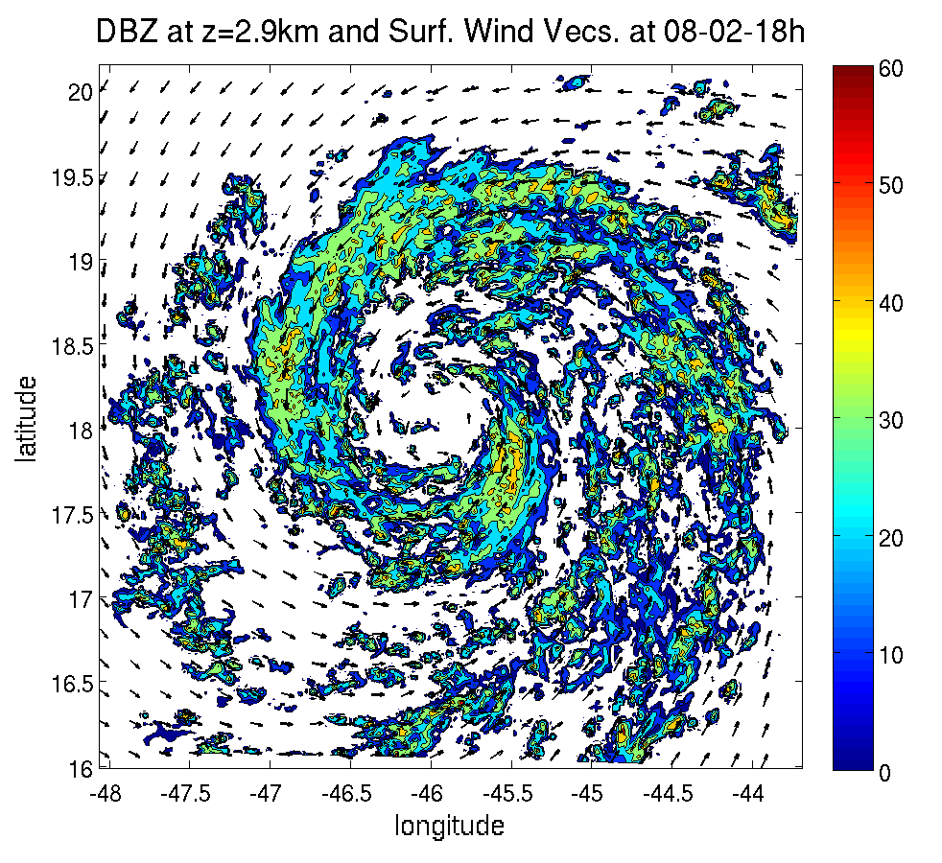
Notes:
13 day lifecycle of a rapidly intensifying N. Atlantic Hurricane

Slide 16
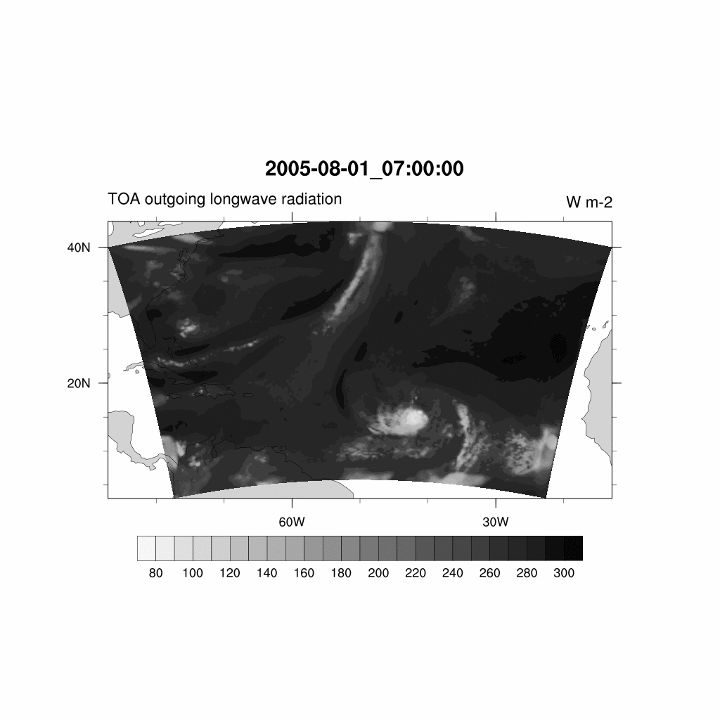
video
Notes:
13 day lifecycle of a rapidly intensifying N. Atlantic Hurricane

Slide 17
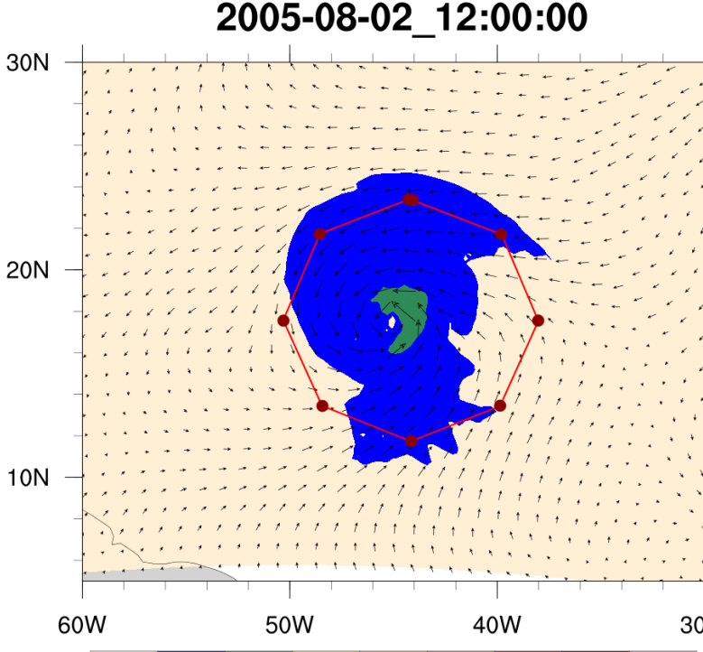
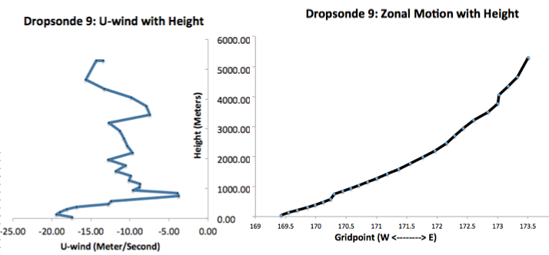
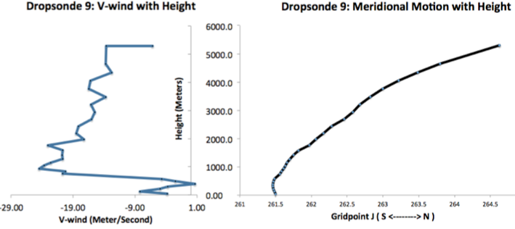
Dropwindsonde Simulation
Dropsonde 9
Aug 02, 2005 at 12 Z)
10-m Wind (knots)
Collects T, Q, P, U, V, W at standard pressure levels
Accounts for horizontal drift
Adjusts vertical speed based on updrafts/downdrafts and atmospheric pressure
Notes:
Aug 01, 2005 Nature Run time!
What are standard pressure levels (double check)

Slide 18
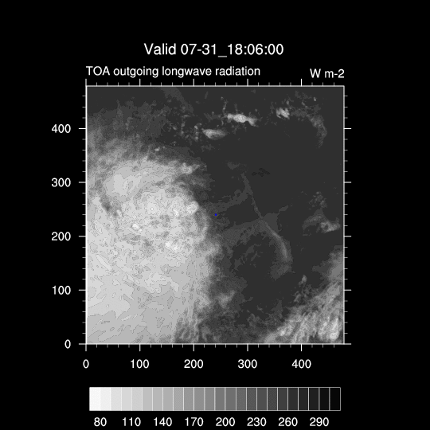
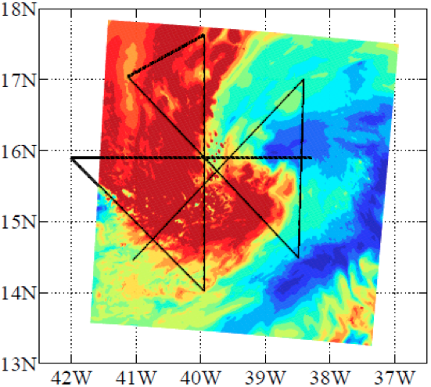
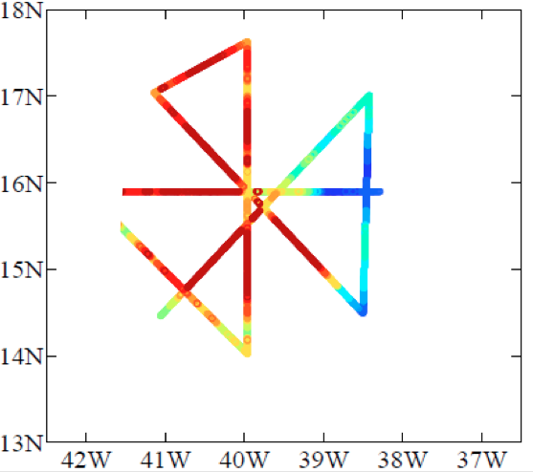
Flight level moisture sample

Slide 19
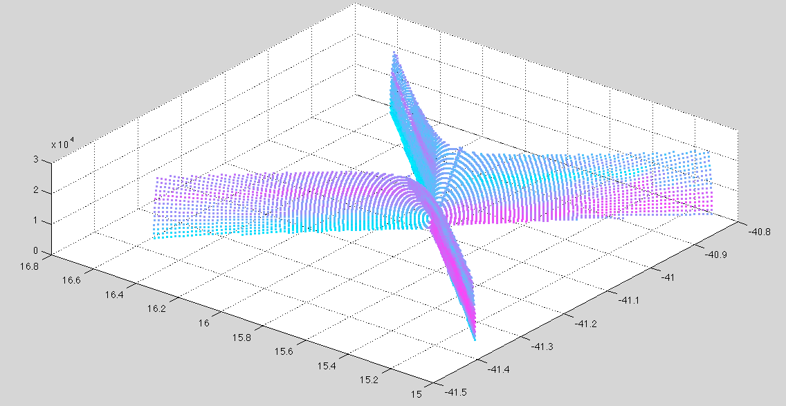
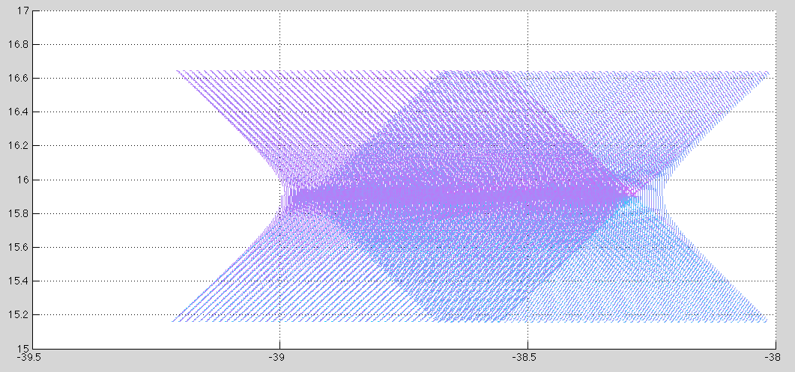
Tail Doppler Radar Simulation
Altitude (m)
Latitude (radians)
Altitude (m)
Longitude (degrees)
Latitude (degrees)
Longitude (radians)
Can simulate both single antenna and dual-antenna X-band TDR
Range: 90 km
Horizontal Res: 3 km
60 rays/second
cwm_thresh = 7.51e-5
Includes operational superobbing routine
~ 70 km
Latitude
Longitude

Slide 20
Data Assimilation
GSI (v3.3) performs analysis over 9km parent domain (d01) of HWRF
3D-Var scheme
6 hourly cycling
6 hour spin up (cold start)
Operationally assimilated data used as control observations for OSSEs
Conventional Observations
radiosondes/dropwindsondes
aircraft reports & buoy/ship observations
land surface observations
pibal winds & wind profilers
radar-derived Velocity Azimuth Display (VAD) wind
WindSat scatterometer winds
GPS-derived integrated precipitable water
Satellite Observations
IR Radiances from: HIRS, AIRS, IASI, GOES
MW Radiances from: AMSU-A, MHS, ATMS
Satellite derived wind: IR/VIS cloud drift & water vapor winds
Forecast Model
NOAA’s Hurricane-WRF model (HWRF v3.5)
61 vertical levels
9km parent domain (d01)
3km storm-following nest (d02)
only active during forecasts
no vortex initialization/relocation
no ocean coupling
Notes:
HWRF:

Slide 21
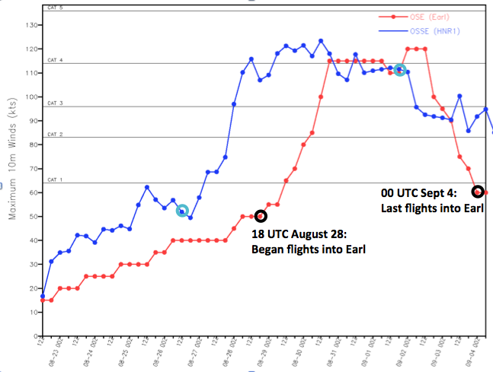
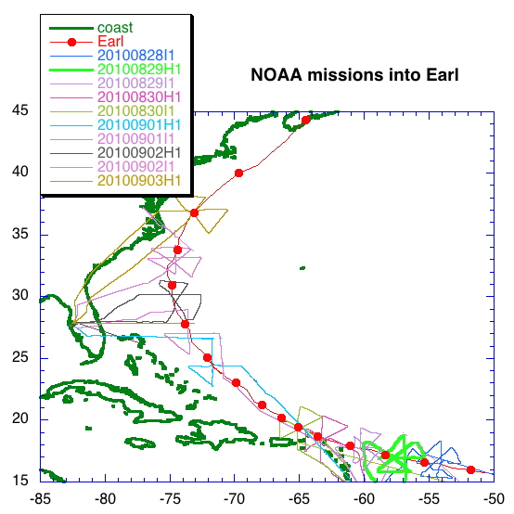
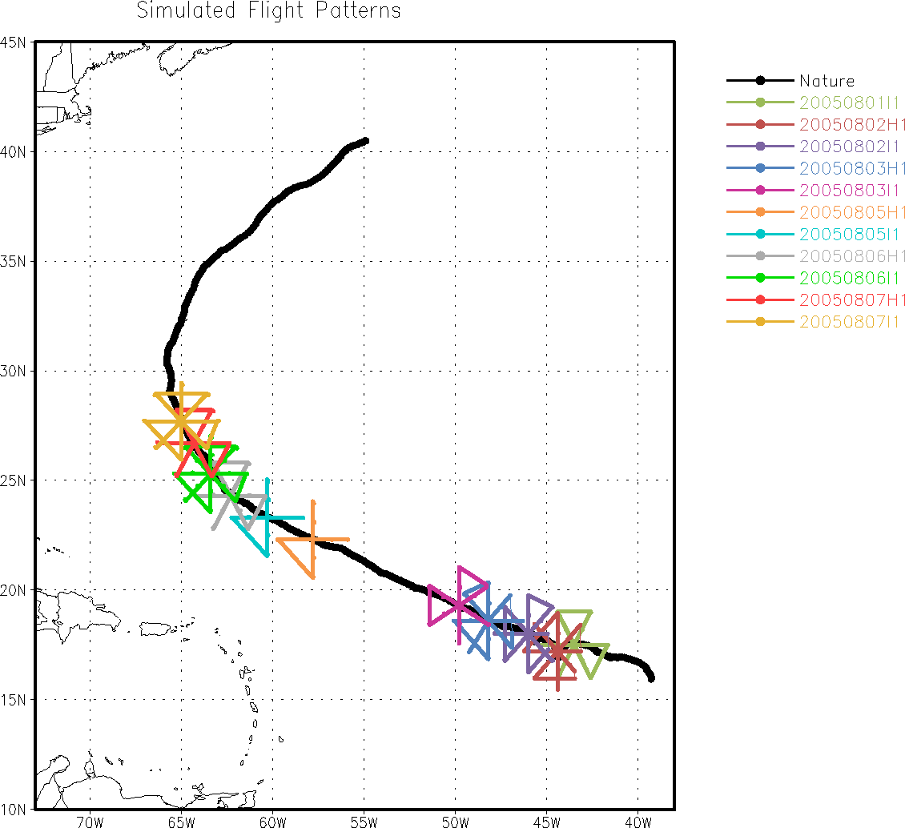
Validation of Regional OSSE System for Hurricanes
Motivation:
Make OSSE system results relatable to real world by setting a baseline
Identify deficiencies in OSSE system and calibrate
Develop a standardized approach to validation for hurricane OSSE systems
Experiment Setup
6 hour cycling for 26 cycles
Assimilate control data on 9km d01
OSE (Hurricane Earl) OSSE (Nature Run)
P-3 FL + drops Synthetic FL + drops
Conclusions:
Comparable O-B values
similar track and intensity error trends
Need multiple cases for a more robust validation
Notes:
Overarching motivation: upgrading in-house hurricane OSSE system

Slide 22
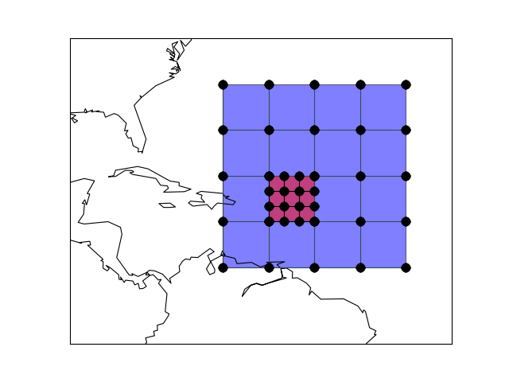
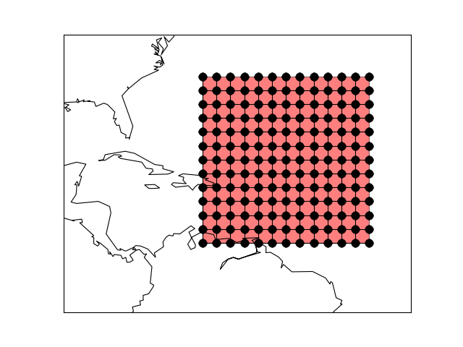
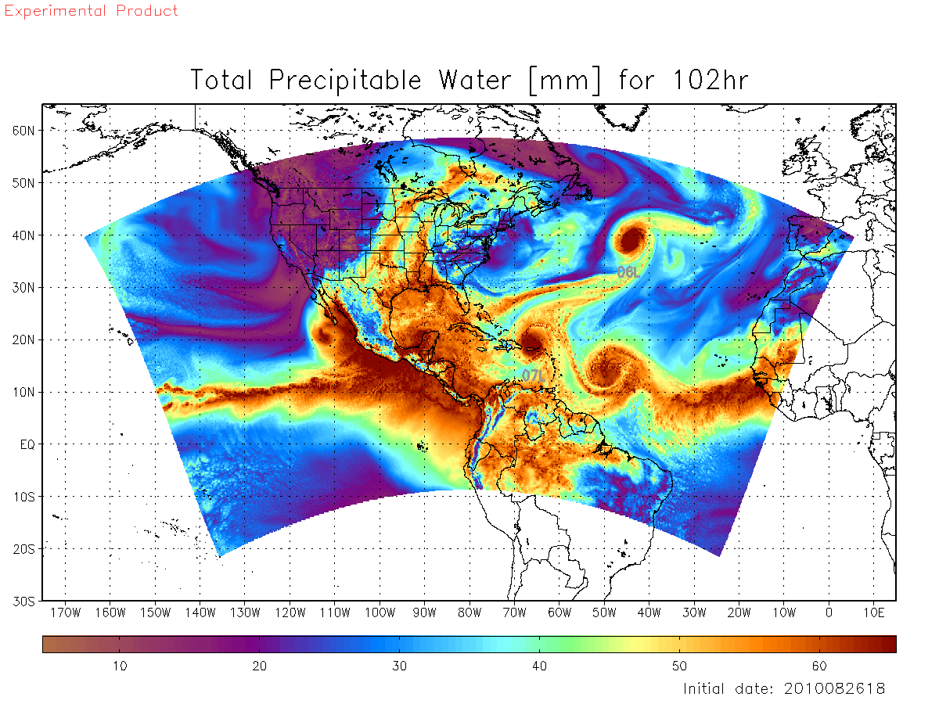
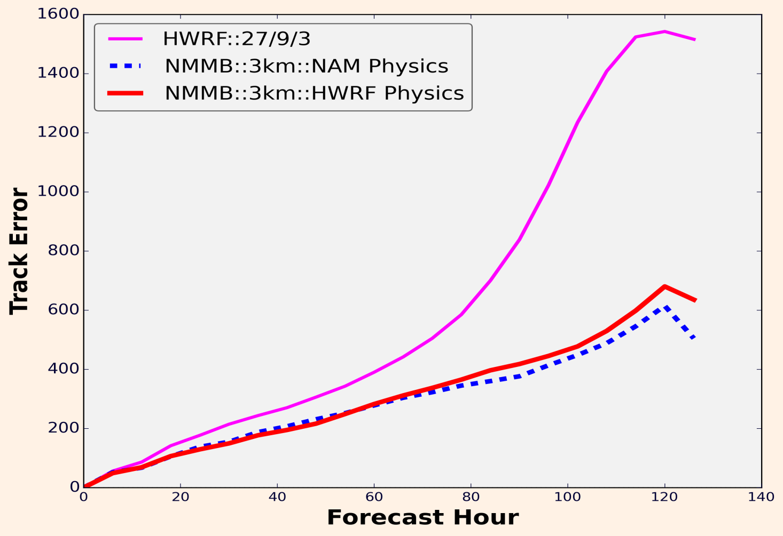
Basin Scale Nature Run
Objective:
Create a uniform high-resolution hurricane Nature Run
utilize new GEOS-5 G5NR Global Nature Run (7km)
72 vertical levels
capture small scale features of multiple hurricanes
Regional Nature Run
NMM-B with NAM physics
embedded in G5NR
3 km uniform resolution
61 vertical levels
Conclusion:
Uniform-3km resolution provides significant forecast improvement, especially for track
Ongoing work:
Increase resolution to 1km
Evaluation/validation of Nature Run output
Notes:
G5NR runs for 2 years
nesting degrades forecast
NAM physics for NR and HWRF physics for experiments---avoid the twin problem (( same model or same physics for both NR and expts produces unrealistic errors ))

Slide 23
G-IV Synoptic Surveillance Targeting
Motivation:
Investigate targeting procedure for synoptic surveillance sampling using NOAA G-IV (NHC)
Near-hurricane environment
Synoptic scale features
X
Current Procedure:
Use generic circumnavigation pattern around hurricane
Sample regions of highest variance in GEFS deep layer mean wind within 20 degrees of hurricane center location
Deploy sondes every 1-2 degrees
Performed 2-3 days before expected landfall
Extremely subjective

Slide 24
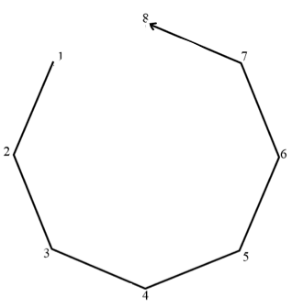
Objectives:
Near-storm environment:
Sensitivity to
Storm relative location
Pattern shape
Dropsonde distribution
Synoptic features:
Sensitivity to
Uncertainty in variable fields from ensemble forecasts
Dropsonde distribution
Evaluate using both regional and global forecast models
HWRF and GFS
Rotated figure 4
circumnavigation

Slide 25
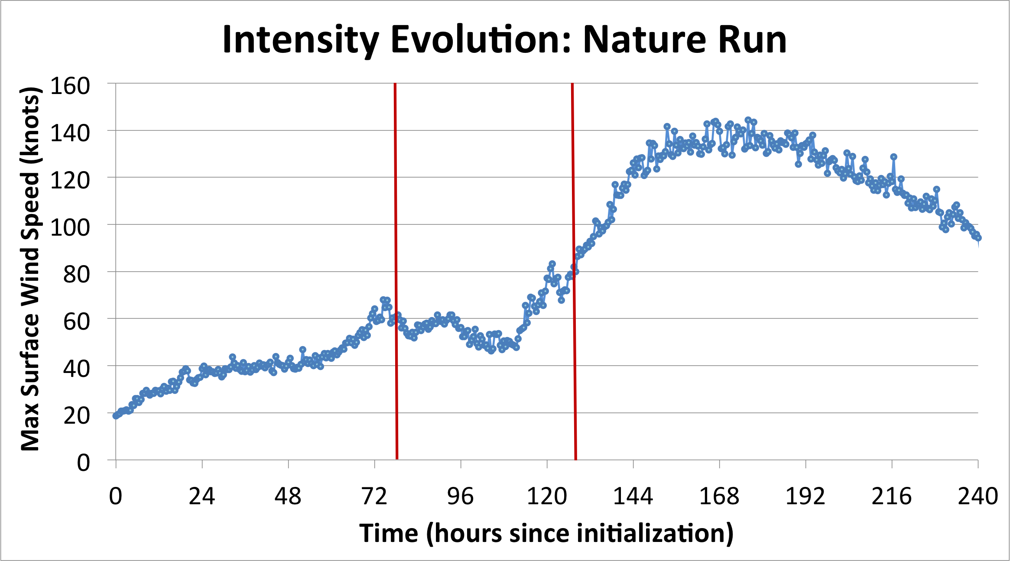
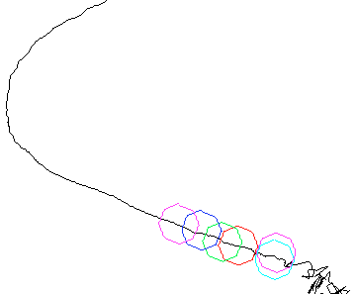
Sensitivity to Radial Distance from Center
Missions every 12 hours
Aug. 1 at 12 Z
Onset of RI
Aug. 4 at 0 Z
Dropsonde coverage:
every 40 degrees (storm relative)
Total Dropsondes: 60
In each mission:
# observations assimilated in experiment:
~ 27215
# observations assimilated in control:
~ 26200

Slide 26
Positive impact on track forecast out to
42 hours for 1.5 x R34
9 hours for 3 x R34
Positive impact on intensity forecast out to 42-60 hours
Little difference between regions
Does not mitigate “spin down”
Does not capture rapid intensification

Slide 27
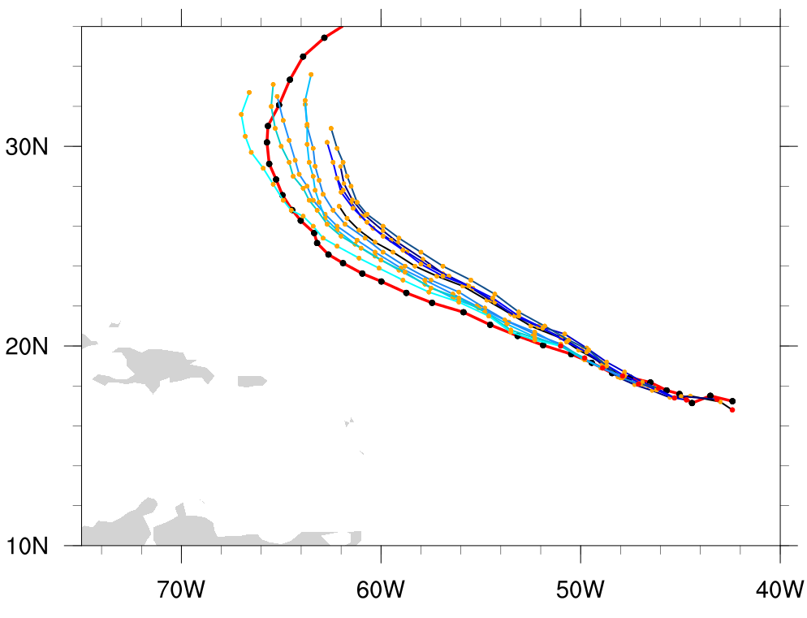
Circumnav. 1.5 X R34
Forecast tracks diverged ~ August 04 00Z
Vortex much smaller & weaker
AND
Subtropical ridge well represented
Vortex embedded within ridge
→ Steers northward
939 mb
982 mb
989 mb
Nature Run
Analysis
48-hr forecast init @ 0802 00Z

Slide 28
Circumnav. 3 X R34
Forecast tracks diverged ~ August 04 00Z
Vortex much weaker, vortex size preserved
AND
Subtropical ridge further south
Vortex embedded within ridge
→ Steers northward
939 mb
992 mb
982 mb
Nature Run
Analysis
48-hr forecast init @ 0802 00Z

Slide 29
Summary (limited # dropsondes)
G-IV dropsonde data provides a positive impact on both the track and intensity forecasts under 2-3 day range
This data does not capture RI of the NR
Observations nearest to the radius of 34-knot winds have the highest impact on track for a longer period of time
Little difference in intensity forecast depending storm-relative location
Track forecast errors are highly influenced by the strength and location of both the vortex and subtropical ridge

Slide 30
Objectives:
Near-storm environment:
Sensitivity to
Storm relative location
Pattern shape
Dropsonde distribution
Synoptic features
Sensitivity to
Uncertainty in variable fields from ensemble forecasts
Dropsonde distribution
Evaluate using both regional and global forecast models
HWRF and GFS
Rotated figure 4
circumnavigation

Slide 31
Track Forecast: most positive impact
with 1.5xR34 at 40º
Intensity Forecast: most positive impact with 3xR34 at 20º
NOTE: dropsonde density at
1.5xR34 at 40º = 3xR34 at 20º = ~ 200 km

Slide 32
Truth
Analyses (1.5xR34 and 3xR34)
Forecasts (1.5xR34 and 3xR34)
Center is dry, moisture highly asymmetric, dry air entrained into vortex
Dry air disrupts organization, but center not dry
Organized RH field, but center not dry
Center is dry but much more broad, entrained dry air does not penetrate the core
Higher RH values NW of center, drier to the E
Moisture fairly symmetric, captures higher RH E of storm
Both oversaturated; 3xR34 exhibits slight presence of WC
Both oversaturated, but center is dry; 3xR34 exhibits slight presence of WC

Slide 33
NR
ANL
Both more humid than truth
Environment N of storm drier and E of storm more saturated than truth
Higher RH exhibited over broader area

Slide 34
NR
FCST
Both more humid than truth
Environment N of storm more saturated than truth, new MCS to SW and stronger moisture source to SE
Both more humid than truth

Slide 35
Summary of Targeting Investigation
G-IV dropsonde data provides a positive impact on both the track and intensity forecasts under 2-3 day range
This data does not capture RI of the NR
Observations nearest to the radius of 34-knot winds have the highest impact on track for a longer period of time, but may be for the wrong reasons
Using the same spatial coverage at 3x the radius of 34-knot wind improves the intensity forecast at the expense of an accurate track forecast
Track forecast errors are highly influenced by the strength and location of the vortex, subtropical ridge, and westerly moving front
Intensity forecast errors are highly influenced by the asymmetry of the vortex and vortex position within synoptic scale flow especially (especially in regard to RH)

Slide 36
Additional Results from Radial Distance Sensitivity
Missions every 12 hours
Aug. 1 at 12 Z
Onset of RI
Aug. 4 at 0 Z
Dropsonde coverage:
every 40 degrees (storm relative)
Total Dropsondes: 60
In each mission:
# observations assimilated in experiment:
~ 27215
# observations assimilated in control:
~ 26200
Dropsonde AND flight level observations

Slide 37
No significant impact on track forecast
Intensity forecast consistently improved out to
42 hours in vmax
72 hours in mslp
“spin down” almost diminished
Distinct impact differences before/after onset of RI

Slide 38
Truth
Forecast w/o FL
Forecast w/ FL
Dry air S of center but does not disrupt RH in core; although still too far north, storm is farther from ridge
Again, more moisture N of storm, new MCS to SW, even stronger moisture source to SE

Slide 39
Nature Run
Before onset of RI
After onset of RI
Location of UL center is displaced from LL center
850 mb Wind
850 mb Wind
UL winds captured in analysis
→ Additional core information improves intensity forecast
200 mb Wind
200 mb Wind

Slide 40
Preliminary Summary of Adding G-IV Flight Level Observations
Assimilating flight level measurements improves intensity forecast despite lack of vortex initialization/relocation or ensemble DA
Does not affect track forecast
Different techniques may be more beneficial before/after onset of rapid intensification

Slide 41
Additional Ongoing Aircraft Experiments
In-house regional OSSE system upgrade (including NR and DA)
Evaluation of P-3 instrumentation for Hurricane Field Program
Optimization of UAS “Coyote” observing system
Assessment of multi-aircraft missions
Impact of Tail Doppler Radar radial velocities
Superobbing / density of observations
Orientation of aircraft
Optimization of Doppler wind LIDAR scanning patterns
Potential impact of Global Hawk Observations on hurricane track & intensity forecasts
Coordination of data collection with satellite passes
Assessing ensemble and hybrid DA methods for inner core

Slide 42
Questions?????
Kelly.Ryan@noaa.gov
lisa.r.bucci@noaa.gov
robert.atlas@noaa.gov
javier.delgado@noaa.gov
shirley.murillo@noaa.gov
frank.marks@noaa.gov
Rigorous OSSE Checklist: http://www.aoml.noaa.gov/qosap/osse-checklist/
HRD website: http://www.aoml.noaa.gov/hrd/
Twitter: https://twitter.com/HRD_AOML_NOAA
Facebook: https://facebook.com/noaahrd

Slide 43
TC Reference Slides

Slide 44
Tropical Cyclones
Defined by:
Deep convection near a warm-cored low pressure center
Closed surface circulation > 35 knots
Impacts:
Strong Winds
Storm Surge
Heavy Rain
Tornados
Typhoon
Hurricane
Cyclone

Slide 45
Tropical Cyclones
Negative correlation between Atlantic and Pacific ACE indices
Notes:
Average of 10 hurricanes per year
→ 2 major hurricanes

Slide 46
Anatomy of a Mature Hurricane
H
L
Positive feedback loop:
Energy evaporated from ocean (“surface flux”)
Enhances convection
Lowers pressure
Increases winds
Increases flux
Warm Ocean

Slide 47
Development (Genesis)
ITCZ
African Easterly Waves

Slide 48
Interaction with Environment
Hurricanes are steered by wind flow around high and low pressure regions
→ May track into unfavorable conditions
Unfavorable conditions:
Dry air decreases buoyancy
Vertical Wind Shear prevents vertical alignment
Wind Shear direction

