Slide 1
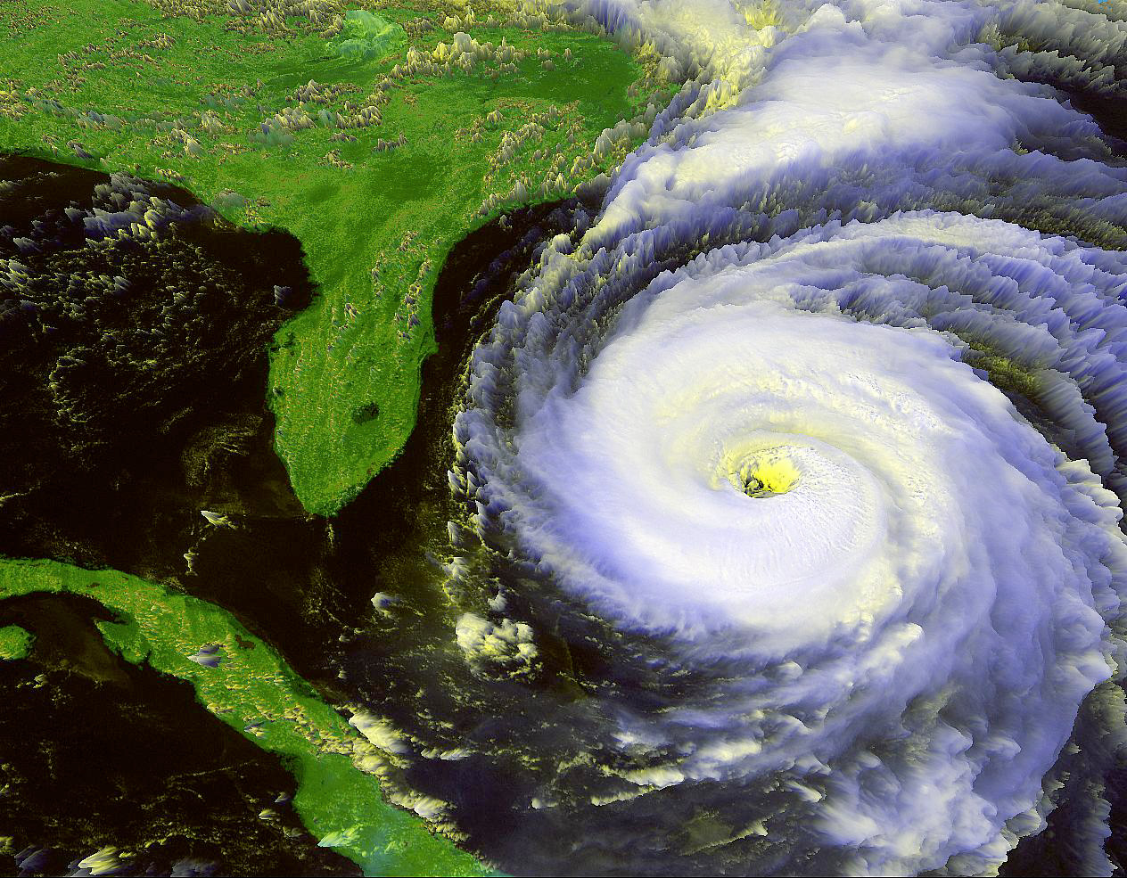

Landfalling Tropical Cyclone Rainfall Distributions
Frank D. Marks
AOML/Hurricane Research Division
26 April 2017

Slide 2
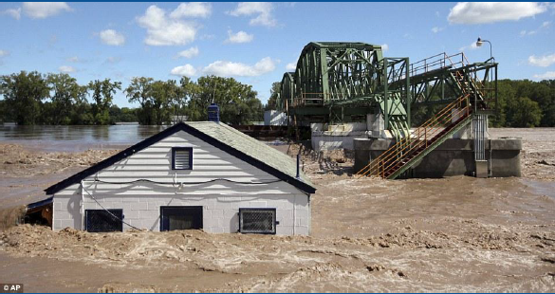
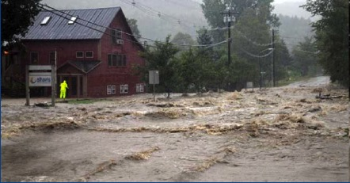
Why TC rainfall is important?
TCs pose significant flooding problem, i.e., Hurricanes Irene 2011 and Matthew 2016.
25-30% of TC deaths caused by freshwater flooding (Rappaport 2000, 2014).
Flooding is a function of rain rate & duration.
Enhanced rainfall at landfall from orography & antecedent rain from synoptic interactions.
Schoharie Valley, NY
Waitsfield, VT

Slide 3
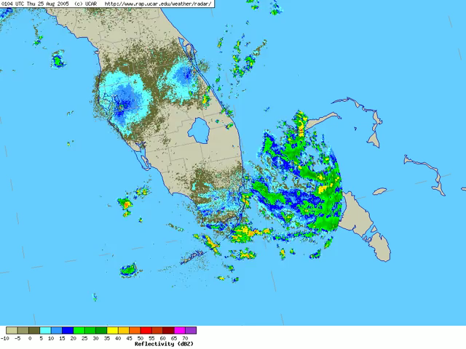
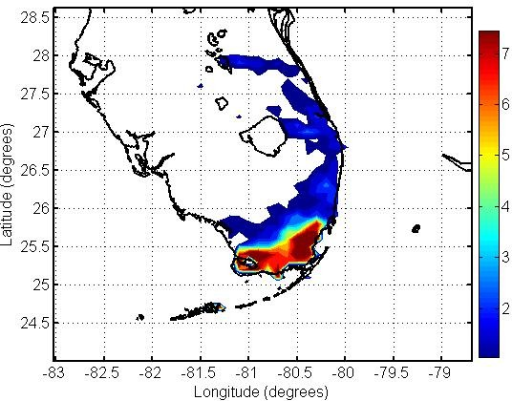
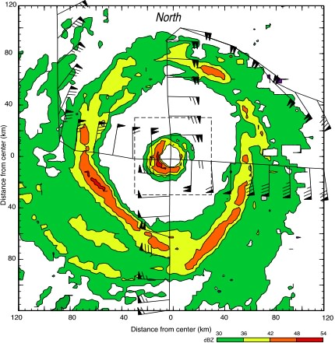
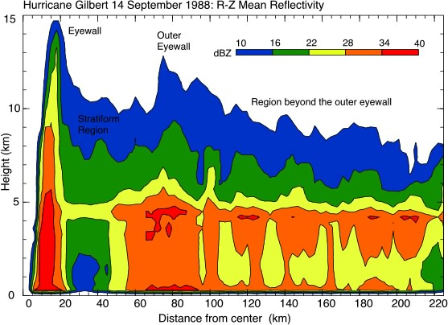
Characteristics of TC precipitation
Vortex constrains small scale (time scale V_{θ}/r).
Perfect laboratory for testing QPF techniques.

Slide 4
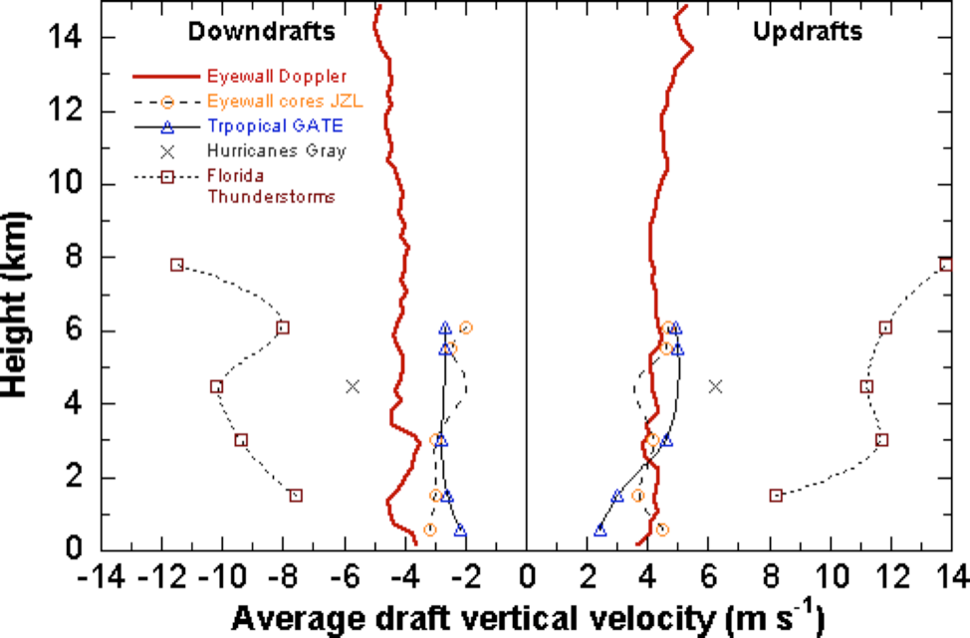
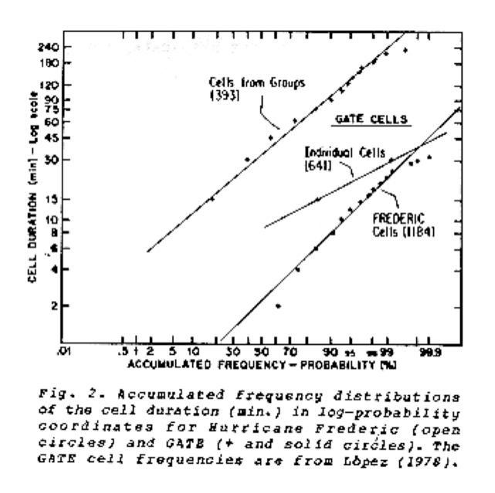
Characteristics of TC precipitation
w drafts: 3 km diameter, 10%>±6.5 ms⁻¹; 1%>±10.5 ms⁻¹, with 3 times more updrafts than down.
R cores: 50% diameters >3.7 km and 10% durations >8 min, cover 10% of rain area. 90% area stratiform.
(Jorgensen & LeMone 1989, Black et al, 1996)
(Parrish et al, 1982)

Slide 5
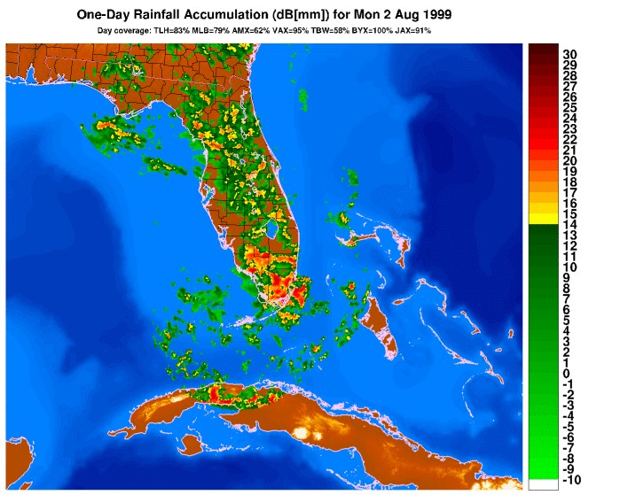
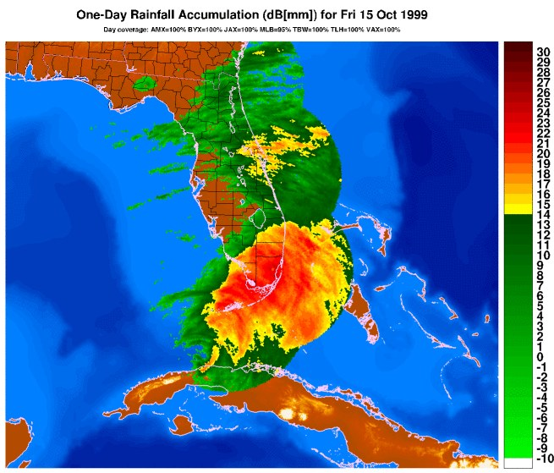
Characteristics of TC precipitation
Stratiform and Convective mechanisms
Stratiform rain ~50% of total rain from TC.
WSR-88D DPA daily accumulations
FL Convection (2 August 1999)
Hurricane Irene (15 October 1999)

Slide 6
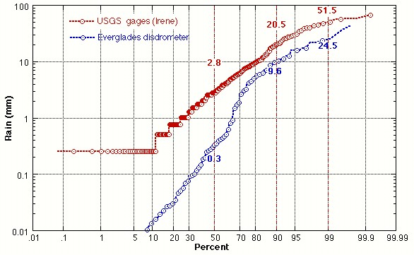
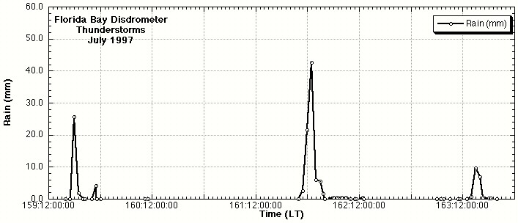
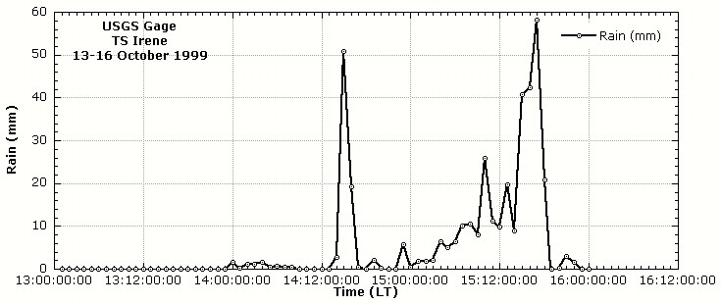
Characteristics of TC precipitation
Stratiform and Convective mechanisms
R σ
Irene 3.76 8.4
FL convection 3.01 5.8
FL convection
Hurricane Irene (99)
1-h rain gage accumulations

Slide 7
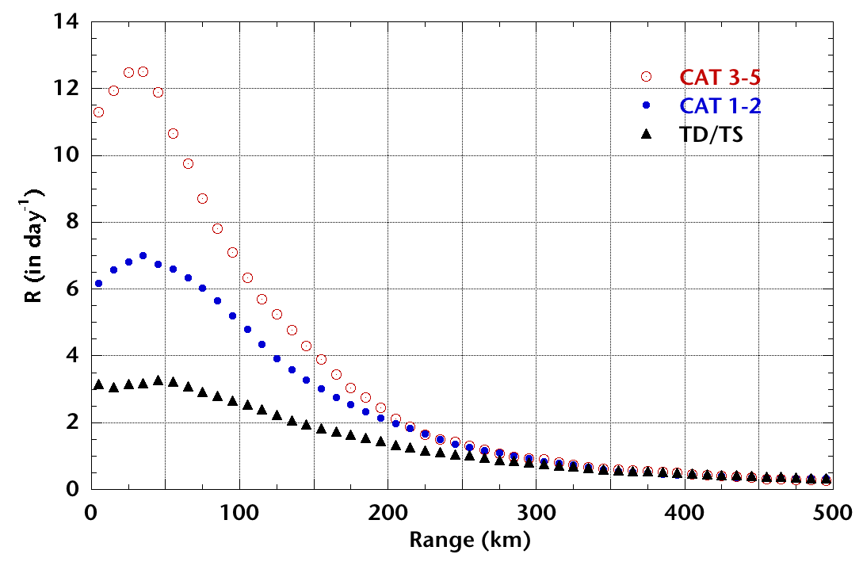
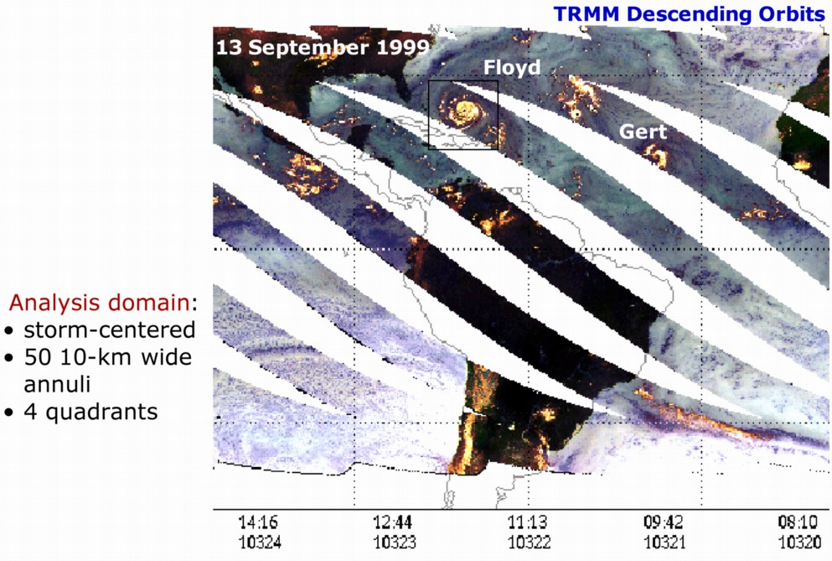
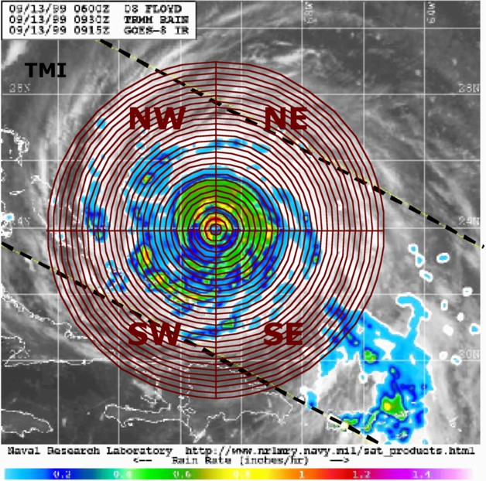
Characteristics of TC precipitation
5-Yr TRMM Microwave Imager (TMI) climatology
TMI over a 758.5 km swath ~5 km resolution. Surface rain (R, mm h⁻¹) estimates from T_{B}.
Storms:
TS 2577
CAT12 966
CAT35 436
Total 3979
Lonfat et al 2004

Slide 8
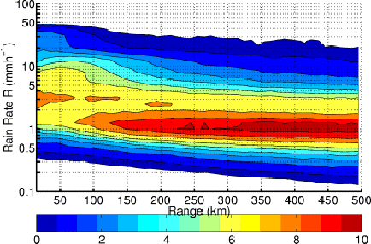
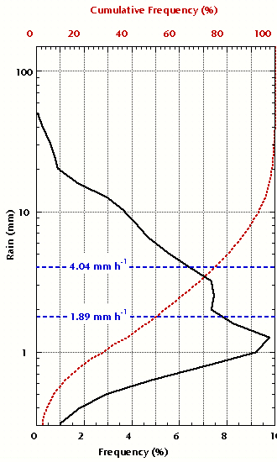
Characteristics of TC precipitation
TMI-500 km radius
(2121 events)
Lonfat et al 2004

Slide 9
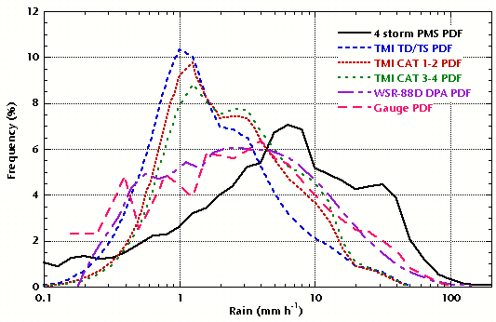
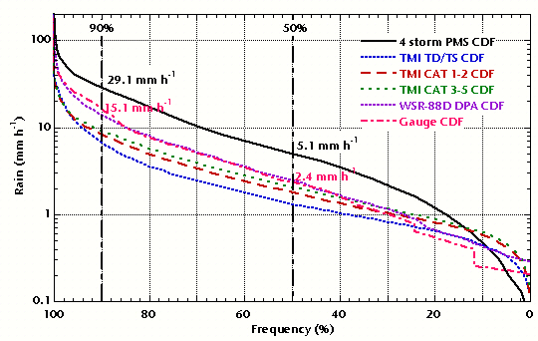
Characteristics of TC precipitation
Scale dependence:
  10-s PMS sample area ~1X10⁻⁶ km²
  1-h gage sample area ~1X10⁻³ km² (wind speed dependent)
  HWRF sample area 4 km²
  Stage IV radar sample area 16 km²
  TMI sample are 25 km²
  ≥10³ gages to cover radar/TMI/ model sample area
PDF narrower and skewed to smaller R as area increases

Slide 10
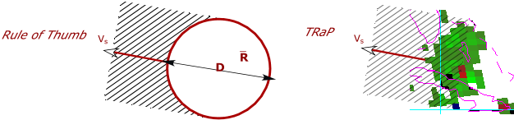
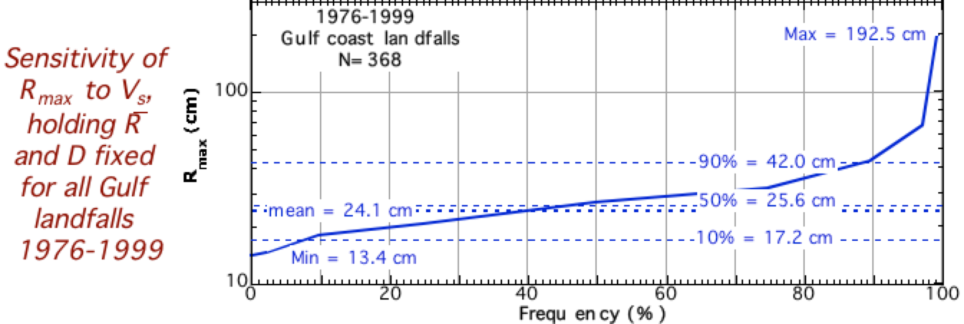
Characteristics of TC precipitation
Simplest TC QPF predicts R_{max}: R_{max}=RDV_{s}⁻¹
Sensitive to assumed R, D, and V_{s} from climatology.
e.g.,
Stumbling blocks: (1) mean R represents distribution (poor measure of non-normal distribution); (2) No adjustments for intensity, topography, etc.

Slide 11
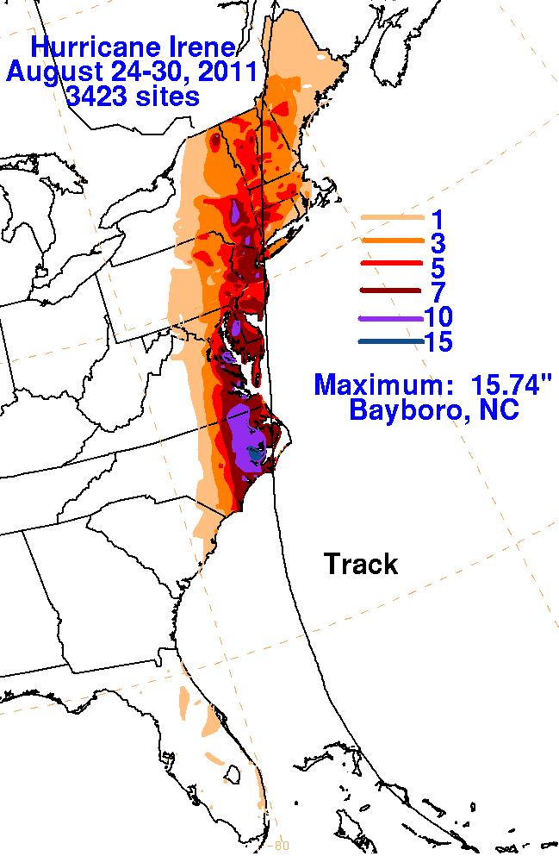
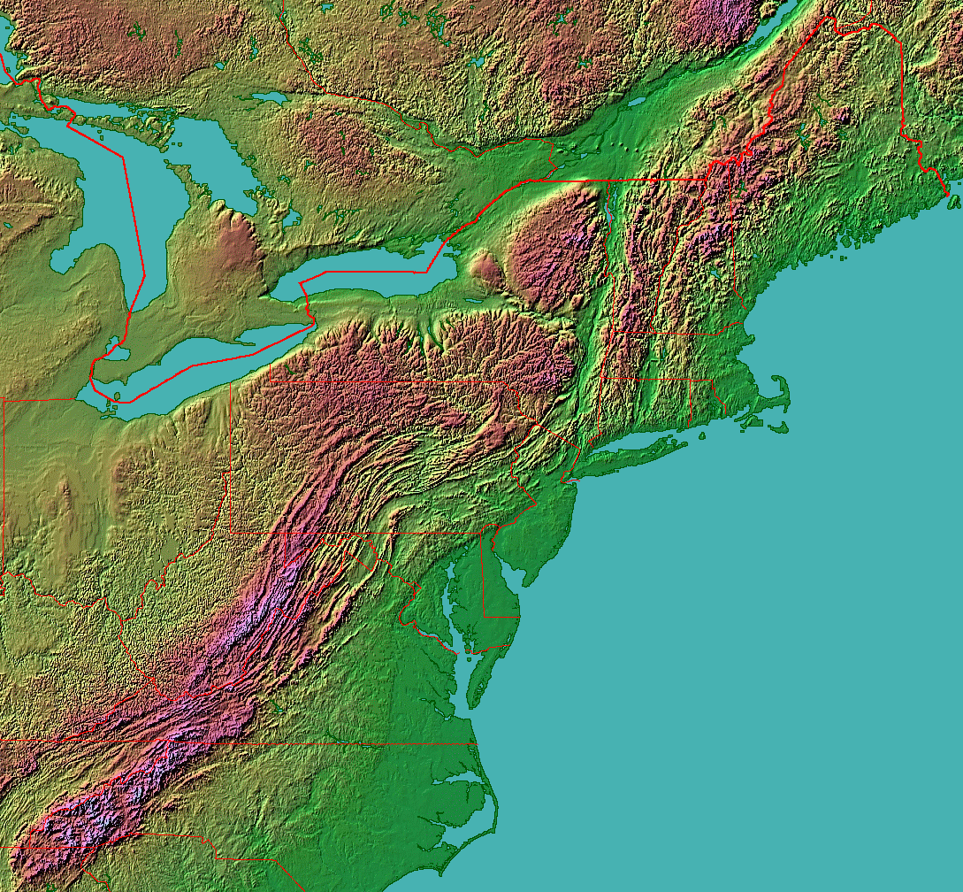
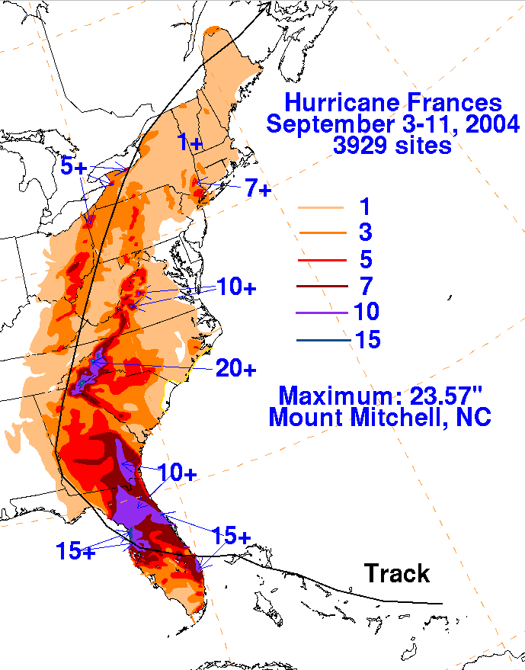

Orographic Enhancement
Catskills
White
Berkshires
Blue Ridge
Notes:
Hurricane Irene: Flood waters cross Route 100, closing the main road to traffic in Waitsfield, VT (Credit: Sandy Maoys, AP)

Slide 12
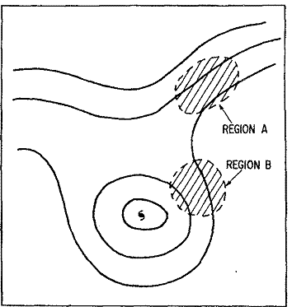
Predecessor Rain Events (PRE)
~1/3 of U.S. landfalling TCs produce at least one PRE
Separation Distance
1086 ± 482 km Median: 935 km
Event Duration
14 ± 7 h Median: 12 h
Time Lag
45 ± 29 h Median: 36 h
Conceptual model of antecedent rainfall
Fig. 13 from Bosart & Carr (1978)
Notes:
~1/3 of U.S. landfalling TCs produce at least one PRE, but landfall is not necessary

Slide 13
PRE Track Relative Position
PRE Locations Relative to TC Track 1998–2006
Potential for flooding in areas not directly impacted by TC rainfall
Potential for excessive flooding beginning before arrival of TC rainfall
26
12
9

Slide 14
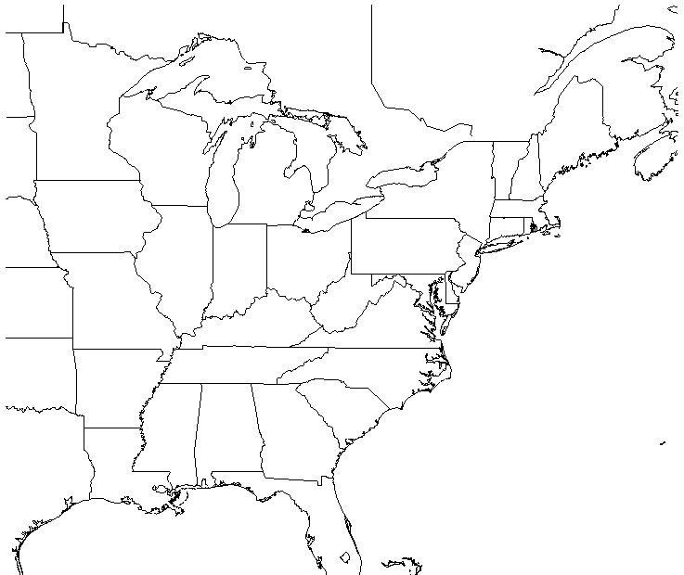
Conceptual Model
UL Jet
LL θ_{e}-Ridge Axis
PREs
ML Streamlines
TC Rainfall
Revised and updated from Fig. 13 of Bosart and Carr (1978)
Representative TC Tracks
Notes:
Cote (2007):
PREs tend to form in a region of confluence downstream of short-wave trough, within the equatorward entrance region of an upper-level jet streak
Precipitation focused along low-level baroclinic zones and along elevated terrain
Galarneau et al. (2010):
Low-level thermal advection and frontogenesis along a baroclinic zone important for PRE development
Ridging associated with diabatic outflow from TC intensifies jet streak

Slide 15
Contribution of TCs to global precipitation
Regional, seasonal, and interannual variations (Jiang and Zipser 2010)
TCPF database: 1998-2006, 771 TCs in six basins: ATL, EPA, NWP, NIO, SIO, and SPA.
Mean monthly rainfall from TRMM 2A25 is derived in 5x5°grid box for non TCPFs and TCPFs for 1998-2000 and 2002-2006 during June-Nov for northern hemisphere and for southern 1998/1999- 2005/2006 during Nov-April hemisphere (total 8 years).

Slide 16
Monthly Rain: Non-TC, TC, & %

Slide 17
Basin Averaged Mean Monthly Rainfall for Each Month

Slide 18
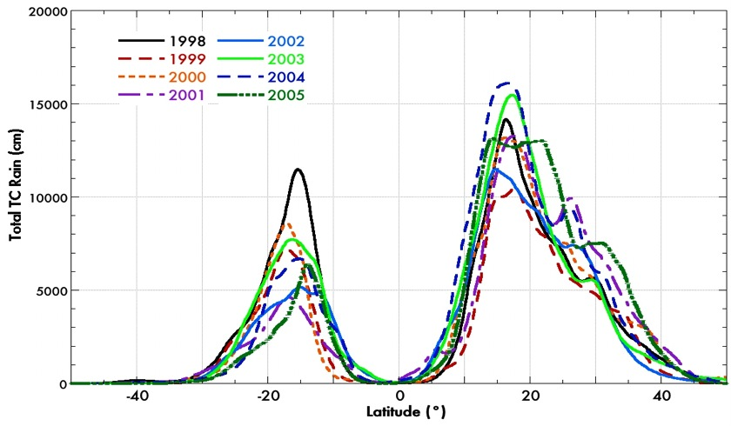
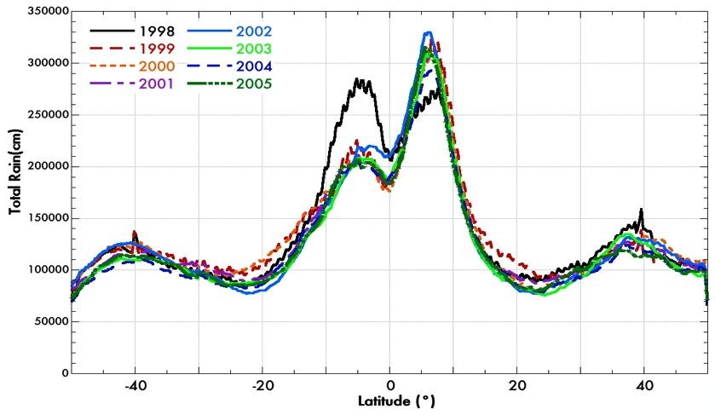
Global Results
TC Rain
TC rainfall peaks when global rainfall is low
Asymmetric-generally more rain in the Northern Hemisphere
Global rainfall is decreasing with increasing latitude while TC rainfall is increasing
TC contributes 10-17% of global rain 15-30° poleward from Equator (subtopics)
Global Rain
3B-43

Slide 19
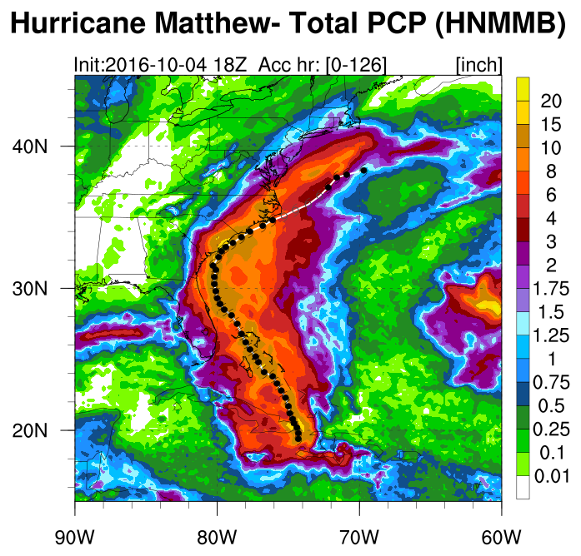
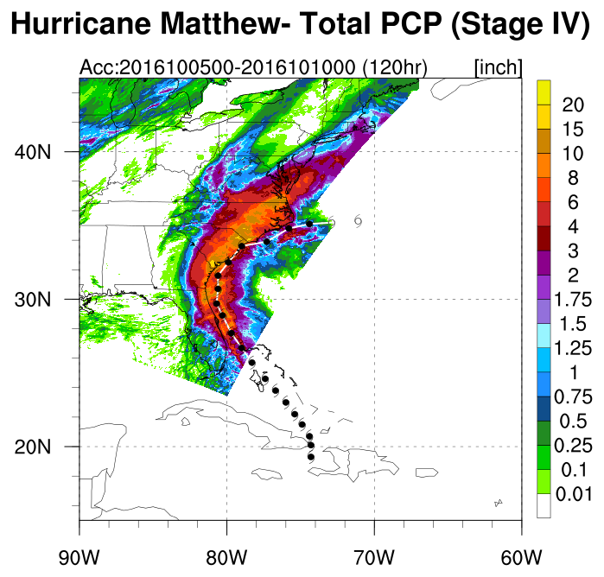
Where do we go from here?
Evaluate TC Quantitative Precipitation Forecasts (QPF)
Model
Stage IV radar/gage
Notes:
Ferrier & Aligo microphysics

Slide 20
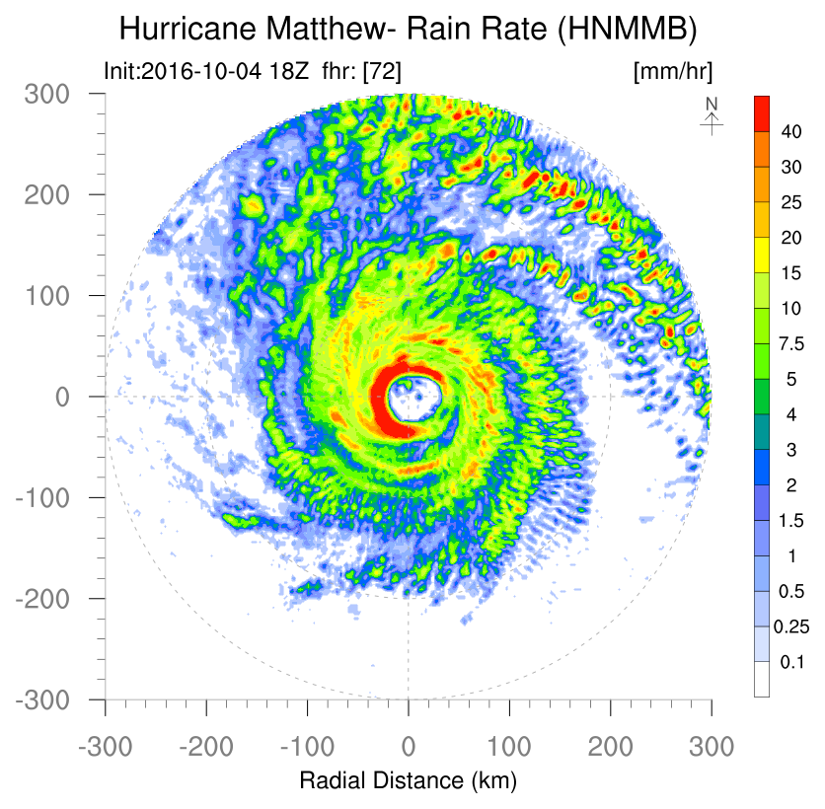
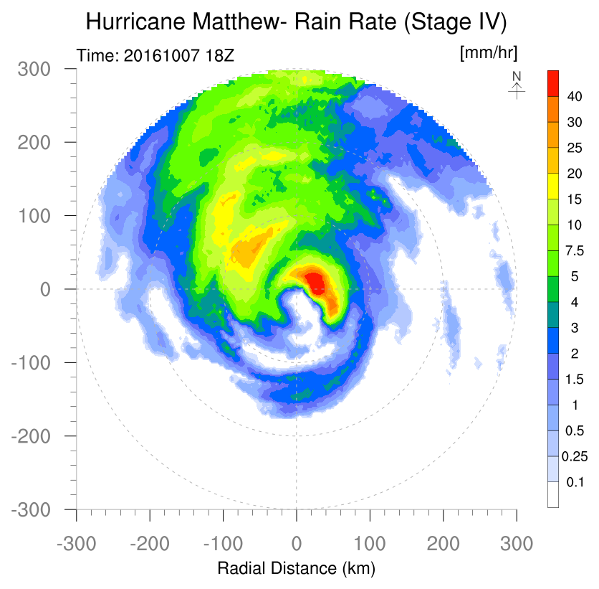
Where do we go from here?
Evaluate TC QPF
Model radial and azimuthal rain structure similar to Stage IV, except model is more cellular

Slide 21
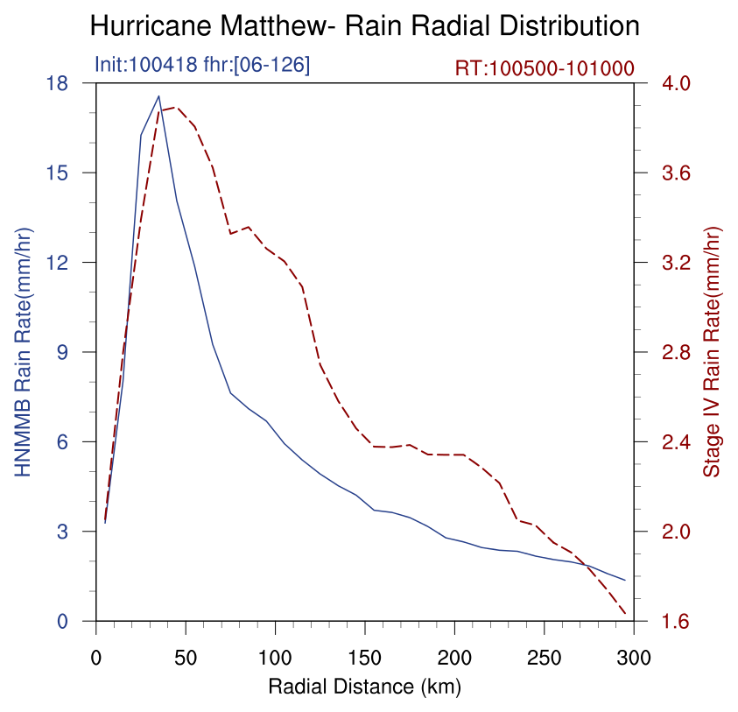
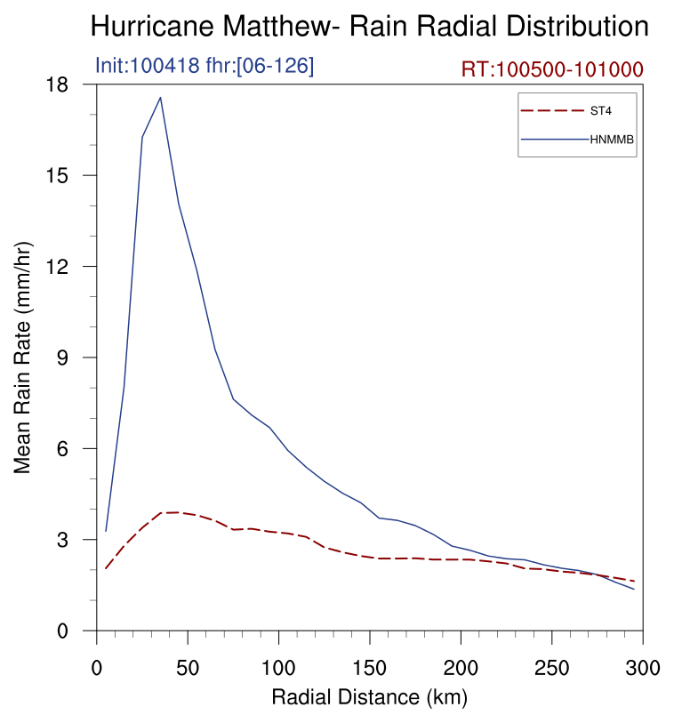
TC QPF
Evaluate TC QPF
Model and Stage IV show similar radial rain rate structure
Model drops 4.5 times as much rain in the core compared to Stage IV

Slide 22
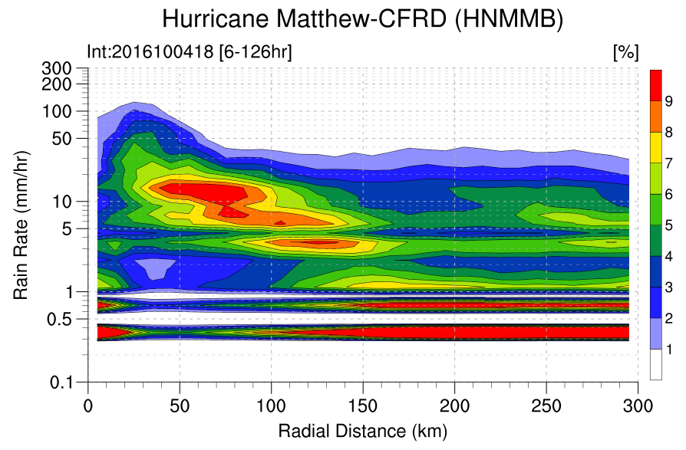
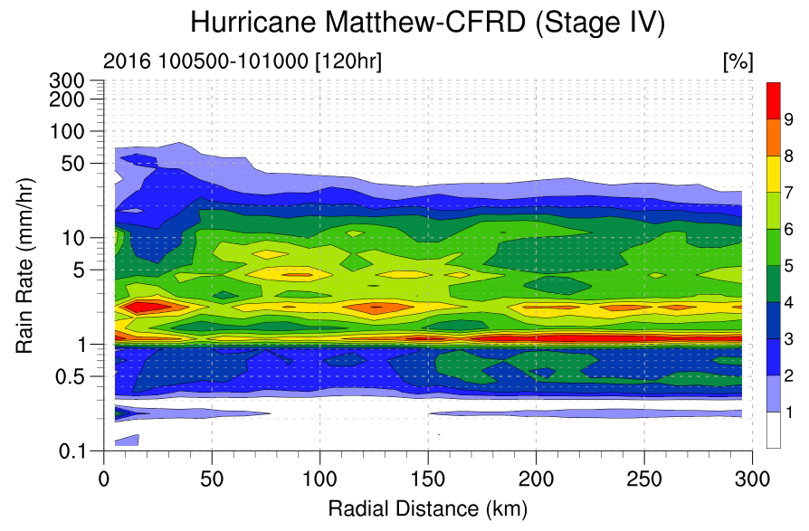
TC QPF
Evaluate TC QPF
Model overestimates rain rates >5 mm h⁻¹ compared to Stage IV
Model underestimates rain rates <5 mm h⁻¹ compared to Stage IV

Slide 23
TC QPF Evaluation
  Model produces realistic rain structure in the eyewall and rainbands compared to Stage IV, with the peak in the eyewall and convective cells in rainbands outside
  Model produces too high average rain rates in the core of the storm (radius <150 km) compared to Stage IV
  Model has too high a frequency of rain rates >5 mm h⁻¹, and too few rain rates <5 mm h⁻¹ in the core of the storm (radius <150 km) compared to Stage IV
  It appears that model microphysics parameterization has a tendency to produce too high rain rates in convective regions

Slide 24
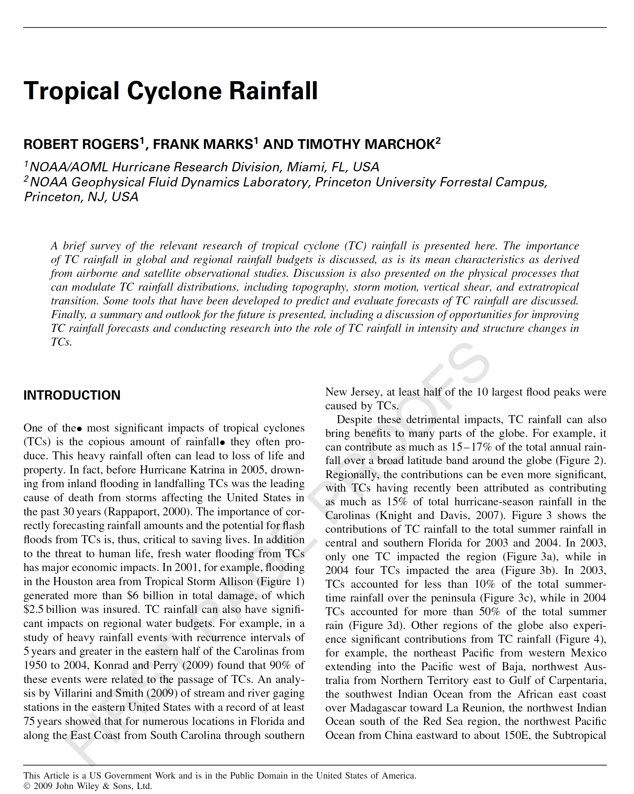
References
Bosart, L. and F. Carr, 1978: A Case Study of Excessive Rainfall Centered Around Wellsville, New York, 20–21 June 1972. Mon. Wea. Rev., 106, 348–362
Carr, F. and L. Bosart, 1978: A Diagnostic Evaluation of Rainfall Predictability for Tropical Storm Agnes, June 1972. Mon. Wea. Rev., 106, 363–374
Galarneau, T., L. Bosart, and R. Schumacher, 2010: Predecessor Rain Events ahead of Tropical Cyclones. Mon. Wea. Rev., 138, 3272–3297
Galarneau, T., 2015: Influence of a Predecessor Rain Event on the Track of Tropical Cyclone Isaac (2012). Mon. Wea. Rev., 143, 3354–3376
Lonfat, M., F. D. Marks, S. Chen, 2004: Precipitation distribution in tropical cyclones using the tropical rainfall measuring mission (TRMM) microwave imager: A global perspective. Mon. Wea. Rev., 132, 1645-1660. doi: http://dx.doi.org/10.1175/1520-0493(2004)132<1645:PDITCU>2.0.CO;2
Rogers, R.F., F. D. Marks, and T. Marchok, 2009: Tropical Cyclone Rainfall. Encyclopedia of Hydrological Sciences. Malcolm G. Anderson (Ed.), Chichester, UK: John Wiley & Sons, Ltd. doi: http://dx.doi.org/10.1002:0470848944.hsa030

