Slide 1
DIY Brownbag Series:
STEM Outreach
Kelly Ryan, Lisa Bucci, Renellys Perez
December 15, 2017
Notes:
Today we are going to test the effects of temperature and salt on density.

Slide 2
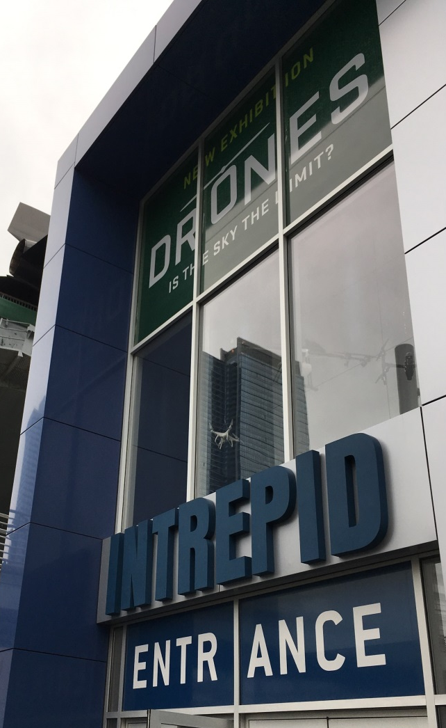
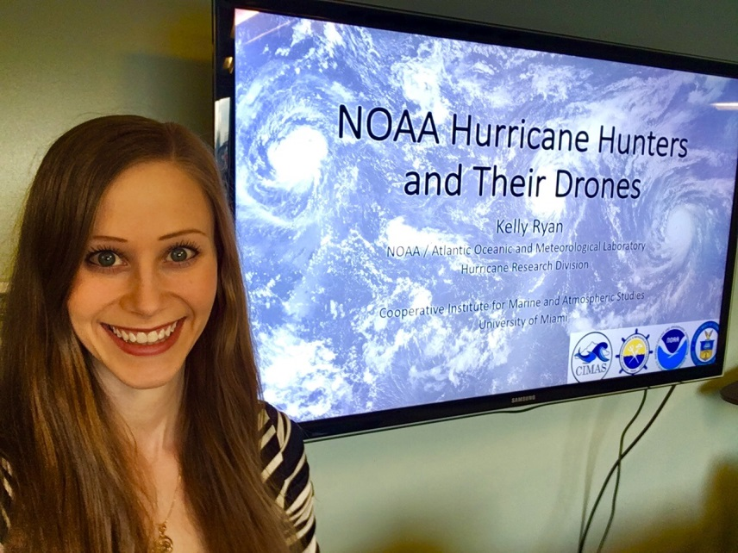
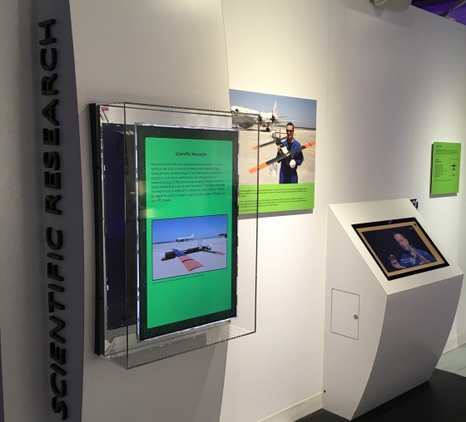
GOALS Forum: “Drones are Here!” Intrepid Air, Sea, and Space Museum November 17, 2017 New York City, NY
Greater Opportunities Advancing Leadership and Science
Notes:
Museum located on the Hudson River in Manhattan on the retired USS Intrepid aircraft carrier
Featured exhibit on drones where NOAA’s UAS Coyote is on display
GOALS (describe acronym): program designed to equip young girls with the skills and resources they need for academic and career success in a STEM field
~90 kids (mostly girls) ages 5 to 18 years old + ~15 parents
Split into 3 groups and rotated through three unique workshops about drones and their applications
→ wildlife monitoring, hurricanes, and how to build your own drone
Speakers in addition to myself: group of undergraduate students from NY Institute of Technology, and a recent graduate of NYIT using her drone to monitor animals in Africa
Students were able to build and operate their own mini-drone and brainstorm ways they could use their drones to benefit society

Slide 3
“NOAA Hurricane Hunters and Their Drones”
What are hurricanes? Why do we care about them?
Why do we need planes AND drones for hurricanes?
What types of drones are used for improving hurricane prediction? What do they tell us?
What career steps can you take to get a STEM position
Notes:
The title of my talk was….
What I wanted the audience to take away from this talk are the answers to these questions (read questions)

Slide 4
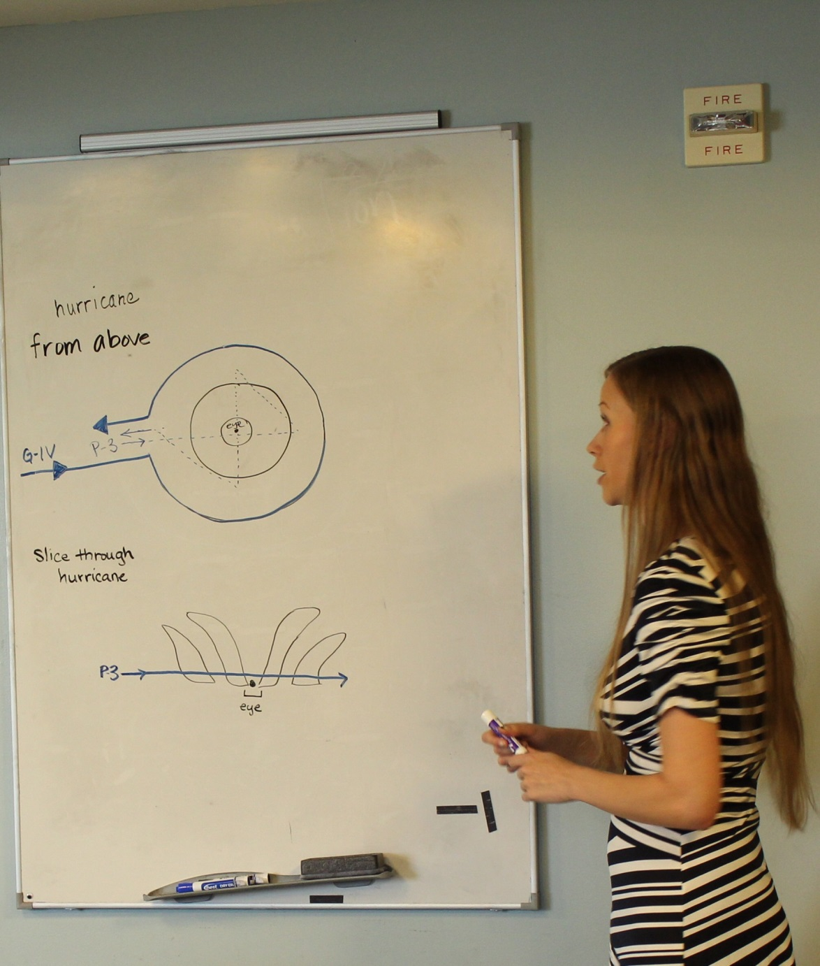
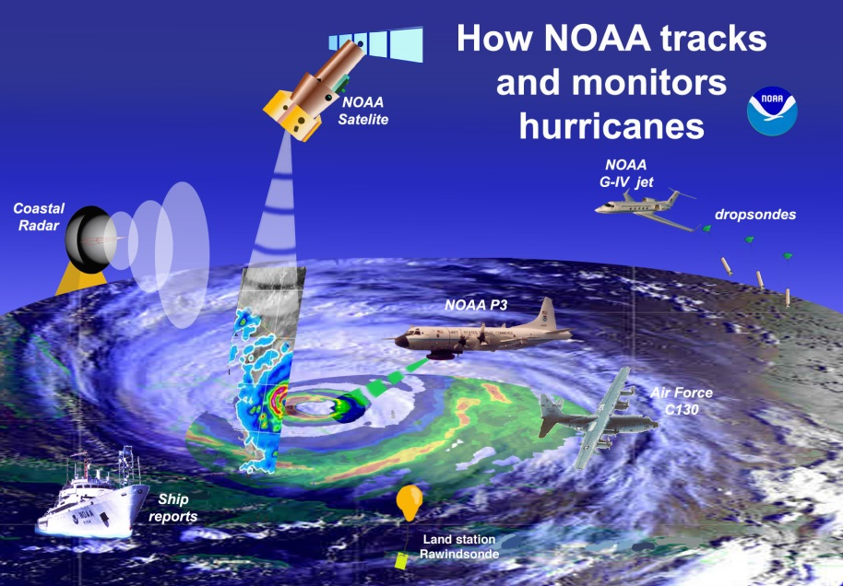
“NOAA Hurricane Hunters and Their Drones”
Global Hawk
+
+
+
+
+
+
+
+
Coyote
+
+
+
+
+
Global Hawk
+
+
+
+
+
Coyote
Notes:
Much of this was an interactive question and answer format; many students were able to contribute to the discussion using guided questions that could point them in the right direction
Hurricanes are low pressure weather systems that form over the tropical ocean; they get their energy through fluxes from the ocean surface
They can cause destruction and loss of life due to winds, rain, storm surge, and severe weather
NOAA monitors hurricanes so that the NWS can provide information to the public so they can minimize damage
Due to instrument limitations, NOAA needs to fly planes into hurricanes to collect direct measurements of the atmosphere over the ocean where regular weather observations are scarce
these data are used in numerical models to improve the forecasts
We are still left with gaps in coverage (figure)
So what I did was indicate on the whiteboard places where we get data
And draw where we get additional data while using NOAA drones

Slide 5
Careers and how to get there
Level of Education
Forecasting vs. research vs. teaching
College
Majors depend on science vs development
College choice depends on goal (i.e. aviation, business, technology)
Teaching: depends on level
Forecasting: specialize or general
Research: make your own experiments vs. work on someone else’s

Slide 6
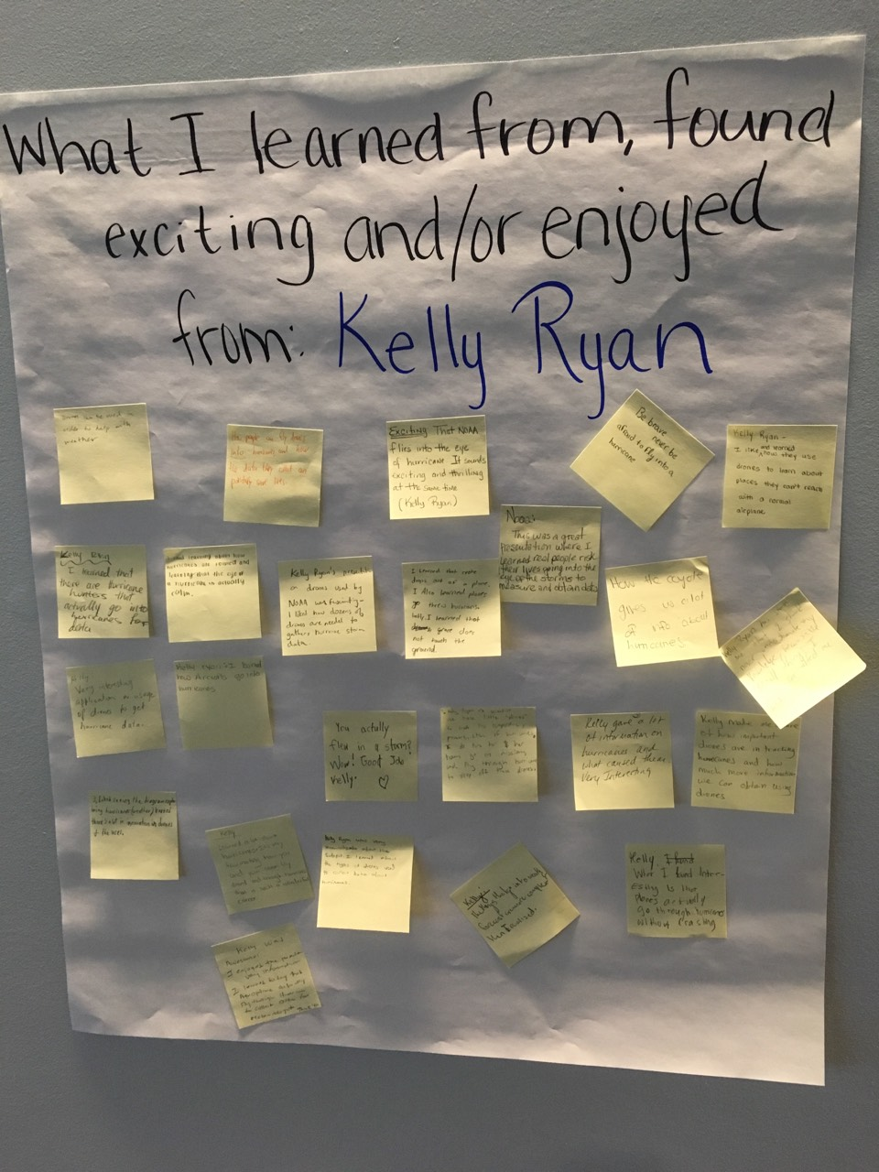
What did they take away from the event?
“ I liked how they use drones to learn about places they can’t reach with a normal airplane”
“ The things that go into weather forecasts are more complex than I realized”
“ I liked learning about how hurricanes are formed and that the eye is actually calm”
Notes:
How do we know what the audiences actually takes away from the talk?
The event coordinator required each student to write one thing they learned about each talk on post-it notes
Can also gauge the receptiveness by questions they asked:
“Why can’t satellites see through clouds?”
“If a hurricane is a low pressure system, why is the eye clear?”
“Do you find the drones and dropsondes after they are deployed?”
“What is”

Slide 7
What did I take away from the event?
Did I say that already…?
THAT much school ?!?!?!
Notes:
It’s a lot harder than I thought to give the same talk multiple times back to back: I found myself wondering what I said to which group
Older kids worry more about how long school will take as opposed to what you learn in school to help with your career goals

Slide 8
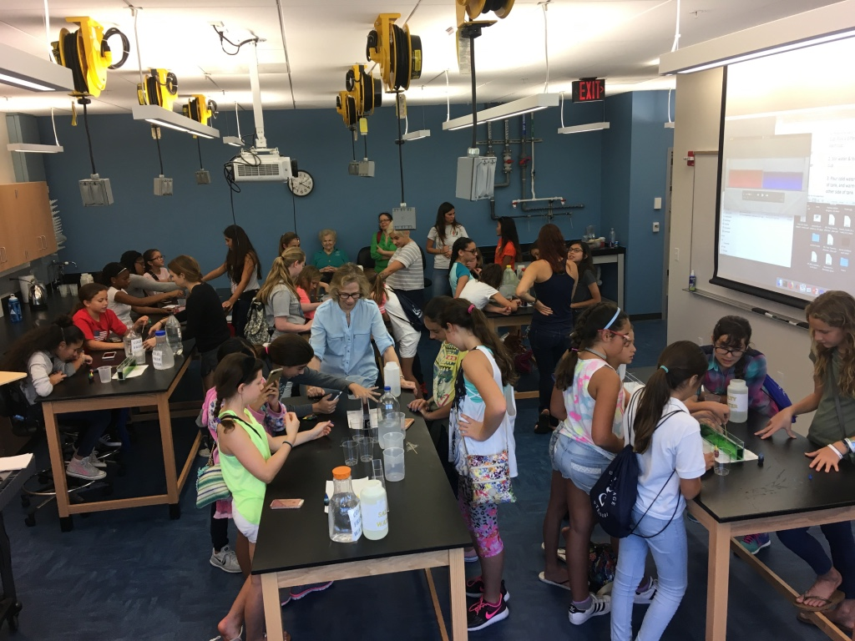
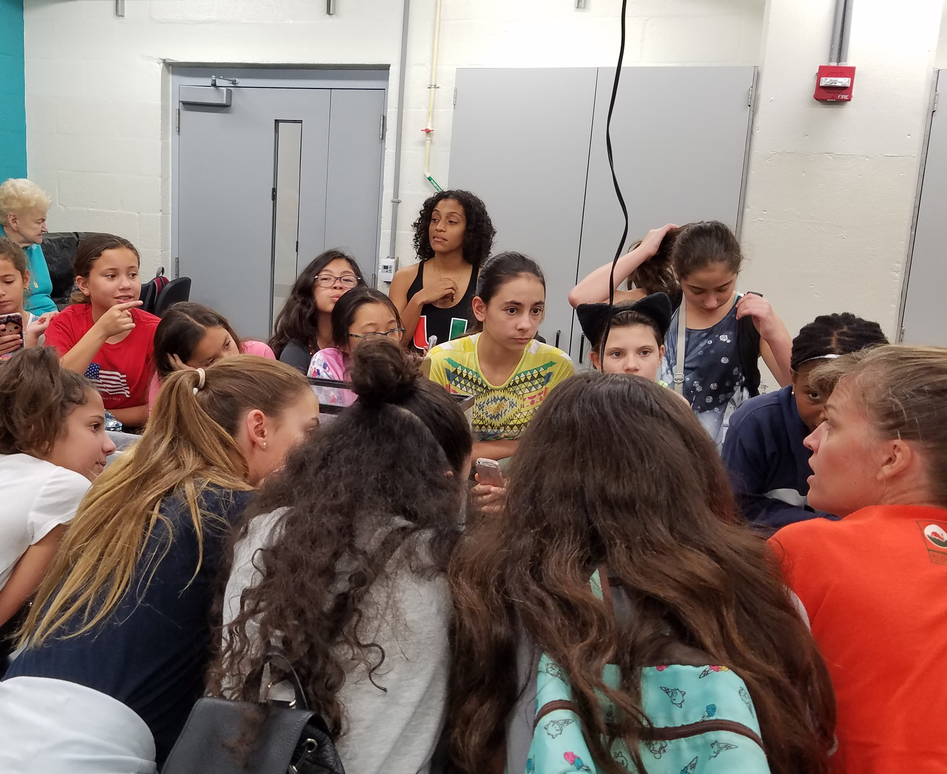
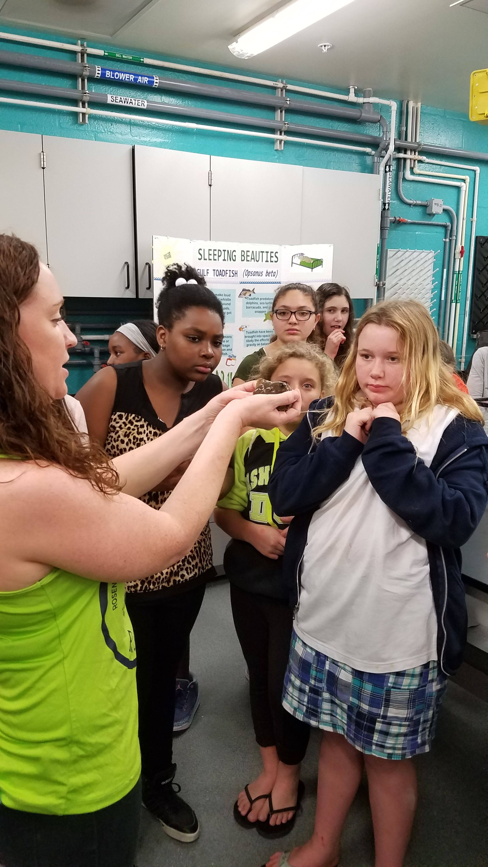
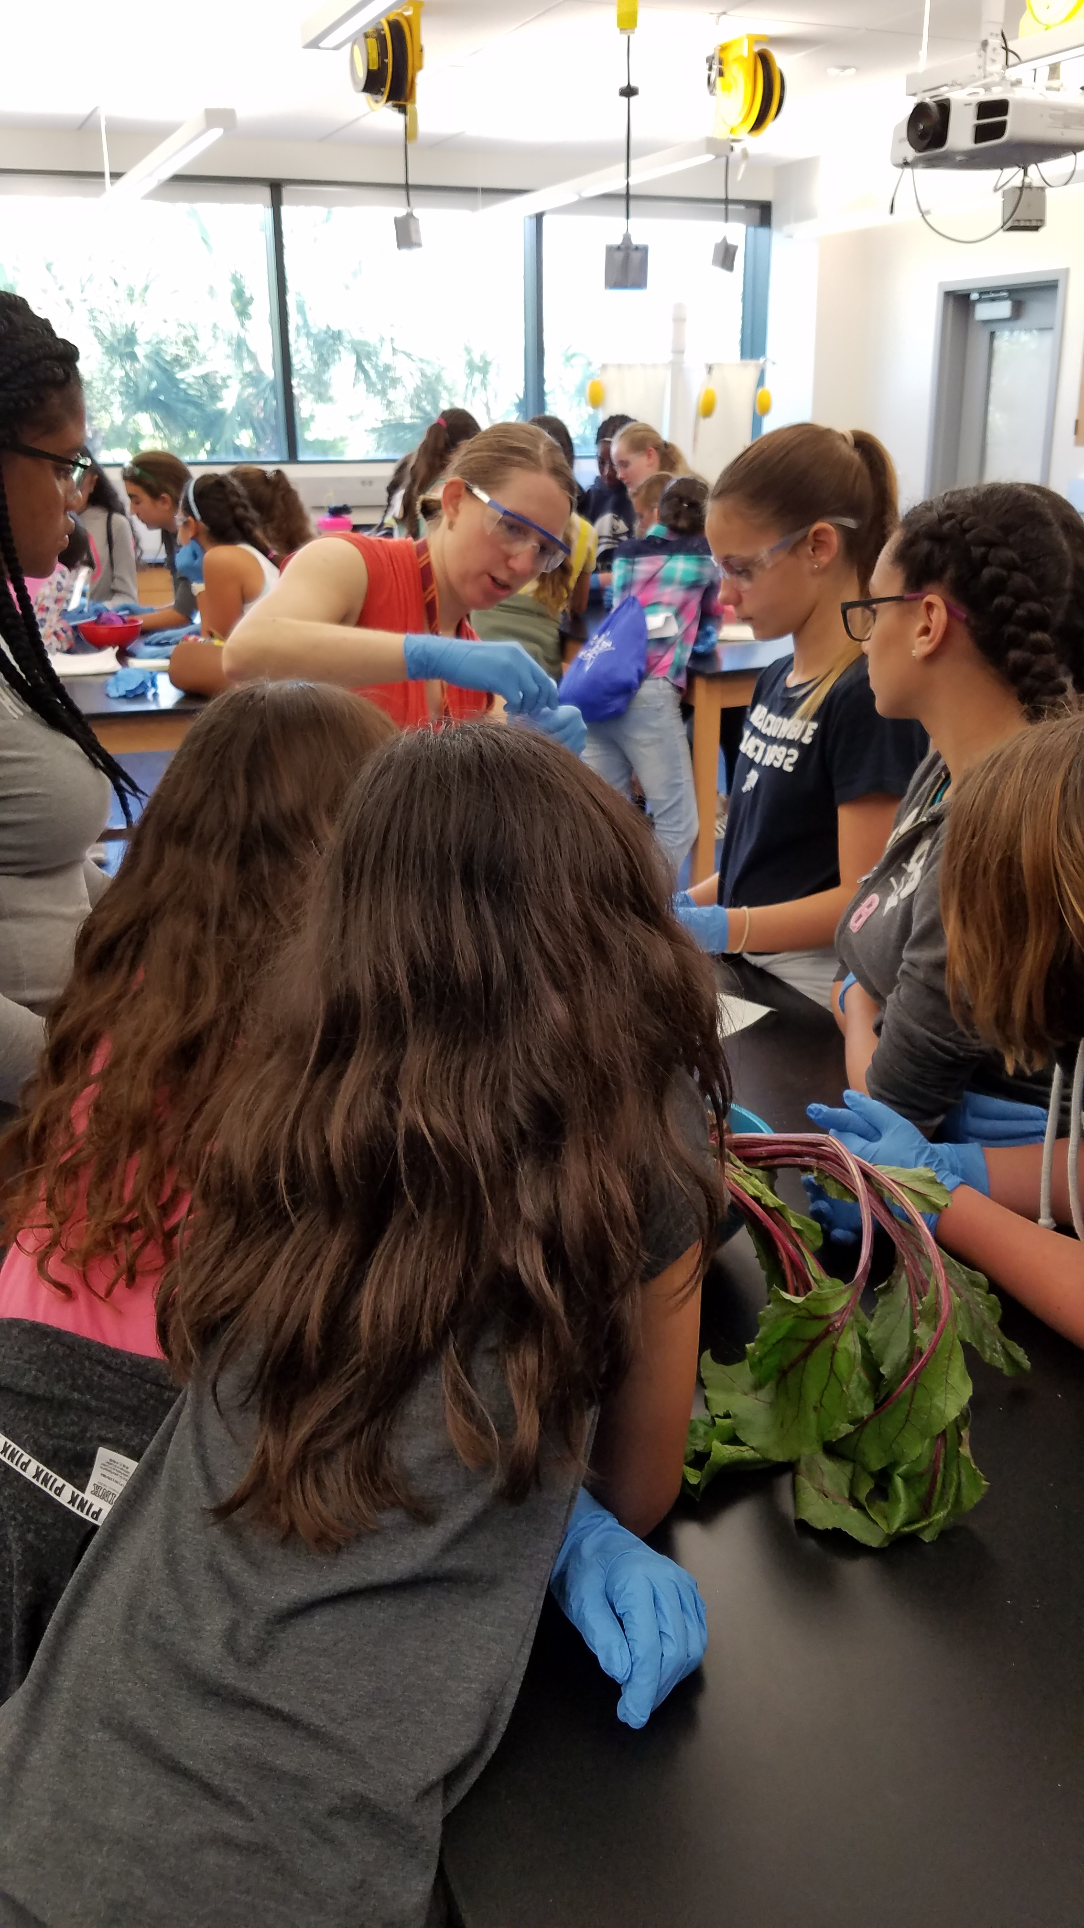
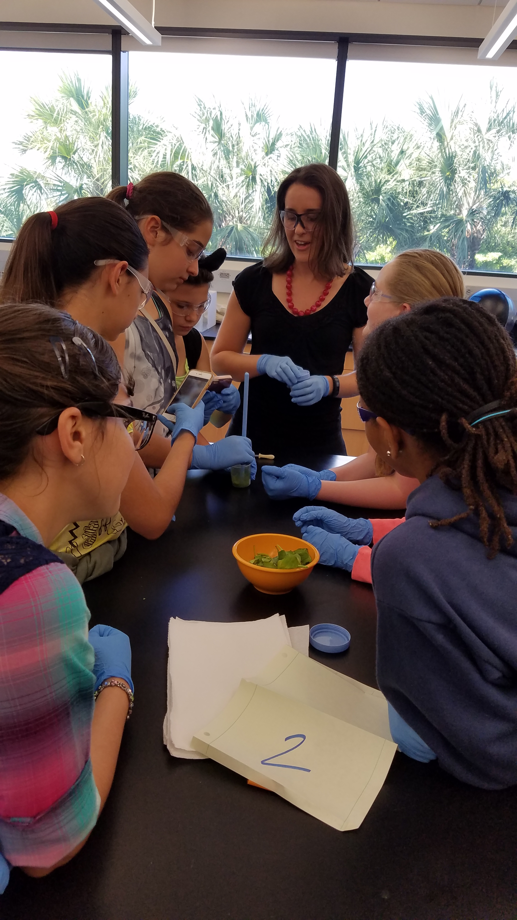
What is the event?
What: Exploring Marine Science Day
Where: UM/RSMAS
When: Nov. 18, 2017 (9am –3pm)
Who: 50 female middle school students, 2 groups
Sponsors: UM/RSMAS, AAUW, CARTHE
Volunteers: Female faculty, scientists, students running 30 minute interactive science demos
Notes:
What is density? Density is the ratio of mass to volume of a substance. So for the same volume, if a substance is heavier it is denser.
Differences in density in the ocean create layers with lighter layers near the surface and heavier/denser layers at the bottom.
In the ocean, the density layers are not flat, and this can set up ocean currents.
The density of seawater depends on temperature, salinity (how salty the seawater is), and pressure.
Today we are going to focus on how temperature and salt affect density.

Slide 9
What did I want to happen during Density’s Child demo?
Demo 1
Demo 3
Warm
Cold
Fresh
Blend
Salty
Demo 2
Demo 4
Salty
Fresh
Fresh
Salty
4 mini-demos to:
Learn about influence of temperature and salinity on density
Form density layers
Observe convection currents
Learn about how fresh ice melts over fresh vs. salty water
Notes:
[If video doesn’t work, show this]
Experiment 1:
When you warm water its volume expands, so its density decreases.
When you cool water its volume contracts, so its density increases.
So warm water is lighter than cold water. You should have observed that the cold water sinks to the bottom.
Experiment 2:
When you add a salt to water, you increase its density.
So Fresh water is lighter than salty water. You should have observed that the salty water sinks to the bottom.
We also set up a current in the tank due to the density differences

Slide 10
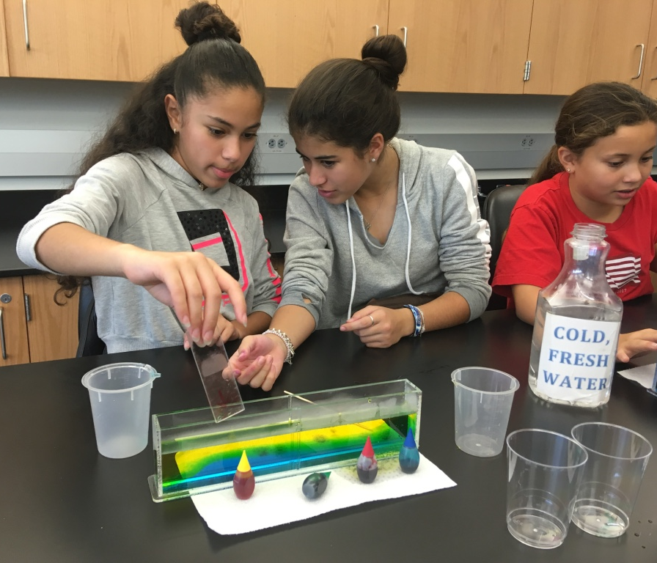
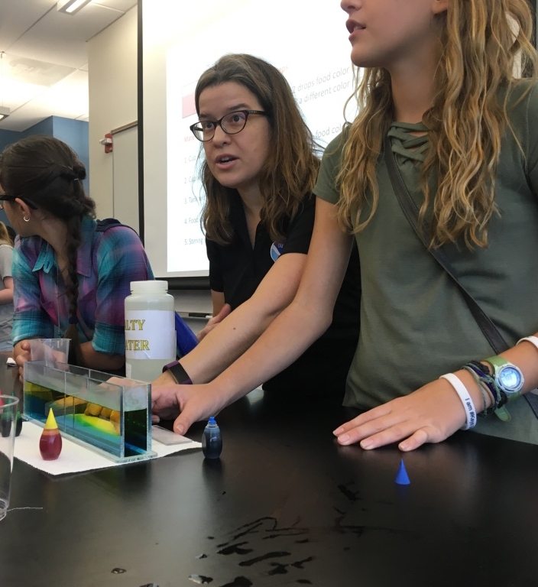
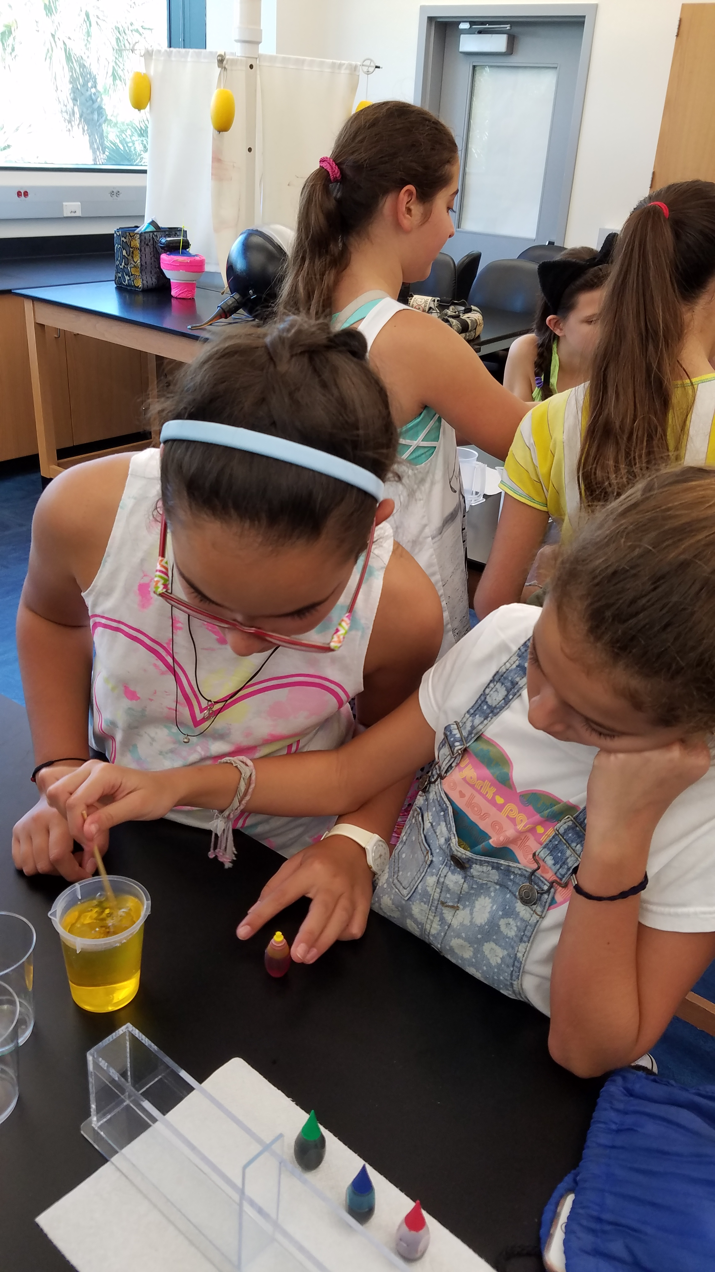
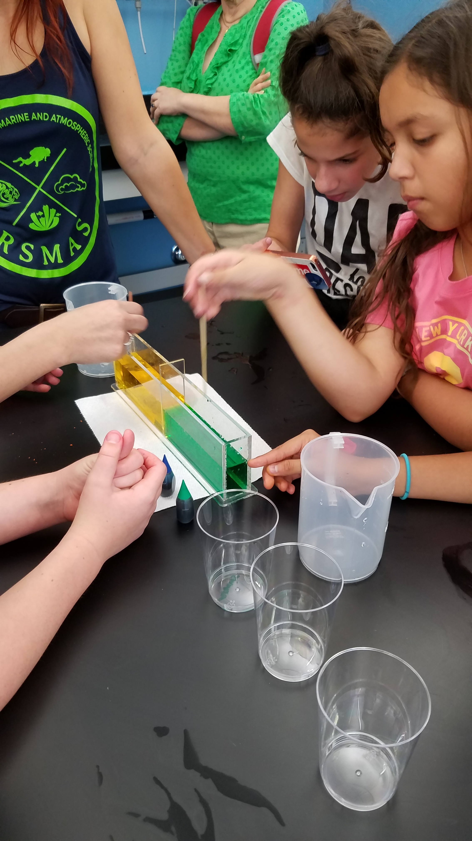
What actually happened?
The demos were fun and successful
The students worked in groups with a volunteer guiding them
We allowed them to mix their own ingredients - which led to food coloring fun, messy science, a little chaos
Some groups worked at a faster/slower pace than others
The volume level increased as the students worked on experiments
It was hard to get all of the students to pause/listen to get the take home message
Some of the kids mixed the layers in demo 2 which they needed for next demo
Sharing of supplies didn’t work!
Notes:
[If video doesn’t work, show this]
Experiment 1:
When you warm water its volume expands, so its density decreases.
When you cool water its volume contracts, so its density increases.
So warm water is lighter than cold water. You should have observed that the cold water sinks to the bottom.
Experiment 2:
When you add a salt to water, you increase its density.
So Fresh water is lighter than salty water. You should have observed that the salty water sinks to the bottom.
We also set up a current in the tank due to the density differences

Slide 11
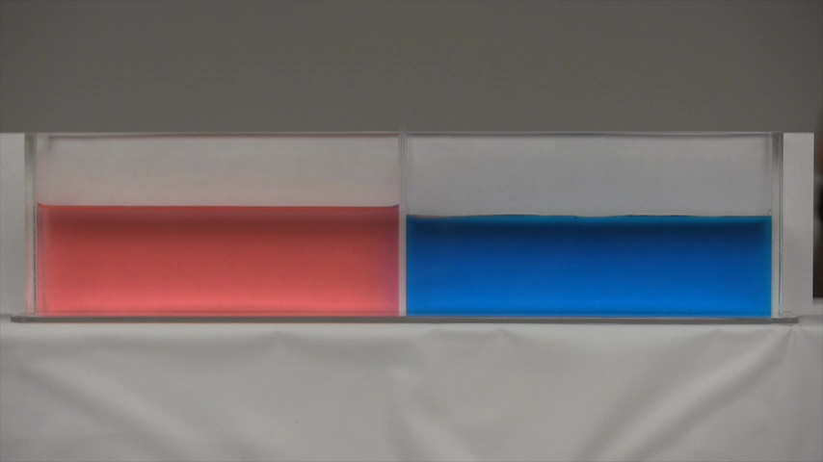
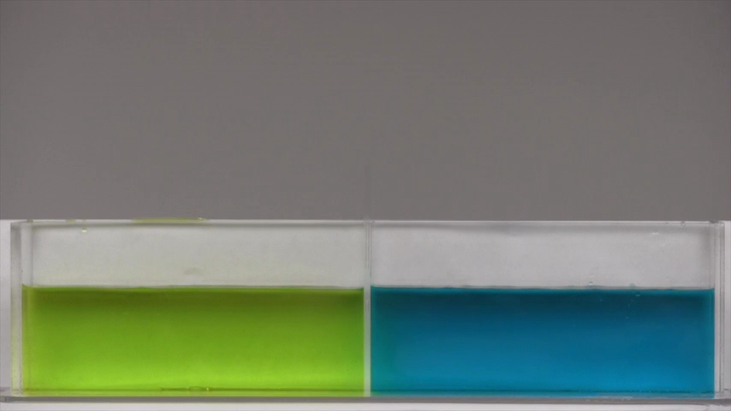
What would I do differently?
Have identical set-ups for all the groups
Make sure everything is properly labeled so students can work more independently and rely less on the volunteers
Coordinate better with volunteers so that they know when to pause and get students to listen to take home messages
We repeated demos for two groups with insufficient time to reset
To save time:
only do three demos
create a short video to set up the demo rather than showing science slides
Learn from student survey feedback and improve next year’s demo
Notes:
[If video doesn’t work, show this]
Experiment 1:
When you warm water its volume expands, so its density decreases.
When you cool water its volume contracts, so its density increases.
So warm water is lighter than cold water. You should have observed that the cold water sinks to the bottom.
Experiment 2:
When you add a salt to water, you increase its density.
So Fresh water is lighter than salty water. You should have observed that the salty water sinks to the bottom.
We also set up a current in the tank due to the density differences

Slide 12
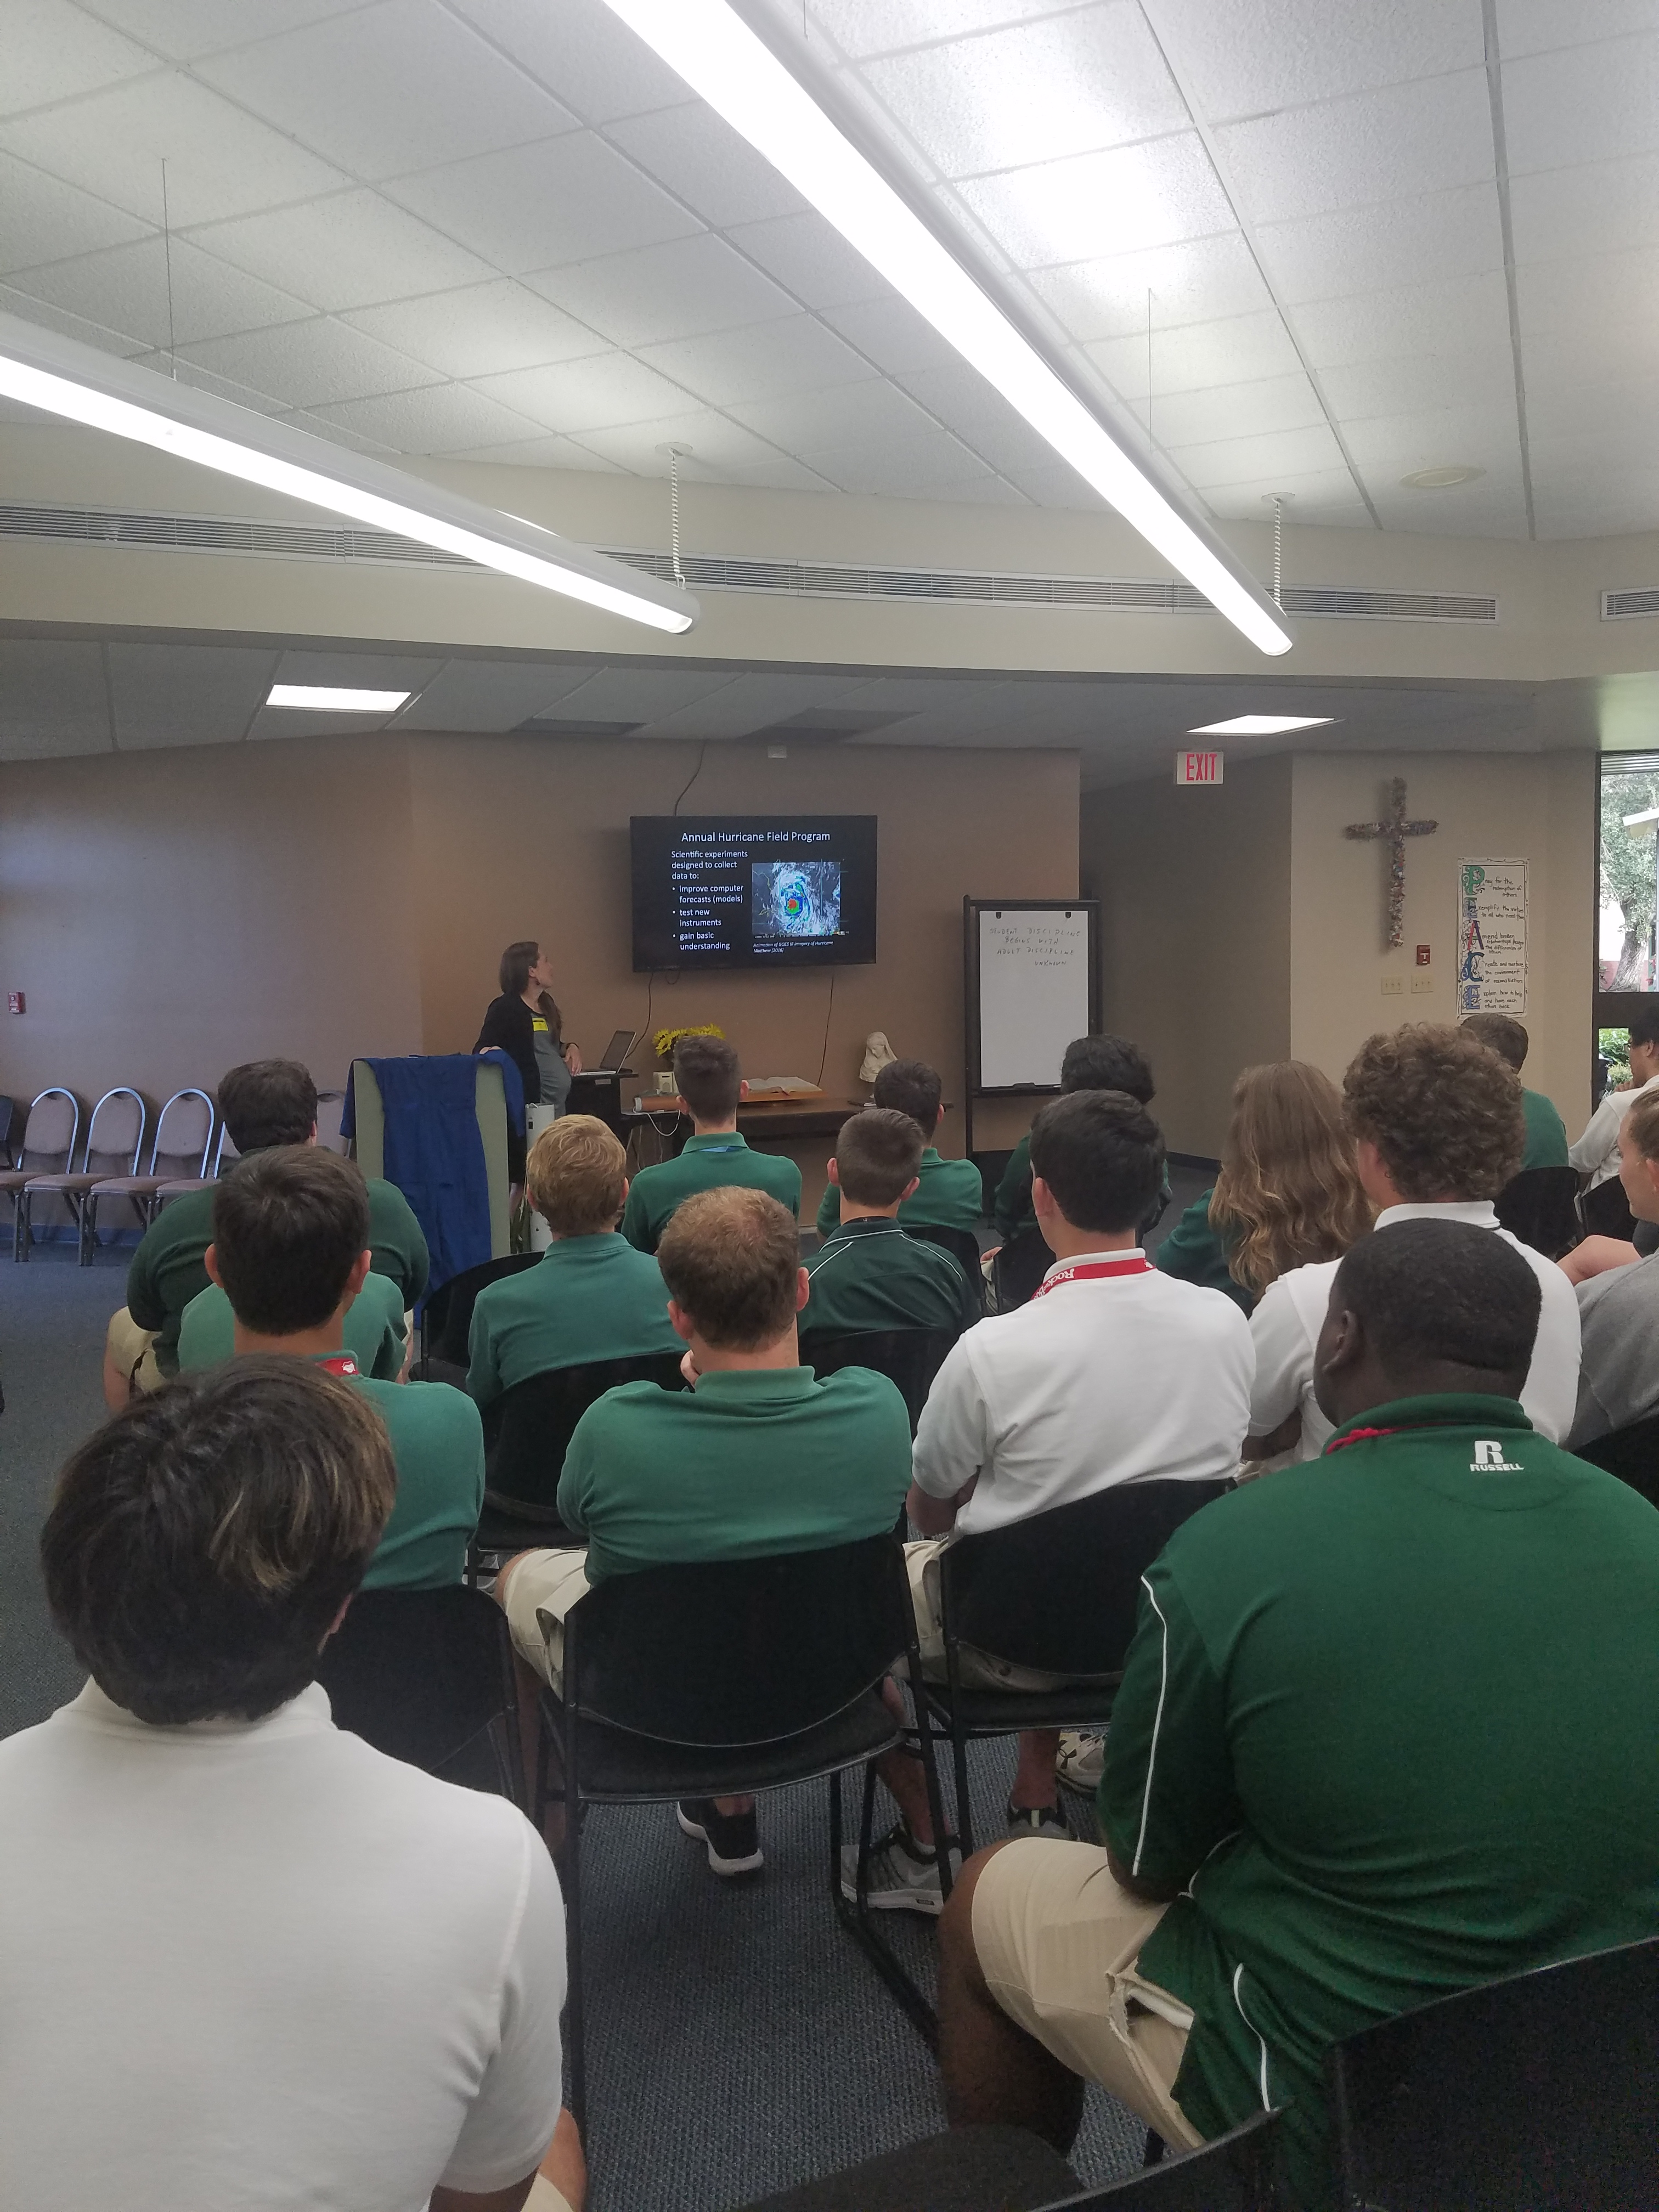
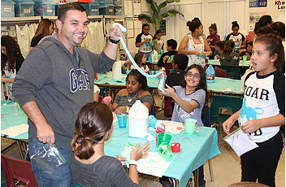
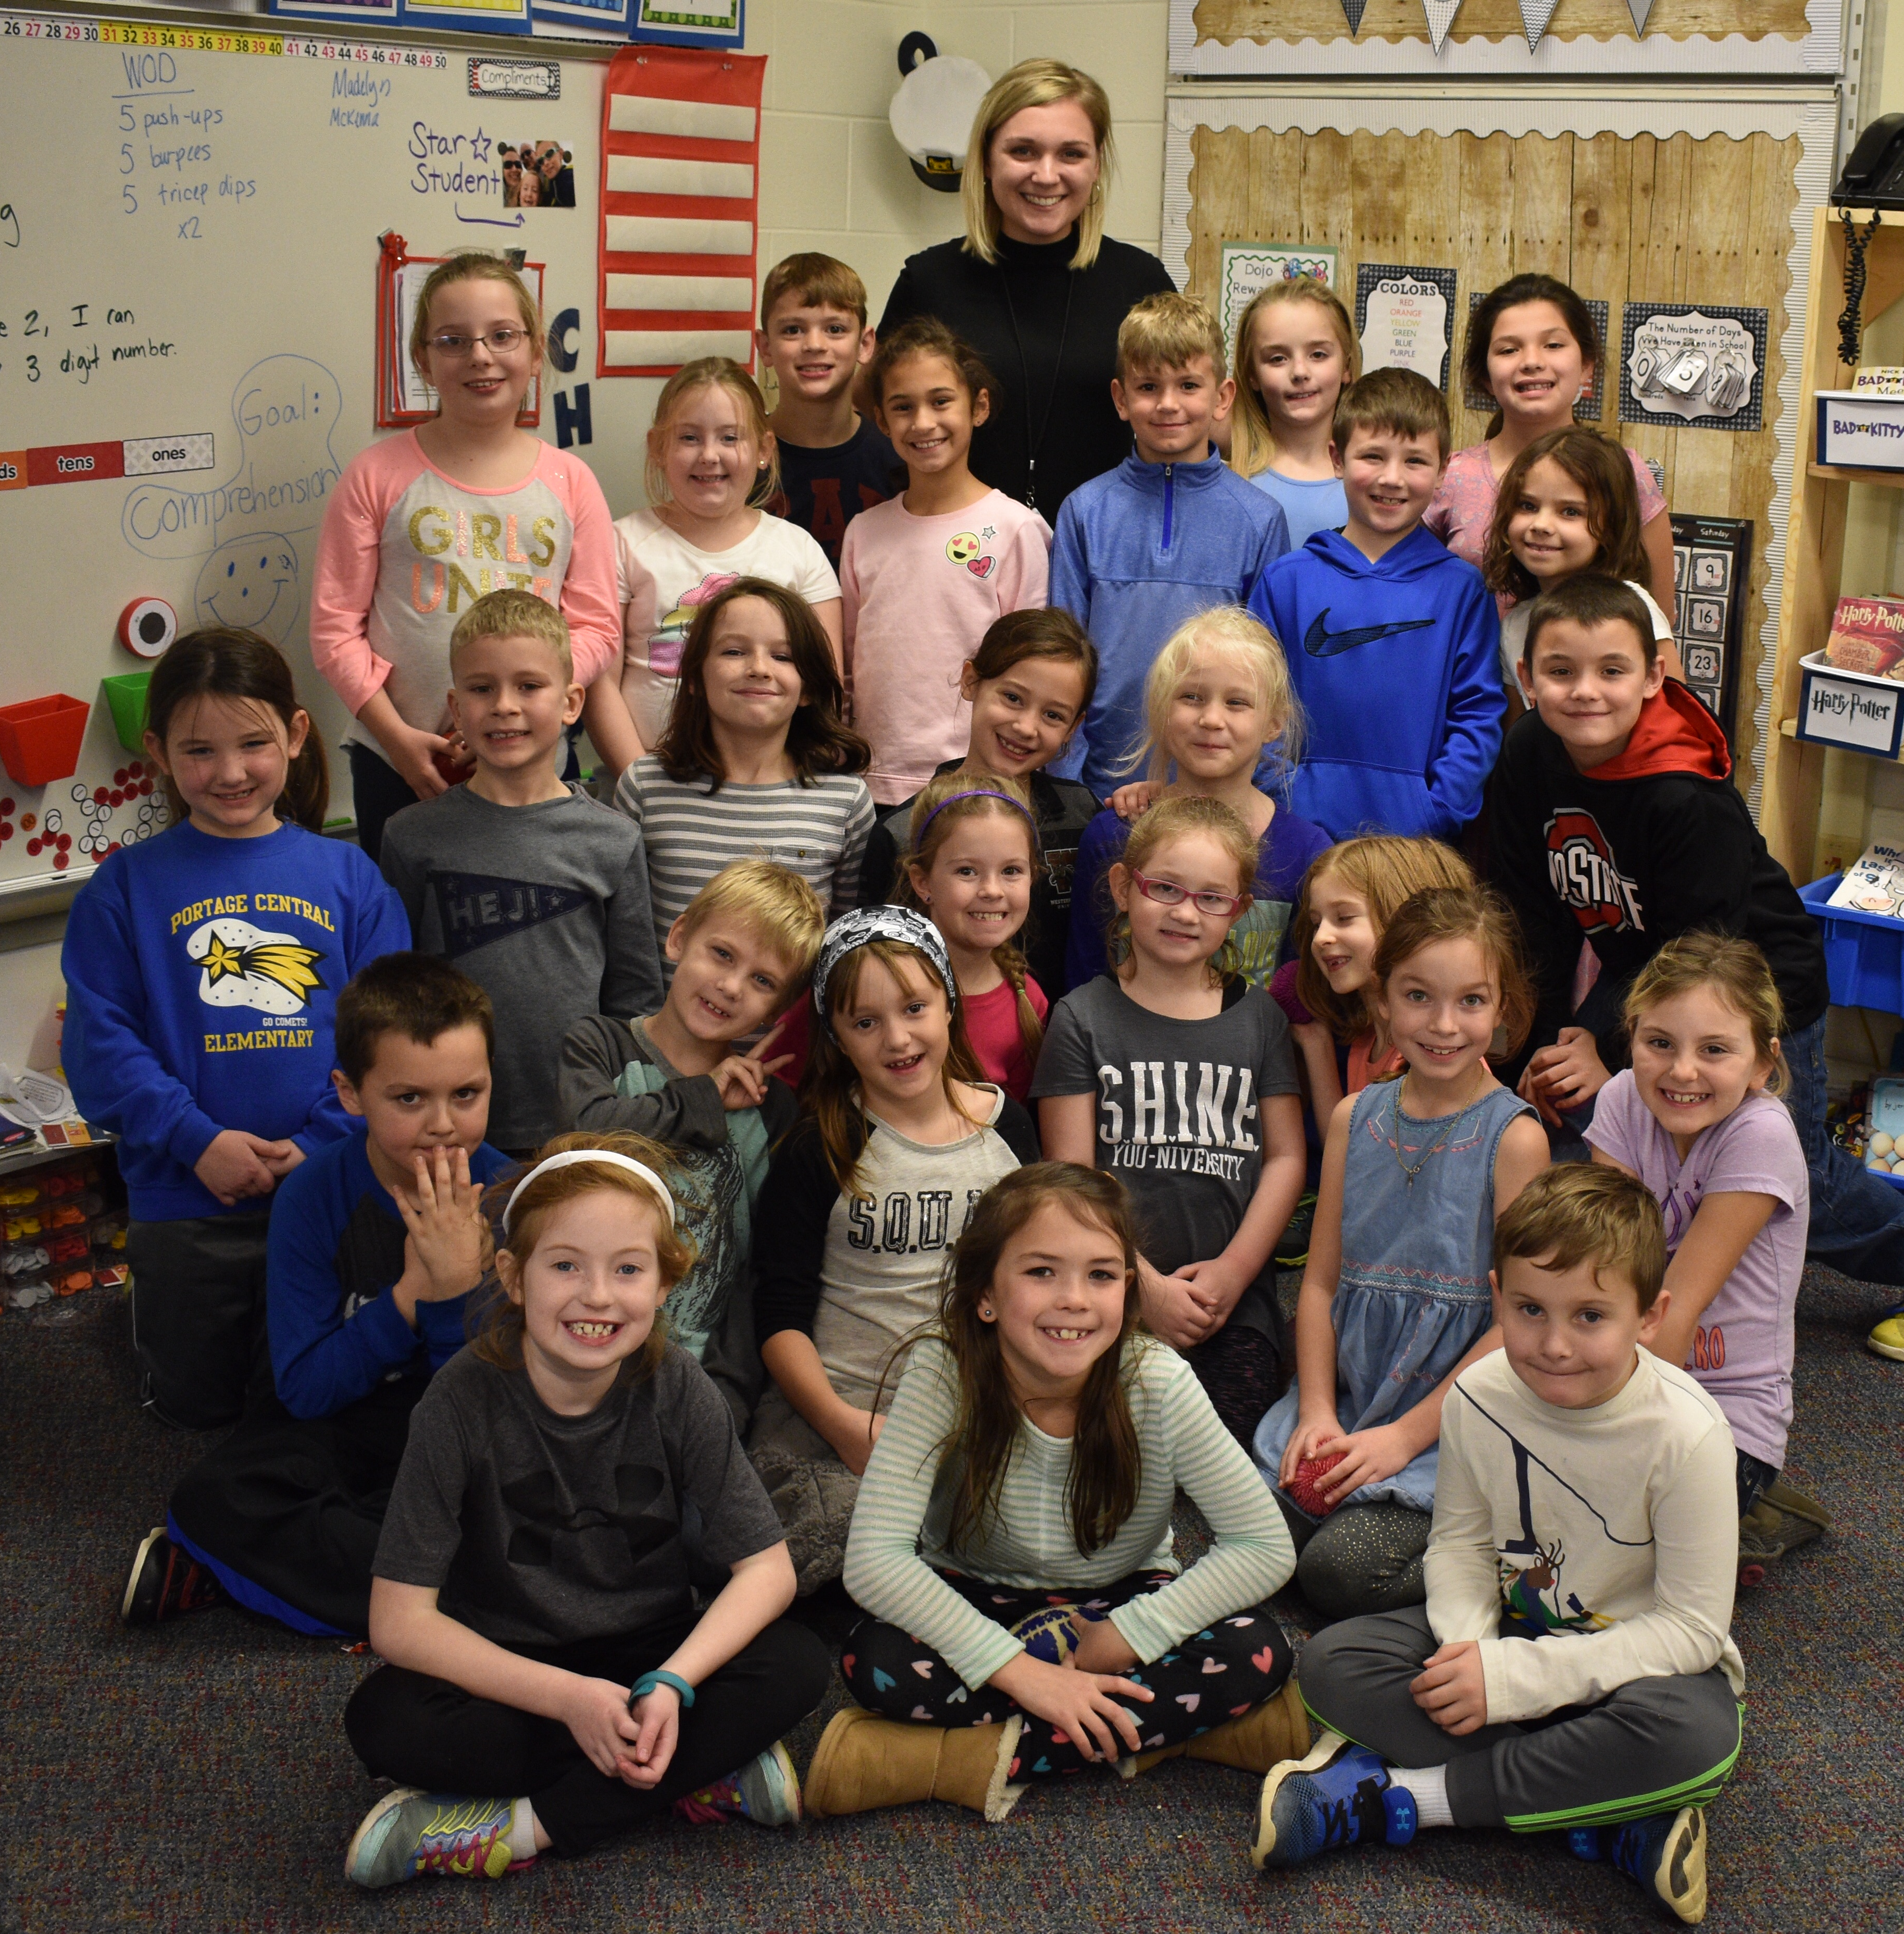
The Events
What: Green Education Fair
Where: Homestead Airbase School
Who: K-8 Homestead Air Base Student
Participants: UM, NOAA, Science Museum, etc.
What: High School Career Talk
Where: Melbourne Catholic Central
Who: Grades 9-12
Participants: Just me!
What: Elementary Career Talk
Where: Skype (Portage Elementary)
Who: 2nd Graders
Participants: Matt Onderlinde (NHC)
) and myself

Slide 13
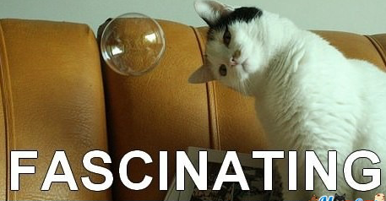
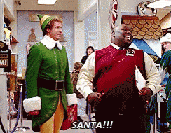
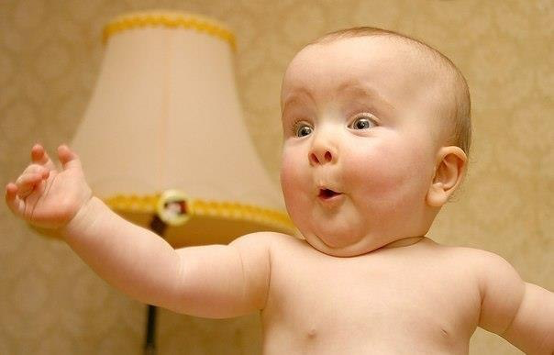
What (reactions) did I want to happen?

Slide 14
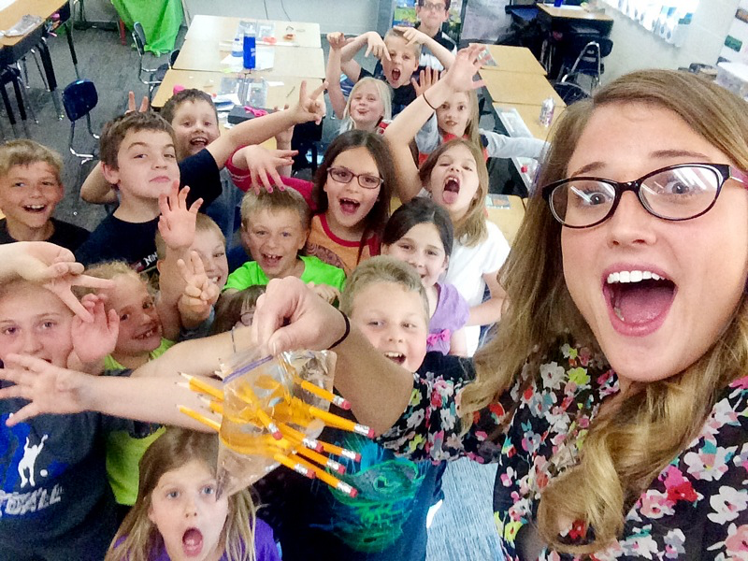
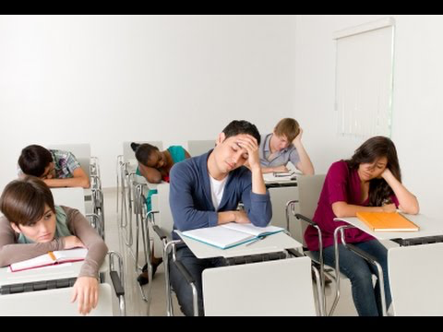
What (reactions) happened?
Elementary
(and parents/teachers)
High School
(Dramatized)

Slide 15
What would I do same/differently?
Use post-it note idea from Kelly’s talks (for the introverts)
Encourage audience participation upfront
Throw candy into crowd or hand out swag (with permission)
Use lots of pictures and animations
Bring props to pass around
Add more relatable information
Your smartphone is ~1 dropsonde
Social media

Slide 16
Funniest Questions
If you can't recover the instruments, isn't that bad for the environment?
Are you crazy?
If we have only observed 5% of the ocean below 2000m, how do we know that megaladons don't exist?
Why is your hair purple?
Have you ever seen a [insert shark name here] shark?
Why did they suddenly start naming winter storms?
Who would win in a fight: a great white or a killer whale?
How many hurricanes have there been in Nevada?
HOW many years of school!?

