Slide 1


Using Aircraft Observations to Improve the Understanding and Prediction of Tropical Cyclones
Robert Rogers
NOAA/AOML Hurricane Research Division

Slide 2
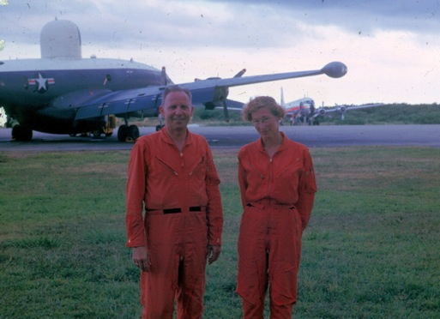
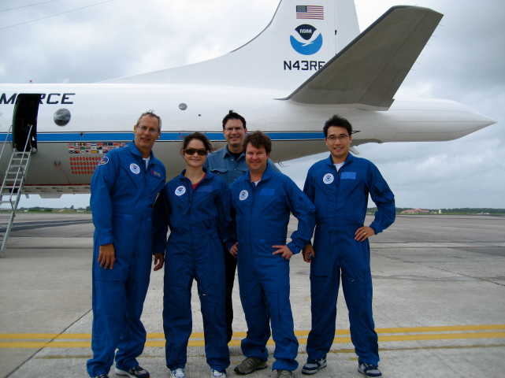
Aircraft Observations and Hurricane Research
Aircraft observations play a critical role in testing theories and initializing and evaluating numerical models.
This research has been instrumental in improving our understanding and prediction of tropical cyclones.
NOAA’s Hurricane Research Division (and its predecessors, NHRP and NHRL), has a long history of conducting hurricane research with aircraft observations.

Slide 3
History of NOAA Airborne Hurricane Research
National Hurricane Research Project (NHRP; 1958-1961)
Project Stormfury (1961-1984)
Post-Stormfury (1985-2005): New instruments, insights, and impacts
Addressing Operational Needs, Intensity Forecasting Experiment (IFEX, 2005-today)

Slide 4
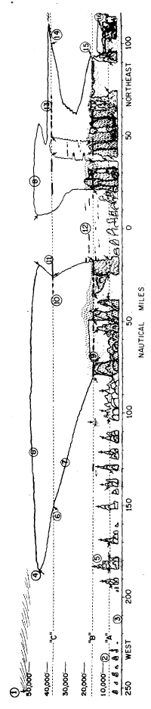
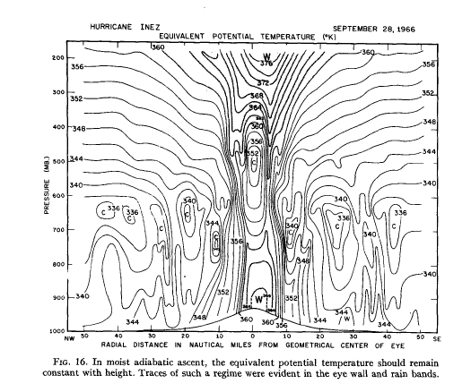
Early NHRP Discoveries
First looks at inner-core structure
Riehl and Malkus 1961
Cloud, precipitation field
Hot towers
Warm core structure
LaSeur and Hawkins 1961

Slide 5
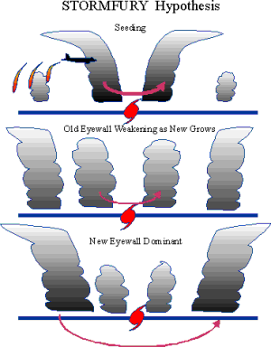
STORMFURY (1961-1984)
Hypothesis and Modification Strategy
Well thought-out, mainstream science
Trigger symmetric instability, or
Construct an outer eyewall, through cloud seeding with AgI
Required abundant supercooled water
Expanded eye should have weaker winds through partial conservation of angular momentum

Slide 6
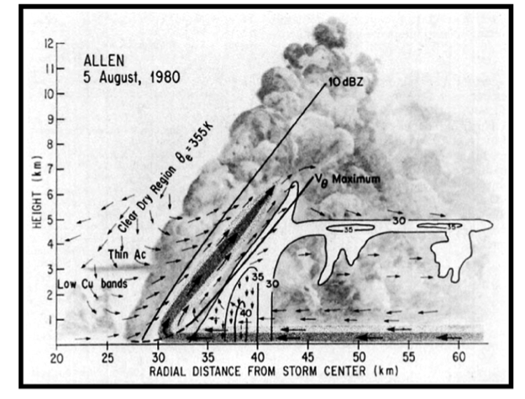
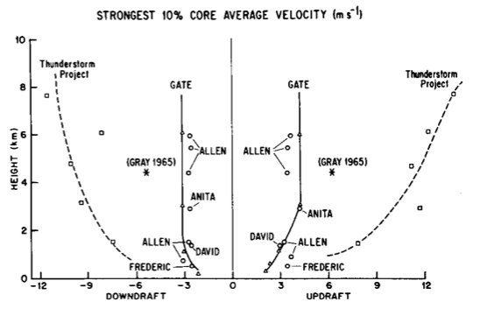
STORMFURY-related studies on inner core structure
Eyewall precipitation and wind structure
Statistics of convective properties
Jorgensen (1984)
Jorgensen (1982)
Eyewall wind, precipitation structure, stratiform structure deduced from flight-level only
Later confirmed by airborne Doppler
Updraft strength in hurricanes weaker than typical thunderstorms

Slide 7
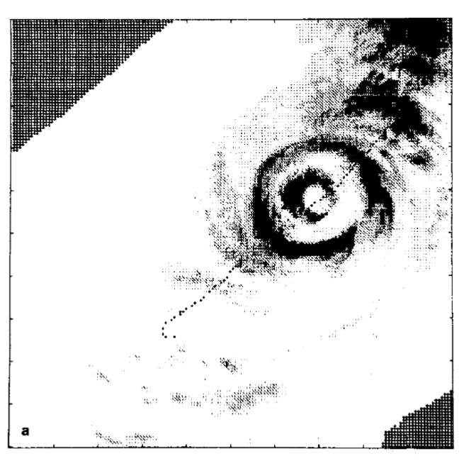
STORMFURY-related studies on inner core structure
Eyewall Replacement Cycle
Storm had weak updrafts & little supercooled water
Willoughby et al (1985)

Slide 8

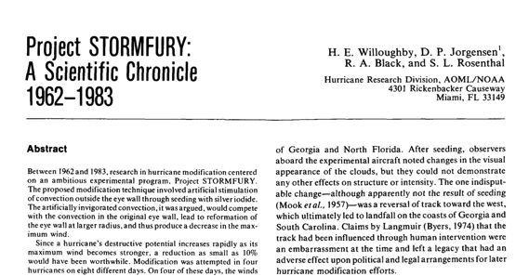
STORMFURY: Abandoned
August 1985
Limited supercooled water
Eye expansion happens in unmodified hurricanes
Political difficulty with finding experimental subjects

Slide 9
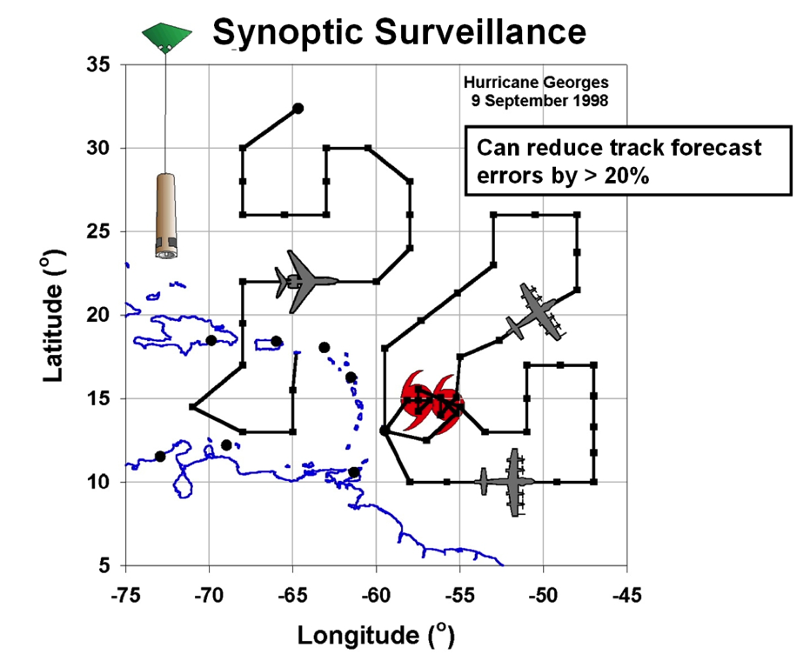
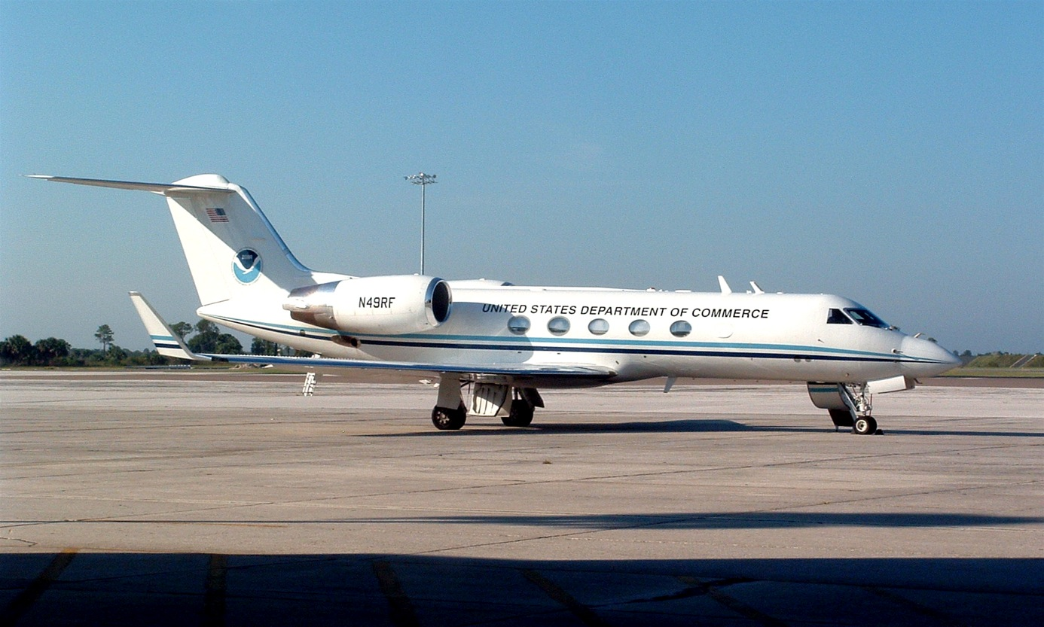
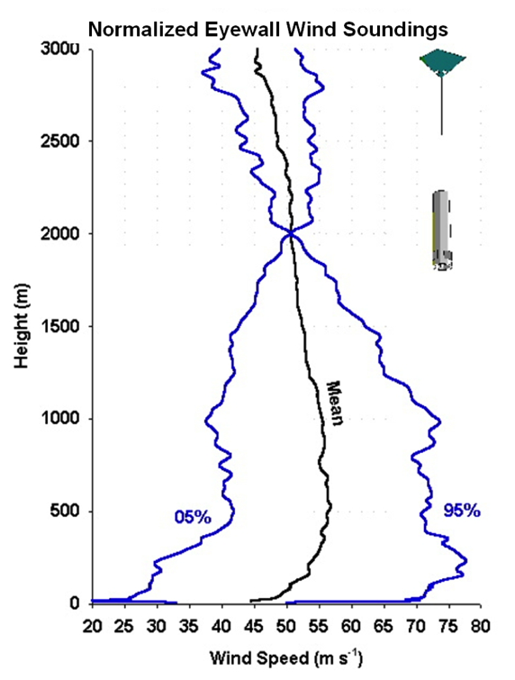
Post-STORMFURY (1984-2005):
New instruments, insights, and impacts
GPS Dropwindsondes
S. Aberson, AOML/HRD, J. Franklin NHC

Slide 10
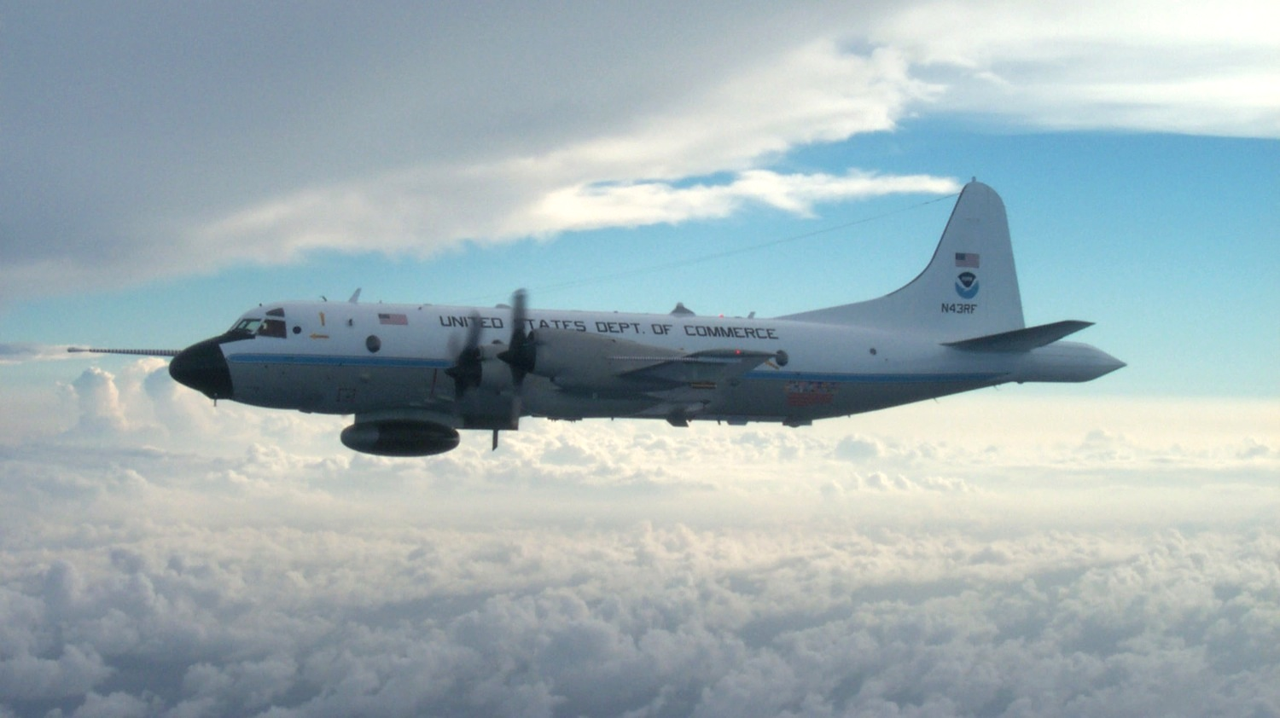
NOAA WP-3Ds (1976-today)

Slide 11
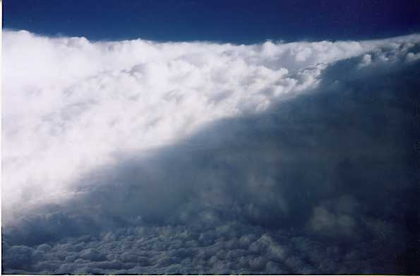
Post-Stormfury: Views from the P-3
“Stadium effect” within the Eye of Hurricane Georges (1998)
eyewall
low clouds above
sea-surface

Slide 12
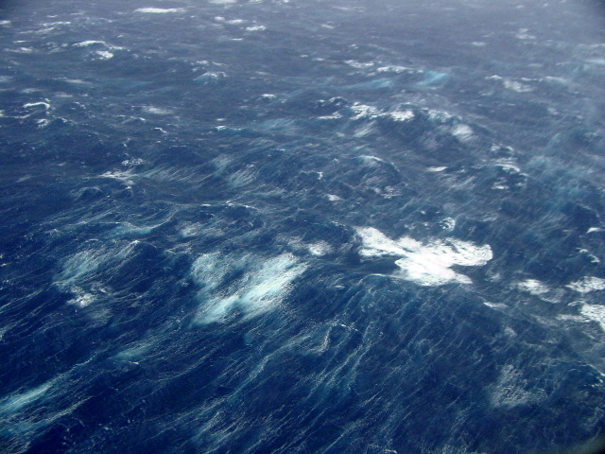
Post-Stormfury: Views from the P-3
Sea state from 200’ altitude in Hurricane Isabel (2003)

Slide 13
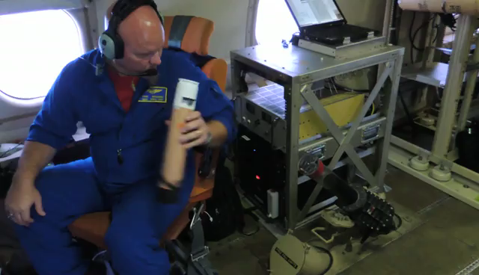
Post-Stormfury: GPS Dropwindsondes

Slide 14

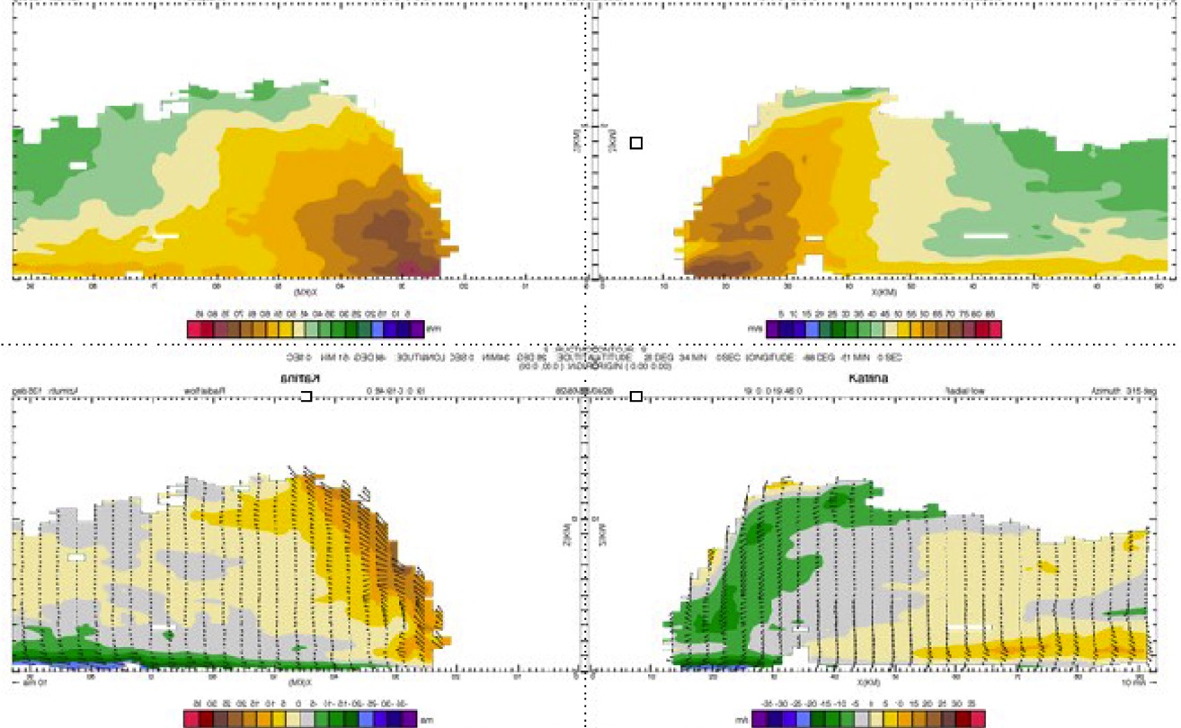
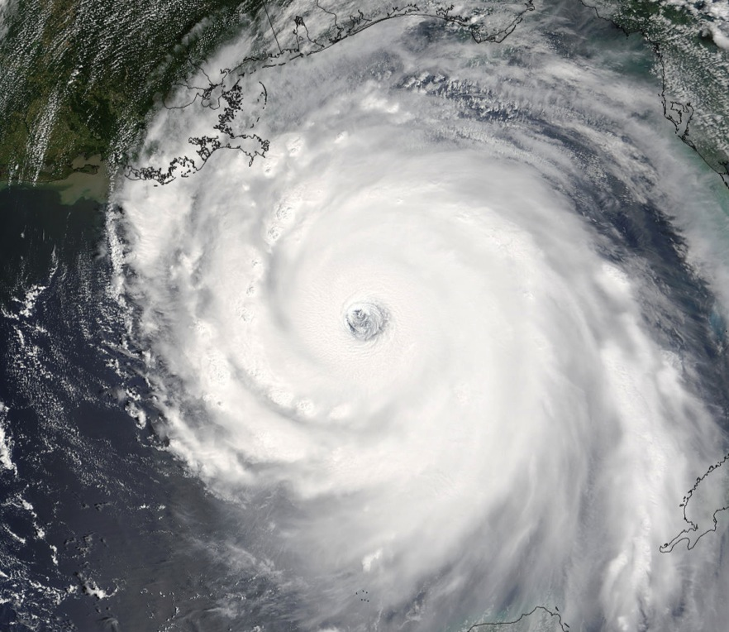
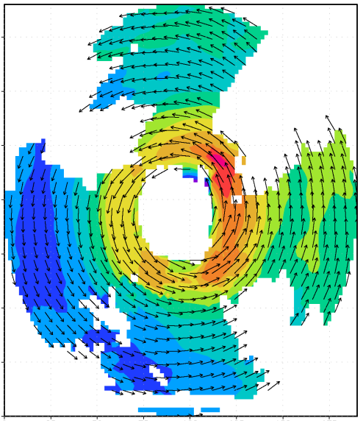

Post-Stormfury: Airborne Doppler Radar
Airborne Doppler-analyzed wind field Hurricane Katrina, 28 September 2005
V_{θ}
150
100
distance (km)
V_{r}, w
50
0
0
50
100
150
distance (km)
John Gamache, AOML/HRD
Notes:
IFEX is multi-year data collection effort to test data flow to initialize HWRF and for use in model data sets. IFEX is partnership with NWS, NESDIS, & AOC
• HRD developed the capability to make a three-dimensional analysis from automatically quality-controlled Doppler data as part of JHT and a G-IV Doppler radar upgrade proposals. Horizontal and vertical cross sections of these analyses were transmitted from the P3 to NHC. The three-dimensional analyses have a vertical resolution of .5 km and a horizontal resolution of 4 km. Analyses of the horizontal and vertical distribution of radius-height-averaged winds are examples of those sent to NHC in nearly all storms for the late phase of IFEX. HRD cooperated with NHC to produce analyses of the greatest interest to NHC, namely the 4-km x 4-km x 0.5-km analyses at 500 m and 1 km.
• Goal is to provide QC Doppler radar-radial-velocity observations from NOAA G-IV and WP-3D aircraft in real time to EMC for assimilation into HWRF. HWRF will be able to use data at 1.5 km horizontal resolution and finer vertical resolution to initialize winds in TC core and immediate environments. Only way to consistently obtain such data is X-Band airborne Doppler radar. 14 real-time analyses sent via SATCOM for NHC in Katrina
Katrina: 5 analyses on 25 August
4 analyses on 27 August
5 analyses on 28 August

Slide 15
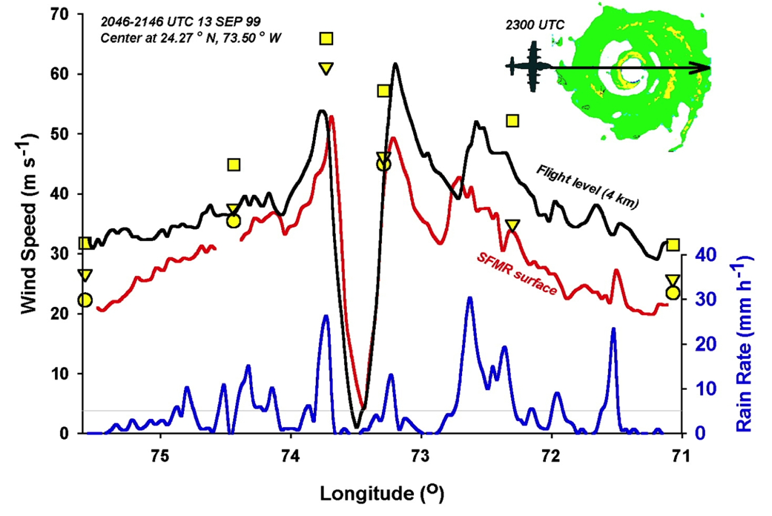
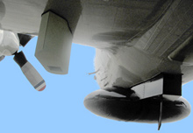
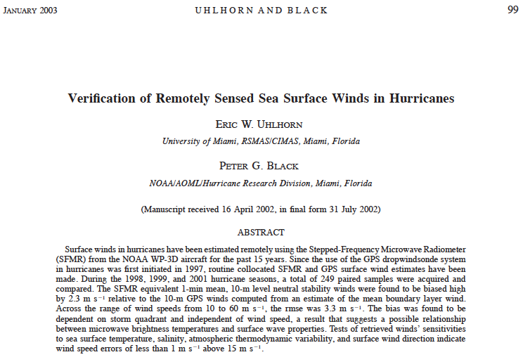
Post-Stormfury: Stepped Frequency Microwave Radiometer (SFMR)
E. Uhlhorn, AOML/HRD

Slide 16

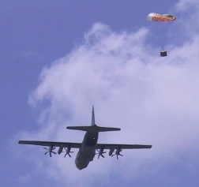
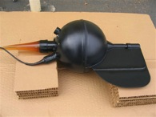
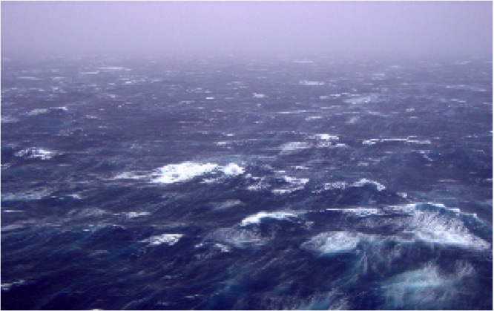
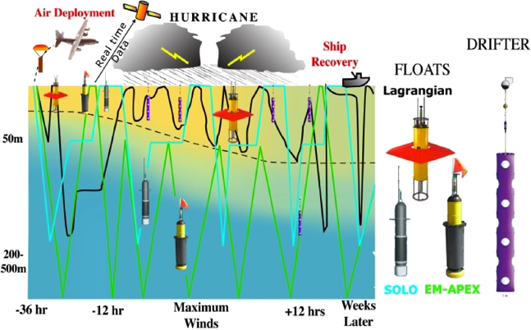
Post-Stormfury: Upper Ocean Observations
Targeted upper ocean observations
TC impact on upper ocean effect of Hurricanes Gustav and Ike (2008)
CBLAST
Waves from 200’ in Isabel
E. Uhlhorn, AOML/HRD, R. Lumpkin AOML/PhOD
Notes:
Drifter array in Gustav and Ike were placed by AFRC WC-130 ahead of storm. Gustav array still functioning when Ike was crossing Gulf. Also deployed AXBT grid post-Gustave which proved to be pre-Ike, followed by in storm Ike AXBT drops and post-Ike array. Revealed warm eddy and cold eddy left behind from Gustav interactions with Loop current.
Upper right picture shows sea-height anomaly (color) with superposition of Ike track and radii of hurricane (red circle) and storm force (yellow circle )winds. Black curly lines are tracks of Gustav drifters and circles are planned deployment locations for Ike drifters and floats. Thin black line shows P-3 track during pre-Ike AXBT pattern. Dropped over 300 AXBTs in Gustav and Ike.

Slide 17
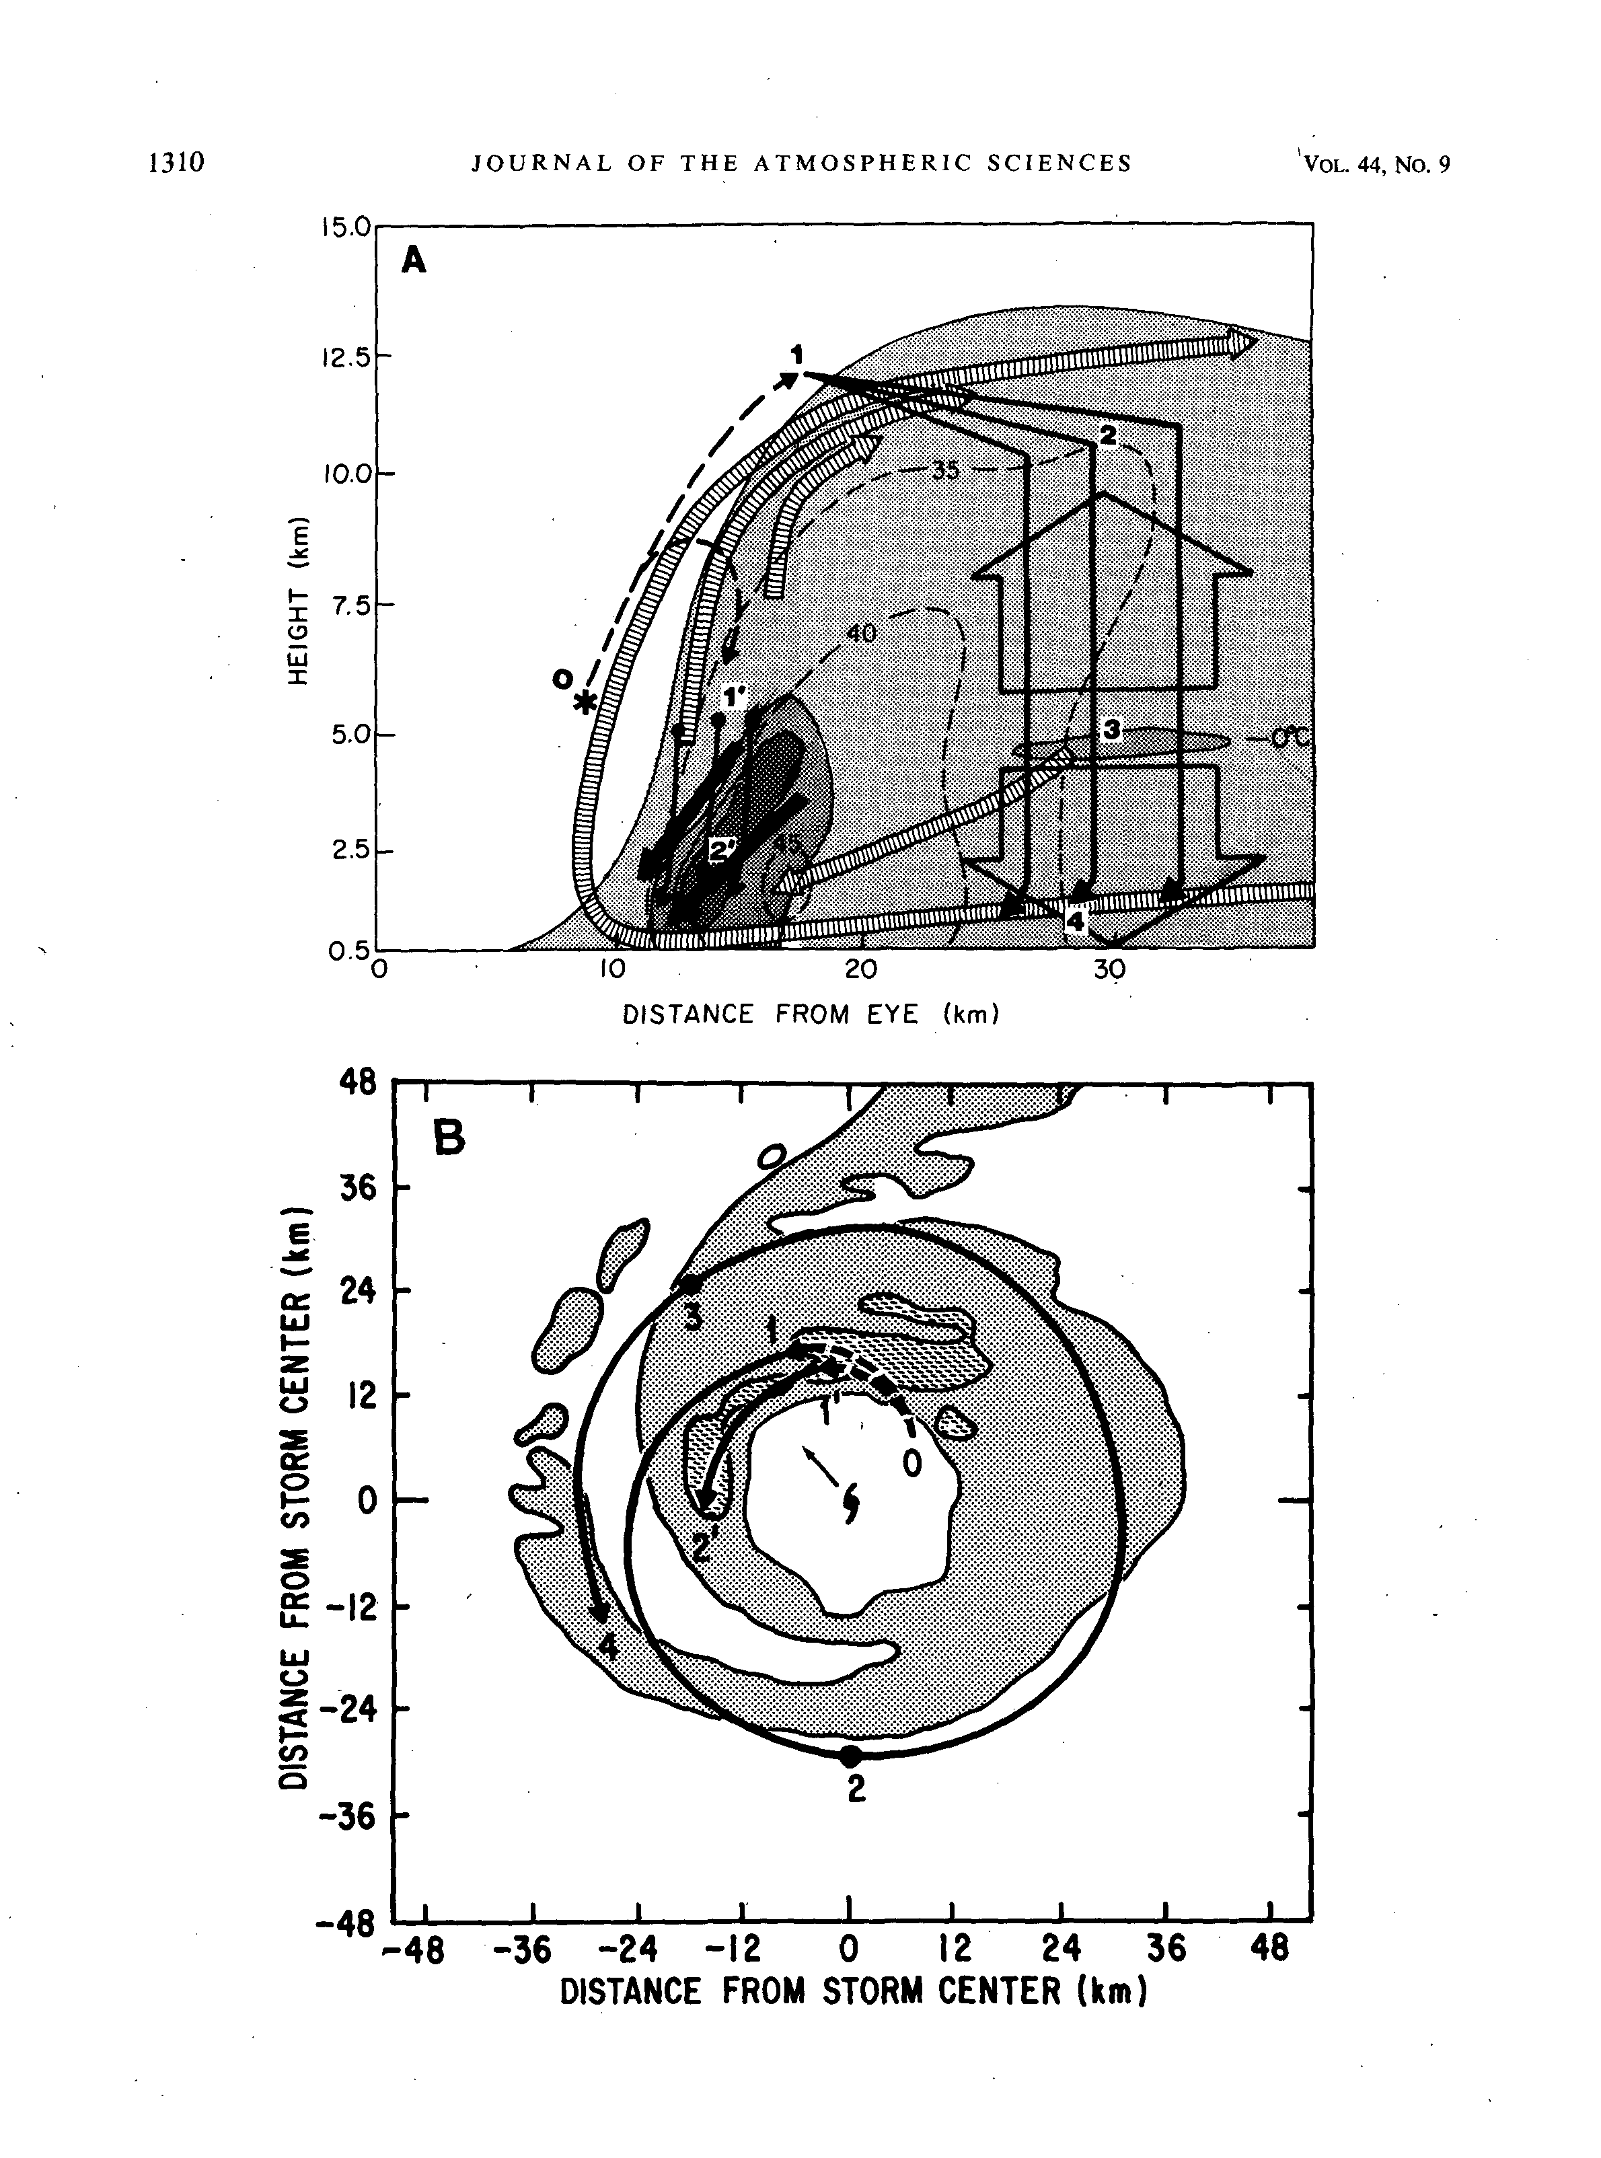
Post-STORMFURY (1984-2005):
New instruments, insights, and impacts
Inner core convective, stratiform structure
Vertical cross section in Alicia (1983)
Hydrometeor trajectories
Marks and Houze (1987)
Marks and Houze (1987)
Outward-sloping secondary circulation
Combination of eyewall, mesoscale downdrafts
Cycling of ice hydrometeors multiple times around storm

Slide 18
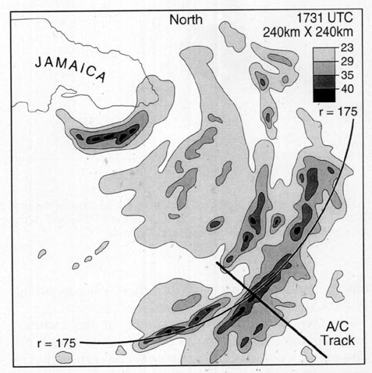
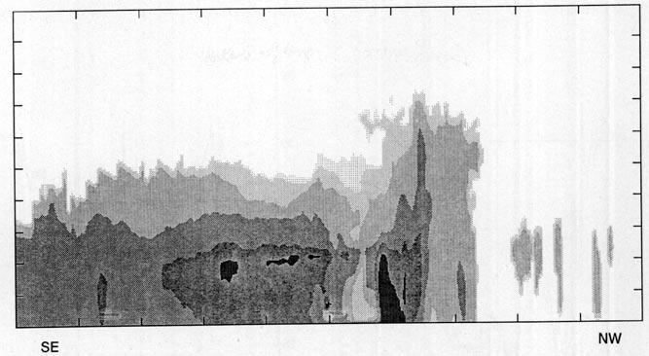
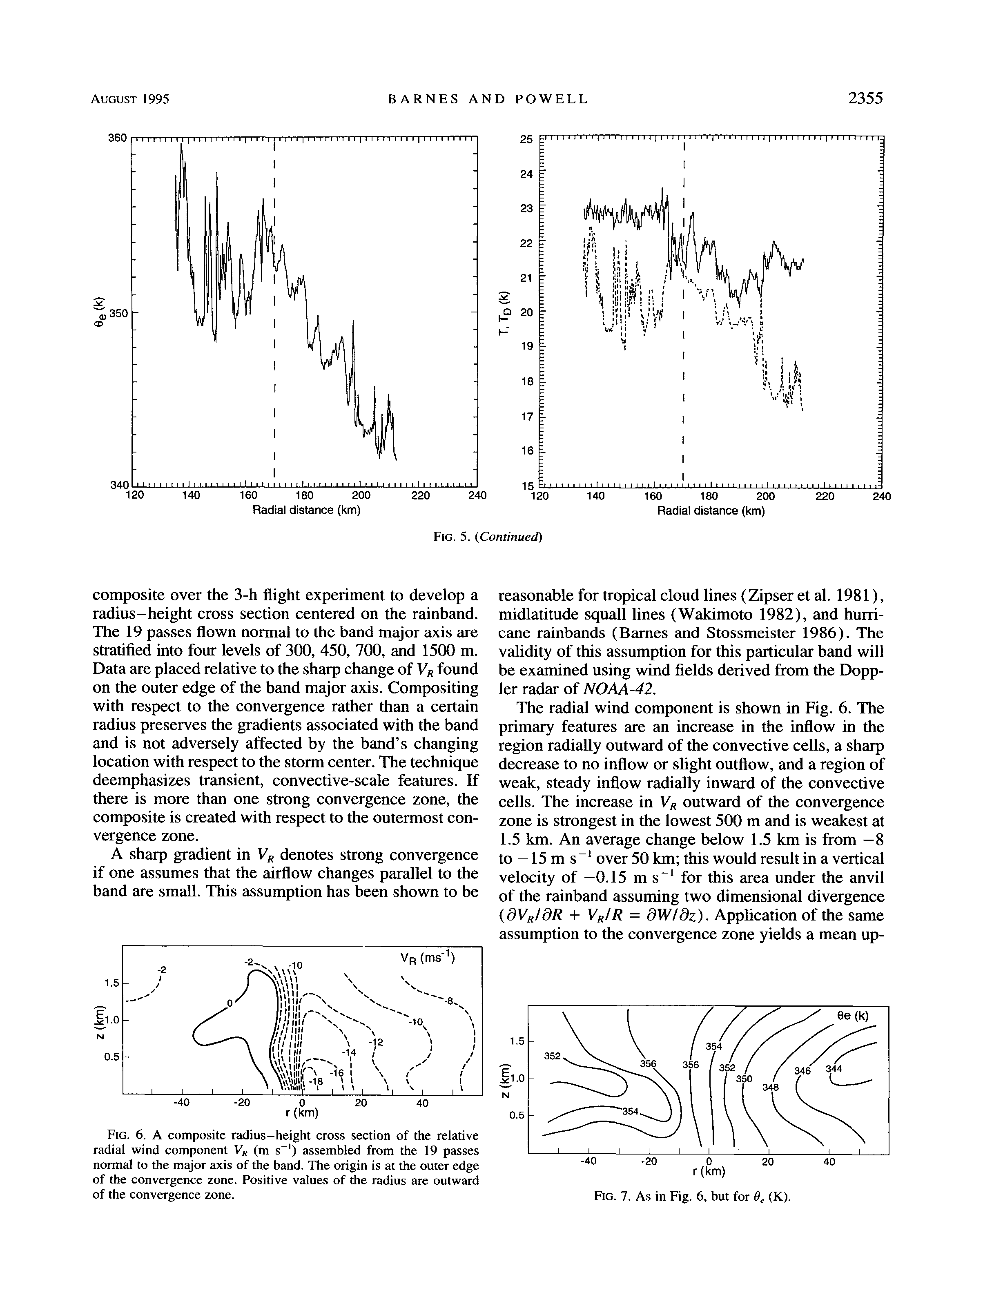
Post-STORMFURY (1984-2005):
New instruments, insights, and impacts
Rainband structure
LF image in Gilbert (1988)
Vertical cross sections across band
TDR dBZ
Barnes and Powell 1995
Strong inflow outside rainband
Rapid recovery of PBL theta-e outside rainband

Slide 19

Addressing Operational Needs (2005-today): Intensity Forecasting Experiment (IFEX)
Intensity Forecasting Experiment (IFEX): Three objectives
Improve prediction of TC intensity change by:
  collecting observations through the TC life cycle for model initialization, evaluation
  developing and refining measurement technologies
  improving understanding of physical processes important in TC intensity change
Rogers et al. 2006

Slide 20
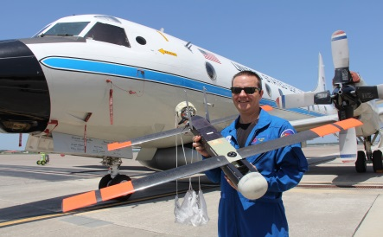
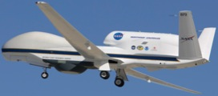
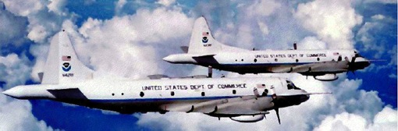
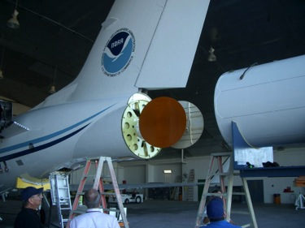
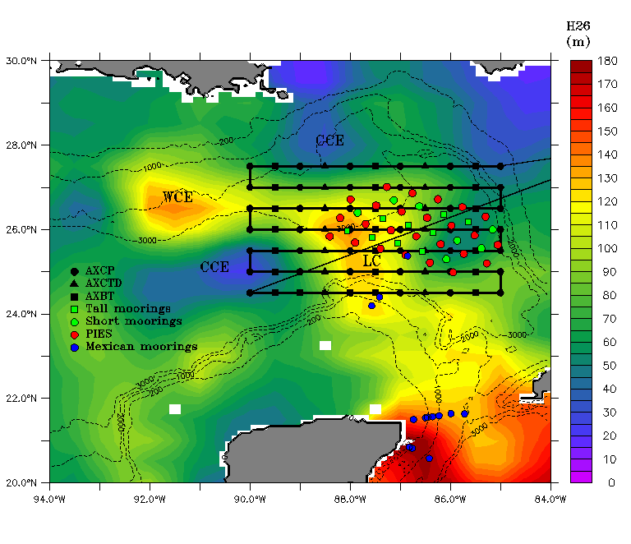
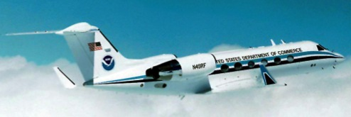
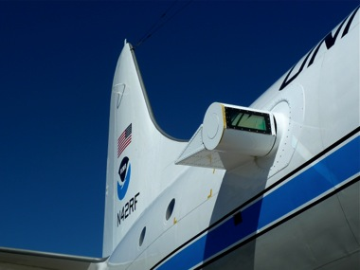
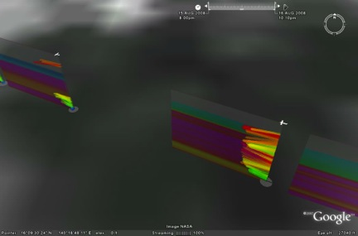
Addressing Operational Needs
(2005-today): IFEX
In-situ
  Wind, press., temp.
Expendables
  Dropsondes
  AXBT, AXCP, buoy
Remote Sensors
  Doppler Radar
  SFMR/HIRAD
  WSRA
  Scatterometer/profiler
  UAS - LALE
Coyote UAS
NASA Global Hawk
G-IV Tail Doppler Radar
AXBT profiles of Loop Current
ONR DWL
DWL profiles from TCS-08
Notes:
UR image depicts dropsonde profiles in eyewall of Hurricane Guillermo (1997)
LR image is Doppler Wind Lidar profiles from TCS-08

Slide 21
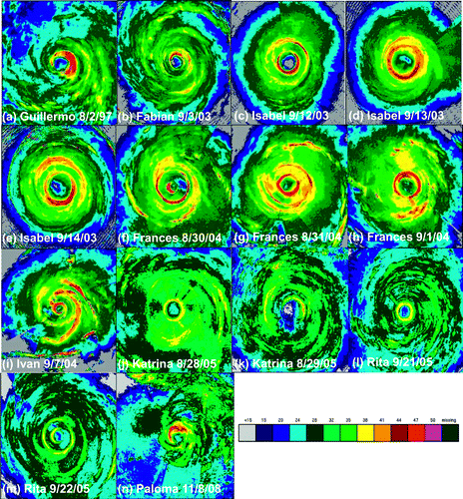
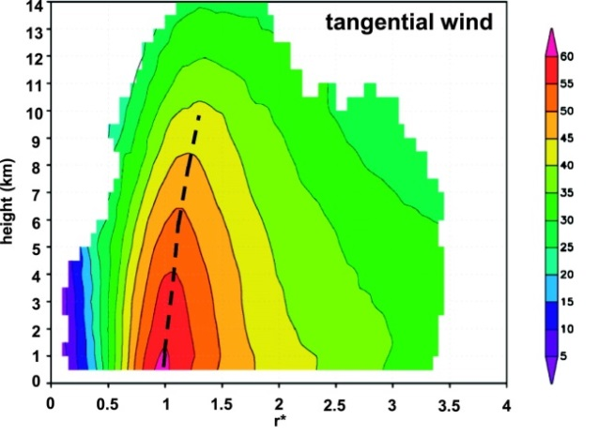
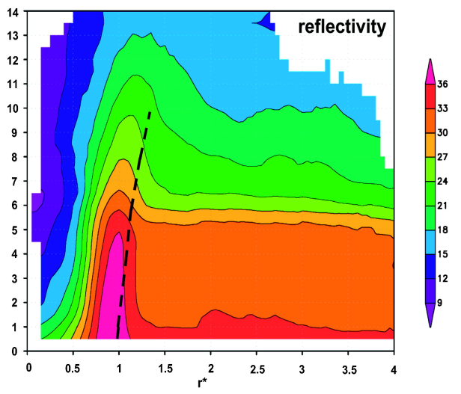
IFEX Goal 3: Improved understanding of “average” TC structure
Extensive database from many years enables composites to be constructed
More robust than case studies
Ideal for model evaluation
Radar images of hurricanes used in composite
Averaged wind and rain structure
RMW
RMW
Rogers et al. 2012
Rogers et al. 2012

Slide 22
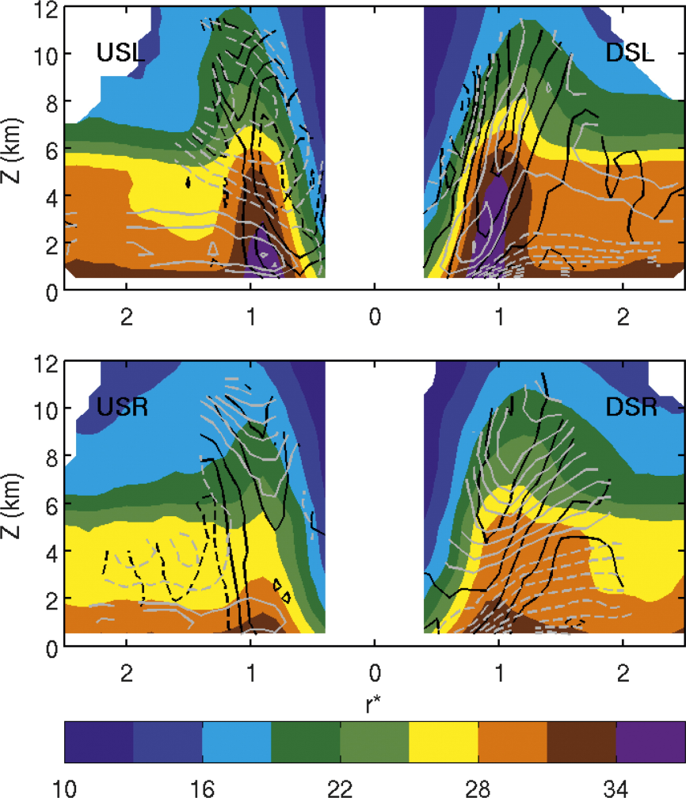
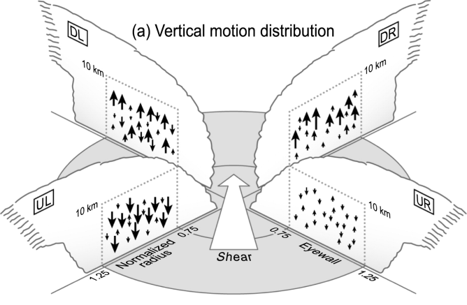

IFEX Goal 3: Improved understanding of TC structure in vertical shear
Vortex response to vertical wind shear
Quadrant averages of radial flow, vertical winds, and reflectivity
Conceptual model
shear
Reasor et al. 2013
DeHart et al. 2014

Slide 23
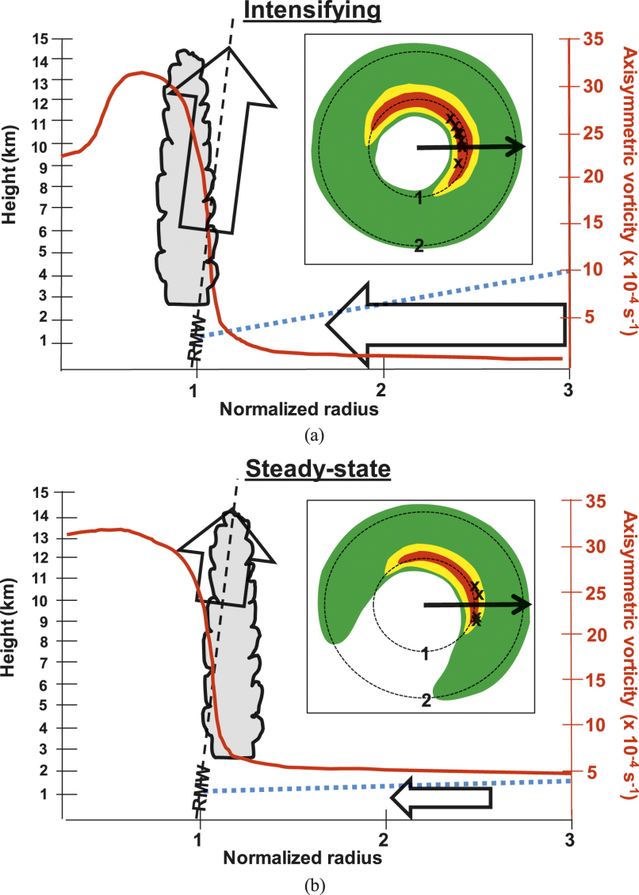
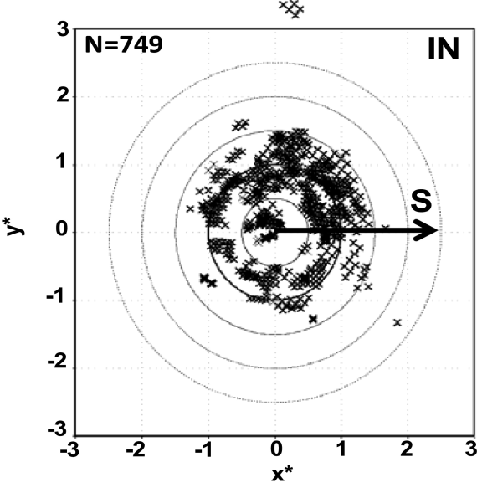

IFEX Goal 3: Improved understanding of convection and TC intensification
Radial location of deep convection and TC intensification
Location of strong thunderstorms in inner core of
intensifying (IN) and steady-state (SS) cases
RMW
RMW
Rogers et al. 2013
Rogers et al. 2013

Slide 24
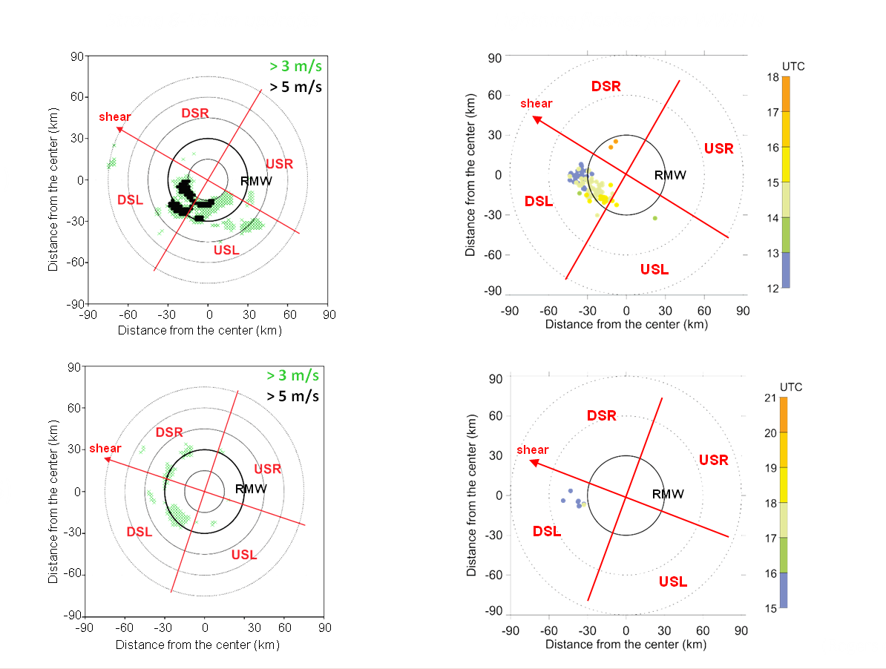
IFEX Goal 3: Improved understanding of convection and TC intensification
Locations of strong updrafts and lightning for Edouard (2014)
Strong 8-16 km updrafts
Lightning flashes from WWLLN
14 September (RI)
Shear: 10 kt
16 September (SS)
Shear: 12 kt
Rogers et al. 2016
14 Sept (RI): Strongest updrafts DSL, USL; Lightning flashes begin DSL, rotate USL and inside RMW
16 Sept (SS): Limited strong updrafts and lightning mostly DSL

Slide 25
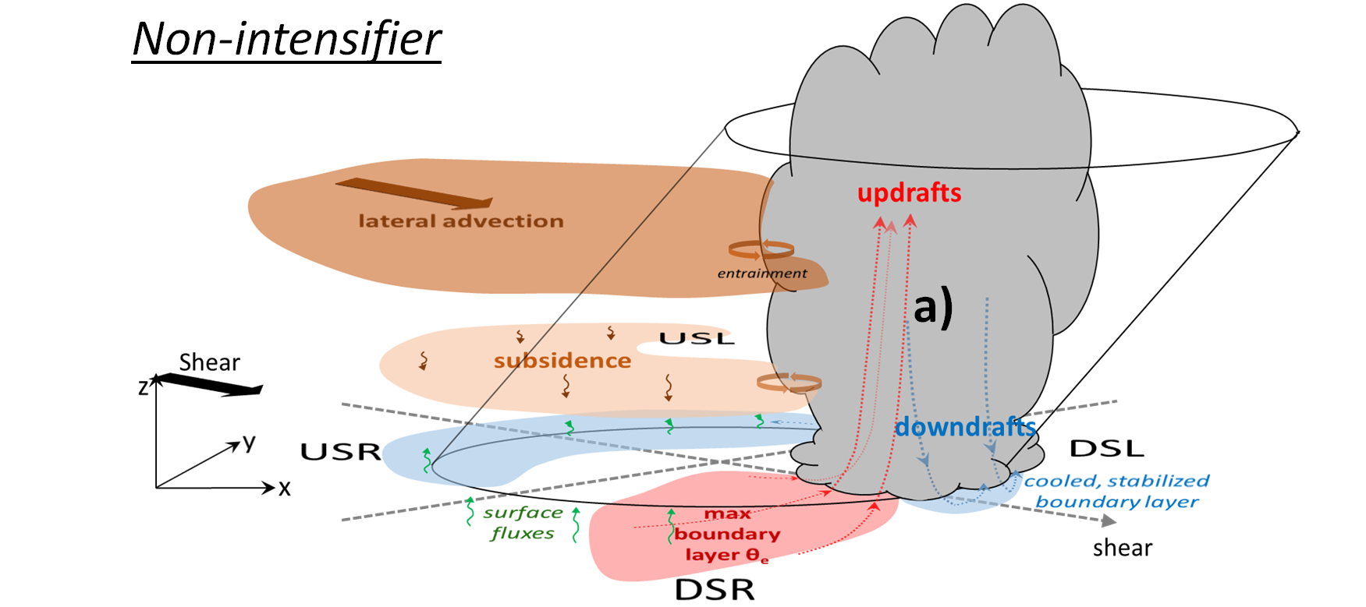
IFEX Goal 3: Improved understanding of convection and TC intensification
Nguyen et al. 2017
Main precipitation/convection downshear left, little to no precipitation upshear
Significant dry air upshear
Subsidence signatures upshear
Broad area of PBL cooling upshear, limited recovery of PBL entropy downshear

Slide 26
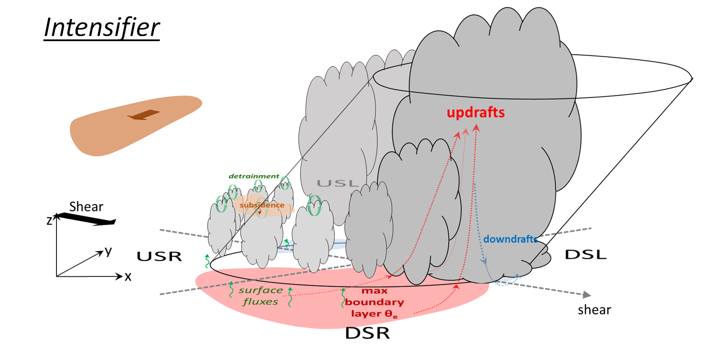
IFEX Goal 3: Improved understanding of convection and TC intensification
Nguyen et al. 2017
Precipitation/convection DSL, coverage of convection USL, shallow precipitation USR/USL
More moist environment upshear
Limited indication of subsidence upshear
Smaller area of PBL cooling upshear, greater area of PBL recovery downshear

Slide 27
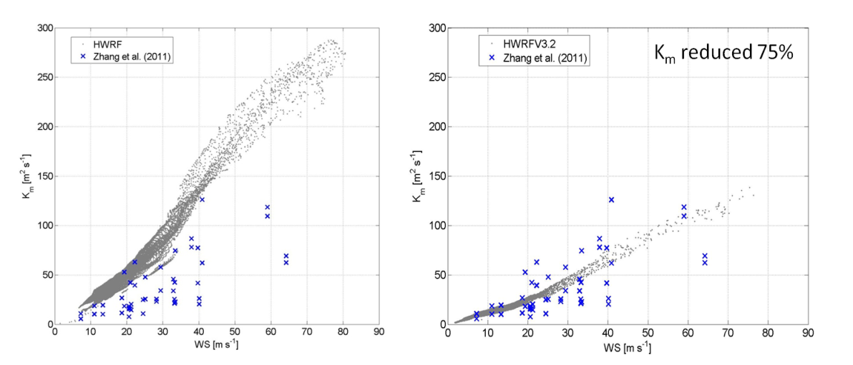
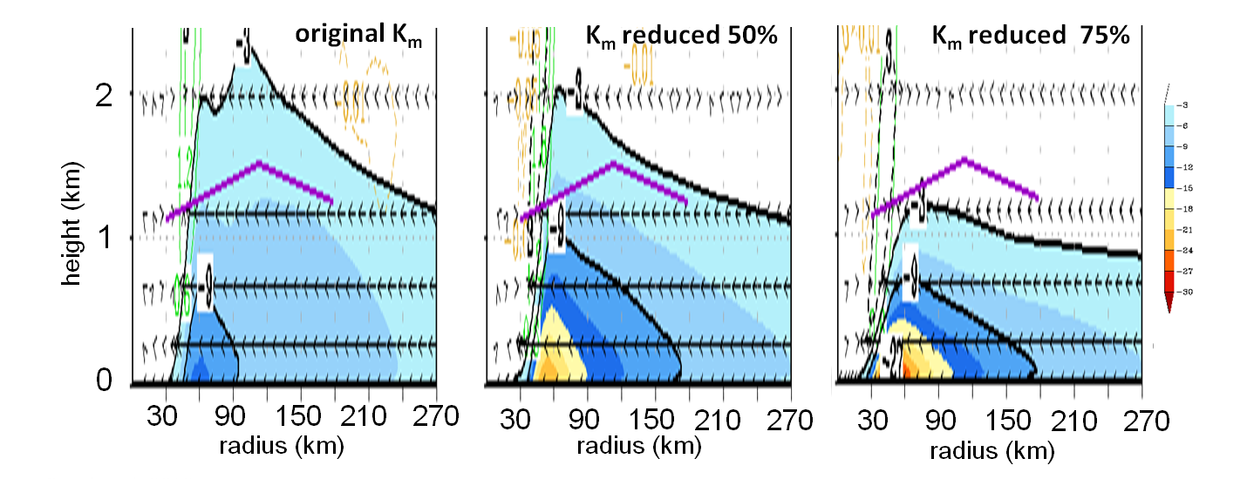
IFEX Goal 1: Improvements in model physics
Modification of vertical mixing (K_{m}) in HWRF based on in situ measurements
Default PBL scheme in HWRF mixes too strongly in the vertical
Sensitivity of radial wind (shaded, m s⁻¹) to vertical eddy diffusivity
Reduced K_{m} results in shallower, stronger PBL inflow – more consistent with observations
Observed inflow depth
Gopal et al. 2012
Notes:
Example of impact of observations on numerical model intensity forecasts. Observations improve model forecasts through improved initial conditions via data assimilation, in this case using the HRD-developed Ensemble-based Data Assimilation System (HEDAS).
Example of forecasts using the HWRF model with and without HEDAS. HWRF forecast with HEDAS (using observations from the P-3 flights in the data assimilation system) showed improved vertical structure of T.S. Isaac compared with HWRF forecast without HEDAS (two cross sections on right side of figure).
Statistics of the intensity forecast errors for Isaac show that runs with HEDAS produced significantly reduced intensity forecast errors (table in bottom left of figure).

Slide 28

IFEX Goal 1: Improvements in model physics
Categorical performance diagram of 55 HWRF RI forecasts of Earl (2010) and Karl (2010)
Perfect forecast
Reduced (more accurate) K_{m} has more “hits”, but more false alarms, than high K_{m}
Better overall RI forecast
Zhang et al. 2017
Notes:
Example of impact of observations on numerical model intensity forecasts. Observations improve model forecasts through improved initial conditions via data assimilation, in this case using the HRD-developed Ensemble-based Data Assimilation System (HEDAS).
Example of forecasts using the HWRF model with and without HEDAS. HWRF forecast with HEDAS (using observations from the P-3 flights in the data assimilation system) showed improved vertical structure of T.S. Isaac compared with HWRF forecast without HEDAS (two cross sections on right side of figure).
Statistics of the intensity forecast errors for Isaac show that runs with HEDAS produced significantly reduced intensity forecast errors (table in bottom left of figure).

Slide 29






IFEX Goal 1: Improvements in model initial conditions
Improving Storm Structure At Initial Time
ISAAC Initial vortex (wind)
Operational HWRF
(No Data Assimilation)
ISAAC (2012): Intensity Errors (kt)
Forecast Hrs | 12 | 24 | 36 | 48
Operational HWRF | 13 | 16 | 26 | 26
With P-3 Data | 8 | 3 | 9 | 20
# Cases | 9 | 7 | 5 | 3
ISAAC Initial vortex (wind)
with assimilation of observations
Sheared
vortex
Notes:
Example of impact of observations on numerical model intensity forecasts. Observations improve model forecasts through improved initial conditions via data assimilation, in this case using the HRD-developed Ensemble-based Data Assimilation System (HEDAS).
Example of forecasts using the HWRF model with and without HEDAS. HWRF forecast with HEDAS (using observations from the P-3 flights in the data assimilation system) showed improved vertical structure of T.S. Isaac compared with HWRF forecast without HEDAS (two cross sections on right side of figure).
Statistics of the intensity forecast errors for Isaac show that runs with HEDAS produced significantly reduced intensity forecast errors (table in bottom left of figure).

Slide 30

IFEX Goal 1: Improvements in assimilation of data into model
Impact of Recon only (FL+drops) and Recon + TDR on HWRF intensity forecasts
hundreds of cases included
including recon data notably improves intensity forecast beyond 24 h
adding TDR results in minor additional improvement
degradation in first 24 h result of spindown

Slide 31


IFEX Goal 2: Toward the future…
Global Hawk Aircraft (Unmanned Aerial System)
can stay airborne for >24 h, compared with 8 h for P-3 and G-IV
First Global Hawk landing at Wallops Flight Facility,
Sept. 7, 2012.
Global Hawk Operations Center
(NASA Armstrong Base, CA)

Slide 32


IFEX Goal 2: New Airborne Platforms
Long range of Global Hawk
Nadine’s track
21
26
28
30
32
(Hurricane and Severe Storm Sentinel, HS3, from 2012)

Slide 33


IFEX Goal 2: New Airborne Platforms
Coyote (Unmanned Aerial System)
released from P-3 like a dropsonde, can be controlled for ~2 h
can get measurements down to surface, where manned aircraft can not reach
Coyote measurements in Hurricane Edouard (2014)
MODIS
1640Z
1420Z
1341Z
1638Z
1316Z
1259Z

Slide 34









Communicating in the field
Our blog
http://noaahrd.wordpress.com
HRD Web page
http://www.aoml.noaa.gov/hrd
Facebook
http://www.facebook.com/noaahrd
Twitter
http://twitter.com/#!/HRD_AOML_NOAA
Tweets from the eye
Visiting scientist program

Slide 35

Thank you!
Notes:
205 storms flown total up to 2005, 89 prior to my arrival at HRD in 1980, 126 since 1980

Slide 36



Some References
Dorst, N. M., 2007: The National Hurricane Research Project: 50 Years of Research, Rough Rides, and Name Changes. Bull. Amer. Meteor. Soc., 88, 1566–1588.
Aberson, S. D., M. L. Black, R. A. Black, R. W. Burpee, J. J. Cione, C. W. Landsea, and F. D. Marks, 2006: Twenty-five years of tropical cyclone research with the NOAA P-3 aircraft. Bull. Amer. Meteor. Soc., 87, 1039–1055.

Slide 37

IFEX Goal 1: Improvements in assimilation of data into model
Positive impact of Tail Doppler radar data on TS Karen intensity forecast
Intensity Forecast for Karen (2013)
Valid 12 UTC 4 October 2013
80
Best track
75
HWRF without Doppler
70
HWRF with Doppler
10-m peak wind (kt)
65
60
55
50
45
40
35
30
25
20
15
0
12
24
36
48
60
72
84
96
108
120
Forecast hour
NHC Forecast Discussion on October 4, 5 PM:
“…THE 12Z HWRF RUN SHOWED CONSIDERABLY LESS INTENSIFICATION WITH KAREN COMPARED TO PREVIOUS RUNS AFTER ASSIMILATING DATA FROM THE FROM THE NOAA P-3 TAIL DOPPLER RADAR. THIS MARKS THE FIRST TIME DOPPLER RADAR DATA HAVE BEEN ASSIMILATIED INTO AN OPERATIONAL HURRICANE MODEL IN REAL TIME. ..”

