Slide 1
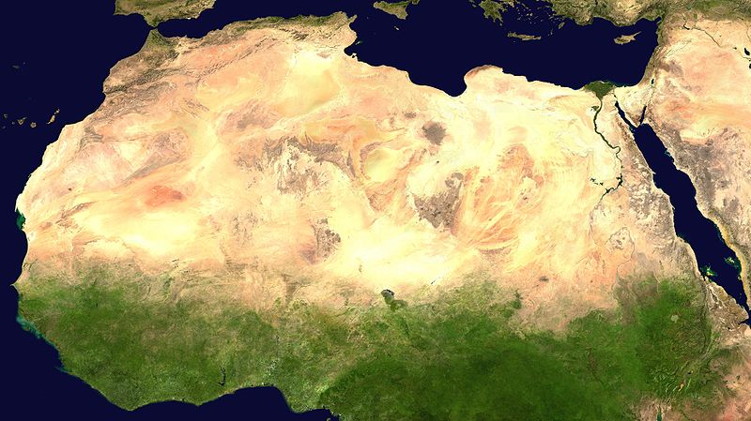
Variability of African Easterly Waves and
their relationship with downstream
tropical cyclogenesis
Chris Thorncroft
Department of Atmospheric and Environmental Sciences
University at Albany
Acknowledgements to:
Alan Brammer (U Albany), Matt Janiga (NRL), Mike Ventrice (WSI)
and George Kiladis (NOAA)
Funded by: NSF and NASA

Slide 2
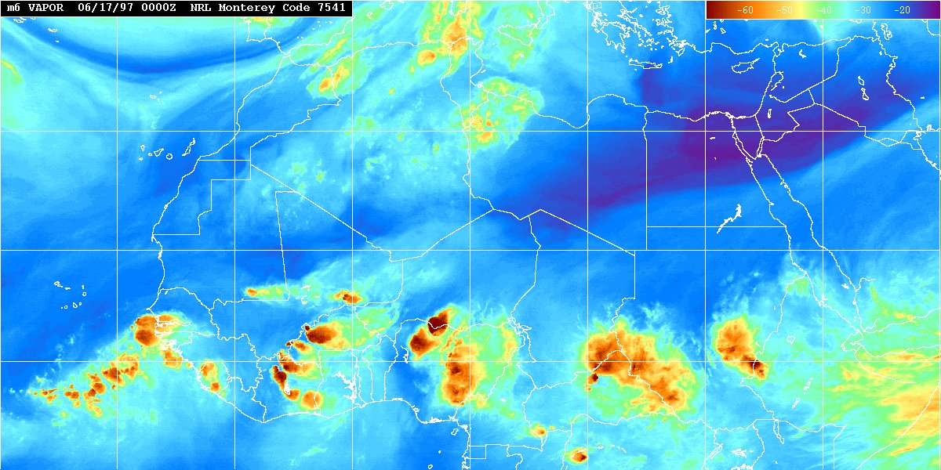
Introduction
(1) Background
(2) Regional Variability in AEW Structures
(3) AEW-TC relationship
(4) Sub-seasonal Variability in AEWs: Role of MJO and CCKWs

Slide 3
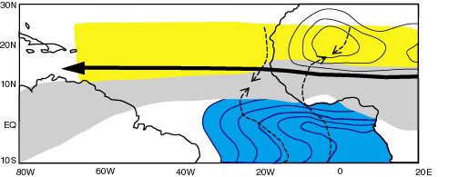
1. Background
Key features of the WAM Climate System during Boreal summer
Heat Low
SAL
AEJ
ITCZ
Cold Tongue

Slide 4
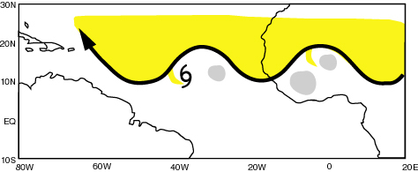
1. Background
SAL
AEWs
TC
MCSs

Slide 5
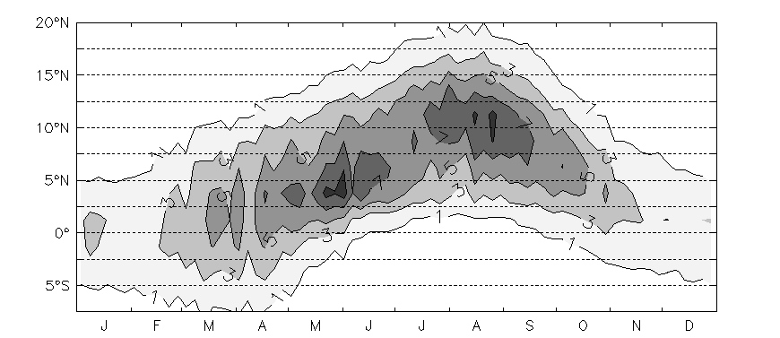
1. Background
Data: GPCP (Global Precipitation Climatological Project).
Resolution: pentad on a 2.5º grid.
Averaged from 10ºW to 10ºE over 23 years (1979-2001).
c.f. Gu and Adler (2004)

Slide 6
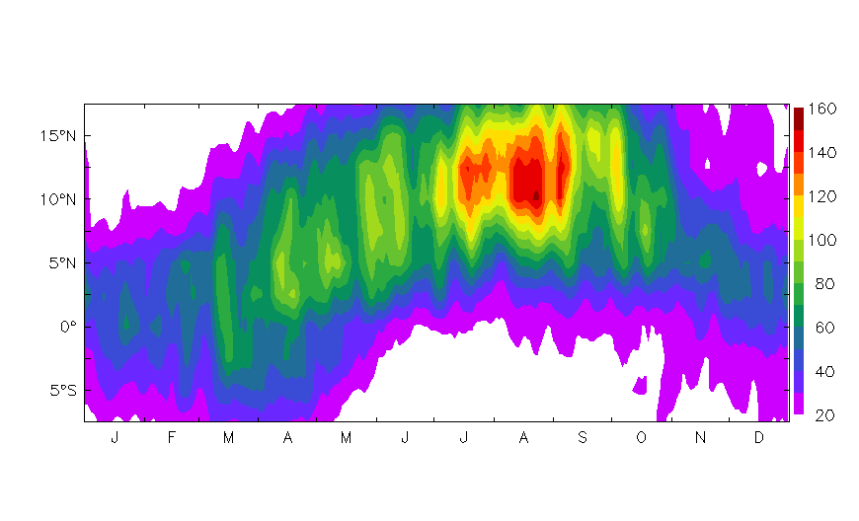
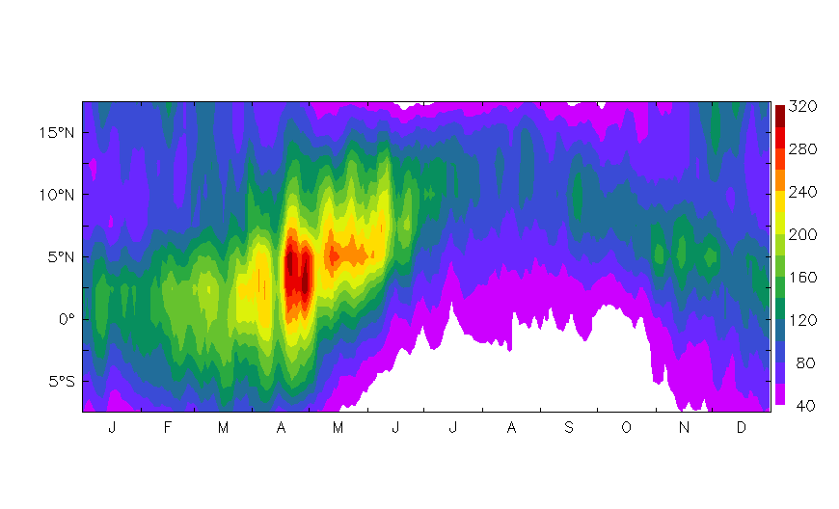
1. Background
TD-filtered OLR (AEW-activity)
Peaks in summer
We know little about the nature and causes of AEW-variability
Kelvin-filtered OLR
Peaks in Spring
Key synoptic system for pre-coastal phase and possibly the coastal phase – much weaker in summer

Slide 7
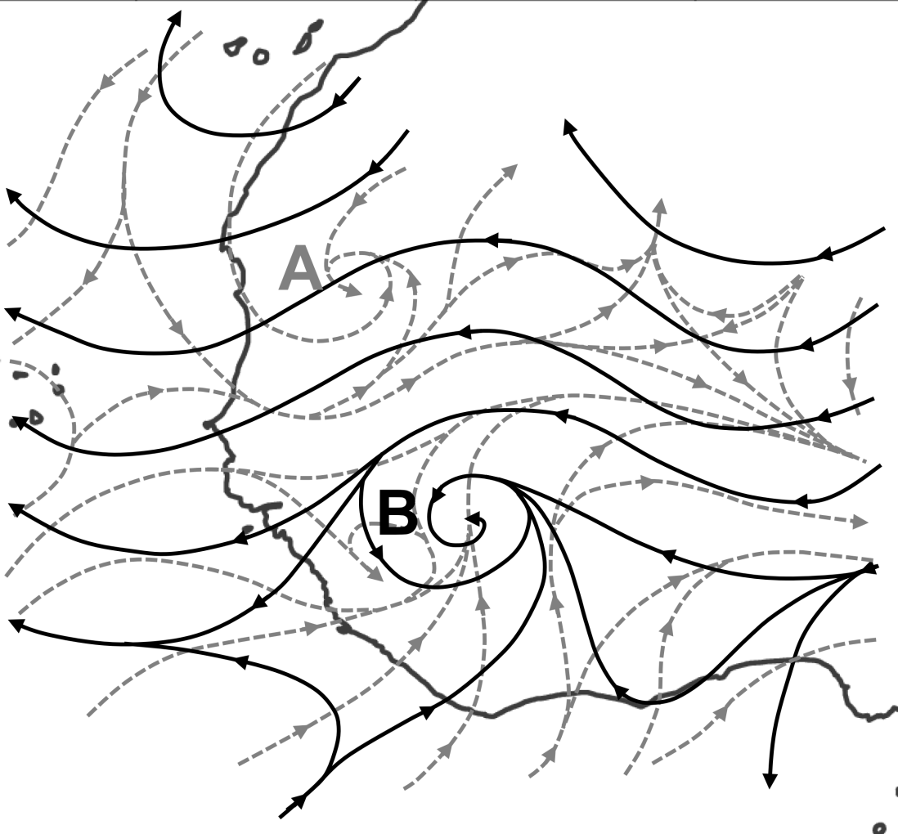
1. Background
Carlson (1969) was the first study to document the tilted structure of AEWs over the continent.
Burpee (1972) described how this was related to the instability of the basic state.
Low-Level Flow
Mid-Level Flow
African Easterly Jet (AEJ)
A
Northern Low-level Vortex
B
Mid-Level Vortex

Slide 8
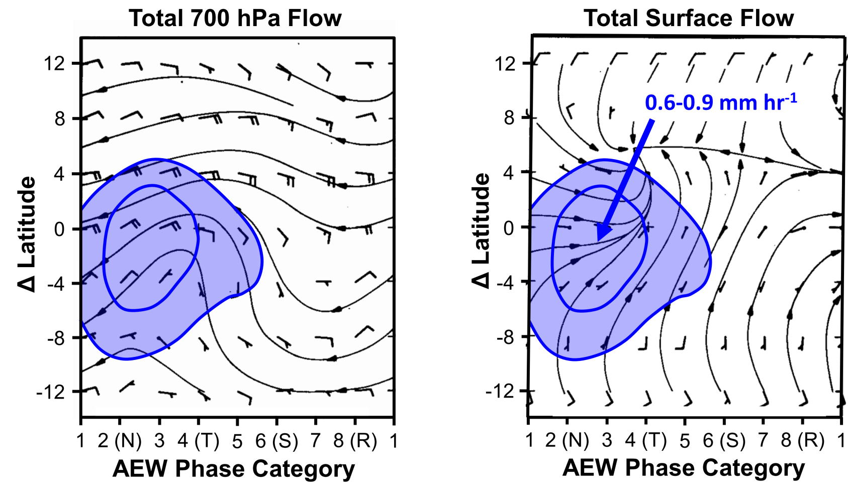
1. Background
Reed et al. (1977)
NV
The GATE Experiment (1974) provided additional details on the structure of
AEWs, their relationship with rainfall, and their energetics (Norquist et al. 1977; Reed et al. 1977; Thompson et al. 1979).

Slide 9
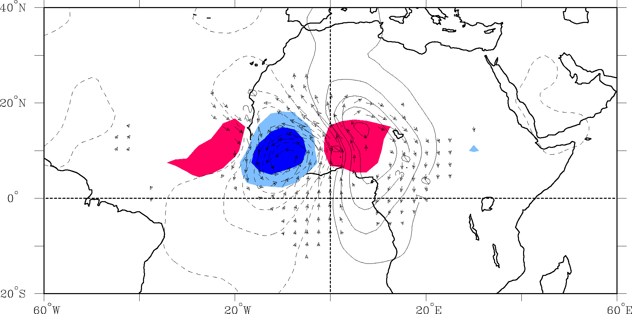
OLR and 850 hPa Flow Regressed against TD-filtered OLR (scaled -20 W m²) at 10°N, 10°W for June-September 1979-1993
Day 0
Streamfunction (contours 1 X 10⁵ m² s⁻¹)
Wind (vectors, largest around 2 m s⁻¹)
OLR (shading starts at +/- 6 W s⁻²), negative blue
Kiladis, Thorncroft, Hall (2006)

Slide 10
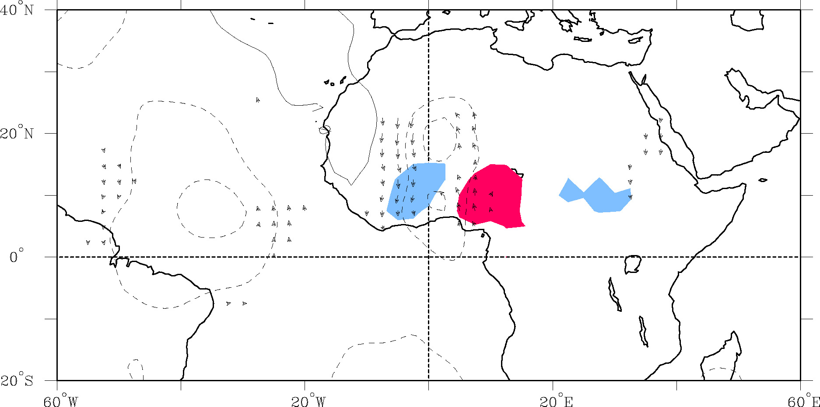
OLR and 850 hPa Flow Regressed against TD-filtered OLR (scaled -20 W m²) at 10°N, 10°W for June-September 1979-1993
Day-4
Streamfunction (contours 1 X 10⁵ m² s⁻¹)
Wind (vectors, largest around 2 m s⁻¹)
OLR (shading starts at +/- 6 W s⁻²), negative blue

Slide 11
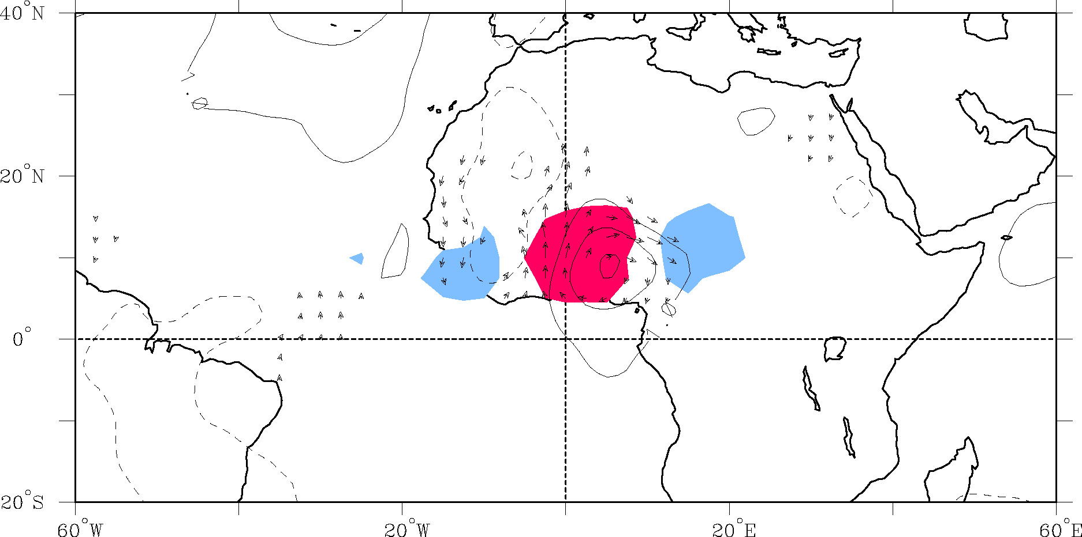
OLR and 850 hPa Flow Regressed against TD-filtered OLR (scaled -20 W m²) at 10°N, 10°W for June-September 1979-1993
Day-3
Streamfunction (contours 1 X 10⁵ m² s⁻¹)
Wind (vectors, largest around 2 m s⁻¹)
OLR (shading starts at +/- 6 W s⁻²), negative blue

Slide 12
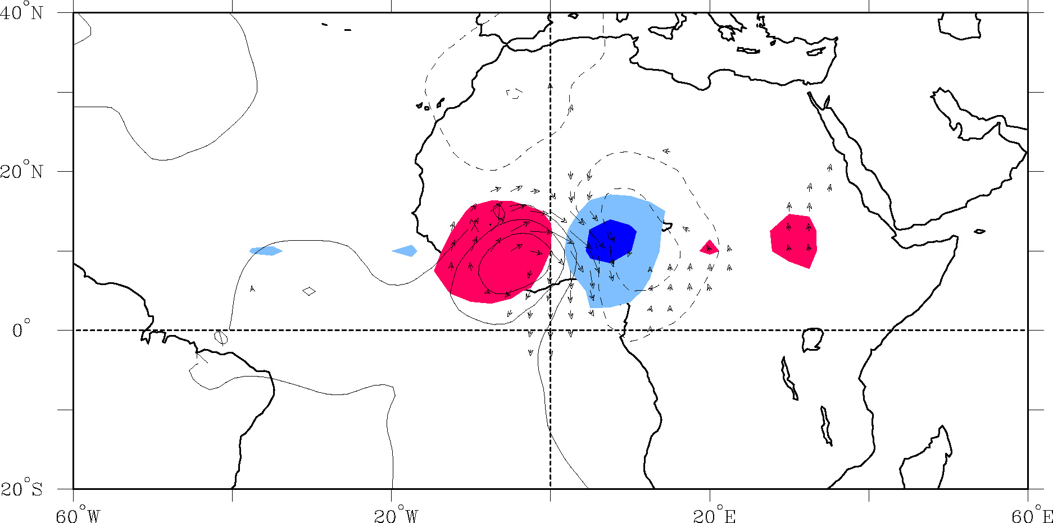
OLR and 850 hPa Flow Regressed against TD-filtered OLR (scaled -20 W m²) at 10°N, 10°W for June-September 1979-1993
Day-2
Streamfunction (contours 1 X 10⁵ m² s⁻¹)
Wind (vectors, largest around 2 m s⁻¹)
OLR (shading starts at +/- 6 W s⁻²), negative blue

Slide 13
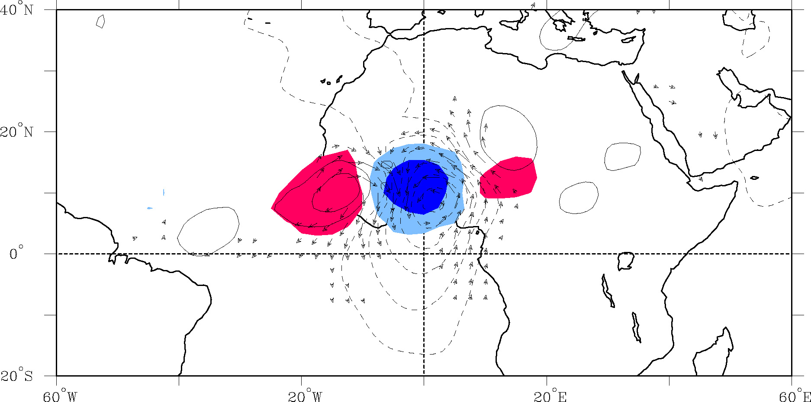
OLR and 850 hPa Flow Regressed against TD-filtered OLR (scaled -20 W m²) at 10°N, 10°W for June-September 1979-1993
Day-1
Streamfunction (contours 1 X 10⁵ m² s⁻¹)
Wind (vectors, largest around 2 m s⁻¹)
OLR (shading starts at +/- 6 W s⁻²), negative blue

Slide 14
OLR and 850 hPa Flow Regressed against TD-filtered OLR (scaled -20 W m²) at 10°N, 10°W for June-September 1979-1993
Day 0
Streamfunction (contours 1 X 10⁵ m² s⁻¹)
Wind (vectors, largest around 2 m s⁻¹)
OLR (shading starts at +/- 6 W s⁻²), negative blue

Slide 15
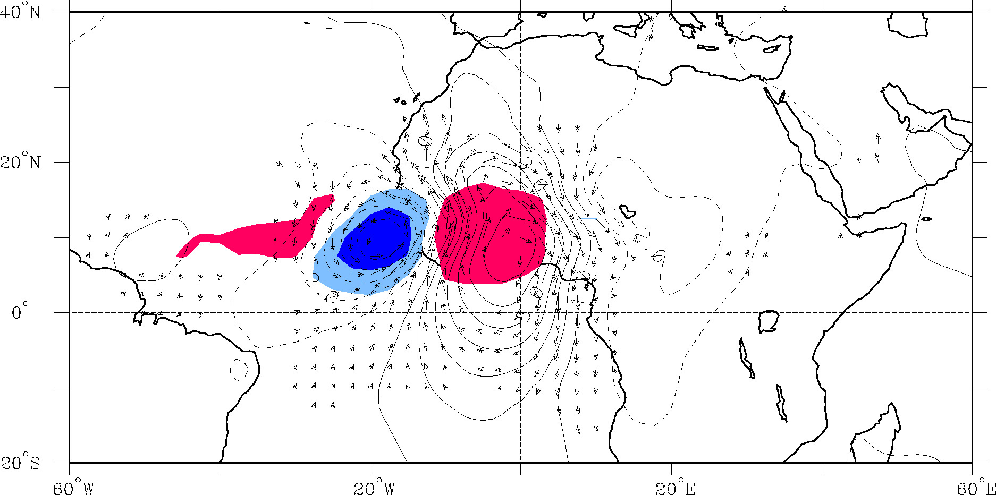
OLR and 850 hPa Flow Regressed against TD-filtered OLR (scaled -20 W m²) at 10°N, 10°W for June-September 1979-1993
Day+1
Streamfunction (contours 1 X 10⁵ m² s⁻¹)
Wind (vectors, largest around 2 m s⁻¹)
OLR (shading starts at +/- 6 W s⁻²), negative blue

Slide 16
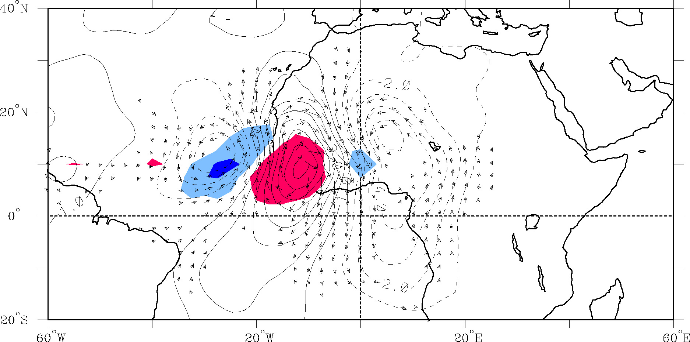
OLR and 850 hPa Flow Regressed against TD-filtered OLR (scaled -20 W m²) at 10°N, 10°W for June-September 1979-1993
Day+2
Streamfunction (contours 1 X 10⁵ m² s⁻¹)
Wind (vectors, largest around 2 m s⁻¹)
OLR (shading starts at +/- 6 W s⁻²), negative blue

Slide 17
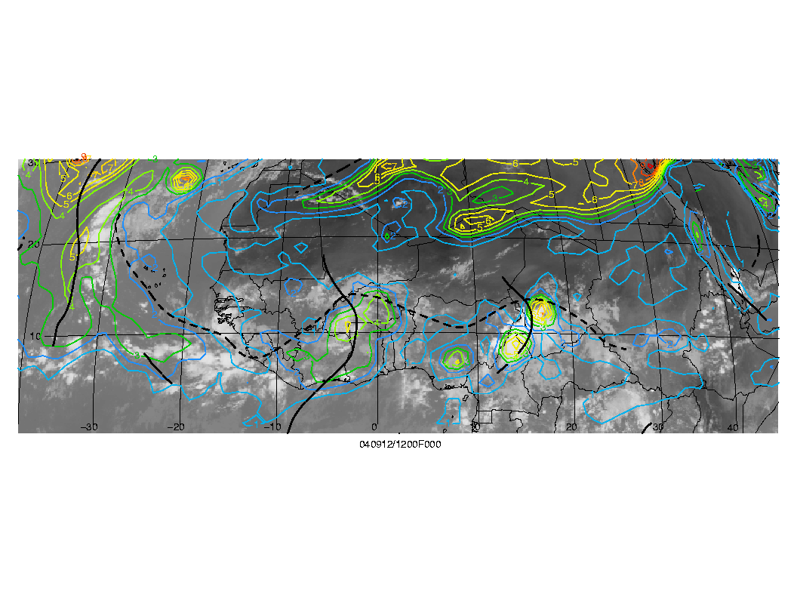
1. Background
Objectively diagnosed troughs (solid lines), African Easterly Jet (dashed), with PV (315K) and IR from METEOSAT
Berry, G., Thorncroft, C. and Hewson, T. (2006)

Slide 18
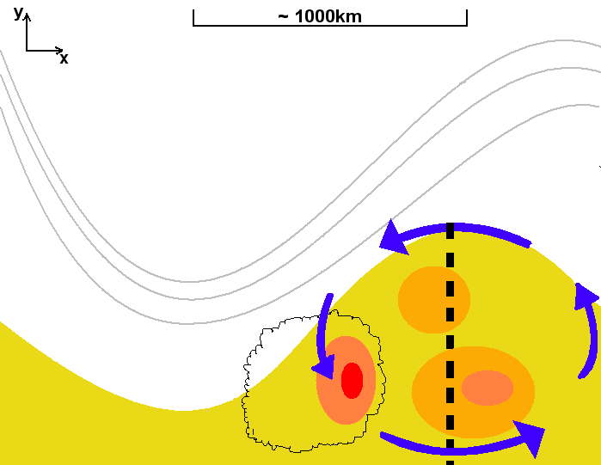
Conceptual framework (ii) Baroclinic growth.
θ’ Max
700hPa Trough

Slide 19
PV-theta analysis of AEWs – Scale Interactions
Synoptic-Mesoscale Interactions

Slide 20
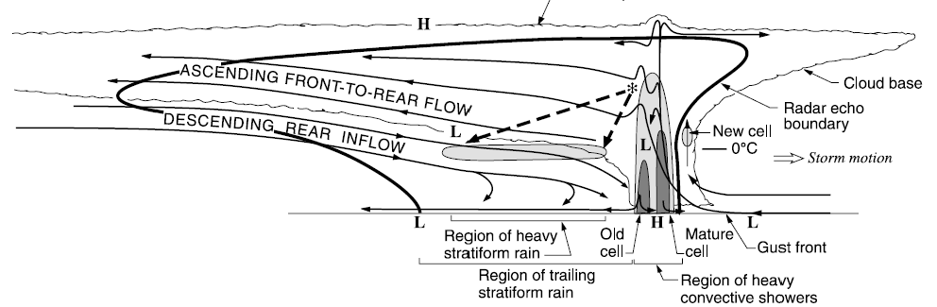
PV-theta analysis of AEWs – Scale Interactions
Synoptic-Mesoscale Interactions

Slide 21
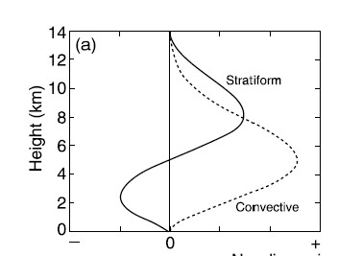
PV-theta analysis of AEWs – Scale Interactions
Synoptic-Mesoscale Interactions
From a PV-theta perspective, the heating rate profiles are crucial to know and understand.

Slide 22
PV-theta analysis of AEWs – Scale Interactions
Synoptic-Mesoscale Interactions
From a PV-theta perspective, the heating rate profiles are crucial to know and understand.
Mesoscale-Microscale Interactions
Ultimately these profiles are influenced by the nature of the microphysics!

Slide 23
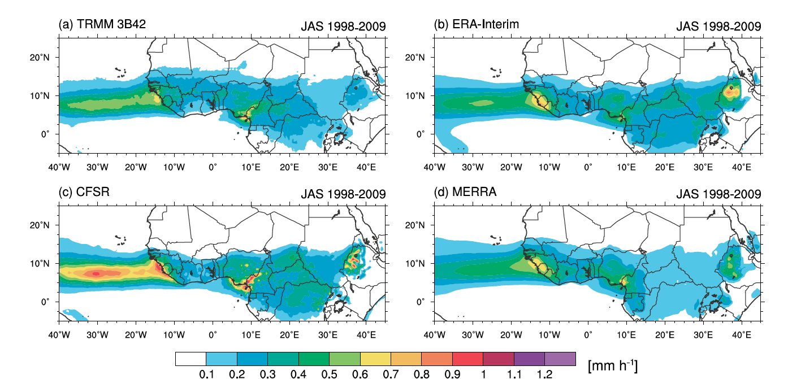
2. Regional Variations in African Easterly Wave Structures
Janiga and Thorncroft (2013)

Slide 24
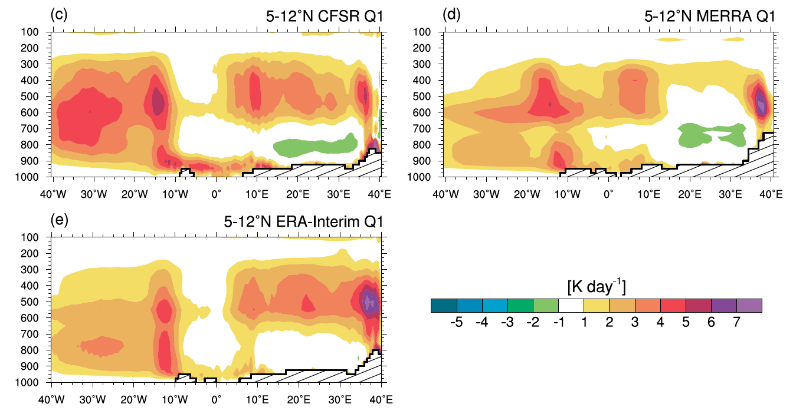
Zonal Variations in Diabatic Heating
Notable E-W variations in heating rates and profiles are seen in the reanalyses

Slide 25
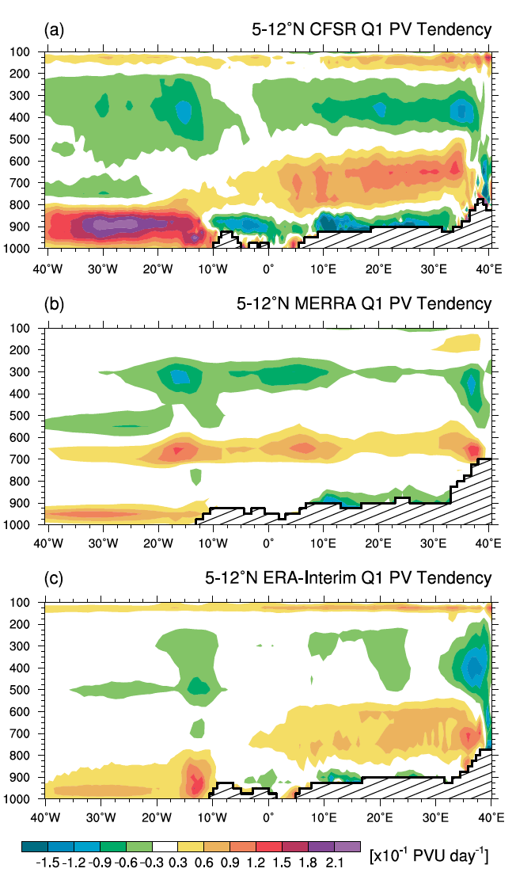
Zonal Variations in PV Tendency
Consistent with the variability in heating rate profiles there are marked E-W variations in PV tendencies
Note following general characteristics:
Positive mid-level PV generation between 40E and GM.
Weaker PV tendencies between GM and coast.
Increased positive PV tendencies at low-levels over ocean.
We expect this to impact AEW structures
Janiga and Thorncroft (2013)

Slide 26
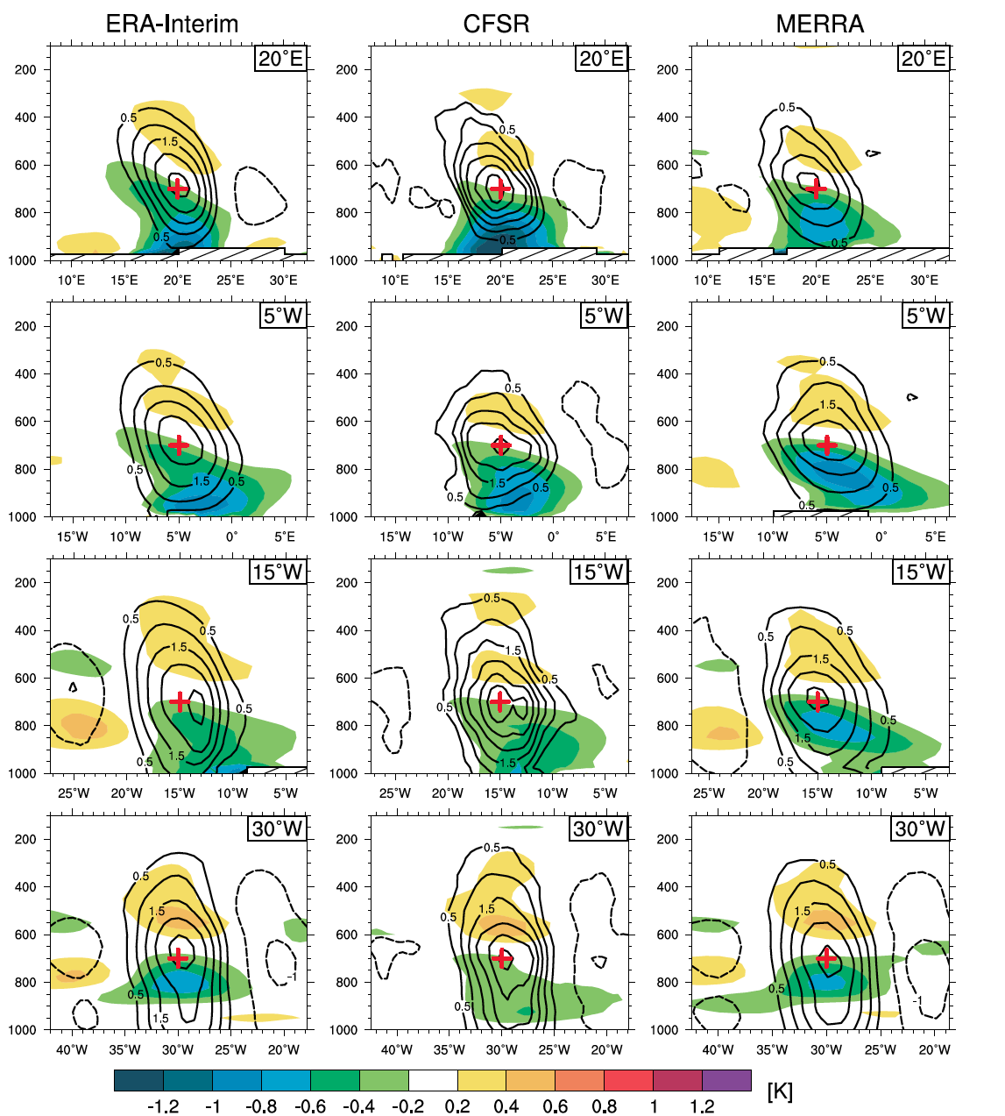
Zonal Variations in AEW Structures
Note marked changes in AEW structure between E and W Africa and the Atlantic
Especially weakened intensity of cold core and development of low-level circulations

Slide 27
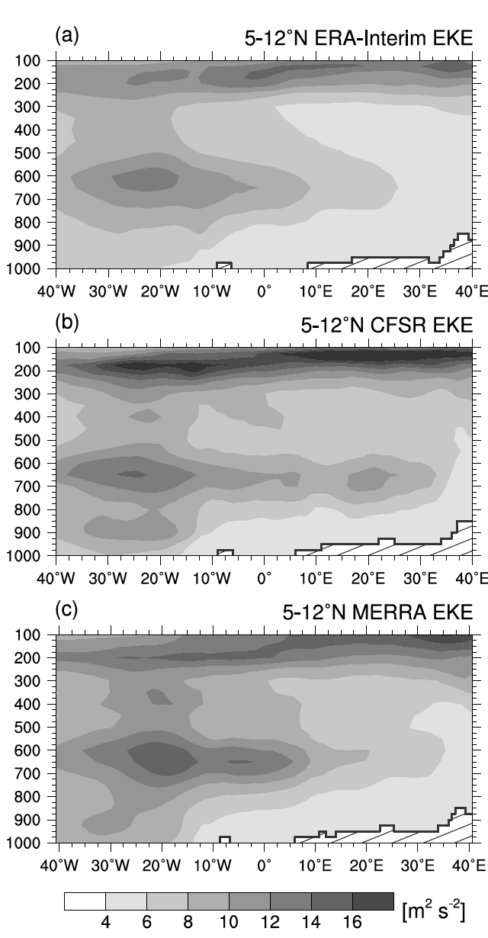
Zonal Variations in EKE
Rapid change in vertical structure occurs as AEWs reach the coastal region.

Slide 28
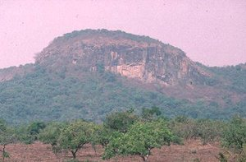
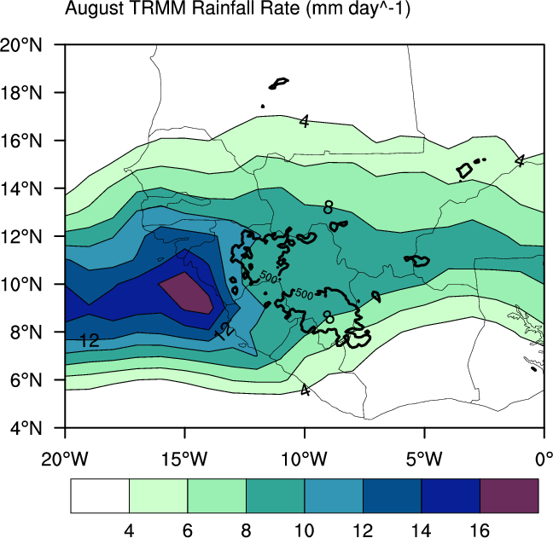
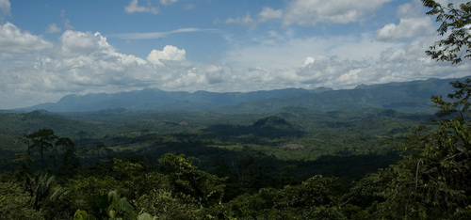
Importance of Guinea Highlands
Marked transition takes place close to Guinea Highlands and Coastal region
AEWs are often invigorated as they pass these regions – especially at low-levels
May influence tropical cyclogenesis probabilities
Fouta Djallon Highlands
~914m
The Nambia Range
~460m

Slide 29
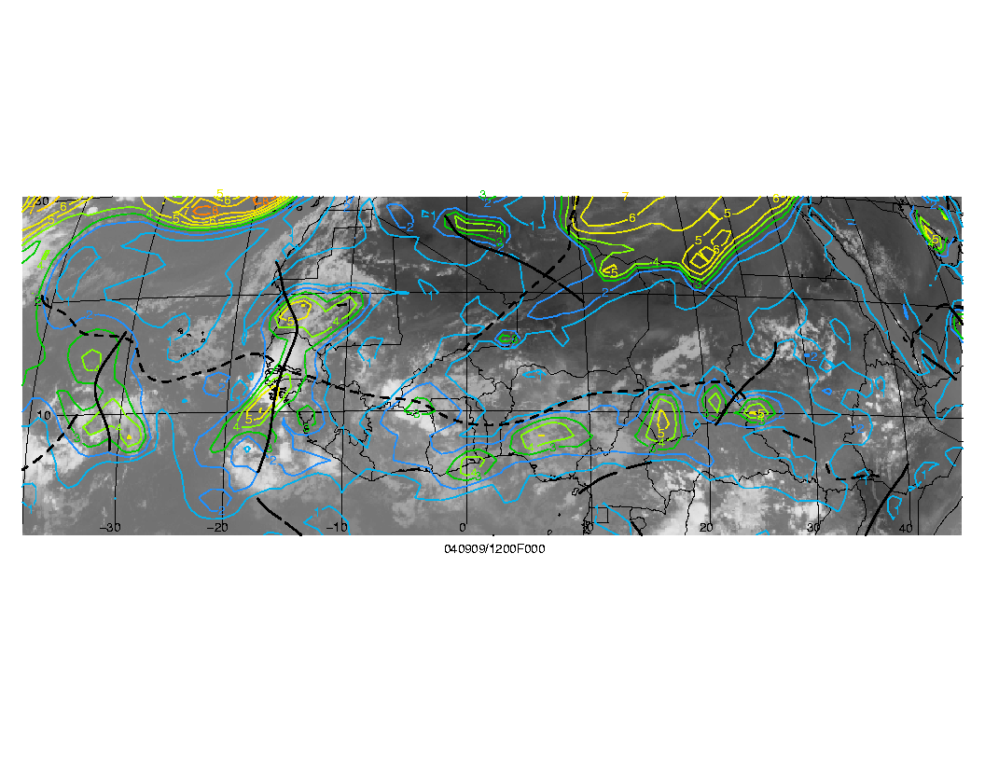
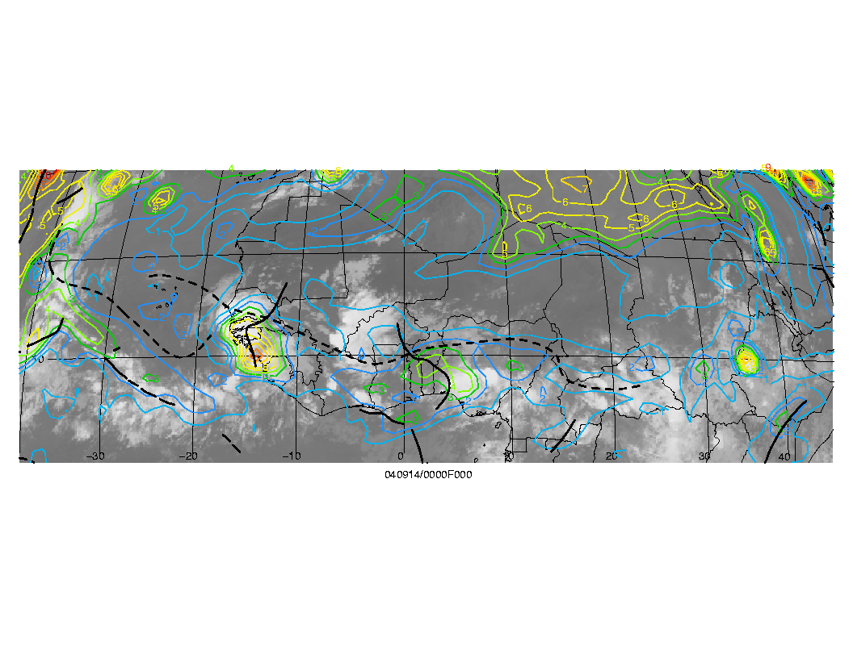
3. AEW-TC Relationship
Most TCs develop in association with AEWs – but which one?

Slide 30
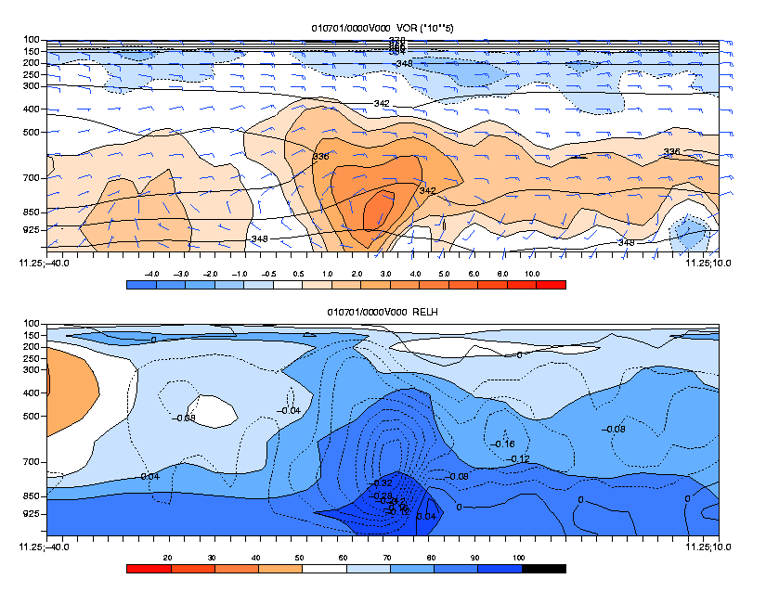
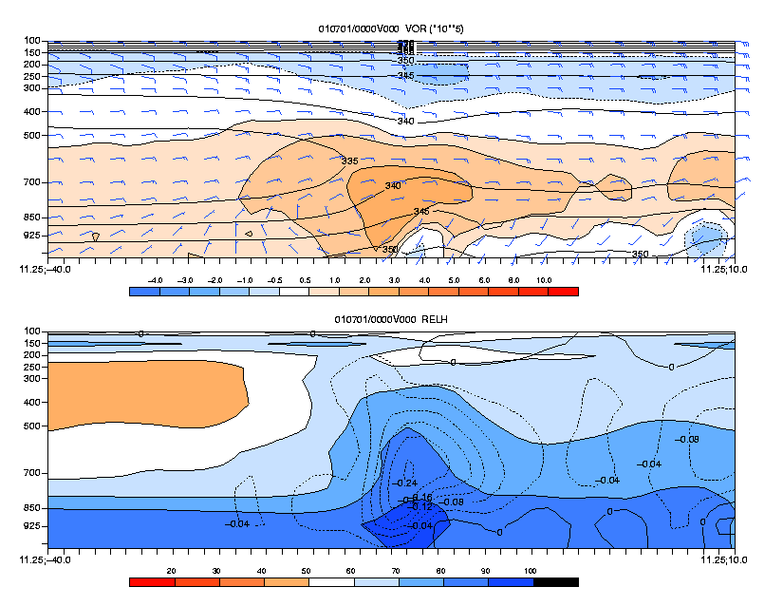
Importance of Guinea Highlands
Composites of East Atlantic Developing and Non-Developing AEWs (1979-2001)
Developing (33) Non-Developing (512)
Hopsch , Thorncroft and Tyle 2009

Slide 31
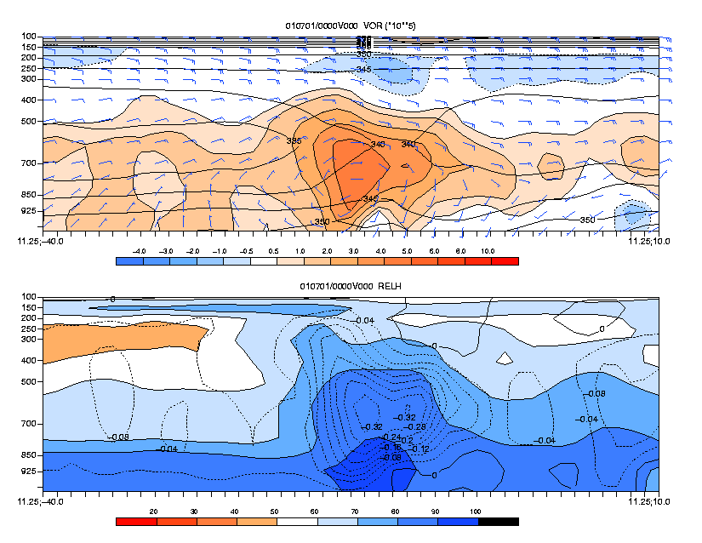
Importance of Guinea Highlands
Composites of East Atlantic Developing and Non-Developing AEWs (1979-2001)
Developing (33) Non-Developing (33 most intense)
Hopsch , Thorncroft and Tyle 2009

Slide 32
TC Genesis Associated with AEWs – Recent papers
Deep convective bursts over West African coastline feedback on trough increasing vorticity for developing waves (Ross & Krishnamurti 2009,2012)
Widespread deep convection over coast more important than small intense convection (Leppert et al 2013)
Horizontal flux of moist enthalpy important for sustained MCSs moving off the coast (Arnault & Roux 2009,2010)
TPW, Precipitation, SST, 1000-600 hPa Vertical shear among best predictors for developing / non-developing systems over Atlantic (Peng et al 2012)

Slide 33
AEW trough tracks
Brammer and Thorncroft 2015

Slide 34
Brammer and Thorncroft 2015

Slide 35
Composite differences in favorable waves
Most non-developing waves are diagnosed as very unfavorable.
Take the top 55, diagnostic ~0.27+
“Un-Favorable”
“Favorable”

Slide 36
“Favourable” AEW evolution
Brammer and Thorncroft 2015

Slide 37
Day 0
Developing – Non-developing AEWs
Total Precipitable Water [mm]
Developing Waves have increased moisture to west and northwest of trough after leaving coast
Non-developing waves have increased moisture near equator, due to horizontal tilt of trough.
Brammer and Thorncroft 2015

Slide 38
Day 0
Developing – Non-developing AEWs
Latitude-height cross section of anomalous specific humidity and geopotential height along 30°W
Moisture to northwest of trough significant at low levels (850 hPa) between 15-25°N
Brammer and Thorncroft 2015

Slide 39
Relative Inflow for AEWs
Trough Relative Streamlines
Blue : 850 hPa
Red : 700 hPa
Brammer and Thorncroft 2015

Slide 40
Back Trajectory Analysis
  Back trajectories were released from within 3° of trough “center”
  Trajectories were calculated for 120hrs
  Trough relative trajectories were calculated by removing the trough location or extrapolated location from each trajectory.
  Calculated for 86 “favourable” AEWs. 43 Developing and 43 Non-developing waves.
Notes:
5th bullet confusing no? Given the following slide

Slide 41
120 h Backward Trajectory Densities
Evolution of trajectory source regions as AEWs cross West Africa

Slide 42
120 h Backward Trajectory Density
Trough relative trajectory density
Trajectories reaching AEW trough above the AEJ.
Trajectories reaching AEW trough below the AEJ.

Slide 43
3D view of inflow into AEW trough
Clustered trajectory routes approaching trough (black column). Looking east towards trough. Humidity along trajectory shaded from Red to Blue (dry to wet).

Slide 44
Analysis of two “Favourable” AEWs

Slide 45
2014 Non-developing (AL90)
Accumulated precipitation within 750km of trough.
Trough axes every 24h
TPW and 300hPa geopotential height for 5th September 2014

Slide 46
Relative Vorticity and Specific Humidity
4° Latitudinal Average on 4th 1800UTC

Slide 47
Relative Vorticity and Specific Humidity
4° Latitudinal Average on 5th 1800UTC

Slide 48
Global Hawk (HS3) sampled dry air ahead of trough!
q at 850mb and storm-relative flow at 850mb and 700mb

Slide 49
Dry air is dust-free!
MODIS: aerosol optical depth
Humidity (dropsondes) and CPL

Slide 50
192h Back trajectories from Dry Air Ahead of AL90
Initialized at 1500m (850hPa)
Reveals tropical subsidence over Atlantic

Slide 51
2012 Pre-Leslie
Accumulated precipitation within 750km of trough.
Trough axes every 24h
TPW and 300hPa geopotential height for 26th August 2012

Slide 52
Relative Vorticity and Specific Humidity
4° Latitudinal Average on 27th 1200UTC

Slide 53
Relative Vorticity and Specific Humidity
4° Latitudinal Average on 28th 1200UTC

Slide 54
AL90 /pre-Leslie comparison

Slide 55
Summary

Slide 56
AEW Characteristics in 2014
Non-developing AL90
Developing AL91
Pre-Edouard

Slide 57
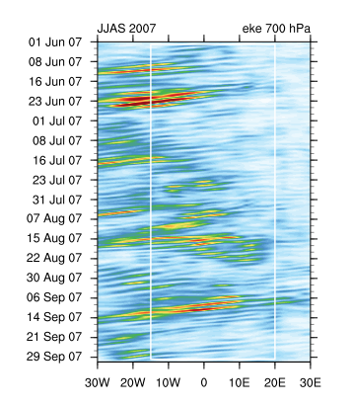
4. Variability in African Easterly Wave Activity

Slide 58
4. Variability in African Easterly Wave Activity
Approach taken here is to consider impact of known phenomena on AEW-activity.
MJO has a coherent relationship with AEW-activity (measured by EKE):
Ventrice, Thorncroft and Roundy, 2012
Alaka and Maloney, 2013
Convectively Coupled Kelvin Waves can impact convection and AEWs:
Ventrice, Thorncroft and Roundy,2012
Ventrice and Thorncroft, 2013

Slide 59
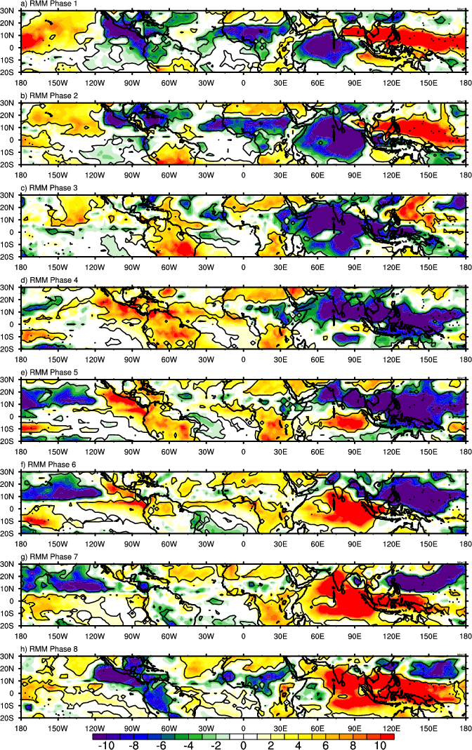
Variability in African Easterly Wave Activity - MJO
OLR
RMM Phase 1
RMM Phase 2
RMM Phase 3
RMM Phase 4
RMM Phase 5
RMM Phase 6
RMM Phase 7
RMM Phase 8
Ventrice et al, 2012

Slide 60
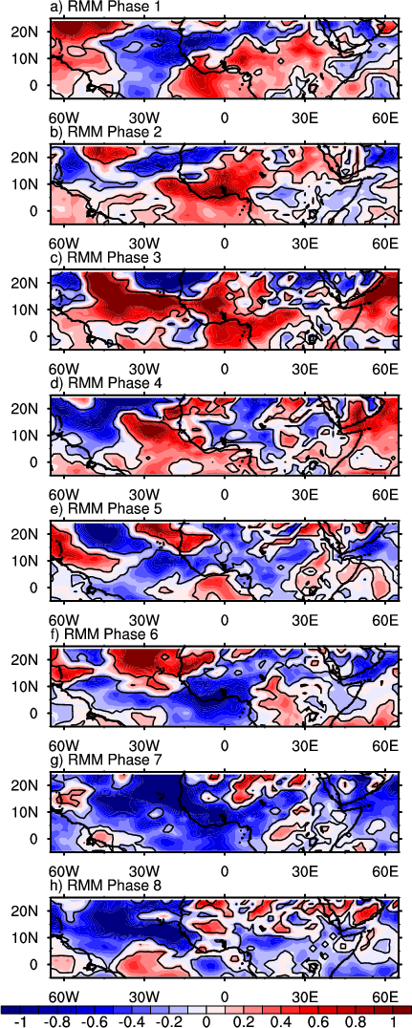
Variability in African Easterly Wave Activity - MJO
OLR 2-10d filtered 700 hPa EKE
RMM Phase 1
RMM Phase 2
RMM Phase 3
RMM Phase 4
RMM Phase 5
RMM Phase 6
RMM Phase 7
RMM Phase 8
Ventrice et al, 2011

Slide 61
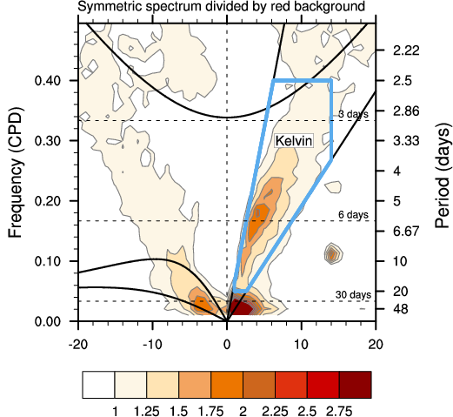
3. Variability in African Easterly Wave Activity
Wheeler and Kiladis (1999)
Kelvin filter:
  Wavenumbers: 1-14
  Period: 2.5-20 days
  Equiv. Depth: 8-90m

Slide 62
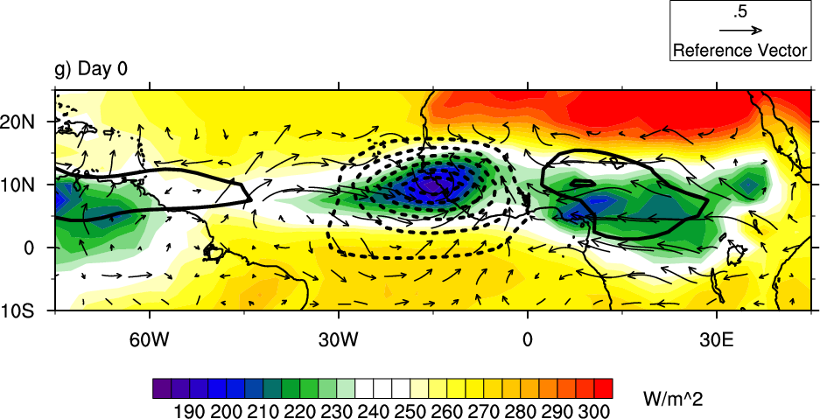
Unfiltered OLR, Kelvin-filtered OLR and 850hPa wind anomalies
Key:
Unfiltered total OLR field (Shaded)
Kelvin filtered OLR (Contours) are contoured if statistically different than zero at the 95% level
Positive (Negative) Kelvin filtered OLR anomalies 850 hPa wind anomalies (Vectors)

Slide 63
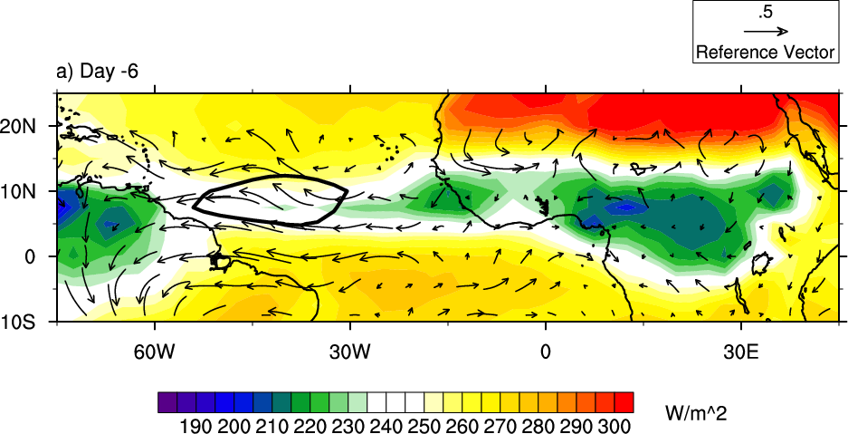
Unfiltered OLR, Kelvin-filtered OLR and 850hPa wind anomalies
Key:
Unfiltered total OLR field (Shaded)
Kelvin filtered OLR (Contours) are contoured if statistically different than zero at the 95% level
Positive (Negative) Kelvin filtered OLR anomalies 850 hPa wind anomalies (Vectors)

Slide 64
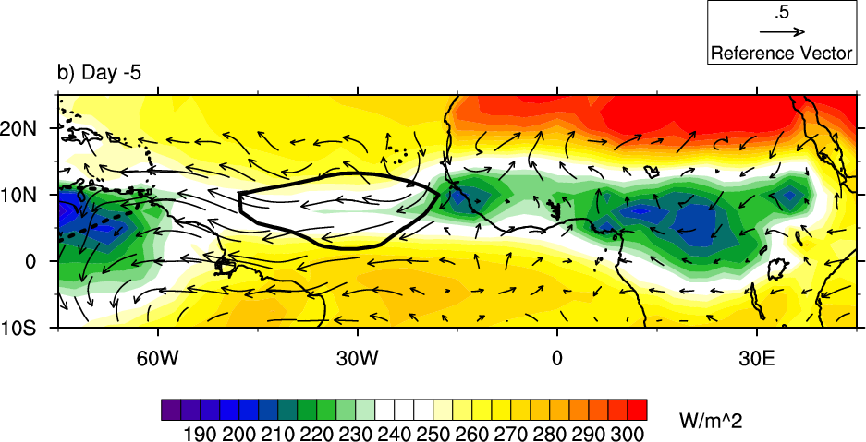
Unfiltered OLR, Kelvin-filtered OLR and 850hPa wind anomalies
Key:
Unfiltered total OLR field (Shaded)
Kelvin filtered OLR (Contours) are contoured if statistically different than zero at the 95% level
Positive (Negative) Kelvin filtered OLR anomalies 850 hPa wind anomalies (Vectors)

Slide 65
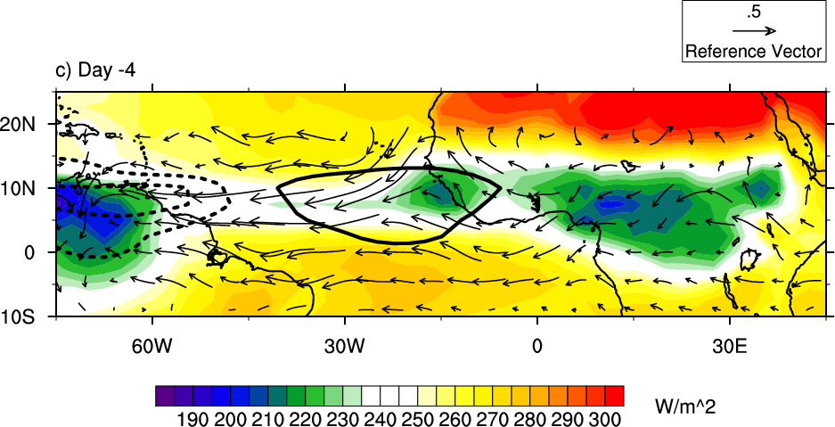
Unfiltered OLR, Kelvin-filtered OLR and 850hPa wind anomalies
Key:
Unfiltered total OLR field (Shaded)
Kelvin filtered OLR (Contours) are contoured if statistically different than zero at the 95% level
Positive (Negative) Kelvin filtered OLR anomalies 850 hPa wind anomalies (Vectors)

Slide 66
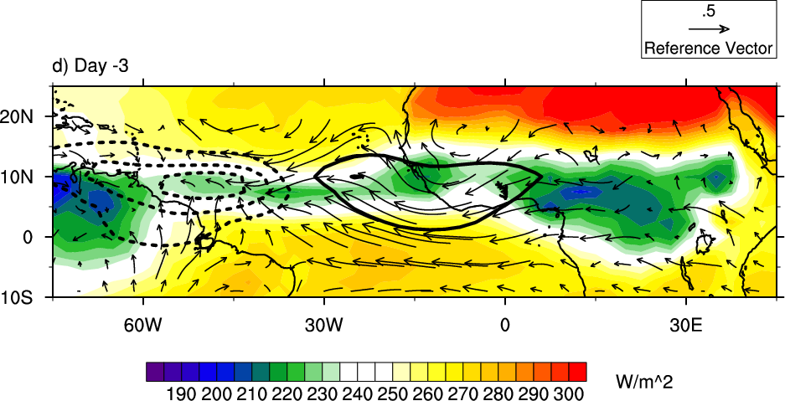
Unfiltered OLR, Kelvin-filtered OLR and 850hPa wind anomalies
Key:
Unfiltered total OLR field (Shaded)
Kelvin filtered OLR (Contours) are contoured if statistically different than zero at the 95% level
Positive (Negative) Kelvin filtered OLR anomalies 850 hPa wind anomalies (Vectors)

Slide 67
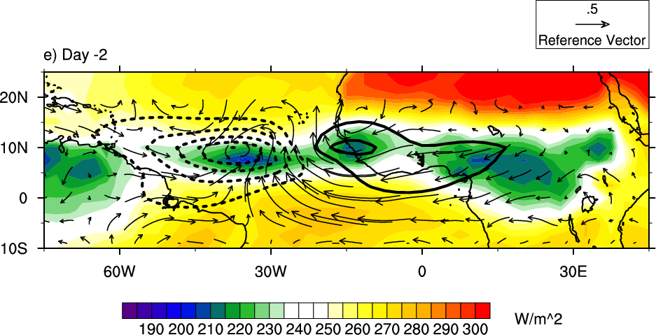
Unfiltered OLR, Kelvin-filtered OLR and 850hPa wind anomalies
Key:
Unfiltered total OLR field (Shaded)
Kelvin filtered OLR (Contours) are contoured if statistically different than zero at the 95% level
Positive (Negative) Kelvin filtered OLR anomalies 850 hPa wind anomalies (Vectors)

Slide 68
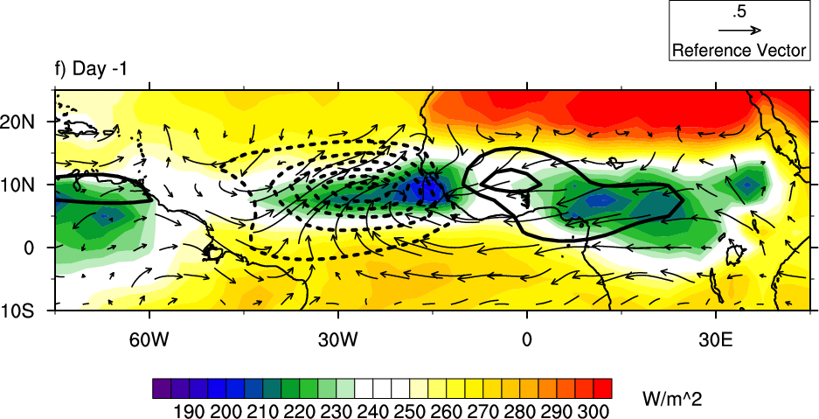
Unfiltered OLR, Kelvin-filtered OLR and 850hPa wind anomalies
Key:
Unfiltered total OLR field (Shaded)
Kelvin filtered OLR (Contours) are contoured if statistically different than zero at the 95% level
Positive (Negative) Kelvin filtered OLR anomalies 850 hPa wind anomalies (Vectors)

Slide 69
Unfiltered OLR, Kelvin-filtered OLR and 850hPa wind anomalies
Key:
Unfiltered total OLR field (Shaded)
Kelvin filtered OLR (Contours) are contoured if statistically different than zero at the 95% level
Positive (Negative) Kelvin filtered OLR anomalies 850 hPa wind anomalies (Vectors)

Slide 70
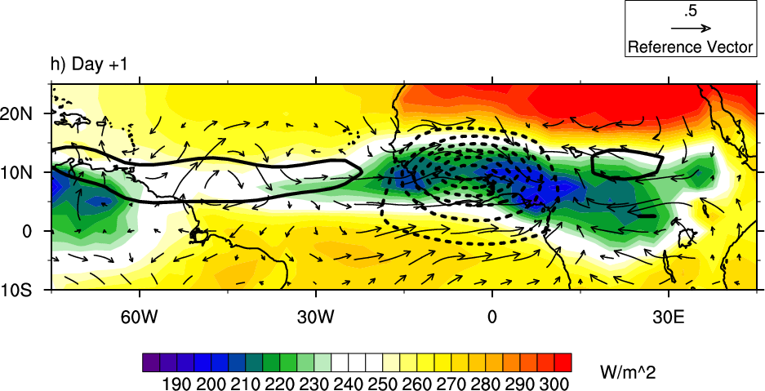
Unfiltered OLR, Kelvin-filtered OLR and 850hPa wind anomalies
Key:
Unfiltered total OLR field (Shaded)
Kelvin filtered OLR (Contours) are contoured if statistically different than zero at the 95% level
Positive (Negative) Kelvin filtered OLR anomalies 850 hPa wind anomalies (Vectors)

Slide 71
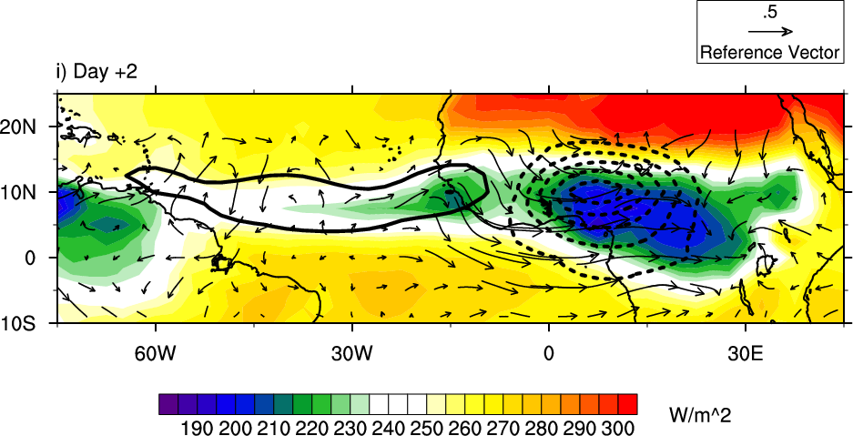
Unfiltered OLR, Kelvin-filtered OLR and 850hPa wind anomalies
Key:
Unfiltered total OLR field (Shaded)
Kelvin filtered OLR (Contours) are contoured if statistically different than zero at the 95% level
Positive (Negative) Kelvin filtered OLR anomalies 850 hPa wind anomalies (Vectors)

Slide 72
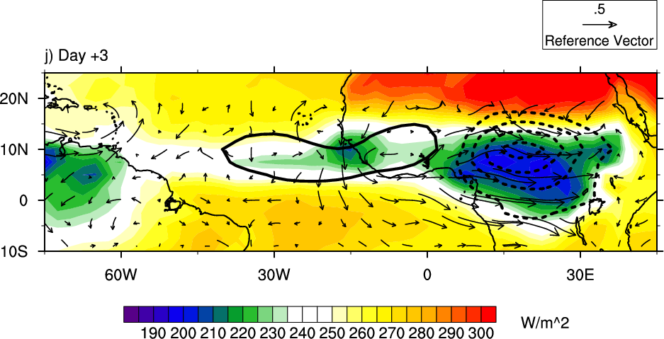
Unfiltered OLR, Kelvin-filtered OLR and 850hPa wind anomalies
Key:
Unfiltered total OLR field (Shaded)
Kelvin filtered OLR (Contours) are contoured if statistically different than zero at the 95% level
Positive (Negative) Kelvin filtered OLR anomalies 850 hPa wind anomalies (Vectors)

Slide 73
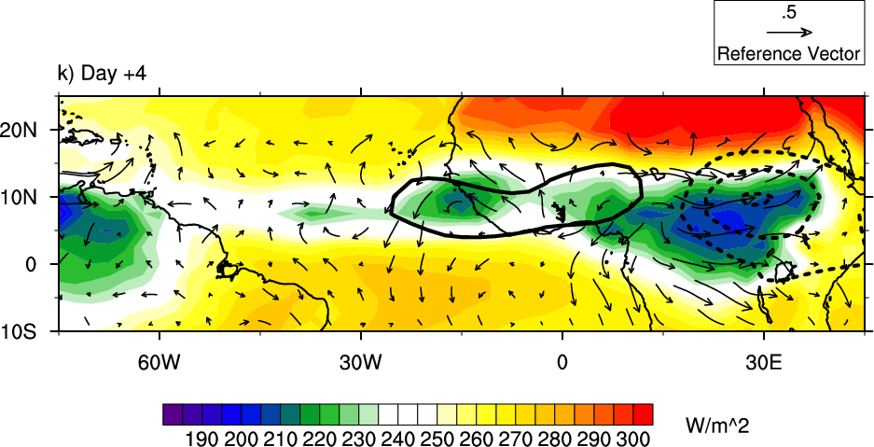
Unfiltered OLR, Kelvin-filtered OLR and 850hPa wind anomalies
Key:
Unfiltered total OLR field (Shaded)
Kelvin filtered OLR (Contours) are contoured if statistically different than zero at the 95% level
Positive (Negative) Kelvin filtered OLR anomalies 850 hPa wind anomalies (Vectors)

Slide 74
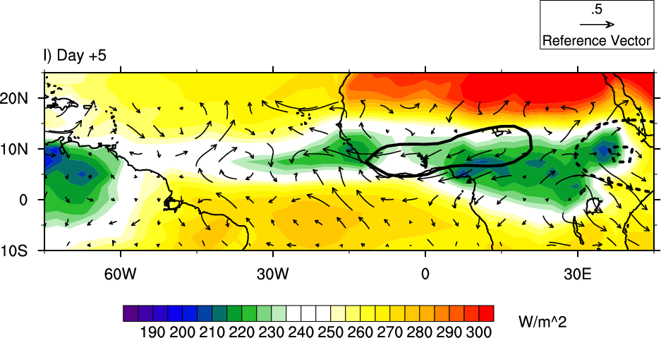
Unfiltered OLR, Kelvin-filtered OLR and 850hPa wind anomalies
Key:
Unfiltered total OLR field (Shaded)
Kelvin filtered OLR (Contours) are contoured if statistically different than zero at the 95% level
Positive (Negative) Kelvin filtered OLR anomalies 850 hPa wind anomalies (Vectors)

Slide 75
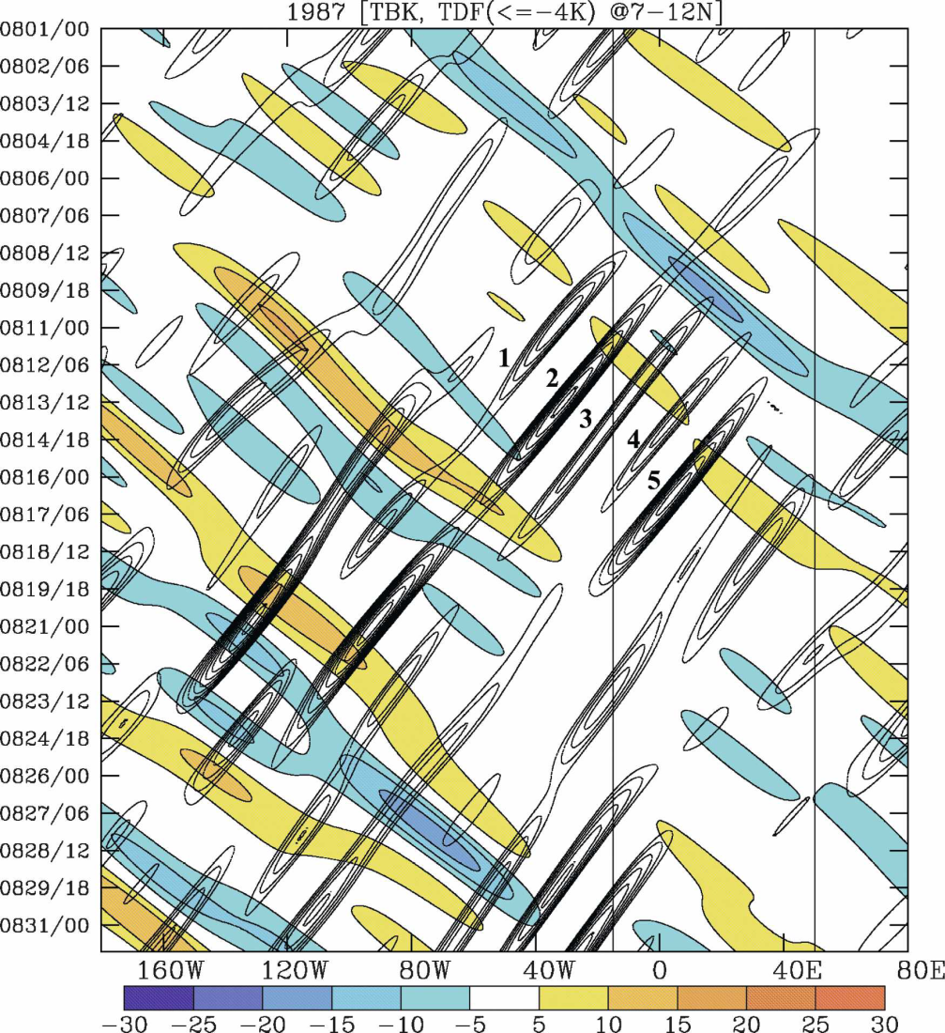
Variability in African Easterly Wave Activity - CCKWs
Shading: Kelvin filtered brightness temperature (Tb) anomalies
Contours: Tropical Depression type wave filtered Tb anomalies
AEW wave train develops after the passage of convectively active phase of a CCKW.
AEWs initiate (or amplify) east of one another
from Mekonnen et al. 2008

Slide 76

CCKW-AEW-activity Relationship
Shading: 700 hPa EKE anomalies (contoured if statistically different than zero at the 90% level)
Bold Black Contours: Kelvin filtered OLR anomalies (dashed if negative)

Slide 77


AEW-CCKW-TC Relationships
Tropical cyclogenesis
relative to the Kelvin wave
-

Slide 78

Overview of the 2012 Season

Slide 79
          Regional Variations in AEW Structure
There are marked variations in AEW structures as they propagate between the African continent and the ocean.
AEWs intensify and develop low level circulations as they pass the Guinea Highlands and coastal region.
These changes appear to be associated with changes in the type of convection and vertical profile in heating rate.
Variability in these processes likely impacts probability of tropical cyclogenesis.

Slide 80
          Tropical Cyclogenesis in East Atlantic
Favorable mid-level AEW-troughs are often “open” at low-levels – due to low-level westerly flow (and a NE-relative shift of low-level vortex over the ocean).
Non-developing favorable troughs tend to be associated with dry low-level air NW of the trough which is ingested beneath the mid-level trough.
Source regions for the low-level dry air include Midlatitudes, Sahara and Equatorial region.

Slide 81
          Variability in AEW Activity
There is marked sub-seasonal variability in AEW activity and related TC-genesis.
The MJO and CCKWs both influence AEW-activity and Tropical Cyclogenesis frequency.

Slide 82
          Exploitation of Ensemble Prediction System Information in Support of Atlantic Tropical Cyclone Prediction
PIs: Chris Thorncroft, Jason Dunion
PDRA at Albany: Alan Brammer
NHC Contact: Chris Landsea
GFDL Contact: Tim Marchok
Overarching Goals:
To ensure that recent and current research concerned with the variability of AEW structures and downstream tropical cyclogenesis probability is transferred into operational decision-making at NHC.
To develop and evaluate tools that exploit key information in dynamical ensemble prediction systems in support of tropical cyclogenesis prediction.

