Slide 1

Eyewall replacement cycles and the tropical cyclone boundary layer
Jeffrey D. Kepert
High Impact Weather
Bureau of Meteorology Research and Development

Slide 2
Eyewall contraction, intensification and replacement
max tangential acceleration
Willoughby, 1988, AMM

Slide 3
How do secondary eyewalls form?
Nobody really knows … not for sure, anyway
  i.e. there is no consensus
Numerous explanations, some have gone, others remain
  Vortex Rossby Waves
  Beta-skirt axisymmetrisation
  WISHE
  Environmental influences
  Boundary-layer supergradient flow
  and more …

Slide 4
What is the role of the BL in an ERC?
Goal: Investigate the boundary-layer flow in a cyclone with concentric eyewalls
Method: Diagnostic models of the tropical cyclone boundary layer
  Model the BL flow as the response to an imposed, axisymmetric pressure field that represents the rest of the cyclone
  One part of a two-way interaction: the cyclone structure and intensity affects the BL flow, but not vice versa.
  Enables controlled experiments
Three models:
  Kepert and Wang (2001): Full nonlinear equations, realistic physics, numerical solution.
  Kepert (2001): Linearised equations, simplified physics, analytical solution.
  Ooyama (1969) and Emanuel (1986): Simplified depth-averaged equations, analytical solution.

Slide 5
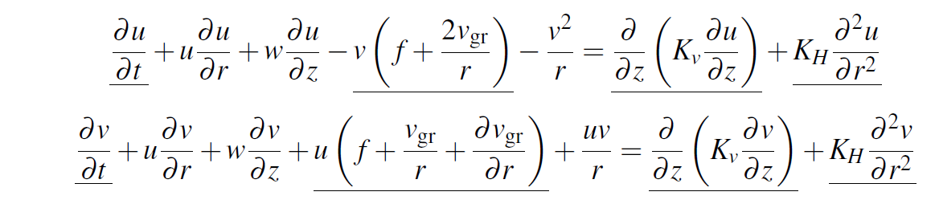
Model description
Aim: controlled experiments on boundary-layer flow
  Control => hold rest of the cyclone fixed
Prescribe p at top of model, solve equations within.
  Ignore feedback from BL to rest of storm
Eqs of motion: axisymmetric momentum eqs, replace v by V+v where V is the gradient wind, write ∂p/∂r in terms of V
  Can solve full eqs, or linearised (underlined)
  Axisymmetric version of Kepert and Wang (2001) model

Slide 6
Is the BL "slaved" to the parent vortex?
I.e. can we assume that the steady-state solution to the BL model is close to the actual BL flow?
Eliassen and Lystad (1977) argue that the BL adjusts with time scale 1/I
In the inner core 1/I is at most a few hours
TCs typically evolve slower than this, so the steady-state assumption looks reasonable
But, we should check …

Slide 7
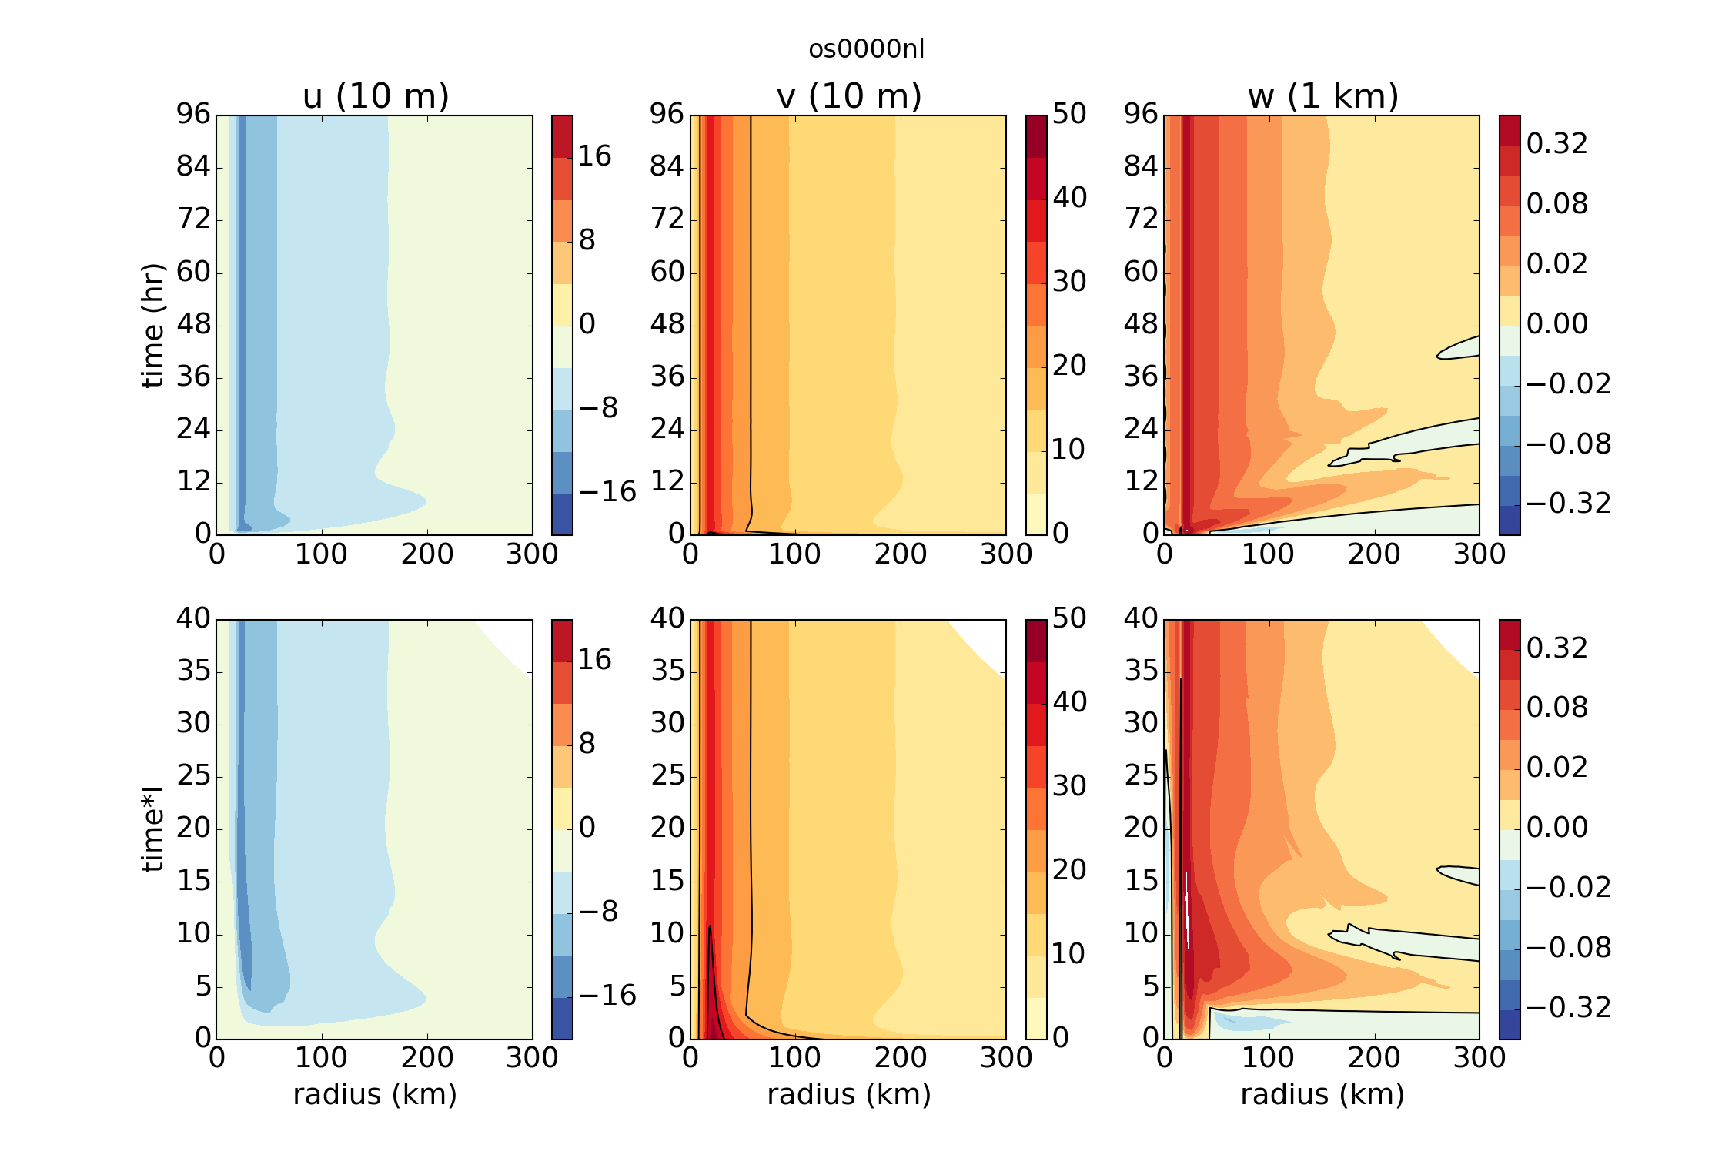
Spin-up of the nonlinear TCBL
Spin-up via decaying inertial oscillations
Period slightly longer than inertial due to nonlinearity
Similar to spinup of Ekman boundary layer except time scale I not f
I is inertial stability of gradient wind

Slide 8
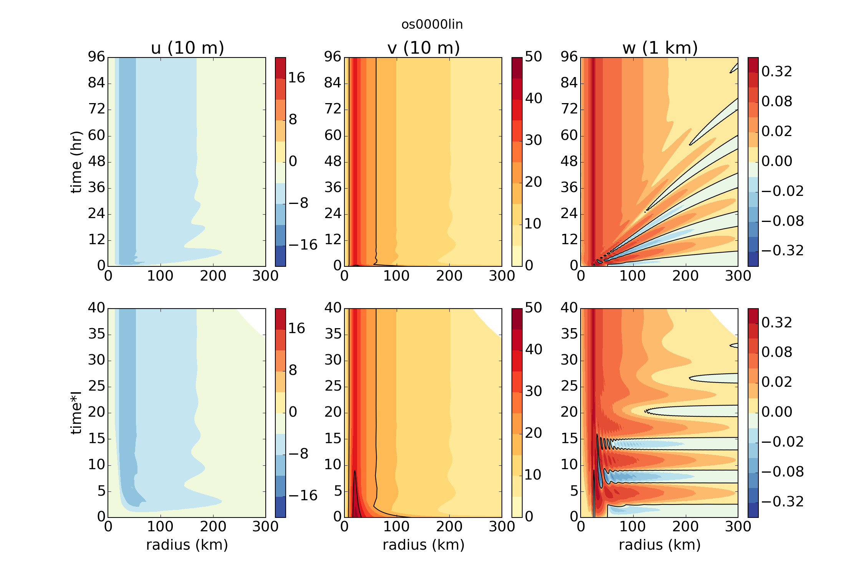
Spin-up of the linear TCBL
Oscillations now at constant I
Oscillations decay more slowly
Also some fine-scale oscillations early on

Slide 9
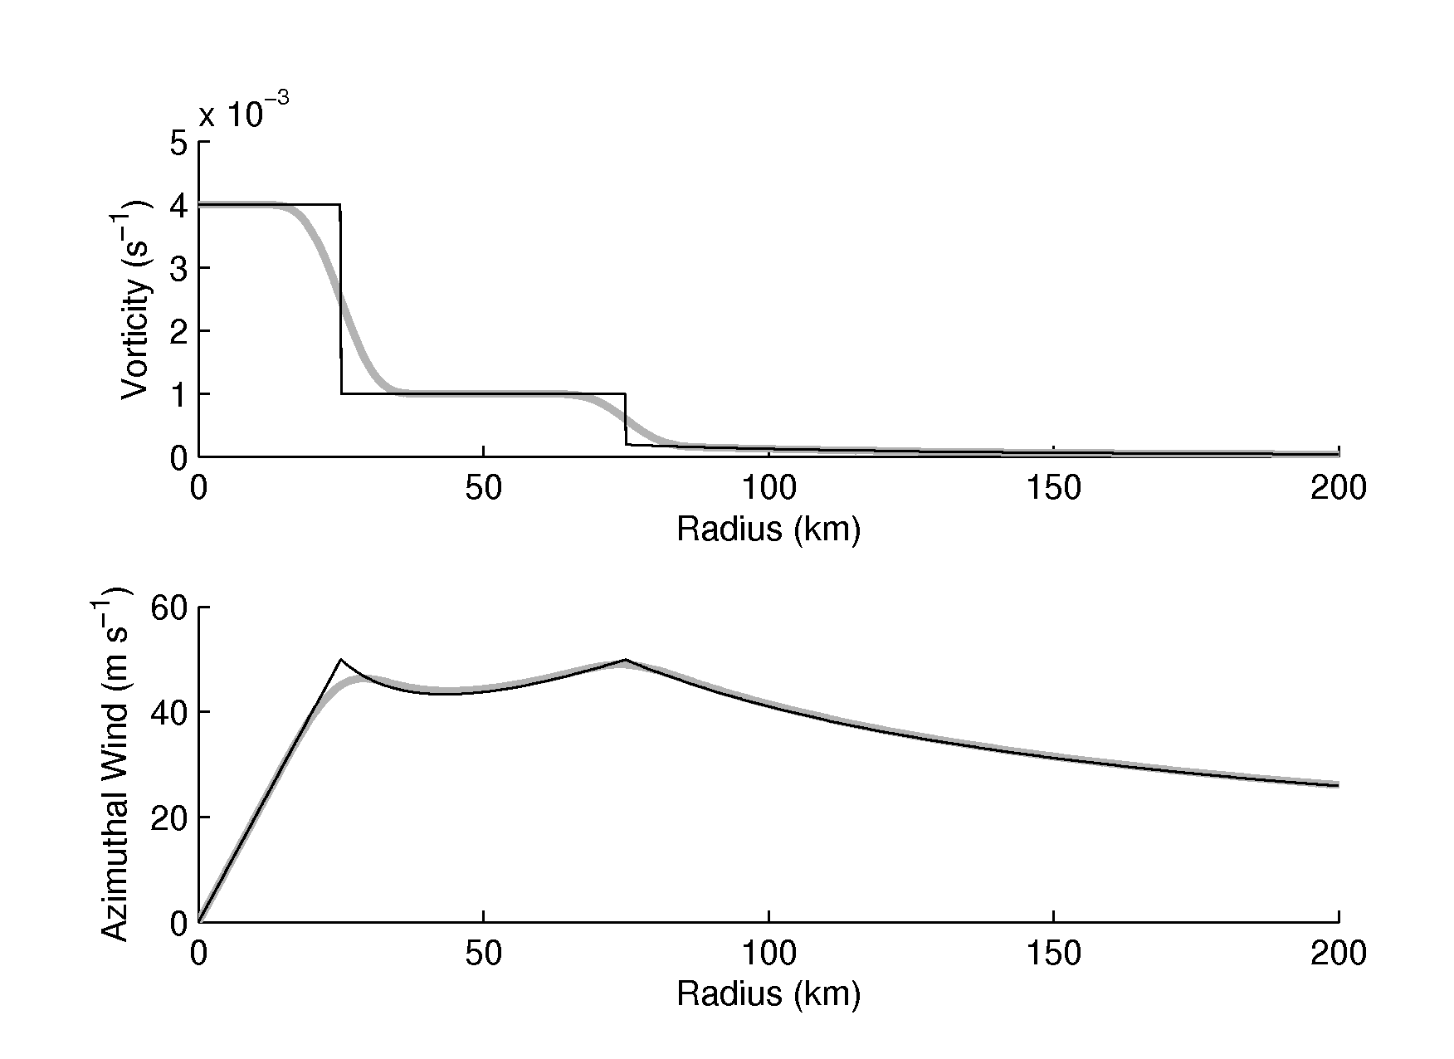

A parametric profile for concentric eyewalls
Parameterise the vortex as
  vorticity of eye region
  vorticity of moat region
  a “skirt” with
  ς ~ r ^{-1-α}
  smooth blending across the transitions (grey)
Calculate the wind from vorticity
eye
moat
skirt

Slide 10
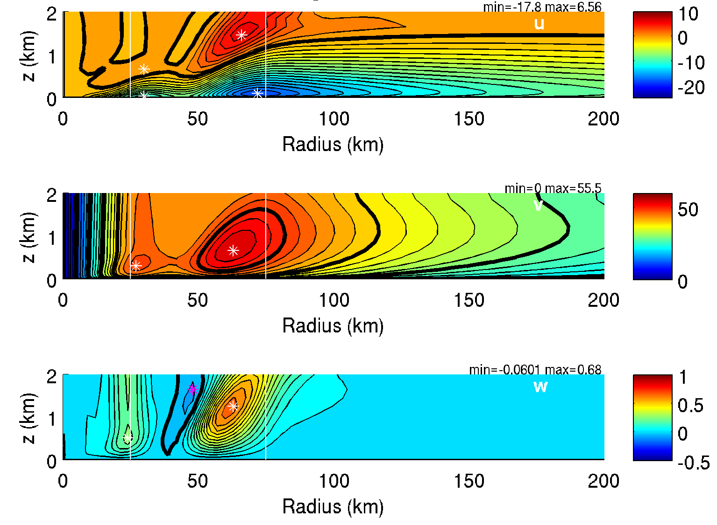
Diagnosed flow, nonlinear model
sg07

Slide 11
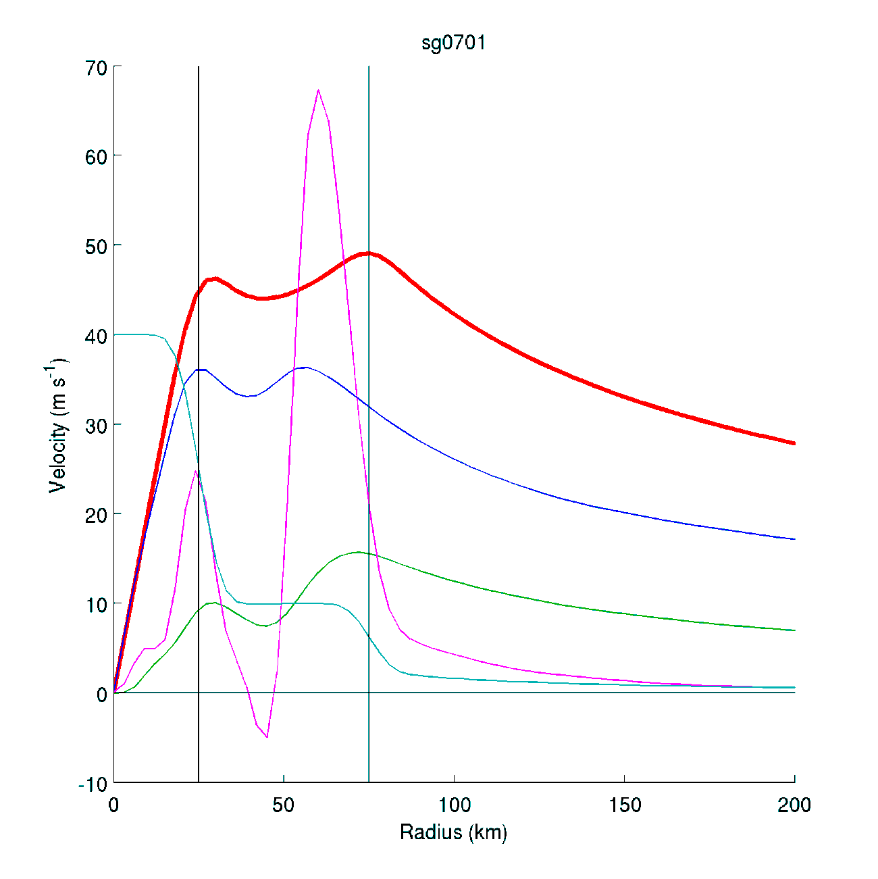
Diagnosed flow, nonlinear model
100w_{1km}
10⁴ς
v_{gr}
v₁₀
-u₁₀

Slide 12
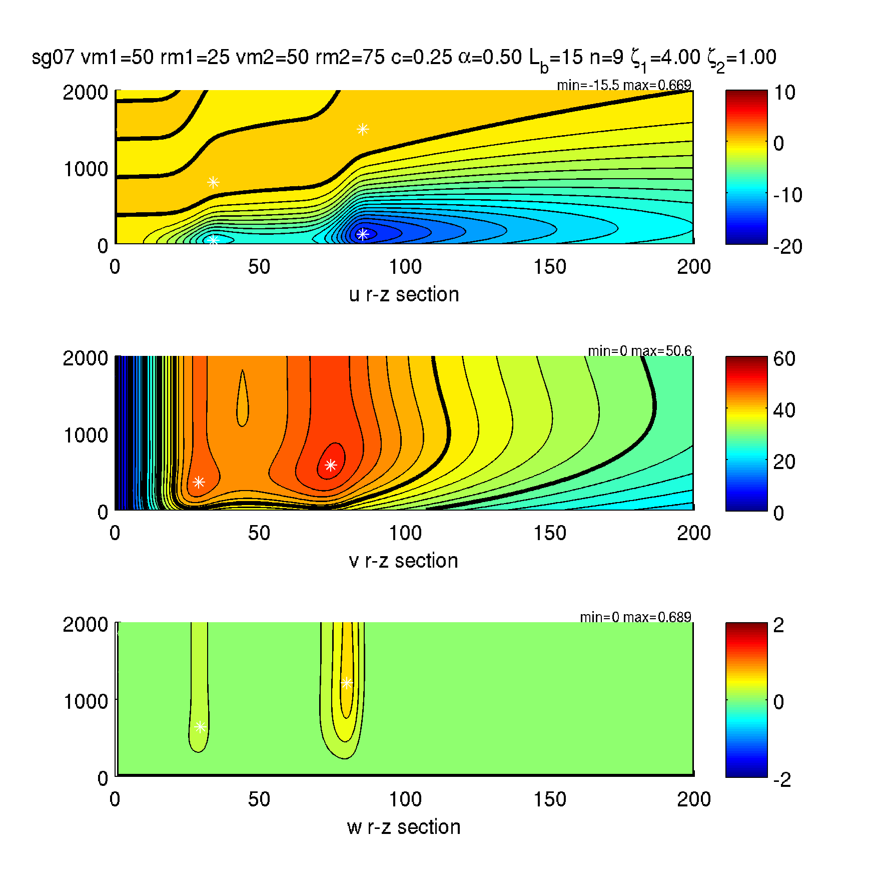
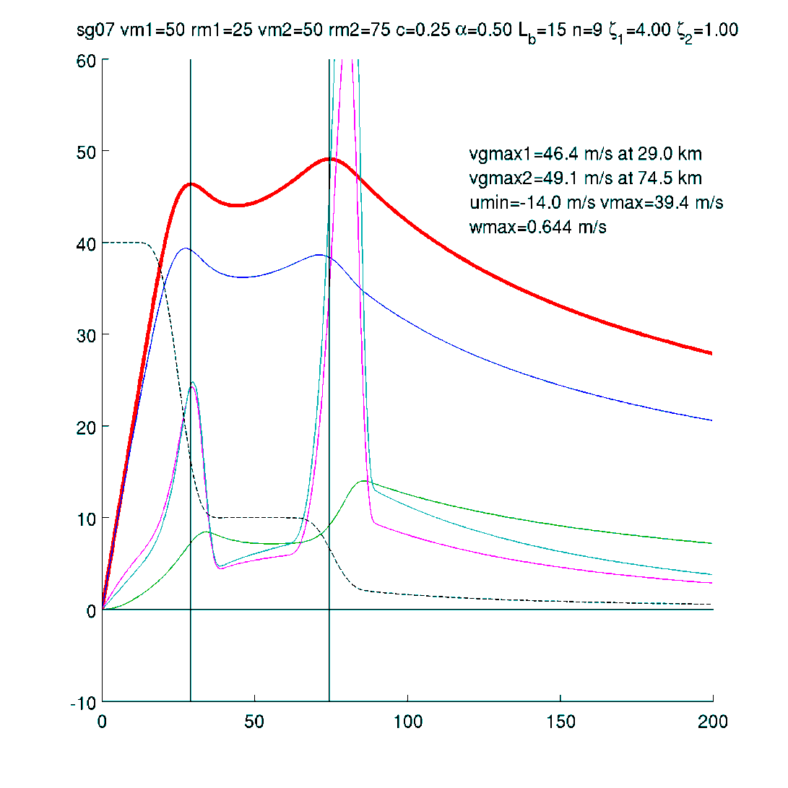
Same case, linear model
100w∞
10⁴ς
v_{gr}
v₁₀
-u₁₀

Slide 13
The w∞ equation
Kepert (2001) gives an analytical expression for w above the BL in a TC
which can be compared to the classical Ekman expression
Expanding the TC expression:

Slide 14
Why the outer RMW has a stronger updraft
ς
Big Δς
Big ς
=> Small w
Small Δς
Small ς
=> Big w

Slide 15
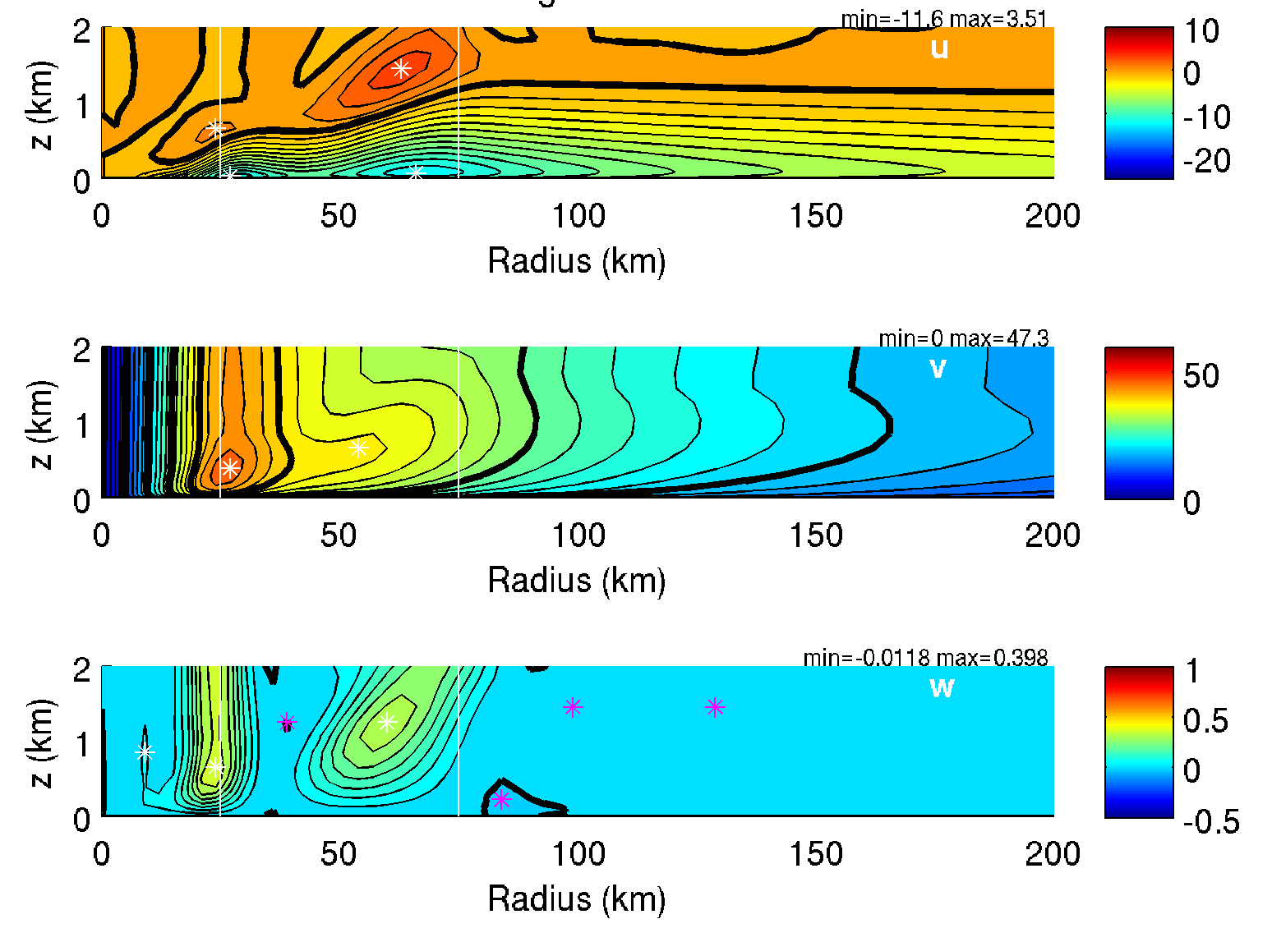
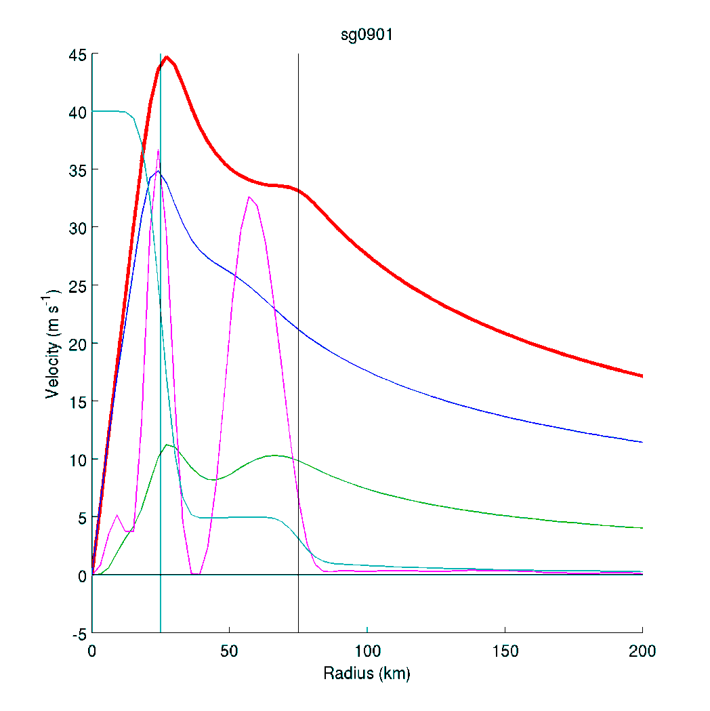
Sensitivity 1: Halve the outer RMW vorticity
10⁴ς
v_{gr}
v₁₀
100w_{1km}
-u₁₀

Slide 16
Hypothesis on role of the BL in SEF
Inviscid processes
Maximum in BL convergence**
Local vorticity maximum in lower troposphere at several times the RMW
Enhanced convection
Increase in low-level vorticity
** Note difference between linear and nonlinear models

Slide 17
Observations of wind and vorticity in H. Rita
Bell et al (2012, JAS)

Slide 18
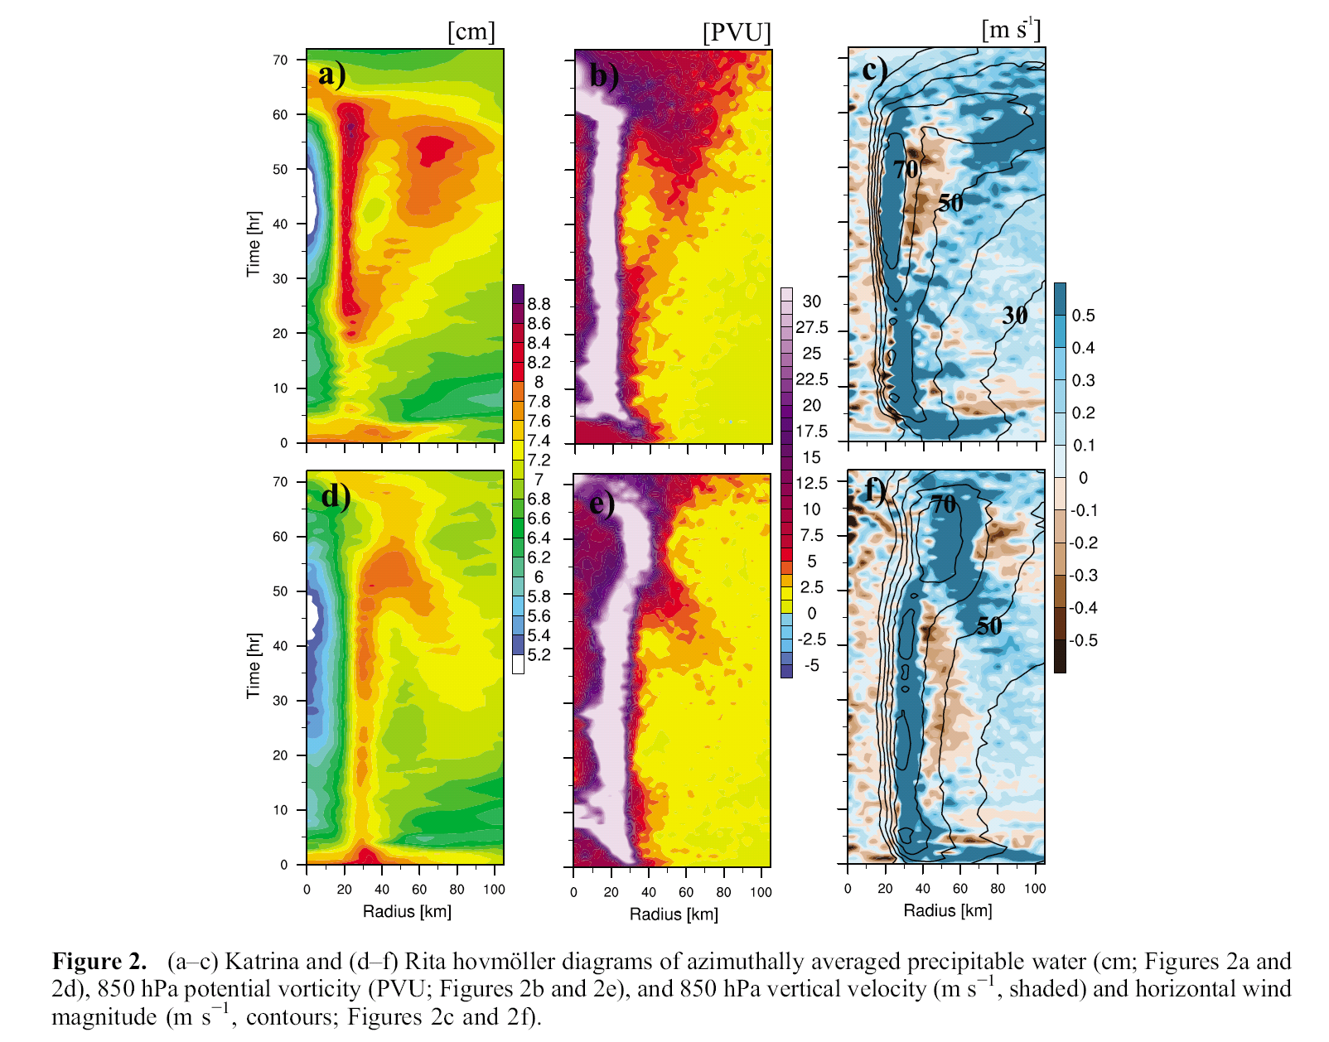
Simulations of H. Katrina and Rita
PW
PV
w
time
H. Katrina
time
H. Rita
Abarca and Corbosiero (2011, GRL)

Slide 19
Net frictional forcing in the linear model
The total upwards mass flux inside a circle of radius s is
where we have used
Thus the net upwards mass flux due to friction inside the circle depends only on conditions at the circumference.

Slide 20
Net frictional forcing
non
and outside of
In the linear model, the inflow across s depends only on conditions at radius s.
  “conditions” = wind speed and vorticity
  From Stokes’ theorem, the circulation (wind speed) around s equals the total vorticity inside s.
  So the updraft distribution can be calculated from the vorticity distribution
Thus the friction-forced updraft at the secondary eyewall “uses up” some of the inflowing mass and “starves” the inner eyewall.
v
v

Slide 21
Vorticity-divergence coupling
Changing the distribution of gradient wind changes the distribution of vorticity
  Stokes’ theorem is an important constraint
If there is a “radius of no change”, then total vorticity and updraft within that radius can’t change
  Formation of a secondary eyewall requires weakening of the primary one, in vorticity and updraft, in that case.
But, observations and models suggest that the wind field expands prior to SEF
  So extra vorticity must be imported (Stokes’ theorem again)
  Which will usually (always?) increase the frictional secondary circulation
  A local updraft maximum requires that the extra vorticity be concentrated into a small annular region
Does SEF really starve the inner eyewall? Or does the extra inflow compensate?

Slide 22
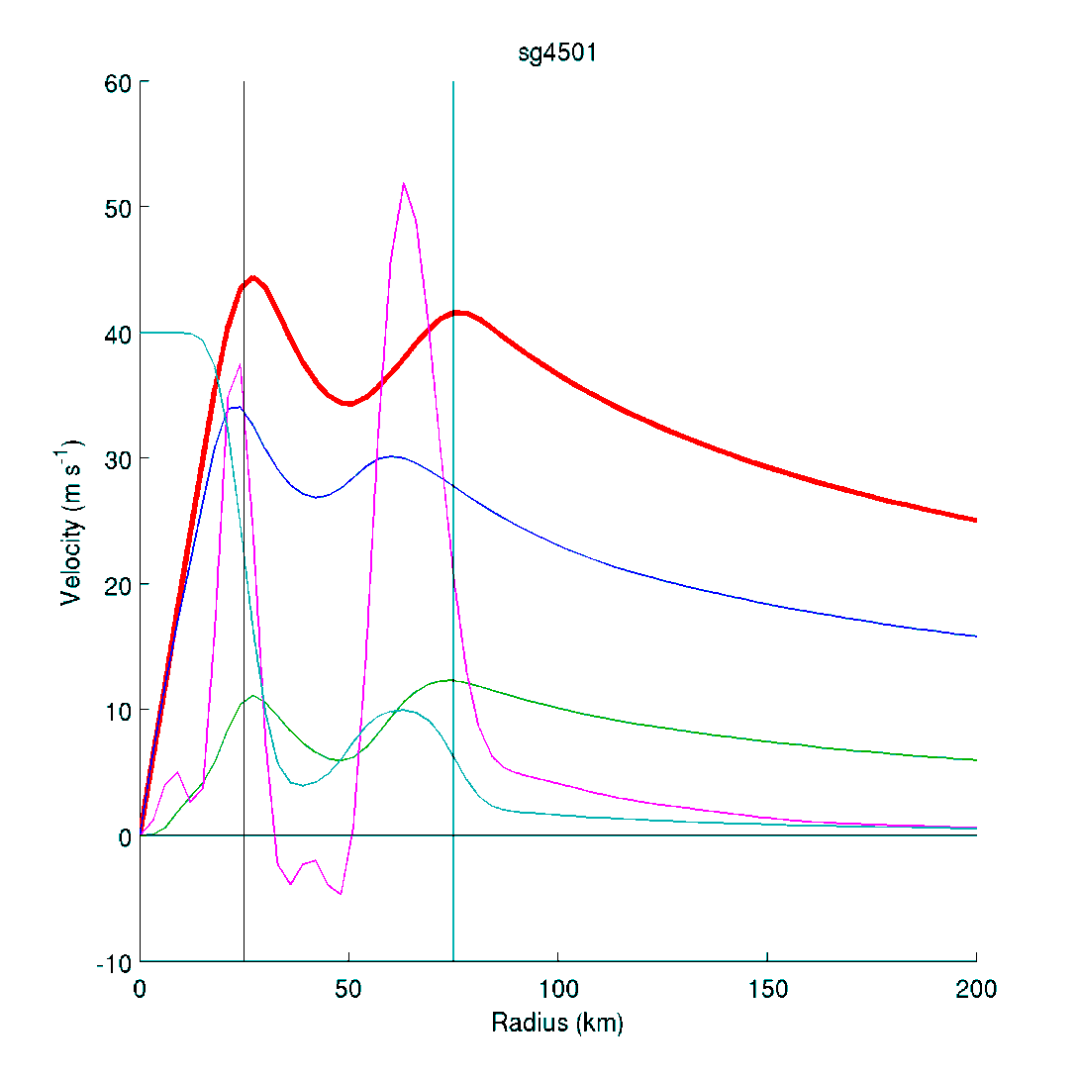

Sensitivity 2: Make the “moat” deeper
100w_{1km}
100w_{1km}
10⁴ς
10⁴ς
v_{gr}
v_{gr}
v₁₀
v₁₀
-u₁₀
-u₁₀

Slide 23
BL of Ooyama’s (1969) model
Depth-averaged equations
Replaces u-momentum equation by gradient wind equation
  Flow is assumed to be balanced, no supergradient flow
v-momentum equation expresses a balance between radial advection of angular momentum, and its destruction by friction
  The magnitude of the inflow is determined by this balance
Ooyama (1969)
Kepert (2001)

Slide 24
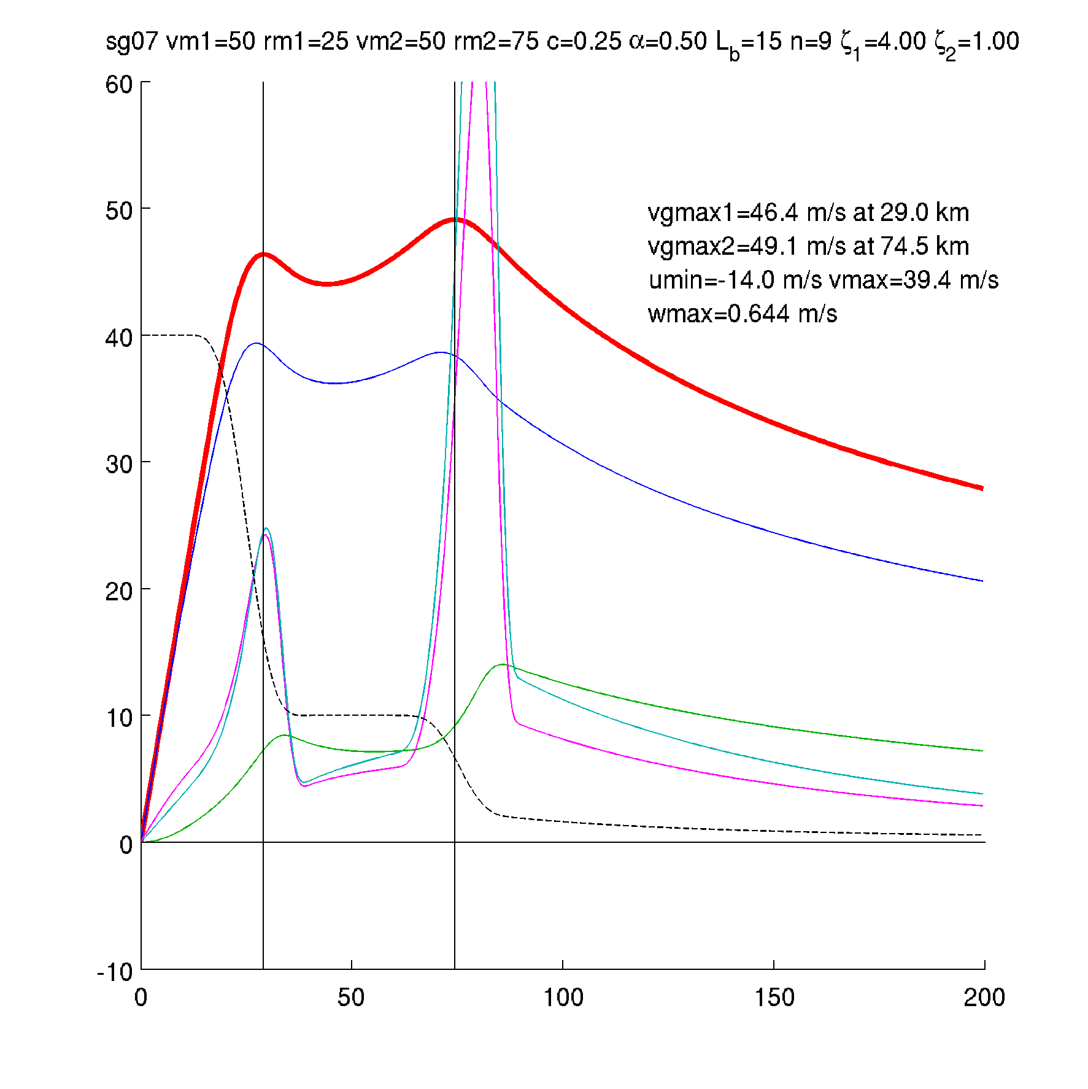
Kepert (2001) compared to Ooyama (1969)
100w∞ (Kepert 2001)
100w∞ (Ooyama 1969 with γ=0.8)
v_{gr}
v₁₀
-u₁₀

Slide 25
First-order dynamics of the TCBL
To first order, v-momentum equation is a balance between destruction and inwards advection of angular momentum.
  Destruction depends on surface friction
  Hence the net inflow depends on the rate of destruction, and the angular momentum gradient or vorticity (noting that ς_{a} = 1/r ∂M_{a}/∂r)

Slide 26
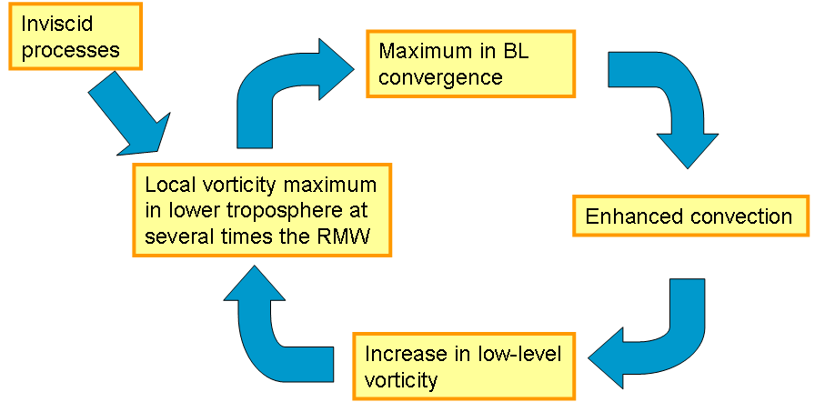
Summary so far …
An outer eyewall inherently has stronger frictional updraft than an inner eyewall of the same wind speed
  Because it is in an environment of lower vorticity
A discrete wind maximum is not necessary for a significant frictional updraft, a “bump” will do
Hypothesised positive feedback for SEF
  Local vorticity max to frictional convergence to convection to local vorticity increase.
  But need to get the bits to properly line up

Slide 27
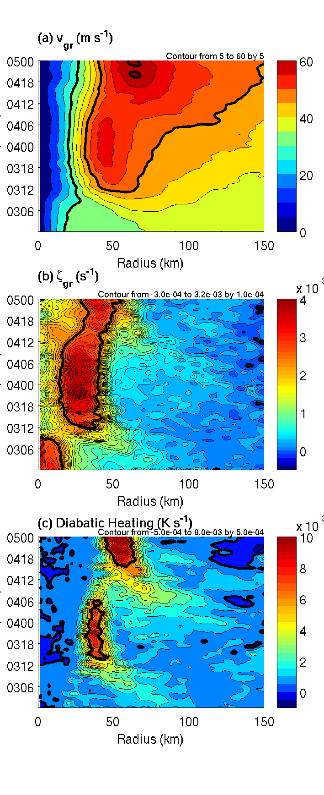
SEF/ERC in HNR1
SEF/ERC occurred in WRF simulation intended for DA research.
Nolan et al (JAMES 2013)
Notes:
Diabatic heating averaged in 1-3 km layer.
Magenta curves indicate maximum heating and progress of SEF/ERC.
NOTE magenta curves are the same for all 3 pictures.
Expansion of the wind field is apparent in vgr … as previously discussed by others.
Max heating occurs somewhat inside of max vgr.
Through Stoke's theorem (or Green's theorem if you want to be less general) the vorticity must increase consistent with the wind field expansion – we see that the vorticity increase tends to broadly match the diabatic heating increase.

Slide 28
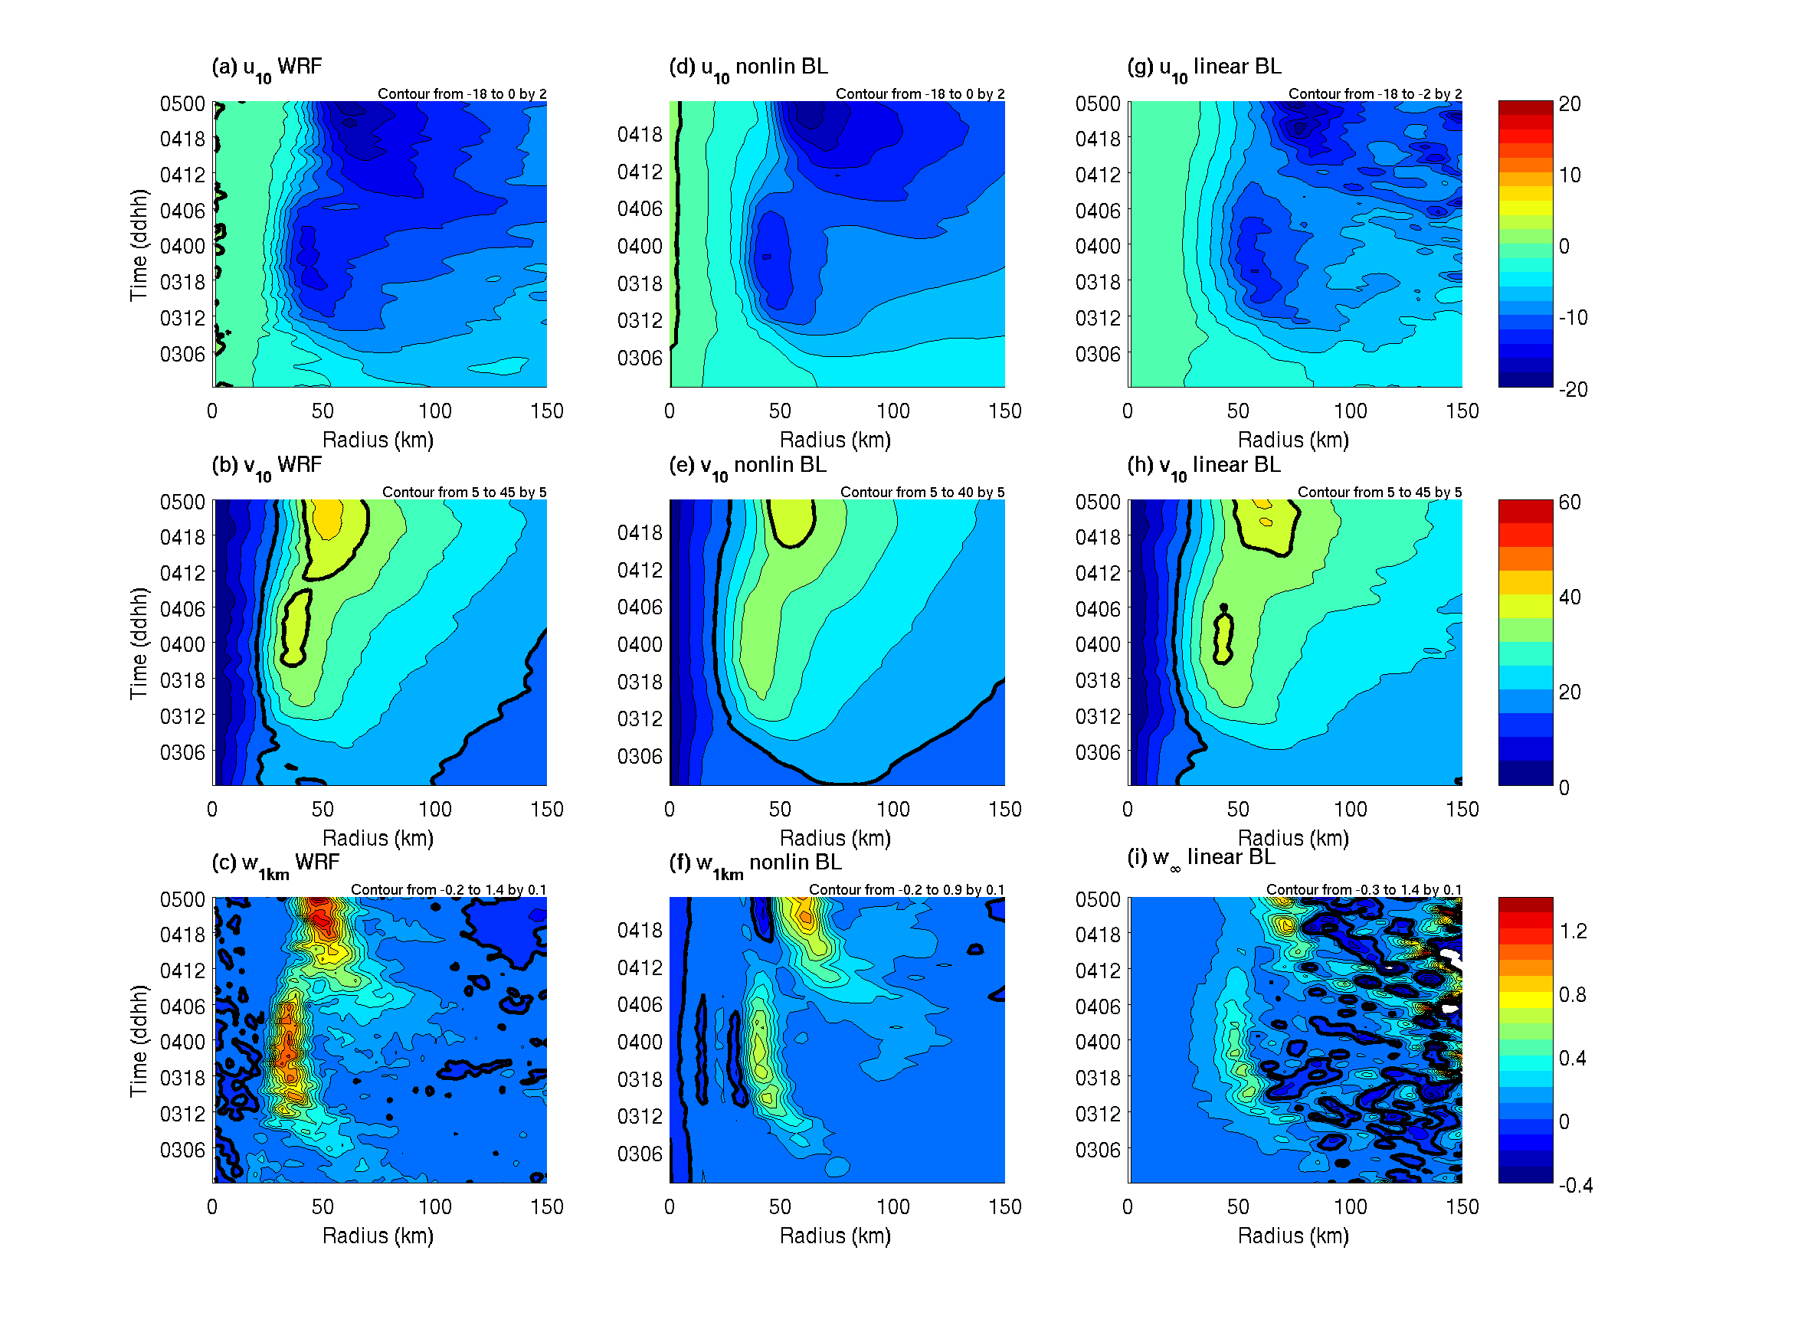
Boundary-layer evolution during ERC
Notes:
These are the WRF fields in the boundary layer: surface winds and W and 1km.
Note the expansion of inflow with time, along with the expansion of the azi wind.
Updraft evolution closely follows the evolution of the diabatic heating (I will add magenta curves to these)

Slide 29
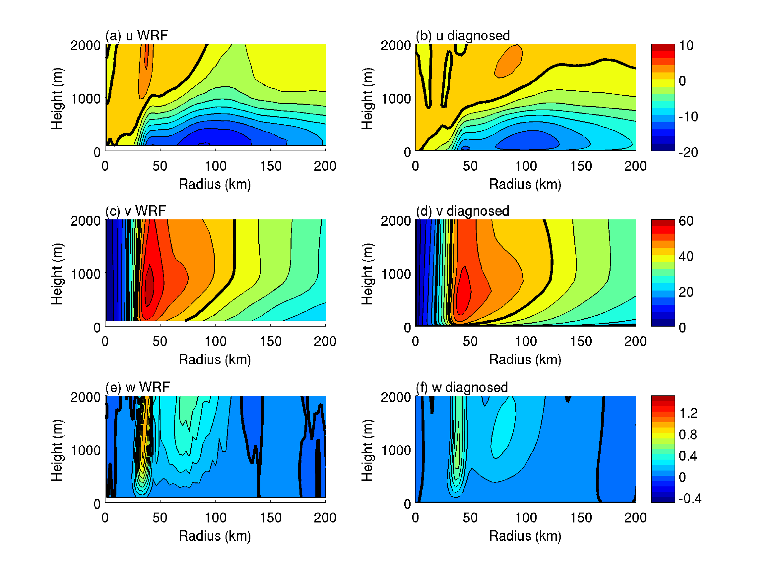
How well does the BL model reproduce HNR1?
Low-pass filtered, azimuthal-mean WRF (left)
Extract p at 2.2 km height (top of BL model)
Insert p in BL model and calculate equilibrium wind field (right)
Structure very similar
Diagnosed fields tend to underestimate strength of secondary circulation
  No buoyancy!
Notes:
This is when SEF is already underway.
Inflow ~ 1 – 2 m/s stronger in WRF, updrafts about twice as strong.
Main reason is probably that the diagnostic model has no heating, whereas WRF gets additional forcing for the secondary circulation from heating. Calculations with the SE model tend to show that the heating-induced circulation is about this strength near the surface, consistent with this.
The distribution and relative strength of the updrafts is very accurately diagnosed by the BL model – remember that these are diagnosed from vgr.
The azi flow is a little stronger in WRF, probably because of advection of Ma by the stronger inflow.

Slide 30
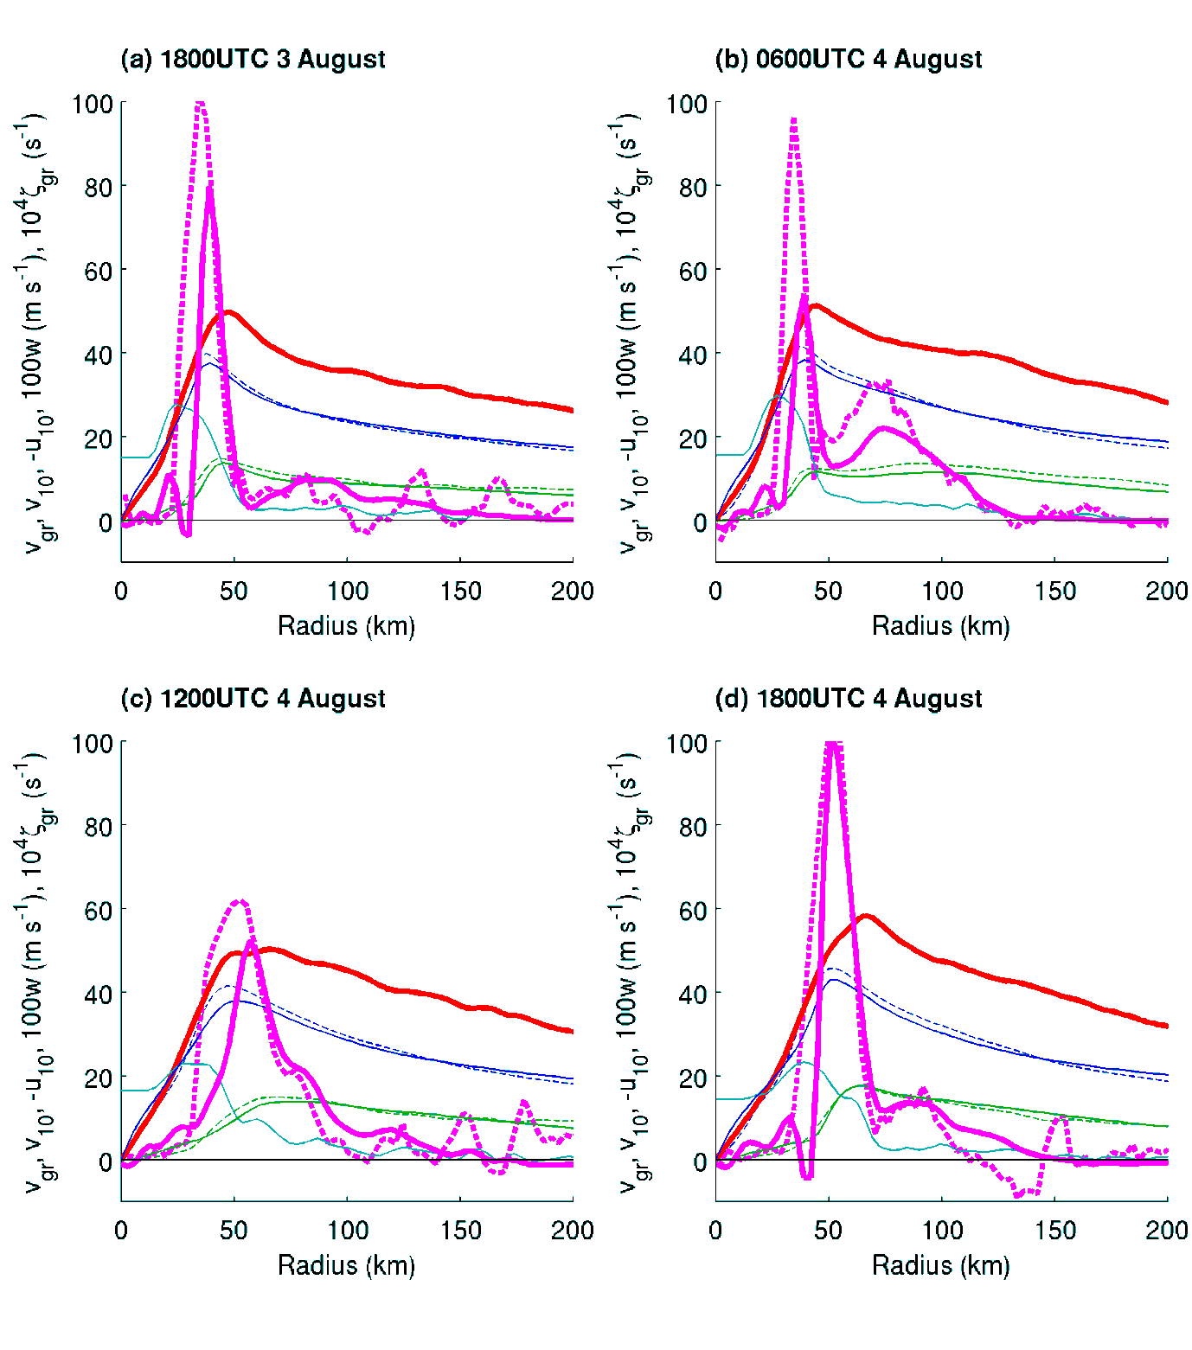
w
v_{gr}
v₁₀
-u₁₀
Diagnostic: solid
WRF: dashed
Notes:
Comparisons at 4 times, including that in previous slide. Focus mainly on the vgr (red) and w (magenta) curves. Black bars show the times.
Before SEF, (b) during ERC, (c) after ERC, (d) during re-intensification.
Excellent agreement at all times, except that the diagnostic model updraft tends to be weaker (no buoyancy, as in last slide).
KEY POINT: the BL model only knows about the vgr field. So changes in updraft in the BL model must be driven by changes in vgr. WRF evolution is similar, so the formation of the outer eyewall updraft must be due to some feature in the vgr field.
Note that large changes in w are driven (in the diagnostic model) by quite subtle changes in vgr.

Slide 31
Boundary-layer evolution during ERC
The nonlinear, diagnostic analysis reproduces the time evolution of the boundary layer.
Notes:
The diagnostic model "works" through the entire 48-hour period. i.e. explains the evolution of the updraft.

Slide 32
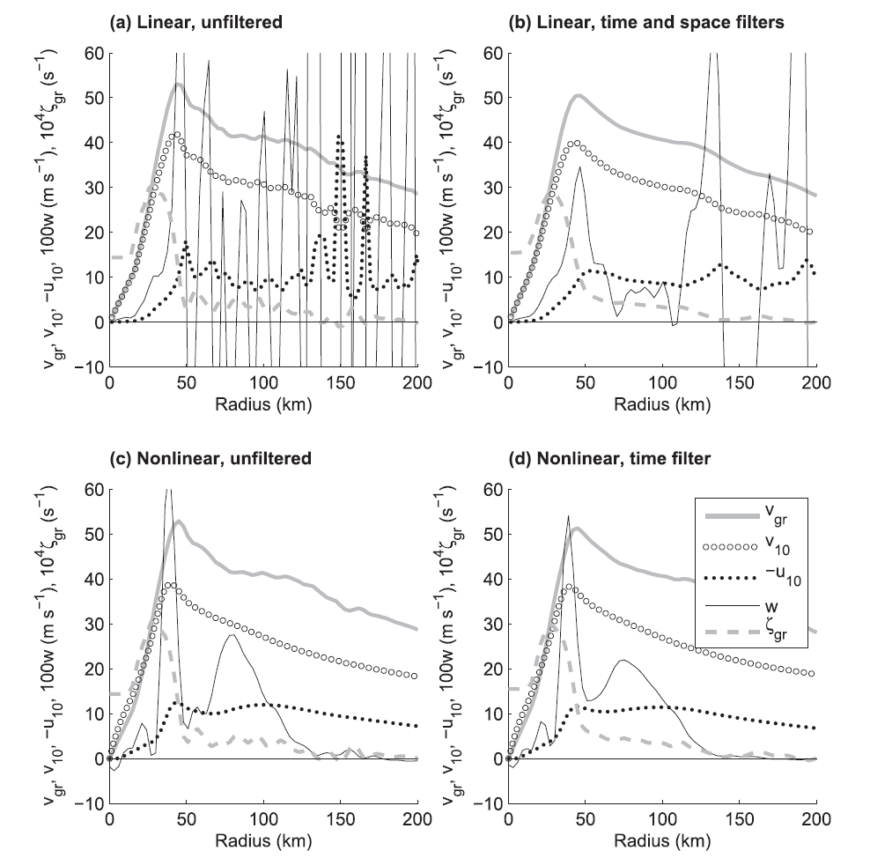
Sensitivity of the linear model to "wiggles"

Slide 33
Notes:
Linear model is subject to noise (and vgr had some spatial smoothing here), but captures the BL evolution well.
NOTE difference in location of W: W is further inward for nonlinear model compared to linear model.

Slide 34
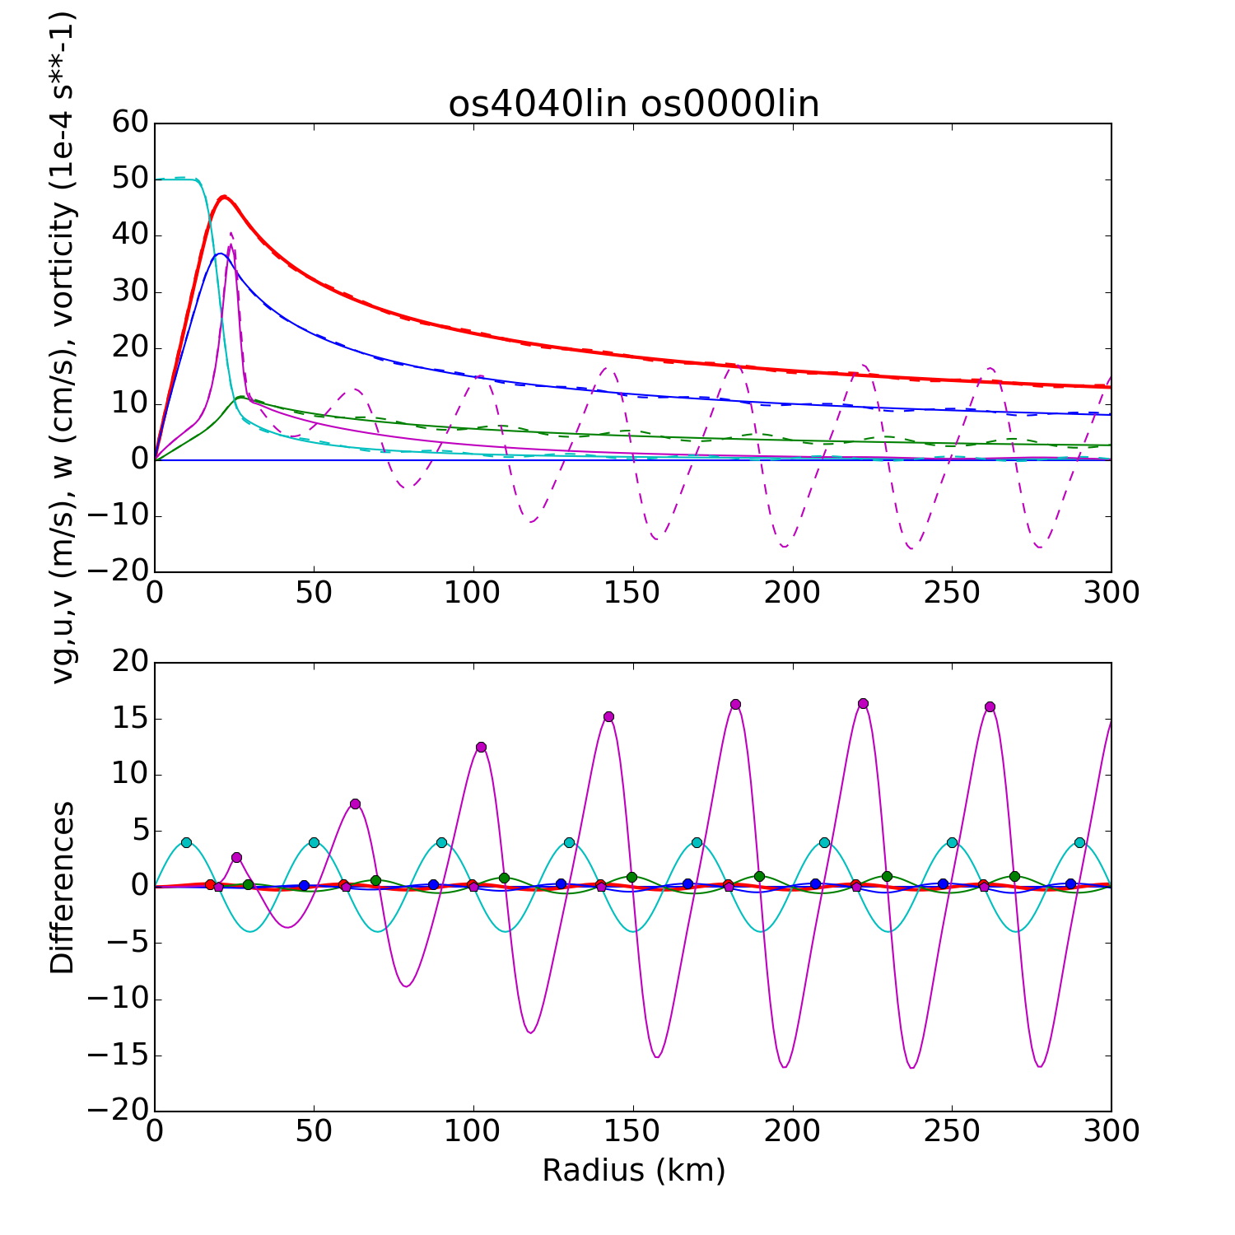
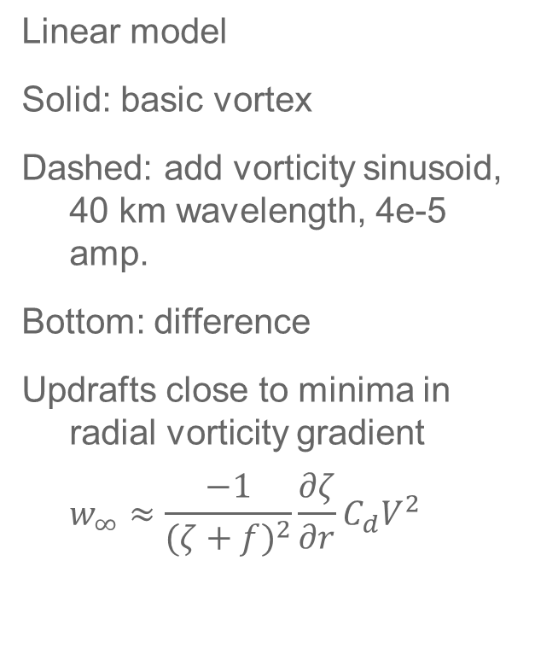
Linear TCBL flow with V "wiggles"
ζ
V
W_{1 km}
v₁₀
-u₁₀
w’
ζ'

Slide 35
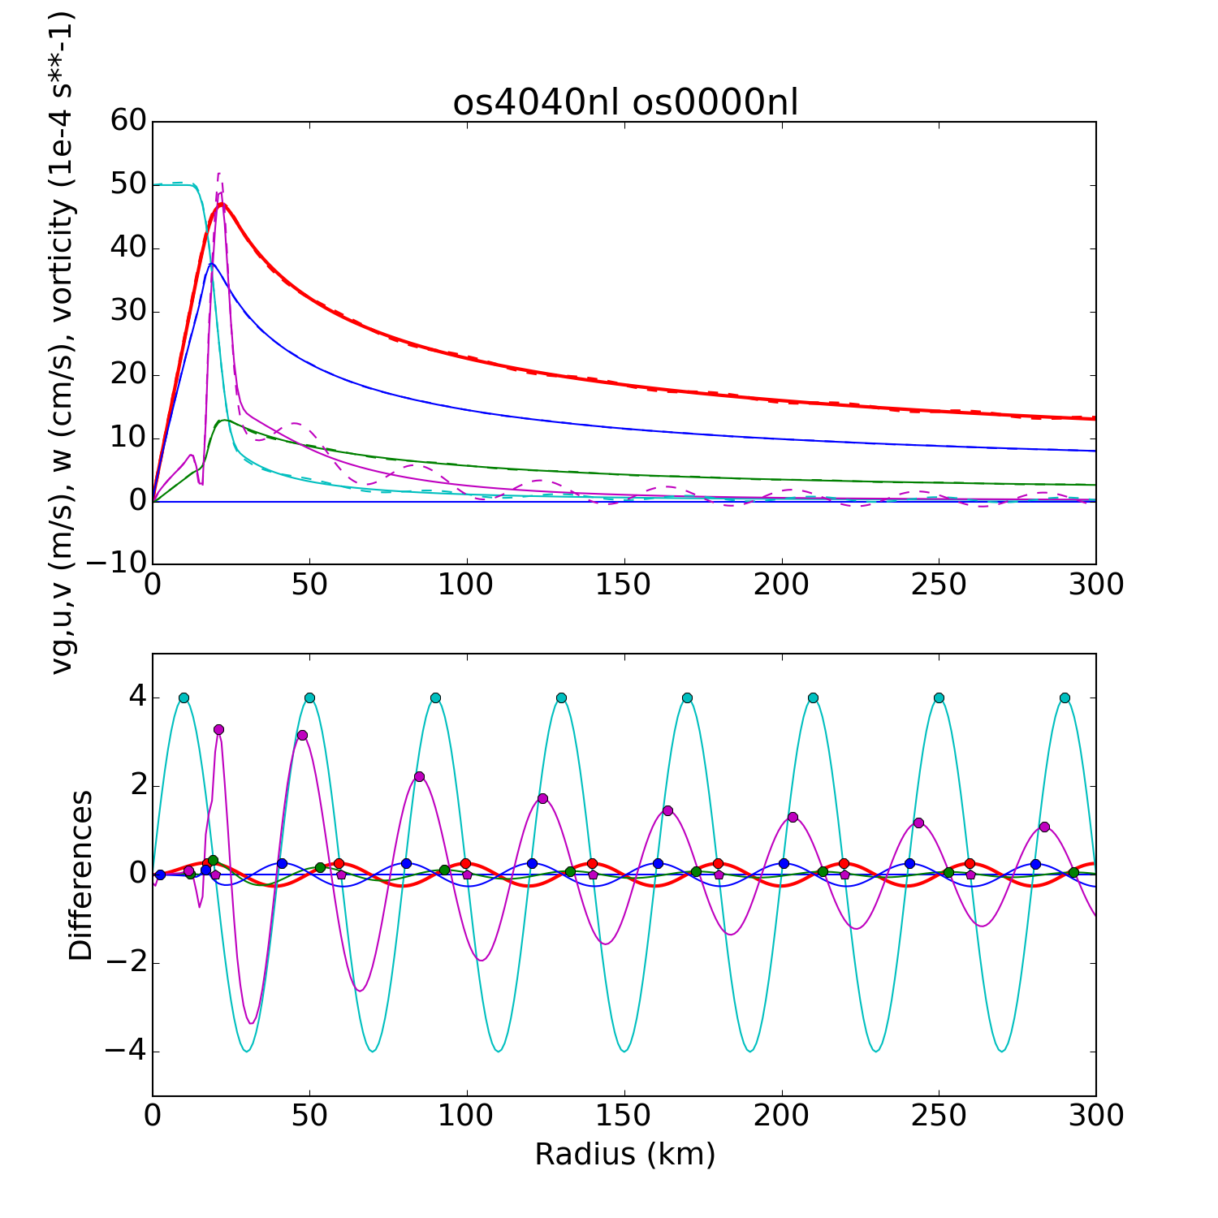
Nonlinear TCBL flow with V "wiggles"
Linear
Nonlinear
ζ
V
v₁₀
w
-u₁₀
w’
ζ'

Slide 36
Spatial filtering
Inflowing air columns experience a change in the BL's parameters
  Gradient wind, vorticity, surface roughness, etc
Columns adjust on time scale I, travel with velocity scale U, hence expect radial space scale U/I.
This effect is missing in the linearized BL model because radial advection of perturbation flow is removed.
Nonlinear BL model filters out the effects of small-scale (i.e. < U/I) perturbations in the gradient wind field

Slide 37
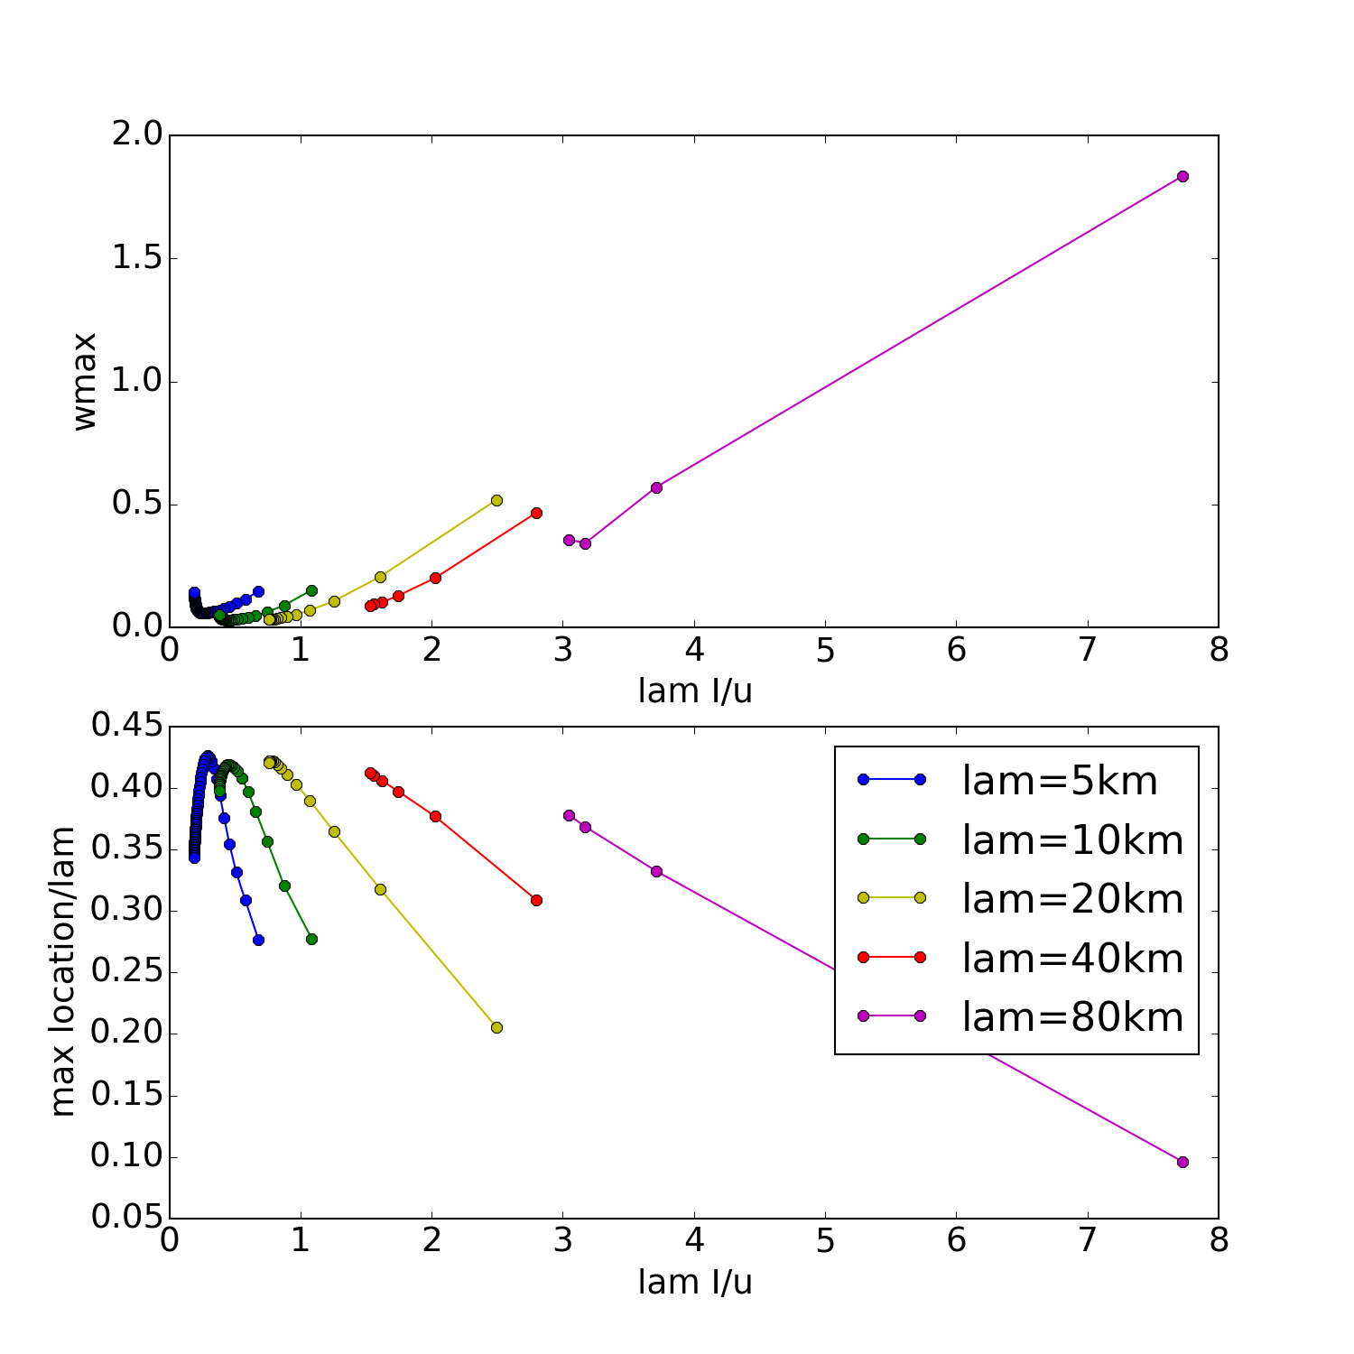
Filter properties
Relative response for various wavelength (lam)
  i.e. amplitude in nonlinear model / amplitude in linear model
Short oscillations are almost eliminated
Longer ones retained (possible resonance in one case)
Normalised
response amplitude
Nondimensional wavelength of perturbation

Slide 38
Where is the eyewall frictional updraft?
Linear analytic solution: updraft approximately
-(ζ+f)⁻²∂ζ/∂r C_{d} V²
  Peak updraft is located slightly outside of RMW
Nonlinear overshoot of inflow displaces the updraft inwards
  But how far?
Physically and dimensionally, U/I is plausible displacement scale

Slide 39
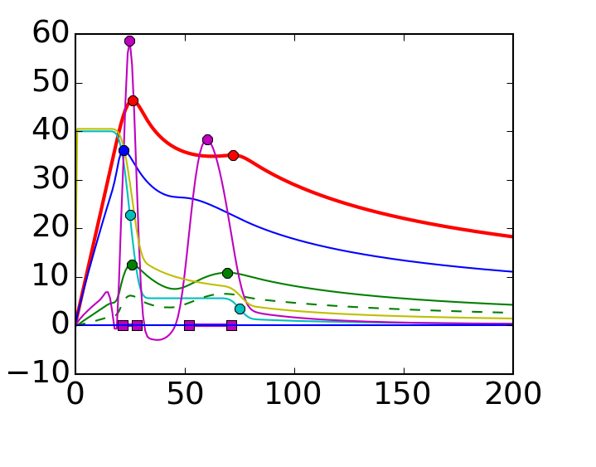
Updraft location with secondary eyewalls
Distance between updraft and wind max is greater for outer eyewall than inner
Does the U/I scaling apply?
w
V
v₁₀
-u₁₀

Slide 40
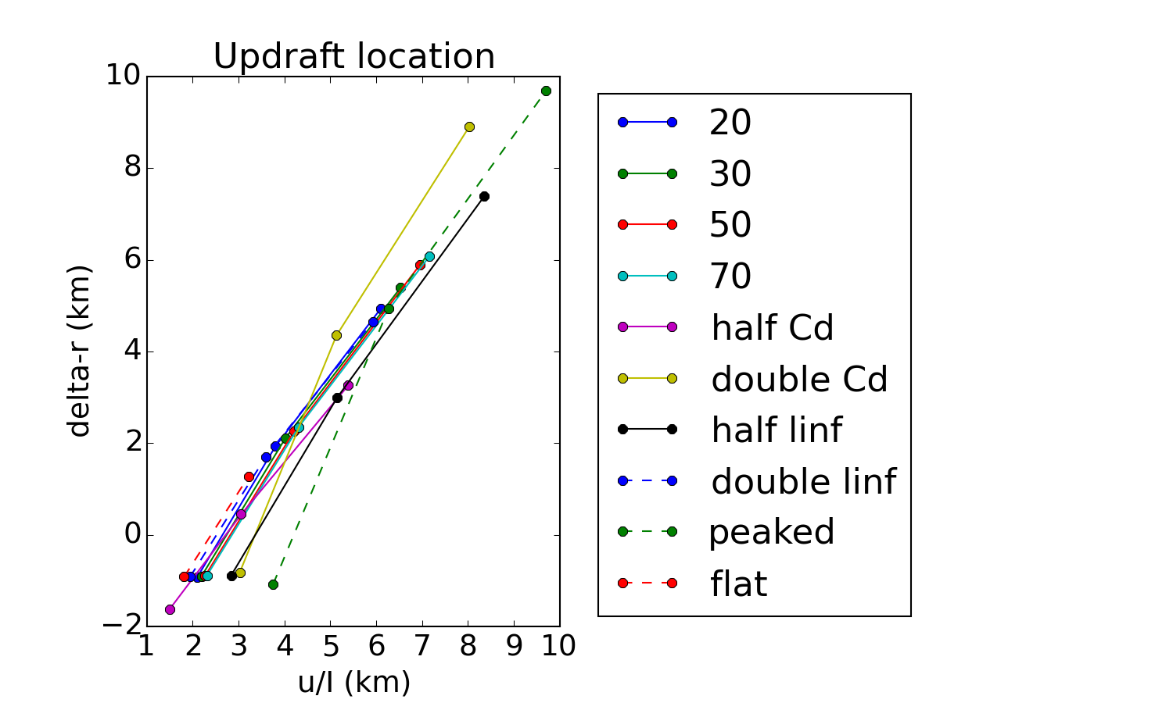
Eyewall updraft location, single eyewall
Location of eyewall updraft maximum at 500-m height, relative to location of max vorticity gradient
3 RMWs (15,25,40 km)
4 intensities (20,30,50,70 m s⁻¹)
Vary C_{d} and K
Vary "peakedness"
Increasing RMW

Slide 41
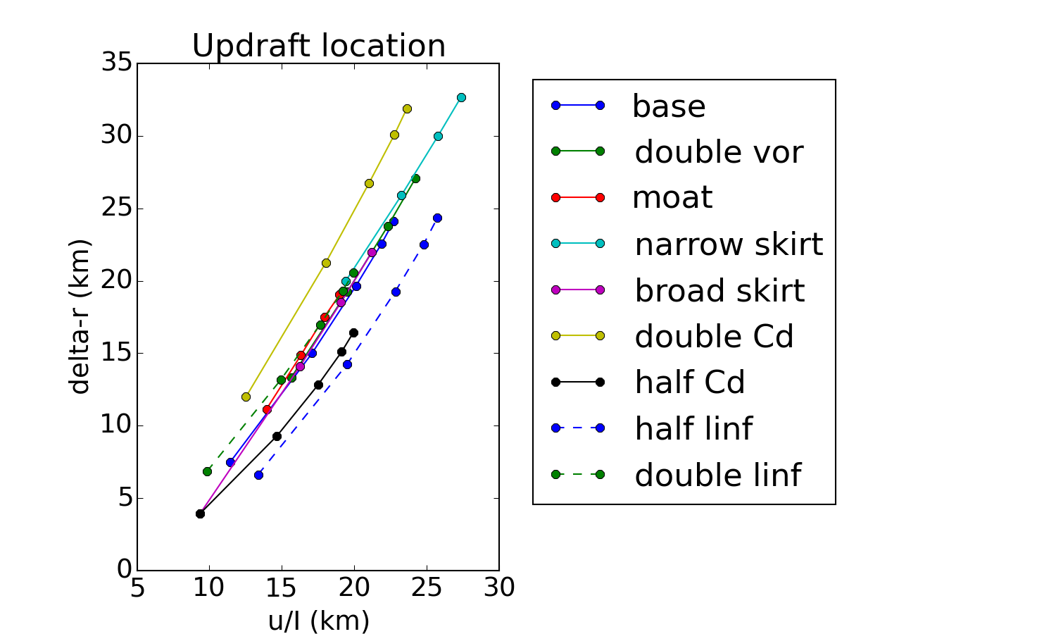
Eyewall updraft location, secondary eyewall
Inwards displacement of secondary eyewall updraft at 1-km height (relative to ∂ζ/∂r extremum)
Various secondary RMWs (50 – 150 km)
Various strengths
Vary outer structure
Vary C_{d} and K
Increasing secondary RMW

Slide 42
SEF/ERC in WRF “Nature Run”
Notes:
Magenta curves indicate maximum heating and progress of SEF/ERC.
Expansion of the wind field is apparent in vgr … as previously discussed by others.
Max heating occurs somewhat inside of max vgr.
Through Stoke's theorem (or Green's theorem if you want to be less general) the vorticity must increase consistent with the wind field expansion – we see that the vorticity increase tends to broadly match the diabatic heating increase.

Slide 43
Cause and effect in fluid dynamics
Diagnosing cause and effect is difficult because the equations are strongly coupled
  E.g. advection terms, continuity equation
Rotating fluids are especially difficult
  Coriolis and generalised Coriolis terms
So we use other methods to supplement momentum budget equations
  Vorticity and PV equation
  Sawyer-Eliassen equation
  Diagnostic boundary layer models

Slide 44
If we claim that A causes B
then
removing A should remove B
Notes:
Discuss the hose analogy

Slide 45
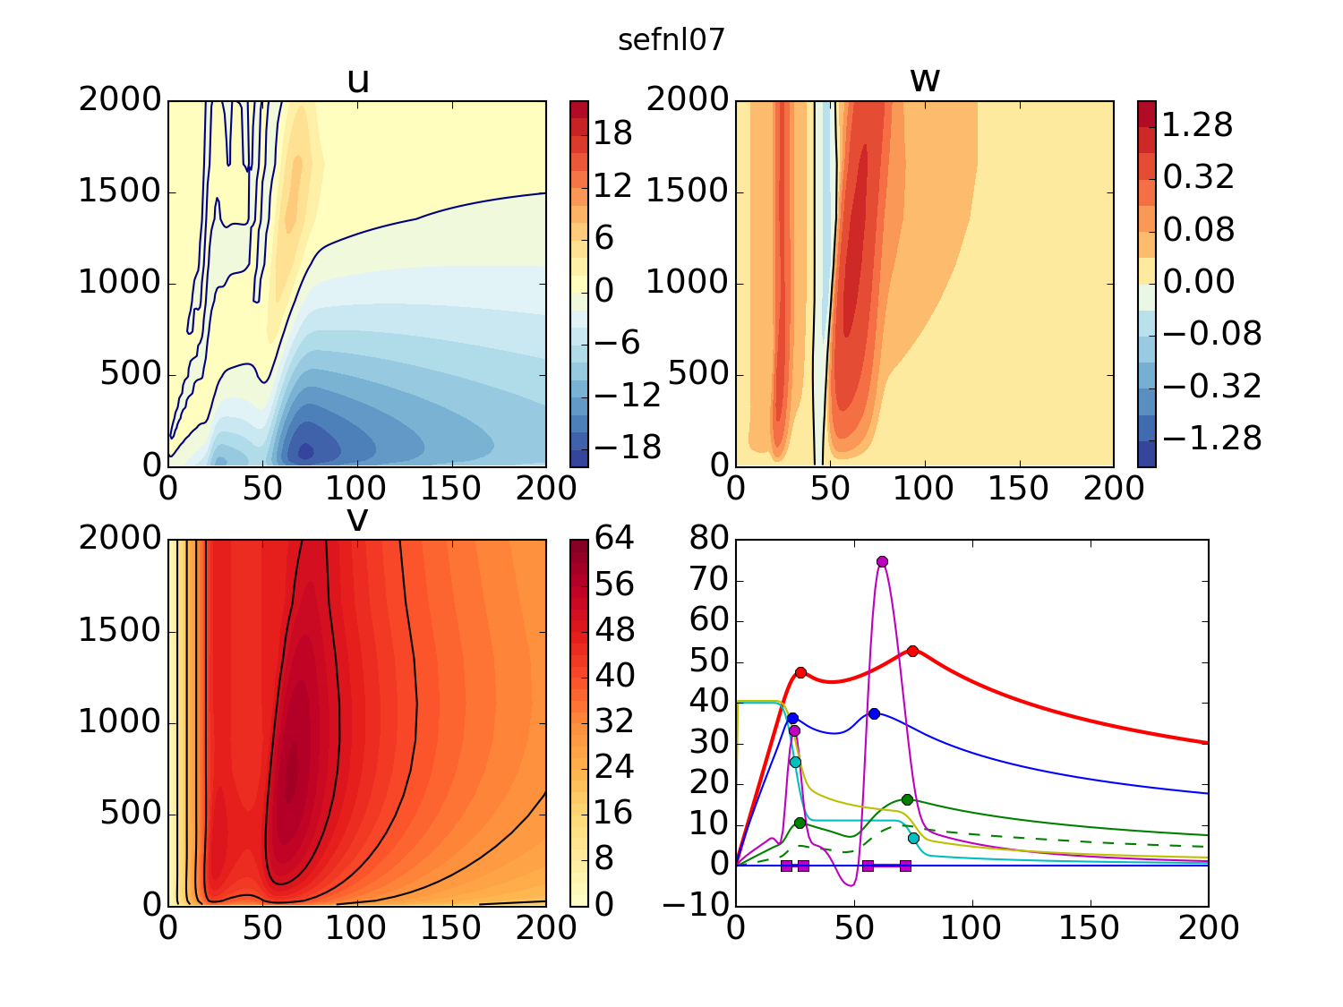
Concentric eyewalls, nonlinear

Slide 46
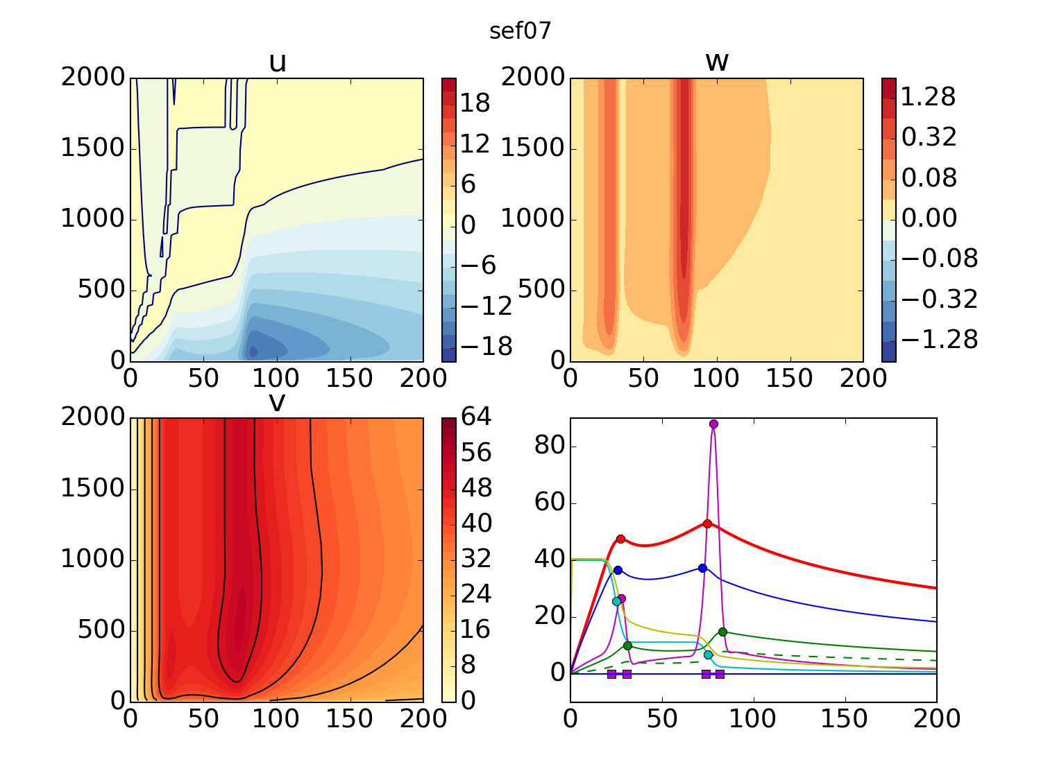
Concentric eyewalls, linear

Slide 47
Removing the nonlinear terms …
Mostly removes the supergradient flow
Alters the strength and location of the inflow maxima
Alters the location and outwards slope of the updraft
But it doesn't eliminate the updraft
This result is inconsistent with the proposition that the supergradient flow causes the updraft

Slide 48
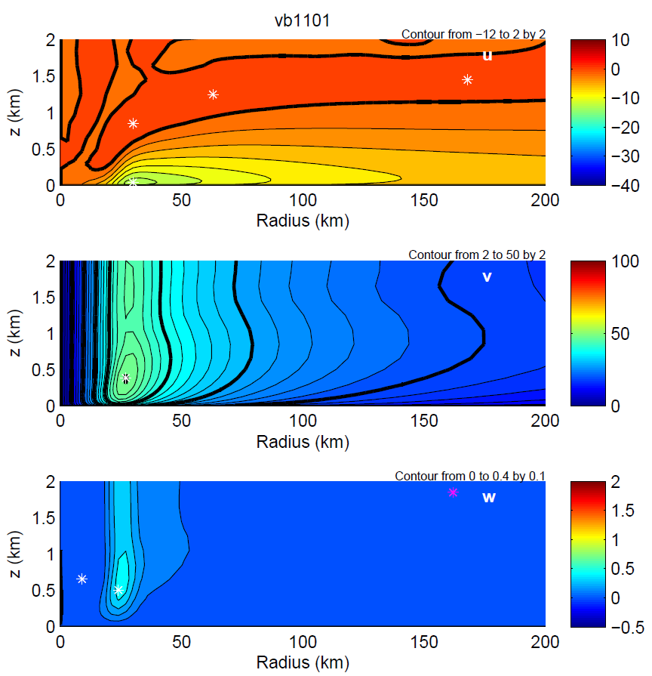
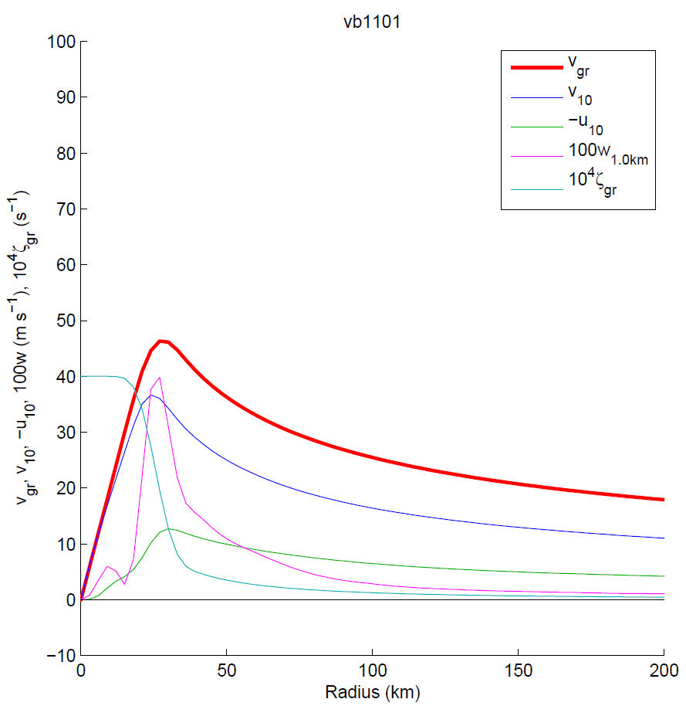
BL flow for modified Rankine vortex

Slide 49
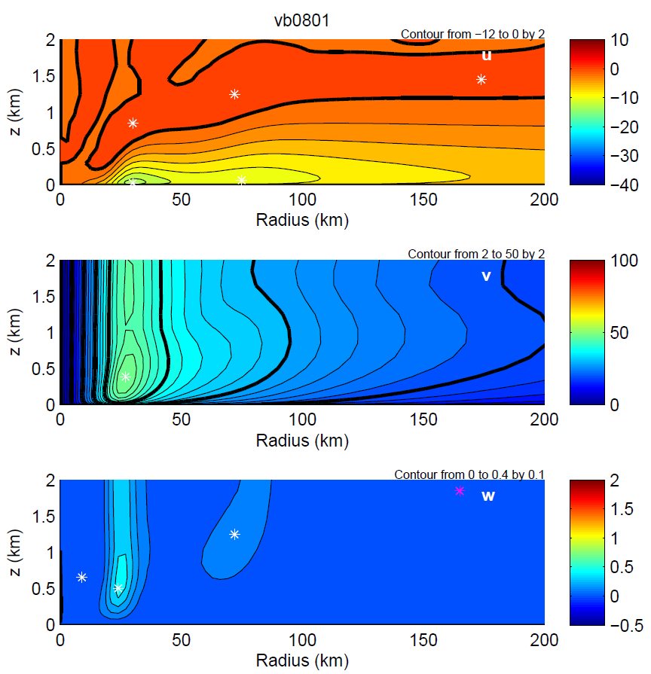
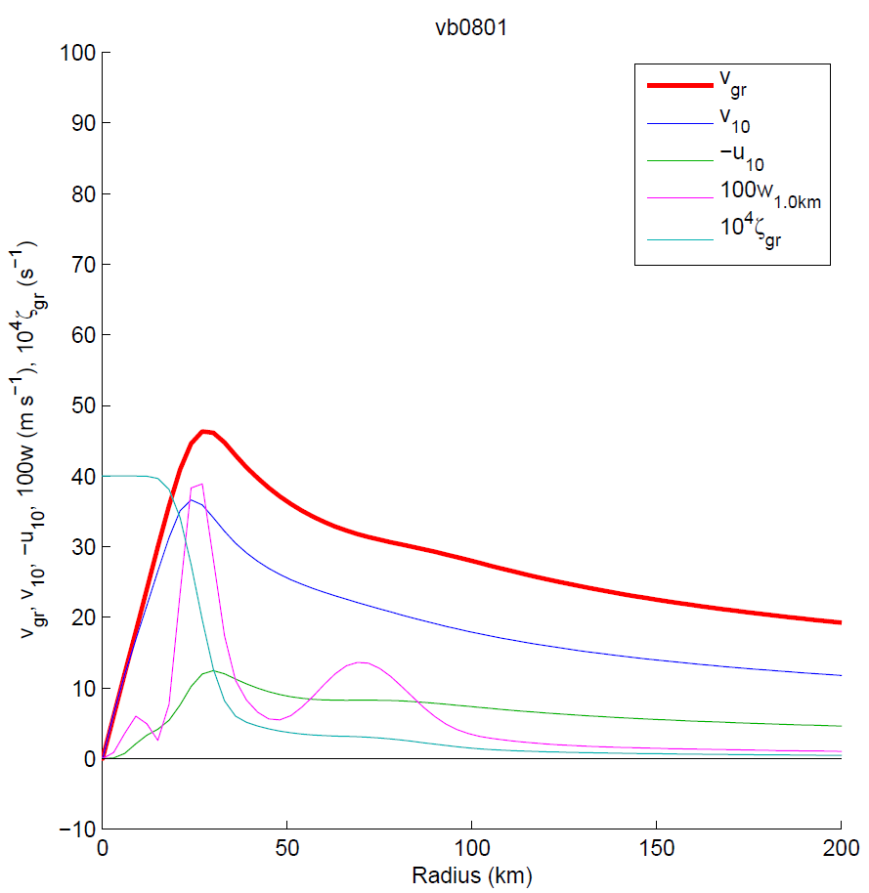
Same vortex + small vorticity bump

Slide 50
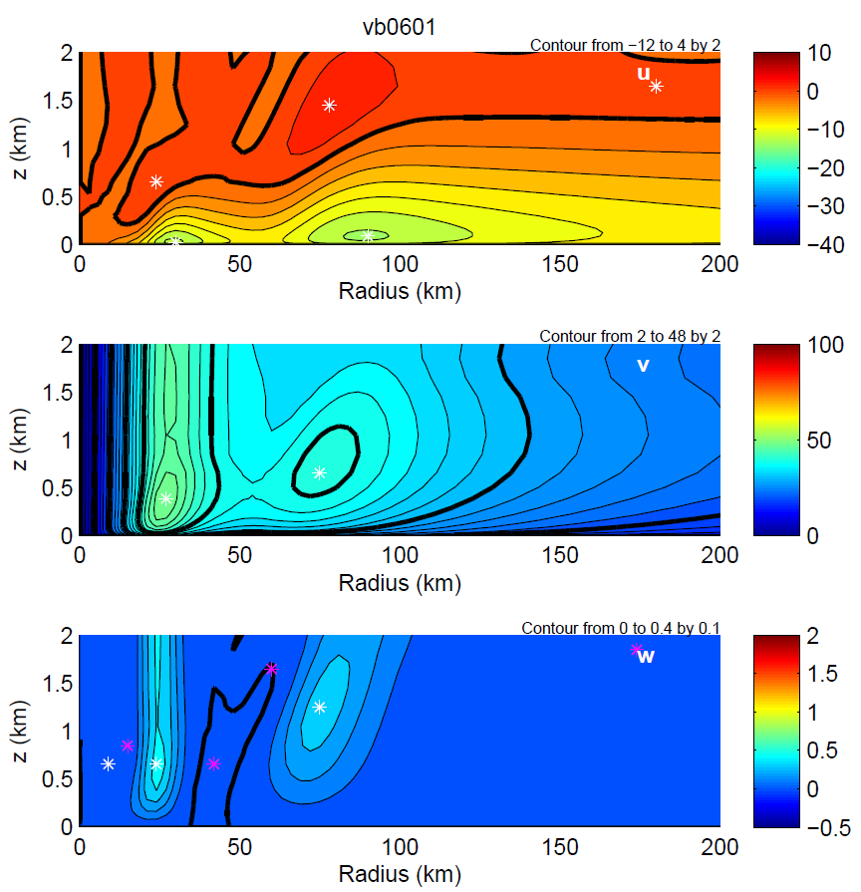
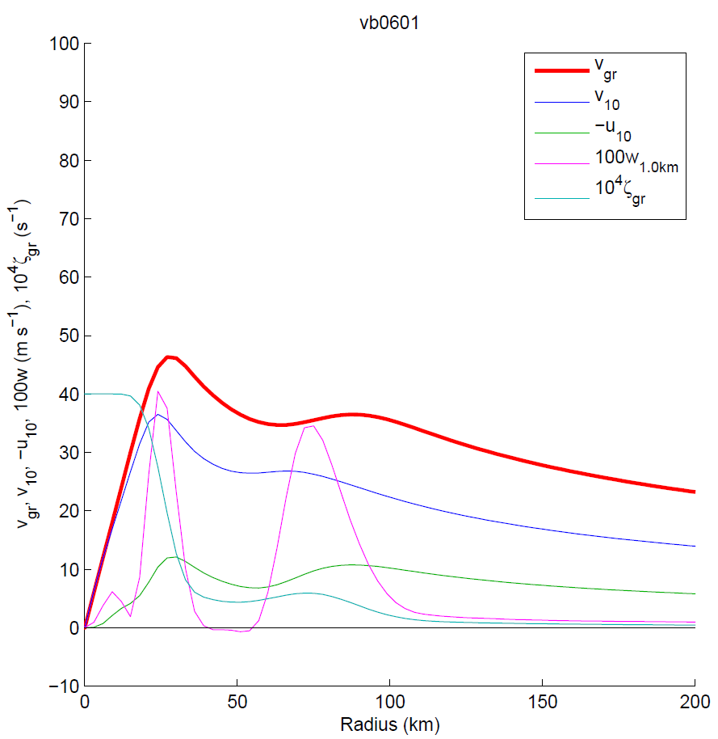
Same vortex + larger vorticity bump

Slide 51
Adding/removing the vorticity bump …
Adds/removes the outer eyewall updraft
Creates/destroys outer inflow maximum
Strengthens/weakens supergradient flow near the bump
These effects increase for a stronger bump
Strong evidence that the vorticity perturbation causes these features

Slide 52
Conclusions
Outer RMW is very efficient in producing frictional updrafts
  Because in environment of low vorticity
Hypothesise SEF/ERC has boundary layer contribution through positive feedback
Boundary-layer diagnostic model captures boundary-layer structure of WRF simulation
Inwards displacement of eyewall frictional updraft scales as U/I,
  Greater displacement for larger RMW

