Slide 1
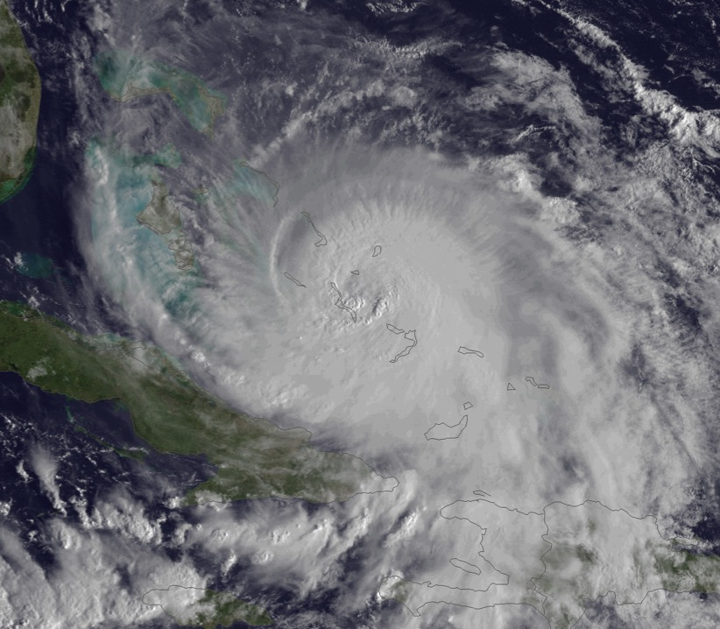
NOAA Hurricane Research
Hurricane Joaquin
F. Marks
NOAA HFIP Research Lead
NOAA/AOML Hurricane Research Division
Notes:
Hurricane Edouard 16 September 2014

Slide 2
Mission:
Advance understanding and prediction of TCs through observations, numerical models, and theory, with emphasis on processes within inner part of storm.
HRD research supports NOAA's Strategic Plan:
Advance understanding and prediction of changes in the environment through world class science and observations
Improve preparedness, response, and recovery from weather and water events by building a Weather-Ready Nation
http://www.aoml.noaa.gov/hrd/
NOAA’s hurricane research focus for >50 years

Slide 3
Vision:
Observing strategies
Aircraft observations
Physical parameterizations
Understanding of TC processes
HWRF model
Analysis systems
HRD is uniquely positioned to advance understanding of TC processes in close cooperation with efforts to improve observing strategies and numerical prediction.

Slide 4
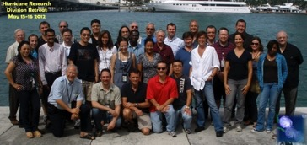
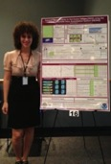
Who?
Staff includes 38 employees: 20 federal & 21 contract
21 research scientists
  4 post-docs
16 support personnel
2-3 summer students
HRD scientists collaborates locally with scientists in other AOML divisions, CIMAS, UM/RSMAS, and FIU
HRD coordinates its research with OAR laboratories (ESRL, GFDL, ARL, NSSL), AOC, NESDIS, NWS (EMC, NHC, & WFOs), and Testbeds (JHT, DTC, JCSDA, & OSSE).
Funded Priorities: NOAA Hurricane Forecast Improvement Project (HFIP), Quantitative Observing System Assessment Project (QOSAP), & Next Generation Global Prediction System (NGGPS).

Slide 5

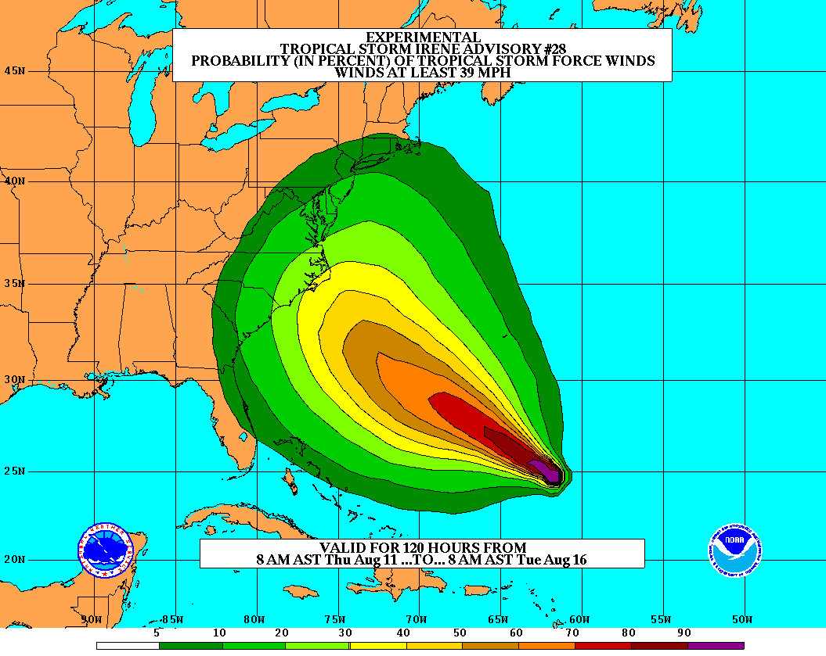
Goals
Improve Forecast Accuracy
  Hurricane impact areas (track) – 50%
  in 10 years
  Severity (intensity) – 50% in 10 years
  Rapid intensity change detection
  Storm surge forecast improvements
Extend forecast reliability out to 7 days
Quantify, bound and reduce forecast uncertainty to enable risk management decisions
Notes:
5

Slide 6

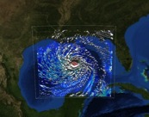



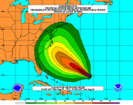
How to get there?
Science
    Improved understanding from combination of observations & models
    High resolution coupled models – especially intensity changes
    Techniques to understand, reduce & communicate uncertainty
Information Technology
  Increased computing power
  IT infrastructure for inter-agency data exchange
Observing Strategy
Improved use of existing and planned systems
Improved Forecaster Products
2014 HFIP Annual Workshop
Notes:
6
Guide and accelerate HFS improvements (HFS)
Accelerate NOAA operational HFS & GFS development
R&D to improve HFS and GFS (need basic research)
R&D for HFS and GFS ensemble systems (need basic research)
Develop observing system strategy analysis capability (OSE)
R&D to improve observing strategy to improve forecasts & inform NOAA investments
Fully fund transition of research to operations (R2O)
Broaden JHT charter and increase support
Develop interactions between JHT, DTC and JCSDA
Increase high performance computing (res & ops)
Coordinate with research community on basic research
NOAA can not meet goals alone!
Broaden base of expertise in tropical cyclone research community
Work closely with federal, academic, and private sector communities Provide dedicated high performance computing capacity for HFS operations and research & development

Slide 7
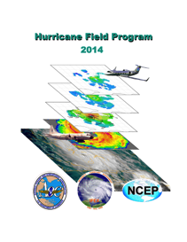
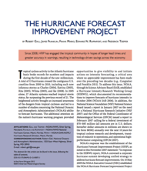
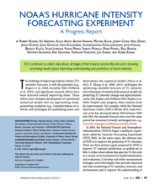
HOW?:
NOAA Intensity Forecast Experiment (IFEX)
Partnership to improve TC intensity/ structure forecasts
Collect observations spanning TC life cycle for model initialization and evaluation
Develop and refine measurement technologies to provide improved real-time monitoring of TC intensity, structure, and environment
Improve understanding of physical processes important in intensity change
http://www.aoml.noaa.gov/hrd/HFP2014/IFEX.html
Rogers et al., BAMS, 2006
Rogers et al., BAMS, 2013
Notes:
• AOML/HRD provides operational support for G-IV surveillance (2 people) and WP-3D reconnaissance SFMR (1 person) missions despite transitioning activities to operations. HRD augments AOC staff by providing meteorological expertise for data QC because they do not have manpower, but we receive no support for these activities. Will become greater issue as we transition airborne Doppler. HRD no longer has internal resources to support these activities.
• 2 tropical cyclones flown from beginning to end of life cycle
Irene
Rina

Slide 8
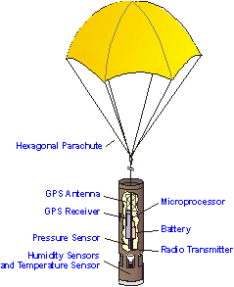

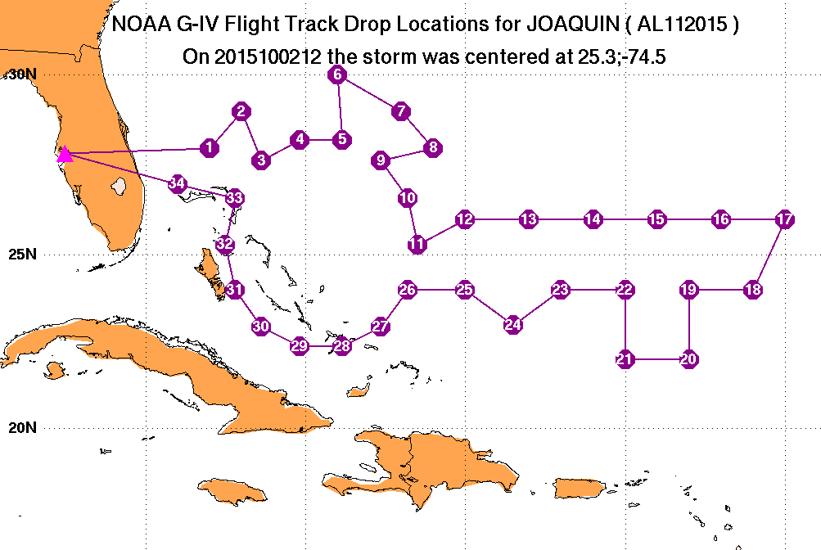
WHAT?:
Current TC research:
Track:
Synoptic-surveillance using dropsondes.
Analytical & numerical studies.
Ensemble track forecasting & targeted observations.
http:/www.aoml.noaa.gov/hrd/data_sub/assesment.html
Notes:
• Track work in partnerships with NWS and NSF. Partially supported through JHT. Work has been slowed by lack of ability to run operational models on EMC development machines since latest model upgrades done at the beginning of 2005 season. Sim has been unable to evaluate 2005 performance to date. This inability to run on development machine is a major stumbling block for this type of model evaluation work like we are proposing for other parameters (surface wind speed, structure). Not sure how we can work with EMC to alleviate this roadblock.

Slide 9
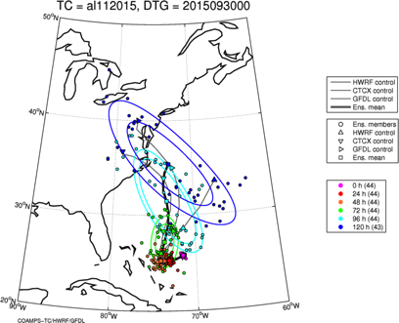
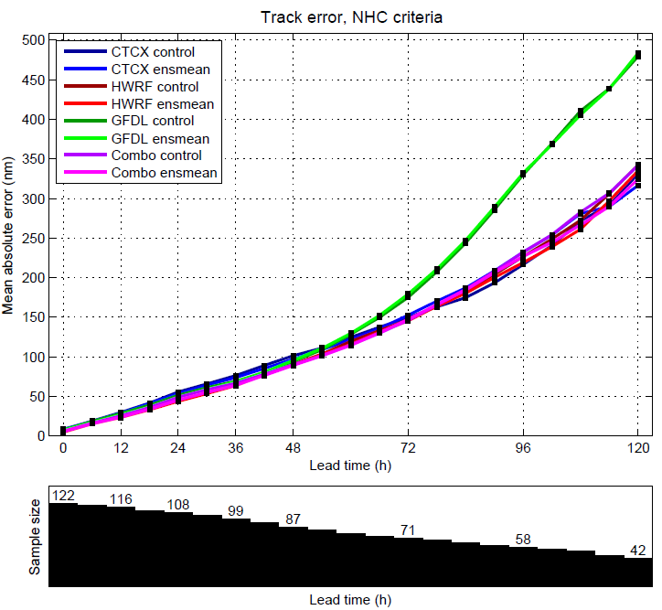
Track (continued):
Ensembles: Single & Multi-model
HWRF EPS (27/9/3 km, 42 levels) – 20 members
GFDL EPS (55/18/6 km, 42 levels)
– 10 members
COAMPS-TC EPS (27/9/3 km, 40 levels) – 10 members
2015 real-time
http://www.emc.ncep.noaa.gov/gc_wmb/vxt/
Notes:
• As the new models are developed to deal with intensity and structure we need to develop new metrics for model and forecast evaluation beyond the traditional minimum central pressure and peak surface wind. The NWS metric of the peak 1-min sustained surface wind anywhere is not as meaningful anymore. A model or forecast could be correct on those parameters for the wrong reason. Customers want to know more about the impacts to expect and that means structure and size matter. Proposed new metrics are structure (radii of 35, 50, 65 kt, and radius of maximum wind in different quadrants) and rapid intensification (FAR vs POD). They need to be tested and improved with data as well as model output.

Slide 10
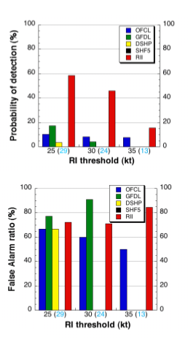
Intensity:
Statistical Models
  Since 1997, D-SHIPS most skillful intensity guidance to NHC/TPC.
  Incorporates wind field decay after landfall.
  Incorporates inner-core SST impact with 6-8% increase in forecast skill.
  Developed Rapid intensification index (RII) that average 5% & 30% improvement for ATL & EPAC (EPAC easier than ATL).
ATL
RII POD higher than any dynamical model & OFCL in both ATL and EPAC, while FAR comparable
Kaplan et al (2009)
Notes:
• Goal of the HRD 2005 AOP was to upgrade SHIPS with Cione’s inner core SST correction ( see reference CIONE, J.J., and E.W. UHLHORN. Sea surface temperature variability in hurricanes: Implications with respect to intensity change. Monthly Weather Review, 131(8):1783-1796 (2003)) and demonstrate a 5% improvement in SHIPS intensity forecasts. We have yet to complete the 2005 evaluation, but rerunning the 2004 storms with the new correction demonstrated a 4% improvement over the operational SHIPS. This year should be at least as good, given storms such as Ophelia, Rita and Katrina.
• Figure shows actual improvement from rerun of the 2004 season in kt (not %). Note dramatic improvement for hurricanes and especially storms undergoing rapid intensification (>25 kt in 24 h), particularly beyond 48 h. Reason for dramatic improvement at later forecast periods is importance of the SST predictor in SHIPS at later times.
• Important note: SHIPS is an example of providing guidance on guidance,as it uses the global model initial conditions and forecast output as predictors. SST is one of the most important of the predictors and the operational version uses the Reynold’s weekly SST. Where the new version is providing improvements is by adding internal storm information, the correction of the Reynold’s SST by a value more representative of what should be under the eyewall. This is a trend in the development of SHIPS that is telling us that to do intensity right we need to know more about the current state of the inner vortex that is not represented in the global model fields. Mark DeMaria has demonstrated similar improvements by using IR satellite information and flight level data. Unfortunately, that information is only available at the initial time and does not seem to show that much improvement to longer time intervals, whereas Cione’s algorithm is applied to all forecast times and seems to better reflect the actual storm conditions.

Slide 11
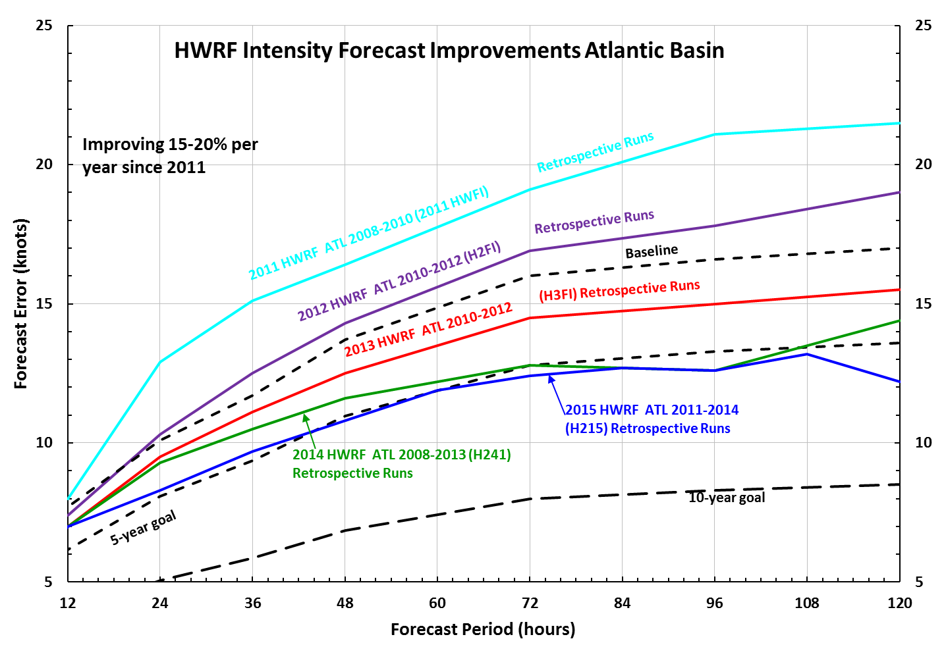
Intensity (continued):
3-D modeling of TC
HWRF:
4 years of continuous improvements in intensity forecasts

Slide 12
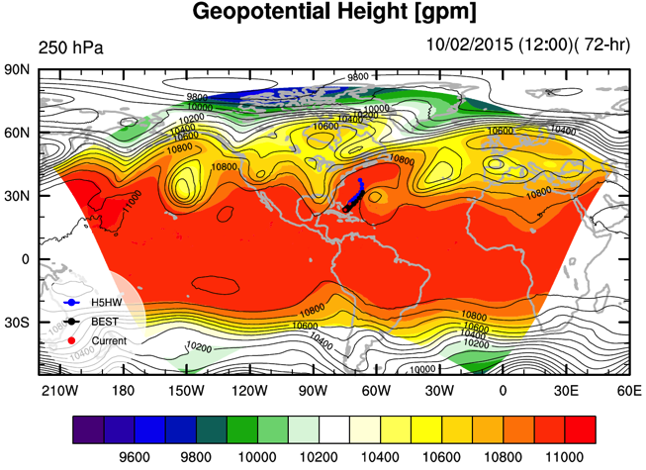
Intensity (continued):
HWRF: Global to local
Experimental Basin-HWRF simulations
(http://storm.aoml.noaa.gov/hwrfxprojects/?projectName=BASIN)
AL99
AL90
Joaquin
Notes:
• As the new models are developed to deal with intensity and structure we need to develop new metrics for model and forecast evaluation beyond the traditional minimum central pressure and peak surface wind. The NWS metric of the peak 1-min sustained surface wind anywhere is not as meaningful anymore. A model or forecast could be correct on those parameters for the wrong reason. Customers want to know more about the impacts to expect and that means structure and size matter. Proposed new metrics are structure (radii of 35, 50, 65 kt, and radius of maximum wind in different quadrants) and rapid intensification (FAR vs POD). They need to be tested and improved with data as well as model output.

Slide 13
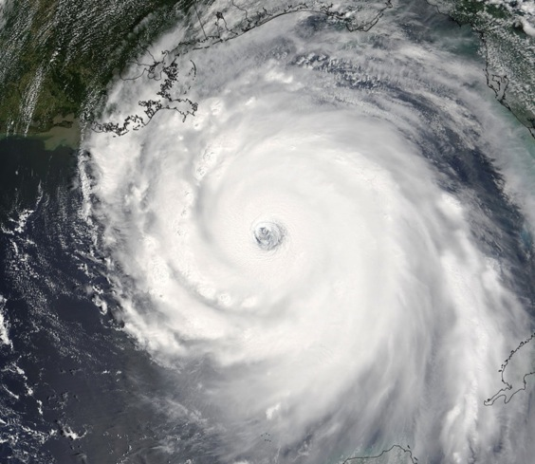
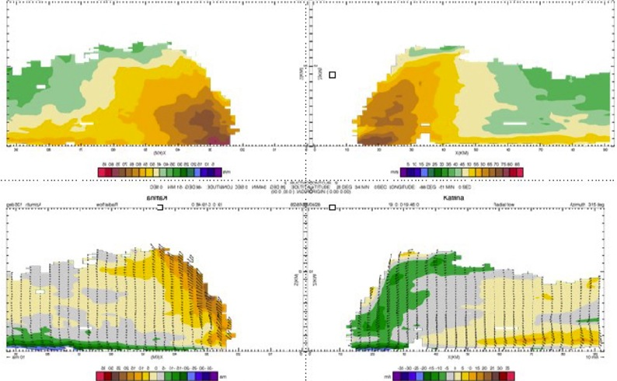
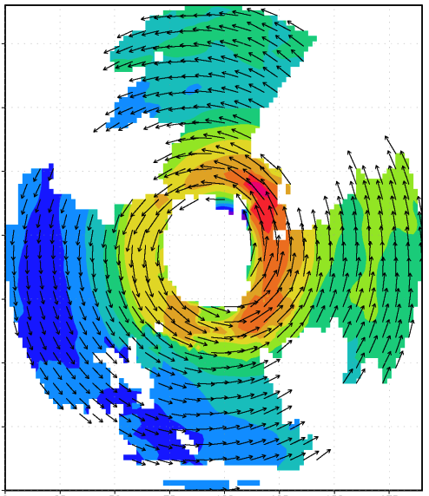

Intensity (continued):
Airborne Doppler radar studies
V_{θ}
150
100
distance (km)
V_{r}, w
50
0
0
50
100
150
distance (km)
Airborne Doppler-analyzed wind field Hurricane Katrina, 28 September 2005
http://www.aoml.noaa.gov/hrd/Storm_pages/katrina2005/radar.html
Notes:
• HRD developed the capability to make a three-dimensional analysis from automatically quality-controlled Doppler data as part of JHT and a G-IV Doppler radar upgrade proposals. Horizontal and vertical cross sections of these analyses were transmitted from the P3 to NHC. The three-dimensional analyses have a vertical resolution of .5 km and a horizontal resolution of 4 km. Analyses of the horizontal and vertical distribution of radius-height-averaged winds are examples of those sent to NHC in nearly all storms for the late phase of IFEX. HRD cooperated with NHC to produce analyses of the greatest interest to NHC, namely the 4-km x 4-km x 0.5-km analyses at 500 m and 1 km.
• Goal is to provide QC Doppler radar-radial-velocity observations from NOAA G-IV and WP-3D aircraft in real time to EMC for assimilation into HWRF. HWRF will be able to use data at 1.5 km horizontal resolution and finer vertical resolution to initialize winds in TC core and immediate environments. Only way to consistently obtain such data is X-Band airborne Doppler radar. 32 real-time analyses sent via SATCOM for NHC
Katrina: 5 analyses on 25 August
4 analyses on 27 August
5 analyses on 28 August
Ophelia: 2 analyses on 8 September
3 analyses on 9 September
5 analyses on 11 September
2 analyses on 12 September
Rita: 1 analysis on 20 September
4 analyses on 21 September
1 analysis on 22 September

Slide 14
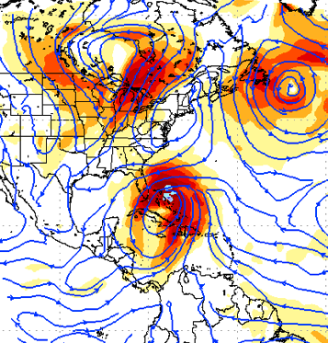
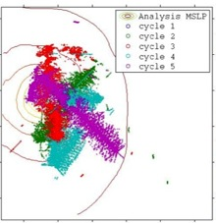
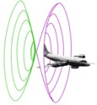
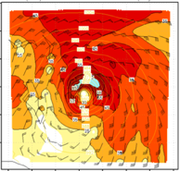
Intensity (continued):
Assimilation of data into numerical models
Synergy of high resolution forecast and airborne observations
P-3 and G-IV observations – superobs (SO)
Data assimilation
Improving the initial condition in storm core region
Improving the high resolution regional forecast
Wind intensity at 10 m
Hurricane Sandy (2012)
F. Zhang (PSU), Aberson, Aksoy, Gamache, Gopal (AOML/HRD)

Slide 15
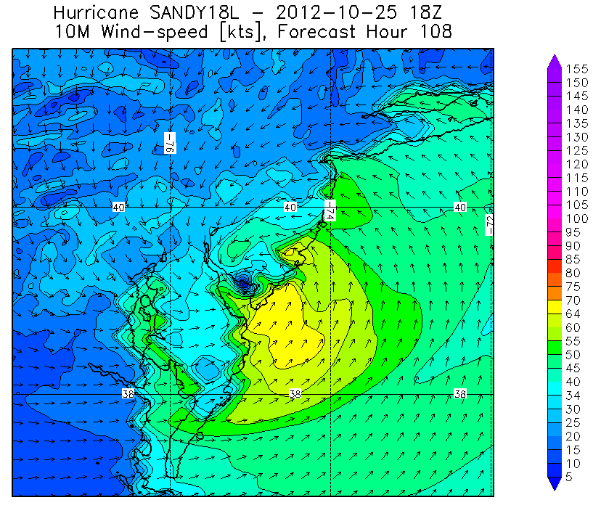
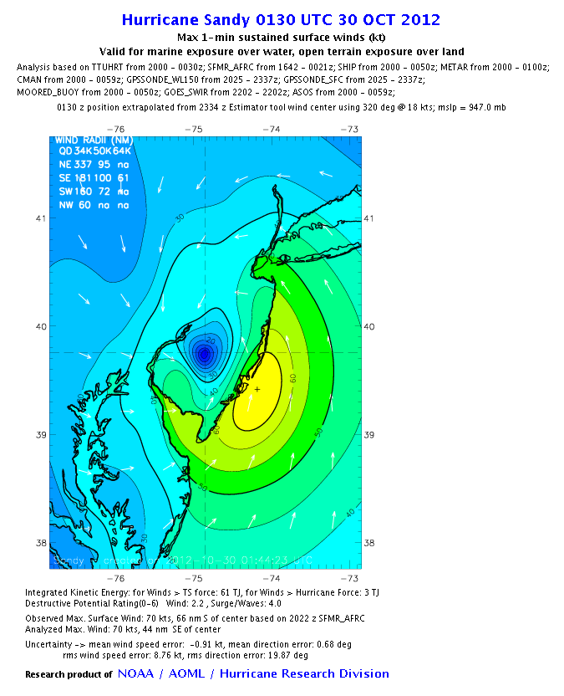

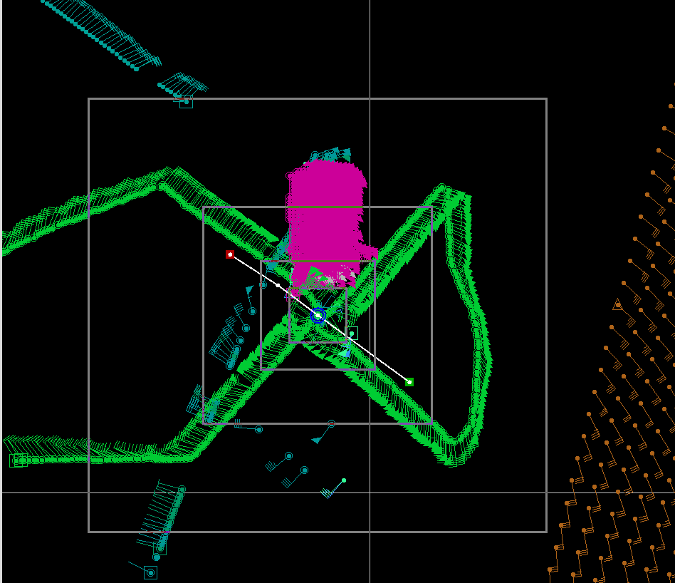
Structure:
Evaluation of Model structure
Data Coverage
H*Wind 10m winds
HWRF 10m winds
HWIND analysis
HWRF Forecast (108 h)
Notes:
• Surface wind field work is mainly supported through a NOPP that Hans Graber controls (collaboration between UM, USACE, HRD, and Vince Cardone’s Ocean Weather). HRD receives support to provide them near real-time surface winds to drive their surge and wave models. HRD also receives support for these wind fields from the USACE, particularly for the production of wind fields for past storms to use for model testing. Finally, some of the support comes from the development of a wind model for the State of Florida CAT model effort in collaboration with FSU, FIU, and UF.

Slide 16
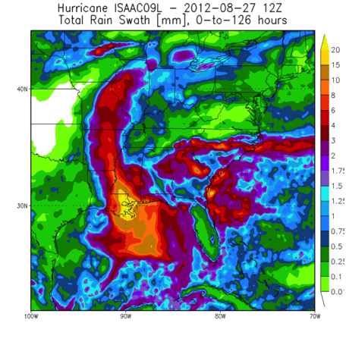
Impacts:
Rainfall
Stage IV rain accumulation (144 h)
HWRF rain accumulation (120 h)
Hurricane Isaac (2012)

Slide 17


What in 2015 & 2016?:
IFEX 2015
  NOAA aircraft flew 30 P3 and 15 G-IV missions
  Highlights include Hurricanes Danny, Erika, Joaquin, & Kate (ATL), Patricia (EPAC), & Oho (CPAC)
  4 NOAA SHOUT Global Hawk missions and 3 ONR WB-57 missions.
  For details see: http://noaahrd.wordpress.com/category/ifex-discussion
IFEX 2016
  2 WP-3D, G-IV – 250 flight hours (1 June-30 Nov.)
  Crews available 2/day missions starting July
  Interact with SHOUT during their field campaign
HFIP real-time model demonstration

Slide 18
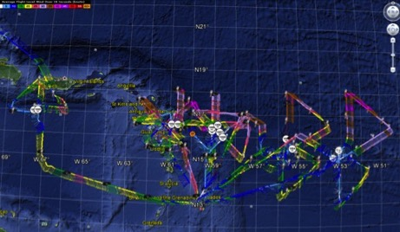
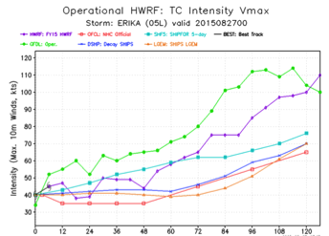
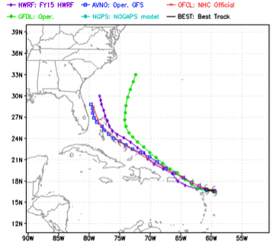
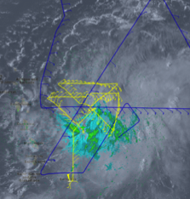
IFEX 2015:
Improved Models & Data: Erika
5 P-3 Flights
25 - 28 August 2015
5 P-3 missions from 25-28 August 2015 at 12 h Doppler sampling (HEDAS/GSI) & 1 G-IV mission
Doppler data transmitted in real-time for assimilation into HWRF
Sampled Erika as a tropical storm
18
Gamache, Reasor, Gopal (AOML/HRD), Tallapragada, Tong (EMC)
Notes:
Map shows flight tracks for all of the NOAA missions (color coded are the flight level winds for the P-3 missions)

Slide 19
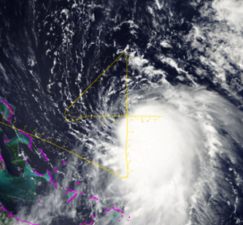
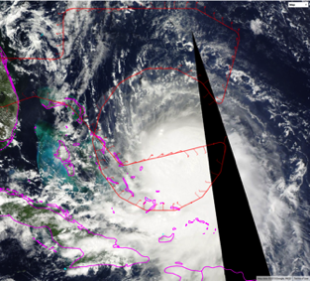
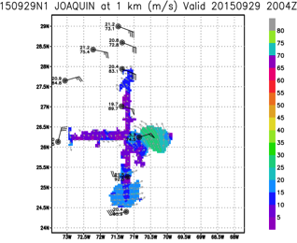
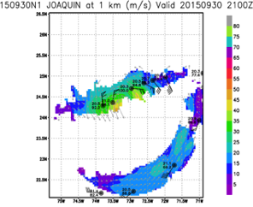
IFEX 2015:
Develop & refine observing technologies:
G-IV flight tracks in Hurricane Joaquin 29 & 30 September 2015
G-IV Doppler analysis at 1-km altitude
G-IV Doppler provides enhanced coverage at higher altitude
G-IV flown further from center to sample environment and supplement P-3
19
Notes:
Map shows flight tracks for all of the NOAA missions (color coded are the flight level winds for the P-3 missions)

Slide 20
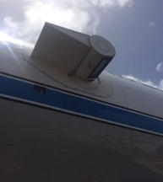
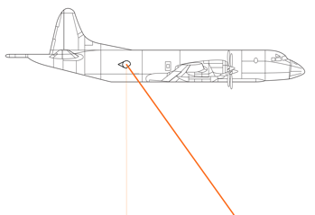
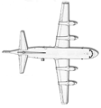
IFEX 2015:
Develop & refine observing technologies:
Doppler Wind Lidar (DWL)
Compliments P-3 & G-IV Tail Doppler radar
9 flights into Tropical Storms Danny and Erika
    7 flights collected data
Elevation angle range of -110° to +110°
Azimuth angle range +/- 30°
Preset scanning modes: conical, sweeps, etc.
Access DWL computer via laptop
P3 Orion Side View
P3 Orion Top View
30° off nadir
20
Notes:
Map shows flight tracks for all of the NOAA missions (color coded are the flight level winds for the P-3 missions)

Slide 21
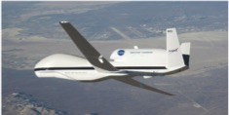

What in 2016?:
SHOUT
GOAL: Test prototype UAS concept of operations that could mitigate the risk of diminished high impact weather warnings in case of polar-orbiting satellite observing gaps
Global Hawk
  Flight level: ~55-60,000 ft
  Duration: ~24 h
  Range: 11,000 nm
  Payload: 1500+ lbs
  Deployment site: NASA Wallops Flight Facility, VA
  5 week deployment (late August through September)
  Instrumentation: AVAPS, HAMSR, & HIWRAP

Slide 22




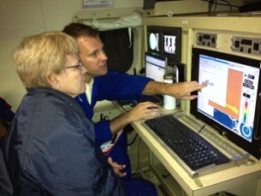

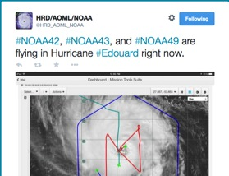
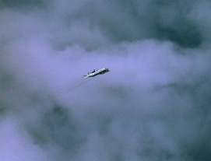
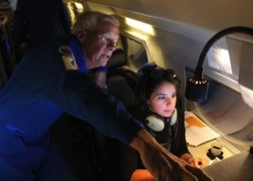
Communicating in the field
Our blog
http://noaahrd.wordpress.com
HRD Web page
http://www.aoml.noaa.gov/hrd
Facebook (3,475 likes)
http://www.facebook.com/noaahrd
Twitter (12,950 followers)
http://twitter.com/#!/HRD_AOML_NOAA
Tweets from the eye
Visiting scientist program
Notes:
Since 15 May 2010 HRD has maintained our Blog on Wordpress which supports a RSS feed, Twitter, and Facebook accounts.
Wordpress Stats: 1,126 posts (18-19 posts per month), 249 comments. Most posts are during the hurricane season where we post our updates on field activities whenever we are operating.
Wordpress Blog Views by Month and Year
Jan Feb Mar Apr May Jun Jul Aug Sep Oct Nov Dec Total
2010 152 753 1,790 3,463 5,521 2,047 1,479 1,019 16,224
2011 1,028 927 1,152 1,143 1,417 1,495 1,959 7,195 2,588 1,885 1,659 1,231 23,679
2012 1,139 1,179 1,305 1,456 1,754 1,855 1,929 14,433 4,537 5,302 3,179 2,770 40,838
2013 3,702 1,880 1,687 1,323 2,264 1,736 2,622 4,619 7,276 1,369 1,167 1,292 30,937
2014 1,591 1,493 1,457 1,608 1,738 2,390 3,773 4,744 4,591 3,314 2,271 2,423 31,393
2015 1,913 1,684 3,597
Since late September 2013 HRD has tracked web pages using Google Analytics:
HRD Web site Stats: Since late September 2013 a total of 188,460 visits or 47,000 visits per month with 383,873 page views
Twitter Stats: 1,666 tweets of which 1,126 are directly from the Wordpress Blog and the rest from “Tweets from the Eye” which we do directly to Twitter from the NOAA aircraft during missions. “Tweets from the Eye” are a very effective and popular outreach tool helping educate the Public to what NOAA does.

