Slide 1
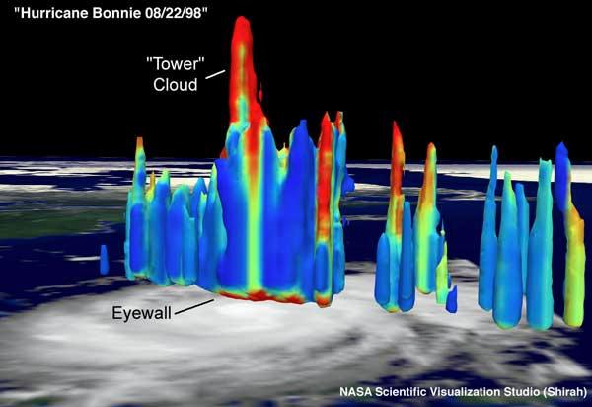
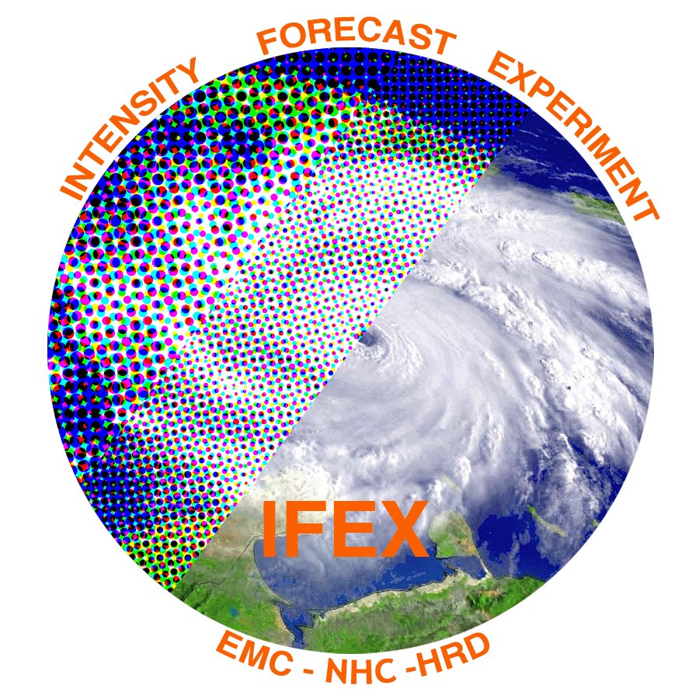

Deep convection and tropical cyclone intensification
Robert Rogers, NOAA/AOML Hurricane Research Division
Thanks to: Jun Zhang, Paul Reasor, Jon Zawislak, Haiyan Jiang, Trey Alvey, Ed Zipser, Stephanie Stevenson, Andy Hazelton, and Josh Wadler

Slide 2
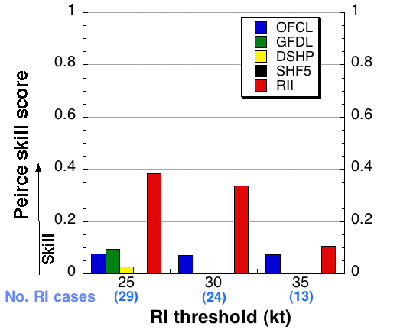
Motivation
Advances in forecasts of tropical cyclone (TC) intensity, and rapid intensity change (RI) in particular, lag advances in TC track forecasts
Multiscale interactions major reason for this – environmental to microscale
RI forecasts (e.g., RI index) based largely on environmental-scale fields generally explain about 35% of skill in RI forecasts
(Kaplan et al. 2009)
To what extent can processes smaller than the environmental scale explain remainder of skill?
What role does deep convection play in governing these intensity changes?

Slide 3
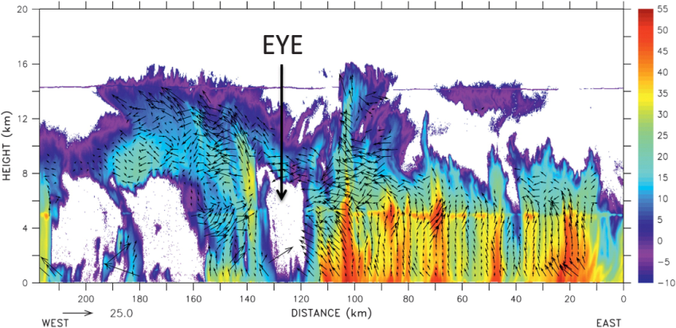
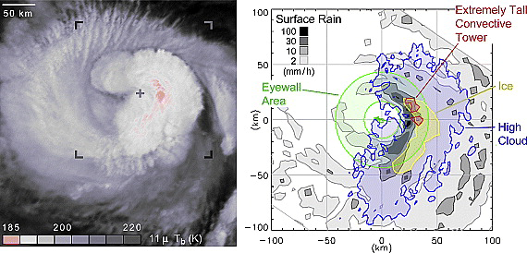
Motivation
Deep convection (“hot towers”) have long been recognized as important components of TC structure (e.g., Malkus 1959)
convective tower
TRMM
PR
Airborne
Doppler
IR & PMW
What is their role in TC intensification?
  Diabatic heating (e.g., Shapiro and Willougby 1982, Schubert and Hack 1982, Hack and Schubert 1986, Nolan and Grasso 2003, Nolan et al. 2007, Vigh and Schubert 2009, Pendergrass and Willoughby 2009, Rogers et al. 2013)
  Upper-level subsidence warming around periphery (e.g., Heymsfield et al. 2001, Guimond et al. 2010, Rogers 2010, Zhang and Chen 2012, Chen and Zhang 2013, Chen and Gopal 2015)
  Stretching and axisymmetrization in vortical hot towers (e.g., Hendricks et al. 2004, Montgomery et al. 2006, Reasor et al. 2009)
  Vortex alignment/downshear reformation (e.g., Reasor et al. 2009, Molinari and Vollaro 2010, Nguyen and Molinari 2012, Reasor and Eastin 2012, Stevenson et el. 2014, Rogers et al. 2015, Nguyen et al. 2015)

Slide 4
Questions to address
1) What is the importance of deep convection in TC intensification?
2) What is the preferred location of deep convection in TC intensification?
3) What controls this location?
4) Can this process be predicted (or at least nowcasted)?
Examine these questions using recent and ongoing research

Slide 5
1) What is the importance of deep convection in TC intensification?

Slide 6
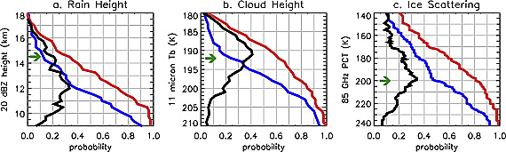
1) What is the importance of deep convection?
Deep convection is important in intensification
CDF’s of satellite-derived parameters for intensifying, non-intensifying TCs
intensifying
non-intensifying
(Kelley et al. 2004)
Intensifying TCs associated with high echo tops, lower infrared brightness temperatures, more ice scattering (all proxies for deep convection)

Slide 7
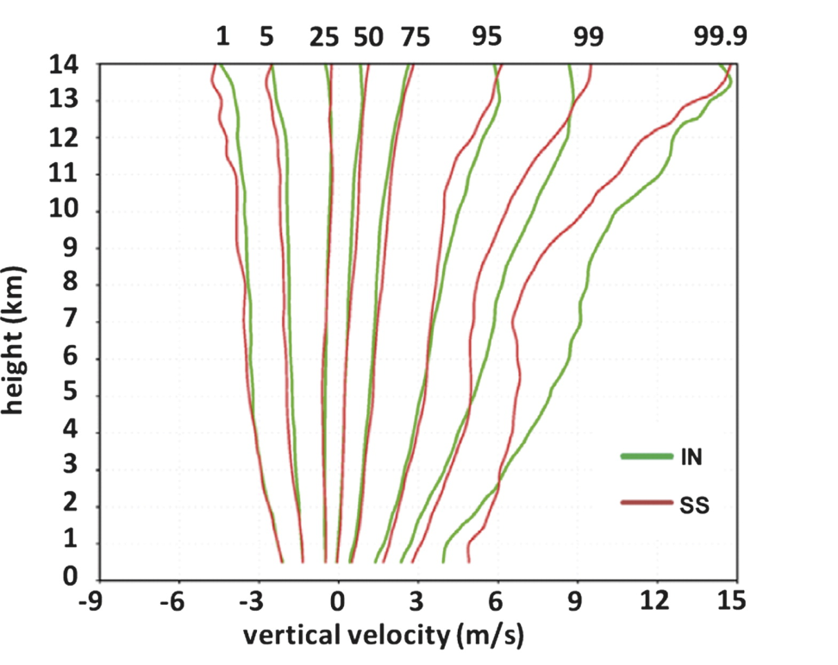
1) What is the importance of deep convection?
Deep convection is important in intensification
Select percentiles of airborne Doppler-derived vertical velocity in the eyewall for IN vs. SS TCs
Top 1%
(Rogers et al. 2013)
  IN cases have more of the strongest eyewall updrafts (top 1% and greater of distribution) above freezing level
  no significant differences in profiles for weaker portions of spectrum, or for downdrafts

Slide 8
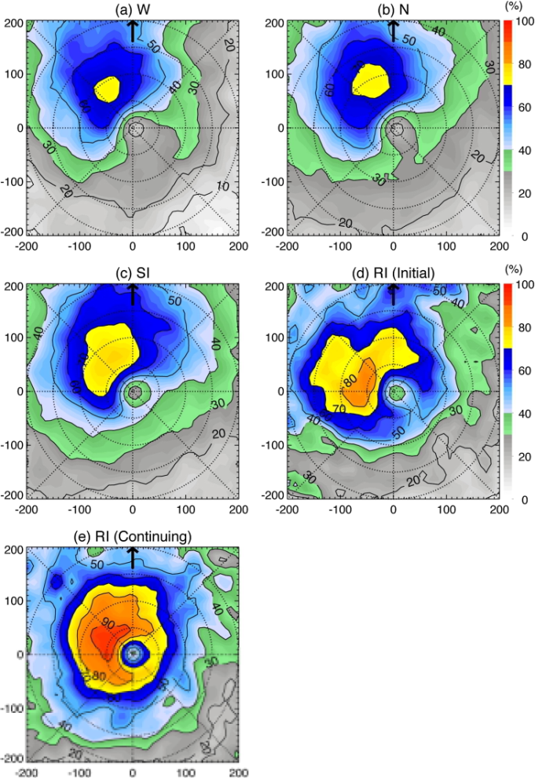
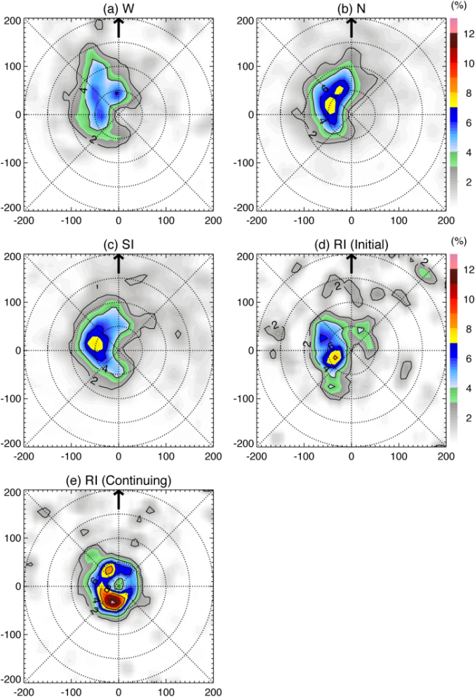
1) What is the importance of deep convection?
Deep convection is *NOT* important in intensification
Occurrence (%) of near-surface reflectivity > 20 dBZ from TRMM PR
Occurrence (%) of 10-km reflectivity > 20 dBZ from TRMM PR
(Zagrodnik and Jiang 2014)
Marked difference in surface rain rates among intensity change groups
Very little difference in “deep” convection, until RI continuing (undergoing RI for 12+ h)
Other support: e.g., Kieper and Jiang 2012, Jiang 2012, Jiang and Ramirez 2013, Tao and Jiang 2015

Slide 9
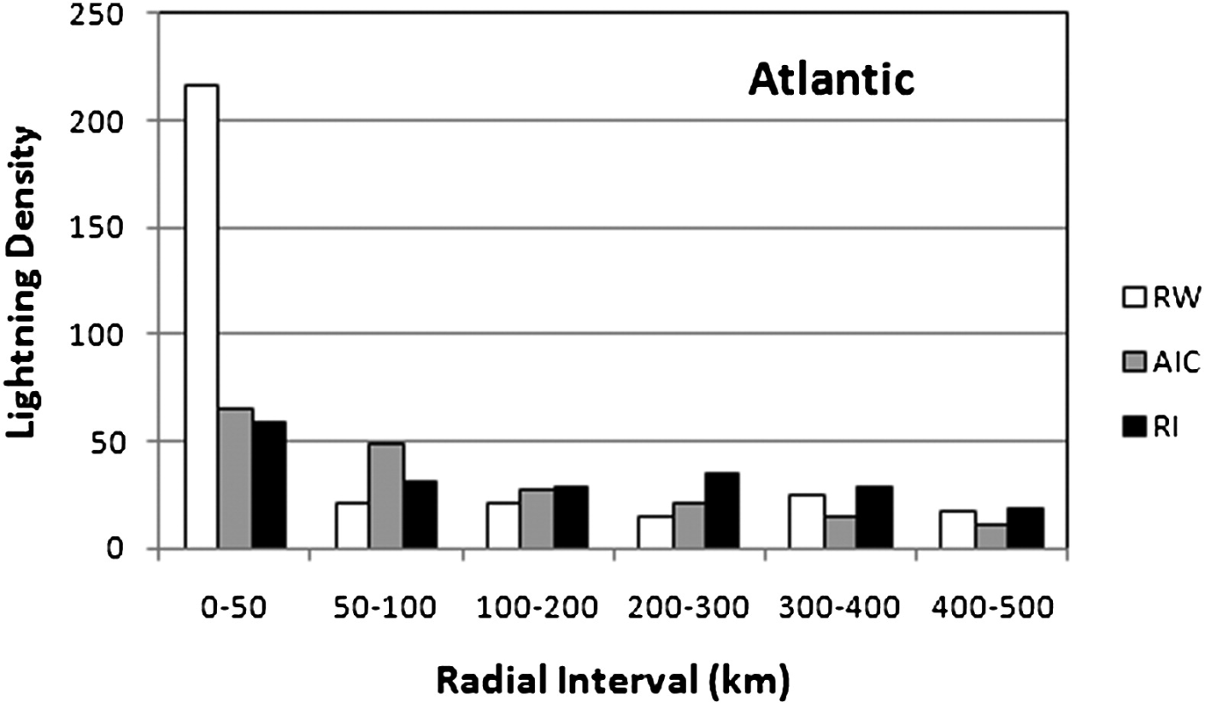
1) What is the importance of deep convection?
Deep convection is *NOT* important in intensification
Lightning density from WWLLN in radial bins for different intensity change categories
(DeMaria et al. 2012)
Highest flash densities in inner 50 km for rapid weakeners, lowest for RI

Slide 10
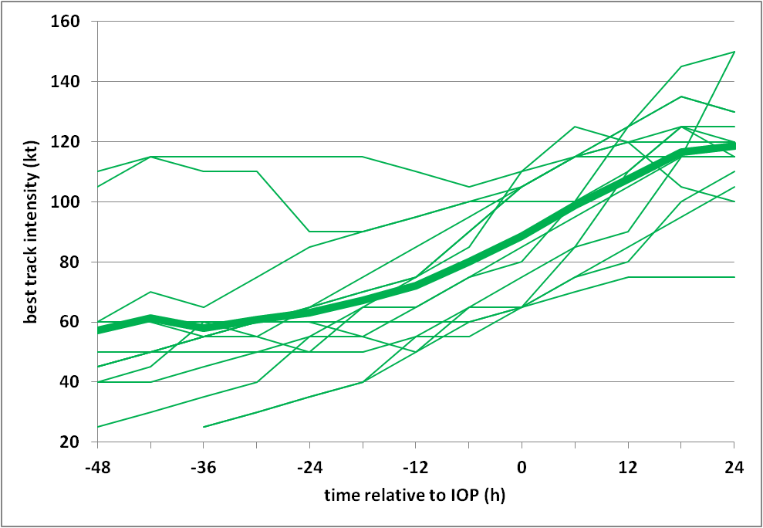
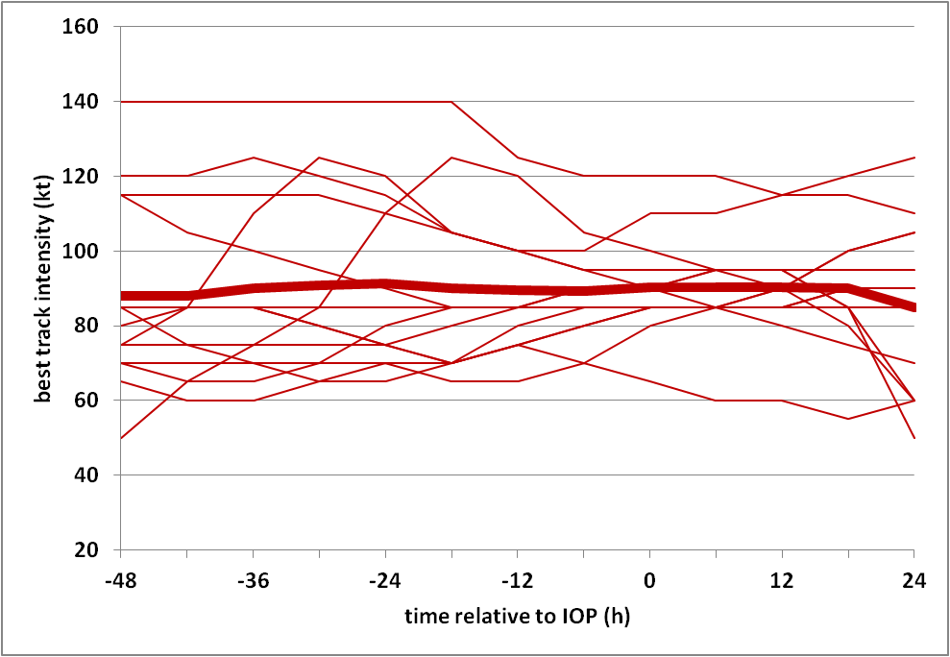
1) What is the importance of deep convection?
So which is it?
One possible explanation: cases in Doppler study were later in RI period
Best track intensity history for each IOP (thick line is mean)
Intensifying (IN)
Steady-state (SS)
IOP
IOP
(Rogers et al. 2013)
  40 eyewall passes from 14 IOP’s in 8 IN TC’s
53 eyewall passes from 14 IOP’s in 6 SS TC’s
Many IOP’s in IN dataset occur in middle of intensification period (“RI continuing” from Zagrodnik and Jiang)
Need to consider kinematic properties of vortex for context of role of convection (later)
Still an open question

Slide 11
1) What is the importance of deep convection in TC intensification?
It may be important…..or it may not be

Slide 12
2) What is the preferred (radial, azimuthal) location of deep convection?

Slide 13
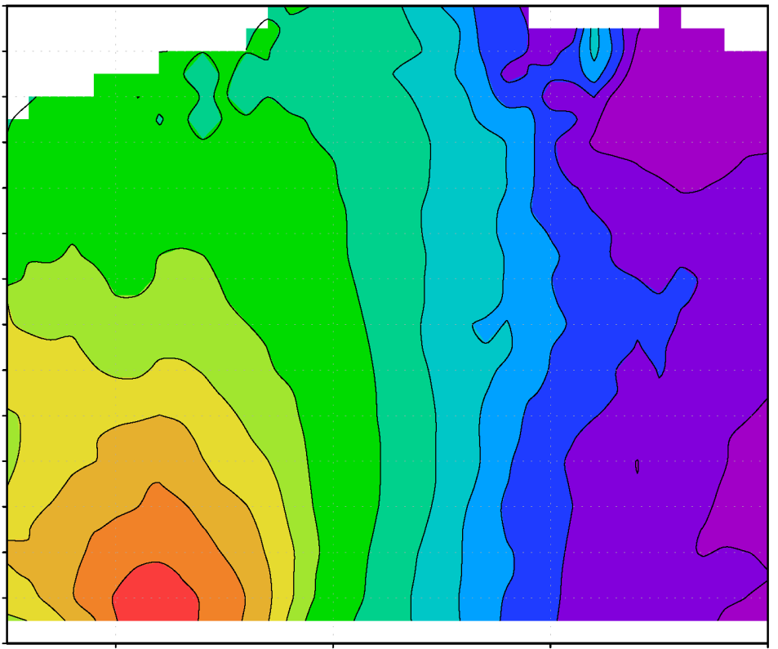
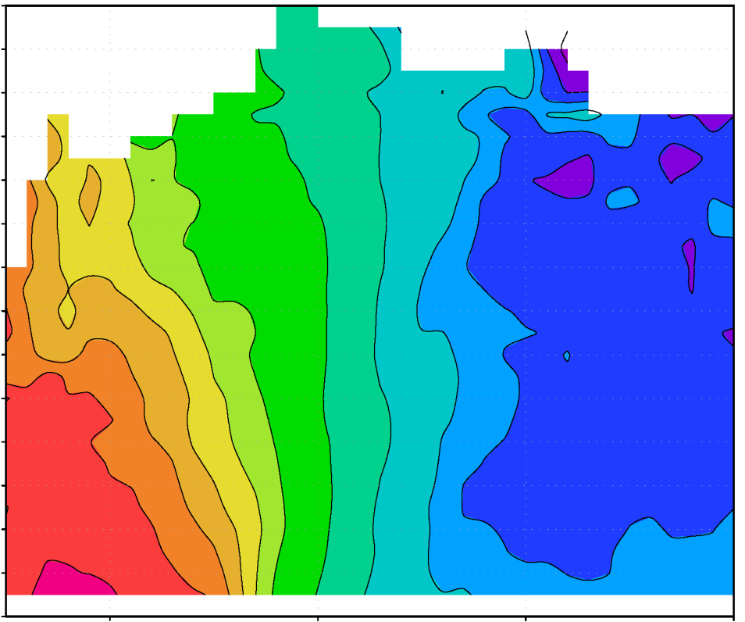
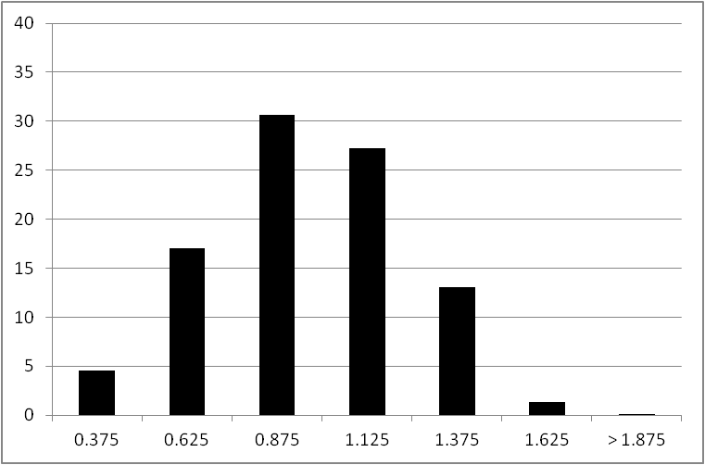
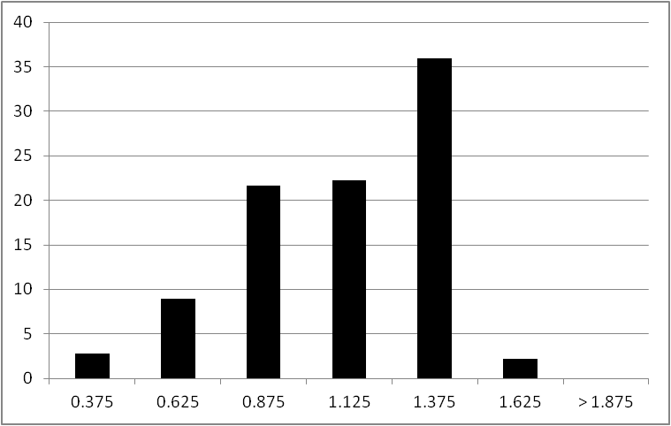
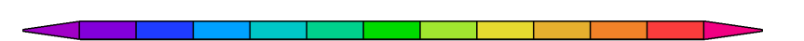
2) What is the preferred radial location?
Comparison of airborne Doppler composites of IN and SS cases
Radial distribution of convective bursts
(Rogers et al. 2013)
vorticity (x 10⁻⁴ s⁻¹)
vorticity (x 10⁻⁴ s⁻¹)
40
IN
40
SS
35
35
30
30
percentage
25
percentage
25
20
20
15
15
10
10
5
5
0
0
0.25
0.5
1
1.25
1.5
2
0.25
0.5
1
1.25
1.5
2
0.25
0.5
0.75
1
1.25
1.5
1.75
2
0.25
0.5
0.75
1
1.25
1.5
1.75
2
0.75
1.75
0.75
1.75
r/RMW
r/RMW
r/RMW
r/RMW
3
4
5
6
8
12
18
21
24
27
30
33
3
4
5
6
8
12
18
21
24
27
30
33
IN cases: distribution of convective bursts peaks inside RMW compared with outside RMW for SS cases

Slide 14

2) What is the preferred radial location?
WWLLN bursts relative to FLIGHT+ (Vigh et al. 2016) RMW and 24-h intensity change
(courtesy Stephanie Stevenson, SUNY Albany)
Intensifying TCs have lightning bursts at or inside RMW
Inside RMW
Outside RMW
Centers reformed

Slide 15
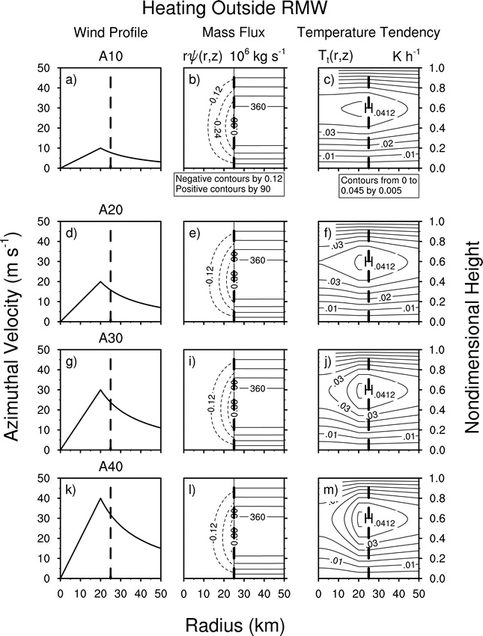
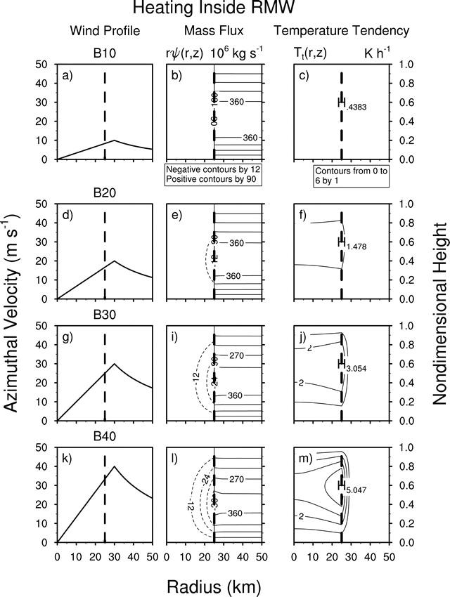
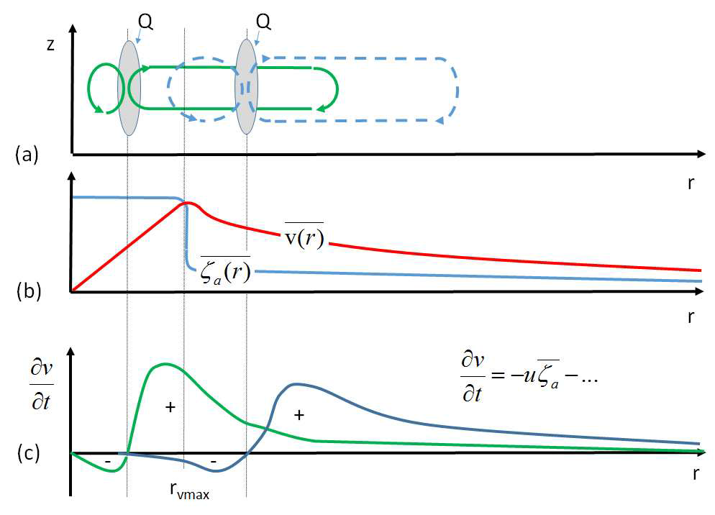
2) What is the preferred radial location?
Two proposed mechanisms
diabatic heating
heating outside RMW
Diabatic heating efficiency
heating inside RMW
diabatic heating
(Vigh and Schubert 2009)
RMW
Angular momentum increase in PBL
Either mechanism requires diabatic heating inside RMW
(Montgomery and Smith 2016, in review)

Slide 16

2) What is the preferred azimuthal location?
Location of high echo tops in shear-relative framework from TRMM PR
Occurrence (%) of 10-km reflectivity > 20 dBZ
Most of high echo tops appear left of shear vector, USL especially after RI has started

Slide 17
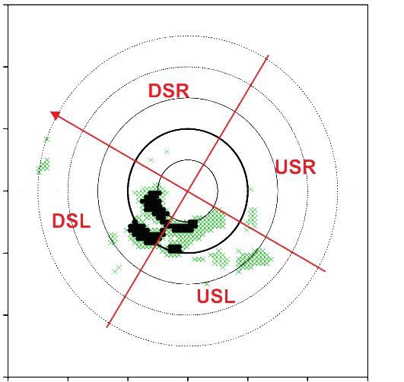
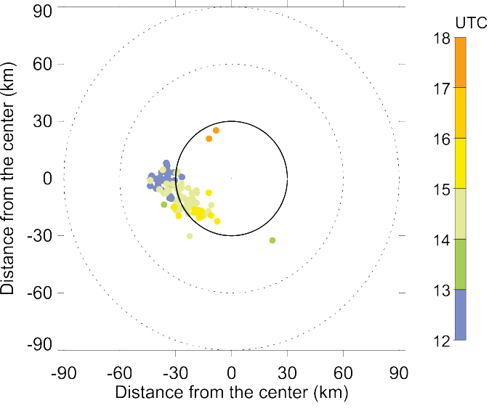

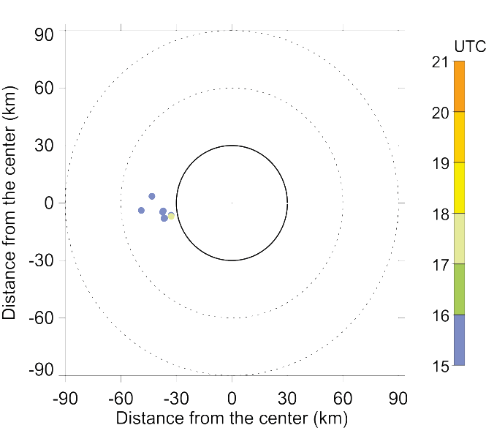
2) What is the preferred azimuthal location?
Locations of strong updrafts and lightning for Edouard (2014)
Strong 8-16 km updrafts
Lightning flashes from WWLLN
90
> 3 m/s
> 5 m/s
60
DSR
Distance from the center (km)
shear
shear
30
USR
14 September
(RI)
0
RMW
DSL
-30
-60
USL
-90
-90
-60
-30
0
30
60
90
Distance from the center (km)
90
> 3 m/s
> 5 m/s
60
DSR
Distance from the center (km)
30
shear
shear
USR
16 September
(SS)
0
RMW
-30
DSL
-60
USL
-90
(Rogers et al. 2016,
in review)
-90
-60
-30
0
30
60
90
Distance from the center (km)
14 Sept (RI): Strongest updrafts DSL, USL; Lightning flashes begin DSL, rotate toward USL and inside RMW
16 Sept (SS): Limited strong updrafts and lightning mostly DSL

Slide 18
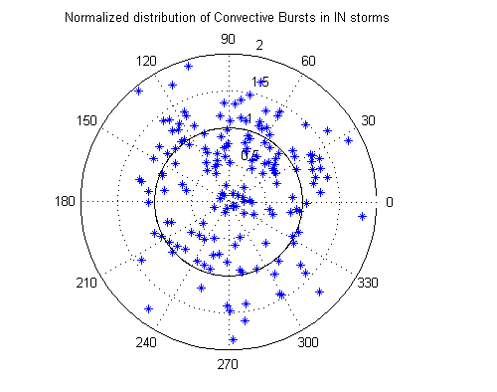
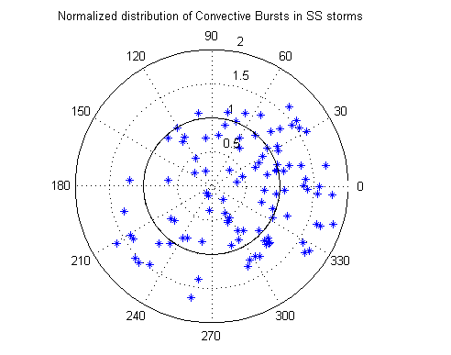
2) What is the preferred azimuthal location?
Composite of Doppler-derived CB distributions and structure vs. intensity change
IN
Shear
SS
Shear
IN storms have more CBs USL, with stronger updrafts and echo tops reaching a higher altitude
(courtesy Josh Wadler, Univ. Oklahoma)

Slide 19
2) What is the preferred azimuthal location?
Precipitation Symmetry in Edouard (2014)
intensification
Symmetry Index (Alvey et al. 2015)
PMW
Mean 85-91 GHz (pixels ≤ 250 K) PCT
Mean IR T_{B}
(1)
In each quadrant
(2)
Subtract the means for each quadrant pair and sum the differences
(DSR-DSL)+(DSR-USL)+(DSR-USR)….
Departure from Symmetry [K]
Day
intensification
IR
Although still asymmetric during RI, increase in precipitation symmetry during intensification
Deep convection predominantly asymmetric (left of shear) throughout
Day
(Zawislak et al, 2016, in review)

Slide 20
2) What is the preferred (radial, azimuthal) location of deep convection?
Preferred radial location inside RMW
Preferred azimuthal location upshear left

Slide 21
3) What controls the (radial, azimuthal) location?

Slide 22
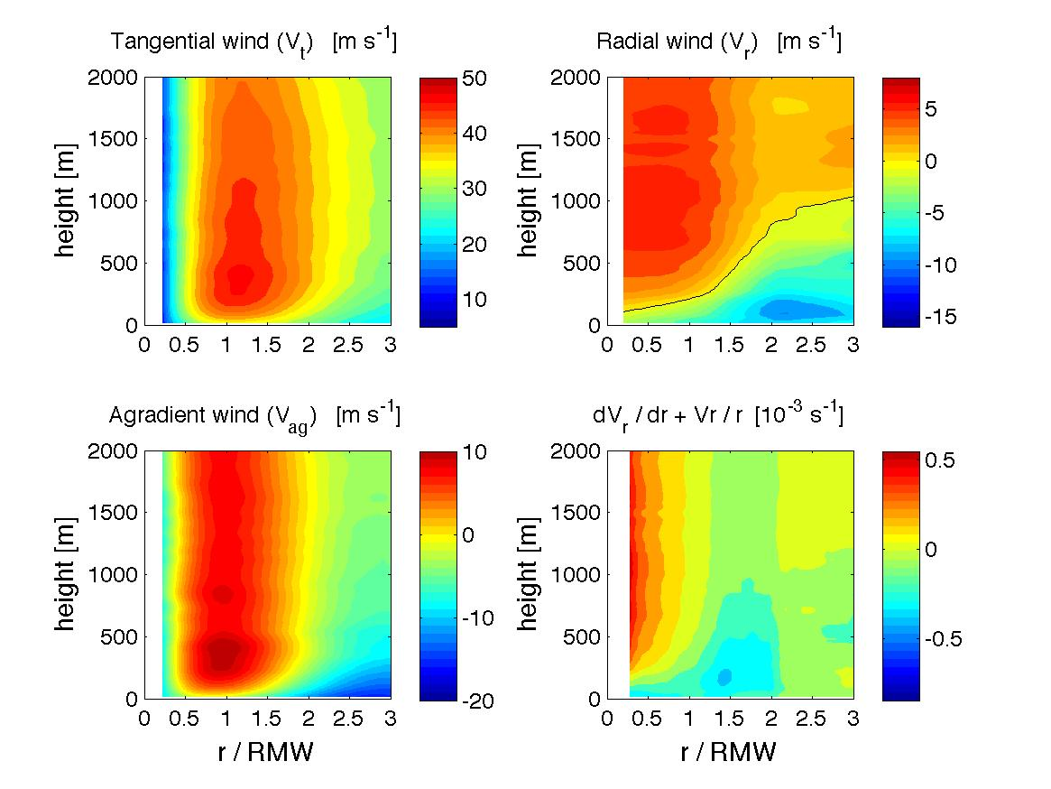
3) What controls the radial location?
PBL convergence
PBL kinematic structures for Earl (2010) and Edouard (2014)
Earl
(RI)
r/RMW
r/RMW
r/RMW
Rogers et al. (2015)
Edouard
(SS)
r/RMW
r/RMW
r/RMW
Rogers et al. (2016, in review)
Edouard (SS) had a shallower, weaker inflow than Earl (RI)
Radial location of peak convergence for Edouard closer to center than Earl

Slide 23
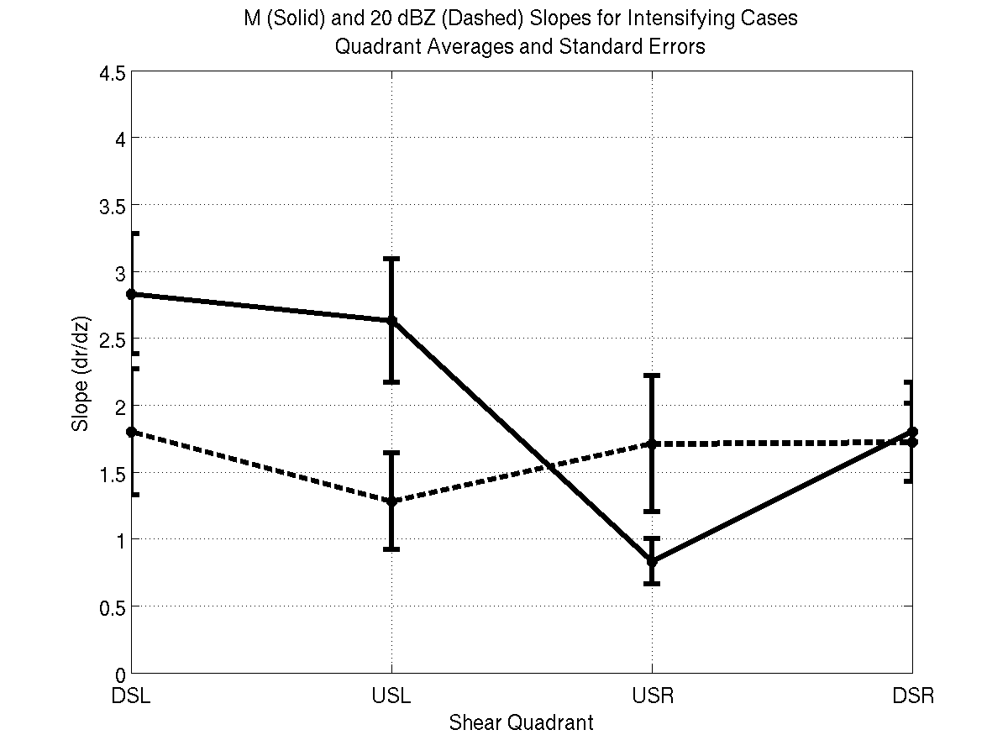
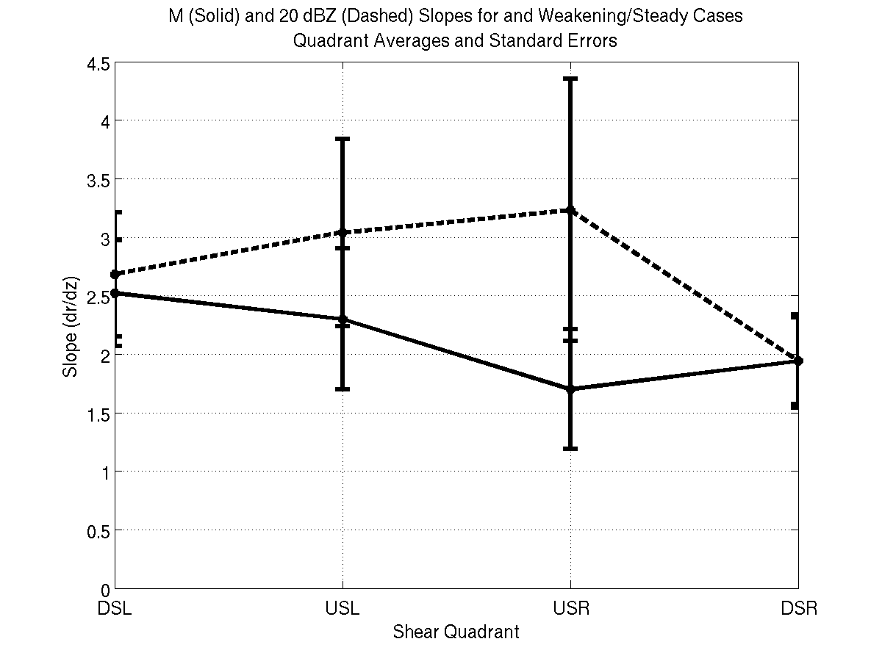
3) What controls the radial location?
Updraft slope
Slopes of reflectivity (dashed) and M (solid) radar composites as a function of shear-relative quadrant
4.5
Intensifying
4.5
Steady-state
4
4
3.5
3.5
dBZ
slope (dr/dz)
3
M
slope (dr/dz)
3
2.5
2.5
M
2
2
1.5
dBZ
1.5
1
1
0.5
0.5
DSL
USL
USR
DSR
DSL
USL
USR
DSR
Shear-relative quadrant
Shear-relative quadrant
Schematic of slope differences left of shear
(Hazelton et al. 2014)
Intensifying
Steady-state
M
M
20 dBZ
20 dBZ
RMW_{2km}
RMW_{2km}

Slide 24
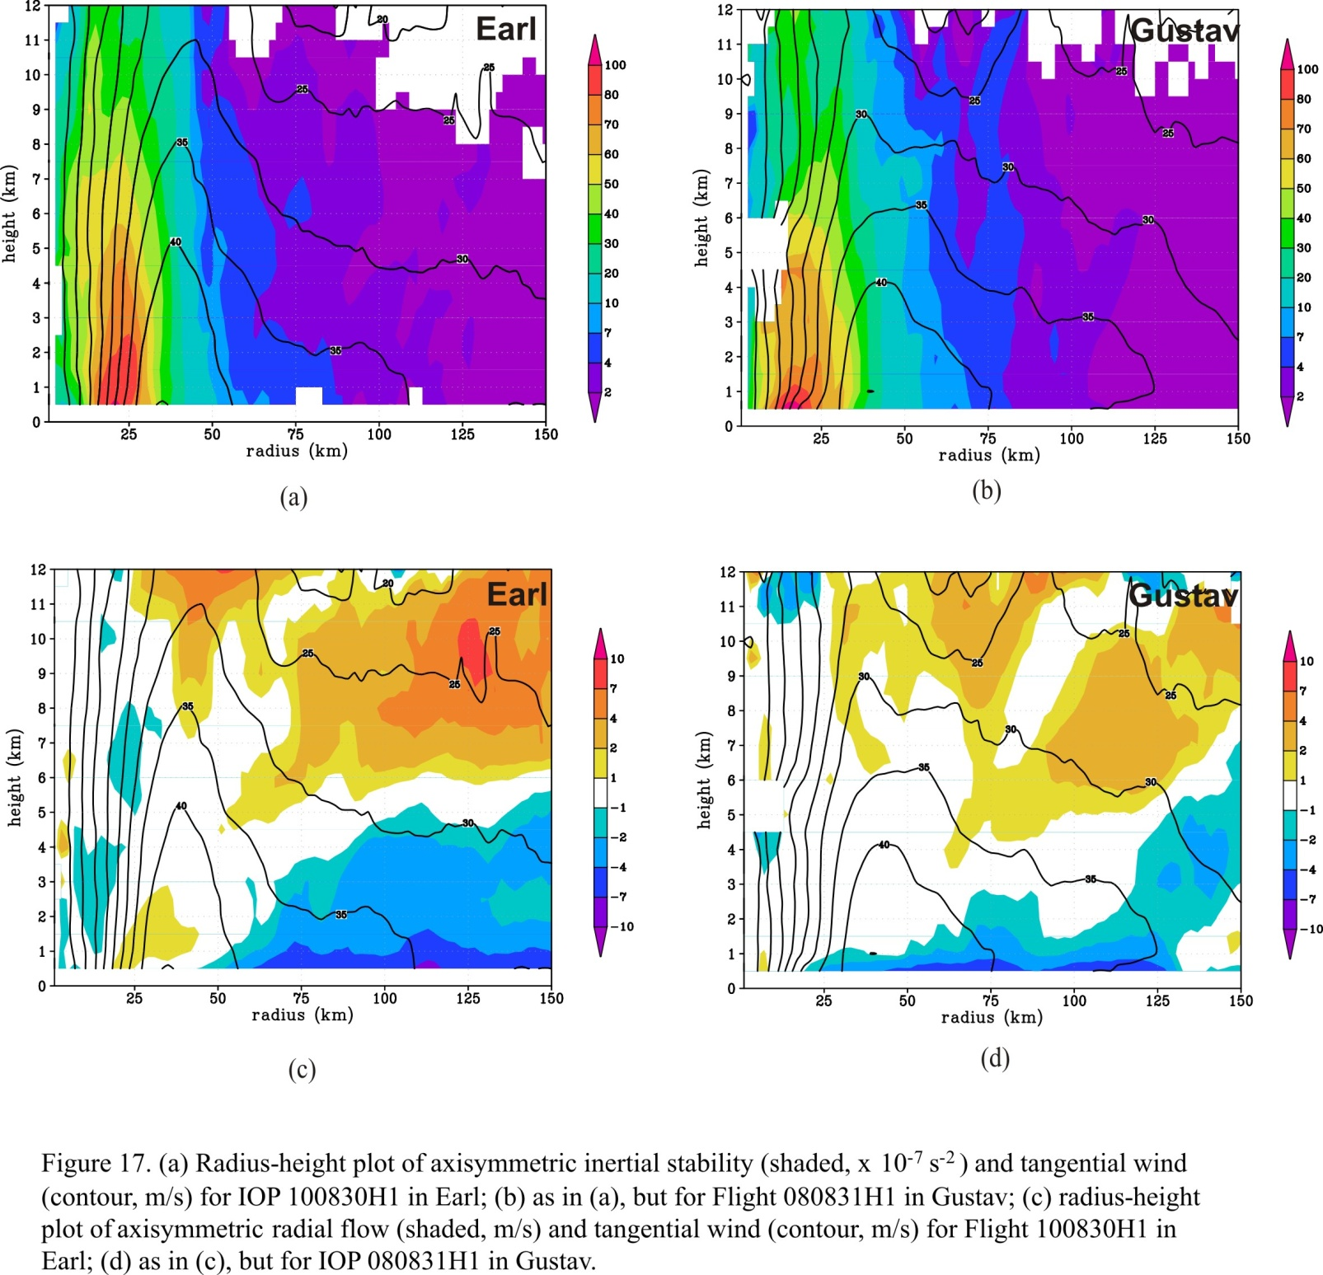
3) What controls the radial location?
Outer core inertial stability
Axisymmetric inertial stability (I², shaded, x 10⁻⁷ s⁻²) and tangential wind (contour, m s⁻¹)
12
12
11
(RI)
100
11
(SS)
100
10
80
10
80
9
70
9
70
8
60
8
60
7
7
height (km)
50
height (km)
50
6
40
6
40
5
30
5
30
4
20
4
20
3
10
3
10
2
7
2
7
1
4
1
4
0
12 UTC Aug 30 2010
2
0
00 UTC Sep 1 2008
2
25
50
75
100
125
150
25
50
75
100
125
150
radius (km)
radius (km)
Axisymmetric radial flow (shaded, m s⁻¹) and tangential wind (contour, m s⁻¹)
12
12
11
(RI)
11
(SS)
10
10
10
10
9
7
9
7
8
4
8
4
7
7
height (km)
2
height (km)
2
6
1
6
1
5
-1
5
-1
4
-2
4
-2
3
-4
3
-4
2
-7
2
-7
1
-10
1
-10
0
25
50
75
100
125
150
0
25
50
75
100
125
150
radius (km)
radius (km)
Lower outer-core inertial stability for Earl than for Gustav
Deeper, stronger inflow layer for Earl than for Gustav

Slide 25
3) What controls the azimuthal location?
Storm motion
motion
motion
motion
(Shapiro 1983)
Inflow and PBL convergence maximized on forward side of storm motion
Corbosiero and Molinari (2003) found that vertical shear dominates storm motion for location of deep convection

Slide 26
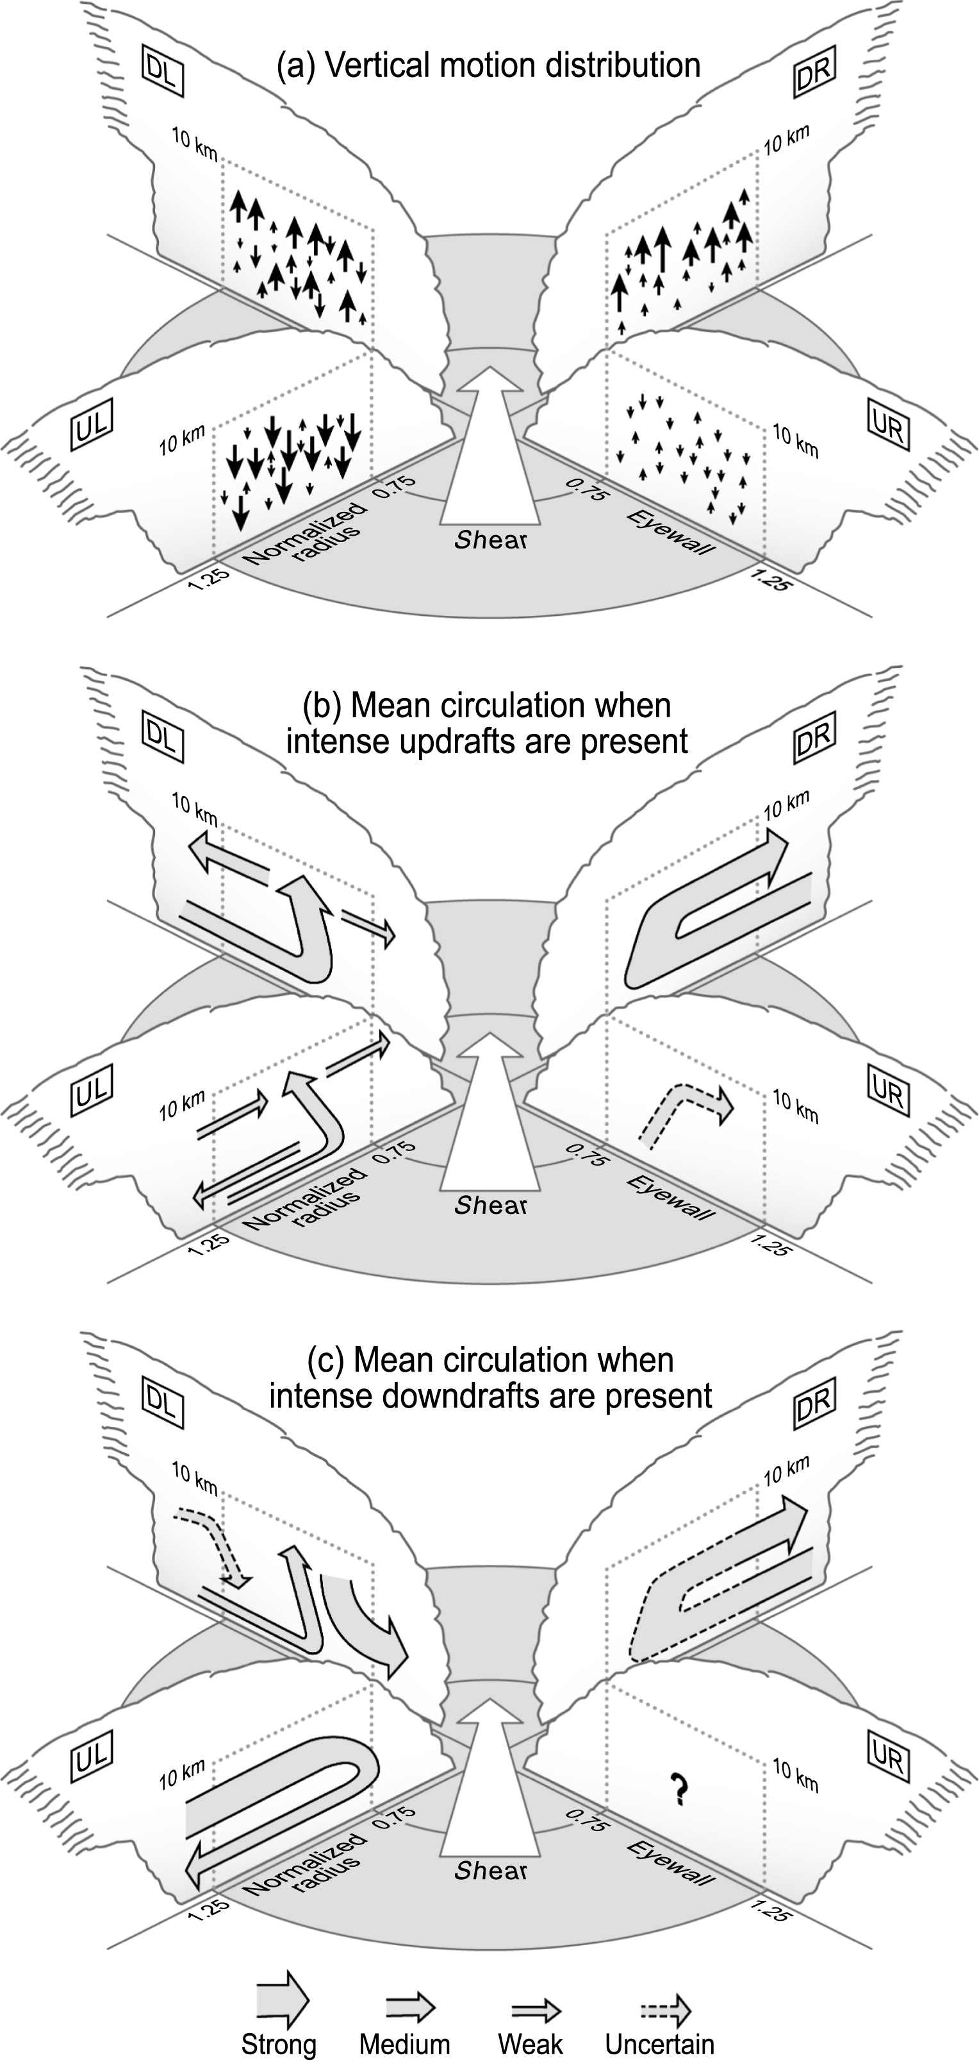
3) What controls the azimuthal location?
Vertical shear
Doppler composite of radial flow (grey, m/s), vertical velocity (black, m/s), and reflectivity (shaded, dBZ)
Schematic of distribution of vertical velocity in shear-relative quadrants
normalized radius
(Reasor et al. 2013)
(DeHart et al. 2014)
Low-level inflow deepest and strongest in the downshear right quadrant
Upper-level inflow and low-level outflow dominates upshear left
Updrafts originate DSR, mature DSL with a mix of downdrafts, mostly downdrafts USL

Slide 27
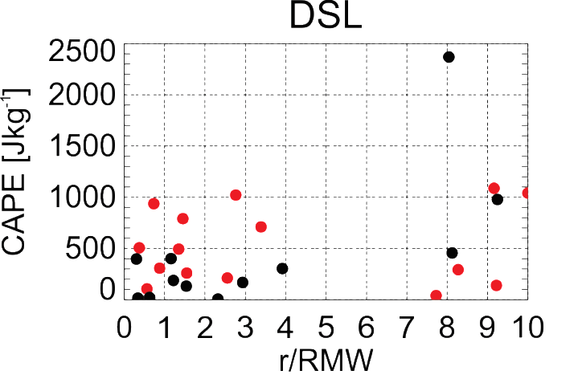
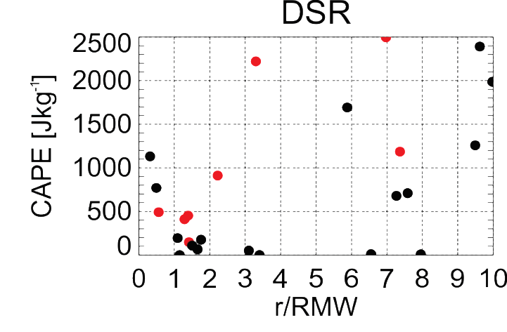
3) What controls the azimuthal location?
Thermodynamic environment of Edouard
SST (shaded, C) and SST anomaly (contour, C)
CAPE from GH sondes outside RMW
DSR
Sept 14-15 (RI)
Sept 16-17 (PEAK)
DSL
14 September
(RI)
USR
USL
DSR
USR
16 September
(SS)
DSL
USL
(Zawislak et al. 2016, In review)
14 Sept: High SST downshear, around storm
  Some points with CAPE downshear of 1000-2500 J/kg
16 Sept: Pronounced cooling USL, USR
Most CAPE values downshear < 500 J/kg

Slide 28
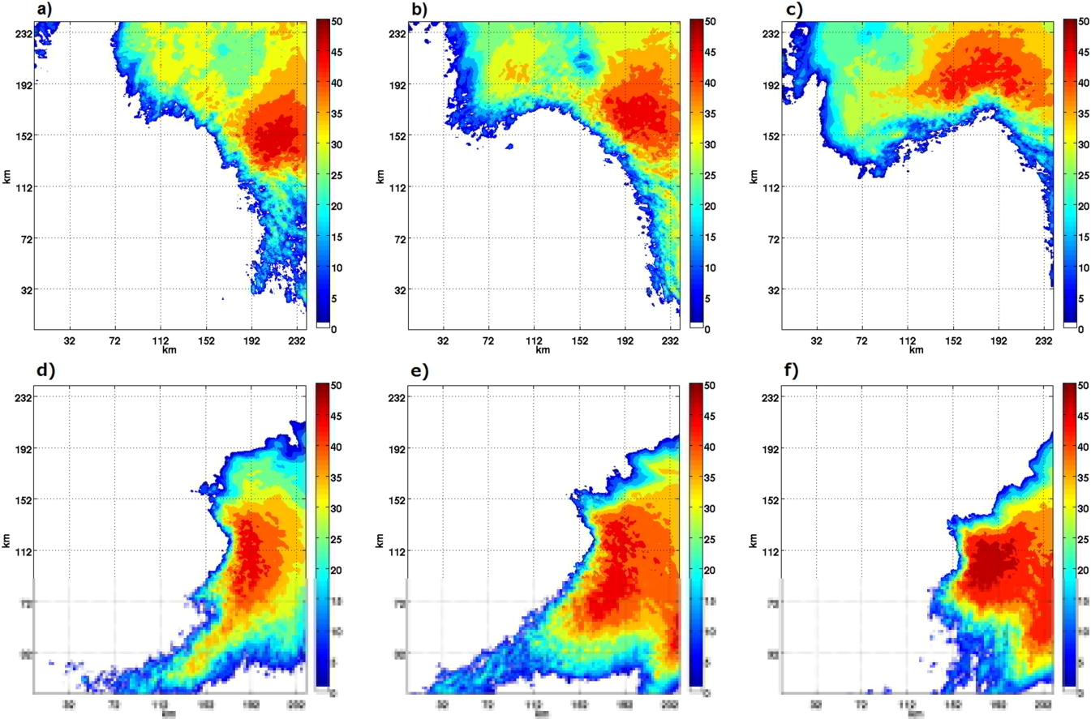
3) What controls the azimuthal location?
Helicity
700 hPa reflectivity in 0.67-km WRF simulations
Positive
TC-relative helicity
shear
24-28h
28-32h
32-36h
Negative
TC-relative helicity
24-28h
28-32h
32-36h
(Onderlinde and Nolan 2016)
Both runs had same 850-200 hPa vertical wind shear
Difference was in wind direction in intermediate levels (helicity)
Positive helicity more conducive to upshear propagation of convection

Slide 29
3) What controls the (radial, azimuthal) location?
Radial location
  PBL convergence
  updraft slope
  outer-core inertial stability
Azimuthal location
  storm motion
  vertical shear/vortex tilt
  thermodynamic environment
  helicity

Slide 30
4) Can this process be predicted (or at least nowcasted)?

Slide 31
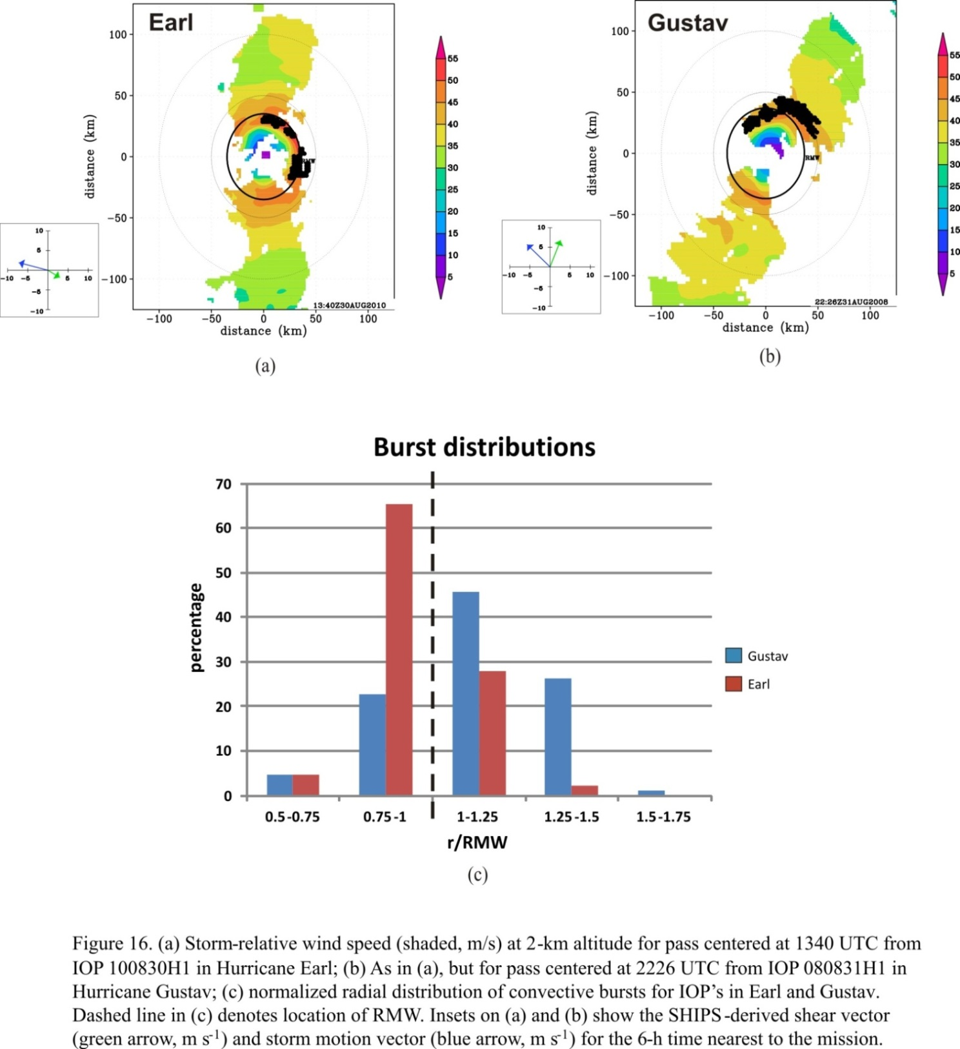

4) Can this process be predicted?
Predictability of deep convection very limited, but environmental and vortex structure (context for the deep convection) is not
Need three pieces of information: Location of deep convection, RMW, vertical shear vector – shear vector can be provided by model analyses (e.g., SHIPS)
With this information, can at least say intensification is likely to be occurring, possibly predict over next 6-12 h
With aircraft it’s easy:
Wind speed at 2 km (shaded, m/s) and convective burst locations from airborne Doppler
(RI)
(SS)
CB locations
RMW
RMW
13:40 UTC Aug 30 2010
22:26 UTC Aug 31 2008
shear
shear
motion
motion
However, aircraft only sample ~30% of TCs, and that’s in the Atlantic
What about satellites?

Slide 32
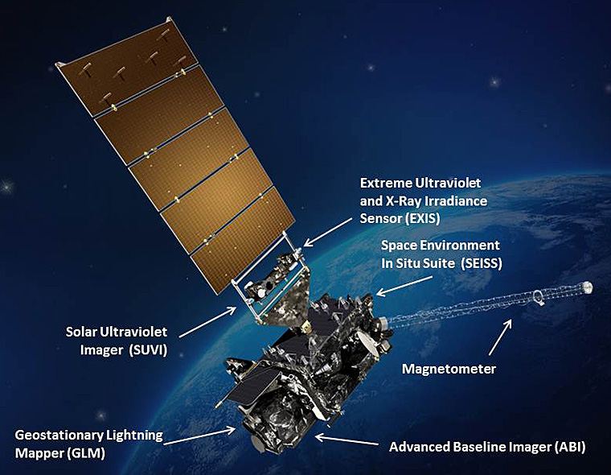
4) Can this process be predicted?
GOES-R
Geostationary Lightning Mapper providing rapid updates on IC lightning distributions

Slide 33
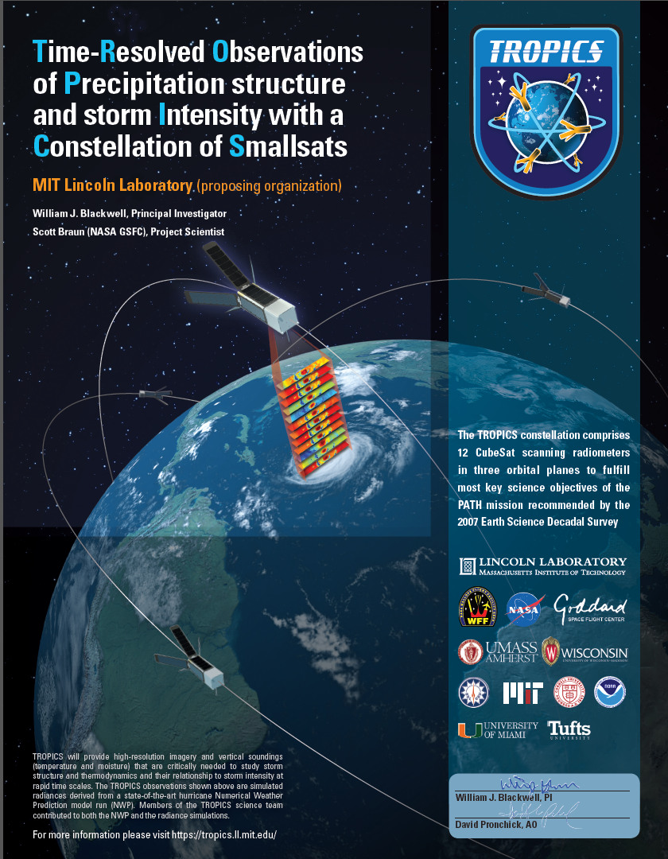
4) Can this process be predicted?
Time-Resolved Observations of Precipitation structure and storm Intensity with a Constellation of Smallsats (TROPICS)
12 Cubesats providing PMW imagery with rapid refresh rates
Median revisit time ~20 minutes

Slide 34
4) Can this process be predicted?
What about RMW?
Can be estimated when there is a clear symmetric eye using PMW (e.g., Kossin et al. 2007)
Techniques for estimating other wind radii (R64, R50, R34) using IR imagery , storm motion, and model analyses (Knaff et al. 2016)
Scatterometry can provide surface winds, but limited resolution, often with attenuation problems (CYGNSS may ameliorate this)
Still uncertainty in calculations, especially for RMW
Sensitivity of intensification to the location of deep convection relative to RMW makes this a continuing challenge

Slide 35
Summary
1) What is the importance of deep convection in TC intensification?
May play a key role, especially when considered in context of vortex structure, but uncertainties remain.
2) What is the preferred location of deep convection in TC intensification?
Radial – inside the RMW
Azimuthally – symmetric, upshear left in particular
3) What controls this location?
Radial – PBL convergence, updraft slope, inertial stability
Azimuthal – shear, thermodynamic environment, helicity
4) Can this process be predicted (or at least nowcasted)?
New satellites provide potential for identifying deep convection, RMW specification still a challenge though

Slide 36
Future Work
Evaluate and improve model ability to correctly place radial and azimuthal distributions of precipitation/deep convection (e.g., PBL inflow structure)
What about alternate modes of precipitation (e.g., shallow, moderate convection, stratiform)?
Combine aircraft, satellite, lightning networks
  Higher temporal resolution than considered here
Modeling studies
  High temporal resolution
  Thermodynamic and kinematic fields
  Trajectory calculations
Work to develop real-time capability to assess deep convection location relative to vertical shear vector, RMW
  Using aircraft data (limited availability)
  Using satellite data

Slide 37
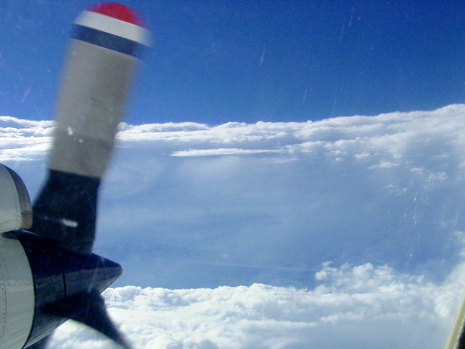
THANK YOU!

Slide 38
Extra slides

Slide 39
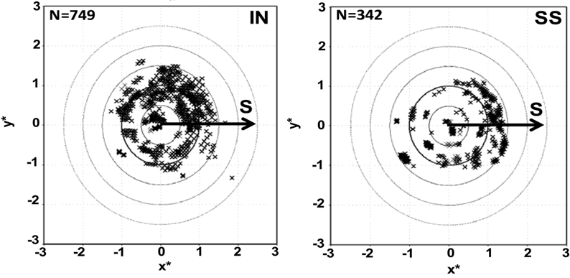
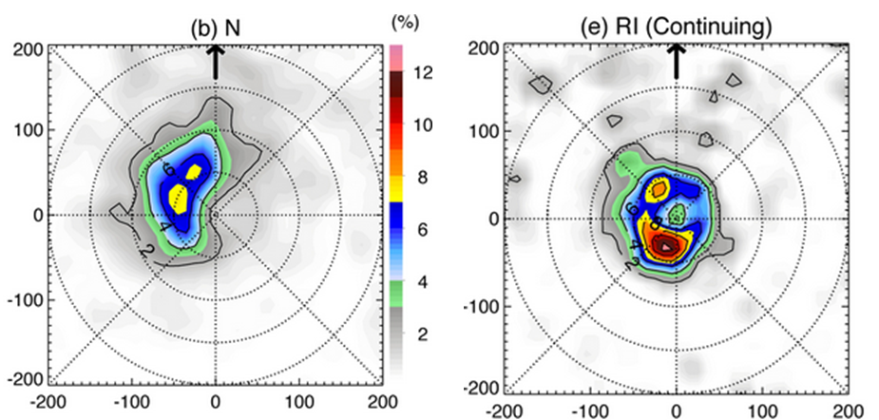
Motivation
Recent aircraft and satellite composite studies of intensifying TC’s have focused on radial and azimuthal distribution of deep convection
  Preferred radial location inside RMW
Location of convective bursts from P-3 airborne Doppler
RMW
RMW
Rogers et al. 2013
  Preferred azimuthal location downshear, upshear left
Location of percent occurrence of 10-km reflectivity > 20 dBZ from TRMM PR
RI (contin)
N
DSL
shear
DSR
shear
USL
USR
Zagrodnik and Jiang 2014

Slide 40
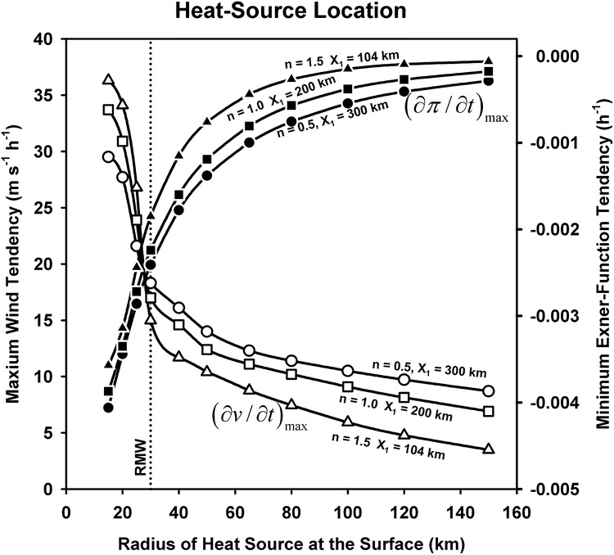
Motivation and background
Analytic studies of diabatic heating and its role in TC intensification
heating outside RMW
diabatic heating
heating inside RMW
diabatic heating
Vigh and Schubert 2009
Pendergrass and Willoughby 2009
Radial location of heating key determinant of subsequent intensity change

Slide 41
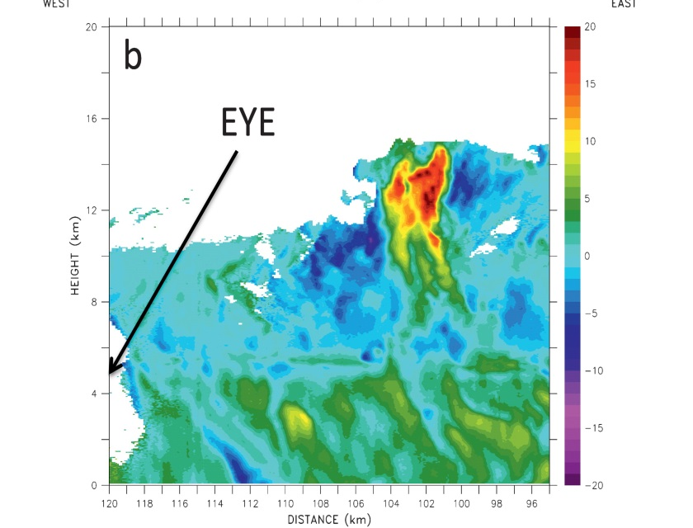


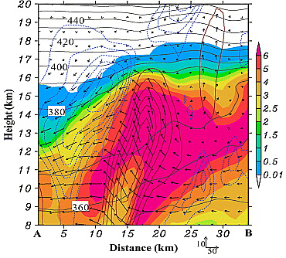

Slide 42
What is the preferred radial location?
WWLLN bursts relative to FLIGHT+ RMW and 24-h intensity change
(courtesy Stephanie Stevenson, SUNY Albany)
Intensifying TCs have lightning bursts at or inside RMW

Slide 43
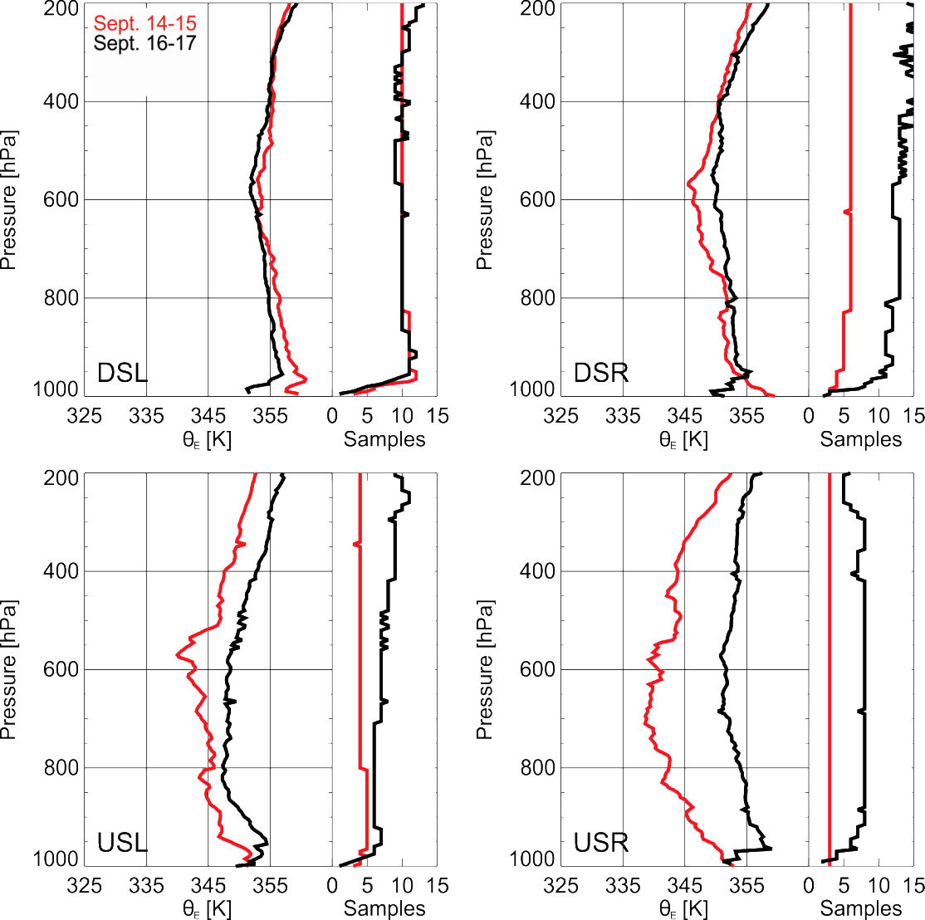
2. What governs distributions?
Shear-relative vertical profiles of θ_{e} from Global Hawk drops from 0-200 km radius
14 Sept: Low stability in lower troposphere in all quadrants
  Stabilization in PBL DSL, recovered by USR, DSR
16 Sept: Stabilization aloft, especially USL, USR
    Stabilization of PBL in all quadrants

Slide 44
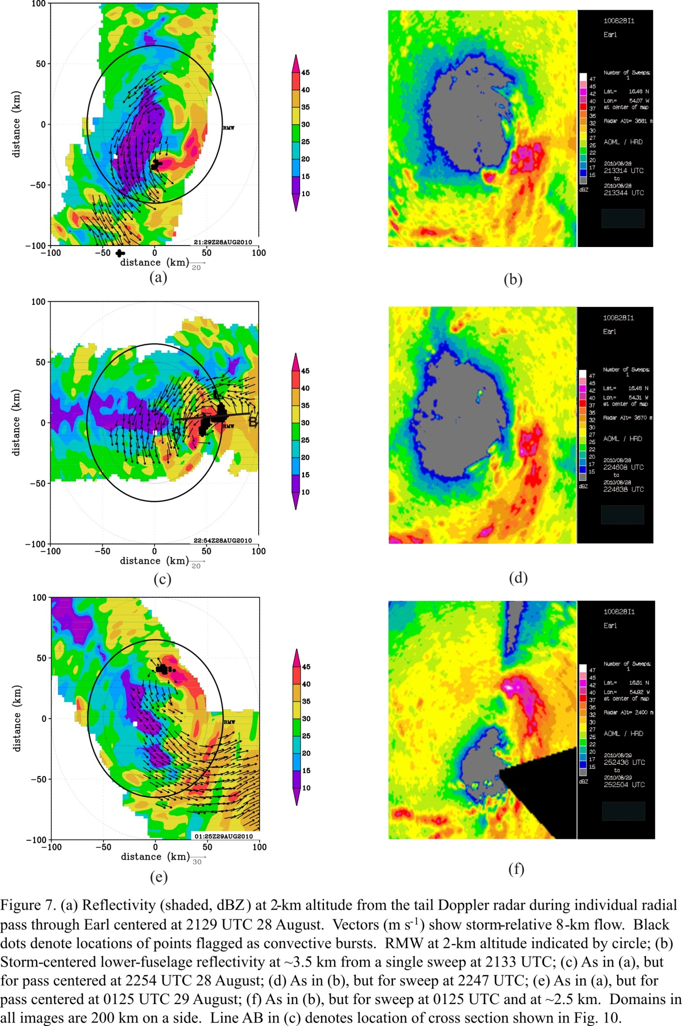

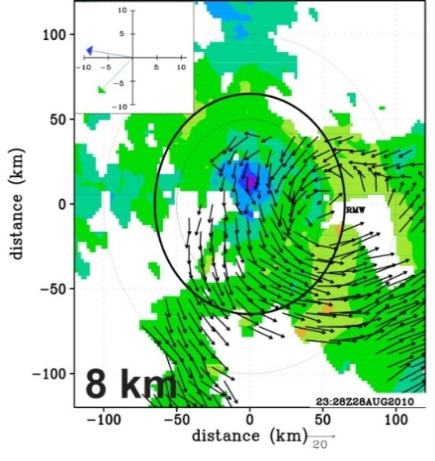


RI onset: Convective bursts and vortex alignment
Reflectivity (shaded, dBZ) from lower fuselage radar at ~ 3 km
100
47
45
50
42
40
shear
shear
shear
37
distance (km)
35
32
0
30
27
25
22
20
-50
17
15
dBZ
-100
-50
21:29 UTC Aug 28
-50
22:54 UTC Aug 28
01:25 UTC Aug 29
0
50
-100
0
50
100
-50
-100
100
distance (km)
-100
0
50
100
distance (km)
distance (km)
2-km wind speed (shaded, m s⁻¹) and 8-km wind vectors from airborne Doppler (m s⁻¹)
motion
motion
shear
shear
00 UTC Aug 29
12 UTC Aug 29
Rogers et al. 2014
Displaced circulation center during first flight
Convective bursts tracked around storm left of shear vector during first flight, inside RMW; evolution supported by lightning data (not shown)
RI began ~ 6 h after end of first flight
Vortex had aligned by time of second flight
Notes:
Circulation center at 8 km ~50 km displaced southeast of 2-km center during first mission, left of shear
Convective bursts evident inside RMW, tracks around left of shear side of storm during first mission

Slide 45
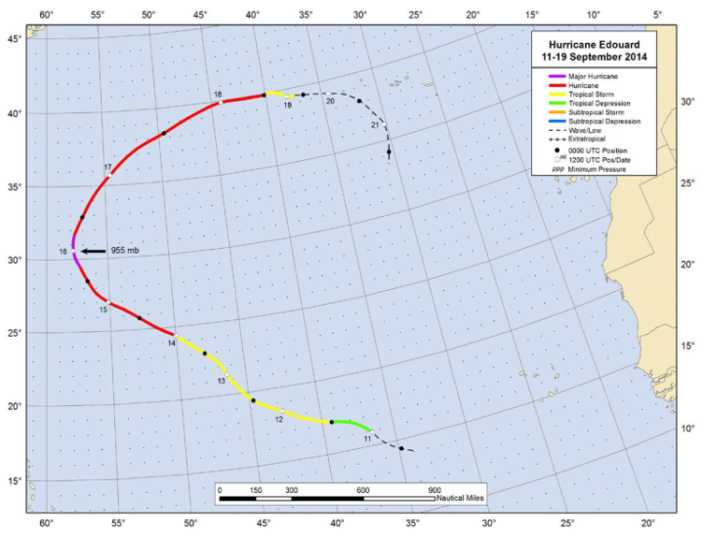
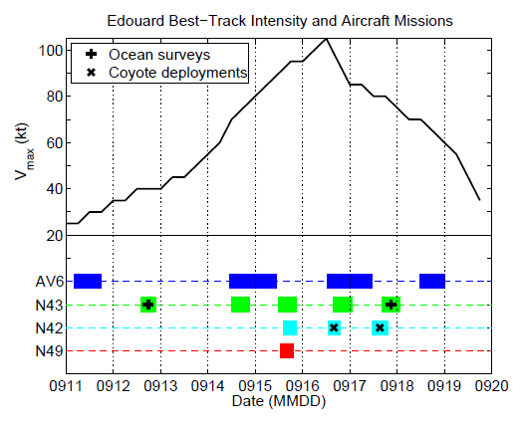
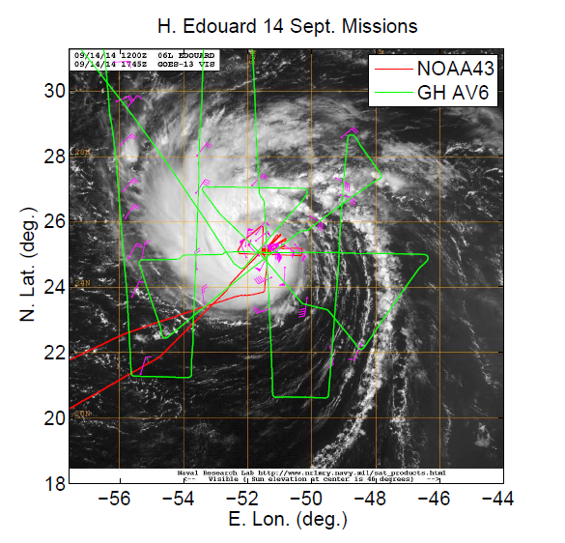
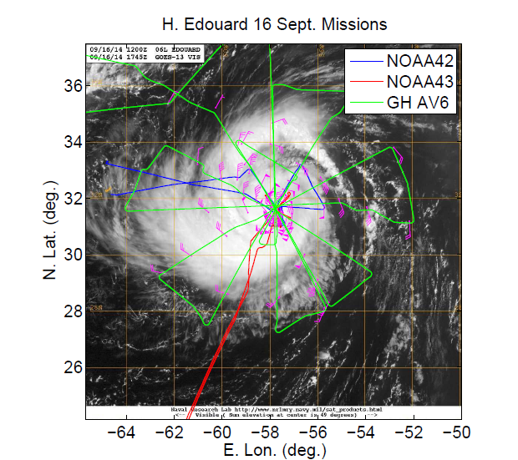
Overview of dataset
Flight tracks and times vs. intensity
16 Sept
14 Sept
Focus will be during joint N43/AV6 missions on 14 Sept and 16 Sept
Storm was intensifying during 14 Sept mission, slowly weakening during 16 Sept mission

Slide 46
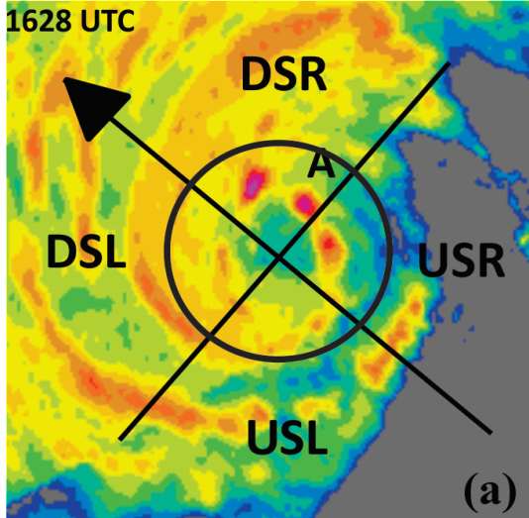






distance (km)
Distribution of precipitation
72
72
72
36
36
36
distance (km)
distance (km)
distance (km)
0
0
0
47
-36
RMW
-36
-36
45
42
40
-72
37
-72
-36
0
36
72
-72
-72
35
distance (km)
-72
-36
0
36
72
-72
-36
0
36
72
32
distance (km)
distance (km)
30
72
72
72
27
25
36
22
36
36
20
17
distance (km)
distance (km)
distance (km)
15
0
0
0
dBZ
-36
-36
-36
-72
-72
-72
-72
-36
0
36
72
-72
-36
0
36
72
-72
-36
0
36
72
distance (km)
distance (km)
distance (km)
Most of highest reflectivity concentrated on SW, S sides of storm (ranging from DSL to USL)
Individual cells seen developing on N side, translating around toward SW on 14 Sept
High reflectivity also seen on SW side during 16 Sept mission

Slide 47
Vortex structure
Wind speed (shaded, m/s) and vectors (m/s)
14 Sept
16 Sept
55
55
50
50
45
45
40
40
35
35
30
30
25
25
20
20
15
15
10
10
8 km
5
5
8 km
55
55
50
50
45
45
40
40
35
35
30
30
25
25
20
20
15
15
10
10
2 km
5
5
2 km
Very little tilt during both days
2-km RMW ~30 km for both days
Broader circulation at 2 km on 16 Sept

Slide 48
Radial distribution: PBL kinematic structures for Earl (2010) and Edouard (2014)
Earl
Edouard
Green – N42
Magenta – C130
Red – DC8
Black – GIV
Blue – N43
Green – N42
Red – GH
RMW
RMW
RMW
RMW
Similar coverage of dropsondes, especially outside the RMW, for Earl and Edouard
This was by design for the GH mission on 9/16

Slide 49


Convective structure within context of vortex structure
Radius-height quadrant averages of reflectivity (shaded, dBZ), tangential wind (contour, m/s) and M surface passing through 2-km RMW (solid) and axis of peak reflectivity (dashed) for upshear-left quadrant
14 Sept
16 Sept
dBZ
36
36
32
dBZ
32
28
28
24
M
24
M
20
20
16
16
12
12
Deep layer of high reflectivity in USL quadrant on 9/14
Inward-sloping RMW below 10 km, coincident with reflectivity axis
Significant difference in slope of dBZ and M surfaces during intensifying phase
For 16 Sept, shallower reflectivity in USL quadrant, dBZ and M surface slopes closer to each other
Similar to Doppler composite results of Hazelton et al. (2015), Earl case study of Rogers et al. (2015)

Slide 50


1. Do we see a similar distribution for deep convection?
P-3 lower fuselage (LF) images at ~2.5 km altitude
72
72
47
47
45
45
36
42
36
42
40
40
distance (km)
37
distance (km)
37
35
35
0
RMW
32
0
32
30
RMW
30
27
27
25
25
22
22
-36
20
-36
20
17
17
15
15
dBZ
dBZ
-72
72
-72
-72
-36
0
36
-72
-36
0
36
72
distance (km)
distance (km)
1746 UTC 14 September (RI)
2124 UTC 16 September (PEAK)
Precipitation generally DSL at and inside RMW on both days
More azimuthal coverage of precipitation on 14 September
More precipitation inside RMW on 14 September

Slide 51




1. Do we see a similar distribution for deep convection?
Echo tops and updraft strength from airborne Doppler
Height (km) of 20-dBZ echo tops
Peak vertical velocity (m/s) in 8-16 km layer
100
100
DSR
DSR
8
50
16
50
5
14
3
distance (km)
DSL
12
distance (km)
DSL
2
1503 UTC
14 September
(RI)
0
10
0
1
USR
USR
0.5
8
-0.5
6
-1
-50
USL
4
-50
USL
-2
2
-3
-5
-100
-8
-100
-50
0
50
100
-100
-50
0
50
100
-100
distance (km)
distance (km)
100
100
DSR
DSR
8
50
16
50
5
distance (km)
14
3
1946 UTC
16 September
(PEAK)
USR
12
distance (km)
USR
2
0
10
0
1
8
0.5
DSL
6
DSL
-0.5
4
-1
-50
USL
2
-50
USL
-2
-3
-5
-100
-100
-8
-100
-50
0
50
100
-100
-50
0
50
100
distance (km)
distance (km)
14 Sept: Deep convection (echo tops > 16 km, updrafts > 7 m/s) on SW side (DSL, USL)
Strong updrafts and high echo tops generally at and inside 2-km RMW
16 Sept: Very small area of echo tops > 10 km, nothing reaching 12 km

Slide 52
Azimuthal Variation in Burst Structure and Intensity Change
97% 95% 98% 97% 95%
One-sided t-test significance level
Error bars are standard error
Intensifying storms have stronger updrafts, at a higher altitude, with higher echo tops in the upshear left quadrant compared with steady-state storms

Slide 53


3. What controls the location? PBL convergence
Low-level kinematic fields in DSR quadrant for Edouard
Tangential (contour, m/s) and radial flow (shaded, m/s)
Vertical velocity (contour, m/s) and divergence (shaded, x10⁻³ s⁻¹)
4
4
3
4
5
3
3
3
height (km)
2
height (km)
2
14 September
(RI)
1
1
2
0.5
2
0.5
0
-0.5
-0.5
-1
1
-1
-2
-2
1
-3
-3
-5
-4
0
10
20
30
40
50
60
70
80
90
0
10
20
30
40
50
60
70
80
90
radius (km)
radius (km)
4
4
3
4
3
5
height (km)
3
height (km)
3
2
2
1
1
16 September
(SS)
2
0.5
2
0.5
0
-0.5
-0.5
-1
1
-1
1
-2
-2
-3
-3
-5
-4
0
10
20
30
40
50
60
70
80
90
0
10
20
30
40
50
60
70
80
90
radius (km)
radius (km)
14 Sept: Inflow penetrates further inward, inside RMW
PBL convergence, updrafts maximized inside RMW
16 Sept: Inflow, convergence, updrafts further outward at and outside RMW

Slide 54


3. Consequences for Intensity Change?
Vertical velocity and inertial stability in DSL, USL quadrants
Vertical velocity (shaded, m/s) and inertial stability (contour, x 10⁻⁷ s⁻²)
18
16
14
12
2.5
height (km)
2
14 September
(RI)
10
1.5
8
1
0.5
6
0
4
-0.5
-1
2
90
80
70
60
50
40
30
20
10
10
20
30
40
50
60
70
80
90
radius (km)
radius (km)
18
16
14
2.5
height (km)
12
2
16 September
(PEAK)
10
1.5
8
1
0.5
6
0
4
-0.5
-1
2
90
80
70
60
50
40
30
20
10
10
20
30
40
50
60
70
80
90
radius (km)
radius (km)
14 Sept: Strong upper-level updrafts in both quadrants, coincident with high I
16 Sept: Strong upper-level updrafts DSL, weak USL, in weaker-I environment

Slide 55


3. What controls the location? PBL convergence
Comparison of HWRF composites using strong and weak PBL vertical mixing
Low-level divergence
strong mixing
Vertical velocity (weak - strong)
weak mixing
Weak mixing (closer to observations):
  better HWRF RI forecasts
  stronger PBL convergence, closer to center
  stronger updrafts inside RMW

Slide 56

3. What controls the location? Updraft slope
Downshear vertical velocity (shaded, m s⁻¹) and tangential wind (contour, m s⁻¹)
12
12
11
peak w
(RI)
11
(SS)
10
10
peak w
9
M surface
2.4
9
M surface
2.4
8
2
8
2
7
1.6
7
1.6
height (km)
1.2
height (km)
1.2
6
0.8
6
0.8
5
0.4
5
0.4
4
0
4
0
3
-0.4
3
-0.4
2
-0.8
2
-0.8
1
12 UTC Aug 30 2010
1
00 UTC Sep 1 2008
0
25
50
75
100
125
0
25
50
75
100
125
radius (km)
radius (km)
Updraft core originates inside RMW for both cases
Slope of updraft core departs from M surface for Earl, parallels M surface for Gustav
Peak heating inside local RMW for Earl, outside for Gustav
Notes:
Updraft core originates from PBL inside RMW for both cases
Slope of updraft core departs signficantly from M surface for Earl, closer to M surface for Gustav
Updraft core inside local RMW, in high inertial stability regime for Earl, outside local RMW for Gustav
Relationship consistent with composite slope results from Hazelton et al. (17C.7, Fri. 3:00 pm talk)

Slide 57

USL eyewall w CFAD from Earl (2010)

Slide 58


3. What controls the azimuthal location?
Vertical shear
Variation of radial flow around Edouard outside RMW
Azimuth-height plots of storm-relative radial flow (shaded, m/s) in 40-60 km radial band
outflow
inflow
outflow
inflow
inflow
(Rogers et al. 2016, In review)
Clear wavenumber-1 pattern consistent with shear-modulated secondary circulation
Low-level inflow from NE around to W sides (DSR, DSL)

