Slide 1
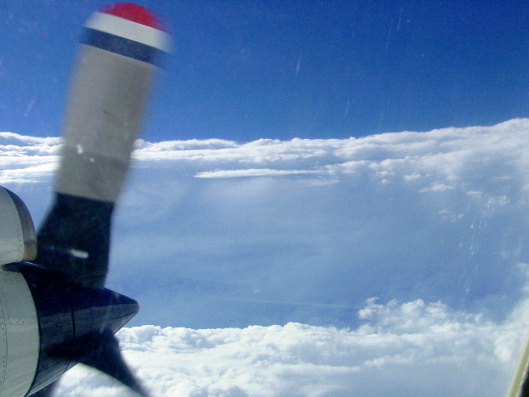


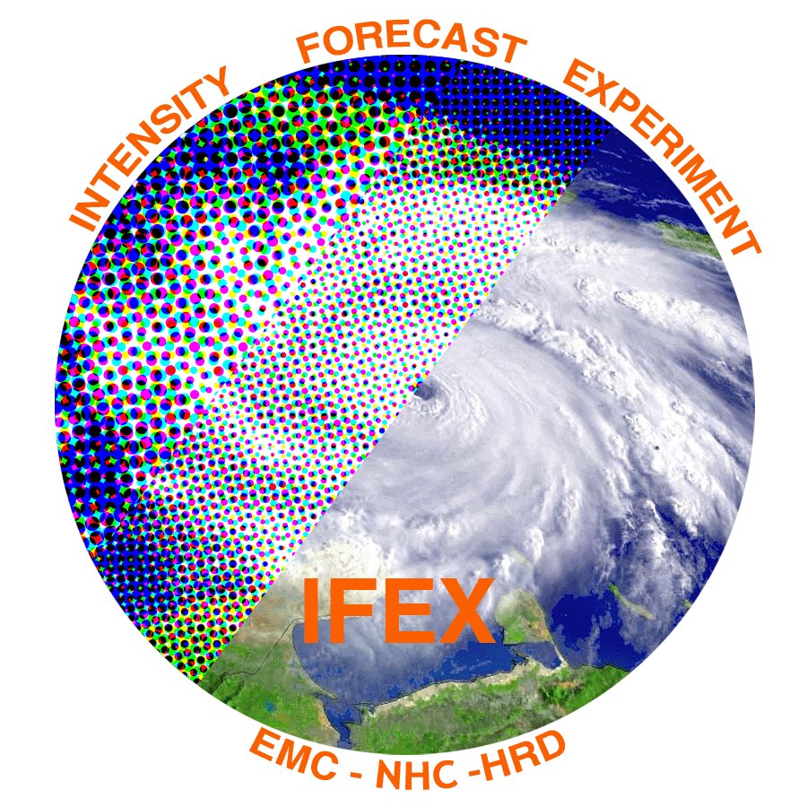

Multiscale kinematic structure and evolution of Hurricane Edouard from 14-16 September using Global Hawk dropsondes and P-3 airborne Doppler radar
Robert Rogers¹, Jun Zhang^{1,2}, Jon Zawislak³, Eric Uhlhorn¹
¹NOAA/AOML Hurricane Research Division
²Cooperative Institute for Marine and Atmospheric Studies, University of Miami
³Florida International University
(Acknowledgements: Paul Reasor, Ed Zipser, Trey Alvey)

Slide 2
Motivation
Recent aircraft and modeling studies of intensifying TC’s have focused on radial and azimuthal distribution of deep convection
  Preferred radial location inside RMW
  Preferred azimuthal location downshear, upshear left
Mechanisms proposed for these distributions
  Radial profiles of PBL convergence
  Outer core lower-tropospheric inertial stability profiles
  Buoyancy distributions (both radial and azimuthal)
  Slope differences between diabatic heating, M surfaces
Observations are limited to investigate these issues
HS3 provided this information for Edouard (2014), which was sampled by the GH and P-3’s during intensifying and slowly-weakening phases
What can the observations in Edouard tell us about these mechanisms?

Slide 3
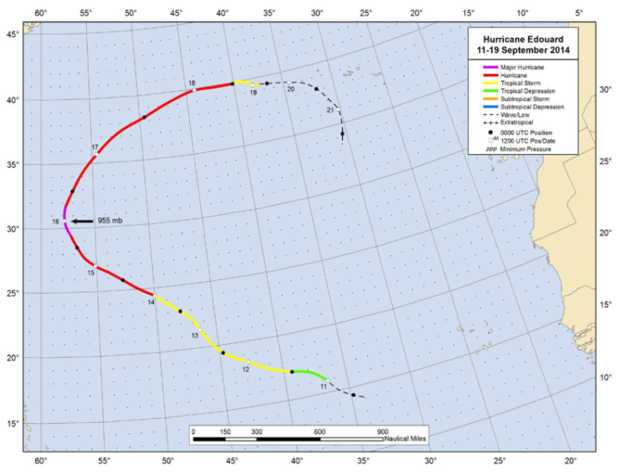
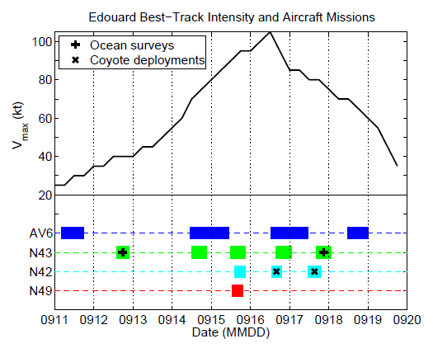
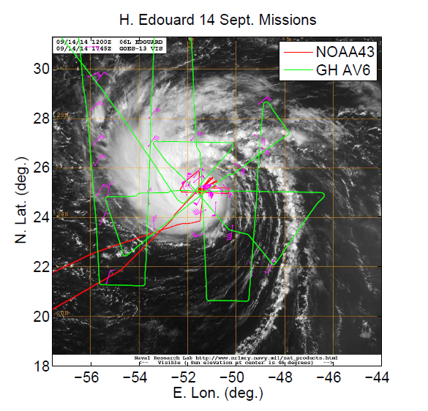
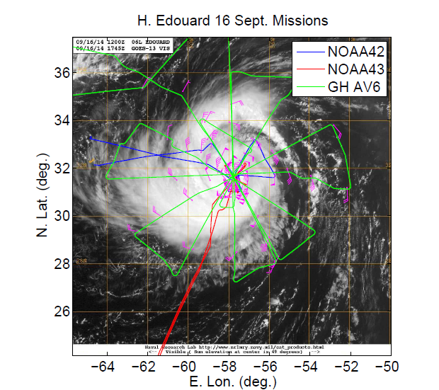
Overview of dataset
Flight tracks and times vs. intensity
16 Sept
14 Sept
Focus will be during joint N43/AV6 missions on 14 Sept and 16 Sept
Storm was intensifying during 14 Sept mission, slowly weakening during 16 Sept mission

Slide 4
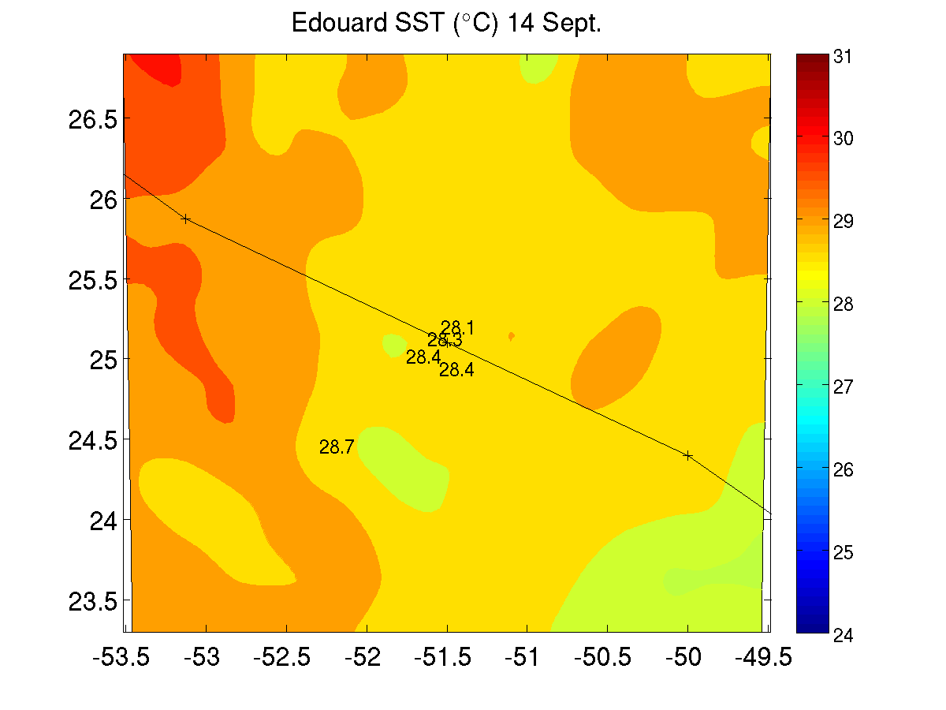
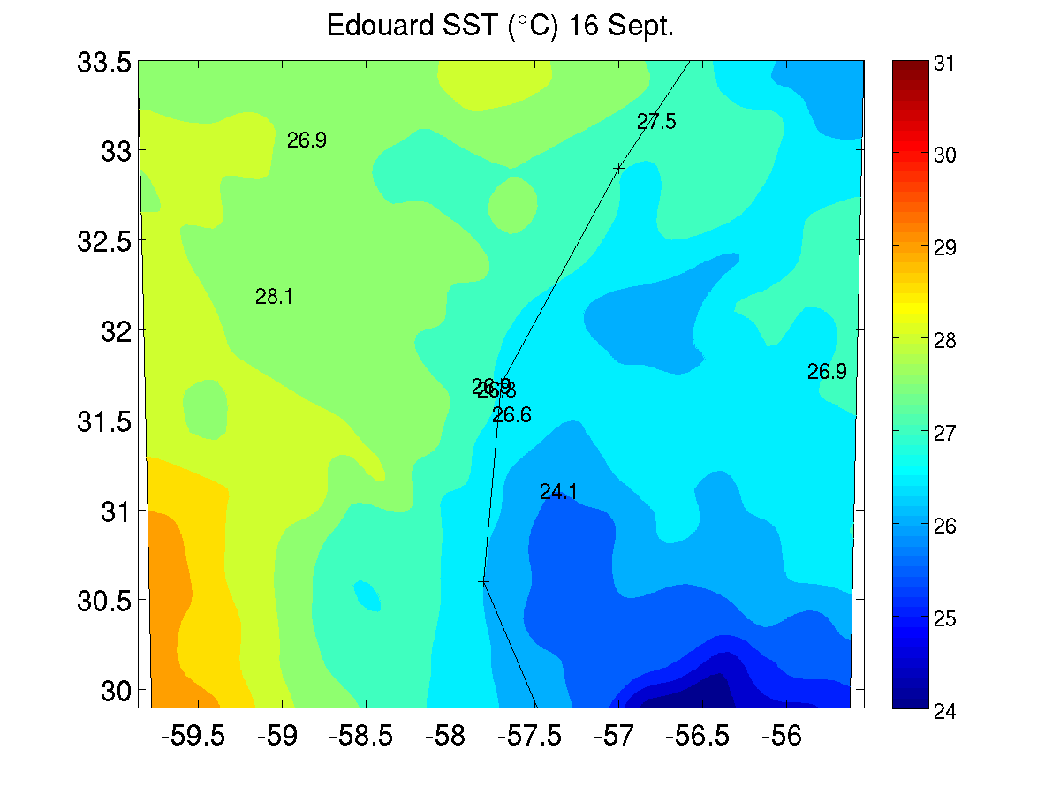
Environmental conditions
14 Sept
16 Sept
m/s
m/s
shear
motion
Storm motion and SHIPS shear vectors (m/s)
m/s
m/s
Storm-centered SST (⁰C) from MW and AXBT’s
Moderate SE shear during 14 Sept, weak E shear during 16 Sept
Motion nearly parallel during 14 Sept, perpendicular toward NNE during 16 Sept
SST > 28 C in front of storm on 14 Sept, cold wake effects on 16 Sept right of track

Slide 5
Vortex structure
Wind speed (shaded, m/s) and vectors (m/s)
14 Sept
16 Sept
55
55
50
50
45
45
40
40
35
35
30
30
25
25
20
20
15
15
10
10
8 km
5
5
8 km
55
55
50
50
45
45
40
40
35
35
30
30
25
25
20
20
15
15
10
10
2 km
5
5
2 km
Very little tilt during both days
2-km RMW ~30 km for both days
Broader circulation at 2 km on 16 Sept

Slide 6
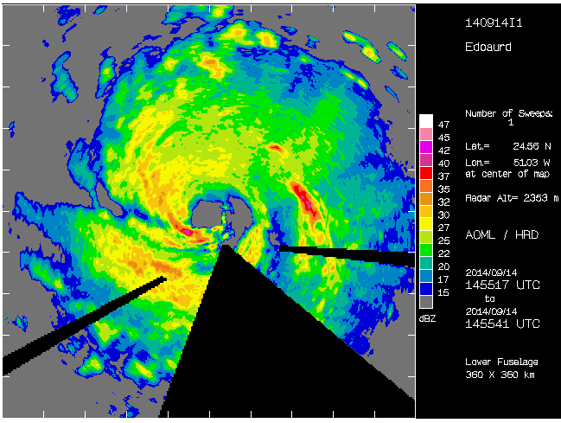
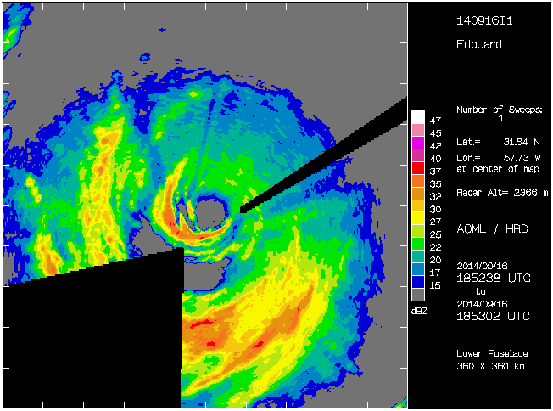
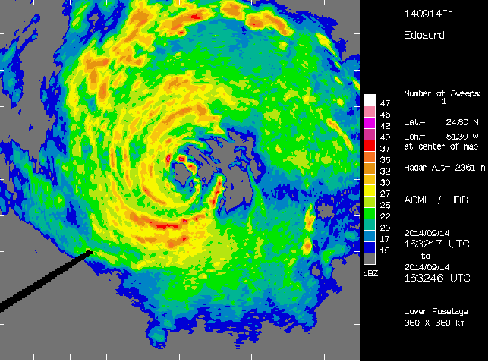
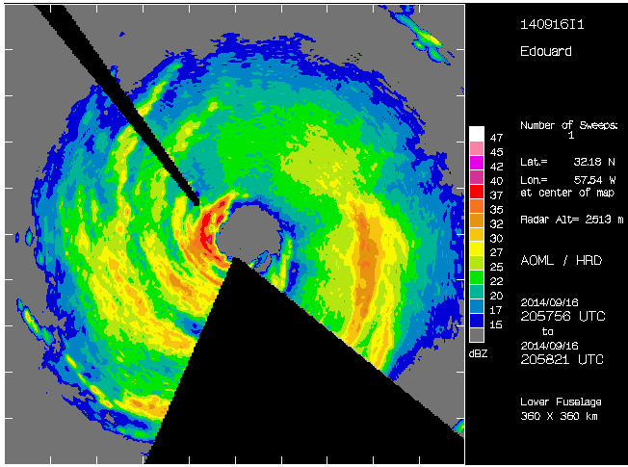
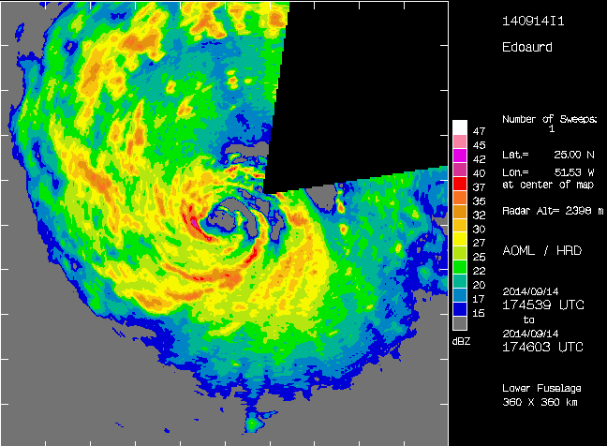
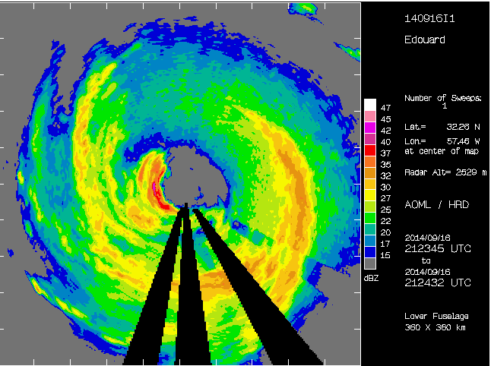
Reflectivity structure and evolution
Lower-fuselage radar images (shaded, dBZ) during 14 Sept and 16 Sept missions
14 Sept
16 Sept
1455 UTC
1852 UTC
1632 UTC
2057 UTC
new cells
1745 UTC
2123 UTC
DSR
DSR
DSL
USR
USR
DSL
USL
USL
Most of highest reflectivity concentrated on SW, S sides of storm (ranging from DSL to USL), similar to DeHart et al. (2014)
Individual cells seen developing on N side, translating around toward SW on 14 Sept
High reflectivity also seen on SW side during 16 Sept mission

Slide 7
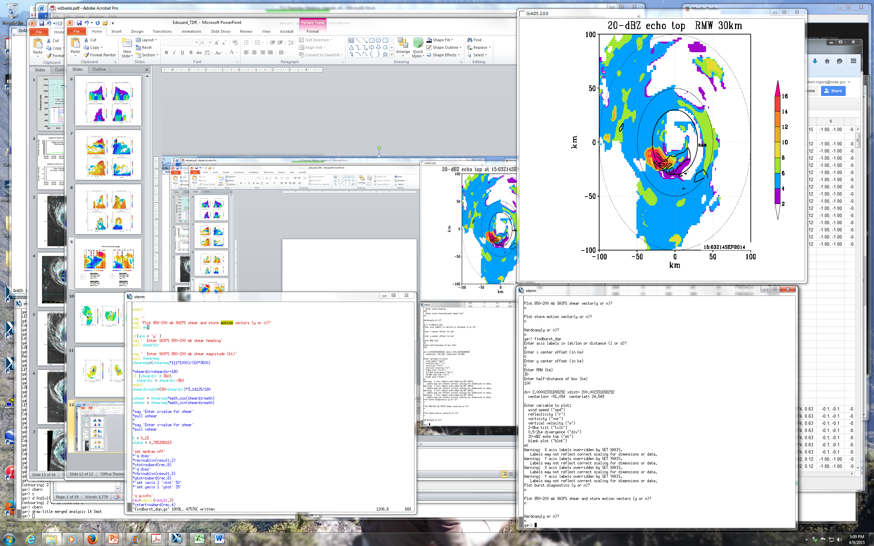
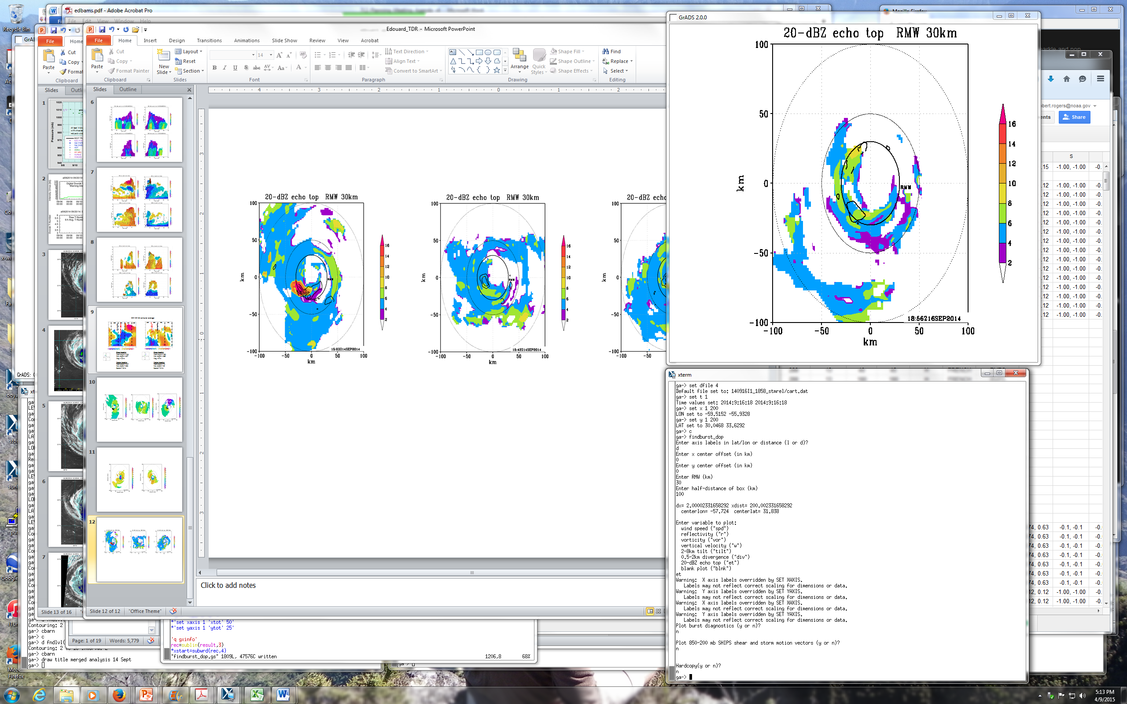
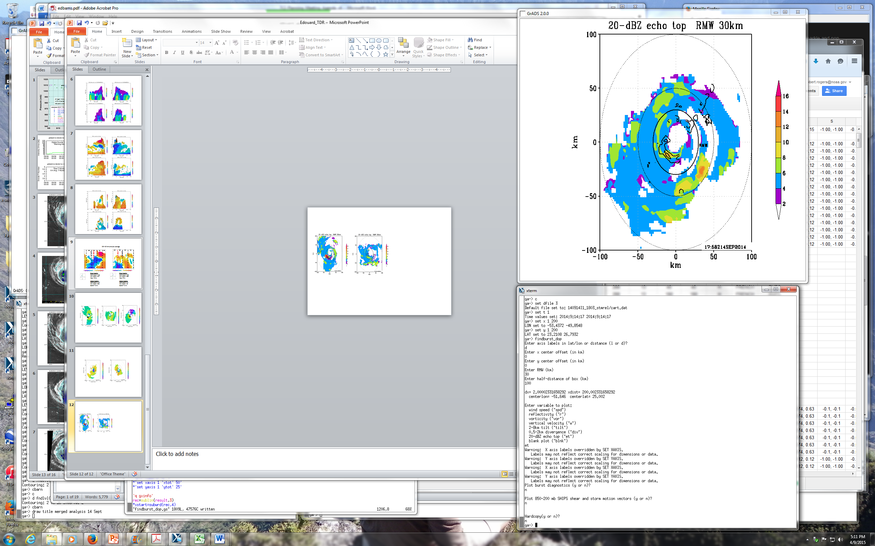
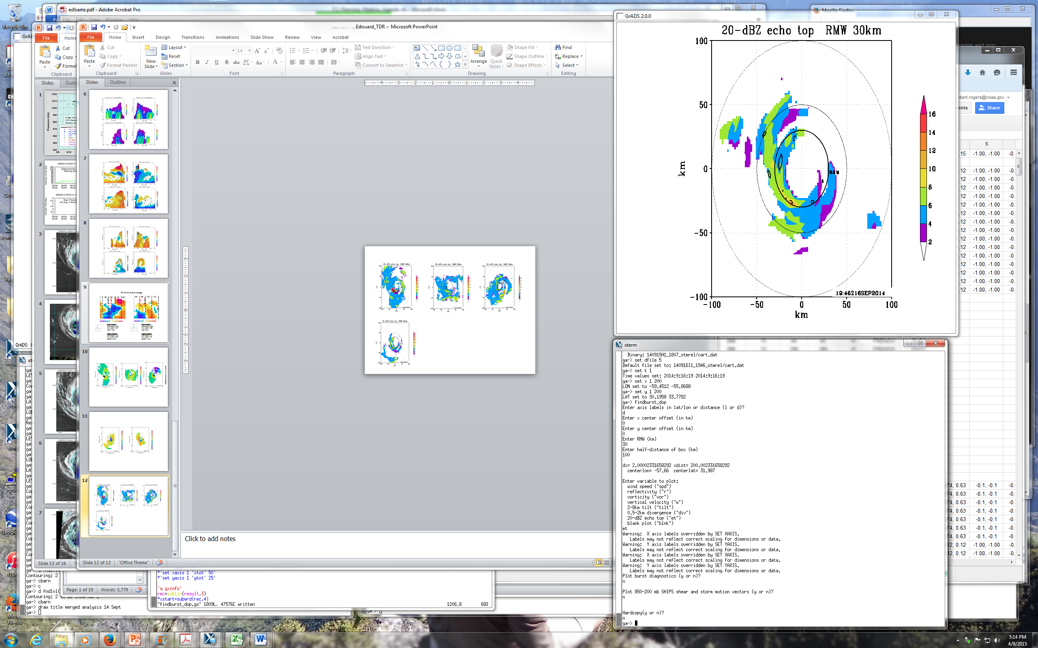
Convective structure
Echo tops (shaded, km) and peak 8-14 km updrafts (contour, 3, 5, 7 m/s)
14 Sept
16 Sept
16
16
14
14
RMW
12
RMW
12
10
10
8
8
6
6
deep convection
4
4
2
2
14 Sept
16 Sept
16
16
14
14
RMW
12
RMW
12
10
10
8
8
DSR
6
DSR
6
DSL
4
USR
4
USR
2
2
DSL
USL
USL
Deep convection (echo tops > 16 km, updrafts > 7 m/s) seen during 14 Sept on SW side (DSL, USL)
Lower echo tops, but still > 10-12 km, seen 2.5 h later in similar location
Strong updrafts and high tops seen generally inside 2-km RMW on 14 Sept
By 16 Sept very small area of echo tops > 10 km, nothing reaching 12 km
Tallest echoes on SW side, some occurring outside 2-km RMW

Slide 8
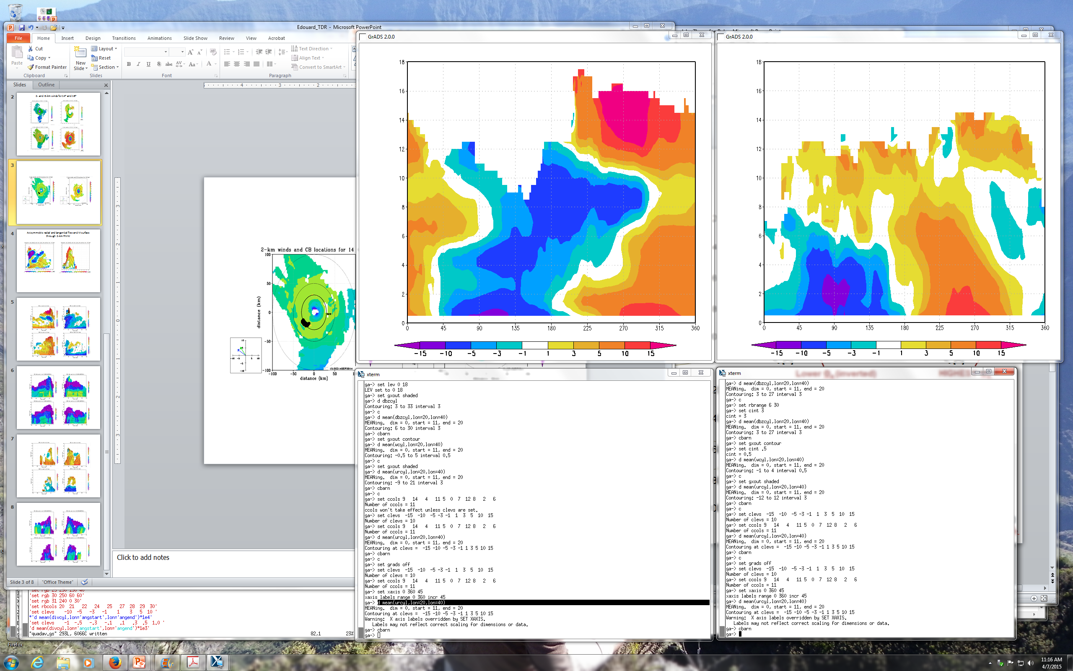
Azimuthal distribution: Radial flow at the eyewall
Azimuth-height plots of storm-relative radial flow (shaded, m/s) surrounding eyewall (20-40 km annular average)
14 Sept
16 Sept
18
DSR
DSL
USL
USR
18
USR
DSR
DSL
USL
16
shear vector
motion vector
16
motion vector
shear vector
14
14
12
12
height (km)
10
height (km)
10
8
8
6
6
4
4
2
2
0
0
North
West
South
East
East
North
West
South
East
East
-15
-10
-5
-3
-1
1
3
5
10
15
-15
-10
-5
-3
-1
1
3
5
10
15
Clear wavenumber-1 pattern seen in lower-tropospheric radial flow
Inflow from NE around to W sides (DSR, DSL); maximized on N side during both flights
Relationship with shear consistent with Doppler composites of Reasor et al. (2013) and SFMR/FL composites of Zhang and Uhlhorn (2012)

Slide 9
Azimuthal distribution: Shear-relative thermodynamic profiles
Shear-relative vertical profiles of theta-e for GH drops from 0-200 km radius
DSR
DSL
USR
USL
shear
vector
DSR
USR
DSL
USL
High low-level theta-e DSR, DSL, decrease in thetae with height below 600 hPa in all quadrants on 14 Sept
Increase in theta-e and stabilization aloft, especially USL, USR, on 16 Sept
Stabilization of PBL on 16 Sept, strongest in USL, USR, weakest in DSL, DSR (consistent with Molinari et al. 2013, Zhang et al. 2013)

Slide 10
Radial distribution: PBL kinematic structures for Earl (2010) and Edouard (2014)
Earl
Edouard
Green – N42
Magenta – C130
Red – DC8
Black – GIV
Blue – N43
Green – N42
Red – GH
RMW
RMW
RMW
RMW
Similar coverage of dropsondes, especially outside the RMW, for Earl and Edouard
This was by design for the GH mission on 9/16

Slide 11
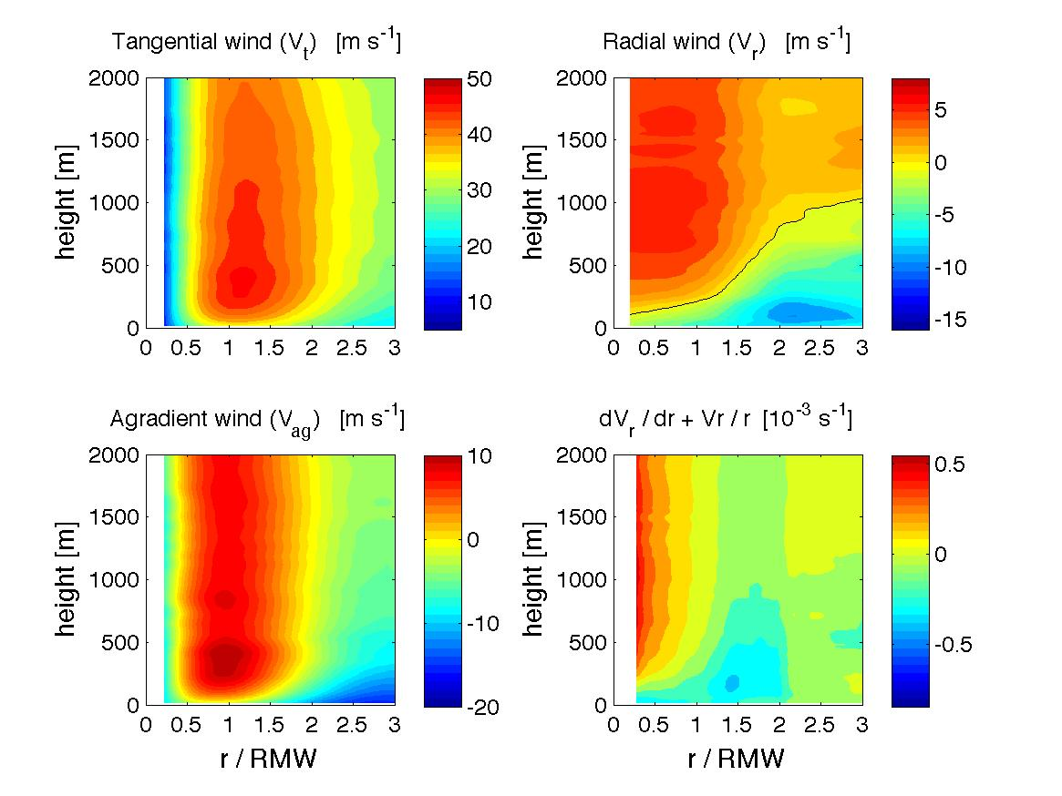
Radial distribution: PBL kinematic structures for Earl (2010) and Edouard (2014)
Earl
r/RMW
r/RMW
r/RMW
Rogers et al. (2015)
Edouard
r/RMW
r/RMW
r/RMW
Both storms showed supergradient flow, Edouard had a shallower, weaker inflow than Earl
Radial location of peak convergence for Edouard at ~1.5 x RMW, for Earl peak was at ~0.75 x RMW – could that explain difference in radial location of tallest echoes for Edouard and Earl?

Slide 12
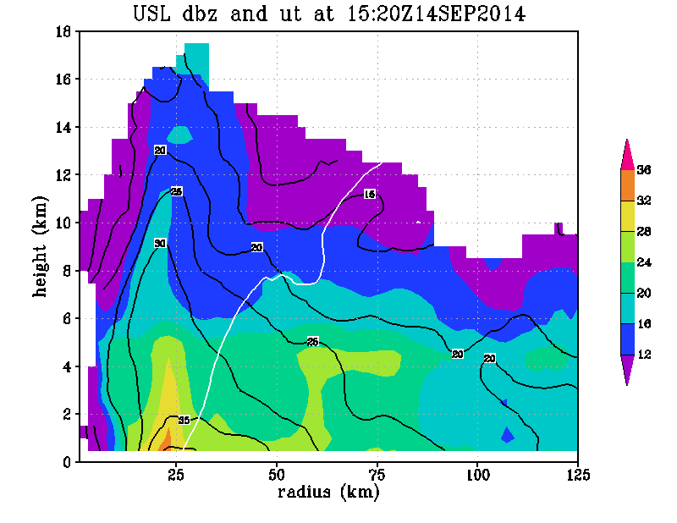
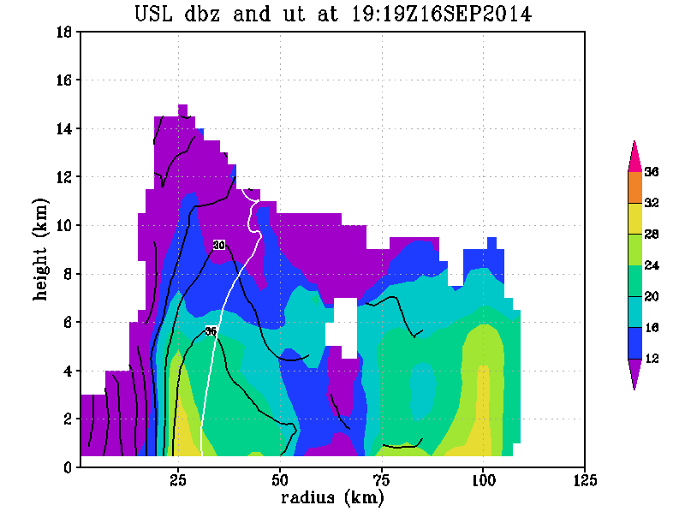
Convective structure within context of vortex structure
Radius-height quadrant averages of reflectivity (shaded, dBZ), tangential wind (contour, m/s) and M surface passing through 2-km RMW (solid) and axis of peak reflectivity (dashed) for upshear-left quadrant
14 Sept
16 Sept
dBZ
36
36
32
dBZ
32
28
28
24
M
24
M
20
20
16
16
12
12
Deep layer of high reflectivity in USL quadrant on 9/14
Inward-sloping RMW below 10 km, coincident with reflectivity axis
Significant difference in slope of dBZ and M surfaces during intensifying phase
For 16 Sept, shallower reflectivity in USL quadrant, dBZ and M surface slopes closer to each other
Similar to Doppler composite results of Hazelton et al. (2015), Earl case study of Rogers et al. (2015)

Slide 13
Summary
Edouard provided a good case for comparing intensifying vs. non-intensifying structure
Deep convection > 16 km located on DSL, USL side during intensifying stage, nothing above 12 km during weakening
Eyewall convergence maximized on north side both days, generally DSR, supporting observed distribution of precipitation
Unstable profiles of thetae aloft 14 Sept, stabilized as warming aloft occurred USL 16 Sept
Stabilization of PBL maximized USL, USR on 16 Sept, probably due to both downdrafts and cooler waters
PBL convergence outside RMW for Edouard, in contrast to Earl
Significant difference in slope of dBZ, M surfaces USL for 14 Sept, nearly parallel for 16 Sept
Future work
Continue analysis of factors governing radial and azimuthal distribution of deep convection
  azimuthal variation of updraft, downdraft statistics (e.g., shear-relative CFADs)
  examine shallow, moderate preciptiation too
Compare angular momentum budgets in PBL, above PBL for Edouard, Earl
Incorporate additional datasets (both from Edouard and other cases)
  additional thermodynamic, cloud information (e.g., CPL, S-HIS, HAMSR)
  additional kinematic profiles (e.g., HIWRAP)

Slide 14
Extra slides

Slide 15
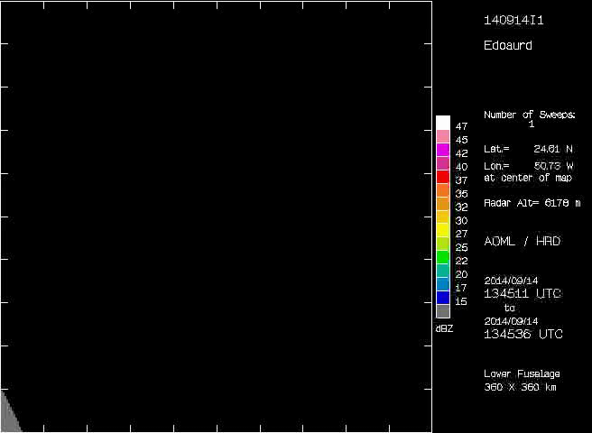
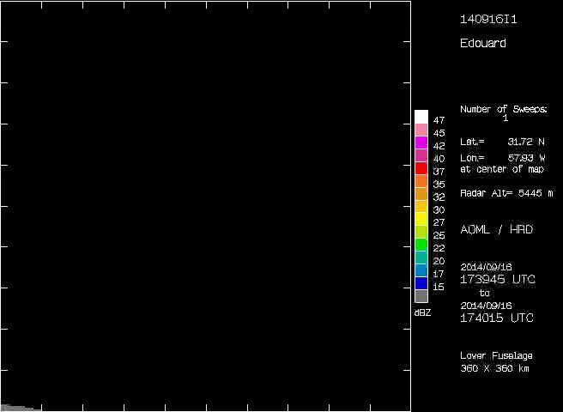
Reflectivity structure and evolution
Storm-centered lower-fuselage radar animations (shaded, dBZ) during 14 Sept and 16 Sept
*On-station altitude for aircraft is ~2.5 – 3 km
14 Sept
16 Sept
DSR
DSR
shear schematic
DSL
USR
USR
DSL
USL
USL
Most of highest reflectivity concentrated on SW, S sides of storm (ranging from DSL to USL)
Individual cells seen developing on N side, translating around toward SW on 14 Sept
High reflectivity also seen on SW side during 16 Sept mission

Slide 16
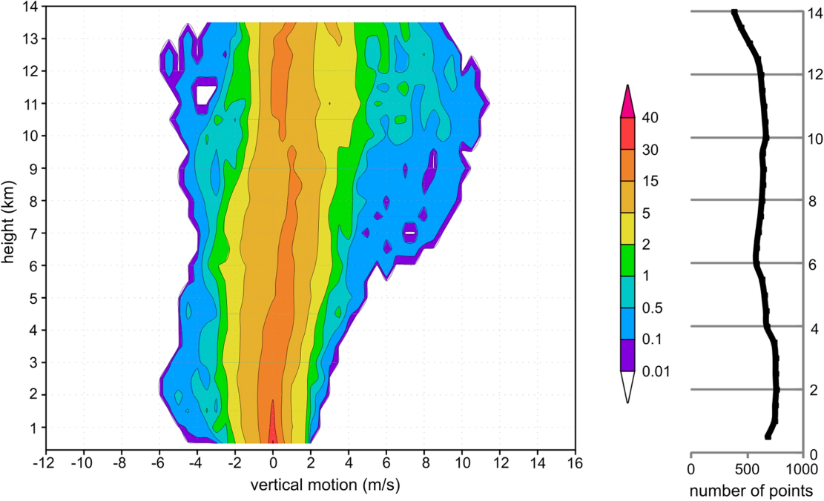
USL eyewall w CFAD from Earl (2010)

Slide 17
Shear-relative radial profiles of near-surface theta-e

Slide 18
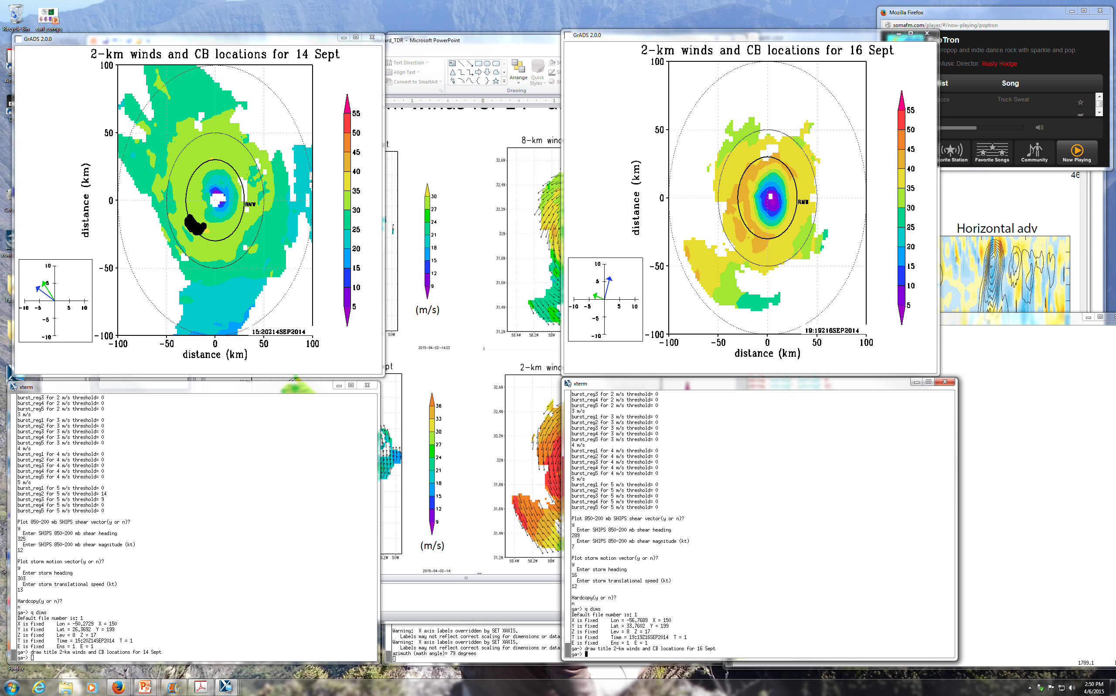
Azimuth-height plots of storm-relative radial flow surrounding eyewall (20-40 km annular average)
DSR
DSL
USL
USR
USR
DSR
DSL
USL
shear vector
motion vector
motion vector
shear vector
height (km)
height (km)
E
N
W
S
E
E
N
W
S
E
Shear heading
Math angle – 123
Nav angle – 327
Mag – 13 kt
Motion heading
Math angle – 147
Nav angle – 303
Speed – 13 kt
Shear heading
Math angle – 161
Nav angle – 289
Mag – 5 kt
Motion heading
Math angle – 74
Nav angle – 16
Speed – 12 kt

