Slide 1
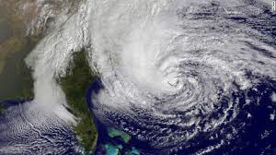
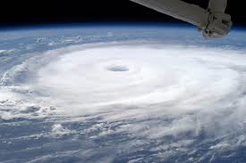


Dynamics and predictability of tropical cyclones evaluated through convection-permitting ensemble analysis and forecasts with airborne radar and sounding observations
Erin Munsell
The Pennsylvania State University
HRD Seminar – November 16th, 2015
In collaboration with Fuqing Zhang (Penn State), Jason Sippel (EMC/IMSG) and Scott Braun (NASA GSFC)

Slide 2
Explore the predictability and uncertainty associated with ensemble track and intensity forecasts generated by the PSU WRF-EnKF Real-time Atlantic Hurricane Forecast System
Ensemble sensitivity, correlation analyses and compositing techniques
Cases Examined:
Tropical Storm Erika (2009)
  Munsell, Zhang, and Stern 2013, JAS
Hurricane Sandy (2012)
  Munsell and Zhang 2014, JAMES
Hurricane Nadine (2012)
  Munsell, Sippel, Braun, Weng, and Zhang 2015, MWR
Hurricane Edouard (2014)
  Munsell, Zhang, Sippel, and Braun, In internal review

Slide 3
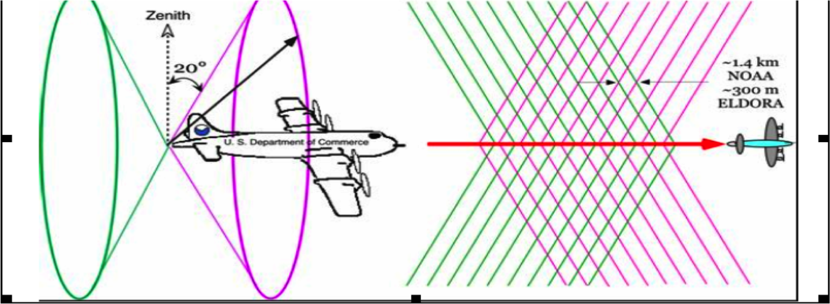
Assimilate Airborne Doppler Winds with WRF-EnKF
Available for 20+ years but never used in operational models due to the lack of resolution and/or the lack of efficient data assimilation methods
SOs are generated on flight of NOAA P3’s; transmitted to ground in real-time
WRF-EnKF: 3 domains (27, 9 & 3 km), 60-member ensemble
(Weng and Zhang 2012, MWR)

Slide 4
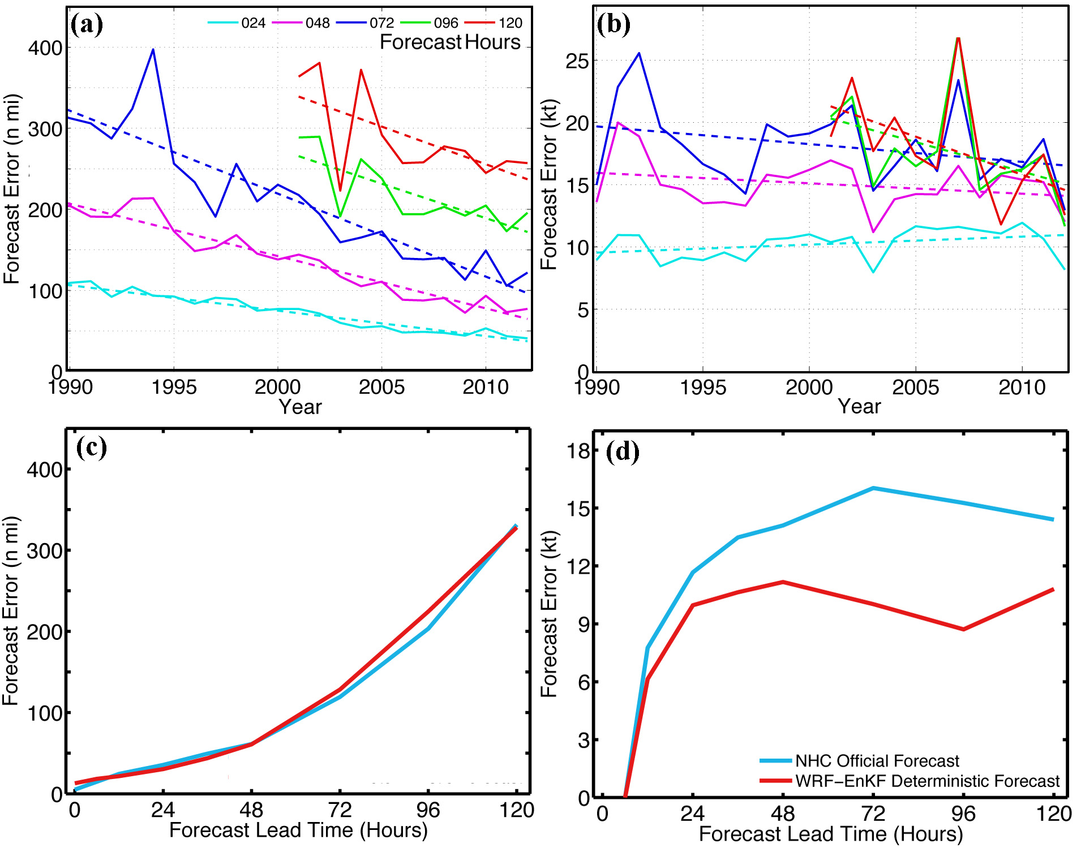
Penn State Real-time Atlantic Hurricane Forecast System Performance
http://hfip.psu.edu
All 100+ P3 TDR missions during 2008-2012
Quasi-operational evaluation by NOAA/NHC since 2011 as stream 1.5 run
Track
Intensity
(Zhang and Weng 2015, BAMS)

Slide 5
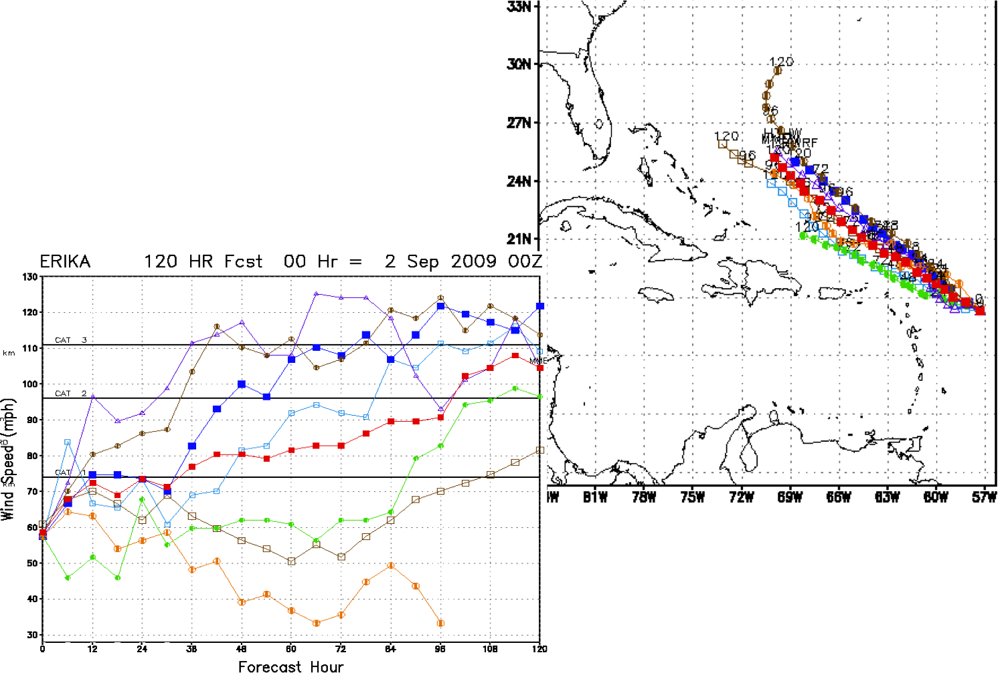
Tropical Storm Erika (2009)
Genesis was well forecasted but…
Poorly forecasted track and intensity
Primary source of error resulted from moderate vertical wind shear
Cat 3
Cat 2
Cat 1
Real-time forecasts by regional operational and experimental models
Courtesy of Krishnamurti at FSU

Slide 6
29
Time Evolution of Minimum Sea Level Pressure (SLP) in mb
Time Evolution of Maximum Wind Speed in kts
Model Simulation: September 2nd, 2009 at 0000 UTC – September 4th, 2009 at 0000 UTC
25
51
46
46
51
25
29

Slide 7
Time Evolution of 850 – 200 mb Wind Shear Averaged Over:
  Intensity groups
  200 km – 500 km radius around storm center
0.32
0.10
Time Evolution of Correlation between 850 – 200 mb Wind Shear and Final Intensity

Slide 8
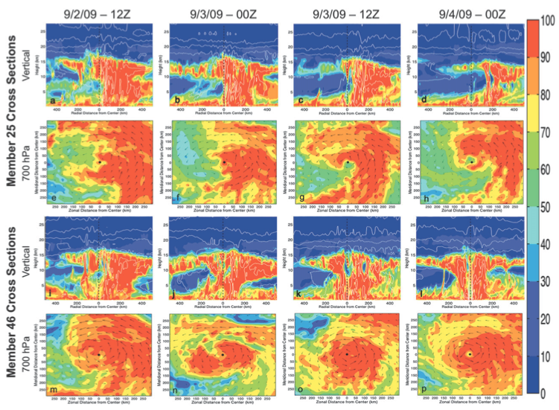
Predictability limited by moderate vertical wind shear magnitude and surrounding environmental dry air
(Munsell et al. 2013, JAS)

Slide 9
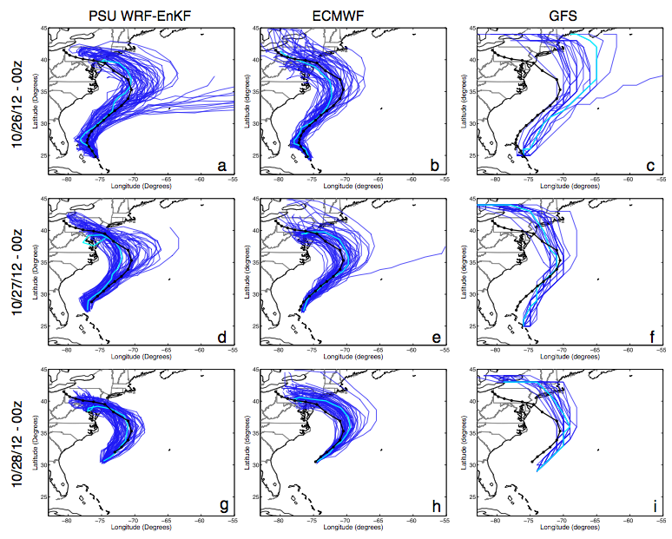
Ensemble Predictions of Hurricane Sandy (2012)
(Munsell and Zhang 2014, JAMES)

Slide 10
Hurricane Sandy Composite Analysis: Mean Tracks
Forecast Hour 24: 10/27/12 at 00Z
Forecast Hour 48:
10/28/12 at 00Z
GOOD Separates
Black: Best Track
Blue: 10 Best Members (GOOD)
Red: 10 Worst Members (POOR)
POOR Separates
Magenta: 10 Members that were furthest off the coast but still made landfall (FAIR)

Slide 11
Forecast Hour 0: 10/26/12 – 00Z
dBZ, 500 mb Geopotential Height, Surface Winds
Top Left: GOOD
Bottom Left: FAIR
Bottom Right: POOR
GOOD
FAIR
POOR

Slide 12
Forecast Hour 24: 10/27/12 – 00Z
dBZ, 500 mb Geopotential Height, Surface Winds
Top Left: GOOD
Bottom Left: FAIR
Bottom Right: POOR
GOOD
FAIR
POOR

Slide 13
Forecast Hour 48: 10/28/12 – 00Z
dBZ, 500 mb Geopotential Height, Surface Winds
Top Left: GOOD
Bottom Left: FAIR
Bottom Right: POOR
GOOD
FAIR
POOR

Slide 14
Forecast Hour 96: 10/30/12 – 00Z
dBZ, 500 mb Geopotential Height, Surface Winds
Top Left: GOOD
Bottom Left: FAIR
Bottom Right: POOR
GOOD
FAIR
POOR

Slide 15
Forecast Hour 0: 10/26/12 – 00Z
dBZ, 500 mb Geopotential Height and Surface Winds differences
Top Left: GOOD – POOR
Bottom Left: GOOD – FAIR
Bottom Right: FAIR – POOR
GOOD – POOR
GOOD – FAIR
FAIR – POOR

Slide 16
Forecast Hour 24: 10/27/12 – 00Z
dBZ, 500 mb Geopotential Height and Surface Winds differences
Top Left: GOOD – POOR
Bottom Left: GOOD – FAIR
Bottom Right: FAIR – POOR
GOOD – POOR
GOOD – FAIR
FAIR – POOR

Slide 17
Forecast Hour 48: 10/28/12 – 00Z
dBZ, 500 mb Geopotential Height and Surface Winds differences
Top Left: GOOD – POOR
Bottom Left: GOOD – FAIR
Bottom Right: FAIR – POOR
GOOD – POOR
GOOD – FAIR
FAIR – POOR

Slide 19
Sensitivity Experiment: Tropical vs. Mid-Latitude Initial Conditions
TCPOOR_MLGOOD
TCGOOD_MLFAIR
TCGOOD_MLPOOR
Sensitivity Experiment: Composited Initial Conditions
(Munsell and Zhang 2014, JAMES)

Slide 20
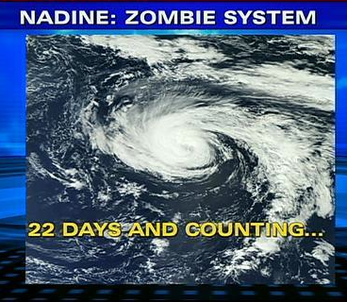
Attained hurricane strength on two occasions; a record 13 days apart
20.75 days as a tropical storm or hurricane; third-longest-lived named storm in the Atlantic
22.25 days (non-consecutive) as a tropical cyclone; fourth-longest-lived Atlantic tropical cyclone

Slide 21
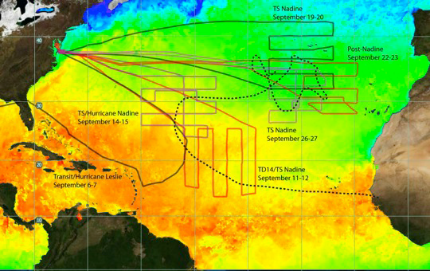
Hurricane and Severe Storm Sentinel (HS3)
Flight tracks of Nadine:
Redevelopment
Intensification
Saharan air layer interaction

Slide 22
Hurricane Nadine (2012) Ensemble Tracks by Performance
GOOD: 10 Best Members (smallest RMSE from best track) – Blue
POOR: 10 Members that curved towards the Northeast – Red
Divergence by FH 48
(Munsell et al. 2015, MWR)

Slide 23
Minimum SLP and Maximum 10-m Winds by Track Performance: Hurricane Nadine Redevelopment Stage
GOOD: 10 Best Members (according to cumulative RMSE from Best Track) – Blue
POOR: 10 Members that curved towards the Northeast – Red

Slide 24
09/20/12 – 00Z
09/25/12 – 06Z
Real-time, Global, Sea Surface Temperature Analysis (RTG-SST)
Initial
Final
Difference (Final – Initial)
Difference

Slide 25
Mean Intensity of Members with Updated SST’s – Thick Lines
Mean Intensity of Members from Original Simulation – Thin Lines
Minimum SLP
Good – Blue
Poor – Red
Maximum 10-m Winds

Slide 26
Upper-level (300-hPa to 200-hPa; warm colors) and lower-level (850-hPa to 700-hPa; cool colors) potential vorticity and winds (vectors)
Poor Good
Forecast Hour 30
Forecast Hour 33
Forecast Hour 36

Slide 27
Upper-level (300-hPa to 200-hPa; warm colors) and lower-level (850-hPa to 700-hPa; cool colors) potential vorticity and winds (vectors)
Poor Good
Forecast Hour 39
Forecast Hour 42
Forecast Hour 45

Slide 28
Differences (Good – Poor) between upper-level (300-hPa to 200-hPa; warm colors) and lower-level (850-hPa to 700-hPa; cool colors) potential vorticity and winds (vectors)
FH 30
FH 33
FH 36
FH 39
FH 42
FH 45

Slide 29
Composite Mean Steering Flow Vectors for Good (blue) and Poor (red) Members; Averaged over the 700-hPa to 500-hPa layer and a 200-km to 500-km radius from the surface center
FH 30
FH 33
FH 36
FH 39
FH 42
FH 45
(Munsell et al. 2015, MWR)

Slide 30
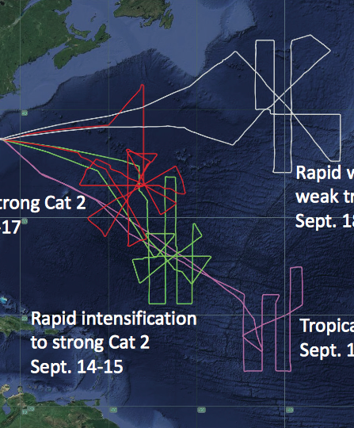
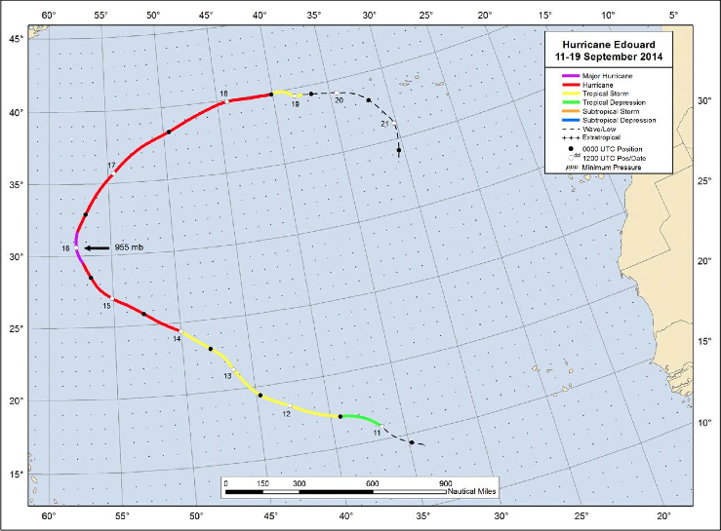
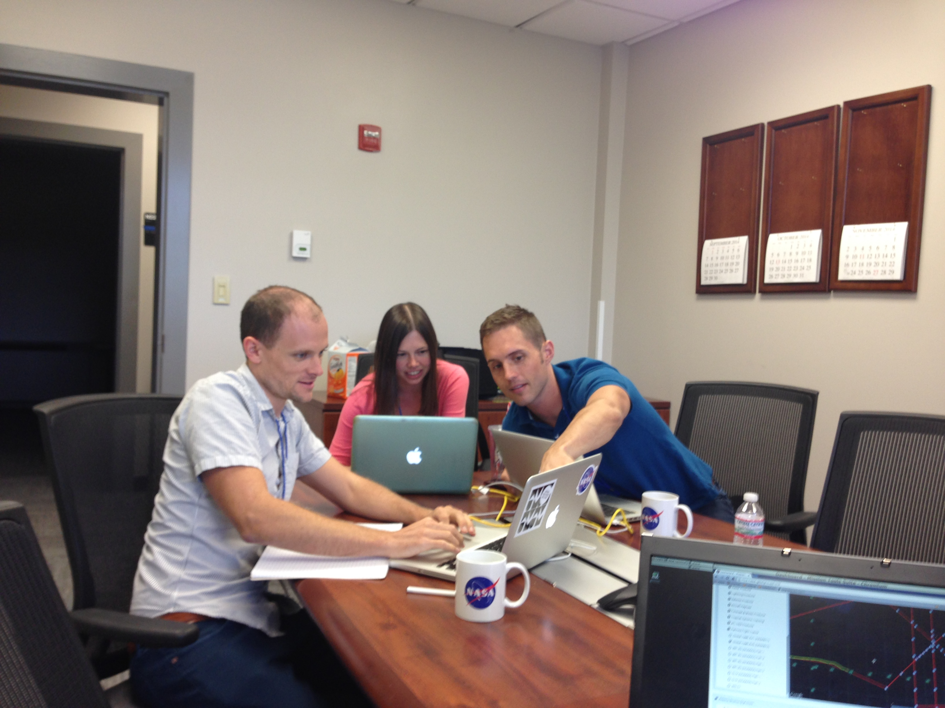
Hurricane Edouard (2014) Best Track and HS3 Flights
PSU WRF-EnKF initialized at 12Z on Sept 11th – TD 6 designation
Simulation ends on 18Z on Sept 16th – just after peak intensity (major hurricane, 1st of HS3!)
Definitely not staged
#dayshift

Slide 31
Ensemble Tracks classified by performance
SST’s contoured (constant amongst members)
Maximum 10-m Wind Speed (kts) classified by performance
Best Track – Black
GOOD – Blue
GOOD_EARLY – Green
GOOD_LATE – Magenta
POOR – Red

Slide 32
Deep-layer shear (850-hPa – 200-hPa) averaged over a 200-km to 500-km radius for the ensemble members of the composite groups

Slide 33
Idealized Experiments: Sensitivity to Increasing Magnitudes of Wind Shear
SH7.5-SST29 (GOOD_EARLY)
SH10-SST29 (GOOD or GOOD_LATE)
SH12.5-SST29 (POOR)
Zhang and Tao 2013, Tao and Zhang 2014

Slide 34
Mean deep-layer (850-hPa – 200-hPa) vertical wind shear of composite groups – time in relation to beginning of RI

Slide 35
Mean tilt magnitude (difference between 850-hPa and 500-hPa weighted PV centers in km) of composite groups of Edouard
Mean tilt magnitude (difference between 850-hPa and 500-hPa weighted PV centers in km) of composite groups in time in relation to beginning of RI

Slide 36
T_{RI} – 48 h T_{RI} – 36 h T_{RI} – 24 h
GOOD_LATE GOOD GOOD_EARLY

Slide 37
T_{RI} – 12 h T_{RI} T_{RI} + 12 h
GOOD_LATE GOOD GOOD_EARLY

Slide 38
Sensitivity Experiments – Set #1
Sensitivity to composited initial conditions
Thick Lines – Composited IC’s
Thin Lines – Mean of Composite Groups from Original Ensemble

Slide 39
Sensitivity Experiments – Set #2 and Set #3
Testing the strength of the GOOD_EARLY vortex
Testing the influence of the POOR environment
R = 300 km
R = 200 km
Linearly Blended
Thick Lines – GOOD_EARLY environment sensitivity
Thin Lines – Composited IC’s

Slide 40

Summary of Sensitivity on Inner-core vs. Environment
Environment
✓✓ - RI at 48 h
✓ - RI at 72 h
✗ - No RI
 | GOOD_EARLY | GOOD | POOR
GOOD_EARLY
GOOD
POOR
Inner-Core

Slide 41
Sensitivity Experiments – Set #4
Assessing the radii at which the POOR environment becomes detrimental
Radius (km) | EnvGoodTcPoor | EnvPoorTcGood
250 | ✓ | ✗
500 | ✓ | ✗
600 | ✓ | ✗
700 | ✗ | ✗
800 | ✓ | ✗
900 | ✗ | ½✓
1100 | ✗ | ✓

Slide 42
700-hPa Relative Humidity (%) and 2-km Radar Reflectivity (dBZ) at 0 h
EnvGoodTcPoor800
EnvGoodTcPoor900
Differences & RMSD Vertical Profiles

Slide 43
Summary and Conclusions
Predictability and dynamics of PSU WRF-EnKF TC track and intensity forecasts explored through ensemble sensitivity, correlation analyses, and compositing techniques
Divergent track forecasts of Sandy and Nadine can be attributed to differences in synoptic-scale steering flow – differences in the speed of westerly trade winds or approaching mid-latitude trough
Intensity errors from non-intensifying TS Erika result from limited predictability under moderate vertical wind shear and ambient dry air
Overintensification in Nadine ensemble results from constant SSTs
RI onset in Edouard ensemble determined by impact of wind shear on vortex tilt, convection and subsequent precession and alignment
  Predictability of RI onset influenced by both inner-core strength and environmental conditions

