Slide 1
NOAA’s Hurricane Research - HFIP
Frank Marks
AOML/Hurricane Research Division
11 February 2015
Notes:
Hurricane Edouard 16 September 2014

Slide 2

Vision
  Organize hurricane community to dramatically improve numerical forecast guidance to NHC in 5-10 years
Goals
Improve forecast accuracy for track & intensity by 20% in 5 years, 50% in 10 years
Extend forecast guidance to 7 days with skill comparable to current 5 day forecasts
Increase probability of predicting (POD) Rapid intensification (RI) at Day 1 to 90% & 60% at Day 5
http://www.hfip.org/
Notes:
http://www.nrc.noaa.gov/HFIPDraftPlan.html
HFIP Team
Frank Marks, research lead
Ed Rappaport, operations lead
Fred Toepfer, project manager
Robert Gall, development manager
Mark DeMaria
Chris Fairall
Jim McFadden
Daniel Melendez
HFIP executieve oversight board:
OAR AA/Robert Detrick, co-chair
NWS AA (acting)/Laura Furgione, co-chair
NCEP/Louis Uccellini,
NHC/Rick Knabb,
NESDIS/Mark DeMaria,
NOS/Jesse Feyen,
AOML/Bob Atlas
PPI/Paul Doremus
NMFS/Bonnie Ponwith,
NOS/Liz Scheffler,
NMAO-PM Aircraft/Mike Devany
OFCM/Sam Williamson
Executive Secretariat: OAR/Brian Orndorff and NWS/Nasheema Lett
http://www.hfip.org/

Slide 3
HFIP Successes to date:
GFS Track Forecast Improvements
(% Improvement over HFIP baseline)
5-yr goal
2006-2008
2012
Dramatic improvement in first 5 years of HFIP

Slide 4
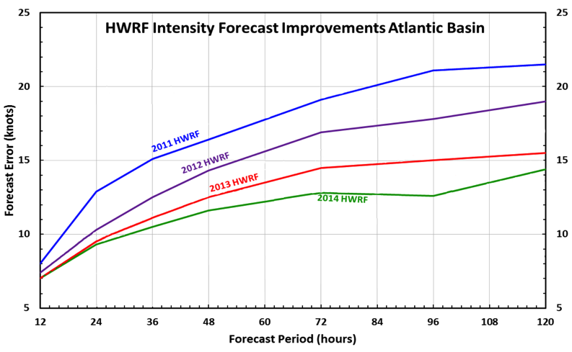

HFIP Successes to date:
HWRF Intensity Forecast Improvements
Improvement 15-20% per year since 2011
5-year goal
Dramatic improvement in first 5 years of HFIP
http://www.emc.ncep.noaa.gov/gc_wmb/vxt/
Notes:
Added 3rd nest in 2012

Slide 5
HFIP Successes to date:
Other Areas
JTWC evaluating HWRF guidance globally using HFIP Demonstration System on Jets – very successful
HWRF WPAC demonstrated improved RI guidance – POD 24% vs JTWC operational 4%
Demonstrated HWRF & Multi-model regional ensembles - shows great promise
Demonstrated impact of aircraft observations on forecast guidance – shows promise
Demonstrated next generation storm surge model – WRN
Grants to Academia – funded 12 new proposals
Scientific Review Committee
Notes:
HFIP running HWRF in WPAC for JTWC 2012-2013
Results indicate that HWRF track forecasts are comparable to global model and better than other regional models in region
HWRF Intensity forecasts are better than other model guidance in WPAC
JTWC is using HWRF model output in their operational forecasts
With HWRF runs in WPAC we have enough cases to evaluate RI. If one define an RI event as >30 kt / 24 h, then HWRF RI POD skill is ~ 23 % and by far has higher POD index as compared to other models and in other basins (previous
analysis of RI for WPAC from 2012 HWRF showed <10% skill).
HWRF ensemble mean (HWMN) track/intensity forecasts improve over HWRF at all lead times, in all 3 basins.

Slide 6
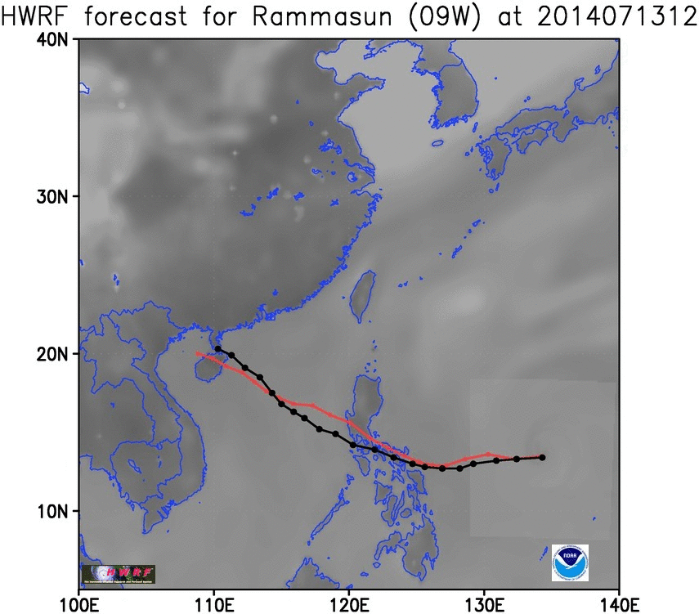
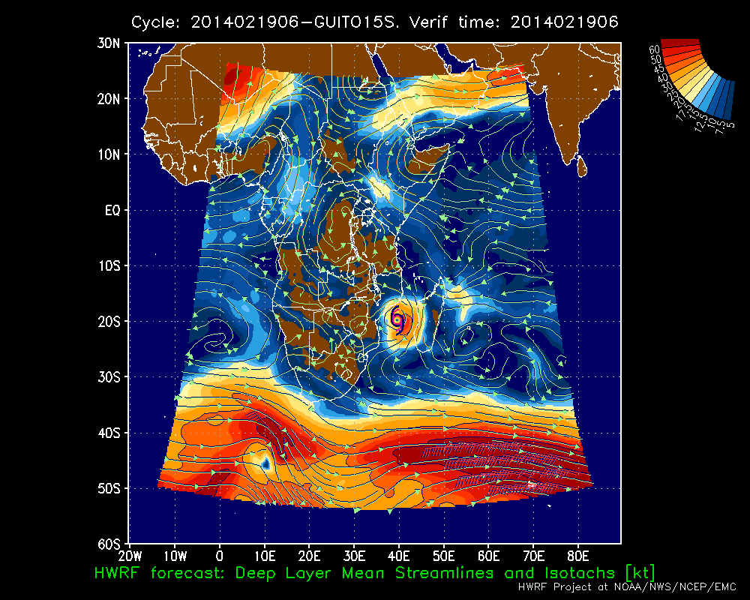
HFIP Successes to date:
Global HWRF
HWRF model forecasts of Typhoon Rammasun (09W) and Cyclone Guito (15S)
http://www.emc.ncep.noaa.gov/gc_wmb/vxt/
Notes:
Right: Experimental Real-Time Forecast Guidance from Operational HWRF for all Tropical Oceanic Basins Including Southern Hemisphere:
Cyclone Guito (15S)
Left: Composite Radar Reflectivity Animation for Typhoon Rammasun (09W)

Slide 7
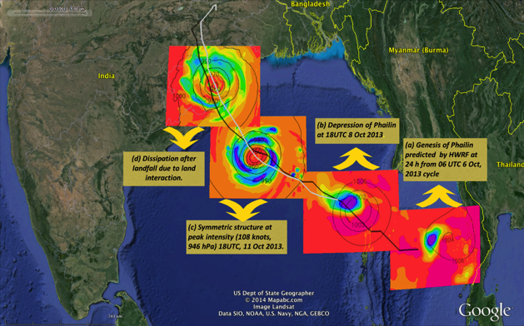
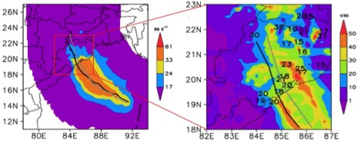
HFIP Successes to date:
Global HWRF
Experimental Real-Time Forecast Guidance from Operational HWRF for all Tropical Oceanic Basins Including Indian Ocean:
Cyclone Phailin (02B)
10 m maximum winds (m s⁻¹) and accumulated rainfall swath (cm)
http://www.emc.ncep.noaa.gov/gc_wmb/vxt/
Notes:
Right: Experimental Real-Time Forecast Guidance from Operational HWRF for all Tropical Oceanic Basins Including Southern Hemisphere:
Cyclone Guito (15S)
Left: Composite Radar Reflectivity Animation for Typhoon Rammasun (09W)

Slide 8
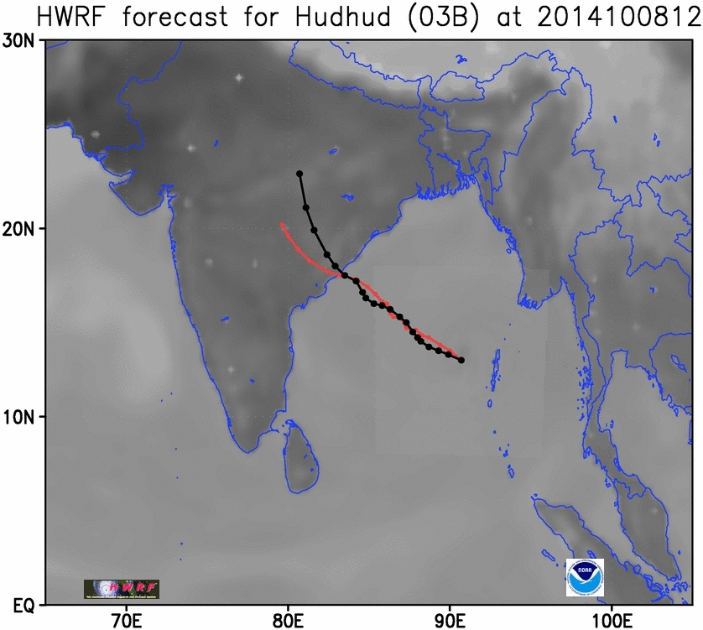
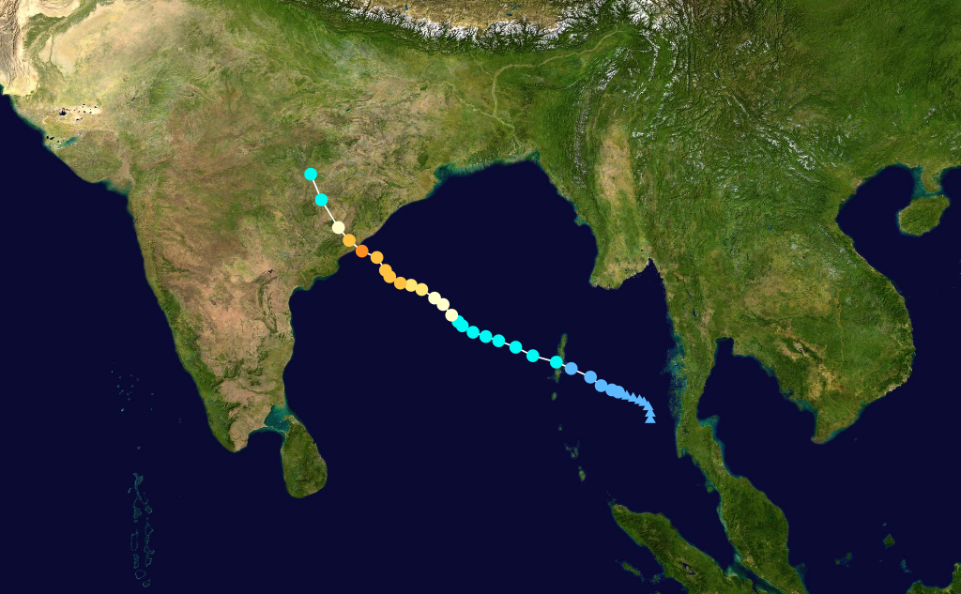
HFIP Successes to date:
Global HWRF
HWRF model forecasts of Severe Cyclone Hudhud (03B)
http://www.emc.ncep.noaa.gov/gc_wmb/vxt/
Notes:
Right: Experimental Real-Time Forecast Guidance from Operational HWRF for all Tropical Oceanic Basins Including Southern Hemisphere:
Cyclone Guito (15S)
Left: Composite Radar Reflectivity Animation for Typhoon Rammasun (09W)

Slide 9
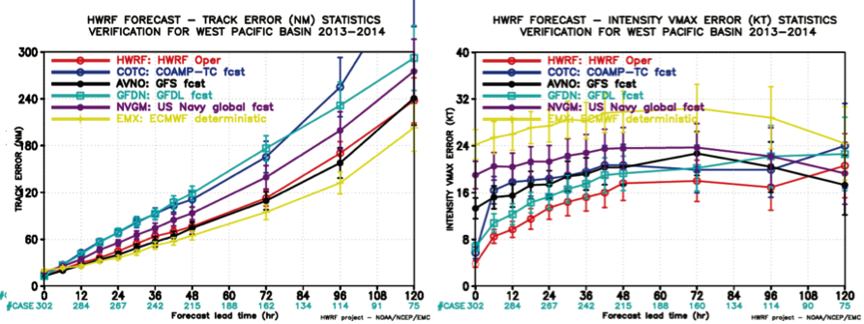
HFIP Successes to date:
Global HWRF
HFIP running HWRF in WPAC for JTWC 2012-2014, globally 2013-2014
HWRF track forecasts comparable to global model & better than other regional models
HWRF Intensity forecasts are better than other model guidance in WPAC
JTWC is using HWRF model output in their operational forecasts
http://www.emc.ncep.noaa.gov/gc_wmb/vxt/

Slide 10
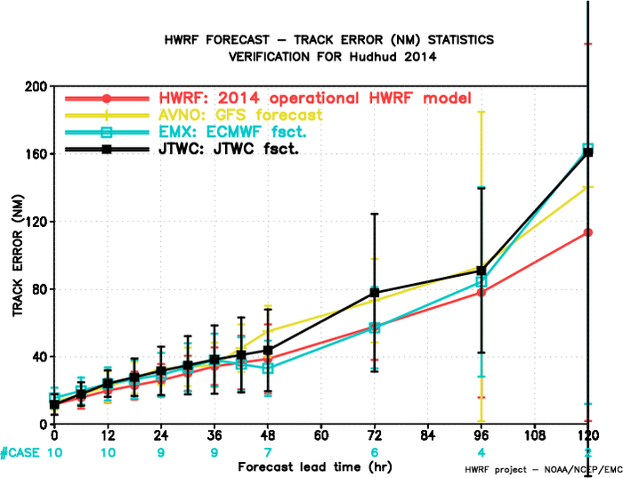
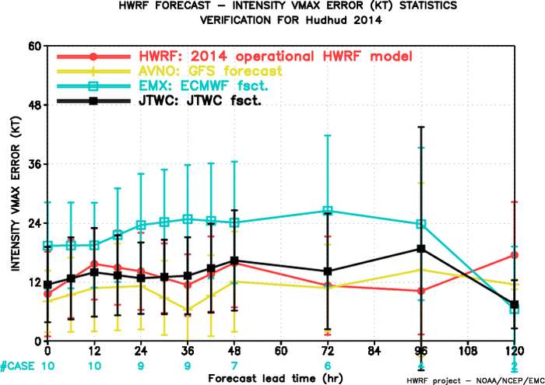
HFIP Successes to date:
Global HWRF - Issues
Verification of intensity forecasts against IMD best track data changed model performance characteristics
GFS is best performing model for intensity
JTWC/HWRF has +15 kt positive bias
WHAT IS TRUE INTENSITY OF HUDHUD? How do we improve models based on this information?
http://www.emc.ncep.noaa.gov/gc_wmb/vxt/

Slide 11
HFIP Successes to date:
HWRF RI in WPAC
HWRF
2012-2013
JTWC
2012-2013
If RI event defined as >30 kt/24 h, HWRF RI POD skill is ~ 22% and has much higher POD compared to operations and other models (previous analysis of RI for WPAC in 2012 showed <10% skill).
The POD is much higher (43%) if considering intensity change tendency >5 kt/6 h.
http://www.emc.ncep.noaa.gov/gc_wmb/vxt/
Notes:
If one define an RI event as >30 kt / 24 h, then HWRF RI POD skill is ~ 23 % and by far
has higher POD index as compared to other models and in other basins (previous
analysis of RI for WPAC from 2012 HWRF showed <10% skill).

Slide 12
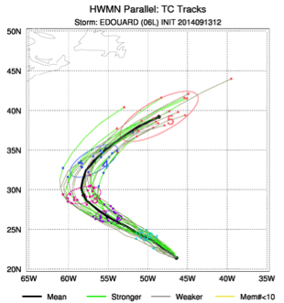
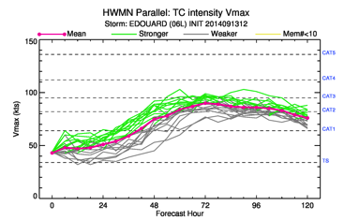
HFIP Successes to date:
HWRF ensembles – 20 members
http://www.emc.ncep.noaa.gov/gc_wmb/vxt/
Notes:
HWRF EPS (27/9/3 km, 42 levels) – 20 members
Use 2014 operational deterministic HWRF model except for
Less vertical resolution: L43 vs. L61;
Smaller D02, D03 domains, same as H213;
No GSI due to lack of GDAS data;
IC/BC Perturbations (large scale): 20 member GEFS.
Model Physics Perturbations (vortex scale):
Stochastic Convective Trigger in SAS: -50hPa to + 50hPa white noise ;
Stochastic boundary layer height perturbations in PBL scheme, -20% to +20%;
Stochastic initial wind speed perturbations with zero mean and 7% standard deviation, Gaussian distribution

Slide 13
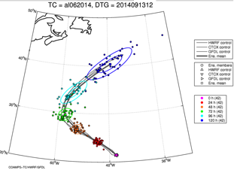
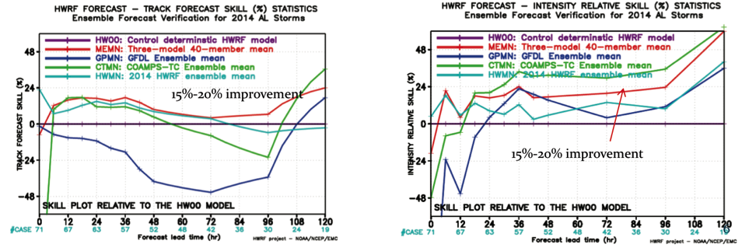
HFIP Successes to date:
Multi-model ensembles - 2014
HWRF EPS (27/9/3 km, 42 levels) – 20 members
GFDL EPS (55/18/6 km, 42 levels) – 10 members
COAMPS-TC EPS (27/9/3 km, 40 levels) – 10 members
Skill relative to operational HWRF
http://www.emc.ncep.noaa.gov/gc_wmb/vxt/

Slide 14

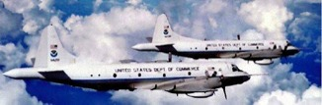
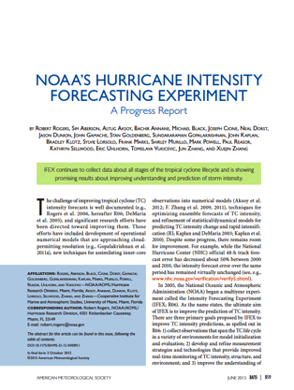
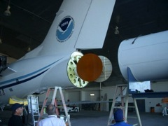

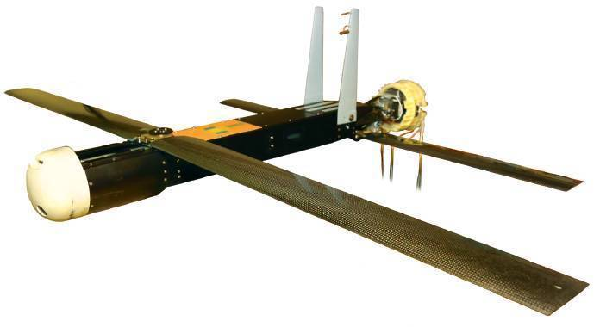
Intensity Forecast Experiment (IFEX)
In-situ
  Wind, press., temp.
Expendables
  Dropsondes
  AXBT, AXCP, buoy
Remote Sensors
  Doppler Radar
  SFMR/HIRAD
  WSRA
  Scatterometer/profiler
  UAS
Improve prediction of TC intensity change by:
  collecting observations through the TC life cycle
  developing and refining observing technologies
  improving understanding of physical processes important in TC intensity change
NASA Global Hawk
G-IV Tail Doppler Radar
Coyote UAS
14
Notes:
UR image depicts dropsonde profiles in eyewall of Hurricane Guillermo (1997)
LR image is Doppler Wind Lidar profiles from TCS-08
See IFEX paper (Rogers et al 2006): http://dx.doi.org/10.1175/BAMS-87-11-1523
HRD IFEX website: http://www.aoml.noaa.gov/hrd/HFP2011/index.html

Slide 15
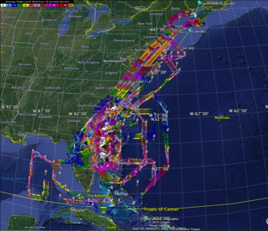

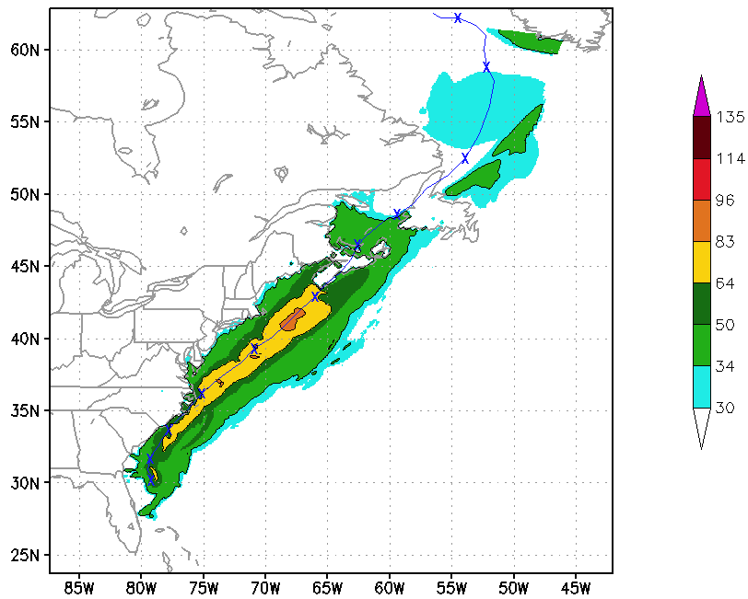
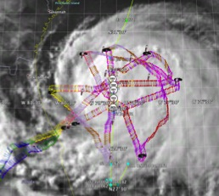
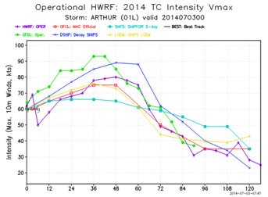
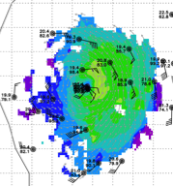
Collect observations over life-cycle: Arthur 2014
5 P-3 Flights
2 July – 5 July 2014
Doppler data transmitted in real-time for assimilation into HWRF
5 P-3 missions from 2-5 July 2014 at 12 h Doppler sampling (HEDAS/GSI) & 3 G-IV missions
Sampled Arthur as a tropical storm to hurricane at landfall in NC, to extra-tropical transition in Nova Scotia
15
Notes:
Map shows flight tracks for all of the NOAA missions (color coded are the flight level winds for the P-3 missions, dropsonde symbols denote G-IV patterns)
Flight track plots courtesy of Tropical Atlantic - http://tropicalatlantic.com/recon/
Model data available at: http://www.emc.ncep.noaa.gov/gc_wmb/vxt/RT_ATLANTIC/ARTHUR01L/

Slide 16
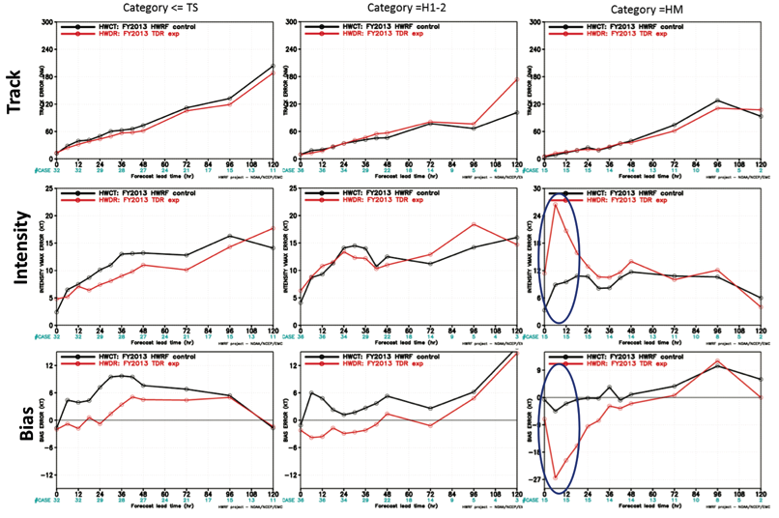
HFIP Successes to date:
Impact of aircraft observations: TDR
Notes:
84 cases in 39 storms over 5 years (2008-2012)
Major issue is with initializing strong storms.

Slide 17
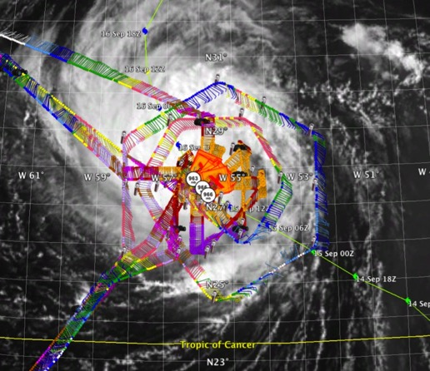
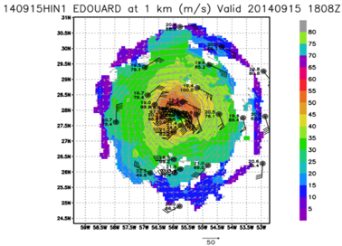
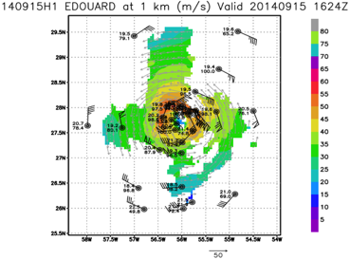
  Develop & refine observing technologies: G-IV TDR
P-3 & G-IV Doppler analysis at 1 km altitude
P-3 Doppler analysis at 1 km altitude
2 P-3 and G-IV flight track in Hurricane Edouard 15 September 2014
17

Slide 18
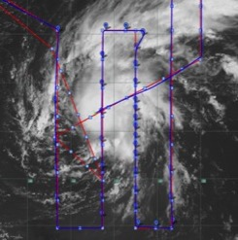
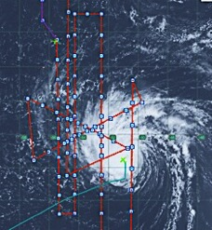
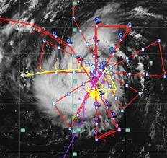
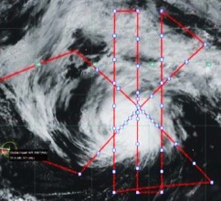
  Develop & refine observing technologies: Global Hawk UAS
4 flights sampled life cycle of Edouard from tropical storm to extra-tropical transition
11 September, Tropical Storm
14 September, Category 1
282 total dropsondes deployed during more than 58 h over and near the storm
16 September flight plan designed and coordinated by NOAA scientists
Multiple drops into eye and eyewall from Global Hawk 60,000 ft
Select dropsondes suggested rapid intensification on 15 September
Novel observations documenting storm decay over colder waters
Dropsonde data processed in real time, transmitted to NWS gateway, and assimilated in operational WRF model
Observations will facilitate several forecast impact studies with multiple numerical models
16 September, Category 3
18 September, Decay
18

Slide 19
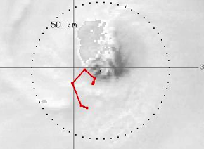
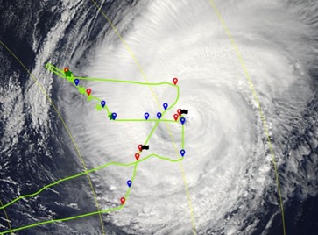
  Develop & refine observing technologies: Coyote UAS
16 September 2014
17 September 2014
MODIS
1640Z
1420Z
1341Z
1638Z
1316Z
VIS Satellite image with Coyote UAS trajectory superposed
1259Z
19

Slide 20
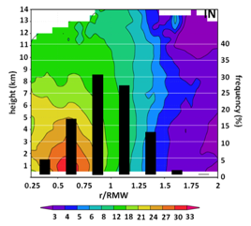
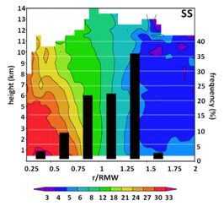
  Improve understanding of physical processes: RI
Rapid intensification (RI) remains challenging research, forecasting problem
Recent research has focused on subsynoptic (vortex, convective, boundary layer) factors and their role in RI
Airborne Doppler composites have identified key vortex- and convective-scale differences between intensifying (IN) and steady-state (SS) hurricanes
  deeper inflow, weaker outer-core vorticity, greater azimuthal coverage of precipitation
  more deep convection, distribution peaked inside 2-km radius of maximum wind (RMW)
Radial distribution of convective bursts (%, top 1% of w distribution) and axisymmetric vorticity (shaded, x 10⁻⁴ s⁻¹)
Rogers et al., MWR, 2013
20

Slide 21
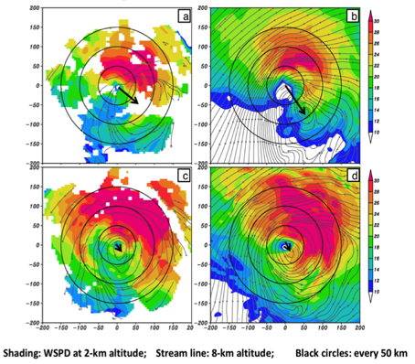
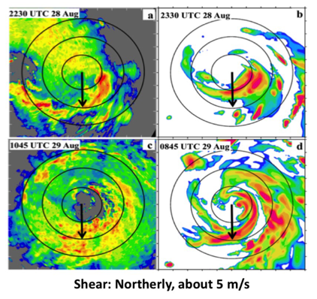
  Improve understanding of physical processes: RI in shear
P-3 Winds
HWRF simulated
P-3 Lower fuselage
HWRF simulated
Pre-RI
RI
Well defined vortex below 5 km and weakly defined circulation aloft, pre-RI. Tilt decreased with improved alignment.
Persistent convection down shear left, pre-RI; Down shear left and up shear left during RI. Convection was asymmetric during RI
21

Slide 22
HFIP Lesson Learned
Fully engage operational partners to set goals & milestones to reflect requirements
Provide support for real-time demonstration as part of T&E leading to faster R2O
Initialization still major issue, particularly in strong storms: Make better use of vortex-scale observations (in-situ & satellite)
Need strategies to use ensembles (single & multi-model) to address uncertainty in track, intensity, & structure
Model architecture must include environmental changes on times scales ~10 days (global model), and resolve rapidly changing inner core structure (moving nests)
Notes:
http://www.hfip.org/documents/reports2.php

Slide 23
HFIP Priorities 2015-2016
Operational Impact
Continue demonstration of real-time Experimental Numerical Forecast System during hurricane season (18/6/2-km)
Demonstrate impact of aircraft data & Doppler Radar (TDR)
Demonstrate multi- & single-model ensembles for Track & Intensity
Research & Development
Develop HWRF GSI hybrid DA - Focus on high resolution inner domains
Improve use of inner core observations operationally
Improve use of satellite data in TC DA (Sandy Supplemental - QOSAP)
Improve HWRF physics (Sandy Supplemental - OAR)
Develop global physics for high resolution (Sandy Supplemental HIWPP)
Technical Advancements
Transition HWRF to basin/global NMM-B (HIWPP)

Slide 24
Challenges
How can we use this research capacity and approach to accelerate TC forecast improvement in India?
  HFIP approach & infrastructure allows for rapid T&E of emerging research and observations for potential R2O into operational hurricane model and DA systems.
  Expand and leverage HFIP partnership to take advantage of new initiatives to foster and enhance existing HFIP partnership, promote collaboration with international research community, and address near-term opportunities
Notes:
24
With increasing budget uncertainty we need to leverage on the successful HFIP approach to further our enhancements of the operational system. HFIP demonstrated an approach similar to that outlined in the OFCM Interagency Strategic Research Plan for Tropical Cyclones: The Way Ahead that is working and accelerating improvements.
In challenging and volatile budget times OFCM serves as an honest broker in bringing together partners from across federal services to insure return on investment and coordination. WG/TCR serves as lynch pin in this endeavor to coordinate and track research across agencies to insure operational requirements are addressed. IHC plays critical role in providing a forum to monitor progress, and for this coordination to be discussed and debated.

Slide 25




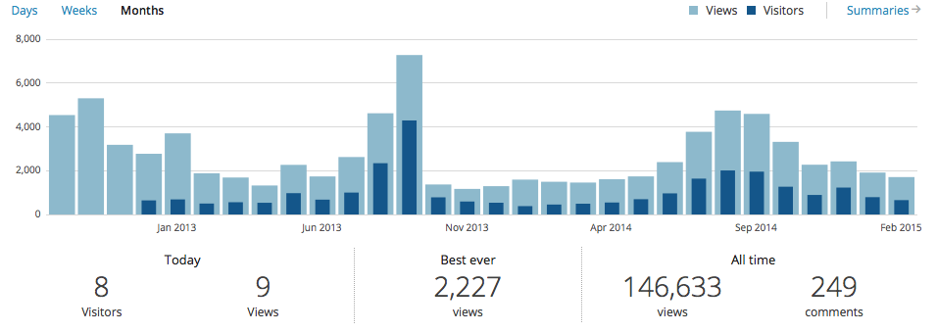
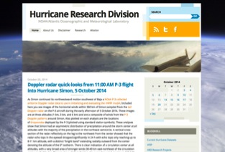
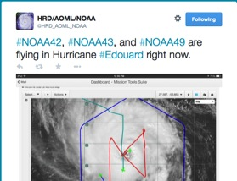
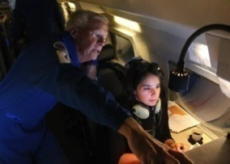
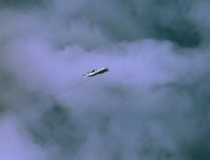
Outreach
Our blog
http://noaahrd.wordpress.com
HRD Web page
http://www.aoml.noaa.gov/hrd
Facebook (3,475 likes)
http://www.facebook.com/noaahrd
Twitter (12,900 followers)
http://twitter.com/#!/HRD_AOML_NOAA
Tweets from the eye
Visiting scientist program
25
Notes:
25
Since 15 May 2010 HRD has maintained our Blog on Wordpress which supports a RSS feed, Twitter, and Facebook accounts.
Wordpress Stats: 1,126 posts (18-19 posts per month), 249 comments. Most posts are during the hurricane season where we post our updates on field activities whenever we are operating.
Wordpress Blog Views by Month and Year
Jan Feb Mar Apr May Jun Jul Aug Sep Oct Nov Dec Total
2010 152 753 1,790 3,463 5,521 2,047 1,479 1,019 16,224
2011 1,028 927 1,152 1,143 1,417 1,495 1,959 7,195 2,588 1,885 1,659 1,231 23,679
2012 1,139 1,179 1,305 1,456 1,754 1,855 1,929 14,433 4,537 5,302 3,179 2,770 40,838
2013 3,702 1,880 1,687 1,323 2,264 1,736 2,622 4,619 7,276 1,369 1,167 1,292 30,937
2014 1,591 1,493 1,457 1,608 1,738 2,390 3,773 4,744 4,591 3,314 2,271 2,423 31,393
2015 1,913 1,684 3,597
Since late September 2013 HRD has tracked web pages using Google Analytics:
HRD Web site Stats: Since late September 2013 a total of 188,460 visits or 47,000 visits per month with 383,873 page views
Twitter Stats: 1,666 tweets of which 1,126 are directly from the Wordpress Blog and the rest from “Tweets from the Eye” which we do directly to Twitter from the NOAA aircraft during missions. “Tweets from the Eye” are a very effective and popular outreach tool helping educate the Public to what NOAA does.

Slide 26
Questions?

