Slide 1
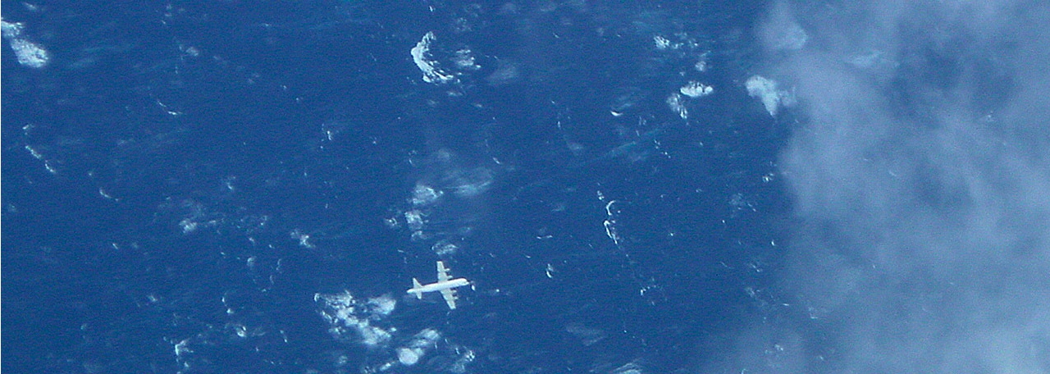
Enhanced Wind-Driven Downwelling Flow in Warm Oceanic Eddy Features During the Intensification of Tropical Cyclone Isaac (2012): Observations and Theory
Benjamin Jaimes
Lynn K. Shay
University of Miami, RSMAS, Department of Ocean Sciences
16 July 2015, AOML/HRD, Miami, FL
Acknowledgments:
Jodi Brewster (RSMAS) and Ryan Schuster
NOAA (HRD, AOC, HFIP)
Deep-C (grant SA1212GoMRI008)

Slide 2
Outline
Background
Upwelling Response to Tropical Cyclones in a Quiescent Ocean
Upwelling Response to Tropical Cyclones in Oceanic Geostrophic Flow
Observations: Ivan, Rita
Steady-state theory: Katrina, Rita
Numerical experiments: Katrina
Upwelling Response to Isaac
Observations
Theory: Tropical Cyclone Pumping in Oceanic Geostrophic Flow
Implications
Concluding Remarks and Future Work

Slide 3
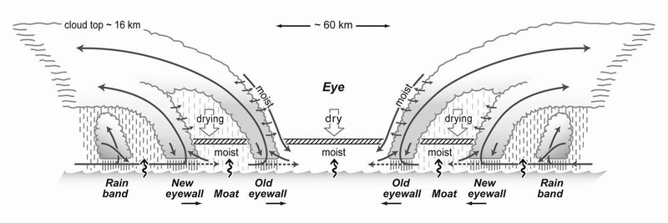
TC-driven Ekman pumping
Forced stage (ocean initially at rest)
Heat fluxes
Transport
Transport
OML
Wind erosion
Thermocline
Thermocline
Upwelling
Notes:
Forced stage: short stage when the storm is passing overhead
Relaxation stage: relatively long stage when the ocean adjust toward equilibrium in the weak of the storm

Slide 4
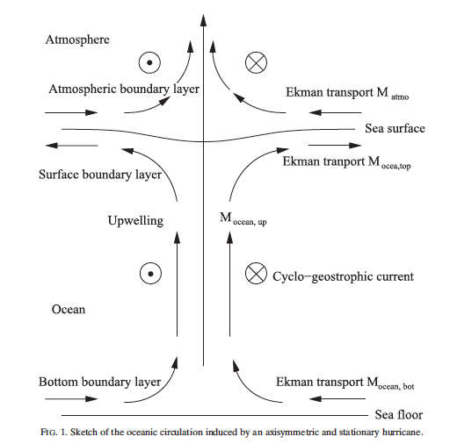
TC-driven Ekman pumping in an homogeneous ocean
(stationary storm)
z
Atmosphere
x
-z
Ocean
Lu and Huang (2010)

Slide 5
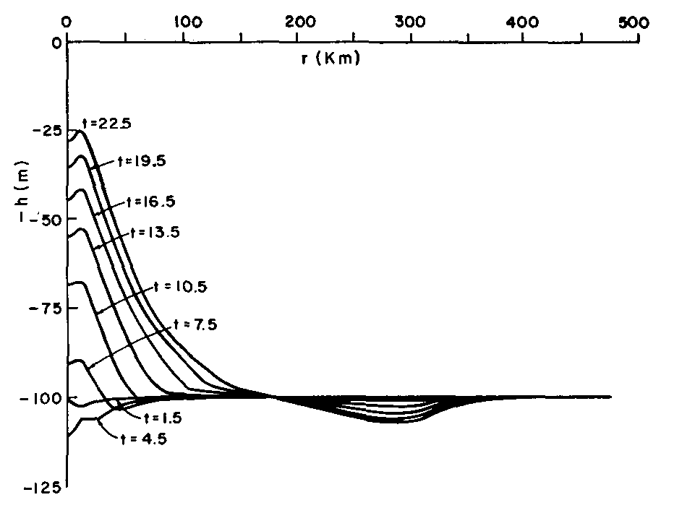
Upwelling response to a stationary hurricane in a quiescent ocean
(Two-layer numerical ocean model)
Radial distance from the storm’s center (km)
h: depth of upper layer
Upwelling
Downwelling
The structure of upwelling and downwelling regimes is essentially determined by the structure of the curl of the wind stress.
(O’Brien and Reid 1967)

Slide 6
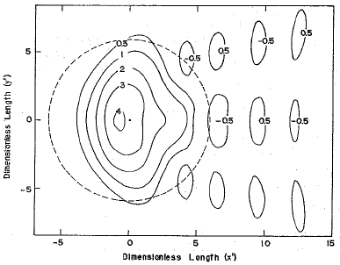
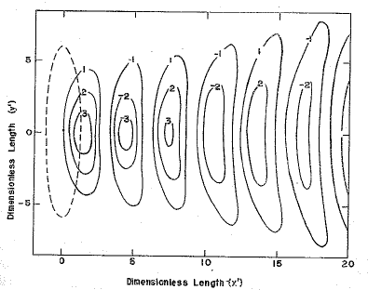
Upwelling response to a moving hurricane in a quiescent ocean
(Two-layer analytical ocean model)
U_{h} : translation speed of the storm
c₁ : phase speed of the ocean’s first baroclinic mode
Slow-moving storm
Fast-moving storm
Fr = U_{h}/c₁< 1
Fr = U_{h}/c₁ > 1
Ekman pumping
(Upwelling)
Near-inertial pumping
Ekman
pumping
Near-inertial pumping
(Geisler 1970)

Slide 7
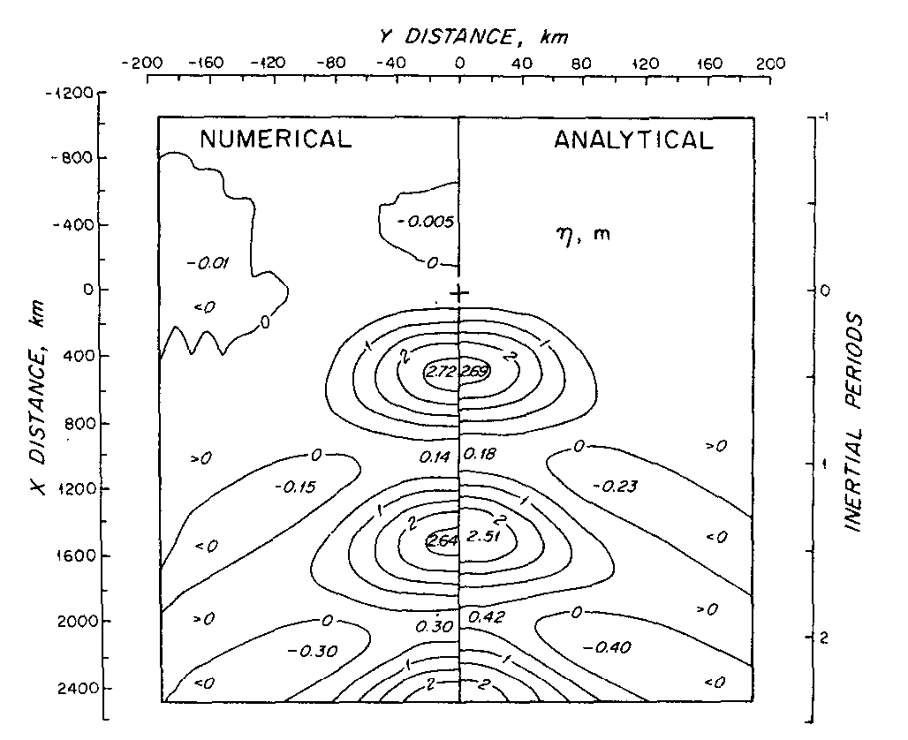
Upwelling response to a moving hurricane in a quiescent ocean
(Multi-layer numerical ocean model)
Direction of storm motion
Again, the structure of the Ekman pumping consists of an intense upwelling flow underneath the storm’s center, and a weaker and broad downwelling flow outside the central region of the storm.
(Price 1981)
(Geisler 1970)
Downwelling
Upwelling
Forced Stage
Relaxation Stage
Price (1981)

Slide 8
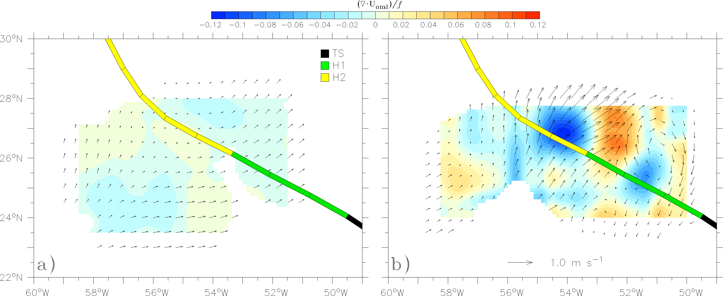
Observed ocean response to Edouard (weak pre-storm ocean currents)
Pre-storm
Post-storm
Convergence
Divergence
From AXCP data
(Geisler 1970)

Slide 9
Outline
Background
Upwelling Response to Tropical Cyclones in a Quiescent Ocean
Upwelling Response to Tropical Cyclones in Oceanic Geostrophic Flow
Observations: Ivan, Rita
Steady-state theory: Katrina, Rita
Numerical experiments: Katrina
Upwelling Response to Isaac
Observations
Theory: Tropical Cyclone Pumping in Oceanic Geostrophic Flow
Implications
Concluding Remarks and Future Work

Slide 10
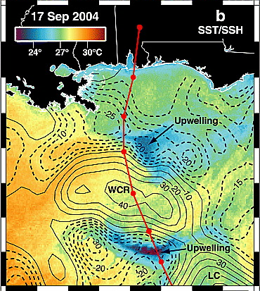
Contrasting upwelling response to Ivan in oceanic geostrophic flow
Oceanic Mixed Layer (OML)cooling < 1ºC in Warm Core Eddies (WCE).
OML cooling ~ 5ºC in Cold Core Eddies (CCE).
Halliwell et al. (2011) found downwelling over the WCE in HYCOM simulations.
No in situ observations of the ocean response over the eddy field (only over the continental shelf and slope; Teague et al. 2007).
CCE
WCE
CCE
Walker et al. (2005)

Slide 11
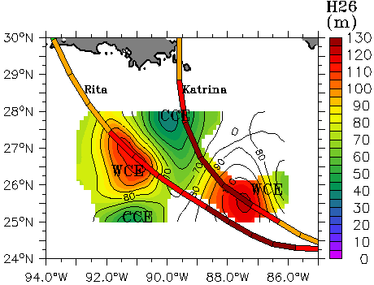
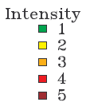
The cases of Katrina and Rita moving over oceanic geostrophic flow
H26= 26ºC isotherm depth from P3 data
Both Katrina and Rita became a category 5 hurricane over the LC bulge (WCE feature).
Airborne ocean data obtained over WCEs and CCEs before, during, and after the passage of Rita.
Pre Rita (or post Katrina)
Jaimes and Shay (2009)

Slide 12
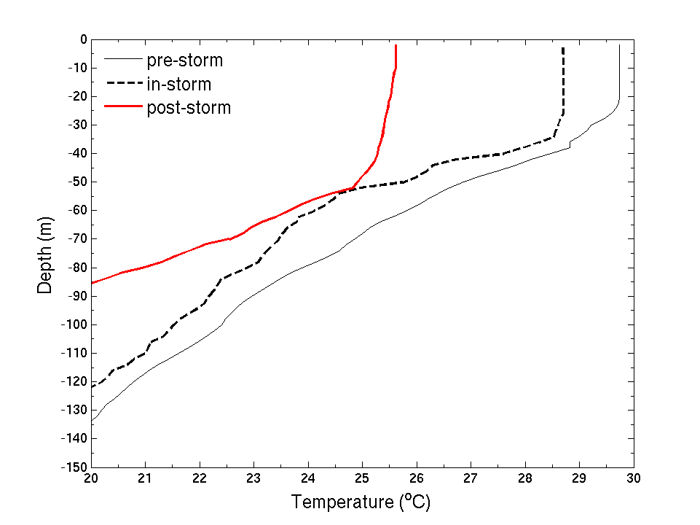
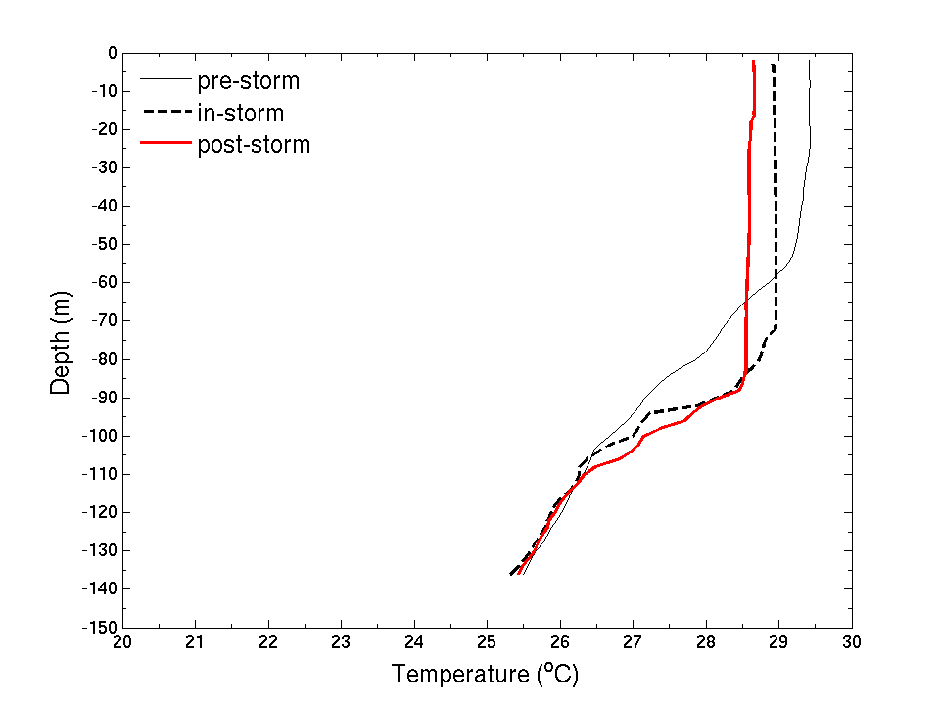
Upwelling response to Rita (Cat 5)
(Airborne ocean profilers)
Geostrophic cyclone
Geostrophic anticyclone (Loop Current)
cooling
cooling
26ºC
warming
26ºC
What is the relative contribution of upwelling (Ekman pumping) and vertical mixing to this warming?
Jaimes and Shay (2009)

Slide 13
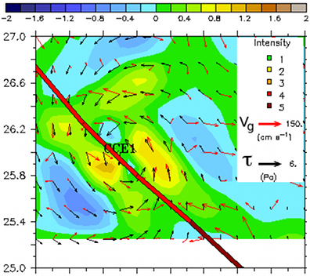
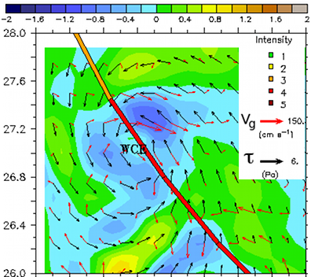
Upwelling response to Katrina and Rita based on Stern’s (1965) Theory
Steady-state (alike Ekman Theory)
Uniform wind stress
Low Rossby number (Ro)
w_{E}
vortex stretching
w (cm s⁻¹)
Upwelling underneath Katrina’s eye in a cyclonic mesoscale feature
Downwelling underneath Rita’s eye in an anticyclonic mesoscale feature
Jaimes and Shay (2009)

Slide 14
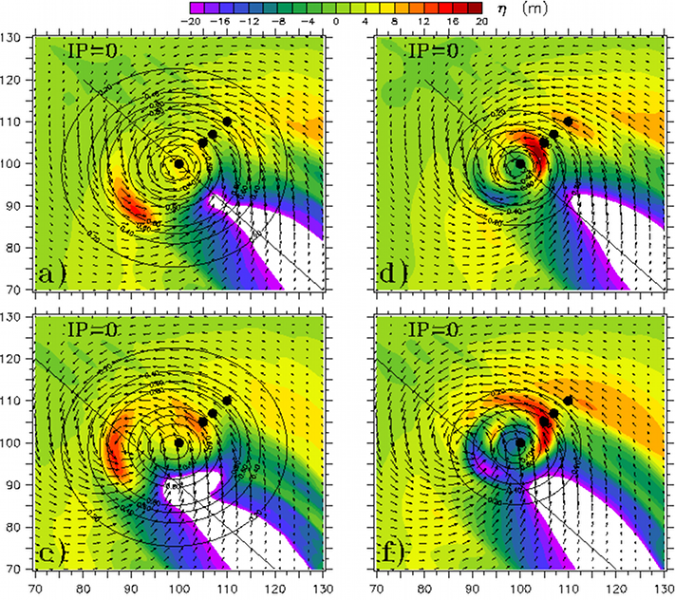
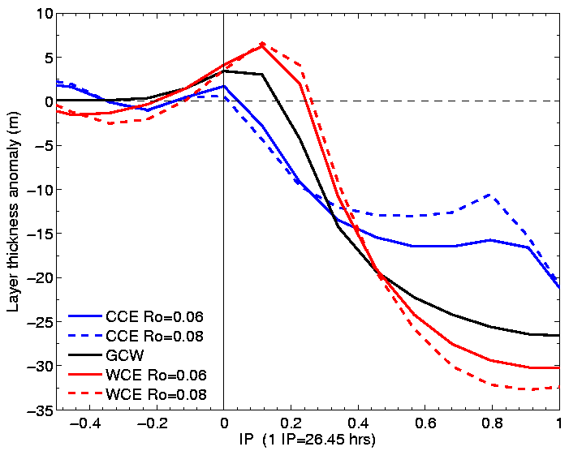
Simulated upwelling response to Katrina
(MICOM, no vertical mixing)
OML thickness anomaly
Downwelling
Upwelling
The same wind forcing (Katrina) was used in all the experiments.
Anticyclones (WCE)
Cyclones (CCE)
(slanted lines are for the storm’s trajectory)
Jaimes et al. (2011)
Notes:
No air-sea fluxes.
No entrainment velocity.
The wind stress is the only source.

Slide 15
Implications of Stern’s (1965) Theory
Steady-state (like Ekman Theory)
Uniform wind stress
Low Rossby number (Ro)
w_{E}
vortex stretching
Ekman drift
Horizontal gradients in geostrophic vorticity
Ekman pumping
Key results:
To maintain the vertical rigidity of the strongly rotating eddy (low Ro), horizontal advection of geostrophic vorticity by the Ekman drift is compensated by vertical velocities (vortex stretching).
The horizontal structure of the wind stress is not necessarily the dominant process in inducing vertical pumping velocities in geostrophic flow.
The tropical cyclone problem:
The wind stress is not uniform (need to recover the Ekman pumping term).
Time-dependent.
Role of the translation speed of the storm?
Magnitude of Ro?

Slide 16
Outline
Background
Upwelling Response to Tropical Cyclones in a Quiescent Ocean
Upwelling Response to Tropical Cyclones in Oceanic Geostrophic Flow
Observations: Ivan, Rita
Steady-state theory: Katrina, Rita
Numerical experiments: Katrina
Upwelling Response to Isaac
Observations
Theory: Tropical Cyclone Pumping in Oceanic Geostrophic Flow
Implications
Concluding Remarks and Future Work

Slide 17
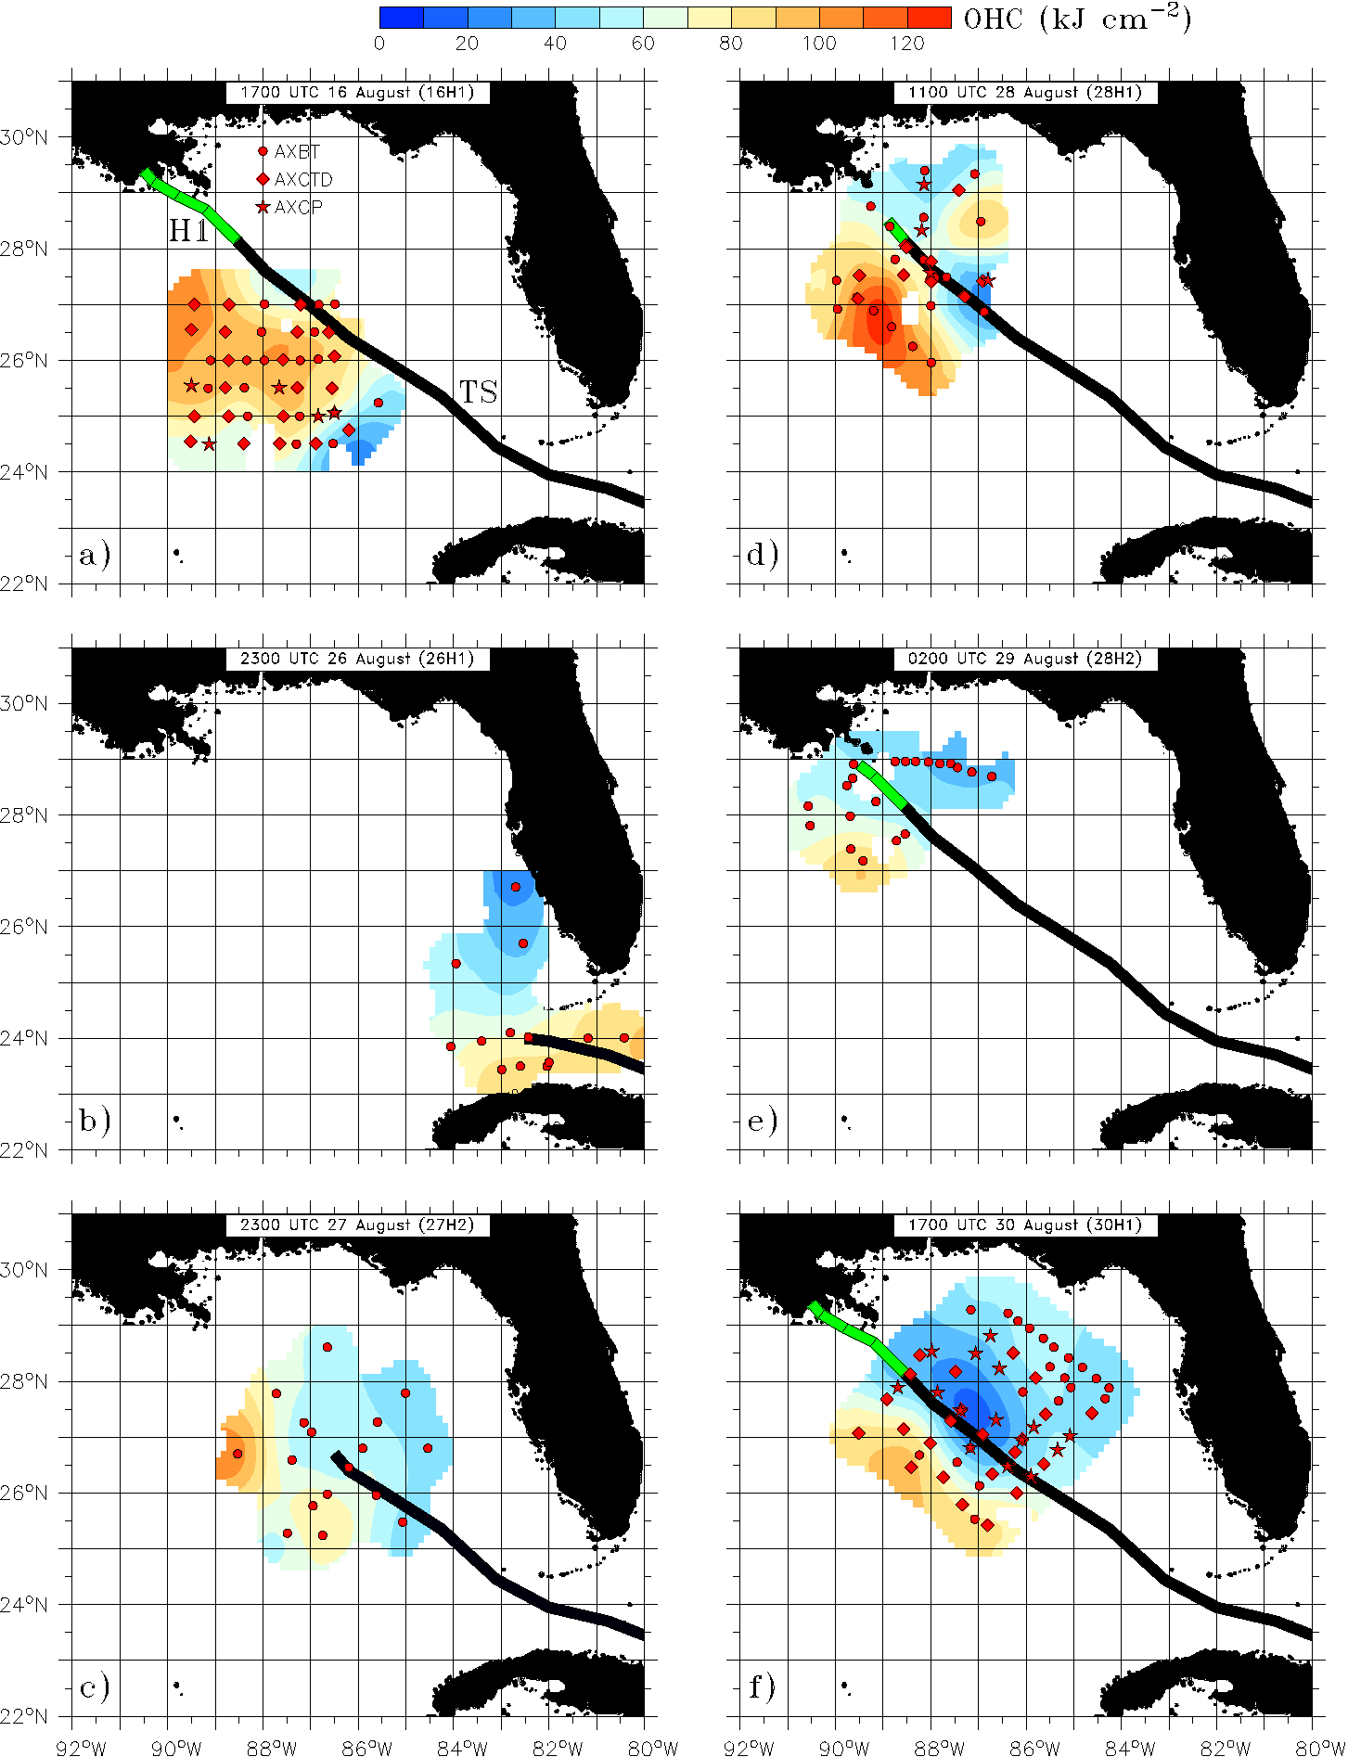
NOAA P3 research flights in Isaac
16H1
28H1
Numbers in parenthesis are quality controlled profilers.
OHC is the ocean heat content relative to the 26ºC isotherm, objectively analyzed from the ocean profilers.
Red and blue shading is associated with anticyclonic and cyclonic ocean eddy features, respectively.
26H1
28H2
27H2
30H1
Jaimes and Shay (2015)

Slide 18
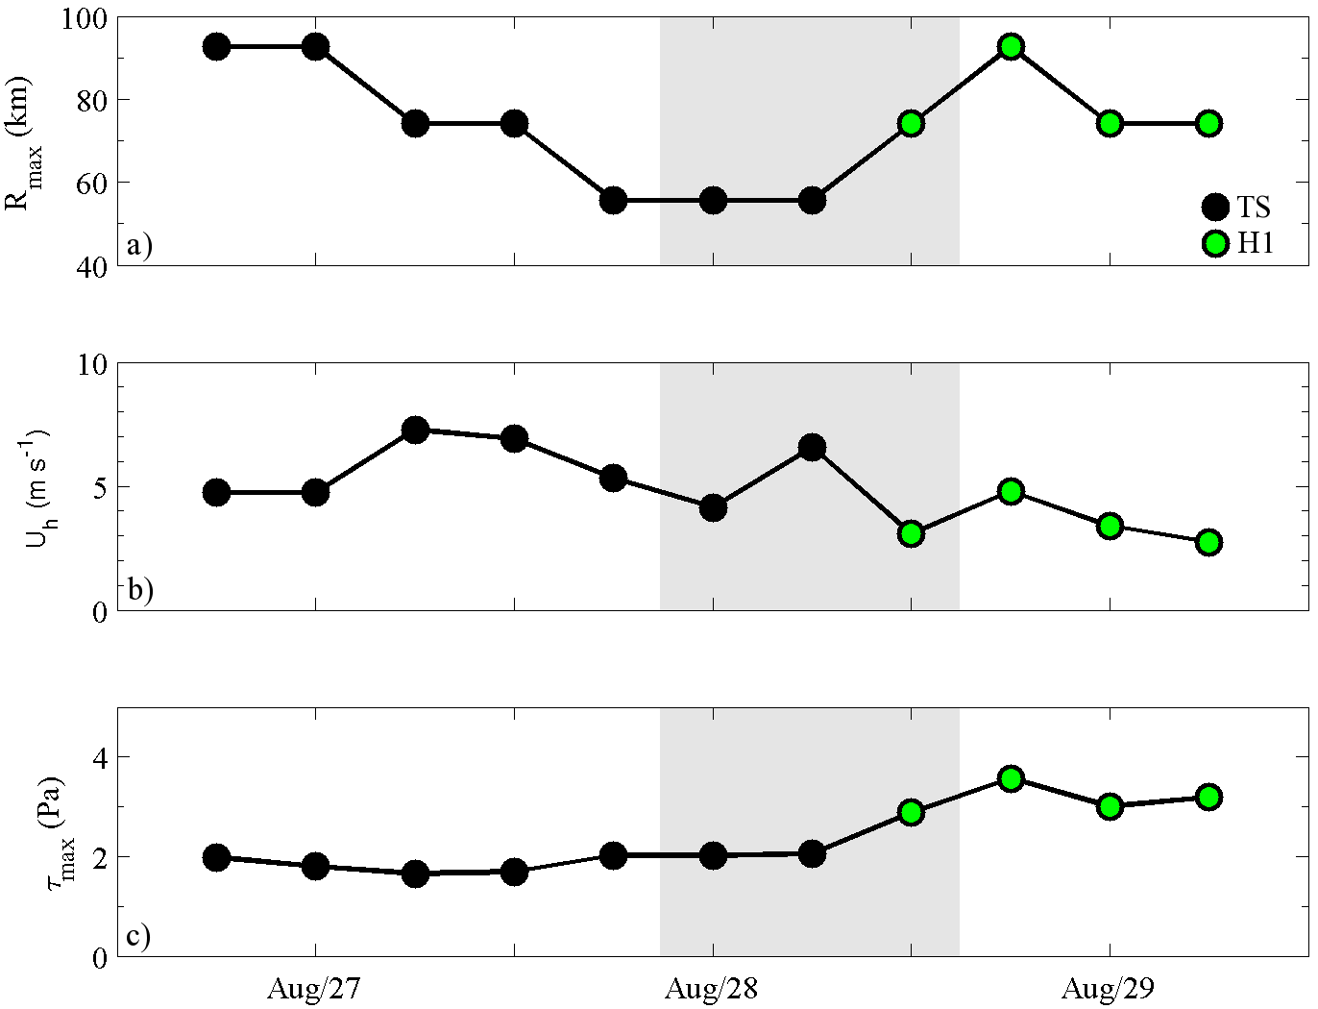
Isaac’s characteristics
Observational period for 27H2 and 28H1
Jaimes and Shay (2015)

Slide 19
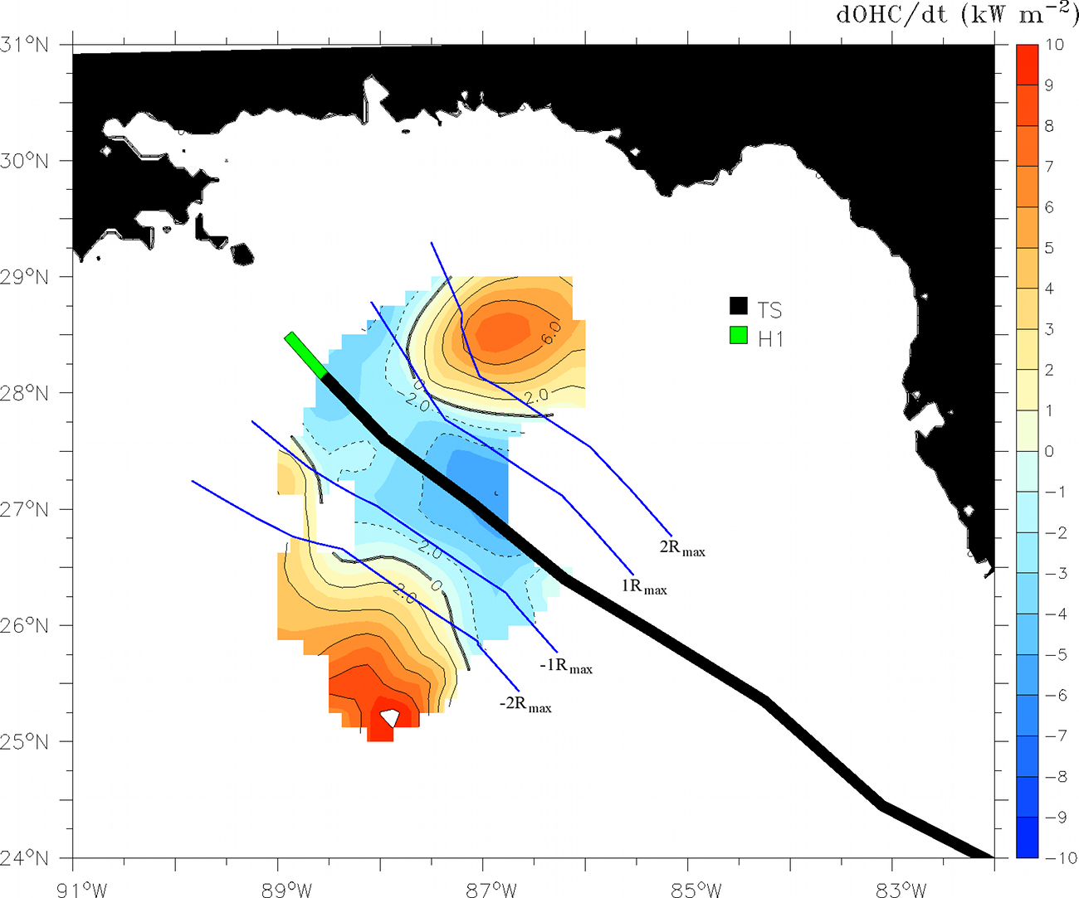
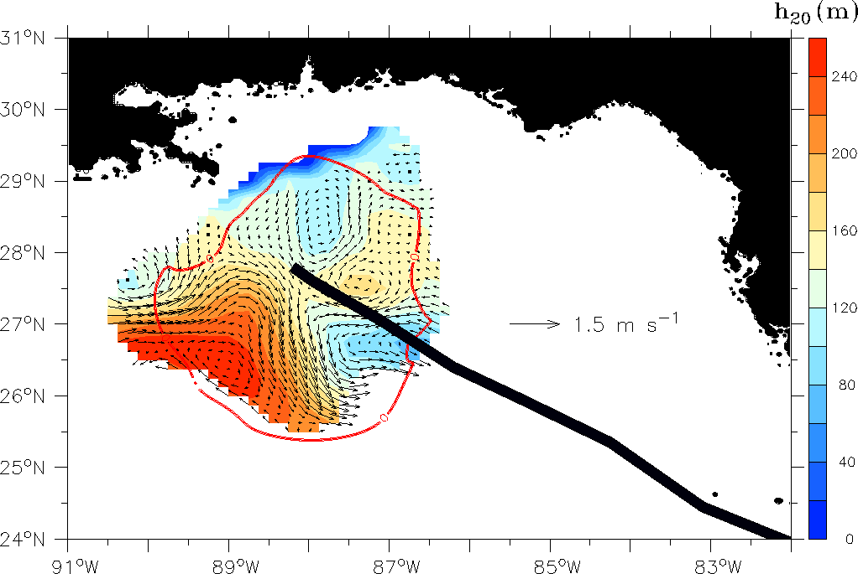
Upper-ocean thermal response to Isaac
Maximum cooling underneath the storm’s center: -3 kW m⁻² over a 12-h interval.
Maximum warming underneath the left and right sides: 8 kW m⁻² over a 12-h interval.
Isaac became a Hurricane over this region of upper-ocean warming (SSTs were above 28ºC).
NOTE: The sea surface heat loss to the storm in intense tropical cyclones is about 1 kW m⁻² (Shay et al. 2000; Shay and Uhlhorn 2008; Lin et al. 2009; Jaimes et al. 2015).
Difference in OHC between profilers from flights 27H2 and 28H1 (12-h interval).
Note: The Systematically Merged Atlantic Regional Temperature and Salinity (SMARTS) climatology is currently used at the National Hurricane Center for hurricane intensity forecasting (Meyers et al. 2014).
Depth of the 20ºC isotherm on 27 August, from the SMARTS product.
Jaimes and Shay (2015)

Slide 20
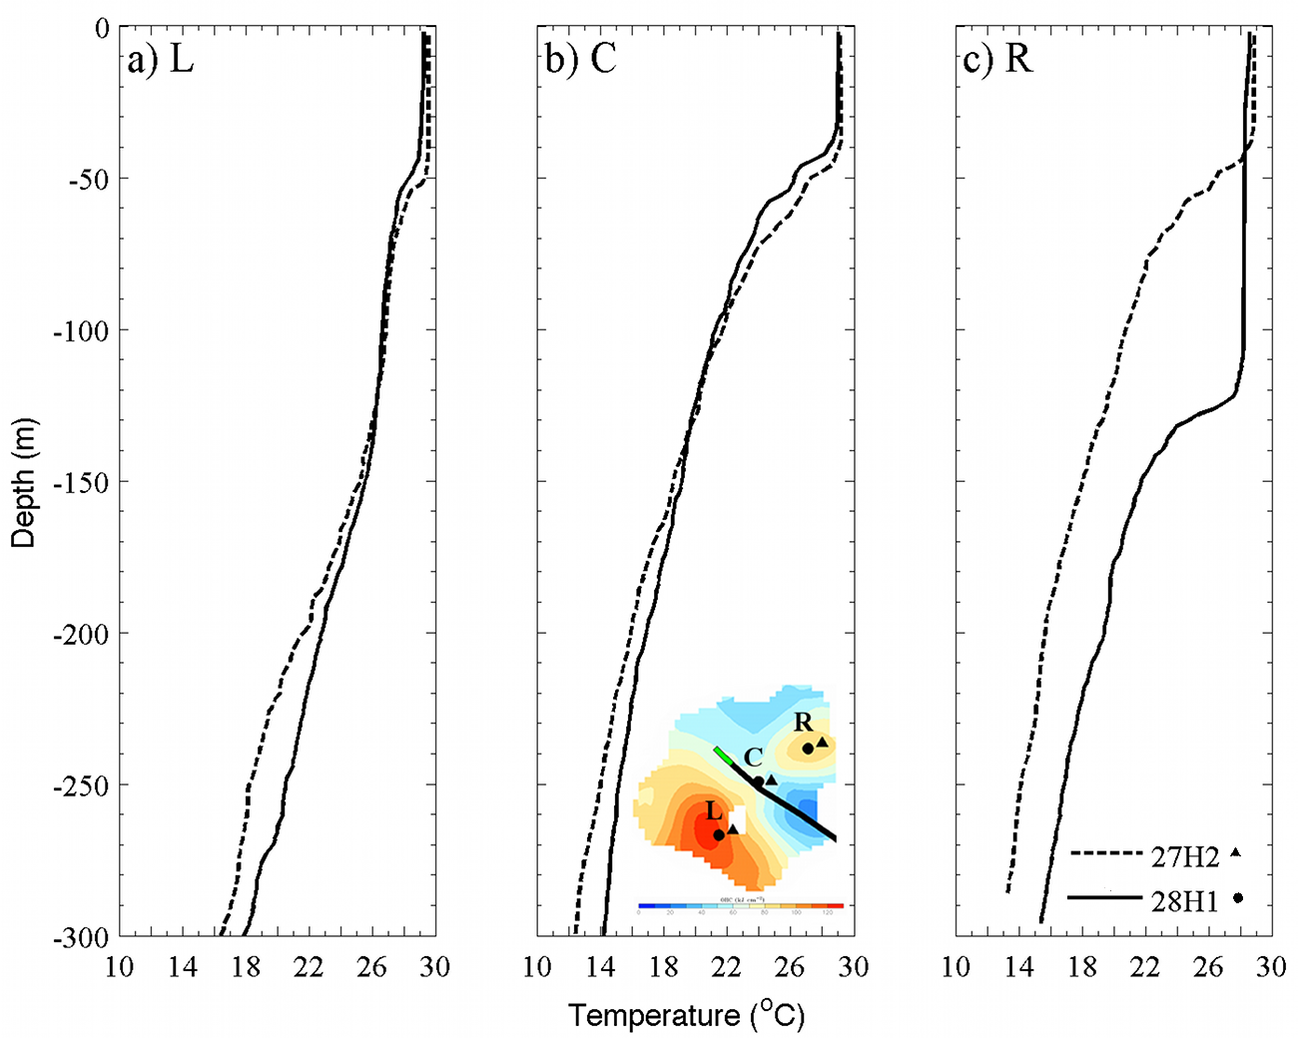
Upper-ocean thermal response to Isaac (12-h interval)
Small OML cooling
Small OML cooling
Small OML cooling
What is the relative contribution of upwelling (Ekman pumping) and vertical mixing to this intense warming?
warming
Jaimes and Shay (2015)

Slide 21
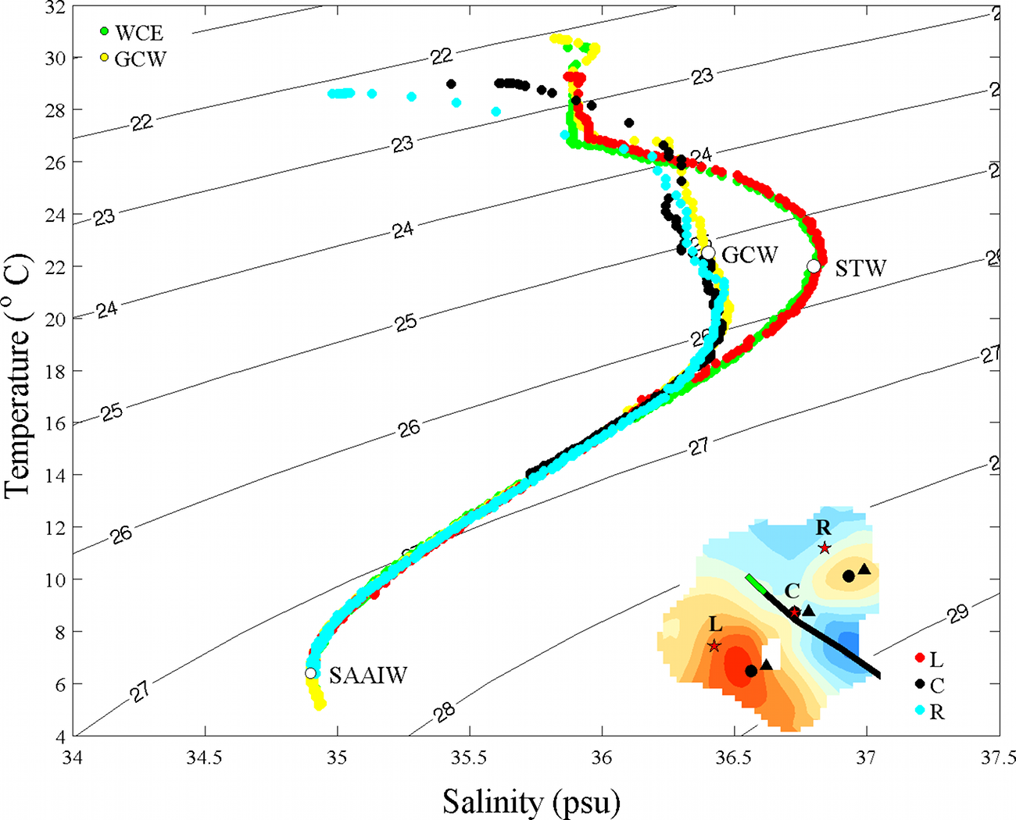
In-storm water-mass response to Isaac (AXCTD data from flight 28H1)
Diabatic cooling regime
(influenced by vertical mixing)
Adiabatic cooling regime
(vertical mixing vanishes)
Evaluate the pure upwelling response (adiabatic reversible process) in terms of fluctuations of the 20ºC isotherm.
Jaimes and Shay (2015)

Slide 22
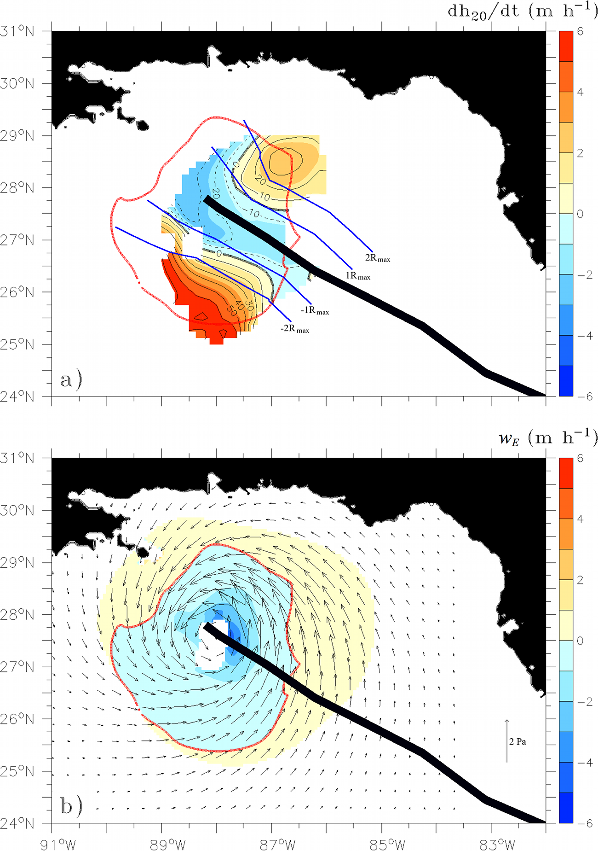
Upwelling response to Isaac (12-h interval)
The observed isotherm’s downwelling was twice the upwelling strength underneath the storm’s center.
This intense downwelling flow explains the observed upper-ocean warming response.
h₂₀: 20ºC isotherm depth
Ekman pumping (w_{E}) based in just the curl of the wind stress.
: wind stress
(from H*Wind; Powell et al. 1996)
Jaimes and Shay (2015)

Slide 23
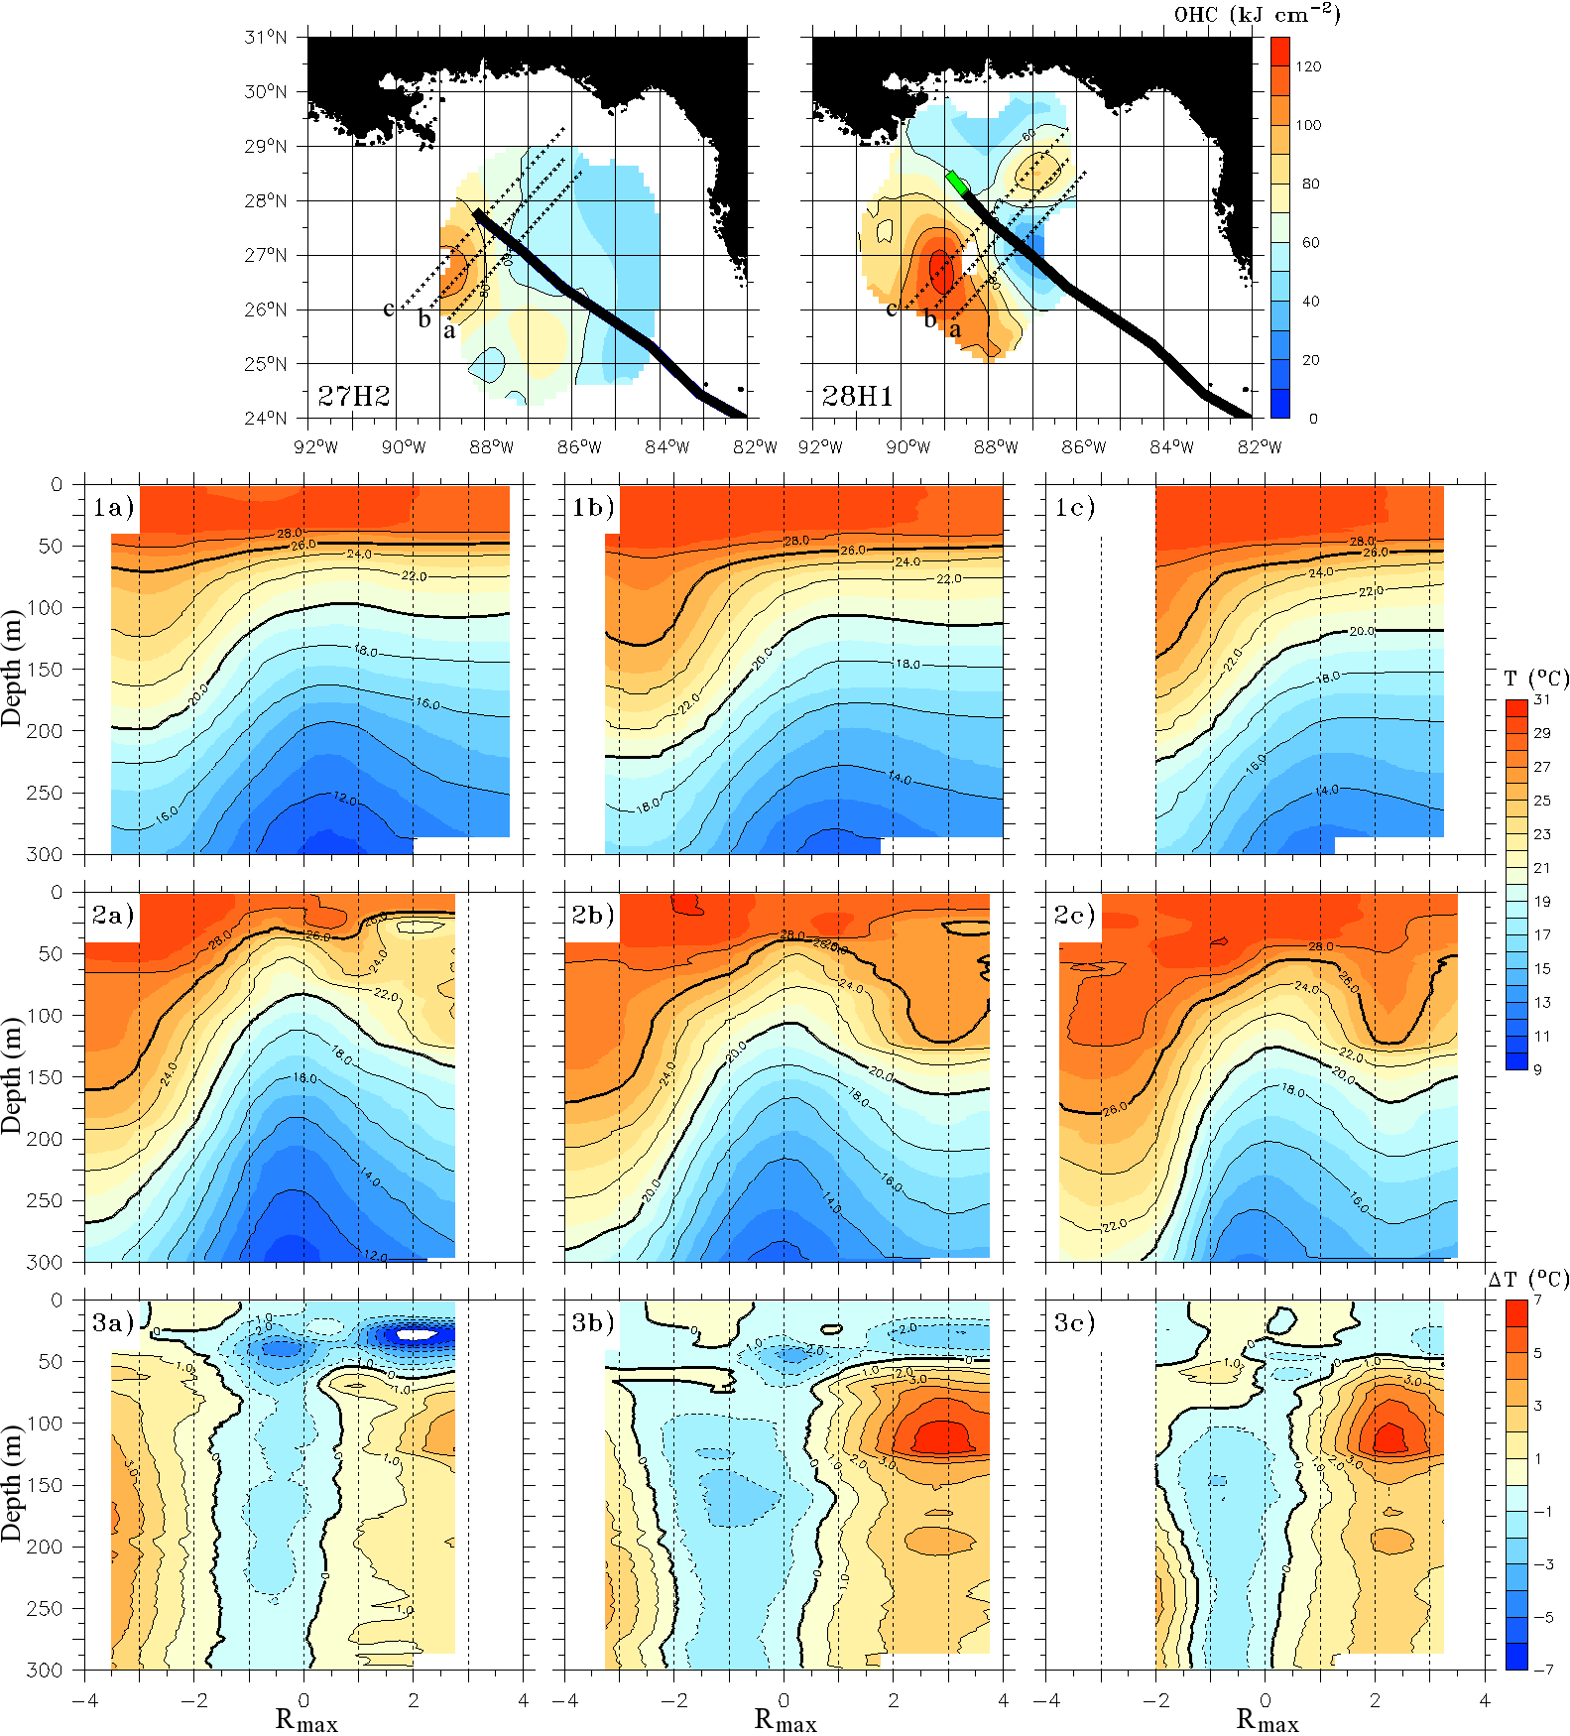
Vertical structure of the temperature response (12-h interval)
27H2
28H1
Difference
(27H2-28H1)
(Jaimes and Shay 2015)

Slide 24
Outline
Background
Upwelling Response to Tropical Cyclones in a Quiescent Ocean
Upwelling Response to Tropical Cyclones in Oceanic Geostrophic Flow
Observations: Ivan, Rita
Steady-state theory: Katrina, Rita
Numerical experiments: Katrina
Upwelling Response to Isaac
Observations
Theory: Tropical Cyclone Pumping in Oceanic Geostrophic Flow
Implications
Concluding Remarks and Future Work

Slide 25
Theoretical Framework
The total fluid flow is separated into two components:
wind-driven component (or frictional component; subscript b);
background geostrophic component (subscript g).
1. Vorticity balance of the frictional flow component in the OML (Stern 1965):
(1)
total horizontal velocity vector
total upwelling or pumping velocity
geostrophic vorticity
turbulent stress vector
k
unit vector

Slide 26
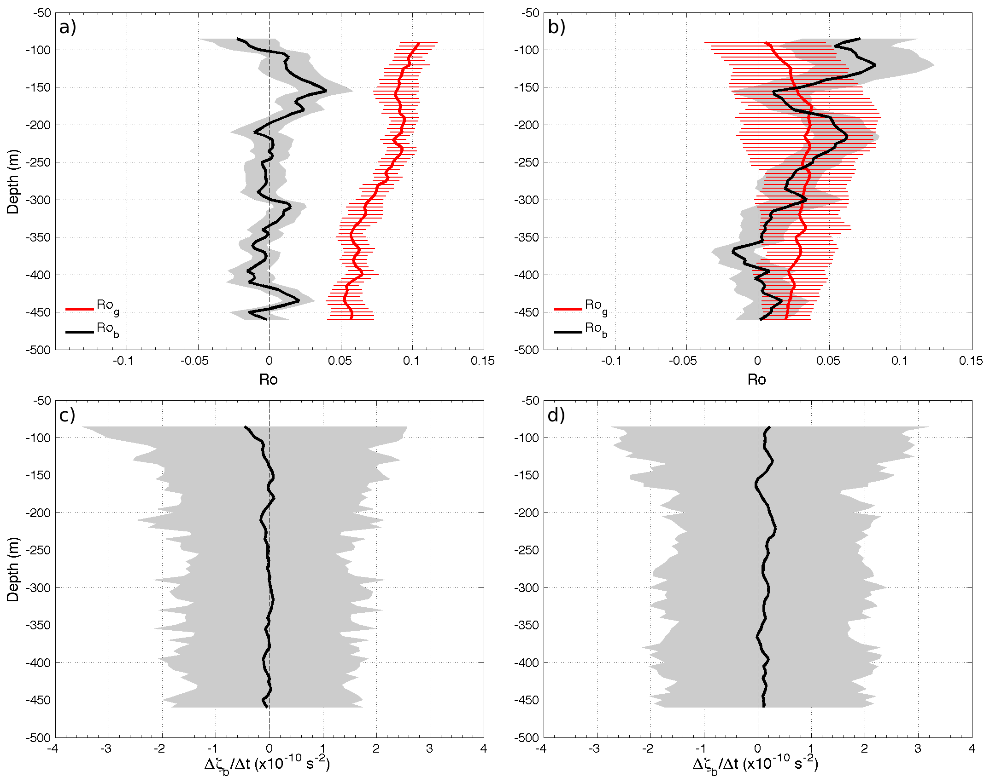
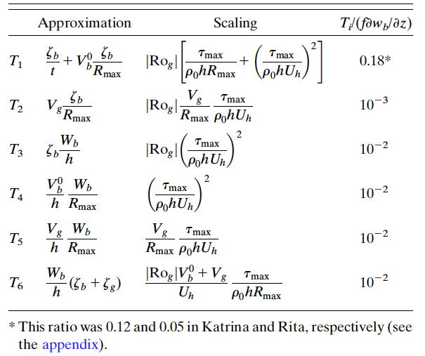
Scaling Analysis
Price (1983)
New
Katrina
Rita
Normalization respect to leading order term (vortex stretching)
Mooring data analysis

Slide 27
Thus, for small Ro_{g} and Ro_{b}, and by neglecting the T_{i} terms because they are much smaller than vortex stretching, (1) becomes
(2)
Vortex stretching
Ekman pumping
Non-linear Ekman pumping
Now, it is easier to get the frictional pumping velocity in geostrophic flow
Integrate (2) from the bottom of the OML to the sea surface
Use the undisturbed Ekman relation
Define boundary conditions: w_{b}(z=0)=w* and θ(z=0)=τ
(3)
Ekman pumping
Non-linear Ekman pumping
Jaimes and Shay (2015)

Slide 28
2. Vorticity balance of the geostrophic flow component in the OML (Stern 1965)
(4)
Assume an Eulerian description of the flow,
Get vertical average of (4) over the OML
Define the boundary conditions (BC) for the OML:
Active BC
z=0
OML
Passive BC
z=-h
Ocean interior
The vorticity balance of the geostrophic flow in the OML is given by:
Passive BC
Active BC
(5)
Non-linear Ekman pumping
Ekman pumping
Pumping velocity in geostrophic flow
(w_{s})
storm’s translation speed
w* from the frictional vorticity balance

Slide 29
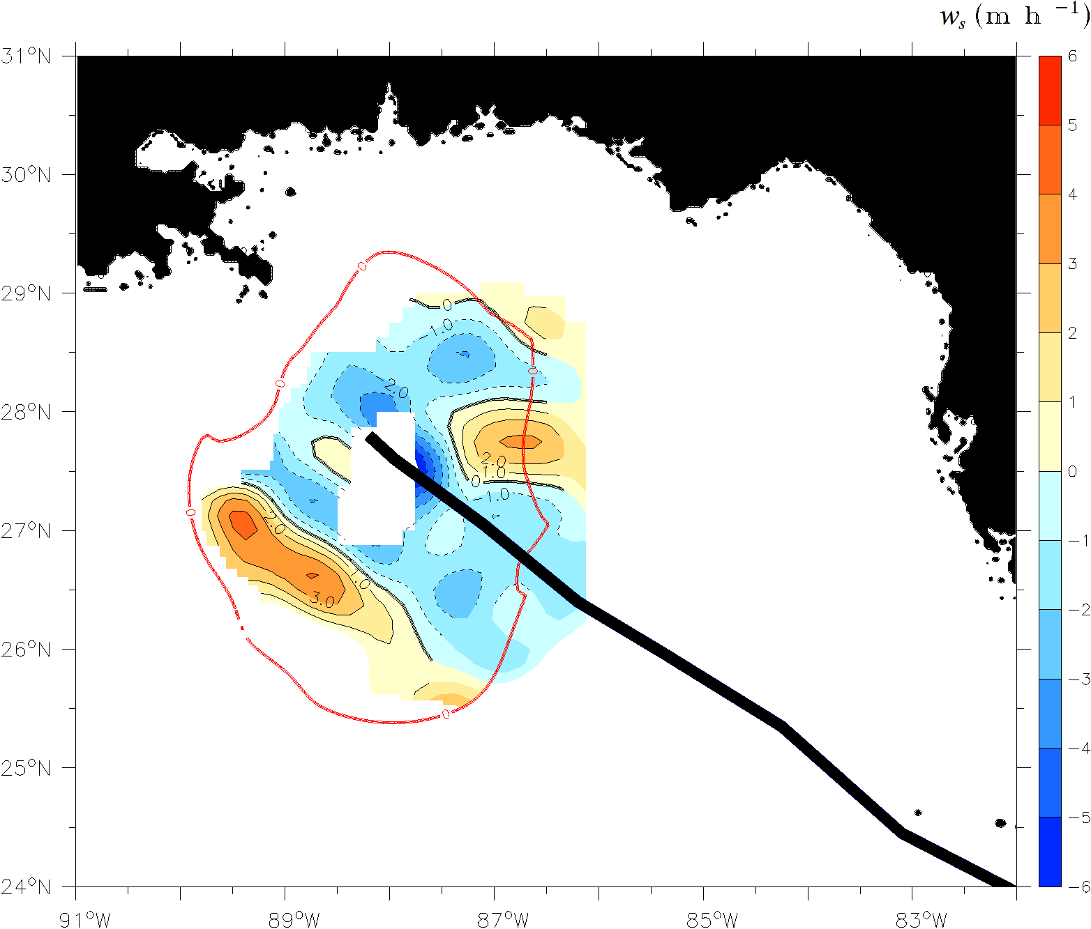
TC-driven pumping velocity in geostrophic flow
Equation (5) can be written as:
Ekman pumping
Non-linear Ekman pumping
Or in parametric form:
and finally:
storm’s translation speed
Ekman pumping
Ekman drift velocity
eddy Rossby number
maximum wind stress
aspect ratio
radius of maximum winds

Slide 30
Outline
Background
Upwelling Response to Tropical Cyclones in a Quiescent Ocean
Upwelling Response to Tropical Cyclones in Oceanic Geostrophic Flow
Observations: Ivan, Rita
Steady-state theory: Katrina, Rita
Numerical experiments: Katrina
Upwelling Response to Isaac
Observations
Theory: Tropical Cyclone Pumping in Oceanic Geostrophic Flow
Implications
Concluding Remarks and Future Work

Slide 31
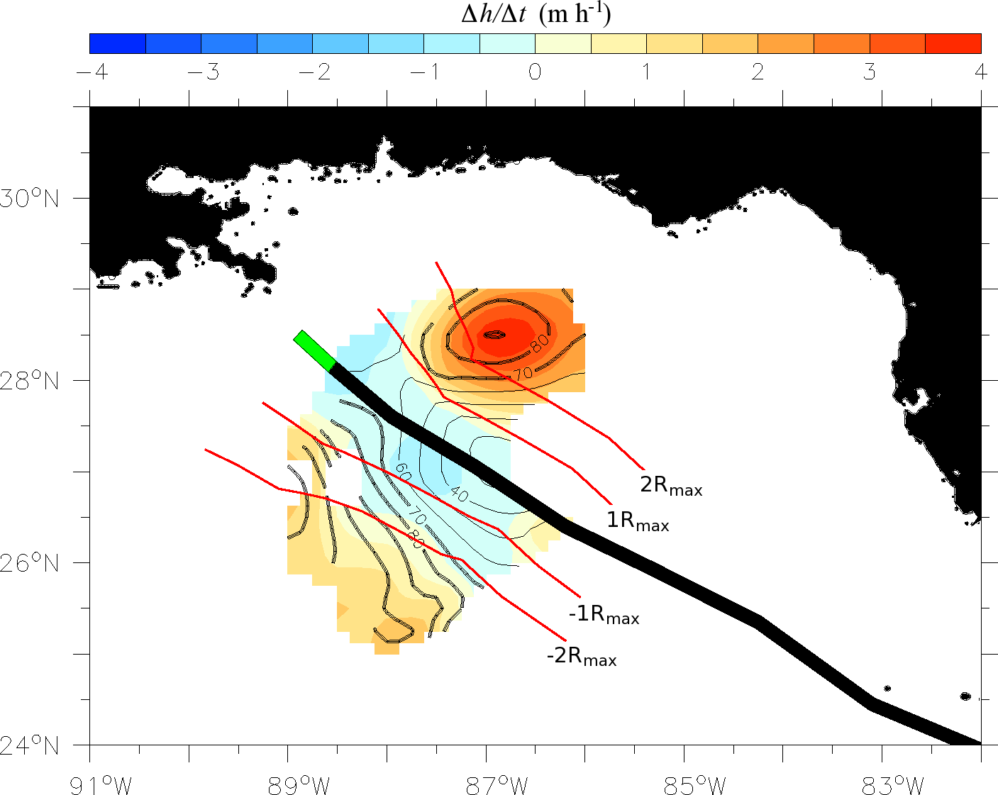
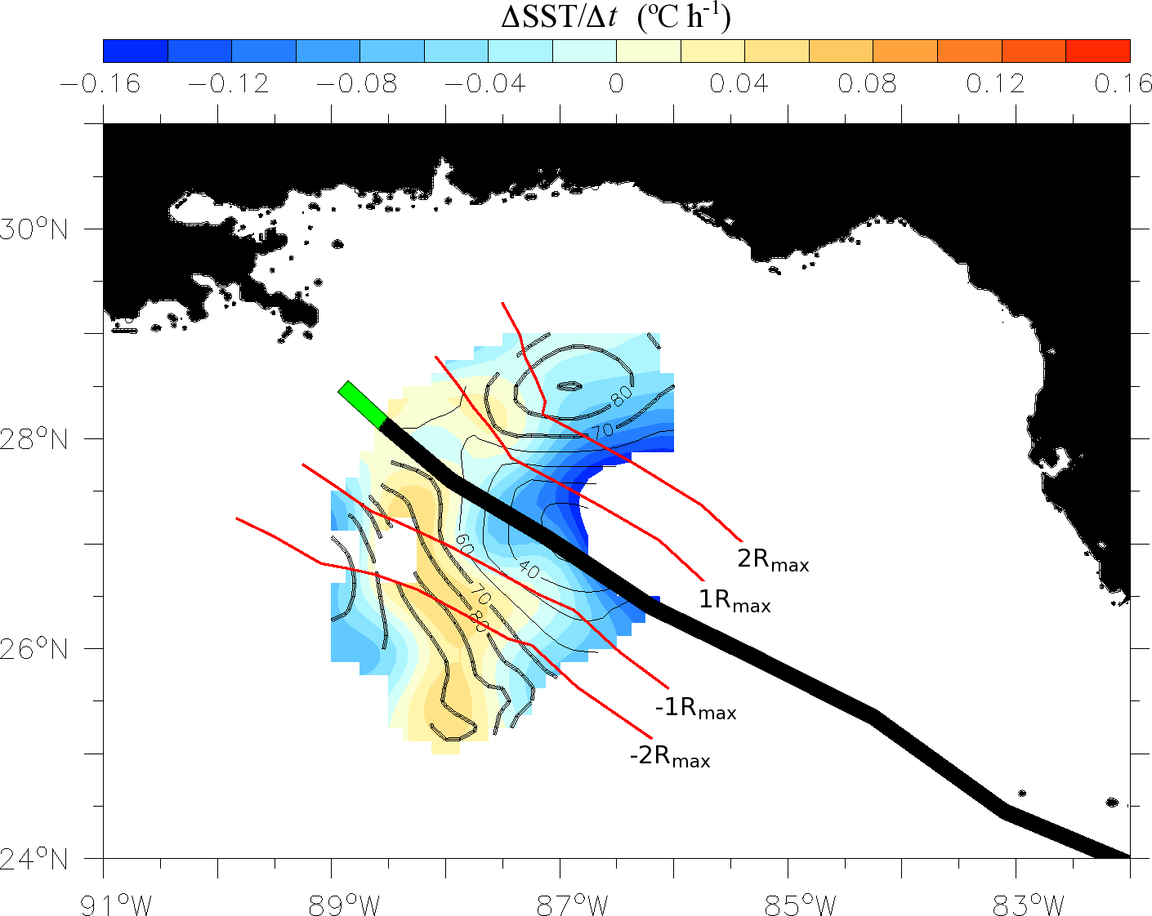
OML and SST responses to Isaac in oceanic geostrophic flow
These response are the 12-h difference between flights 27H2 and 28H1
WCE
WCE
CCE
CCE
WCE
WCE
Contours: OHC [kJ cm⁻²]
Contours: OHC [kJ cm⁻²]
Sea surface warming by wind-driven horizontal advection of thermal structure
Jaimes, B., L. K. Shay, and J. K. Brewster, 2015: Coupled air-sea response during the intensification of tropical cyclone Isaac over warm oceanic features. To be submitted to JGR-Oceans, dedicated issue on Physical Processes Responsible for Material Transport in the Gulf of Mexico for Oil Spill Applications, edited by D. Kirwan Jr., T. Ozgokmen, and E. North.

Slide 32
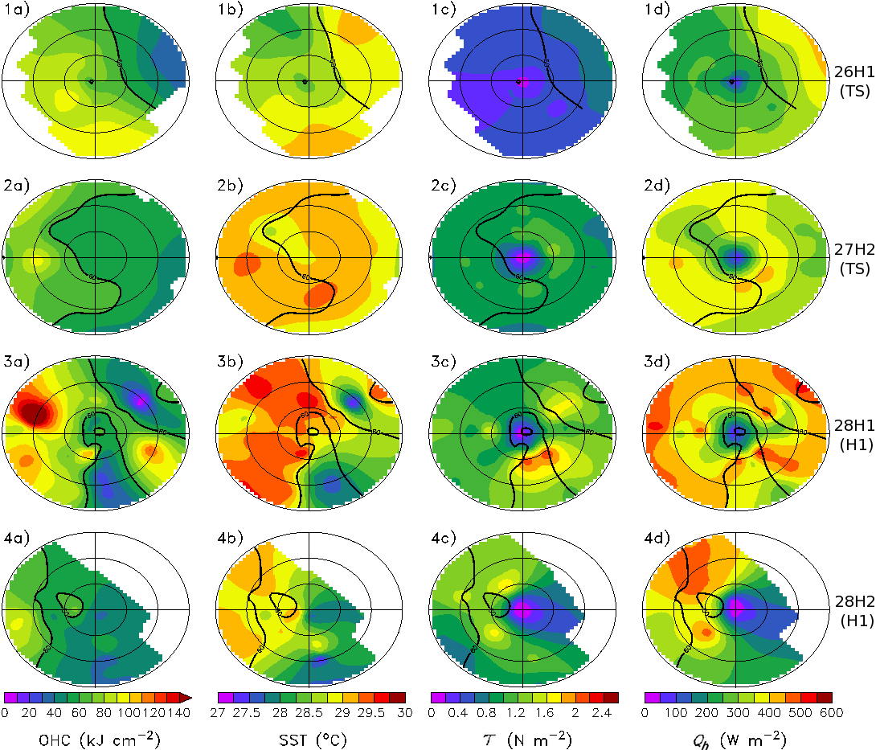
Air-sea fluxes in Isaac over oceanic geostrophic flow
OHC
SST
Momentum flux
Enthalpy flux
Moisture disequilibrium
26H1
(TS)
27H2
(TS)
Positive Feedback
28H1
(H1)
Horizontal current convergence
28H2
(H1)
Sea surface warming
Moisture disequilibrium
Enhanced enthalpy fluxes
Jaimes et al. 2015 (to be submitted to special JGR issue)

Slide 33
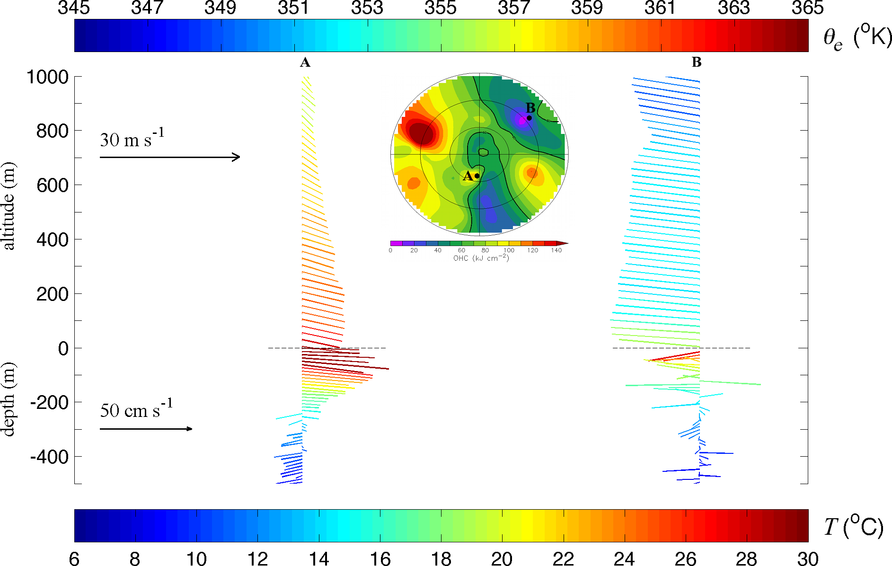
Coupled response to Isaac in oceanic geostrophic flow
Dropsonde data
AXCP data
Jaimes et al. 2015 (to be submitted to special JGR issue)

Slide 34
Concluding Remarks
Strength and structure in the oceanic geostrophic flow significantly impact upwelling and downwelling responses, and these responses can be very fast.
Because downwelling responses warm the upper-ocean preventing significant cooling of the sea surface in TCs, they are expected to create favorable ocean conditions for TC development, maintenance, and rapid intensification.
The coupled interaction of the wind stress and oceanic geostrophic flows is a leading order, tri-dimensional dynamical process. Thus, incorporating realistic ocean states in coupled numerical hurricane models is a necessary condition to improve intensity forecasting.
We need direct measurements to correctly initialize the atmospheric and oceanic components in coupled operational models.

Slide 35
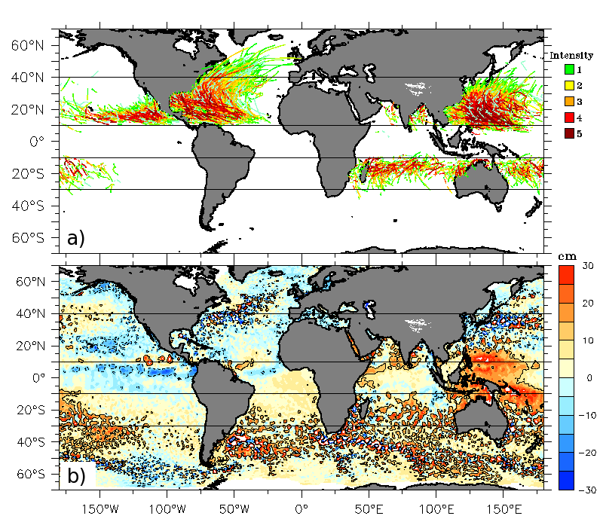
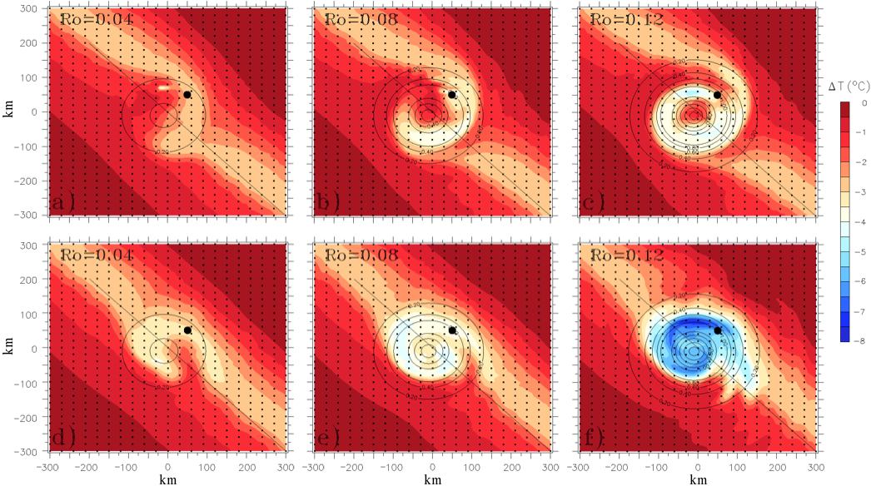
Future Work
“Wind-driven upwelling and vertical mixing in mesoscale eddies from a global perspective”. NASA Grant Number NNX15AG43G (2015-2018).
Regions of intense TC activity are collocated with regions of intense mesoscale oceanic eddy activity (Jaimes et al. 2011).
Working scientific hypothesis:
Ro=0.04
Ro=0.08
Ro=0.12
The thermal response of mesoscale oceanic eddies to wind forcing events is a function of eddy strength (Ro) (Jaimes et al. 2011; Jaimes and Shay 2015).
Anticyclones
Ro=0.04
Ro=0.08
Ro=0.12
Cyclones

