Slide 1


Advances in Numerical Modeling for Tropical Cyclone Predictions
Sundararaman gopalakrishnan (gopal)
noaa/aoml/Hurricane research division, Miami, FL, USA
Presented at India Meteorological Department
Bhubaneswar. Dec 18, 2014

Slide 2
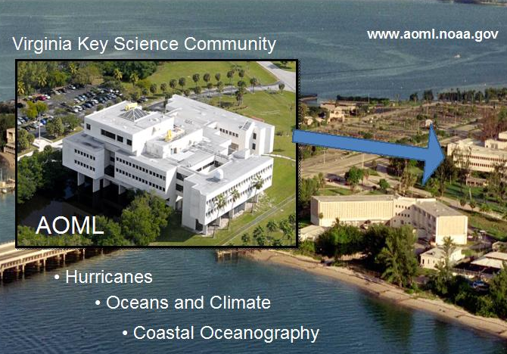
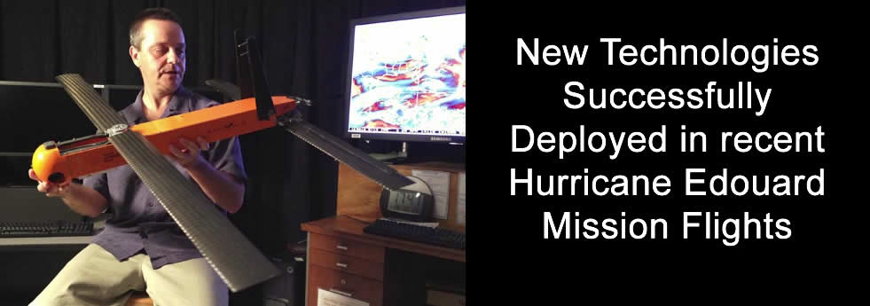






Who are we ?
AOML Modeling Team
Dr. Xuejin Zhang
Dr.Thiago Quirino
Dr.Hua Chen
Mr.Stanley Goldenberg
Mr.Robert Black
Dr.Steven Diaz
Dr.Gus Alaka
Dr.Javier Delgado
Mr.Russell Fluer
Dr.Jun Zhang
Dr.Krishna Kishore (IIT.Bhubaneswar)
J.-W.Bao (PSD/ESRL)
George Halliwell (PHOD/AOML
Acknowledgements
Drs. Frank Marks, Robert Atlas and Prof.U.C.Mohanty

Slide 3

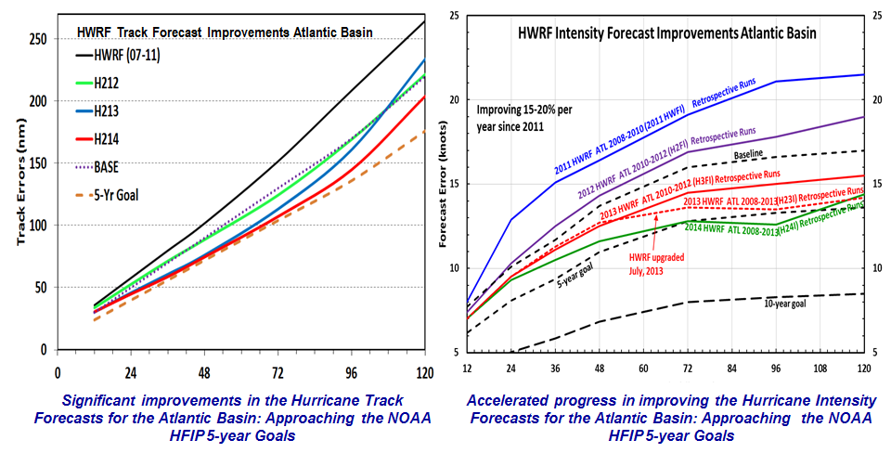
Goals
Improve Forecast Accuracy
  Hurricane impact areas (track) – 50% in 10 years
  Severity (intensity) – 50% in 10 years
  Rapid intensity change detection
Extend forecast reliability out to 7 days
Quantify, bound and reduce forecast uncertainty to enable risk management decisions
Response
NOAA research (AOML/HRD), NWS (NCEP/EMC) and HFIP partners (DTC) are developing the HWRF modeling system to address our immediate and future operational needs.
Credits to HWRF team at EMC
Highlights
2011: First cloud resolving operational TC forecasting system for Atlantic and East Pacific basins
2012: Official guidance model for JTWC and India Meteorological Department
2013: Significant progress in TC track, structure, intensity and RI predictions over all basins
http://www.hfip.org/
Notes:
In response to the HFIP goals, NOAA operations and research along with the community have worked together to develop the high resolution HWRF system

Slide 4

Hurricanes Observations
We use all types of observation platforms
Two examples: NOAA Gulfstream-IV (G-IV) jet and the NOAA P-3 jet
NOAA G-IV
NOAA P-3
NOAA P-3:
Flight altitude: ~25,000 ft (7600m, 400 hPa)
Instruments: uses Doppler Radar
NOAA G-IV:
Flight altitude: ~45,000 ft (13700m, 150 hPa)
Instruments: uses GPS dropsondes

Slide 5
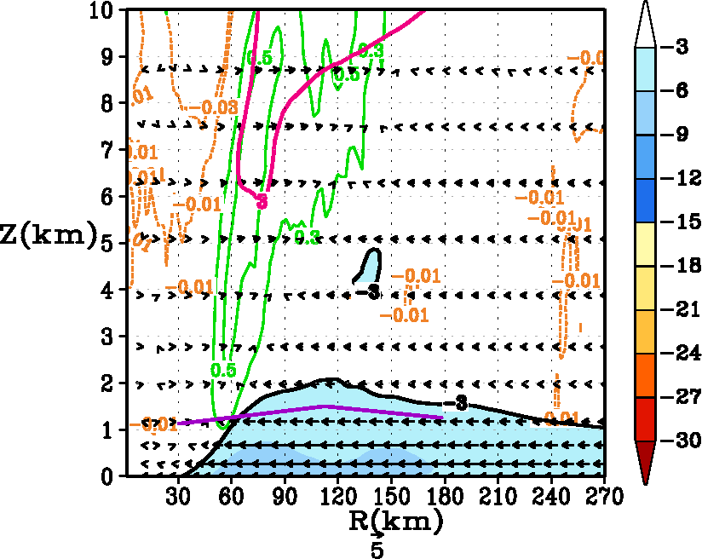
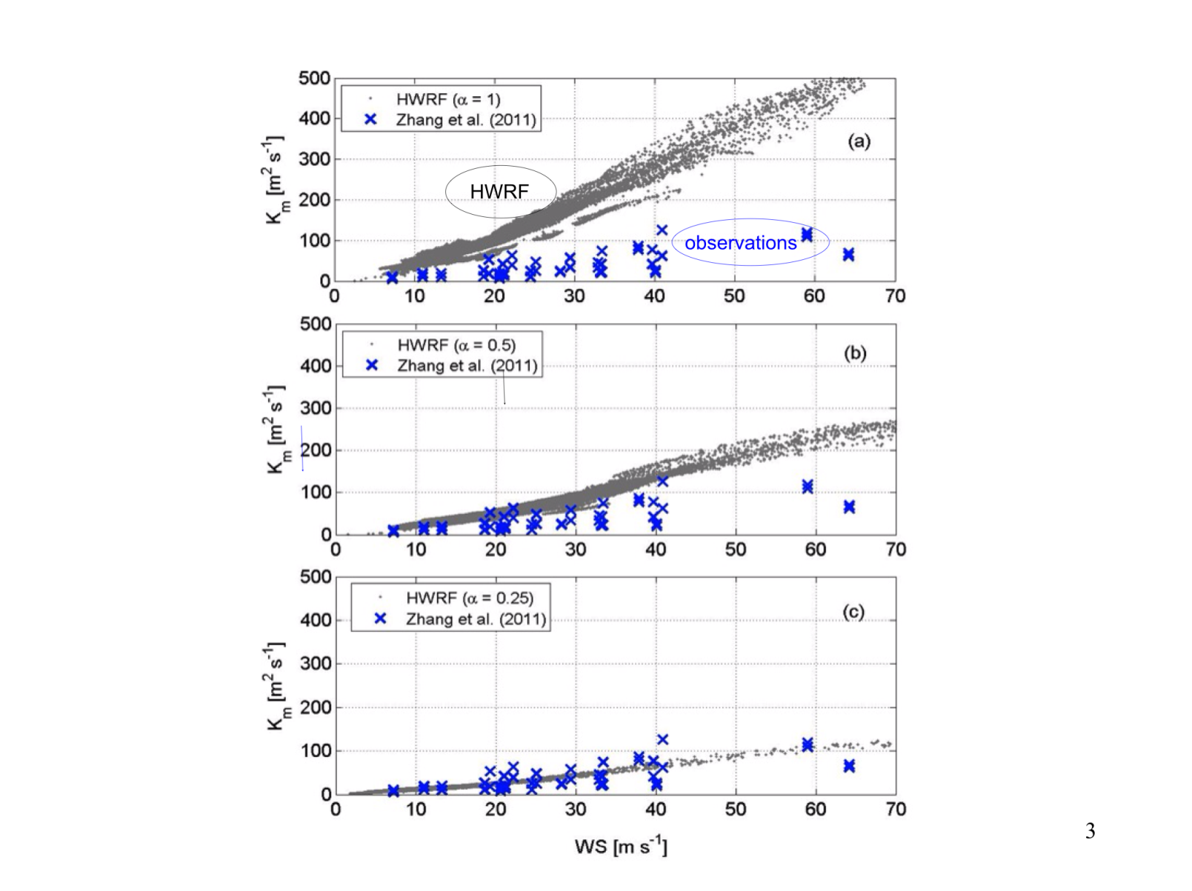

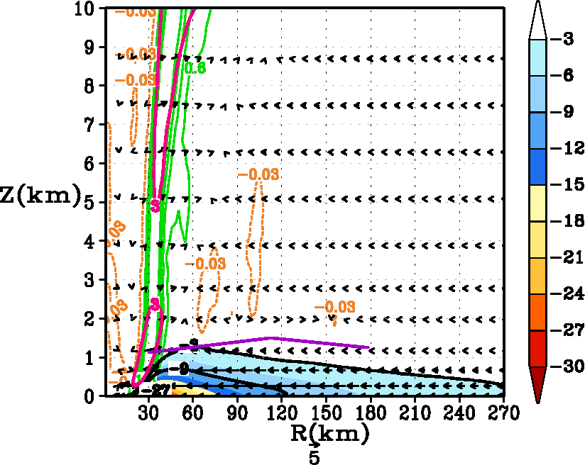
ADVANCES IN HURRICANE PHYSICS: USE OF P3s & G-IV IN IMPROVING PBL
K_{m} = k (U*/F_{m}) Z {a(1 – Z/h) ²}
Eddy Diffusivity
α=1.0
Before
α=0.25
Improved
Improved observation-based PBL in the High Resolution HWRF.
Findings: Improved secondary circulation, stronger inflow & smaller mature storms
---------------------------------------------------------------
Gopalakrishnan et al., 2013 (JAS)
Notes:
An example of how hurricane observations can be used to improve modeled PBL parameterization. The theoretical work (Gopalakrishnan et al., 2013) cited above and observational work (Zhang et al., 2011) transitioned to operations. An example of R2O effort. Figure on the right shows the mean secondary circulation from the original, diffusive GFS scheme and with the improved scheme. High resolution and physics improved for the high resolution HWRF had some significant positive impacts on the operational HWRF system.

Slide 6

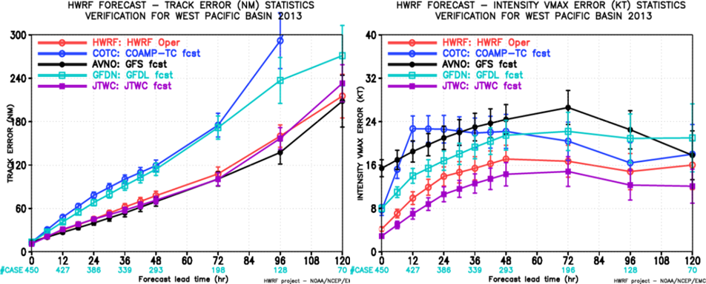
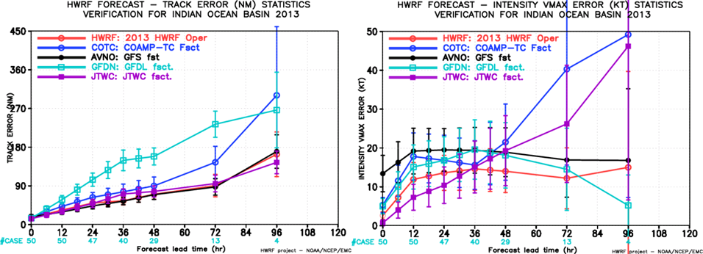
HWRF Forecast in Global Basins
Credits to HWRF team at EMC, NCEP
Steep Step Improvements in Track and Intensity guidance over all basins

Slide 7
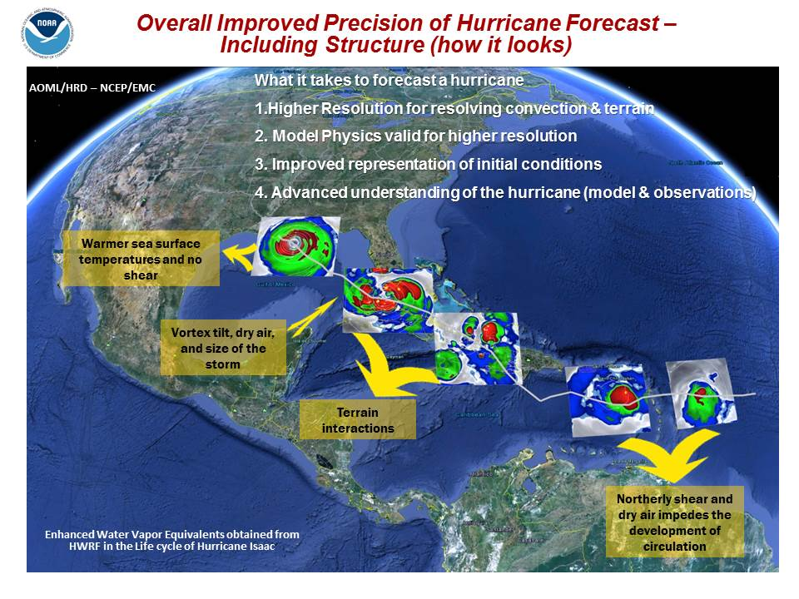
NOAA HURRICANE MODEL: STATE-OF-THE-ART
Where are we? These are not enhanced water vapor imageries from GOES Satellites but are modeled equivalents. High resolution models are getting close to reality. How did NOAA get here? High resolution is not only important for simulating improved vortex scale interactions, but also for forecasting terrain interactions.
Notes:
Where are we? These are not enhanced water vapor imageries from GOES Satellites but are modeled equivalents. High resolution models are getting close to reality. How did NOAA get here? High resolution is not only important for simulating improved vortex scale interactions, but also for forecasting terrain interactions.

Slide 8
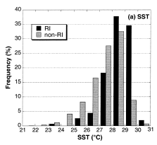
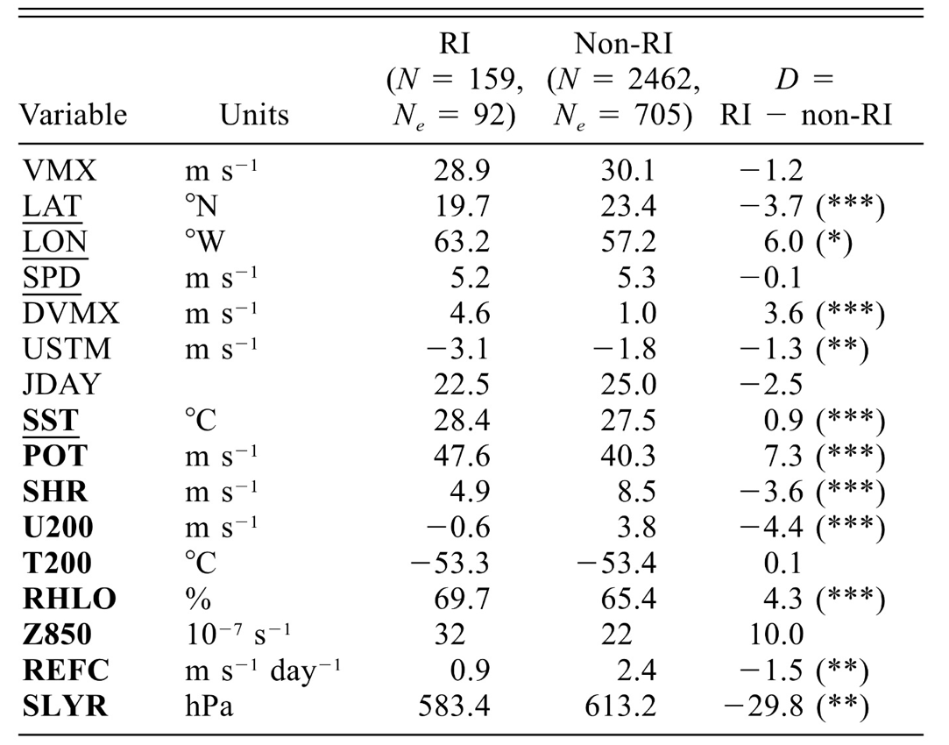
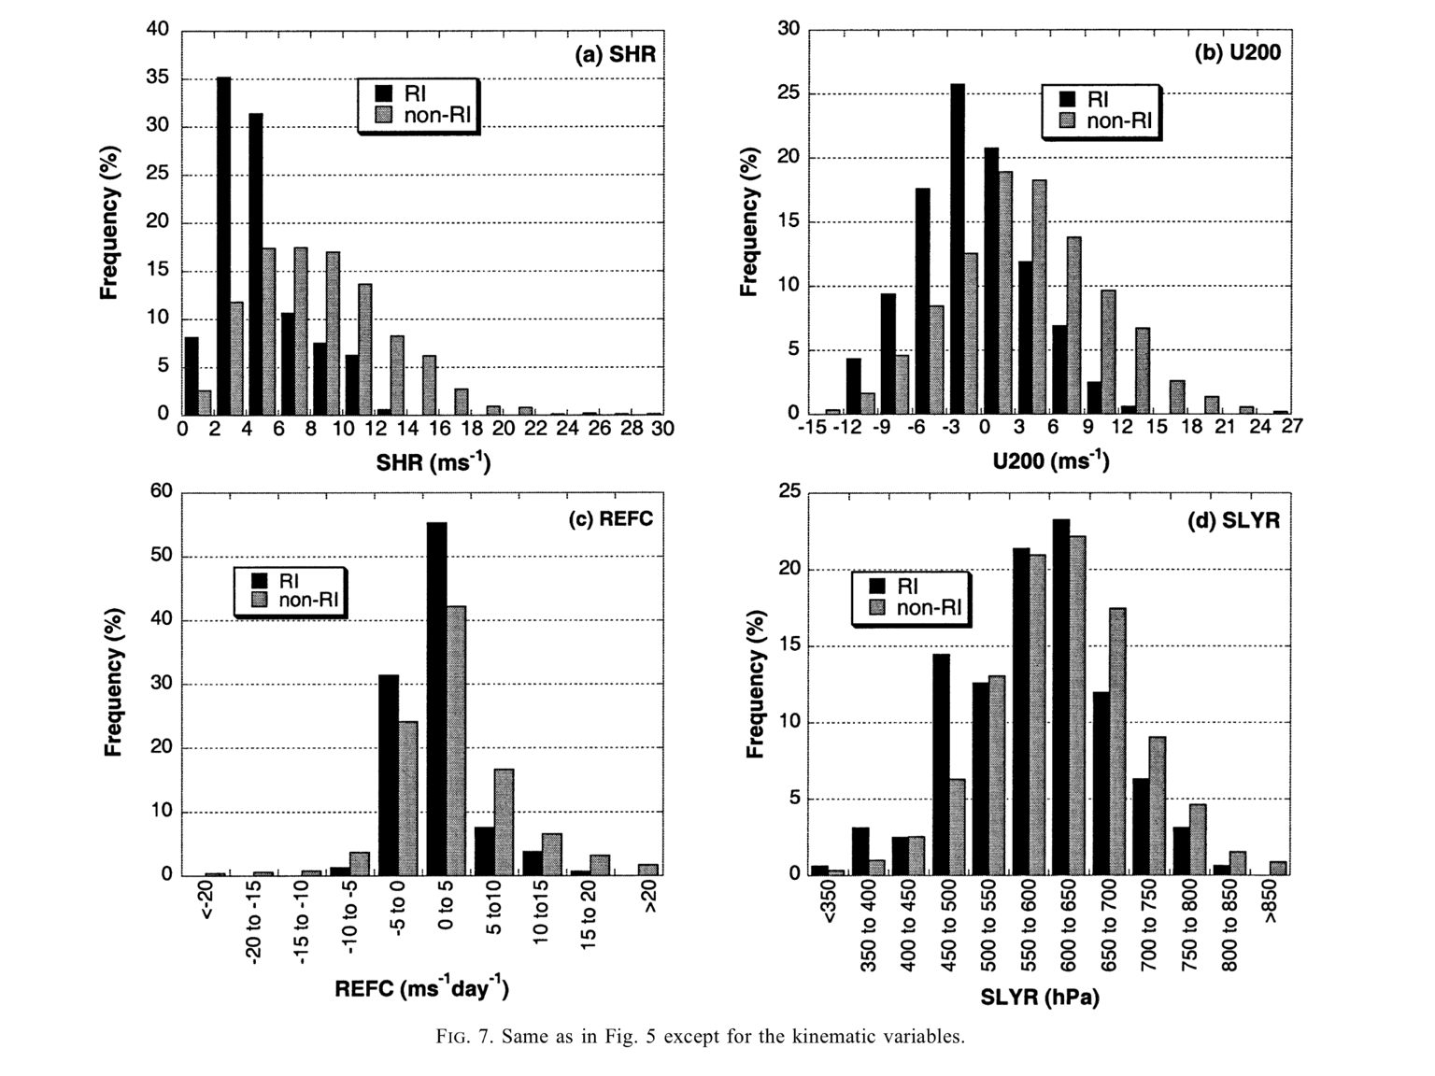
Factors that influence TC Rapid Intensification
Adopted from Kaplan and DeMaria, 2003, Weather and Forecasting
SST
Deep-Layer Shear
Factors interact in a non-linear manner. HWRF may be for conducting control experiments and for understanding modeled intensification process [Gopal et al, 2011 (MWR), Bao et al., 2012 (MWR), Gopal et al, 2013 (MWR), Kieu et al, 2014 (GRL), Halliwell et al, 2014 (MWR), D.-L. Zhang et al. ,2014 (MWR)

Slide 9
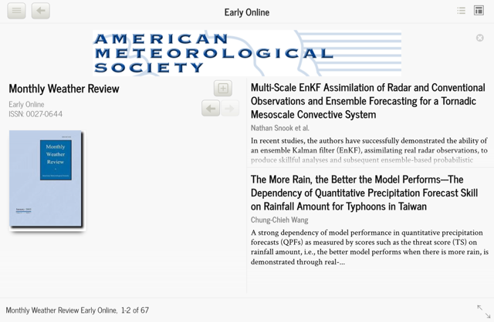
Idealized Study of Ocean Impacts on Tropical Cyclone Intensity Forecasts
G.R.Halliwell, S.Gopalakrishnan, Frank Marks and D.Willey
Idealized coupled tropical cyclone (TC) simulations are conducted to isolate ocean impacts on intensity forecasts. A one-dimensional ocean model is embedded into the Hurricane Weather Research and Forecasting (HWRF) model. For storms translating at >2 m/s, ocean impact on quasi-equilibrium intensity is minimal for storms travelling over regions with TCHP > 85 kJ/cm⁻², more so for small storms compared to large ones. When storms encounter an oceanic region with different heat potential, enthalpy flux adjustment is governed primarily by changes in air-sea temperature and humidity difference that respond within 2-4 h in the inner- core region, and secondarily by wind speed changes occurring over a time interval up to 18 h after the transition. Atmospheric feedback always acts to limit the change in enthalpy flux and intensity through adjustments in 10-m temperature and humidity.

Slide 10
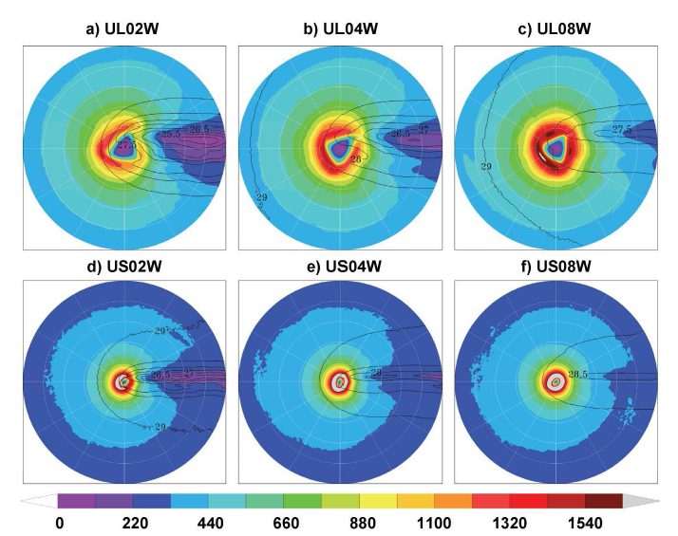
Influence of Ocean on TC intensity Forecast
Total enthalpy flux at hour 60 with SST contours overlaid for six uniform-ocean forecasts initialized with warm ocean conditions. The top row is for large storms with translation speeds of (a) 2 m/s, (b) 4 m/s, and (c) 8 m/s. The bottom row is for small storms with translation speeds of (d) 2 m/s, (e) 4 m/s , and (f) 8 m /s. In all panels, SST is contoured at 0.5ºC intervals.
Ocean interactions become very important for slow moving and large storms, though

Slide 11
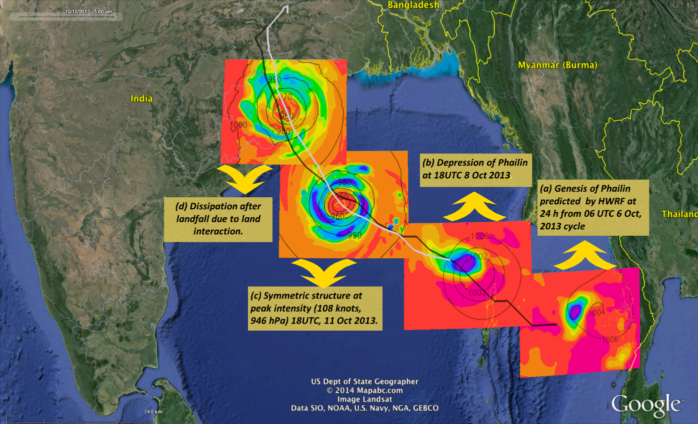
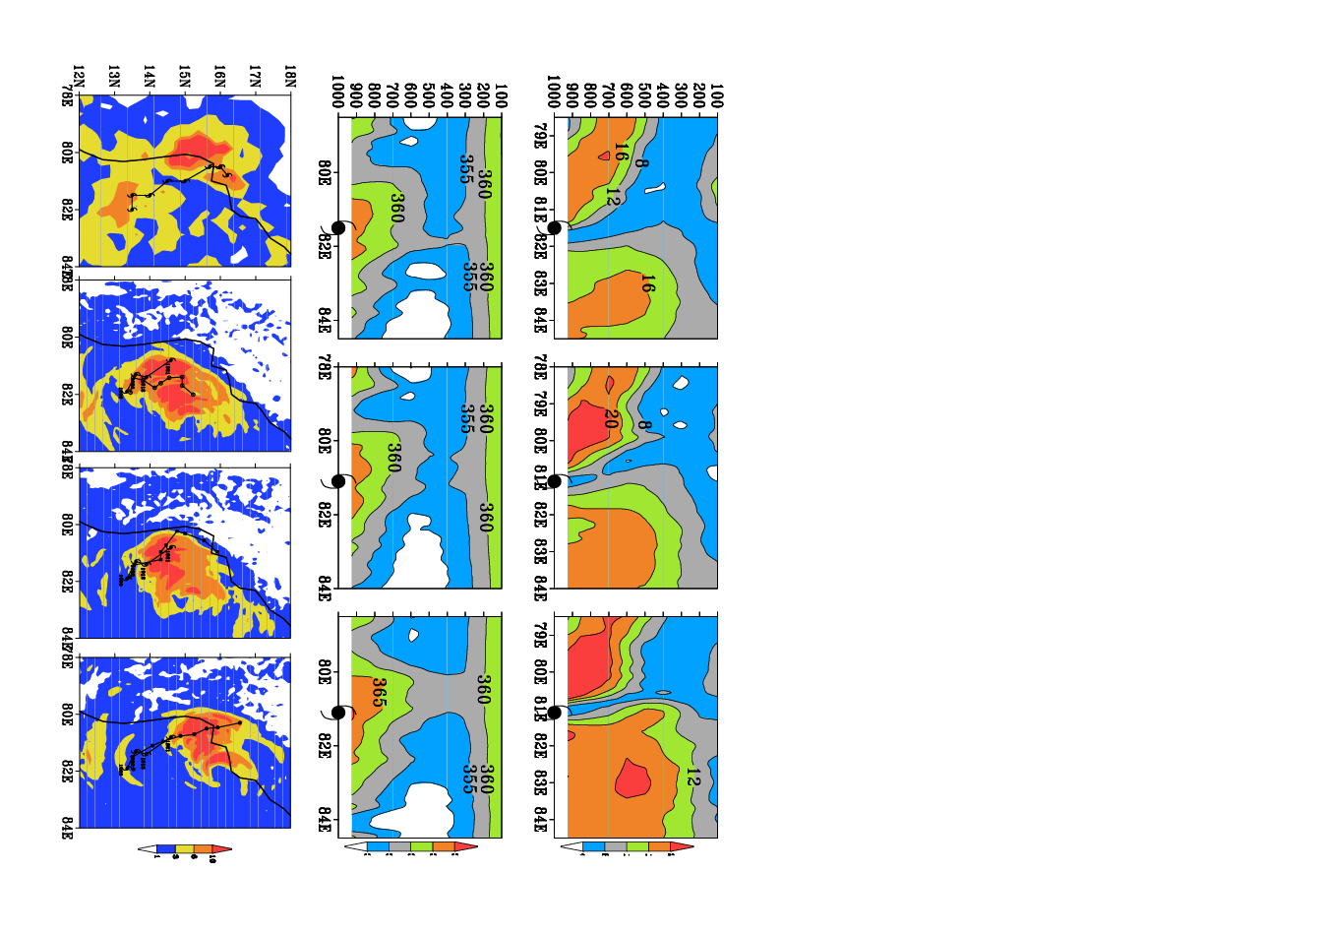


TC Research in BoB (at IIT BBSR)
HWRF Predictions of Phailin (2013)
TC Laila: 00UTC 19 May 2010
CNTL DWR obs
Osuri et al. (2014), Monthly Weather Review
Peak surge (m) Sea surface elevation (m)
J. Appl. Meteor. Climatol.,
Real-Time Track Prediction of Tropical Cyclones over the North Indian Ocean Using the ARW Model.
Krishna K. Osuri, U. C. Mohanty, A. Routray, M. Mohapatra, and Dev Niyogi
J. Appl. Meteor. Climatol., 52, 2476–2492.
Mohanty et al. (2014), Earth Interactions

Slide 12
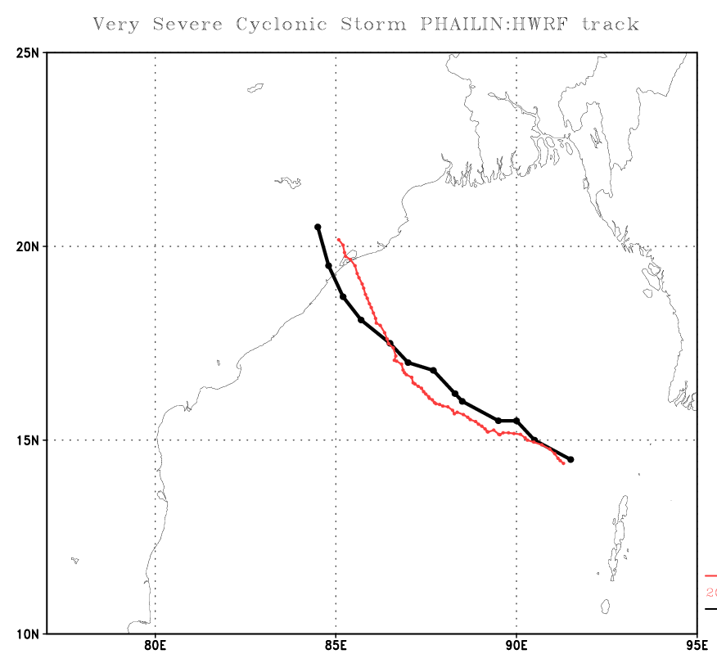
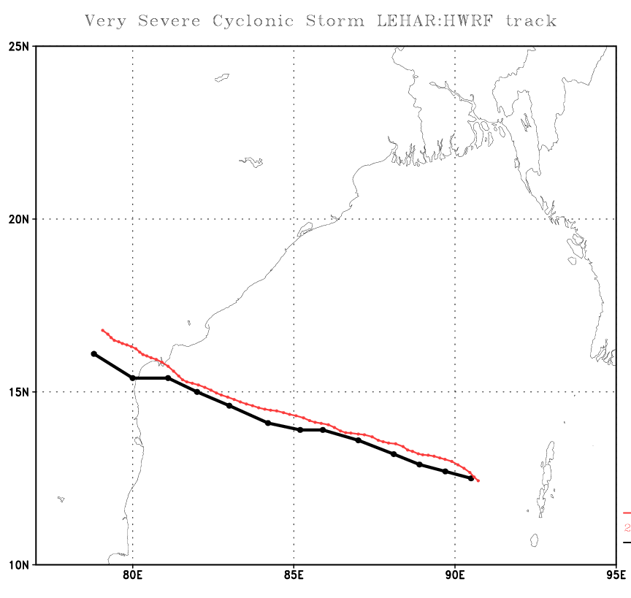
Understanding Intensity changes: Impact of moisture
Black: Observed
Red: HWRF
Dotted line: HWRF BLUE: MSLP (hPa)
Solid line with circle: OBS ORANGE: 10-m wind (kt)
Dotted line: HWRF BLUE: MSLP (hPa)
Solid line with circle: OBS ORANGE: 10-m wind (kt)

Slide 13
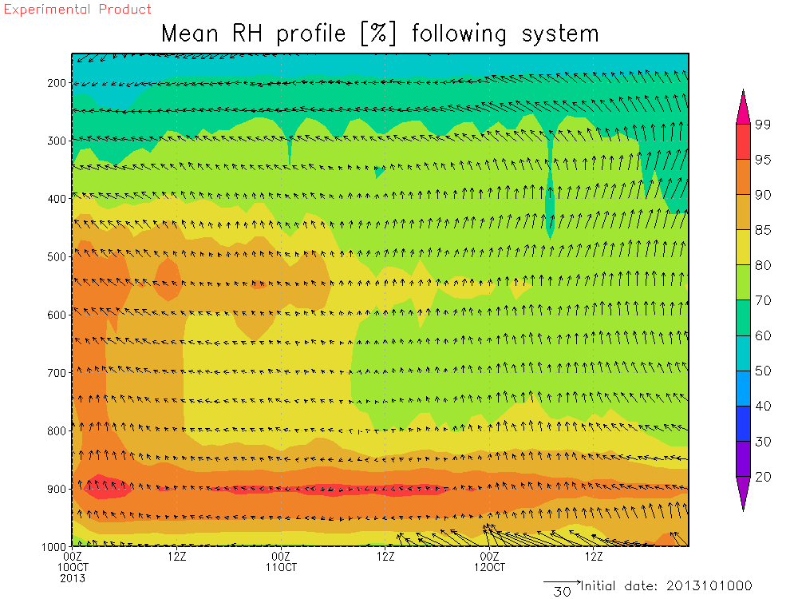
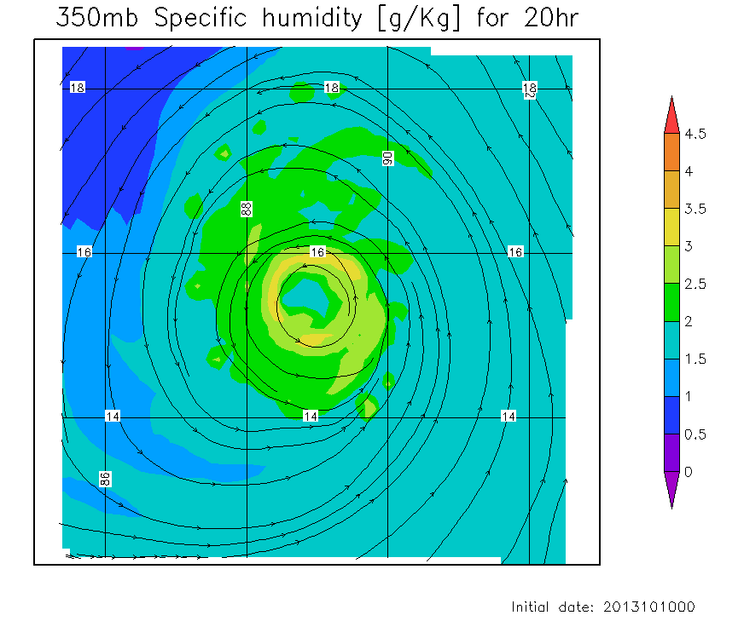
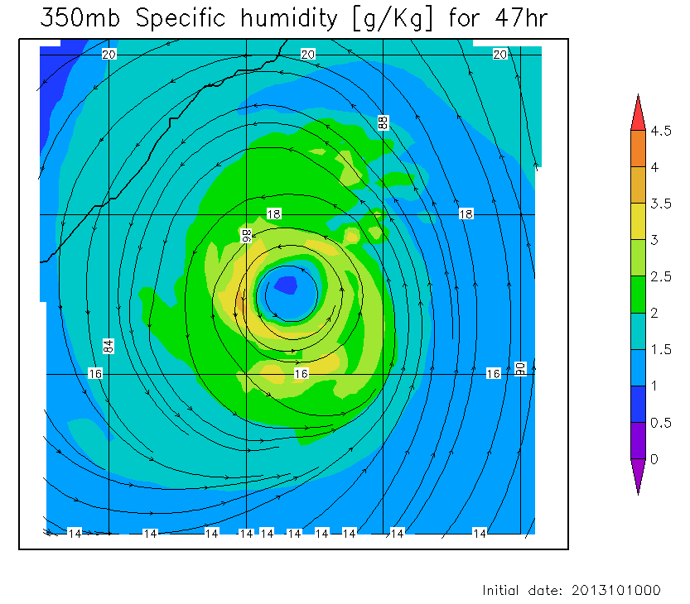
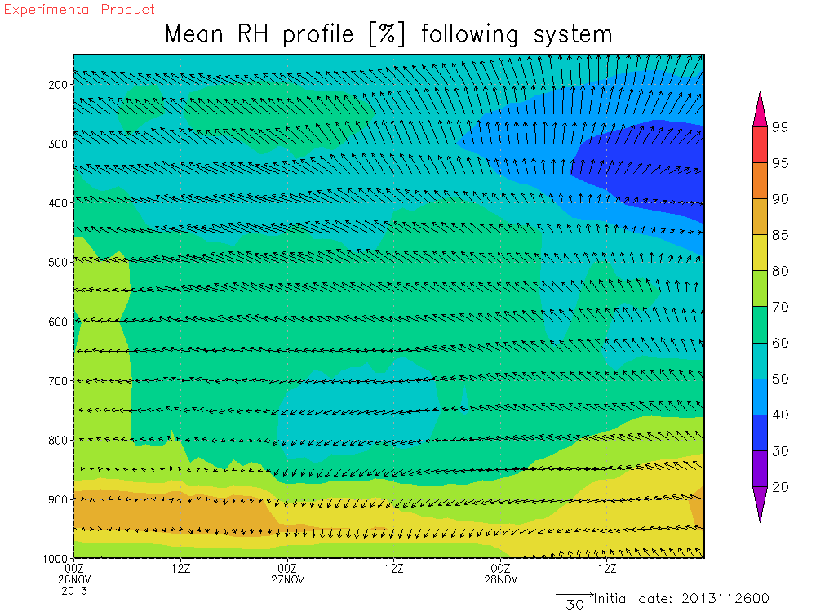
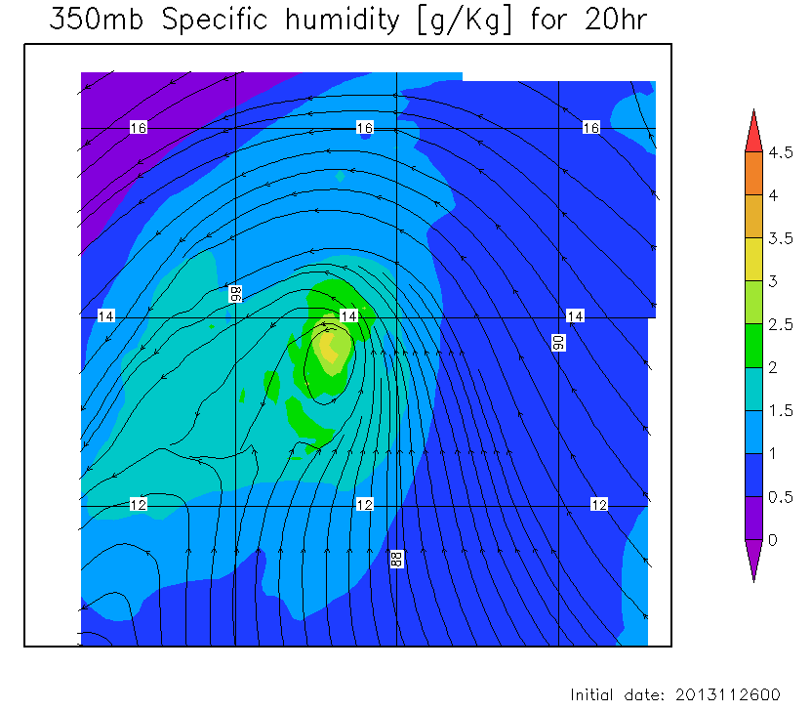
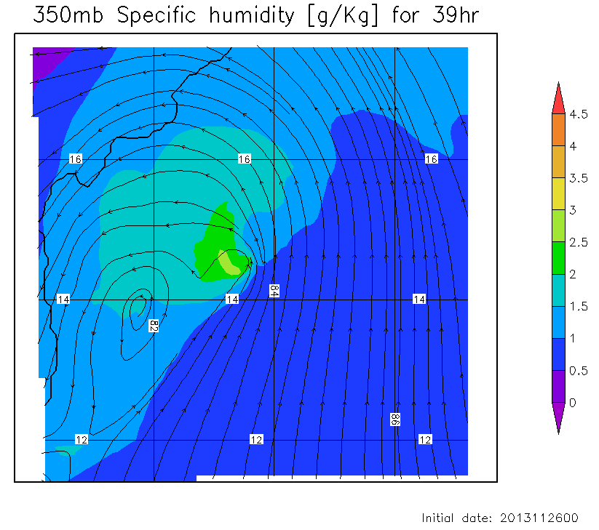
Understanding Intensity changes: Impact of moisture
Phailin
(IC: 00UTC 10 Oct 2013)
Lehar
(IC: 00UTC 26 Nov 2013)

Slide 14

For the first time NOAA’s HWRF hurricane track and intensity forecast model was used to help understand the complex processes of Rapid Intensification (RI) in tropical cyclones. An important key to understanding the RI process was the availability of detailed aircraft observations in the inner core of the hurricane with which to compare the model results. The model was able to reproduce the evolution of the hurricane structure that caused the RI process similar to what was seen in the actual detailed observations. During the times and in the regions of the hurricane where detailed aircraft observations were not available, the model was able to used as a proxy to gain even more understanding of the four-dimensional intensification process.
A Study on the Asymmetric Rapid Intensification of Hurricane Earl (2010) using the HWRF System
Hua Chen and Sundararaman G. Gopalakrishnan
For the first time NOAA’s HWRF hurricane track and intensity forecast model was used to help understand the complex processes of asymmetric Rapid Intensification (RI) in tropical cyclones. An important key to understanding the RI process was the availability of detailed aircraft observations in the inner core of the hurricane with which to compare the model results. The model was able to reproduce the evolution of the hurricane structure that caused the RI process similar to what was seen in the actual detailed observations. During the times and in the regions of the hurricane where detailed aircraft observations were not available, the model was able to used as a proxy to gain even more understanding of the four-dimensional intensification process.

Slide 15
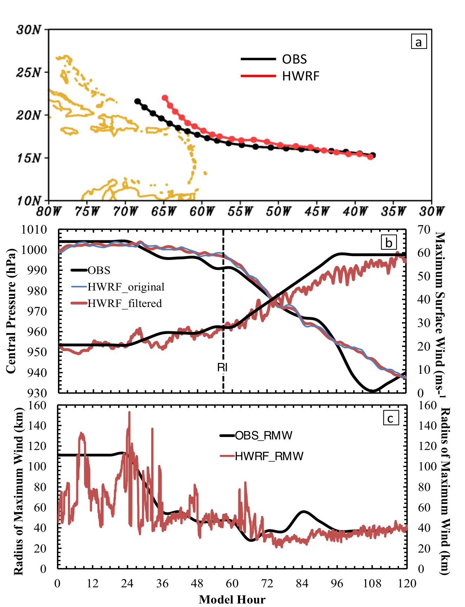
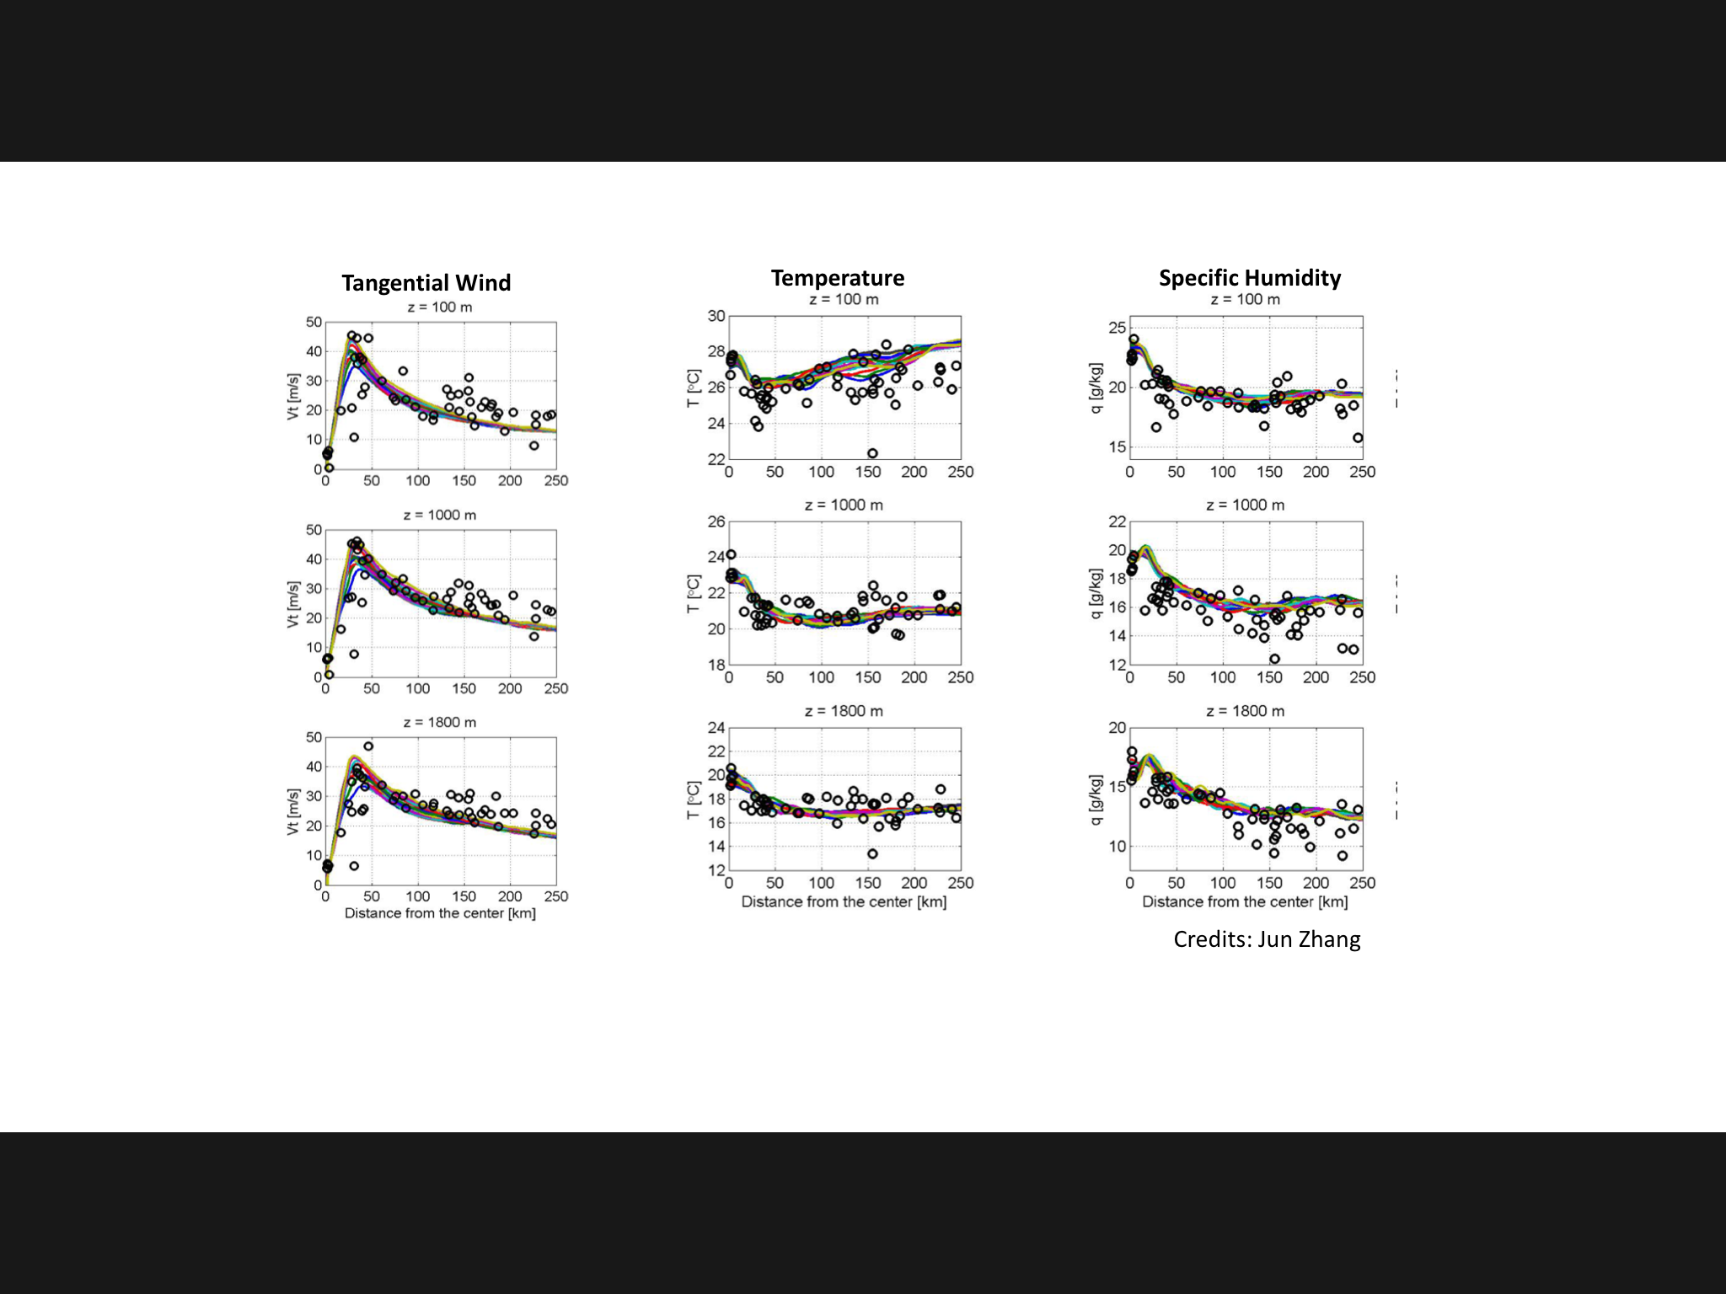
Hurricane Earl (2010): How close are we to reality?
Aug 26, 18 Z forecast
Apart from the standard verification metrics (track and peak winds), HWRF reproduced the storm structure extremely well making this an unique data set

Slide 16
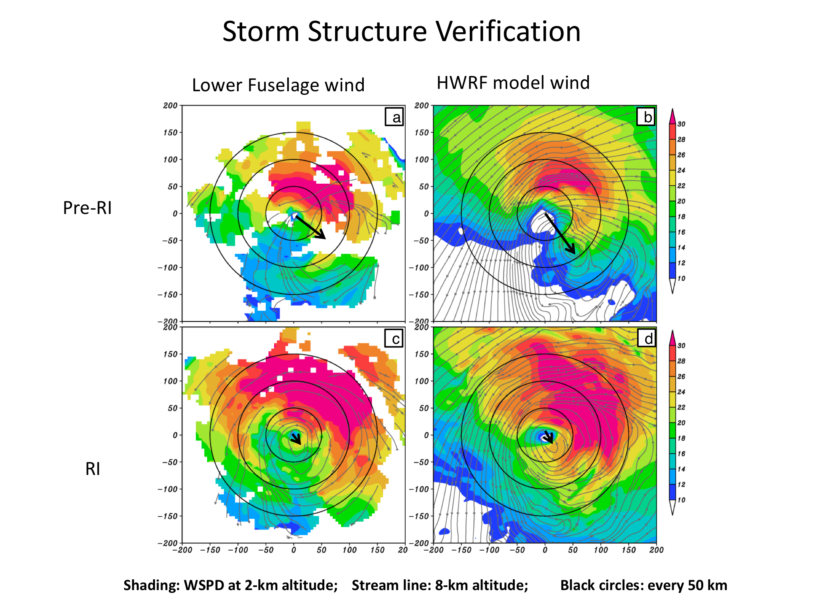
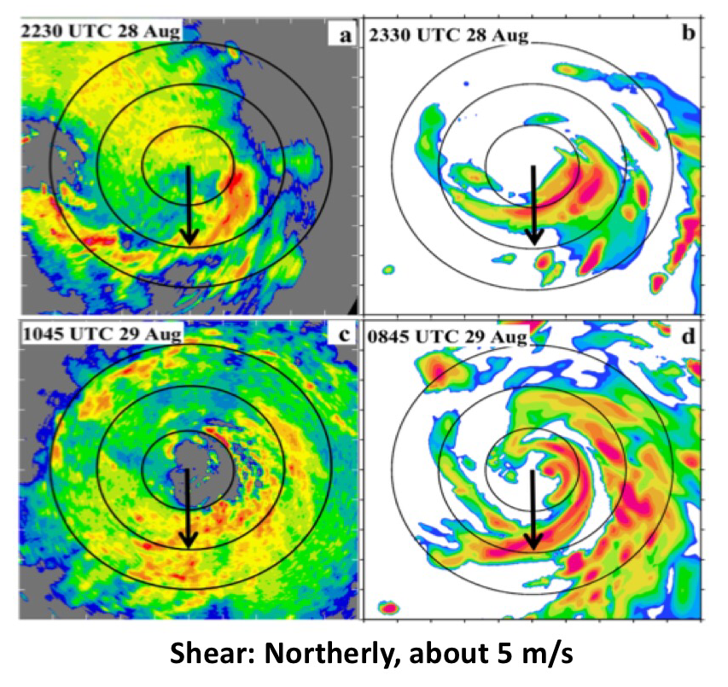
Hurricane Earl (2010): Vortex Tilt and Convection
P-3 Winds
HWRF simulated
P-3 Lower fuselage
HWRF simulated
Tilt
Pre-RI
RI
Well defined vortex below 5 km and weakly defined circulation aloft, pre-RI. Tilt decreased with improved alignment.
Persistent convection down shear left, pre-RI; Down shear left and up shear left during RI. Convection was asymmetric during RI

Slide 17
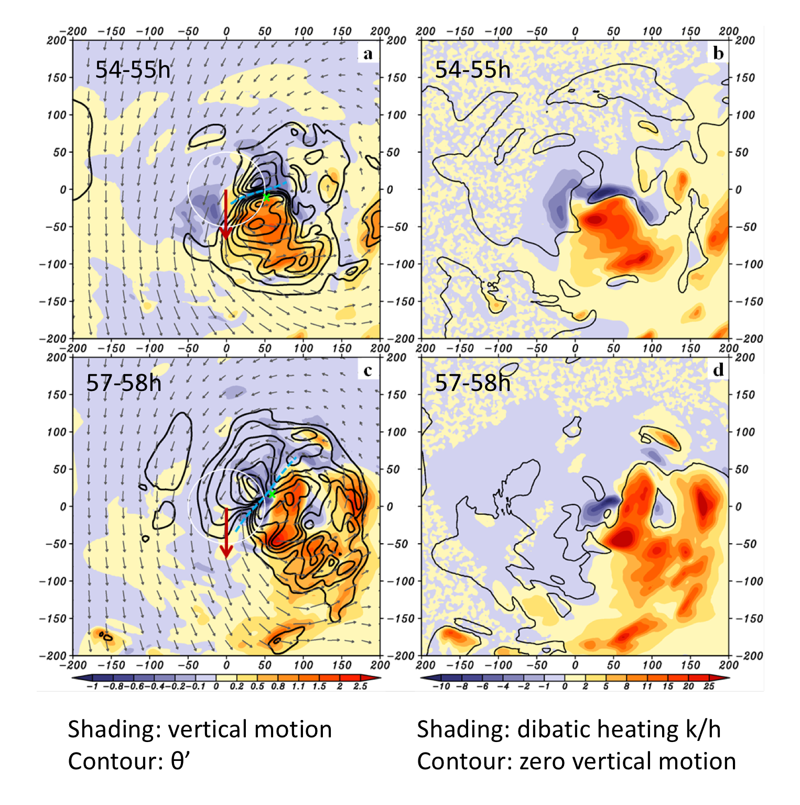
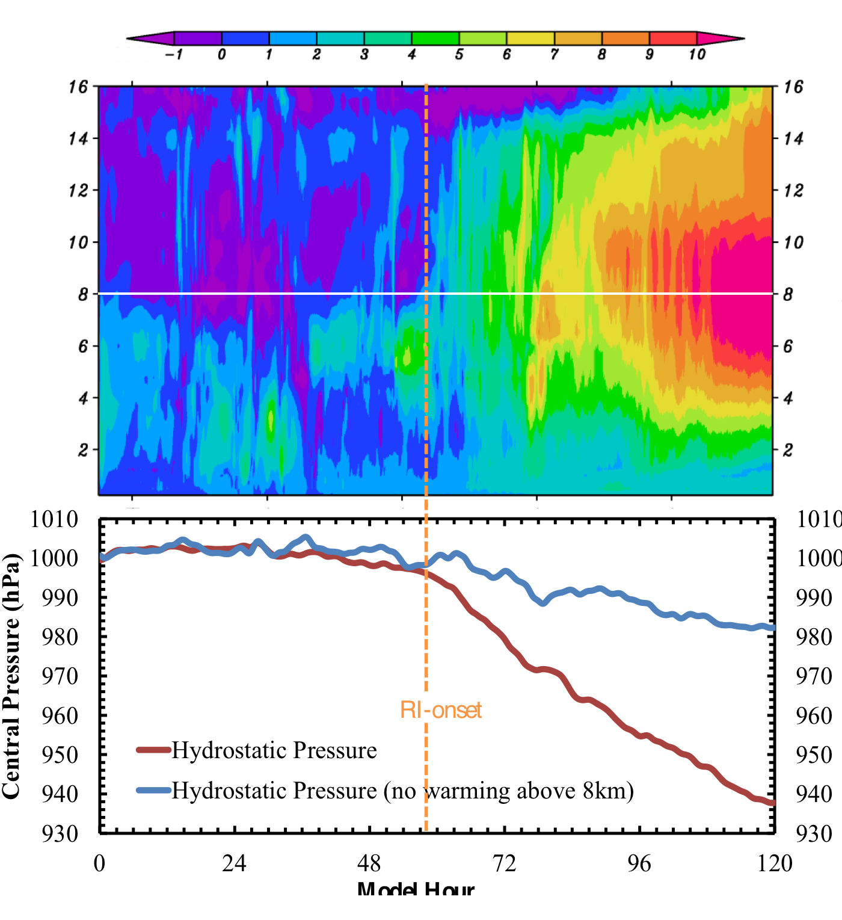
Hurricane Earl (2010): Modeled Rapid Intensification
Pre-RI
8 km height
RI
Horizontal advection of potential temperature perturbations associated with downdrafts/ subsiding motion in a region of large scale descent. This configuration supports intensification
Development of upper level warm core and the associated deepening

Slide 18
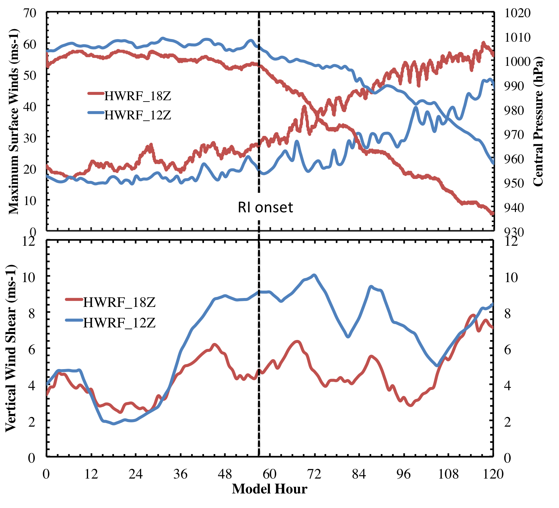
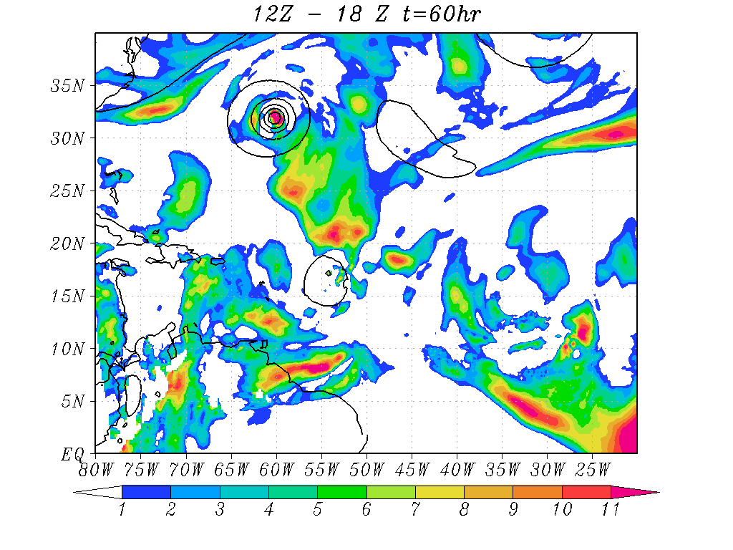
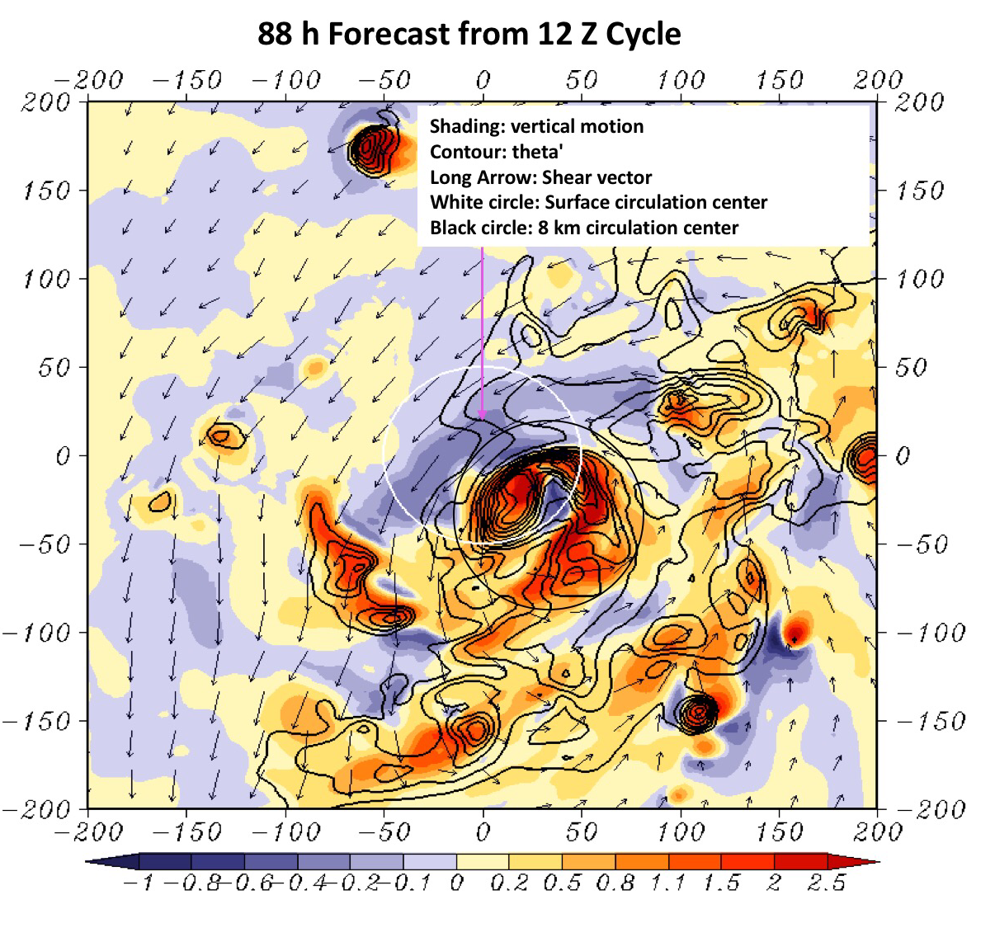
RI problem: Importance of Multi-Scale interactions
Shear vortex interactions during RI in Hurricane Earl (2010)
Shear difference between 12Z and 18Z runs at RI onset
Not all forecasts are as good as the 18Z run! The 12Z forecast was not impressive!
Larger Scale: Higher Shear mostly driven by outflow from Dannielle
Delayed RI with efficiency reduced due to larger shear. But the favorable configuration for RI still holds good!

Slide 19
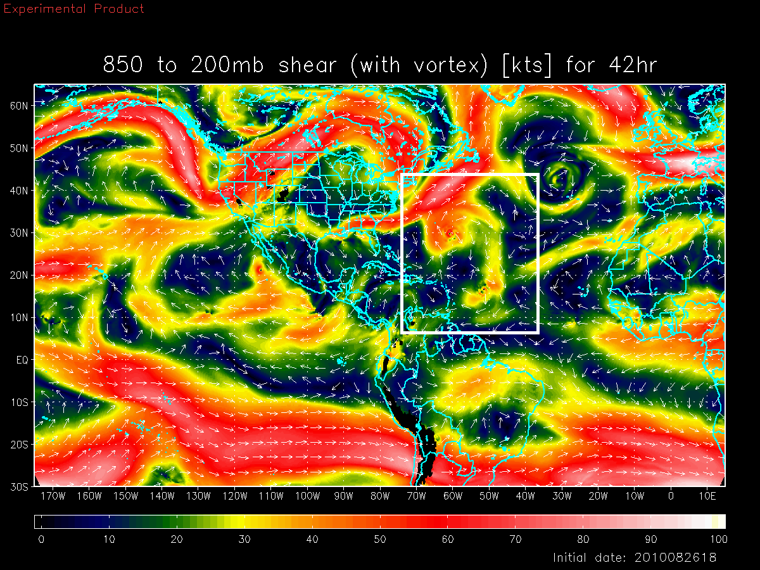
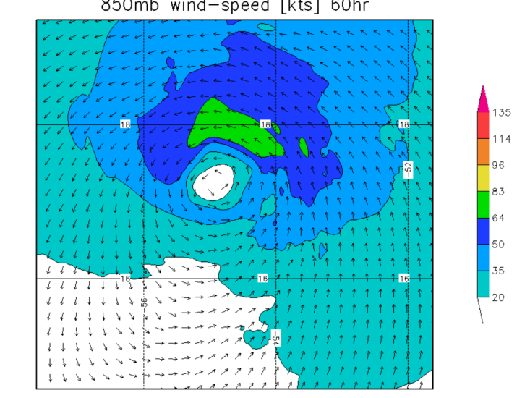
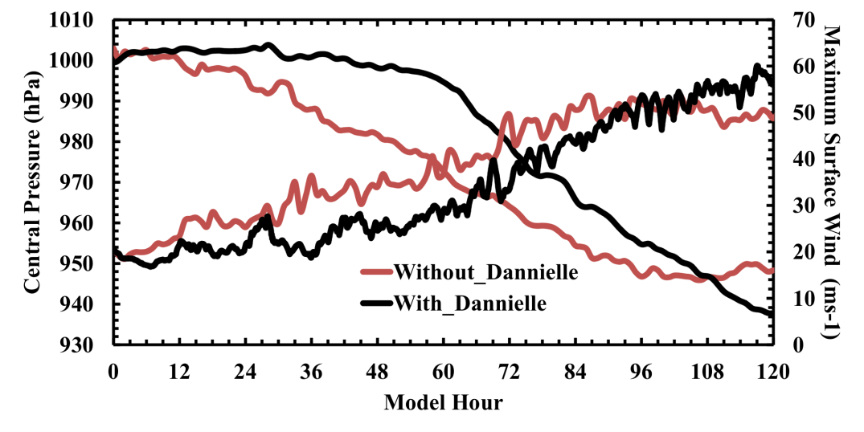
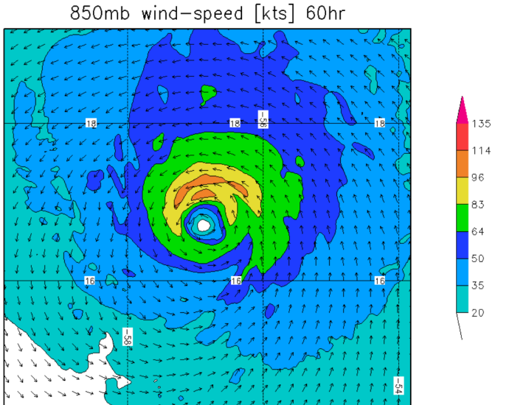
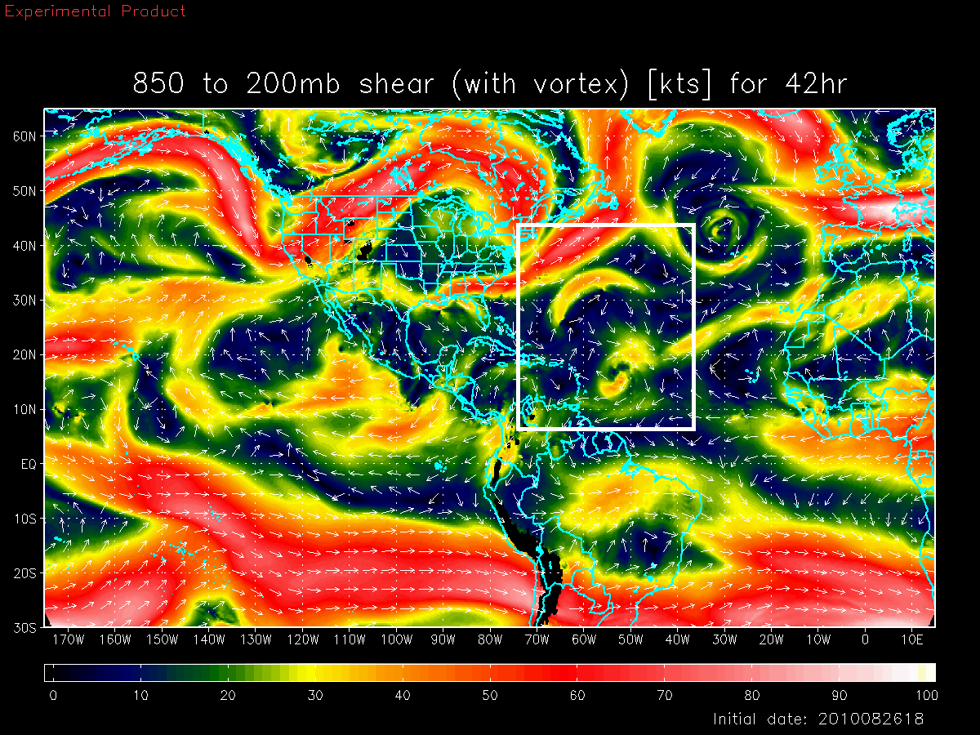
Basin Scale HWRF: Environmental Interactions
Shear vortex interactions during RI in Hurricane Earl (2010)
Deep-Layer Shear with Danielle
Earl
Earl with Danielle Interactions
Deep-Layer Shear without Danielle
Both large and vortex scale processes are critical for forecasting RI events
Earl
Earl W/O Danielle interactions
Credits: Xuejin Zhang
Notes:
Earl interactions with Dannielle

Slide 20
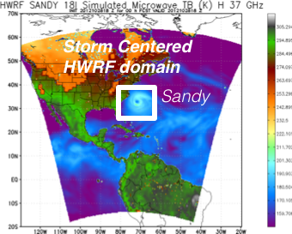
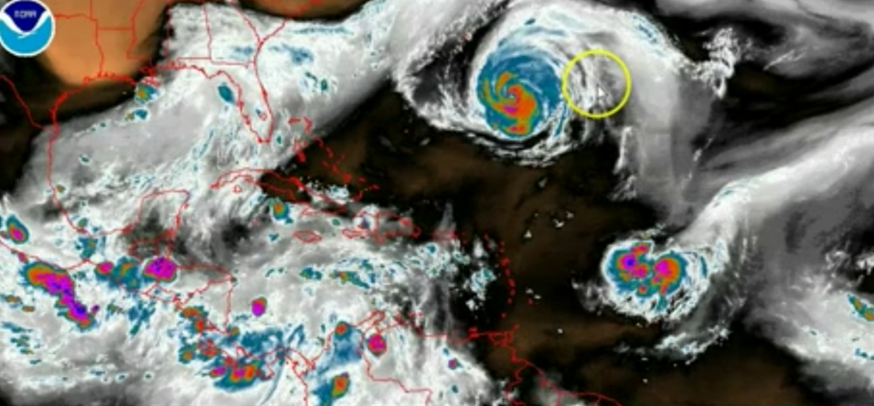
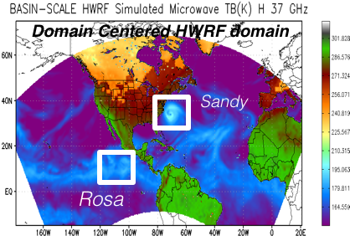
Addressing Our Immediate TC Prediction Needs
A Busy Day in the Tropics
Storm Centric -VS- Domain Centric Forecasts
- Tropical predictions system (Extended predictions)
- Improved storm-storm & multi-Scale interactions
- Landfall and post landfall (storm surge & rainfall)
- Genesis
- Regional ensembles
- Data assimilation

Slide 21
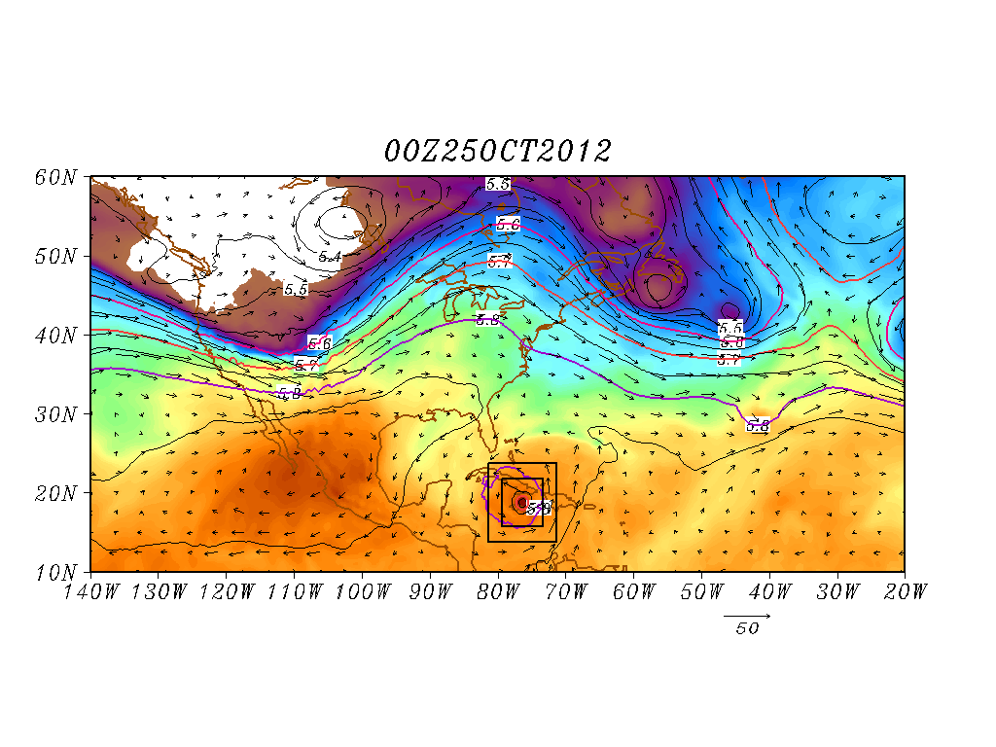
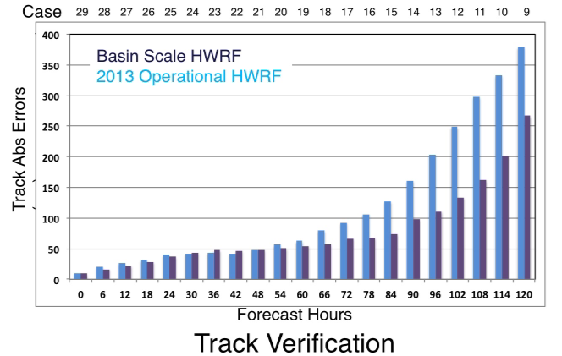
Basin Scale HWRF: Land-Storm Interactions
Hurricane Sandy Predictions: Domain Size and Vortex- Mean Flow interactions
Improved scale interactions and improved track & size forecasts (25 00Z Predictions)
Shading: T at 500 hPa; Contour: GHT at 500 hPa
Vector: Flow averaged between 500 hPa and 200 hPa
Shading: T at 500 hPa; Contour: GHT at 500 hPa
Vector: Flow averaged between 500 hPa and 200 hPa

Slide 22

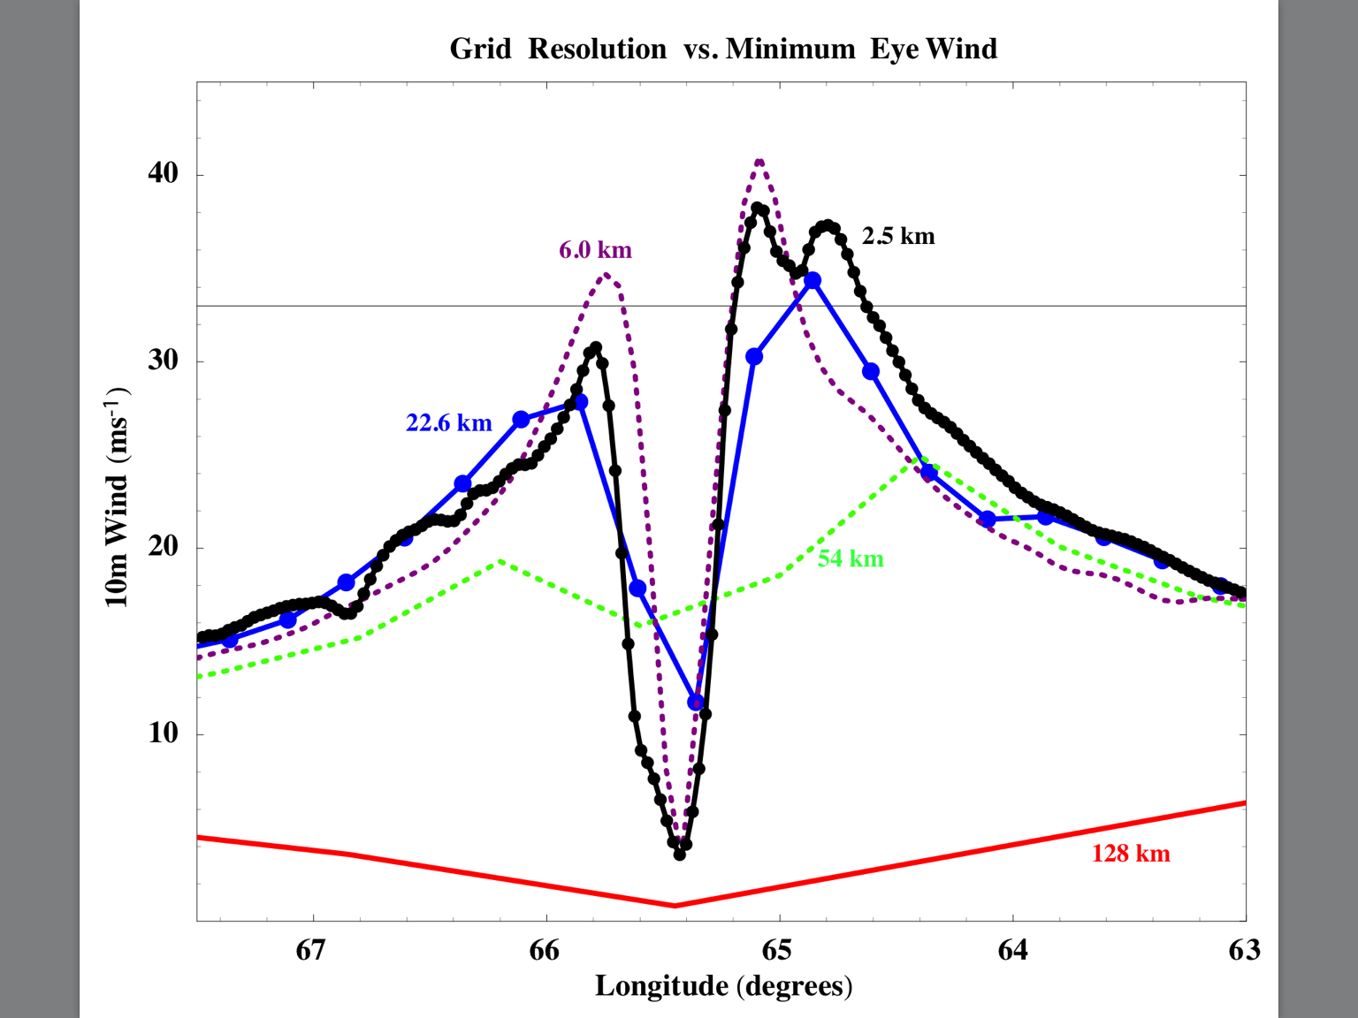
Motivation: Need For Global Nests
NOAA's High Impact Weather Prediction Project goal will be to develop a system that can produce 10-day forecasts at ~3-km global resolution fast enough to meet operational requirements by the end of the decade, with forecast skill exceeding that of the updated hydrostatic GFS and other chosen baselines.
HWRF is now used for guidance in all basins in the globe. Proven value for track, intensity and structure predictions.
Leverage on NOAA’s success with the HWRF system and accelerate progress towards creating high resolution, next generation model with the potential transitions to regional and global "HWRF".
We propose a seamless approach and illustrate how this approach is important for TC predictions
Impact of global model resolution on prediction of the inner core structure of Hurricane Earl (2010)

Slide 23
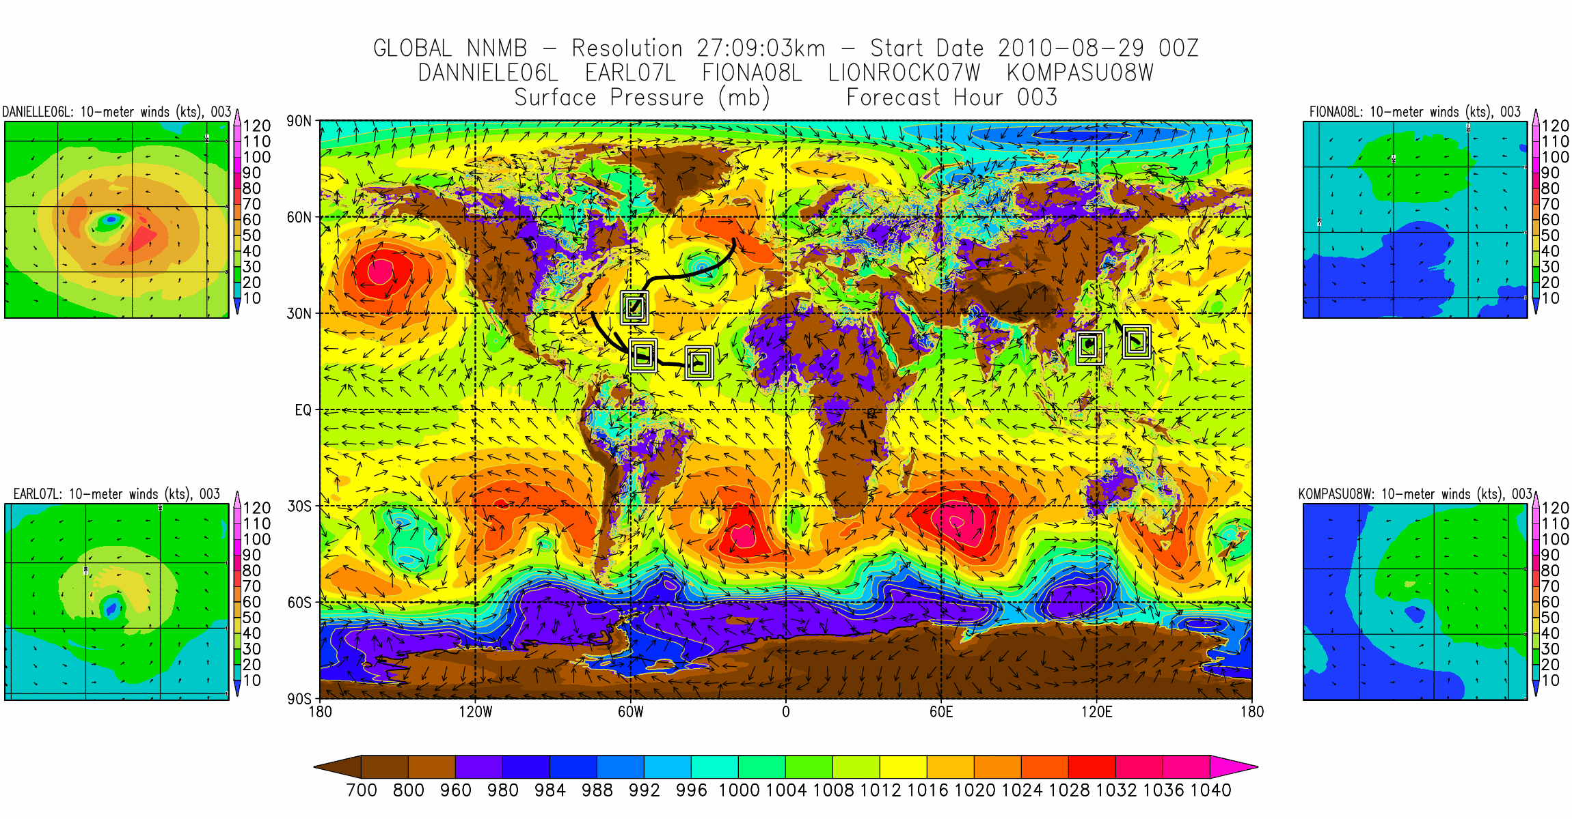
A Global Tropical Prediction System

Slide 24

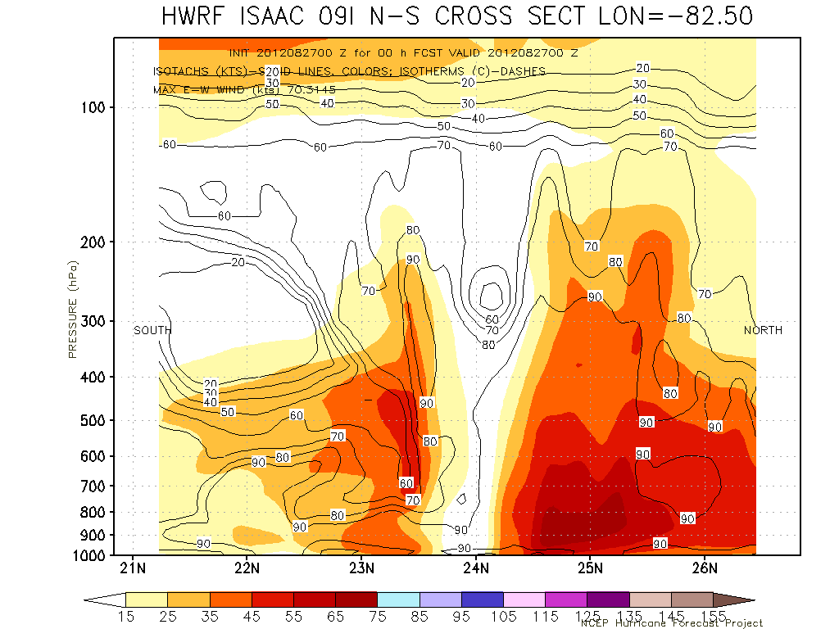
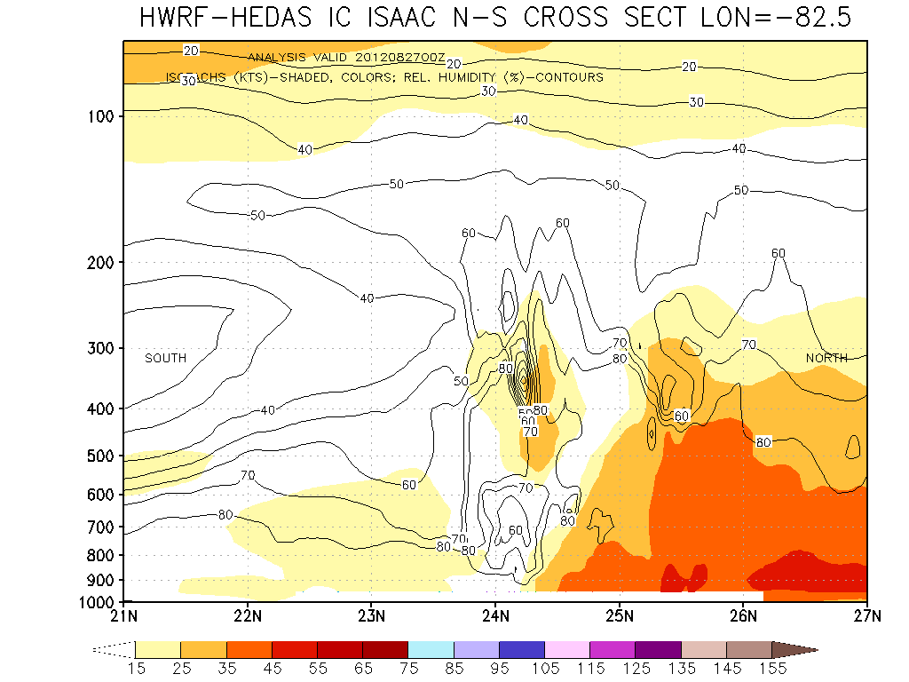
We also need Data Assimilation to Incorporate the
Observations into the Model for Improved Initial Conditions
_{ISAAC Initial vortex (wind)}
without assimilation of observations
_{ISAAC Initial vortex (wind)}
with assimilation of observations
ISAAC (2012): Intensity Errors (kt)
Hours | 12 | 24 | 36 | 48
Operational HWRF | 13 | 16 | 26 | 26
With P3 Data | 8 | 3 | 9 | 20
Cases | 9 | 7 | 5 | 3
Notes:
Reference for table:
Aksoy, A., S. Lorsolo, T. Vukicevic, K. Sellwood, S. Aberson, and F. Zhang, 2012: The HWRF Hurricane Ensemble Data Assimilation System (HEDAS) for highresolution data: The impact of airborne Doppler radar observations in an OSSE. Mon. Wea. Rev (in press).

Slide 25
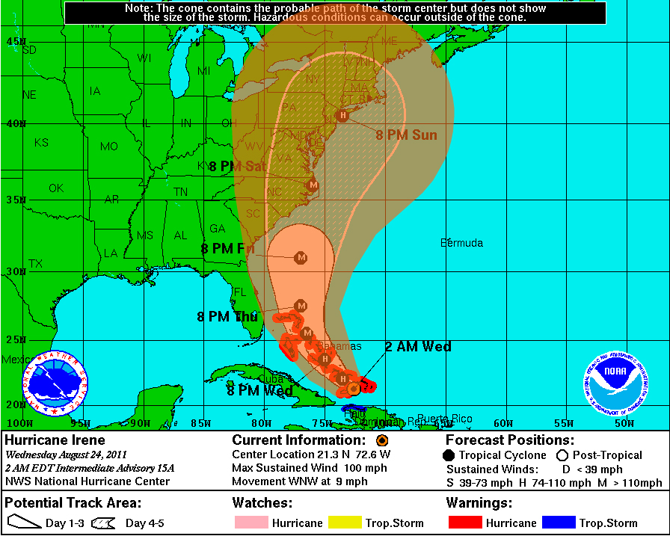
Summary & Talking Points
Steep Step improvements in Tracks
Intensity and structure forecasting is our next challenge
HWRF shows some promise in intensity forecast
Improved shear vortex interactions may hold the key
Role of moisture vs shear ?
TC land interactions
Observations are key to improve TC forecasting
Advances in data assimilation techniques is important
Multi scale data assimilation technique is recommended
Reduction in cone of uncertainity due to improvements in track prediction

Slide 26

Questions ??
HWRF: EMC
HWRF: DTC
HRD: Modeling & Observations
HWRF
University
Collaborations
Forecast Offices
NHC, JTWC, IMD, international
Thanks are due to the Indo-US forum for Science and Technology

