Slide 1
Deterministic TC Genesis Prediction in a Suite of Operational Global NWP models
Part II: Verification and Spurious model TCs
Mike Fiorino
Commander, United States Navy (retired)
B.S. (’75 PSU), M.S. (’78 PSU), Ph.D. (’87 NPS) all in Meteorology michael.fiorino@noaa.gov
Earth System Research Laboratory, Global Systems Division, Boulder CO
National Hurricane Center, Miami FL
Joint Typhoon Warning Center, Pearl Harbor HI
Lawrence Livermore National Laboratory, Livermore CA
European Centre for Medium-Range Weather Forecasts, Shinfield Park, Berskshire, UK
Meteorological Research Institute – Japan Meteorological Agency, Tsukuba JAPAN
Space and Naval Warfare Systems Command, Arlington VA
NASA Goddard Space Flight Center, Greenbelt MD
National Centers for Environmental Prediction, Camp Springs MD
Naval Postgraduate School, Monterey CA
Fleet Numerical Meteorology and Oceanography Center, Monterey CA
Naval Research Laboratory, Monterey CA
Atlantic Oceanographic and Meteorological Laboratory, Miami FL
Pennsylvania State University, University Park PA

Slide 2
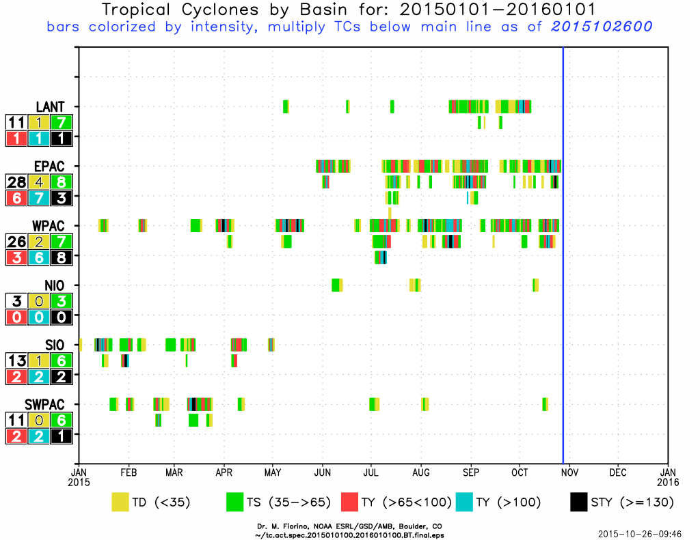
TC activity thru 20151026
C+EPAC >
WPAC
except for STYs

Slide 3
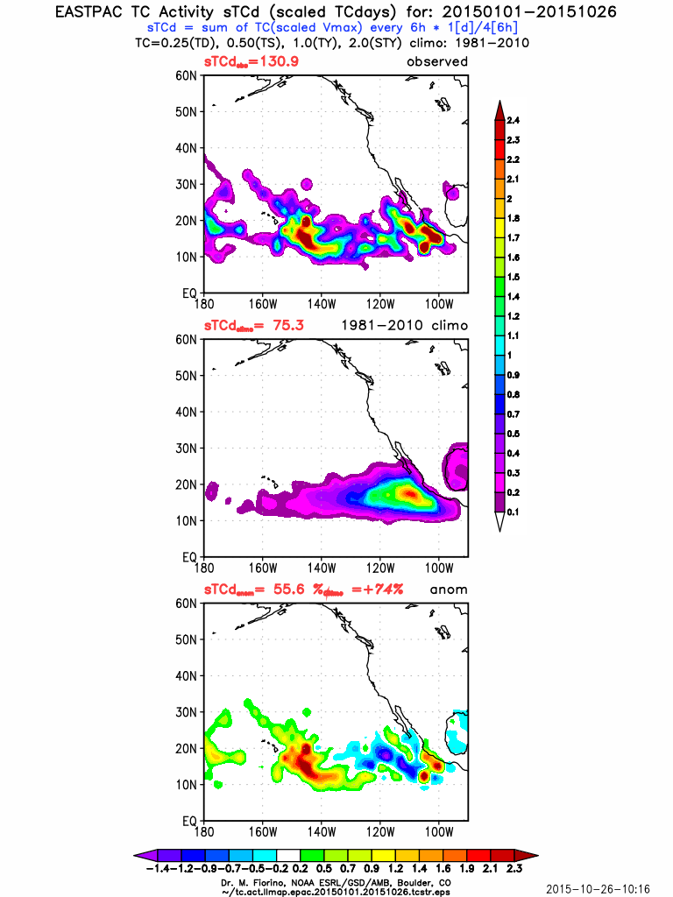
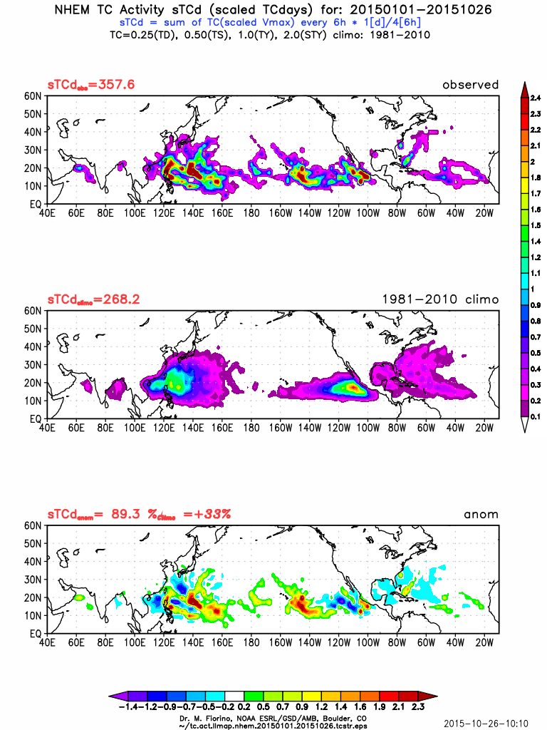
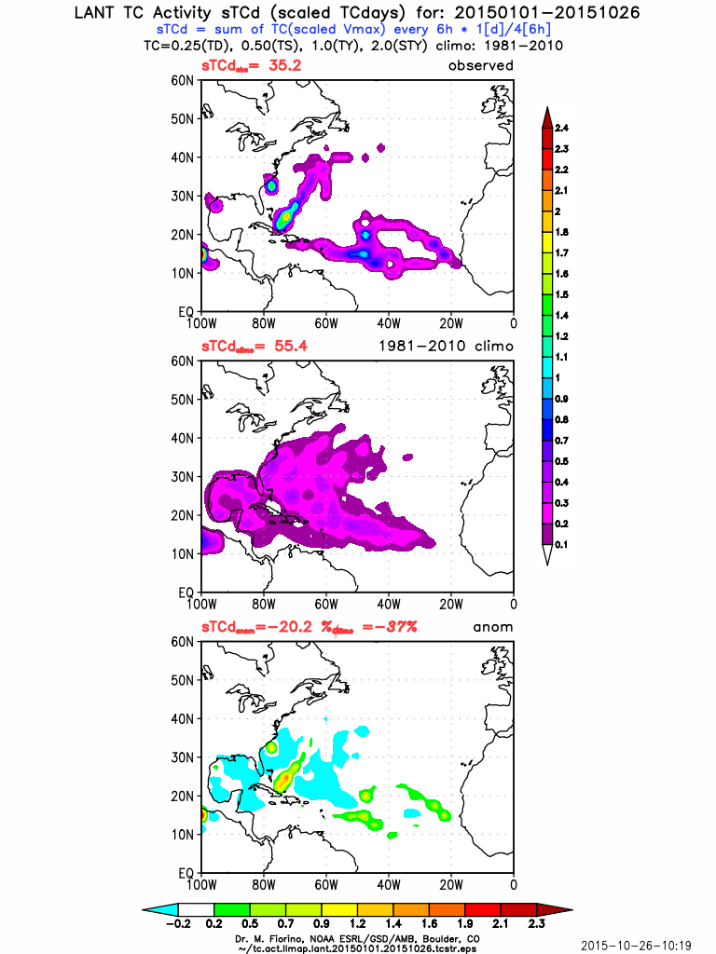
TC activity thru 20151026
LANT
-37%
NHEM: +33%
C+EPAC
+74%

Slide 4
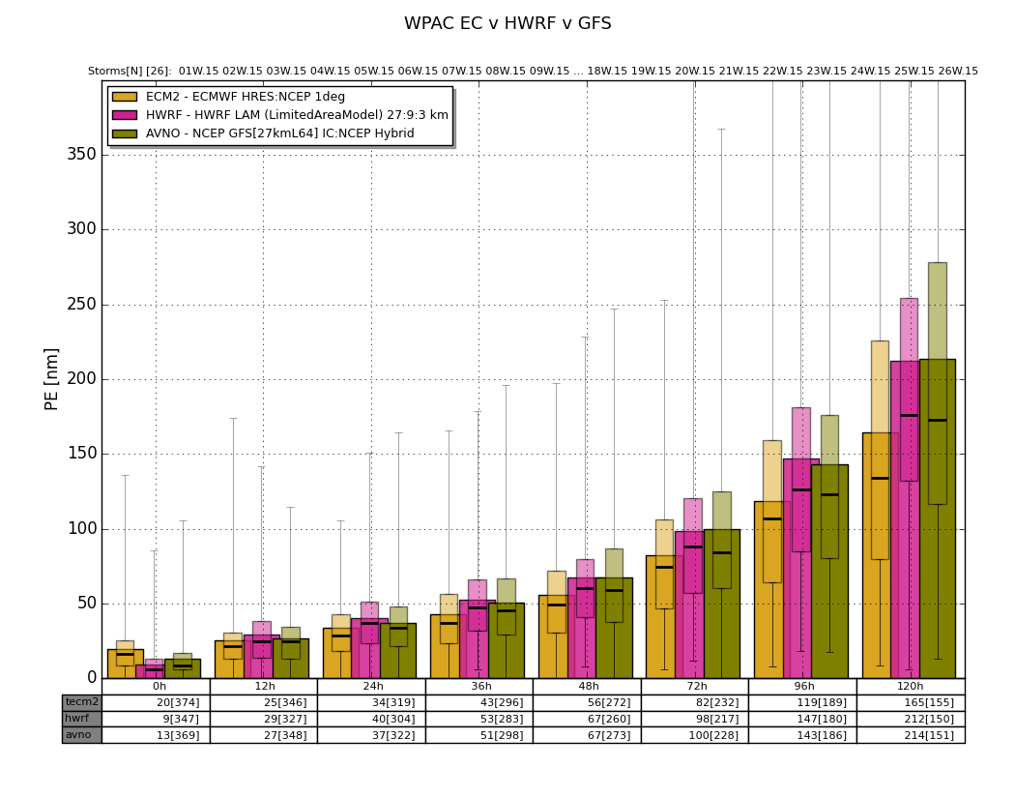
WPAC 2015 thru 20151029
72-h
EC: 82 nmi
HWRF: 98 nmi
GFS: 100 nmi

Slide 5
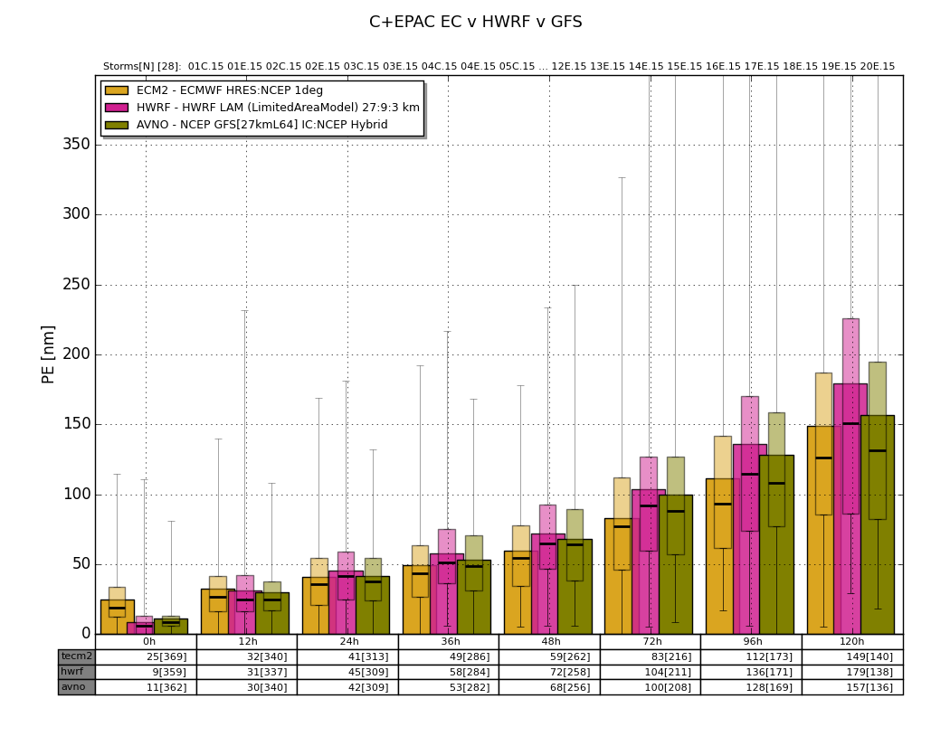
C+EPAC 2015 thru 20151029
72-h
EC: 83 nmi
HWRF: 104 nmi
GFS: 100 nmi

Slide 6
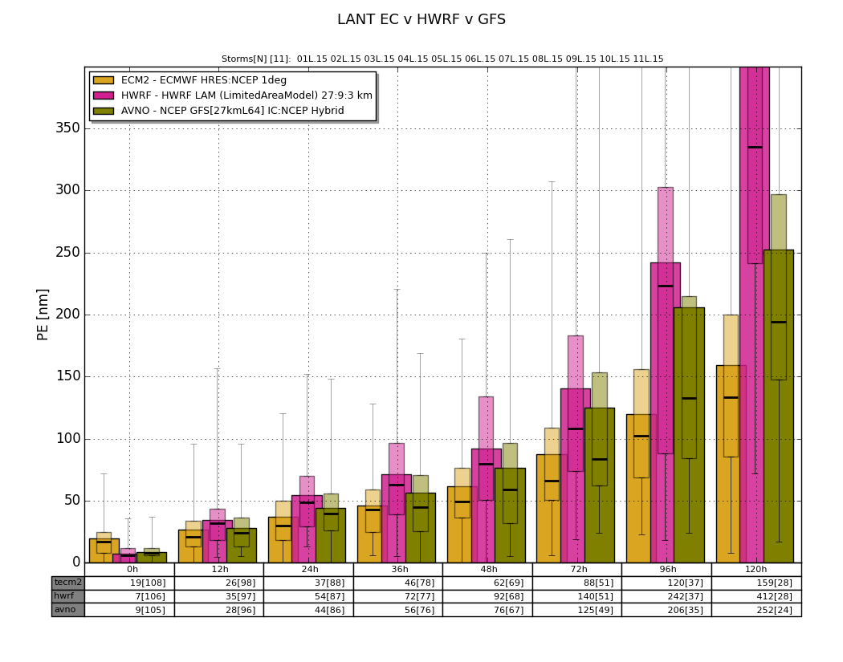
LANT 2015 thru 20151029
72-h
EC: 88 nmi
HWRF: 140 nmi
GFS: 125 nmi

Slide 7
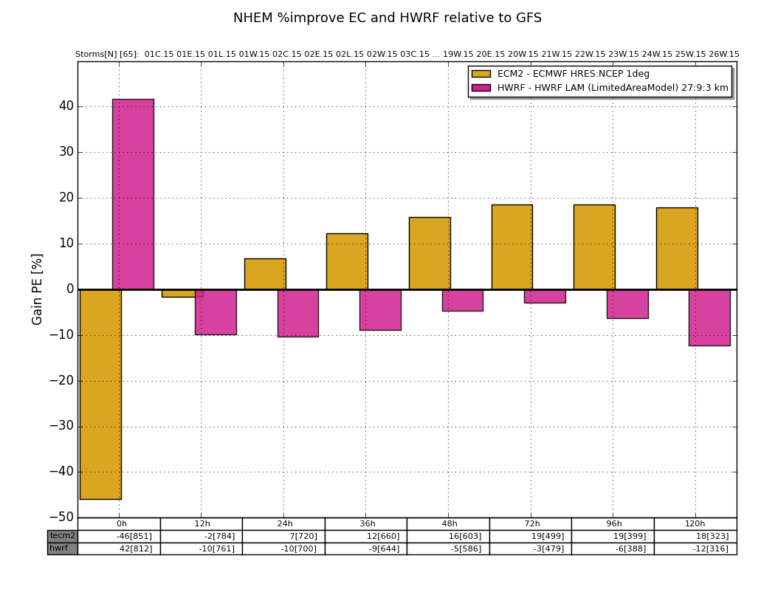
NHEM 2015 thru 20151029
% improve over GFS
0-h
HWRF >> GFS
ECMWF << GFS
12 → 120 h
HWRF < GFS
ECMWF >> GFS

Slide 8


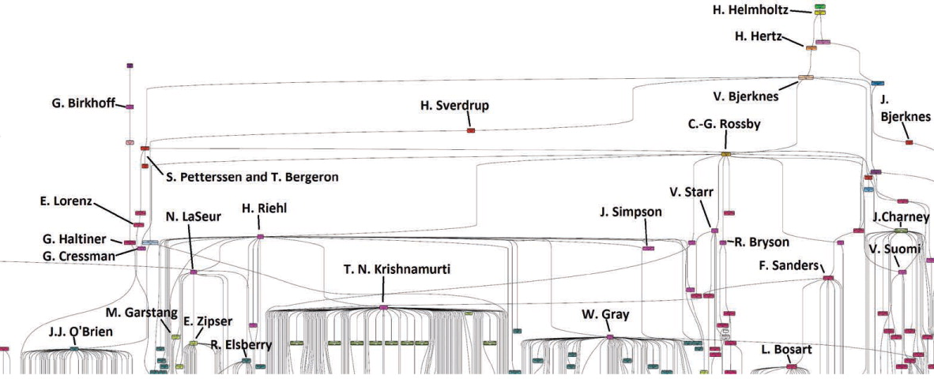
My degree maybe from NPS but I really went to CSU, Monterey…
academic great-grandfather
Rossby
academic grandfather Riehl
academic father
Russ Elsberry
academic uncle
Krish
academic uncle
Bill Gray

Slide 9
The Question… when giving a seminar at CSU in the 1980/90s…
“This is all well and good Mike…

Slide 10
The Question… when giving a seminar at CSU in the 1980s…
“This is all well and good Mike…
but why (on earth) are
you doing this? *#%!!”

Slide 11
The Question…
“This is all well and good Mike…
but why (on earth) are
you doing this? *#%!!”
Uncle Bill Gray
Notes:
using a numerical maaadel

Slide 12
The real answer…
Bob Gall asked me to “look at genesis” 2010
The “big three rule”
If a model makes good track forecasts → accurate tropical large-scale circulation? → potential for genesis forecasts?
TCAD principle – Tropical Cyclones Are Diagnostics
  dependence on convection
Deterministic genesis requires a data set of pre TC disturbances

Slide 13
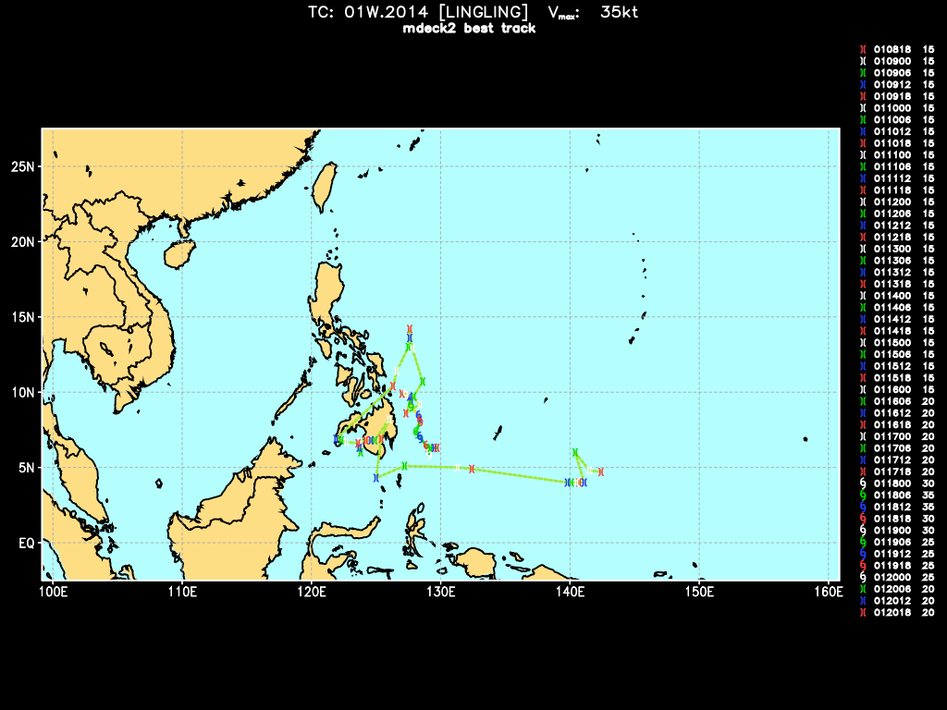
Operational Motivations (O2R)
…maybe those d!*#%ng models are pretty good after all…
“The models are getting downright phenomenal in their skill and usefulness. Several days ago, the NVG and GFS began picking-up on 91W making it to the Philippines, and these two models have been (somewhat) consistent in track and timing ever since.”
Mark Lander,UofGuam in an email to tstorm.org list on 2014010909
2014010818 A1W.2014 015 ---- 4.7 142.4E --- --- 303.1 11.9 B NT NW --- 1/38 lf: 0.00
2014010900 A1W.2014 015 ---- 4.8 141.5E --- --- 303.1 11.9 B NT NW --- 2/38 lf: 0.00
2014010906 A1W.2014 015 ---- 6.0 140.4E --- --- 303.1 11.9 B NT NW --- 3/38 lf: 0.00
2014010912 A1W.2014 015 ---- 4.0 141.1E --- --- 206.5 4.5 B NT NW --- 4/38 lf: 0.00
.
.
2014011706* A1W.2014 020 1007 9.7 127.9E --- --- 230.0 2.0 C DB NW --- 35/38 lf: 0.00 INVEST <**Genesis
2014011712* A1W.2014 020 1007 9.7 127.6E --- --- 255.0 2.0 C DB NW --- 36/38 lf: 0.00 INVEST <**Genesis
2014011718* A1W.2014 020 1005 9.9 127.0E --- --- 280.0 4.0 C DB NW --- 37/38 lf: 0.00 INVEST <**Genesis
2014011800* A1W.2014 030 1000 9.9 127.3E --- --- 304.1 1.8 B TD NW --- 38/38 lf: 0.00 <**Genesis
2014011806* 01W.2014 035 996 8.9 127.8E --- --- 156.3 4.9 B TS WN TJM 20/30 lf: 0.00 LINGLING <**Genesis
2014011812* 01W.2014 035 996 8.4 128.3E --- --- 138.1 7.4 B TS WN TJM 21/30 lf: 0.00 LINGLING <**Genesis
.
.
2014011918 01W.2014 025 1004 6.6 128.7E --- --- 140.4 3.9 B TD WN SJB 26/30 lf: 0.00 LINGLING
2014012000 01W.2014 025 1008 6.3 129.0E --- --- 135.2 4.2 B TD NW --- 27/30 lf: 0.00 LINGLING
2014012006 01W.2014 020 1004 6.3 129.2E --- --- 121.1 2.9 B TD NW --- 28/30 lf: 0.00 LINGLING
2014012012 01W.2014 020 1004 6.3 129.5E --- --- 90.0 2.5 B TD NW --- 29/30 lf: 0.00 LINGLING
2014012018 01W.2014 020 1007 6.3 129.7E --- --- 90.0 2.5 B TD NW --- 30/30 lf: 0.00
2014 01W TS LINGLING : 35 : 3.2; 7.2 : 8.9 127.9 : 010818<->012018 : 6.3<->11.9 :126.3<->129.7 : 0.8 : 0.1 : 0: 0: 0: :
tG:222 9X: 91W 1st: 011800
01W.2014 was 91W for 222 h before JTWC issued 1st warning
similar to observations of the NHC specialists 2006-2008 that if the big three models (GFS/ECMWF/UKMO) forecast the formation of a cyclone, in a similar location, then…
Notes:
there are no miranda rights on the tc list – any statements you make on the Tclist may and/or will be used against you in a tropical conference or a PhD comp

Slide 14
Deterministic TC genesis
grandpa Riehl’s 1954 book on tropical meteorology has two chapters on tropical disturbances…the four stages of TC
  disturbance
  cyclone
  TS-HU-STY
  dissipation
Model TC genesis is an accounting problem – model v observed TCs – yes/no genesis forecast and spurious model TCs or ‘spuricanes’
the problem is observed TCs – need both pre/potential-TC disturbances (‘pTCs’) and TCs

Slide 15
ingredients of the TCgen2 model diagnostic system http://ruc.noaa.gov/hfip/tcgen
TIM (TCs In Models) cyclone tracker – Marchok, GFDL
  tracker mode – track cyclones from an initial position in the initial conditions (a priori)
  genesis mode – find and track cyclones during the integration (a posteriori)
  measure of model cyclone strength – “scaled Tropical Depression days” (sTDd)
Genesis definition – operational per NHOP/PACOM
  30-h window around the first advisory(NHC)/warning(JTWC) to give the 00/12 UTC models three shots at the foul line to forecast genesis
TC demographics of ?TCs and SPURious hurrICANES or SPURIPHOONS
Scheme to match model cyclones (genesis & tracker) to real ?TCs
  closeness defines a ‘hit’ or correct forecast – compare positions of ?TCs to model TCs within a 24-h window ending at the forecast tau, e.g., 60-84 h for the D+3 forecast
  a bit of an accounting nightmare…with so many possible model v real TC comps
Weather maps + model diagnostics
  sanity check the tracker and matching scheme ; synoptic evaluation
  basin-wide, over-ocean precipitation + ratio of convective/total precip

Slide 16
The Models
2009-2013 May-October (~8 Tb)
ATCF ID | Model | Resolution circa 2013 | Comments
AVNO | GFS T574L64 | 27 km L64 | 3DVAR-EnKF Hybrid/GFS 2012 physics
FIM8 | FIM G8 | 30km L64 | 3DVAR-EnKF Hybrid/2011 GFS physics, dynamical core improves
FIM9 | FIM G9 | 15 km L64 | same as FIM8 except higher res
CGD6/CMC2 | CMC GDPS | 25 km L79 | major update in 201305; 4DVAR
UKM2 | UKMO UM | ~32 km L70 | upcoming major upgrade in 201405, 4DVAR
NGPC/NAVG | NOGAPS NAVGEM | 37 km L50 | 4DVAR-AR; SL dynamical core/GFS cumulus
ECMT/ECM2 | ECMWF HRES | 16 km L137 | IFS cycle 38r2 (25 JUN 13) increased vertical res; sfc drag; shallow cu…
Notes:
relationship between # layers and location on the anomaly league table

Slide 17
TC Demographics pTCs, TCs, mTCs, aTCs and the spuricane
Type | Naming | Features
TC | 01-49 numbered TCs 01W.2014 TC #1 in WESTPAC in 2014 | tropical cyclone as analyzed by JTWC/NHC ATCF TC designations: TD, TS, TY, HU, STY, [SD, SS] ATCF non-TC designations: PT, XT, ET
pTC | 9X or INVEST systems 94S.2014 – the landphoon over eastern OZ | pre/potential TC as analyzed by JTWC/NHC ATCF designations: LO, DB, WV Database of pTCs in WPAC/SHEM/IO 1999-2013; LANT/EPAC 2006-2013
mTC | TGNNNN NN or 9X | model cyclone from a tracker genesis mode – 1.5 mb center-outer deficit
aTC | TGNNNN | initial mTC that the model maintains for >= 24 h into the forecast, not associated with a TC/pTC
SPURICANE | TGNNNN | mTC that cannot be associated with a TC, pTC, aTC mTC associated with a dissipated ?TC mTC much stronger than pTC
Notes:
note 9X dataset for Kevin Tory, dataset being fully vetted using TIM and tcdiag answer the mail from Jack Beven and Sim Aberson

Slide 18
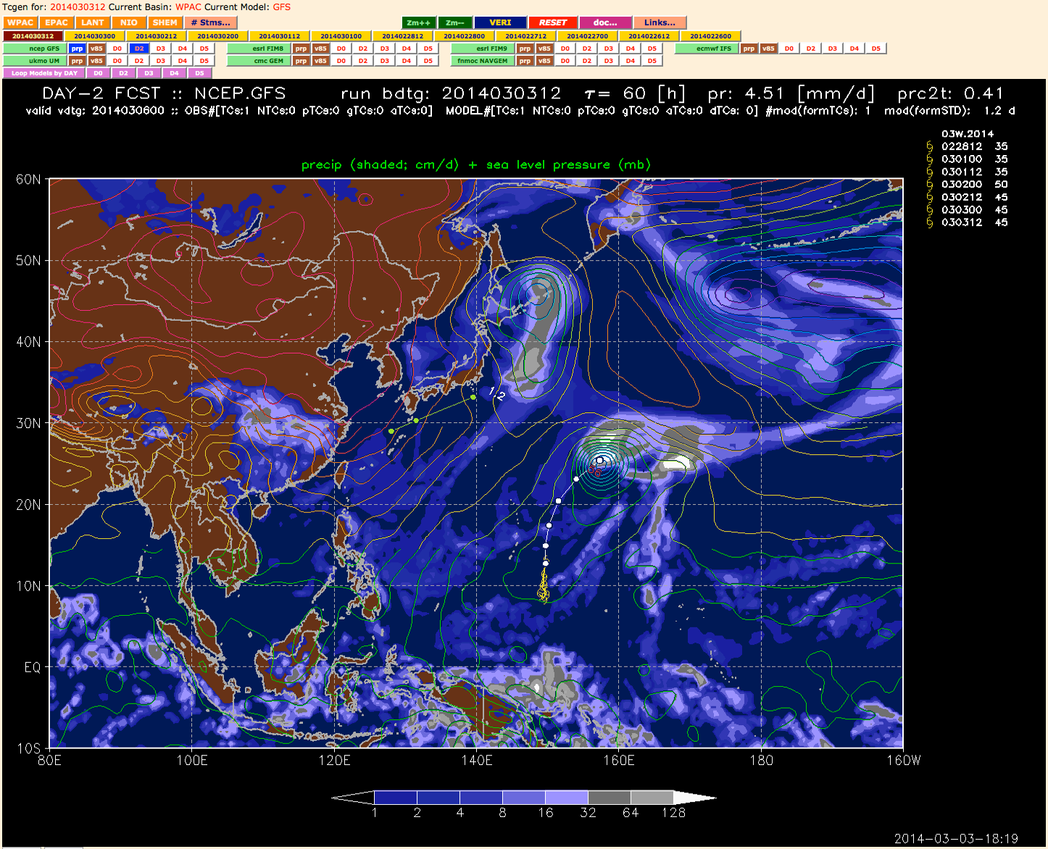
TCgen2 – front page – FCST mode – forecasting http://ruc.noaa.gov/hfip/tcgen
7 global NWP models
+12 h model forecast for consistency with forecast e.g, day+2 (D2) uses 36-60 h model forecast
tropical, ocean-only precip stats for model diagnostics…
model and observed ?TCs
FCST (forecast) & VERI (verification) modes
single model or loop mode

Slide 19
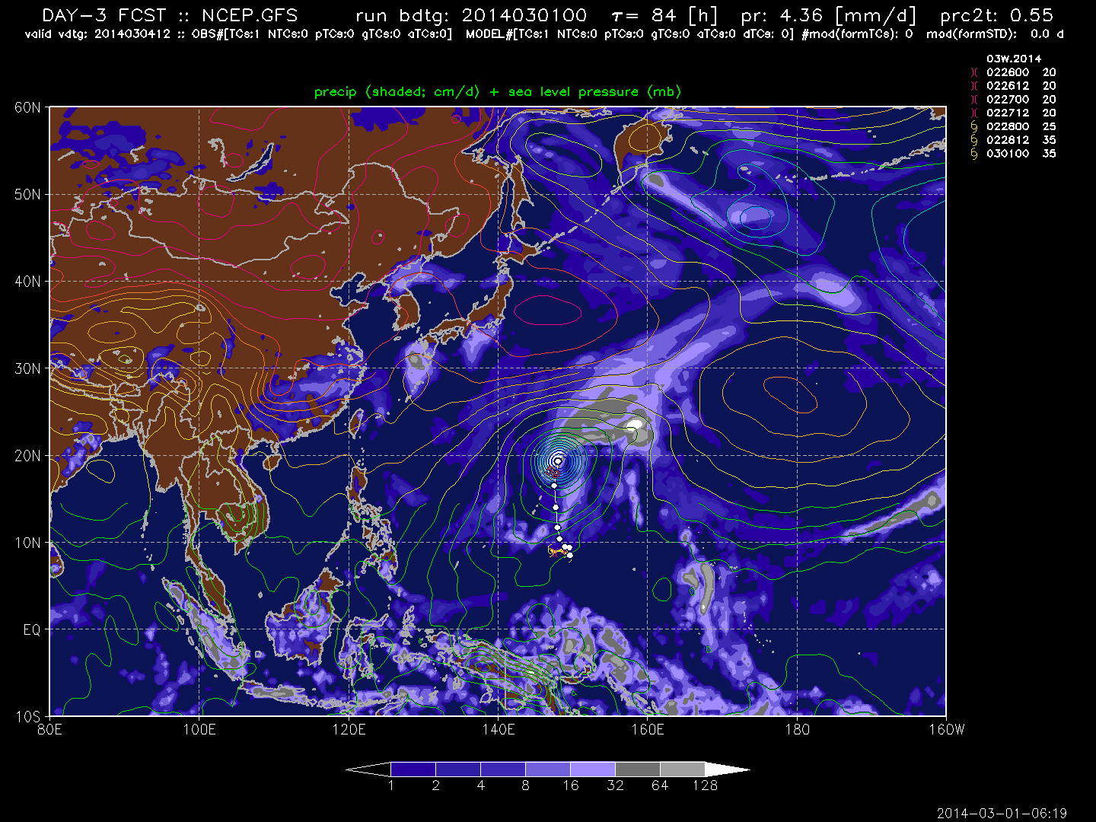
TCgen2 – two WxMAP2 product: thermo (precip) http://ruc.noaa.gov/hfip/tcgen
?TCs & genesis/IC trackers
thermo (precip) and mass (sea-level pressure)
D3 forecast (tau 84) for 03W verifying today (030412)

Slide 20
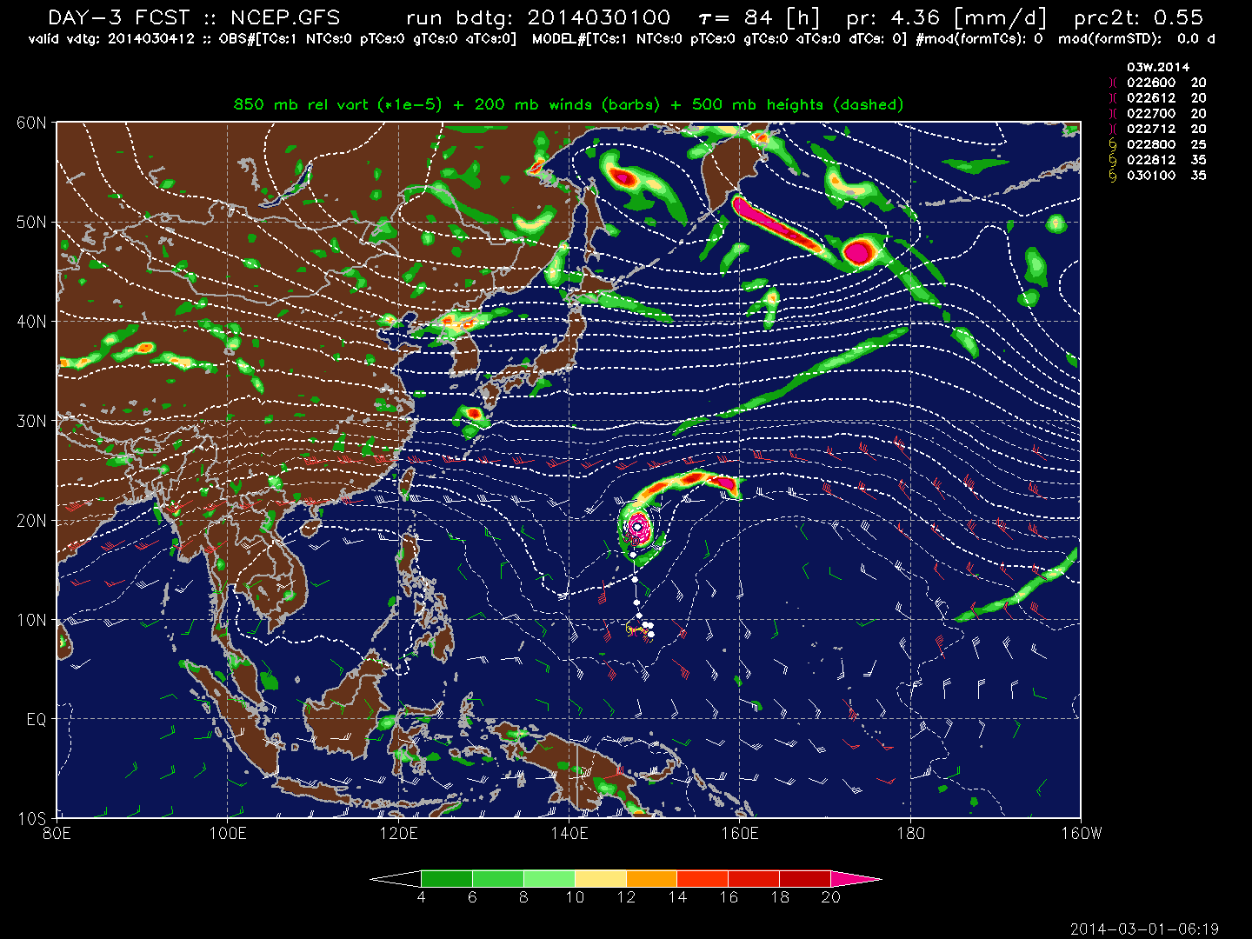
TCgen2 – two WxMAP2 products: dynamical (NHC 850 McAdie chart) http://ruc.noaa.gov/hfip/tcgen
dynamics – 850 mb relative vorticity
mass – 500 mb heights – STR & breaks
dynamics – 200 mb wind – shear

Slide 21
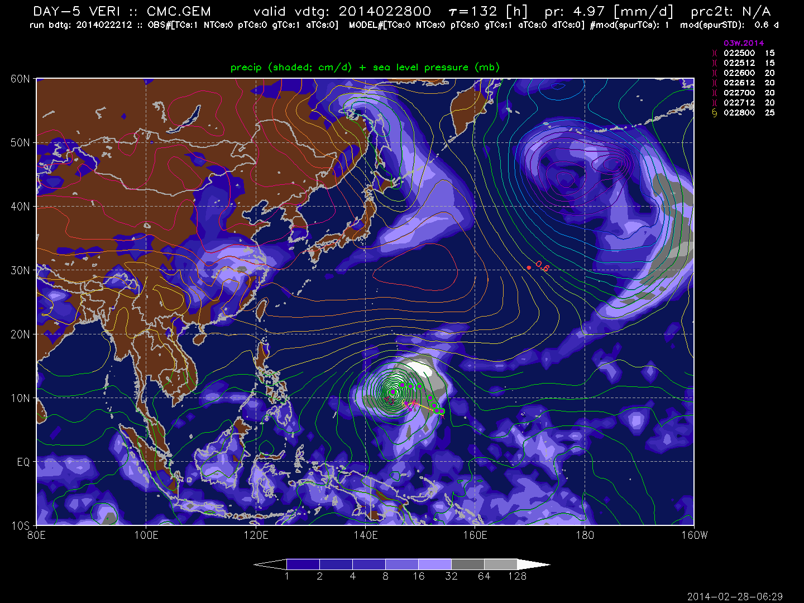
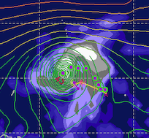
TCgen2 – VERI mode – verification – CMC CGDP D+5 03W http://ruc.noaa.gov/hfip/tcgen
first JTWC warning for 03W on 2014022800 – genesis
CMC mTC located ‘near enough’ to 03W to be declared a ‘hit’ of genesis forecast Vmax=43 kt
spuricane on top of tropical band
spuricane

Slide 22
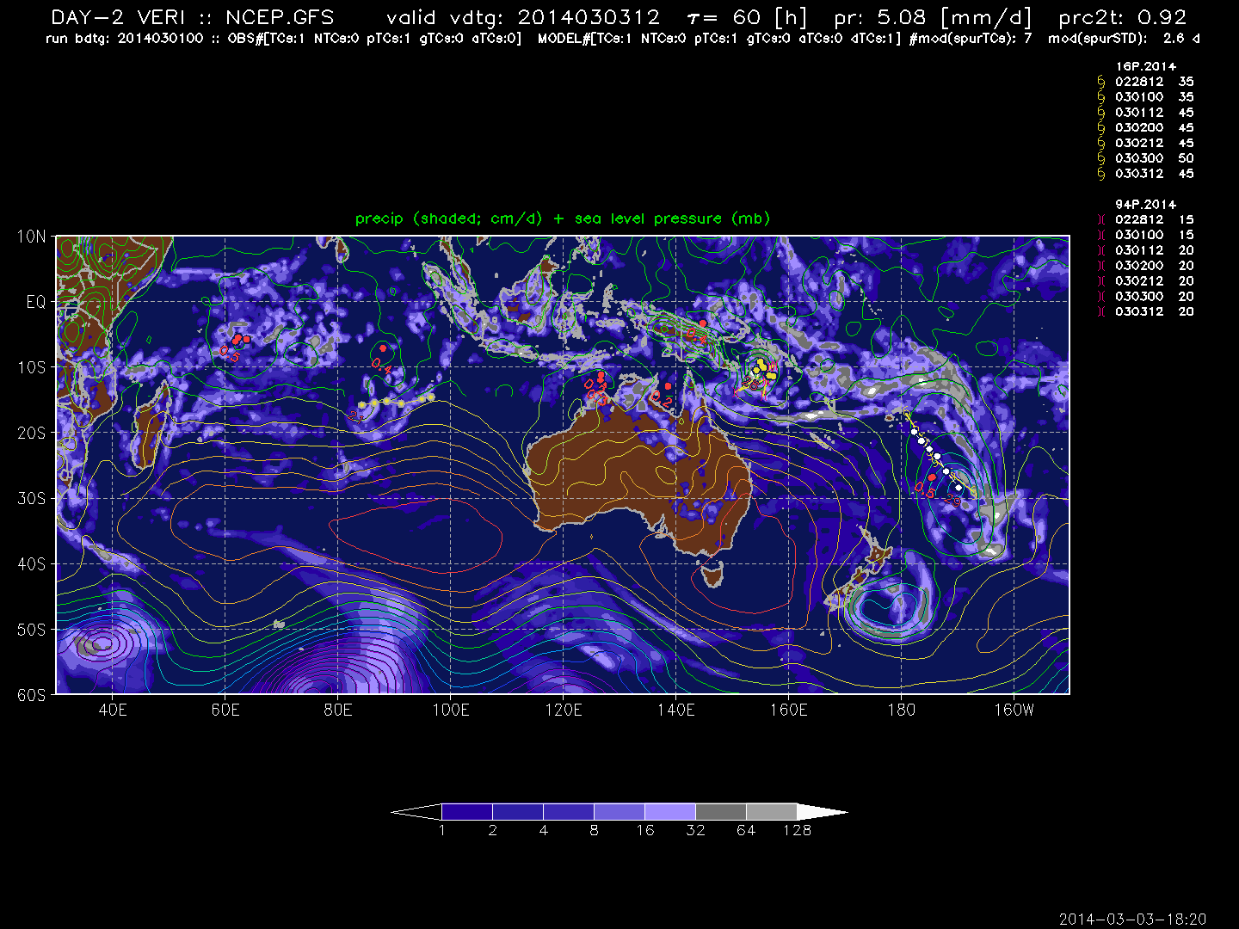
TCgen2 – VERI mode – SPURICANES class 1 & 2 – NCEP GFS D+2 forecast http://ruc.noaa.gov/hfip/tcgen
GFS
GFS correctly forecasts both TC 16P and pTC 96P
7 class I spuricanes but sTDd <= 0.5 d
model maintained a TC that dissipated – class II spuricane
FIM9
7 class I spuricanes
class II spuricane

Slide 23
TC Demographics pTCs, TCs, mTCs, aTCs and the spuricane
Type | Naming | Features
TC | 01-49 numbered TCs 01W.2014 TC #1 in WESTPAC in 2014 | tropical cyclone as analyzed by JTWC/NHC ATCF TC designations: TD, TS, TY, HU, STY, [SD, SS] ATCF non-TC designations: PT, XT, ET
pTC | 9X or INVEST systems 94S.2014 – the landphoon over eastern OZ | pre/potential TC as analyzed by JTWC/NHC ATCF designations: LO, DB, WV Database of pTCs in WPAC/SHEM/IO 1999-2013; LANT/EPAC 2006-2013
mTC | TGNNNN NN or 9X | model cyclone from a tracker genesis mode – 1.5 mb center-outer deficit
aTC | TGNNNN | initial mTC that the model maintains for >= 24 h into the forecast, not associated with a TC/pTC
SPURICANE | TGNNNN | mTC that cannot be associated with a TC, pTC, aTC mTC associated with a dissipated ?TC mTC much stronger than pTC
Notes:
note 9X dataset for Kevin Tory, dataset being fully vetted using TIM and tcdiag answer the mail from Jack Beven and Sim Aberson

Slide 24
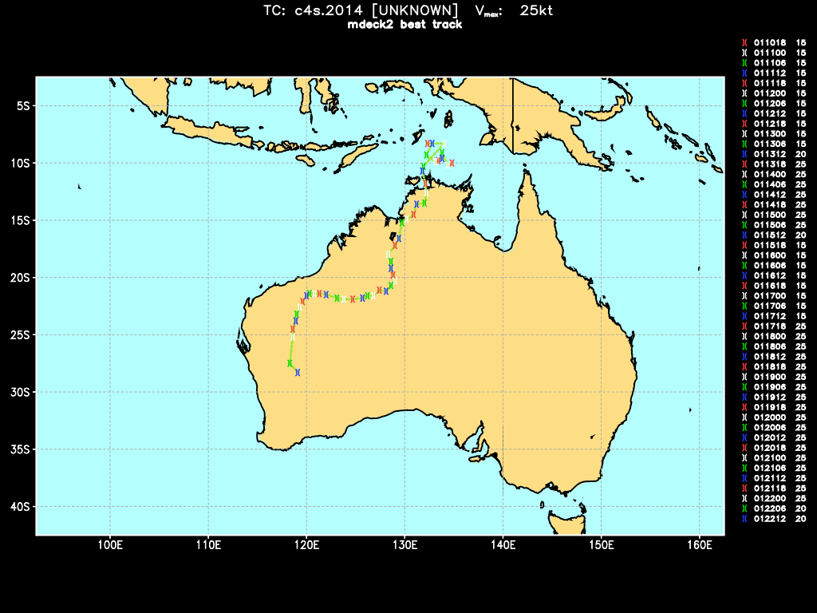
C4S.2014 (the 3rd 94S pTC) – OZ Landphoon

Slide 25
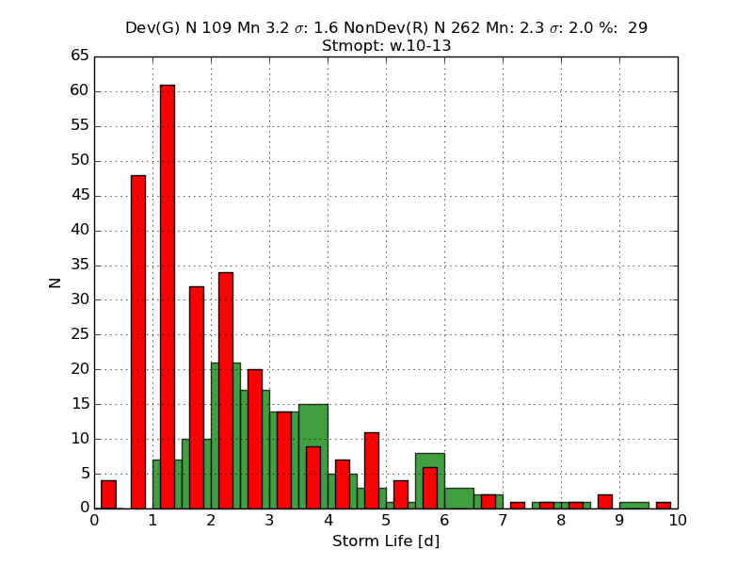
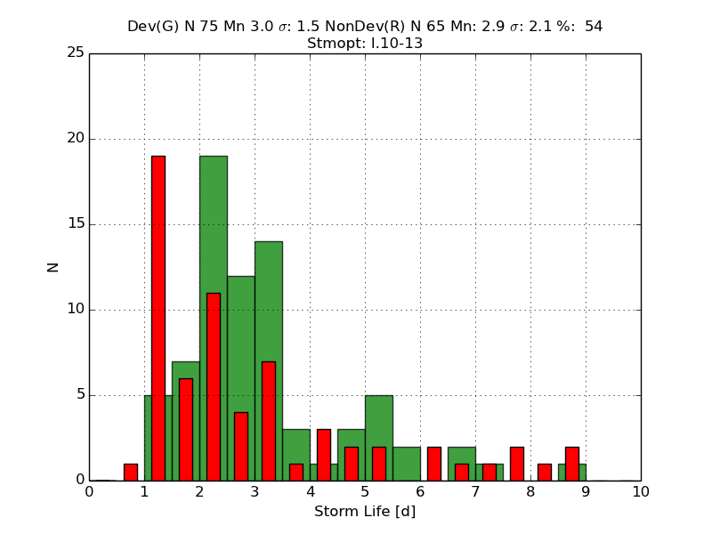
TC Demographics – Dev v NonDev
WPAC 2010-2013
29% Dev
Dev: 3.2d NonDev: 2.3d
LANT 2010-2013
54% Dev
Dev: 3.0d NonDev: 2.9d

Slide 26
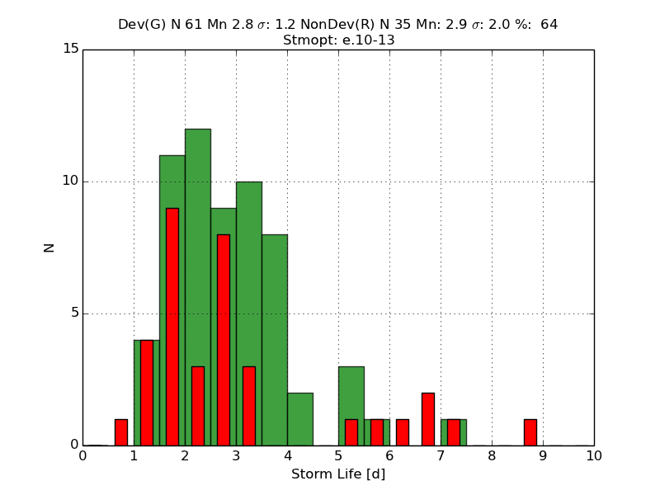
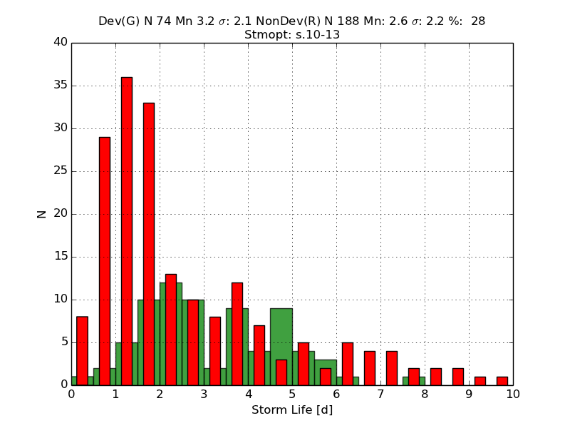
TC Demographics – Dev v NonDev
EPAC 2010-2013
64% Dev
Dev: 2.8d NonDev: 2.9d
SHEM 2010-2013
54% Dev
Dev: 3.2d NonDev: 2.6d

Slide 27
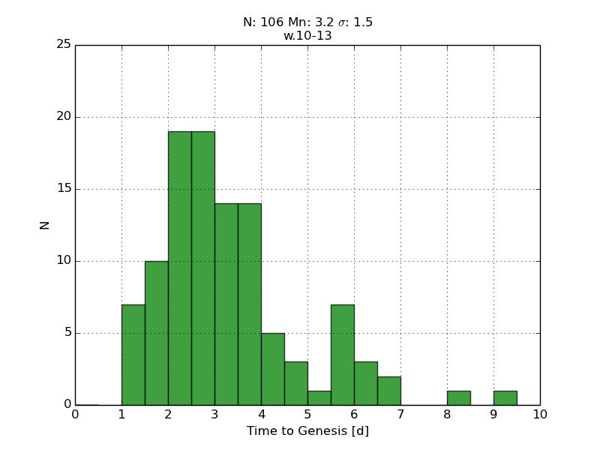
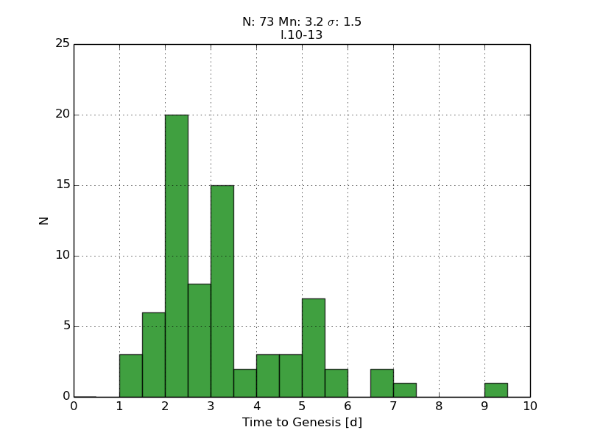
TC Demographics – time to genesis
WPAC 2010-2013
Mean: 3.2 d
LANT 2010-2013
Mean: 3.2 d

Slide 28
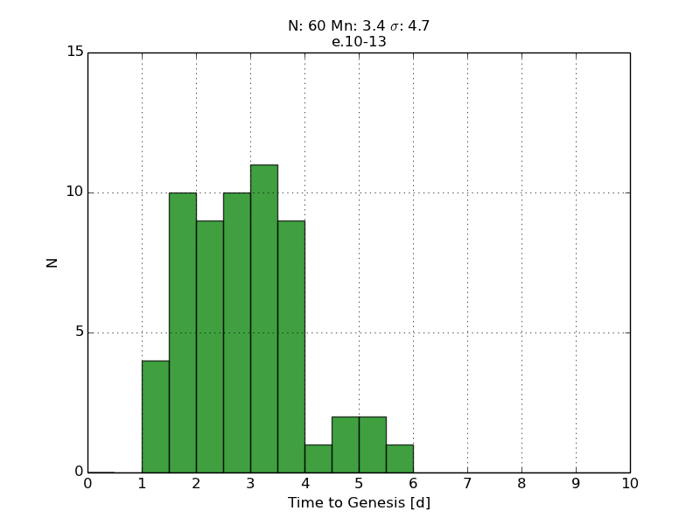
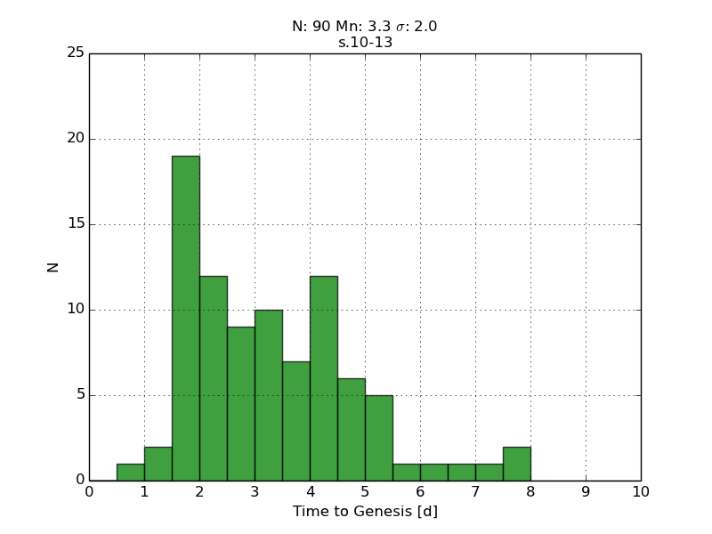
TC Demographics – time to genesis
EPAC 2010-2013
Mean: 3.4 d
SHEM 2010-2013
Mean: 3.3 d

Slide 29
Summary of TC demographics
mean time to genesis ~ 3.3 d in all basins
formation rate:
  WPAC lowest ~ 30%
  EPAC highest ~ 64%
  SHEM & LANT ~ 50%
mean lifetime
  EPAC fastest dev time ~ 2.8 d
  EPAC & LANT longest nondev time ~ 2.9 d
  WPAC & SHEM longest dev time ~ 3.2 d

Slide 30
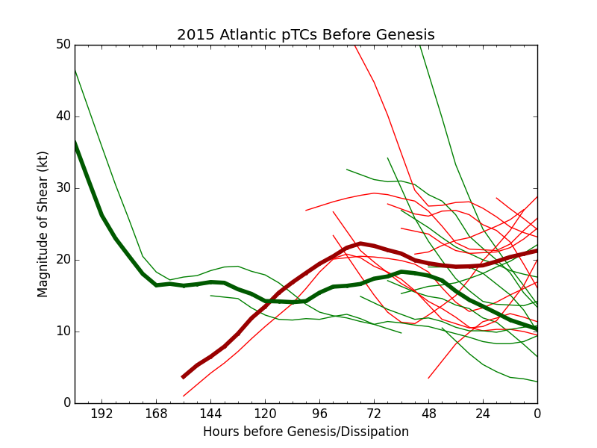
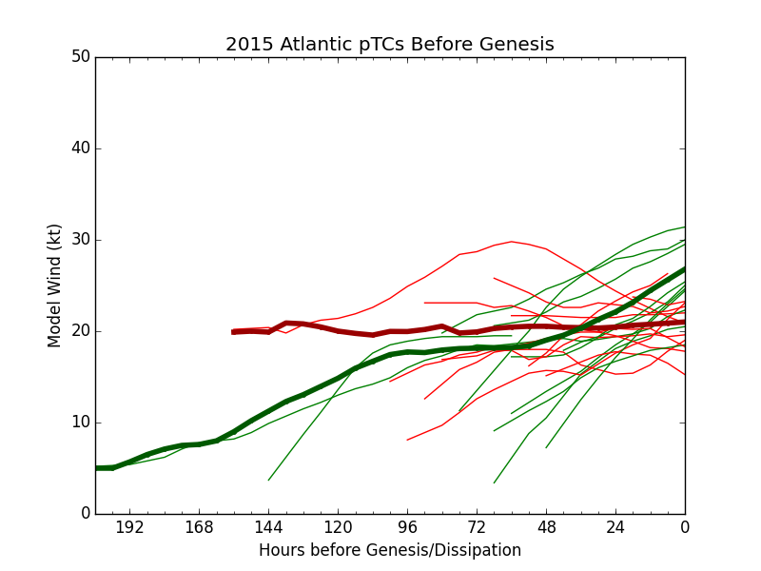
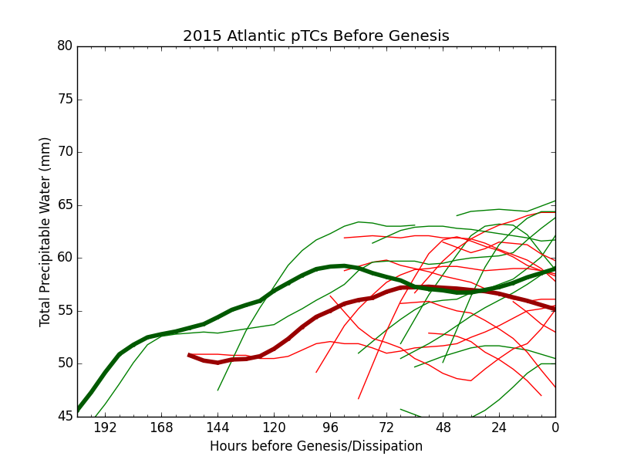
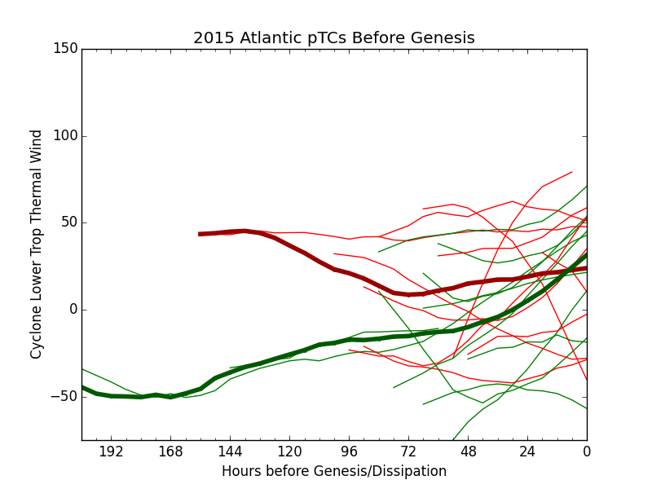
LANT 2015 – extended mdecks
SHRMAG
ModVmax
CPSVTL
TPW

Slide 31
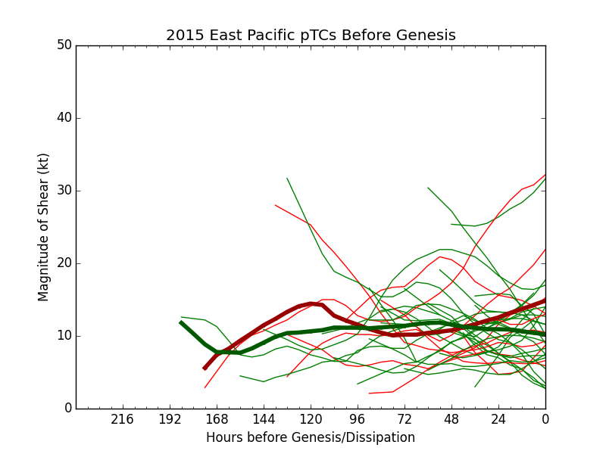
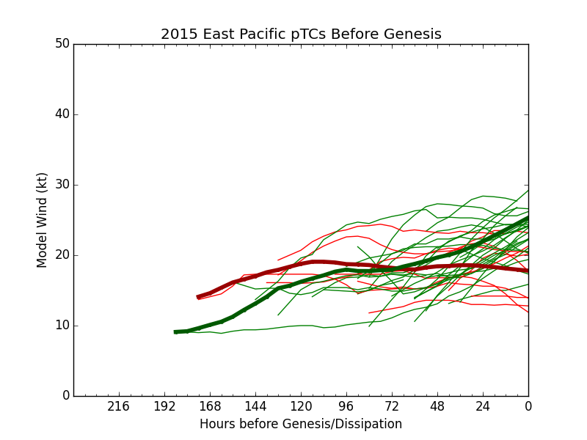
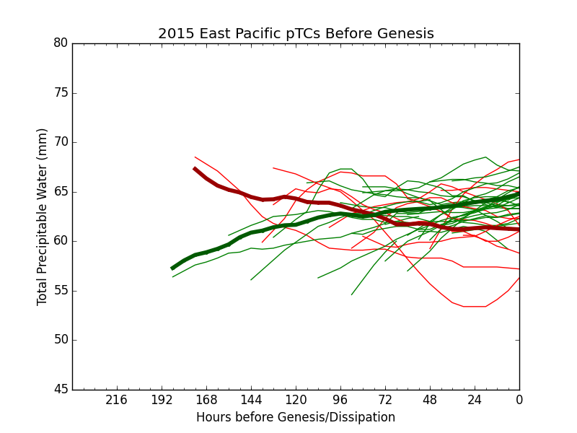
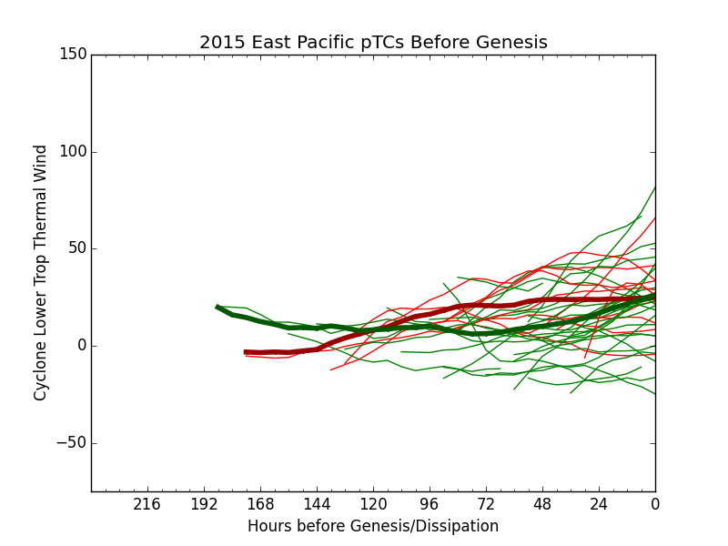
C+EPAC 2015 – extended mdecks
SHRMAG
ModVmax
CPSVTL
TPW

Slide 32
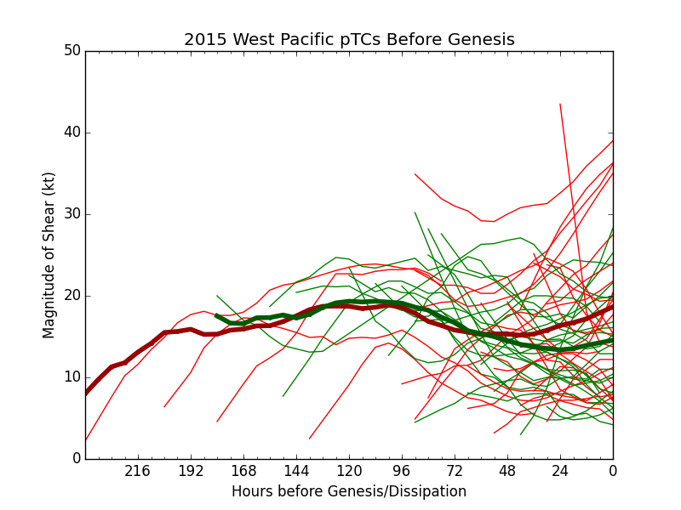
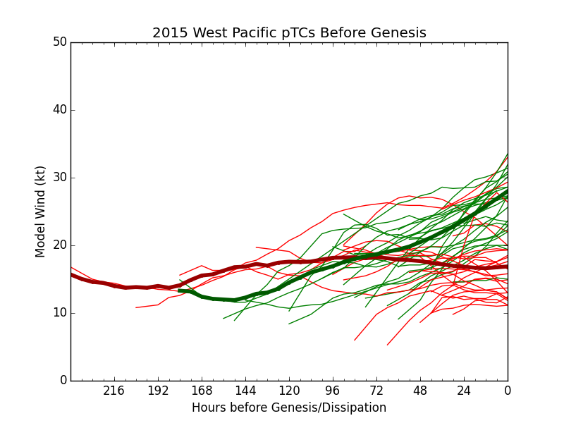
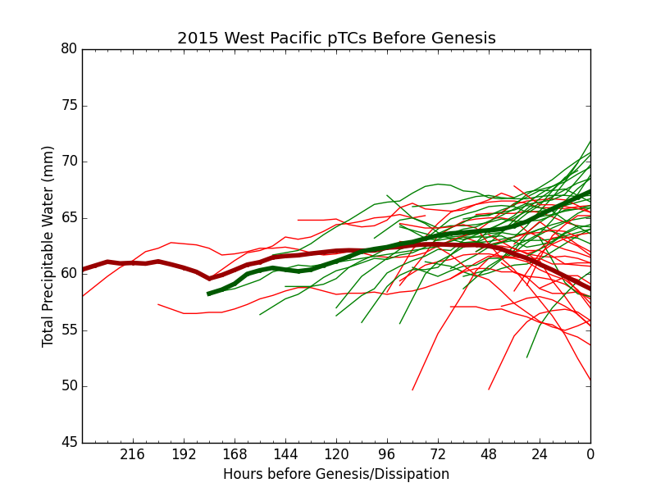
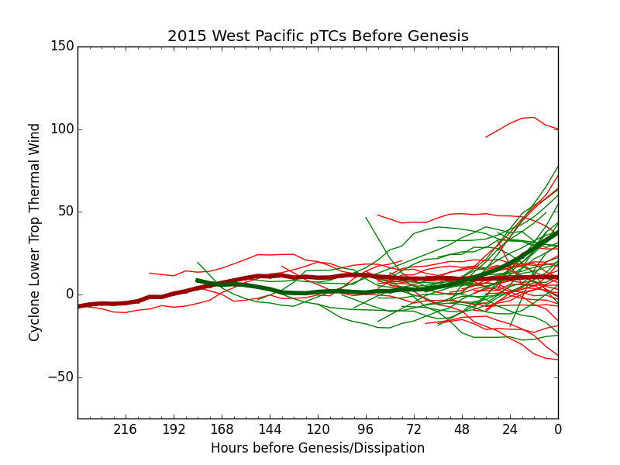
WPAC 2015 – extended mdecks
SHRMAG
ModVmax
CPSVTL
TPW

Slide 33
Summary of extended mdecks
dev v nondev pTCs begin to diverge ~ 48-72 before formation – forecast potential?
model Vmax and trend – strong indicator of development
shear mag and trend is similar to model Vmax, especially in trend
moisture (TPW) and thermo (CPSVTL) less distinct
signals strongest in WPAC and weakest in LANT

Slide 34
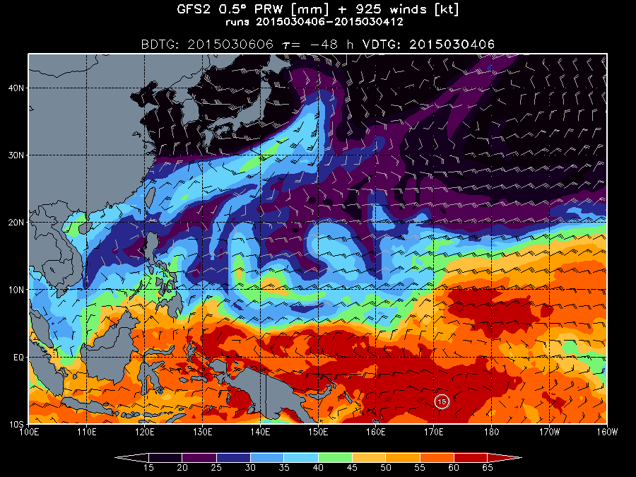
WxBreak I – WWB

Slide 35
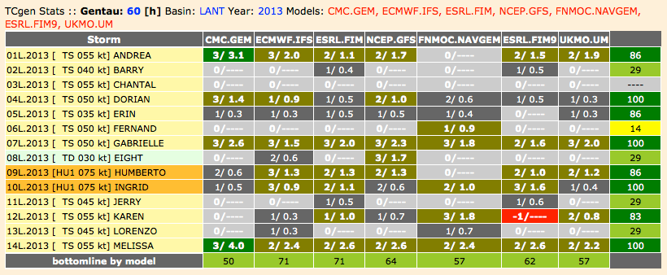
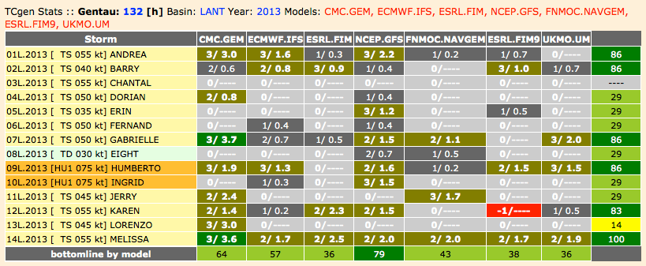
TCgen2 – seasonal verification – atLANTic 2013 – D+2 & D+5 http://ruc.noaa.gov/hfip/tcgen
box color | key
 | no model run
 | 0 forecasts of genesis
 | 1 of 3 forecast verified
 | 2/3 forecasts verified
 | 3/3 forecasts verified
 | 0%
 | < 25 %
 | 25 >= % < 75
 | >= 75
D+2
D+5

Slide 36
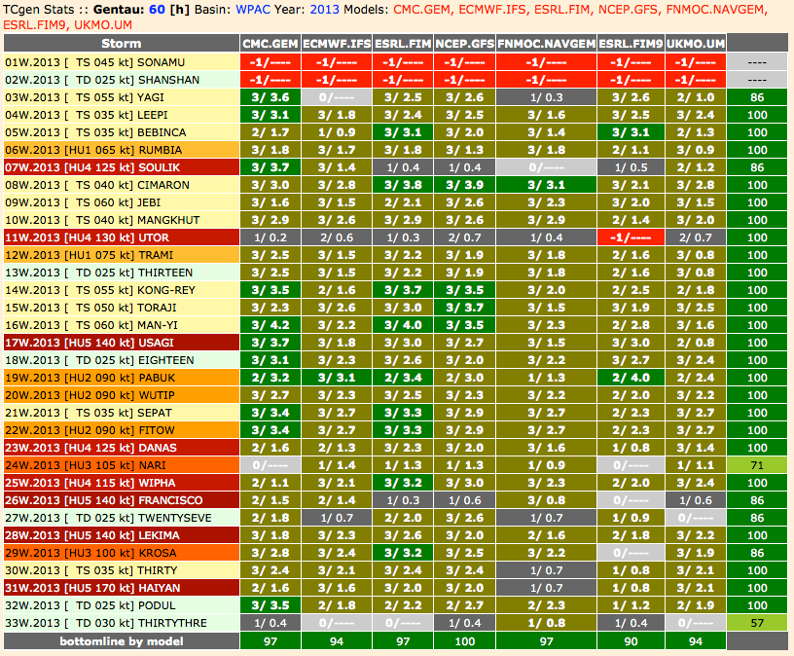
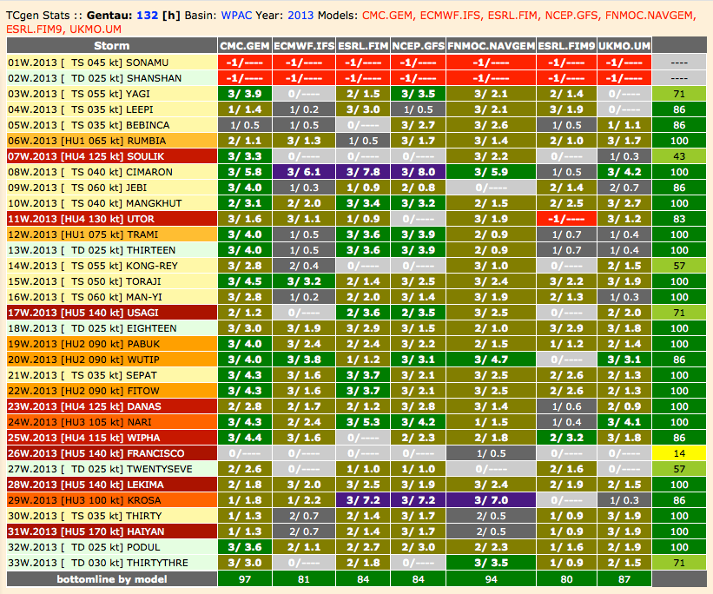
TCgen2 – seasonal verification – WPAC 2013 – D+2 & D+5 http://ruc.noaa.gov/hfip/tcgen
D+2
D+5
box color | key
 | no model run
 | 0 forecasts of genesis
 | 1 of 3 forecast verified
 | 2/3 forecasts verified
 | 3/3 forecasts verified
 | 0%
 | < 25 %
 | 25 >= % < 75
 | >= 75
D+2
D+5

Slide 37
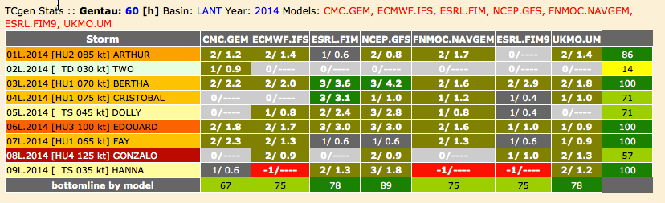
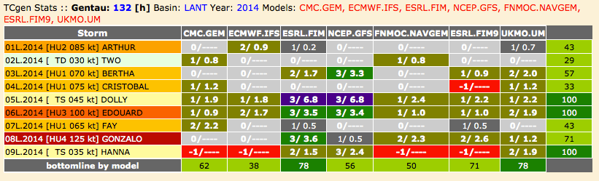
TCgen2 – seasonal verification – atLANTic 2014 – D+2 & D+5 http://ruc.noaa.gov/hfip/tcgen
box color | key
 | no model run
 | 0 forecasts of genesis
 | 1 of 3 forecast verified
 | 2/3 forecasts verified
 | 3/3 forecasts verified
 | 0%
 | < 25 %
 | 25 >= % < 75
 | >= 75
D+2
D+5

Slide 38
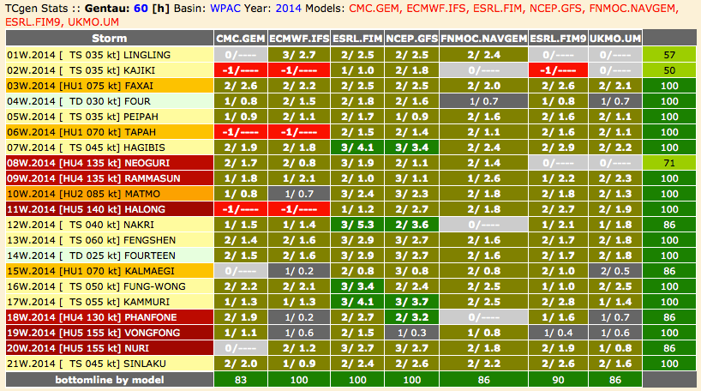
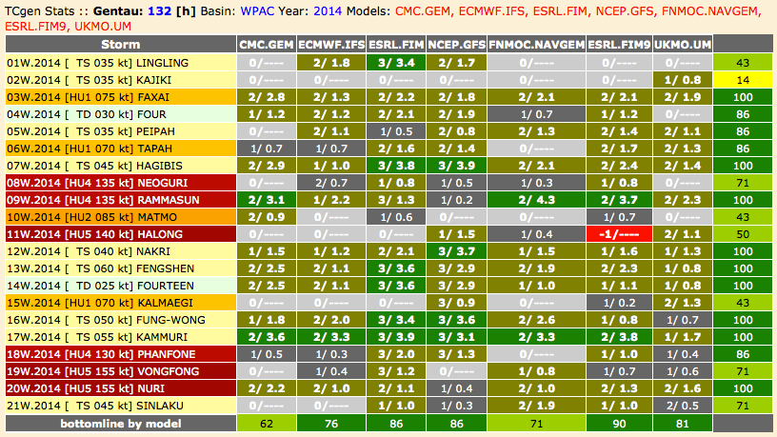
TCgen2 – seasonal verification – WPAC 2014 – D+2 & D+5 http://ruc.noaa.gov/hfip/tcgen
box color | key
 | no model run
 | 0 forecasts of genesis
 | 1 of 3 forecast verified
 | 2/3 forecasts verified
 | 3/3 forecasts verified
 | 0%
 | < 25 %
 | 25 >= % < 75
 | >= 75
D+2
D+5

Slide 39
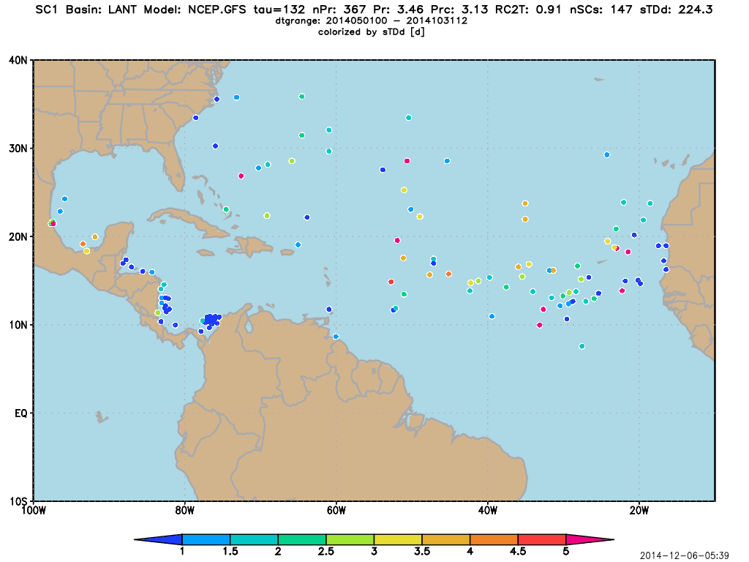
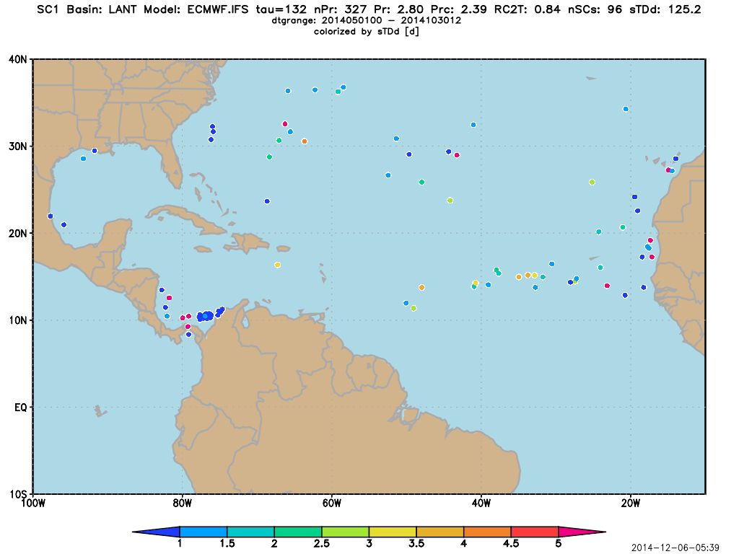
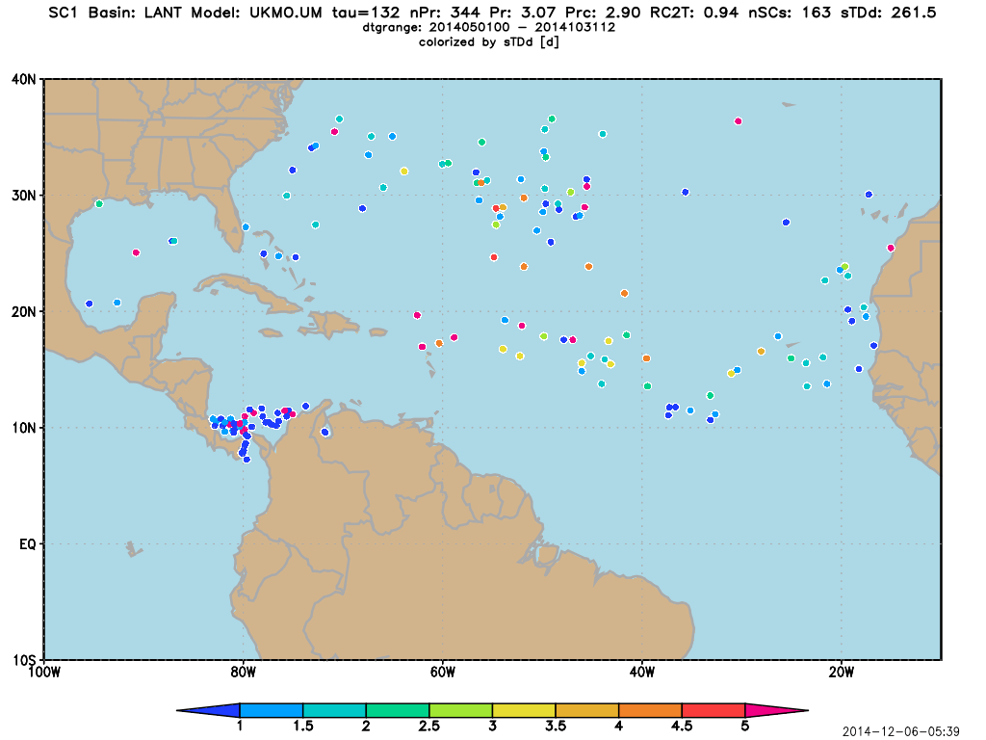
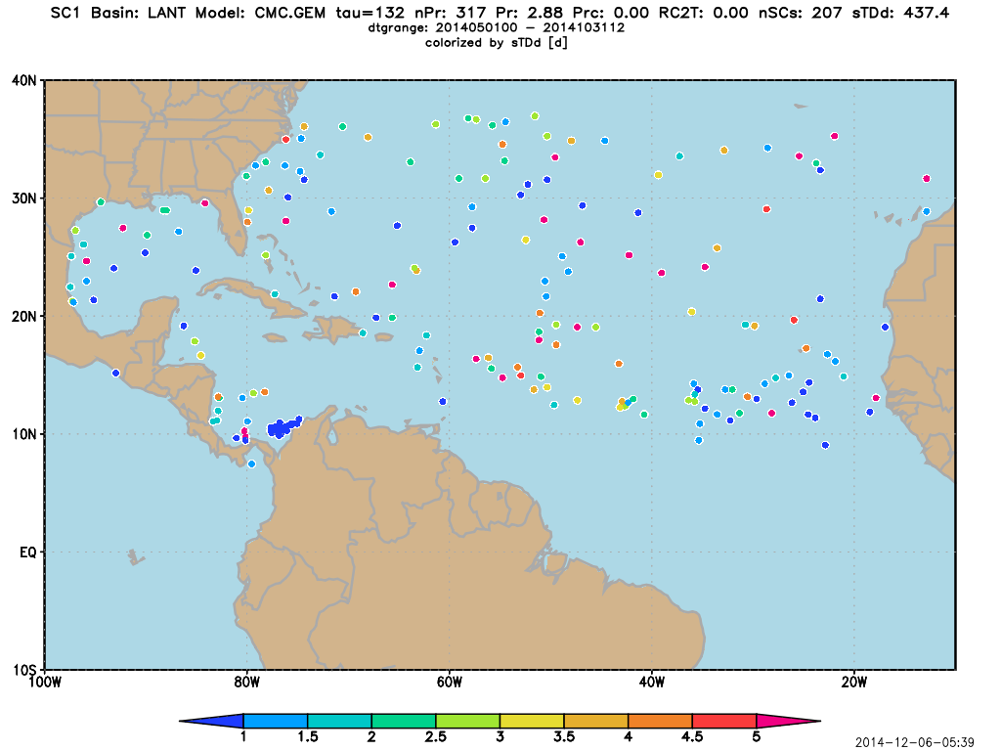


class I spuricane analysis – SC1 – LANT 2014
model | NSC1 | sTDd
GFS | 147 | 224
ECMWF | 96 | 125
UKMO | 163 | 261
CMC | 207 | 437
FIM8 | 125 | 251
FIM9 | 108 | 216
model | Pr | Prc/Pr
GFS | 3.46 | 0.91
ECMWF | 2.80 | 0.84
UKMO | 3.07 | 0.94
CMC | 2.88 | ---
FIM8 | 2.51 | 0.72
FIM9 | 2.31 | 0.72

Slide 40






class I spuricane analysis – SC1 – WPAC 2014
model | NSC1 | sTDd
GFS | 193 | 361
ECMWF | 157 | 251
UKMO | 242 | 386
CMC | 516 | 1169
FIM8 | 145 | 351
FIM9 | 128 | 297
model | Pr | Prc/Pr
GFS | 5.65 | 0.89
ECMWF | 6.40 | 0.87
UKMO | 7.02 | 0.95
CMC | 7.04 | ---
FIM8 | 4.18 | 0.72
FIM9 | 4.13 | 0.70

Slide 41
Takeaways
TCgen2 was developed based on NHC operations (O2R) for HFIP
FCST mode consistent with NHC operations, e.g., use 36-60 h model solution for D+2 forecast
VERI mode to see how the models are doing in real time, based on a detailed comparison of model v observed (NHC/JTWC-analyzed) (p)TCs
in WPAC/EPAC 2013 models had 100% correct genesis forecasts at D+2 reduces to ~80% at D+5
LANT 2013 genesis forecasts much less skillful, perhaps because the season had the lowest hurricane ACE in the last 48 years…
a comprehensive and vetted dataset of pTCs – 1999-2014
verification of pTC forecasts, analyzed model TCs, 7-d forecasts…

Slide 42
Takeaways
TCgen2 was developed based on NHC operations (O2R)
FCST mode consistent with NHC operations, e.g., use 36-60 h model solution for D+2 forecast
VERI mode to see how the models are doing in real time, based on a detailed comparison of model v observed (NHC/JTWC-analyzed) (p)TCs
in WPAC/EPAC 2013 models had 100% correct genesis forecasts at D+2 reduces to ~80% at D+5
LANT 2013 genesis forecasts much less skillful, perhaps because the season had the lowest hurricane ACE in the last 48 years…
a comprehensive and vetted dataset of pTCs – 1999-2014
verification of pTC forecasts, analyzed model TCs, 7-d forecasts…

Slide 43
Takeaways
TCgen2 was developed based on NHC operations (O2R)
FCST mode consistent with NHC operations, e.g., use 36-60 h model solution for D+2 forecast
VERI mode to see how the models are doing in real time, based on a detailed comparison of model v observed (NHC/JTWC-analyzed) (p)TCs
in WPAC/EPAC 2013 models had 100% correct genesis forecasts at D+2 reduces to ~80% at D+5
LANT 2013 genesis forecasts much less skillful, perhaps because the season had the lowest hurricane ACE in the last 48 years…
a comprehensive and vetted dataset of pTCs – 1999-2014
verification of pTC forecasts, analyzed model TCs, 7-d forecasts…

Slide 44
Takeaways
TCgen2 was developed based on NHC operations (O2R)
FCST mode consistent with NHC operations, e.g., use 36-60 h model solution for D+2 forecast
VERI mode to see how the models are doing in real time, based on a detailed comparison of model v observed (NHC/JTWC-analyzed) (p)TCs
in WPAC/EPAC 2013 models had 100% correct genesis forecasts at D+2 reduces to ~80% at D+5
LANT 2013 genesis forecasts much less skillful, perhaps because the season had the lowest hurricane ACE in the last 48 years…
a comprehensive and vetted dataset of pTCs – 1999-2014
verification of pTC forecasts, analyzed model TCs, 7-d forecasts…

Slide 45
Takeaways
TCgen2 was developed based on NHC operations (O2R)
FCST mode consistent with NHC operations, e.g., use 36-60 h model solution for D+2 forecast
VERI mode to see how the models are doing in real time, based on a detailed comparison of model v observed (NHC/JTWC-analyzed) (p)TCs
in WPAC/EPAC 2013 models had 100% correct genesis forecasts at D+2 reduces to ~80% at D+5
LANT 2013 genesis forecasts much less skillful, perhaps because the season had the lowest hurricane ACE in the last 48 years…
a comprehensive and vetted dataset of pTCs – 1999-2014
verification of pTC forecasts, analyzed model TCs, 7-d forecasts…

Slide 46
Takeaways
TCgen2 was developed based on NHC operations (O2R)
FCST mode consistent with NHC operations, e.g., use 36-60 h model solution for D+2 forecast
VERI mode to see how the models are doing in real time, based on a detailed comparison of model v observed (NHC/JTWC-analyzed) (p)TCs
in WPAC/EPAC 2013 models had 100% correct genesis forecasts at D+2 reduces to ~80% at D+5
LANT 2013 genesis forecasts much less skillful, perhaps because the season had the lowest hurricane ACE in the last 48 years…
a comprehensive and vetted dataset of pTCs – 1999-2014
verification of pTC forecasts, analyzed model TCs, 7-d forecasts…

Slide 47
Takeaways
TCgen2 was developed based on NHC operations (O2R)
FCST mode consistent with NHC operations, e.g., use 36-60 h model solution for D+2 forecast
VERI mode to see how the models are doing in real time, based on a detailed comparison of model v observed (NHC/JTWC-analyzed) (p)TCs
in WPAC/EPAC 2013 models had 100% correct genesis forecasts at D+2 reduces to ~80% at D+5
LANT 2013 genesis forecasts much less skillful, perhaps because the season had the lowest hurricane ACE in the last 48 years…
a comprehensive and vetted dataset of pTCs – 1999-2014
next steps: spuricanes, verification of pTC forecasts, analyzed model TCs, 7-d forecasts…

Slide 48








Slide Break – JTWC
COMPACFLT Makalapa Compound, Pearl Harbor, HI
M. Fiorino :: NCEP 20051215

Slide 49
Slide Wars – ROE I
1
The Peter* Principle
One Slide per Minute
*Pete Black aka Pedro Negro circa 1978

Slide 50
Slide Wars – ROE II
2
The Alan Weinstein Principle
When briefing the Admiral you only have ONE slide…
the ONE slide must:
  never, never, EVER show equations
  be a cartoon – the simpler the better – NO squiggly lines!
  no more than 10 words

Slide 51


Slide Wars – ROE III
3
FNMOC – ‘you’re only as good as what you measure’
  FNMOC = Fleet Numerical Meteorology and Oceanography Center
  pronounced ‘FinMock’ != jokes about the Finns
ONR – answer the ‘So What? Who Cares?’
CNE-C6F
  make maximum use of local acronyms
    so that no one, especially the CO, fully understands…
    so as to be the SME
  local quality of brief proportional # of WOFs
    WOF != Warn On Forecast
    WOF = Warheads On Foreheads
MF rule – because of the Bill-Steve wars – no .ppt(x) only (simple).pdf
  progressing forward to the 1980s – .pdf = digital acetate slides

Slide 52
So What? Who Cares?
4
WHO? | WHAT? | WHY? | Comments
JTWC | TCFA Tropical Cyclone Formation Alert deterministic D+1 forecast that a pTC (INVEST or 9X) will become a TC | PACOM | pTC analysis procedure similar to JMA EDA (Early Dvorak Analysis)
NHC | GTWO Graphical Tropical Weather Outlook probabilistic D+2 and D+5 of TC dev/form | NHOP non-GPRA goal | 1st true forecaster (HS) probability product
MF | TCgen2 http://ruc.noaa.gov/hfip/tcgen deterministic D+1,2,3,4,5 forecast | Bob Gall | developed a validated set of pre/potential TCs (pTCs) based on operations genesis window based on operations
AMS 31st Hurr Trop Conf | 4 sessions on TC genesis | NSF? NHC? ONR? – somebody must be funding TCgen research | no consistent definition of genesis – “I don’t know how to define *.*, but I know it when I see it” no consistent definition and/or use of pTCs
Notes:
Potter Stewart Stewart wrote, "I shall not today attempt further to define the kinds of material I understand to be embraced within that shorthand description; and perhaps I could never succeed in intelligibly doing so. But I know it when I see it, and the motion picture involved in this case is not that." (emphasis added)

Slide 53




One Slide to rule them all and in the…
5a
2014 NHEM Season
GEN%
FAR%
Notes:
Potter Stewart Stewart wrote, "I shall not today attempt further to define the kinds of material I understand to be embraced within that shorthand description; and perhaps I could never succeed in intelligibly doing so. But I know it when I see it, and the motion picture involved in this case is not that." (emphasis added)

Slide 54

One Slide to rule them all and in the…
5a
2014 NHEM Season
GEN%
FAR%
Notes:
Potter Stewart Stewart wrote, "I shall not today attempt further to define the kinds of material I understand to be embraced within that shorthand description; and perhaps I could never succeed in intelligibly doing so. But I know it when I see it, and the motion picture involved in this case is not that." (emphasis added)

Slide 55
One Slide to rule them all and in the…
5a
GREEN-BROWN :: GOOD
are the genesis forecasts
GEN%
RED :: BAD
more alse alarms, i.e., more spuricanes
FAR%
Notes:
Potter Stewart Stewart wrote, "I shall not today attempt further to define the kinds of material I understand to be embraced within that shorthand description; and perhaps I could never succeed in intelligibly doing so. But I know it when I see it, and the motion picture involved in this case is not that." (emphasis added)

Slide 56
One Slide to rule them all and in the…
5a
USN best FAR in the LANT; other models have more spuricanes
ECMWF lowest FAR
except in the gulf of Mosquitos
UKMO consistent and good GEN
.ca – very high FAR
in all basins, eh?
Notes:
Potter Stewart Stewart wrote, "I shall not today attempt further to define the kinds of material I understand to be embraced within that shorthand description; and perhaps I could never succeed in intelligibly doing so. But I know it when I see it, and the motion picture involved in this case is not that." (emphasis added)

Slide 57
One Slide to rule them all and in the…
5
ECMWF lowest FAR
except in the gulf of Mosquitos
USN best FAR in the LANT; other models have more spuricanes
UKMO consistent and good GEN
.ca – very high FAR
in all basins, eh?
Notes:
Potter Stewart Stewart wrote, "I shall not today attempt further to define the kinds of material I understand to be embraced within that shorthand description; and perhaps I could never succeed in intelligibly doing so. But I know it when I see it, and the motion picture involved in this case is not that." (emphasis added)

Slide 58

STEP 1: generate a WxMAP with model v obs cyclones genesis of 02W.15 (TC) on 2015020700 – developed from 94W (pTC)
6a
started as 94W on 020406
1st JTWC warning on 020706
72 h as a pTC
Notes:
Potter Stewart Stewart wrote, "I shall not today attempt further to define the kinds of material I understand to be embraced within that shorthand description; and perhaps I could never succeed in intelligibly doing so. But I know it when I see it, and the motion picture involved in this case is not that." (emphasis added)

Slide 59
STEP 1: generate a WxMAP with model v obs cyclones genesis of 02W.15 (TC) on 2015020700 – developed from 94W (pTC)
6b
started as 94W on 020406
1st JTWC warning on 020706
72 h as a pTC
genesis track close to posit at 020706 = ‘HIT’
Notes:
Potter Stewart Stewart wrote, "I shall not today attempt further to define the kinds of material I understand to be embraced within that shorthand description; and perhaps I could never succeed in intelligibly doing so. But I know it when I see it, and the motion picture involved in this case is not that." (emphasis added)

Slide 60
STEP 1: generate a WxMAP with model v obs cyclones genesis of 02W.15 (TC) on 2015020700 – developed from 94W (pTC)
6c
these two genesis tracks NOT close to posit at 020706 = ‘MISS’ =
class I Spuricane (SC1)
started as 94W on 020406
1st JTWC warning on 020706
72 h as a pTC
genesis track close to posit at 020706 = ‘HIT’
Notes:
Potter Stewart Stewart wrote, "I shall not today attempt further to define the kinds of material I understand to be embraced within that shorthand description; and perhaps I could never succeed in intelligibly doing so. But I know it when I see it, and the motion picture involved in this case is not that." (emphasis added)

Slide 61
STEP 1: generate a WxMAP with model v obs cyclones genesis of 02W.15 (TC) on 2015020700 – developed from 94W (pTC)
6d
these two genesis tracks NOT close to posit at 020706 = ‘MISS’ =
class I Spuricane (SC1)
started as 94W on 020406
1st JTWC warning on 020706
72 h as a pTC
strength of SC1 = sTDd = 0.4
scaled TD (25 kt) days
genesis track close to posit at 020706 = ‘HIT’
Notes:
Potter Stewart Stewart wrote, "I shall not today attempt further to define the kinds of material I understand to be embraced within that shorthand description; and perhaps I could never succeed in intelligibly doing so. But I know it when I see it, and the motion picture involved in this case is not that." (emphasis added)

Slide 62
STEP 1: generate a WxMAP with model v obs cyclones genesis of 02W.15 (TC) on 2015020700 – developed from 94W (pTC)
6
statistics of
TCs
pTCs
gTCs
sTDd
stored in a .pypdb file
these two genesis tracks NOT close to posit at 020706 = ‘MISS’ =
class I Spuricane (SC1)
started as 94W on 020406
1st JTWC warning on 020706
72 h as a pTC
strength of SC1 = sTDd = 0.4
scaled TD (25 kt) days
genesis track close to posit at 020706 = ‘HIT’
Notes:
Potter Stewart Stewart wrote, "I shall not today attempt further to define the kinds of material I understand to be embraced within that shorthand description; and perhaps I could never succeed in intelligibly doing so. But I know it when I see it, and the motion picture involved in this case is not that." (emphasis added)

Slide 63

STEP 2: analyze stats from the WxMAPs
May-October for NHEM seasons, by model and forecast – GFS D+5 WPAC
7a
triangles are correct genesis forecasts
dots are SC1s
squares are missed
genesis forecasts
colorize by sTDd [d]
Notes:
Potter Stewart Stewart wrote, "I shall not today attempt further to define the kinds of material I understand to be embraced within that shorthand description; and perhaps I could never succeed in intelligibly doing so. But I know it when I see it, and the motion picture involved in this case is not that." (emphasis added)

Slide 64
STEP 2: analyze stats from the WxMAPs
May-October for NHEM seasons, by model and forecast – GFS D+5 WPAC
7
Genesis Rate
% correct genesis forecasts
False Alarm Rate
#SC1/#genTC points
# dots/(#triangles+#squares)
Notes:
Potter Stewart Stewart wrote, "I shall not today attempt further to define the kinds of material I understand to be embraced within that shorthand description; and perhaps I could never succeed in intelligibly doing so. But I know it when I see it, and the motion picture involved in this case is not that." (emphasis added)

Slide 65
Critical Factors...
8
the TIM (Tcs In Models – GFDL) tracker locates/forms cyclones during the model forecast…but model cyclone max wind (in sTDd) is insufficient to identify spuricanes…but the Hart CPS (Cyclone Phase Space) can…but FAR is sensitive to CPS thresholds…
used sTDd threshold to define “significant” model cyclones for making a yes/no forecast of genesis…but need to include CPS…still need to improve the calibration…

Slide 66
Conclusions and Takeaways
9
the global models DO forecast genesis
  higher success rates at D+2 v D+5
  increase in FAR from D+2 to D+5 not as large as between basins
  2014 LANT spuricanes mostly a gulf of Mosquitoes problem
  2014 WPAC had fewer spuriphoons (lower FAR)
next step – probability of genesis from the multi-model ensemble when calibration improved
whenever you can make a WxMAP – Just Do It!
http://ruc.noaa.gov/hfip/tcgen

Slide 67
Thank You
Mahalo
どうもありがとう ございます
“dough-moe a-rig-e-toe”
as Uncle Bill would say

