Slide 1
An overview of the Radio Occultation Technology and its impact in Operational Numerical Weather Prediction
Lidia Cucurull
Chief, Global Observing Systems Analysis (GOSA) Group
NOAA ESRL Global Systems Division
AOML, Miami, FL, 16 December 2014.

Slide 2
Outline
Introduction to the Global Navigation Satellite Systems (GNSS) Radio Occultation (RO) Technology
Impact of RO observations in operational global weather forecasting
Introduction to the Global Observing Systems Analysis (GOSA) Group
GOSA OSE and OSSE activities

Slide 3
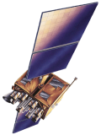
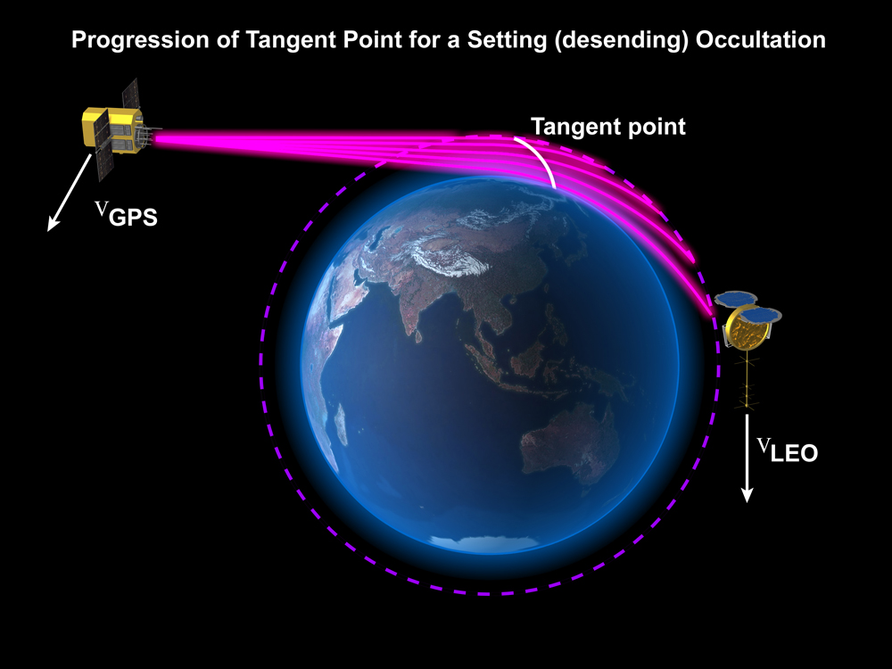
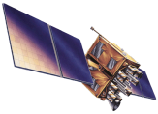
Global Position System (GPS)
The ground-based GPS technique and GPS Radio Occultation technique observe the same transmitters and are based on the same physical principles.
The only difference is that ground-based looks “up” and Radio Occultation looks to the limb of the Earth from space.
derived product: time series of precipitable water
derived product: vertical profiles of temperature/moisture
Mapping Function
~1/sin(a)
s_{j}
s_{z}
s_{i}
h~500 hPa
~5km
a
a
FOV
~22 km

Slide 4
It is the same physics
In both cases, the fundamental measurement is
n(s) = index of refraction of the atmosphere along the path of the radio signal
Raw measurement is traceable to atomic clock time standard – assured long-term stability, no need for external calibration
Notes:
Raw measurement is traceable to atomic clock time standard
Raw measurement is traceable to an absolute SI standard – assured long-time stability. So,
Unbiased raw measurements
No drift, no need for calibration

Slide 5
Radio Occultation concept
An occultation occurs when a GNSS satellite rises or sets across the limb wrt to a LEO satellite
A ray passing through the atmosphere is refracted due to the vertical gradient of refractivity (density and moisture in the neutral atmosphere)
During an occultation (~ 3min) the ray path slices through the atmosphere
Raw measurement: change of the delay (phase) of the signal path between the GPS and LEO during the occultation. (It includes the effect of the atmosphere)
GPS transmits at two different frequencies: ~1.6 GHz (L1) and ~1.3 GHz (L2)
Occulting GPS
Ionosphere
Neutral atmosphere
LEO
Earth

Slide 6
Geometry of a GPS RO profile
1D
We need to think in 3D
TP₁
TP₁
ray 1
TP₂
ray 2
TP₂
0.1-1km
1km
TP₃
TP₃
ray 3
TP₄
TP₄
ray 4
100-300 km
3,000 rays!!!!
An occultation is not just a vertical profile. The relative motion
of the satellites involves an inclination away from the vertical of the
surface swept out by the occulting rays (a surface, moreover, that
is not in general even a plane)

Slide 7
RO processing
s₁, s₂,
Raw measurements of phase of the two signals (L1 and L2)
Bending angles (change in the ray path direction
accumulated along the ray path) of L1 and L2
α₁, α₂
(neutral) bending angle
Clocks correction,
orbits determination,
geometric delay
α
Refractivity, N= 10⁶ (n-1)
Ionospheric correction
Atmospheric
products
N
Abel transfrom
T, Pw, P
Hydrostatic equilibrium,
eq of state, apriori information

Slide 8
Atmospheric variables
At microwave wavelengths (GPS), the dependence of N on atmospheric variables can be expressed as:
Ionosphere
f is the frequency (Hz)
n_{e} electron density(m⁻³)
Hydrostatic balance
P is the total pressure (mb)
T is the temperature (K)
Scattering terms
W_{w} and W_{i} are the liquid
water and ice content (gr/m³)
Moisture
P_{w} is the water vapor
pressure (mb)
  important in the troposphere for T> 240K
  can contribute up to 30% of the total N in the tropical LT.
  can dominate the bending in the LT.
Contributions from liquid water & ice to N are very small and the scattering terms can be neglected
RO technology is almost insensitive to clouds.

Slide 9
Atmospheric variables
ionospheric term dominates and the rest of the contributions can be ignored. N directly corresponds to electron density
ionosphere
~ 70 km
height of tangent point
“dry” (P_{w}~ 0) atmosphere
P and T
the ionospheric correction removes the
1st order ionospheric term (1/f²) because
GPS has two frequencies.
neutral
atmosphere
(hydrostratic
term dominates)
~ 6 km
“wet” atmosphere (P,T, P_{w})

Slide 10
“Dry” atmosphere: P and T
Where the contribution of the water vapor to the refractivity can be neglected (T< 240K) the expression for N gets reduced to pure density (and P=P_{d}),
+ equation of state:
+ hydrostatic equilibrium
Given a boundary condition (eg. P=0 at 150 km), one can derive
  Profiles of pressure
  Profiles of temperature (from pressure and density)
  Profiles of geopotential heights from the geometric heights (RO provides independent values of pressure and height).
with m=mean molecular mass of dry air
R=gas constant

Slide 11
“Dry” atmosphere: P and T (cont’d)
When there is no moisture in the atmosphere, the profiles of P and T retrieved from N correspond to the real atmospheric values.
But when there is moisture in the atmosphere, the expression
will erroneously map all the N to P and T of a dry atmosphere.
In other words, all the water vapor in the real atmosphere is replaced by dry molecules that collectively would produce the same amount of N.
As a consequence, the retrieved temperature will be lower (cooler) than the real temperature of the atmosphere
Within the GPS RO community, these profiles are usually referred to “dry temperature” profiles.
This is confusing and misleading…
I agree!!!

Slide 12
Retrieved vs Physical temperature
Moisture
becomes
significant

Slide 13
“Wet” atmosphere: mass and moisture
When the moisture contribution to N is important (middle and lower troposphere), the system is undetermined (P,T,P_{w}).
We need independent knowledge of temperature, pressure or water vapor pressure to estimate the other two variables.
Usually, temperature is given by an external source (model) and we solve for pressure and moisture iteratively.
Alternatively, we can use apriori information of pressure, temperature and moisture from a model along with their error characterization (background error covariance matrices) and find the optimal estimates of P, T and q (variational assimilation)

Slide 14
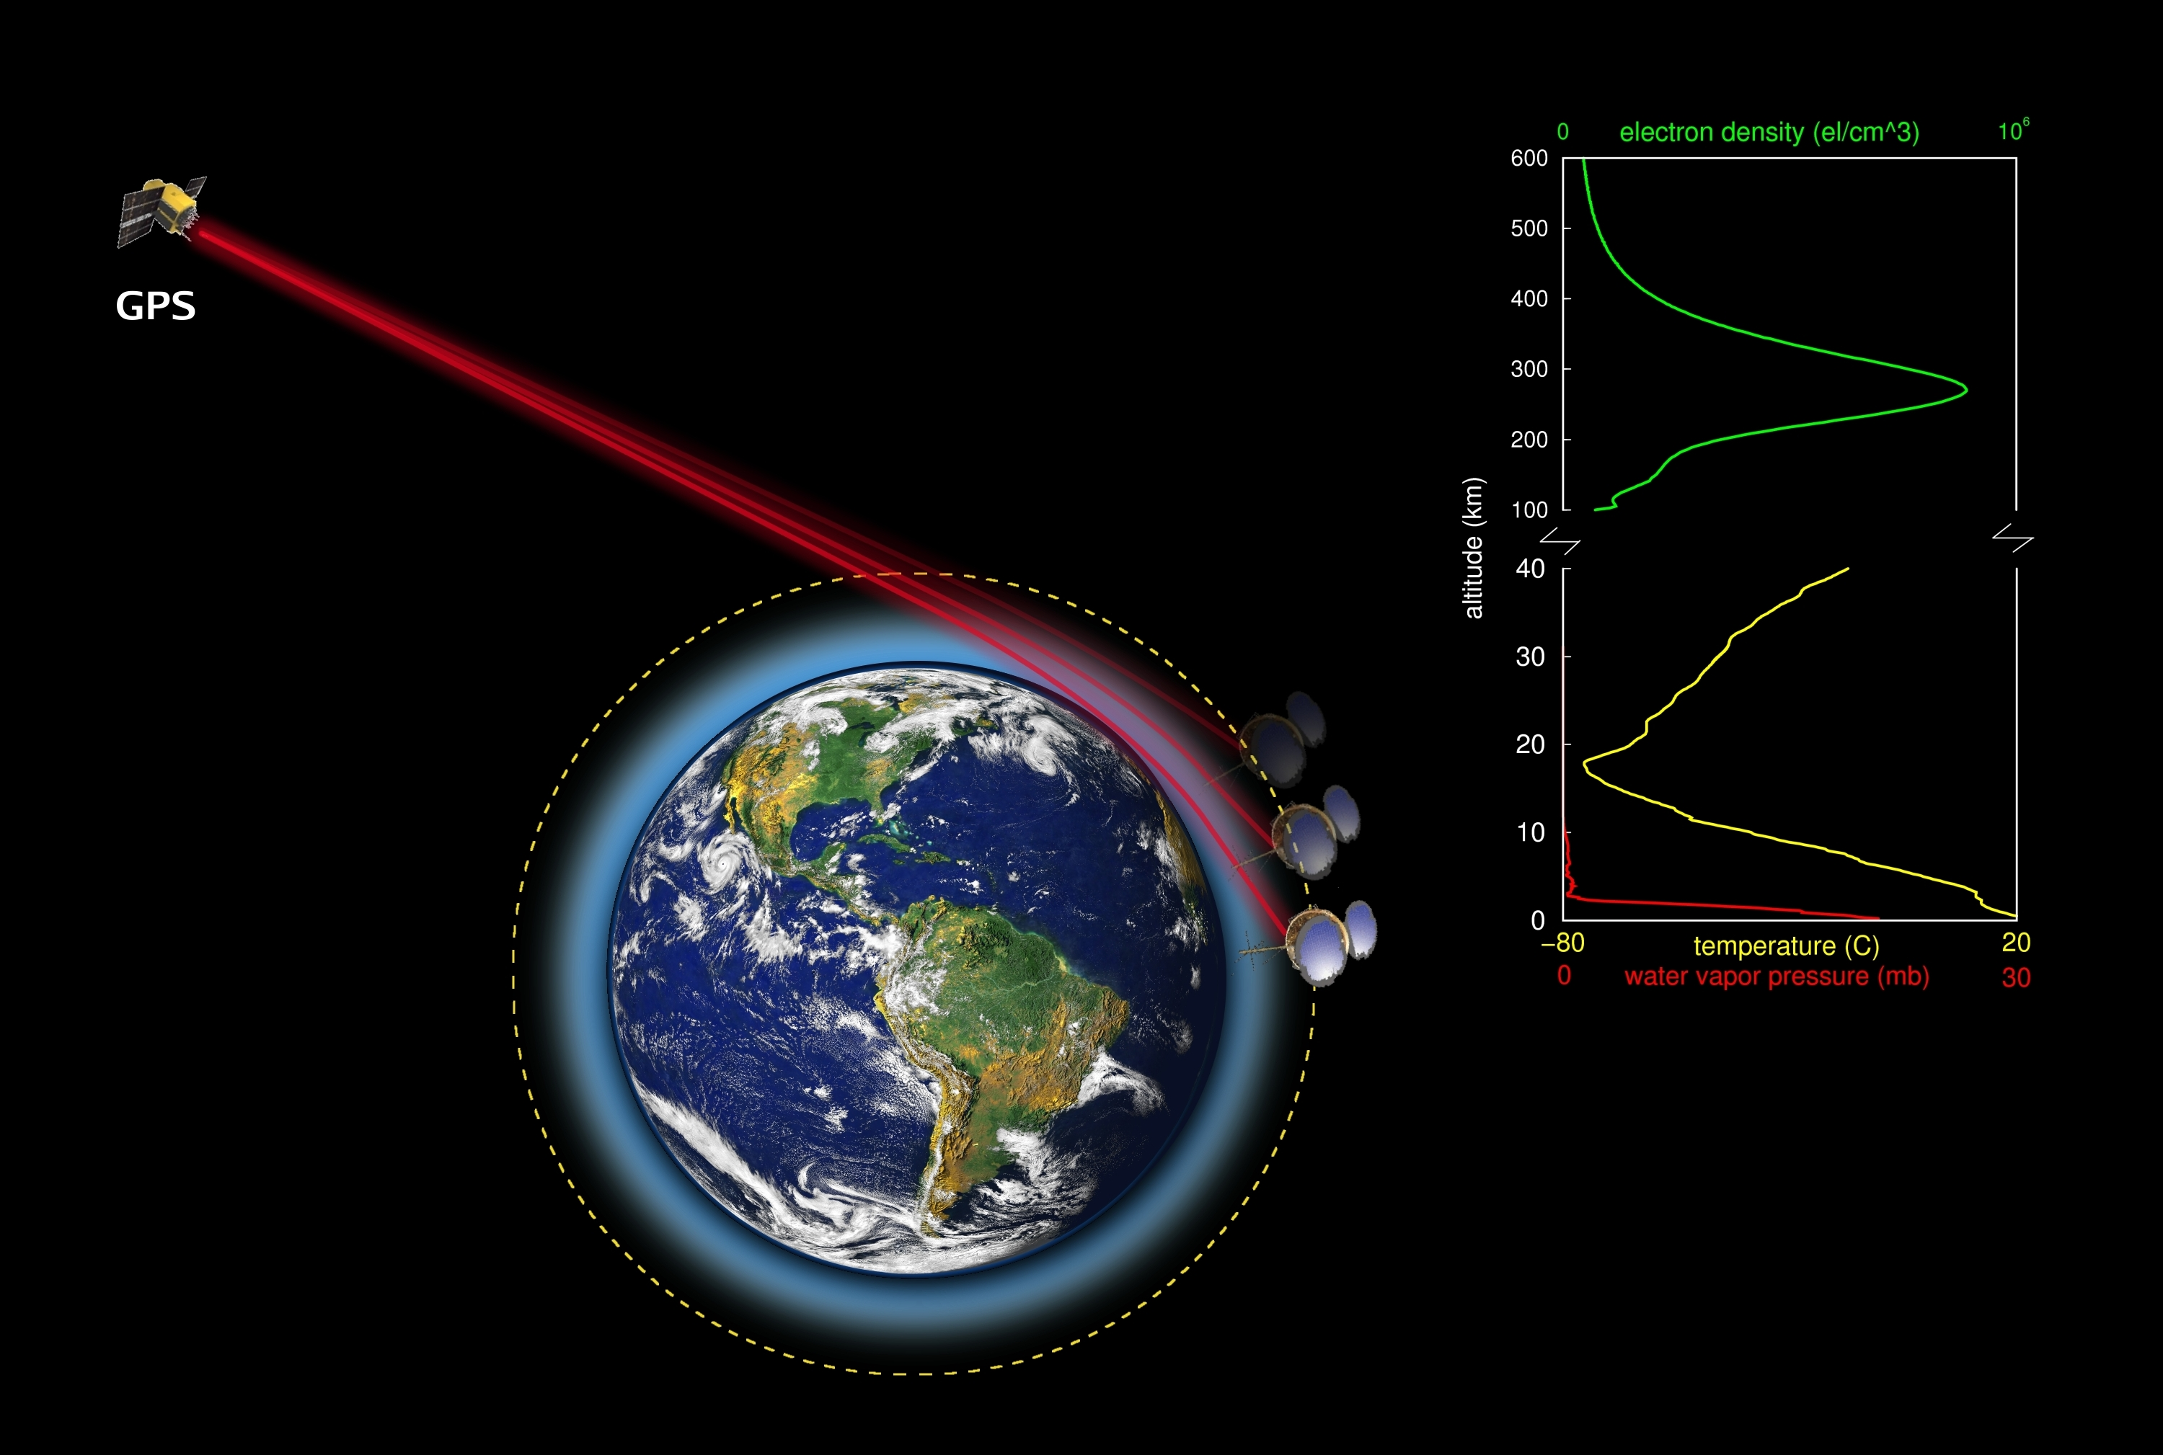
Benefits of Radio Occultation Data
High vertical resolution (~100 m)
High vertical resolution (~100 m)
Lower “along-track” resolution (~200 km)
Measurement has very small “volume” or “pixel” (200 km x 0.1 km x 1 km)
All weather - minimally affected by aerosols, clouds or precipitation
High accuracy (< 0.1 K) - equivalent accuracy over ocean and land
Global coverage
Independent height & pressure/temp data
Can be used in NWP without bias correction
Inexpensive

Slide 15
Comparison of collocated Profiles
C. Rocken (UCAR)

Slide 16
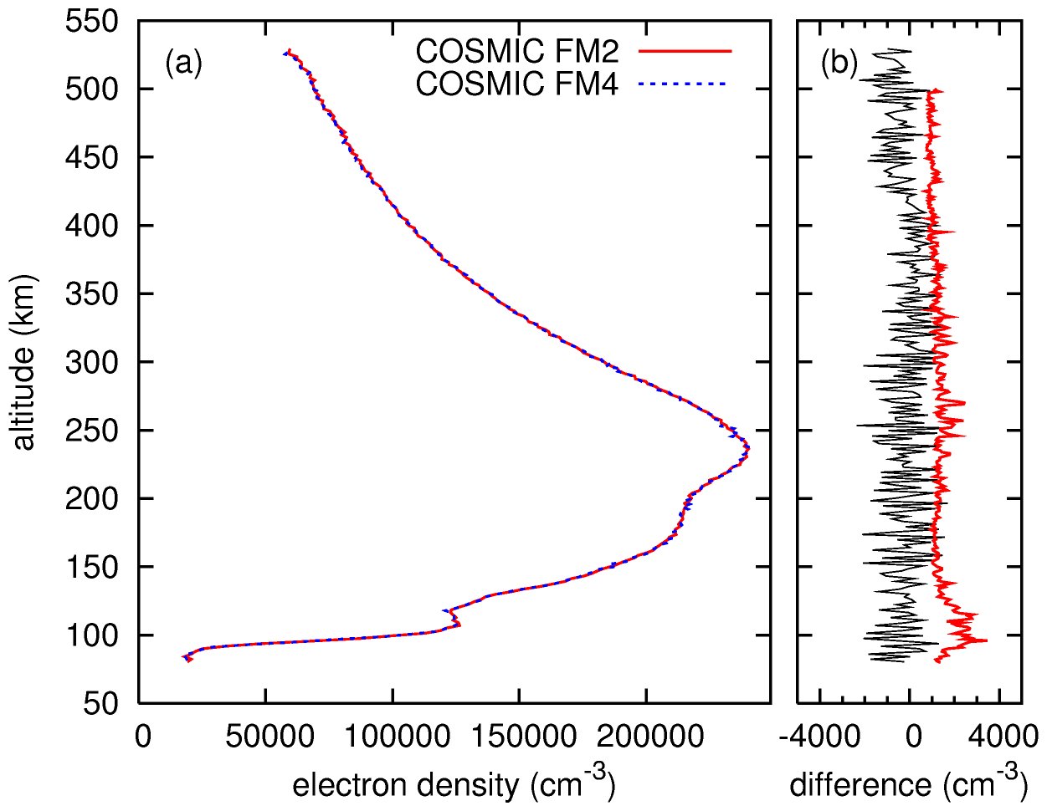
First collocated ionospheric profiles
From presentation by S. Syndergaard,
UCAR/COSMIC

Slide 17
Variational assimilation of RO data
In Variational Analysis (e.g. 3D- or 4D-VAR), we minimize the cost function:
where x is the analysis vector, x_{b} is the background vector, y₀ is the observation vector, (O+F) is the observation error covariance matrix (F is the representativeness error) and B is the background error covariance matrix.
H is the forward model (observation operator) which transforms the model variables (e.g. T, u, v, q and P) to the observed variable (e.g. radiance, bending angle, refractivity, or other observables).
We first need to decide what do we want to assimilate
J(x)=(x-x_{b})^{T}B⁻¹(x-x_{b})+(y₀-H(x))^{T}(O+F)⁻¹(y₀-H(x))
Background + errors + dynamics
analysis
Observations + errors

Slide 18
choice of ‘observations’
s₁, s₂,
Raw measurements of phase of the two signals (L1 and L2)
Bending angles of L1 and L2
α₁, α₂
(neutral) bending angle
Clocks correction,
orbits determination,
geometric delay
α
Refractivity
Ionospheric correction
Atmospheric
products
N
Abel transfrom
T, Pw, P
Hydrostatic equilibrium,
eq of state, apriori information

Slide 19
Choice of observation operators
L1, L2 phase
L1, L2 bending angle
Neutral atmosphere bending angle (ray-tracing)
Linearized nonlocal observation operator (distribution around TP)
Local refractivity, Local bending angle (single value at TP)
Retrieved T, q, and P
Not practical
Complexity
Possible choices
Not good enough

Slide 20
RO Data Assimilation at NCEP
A forward operator for refractivity was initially used to assimilate RO observations from the COSMIC mission into the NCEP’s operational global data assimilation system (GSI/GFS) starting in May 2007
Cucurull et al. 2007 (MWR); 2008 (MWR); Cucurull and Derber 2008 (WAF); Cucurull 2010 (WAF); Cucurull 2011 (ASL)
Operational assimilation of RO at NCEP switched from soundings of refractivity to soundings of bending angle (NCEP’s bending angle method, NBAM) on 22 May 2012
  Top of the profiles raised from 30 to 50 km
  Algorithms to include the compressibility factors in the computation of the model geopotential heights were implemented
Cucurull et al. 2013 (JGR)

Slide 21
RO Data Assimilation at NCEP (cont’d)
An improved forward operator for the assimilation of bending angles (NCEP’s advanced bending angle method, NABAM) is under development (in collaboration with Jim Purser from NCEP/EMC) – expected to improve the use of the RO observations in the lower troposphere
Cucurull 2014 (AMT, in preparation); Cucurull and Purser 2014 (JGR, in preparation)
Operational assimilation of RO (refractivities) in the NCEP’s regional system started on 18 October 2011. However, the use of RO observations in the global model already provided feedback to the regional – through boundary and initial conditions. Assimilation of bending angles replaced the assimilation of refractivities operationally in August 2014

Slide 22
GPS RO Soundings
NCEP assimilates operationally the following RO instruments for total daily soundings of ~ 2,700:
  COSMIC 1-6 (US and Taiwan) – since May 2007
  MetOp-A/GRAS (Eumetsat) - since February 2010
  GRACE-A (Germany) - since February 2010
  SAC-C (Argentina) – since May 2011 – RIP SAC-C August 2013
  C/NOFS (US Air Force) – since May 2011 - placed in SAFE mode on 4 June 2013 due to funding issues. Restarted late 2013, but data latency is still too high for operations.
  TerraSAR-X (Germany) - since May 2011
  MetOp-B/GRAS (Eumetsat) – since August 2013
Near-operational monitoring of the systems above can be found in:
  http://www.emc.ncep.noaa.gov/gmb/gdas under “GPSRO Monitoring”

Slide 23
High vertical resolution (~100 m)
Impact of RO assimilation in operational weather forecasting

Slide 24
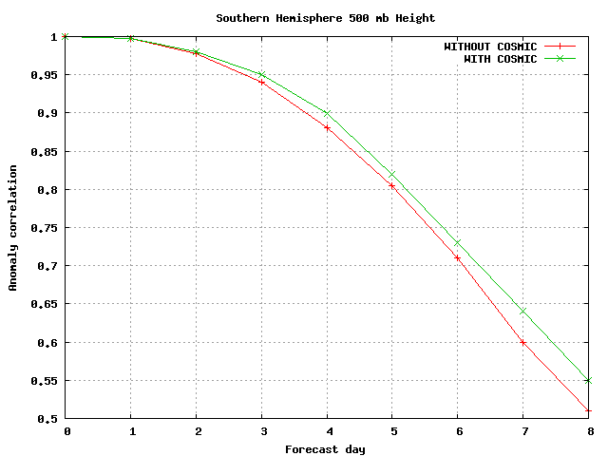
Impact with COSMIC
COSMIC provides 8 hours of gain in model forecast skill starting at day 4
Cucurull 2010 (WAF)
Notes:
The AC is designed to detect similarities in the patterns of departures (i.e. anomalies) from the climatological mean field. If the forecast and analysis fields are both above/below the climatological value, AC will be positive. On the other hand, if forecast and analysis occur on different sides of the climatological values, AC will become smaller.
Anomaly Correlation score (the higher the better) as a function of the forecast day for the 500 mb geopotential heights in the Southern Hemisphere
April 2008

Slide 25
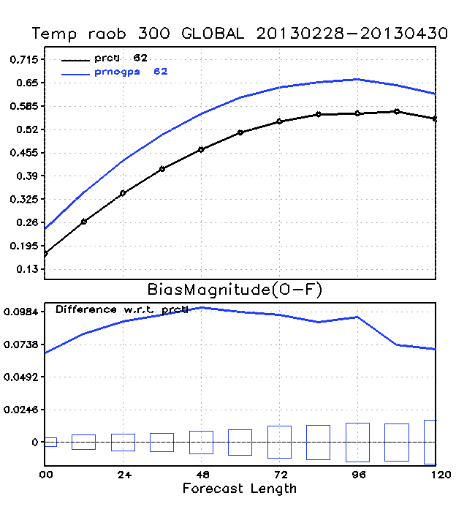
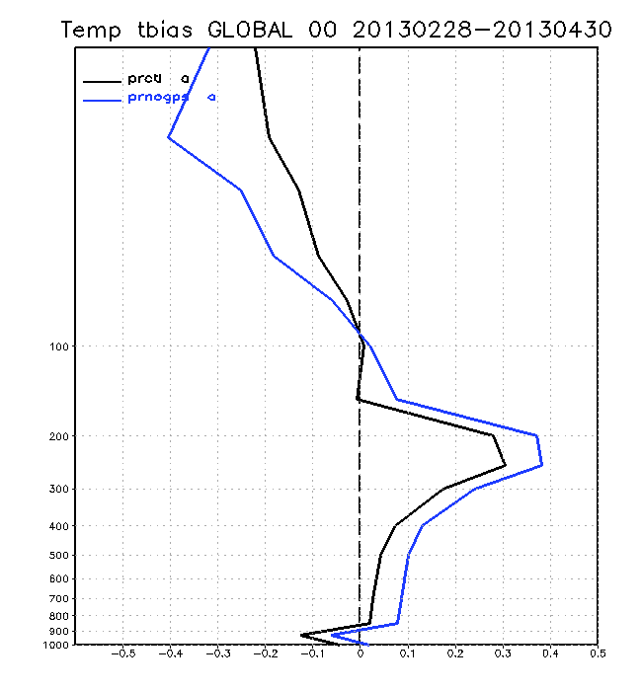
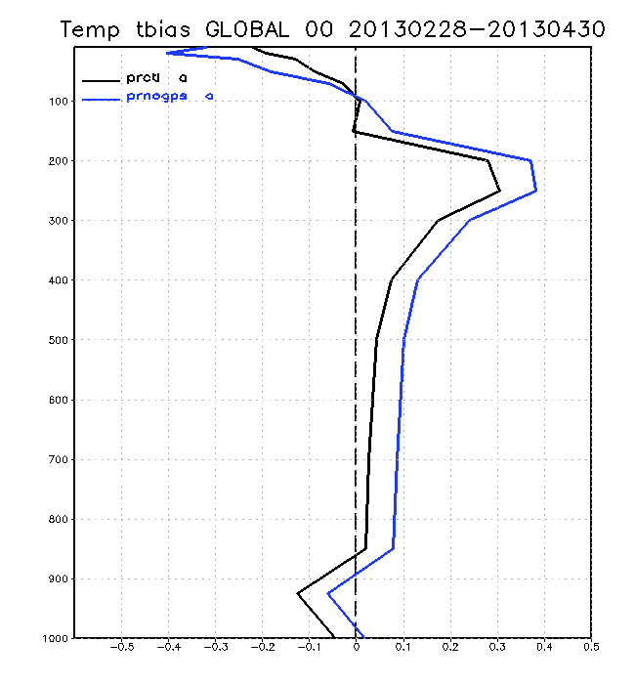
Fit to radiosondes
Evolution of
bias at 300 mb
F-O temperature (K)
work in support of NOAA’s Data Gap Mitigation activities

Slide 26
Radio Occultation ranks very high
Cardinalli et al. 2011
Notes:
Spell out ECWMF: European Centre for Medium-Range Weather Forecasts – leading center in weather forecasting
Acknowledge there is a lot of acronyms
Satellite radiances (in particular microwave) are the #1 contributor in reducing model error – why satellite radiances are important
GPS RO is very important (shown here in brown)
we have a lot of satellite radiances!

Slide 27
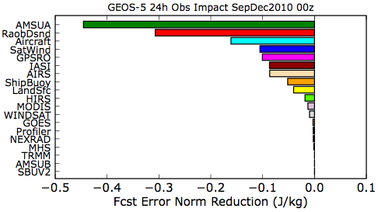
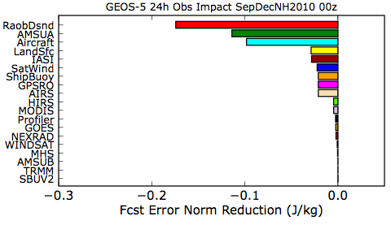
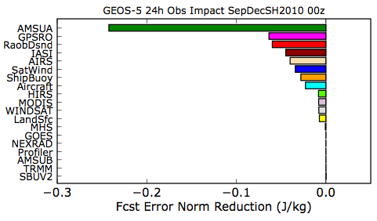
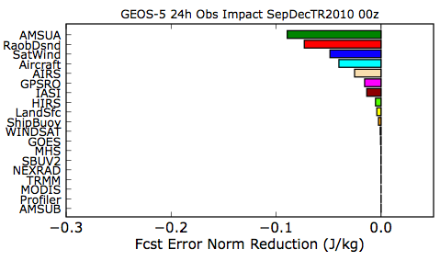
Impact of Various Observing Systems by Region
With GEOS-5: 01 Sep – 31 Dec 2010 00z
RO
Global
Northern Hemisphere
Southern Hemisphere
Tropics
Courtesy of R. Gelaro
Notes:
Global 24-h forecast error measure, sfc-150 hPa
Dry total energy norm (u, v, T, p_{s} J/kg)
Dry adjoint model physics
The metric used highly weights the troposphere, as it is a combination of wind, temperature and surface pressure. Although this is unfair for the gps ro data, the total impact of GPS RO is still very significant.
~2.4 million obs/6-h assimilated, includes:
5 AMSU-A
5 HIRS-3/4
AIRS
IASI
5-7 GPSRO
Satellite Winds (AMVs)
Conventional

Slide 28
Satellite radiance assimilation
Satellite radiance observations contain systematic errors (i.e. biases), either in the retrievals, instruments and/or forward models
These biases can be larger than the signal, so the use of radiances in DA requires the utilization of significant bias corrections
Typically, these biases corrections do not account for biases that might exist in the model, which requires some measurements to be assimilated without bias correction to ‘anchor’ the model, avoiding a drift of the bias correction algorithms
RO is an anchor measurement: unbiased observations – or at least their bias is small enough so they do not need to be bias corrected

Slide 29
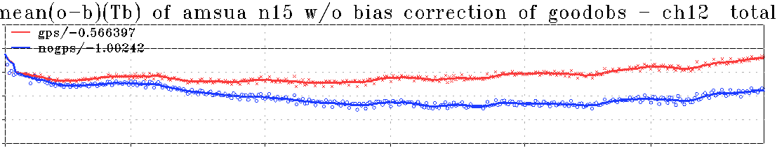
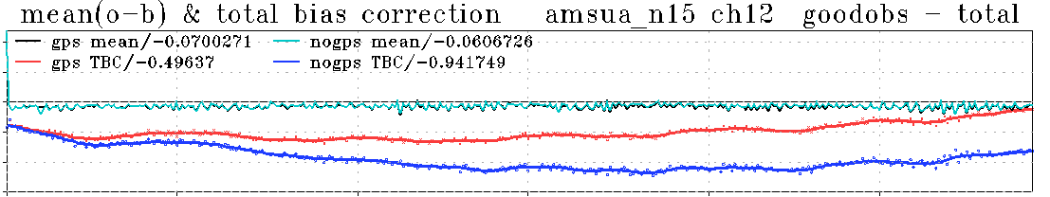
Benefits of RO on satellite radiance assimilation
Radio Occultation keeps the weather model from
drifting away from reality
Temporal evolution of (o-b) without bias correction
0.5 0 -0.5 -1 -1.5 -2
with GPS
w/o GPS
Difference
of ~ 0.5 K
1Dec 2007 1Jan2008 1Feb2008 1March2008
Temporal evolution of the total bias correction
1 0.5 0 -0.5 -1 -1.5
with GPS
w/o GPS
1Dec 2007 1Jan2008 1Feb2008 1March2008
Cucurull, Anthes and Tsao 2014 (JAOT)

Slide 30
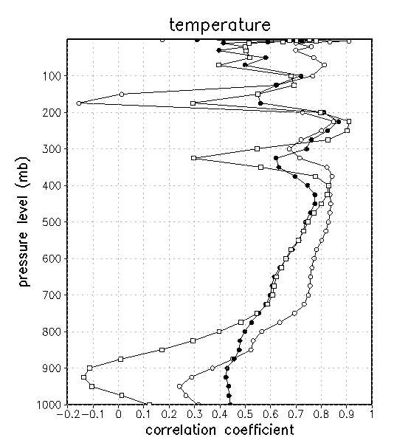
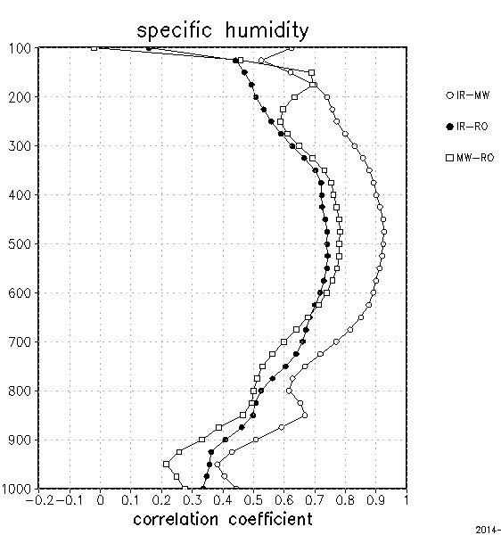
Complementarity of satellite sources
Investigate similarities/differences between the assimilation of satellite IR, MW, and RO observations in the NCEP’s operational global data assimilation system
Cucurull and Anthes 2014 (MWR)

Slide 31
Key Results
Radio Occultation is a very significant component of the Observing System
We have not reached saturation in weather forecast skill with the current RO constellation
Adding more RO observations beyond the 2,700 profiles/day we currently assimilate operationally in NWP will keep improving weather forecast
Need Observing System Simulation Experiments (OSSEs) to provide answers to how much improvement can be achieved by adding more RO observations
Observing System Experiments (OSEs) only provide information on the impact of the current observations

Slide 32
~ 1,300 profiles/day
2016
6 satellites
equatorial orbits
2018
6 satellites
polar orbits
~ 12,000 profiles/day
Courtesy of UCAR

Slide 33
Global Observing Systems
Analysis (GOSA) Group
“We test new ideas”

Slide 34
GOSA Mission Statement
Maximize and optimize the uses of current and future global observations to improve numerical weather prediction forecast skill in NOAA’s models.
This includes algorithm development, management, and science support.
A major objective of GOSA is to quantitatively evaluate the complementarity of different observing systems through Observing System Simulation Experiments (OSSEs) and Observing System Experiments (OSEs) to help NOAA management prioritize mission designs in a cost-effective way in support of NOAA’s Quantitative Observing System Assessment Program (QOSAP).

Slide 35
GOSA
Services
Missions
support
Commercial
services
Algorithm
development
Collaborative
Science projects
OSE
OSSE
Cal/Val
Products
C-2 (RO)
Jason-CS (RO)
GNSS-R
...
Management & science support
Radio occultation
Ground-based GPS
Sat bias correction
RS bias correction
PBL-RO
PAZ
CYGNSS
NSSL
AOML
CWB
DWTS
MIT
RO
HS GEO
SHOUT
R2O
New instruments
Risk mitigation
Complementarity
GOES-R
JPSS
C-2
Jason-CS
…
Funding sources
NESDIS
NASA
CRADA/contract
NWS - including SWPC
C-2 (NWS, NESDIS)
Jason-CS
GOES-R
JPSS
…
Projects
Base funding
NSF
…
Sandy Supplemental
Base funding
Commercial sector
GOES-R
JPSS
…
GOES-R
JPSS
Jason-CS
C-2

Slide 36
Director’s Office
Kevin Kelleher, Dir.
Jennifer Mahoney, Deputy
Research Support Services (A&R)
Penny Granville, AO
Information Tech. Services (ITS)
Scott Nahman
GSD Senior Scientist DTC Science Advisor
Global Observing Systems Analysis (GOSA) Group
Chief: Lidia Cucurull
Earth Modeling Branch (EMB)
Acting Chief: Stan Benjamin
Deputy: Tim Schneider
Advanced Technology and Outreach (ATO) Branch
Chief: John Schneider
Evaluation and Decision Support (EDS) Branch:
Chief: Mike Kraus
Assimilation
Model Physics
EV&O
HPC
FIQAS
Forecast System Evolution
Global Modeling
Earth System/Chem
I&V
IWDS
Decision Support
Systems Support
Model Assessment

Slide 37
Organization chart
GSD OD
Kevin Kelleher
GOSA Science Advisors:
Robert Atlas
Alexander E. MacDonald
Richard A. Anthes
GOSA Chief
Lidia Cucurull
Francisco Alvarez
Atmospheric Scientist
Hongli Wang
Atmospheric
Scientist
Tanya Peevey
Atmospheric
Scientist
Ruifang Li
Computer
Scientist
Kirk Holub
Engineer

Slide 38
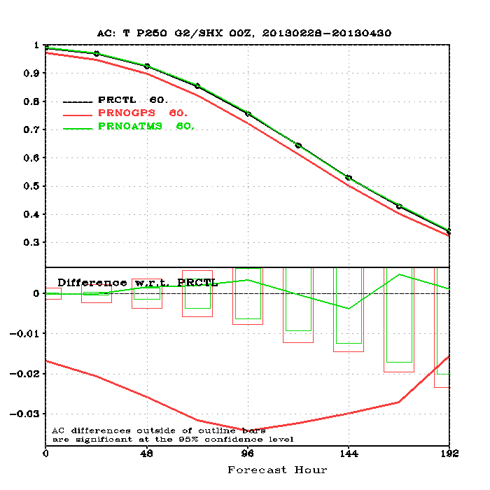
Observing System Experiments
Complementarity of satellite radiances and RO observations in support of the Data Gap mitigation activities
Time period: March-April 2013
NCEP’s operational configuration
Verification done against consensus analysis (average of NCEP, ECMWF and UK Met Office analyses)
Experiments:
  prctl: control, operational configuration with all the observations
  prnogps: prctl without RO observations
  prnoatms: prctl without ATMS observations
Cucurull and Anthes 2014 (WAF, under review)

Slide 39
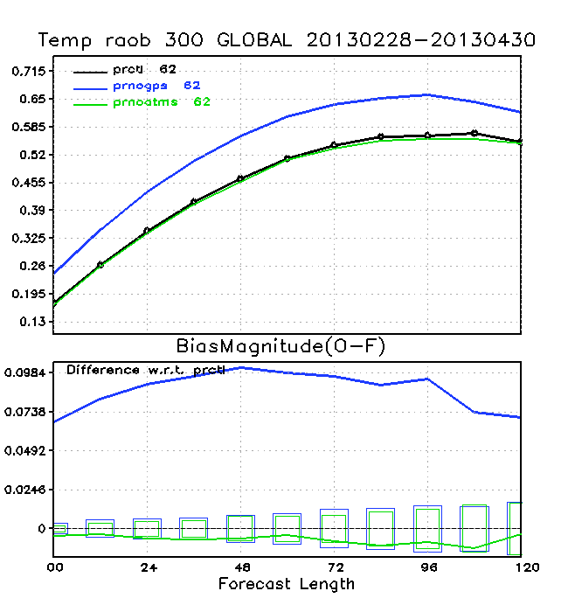
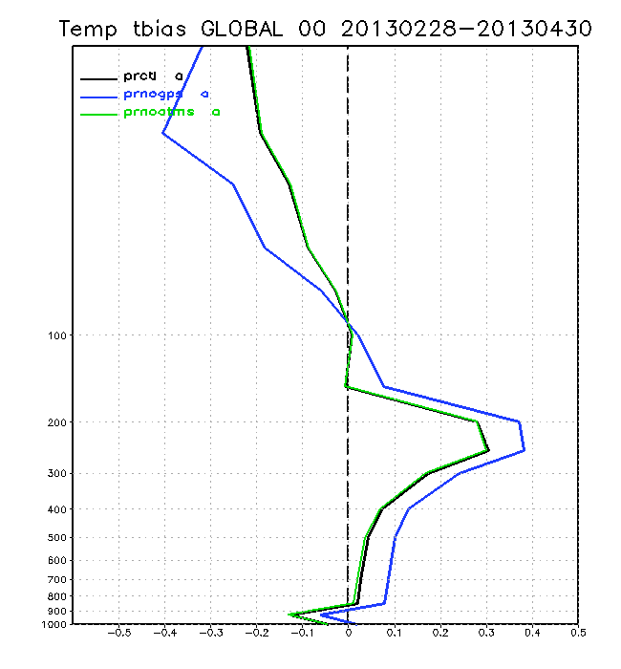
Fit to radiosondes
Evolution of
bias at 300 mb
F-O Temperature (K)

Slide 40
Preliminary OSSE results with Radio Occultation observations
Increasing the number of assimilated RO satellites results in better weather forecast skill:
  18 satellites is better than 12 satellites; 12 satellites is better than 6 satellites
However, there is a lot of room to optimize the assimilation system
Some cases need to be evaluated with more detail to understand how results can be improved
These preliminary studies do not use the state-of-the-art OSSE system:
  low-resolution nature run
  low resolution assimilation system
  perfect observations
  non-hybrid analysis
  RO refractivity profiles
  top of the RO profiles stops at 30 km

Slide 41
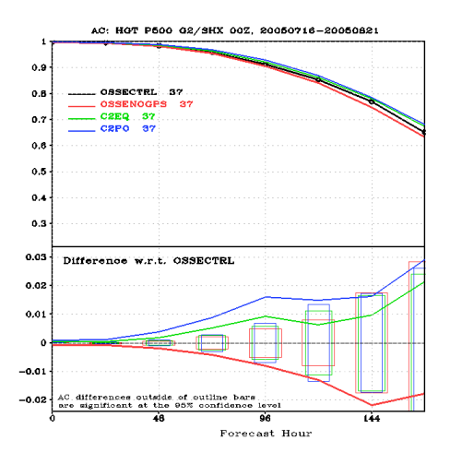
Preliminary OSSEs with RO (cont’d)
Experiments ran from 2 July 2005 to 21 August 2005
Verification covers the period of 16 July – 21 August 2005
Number of RO satellites:
  OSSENOGPS (0 RO satellites)
  OSSECTRL: Current RO constellation: primarily COSMIC (6 RO satellites)
  C2EQ: OSSECTRL + COSMIC-2, equatorial component (12 RO satellites)
  C2PO: C2EQ + COSMIC-2 polar component (18 RO satellites)
SH

Slide 42
Additional OSSE/OSE activities
Sensing Hazards with Operational Unmanned Technology (SHOUT) to Mitigate the Risk of Satellite Observing Gaps – impact of observations from instruments on the Global Hawk on NWP
3-way MOU with NWS & NESDIS to support COSMIC-2 mission with with RO data assimilation development – transition to operations
Quantitative Observing System Assessment Program (QOSAP) – NOAA cross-line offices Program that attempts to coordinate and prioritize OSSE efforts
(K. Kelleher and I are the OAR QOSAP representatives)

Slide 43
That’s it!
Thanks for your attention!!

