Slide 1
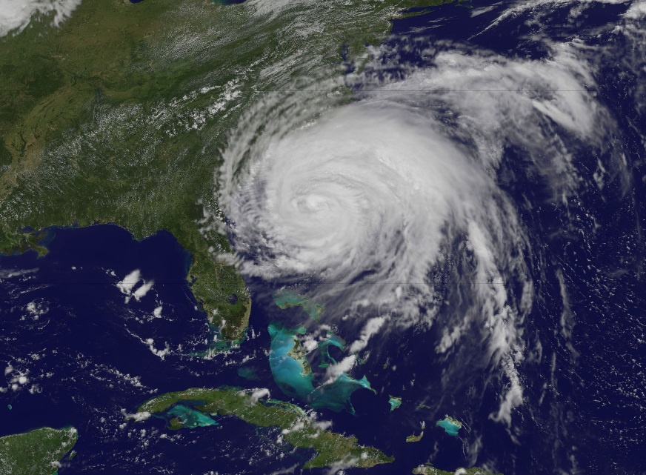
Sensitivity to the
Planetary Boundary Layer Scheme for
High-Resolution Simulations of Irene (2011)
(NASA)
Bryce Tyner
Department of Marine, Earth, and Atmospheric Sciences
North Carolina State University
Tuesday, July 15, 2014

Slide 2
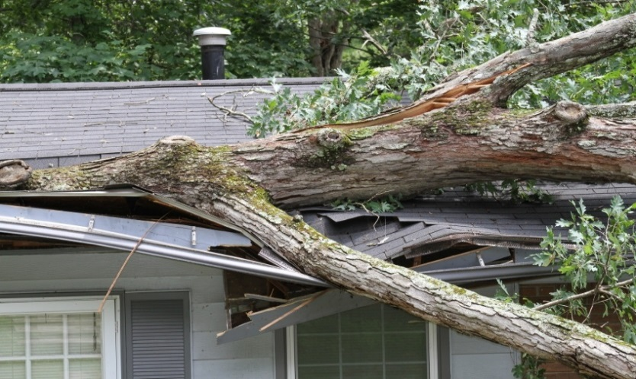

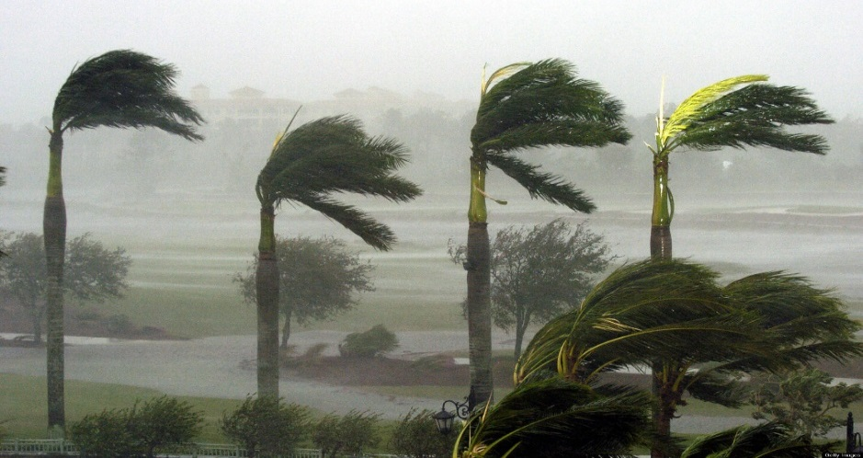
Motivation
Strong near-surface winds associated with tropical cyclones (TCs) can pose a significant threat to life and property
Forecasters struggle with developing surface wind forecasts for tropical cyclones
Understanding the characteristics of the tropical cyclone boundary layer is key to improving the wind forecasts
(Virginian Pilot)
(National Geographic)
(USA Today)

Slide 3
Background
Several studies have examined the sensitivity of TC simulations to the choice of planetary boundary layer (PBL) scheme (e.g., Braun and Tao 2000; Li and Pu 2008; Nolan et al. 2009a,b; Smith and Thomsen 2010)
Previous results suggest TC intensity differences as large as 19 hpa, depending on PBL scheme chosen (Li and Pu 2008)
Differences in boundary layer depth, vertical mixing, latent/sensible heat fluxes, and strength of radial inflow/outflow linked to changes in TC intensity

Slide 4
Background
With the increase in computational power, characteristics of the TC PBL can explicitly be simulated using the Weather Research and Forecasting (WRF) model
Large-eddy simulation (LES) domains nested within outer mesoscale domains
WRF-LES produces realistic turbulent eddy circulations as the TC temporally and spatially evolves

Slide 5
Background
To date, very few studies have used WRF-LES to simulate TCs
Zhu (2008): simulation of Ivan (2004)
  Simulated large-eddy circulations shown to play pivotal role in vertical transport of energy, moisture, and momentum within the PBL
  Use of Yonsei University (YSU) PBL scheme for non-LES domains
Results only using YSU scheme for outer domains: influence of PBL scheme choice on simulated LES?

Slide 6
Motivation
TC evolution has been shown sensitive to PBL scheme
To date, very few publications using WRF-LES in TC setting
Need to examine sensitivity of WRF-LES to selection of PBL scheme in outer mesoscale domains
Irene (2011): Interest to National Weather Service offices, follow-up to wind analysis conducted as part of CSTAR research

Slide 7
Model Setup
Setup similar to Zhu (2008)
  Five nested domains: 8.1 km grid spacing outer domain, 100 m grid spacing innermost domain
  Two-way nesting used among mesoscale domains, one-way nesting within LES domains
  Only PBL and respective surface layer schemes altered within the model

Slide 8
  Model Initialized 00 UTC 27 August
  24 Hour Simulation Conducted

Slide 9
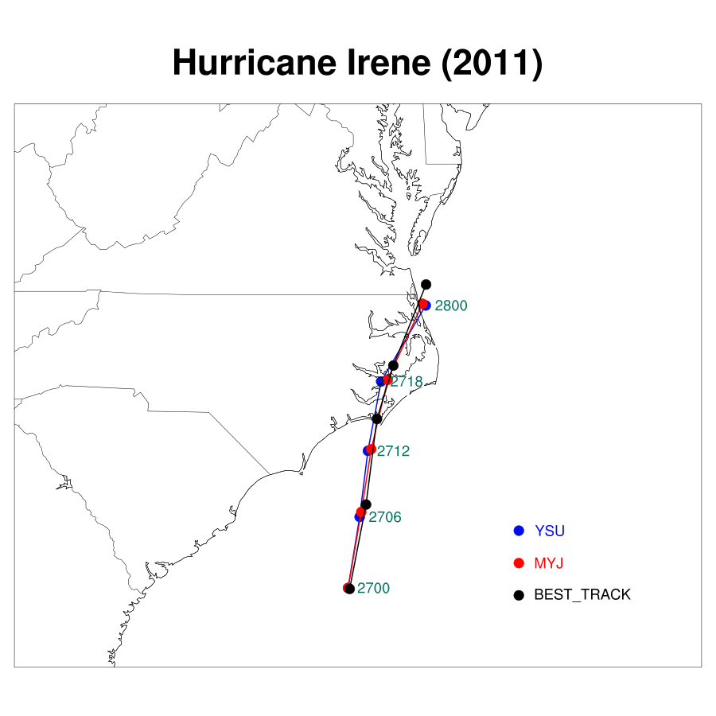
TC Simulated Track
Slower propagation in first 12 hours of simulation
Similar simulated storm tracks, correlate to best track data

Slide 10
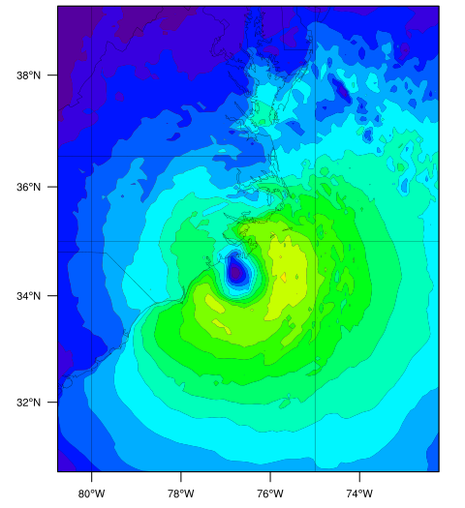
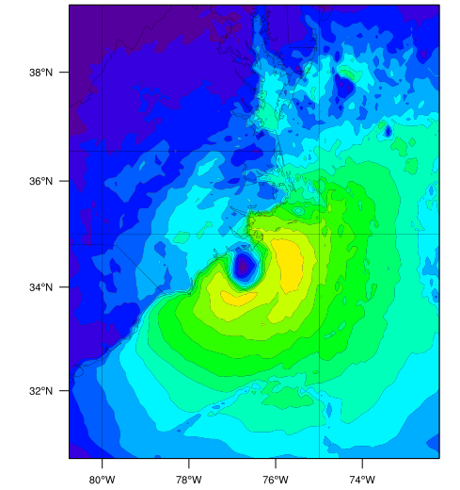
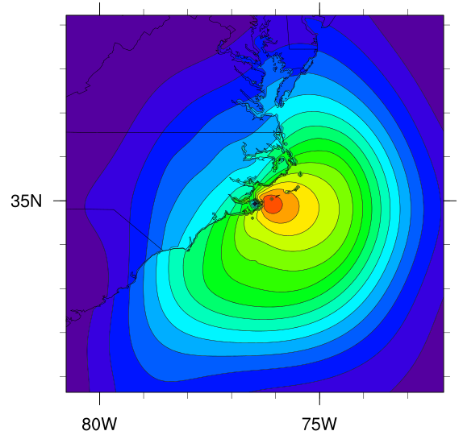
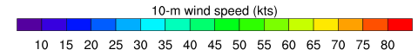
10-m Wind Speed
MYJ 1300 UTC, D01 Winds
YSU 1300 UTC, D01 Winds
H*Wind 1330 UTC
Similar distributions and location of strongest wind speeds
Slightly stronger maximum wind speeds in YSU simulation; weaker over land (closer to H*Wind analysis)

Slide 11
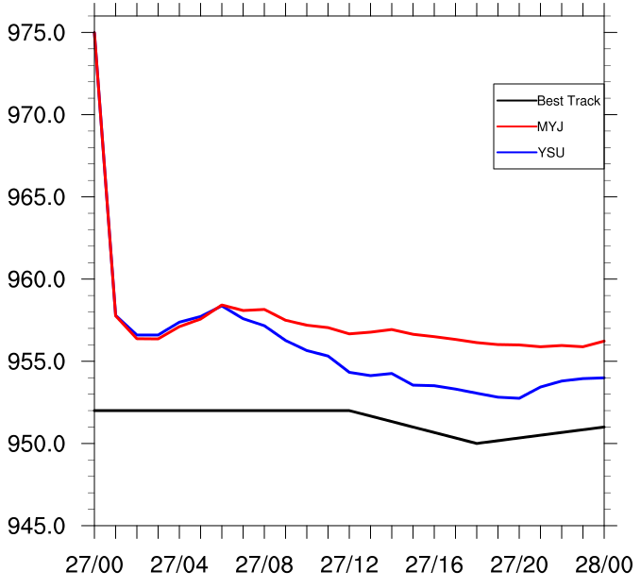
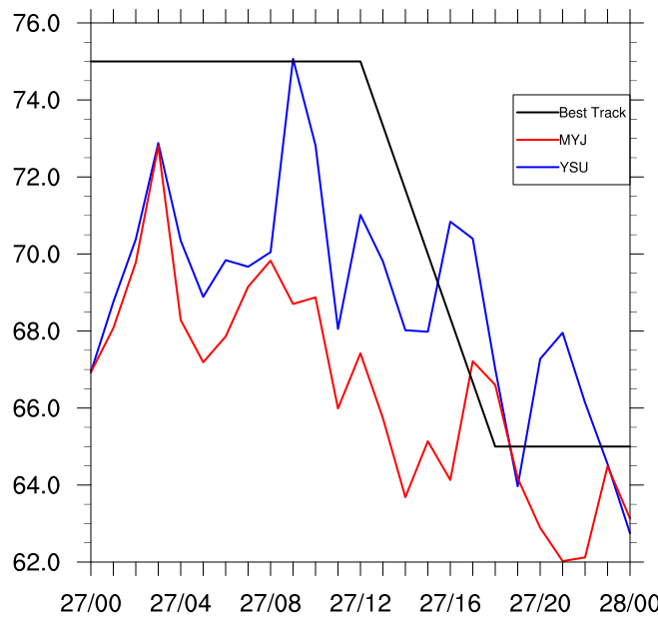
TC Simulated Intensity
Domain 2
Min. Sea Level Pressure (hPa)
Max. Sustained Winds (kt)
Date/Time
Date/Time
Similar, too weak storm intensity in first 8 hours of simulation (spin-up period)
YSU becomes stronger and closer to best track in final 12 hours of simulation

Slide 12
Preliminary Results: Total Precipitation (mm)
27 August
TRMM Data
YSU, D03
MYJ, D03
Higher simulated precipitation compared to TRMM data
Highest simulated precipitation in YSU simulation

Slide 13
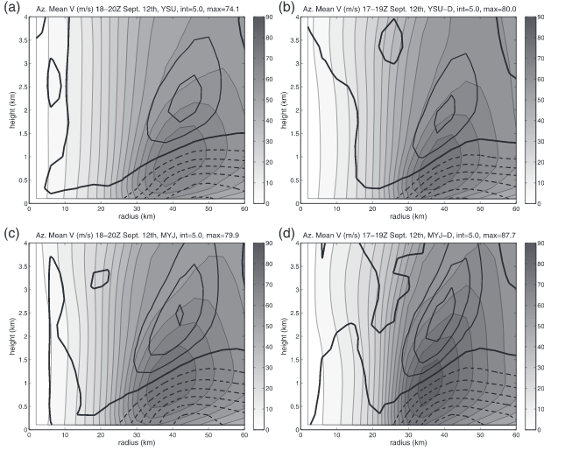
YSU
YSU-D
Strongest Radial Outflow
MYJ
MYJ-D
Strongest Radial Inflow
(from Nolan et al. 2009b)

Slide 14
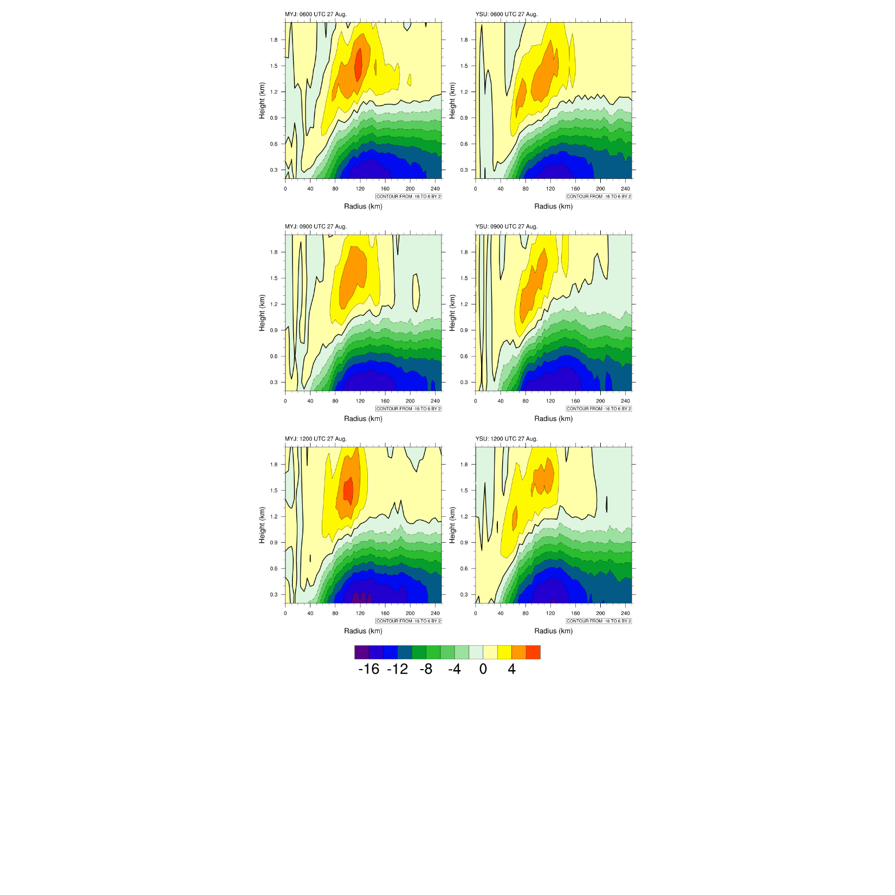
Radial Winds (m/s)
0600 UTC 27 August
MYJ
YSU
Slightly stronger radial inflow/outflow in MYJ simulation
Inconsistent with stronger TC

Slide 15
Radial Winds (m/s)
1200 UTC 27 August
MYJ
YSU
Slightly stronger radial inflow/outflow in MYJ simulation
Inconsistent with stronger TC

Slide 16
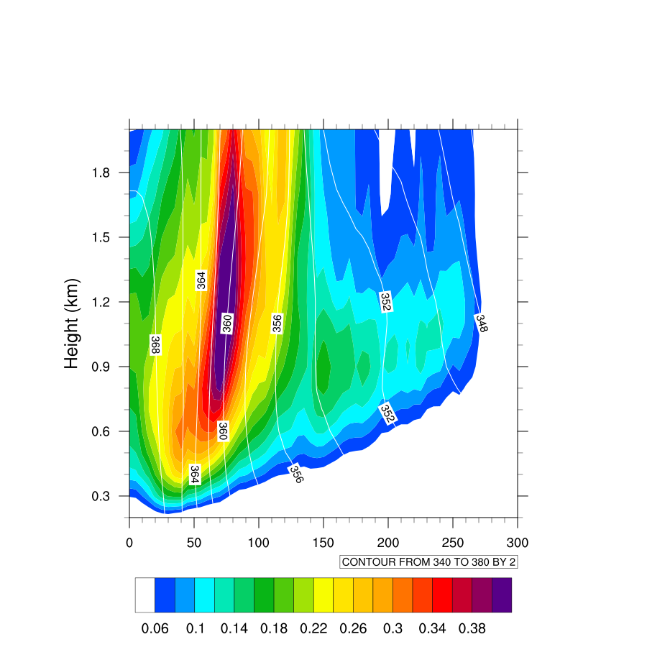
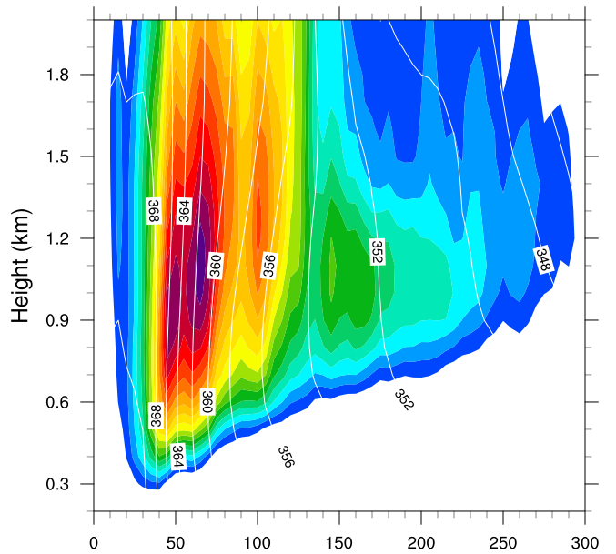
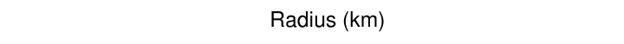
BL Moisture
Average 0600 UTC – 1800 UTC 27 August
MYJ
YSU
Slightly higher cloud water in lower PBL within 150 km of storm center in MYJ simulation

Slide 17
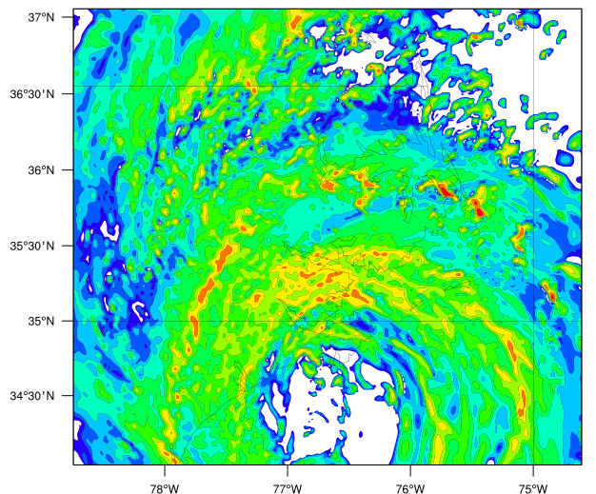
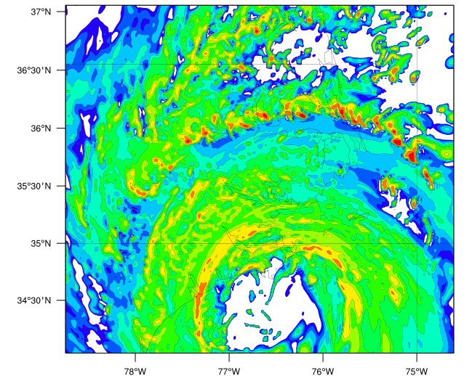
Simulated Reflectivity (dbz)
1300 UTC 27 August
MYJ
YSU
More symmetric eyewall in YSU simulation
More organized spiral bands with embedded localized convective cells in YSU simulation

Slide 18
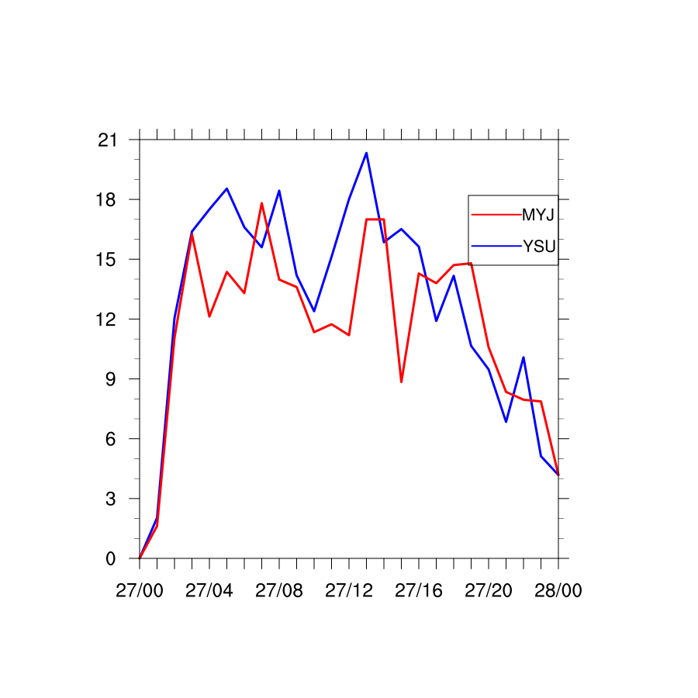
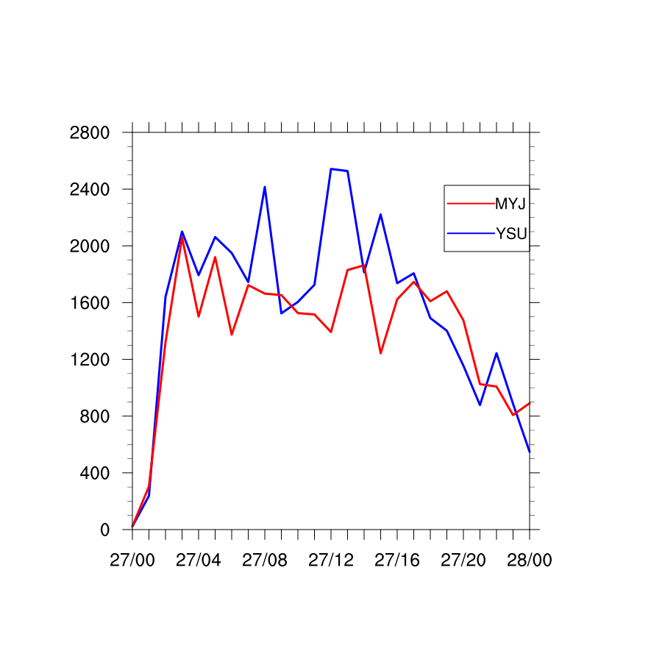
Preliminary Results: Time Series
Maximum 850 Vert. Vel. and Abs. Vorticity
Max. Vertical Velocity (m/s)
Max. Abs. Vorticity (10⁻⁵ s⁻¹)
MYJ
YSU
YSU simulation has stronger maximum abs. vorticity and vertical velocity during period when TC intensifies more

Slide 19
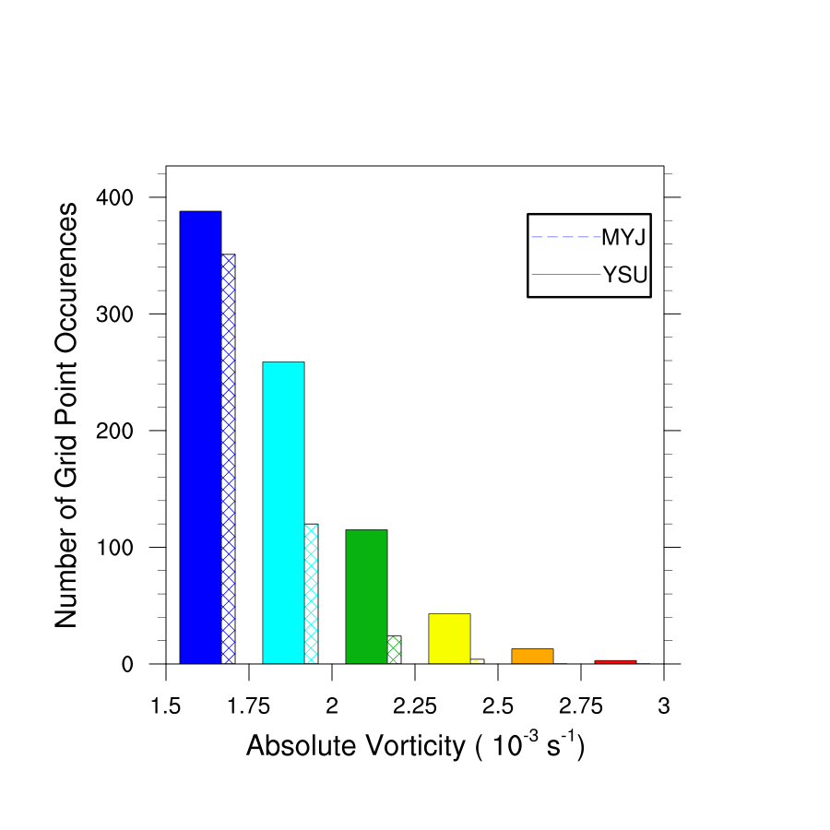
850 Abs. Vorticity
Average 0600 UTC – 1800 UTC 27 August
Max. Abs. Vorticity (10⁻⁵ s⁻¹)
YSU simulation has shift in absolute vorticity distribution to higher values during period when TC intensifies more

Slide 20
Mesoscale Results
Mesoscale characteristics of the simulated TCs matched well to observations within six hours of model spin-up
  Track, intensity, and wind speed distributions agreed well with observations/analyses
Radial inflow near the surface and low-level moisture highest in MYJ simulation
  Inconsistent with strongest simulated storm (YSU)

Slide 21
Mesoscale Results
Abs. vorticity associated with vertical hot towers in spiral bands stronger, more frequent in YSU simulation
Processes within the boundary layer itself cannot fully determine storm strength (Montgomery and Smith 2012)
Multiple pathways to TC intensification

Slide 22
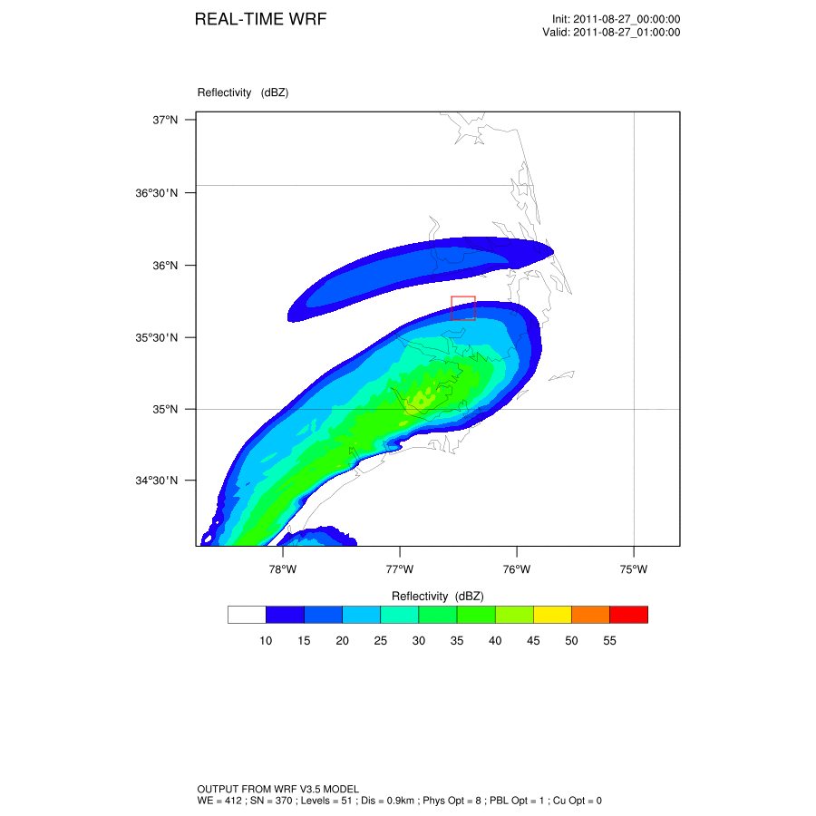
Simulated Radar Reflectivity (dbz)
YSU Simulation
Main TC Impact:
1630 UTC – 1830 UTC

Slide 23
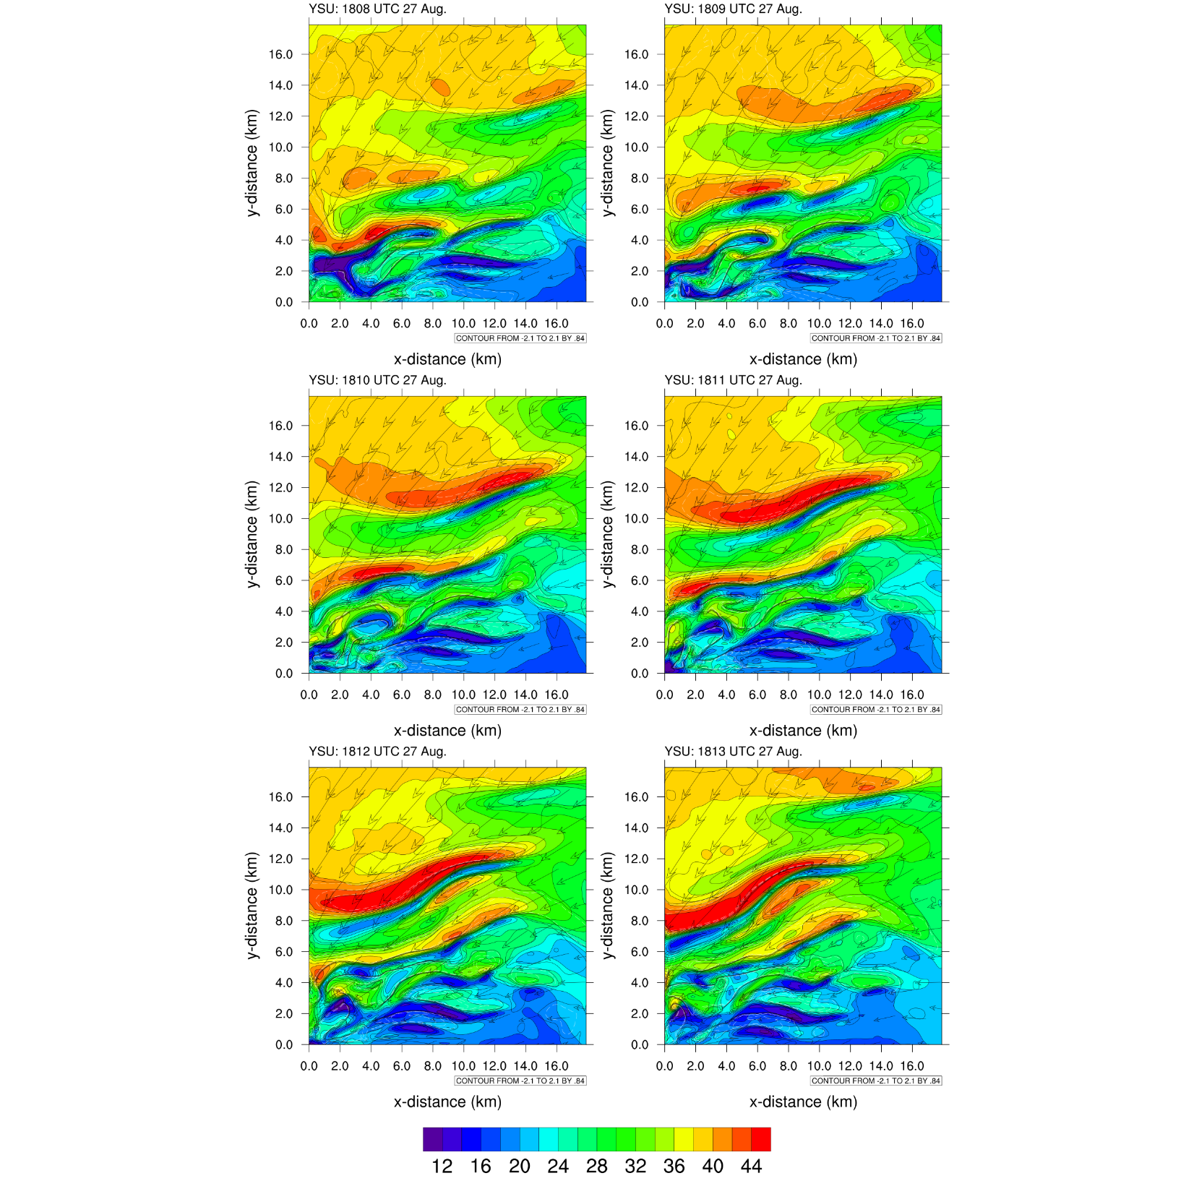
Large-eddy Circulations: YSU
1808 UTC 27 August

Slide 24
Large-eddy Circulations: YSU
1809 UTC 27 August

Slide 25
Large-eddy Circulations: YSU
1810 UTC 27 August

Slide 26
Large-eddy Circulations: YSU
1811 UTC 27 August

Slide 27
Large-eddy Circulations: YSU
1812 UTC 27 August

Slide 28
Large-eddy Circulations: YSU
1813 UTC 27 August

Slide 29
Large-eddy Circulations: YSU
1810 UTC 27 August

Slide 30
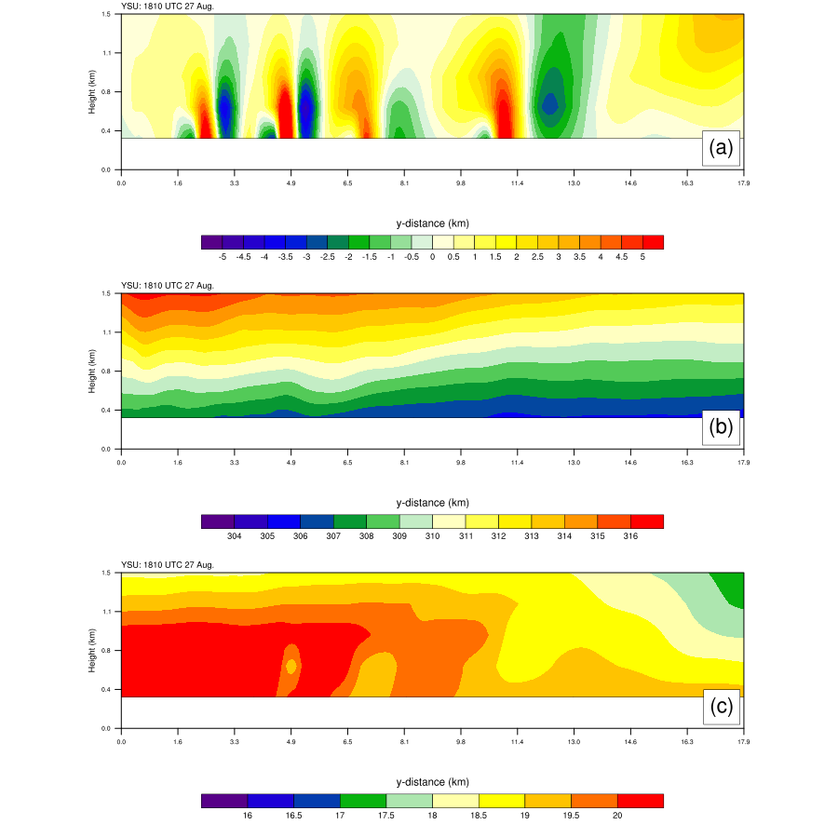
Large-eddy Circulations: YSU
1810 UTC 27 August
Vertical Velocity (m/s)
Virtual Potential Temperature (K)
Large eddy circulations vertically limited to boundary layer and play role in moisture and temperature transport

Slide 31
Simulated Radar Reflectivity (dbz)
MYJ Simulation
Main TC Impact:
1400 UTC – 1600 UTC

Slide 32
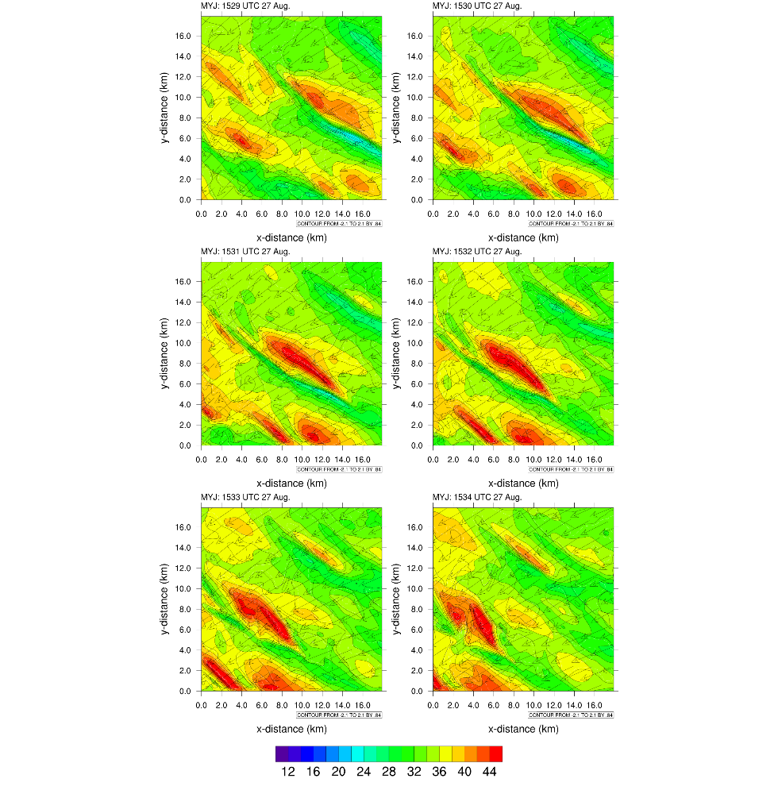
Large-eddy Circulations: MYJ
1529 UTC 27 August

Slide 33
Large-eddy Circulations: MYJ
1530 UTC 27 August

Slide 34
Large-eddy Circulations: MYJ
1531 UTC 27 August

Slide 35
Large-eddy Circulations: MYJ
1532 UTC 27 August

Slide 36
Large-eddy Circulations: MYJ
1533 UTC 27 August

Slide 37
Large-eddy Circulations: MYJ
1534 UTC 27 August

Slide 38
Large-eddy Circulations: MYJ
1531 UTC 27 August

Slide 39
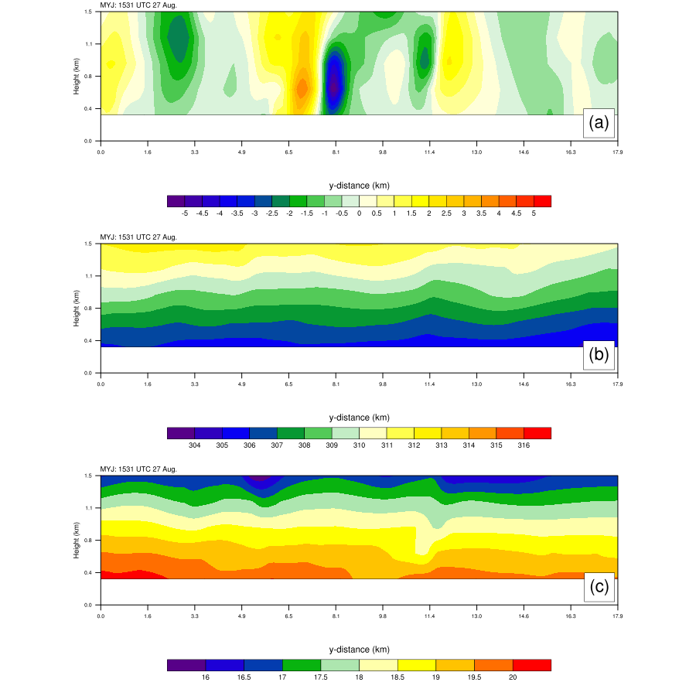
Large-eddy Circulations: MYJ
1531 UTC 27 August
Vertical Velocity (m/s)
Virtual Potential Temperature (K)
Large eddy circulations vertically limited to boundary layer and play role in moisture and temperature transport

Slide 40
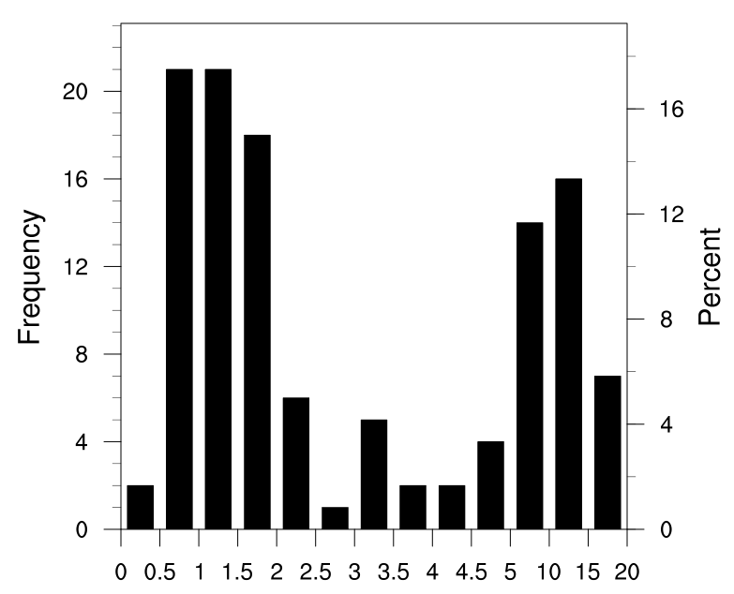
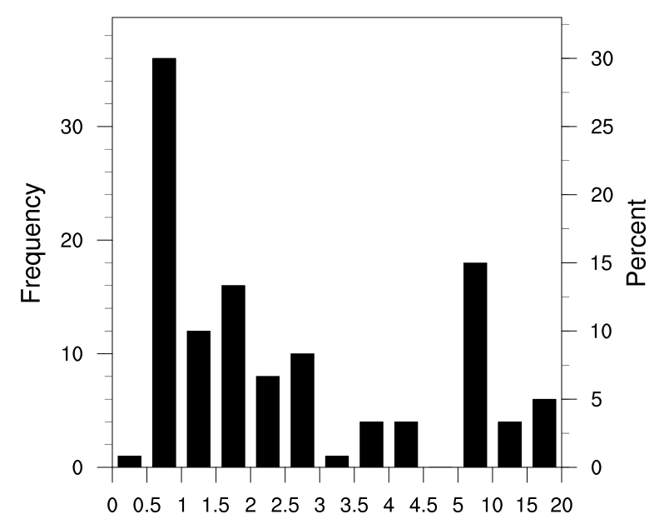
Distance between maximum updraft/downdraft cores (km)
MYJ
YSU
More uniform size distribution in YSU simulation than MYJ simulation

Slide 41
LES Preliminary Results
Large eddy circulations in general stronger in YSU simulation
Variable widths, but often updraft region and adjacent large downdraft region (similar to convective circulation)
Large eddy circulations vertically limited to boundary layer and play role in moisture and temperature transport
More uniform size distribution in YSU simulation than MYJ simulation

Slide 42
Continuing/Future Work
Continue examining differences in the boundary layer characteristics within the LES domains for the two simulations
  Turbulent flux profiles
  Turbulent kinetic energy budget of resolved turbulence
How large-eddy circulations within the boundary layer change as eyewall moves from ocean to land
Sensitivity of large-eddy circulations to storm characteristics (track, intensity)

Slide 43
Acknowledgements
Dr. Anantha Aiyyer, Dr. Sukanta Basu, and Dr. Gary Lackmann (North Carolina State University)
Dr. Michael Brennan (NHC)
NCAR Yellowstone computational resources
NSF Grant ATM-0847323

