Slide 1
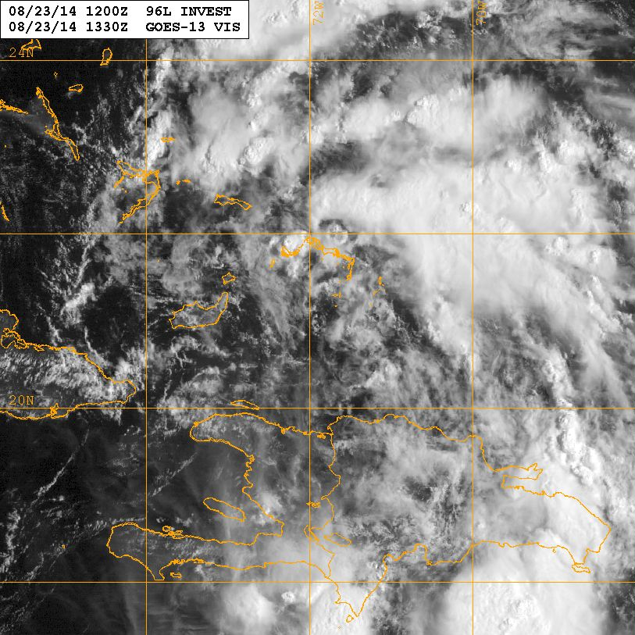
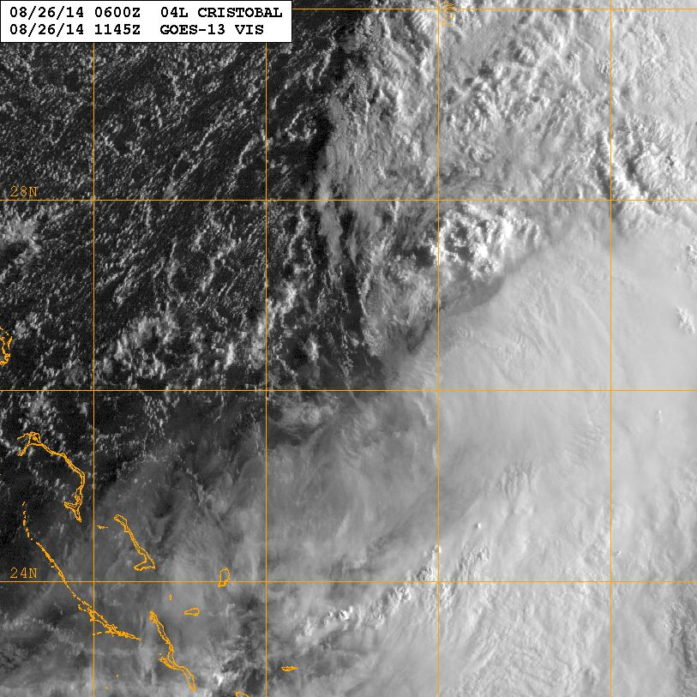
Hurricane Cristobal Debrief
23 Aug
26 Aug
Flight ops re-cap: 10 Total flight missions
62 P-3 and 16 G-IV flight hours; 162 GPSsondes; 5 AXBTs
September 5, 2014

Slide 2
Agenda
Missions Overview (Reasor)
Science Discussions
140823I1 TDR (Aberson)
140824H1 TDR (Rogers)
140824N1 HRD-TDR (M. Black)
140824I1 HRD-TDR (Sellwood)
140825H1 TDR (Zhang)
140825N1 HRD-TDR (Aksoy)
140825I1 TDR (Sellwood)
140826H1 TDR (Zhang)
140826I1 TDR (Sellwood)
140827I1 Ocean Winds (Chang)
Field Program Issues

Slide 3
Missions Overview
Purpose: EMC-tasked TDR, G-IV TDR test, IR Sonde test, and SFMR hi-incidence
Target: TD4 on 23 Aug in SE Bahamas; Hurricane Cristobal (11PM) on 25 Aug
Background: TD4 developed from an easterly wave disturbance on 23 Aug north of Hispaniola. Northerly shear impacted the convective distribution. On 26 Aug, Cristobal became embedded within a frontal zone.

Slide 4
Missions Overview
23 Aug: N43 (2PM) TDR
24 Aug: N42 (2AM) TDR; N49 (130PM) TDR; N43 (2PM) TDR/SFMR
25 Aug: N42 (2AM) TDR; N49 (130PM) TDR; N43 (2PM) TDR/IR Sonde/SFMR
26 Aug: N42 (2AM) TDR/IR Sonde; N43 (140PM) TDR/IR Sonde/SFMR
27 Aug: N43 (1230PM) Ocean Winds

Slide 5
Missions Highlights
Scientifically interesting case of a storm undergoing slow intensification to a hurricane with a highly asymmetric convective distribution
24th
25th
26th
27th
28th

Slide 6
Science Discussions
140823I1 TDR (Aberson)
140824H1 TDR (Rogers)
140824N1 HRD-TDR (M. Black)
140824I1 HRD-TDR/SFMR (Sellwood)
140825H1 TDR (Zhang)
140825N1 HRD-TDR (Aksoy)
140825I1 TDR/SFMR/IR Sonde (Sellwood)
140826H1 TDR/IR Sonde (Zhang)
140826I1 TDR/SFMR/IR Sonde (Sellwood)
140827I1 Ocean Winds (Chang)

Slide 7
20140823I1 Cristobal
EMC-tasked TDR mission
At takeoff time, system was still not named a depression.
Only moderate convection.

Slide 8
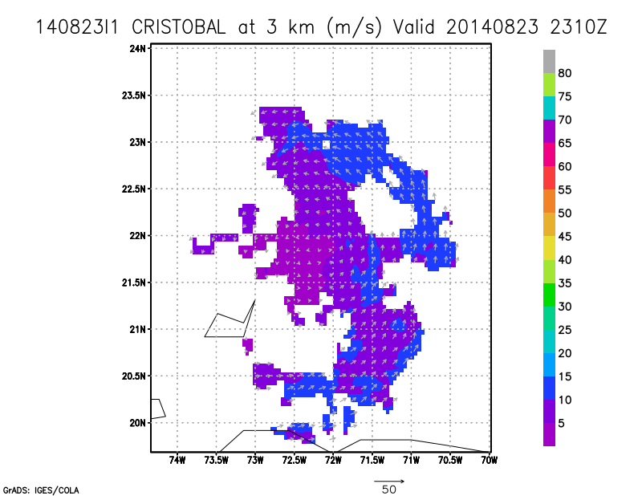
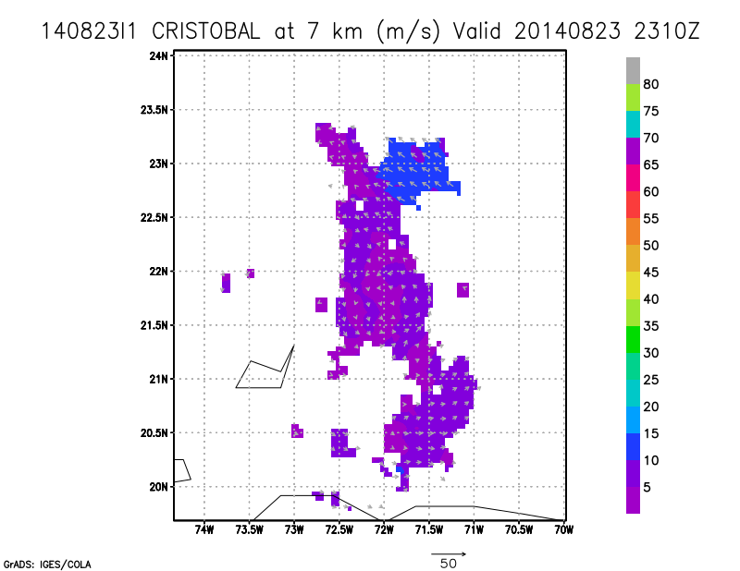
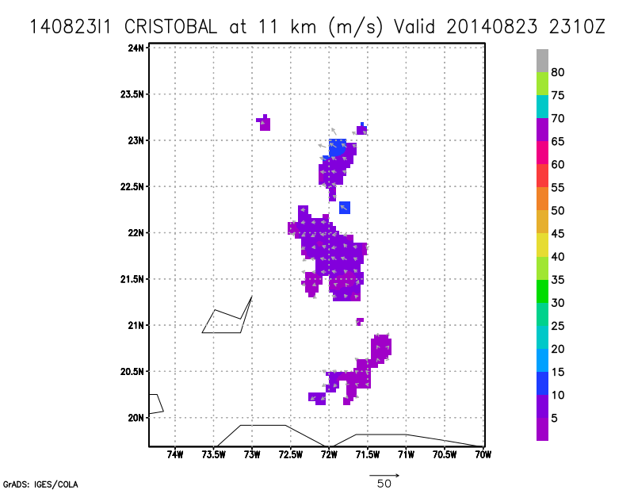
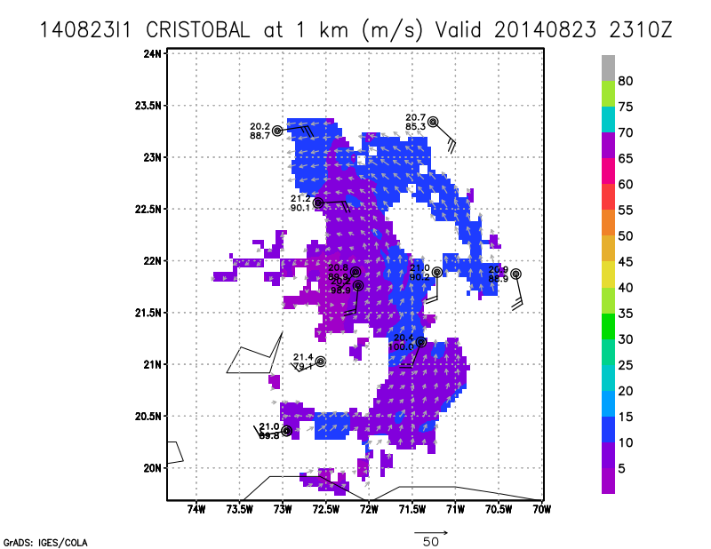
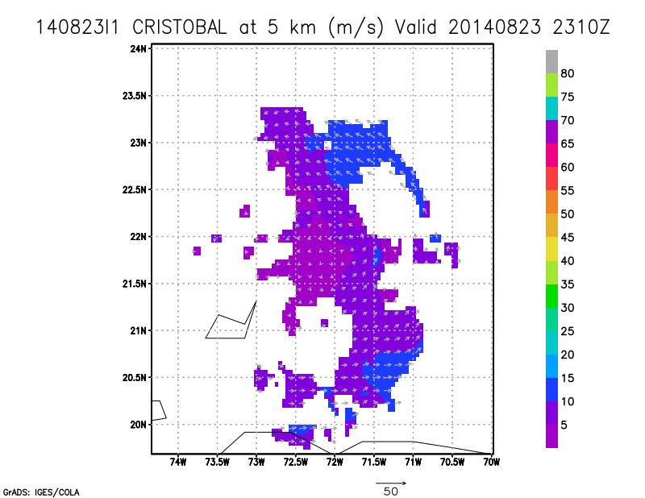
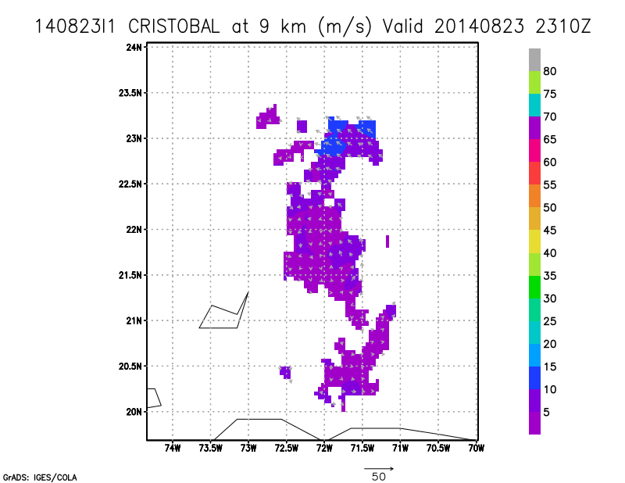
Weak, tilted (to the SE), and disorganized circulation seen in
Doppler analyses.
Air with > 30-degree dew point depressions to west of storm.

Slide 9
Executed most of the pattern as planned.
Some signs that the center was trying to reform near the convection to the southeast. By end of flight, some 50 dBZ cells were seen on LF.
Leg length was too short to reach RMW.
Some (minor) issues with dropping sondes at exact locations due to land issues (Bahamas)
Doppler coverage was a lot better than expected with relative lack of scatterers.
LF locked up a few times, but was reset.
FD set incorrect Mission ID, so first three sondes (and lots of HDOBS had to be resent with corrections.
NESDIS equipment moved to C3X. Heat no longer seems to be a problem.
First of four spectacular sunsets.

Slide 10
Flight 140824H1
Highlights:
Storm was a tropical depression in southern Bahamas
Experiencing moderate W shear, low, mid, and upper-level dry air particularly on W side
Asymmetric precipitation and wind field distribution, some embedded deep convection on SE side
Circulation showed ~80-100 km displacement between 2-8 km toward SE (downshear) side
Some vigorous upper-level updrafts, overshooting tops on downshear side, all inside broad 2-km RMW

Slide 11
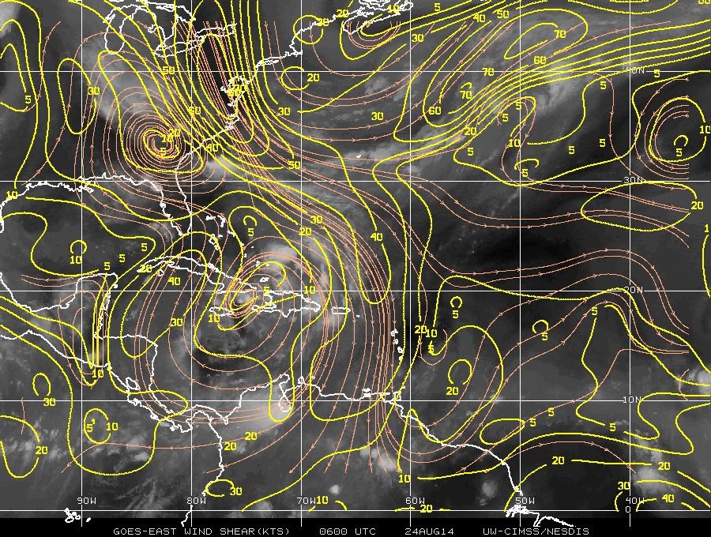
CIMSS 850-200 hPa shear valid 06 UTC August 24

Slide 12
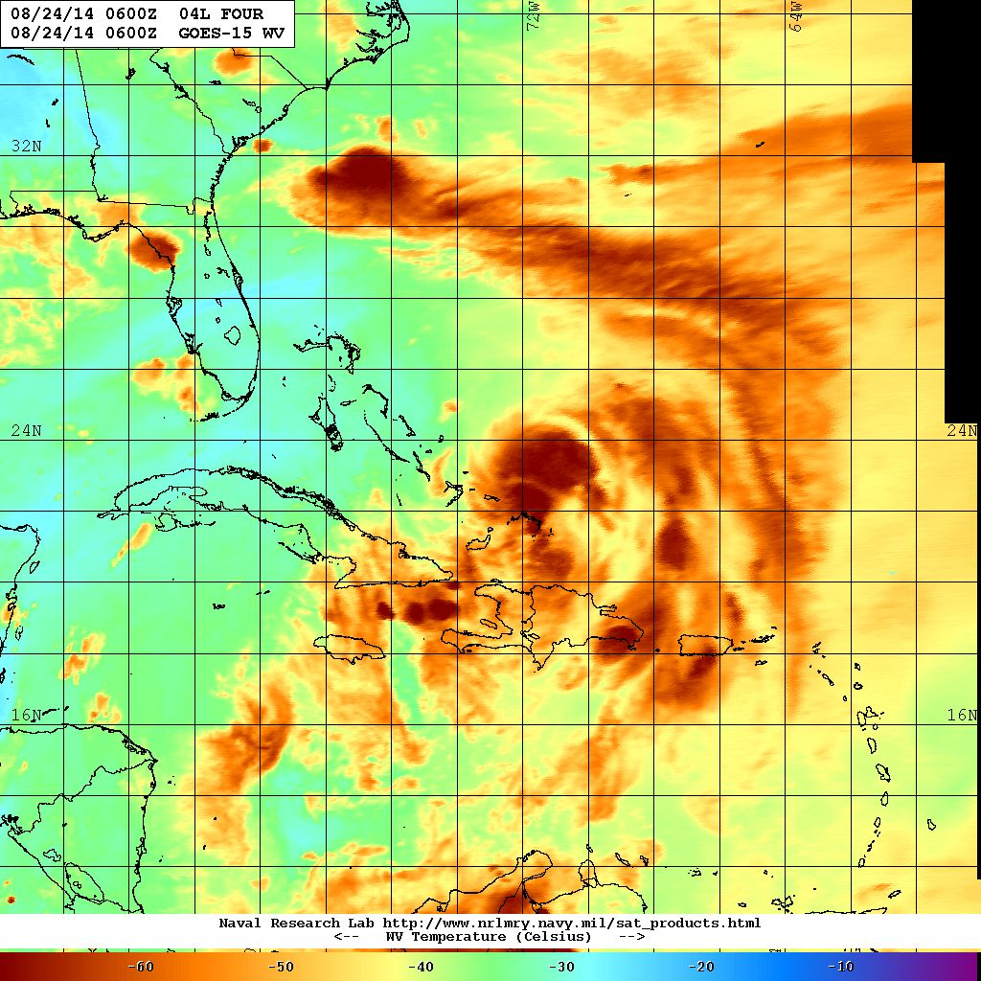
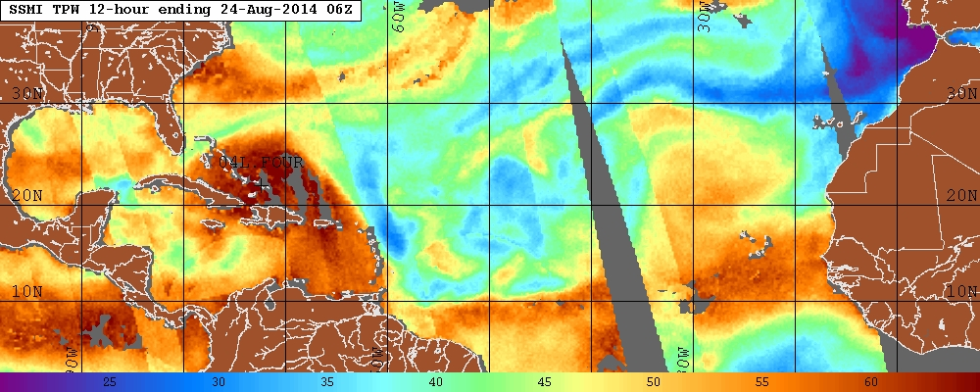
WV image valid 06 UTC August 24
TPW valid 06 UTC August 24

Slide 13
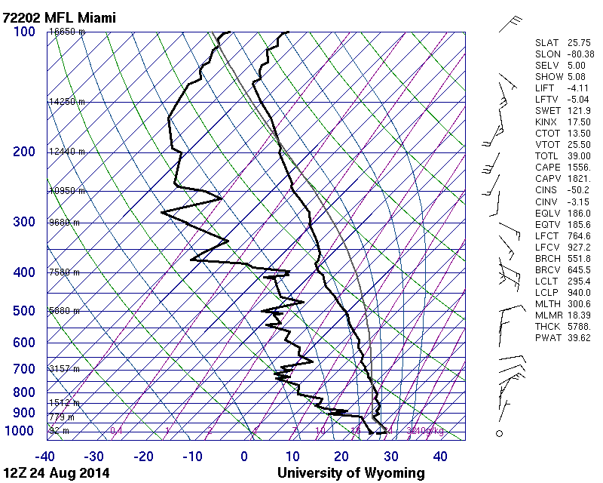
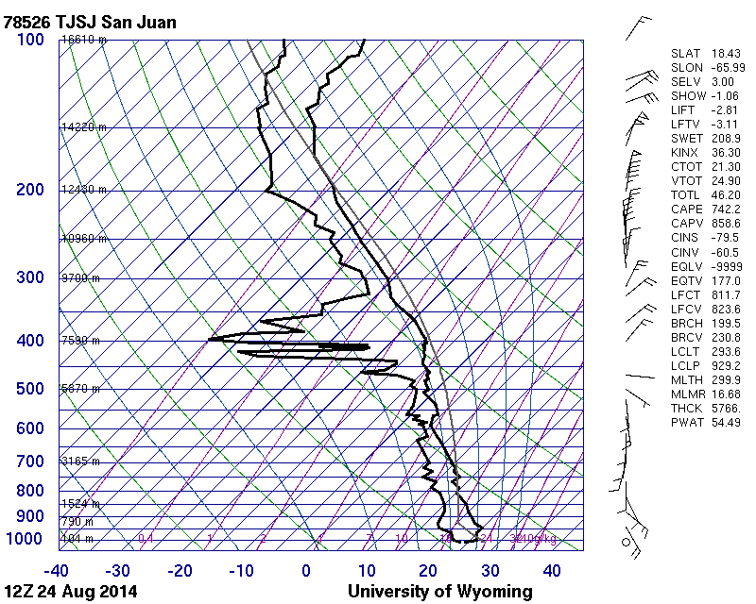
Skew-T valid 12 UTC August 24 for Miami, FL
Skew-T valid 12 UTC August 24 for San Juan, PR

Slide 14
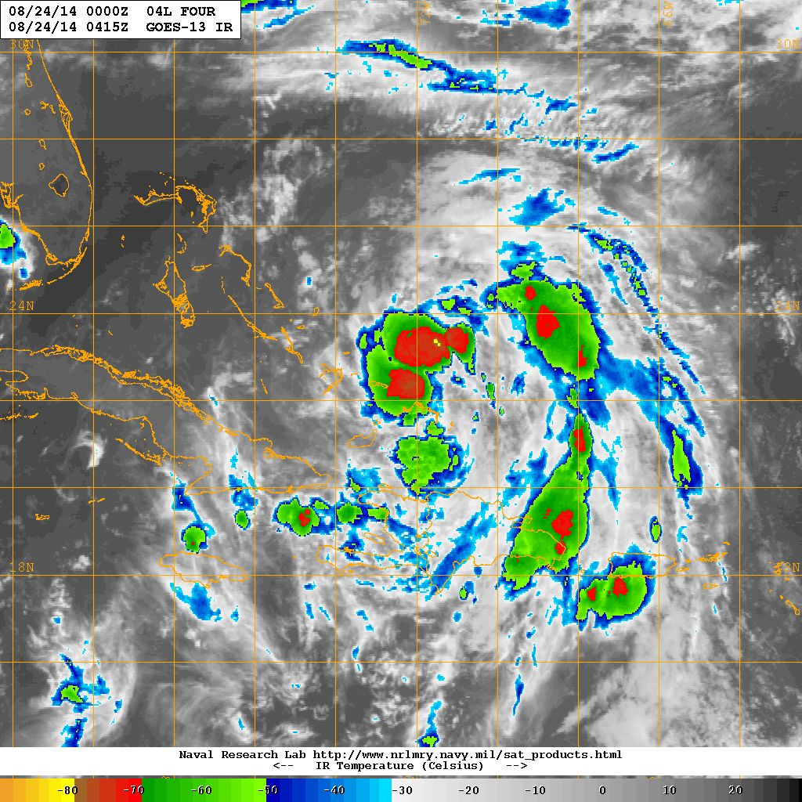
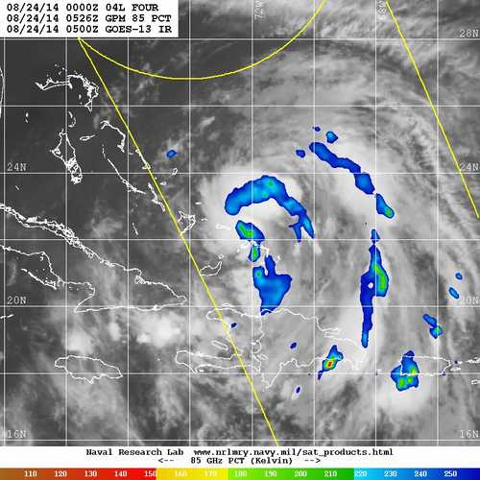
GOES IR 0415 UTC
GPM GMI 85 GHz 0526 UTC

Slide 15
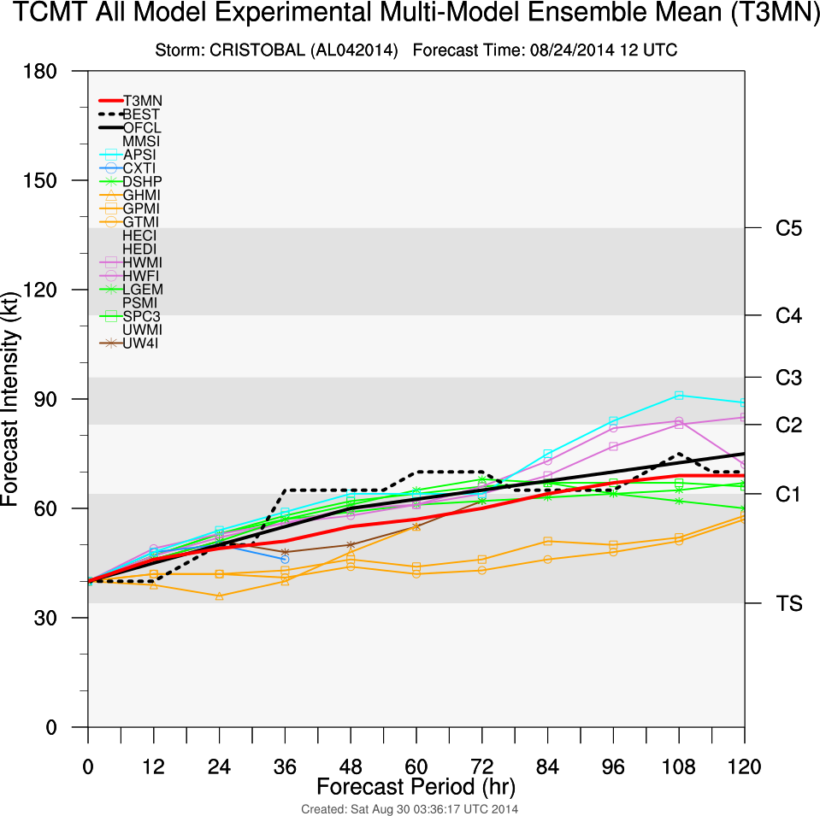
Track guidance
Intensity guidance

Slide 16
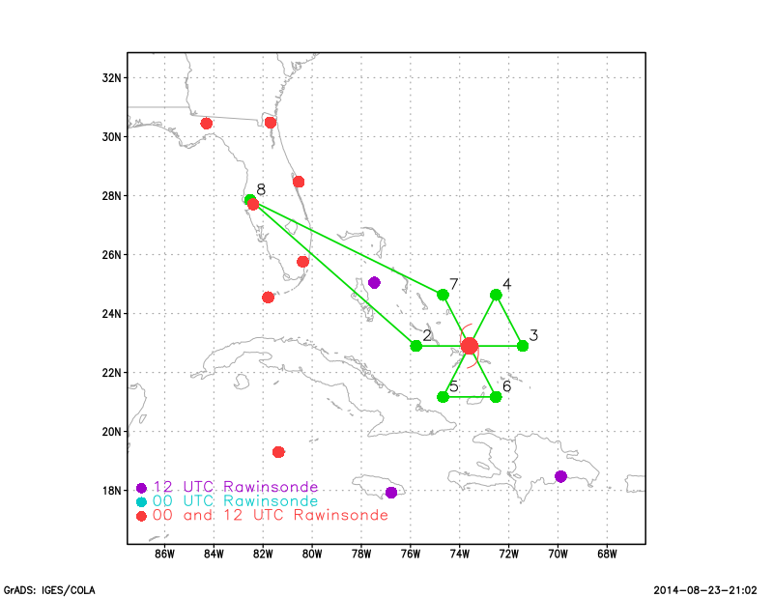
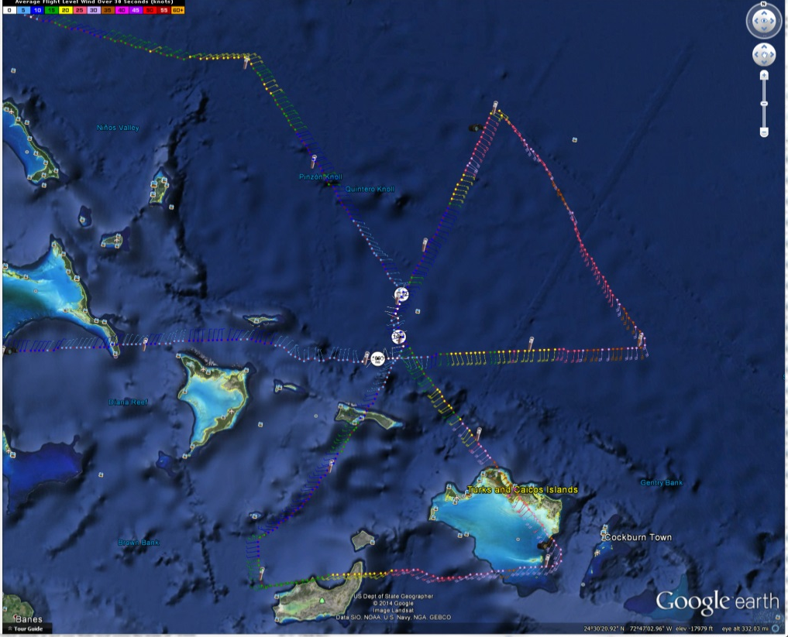
Proposed flight track
Actual flight track

Slide 17
Doppler-derived
2-km winds
Doppler-derived
8-km winds

Slide 18
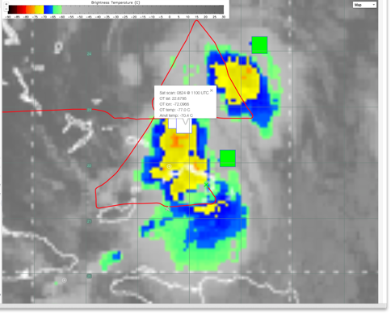
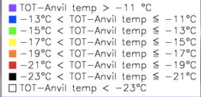
IR temperature and tropical overshooting tops valid 1100 UTC

Slide 19
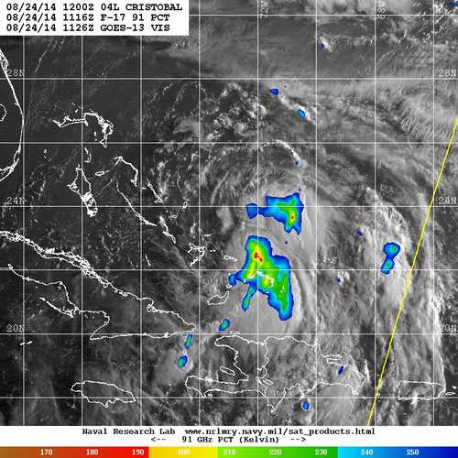
Reflectivity at 15 km altitude
SSMI/S 91 GHz at 1116 UTC

Slide 20
2-km wind speed (shaded; m/s) and vectors and 8-14 km peak vertical velocity (contour; only 2, 3 m/s shown)
8-14 km peak vertical velocity (shaded; m/s)

Slide 21
20140824I1
Non tasked TDR mission due to FTP failure on previous flights
Take off and landing from MacDill AFB
Flight duration 1755Z to 0125Z
Objectives: collect process and transmit tail Doppler radar and dropwindsonde data in real time for operational DA into HWRF model, conduct high incidence angle tests for the SFMR, and coordinate with NESDIS to conduct sector scans.
Dropsondes at center and midpoint of 105nm legs.
GIV sampling environment
Expendables 10 GPS Dropwindsondes (HRD)

Slide 22
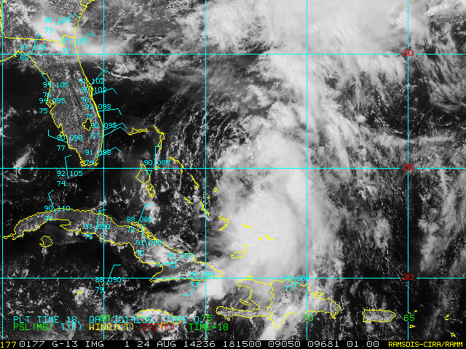
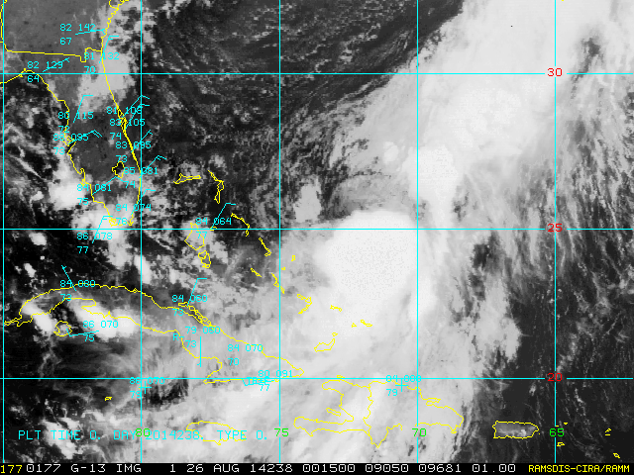
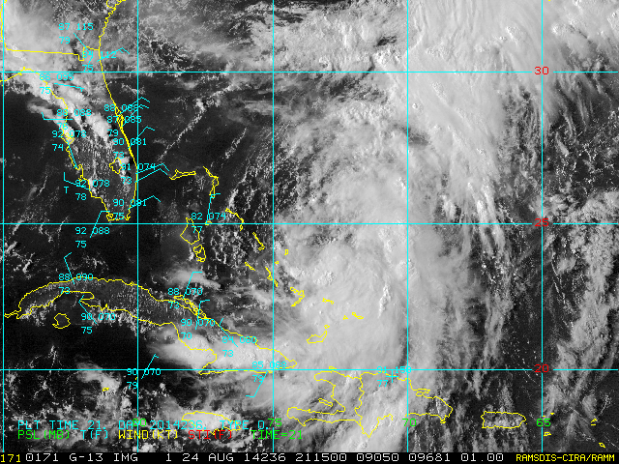
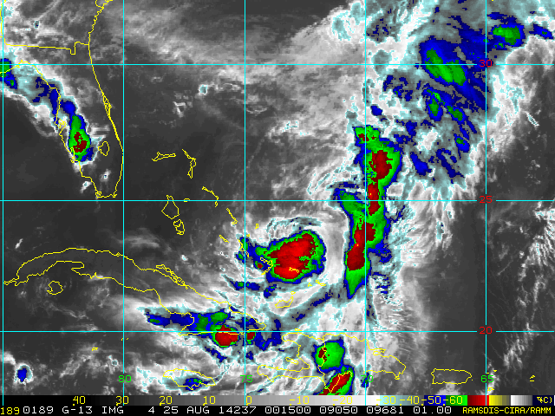
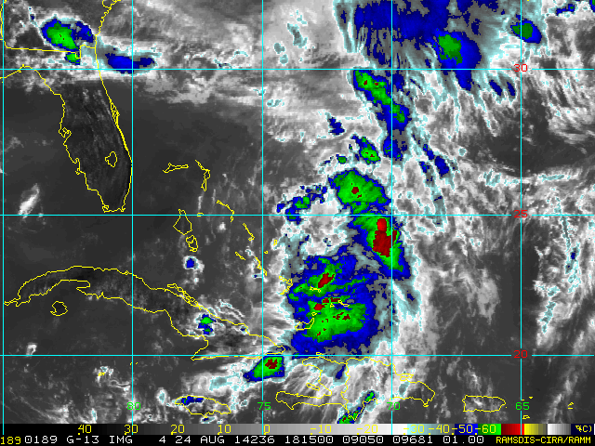
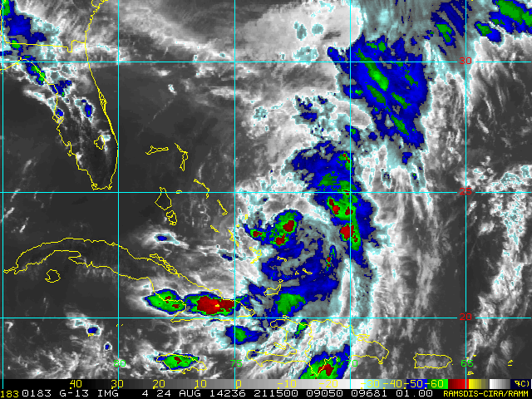
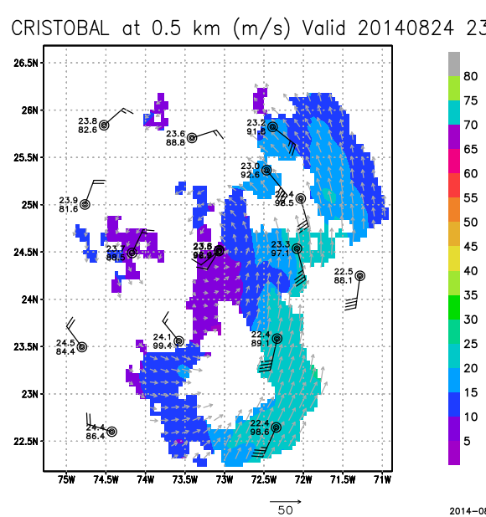
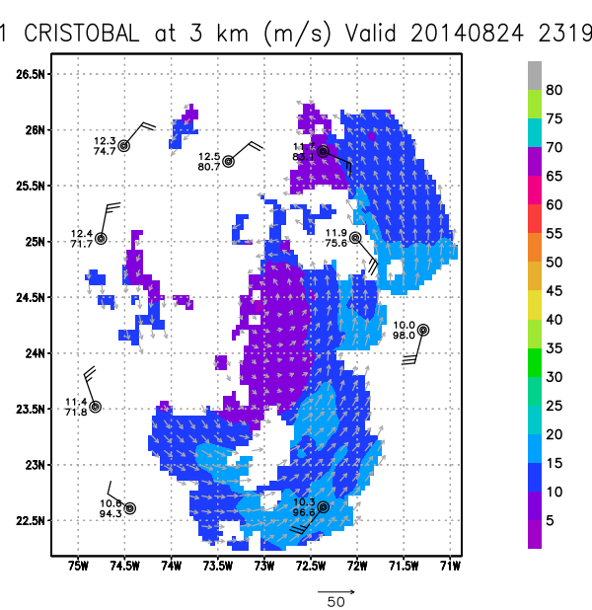
Synoptic
Dry air to the WNW
Convection confined to east side of storm
Coldest cloud tops to the SE
Convection increased towards end of flight
Vertical shear appeared to be greater than guidance
Minimal central pressure 999mb on all passes
Max wind 38kts (drop) 44kts (SFMR)
Meandering motion mainly to the southwest at ~5kts.

Slide 23
Flight Summary
First center fix was to the south of the previous Air Force fix.
FTP was still down an beginning of the flight but a backup was operational by the time we reached the IP. Primary FTP was working for the final leg.
3 real-time radar analyses were created and FTP’d from aircraft in time to be ingested into 18Z and 0Z cycles.
Final analysis from 20140823i1 was remade and sent to AOML.
First 2 jobfiles created on plane and the final jobfile was successfully sent from the ground.
Minor glitches due to inconsistency between radar scripts and temporary FTP location.
Released dropsondes at center and midpoints plus rmw drop on W side, all drops were good.
Conducted SFMR test during second penetration in NW quadrant. 3 circles were completed at each 15, 30, 45 degree incidence angles in clear air with 15m/s surface winds. [Heather Holbach, FSU]
Maximum observed surface wind speeds were 44kts near SE turn point on the final leg from the SFMR and 38kts at the eastern midpoint on the first leg from dropsonde. Was not able to get a dropsonde out in time to sample strong winds near the SE turn.
Had to cut second downwind leg short by about 20nm to avoid strong convection during the turn.

Slide 24
HRD Ground-Based LPS
Communications
-room for improvement
-prebrief: make it known that you’ll be the HRD LPS
-use #N49RF XChat channel to talk with G-IV FD
-use the FD’s chat room name in your message to “alert”
-NASA MTS >> Cloudtop Heights, OTs, lightning >>useful
-AOC server issues: limited effectiveness
-LPS: onboard vs remote
NASA MTS
-tkmap turns and drops files >> HRD ftp >> MTS
-Jason will coordinate this for rest of 2014 (42/43/49)

Slide 25
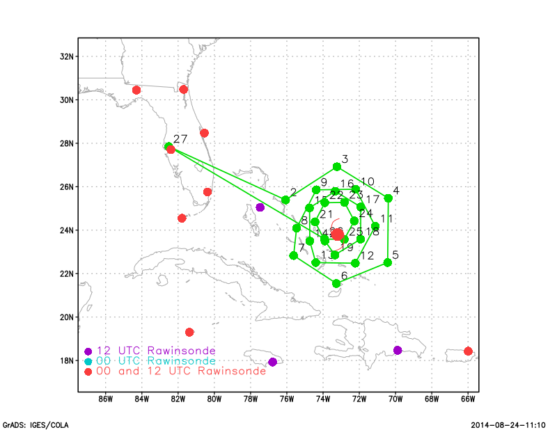
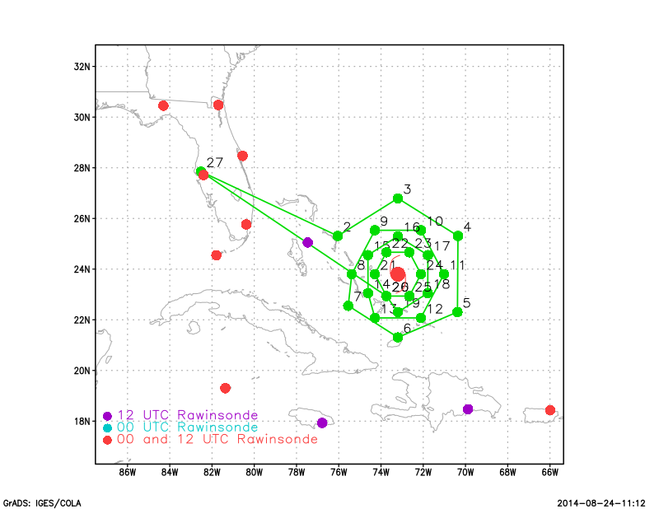
TS CRISTOBAL G-IV TDR Mission: 140824N1
Earth Relative
Storm Relative
Take-off ~1730z (MacDill);
Landing ~0045z (MacDill)
27 GPS dropsondes
4 circumnavigations (3/2/1.5/1 deg)

Slide 26
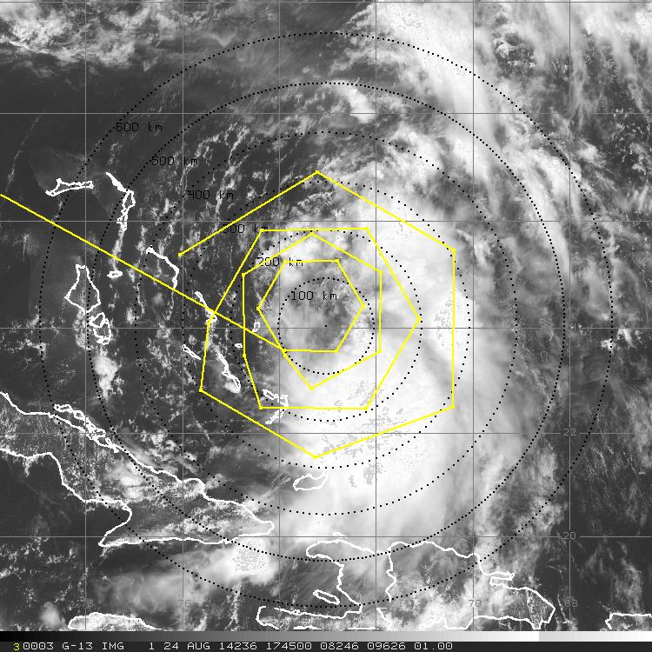
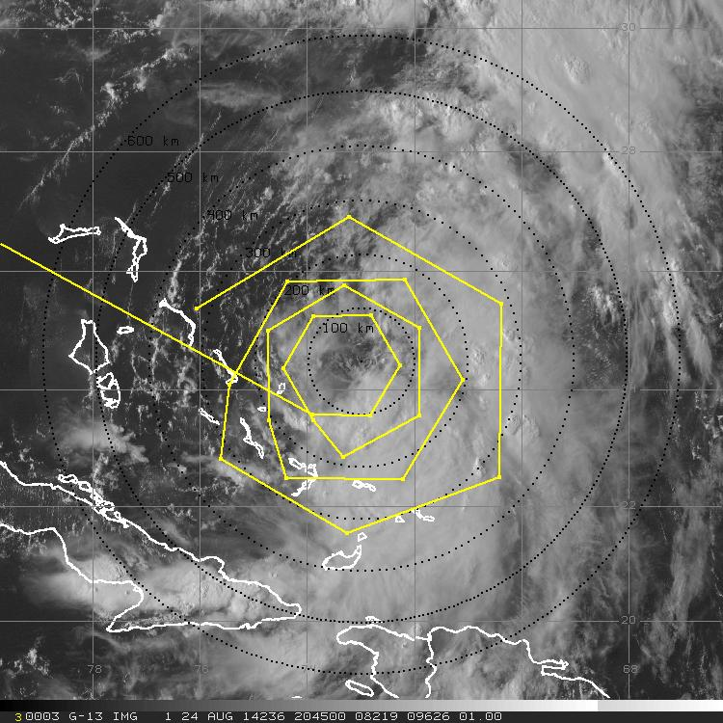
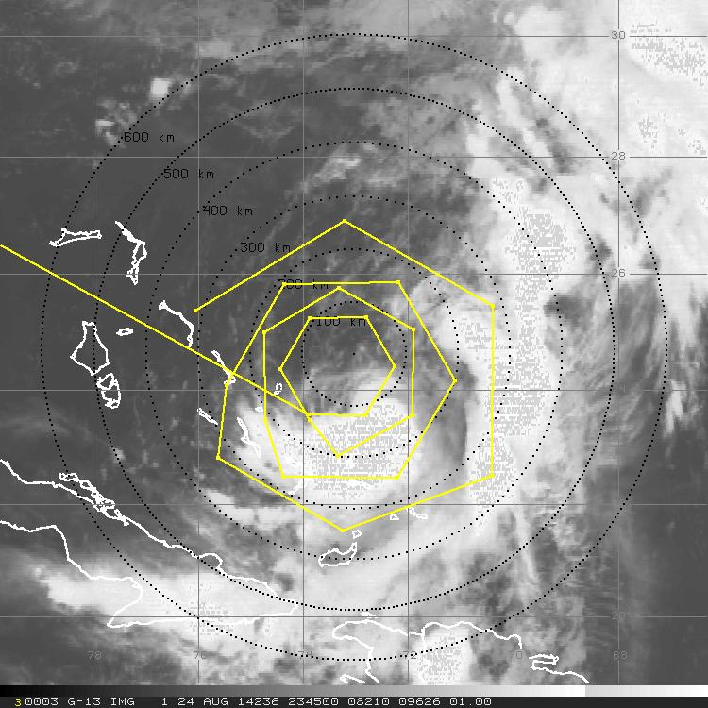
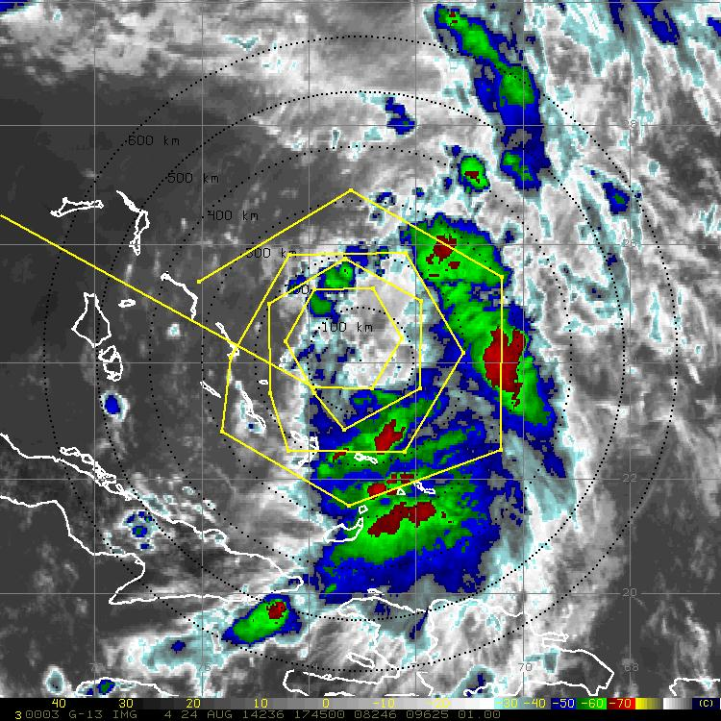
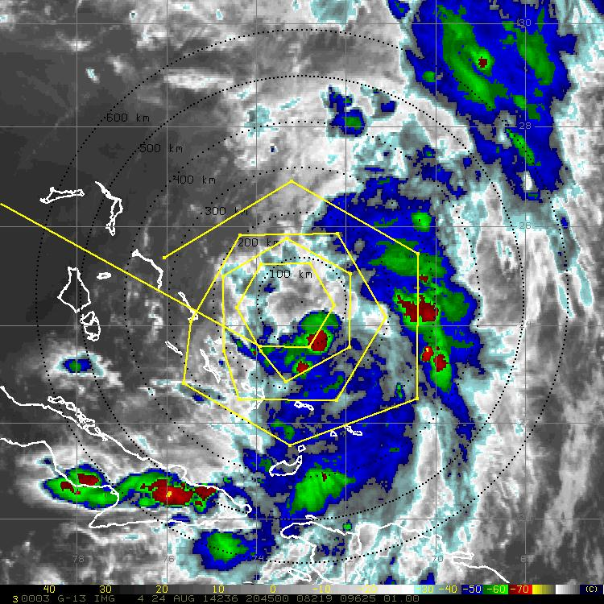
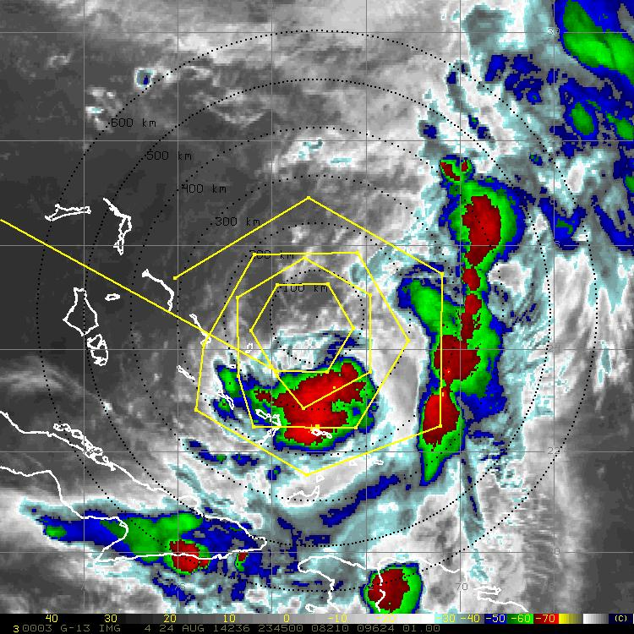
TS Cristobal G-IV TDR Mission: 140824N1
10
10
IP
IP
15
15
25
25
20
20
5
5

Slide 27
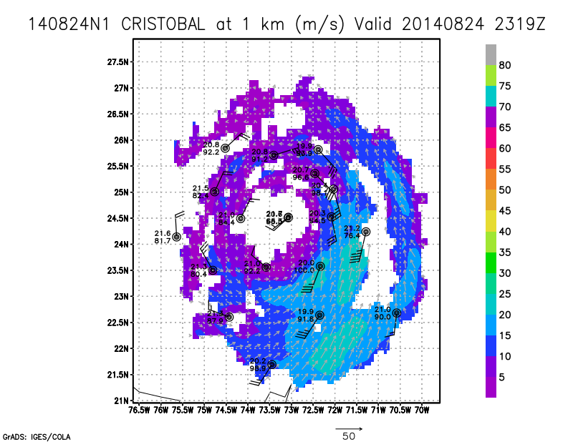
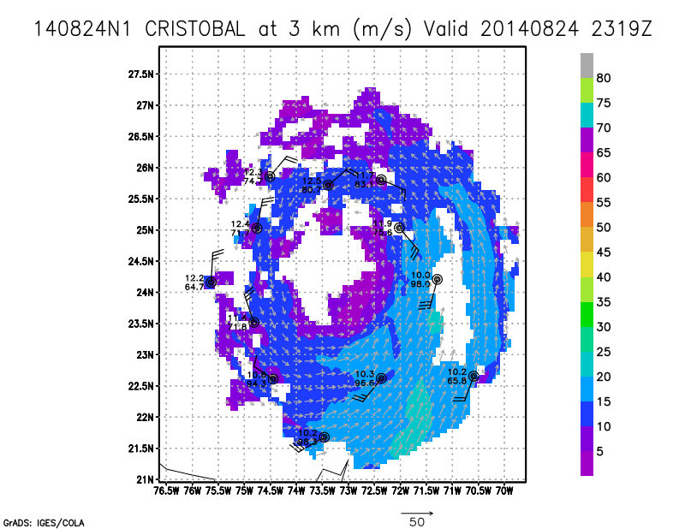
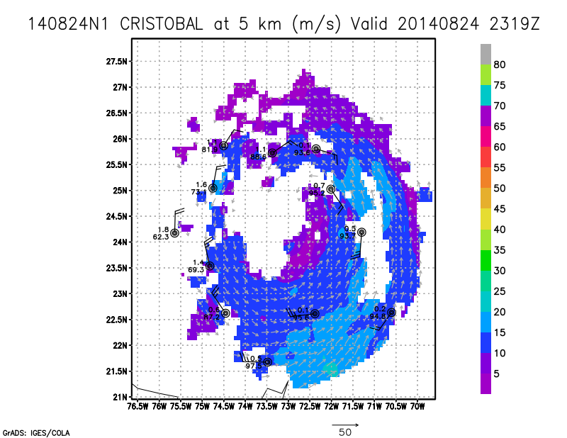
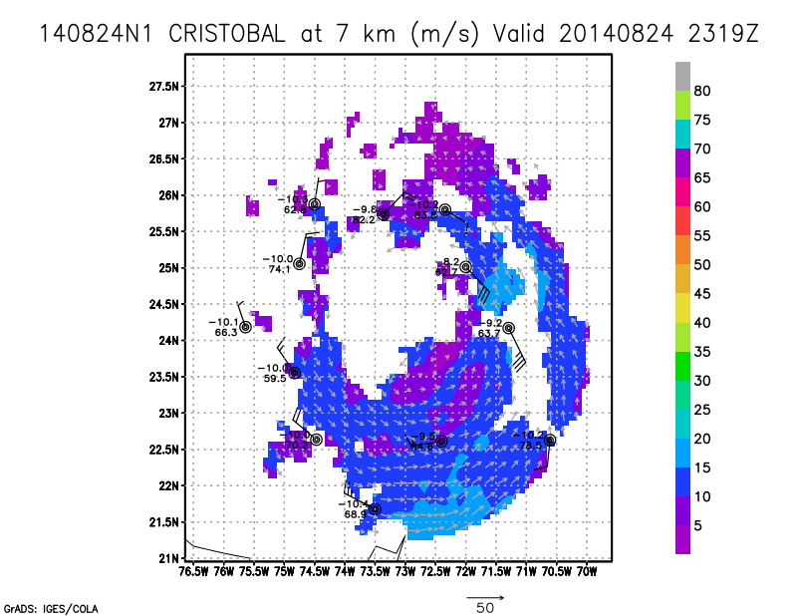
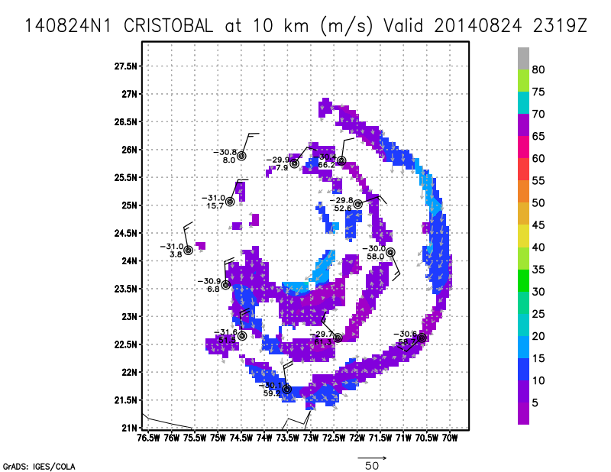
TDR & Dropsonde Analyses

Slide 28
Summary
Circumnavigations >> R= 3/2/1.5/1 degrees
-using storm relative in tkmap >> useful for small radius circumnavs
Proximity to MacDill >> allowed for a combination of inner core and environmental sampling (~100-300 km)
27 GPS dropsondes deployed (26 planned, 1 backed-up)
AOC server issues: Mike was not able to communicate with the G-IV or track the mission in real-time. Updated morning track was “good” >> successful mission

Slide 29
Flight 140825H1 LPS: Jun Zhang; Radar Scientist: Robert Rogers; Sonde Scientist: Frank Marks
Highlights:
Tropical storm Cristobal was a sheared TC with the low-level center fully exposed on the north side of the deep convective clouds.
heading N-NE (015 degree) at 2-4 knots.
Shallow vortex from the radar analysis.
Problems:
1) Data system not working till the IP, circling there for 30 minutes, first leg delayed; (discussed possible flight patterns if TDR mission was cancelled)
2) TDR not recording data till 0913 UTC;
3) Netman was down till 1040 UTC, couldn’t transfer data to the ground
4) Have to transfer the droponde data or vortex message through Xchat
5) Radar software ‘startRawCopy’ not working mainly due to the Netman was down. Working with Sonia and AOC folks, Rob finally fixed the problem and finished all the radar analyses and super obs were transferred to EMC.

Slide 30
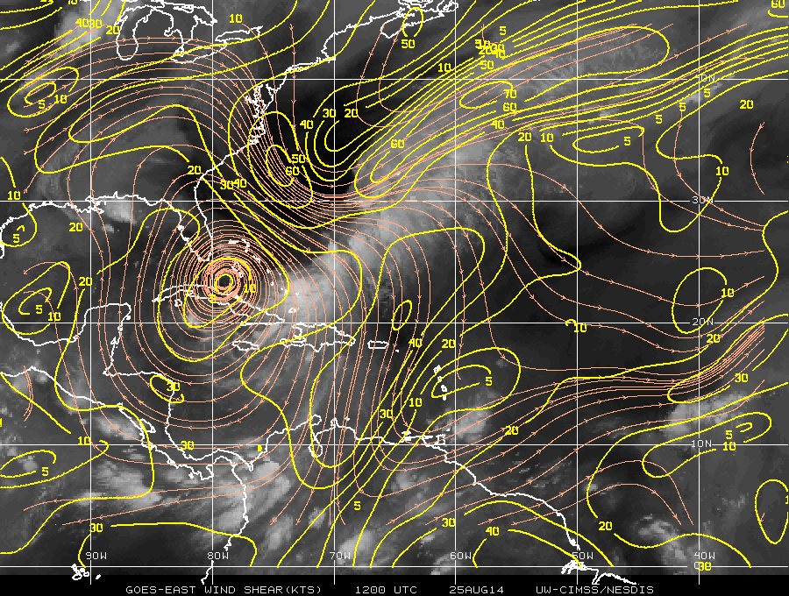
850-200 mb shear 12Z August 25

Slide 31
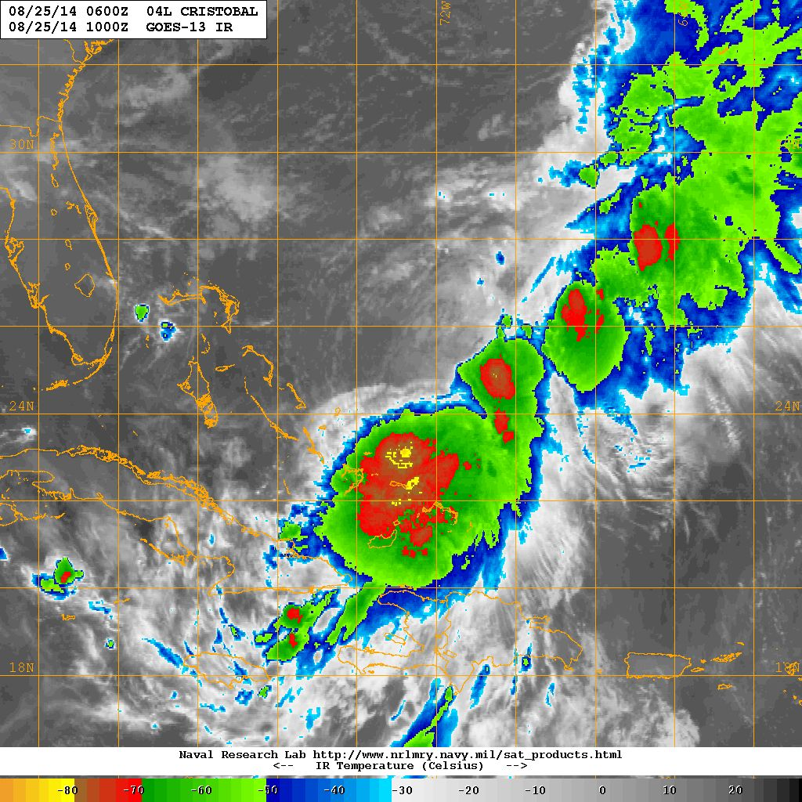
GOES IR 0600-1000Z August 25

Slide 32
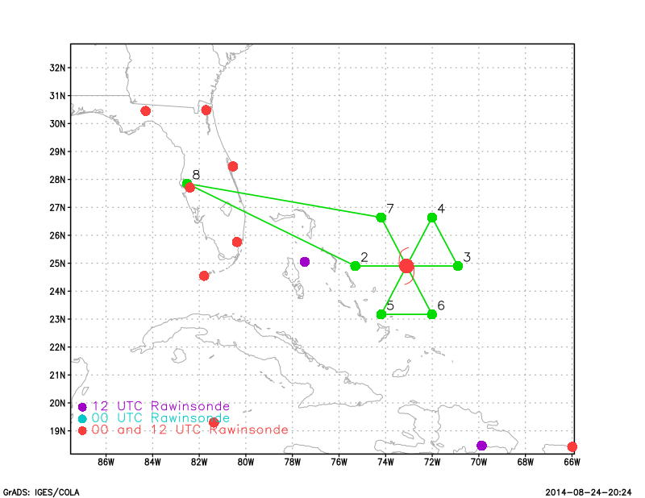
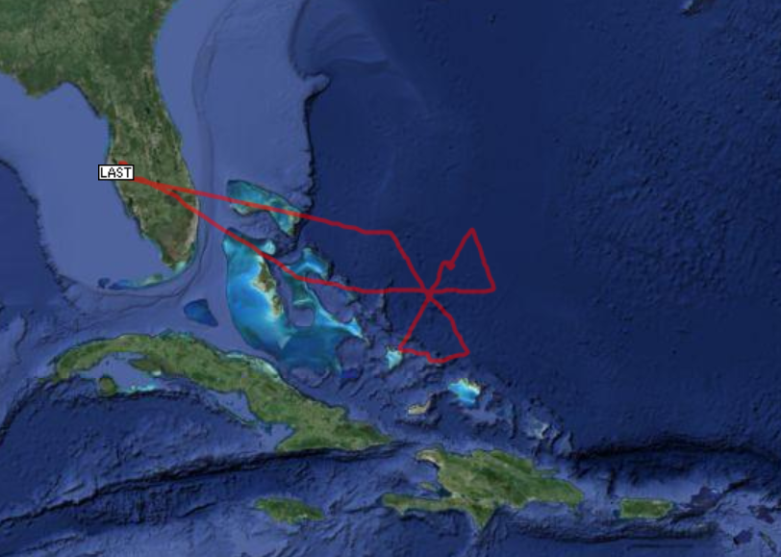
Planned vs. Actual Flight Track
Dropped 17 sondes

Slide 33
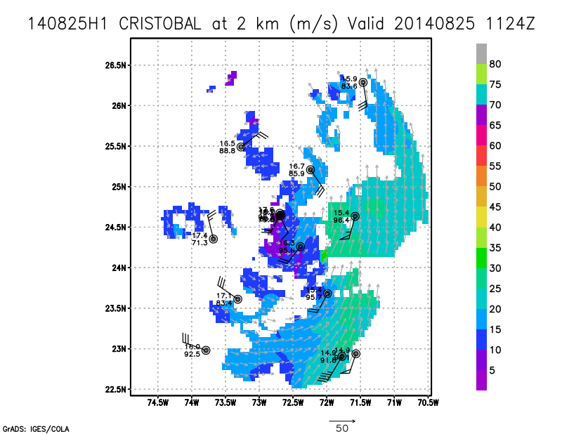
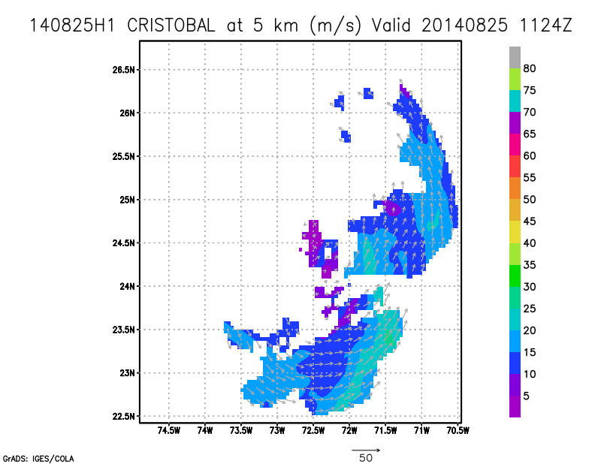
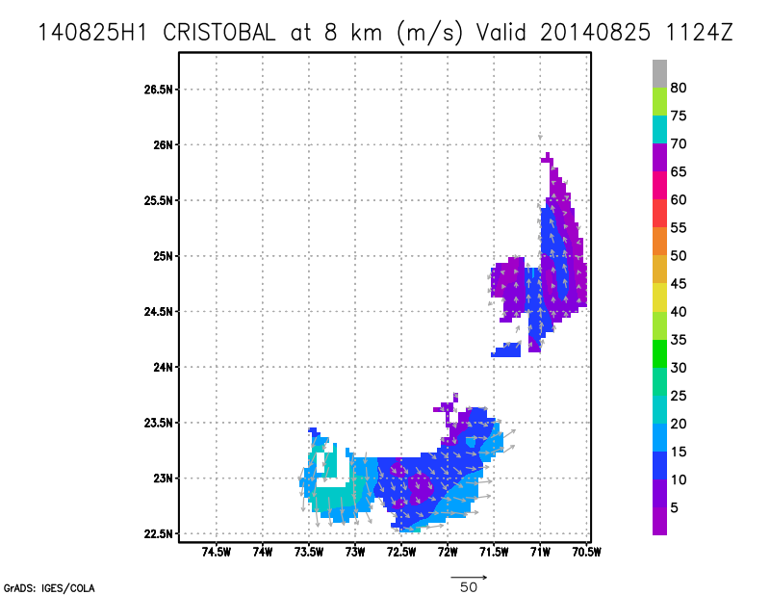
Radar Composites

Slide 34
20140825I1
EMC tasked TDR mission.
Take off and landing from MacDill AFB.
Flight duration 1753Z to 0143Z
Objectives: collect process and transmit TDR and dropwindsonde data in real time for DA into HWRF model, conduct high incidence SFMR tests and test of IR and mini dropsondes. Possible convective burst module if a suitable target is identified.
Flight legs extended to 120nm to sample RMW.
Dropsondes at center and midpoints of each leg.
GIV sampling the environment
Expendables: 14 dropsondes (13 HFIP 1 Cione), 1 IR dropsonde (Cione), 1 mini dropsonde (Cione), 1 AXBT (Cione)

Slide 35
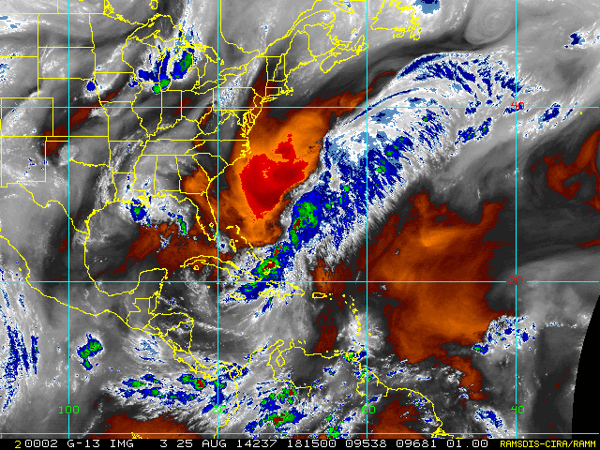
Synoptic
Large area of dry air to the north and west
Effects of shear are still evident
Moderate convection near center but still confined to southeast side of storm.
Convection increasing as flight progressed
Convective burst coinciding with final pass through center with frequent lightning.
Minimum central pressure decreased from 992mb to 990mb
Maximum surface winds of 62kts(drop) 71kts(SFMR) 72kts (fl lev)SE of center
Special 8pm advisory upgraded Cristobal to a hurricane based on flight data.
Motion nearly stationary at beginning of flight then moving easterly at ~9kts.

Slide 36
Flight Summary
3 TDR analyses created and transmitted in real time. FTP and radar scripts worked correctly and the last 2 analyses were received in time for DA. First leg could not be completed in time due to length of ferry.
High incidence SFMR test was completed on first leg in 20-25m/s winds in the same manner as the previous flight. [Heather Holbach, FSU]
Tested IR and mini dropsondes targeting the surface wind maximum in the SE quadrant. AXBT and conventional dropsonde released at same location.
All dropsondes transmitted to surface, experimental sondes SSTs were 4-5 degrees lower than the AXBT measurement.
Extra HFIP dropsonde released in SE quadrant at estimated RMW, Cristobal was upgraded to a hurricane as a result of the observations in this area.
Central pressure measurements indicated a slow but steady strengthening of the storm during the flight.
Minimum observed surface pressure was 990mb
Maximum surface wind was 62kts from dropsonde and 71 kts from the SFMR on the SE side about 25nm from the center. Flight level wind max of 73kts.
Frequent lightning observed on final pass.
No convective burst module was initiated due to lack of time and safety concerns. The fortuitous location of the NOAA49 allowed for sampling along both the east and west sides of the strongest convective region before and after the P3 pass effectively completing a 2 aircraft convective burst module. TDR and thermodynamic information was obtained as the feature evolved.

Slide 37
140825N1
Planned Flight Track & Satellite Image (18:15Z)
1
25

Slide 38
140825N1
Planned Flight Track & Satellite Image (00:15Z)
1
25

Slide 39
140825N1
Planned Flight Track & Satellite Image (18:00Z)
1
25

Slide 40
140825N1
Planned Flight Track vs. Actual Flight Track
Planned flight track and dropsonde locations
1
Actual flight track from raw
HDOBS data
Actual dropsonde obs from
TEMPDROP messages
25
Deviations in track were due to the strong convective activity SSW of the center.
Missing dropsonde data should be investigated.

Slide 41
140825N1
TDR Analyses

Slide 42
P3-GIV “convective burst module”
2300Z
GIV circles to the east of the convective feature
prior to P3 sampling
2326Z
GIV circles to the west of the feature
after P3 has passed
GIV
GIV
P3
P3

Slide 43
Flight 140826H1 LPS: Jun Zhang; Radar Scientist: Frank Marks; Sonde Scientist: Robert Rogers
Highlights:
Hurricane Cristobal’s cloud pattern is not typical of a hurricane on the RI image but the surface wind measured reached hurricane strength.
Storm weakened slightly during our flight.
Heading N-NE (10 degree) at 6-10 knots.
Convection is sheared to S and SE of the low-level storm center.
Shallow vortex tilted based on the radar analysis.
Problems:
1) Dewpoint sensor reading wrong;
2) HD ob software went off several times at the flight director’s station;
3) Radar analysis software was working well till the third analysis. Working with Sonia and John to fix the problem. Sending the superobs after the landing. Mission successful at the end. Frank was having fun with the radar slicer and tweeting radar analysis results until the third radar leg.
4) Data system, HD ob software went down at the starting point of the third radar leg, with aircraft orbiting there for ~15 minutes.
5) Couldn’t drop IR sonde and AXBT at the highest wind region. SST measured by IR sonde and AXBT match excellently for surface wind of 40 kt with no convection.
Notes:
My first hurricane flight of this year

Slide 44
850-200 mb shear 12Z August 26

Slide 45
GOES IR 0600-1000Z August 26

Slide 46
Planned vs. Actual Flight Track
Dropped a total of 21 sondes

Slide 47
Radar Composites

Slide 48
Radar reflectivity cross-section plotted by Frank Marks

Slide 49
Left: working on new droposnde locations with the same flight pattern Right: Prepare convective burst module and/boundary layer entrainment flux module in flight.
Great LPS experience
Many thanks to Rob Rogers and Frank Marks!

Slide 50
20140826I1
EMC tasked TDR mission.
Take off and landing from MacDill AFB.
Early take off to get TDR into 18Z DA cycle.
Flight duration 1740Z to 0131Z
Extended legs to 120nm for sampling the RMW.
Objectives: collect process and transmit TDR and dropwindsonde data in real time for DA into HWRF model, conduct high incidence SFMR tests and test of IR and mini dropsondes. Possible convective burst module if a suitable target is identified.
Dropsondes at center, endpoints and midpoints of 120nm legs.
AV6 sampling the environment
Expendables: 19 GPS dropsondes (16 HFIP,1 Cione, 2 Chang),1 IR dropsonde (Cione), 1 mini dropsonde (Cione), 2 AXBT (Cione)

Slide 51
Synoptic
Convection now wrapping around to the north side of the storm.
Consistent 50kt winds out to the end of the east leg (merging with front?).
Again convection started firing up on the final pass.
Strong vertical motion SE of center 13m/s up and 9m/s down
Vortex appears to be more vertically aligned.
Central pressure decreased from 986mb to 983mb during flight
Maximum winds 72kts(drop), 70kts(SFMR), 85kts(fl lev)
Motion northward at >12kts.

Slide 52
Flight Summary
3 TDR analysis completed and transmitted in time to make it into both 18Z and 0Z DA cycles.
Released IR and mini dropsonde along with a control sonde and an AXBT at SE midpoint, released a second AXBT inside the RMW due to the first one failing.
Released 2 extra dropsondes on the final leg to sample RMW, first drop was early so a second drop was called.
Executed a maneuver to turn back across the RMW on the last pass for Paul Chang’s group dropping additional sondes to the east and west. Although the plan was to cross the RMW again to get back to the center the pilots diverted around for safety reasons.
The plane encountered strong vertical winds on the SE side experiencing a 13 m/s updraft followed by a 9 m/s downdraft.
Again frequent lightning was observed to the SE of the center.
A safe location was found near the end of the final leg in the NW quadrant to complete 3 circles at 30 and 45 degrees to collect SFMR data. [Heather Holbach, FSU]
Maximum surface winds from dropsondes of 69kts and kts from SFMR about 25nm from the center. Maximum flight level winds of 90 kts.
Minor communication issues regarding number of passengers and flight plan for final leg.

Slide 53
140827I1
Ocean Winds mission
Heather Holbach (FSU) on board
Tested ground-based TDR processing/analysis with no HRD personnel on aircraft (no transmission to EMC)

Slide 54
Issues
Single-point failures hindered data getting to EMC.
Earlier take off may be needed to ensure data get into two DA cycles. Best practice is to complete the first figure 4 before attempting any modules to obtain situational awareness and to ensure that the data gets off the plane in a timely manner.
Tropical Atlantic tracking fails when HDOBS are not transmitted and MTS fails when the FTP site is down making ground support difficult.
Dropsonde processing issue, interface not friendly pointed out by Frank.
ASPEN bug encountered when making skew-T diagrams, appears to only affect the CENTOS version.
Tracking ball mouse not friendly
Suggest AOC switch the stations between LPS and radar scientist.
N43 Lower fuselage radar in wedge mode during final pass for NESDIS sector scan.
Good idea to briefly summarize flight plan and possible modules with field program director and Jim McFadden to make sure everyone has the same understanding of what to expect.
N43 experienced engine issue on ferry back during 140827I1
N49 experienced hydraulic problem at end of 140825N1. Had to cancel mission 140826N1.
WSRA transmitter power amplifier not working correctly. No WSRA data collected.

