Slide 1
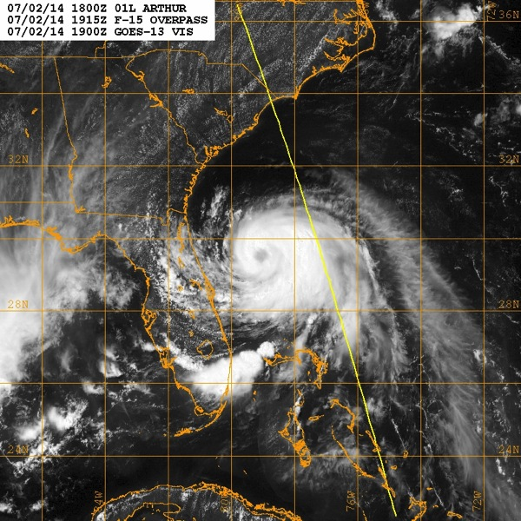
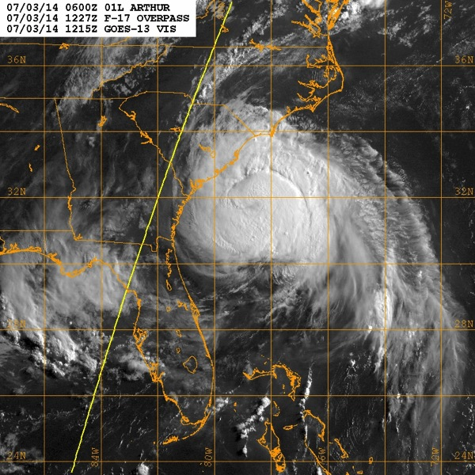
TS/Hurricane Arthur Debrief
2 July
3 July
Flight ops re-cap: 6 Total flight missions (+ 3 NHC-tasked)
27 P-3 and 14 G-IV flight hours; 117 GPSsondes; 10 AXBTs
July 11, 2014

Slide 2
Agenda
Missions Overview (Reasor)
Science Discussions
  N42: TDR (Rogers/Bucci)
  N43: TDR (Aberson/Zhang)
  G-IV: TDR/ET (Gamache/Aberson)
Field Program Issues

Slide 3
Missions Overview
Purpose: Collect P-3 TDR data for assimilation into the operational HWRF model, further test the G-IV TDR system and flight patterns, and document ET.
Target: TS Arthur on 2 July off NE Florida coast; Hurricane Arthur (5AM) on 3 July; extratropically-transitioning Hurricane on 4 July
Background: 91L formed from a non-tropical low initially over S. Carolina. On 27 June it was given a 20% chance of development in 5 days. EMC put the P-3s on alert for a TDR tasking on 30 June.

Slide 4
Missions Overview
2 July: N42 (2AM) figure-4/circ pattern; N43 (2PM) figure-4/circ pattern; N49 (130PM) Synoptic surveillance
3 July: N42 (2AM) figure-4/circ pattern; N43 (2PM) figure-4/circ pattern; N49 (130PM) circ pattern
(N. Carolina landfall late on 3 July – EMC missions done)
4 July: N49 (130PM) butterfly pattern
5 July: N42 (2AM) NHC-ET pattern

Slide 5
Missions Highlights
Scientifically interesting case of RI and subsequent extratropical transition.
1st
2nd
3rd
4th

Slide 6
Missions Highlights
P-3 and G-IV QC’d TDR data from all TDR missions transmitted to the ground in real time and sent to EMC for assimilation
To the extent possible, P-3 TDR data was transmitted in time for assimilation into consecutive HWRF cycles
Circumnavigation module executed during P-3 TDR missions
G-IV overflies eyewall in strong Cat-1 hurricane
Data collected during ET (G-IV and P-3)
LPS training

Slide 7
Science Discussions
N42 TDR (Rogers/Bucci)
N43 TDR (Aberson/Zhang)
G-IV TDR/ET (Gamache/Aberson)

Slide 8
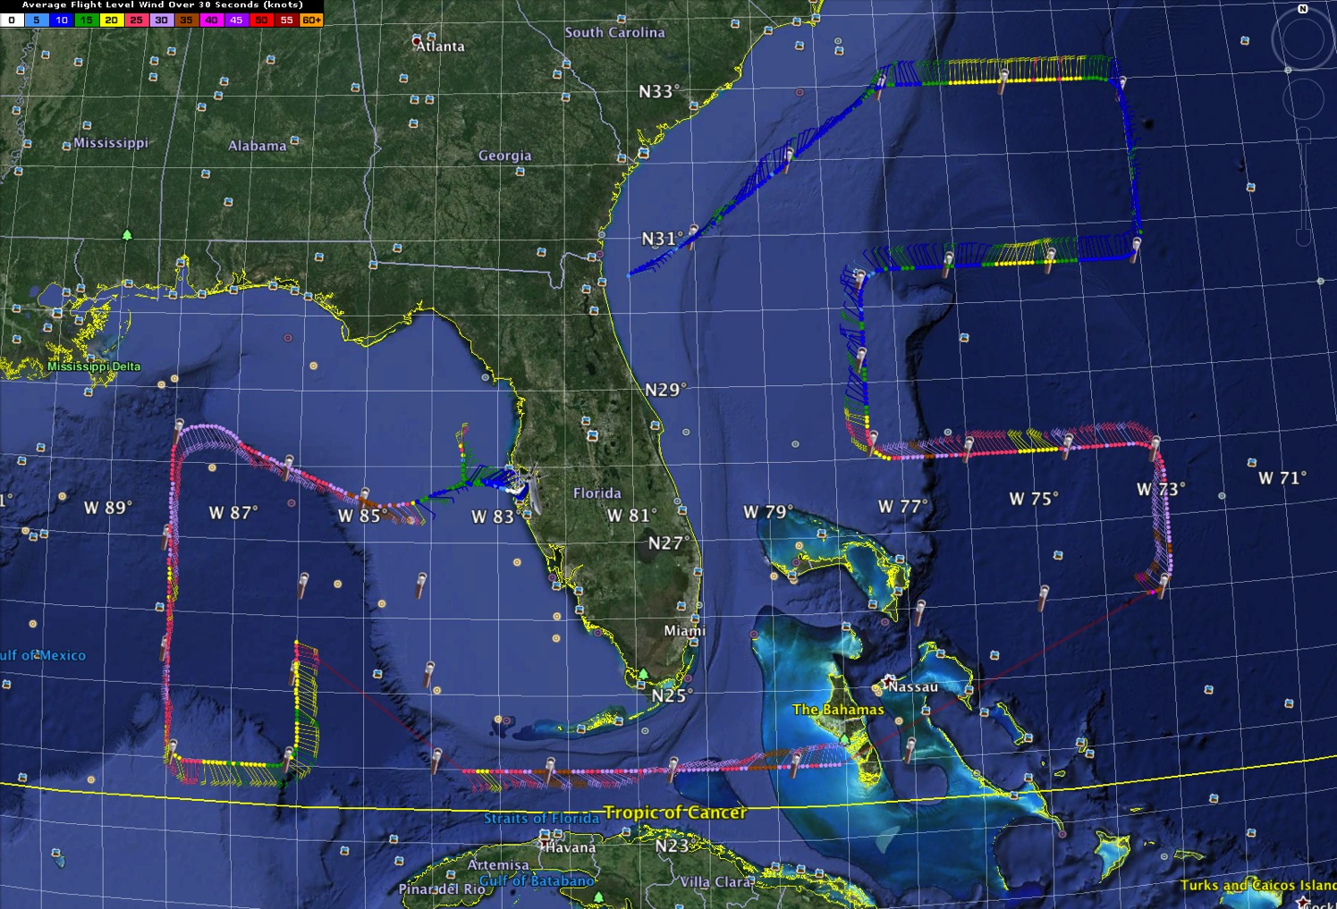
20140701N1
NHC Tasked

Slide 9
Flight 140702H1
Highlights:
Storm was a tropical storm off coast of Melbourne
Experiencing moderate NW shear, mid-upper level dry air
Widespread precipitation and embedded deep convection on SE side
Circulation appeared aligned between 2-8 km
Some vigorous upper-level updrafts on downshear side, some inside 2-km RMW
Some problems with communications of radar jobfiles, radar processing – prevented timely transmission of first two analyses, but was resolved

Slide 10
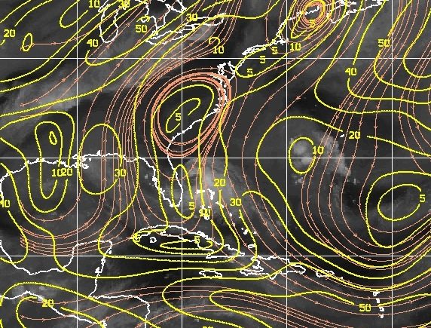
850-200 hPa shear valid 06 UTC July 2

Slide 11
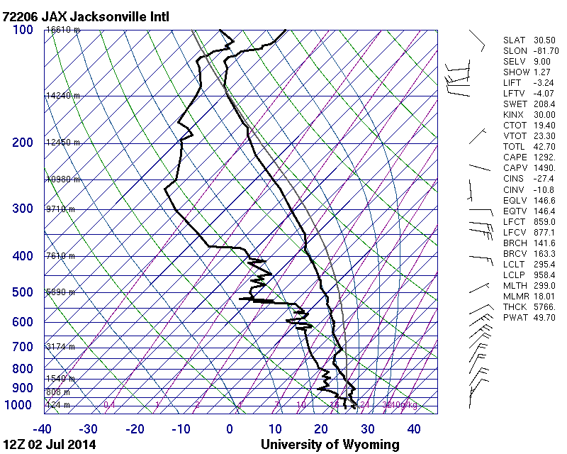
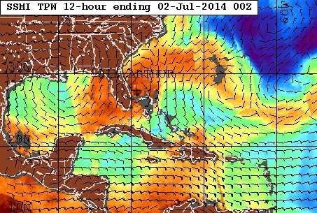
TPW valid 00 UTC July 2
JAX skew-T valid 12 UTC July 2
700-500 hPa average RH = 55%

Slide 12
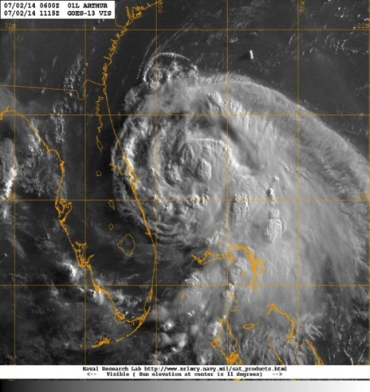
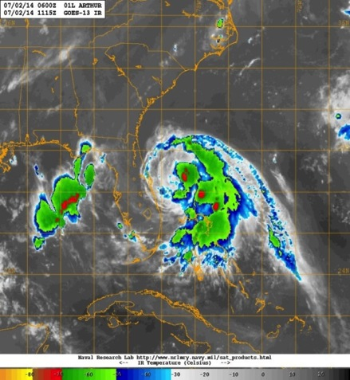
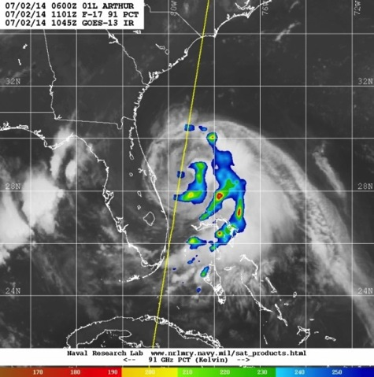
GOES Visible 1115 UTC
GOES IR 1115 UTC
SSMI/S 91 GHz 1101 UTC
A
B
A
A
C
B
B
C
C

Slide 13
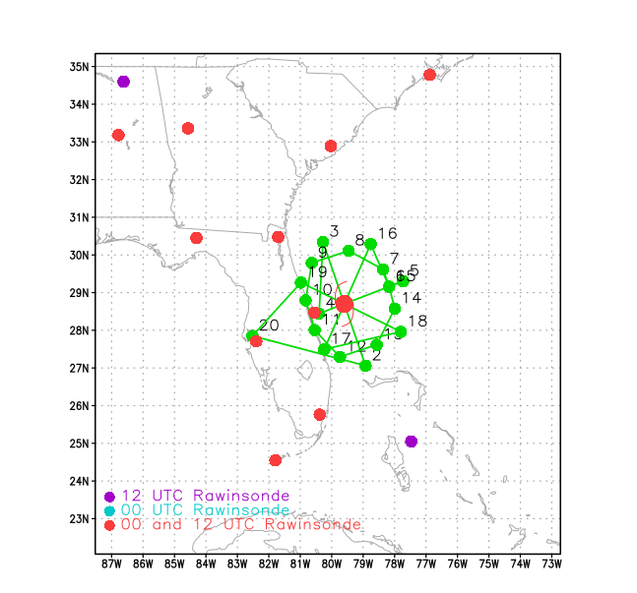
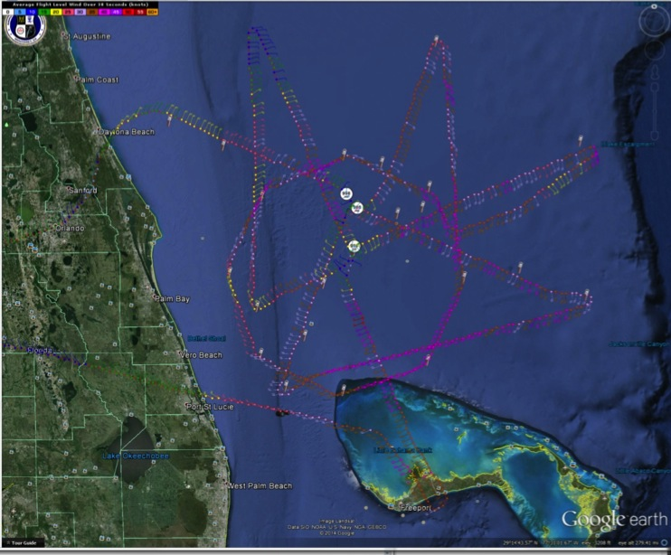
Proposed flight track
Actual flight track

Slide 14
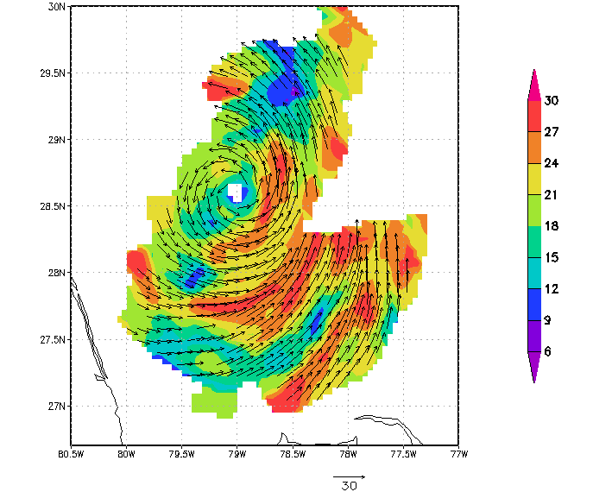
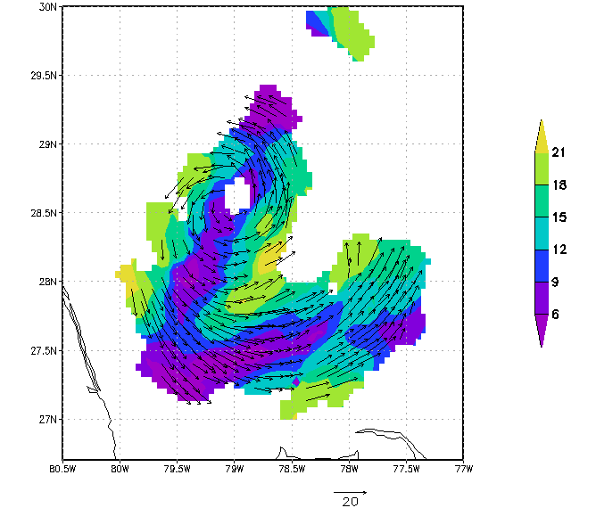
2-km reflectivity and winds at 1047 UTC
8-km reflectivity and winds at 1047 UTC

Slide 15
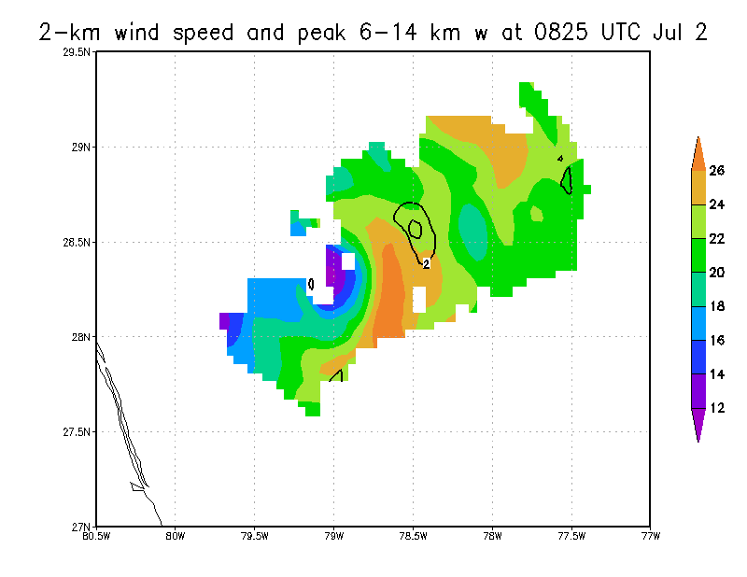
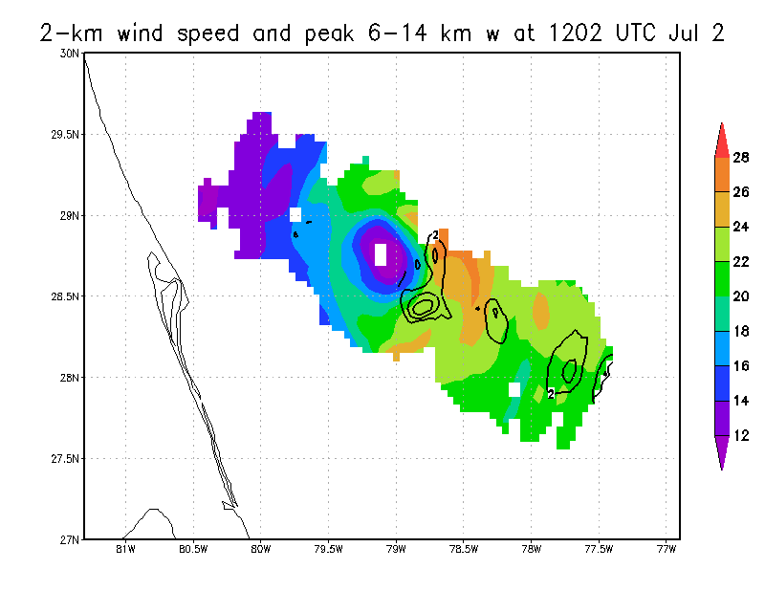
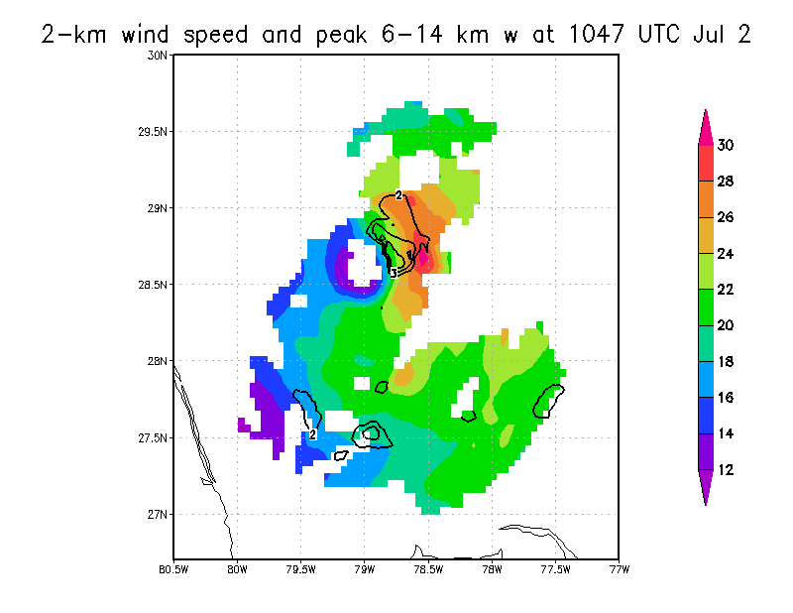
2-km wind speed and 6-14 km peak vertical velocity
0825 UTC
1202 UTC
A
1047 UTC
B
A

Slide 16
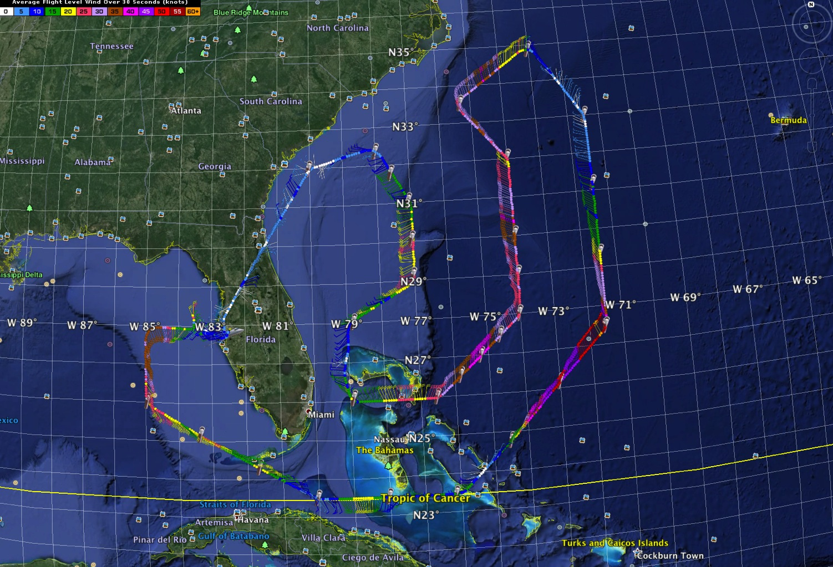
20140702N1
NHC Tasked

Slide 17
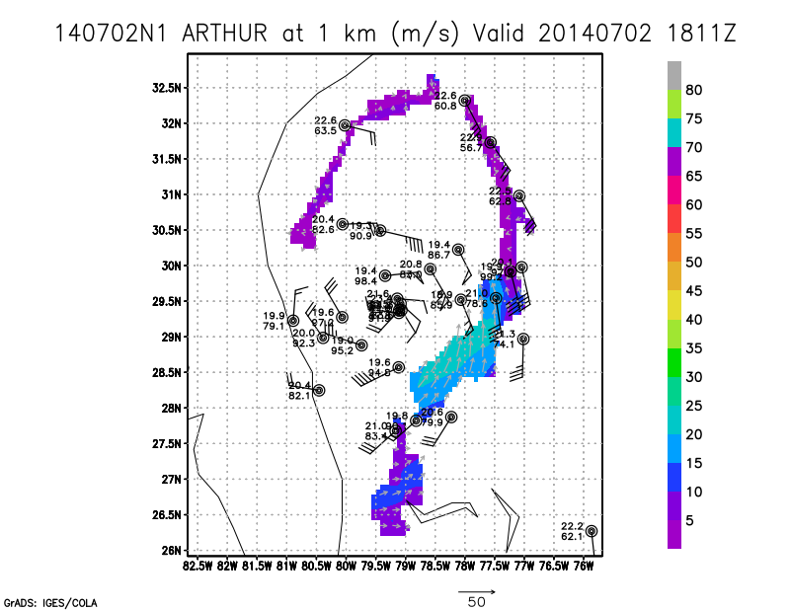
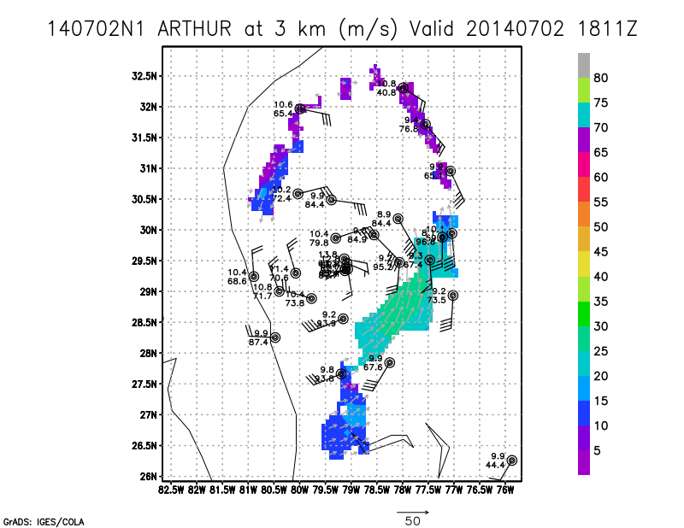
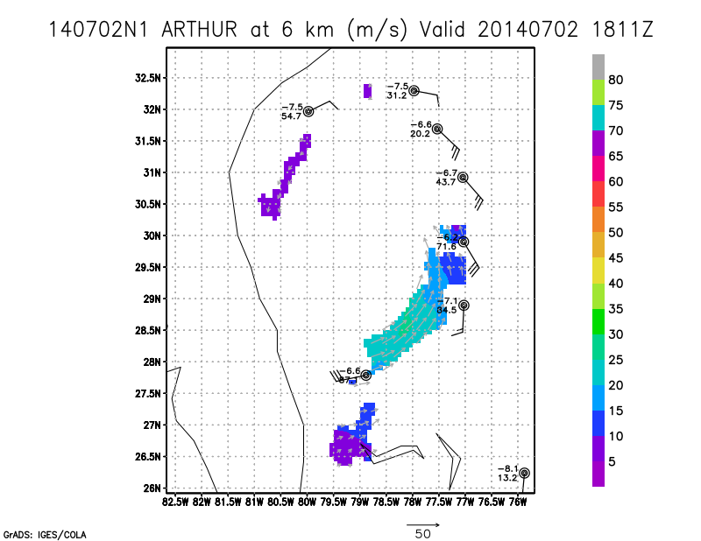
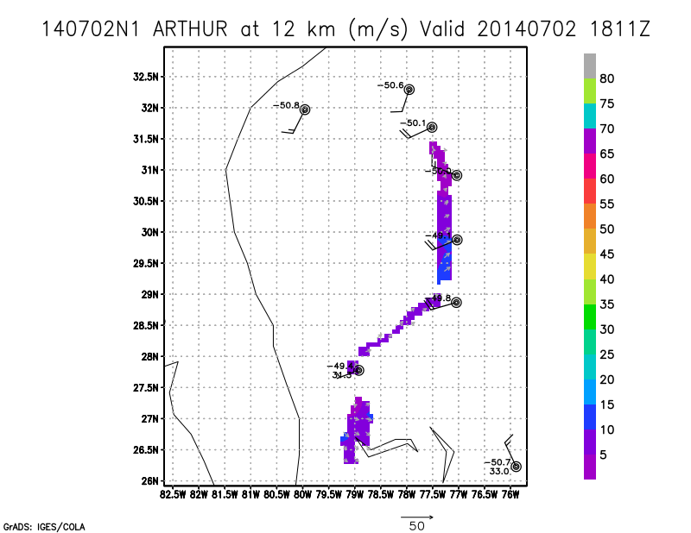

Slide 22
Flight 140703H1
Highlights:
Storm was upgraded from tropical storm to category 1 hurricane
Off the coast of Georgia and South Carolina heading N-NE at 7 knots
Forming eyewall and spiral bands with embedded deep convection
Vertically aligned vortex in 2-8 km
No major problems- communication, jobfile creation and data transmission all went smoothly

Slide 23
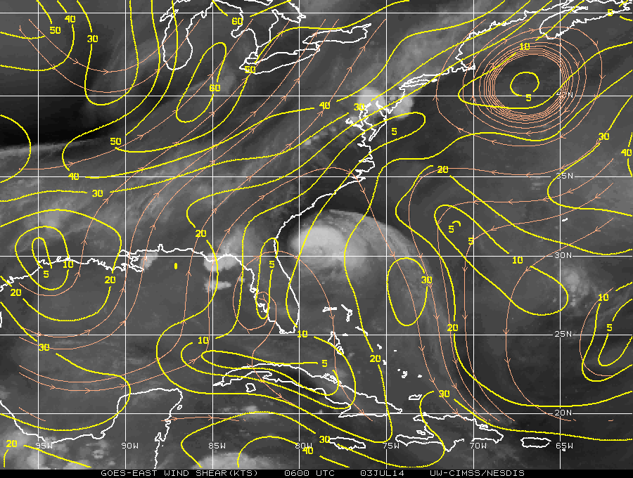
850-200 mb shear 06Z July 03

Slide 24
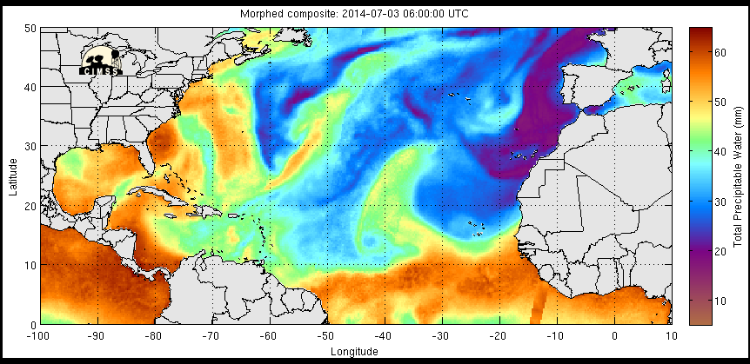
TPW valid 06Z July 03

Slide 25
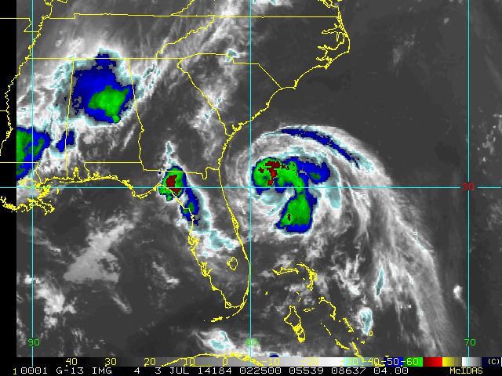
GOES IR 0200-0600Z July 03

Slide 26
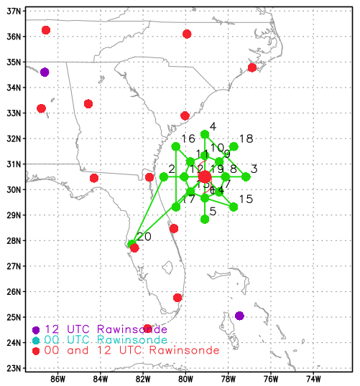
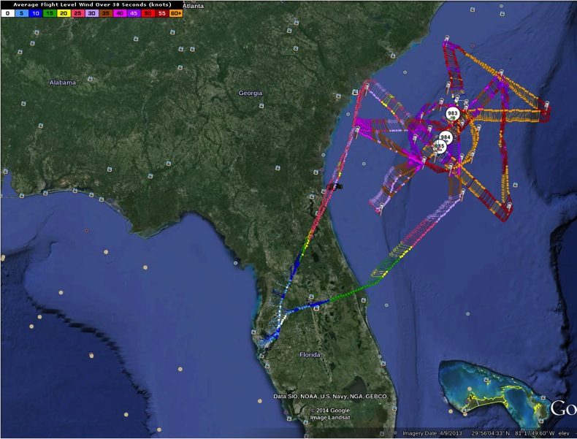
Planned vs. Actual Flight Track

Slide 27
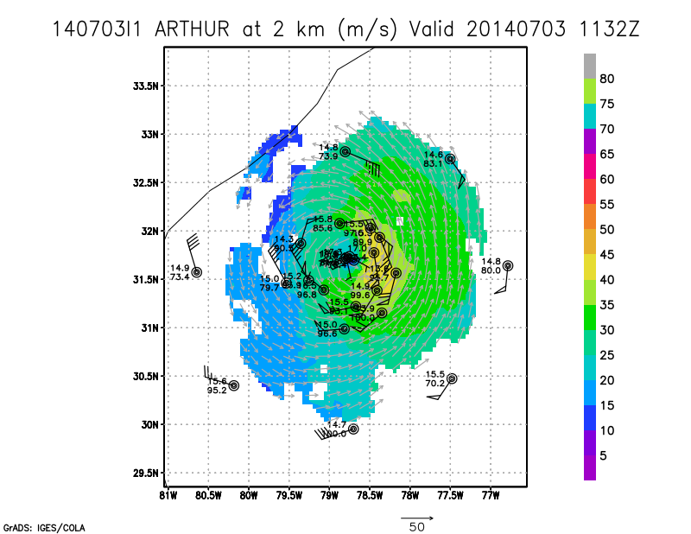
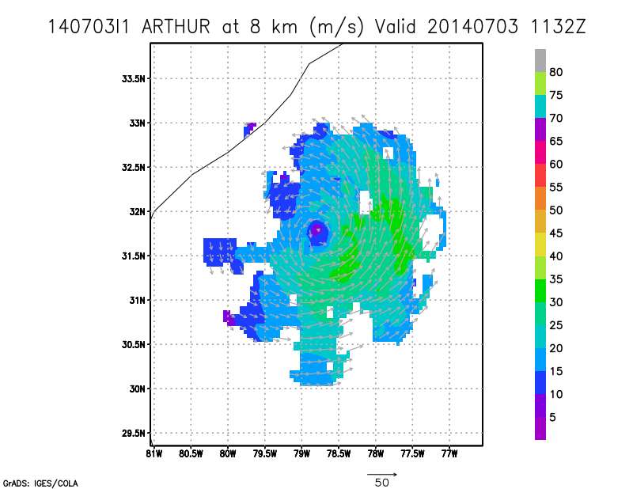
Radar Composites

Slide 28
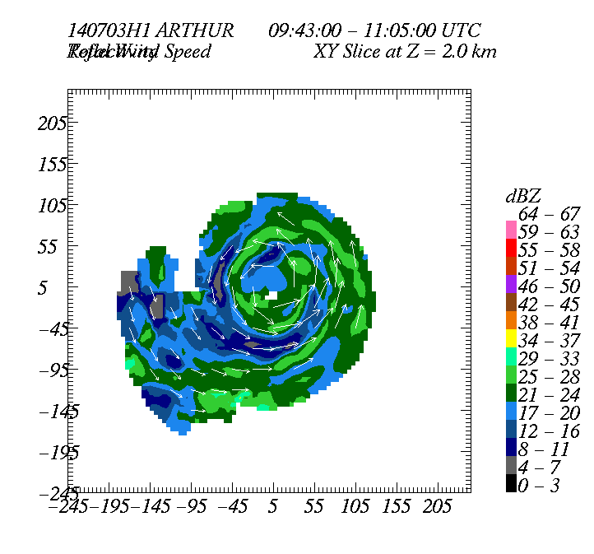
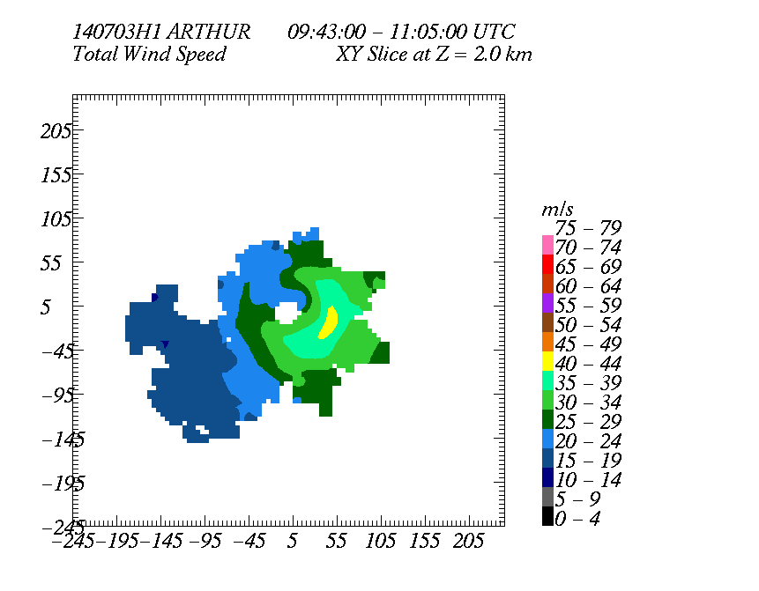
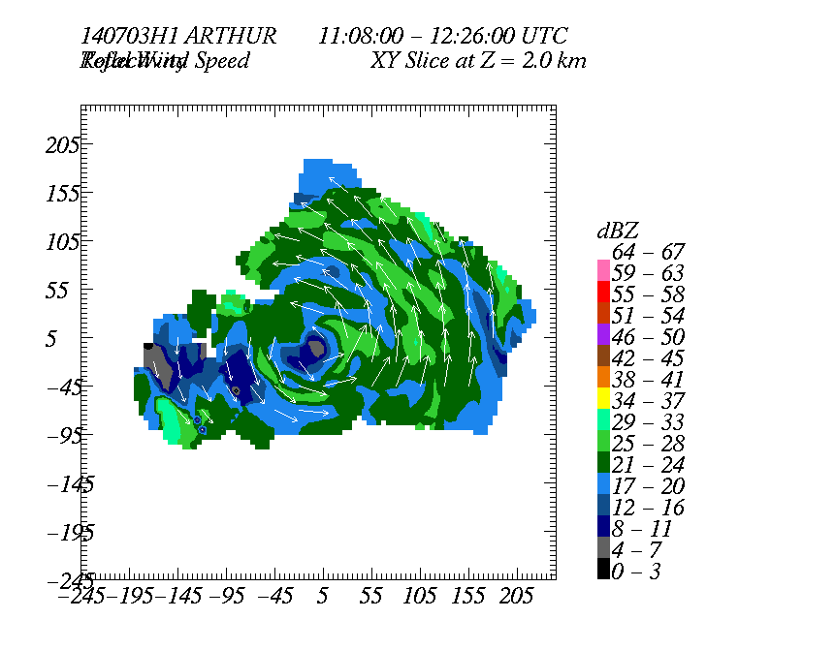
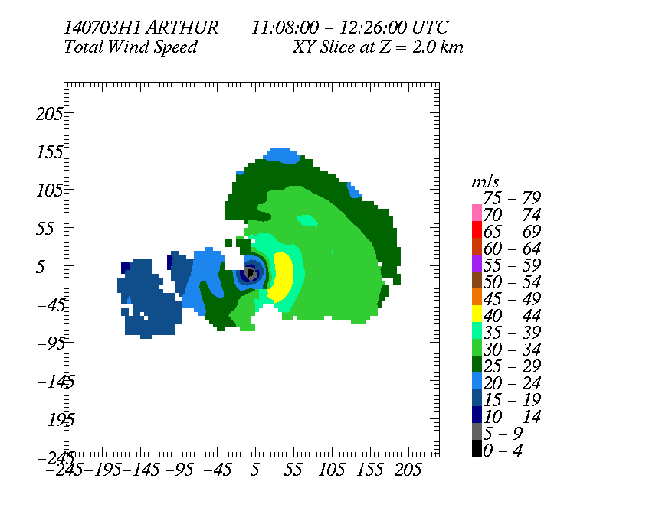
Circumnavigation
Cross section & downwind

Slide 29
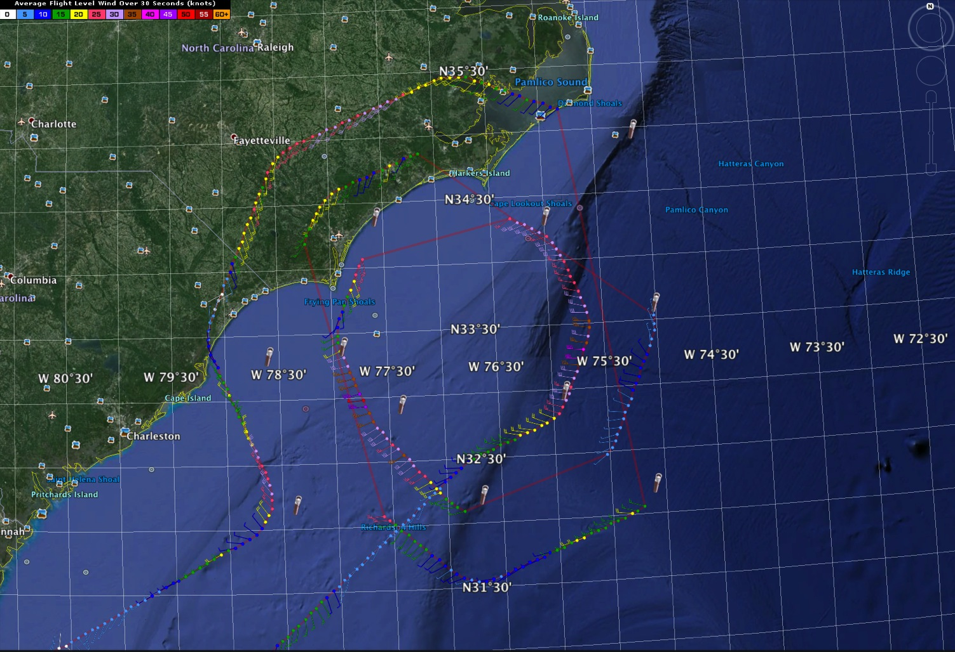
20140703N1
HRD Tasked

Slide 30
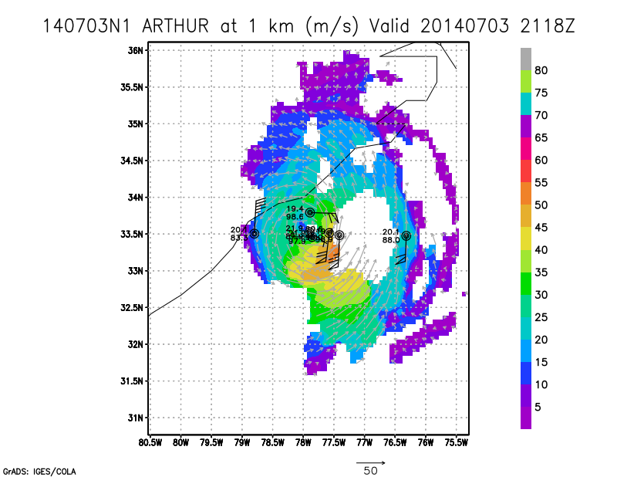
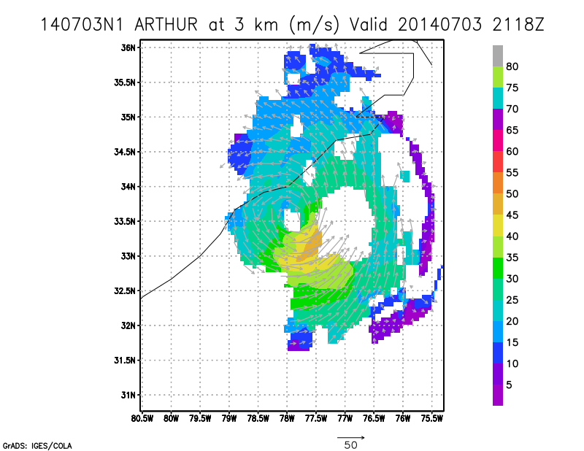
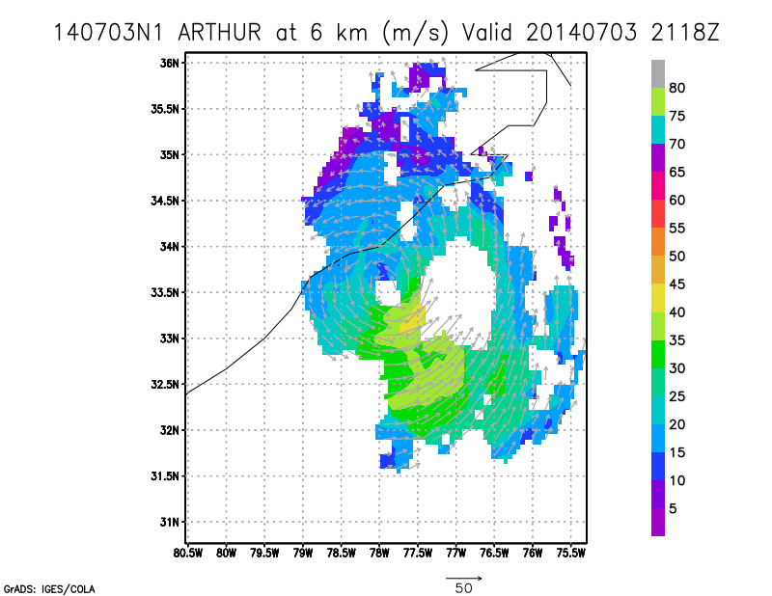
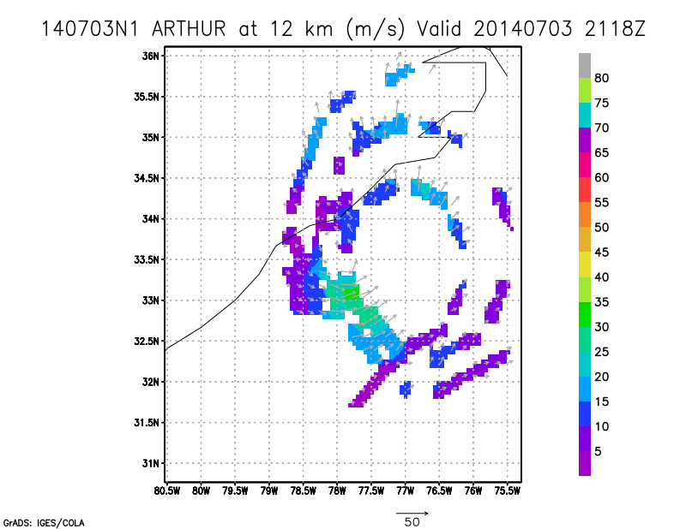

Slide 35
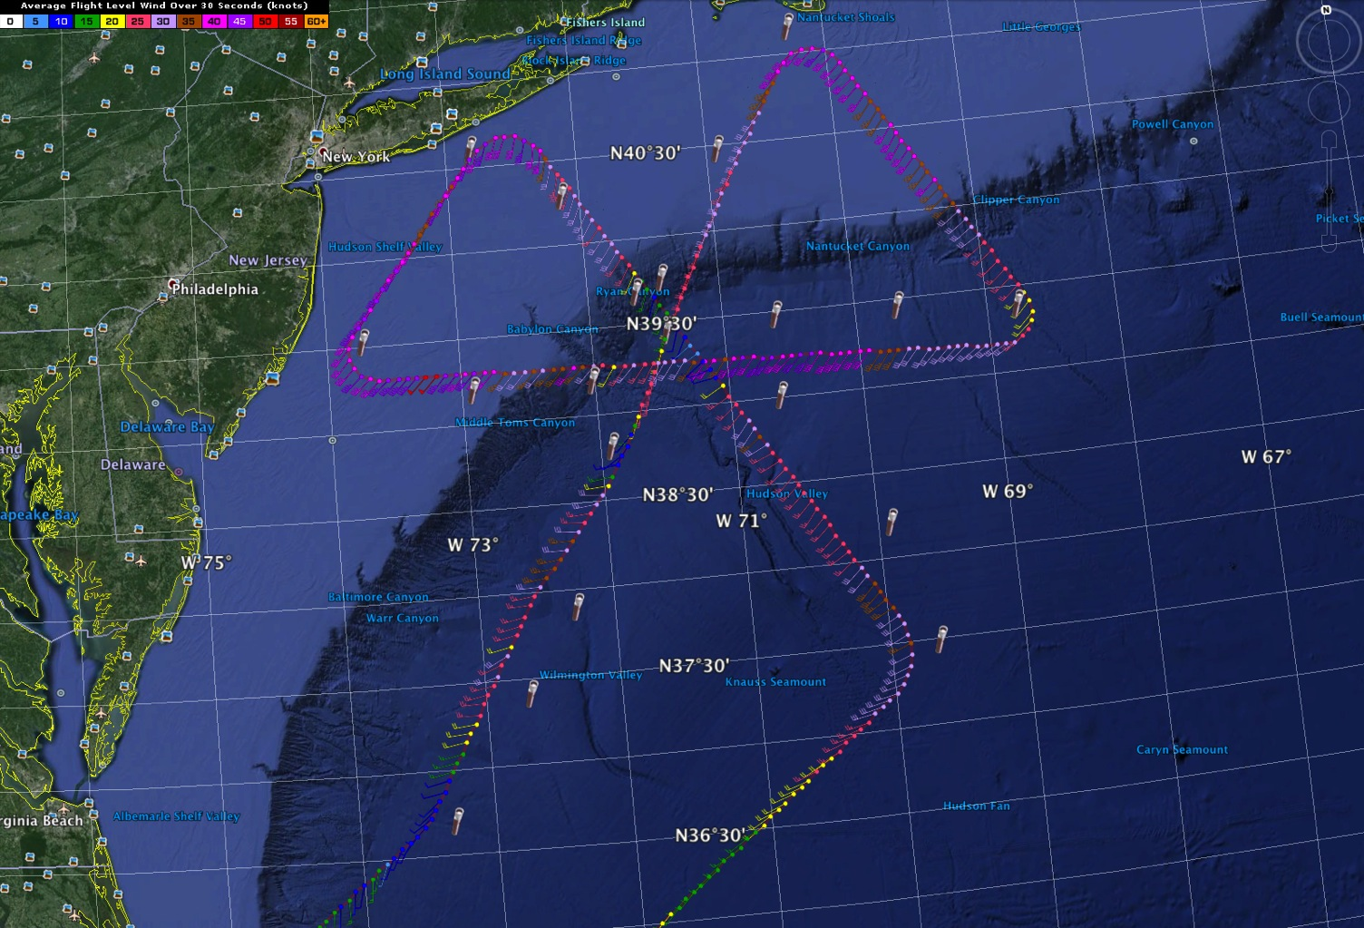
20140704N1
HRD Tasked

Slide 36
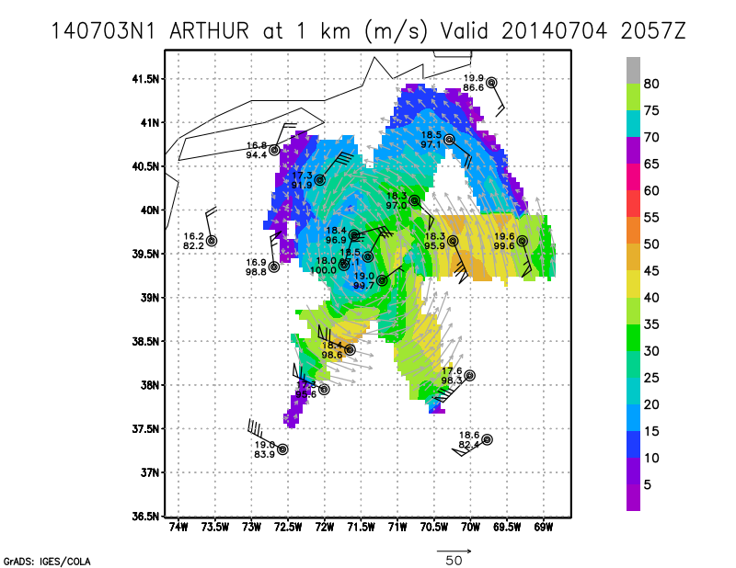
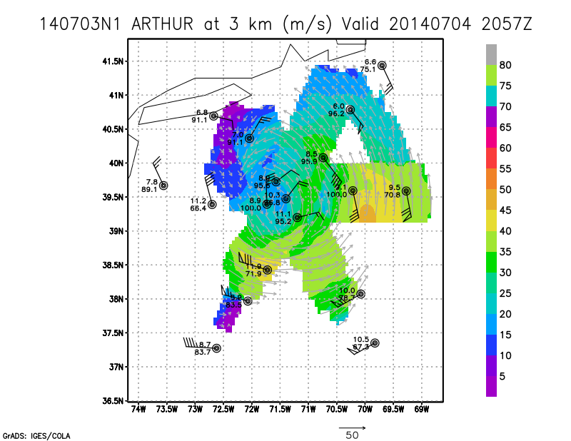
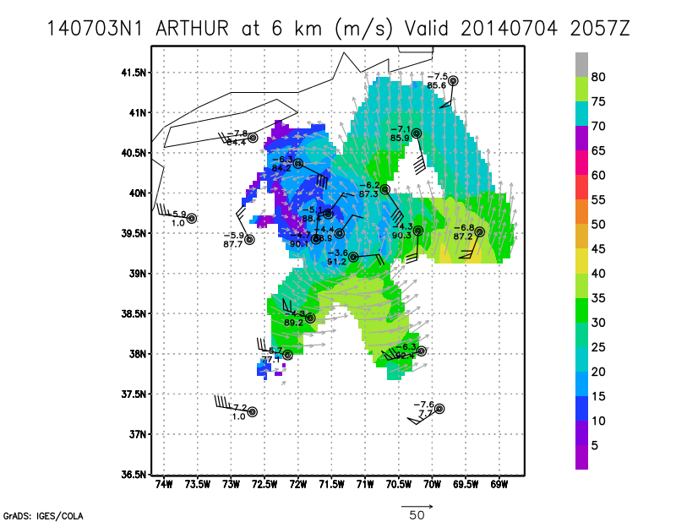
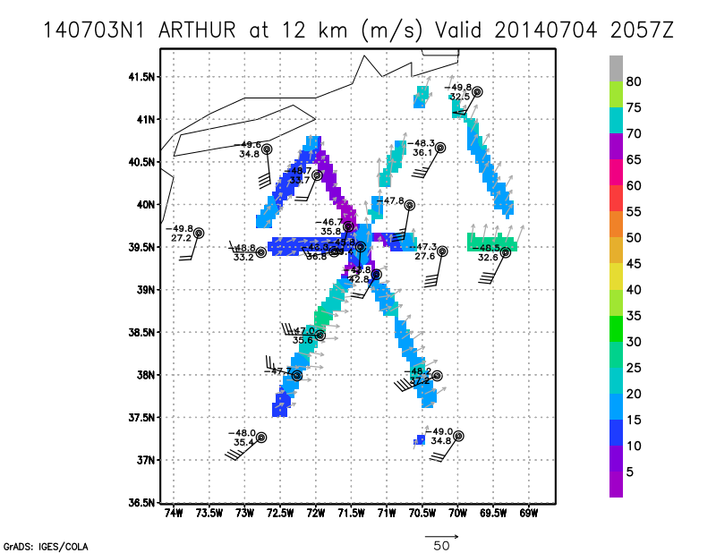

Slide 41
Hurricane Arthur G-IV flights

Slide 42
Method used to create
Doppler obs on G-IV
Gamache followed the flight with NASA tracker and approximated center from NHC or used fixes from any aircraft when possible (More necessary for concentric circle pattern)
Used Sonia Otero’s JobFile.app to generate job files for analysis/QC
Submitted through AOC’s portal
John Hill’s (AOC) software obtained new job files and Joe Greene (AOC) ran HRD Doppler analysis/QC with them
At end of process, Doppler radials (NCO), superobs (HRD and partners) and wind analyses now sent to ground using all AOC- or RSS-provided scripts
Sonia worked with John Hill, Joe Greene and Gabe Defeo (AOC) to troubleshoot script problems, so by the final flight all obs were sent to the ground including the first set in time for the 18 UTC HWRF ingest

Slide 43
Success with NCO obs
20140702H1—all obs eventually sent after delays—difficulty with permissions to obtain jobfiles—aft data were not being converted to product-raw format—data not ingested into 6 UTC HWRF
20140702I1– all data set—data ingested in 18 UTC run
20140702N1—data from a near-circle in NHC pattern from 18-1930 UTC finally sent around 00 UTC—no other data sent—not much to see outside of that circle
20140703H1—data from first pass made it into 6 UTC run—all data eventually made it to ground
20140703I1—delayed (A/C) and shortened (nose radar equipment burnout) pattern—delay meant no data in 18 UTC run—all data eventually sent
20140703N1—data sent; however, most data collected before 21 UTC and sent after 2115 UTC
20140704N1– nearly all data sent; however, most data collected before 21 UTC and second and third passes sent after 915 UTC
20140705N1—real-time analysis/QC was not done

Slide 44
General impressions
Usual, maybe a little more than usual, issues with getting up to speed for the season and addressing bugs in software changes
When all issues are addressed, running software on the aircraft will be more stress-free than in previous years. Job-file submission from the ground work
At the time of the end of the last flight, there were still some issues with creating job files on the aircraft and running them—also had an issue of a hanging file that was preventing transmission of last data on 140704N1

Slide 45
New Airborne Sciences Tracker
http://mts-tracker-v1.0.6.s3.amazonaws.com/tracker.html
Provided by Aaron Duley (NASA Ames Research Center)

Slide 46
Issues – Mission Related
Jobfile creation on ground worked great, but significant problems with receiving and sending files on aircraft (AOC software)
Tail radar product RAW files not created properly on 140702H1
Delayed take-offs required last-minute pattern modification
Mission abort during 140703I1, after initial figure-4
N43 challenges executing circumnavigation pattern as planned
N49 did not use updated center position for circumnavigation
Decision not to fly 2AM mission on 4 July

Slide 47
Issues - Misc
GOV accident in parking garage – make sure we are all aware of proper procedure for reporting accidents
Strict HRD-AOC-POC communication not followed
Air sickness etiquette
AOC and HRD expectations for students
Non-Feds need to show ID to get tax-exempt
GOV should be parked in hotel valet lot
FNs need to have documents on person when at MacDill

