Slide 1
Why do model tropical cyclones intensify more rapidly at low latitudes?
Roger K. Smith . . . . LMU Munich
Michael Montgomery . . . NPS Monterey
Gerard Kilroy . . . . LMU Munich

Slide 2
Today’s talk
To appear in the Journal of the Atmospheric Sciences, 2014
Available at: http://www.meteo.physik.uni-muenchen.de/~roger/Roger/Rks_pubs.html/M9A

Slide 3
Why is the problem of interest?
If the more rapid intensification at low latitudes happens in reality, it would have implications for forecasting.
The problem is of intrinsic scientific interest. An answer to it would contribute to our understanding of tropical cyclone intensification in general.
Our answer to this seemingly simple question touches on practically all facets of the dynamics and thermodynamics of tropical cyclones.
The answer invokes the conventional spin up mechanism as articulated in classical and recent work.
In particular, it invokes a boundary layer feedback mechanism linking the strength of the boundary layer inflow to that of the diabatic forcing of the meridional overturning circulation.

Slide 4
Revised view : two spin-up mechanisms
15
10
z km
5
M conserved
0
50
r km
100
M reduced by friction, but
strong convergence  small r  large v

Slide 5
Previous studies: see Smith et al. (2014)
Previous numerical studies
DeMaria and Pickle, MWR, 1988
Bister, JAS, 2001
Smith et al., QJRMS, 2011
Rappin et al., JAS, 2011
Li et al., TCRR, 2012
Theories
Ooyama, JAS, 1964
Carrier, JFM, 1971
Emanuel, Ann. Rev. Earth Planet. Sci., 2003
See Smith et al. (2014) for an appraisal of all these studies.

Slide 6
Thought experiment for tropical cyclone intensification
Initial condition
Mean sounding
Modest strength
(V_{max} = 15 m s⁻¹) axisymmetric dry vortex
T(z)
q(z)
V(r,z)
r
p_{s}
27ºC
sea
Inner domain size (500 km × 500 km), grid size (5 km)

Slide 7
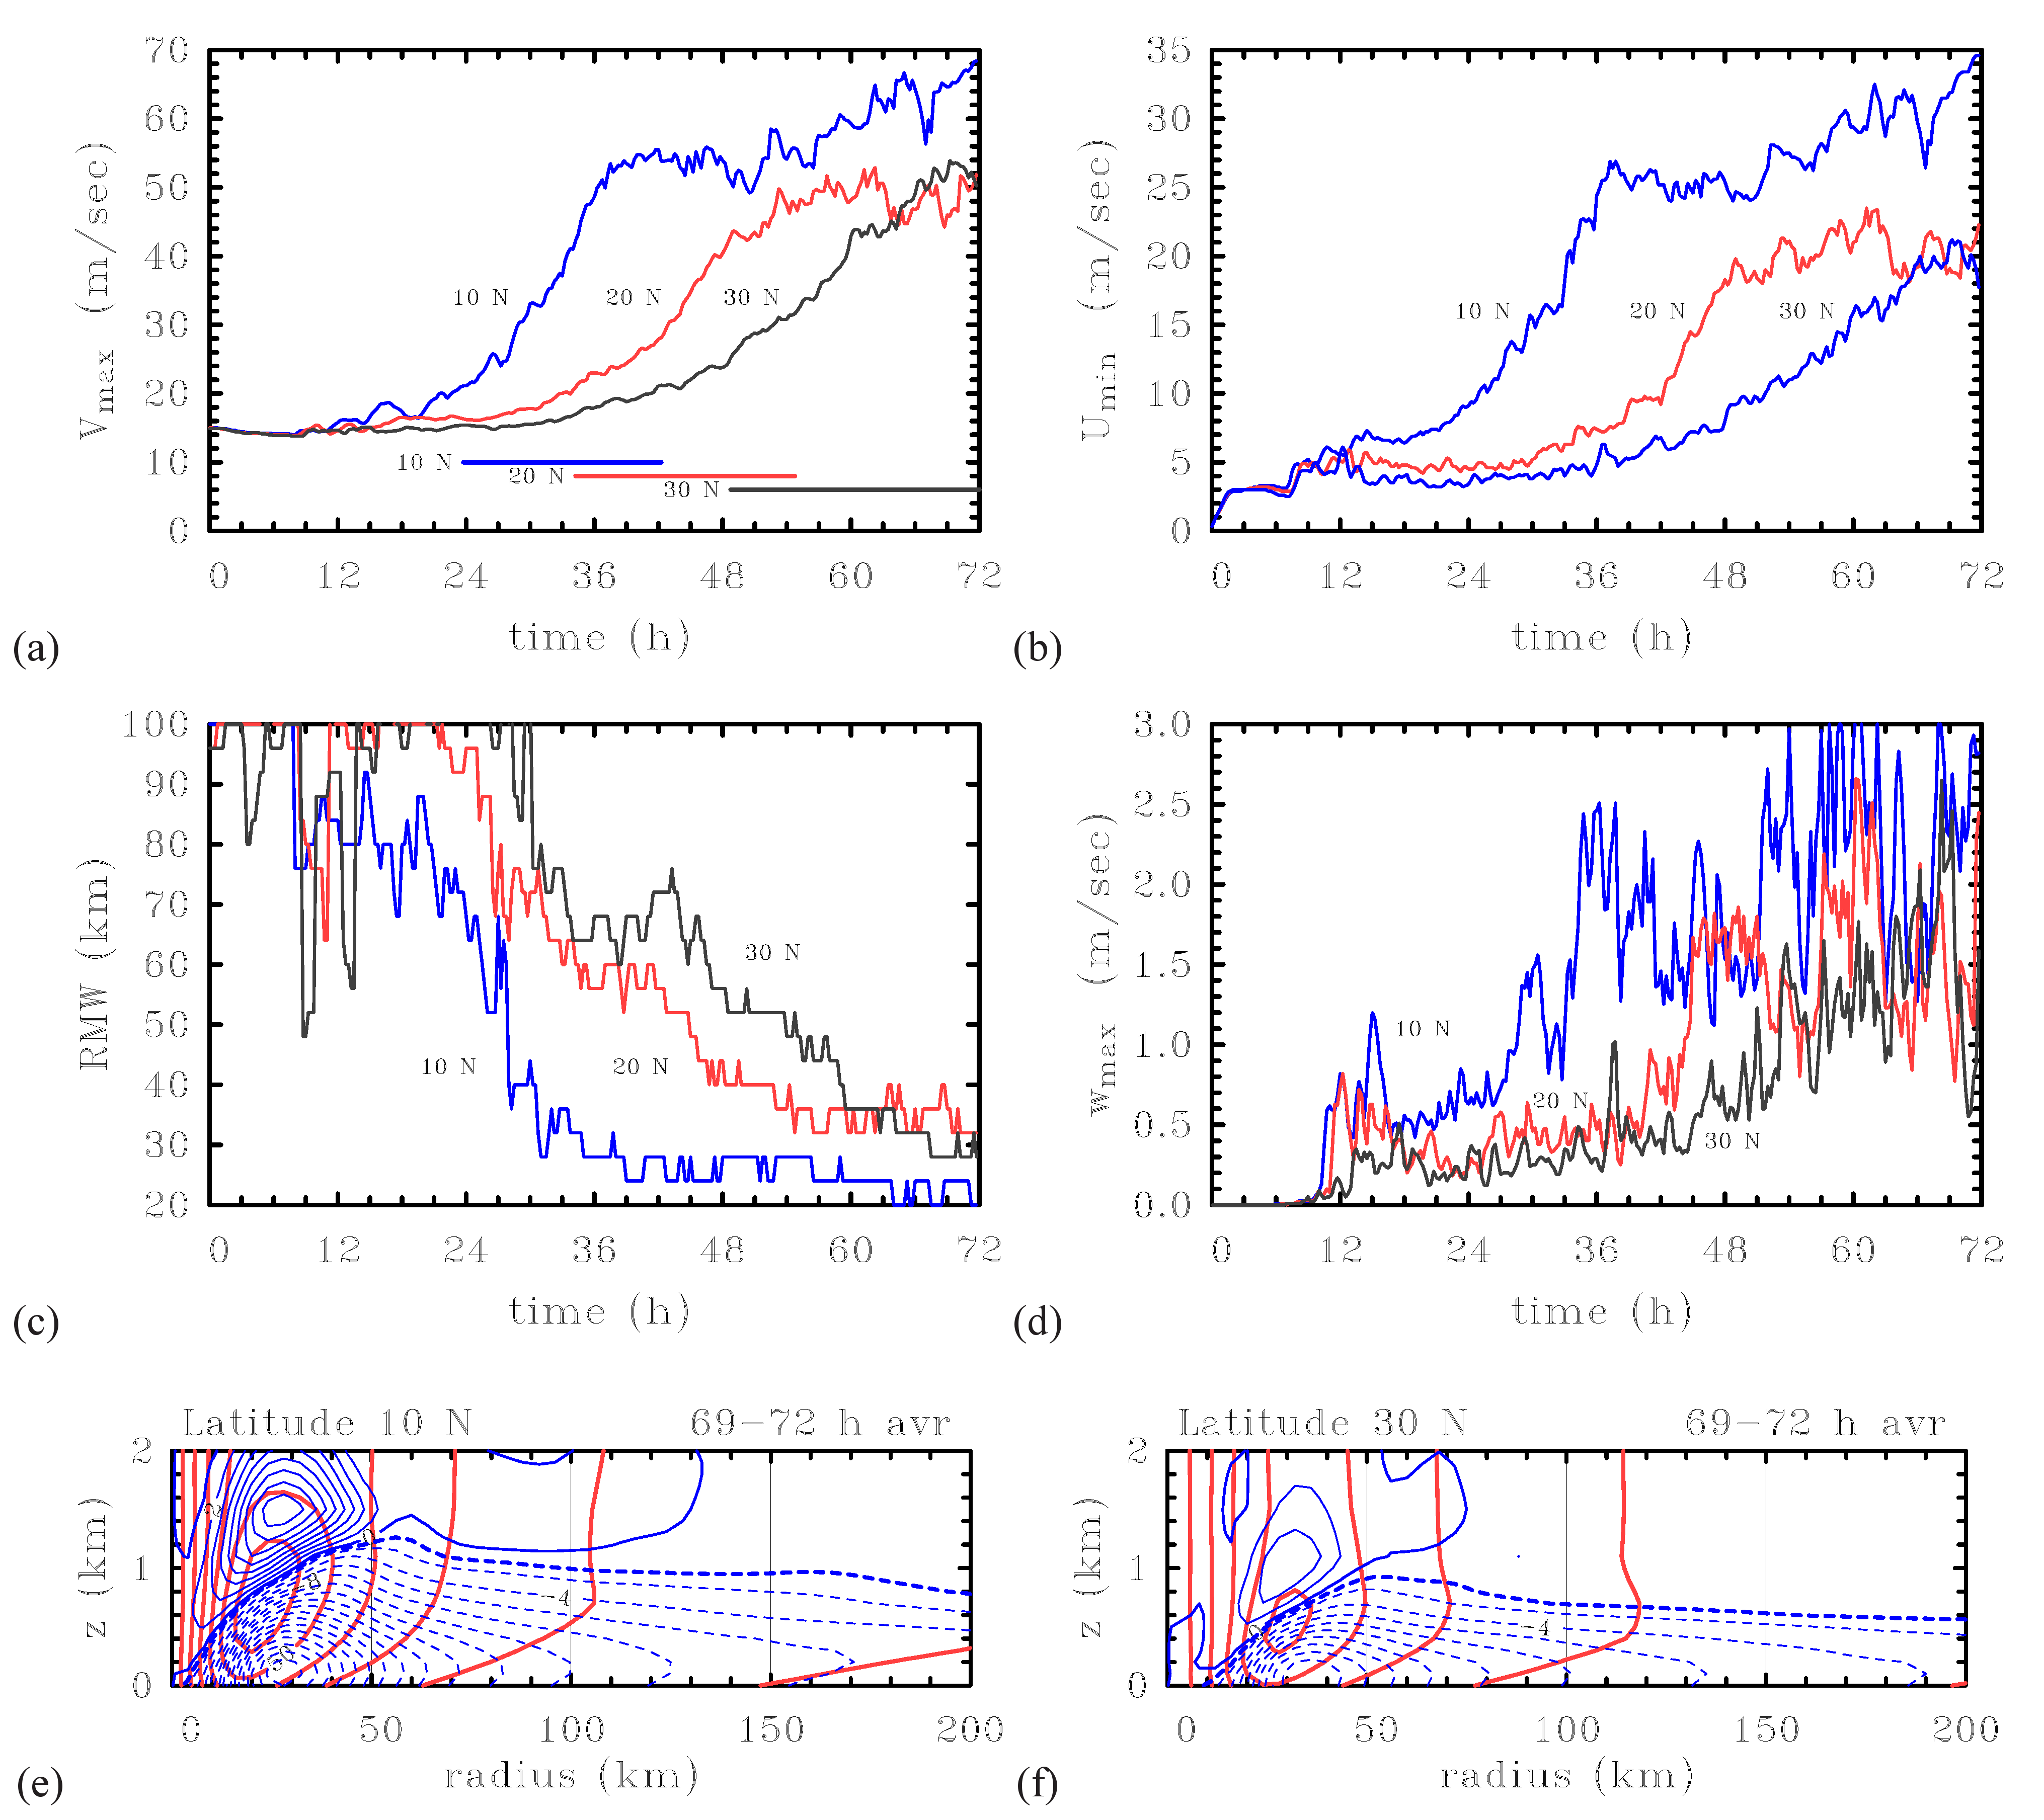

Slide 8
10
10

Slide 9
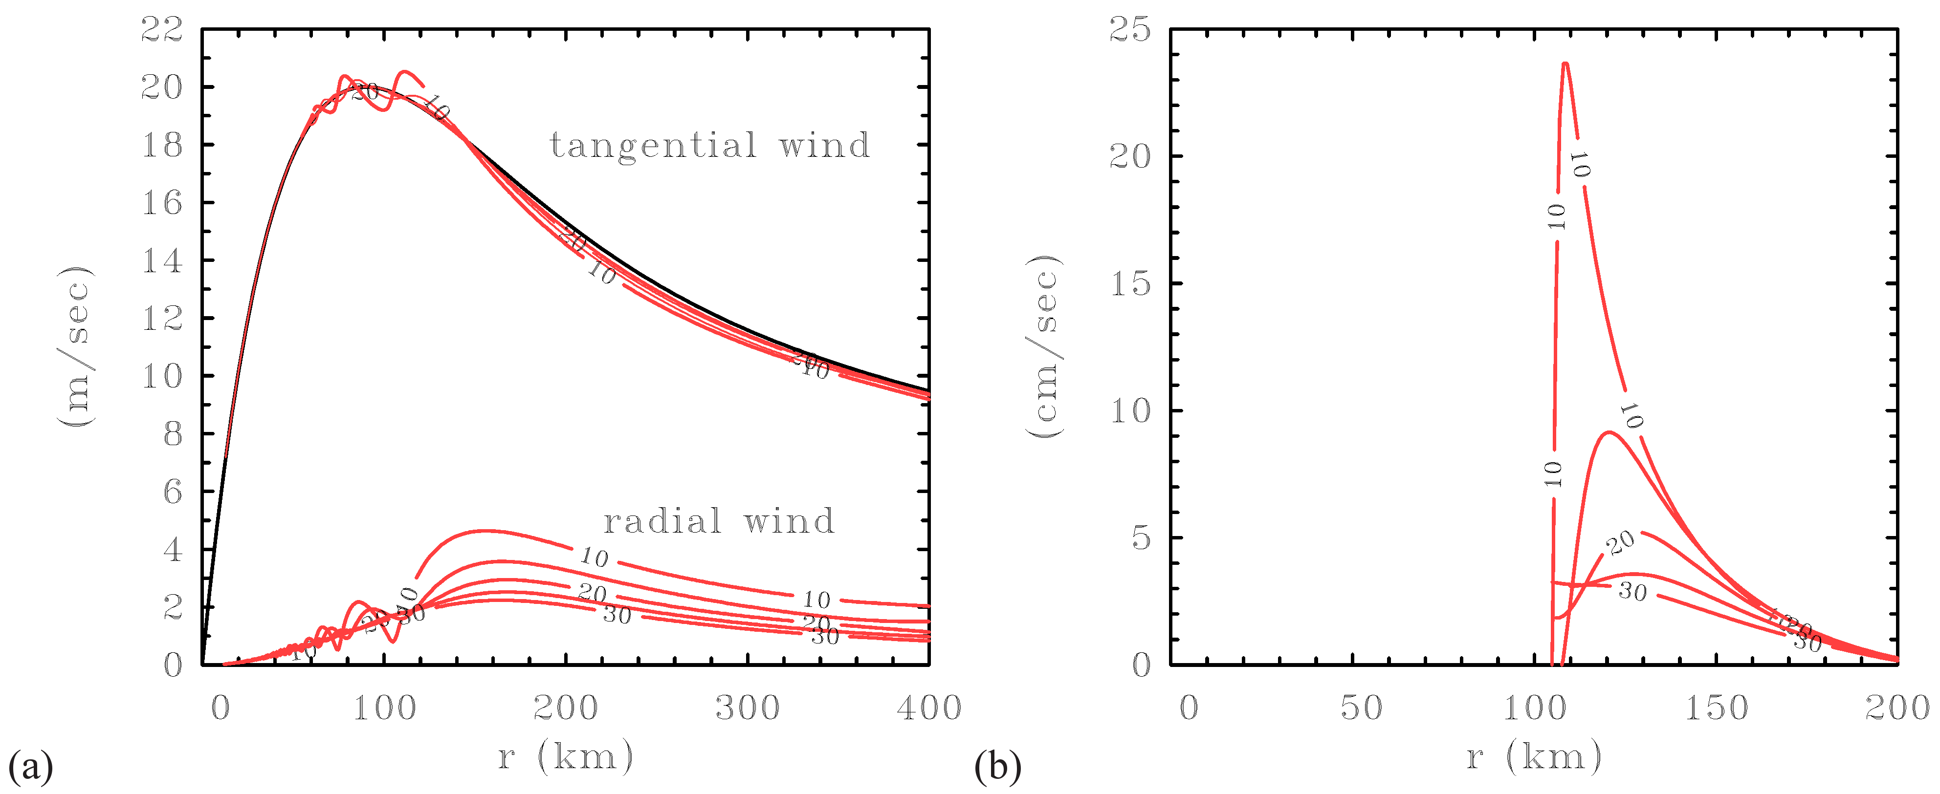
A steady, axisymmetric, nonlinear, slab boundary-layer model
Tangential wind profile fixed
v(r)
w_{topBL}(r)
v_{g}(r)
u(r)
Could these results be relevant to answering our question?

Slide 10
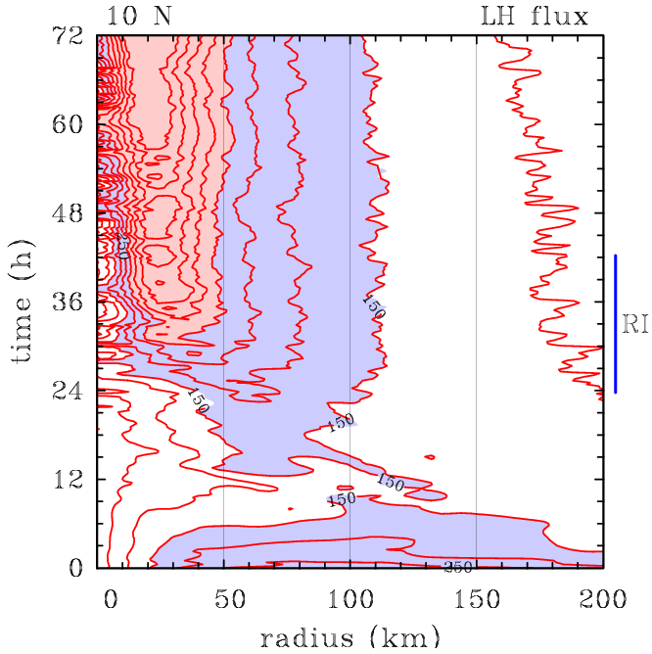
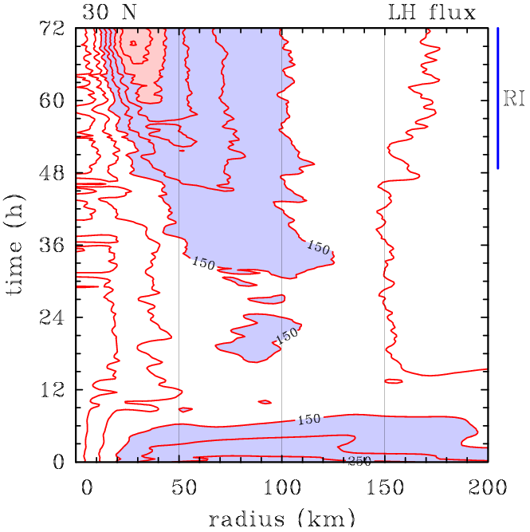
Comparison of surface fluxes in MM5 simulations (Units W m⁻²)
≥ 300 W m⁻²

Slide 11
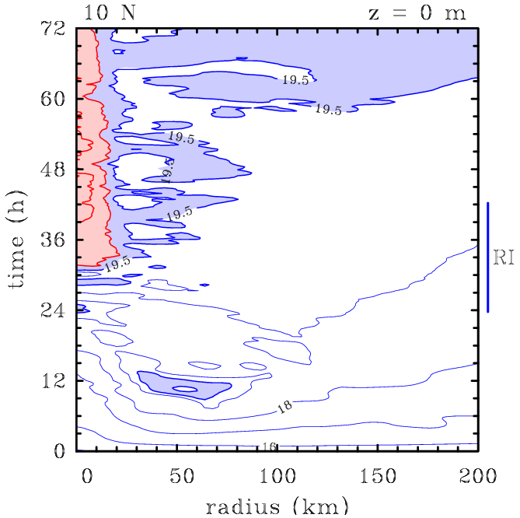
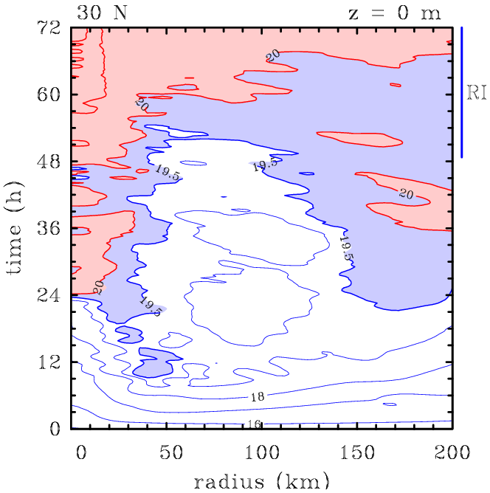
Comparison of surface specific humidity (Units W m⁻²)

Slide 12
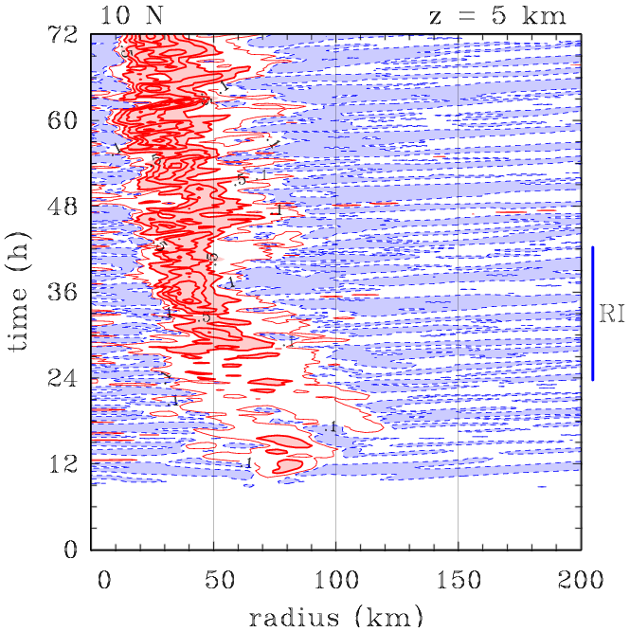
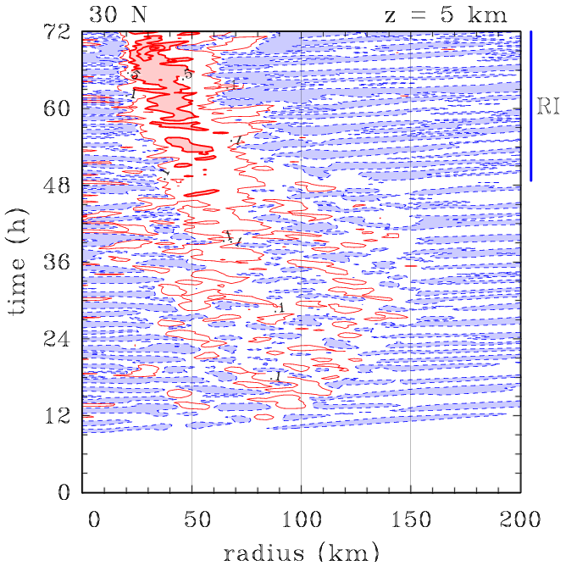
Comparison of azimuthally-averaged vertical velocity at z = 5 km (Units m s⁻²)
Contour interval (red) 0.5 m s⁻¹ , (blue) 0.01 m s⁻¹

Slide 13
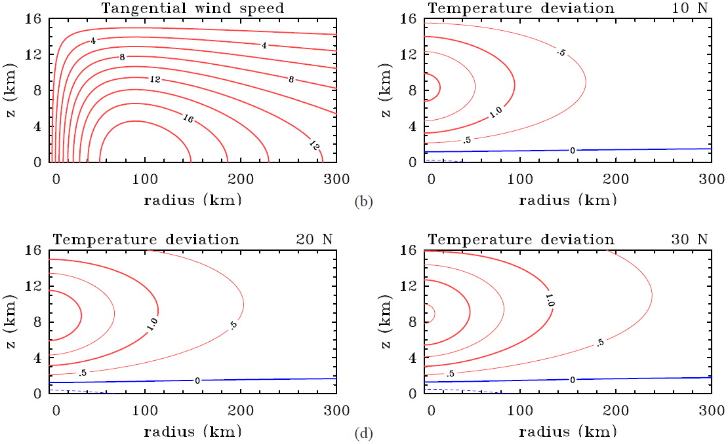
Idealized calculation to examine the balanced temperature field
Initial vortex

Slide 14
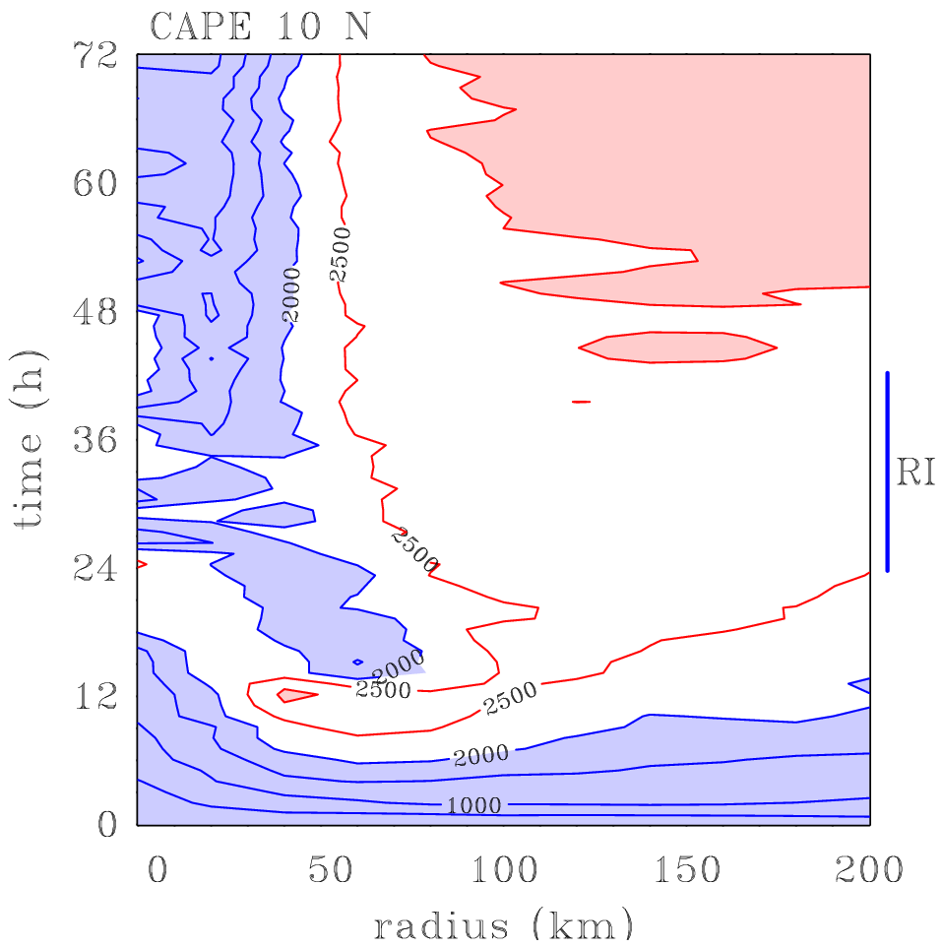
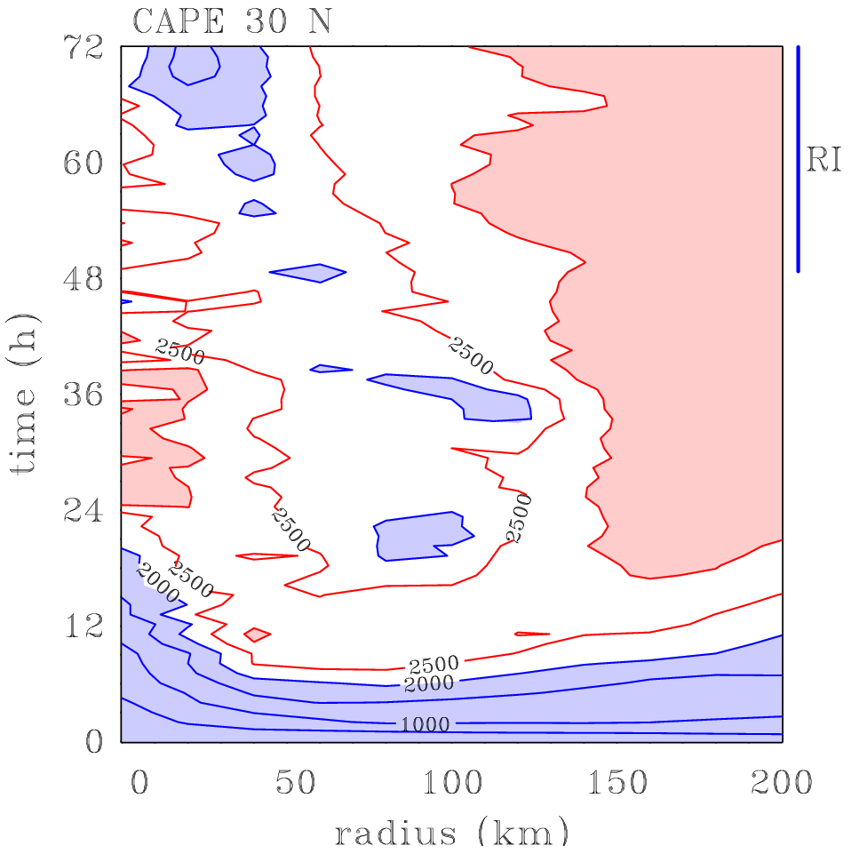
Comparison of azimuthally averaged CAPE (Units J kg⁻¹)
≥ 3000 J kg⁻¹
≥ 3000 J kg⁻¹

Slide 15
Difference in CAPE
Difference in local w_{max}
≥ 0 J kg⁻¹
500 J kg⁻¹
≤ -500 J kg⁻¹
≥ 0 J kg⁻¹
Notes:
Contour interval 500 J kg-1. Values 500 J kg-1 are shaded light blue; positive values are shaded pink.

Slide 16
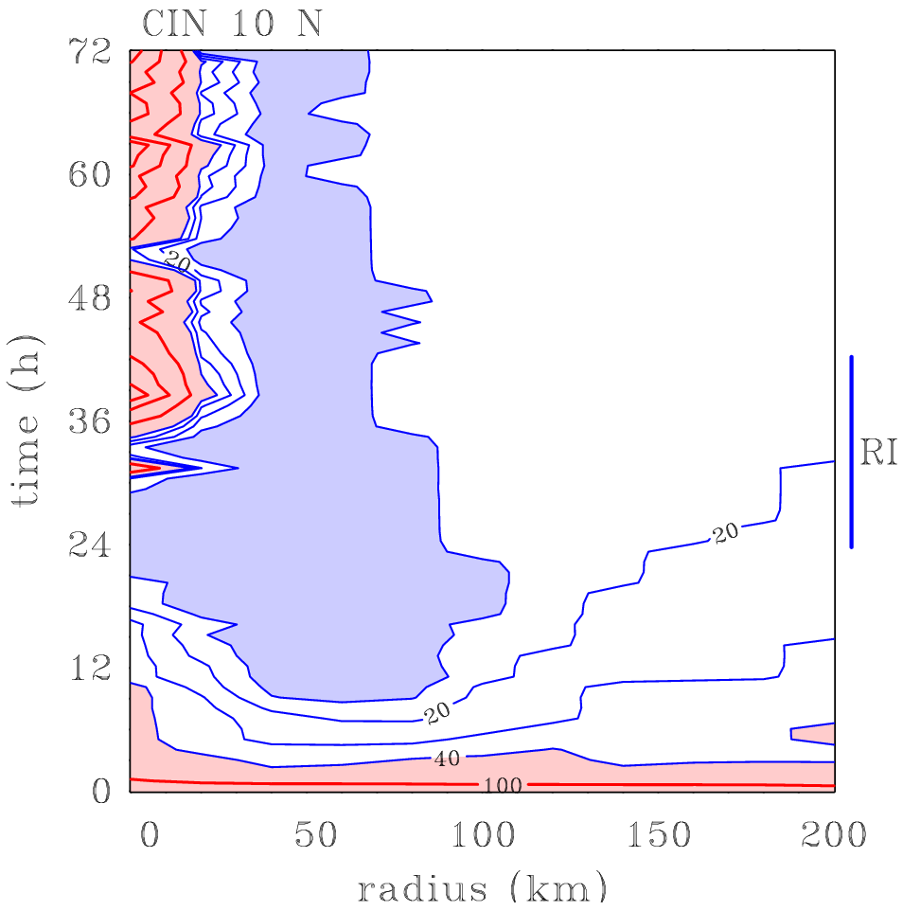
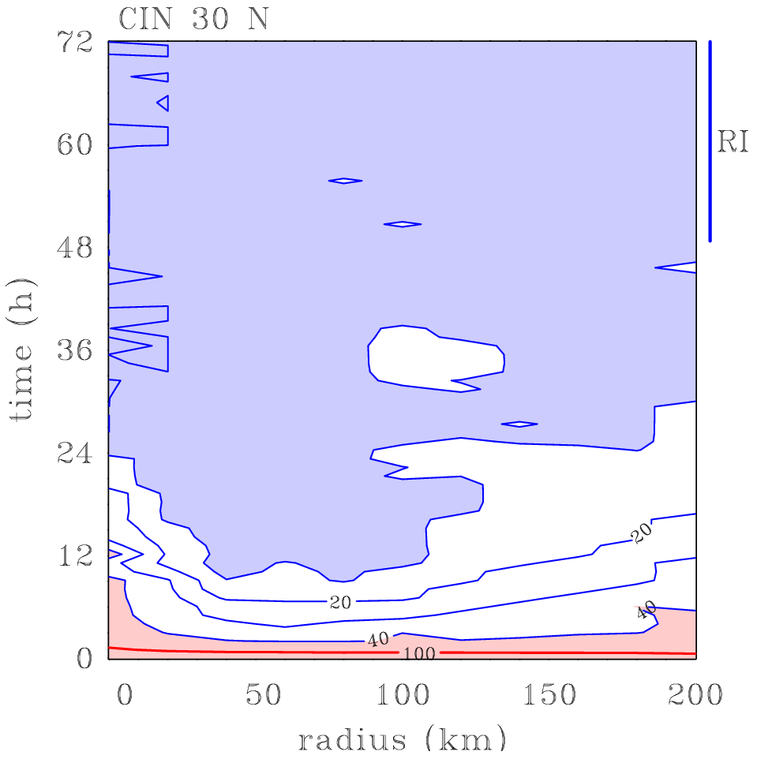
Comparison of azimuthally averaged CIN in MM5
(Units J kg⁻¹)
≤ 10 J kg⁻¹
≤ 10 J kg⁻¹

Slide 17
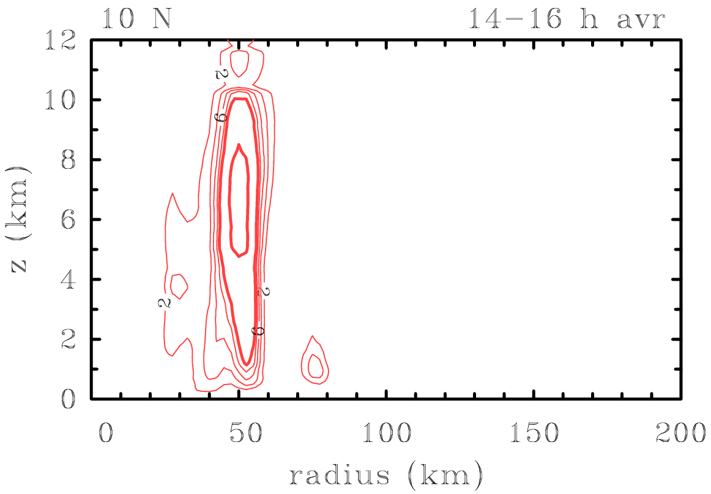
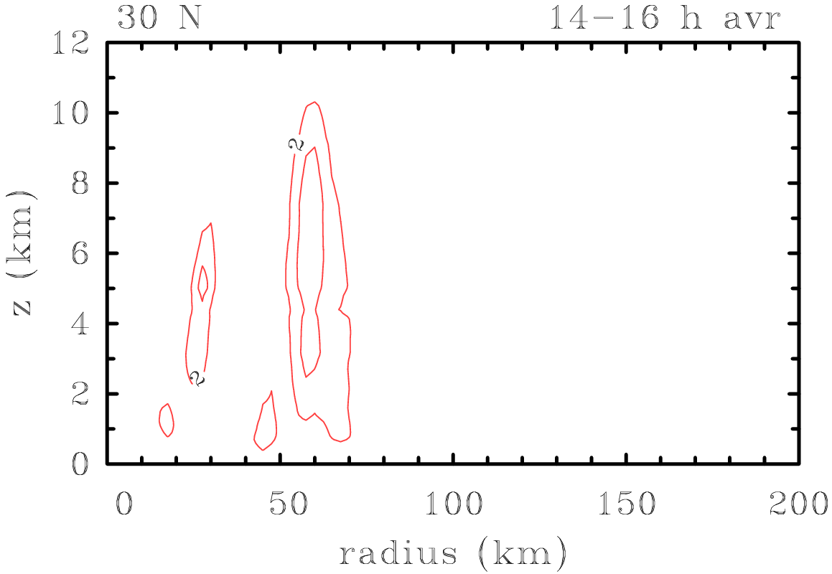
Comparison of azimuthally-averaged diabatic heating rate (Units K h⁻¹)
Max 26 K h⁻¹
Max 6 K h⁻¹

Slide 18
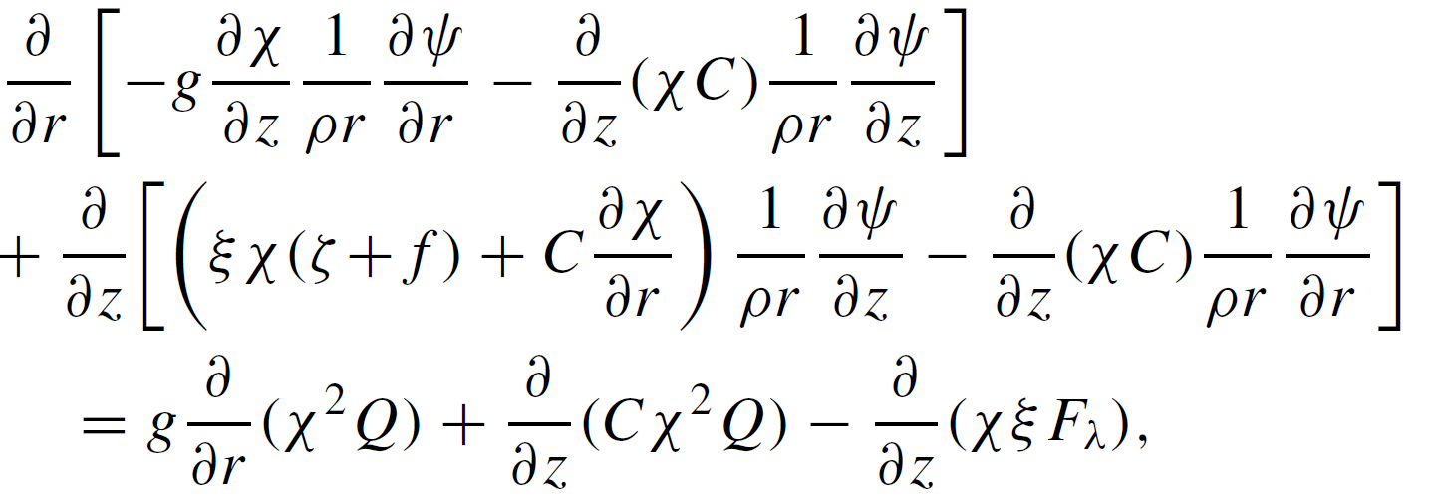
The Sawyer-Eliassen equation
Continuity equation
Streamfunction: ψ

Slide 19
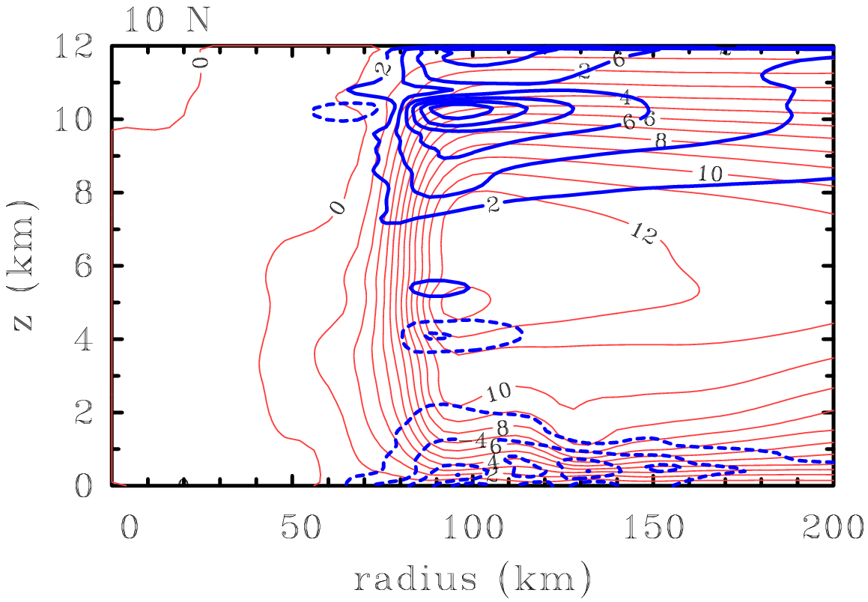
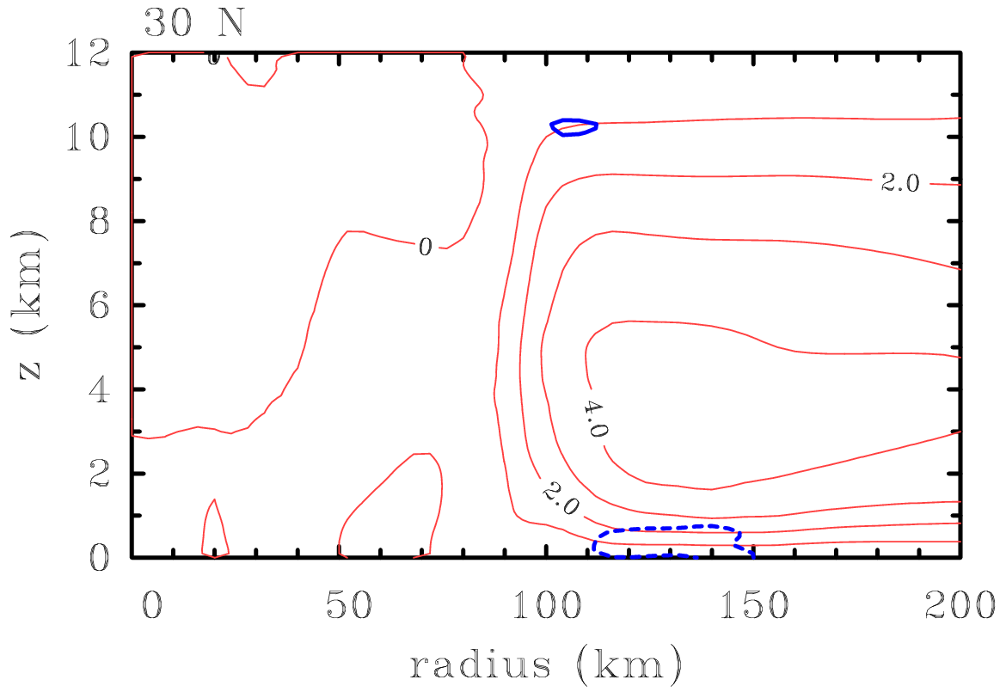
Consequences of diabatic heating rate differences: Idealized solutions of the Sawyer-Eliassen equation for ψ
(Units for u: m s⁻¹)
u > 0
u > 0
ψ
ψ
u < 0
u < 0
Max inflow 8.1 m s⁻¹
Max inflow 2.5 m s⁻¹

Slide 20
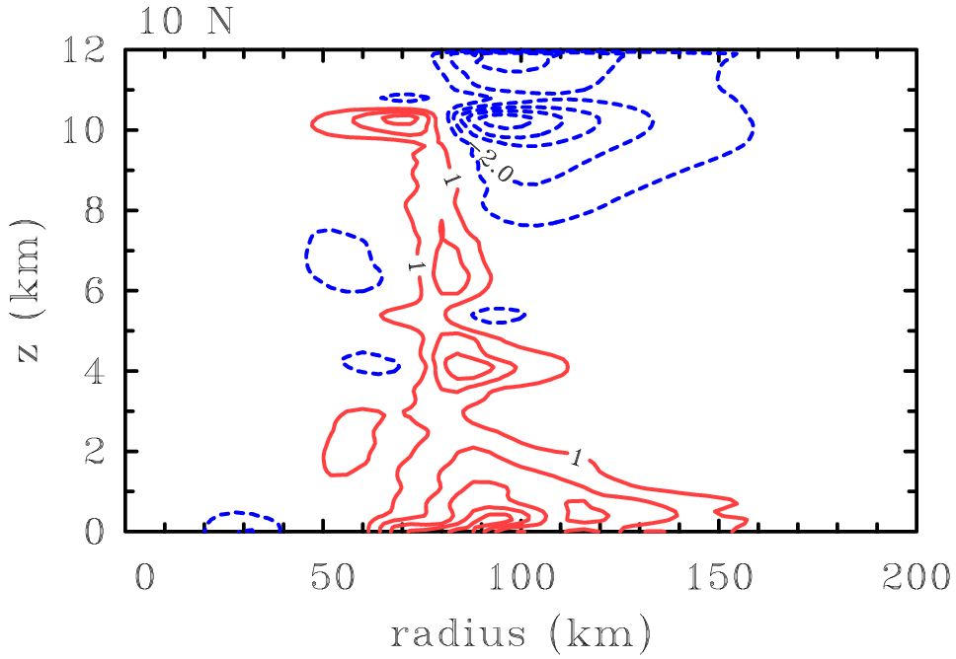
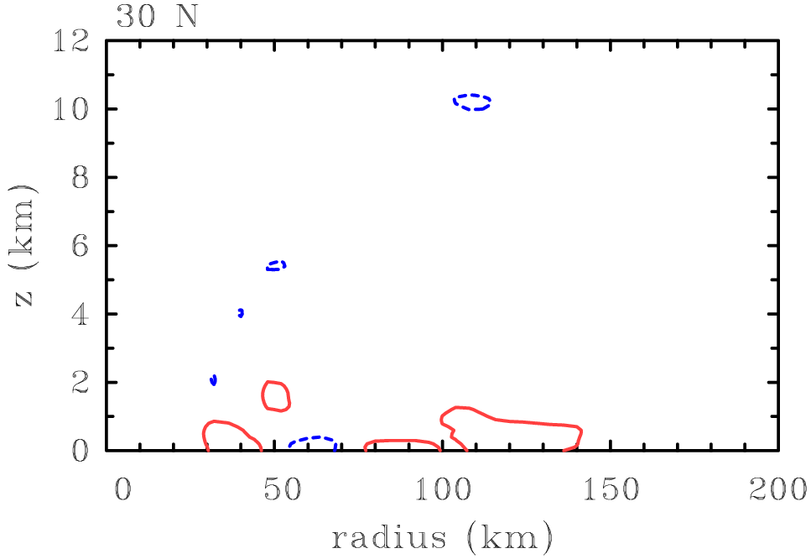
Comparison of balanced tangential wind tendencies
(Units m s⁻¹ h⁻¹)
$$\frac{∂v}{∂t}$$
$$\frac{∂v}{∂t}$$
Max dv/dt 5.6 m s⁻¹ h⁻¹
Max dvdt 1.2 m s⁻¹ h⁻¹

Slide 21
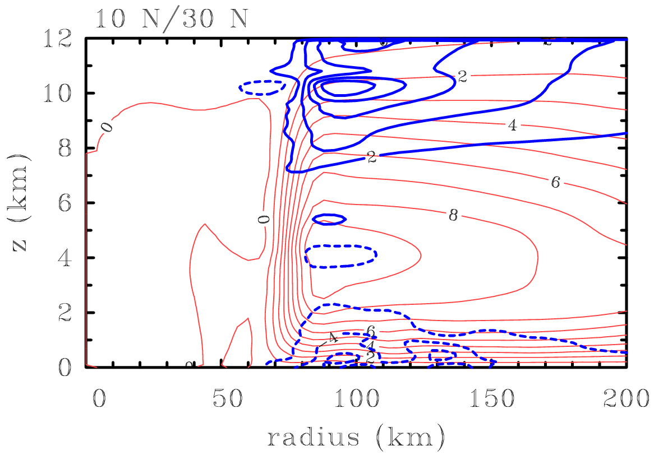
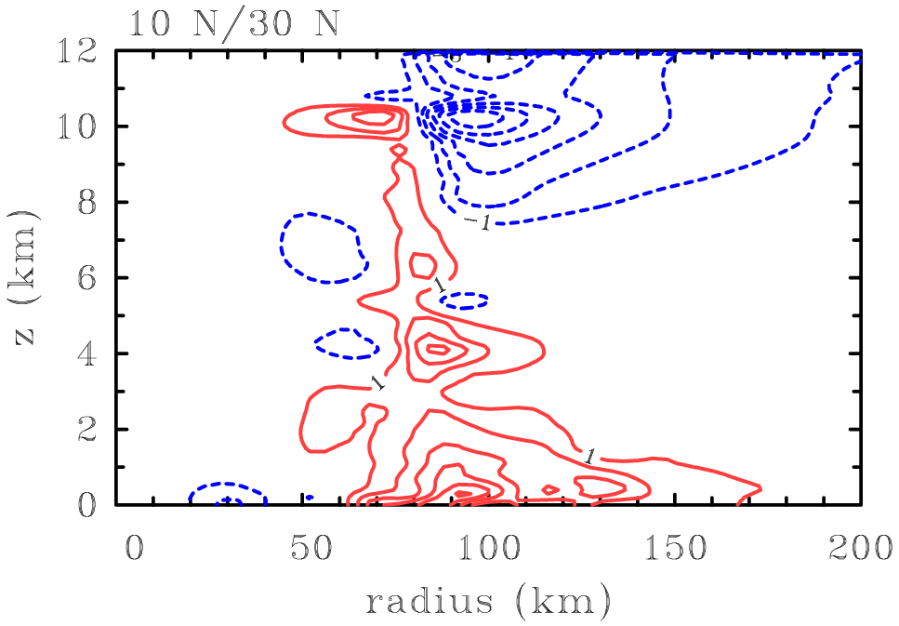
Diabatic heating rate for 10ºN: differences in latitude, i.e. in inertial stability
(Units for u: m s⁻¹)
(Units for u: m s⁻¹)
$$\frac{∂v}{∂t}$$
u > 0
ψ
u < 0
Max inflow 7.1 compared with 8.1 m s⁻¹ at 10ºN
Max dv/dt 6.2 m s⁻¹ h⁻¹ compared with 5.6 m s⁻¹ h⁻¹ at 10ºN

Slide 22
Summary
Our early analysis suggested that the dynamics of the frictional boundary layer may be a key element to understanding the problem at hand.
To help isolate the effect of the boundary layer, we examined an axisymmetric, steady, nonlinear, slab boundary layer model.
This model is worth exploring because it replicates some essential structural features of many previous studies including new, 3D, time-dependent, numerical simulations for the prototype intensification problem in a quiescent environment.
In particular, despite the steady-state restriction, the slab model produces stronger low-level inflow and stronger and more confined ascent out of the boundary layer as the latitude of the calculation is decreased, even if the tangential wind profile at the top of the boundary layer is held fixed.

Slide 23
Conclusions 1
In an azimuthally-averaged view of the problem, the most prominent quantitative difference between the time dependent simulations at 10ºN and 30ºN is the much larger diabatic heating rate and its radial gradient above the boundary layer at the lower latitude.
We attribute these differences in heating rate to the larger vertical velocity found through the troposphere at 10ºN. Recall that the heating rate, itself, is approximately proportional to the vertical velocity.
But why is the vertical velocity different between 10ºN and 30ºN when the differences in CAPE are found to be relatively small?
The difference in the vertical velocity must be due to the differences in the vertical velocity of air exiting the boundary layer.

Slide 24
Conclusions 2
These arguments for the dependence of spin up rate on latitude invoke the conventional spin up mechanism, in conjunction with a boundary layer feedback mechanism linking the strength of the boundary layer inflow to that of the diabatic forcing.
The foregoing differences greatly surpass the effects of rotational stiffness (inertial stability) and evaporative-wind feedback that have been proposed in some prior explanations.
The much larger radial gradient of diabatic heating at 10ºN produces a larger radial inflow in the low and mid-troposphere, leading to an increase in the rate at which absolute angular momentum (M) surfaces are drawn inwards.
Although the radial gradient of M is larger at 30ºN than at 10ºN, the much larger inflow at 10ºN is sufficient to give the larger spin up rate at this latitude.

Slide 25
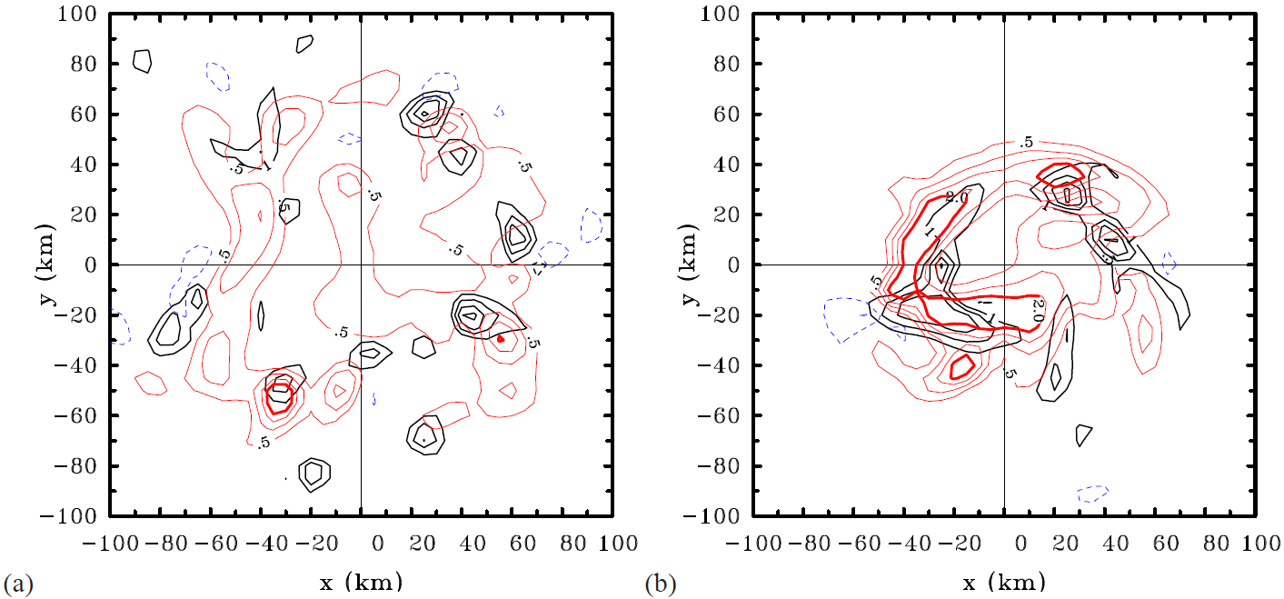
Non-axisymmetric issues:
Vertical velocity and vertical vorticity at 5 km for 10ºN
21 h
30 h
w
ζ
The azimuthally-averaged fields of vertical velocity, vertical vorticity and diabatic heating rate are dominated by localized, rotating convective structures and their progressive aggregation!
Notes:
Figure 8. Horizontal cross sections of vertical velocity (black contours) and vertical vorticity (positive values red, negative values blue) at a height of 5 km in the 10oN calculation at (a) 21 h, and (b) 30 h. Contour interval: vertical velocity contours (black) 1 m s⁻¹, solid contours positive, dashed contours negative. Vertical vorticity contours: thin contours 5 × 10⁻⁴ s⁻¹ from 5 × 10⁻⁴ s−1 to 2 × 10⁻³ s⁻¹, thick contours 2 × 10⁻³ s⁻¹. Solid (red) contours positive, dashed (blue) contours negative.

Slide 26
Future work
A more complete understanding of the latitudinal dependence of the intensification problem requires an improved understanding of:
the role of rotating convective structures,
their progressive aggregation,
the effects of ambient rotation on them, and
their coupling to the boundary layer and interior vortex.

Slide 27
An advert: should be out soon in a Special Issue in memory of Prof. Bruce Morton

Slide 28
Thank you for your attention!

