Slide 1
Vortex spin-down and imbalances in inner-core data assimilation Hurricane Earl 9-01-2010: a case study
Kathryn Sellwood *
T. Vukicevic**, P. Reasor** and A. Aksoy*
*Cooperative Institute of Marine and Atmospheric Studies, University of Miami
** Hurricane Research Division, NOAA/AOML
Notes:
Which lead to reduced skill in the short term forecast of TC intensity – when Earl was already a strong TC and continuing to intensify

Slide 2
Background and Motivation:
Improving the short term (< 36 h) skill of TC forecasts is crucial for improved warning
Sufficient resolution, skillful model and good estimate of the initial state are all required
Currently regional models and flow dependent data assimilation systems appear to offer
the most promise
Best method of representing the initial state is still an open question but all techniques
require some information about the vortex scale structure and intensity
Regional models exhibit significant short term forecast error (<36hrs), often evident
as a spin down of the vortex
Two possible causes are investigated
(1) Model imbalance is introduced by data assimilation
-comparison of mass and wind field update
-comparison of wind field with gradient wind value
(2) Initial secondary circulation is too weak to support the analyzed vortex structure
-compute Sawyer-Eliaasen solution for secondary circulation using model derived forcing
-compare model circulations with observations (not presented here)
Notes:
1) Important for human safety reason – also time period when observations are expected to have maximum positive impact- vortex scale processes which impact intensity may have inherent predictability limits beyond this time range - how can we have confidence in longer range forecast if there is no skill in the short range (2) in order for the model to simulate the vortex scale processes important for intensity prediction …

Slide 3
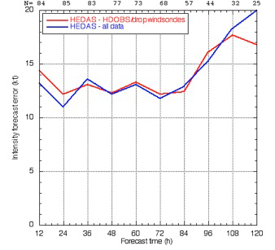
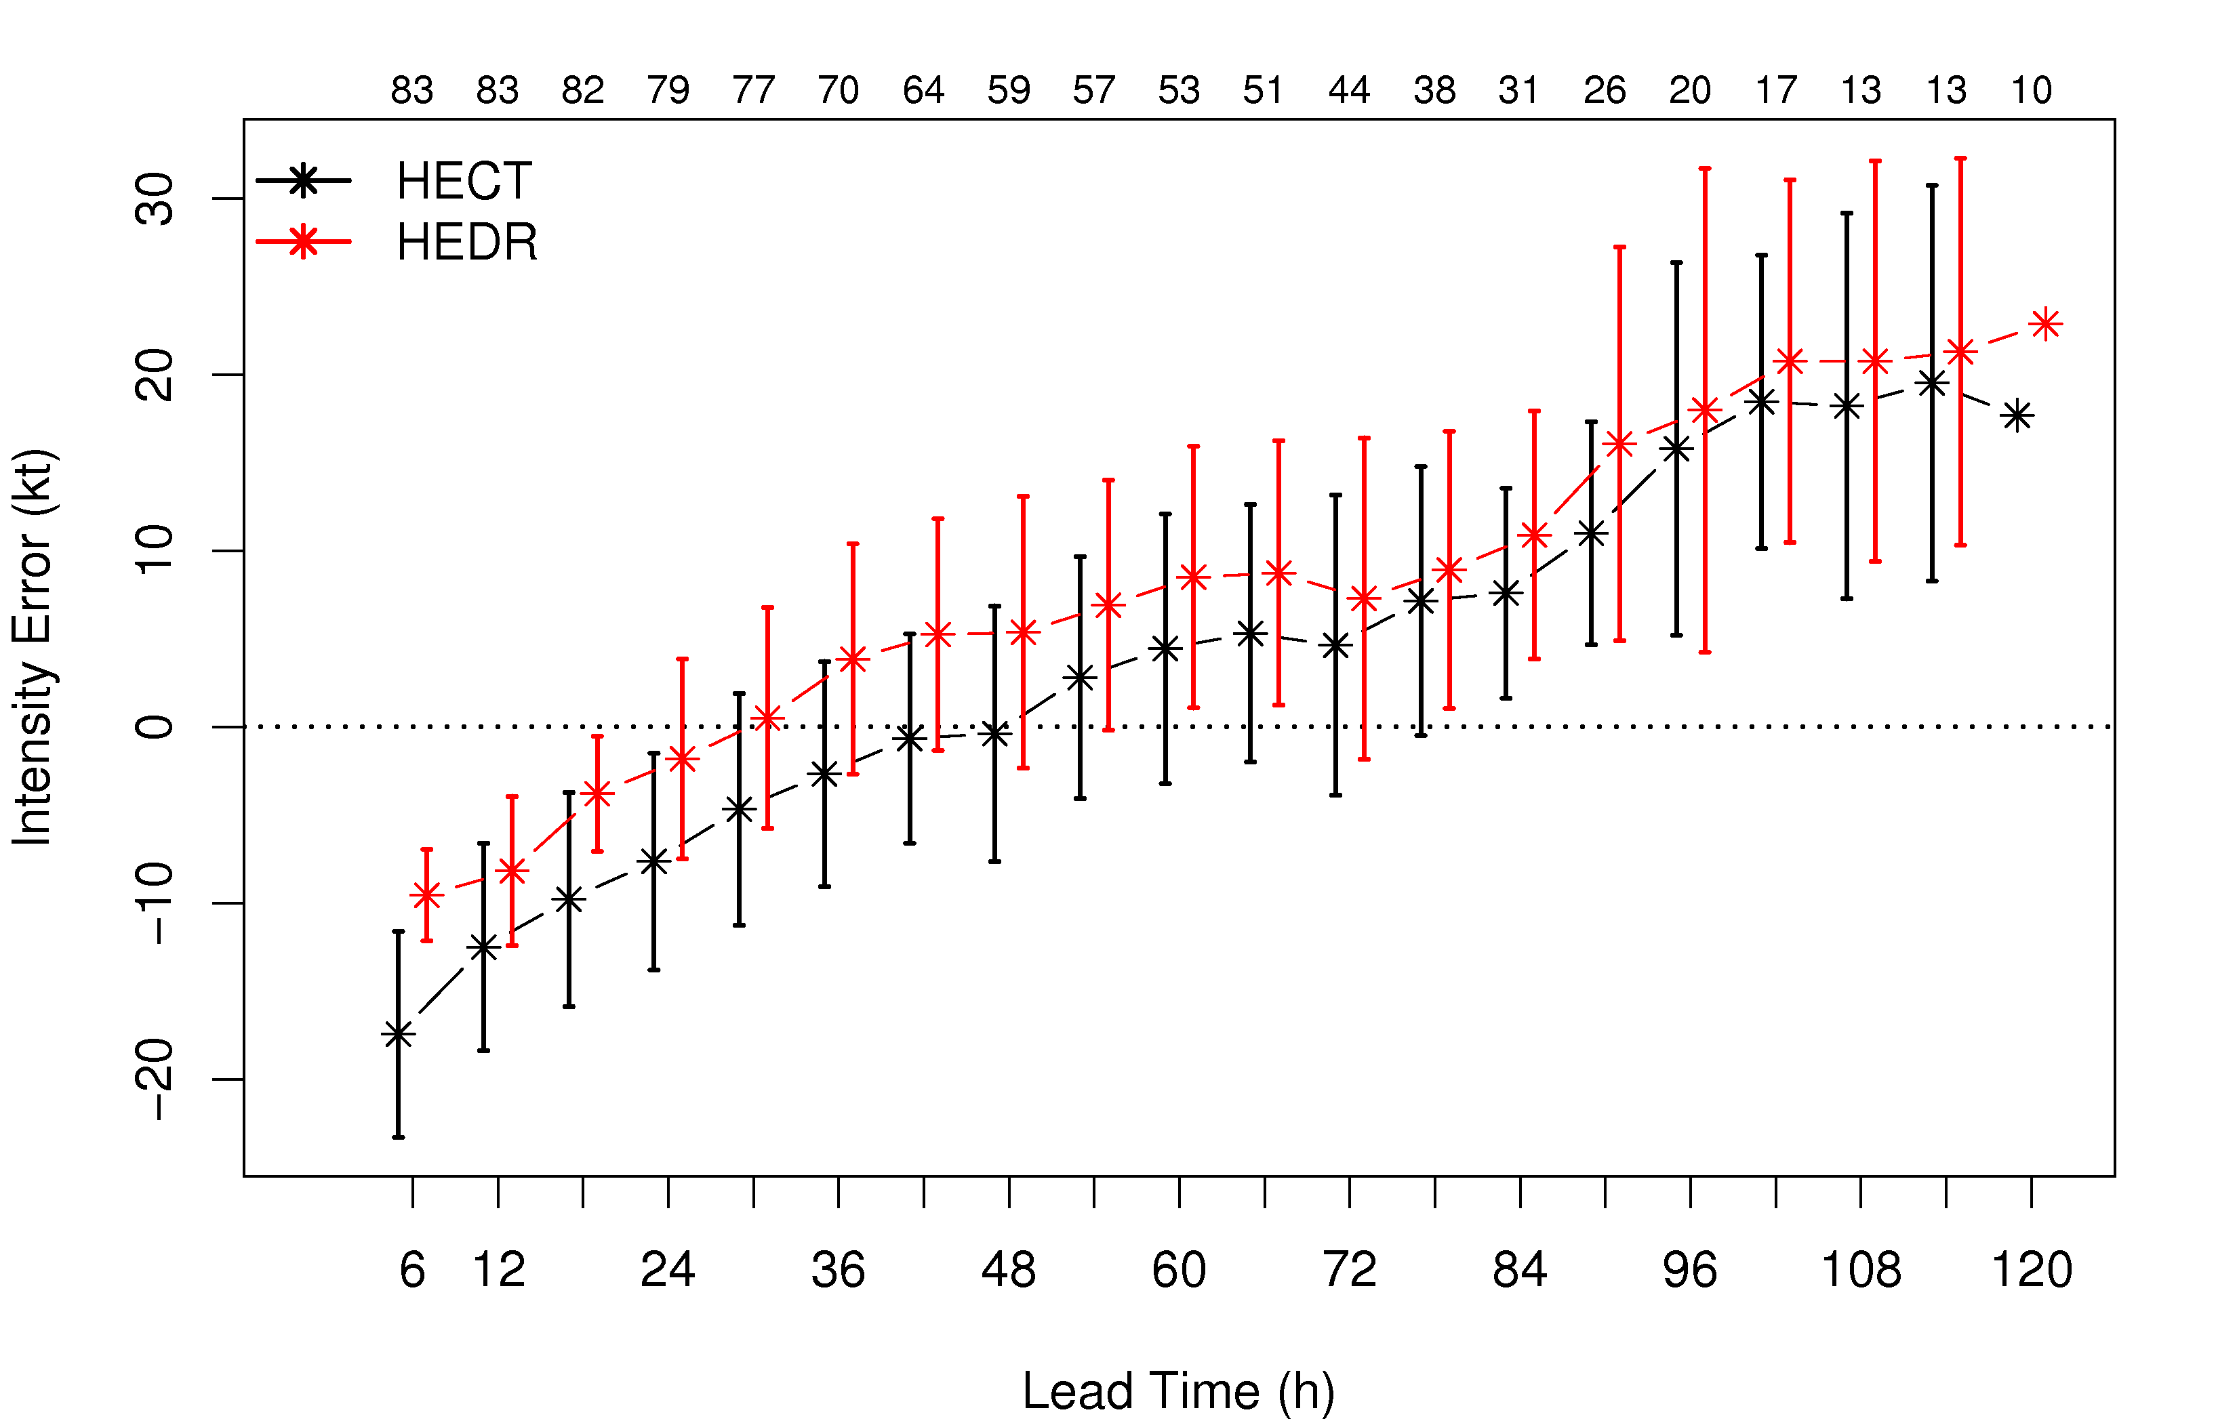
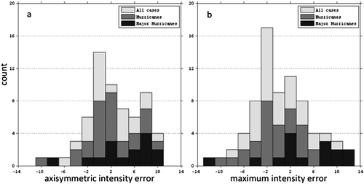
HWRF HEDAS examples:
airborne data no-TDR
Large short-term intensity error
Small improvement for addition of
Tail Doppler Radar (TDR) data
HWRF initialized using
Hurricane Ensemble Data Assimilation System (HEDAS)
Multi-season evaluation : RDITT cases (Aberson etal 2014)
all airborne data
12 h
Negative intensity bias 0-48 hours
Suggests large short term error growth
HWRF initialized using HEDAS
Multi-season evaluation (RDITT report, 2014)
Greater initial mean intensity error and
overall negative intensity bias for
strong hurricanes
HWRF initialized using HEDAS
Intensity error distributions for different intensities
Multi-season retrospective study (Vukicevic etal, 2013)
Max of axisymmetric 10 m wind
Max of
10 m wind
Notes:
The top 2 figures show an evaluation of ?forecasts using the HWRF model initialized from the HEDAS IC which was completed in order to quantify the value of TDR observations. On the x axes are the forecast length in hours, the top figure shows the mean absolute error in the maximum 10m wind speed compared with the best track estimate and the middle figure shows the mean overall error in the same forecasts. The bottom figure gives the error in the maximum of 10m wind speed on the right and the wave #0 contribution on the left for all cases in the lightest shading, weak storms in the darker shading and cat2 or stronger hurricanes are the darkest. This figure indicate ovarall larger error and negative bias for the strong huricanes

Slide 4
Case Study: Hurricane Earl 9-01-2010
HWRF model initialized from GFS EnKF + 4 hour spin up
9/3 km resolution
10 degree static inner nest for DA
5, 1 hour Data Assimilation cycles
Flight level and dropwindsonde U, V, T, Q, SFMR surface wind speed and TDR radial wind
from NOAA and USAF aircraft assimilated within HEDAS
Wave number decomposition onto 41 equally spaced vertical levels using Diapost
Analysis of Wave #0 (R Z mean) fields
First model level removed from analysis due to large number of bad data points

Slide 5
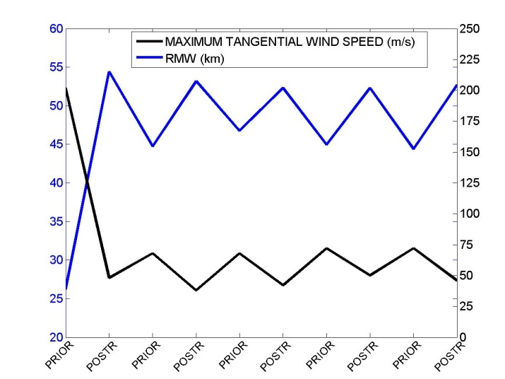
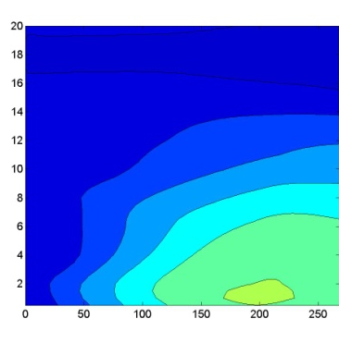
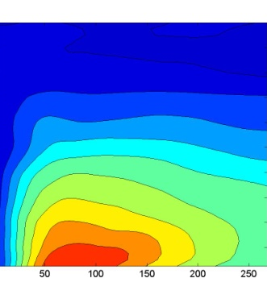
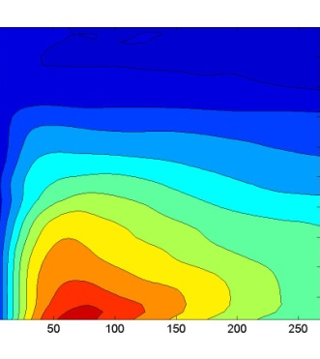
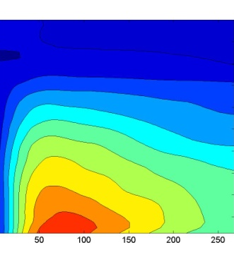
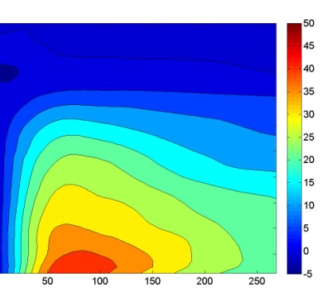
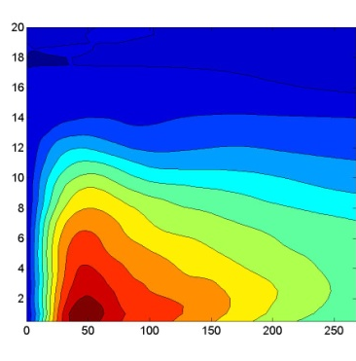
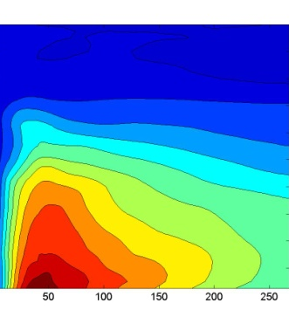
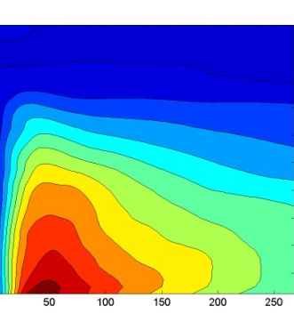
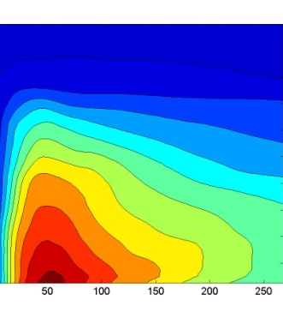
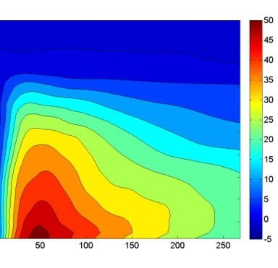
Evolution of Wave #0 Tangential Wind Field during cycling
Model consistently reverts to broader, shallower and
weaker wind field during 1hr forecast between DA cycles
P
R
I
O
R
P
O
S
T
E
R
I
O
R
10 km
Height (km)
10 km
CYCLE 1 CYCLE 2 CYCLE 3 CYCLE 4 CYCLE 5
FINAL ANALYSIS
Radius (km)
Notes:
Contour plots show the wave #0 tangential wind field in meters per second on radius/height coordinates in kilometers during cycling with observations. Initial vortex is much larger and weaker than observed. The model adjusts back towards the initial vortex structure during each 1 hour forecast between cycling with observations. Observations introduce wind increments of up to 45 m/s and pressure increments of 39mb during the first cycle still as large and 22m/s 17mb by the final cycle. Currently no QC is applied to reject observations that are too different from the background.

Slide 6
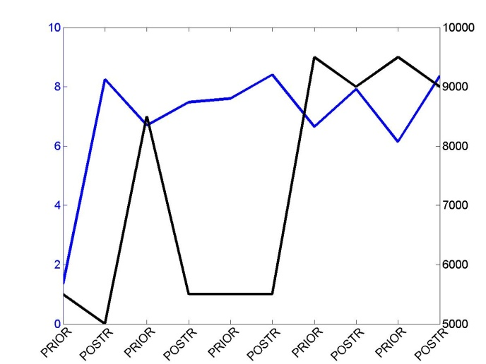
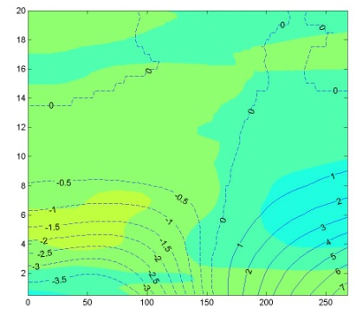
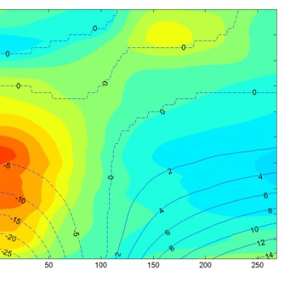
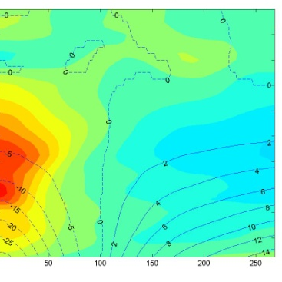
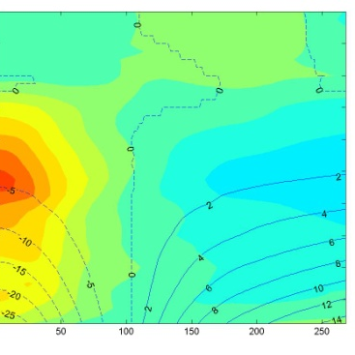
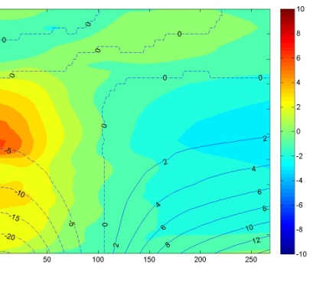
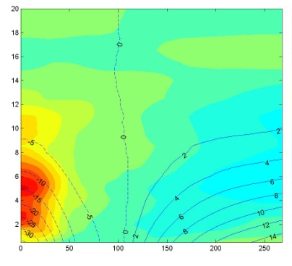
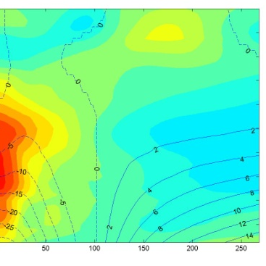
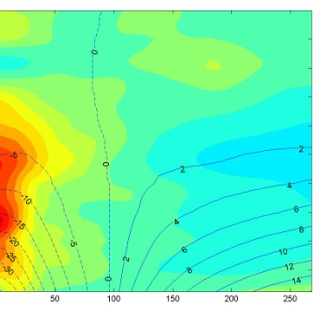
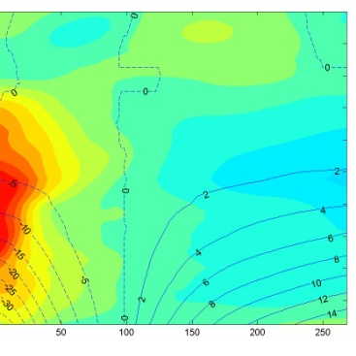
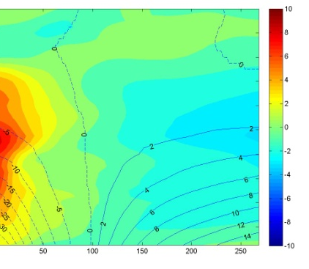
Evolution of Wave #0 Temperature Anomaly:
Mass fields relax towards prior state between cycles
Warm core becomes concentrated at upper levels
Model develops upper level pressure/temperature anomaly
Fields outside RMW are well retained
Maximum T anomaly (K)
Height of maximum (m)
P
R
I
O
R
P
O
S
T
E
R
I
O
R
10 km
Height (km)
10 km
CYCLE 1 CYCLE 2 CYCLE 3 CYCLE 4 CYCLE 5
FINAL ANALYSIS
Radius (km)
Notes:
We would expect a spin-down of the vortex if the mass field did not adjust sufficiently to support the observed wind field. Direction of the mass adjustment agrees with wind adjustment / obs increase t anomaly at lower levels where the majority of the observations are obtained – may accelerate wind decay in forecast via thermal wind relationship / cause of upper level P/T anomaly unknown / observation impact at this level is through the covariances suggests need for more upper level thermo obs

Slide 7
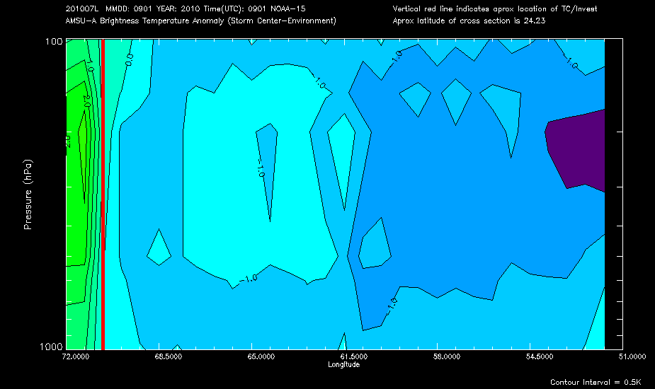
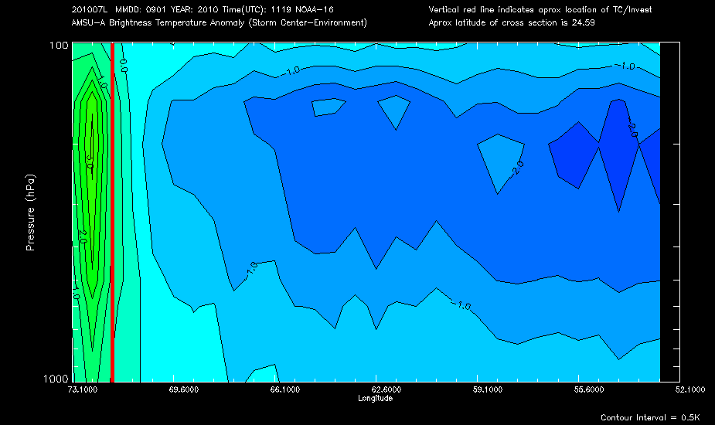
Observed Warm Core structure:
CIMSS analysis produced from
AMSU-A 4 channel brightness temperature anomaly.
Observed warm core maximum
is higher than model
Similar evolution as the HEDAS
analyses (stronger & higher at later time).
No indication of secondary warm anomaly
Upper level thermo-dynamic observations needed to better initialize warm core
2010/09/01 09:01 UTC
Flight Level
2010/09/01 11:19 UTC
Flight Level

Slide 8
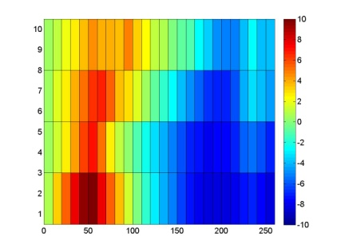
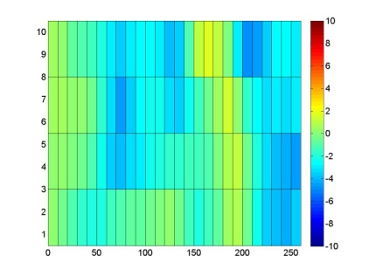
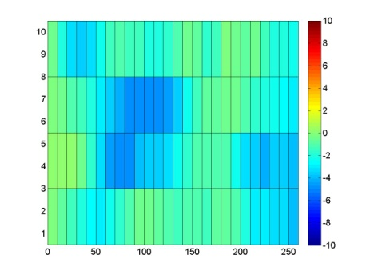
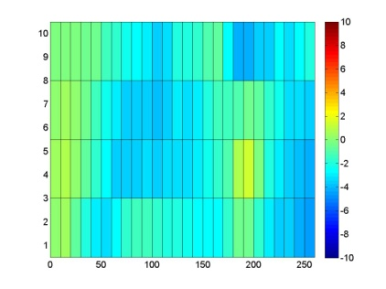
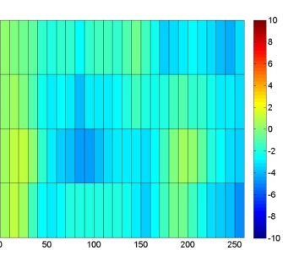
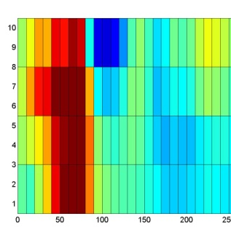
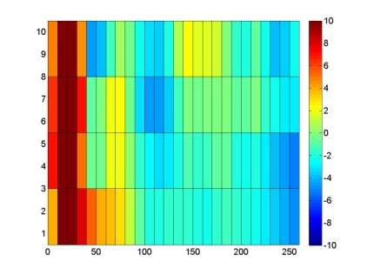
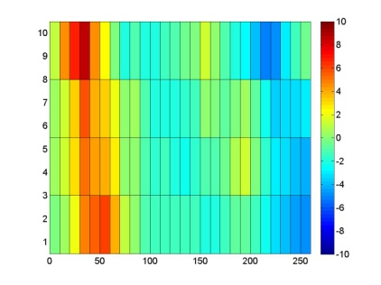
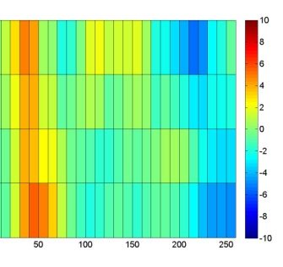
Departure from Gradient Wind Balance:
Cycle 1 prior unbalanced from spin up from large scale I.C.
Wave #0 prior wind field within 3m/s of gradient wind value
Larger departure from balance after adding observations
Super-Gradient winds near/away from posterior/prior RMW
Prior states retain super-gradient winds at large radii (possible source of spurious correlation)
P
R
I
O
R
P
O
S
T
E
R
I
O
R
Agradient wind = V_{t} - V_{g} (m/s)
10 km
Height (km)
10 km
CYCLE 1 CYCLE 2 CYCLE 3 CYCLE 4 CYCLE 5
FINAL ANALYSIS
Radius (km)
Notes:
Initial vortex unbalanced due to adjustment from large scale IC. Model prior condition is within 10% of gradient balance throughout the
Vortex, posterior is less balanced overall. Near surface sub-gradient winds are consistent with boundary layer friction effects throughout cycling. DA induces super-gradient winds at the RMW. This effect is greatest near the surface and between 6 and 9 km. Model develops strongest super-gradient winds near the center rather than at the RMW. Agradient structure at 3 RMW is persistent during cycling, indication that some aspects of initial vortex remain. Model moves closer to balanced state as cycling continues.

Slide 9
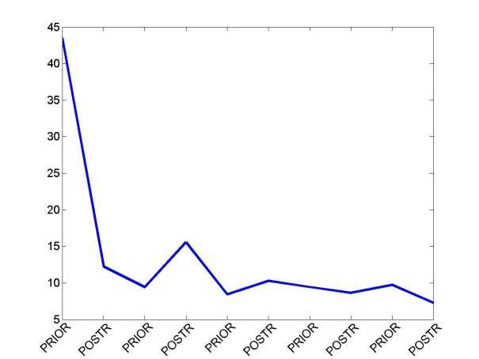
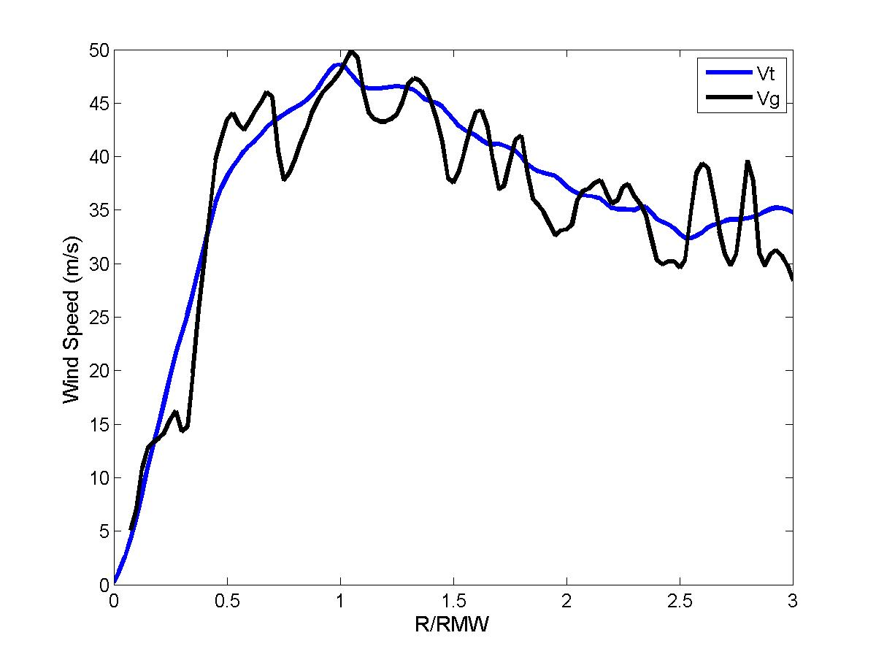
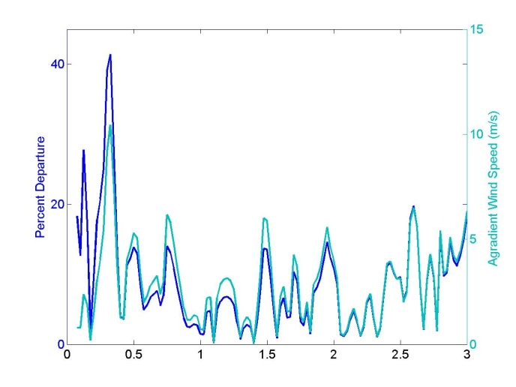
Observed wind field within ~10% of gradient Balance
Model priors also in near gradient balance
Posterior analyses more unbalanced on average
Observed super-gradient winds in same location as in
posterior analyses with lesser magnitude
Percent Departure From Balance
= V_{t} - V_{g} / V_{t} (%)
Model
( mean over lowest 10km)
Observed Flight-Level Wave #0
Tangential vs Gradient Wind Speed (m/s)
Observed (flight level)

Slide 10
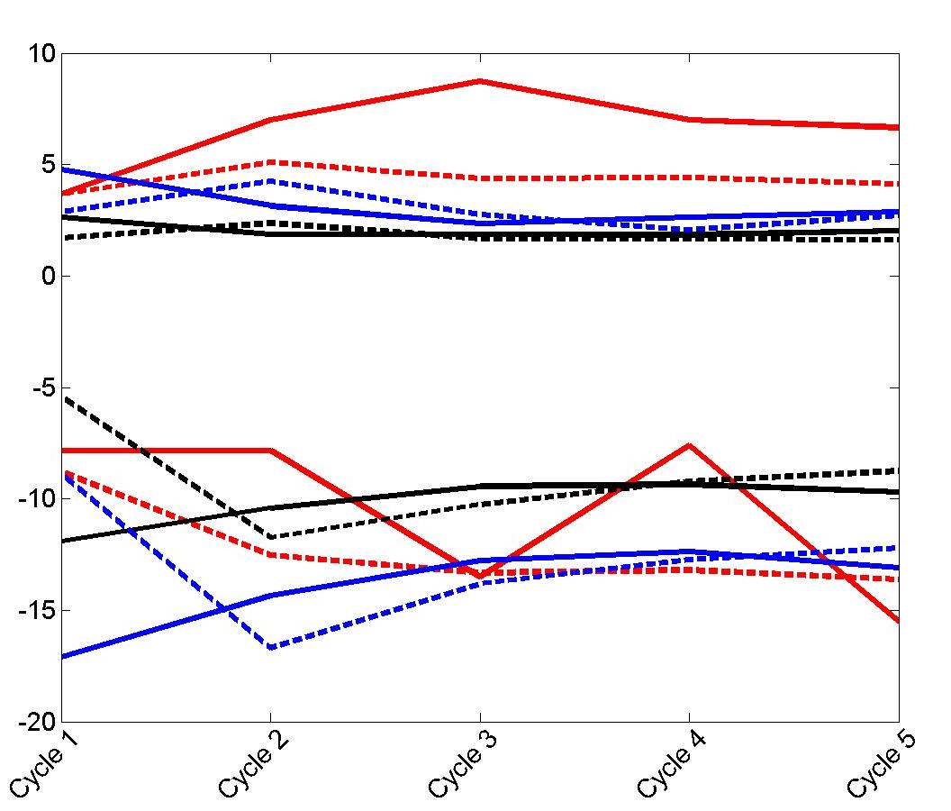
How well does the Sawyer-Eliaasen Model reproduce the secondary circulation?
Wave #0 Radial Wind Speed
Wave #0 heating underestimates
secondary circulation
Wave #0 + 1 heating gives close
estimate of prior circulation
S-E solution gives stronger inflow in both
prior forecast and HEDAS analysis
Model unable to recover frictional inflow
circulation during 1hr forecast
S-E solution suggest possibly too strong
outflow in HEDAS analysis
outflow
inflow
Model Prior SE Prior SE Prior 2
Model Posterior SE Posterior SE Posterior 2
Notes:
Strength of Secondary Circulation During Cycling:
The Sawyer-Eliaasen solution is computed from the wave #0 HEDAS analyses .The model fields are taken from the wave #0 radial wind speed from the HEDAS analyses.The S-E solution for the radial wind speed is consistent with the structure
and magnitude with that sampled by the NOAA P3 tail Doppler radar except that it does not reproduce the observed upper level outflow

Slide 11
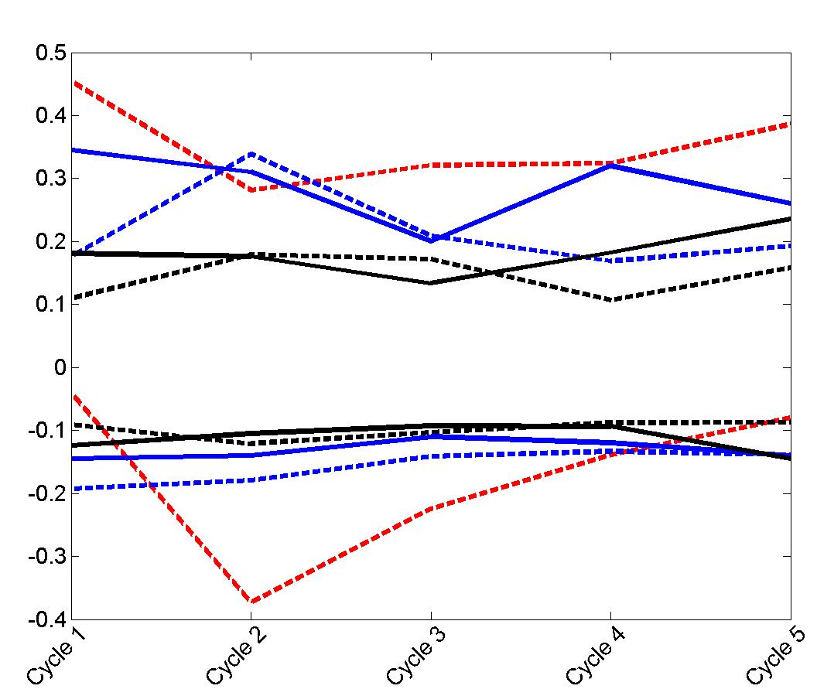
W initialized to 0 in model (not a prognostic variable) – updated via DWDT = 1/g * dw/dt
Model response after the first cycle is to reduce upward motion and increase downward
motion consistent with amplification of the warm core in this case
From cycle 2 onward the model only
partially recovers to S.E. solution
between cycles
S-E solution with wave # 0 +1 supports
stronger upward motions and weaker
downward motion for the posterior
analyses than the prior condition
Fluctuation in magnitude of the prior
vertical circulations suggest changing
tendencies between cycles
Model tendencies are in the opposite
direction as the S.E. tendencies
Wave #0 Vertical Wind Speed
upward
downward
Model Prior SE Prior SE Prior 2
Model Posterior SE Posterior SE Posterior 2
Notes:
The solution for the vertical wind speed is somewhat weaker than observed and is mainly confined to lower levels whereas the strongest updrafts were observed in convective plumes reaching 12km or higher. W is not a prognostic variable in HWRF as it is diagnosed via DWDT – leading into next slide

Slide 12
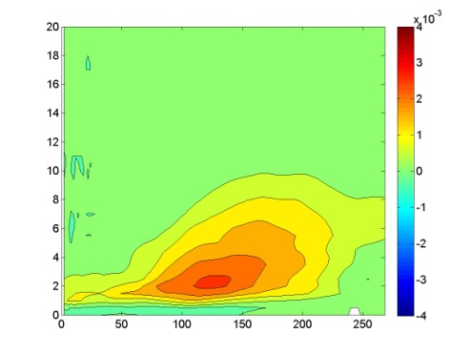
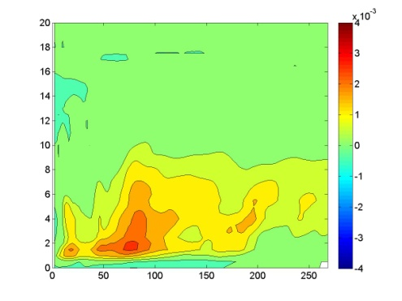
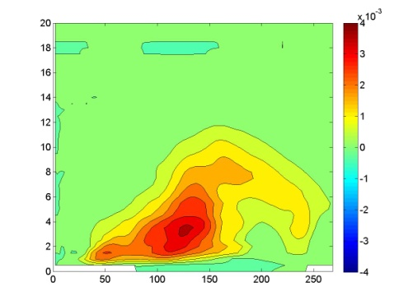
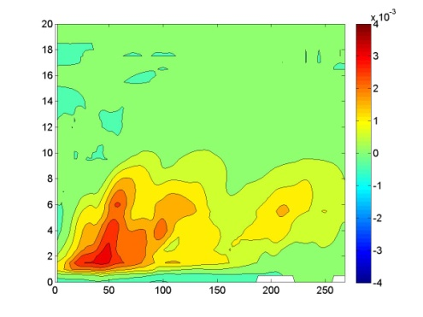
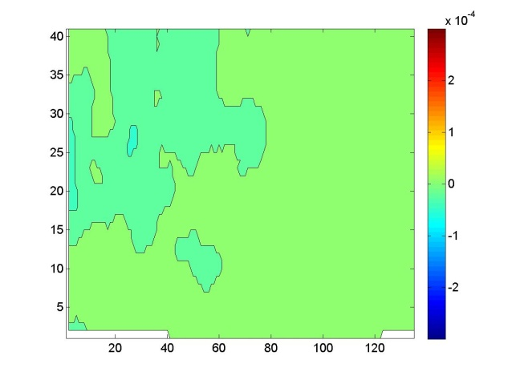
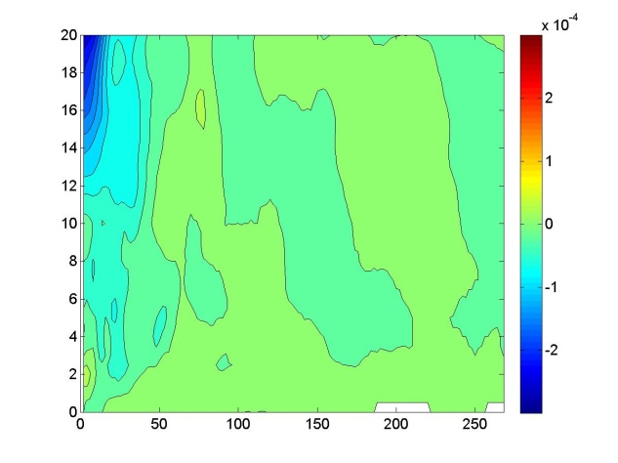
Diabatic Heating
DA moves diabatic heating inward in
first cycle but outside of observed RMW
Traces of original eye-wall are present
at final analysis time
Heating distribution suggests analysis
retains too much of the initial background
Update of vertical accelerations
HEDAS has included update to DWDT
since 2013 – initial results indicate some
improvement of secondary circulation
Primary tendency is downward motion
in the vortex center – supporting warm
core
Weak upward motion near surface but no
localized structure that would specifically
support eyewall convection
CYCLE 1
CYCLE 5
Prior dT/dt
Posterior dT/dt
Posterior 1/g * dw/dt

Slide 13
Conclusions:
The wave #0 circulation is well approximated by gradient balance in the model while DA
introduces super-gradient imbalance in this case, despite update to mass field
2. SE solution with stronger heating (eg., including wave 1) is consistent with circulation that
model tries to recover as shown by the priors, in terms of strength of inflow and
upward vertical velocities
DA does not support this solution because W is not updated while Vr update near surface
is weaker than it should be by the balance due to lack of observations there and heating
profile which in too slow to develop in eye-wall region.
The update of vertical acceleration seems to only support building of warm core
Question is how to make the update that would support the balanced circulation?
Obtain more thermodynamic and upper-level observations
Filter observations and cycle more often to nudge model towards final analysis
Use balance solution to constrain initial secondary circulation
Improve update of DWDT
Increase frequency of physics calls to improve diabatic heating distribution
Update additional microphysics variables

Slide 15
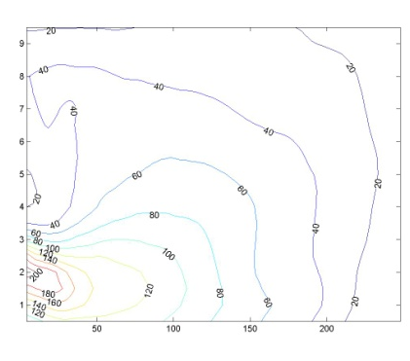
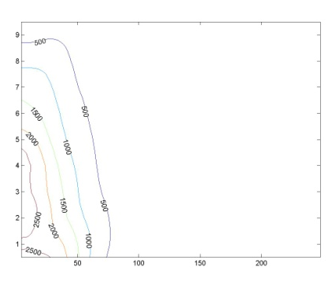
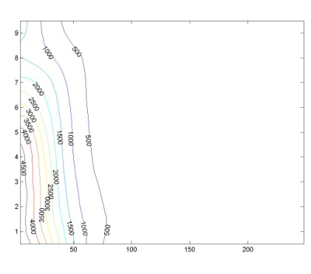
Inertial Stability:
The Hedas analyses tend to be more strongly stable and thus resistant to radial motion.

Slide 16
Static Stability:
(dѲ/dz > 0 stable; dѲ/dz = 0 neutral; dѲ/dz < 0 unstable ):
Hedas analysis tend to be more strongly stable near the center due to the warm core
structure, but less stable throughout the vortex core. The second and fourth cycles are
both exceptionally stable at the center but the vortex in not as well retained after cycle 4
as after cycle 2.

Slide 17
Since 2013 HEDAS has been updating DWDT term (1/g dw/dt)
What is the initial tendency?
Diabatic heating (dT/dt) is updated via the temperature updates
How does the heating distribution evolve during cycling?
CYCLE 1
CYCLE 2
Notes:
Main effect of DWDT update is to induce subsidence in the eye. Neutral or slight upward tendency near the surface and weak downdrafts (likely due to evaporative cooling than erosion of prior eyewall given the structure/magnitude). Heating distribution reflects the displacement between the prior and posterior RMW. Although the observed RMW was much smaller than the prior the ensemble covariances apparently also enhanced convective heating in the location of the prior eyewall region. This effect gradually fades as cycling progresses. Heating term is averaged over individual physics calls which generally produces much smaller temperature differences than those introduced during cycling.

Slide 18
CYCLE 3
CYCLE 4
CYCLE 5
Notes:
By the third cycle DA has little effect on the heating until the final cycle when the prior and posterior eyewalls are nearly co-located and the ensemble covariances support enhanced heating there. However there is still evidence of the initial background eye-wall. Two possible explanations for the relatively small change in the heating during cycle 3 and 4 are (1) Since obervations are randomized it is possible that there are fewer thermal observations in the eye/eye-wall region in these cycles. (2) Once the wind field reaches a certain strength it is theorized that the wind field in more prone to adjust to the mass field rather than the mass adjusting to the wind.

Slide 19
Azimuthally averaged composite of Tail Doppler Radar:
Vt
Vr
W

Slide 20
SE Percent of Model Value
SE Percent of Model Value
outflow
upward
inflow
downward

